Slide 1
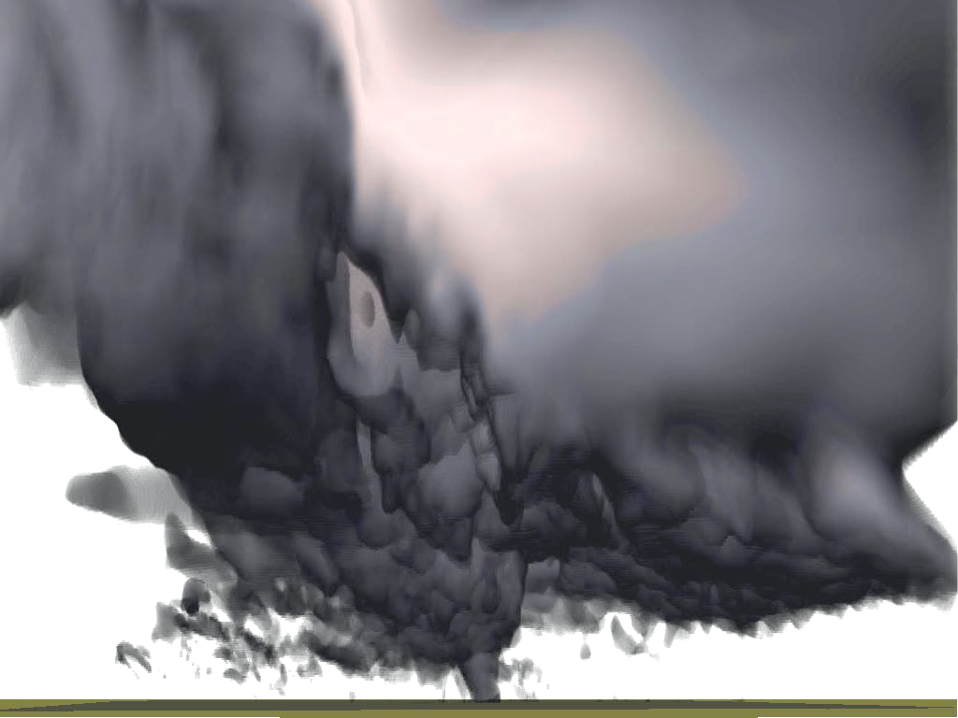
Origin of Vorticity in Tornadoes: Generation by Surface Friction
Ming Xue
Center for Analysis and Prediction of Storms and School of Meteorology,
University of Oklahoma Norman, Oklahoma, USA
mxue@ou.edu
10/2025

Slide 2
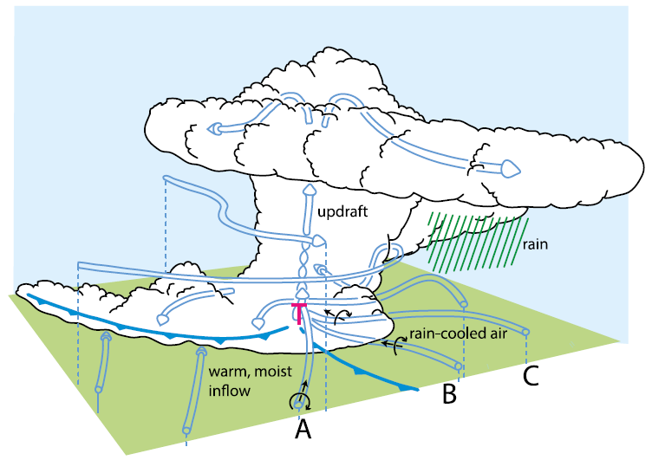
Possible Sources of Tornadic Vorticity in Supercells
-
+
Baroclinic vorticity generation by a cold bubble
+
Environmental Vorticity due to Vertical Shear
Based on idealized supercell simulations, Rotunno & Klemp (1985)、Klemp (1987) proposed：
Vorticity generated along FFGF baroclinically via buoyancy gradient can be much larger that coming from environment vertical shear. The generated vorticity is brought down to near the surface by downdrafts and provide near-surface vorticity needed for tornadogenesis.
This is the prevailing theory for over 30 years.
Mesocyclone
Downdraft
Baroclinic Vorticity
Rear Flank Gust Front
Forward Flank Gust Front
Baroclinic Vorticity
Along Gust Front
Environmental
Vorticity
Adapted from Klemp (1987)
Notes:
There are several possible sources of horizontal vorticity. One is that already existing in the storm environment due to vertical wind shear, as illustrated by this top right schematics. Environmental vorticity is known as the primary source of rotation in mesocyclones within supercell storms, i.e., is the cause of the rotating updraft, and is usually not enough to produce tornado.
Another important source is the so called baroclinic generation, due to horizontal gradient of buoyancy. Such gradient exists along the gust fronts, and at the edge of negatively buoyant downdraft. Earlier pioneering 3D modeling studies by NCAR scientists Rich Rotunno and Joe Klemp pointed out that baroclinically generated horizontal vorticity can be much larger than that of the environment. When air parcels carrying it descends to be close to the ground, it provides the vorticity source for tornadogenesis. This is a view held by most for several decades, although direct observational proof is difficult.

Slide 3
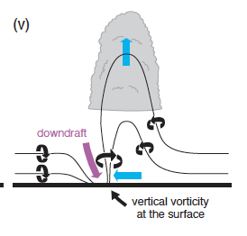
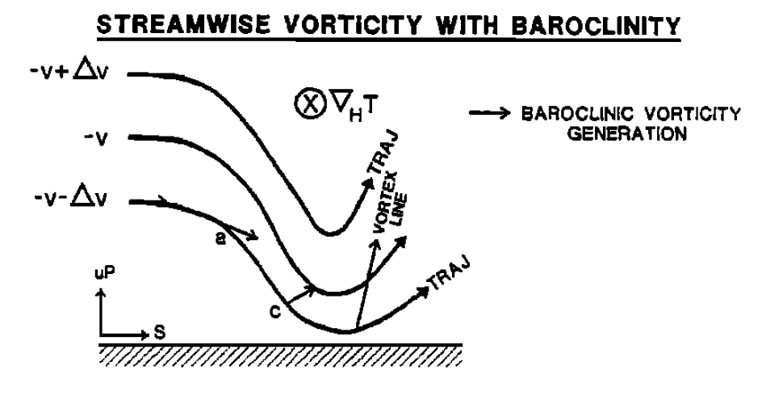
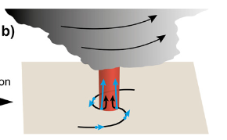
Davies-Jones-Books Theory: Vertical vorticity generated baroclinically is turned into vertical before descending to the ground level
Importance of downdrafts: Bring horizontal vortex tubes down to the surface and tilt it into vertical
In-and-up theory
Strong enough horizontal vorticity is turned into the vertical near ground abruptly. Vertical vorticity at ground level is not essential
Streamwise vorticity with baroclinity
Markowski and Richardson (2010).
(Rotunno et al 2017; Fischer and Dahl 2022)
Davies-Jones and Brooks (1993).

Slide 4
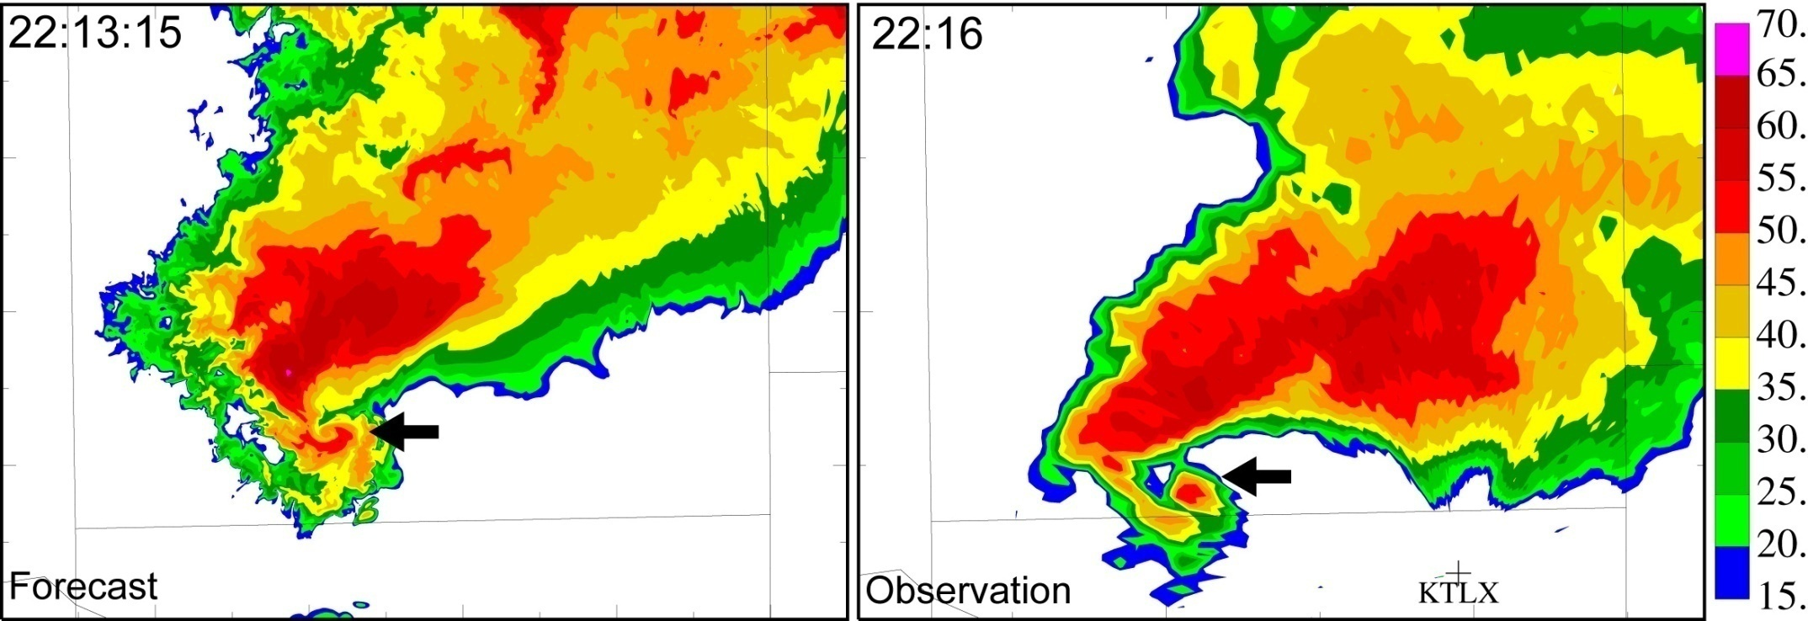
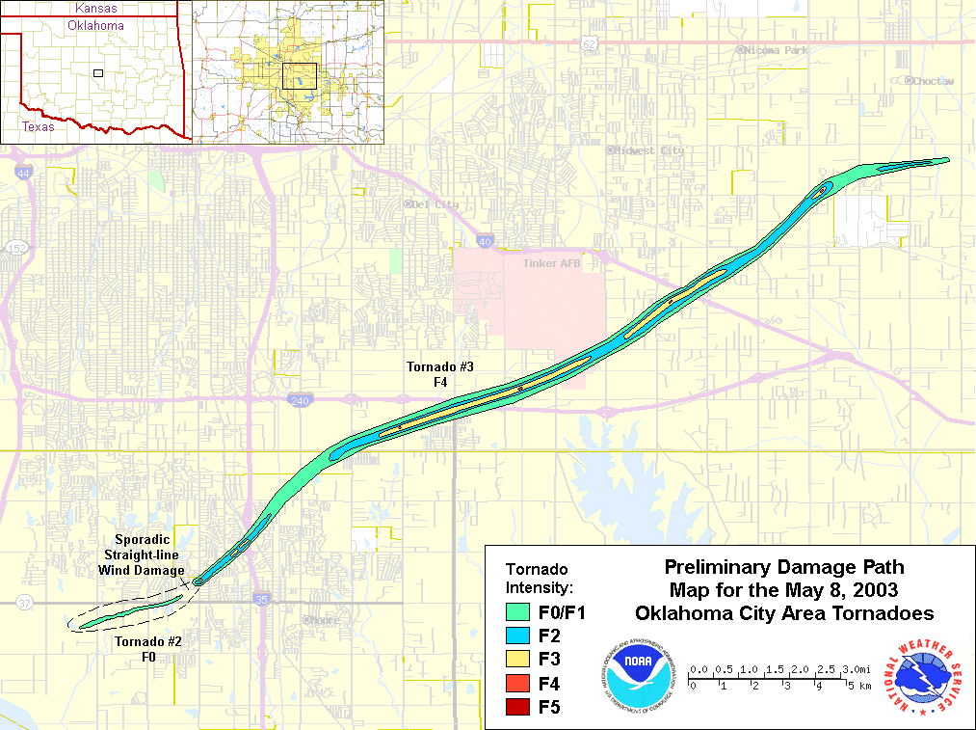
Radar Assimilation and Prediction of May 8th, 2003 OKC F4 Supercell Tornado using ARPS and its DA system
Dx=50m
43 min forecast
3DVAR+Cloud Analysis
Forecast
2030 UTC
2140 UTC
Observed
Xue, M., M. Hu, and A. D. Schenkman, 2014: Numerical Prediction of the 8 May 2003 Oklahoma City Tornadic Supercell and Embedded Tornado Using ARPS with the Assimilation of WSR-88D Data. Wea. Forecasting, 29, 39-62.
Notes:
4
Our first paper that highlighted this frictional mechanism was actually based on a successful simulation of a real tornadic supercell, that was initialized by assimilating radar data very 5 minutes for over one hour. The resulting simulation of the tornadic storm on a 50 m grid is very closed to the radar observation. Most of the simulation studies used the ARPS model that I led the development at CAPS, University of Oklahoma.

Slide 5
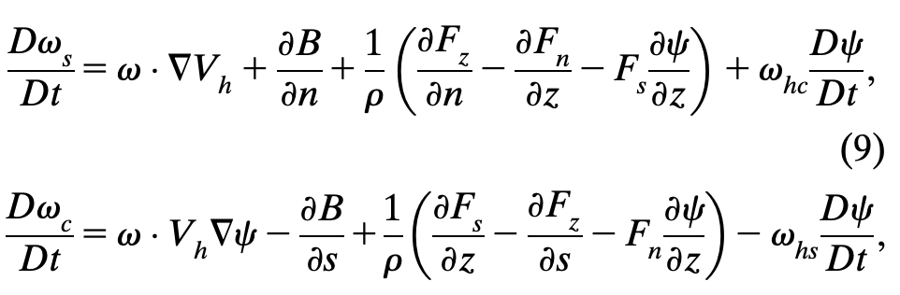
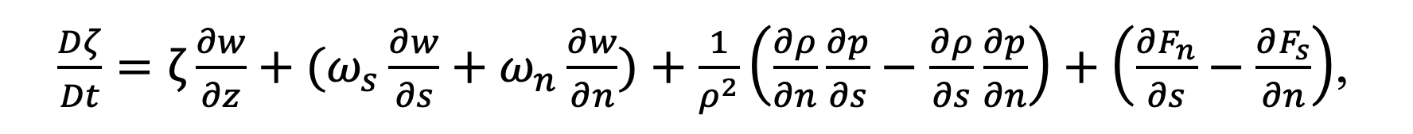
Prognostic equations for streamwise and crosswise horizontal vorticity, and vertical vorticity
H. Stretching/tilting Baroclinic Friction Exchange
Streamwise
Crosswise
Streamwise
Crosswise
Streamline
H. Stretching/tilting Baroclinic Friction Exchange
Vertical
V. Stretching Tilting Sinusoidal (small) Friction
Can calculate contributions from different processes along air parcel trajectories.

Slide 6
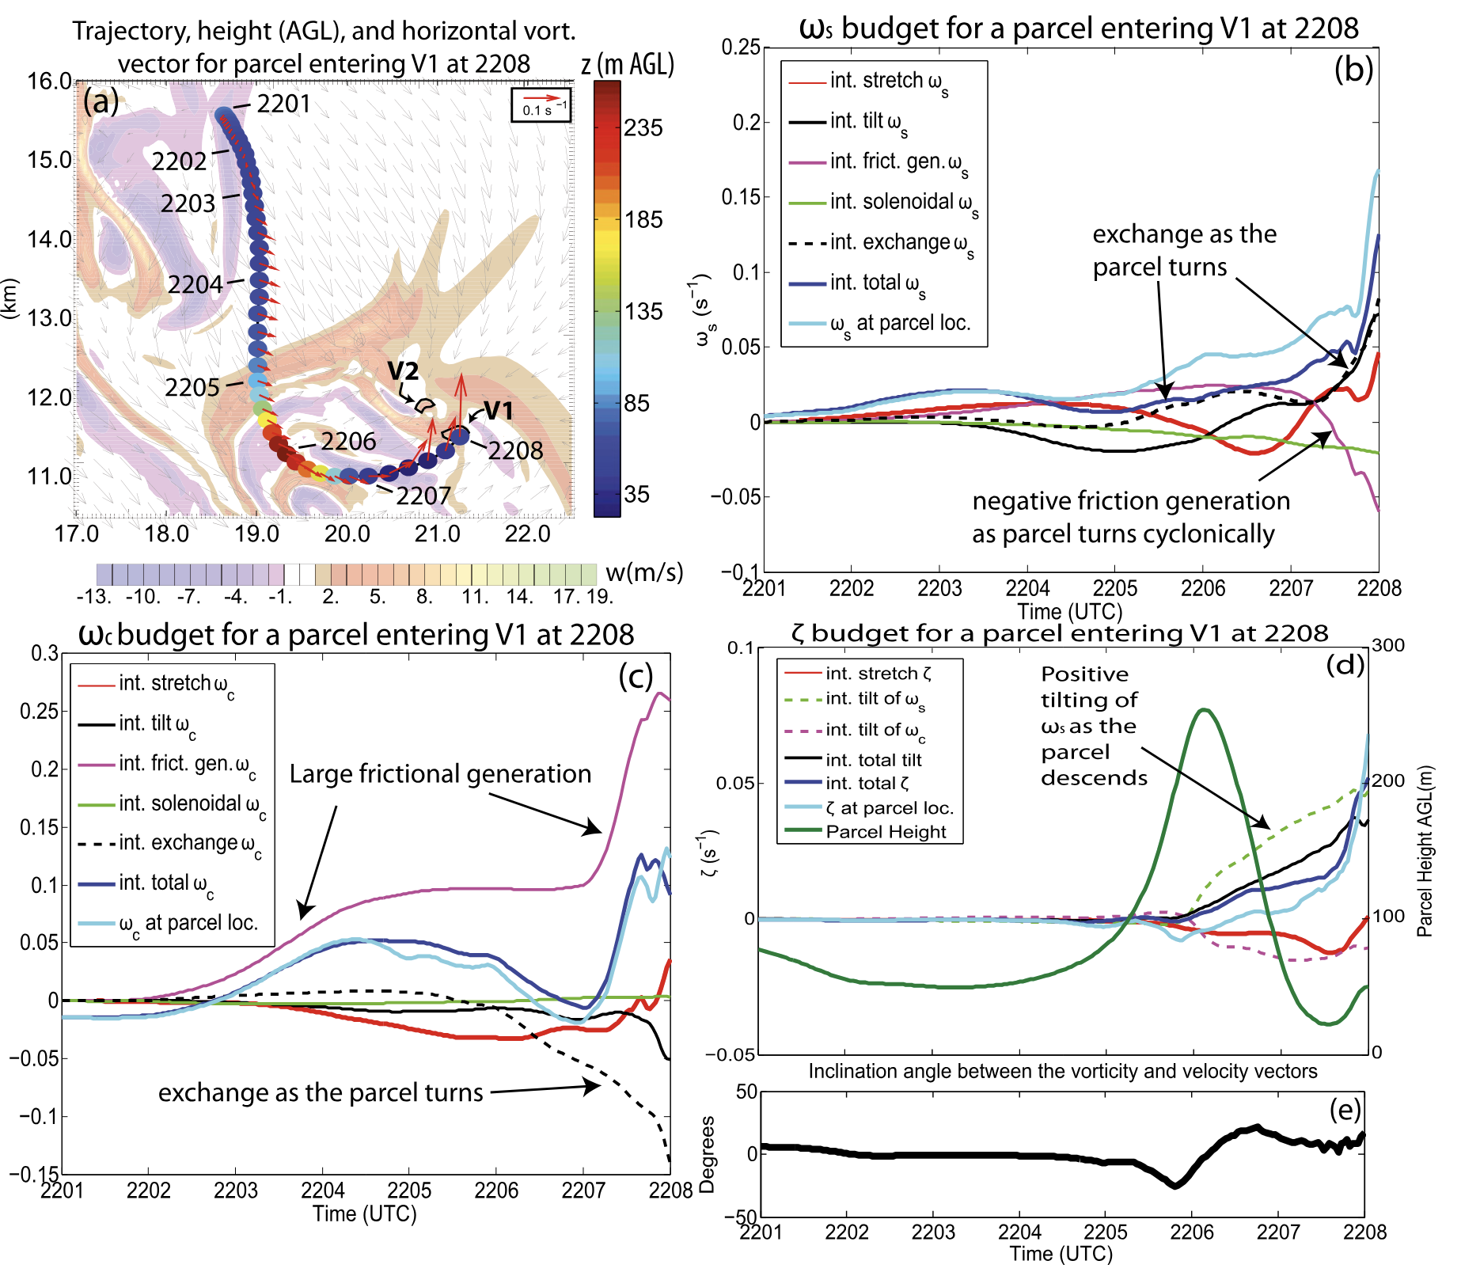
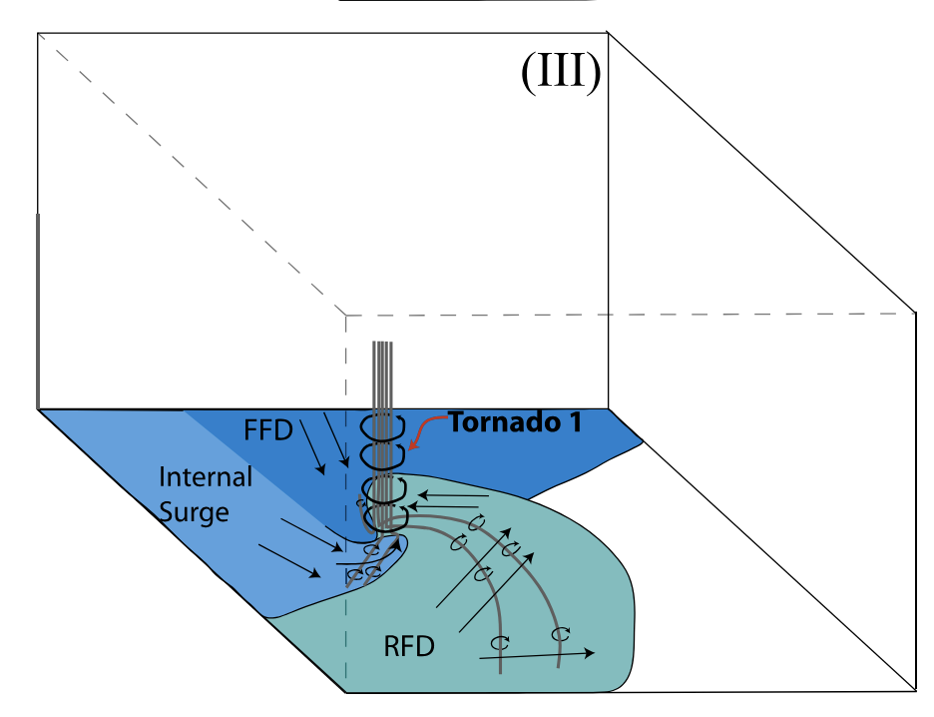
Roles of Frictionally-Generated Horizontal Vorticity near Ground in Real Tornado Simulation of Schenkman, Xue et al. (2004)
Crosswise
Streamwise
Streamline
Surface drag produces most horizontal vorticity reaching tornado vortex.
Drag-generated large crosswise vorticity is exchanged to streamwise then tilted into vertical direction
Baroclinic generation
Notes:
Tracking vorticity generation terms along air parcel trajectories that enter the tornado has become a common practice for studying origin of vorticity. The top left panel shows that a lot of crosswise vorticity is generated along a representative trajectory that is consistent with frictional generation. The bottom left panel shows that the generation by friction is the largest for the cross-wise vorticity. In this case, much of the crosswise vorticity is directly titled into the vertical. In contrast, the baroclinic generation term is almost zero. Here is a conceptual model for one of the tornadoes simulated in the case emphasizing the important contribution of surface friction.

Slide 7
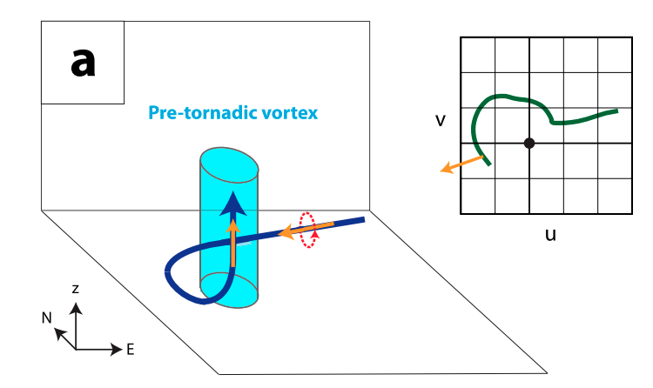
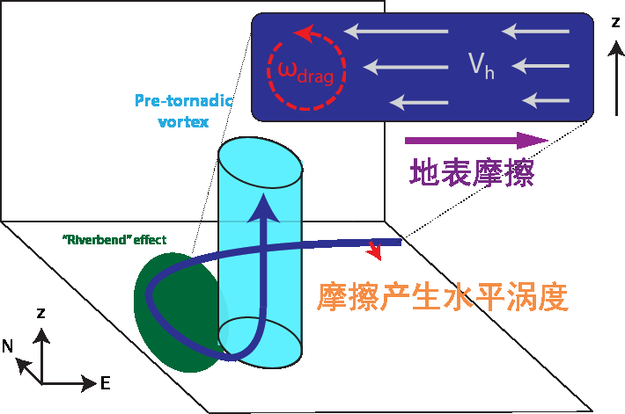
Horizontal Vorticity Generated by Surface Friction can be Another Important Source of Vorticity for Tornadoes
- Friction was Ignored in most earlier Tornado Simulation Studies
B
Sfc Friction
Environmental
Streamwise vorticity
- Called barotropic
Friction-Generated
Vorticity
Proposed by a Series Studies by Dr. Xue’s Research Group
Schenkman, Xue et al (2012, 2014), Xu, Xue et al. (2015), Roberts and Xue (2016, 2017, 2020)
Supported by Markowski (2016,2024), Houser, Bluestein et al. (2016), Tao and Tamura (2020), etc.
Notes:
We all know that surface drag or frictional slows down air flow, and creates very strong near-surface vertical shear, giving rise to large horizontal vorticity that is very close to the ground. This can be another important source of vorticity for tornadogenesis. Indeed, through a series of modeling studies over the past decade, for both real tornado cases employing data assimilation, and idealized simulations with storms triggered by a thermal bubble, we showed that this is true. Here is a conceptual model we proposed. Here, the low-level flow accelerating towards a convergence center underneath a buoyant updraft is slowed down at the surface, creating cross-wise horizontal vorticity pointing to the left of parcel trajectory. As the flow turns leftward toward the convergence center, the crosswise vorticity becomes streamwise due to the riverbend effect, and the streamwise vorticity is abruptly tilted into the vertical and stretched to result in tornadogenesis, or to help maintain an ongoing tornado. Since our initial studies, other researchers have also looked into this issue and confirmed our findings, some with caveats and conditions.

Slide 8
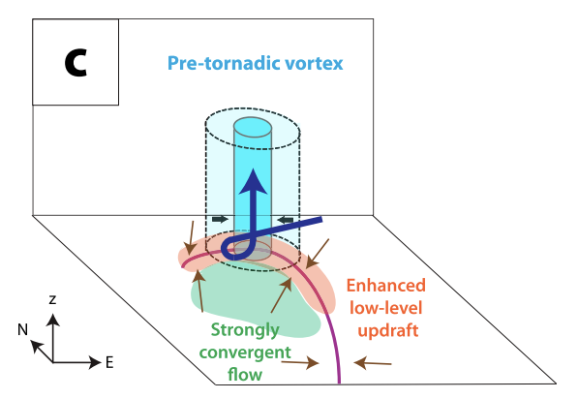
Horizontal Vorticity Generated by Surface Friction can be Another Important Source of Vorticity for Tornadoes
- Friction was Ignored in most earlier Tornado Simulation Studies
B
Tornadic vortex
+
Sfc Friction
Surface drag
Friction-Generated
Vorticity
Robert
Effect of drag on
wind profile
Proposed by a Series Studies by Dr. Xue’s Research Group
Schenkman, Xue et al (2012, 2014), Xu, Xue et al. (2015), Roberts and Xue (2016, 2017, 2020)
Supported by Markowski (2016,2024), Houser, Bluestein et al. (2016), Tao and Tamura (2020), etc.
Notes:
We all know that surface drag or frictional slows down air flow, and creates very strong near-surface vertical shear, giving rise to large horizontal vorticity that is very close to the ground. This can be another important source of vorticity for tornadogenesis. Indeed, through a series of modeling studies over the past decade, for both real tornado cases employing data assimilation, and idealized simulations with storms triggered by a thermal bubble, we showed that this is true. Here is a conceptual model we proposed. Here, the low-level flow accelerating towards a convergence center underneath a buoyant updraft is slowed down at the surface, creating cross-wise horizontal vorticity pointing to the left of parcel trajectory. As the flow turns leftward toward the convergence center, the crosswise vorticity becomes streamwise due to the riverbend effect, and the streamwise vorticity is abruptly tilted into the vertical and stretched to result in tornadogenesis, or to help maintain an ongoing tornado. Since our initial studies, other researchers have also looked into this issue and confirmed our findings, some with caveats and conditions.

Slide 9
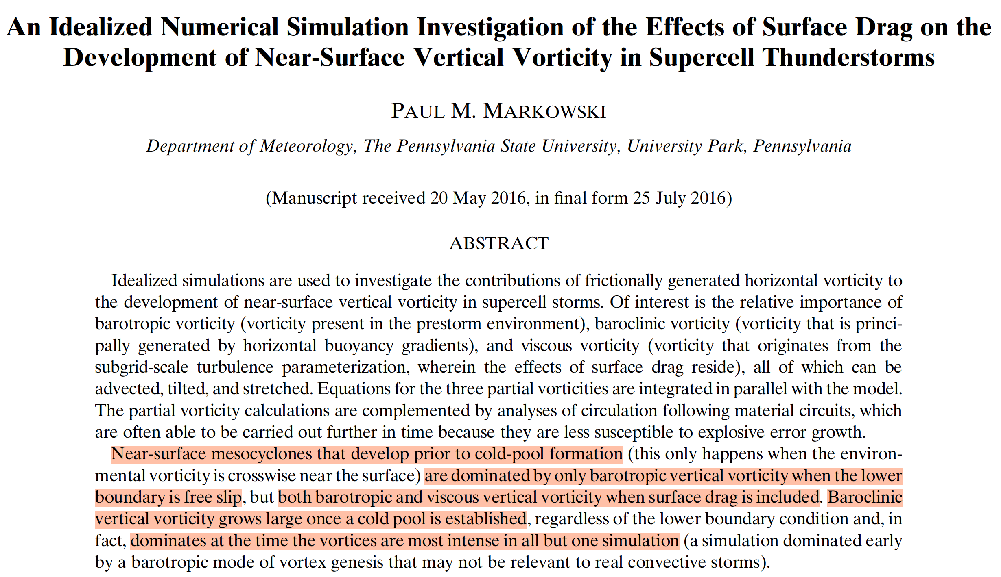
Markowski (JAS 2016)

Slide 10
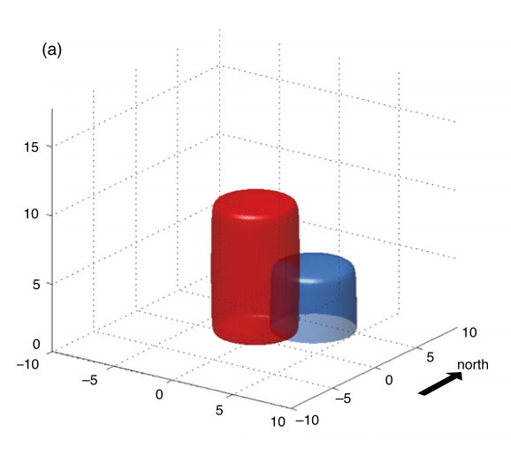
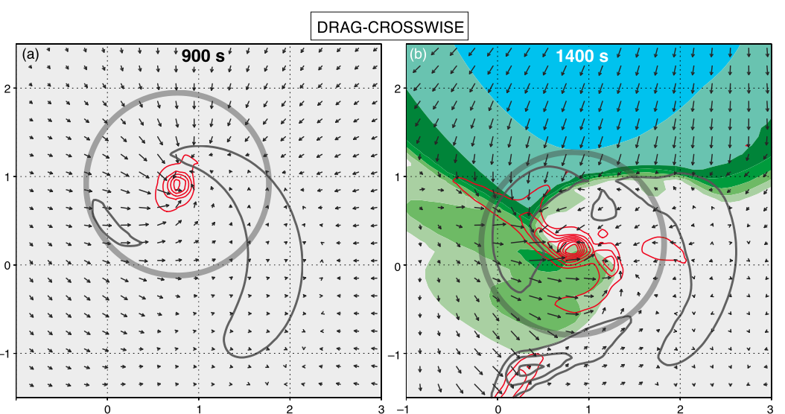
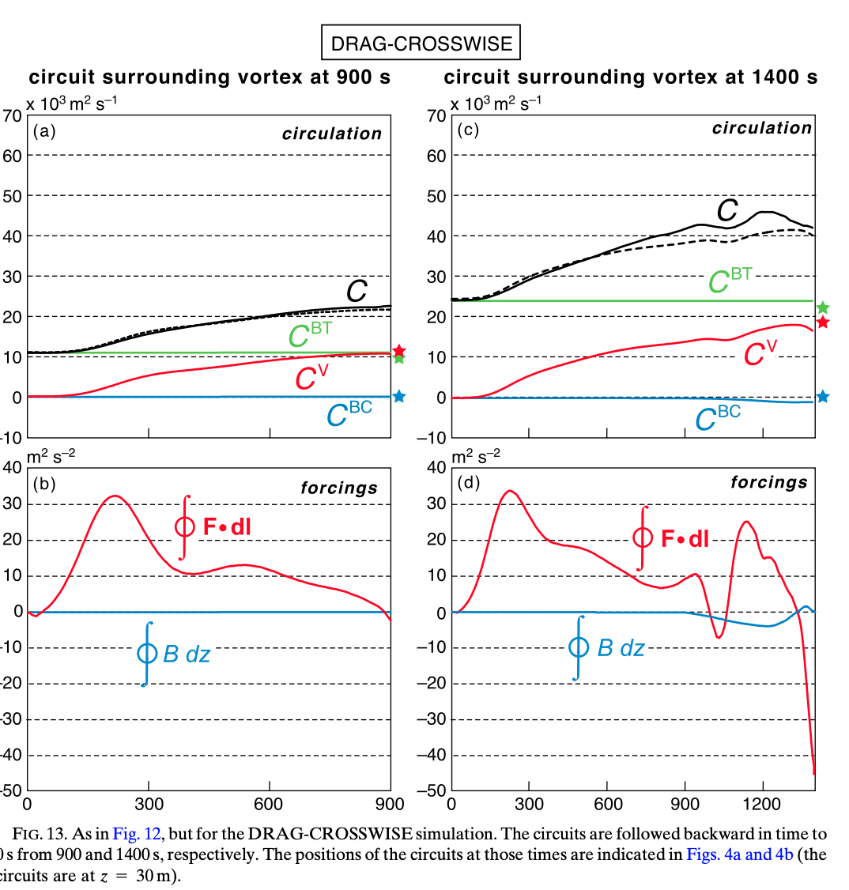
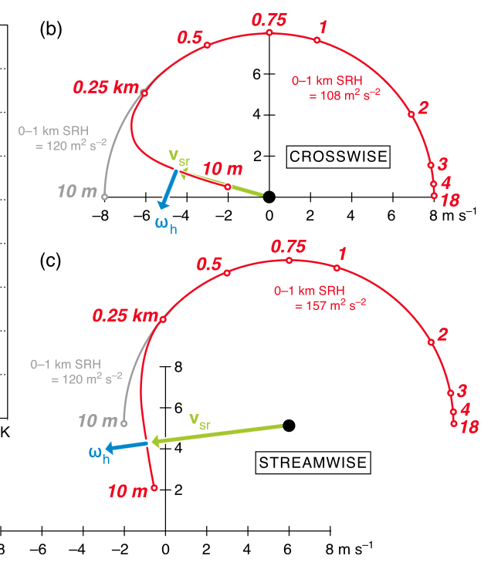
Pseudo-storm simulation: Circulation change from different sources
Markowski (JAS 2016)
Viscous generation (C^{V}) >> baroclinic generation (C^{BC})

Slide 11
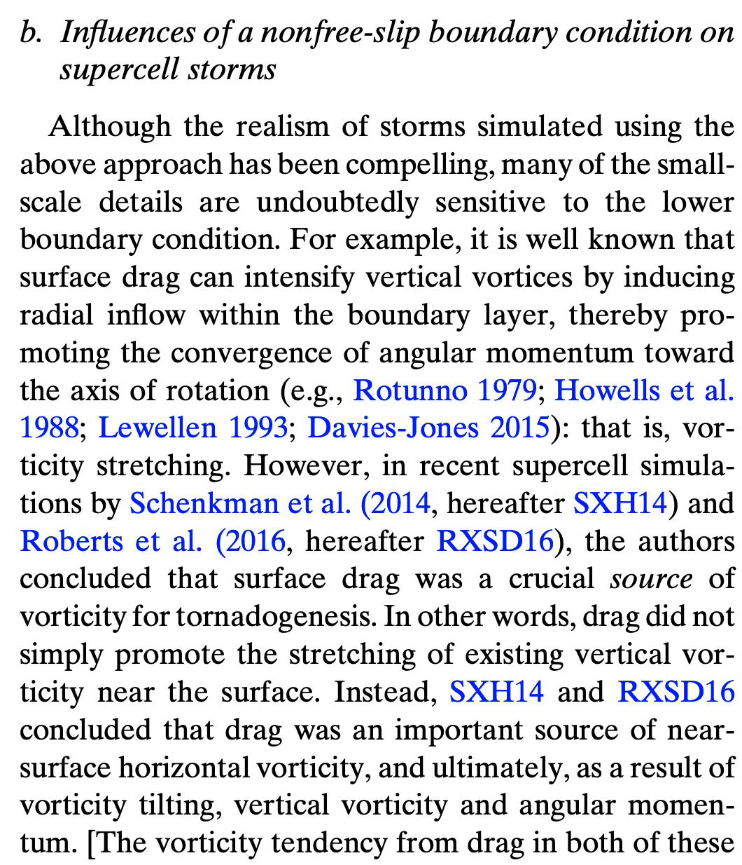
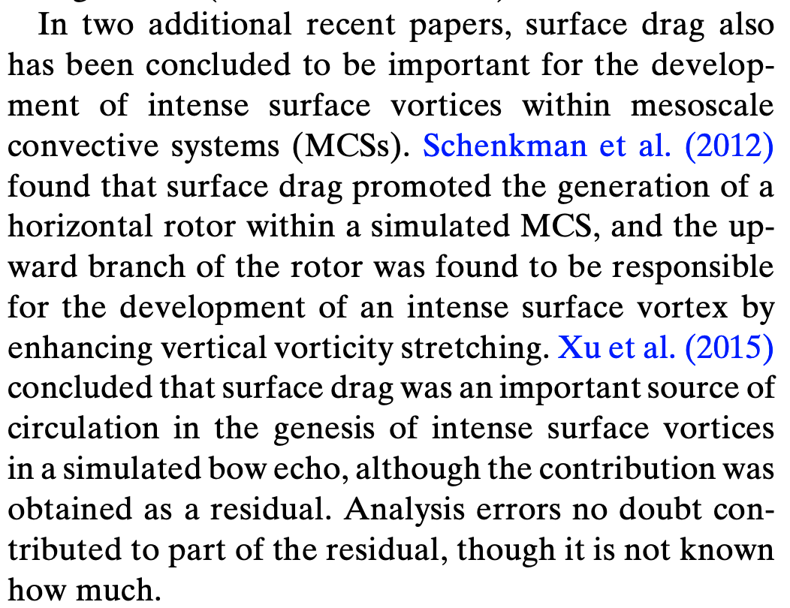
SXH14: Schenkman, A. D., M. Xue, and M. Hu, 2014: Tornadogenesis in a high-resolution simulation of the 8 May 2003 Oklahoma City Supercell. J. Atmos. Sci., 71, 130-154.
RXSD16: Roberts, B., M. Xue, A. D. Schenkman, and I. Daniel T. Dawson, 2016: The role of surface friction in tornadogenesis within an idealized supercell simulation. J. Atmos. Sci., 73, 3371–3395.
Xu, X., M. Xue, and Y. Wang, 2015: The genesis of mesovortices within a real data simulation of a bow echo system. J. Atmos. Sci., 72, 1963-1986.
Markowski (JAS 2016)

Slide 12
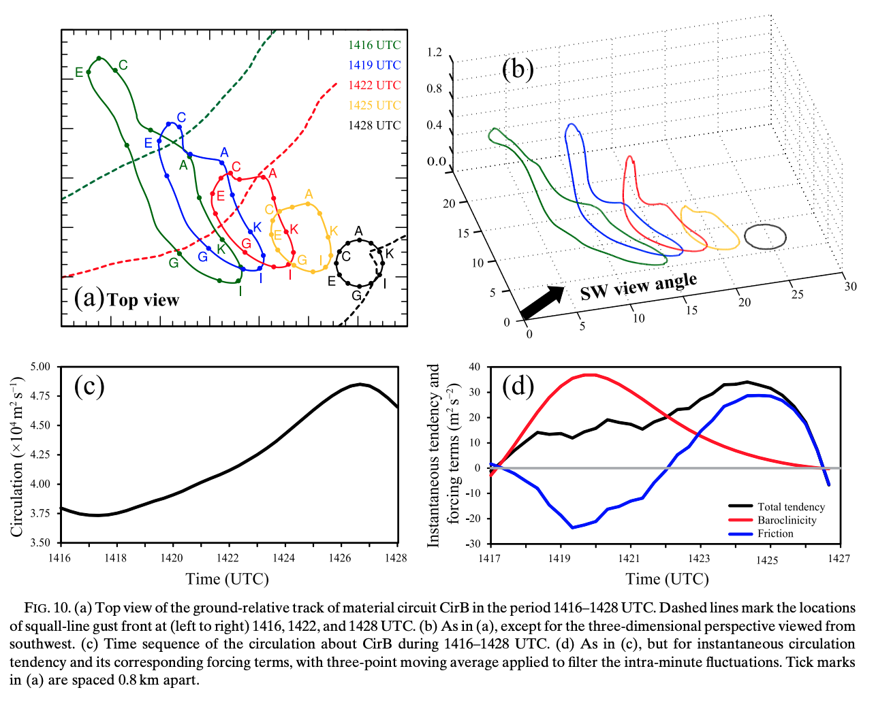
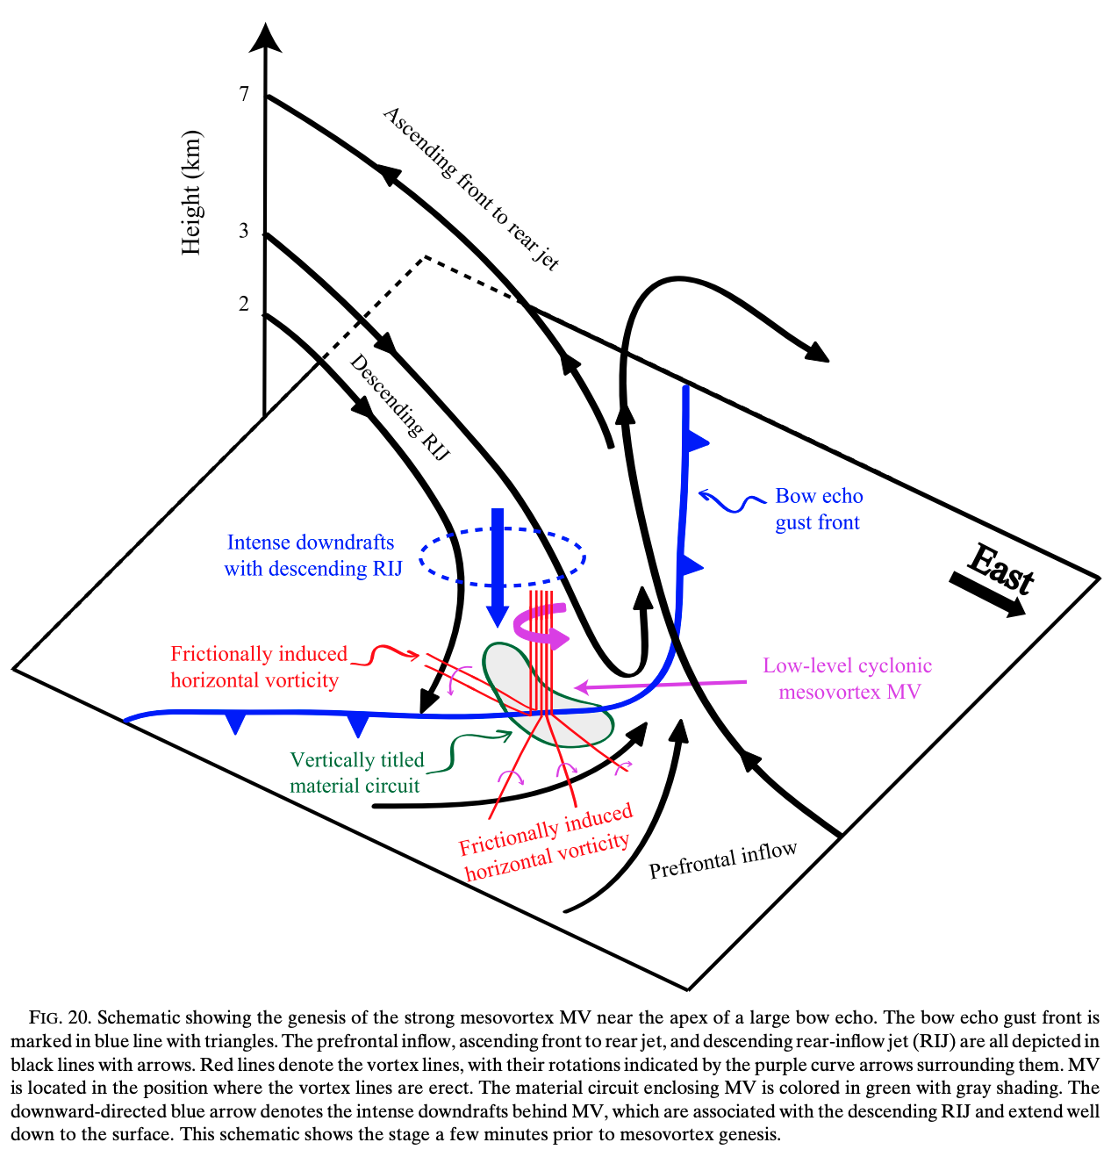
Xu, X., M. Xue, and Y. Wang, 2015: The genesis of mesovortices within a real data simulation of a bow echo system. J. Atmos. Sci., 72, 1963-1986.

Slide 13
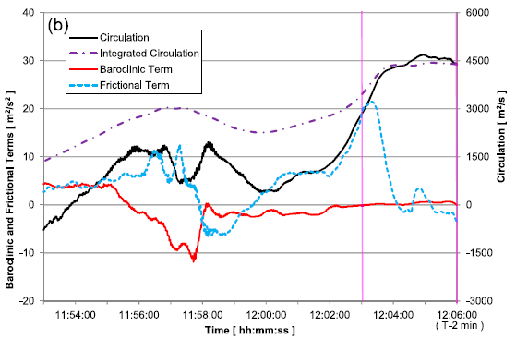
Work by three different groups of Japanese Scientists
Mashiko (2016a,b) simulated the 2012 Tsukuba supercell tornado in Japan using JMA model, and found that for circulation of circuits initialized around low-level mesocyclone and tornado,
friction dominates vorticity generation for “pre-onset stage” of tornado
baroclinic term dominates once tornado matures.
Circulation budget in pre-onset stage

Slide 14
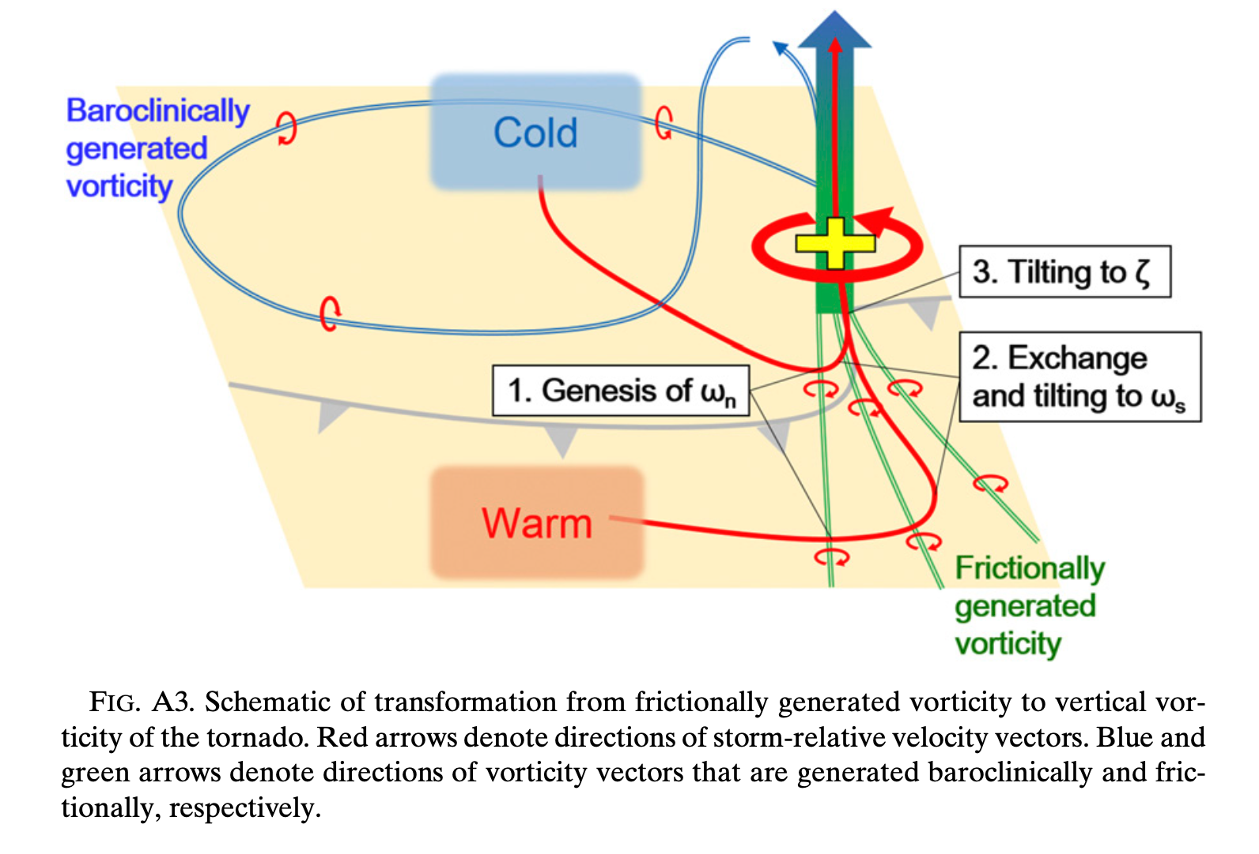
Work by three different groups of Japanese Scientists
Yokota, Niino et al. (2018) simulated the same 2012 Tsukuba tornado using an JMA model ensemble and analyzed the circulation sources of the vortices at the times of tornadogenesis and maximum intensity.
The authors revealed that circulation generation is mainly (not always) due to the frictional terms. The baroclinic terms can also be dominant at times.

Slide 15
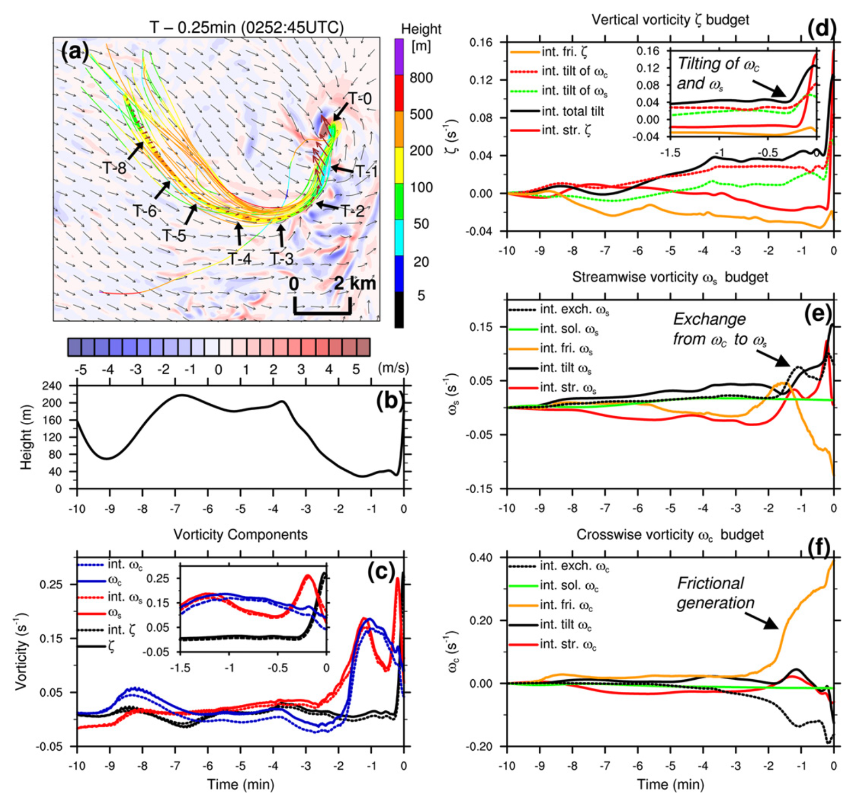
Work by different groups of Japanese Scientists
Tao and Tamura (2020) re-simulated the Tsukuba tornado using WRF and found that “Circulation budgets for the circuits initialized around the pretornadic and tornadic vortices showed that the magnitude of the frictional term was consistently much larger than the magnitude of the baroclinic term.”
The results for mature tornado differ from earlier results of Mashiko (2016a,b)

Slide 16
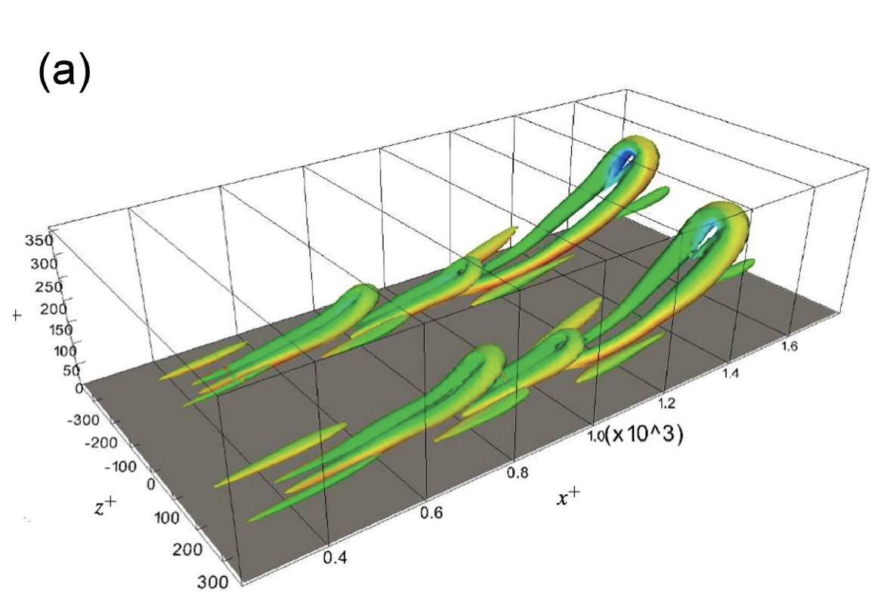
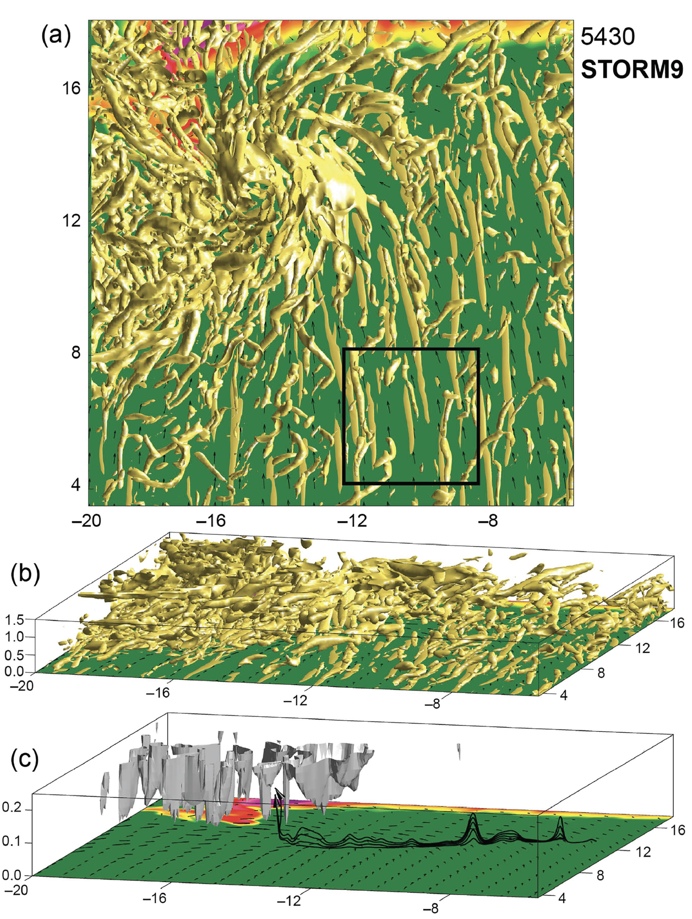
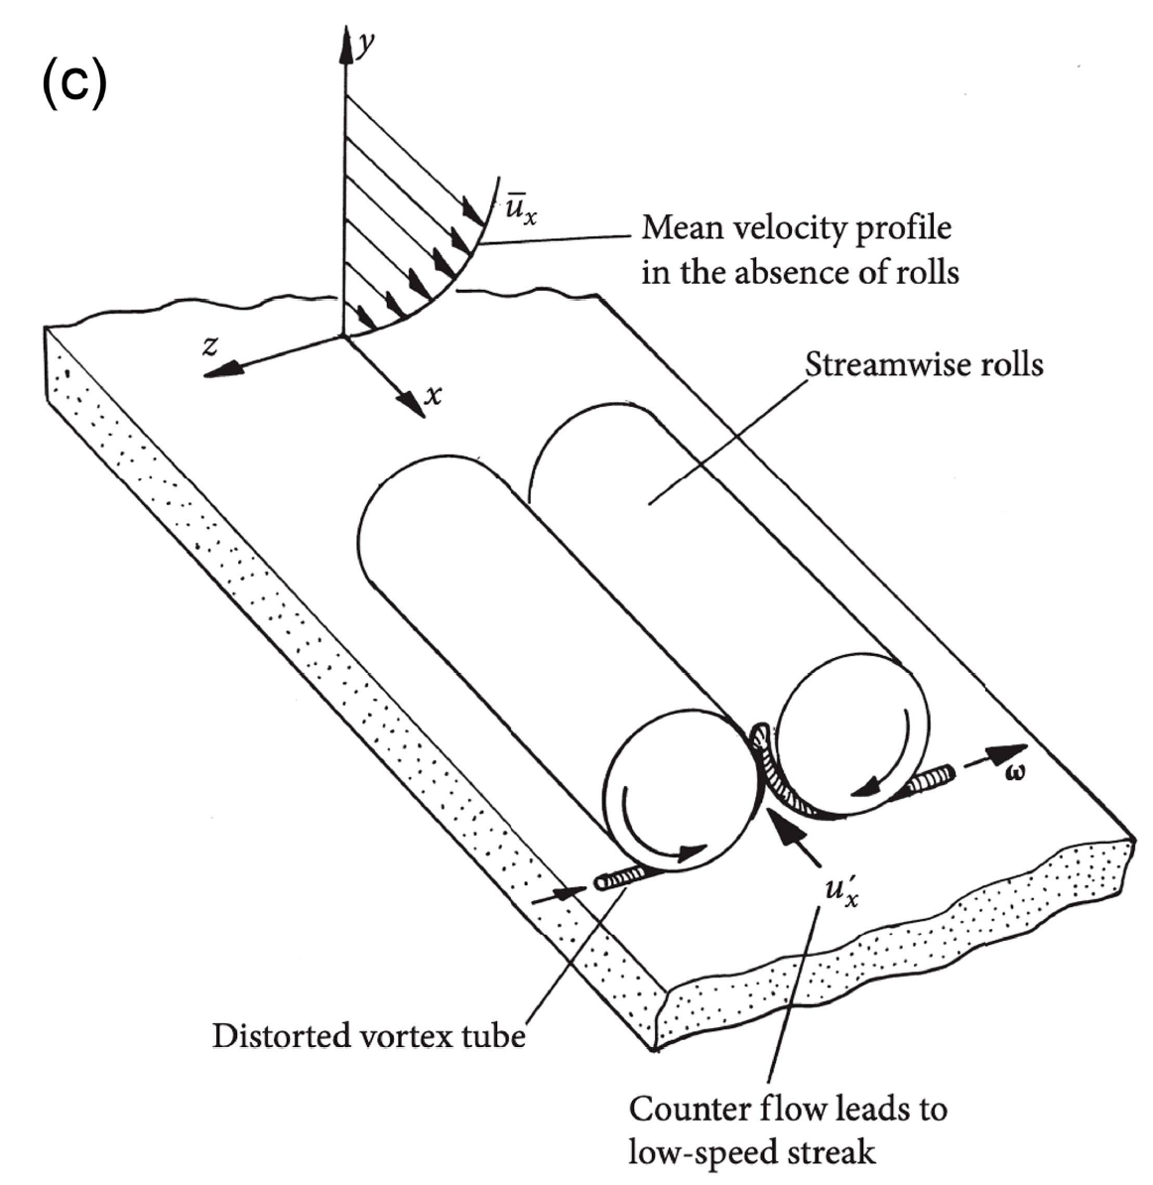
A New Pathway for Tornadogenesis
Markowski, P. M. (2024)
Coherent structures In surface layer
Hairpin structures
Vertical vorticity ζ streaks can develop in turbulent inflow near the surface.
The ζ streaks serve as focal points for tornadogenesis.
Vertical vorticity streaks
Strong sfc layer shear due to friction
rolls
rolls
Distorted vortex tube
Markowski, P. M., 2024: A New Pathway for Tornadogenesis Exposed by Numerical Simulations of Supercells in Turbulent Environments. J. Atmos. Sci., 81, 481-518.

Slide 17
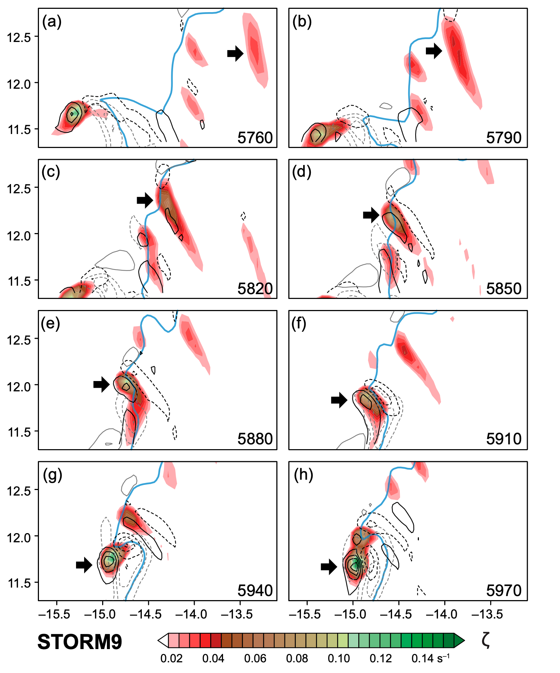
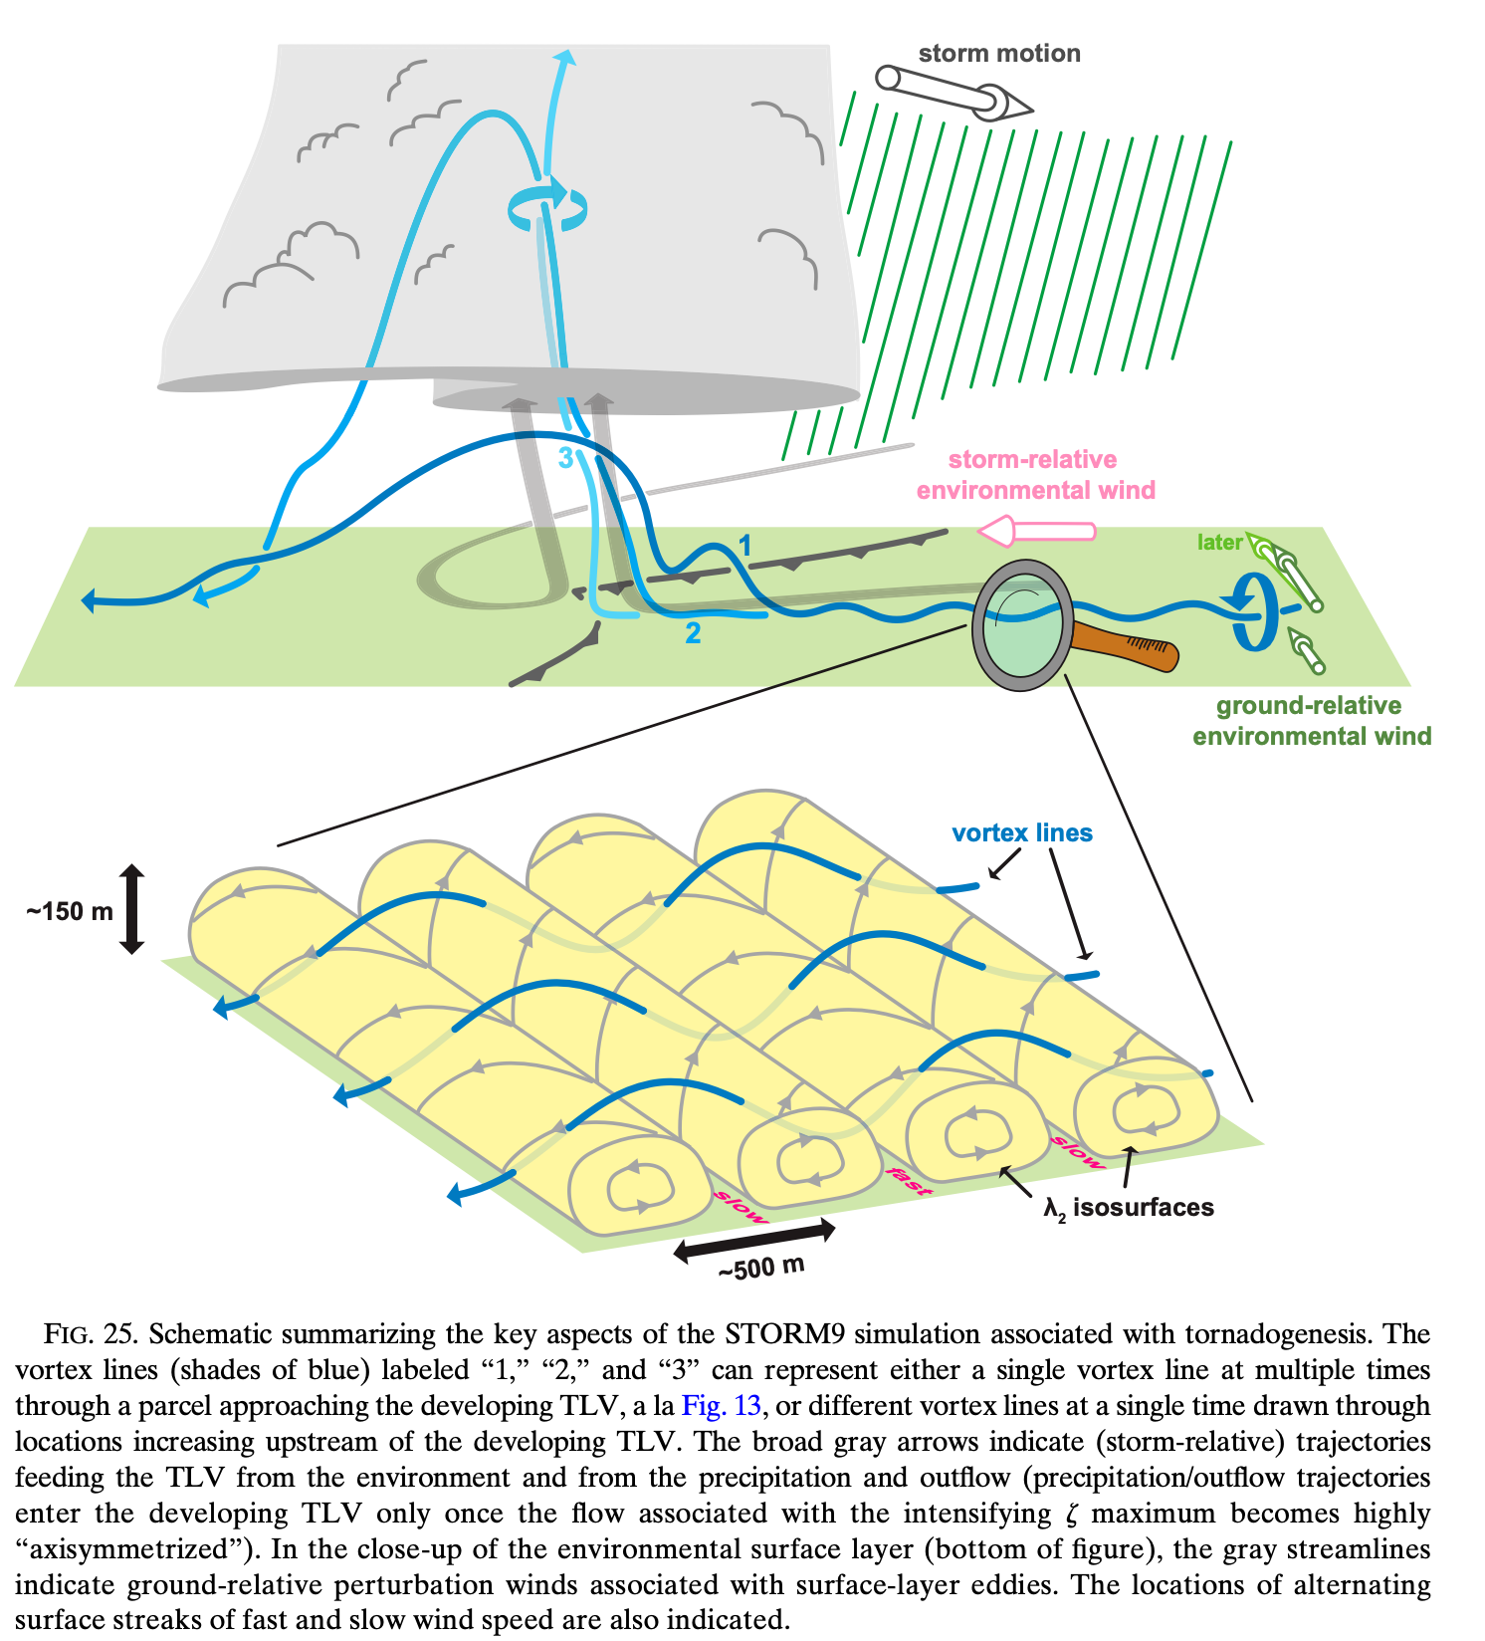
ζ streaks
Develops into TLV
Markowski, P. M., 2024: A New Pathway for Tornadogenesis Exposed by Numerical Simulations of Supercells in Turbulent Environments. J. Atmos. Sci., 81, 481-518.

Slide 18
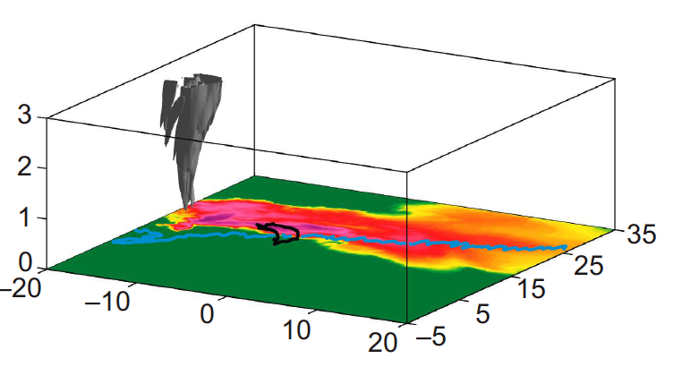
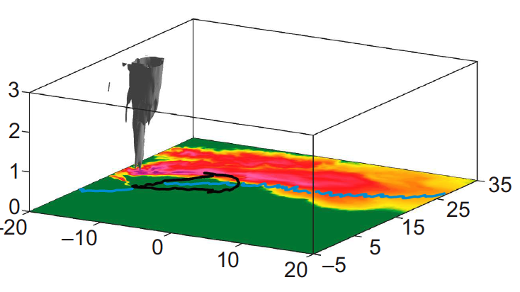
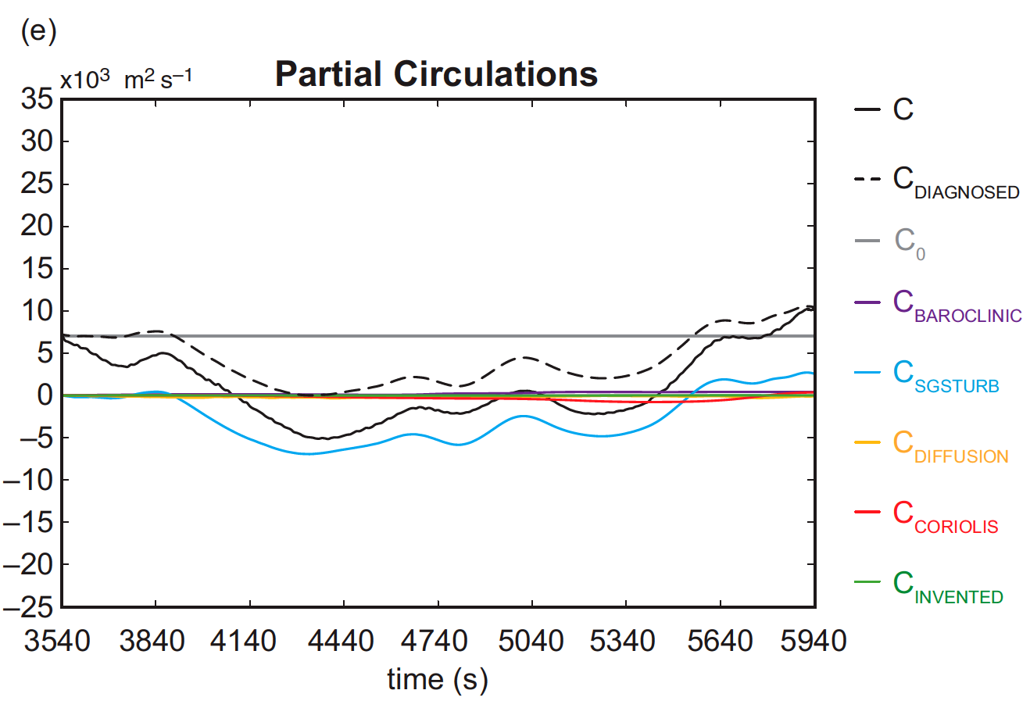
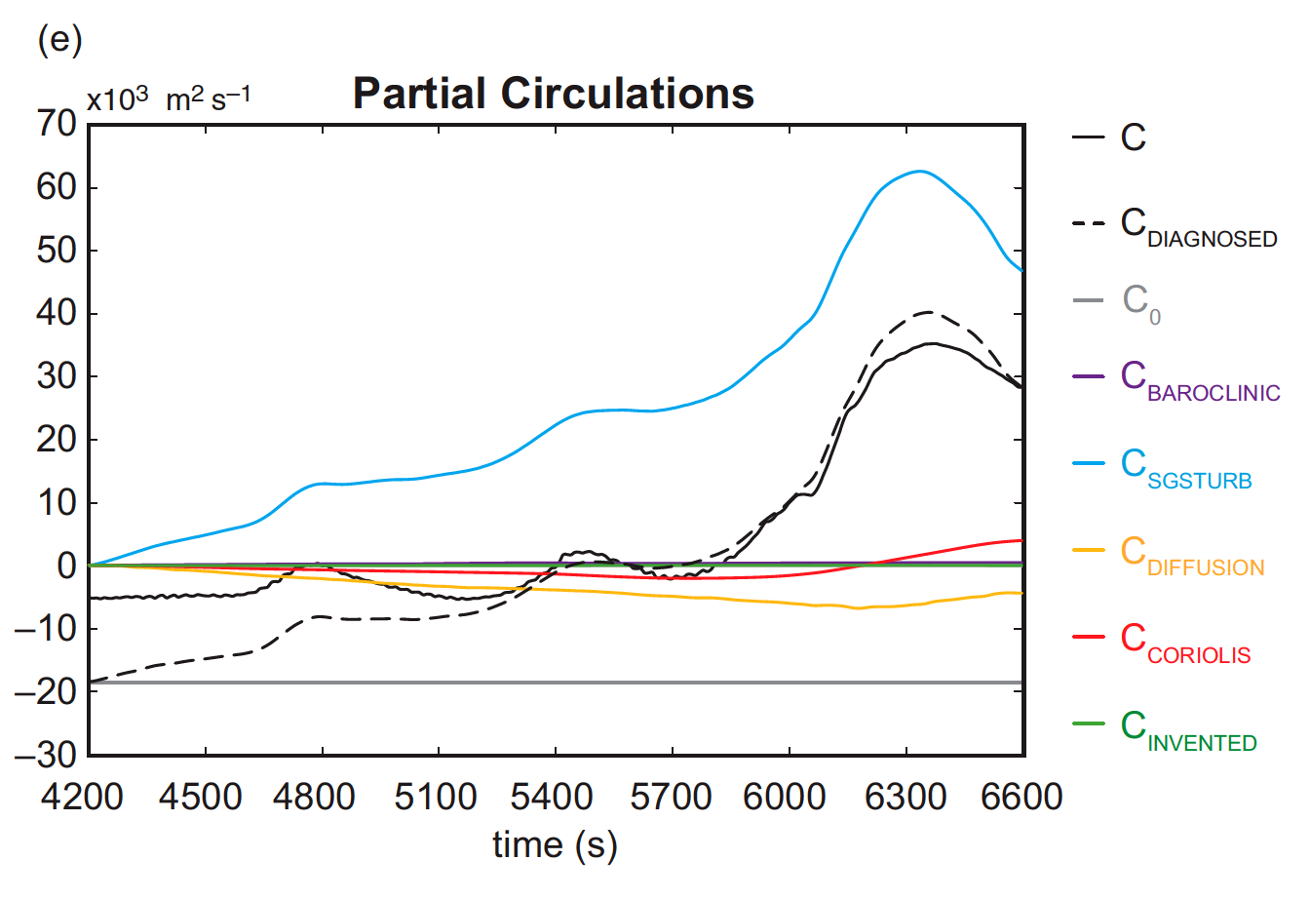
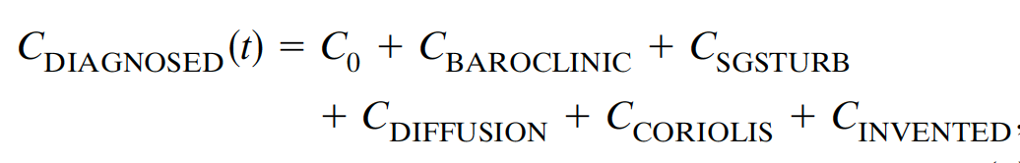
A New Pathway for Tornadogenesis
Markowski, P. M. (2024)
Circulation Analyses for two Circuits Prior to TLV Genesis and Mature TLV
Distorted vortex tube
Contribution from baroclinicity, Coriolis, Diffusion, “Invented force” are all negligible.
The lack of a significant role for baroclinic generation is particularly noteworthy.
frictional
Baroclinic
frictional
Baroclinic
70% of circulation comes from background C0, and 30% from turbulence/friction generation.
C0<0 initially. Almost all C is generated by turbulence/friction term.

Slide 19
Summary Points
Tornado simulations without surface drag is in many aspects unrealistic
Often exaggerate the role of baroclinic vorticity generation, because of no other generation source.
Surface drag that is often large in tornadic storms is grossly neglected.
The possibly more important role of friction-generated vorticity has taken its time for the community to accept. Many simulation studies continue to neglect it.
More and more research is starting to recognize the important contributions of friction-generated vorticity.
More and more evidences based on both idealized (but realistic) and real data simulations.
Being dynamically forced, downdrafts in tornadic supercell storms are often warm instead of cold
Near-surface wind shear as created by surface friction is very hard to measure – a challenge to be overcome

Slide 20
References cited
Schenkman, A. D., M. Xue, and M. Hu, 2014: Tornadogenesis in a high-resolution simulation of the 8 May 2003 Oklahoma City Supercell. J. Atmos. Sci., 71, 130-154.
Xu, X., M. Xue, and Y. Wang, 2015: The genesis of mesovortices within a real data simulation of a bow echo system. J. Atmos. Sci., 72, 1963-1986.
Roberts, B., M. Xue, A. D. Schenkman, and I. Daniel T. Dawson, 2016: The role of surface friction in tornadogenesis within an idealized supercell simulation. J. Atmos. Sci., 73, 3371–3395.
Markowski, P. M., 2016: An idealized numerical simulation investigation of the effects of surface drag on the development of near-surface vertical vorticity in…. J. Atmos. Sci., 73, 4349-4385.
Roberts, B., and M. Xue, 2017: The role of surface drag in mesocyclone intensification leading to tornadogenesis within an idealized supercell simulation. J. Atmos. Sci., 74, 3055-3077.
Roberts, B., M. Xue, and D. T. Dawson, 2020: The Effect of Surface Drag Strength on Mesocyclone Intensification and Tornadogenesis in Idealized Supercell Simulations. J. Atmos. Sci., 77, 1699-1721.
Tao, T., and T. Tamura, 2020: Numerical study of the 6 May 2012 Tsukuba supercell tornado: Vorticity sources responsible for tornadogenesis. Mon. Wea. Rev., 148, 1205-1228.
Yokota, S., H. Niino, H. Seko, M. Kunii, and H. Yamauchi, 2018: Important factors for tornadogenesis as revealed by high-resolution ensemble forecasts of the Tsukuba supercell tornado of 6 May 2012 in Iapan. Mon. Wea. Rev., 146, 1109-1132.
Markowski, P. M., 2024: A New Pathway for Tornadogenesis Exposed by Numerical Simulations of Supercells in Turbulent Environments. J. Atmos. Sci., 81, 481-518.

