Slide 1
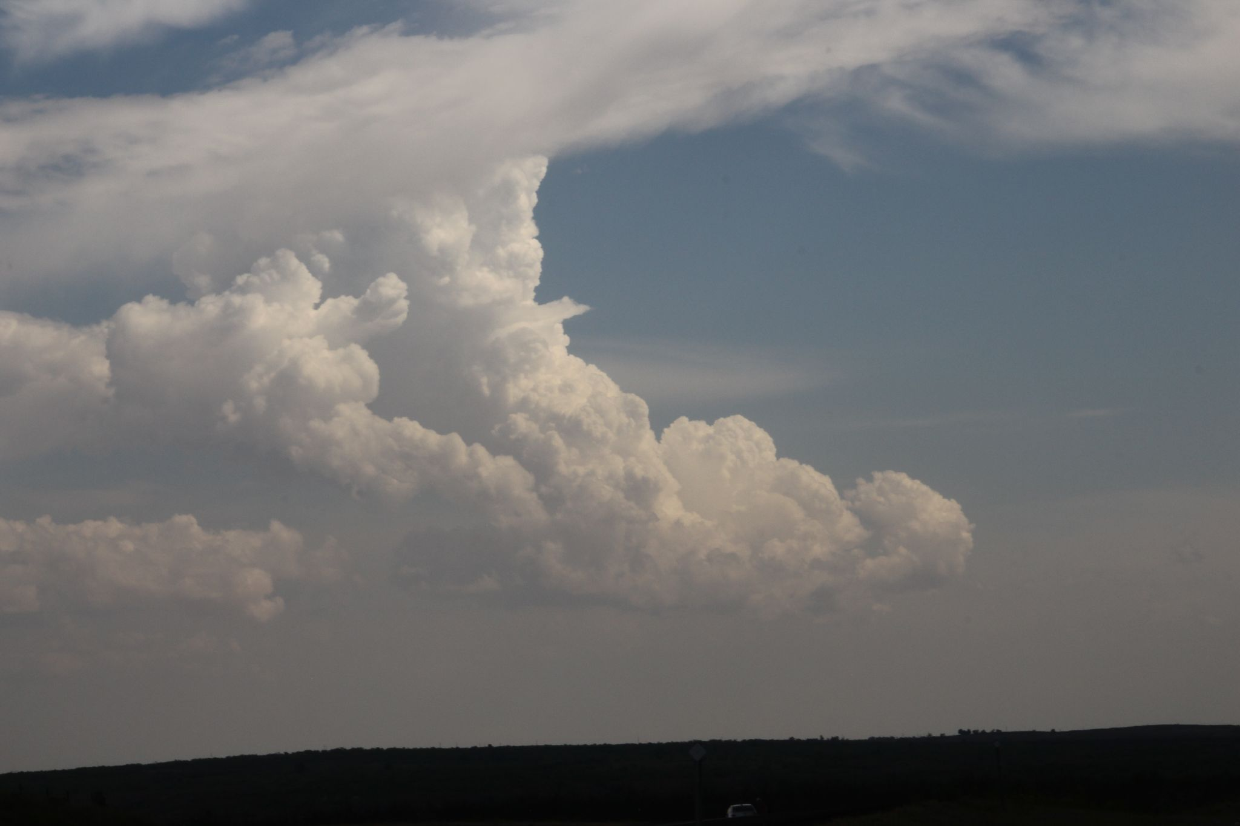
Deep-layer
Vertical
Wind Shear

Slide 2
Deep-layer Vertical Wind Shear
What is it?
Where does it come from?
What is its influence on deep convection?
How do we measure it?
How to forecast it?

Slide 3
Vertical Wind Shear
What is it?
Defined as:
“The condition produced by a change in wind velocity (speed and/or direction) with height.”
- AMS Glossary
Speed Shear
Directional Shear
Combination of both
(most common)

Slide 4
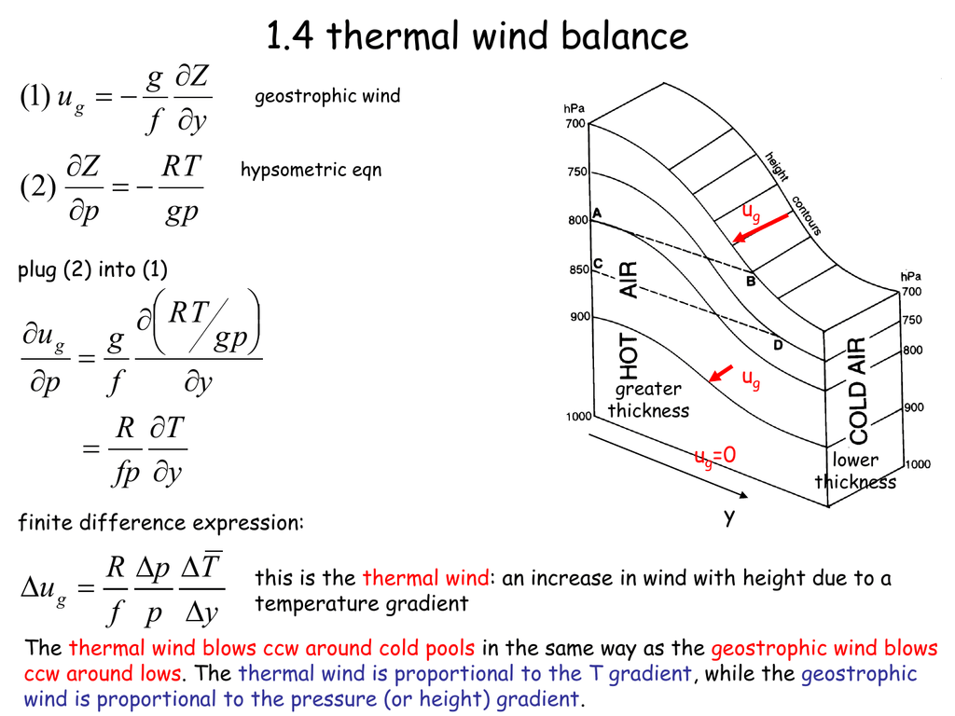
Vertical Wind Shear
Where does it come from?
Primary contribution:
“Large-scale horizontal temperature gradients via the thermal-wind relation” (M.R. 2010)
For additional reading: M.R. 2010 and Doswell 1991

Slide 5
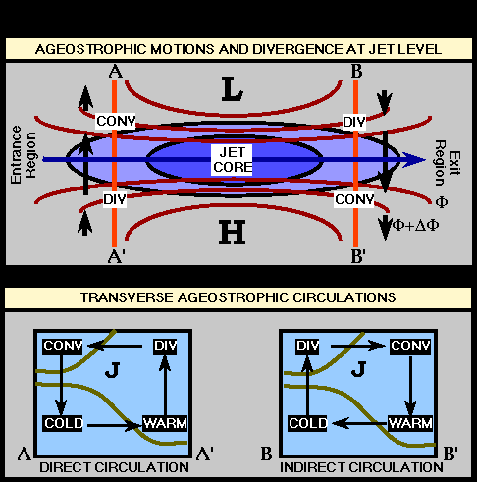
Vertical Wind Shear
Where does it come from?
Secondary contributions:
Large accelerations of the horizontal wind due to large ageostropic winds
(think near jet streaks, areas of frontogenesis, and/or rapidly intensifying cyclones).
Erodes horizontal temperature gradient
(weaker thermal wind)
Enhances horizontal temperature gradient
(stronger thermal wind!)
For additional reading: M.R. 2010 and Doswell 1991

Slide 6
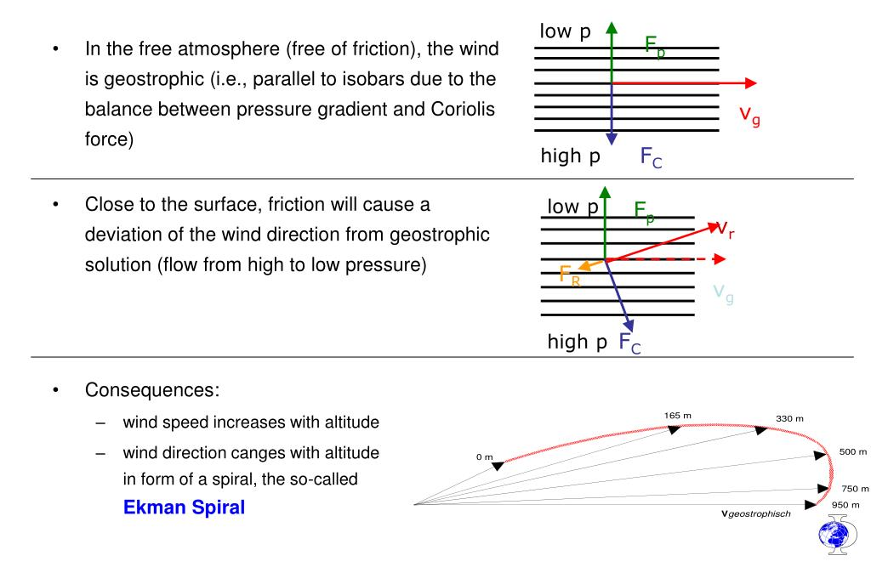
Vertical Wind Shear
Where does it come from?
Tertiary contributions: Boundary-layer friction, which may be present in the absence
of large-scale baroclinicity (think Ekman Spiral).
For additional reading: M.R. 2010 and Doswell 1991

Slide 7


Slide 8
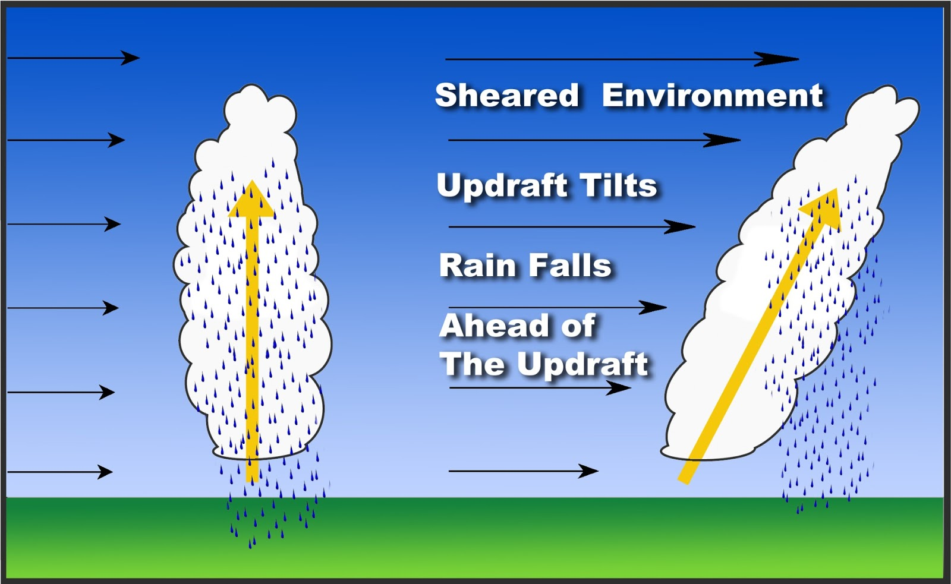
Vertical Wind Shear
Influence on convection?
The role of deep-layer vertical wind shear is to displace negatively buoyant air and hydrometeors away from the updraft region.
This favors storm longevity and (perhaps more importantly) is the origin of mesocyclone rotation.
(Much more on that idea later in the class!)

Slide 9
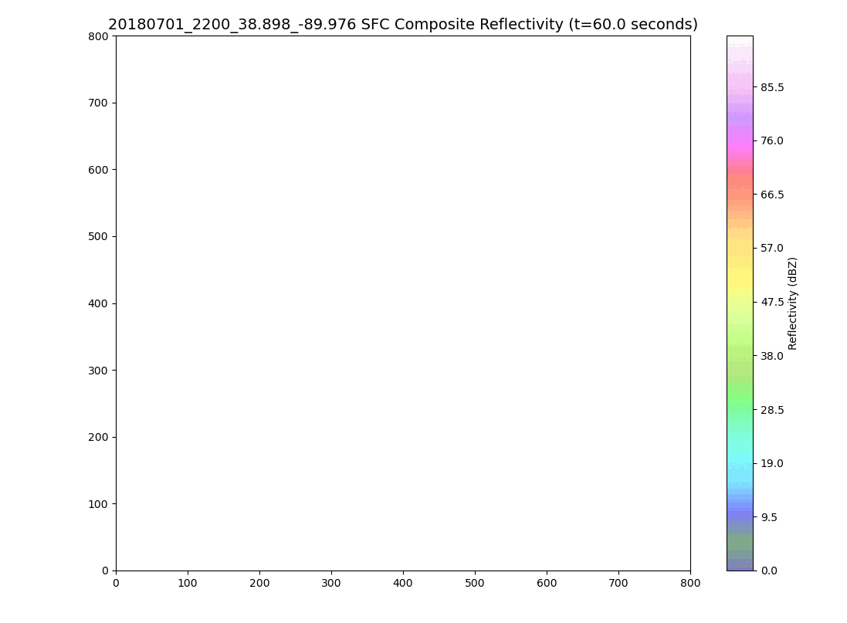
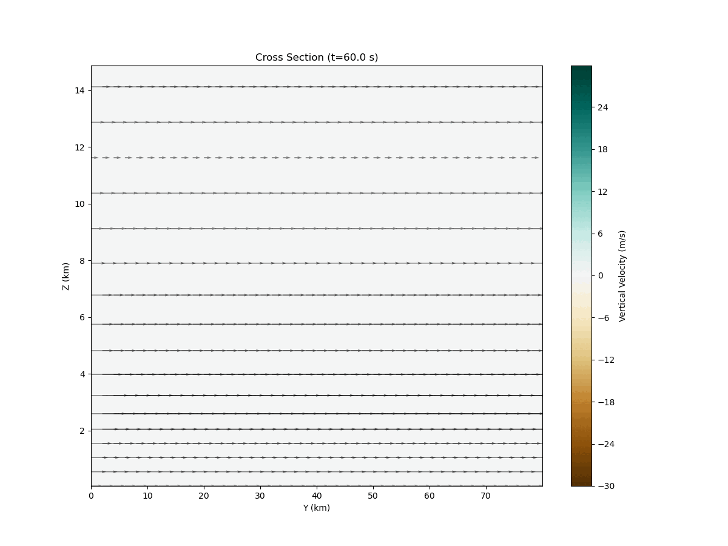
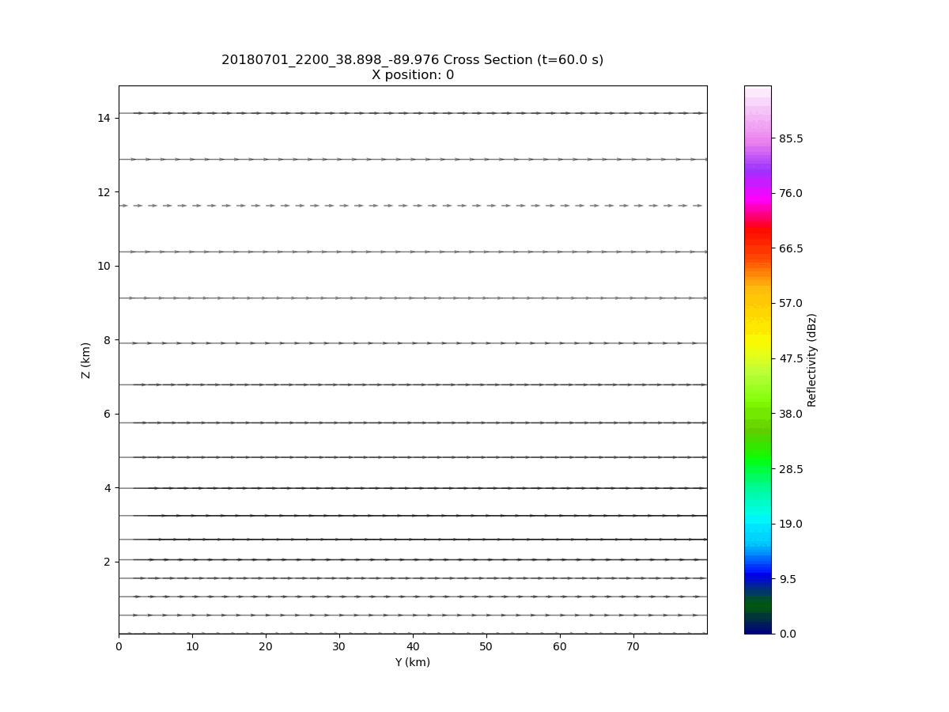
Vertical Wind Shear
Simulation of a T-storm in a low-shear environment.
(Note the single updraft pulse followed by a quick collapse.)
Composite Reflectivity
Reflectivity Cross Section
Vertical Velocity Cross Section

Slide 10
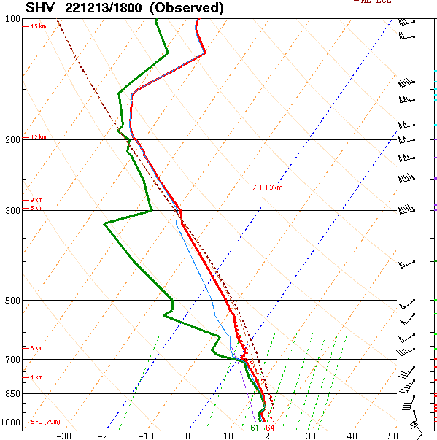
Vertical Wind Shear
How do we measure it?
Bulk Wind Difference:
The magnitude of the vector difference between the winds at two different levels.
0-3 km Shear Vector
3 km wind
0-6 km Shear Vector
10 m wind
6 km wind

Slide 11
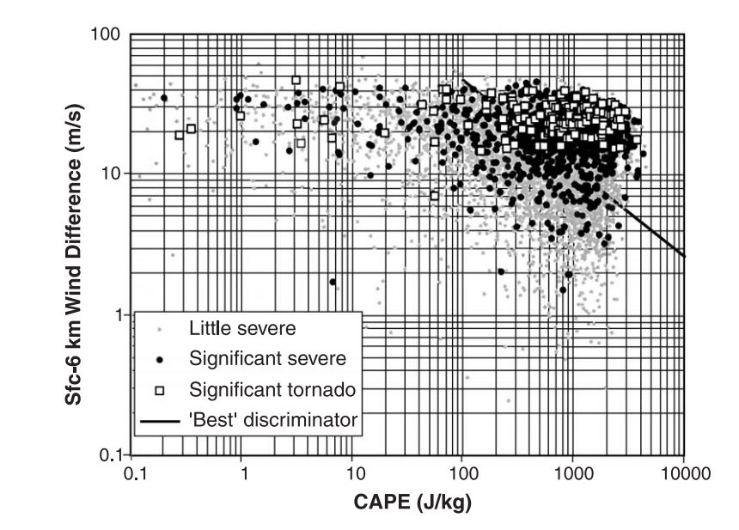
Vertical Wind Shear
How do we measure it?
Surface to 6 km BWD is a very common
metric to gauge the magnitude of deep-layer wind shear.
Many studies have shown that around 10 m/s (~20 knots) is a reasonable discriminator between severe and non-severe environments.
(although not perfect!)
Other common BWD metrics used in convective forecasting include:
0-1 km BWD
0-3 km BWD
0-8 km BWD
Fig. 1 from Brooks et al. 2003

Slide 12
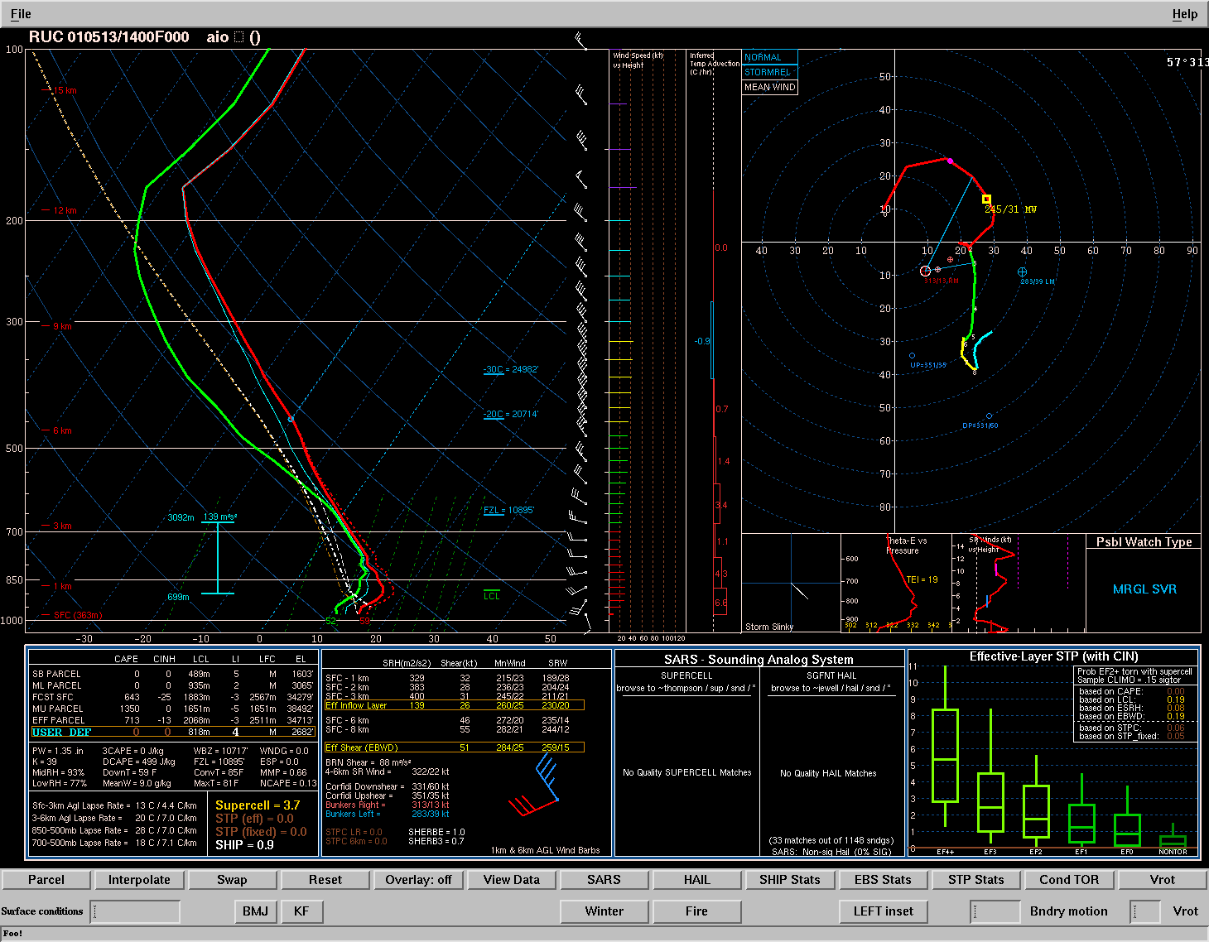
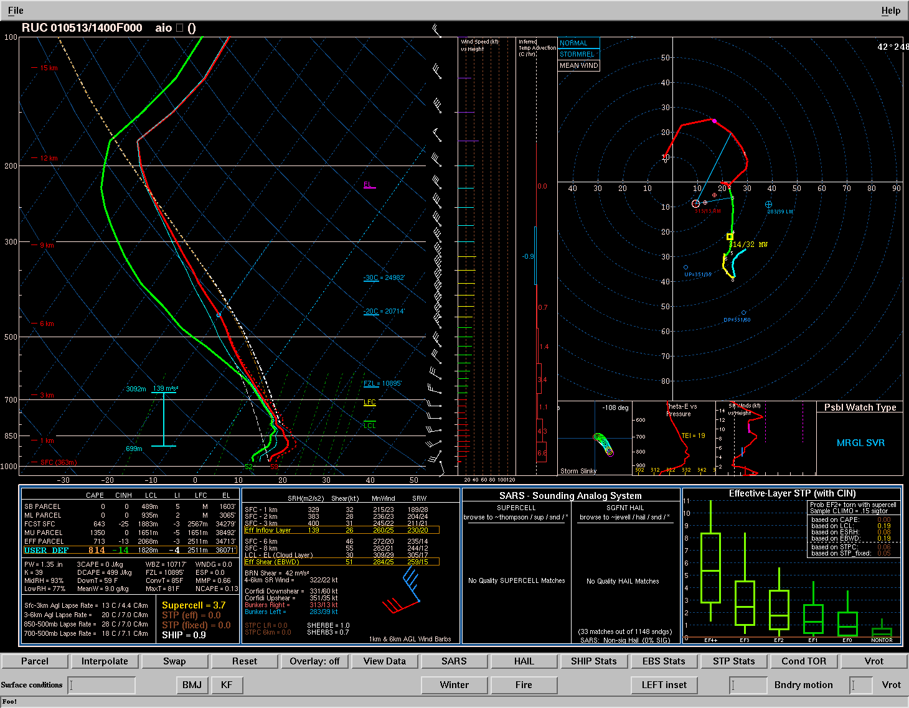
Vertical Wind Shear
How do we measure it?
0-6 km Bulk Wind Difference Pros:
Quick estimate of whether or not the environment will support downdraft displacement from the updraft region (i.e. will the environment support storm venting).
Very easy to calculate and interpret.
0-6 km Bulk Wind Difference Cons:
Does not contain information about the “shape” of the wind profile (i.e. there is no information about the hodograph).
May not accurately represent the layer of the atmosphere contributing to deep convection.

Slide 13
Vertical Wind Shear
How do we measure it?
0-6 km BWD may not accurately represent the layer of the atmosphere contributing to deep convection.
Is the surface parcel contributing
to the updraft?

Slide 14
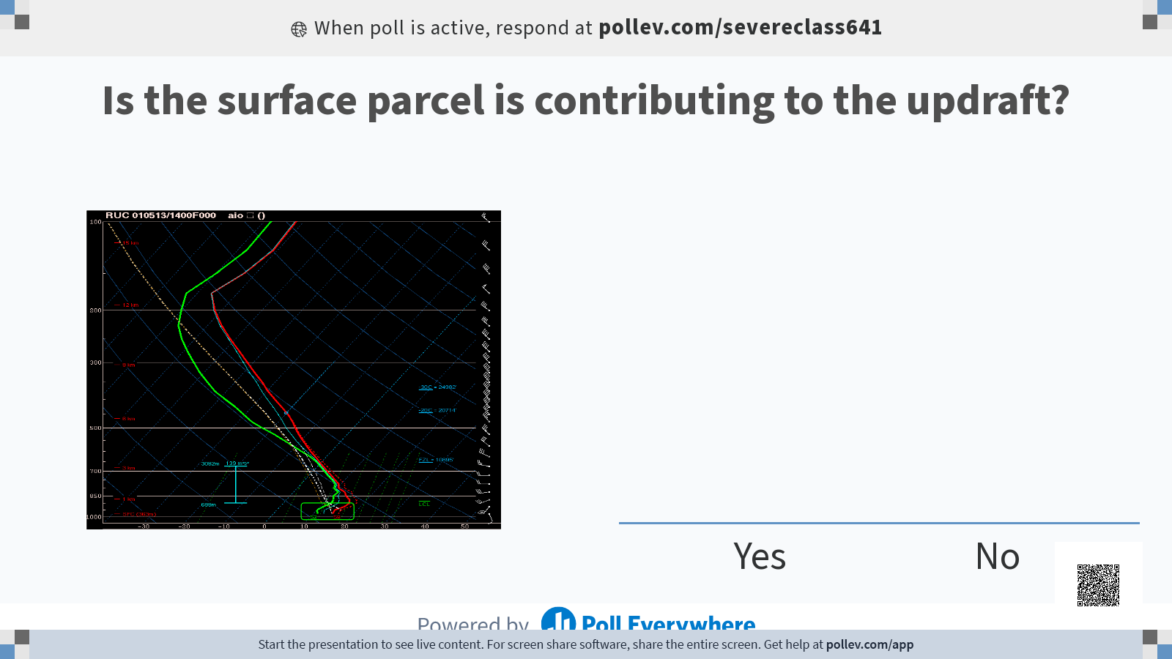

Slide 15

Vertical Wind Shear
How do we measure it?
0-6 km BWD may not accurately represent the layer of the atmosphere contributing to deep convection.
How about this parcel (green)?
Probably!

Slide 16
Vertical Wind Shear
How do we measure it?
0-6 km BWD may not accurately represent the layer of the atmosphere contributing to deep convection.
How about this parcel (green)?
Probably!
Parcels below this layer are NOT contributing to the updraft, therefore we don’t want to consider the parcel’s trajectory/wind velocity in shear calculations.

Slide 17
Vertical Wind Shear
How do we measure it?
0-6 km BWD may not accurately represent the layer of the atmosphere contributing to deep convection.
Let’s identify all of the parcels that are contributing to the storm’s updraft.
We’ll use the criteria:
>= 100 J/kg CAPE
>= -250 J/kg CIN

Slide 18
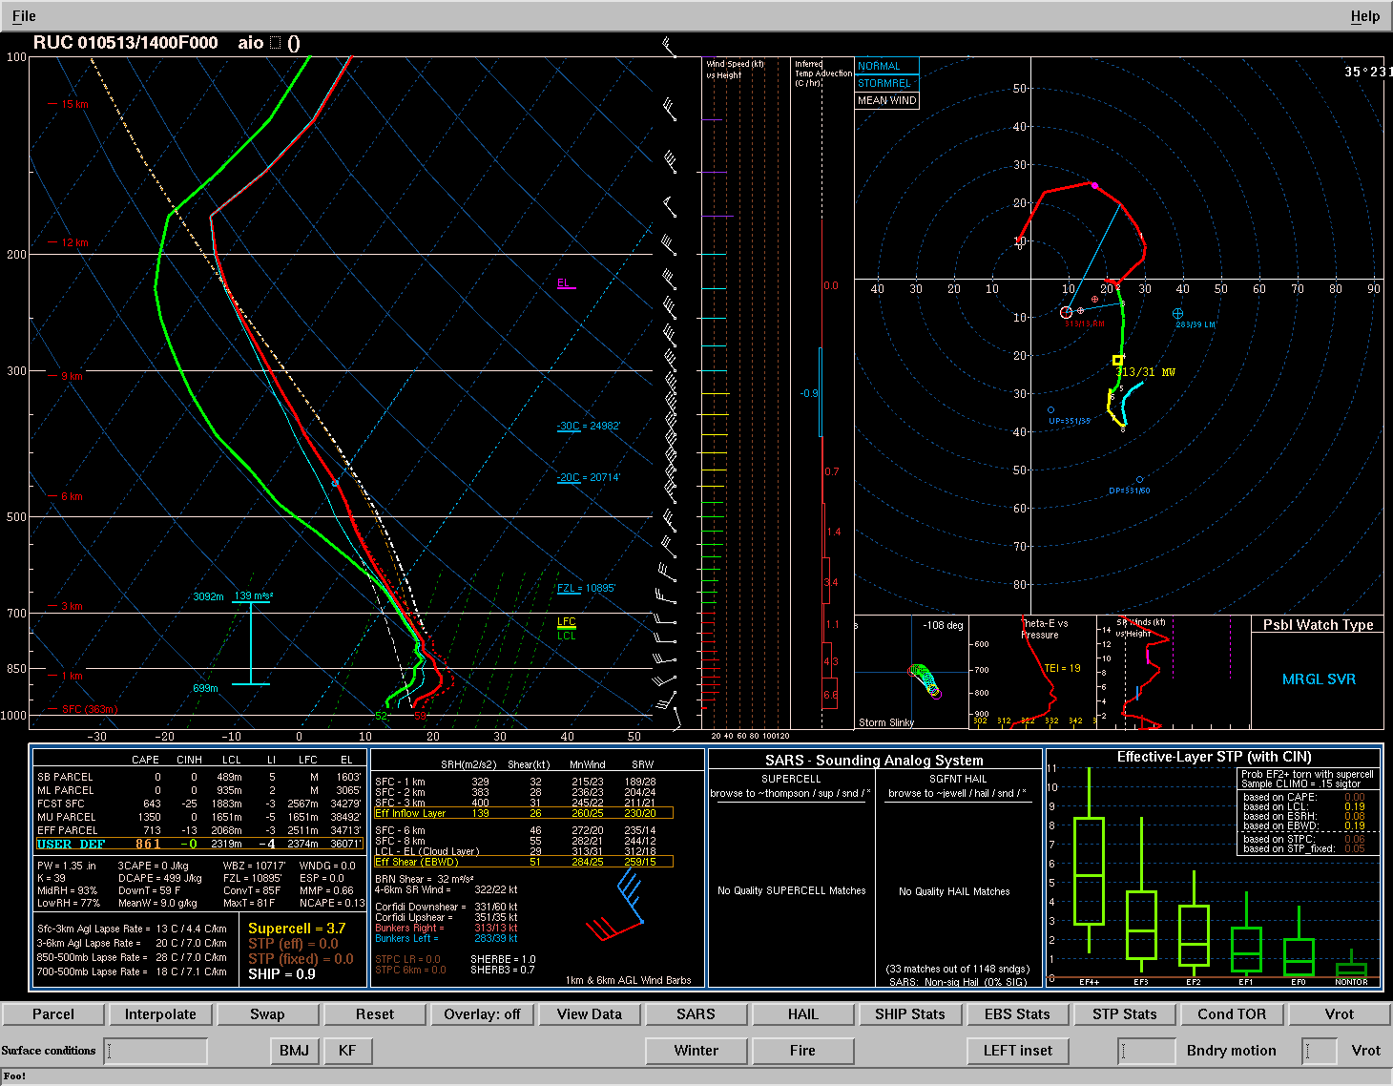
Vertical Wind Shear
How do we measure it?
0-6 km BWD may not accurately represent the layer of the atmosphere contributing to deep convection.
Let’s identify all of the parcels that are contributing to the storm’s updraft.
We’ll use the criteria:
>= 100 J/kg CAPE
>= -250 J/kg CIN
start

Slide 19
Vertical Wind Shear
How do we measure it?
0-6 km BWD may not accurately represent the layer of the atmosphere contributing to deep convection.
Let’s identify all of the parcels that are contributing to the storm’s updraft.
We’ll use the criteria:
>= 100 J/kg CAPE
>= -250 J/kg CIN
start

Slide 20
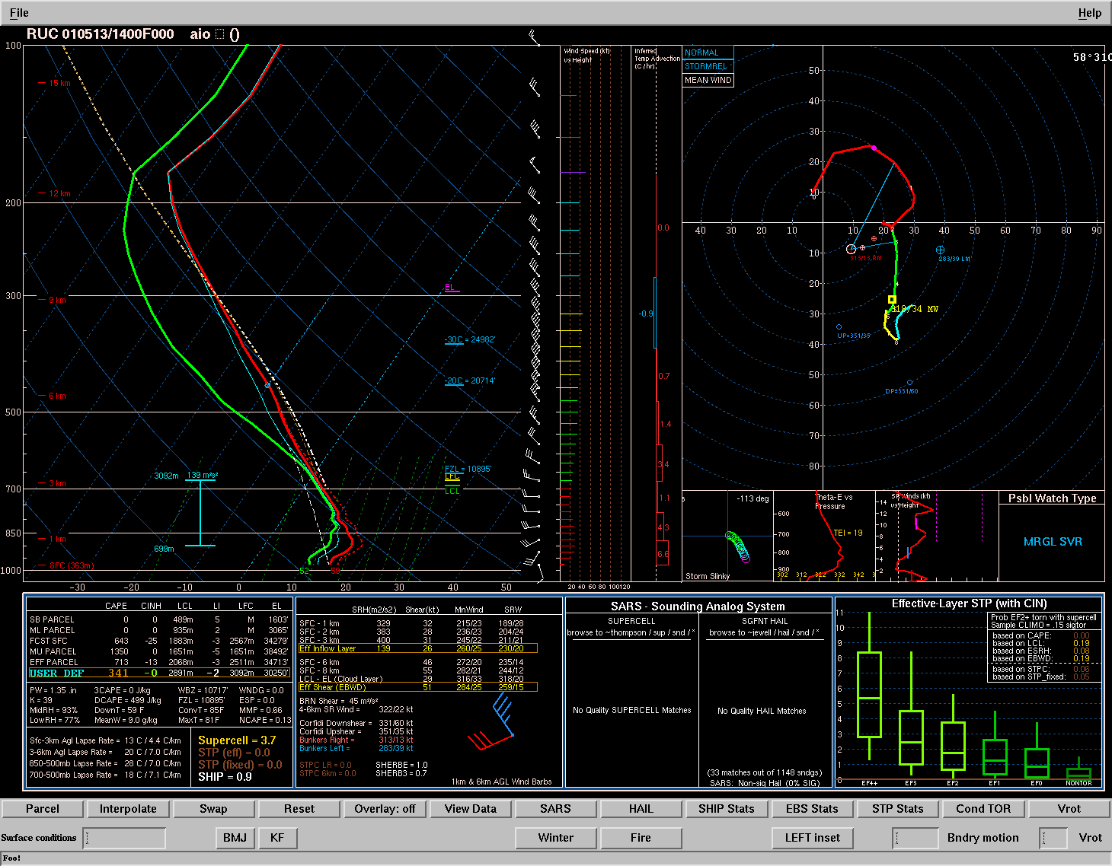
Vertical Wind Shear
How do we measure it?
0-6 km BWD may not accurately represent the layer of the atmosphere contributing to deep convection.
Let’s identify all of the parcels that are contributing to the storm’s updraft.
We’ll use the criteria:
>= 100 J/kg CAPE
>= -250 J/kg CIN
start

Slide 21

Vertical Wind Shear
How do we measure it?
0-6 km BWD may not accurately represent the layer of the atmosphere contributing to deep convection.
Let’s identify all of the parcels that are contributing to the storm’s updraft.
We’ll use the criteria:
>= 100 J/kg CAPE
>= -250 J/kg CIN
stop
start

Slide 22
Vertical Wind Shear
How do we measure it?
0-6 km BWD may not accurately represent the layer of the atmosphere contributing to deep convection.
This is the portion of the profile that is contributing to the storm’s updraft
(by our criteria at least).
Let’s identify all of the parcels that are contributing to the storm’s updraft.
We’ll use the criteria:
>= 100 J/kg CAPE
>= -250 J/kg CIN
stop
start

Slide 23
Vertical Wind Shear
How do we measure it?
0-6 km BWD may not accurately represent the layer of the atmosphere contributing to deep convection.
This is the
Effective Inflow Layer.
It is typically denoted in soundings here.
Let’s identify all of the parcels that are contributing to the storm’s updraft.
We’ll use the criteria:
>= 100 J/kg CAPE
>= -250 J/kg CIN
stop
start

Slide 24
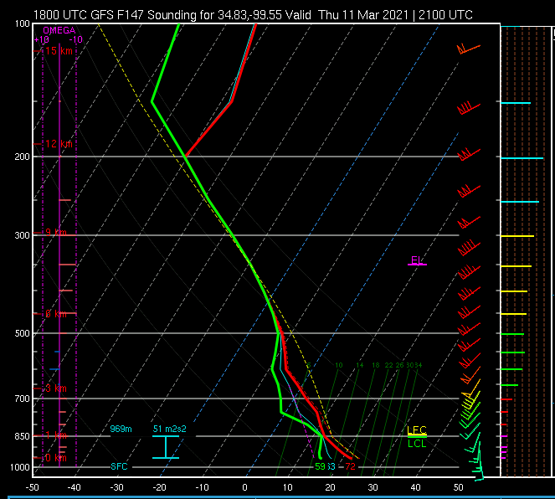
Vertical Wind Shear
How do we measure it?
Effective Inflow layer begins at the surface
(surface-based)
Effective Inflow layer begins above the surface
(elevated)
Which will have a higher tornado potential? Why?

Slide 25
Vertical Wind Shear
How do we measure it?
“Deep-layer” shear should
represent the storm’s depth
Simulations show sufficient shear
from 0 to 5/6 km AGL sustains
supercells...
0-6 km bulk layer

Slide 26
Vertical Wind Shear
How do we measure it?
“Deep-layer” shear should
represent the storm’s depth
Simulations show sufficient shear
from 0 to 5/6 km AGL sustains
supercells...
But we can use the Eff. inflow layer to consider the depth from the CAPE-bearing layer to the EL.
Eff. Bulk Layer
0-6 km bulk layer

Slide 27
Vertical Wind Shear
How do we measure it?
“Deep-layer” shear should
represent the storm’s depth
Simulations show sufficient shear
from 0 to 5/6 km AGL sustains
supercells...
But how do we define the bottom of this layer? Top of the eff. layer?
Bottom of the eff. layer?
Eff. Bulk Layer
0-6 km bulk layer

Slide 28
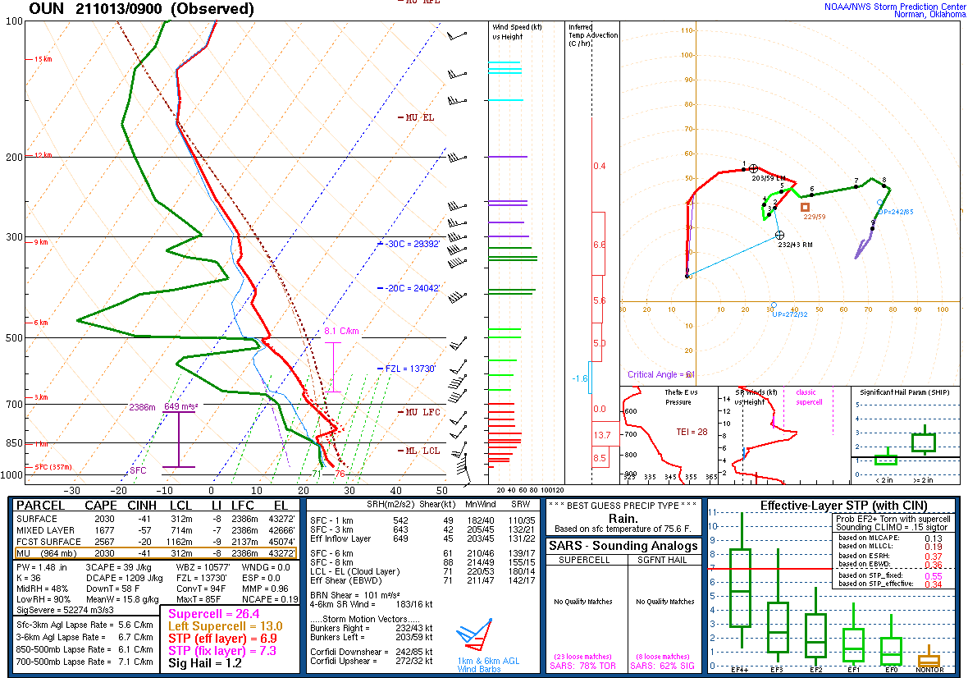
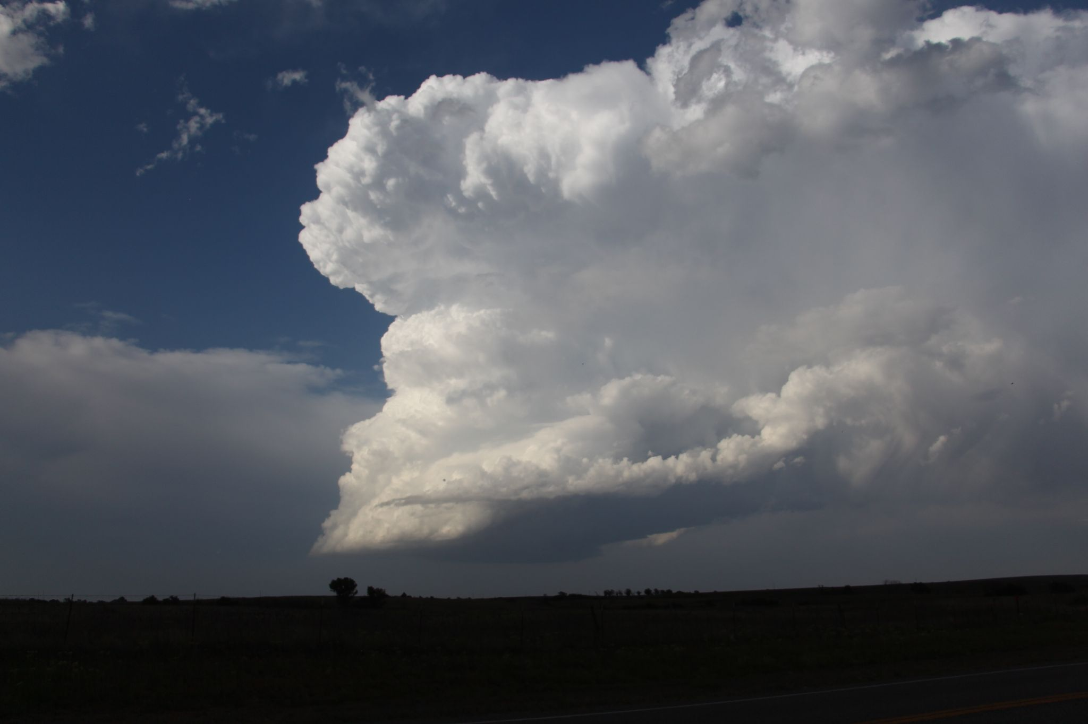
Calculating Effective Bulk Shear
2) Find EL of most-unstable parcel
100% Base-EL depth
75% Base-EL depth
3) Find BWD between
inflow base and some %
of the base-EL layer
50% Base-EL depth
25% Base-EL depth
Start at the effective inflow base

Slide 29
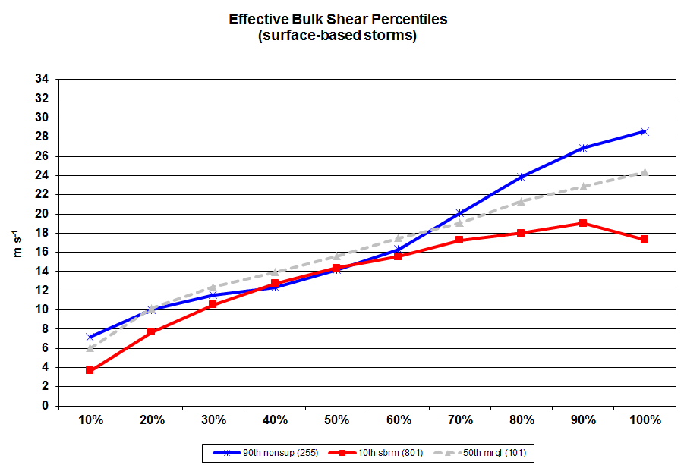
Strongest BWD with non-supercell storms
(top “whisker”)
Weakest BWD with supercell storms
(bottom “whisker”)
% Depth of Base - EL Layer

Slide 30
Strongest BWD with non-supercell storms
(top “whisker”)
Weakest BWD with supercell storms
(bottom “whisker”)

Slide 31
Here is where we see the greatest discrimination between supercells and non-supercells!
Strongest BWD with non-supercell storms
(top “whisker”)
Weakest BWD with supercell storms
(bottom “whisker”)

Slide 32
Effective Bulk Wind Difference
BWD between the bottom of the Eff. Inflow layer and 50% of the [Eff. inflow layer - EL] layer depth.
Similar to 0-6 km Bulk Wind Difference in “typical” (surface-based) scenarios
More flexible than 0-6 km BWD
Captures shallow and deep buoyancy environments
Captures elevated thunderstorm environments

Slide 33
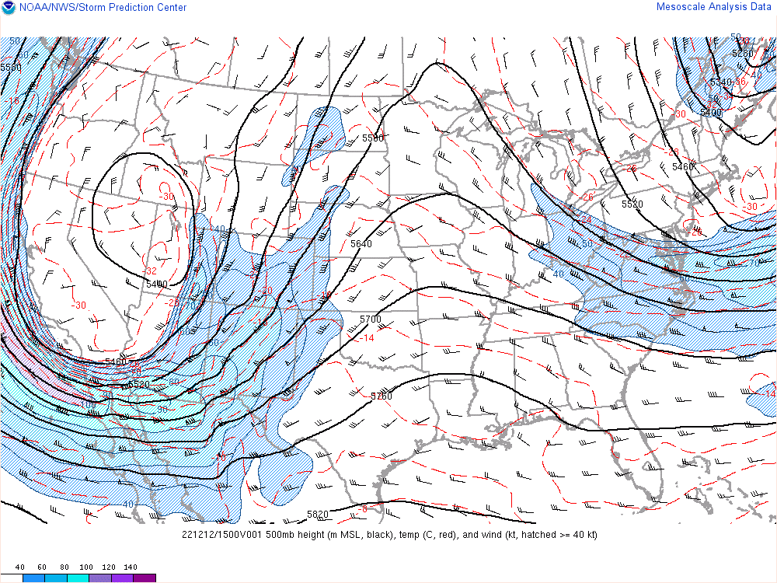
Vertical Wind Shear
How to forecast it?
Use Q.G. methods to anticipate how the wind profile will change.
Using the Q.G. Height tendency equation, how will the 500 mb field change over the next 8-12 hours?
What will this do to the winds at 500 mb over Dodge City, KS (red dot)?
Assuming steady state conditions near the ground, what will this do to the 0-6 km BWD?

Slide 34


Slide 35
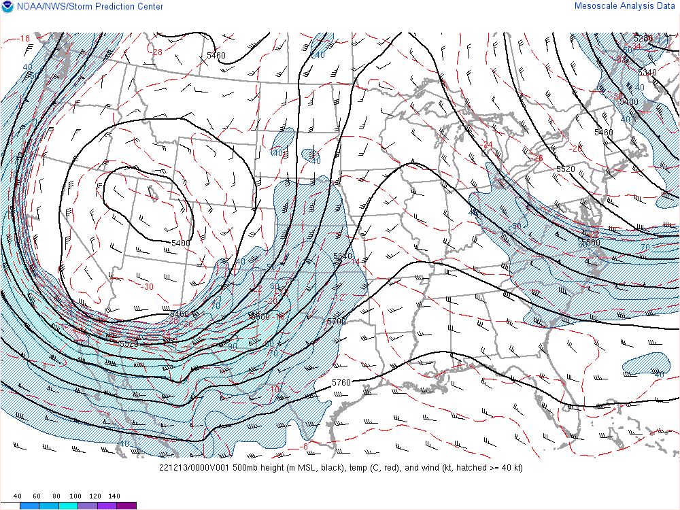
Vertical Wind Shear
How to forecast it?
Use Q.G. methods to anticipate how the wind profile will change.
Using the Q.G. Height tendency equation, how will the 500 mb field change over the next 8-12 hours?
What will this do to the winds at 500 mb over Dodge City, KS (red dot)?
Assuming steady state conditions near the ground, what will this do to the 0-6 km BWD?

Slide 36
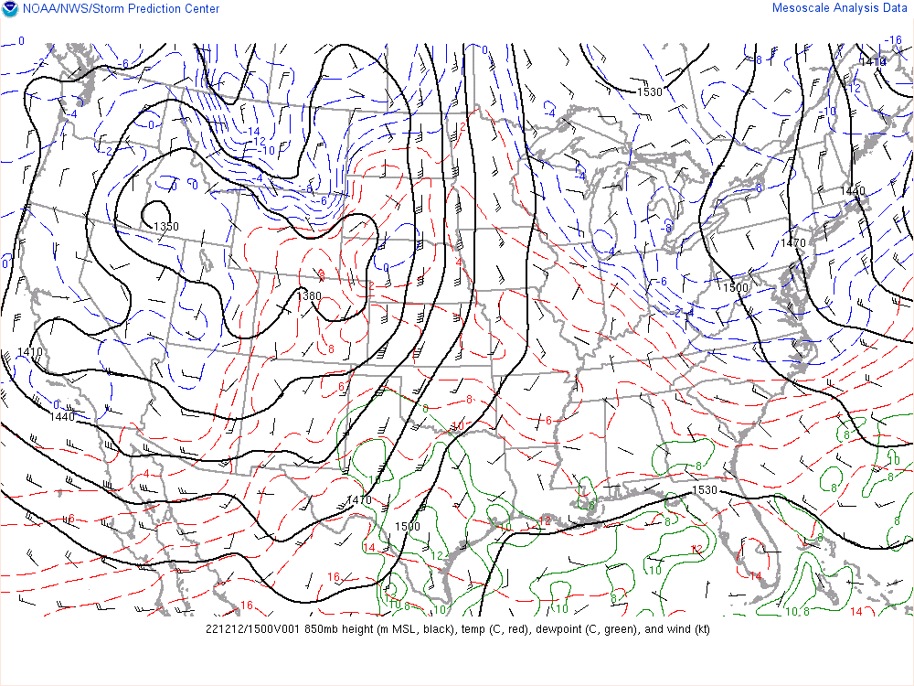
Vertical Wind Shear
How to forecast it?
Use Q.G. methods to anticipate how the wind profile will change.
Using the Q.G. Omega equation, will the 850 mb low over the CO/NE/WY region deepen or weaken?
What will this do to the winds at 850 mb over Norman, OK (red dot)?
Assuming steady state conditions near the ground, what will this do to the surface to 850 mb BWD?
*also consider thermal wind response of tightening 850 mb thermal gradient.
500 mb Jet
Notes:
Also notice the cold front moving across AZ. Will this increase or decrease the low-level baroclinicity? What will this due to the thermal wind response?

Slide 37


Slide 38
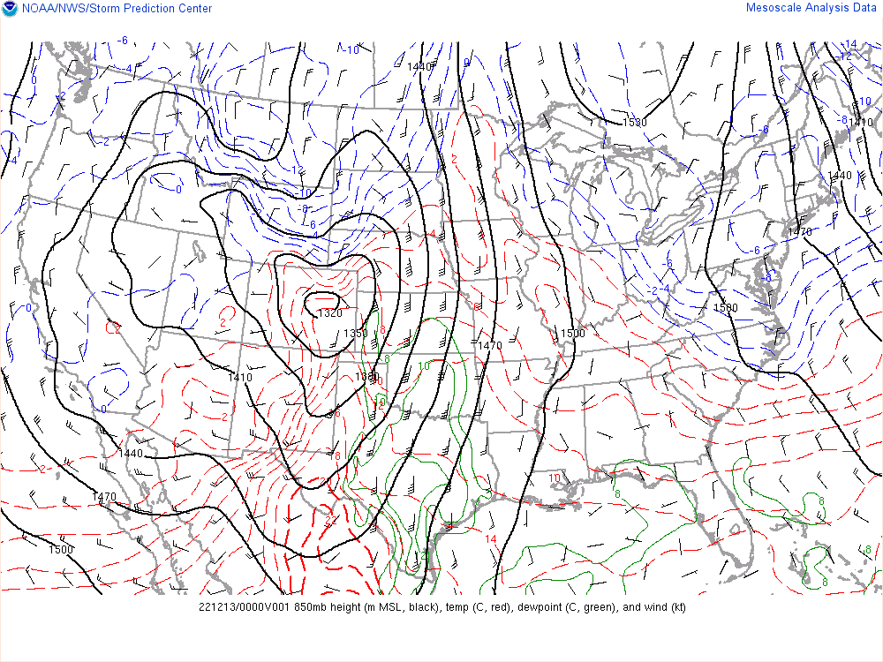
Vertical Wind Shear
How to forecast it?
Use Q.G. methods to anticipate how the wind profile will change.
Using the Q.G. Omega equation, will the 850 mb low over the CO/NE/WY region deepen or weaken?
What will this do to the winds at 850 mb over Norman, OK (red dot)?
Assuming steady state conditions near the ground, what will this do to the surface to 850 mb BWD?
*also consider thermal wind response of tightening 850 mb thermal gradient.
500 mb Jet
Notes:
Also notice the cold front moving across AZ. Will this increase or decrease the low-level baroclinicity? What will this due to the thermal wind response?

Slide 39
Nocturnal Low-Level Jet (LLJ)
Plains often see early nocturnal low-level jet (LLJ) ramp up with lee cyclogenesis
Related to two primary factors:
Boundary-layer decoupling and loss of surface friction (“inertial oscillation”)
Diurnal temperature variations over sloped terrain (thermal wind)
Part of the process that can favor late evening/early overnight tornadoes (with favorable moisture/CAPE)

Slide 40
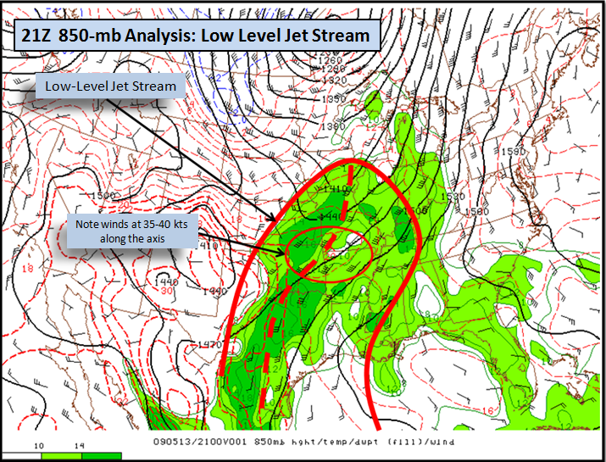
Nocturnal Low-Level Jet (LLJ) Formation
LLJs form in response to difference in terrain heights, heat fluxes and thickness across pressure surfaces that induces a horizontal Pressure Gradient Force.
Coriolis forcing turns the momentum northward resulting in an enhanced southerly flow.
Surface decoupling favors lower friction and acceleration of the jet above the surface
Lee Cyclones can also enhance it by increasing the PGF.
850 mb
Constant geopotential Height
PGF
850 mb
Lower
Thickness
Higher
Thickness
V++
Surface decoupling lower friction

Slide 41
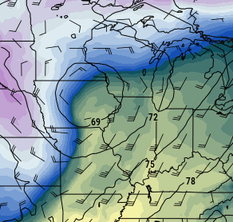
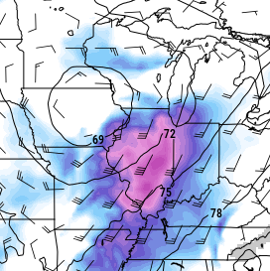
Cyclone induced Low-Level Jet (LLJ) Formation
LLJs form in response to difference in heat fluxes and thickness across pressure surfaces that induces a horizontal Pressure Gradient Force.
Coriolis forcing turns the momentum northward resulting in an enhanced southerly flow.
Surface decoupling favors lower friction and acceleration of the jet above the surface
Lee Cyclones can also enhance it by increasing the PGF.
L
850 mb
Constant geopotential Height
PGF
850 mb
Lower
Thickness
and pressure
Higher
Thickness
Cold Front
V++
Surface decoupling lowers friction at night

Slide 42
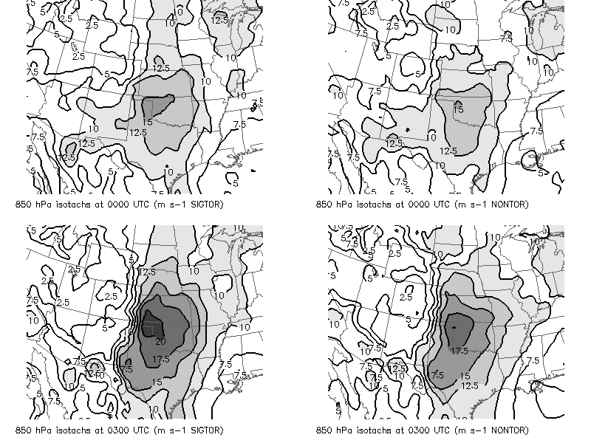
EF2+ supercell events
Nontornadic supercell events

