Slide 1
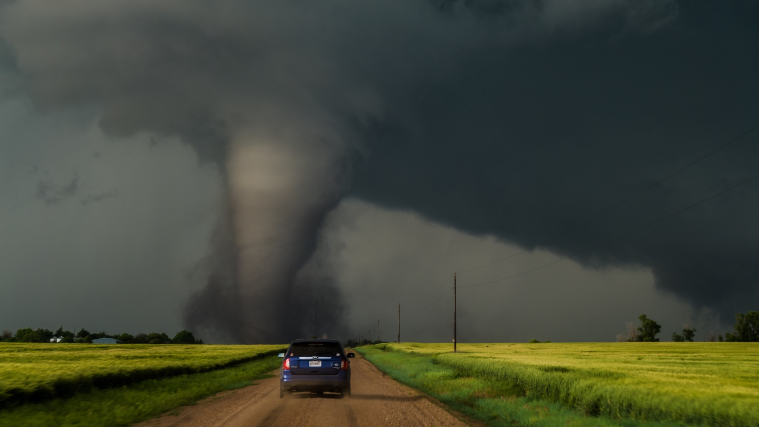
Supercell Tornadogenesis
METR 4403/5403
Spring 2026
Kelton Halbert

Slide 2
Disclaimer!
I do not possess the credentialed letters of an “expert”, but I have spent the better of 8 years in the weeds of tornado research.
Even if I was an expert, a lot of this knowledge is evolving and new!
The papers referenced are a great resource for more depth.
The papers referenced are only a subset of a rich history of literature on the matter, and there is plenty of ongoing and recently published research not referenced.
The atmosphere cares not for our conceptual models

Slide 3
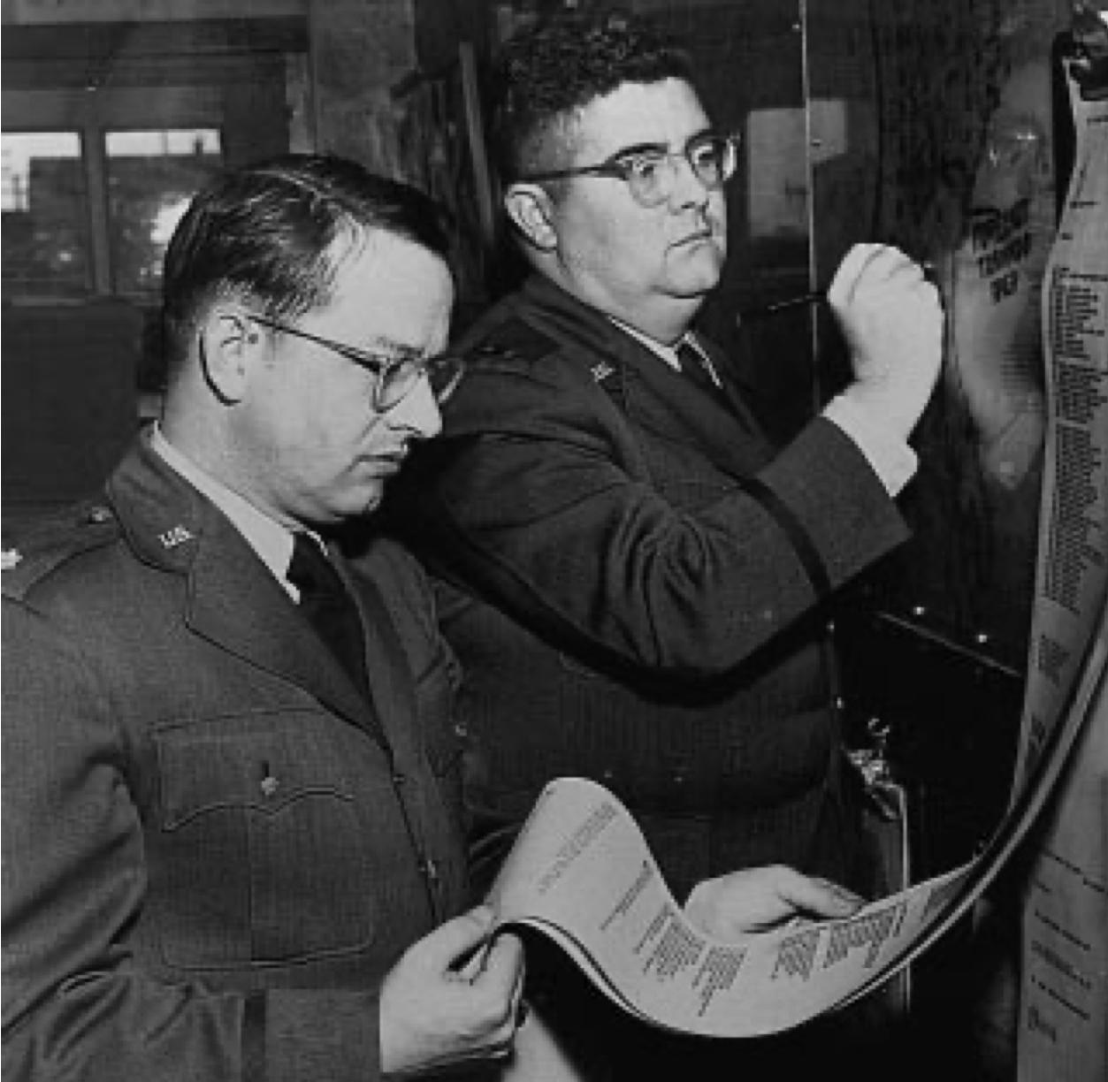
The First Successful Tornado Forecast: 1948
Ernest J Fawbush & Robert C Miller
Major Ernest J Fawbush and Colonel Robert C Miller were meteorologists stationed at Tinker Air Force Base in Oklahoma
March 20th, 1948: A tornado strikes Tinker AFB, causing significant damage to base infrastructure and aircraft
March 22-24th: Fawbush and Miller analyzed the surface and upper-air charts for the 20th, as well as other outbreaks of tornadoes that had recently occurred.
March 25th, 1948: Only 5 days after the Tinker tornado, they noticed the pattern was incredibly similar to the 20th and their list of criteria for tornado outbreaks.
  They were pressured by the base commander to issue a forecast. Eventually, they issued the forecast for tornado development, believing it to be career suicide.
Miller and Crisp (1999)

Slide 4
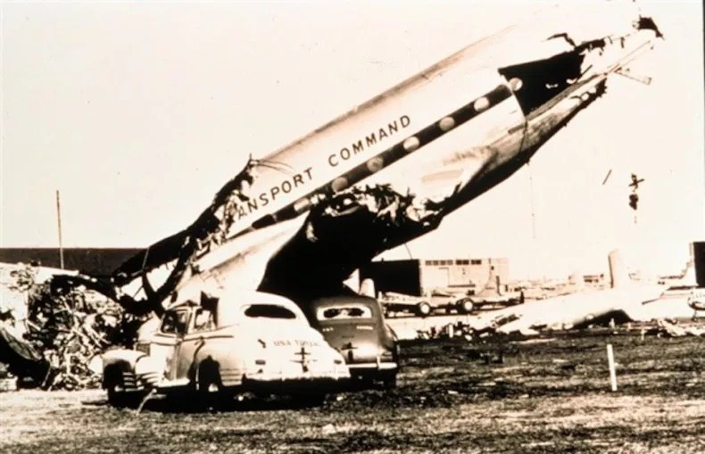
The First Successful Tornado Forecast: 1948
Ernest J Fawbush & Robert C Miller
Shortly after 6:00 PM on March 25th, Tinker AFB was struck by a tornado. It caused extensive damage, but because of the early warning, losses were minimized.
NOAA

Slide 5
The forecast of Fawbush and Miller would break over a half-century ban on tornado forecasting
In 1951, They established the Severe Storms Forecast Center at Tinker AFB. It would go through many renamings and relocations (Severe Local Storm [SELS] unit, National Severe Storms Forecast Center [NSSFC]), but would eventually become the NOAA Storm Prediction center in Norman, Oklahoma.
In 1955, the National Severe Storms Project (NSSP) was established, later renamed the National Severe Storms Laboratory (NSSL) and moved to Norman, OK in 1964. The NSSL now shares a building with the NOAA SPC.

Slide 6
The First Tornadogenesis Theory Tied to the Supercell Thunderstorm Model
Based on observations of supercells and tornadoes using doppler radar, limited surface observations, and storm-chaser photography/videography

Slide 7
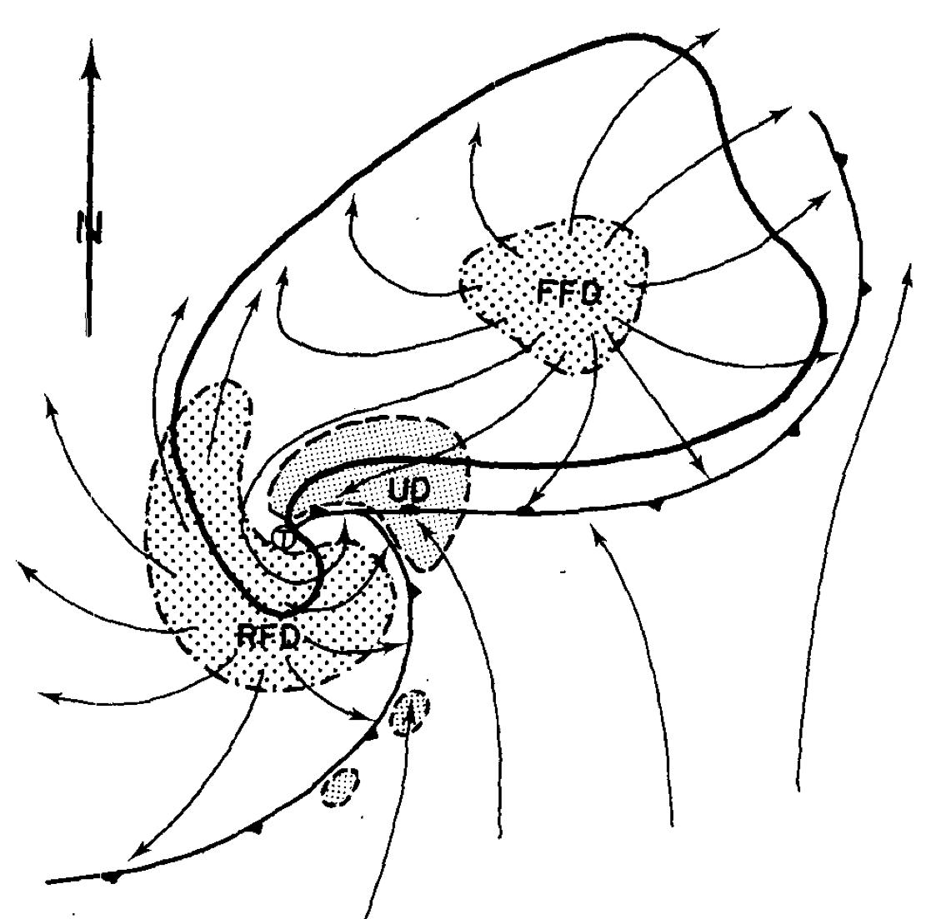
Theories of Supercell Tornadogenesis:
Lemon and Doswell 1979
Prior theories about tornadogenesis had been proposed, but none incorporated the observations of supercells and tornadoes collected from Doppler radar.
Les Lemon and Charles Doswell of the NSSFC proposed a modified conceptual model of supercell thunderstorms, but more importantly, used the collected observations to limit the proposed theories of tornadogenesis
Their additions to the supercell model of Browning (1964) includes the Rear Flank Downdraft (RFD), which they also propose as being responsible for tornadogenesis

Slide 8
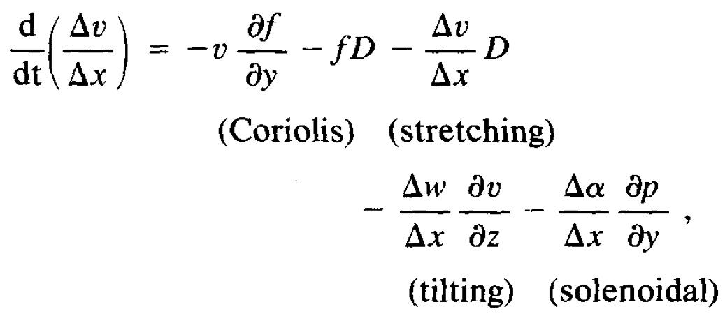
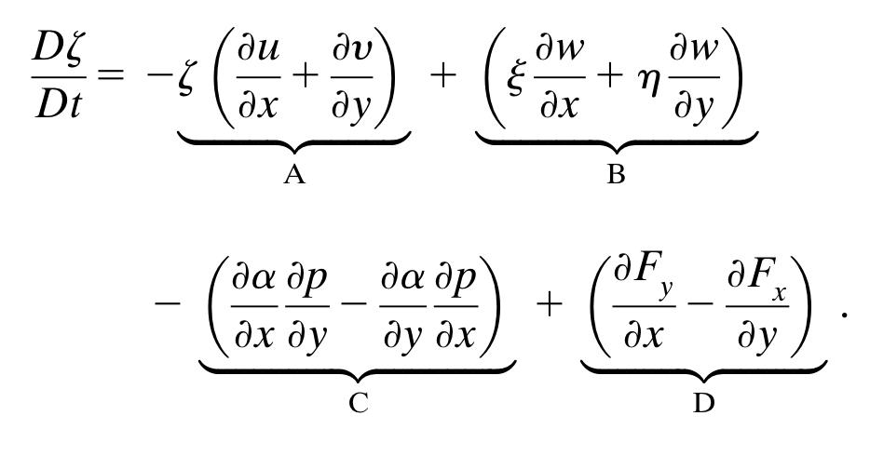
Prior Theories of Tornadogenesis
Convergence of existing vertical vorticity was considered questionable due to tornadogenesis being associated with updraft weakening in radar observations (Lemon 1977; Lemon et al. 1978).
The low-level gust front along the forward flank was suggested as a formation mechanism. It was proposed that the roll-up of shear vortices along a vertical vortex sheet could supply the vertical vorticity (Barcilon and Darzin 1971; Brandes 1977).
  Lemon and Doswell eliminated this due to Doppler observations of elevated tornado vortex signatures.
Scale analysis was used to reason that vortex tilting and stretching were both likely candidates for generating vertical vorticity.
Baroclinic (solenoidal) vorticity generation was hypothesized to be important, but few thermodynamic observations near supercells existed.
Vortex Stretching
Vortex Tilting
Baroclinic Generation
Turbulence/Friction

Slide 9
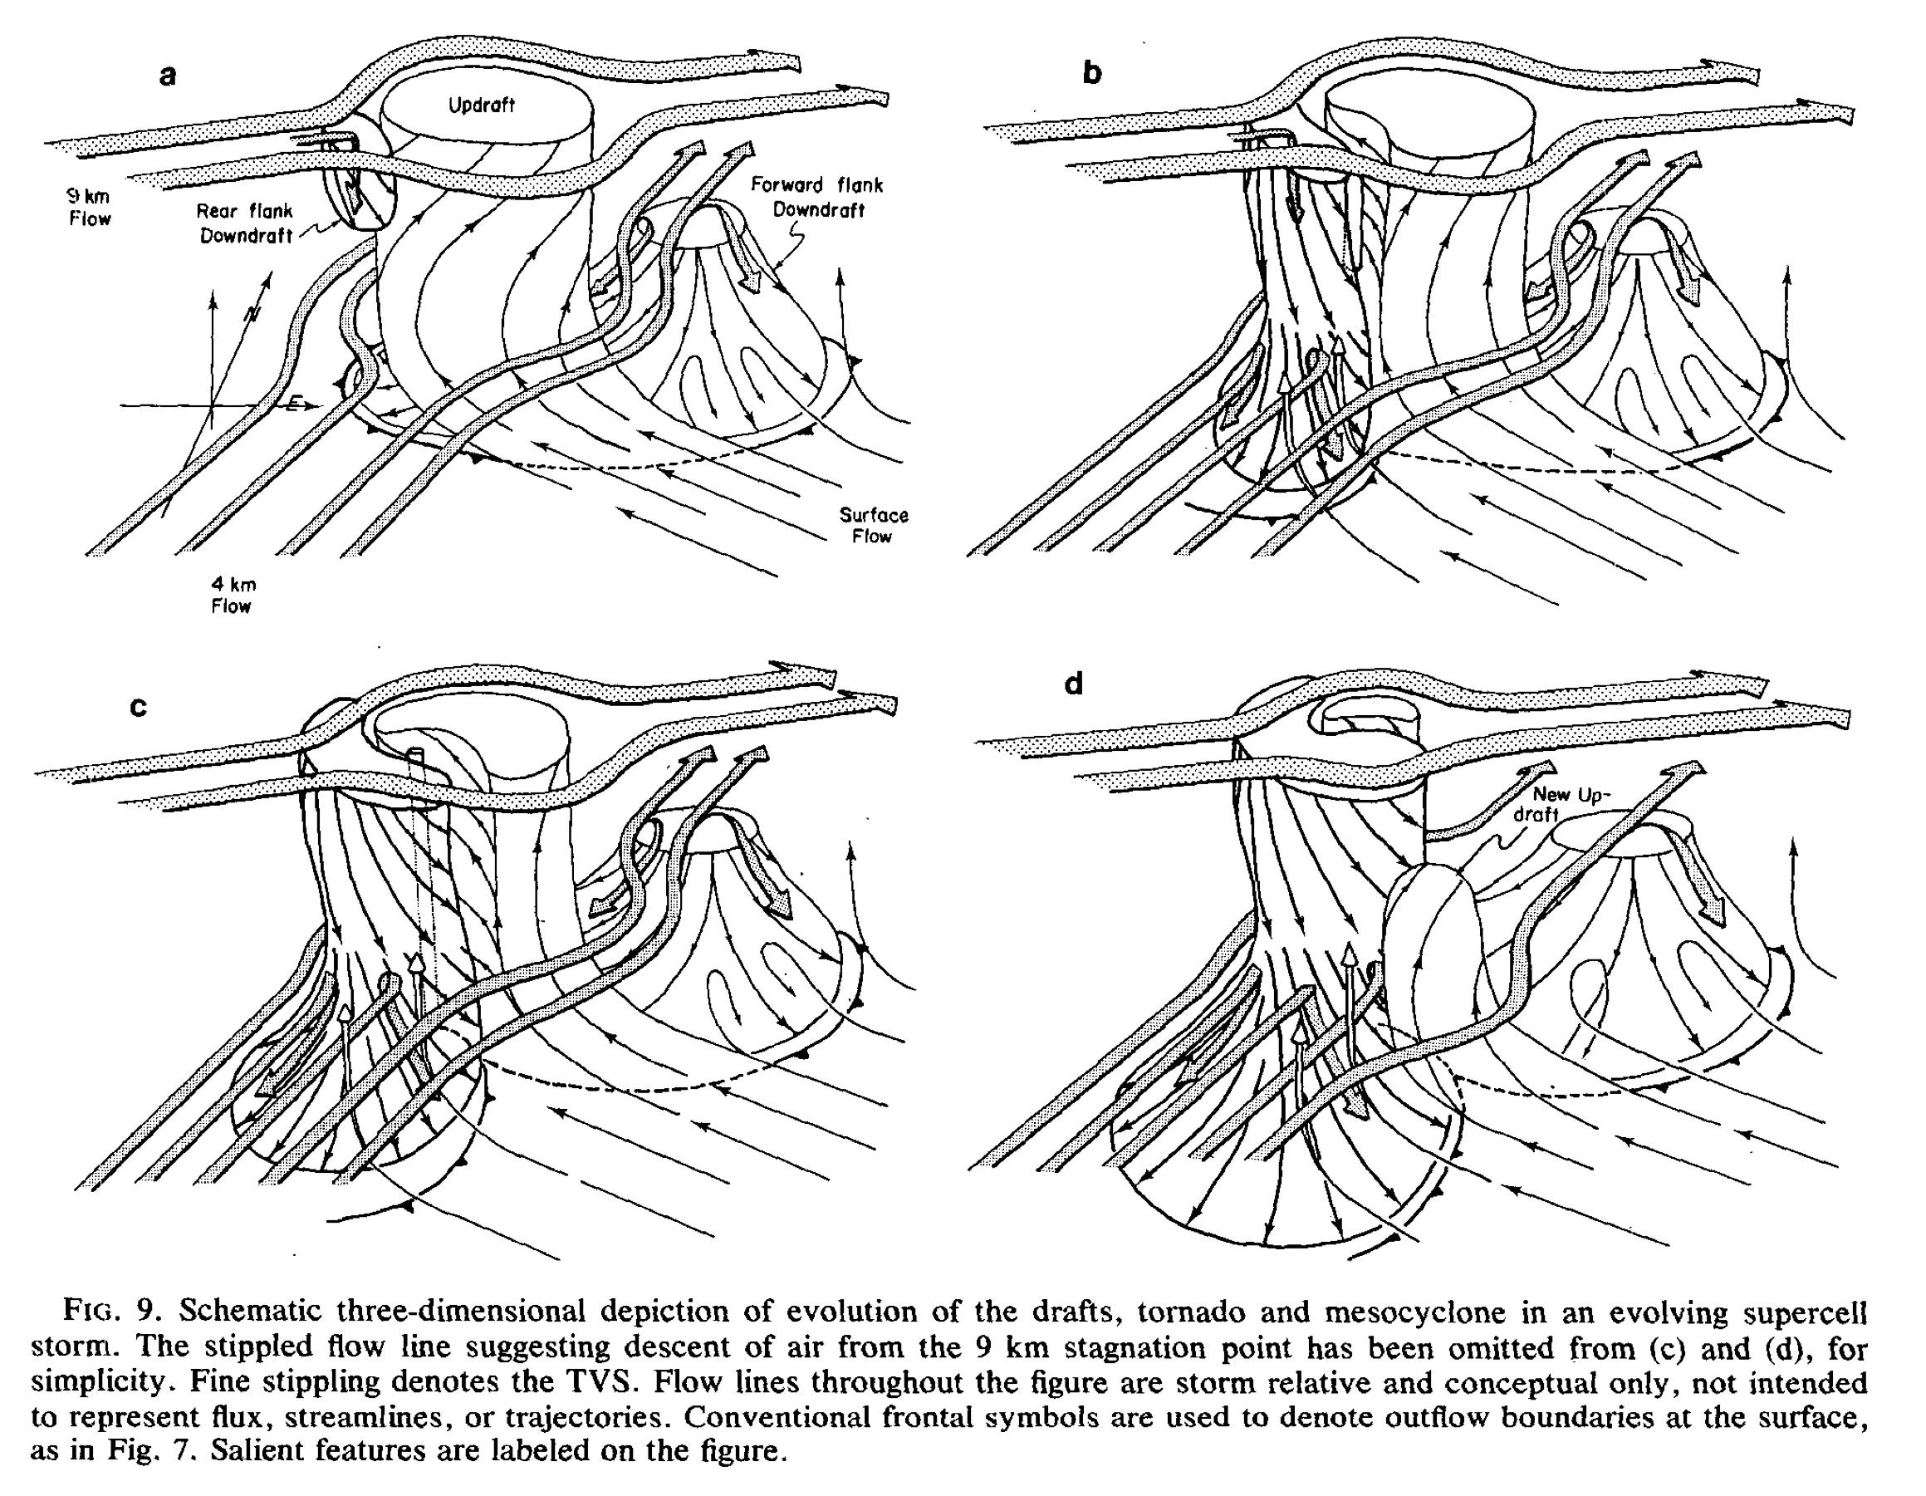
From Lemon and Doswell, 1979

Slide 10
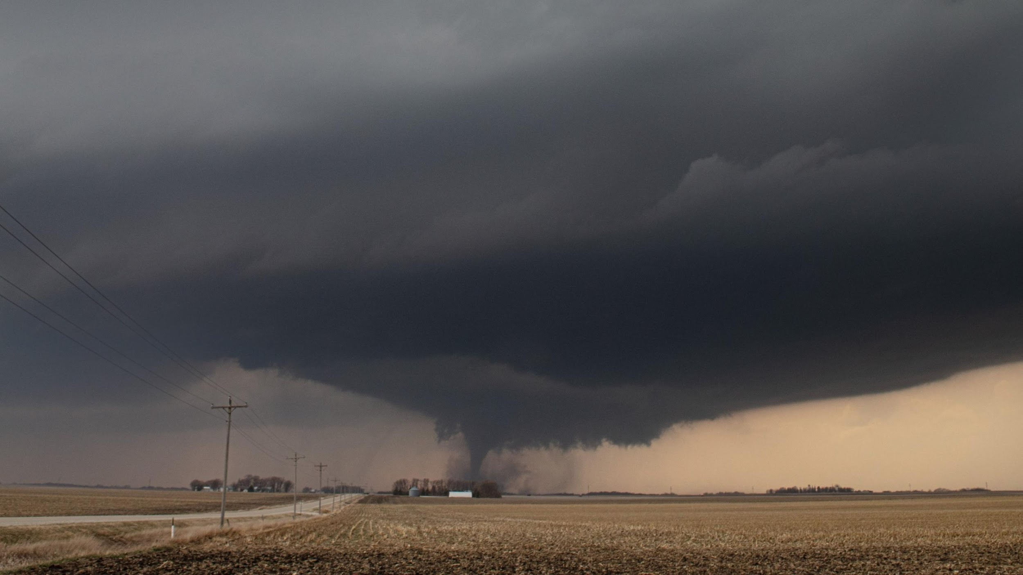
Example of RFD
13 April, 2022 in Iowa
Courtesy of Isaac Schluesche

Slide 11
Summary of Lemon and Doswell 1979
Supercell conceptual model updated to include the Rear Flank Downdraft (RFD), based primarily on Doppler radar observations
Vortex tilting/stretching believed to be the primary source of vertical vorticity
Baroclinic vorticity generation not ruled out, but they lacked observations to support this theory
Shear vortices along the forward-flank gust front ruled out due to radar indicated elevated tornado vortex signatures. It is pretty well agreed in current literature that tornadoes form from below, not above.
They proposed the tornado vortex forms aloft, in the vertical velocity gradient between the updraft/mid-level mesocyclone and the rear-flank downdraft
The rear-flank downdraft descends, bringing the elevated vortex towards the surface

Slide 12
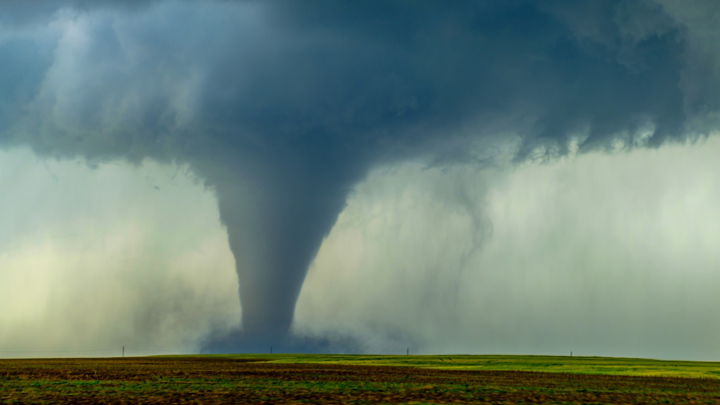
Supercell Tornadogenesis in the Modern Era
Theories derived from numerical simulations of supercell thunderstorms that produce significant near-surface vertical vorticity

Slide 13
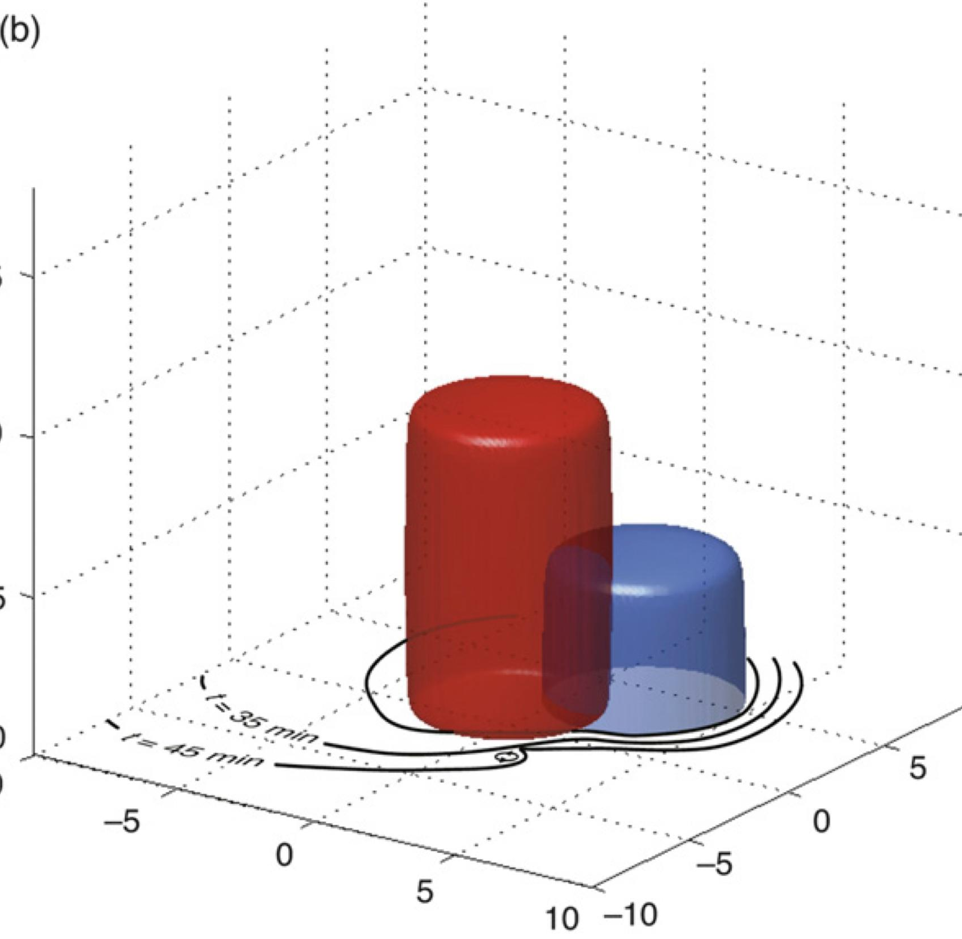
Theories of Tornadogenesis:
Markowski and Richardson 2014
Used simulated “pseudo-storms” to quantify the effects of low-level wind shear and cold-pool buoyancy on tornadogenesis
  Used a dry heat source as a proxy for the updraft, and a thermodynamic heat-sync to represent the downdraft and to create a cold-pool
  No moist processes (no latent heating, no hydrometeors) to reduce degrees of freedom.

Slide 14
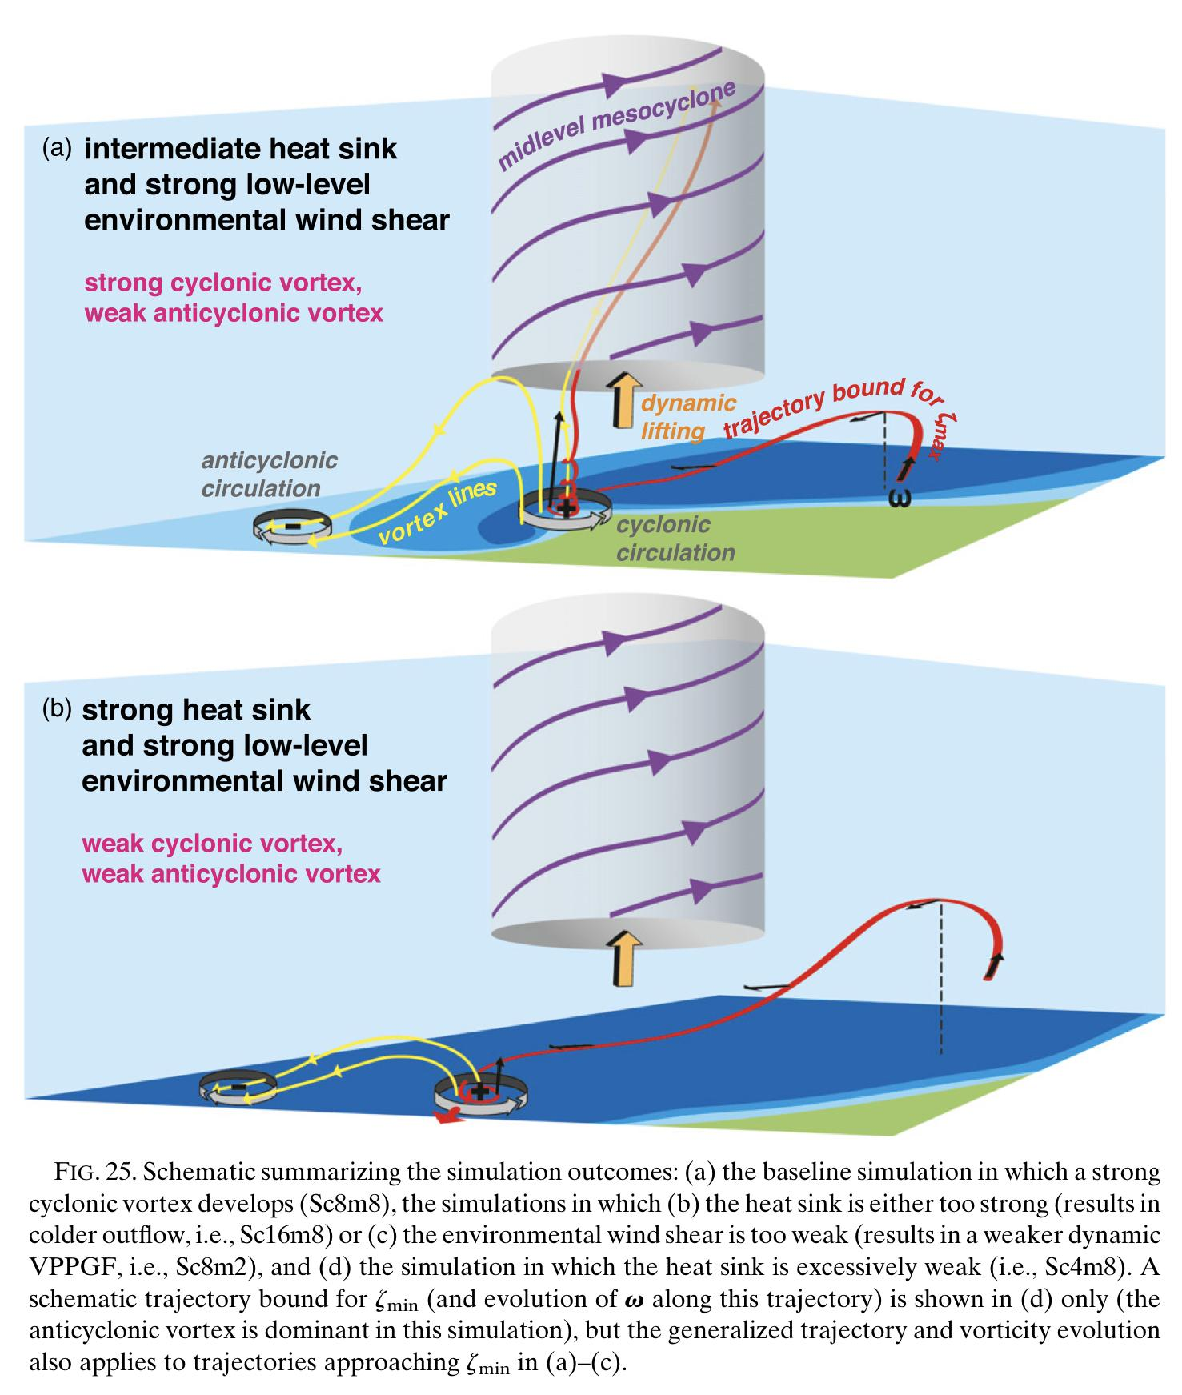
Theories of Tornadogenesis:
Markowski and Richardson 2014
Low-level horizontal vorticity is primarily generated by the baroclinic mechanism
Strong low-level environmental shear results in stronger mid-level mesocyclones, and therefore stronger dynamic lifting by the mesocyclone
The combination of strong dynamic lifting and weak negative buoyancy provides the best combination of factors leading to tornadogenesis
Downdraft is critical for re-orienting baroclinicly generated horizontal vorticity into the vertical, and then is stretched and amplified underneath low-level mesocyclone

Slide 15
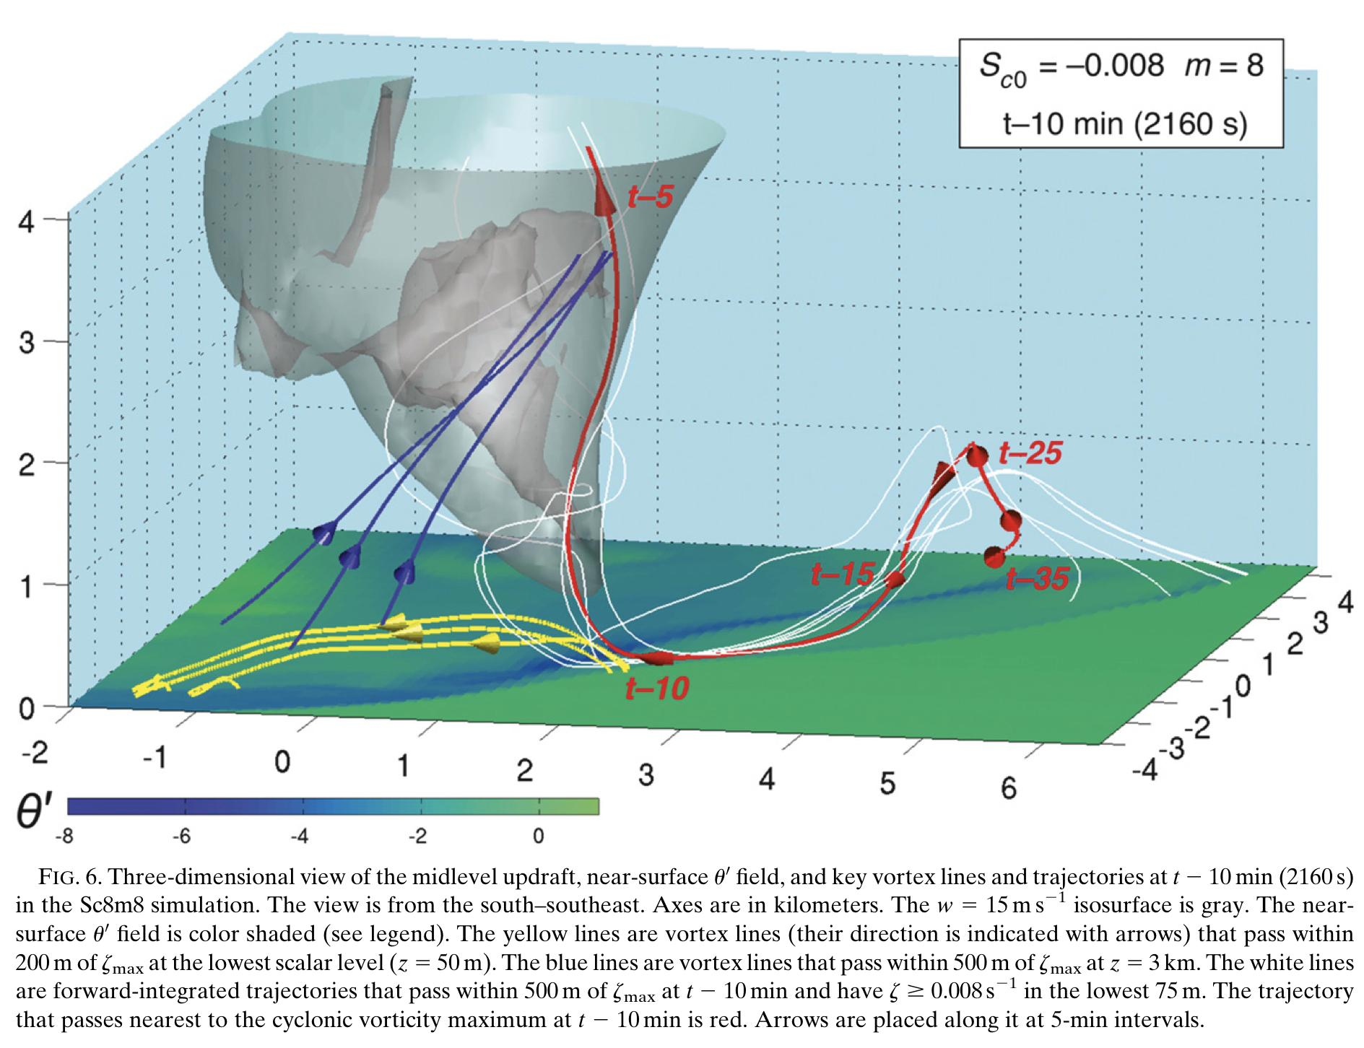
From Markowski and Richardson, 2014

Slide 16
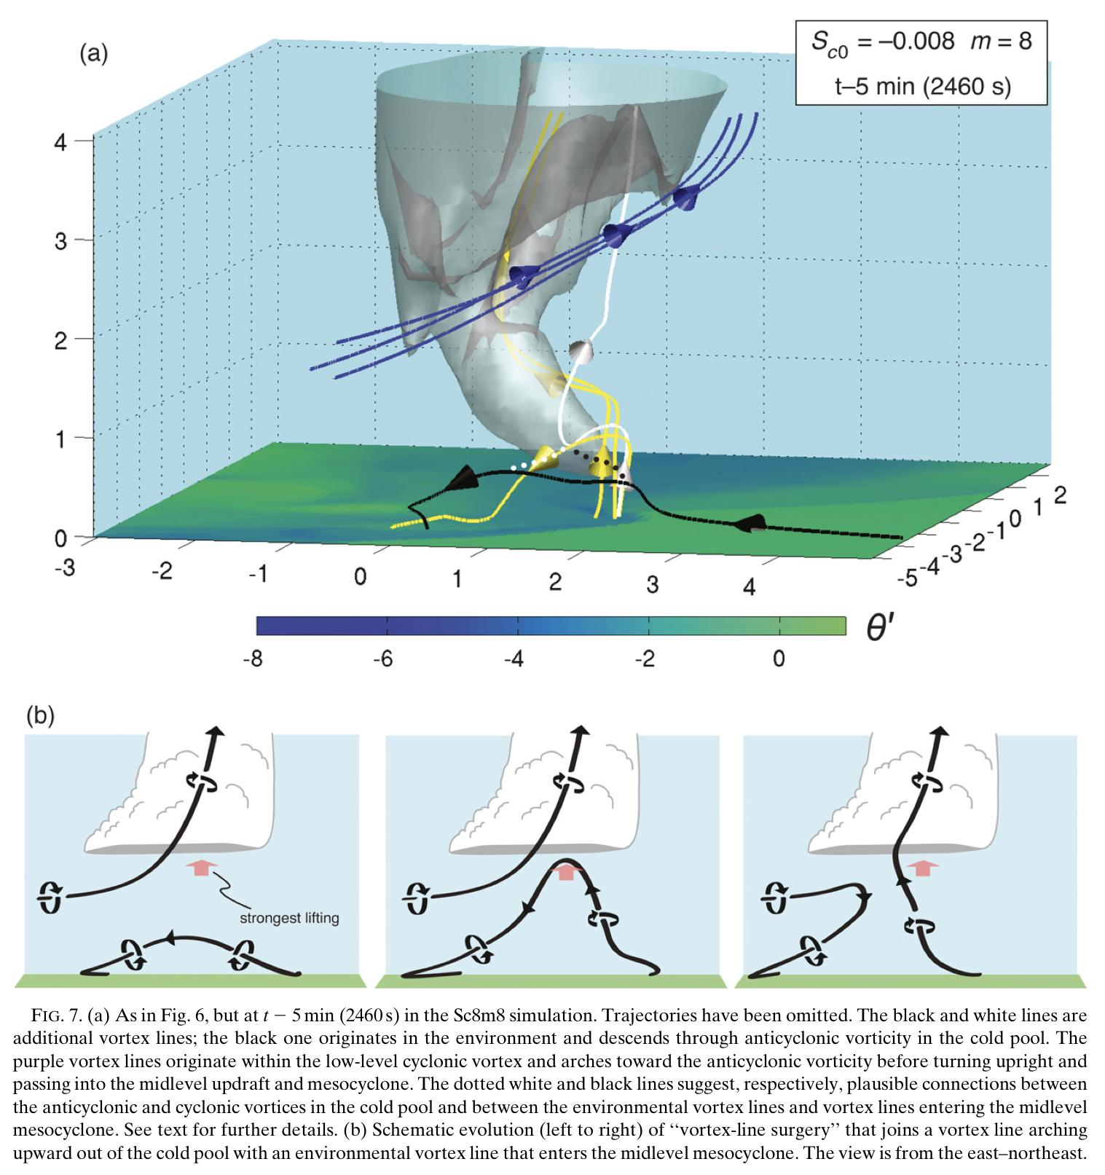
From Markowski and Richardson, 2014

Slide 17
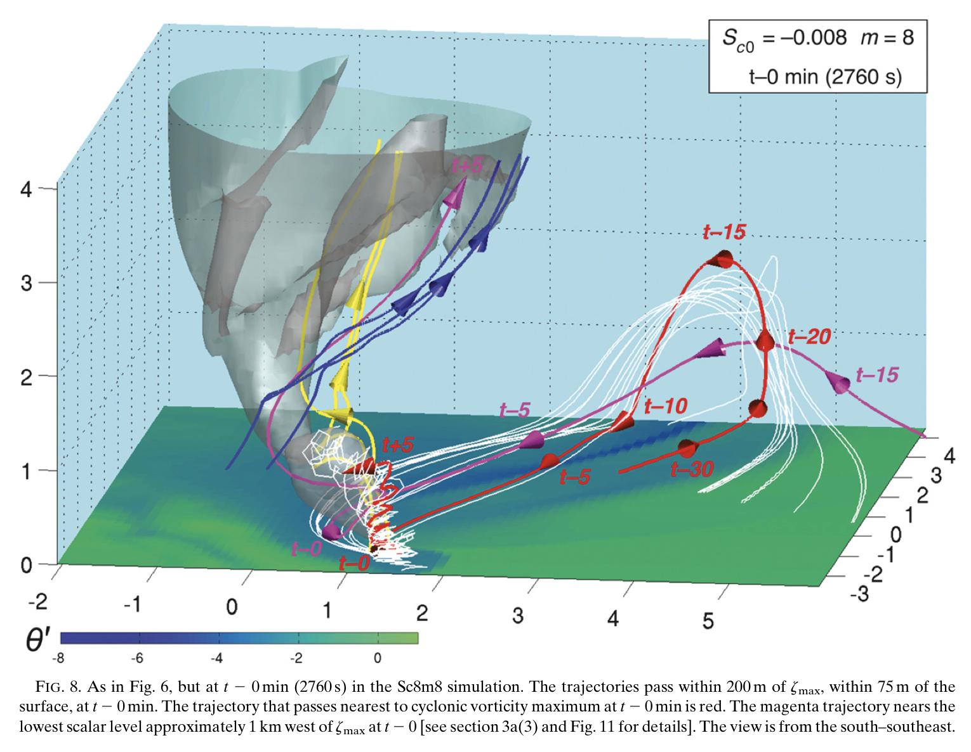
From Markowski and Richardson, 2014

Slide 18
Summary of Markowski and Richardson 2014
Environments with large amounts of streamwise vorticity (strong SRH in the low-levels) result in stronger mesocyclones closer to the surface.
This provides strong dynamic lifting through the VPPGF
Baroclinic generation of horizontal vorticity and downdrafts are crucial for generating near-surface vertical vorticity
Strong negative buoyancy in the thunderstorm outflow results in a stronger circulation, but it is unable to be lifted by the mesocyclone
Weak negative buoyancy does not develop strong enough near-surface circulation
Intermediate negative buoyancy is required to generate enough circulation for tornadogenesis while not being so negatively buoyant it cannot be lifted by the mesocyclone

Slide 19
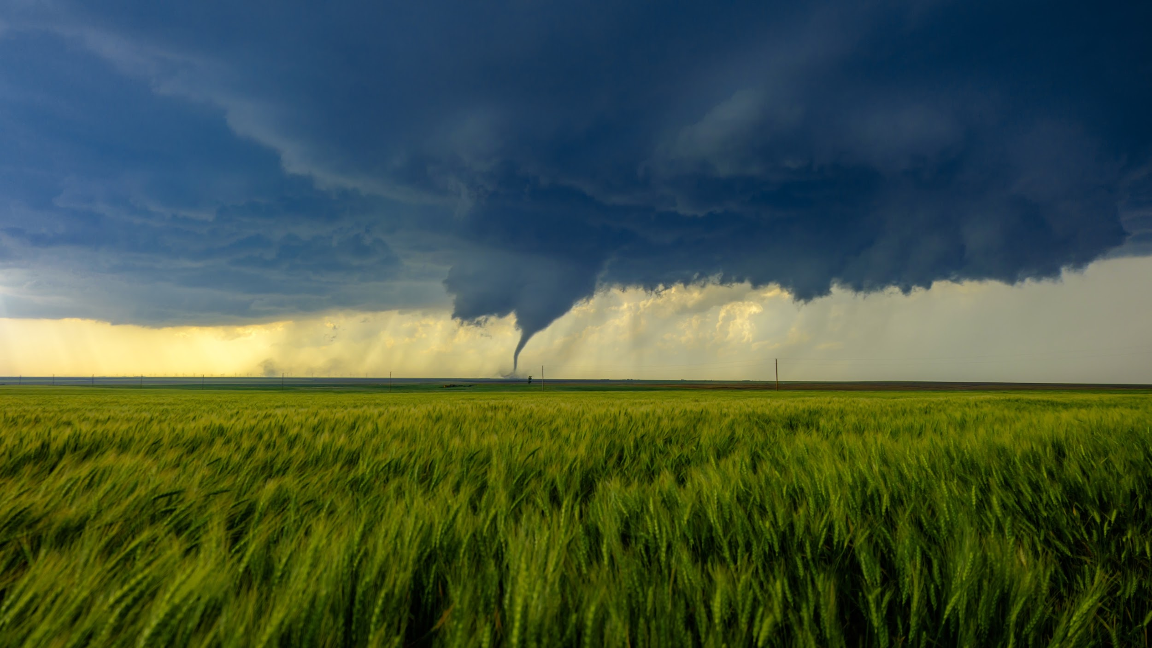
Summary of Current Theories on the Generation of Near-Surface Vertical Vorticity

Slide 20
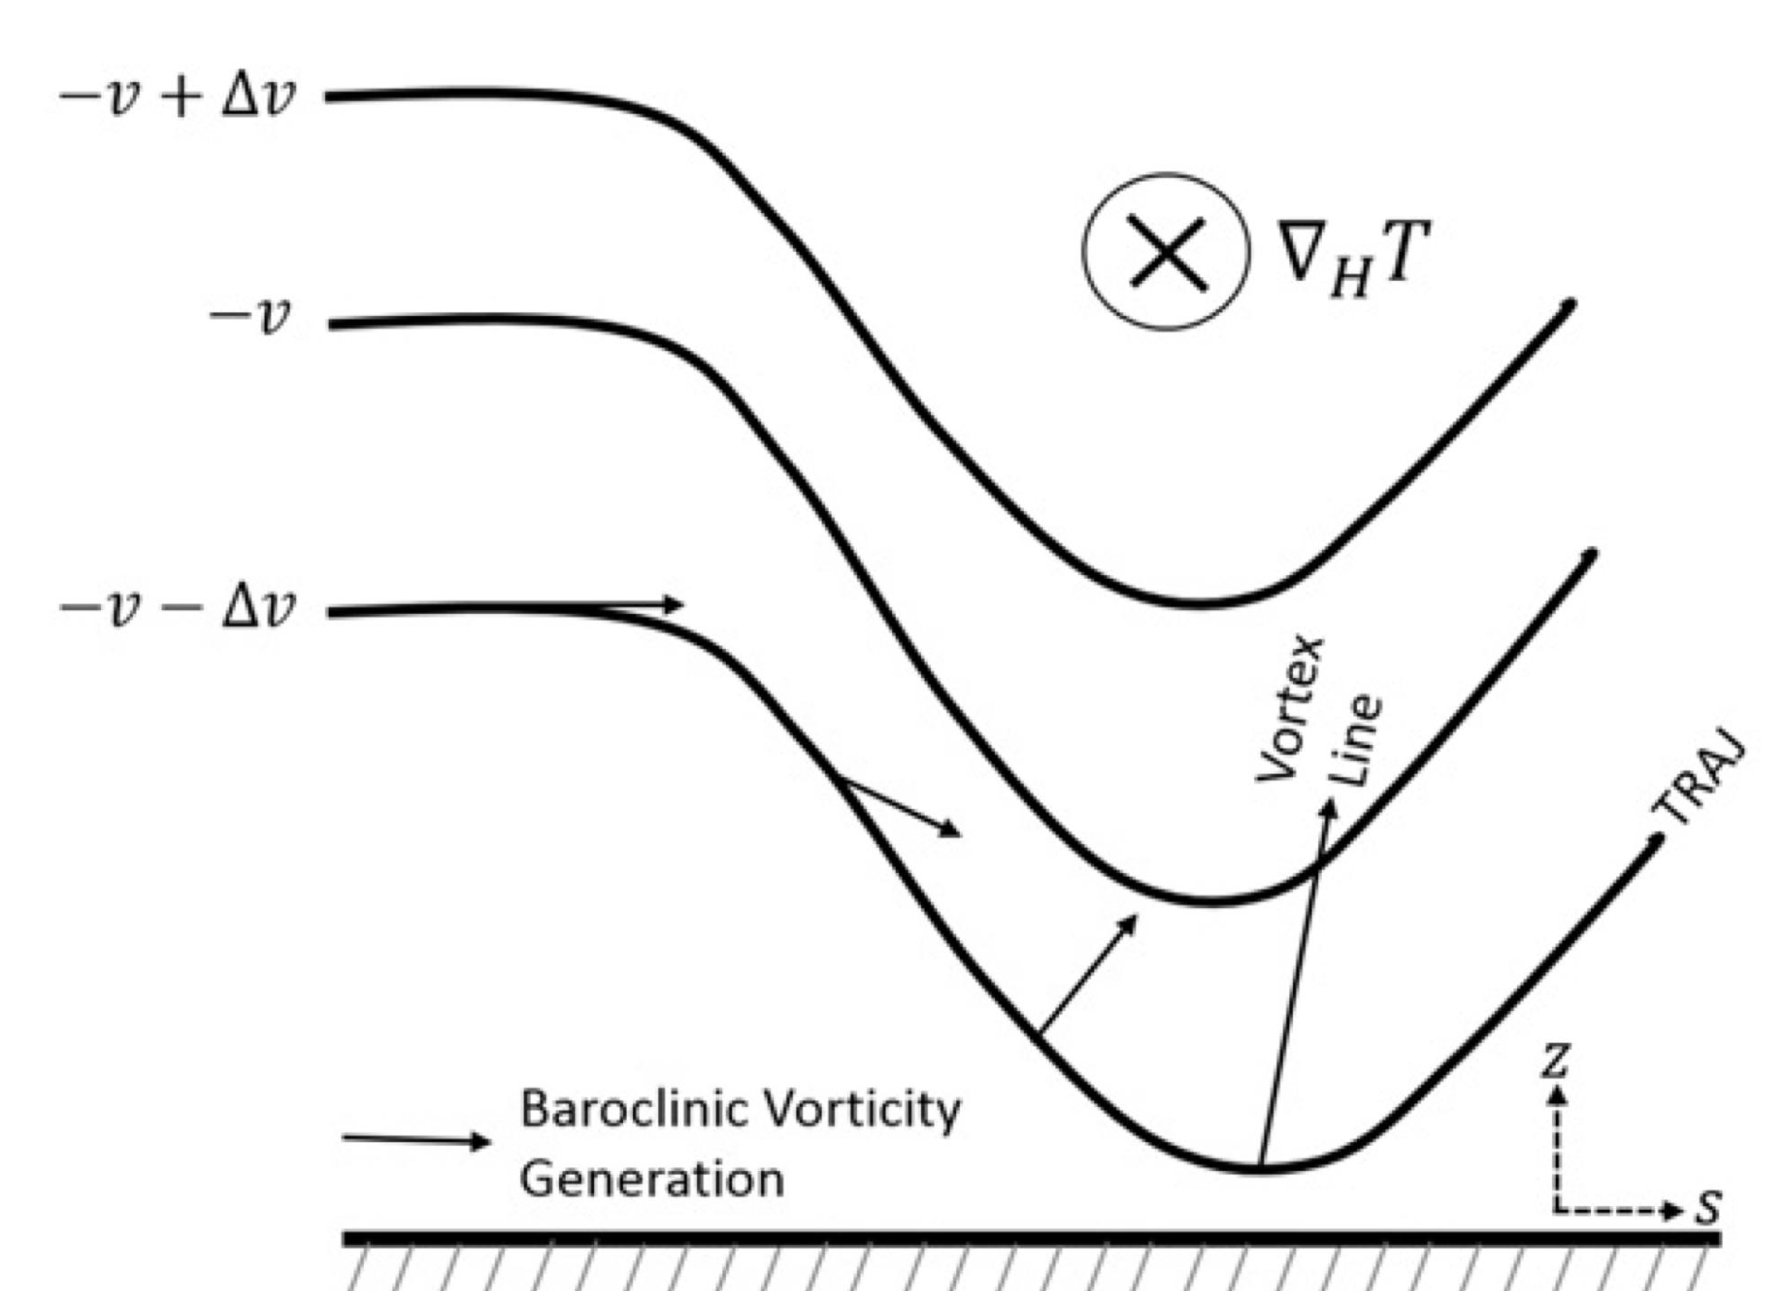
Davies-Jones and Brooks (1993) Mechanism
Using idealized simulation, the study describes how initially horizontal vorticity interacts with a downdraft, reorienting it into vertical vorticity
Horizontal vorticity is continually generated along a trajectory via the baroclinic mechanism
The vorticity vector is initially tilted downward by the downdraft, but continuous baroclinic generation of horizontal vorticity results in a mismatch between the velocity and vorticity vector
This “slippage” means that by the time a parcel reaches the bottom of its descent, it acquires upward (or vertically) oriented vorticity
This vorticity is then stretched underneath a low-level updraft and amplified into a tornadic vortex
Markowski and Richardson (2014) claimed this as the mechanism in their simulations

Slide 21
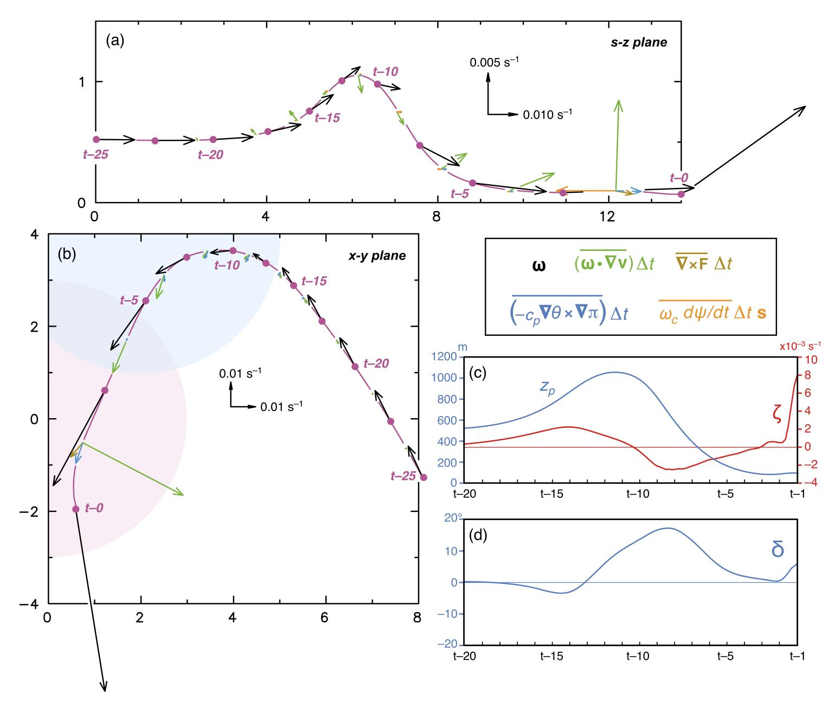
From Markowski and Richardson, 2014

Slide 22
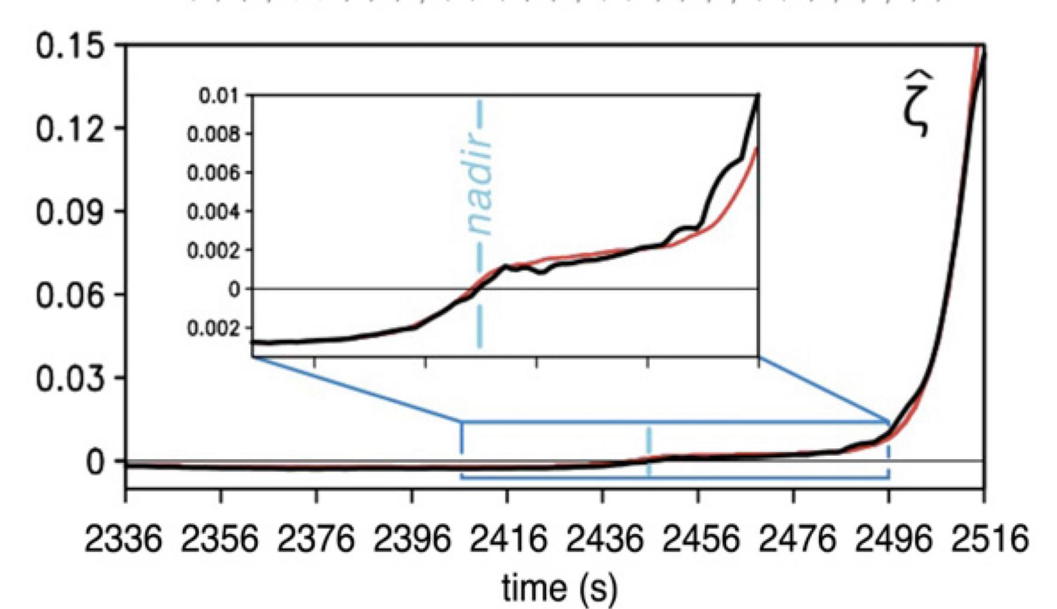
Rotunno et al. (2017) Mechanism
The DJB mechanism requires that a parcel have positive vertical vorticity by the time I teaches it’s maximum descent, or nadir.
This study demonstrates that while the vortex tilting described by DJB occurs, it need not have positive vertical vorticity at the nadir.
The downdraft is responsible for generating near-surface horizontal vorticity through the baroclinic mechanism.
The parcel’s vertical vorticity can be zero at the nadir, and then tilting and stretching of horizontal vorticity into the vertical is responsible for significant vertical vorticity.
Vertical vorticity need not be present near the surface for tornadogenesis - purely horizontal vorticity is sufficient.
This is effectively a revision of the DJB mechanism

Slide 23
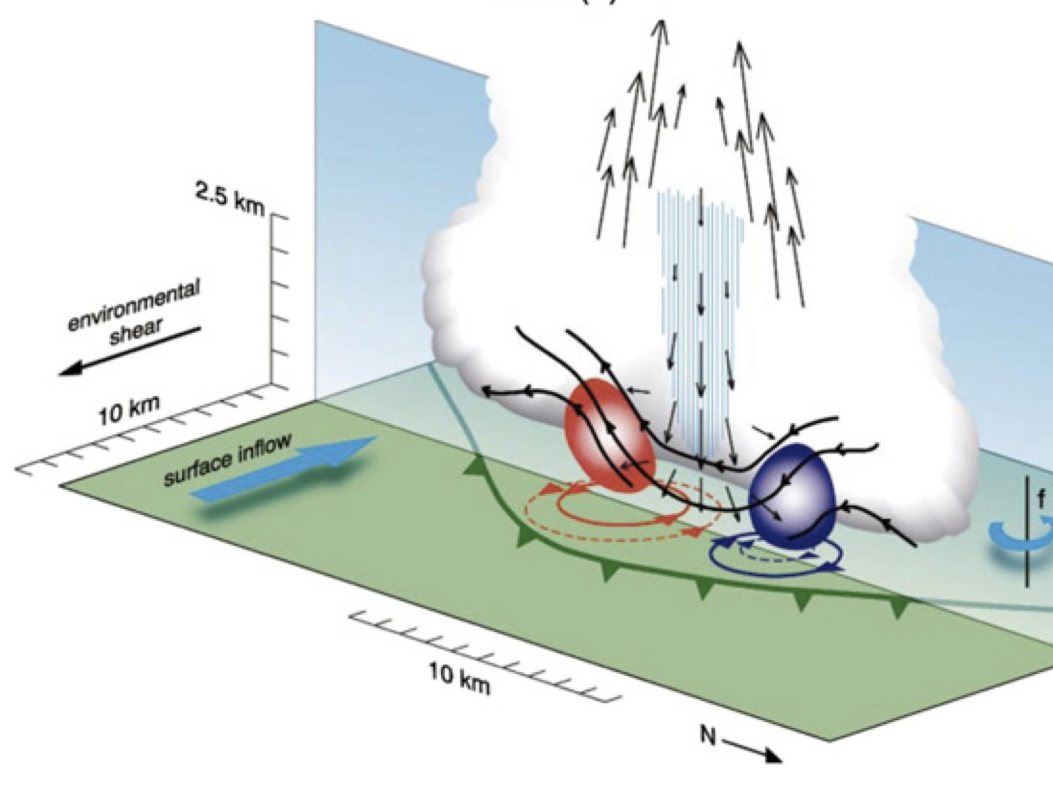
Trapp and Weisman (2003) Mechanism
Proposed for Quasi-Linear-Convective-System (QLCS) tornadogenesis by Trapp and Weisman (2003); Dahl (2015) found it to be present in simulated supercells as well.
Thunderstorm downdrafts depress horizontal vortex lines towards the surface, creating a pair of counter-rotating vortices.
In simulations, the cyclonic vortex forms to the south, and the anti cyclonic vortex forms towards the north.
The updraft then stretches and amplifies the cyclonic vertical vortex.

Slide 24
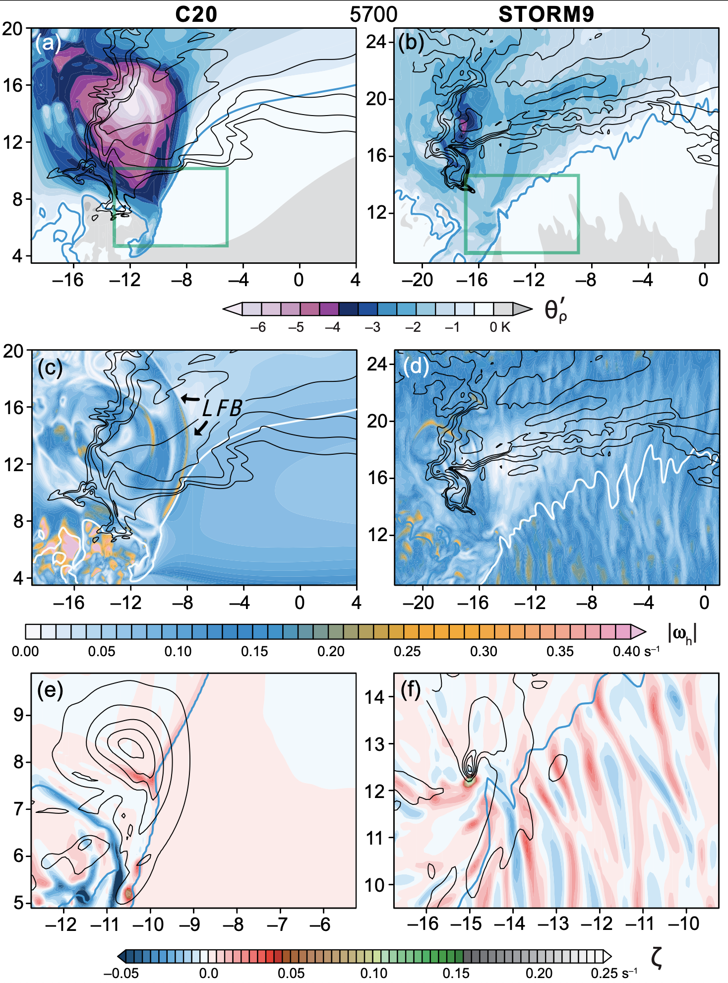
Markowski 2024: Turbulence, Turbulence, and More Turbulence!
Most prior (20th century; C20) simulations are laminar-flow simulations. The real atmosphere has turbulence! What happens when turbulence is included in the inflow and storm environment?
Source of vorticity for initial TLV comes from surface-layer features (~0-50m AGL), instead of from baroclinically generated/amplified sources.
The proximity of the updraft to the surface, and subsequently, dw/dz, is of great importance for drawing up these surface-layer features into the updraft.
Per trajectory analysis, baroclinic vorticity generation is not a leading source of vorticity for the TLV at any point in its lifecycle.

Slide 25
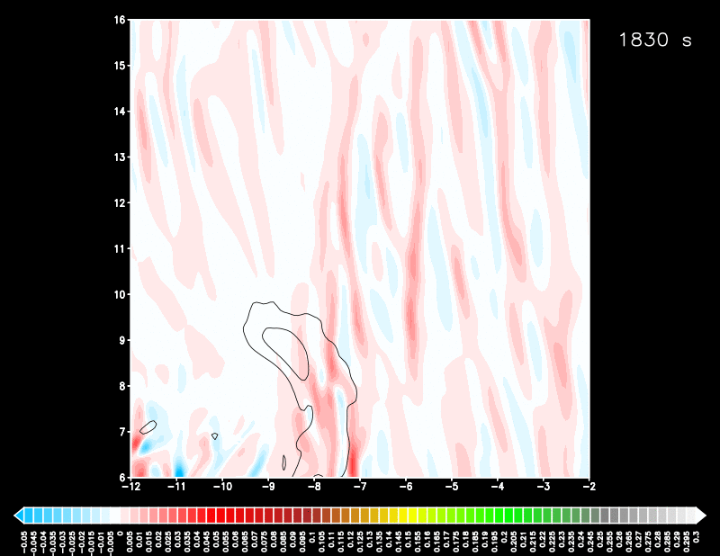
Markowski 2024: Turbulence, Turbulence, and More Turbulence!

Slide 26
So Which Is It?
All of these mechanisms have been found to be present in simulations of supercell thunderstorms.
All of these mechanisms and studies have flaws and caveats, whether it’s the lack of turbulence, poor surface-layer and turbulence closure schemes/assumptions, or parameterized microphysics.
It is entirely possible that tornadoes form via many (or all) of these methods in nature.

Slide 27
Caveats
Many of these simulations have a sufficient resolution for resolving supercells, but not tornadoes. These vortices are called “tornado-like”, but are not tornadoes.
Most of these simulations are “free-slip” - the impacts of friction are completely unaccounted for.
  Recent studies (e.g. Roberts et al. 2016 & 2017, Markowski 2020 & 2024) have looked at semi-slip boundary conditions in simulations of supercells and TLVs. Often, with the inclusion of friction and turbulence, it comes out with first-order importance relative to baroclinic mechanisms.
  However, it has been shown by Markowski and Bryan (2016) that our current understanding of the surface-layer in thunderstorm outflow is severely lacking, and standard boundary layer application of friction in cloud models is erroneous.
  The true role of friction and the surface-layer in tornadogenesis is an unknown and ongoing research topic.

Slide 28
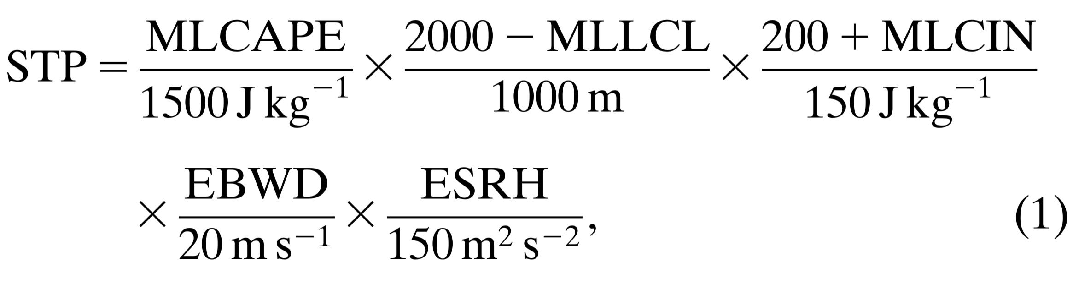
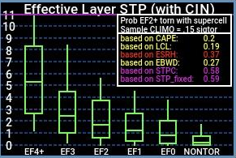
How do we use any of this to predict the formation of tornadoes?
Thompson et al. 2003 (revised by Thompson et al. 2007) created the Significant Tornado Parameter (STP)
  Mixed-layer CAPE used to assess buoyancy for thunderstorm development
  The mixed-layer lifted condensation level (LCL) is used as a proxy for cold pool buoyancy. Lowe LCLs are indicative of higher boundary layer relative humidity, which means less evaporation of hydrometeors.
  The mixed layer CIN is included to allow for the presence of some inhibition (i.e. nocturnal tornadoes)
  The bulk wind difference (wind shear) is used to discriminate supercell potential
  Storm Relative Helicity is used to asses low-level shear (and subsequently mesocyclone strength)
Recent work by Coffer et al. 2019 suggests that using the surface-500 meter storm relative helicity may be an even better discriminator than what is currently used in STP

Slide 29
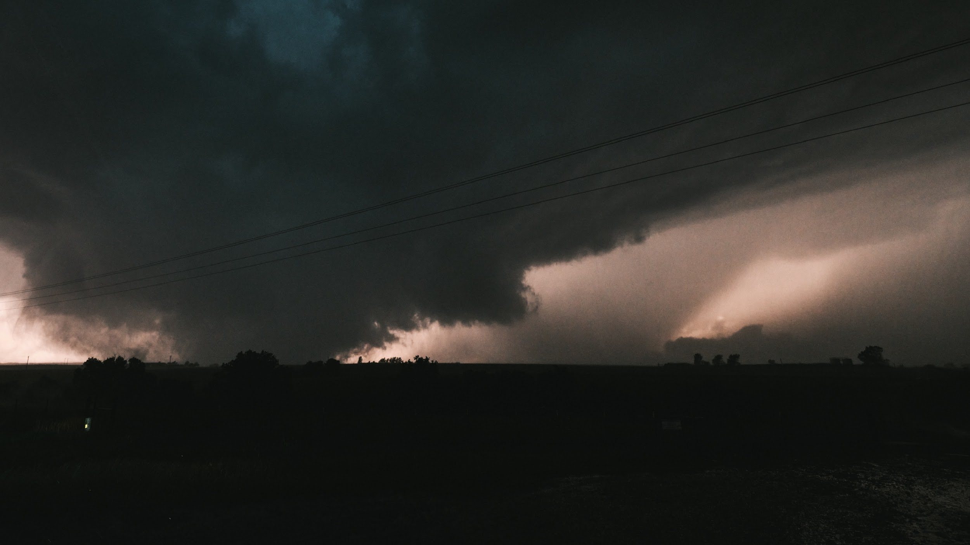
Congratulations! You are all now tornadogenesis experts!
I’ll try to answer any questions the best I can!
Email: kelton.halbert@noaa.gov
BlueSky: @stormscale.io

