Slide 1
Skew-T Diagram Basics
METR 4403/5403
Material originally prepared by Rich Thompson
Updated by Andrew Lyons, Andrew Moore

Slide 2
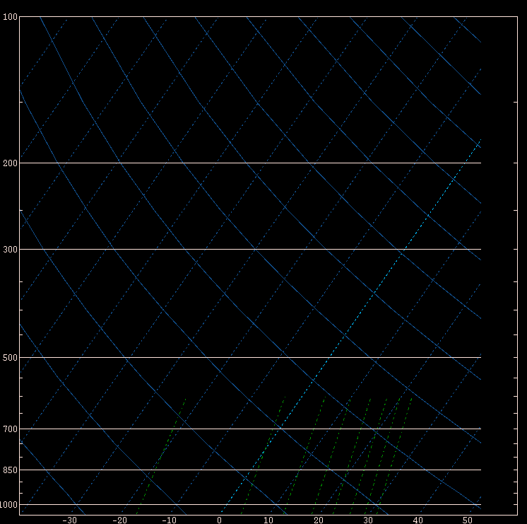
Raw SkewT-log P diagram
Constant pressure
Constant Temp
Dry adiabat
Constant
Mixing ratio
“skew”

Slide 3
Features of note in SkewT log P
Temperature is skewed about 90º from the dry adiabats
Pressure decreases as a logarithm of height (faster at bottom than top)
Mixing ratio crosses over temperature lines
  It’s a function of pressure, which is why the same dew point temperature at higher elevation contributes more to buoyancy
One thing missing is a plot of saturated parcel ascent

Slide 4
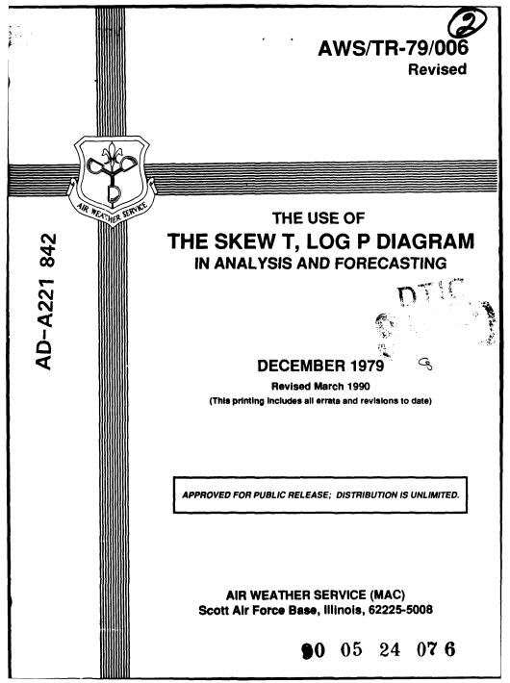
Common Sounding Terms
LCL – lifting condensation level
LFC – level of free convection
EL – equilibrium level
CAPE – buoyancy (positive area)
CIN – convective inhibition (negative area)
Autoconvective Lapse Rate (34.2 C/km)
Convective Temperature
Virtual Temperature
Potential Temperature
Equivalent Potential Temperature
Lifted Index
A tremendous resource!

Slide 5
Adiabatic Motion
In parcel theory it is assumed that parcel motions are adiabatic processes - that is parcel exchange no energy/mass with their environment (not true!).
This also means there paths are predictable along lines of constant entropy (isentropes).
Saturated ascent (clouds) –
parcel cools at a rate of
~6.5 C km⁻¹
(pseudo adiabatic “lapse rate”)
Lapse rates between saturated and unsaturated – “conditionally unstable”
Dry ascent (no clouds) –
parcel cools at a rate of ~9.8 C km⁻¹
(dry adiabatic “lapse rate”)

Slide 6
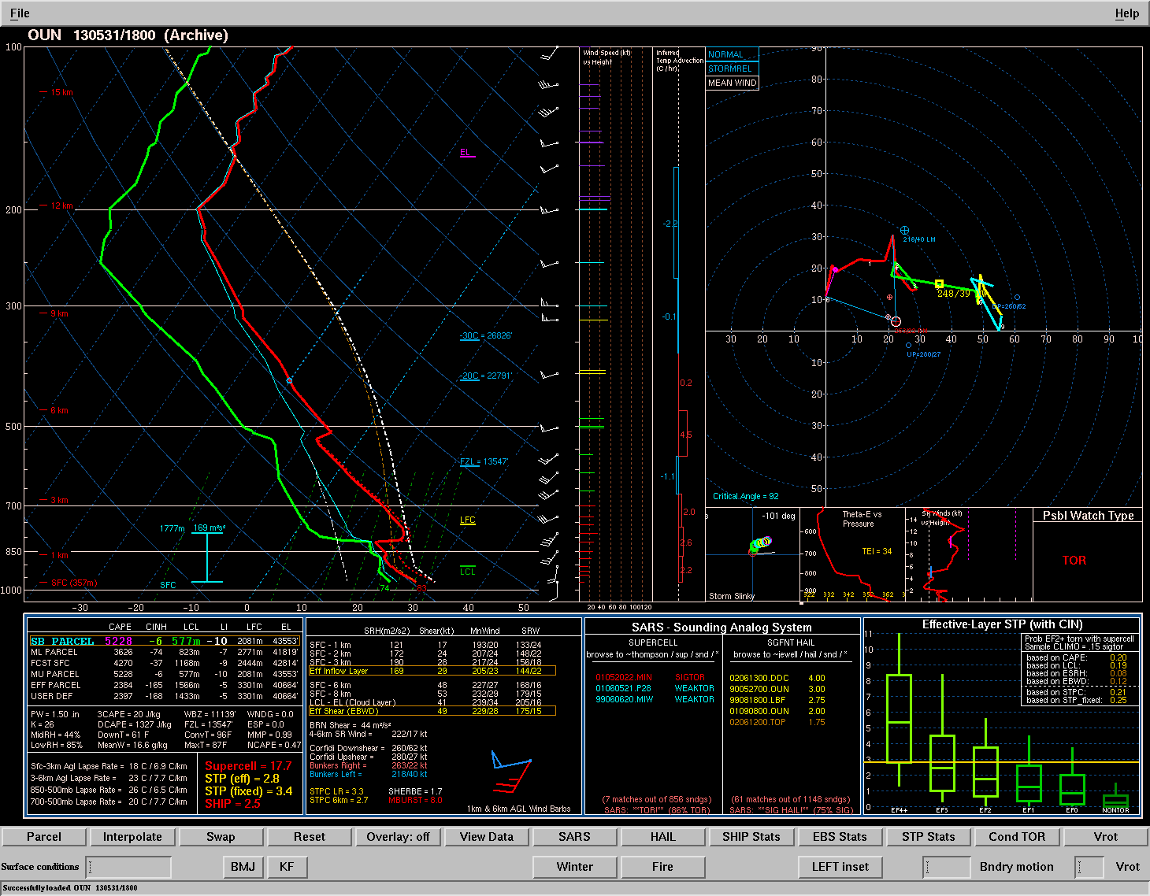
Lapse Rate
A lapse rate is simply the change in temperature over some depth (dT/dz)
Lapse rates in most T-storm environments will be conditionally unstable…
In other words, between the dry adiabatic lapse rate
(9.8 C/km) and the moist adiabatic lapse rate
(~6.5 C/km).
Absolutely Stable
Conditionally Unstable
Moist Adiabat
Dry Adiabat
Absolutely Unstable
LFC

Slide 7
Lifting a Parcel
Choose a parcel (sfc, mixed layer, most-unstable, etc…)
Find temperature and dewpoint.
Assume dry adiabatic ascent until you reach Lifted Condensation Level (LCL).
Assume moist adiabatic ascent until you reach the Equilibrium Level (EL).
EL
Moist adiabat
LCL

Slide 8
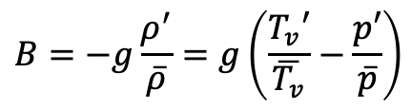
Buoyancy Basics
If parcel temperature > ambient temperature:
Buoyancy > 0
Parcel accelerates upwards
If parcel temperature < ambient temperature:
Buoyancy < 0
Parcel accelerates downward
If parcel temperature = ambient temperature:
Buoyancy = 0
Parcel experiences no buoyant forces (either continues in direction of motion or remains motionless)
Convective Available Potential
Energy
(CAPE)
Convective Inhibition
(CIN)
From ideal gas law:

Slide 9
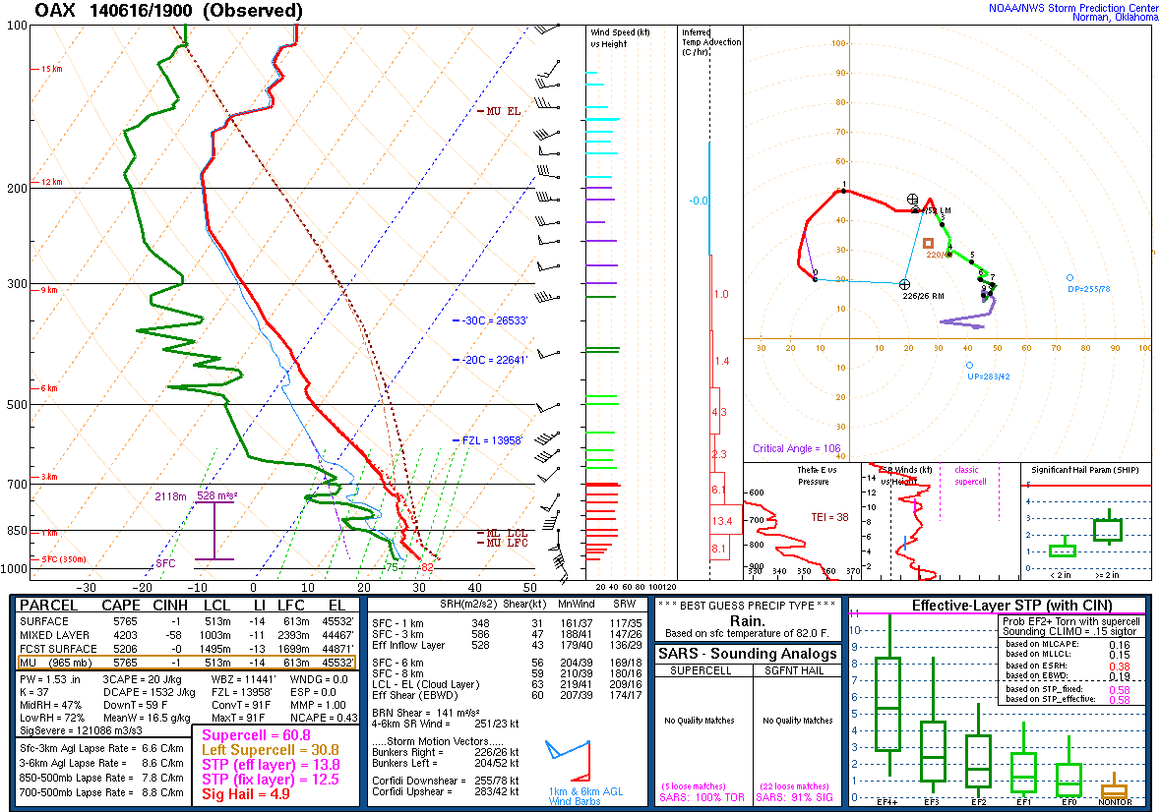
Lifted Index
A more simplistic way to quantify buoyancy of a parcel.
1) Lift a parcel from the surface (or whatever level you want)
2) Find the temperature of the parcel at 500 mb
3) Find the environmental temperature at 500 mb
4) LI = Env Temp 500 mb - Parcel Temp 500 mb
LI > 0 = Stable!
-1 to -4 = Weakly unstable
-5 to -9 = Very unstable
-10 and lower = Extremely unstable!

Slide 10
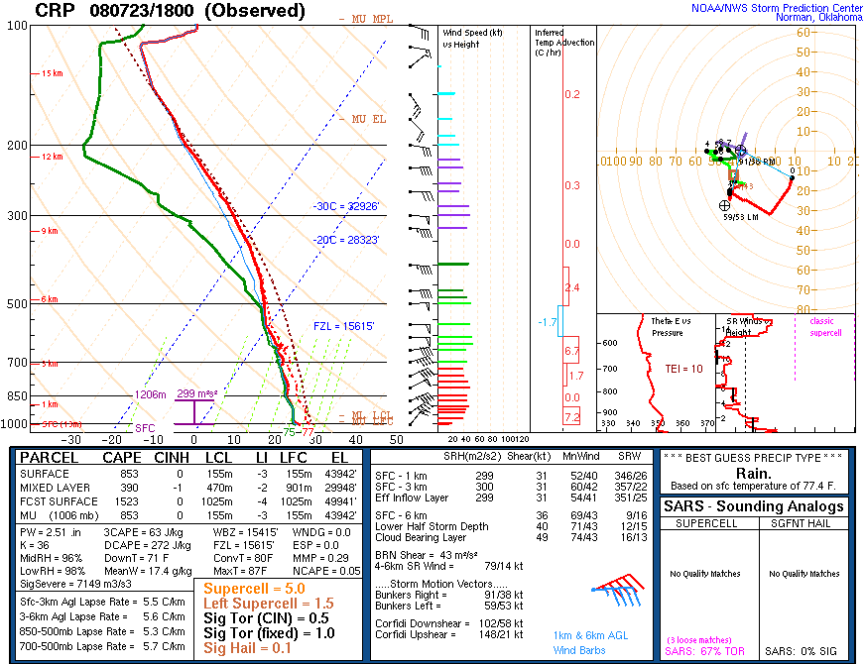
Lifted Index
A more simplistic way to quantify buoyancy of a parcel.
Pros:
Very simple to calculate and interpret!
Implicitly accounts for lapse rates!
Cons:
Very simplistic.
May miss critical buoyancy (e.g. elevated buoyancy)
LI > 0 = Stable!
-1 to -4 = Weakly unstable
-5 to -9 = Very unstable
-10 and lower = Extremely unstable!

Slide 11
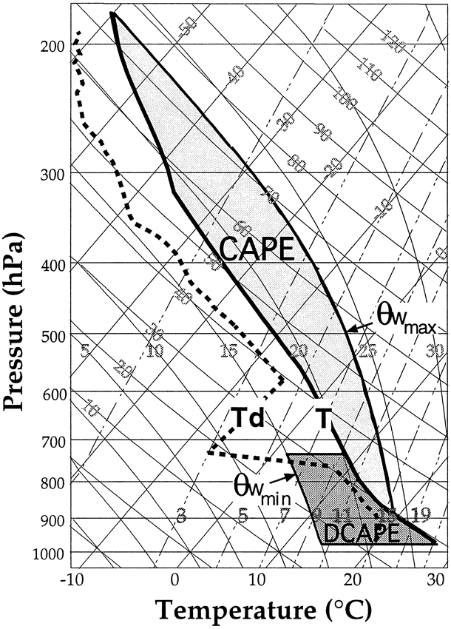
Downdraft CAPE (DCAPE)
Estimates the negative buoyancy a downdraft parcel could have.
This gives you an estimation of potential downdraft strength.
Assumes you know where the downdraft is originating from! (Other parcel theory assumptions apply.)
Because of this, it often doesn’t show up as a strong discriminator for severe wind.
Fig. 1 Gilmore and Wicker 1998

Slide 12
Parcel Selection - Which is Best?
Surface-Based (SB) Parcel
Lift a parcel from the surface pressure using the surface temperature and dewpoint.
Easy to calculate!
Often unrepresentative: too unstable with too little inhibition. Does not account for elevated convection (more later).

Slide 13
Parcel Selection - Which is Best?
Mixed-Layer (ML) Parcel
Find the average temperature, & dewpoint from the lowest 100 mb. Lift this parcel from the surface.
Found to be a good representation of parcel buoyancy on most typical severe weather days.
Often features less CAPE and more CIN compared to other parcels.

Slide 14
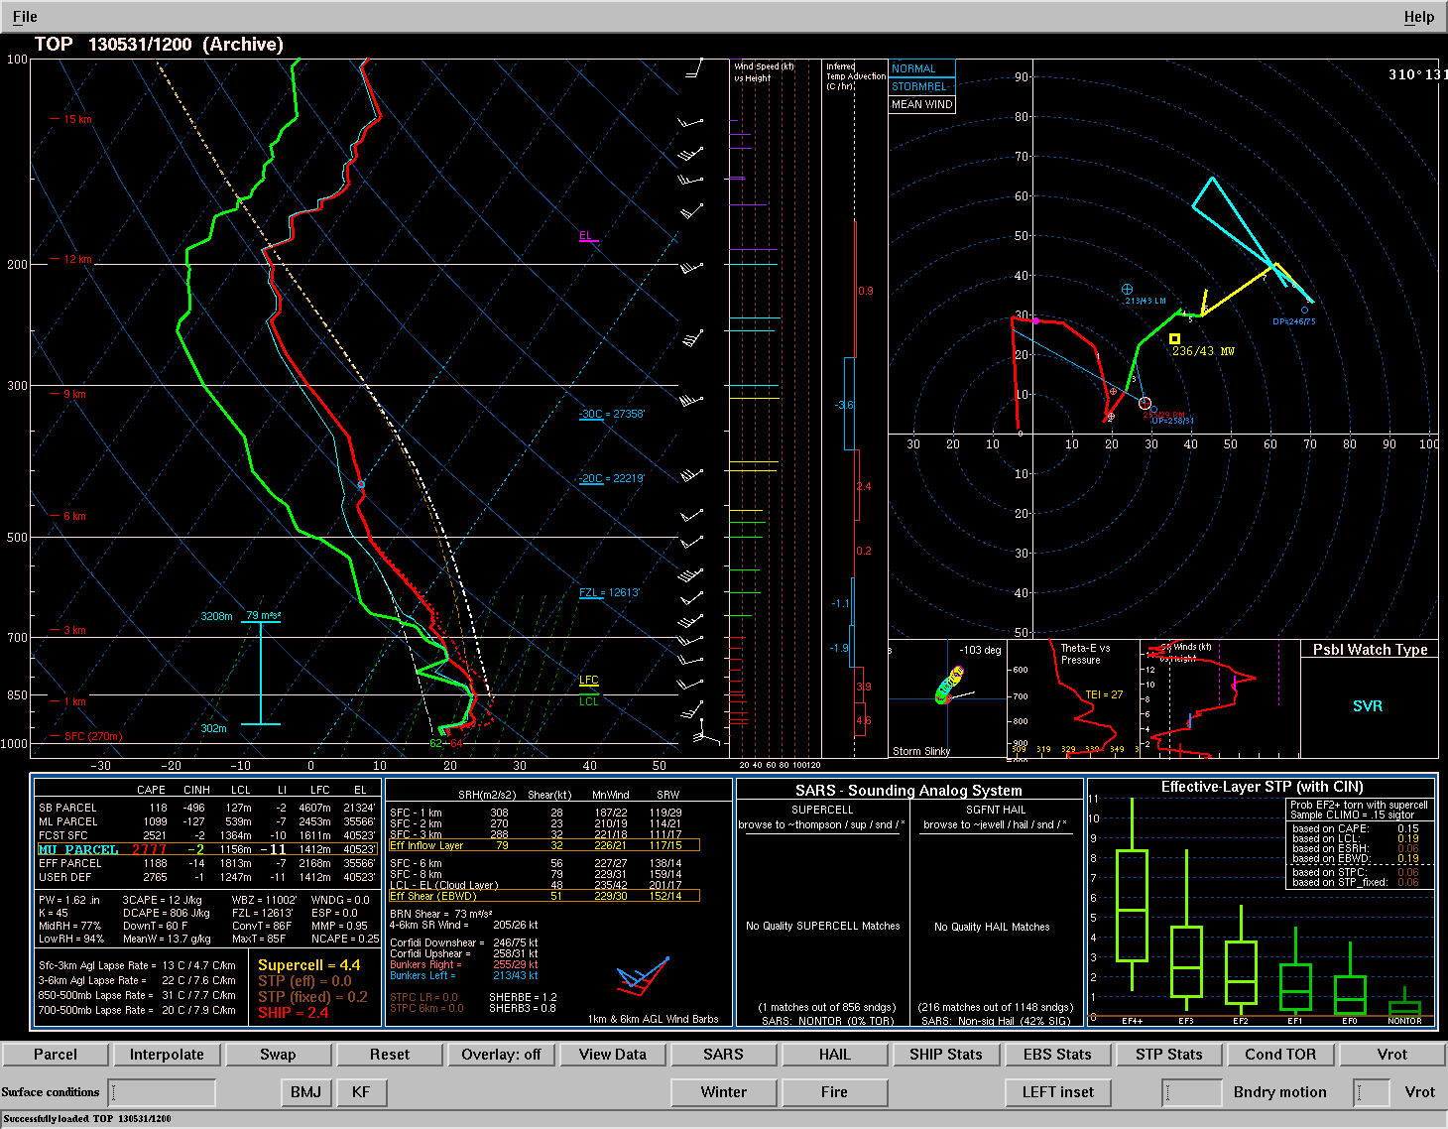
Parcel Selection - Which is Best?
Most-Unstable (MU) Parcel
Find the highest Theta-e value in the lowest 400 mb (typically). Use this level’s temperature, dewpoint, and pressure level to lift a parcel.*
Essential for identifying elevated T-storm environments.
Often overestimates CAPE and underestimates CIN in non-elevated T-storm environments.
The SB Parcel is often the MU Parcel when if there is a convective boundary layer in place.
*This is not the only method!

Slide 15
Parcel Selection - Which is Best?
Least Inhibited (LI) Parcel
Lift a series of parcels, find the parcel with the lowest amount of inhibition.
This is often, but not always, the MU Parcel.
Not particularly useful for severe convection, but can be helpful for identifying or explaining areas of weak thunderstorms.

Slide 16
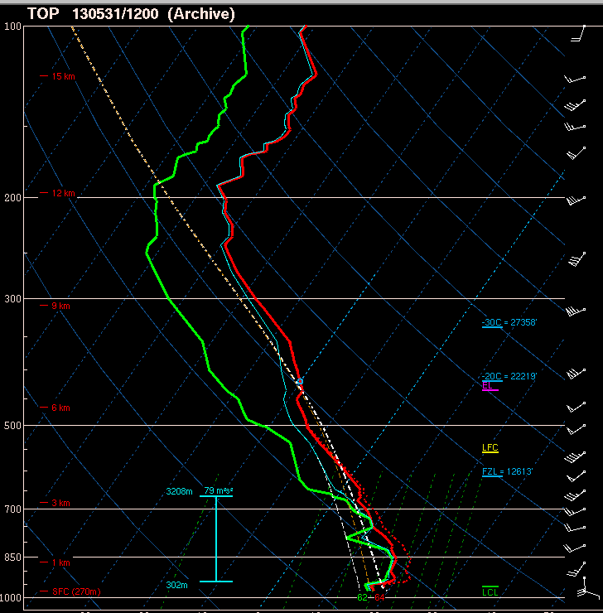
Surface parcel

Slide 17

100 mb mean parcel

Slide 18
Most unstable parcel

Slide 19
What do we assume in parcel theory?
No mixing with environment (not true)
  “entrainment” usually reduces updraft strength from expectations based on CAPE alone
Hydrometeor falls out instantly (not true)
  Suspended rain particles reduces updraft strength. That’s why we say “pseudo” adiabatic for saturated parcel ascent
Neglects downward pressure perturbation pressure
  Acts to hinder the upward motion of parcels.
Parcel vertical motion is due to buoyancy alone
  We don’t explicitly incorporate environmental ascent (e.g. mesoscale, synoptic ascent, etc…)

Slide 20
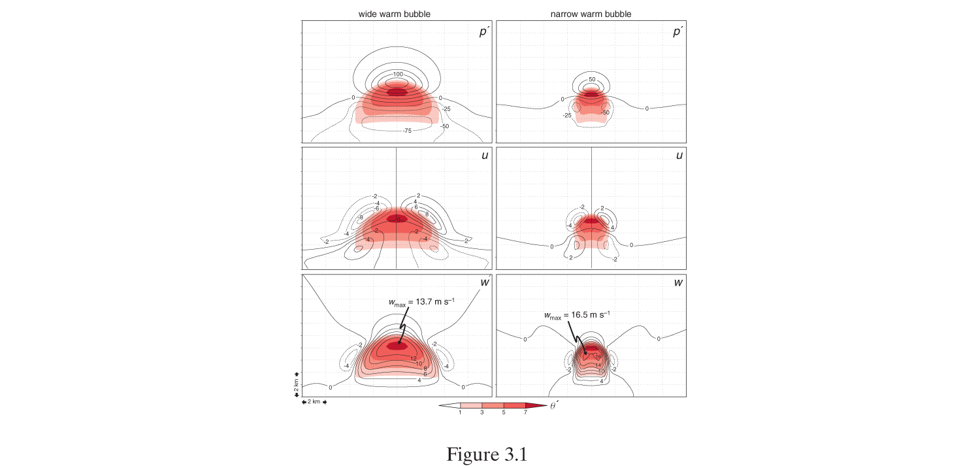
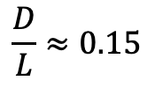
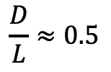
B
B
H
H
Vertical PGF
PGF
L
PGF
L
Wider thermal has larger PGF compared to narrow thermal (more air needs to be moved out of the way)
As thermal becomes wider the scenario approaches hydrostatic where PGF offsets buoyancy (dw/dt=0)
In theory, narrow thermals more favorable for convective initiation
Fig. 3.1 MR 2010

Slide 21
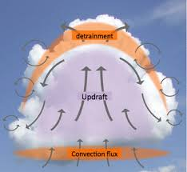
Dry Air Entrainment & E-CAPE
Mixing by two mechanisms:
The condensed updraft is very moist (RH near 100%), the environment is relatively dry. Moisture flux from updraft to the environment to restore thermodynamic equilibrium.
Differential vertical motion across the updraft (dw/dx and dw/dy) causes mechanical mixing on the cloud exterior.

Slide 22
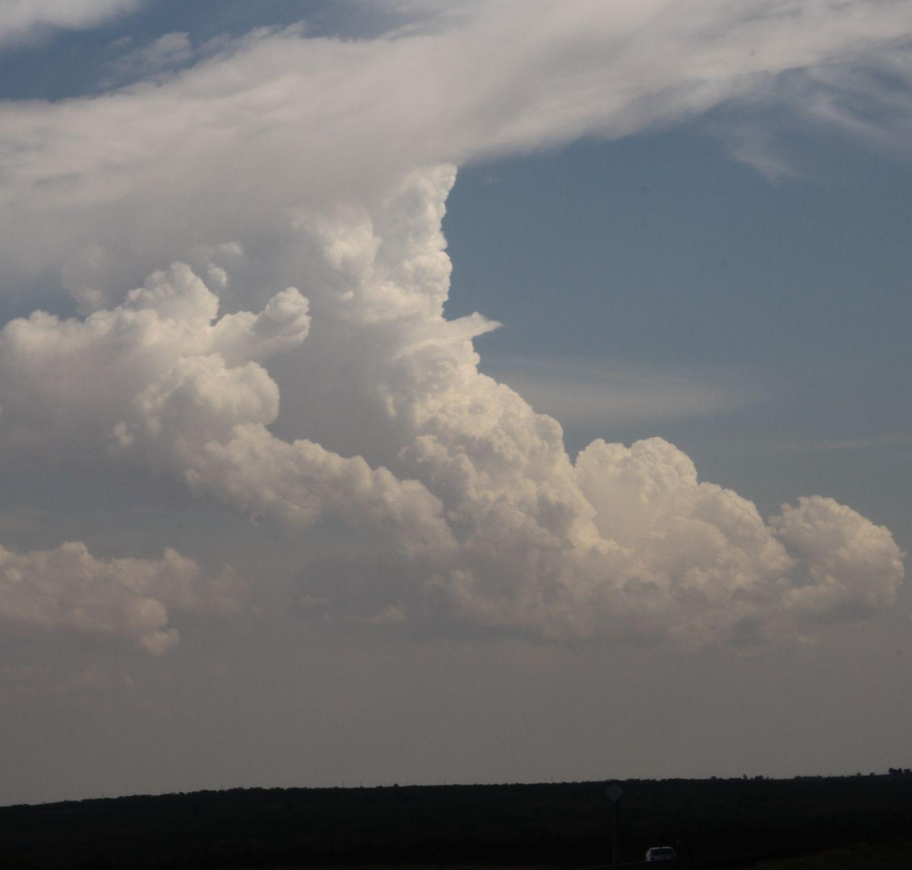
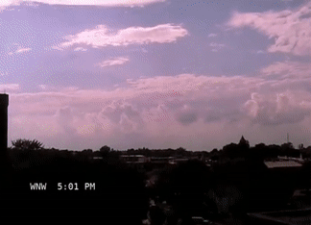
Dry Air Entrainment & E-CAPE
This updraft looks narrow, will dry air entrainment kill it?
Video by Daryl Herzmann

Slide 23
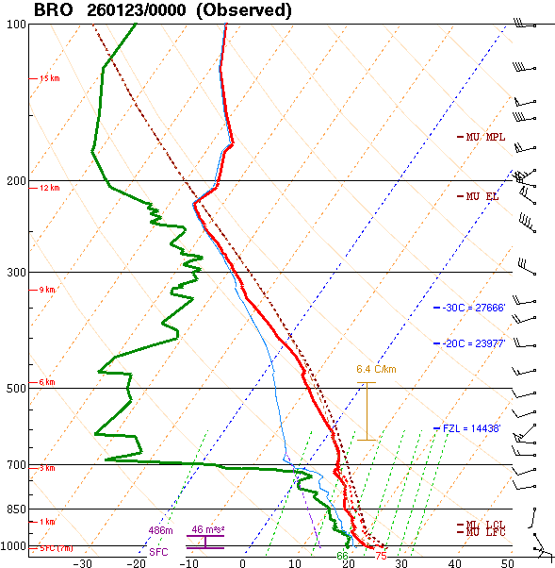
Dry Air Entrainment & E-CAPE
Dry air entrainment occurs all of the time!
How do we know when it could be a problem?
Thermodynamically: look for dry layers coincident with very narrow buoyancy profile (i.e. weak CAPE).
Mechanical lift: In weak-lift regimes, T-storms are dependent on their own thermodynamic buoyancy with no help from environmental ascent.
Weak updraft acceleration
Dry layer
Video by Daryl Herzmann

Slide 24
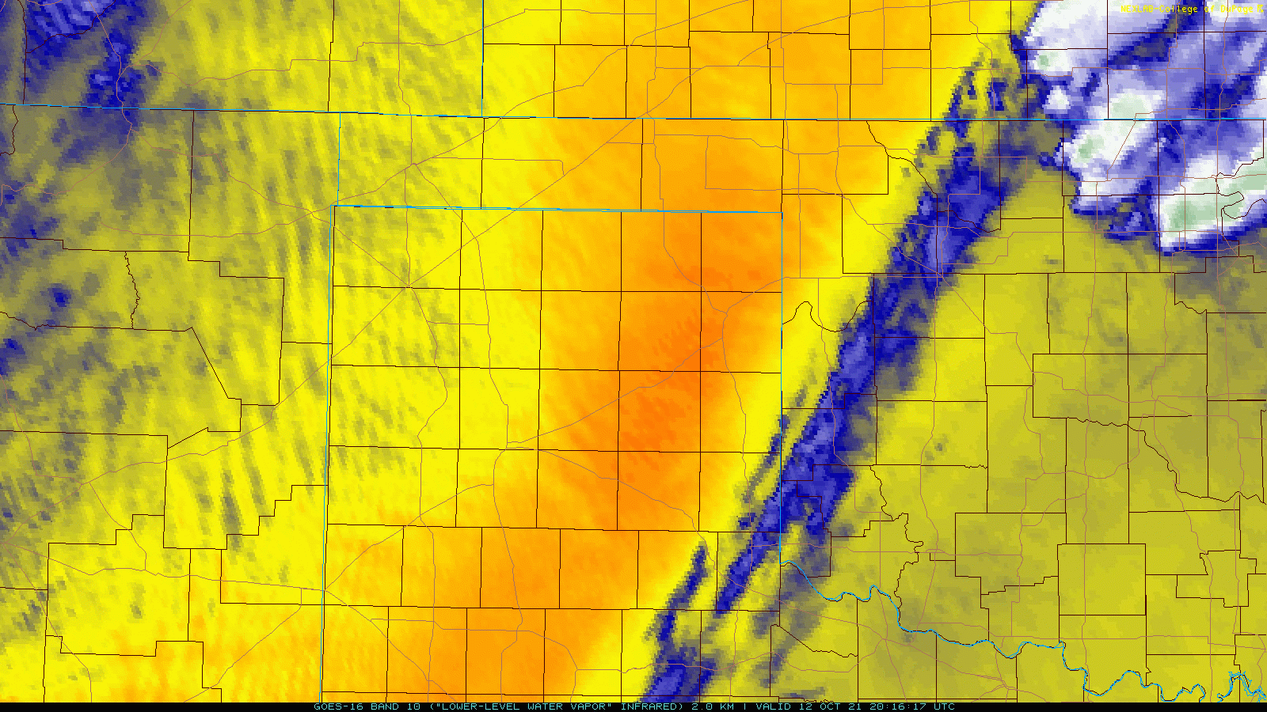
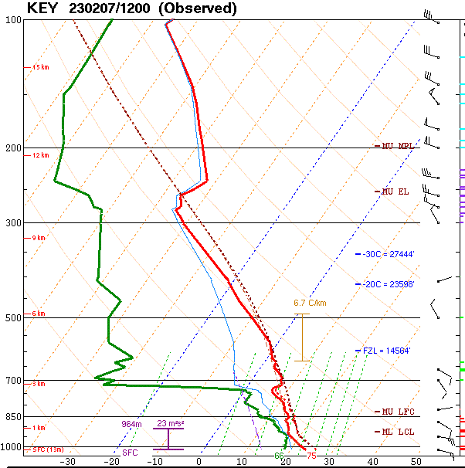
Dry Air Entrainment
Detrimental to updraft maintenance, but when is it important to consider?
Sampling this layer
Plume of dry air
Look for a combination of:
Weak forcing for ascent
Small temperature difference between parcel and environment (i.e. small updraft accelerations) coincident with dry layer
Weak updraft acceleration
Dry layer

Slide 25
Dry Air Entrainment
Detrimental to updraft maintenance, but when is it important to consider?
Sampling this layer
Failed Convective Initiation
Look for a combination of:
Weak forcing for ascent
Small temperature difference between parcel and environment (i.e. small updraft accelerations) coincident with dry layer
Weak updraft acceleration
Dry layer

Slide 26



Dry Air Entrainment & E-CAPE
So how can we account for this?
By using ECAPE!
Pros:
Accounts for dry air entrainment!
Reduces CAPE in dry environments
Increase CAPE in moist environments.
Cons:
Computationally expensive (changing)
Not as intuitive to determine from sounding.
Weak updraft acceleration
Dry layer

Slide 27
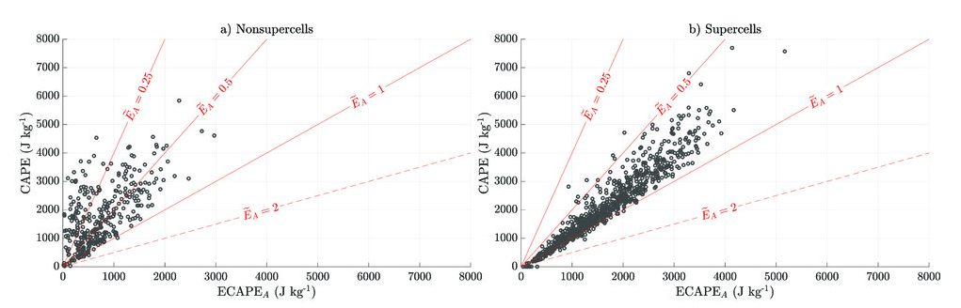
Dry Air Entrainment & E-CAPE
Ultimately, why and when does this matter?
Which CAPE you use an influence how you interpret updraft intensity.
But be weary, they’re all still just estimates!
Fig 10 from Peters et al 2023

Slide 28
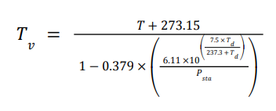
Virtual Temperature Correction
Which parcel trace is correct?
Accounts for the reduction in density a parcel experiences as the proportion of water vapor in the parcel increases.
Conservation of mass in a parcel
H2O
O2
In effect, this makes our parcel trace more representative of reality by:
Increasing CAPE
Reducing CIN
N2
~18 g/mole
~29 g/mole

Slide 29
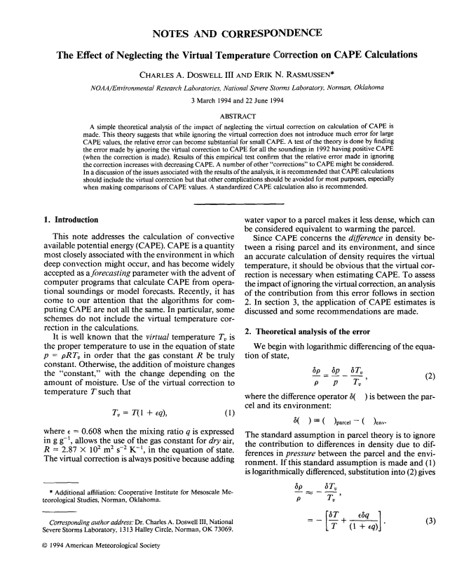
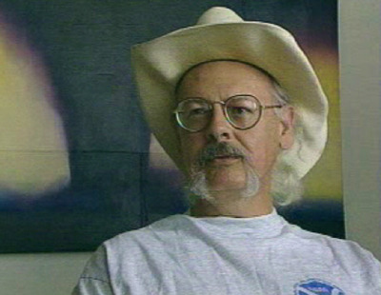
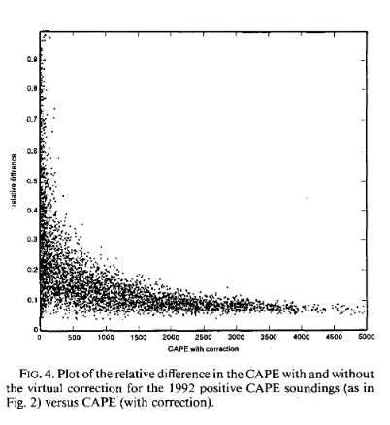
Virtual Temperature Correction
Which parcel trace is correct?
Accounts for the reduction in density a parcel experiences as the proportion of water vapor in the parcel increases.
Matters most in moist, low-CAPE environments
Conservation of mass in a parcel
In effect, this makes our parcel trace more representative of reality by:
Increasing CAPE
Reducing CIN
H2O
O2
N2
~18 g/mole
~29 g/mole

Slide 30
In which sounding will the virtual temperature correction matter more?

Slide 31
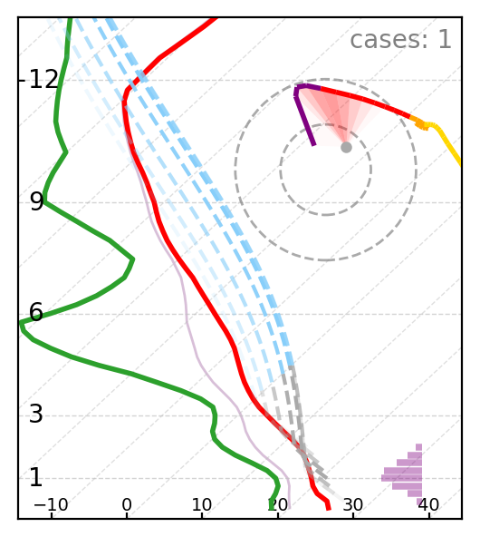
At the end of the day…
Parcel selection matters!
  Influences your interpretation of the environment.
Know when to use the right parcel and when to make adjustments.
Realize that we’re working with an imperfect model of the atmosphere. Treat thermodynamic parameters as estimates!
Which parcel is actually going into the T-storm?
Courtesy of Dr. Cameron Nixon

Slide 32
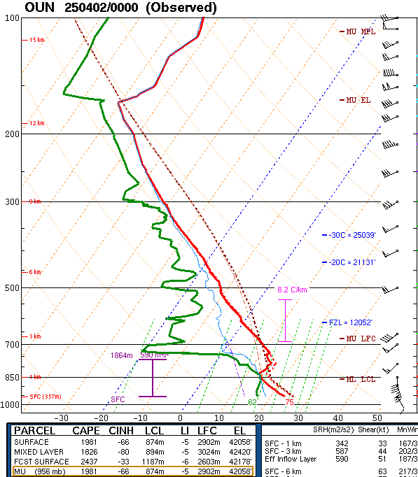

What is feeding the storm?
Is this storm surface-based?
Storm motion suggested it was not.
(more on that later)
No discernable rising scud.

Slide 33

What is feeding the storm?
Is this storm surface-based?
Increasing rising scud into a lowering cloud base.
Notable updraft pulses.
Suggested the storm was ingesting near-surface parcels!

Slide 34

What is feeding the storm?
Is this storm surface-based?
Rising scud diminishes.
Weak updraft pulses.
Cloud based climbs up and elongates.
Storm begins accelerating away from us.
Storm dies within 20 minutes.
Was the storm elevated the whole time? Storm behavior suggested it was!

Slide 35

Quality of Observations Aloft?

Slide 36
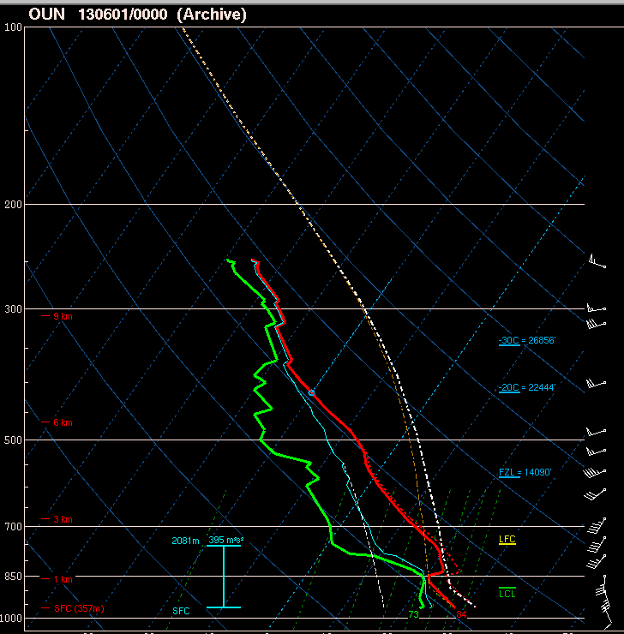

Slide 37
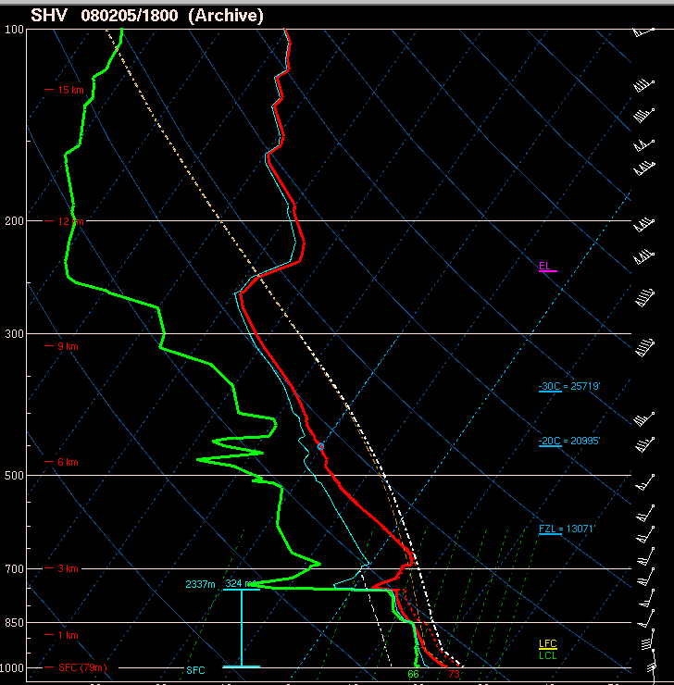

Slide 38
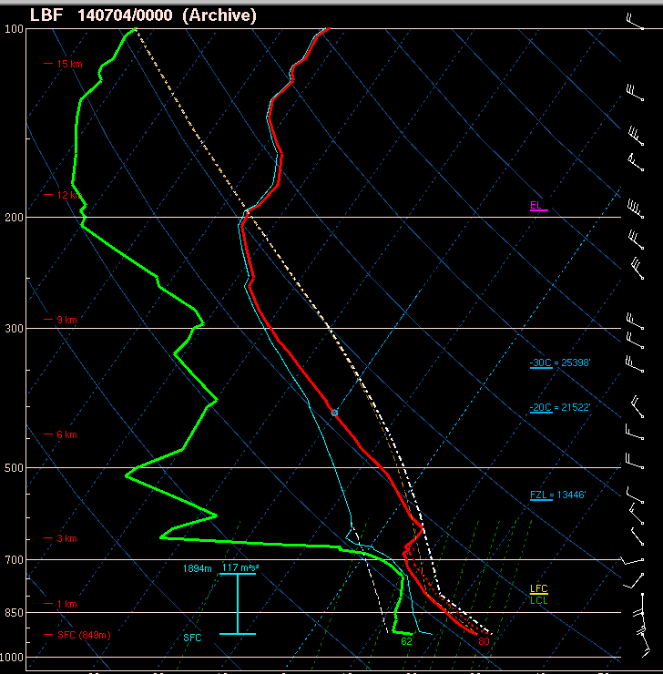

Slide 39
Understand the Data and Processes!
Understanding the processes gives you a sound way to interpret weather data, and recognize errors
If you don’t know what you’re using, how do you know if you’re using it correctly?
  Must consider data quality
Focus on observations!

Slide 40
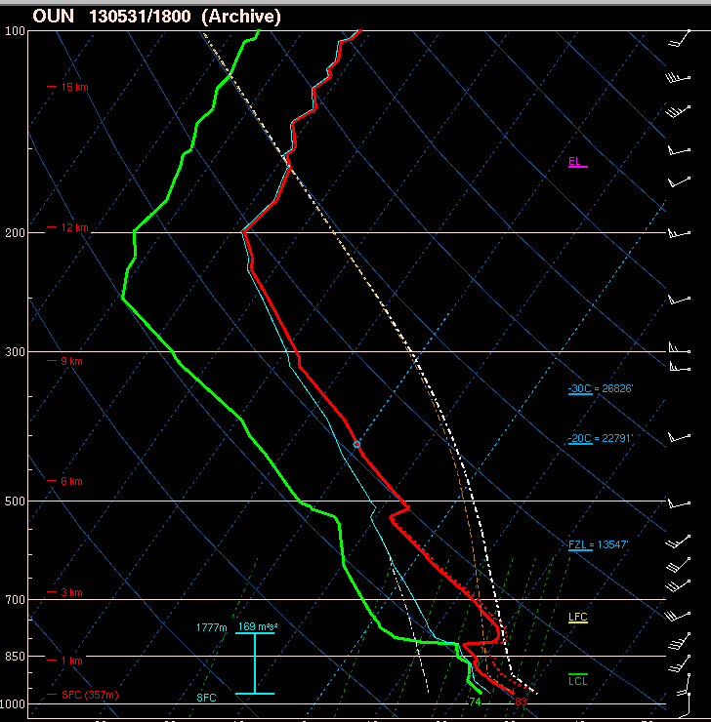
Surface and most unstable parcel are the same

Slide 41
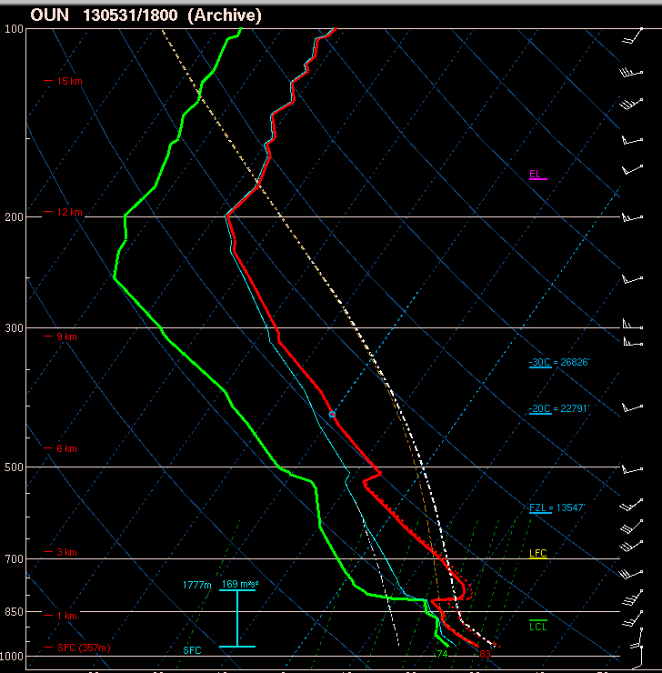
Lowest 100 mb mean parcel

Slide 42
Always keep in mind what we don’t know:
Uncertainty in observations
  “Good” measurements?
  Do they represent what we’re trying to forecast?
Unknown details with lifted parcels
  What is right layer to view?
  What assumptions are valid, and which might be terribly wrong?
Lots of room for error, but the concepts are useful!

Slide 43

Simple vertical mixing
Surface heating drives thermals and mixing, which take heat and moisture both upward (from surface) and downward (from aloft)
Usually see surface dew point drop in afternoon if not offset by moisture advection (bringing in greater moisture from somewhere else)

Slide 44
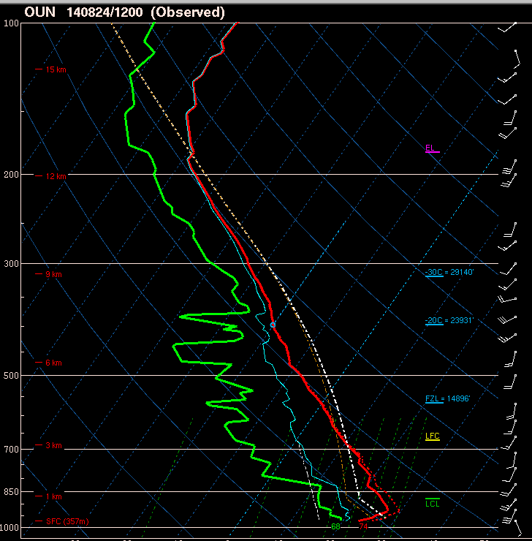

Slide 45
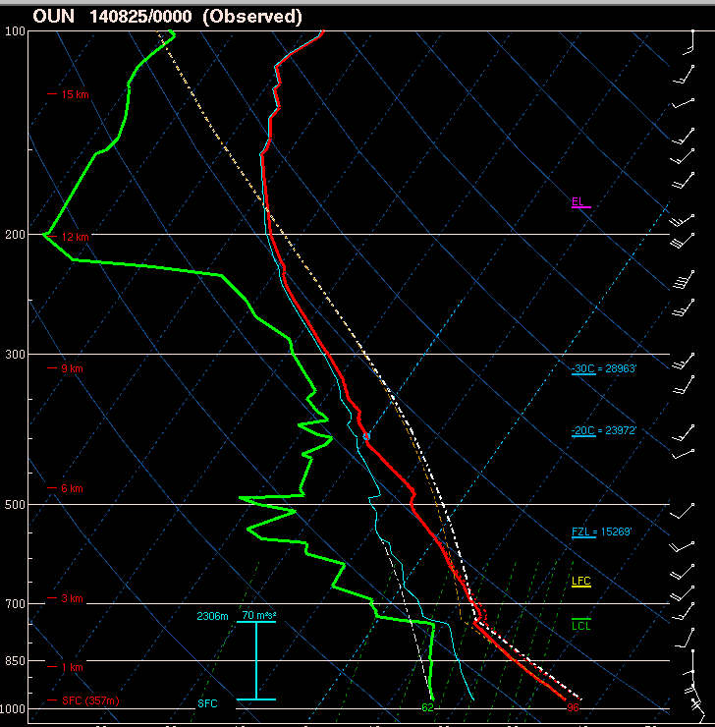
Surface heating drives vertical mixing

Slide 46
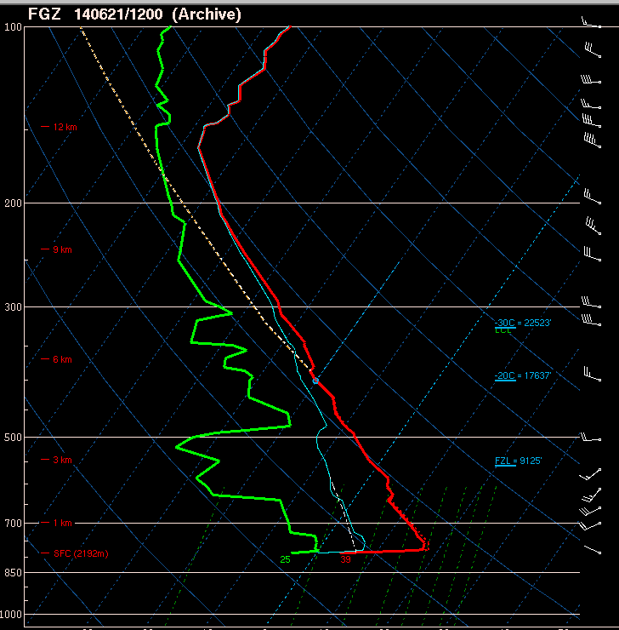

Slide 47
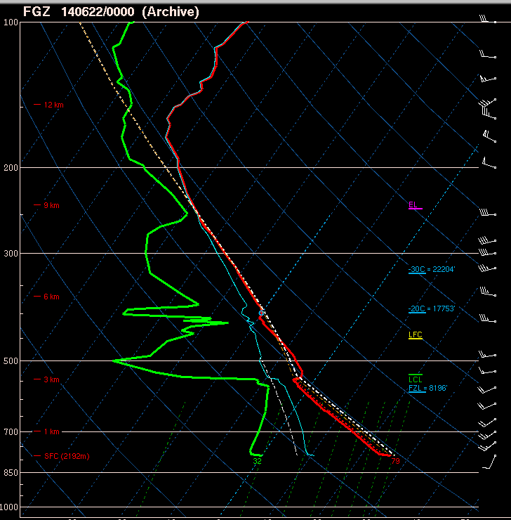
“super adiabatic” contact layer – lapse rate steeper than dry adiabatic drives vertical mixing

Slide 48
Impact of ascent and moisture advection
See moist layer deepen faster than you would expect with just surface heating and mixing
“Deep” moist layer and horizontal moisture advection both combat vertical mixing driven by surface heating
  Can see moist layer deepen while dew points increase near surface

Slide 49
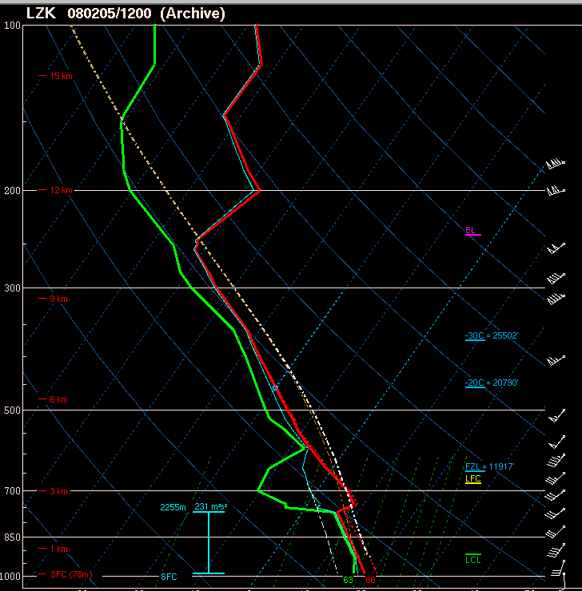

Slide 50
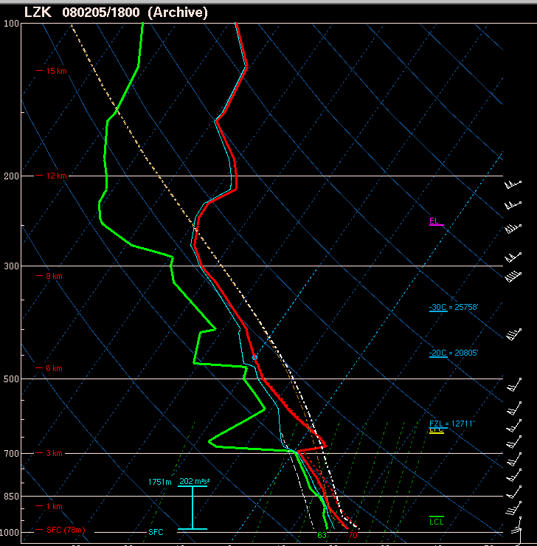

Slide 51
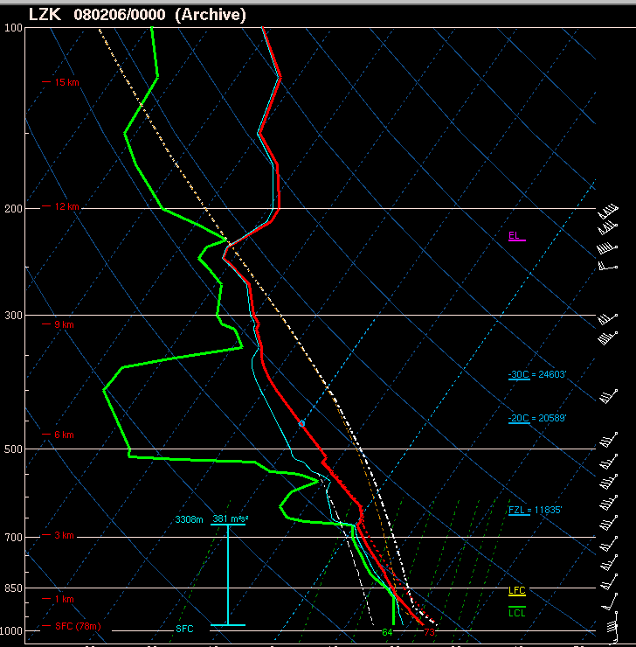

Slide 52
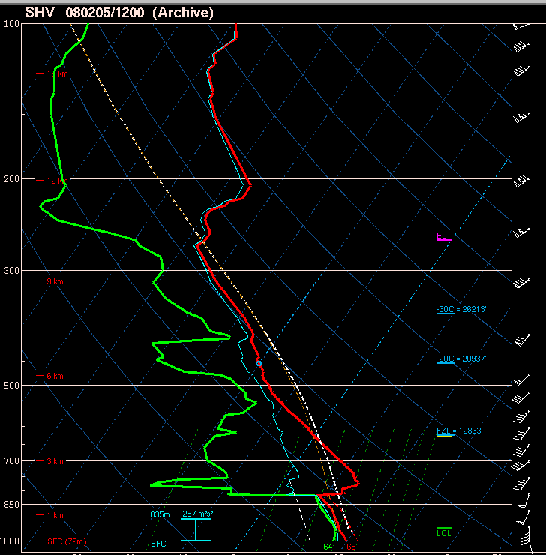

Slide 54
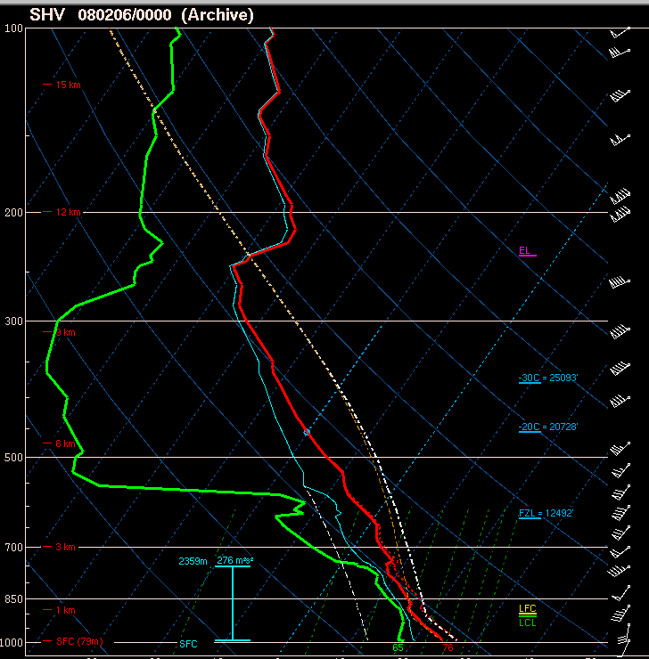

Slide 55
Sounding diagrams are used for…
Moisture and temperature profiles
Estimates of CAPE, CIN, Lifted Index, etc.
  Will storms form?
Vertical wind shear (material on hodographs to come!)
  What kind of storms will form?
Many of your favorite thunderstorm parameters are based in these diagrams, and subject to the same errors and concerns!

Slide 56
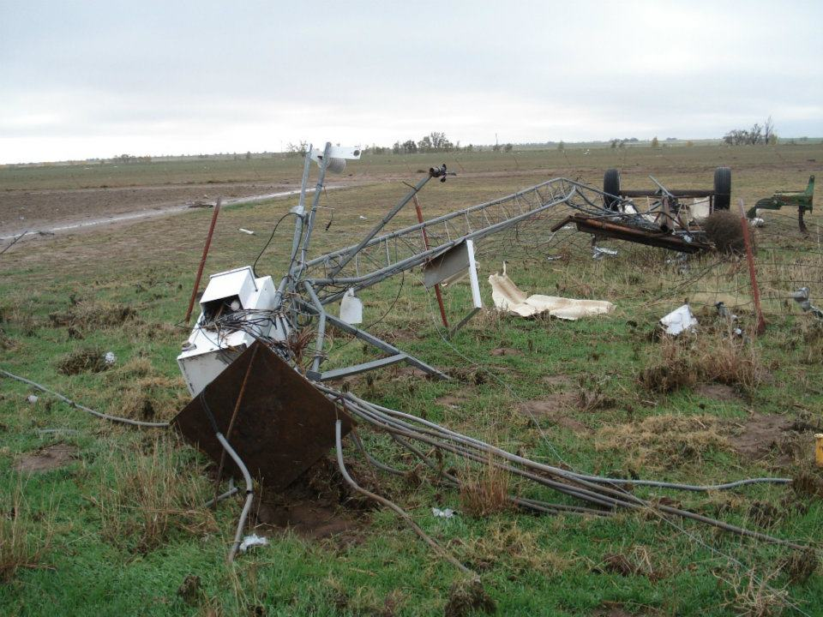
Quality of Surface Observations?
Courtesy of Oklahoma Mesonet
Notes:
Tipton mesonet, got knocked over by a tornado

Slide 57
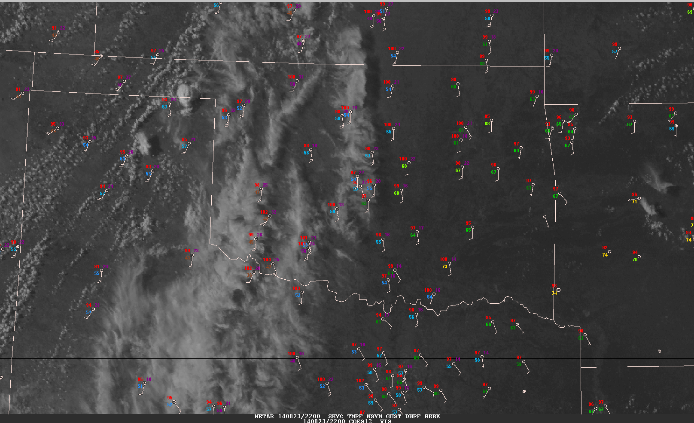
Standard surface observations

Slide 58
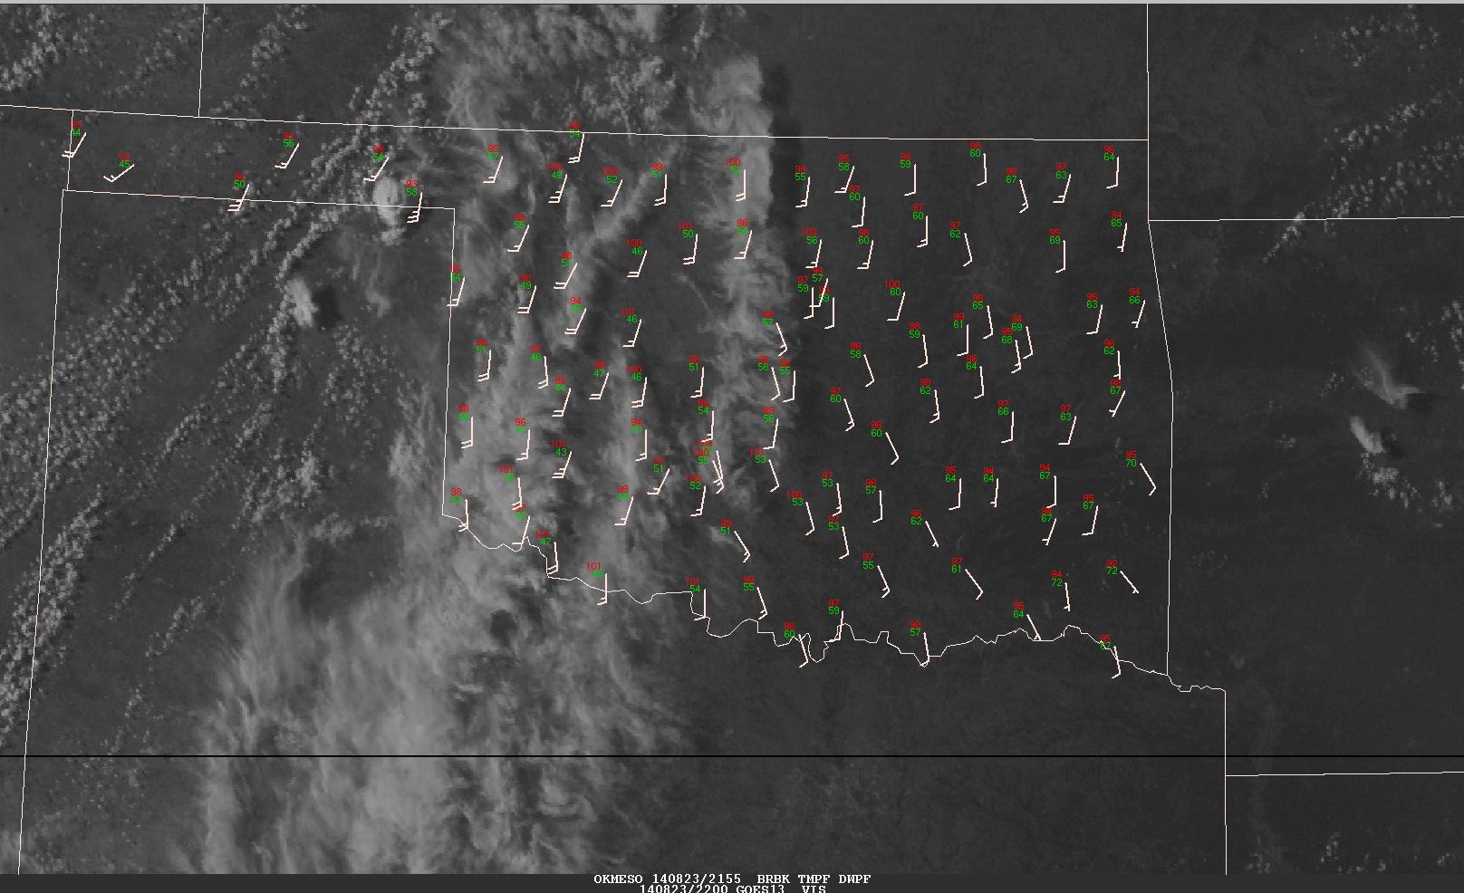
OK mesonet observations at the same time

Slide 59
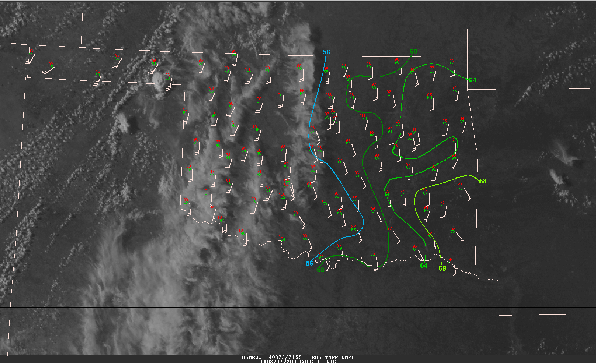
Dew point analysis for OK mesonet observations

Slide 60
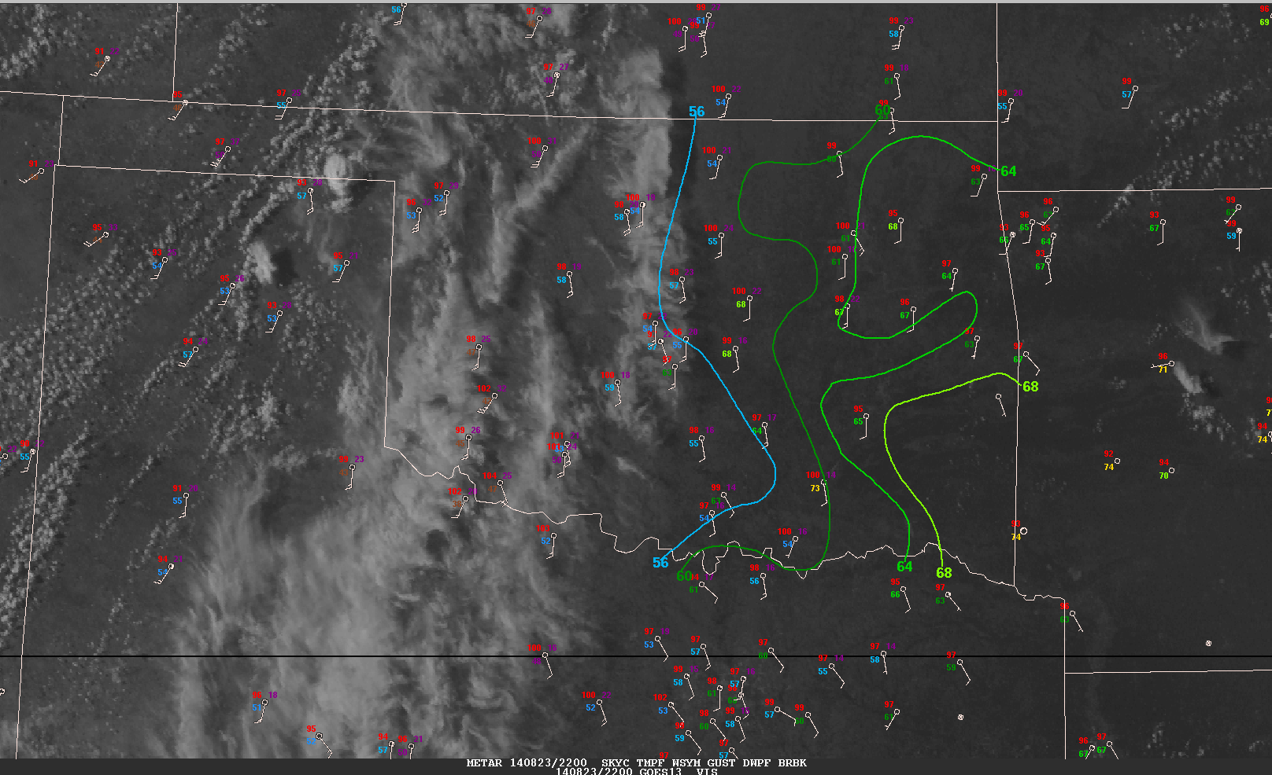
What do these sites have in common?
68
63
68
73
Notes:
ASOS stations are inferior to AWOS stations (OK Mesonet).

Slide 61
Parcel Theory
Material prepared by Tom Galarneau

Slide 62
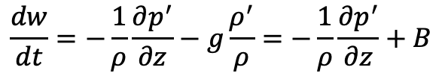
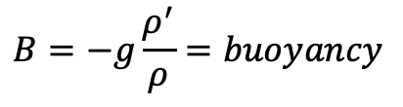
Buoyancy
Buoyancy is the upward force arising from the displacement of a fluid by another fluid or object (Archimedes’ Principle)
  The upward force is equal to the weight of the displaced fluid
  Buoyancy is the key force for convection! (Supercells are more complicated…)
Vertical momentum equation for convective scales goes as:
B controls the parcel acceleration. So, rising parcels can continue to rise for some time after becoming negatively buoyant (like overshooting top!)

Slide 63
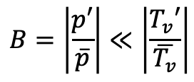
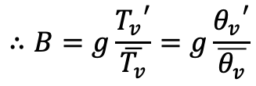
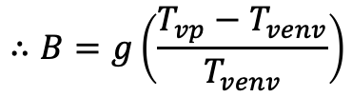
Buoyancy
Write buoyancy in terms of temperature since we measure that
Reference state temperature is environment (temperature line on sounding)
Using ideal gas law:
For small mach number:
T_{vp} is virtual temperature of air parcel
T_{venv} is virtual temperature of ambient environment

Slide 64
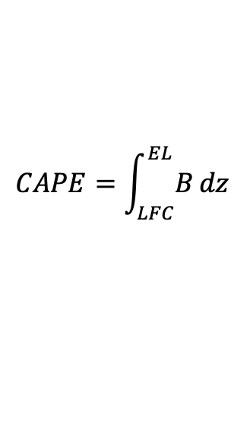

Parcel theory
We need to be able to determine whether a lifted parcel has buoyancy
Convective available potential energy (CAPE) tells us the kinetic energy a parcel may gain due to buoyant acceleration
Convective inhibition (CIN) tells is the work done by a parcel against stable stratification to reach its LFC
Vertical integration of buoyancy from LFC to EL.
Caveats: CAPE>0 does not guarantee convection.
Not all parcels have an LFC.
Vertical integration of buoyancy from ground to EL.
Need to overcome CIN to trigger convection.

Slide 65



Theoretical Maximum Updraft Speed
1000 J kg⁻¹ CAPE 🡪 45 m s⁻¹ updraft (??)

Slide 66
Summary
Parcel theory overestimates updraft speed
  Vertical PGF limits updraft speed; significant for wide updrafts
  Entrainment limits updraft speed; significant for narrow/tilted updrafts
  Hydrometeor loading also limits updraft speed
Bryan and Weisman 2000

