Slide 1
Severe Weather Ingredients
Material by Tom Galarneau Andrew Lyons,
Rich Thompson and Harry Weinman

Slide 2
Ingredients for
Organized Severe Thunderstorms
Instability (Lapse Rates)
Lift (QG, mesoscale, convective scale)
Moisture (return flow, soil moisture, evapotranspiration)
Vertical wind shear

Slide 3
Ingredients for
Organized Severe Thunderstorms
Instability (Lapse Rates)
Lift (QG, mesoscale, convective scale)
Moisture (return flow, soil moisture, evapotranspiration)
Vertical wind shear - a separate lecture
This lecture
Key ingredient for organized severe storms

Slide 4
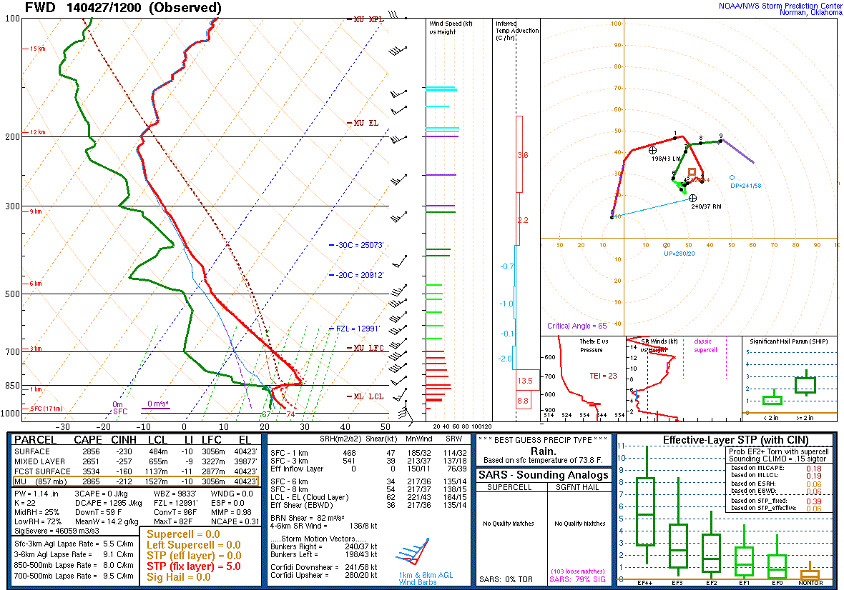
Instability: The Basics
Give a parcel a nudge and see what happens!
We determine an environments stability by its lapse rate (Change of environmental temperature with height)
EL
Parcel is warmer
than surroundings
LFC
LCL

Slide 5
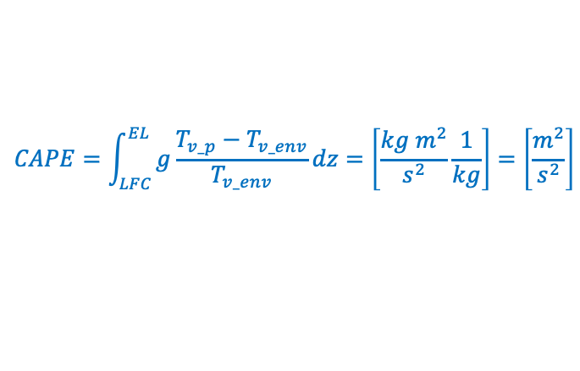

Instability: The Basics
Integrate the depth where parcel is warmer/less dense than its surrounding
CAPE (Convective Available Potential Energy)
CAPE

Slide 6

Instability: The Basics
Take a small finite layer depth within CAPE profile
Upward Acceleration!
Short/thick CAPE:
Drives larger upward acceleration
1. Offsets negative effects of dry air entrainment into updraft
2. Mitigates effects of precipitation drag on updraft
Tall/narrow CAPE:
Smaller upward acceleration
Water loading and entrainment more substantially weaken updraft

Slide 7
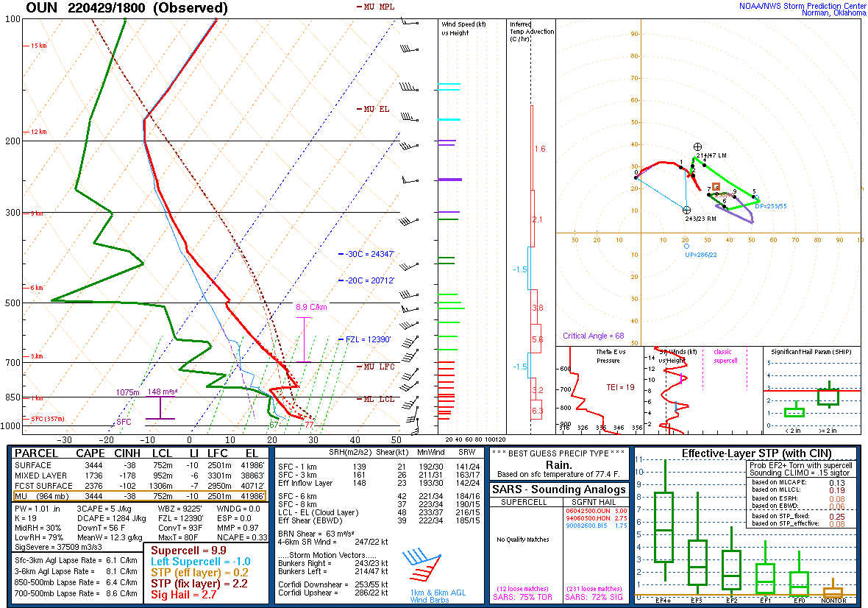
So, how do we get wider CAPE?
Steepen mid-level lapse rates
Warm and moisten the surface.
introduce strong synoptic and mesoscale ascent.

Slide 8

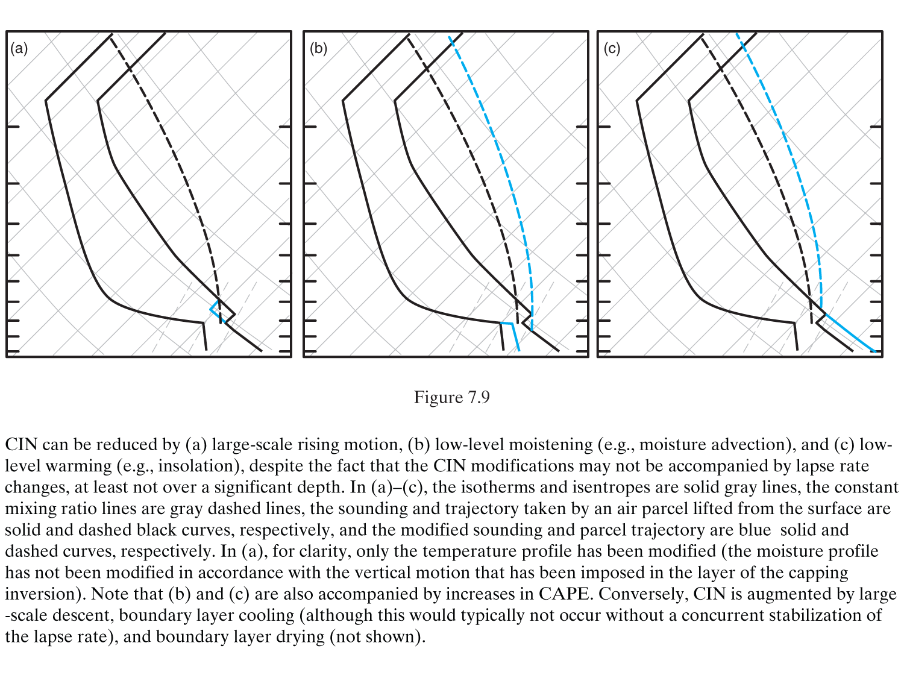
CIN can be reduced and/or CAPE increased by:
Rising motion
Low-Level Moistening
Low-Level Warming
(Markowski and Richardson 2010, Fig. 7.9)

Slide 9
Instability: Elevated Mixed Layer (EML)
Deep mixed layer forms over Rockies and Sierra Madre in response to surface heating
Stronger heating and/or cooler temperatures aloft results in deeper mixed layer
Mixed layer is advected eastward and becomes elevated east of the Rockies and Sierra Madre (really, east of the dryline)
Differential advection (eastward advection of EML above northward advection of moisture from GoM) created “loaded gun” profile

Slide 10
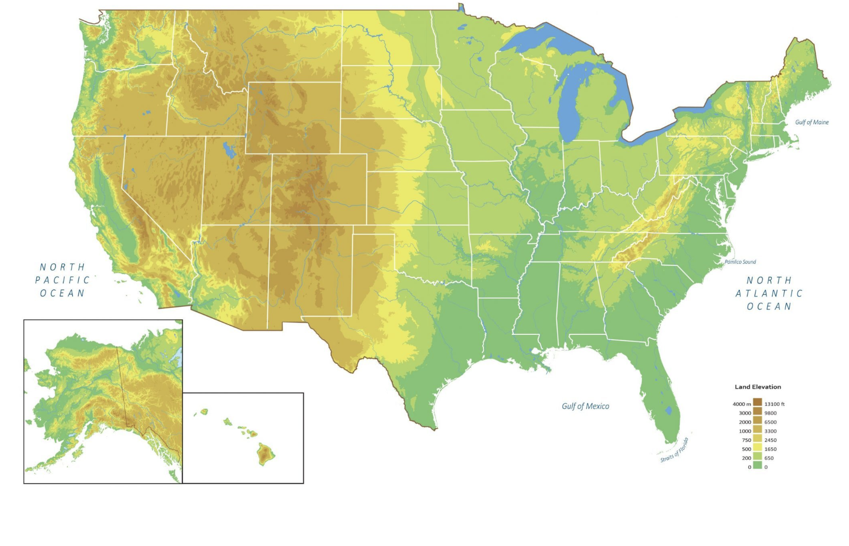
Elevated Mixed Layer (EML) Differential Advection
A’
A
A
A’

Slide 11
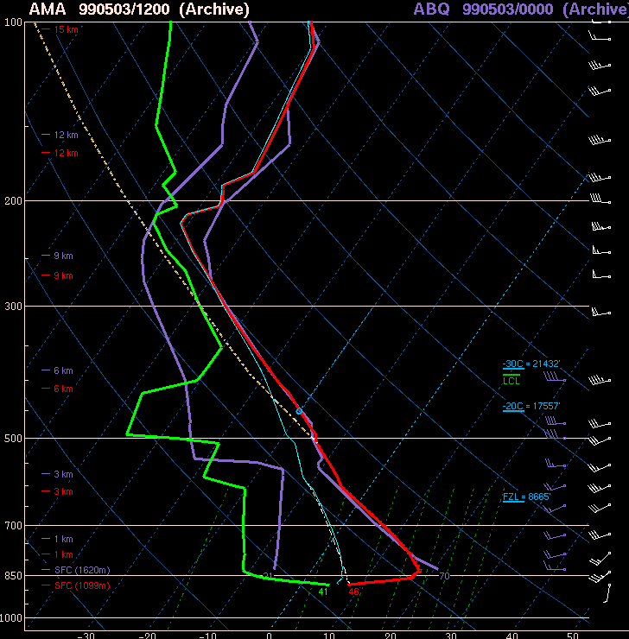
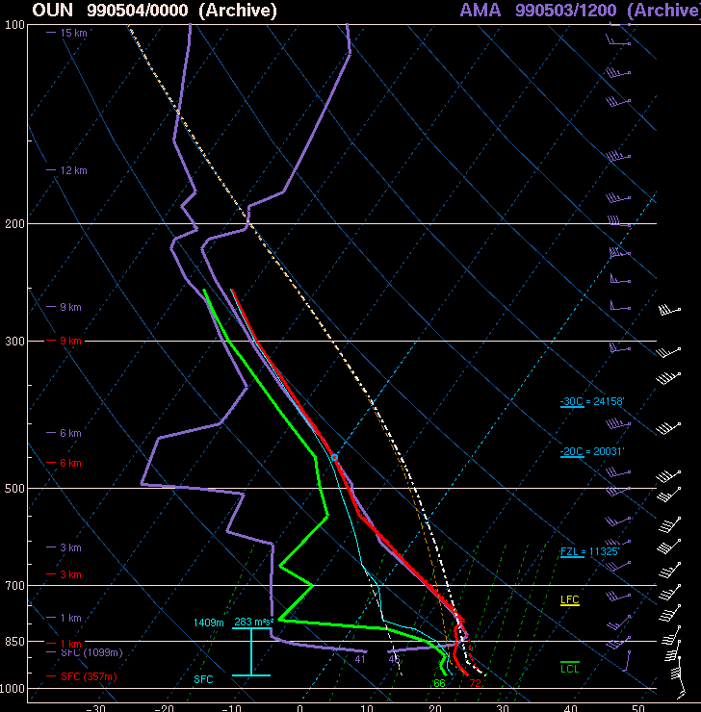
EML at OUN (0000 UTC 4 May 1999)
Cap: inversion at
base of EML
Notes:
Comparing the two. EML is the same, there’s just a surface layer in AMA.

Slide 12
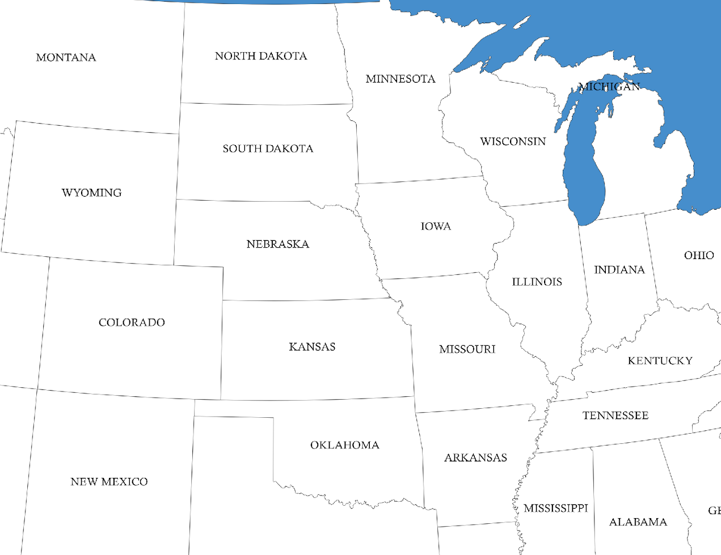
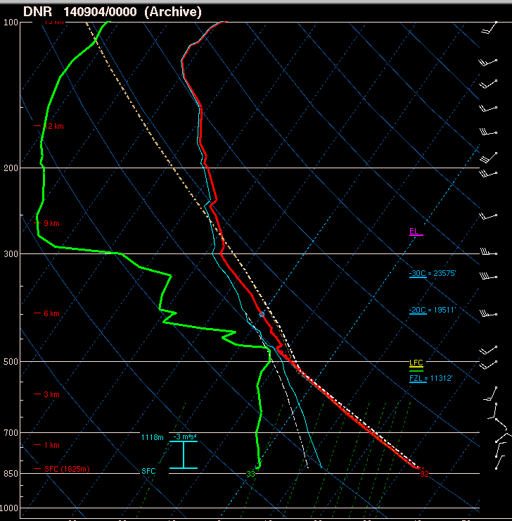

Slide 13
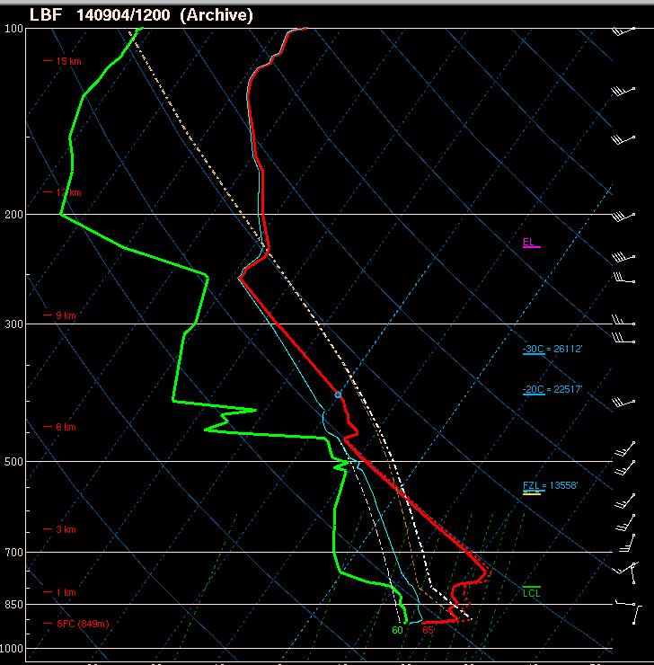

Slide 14
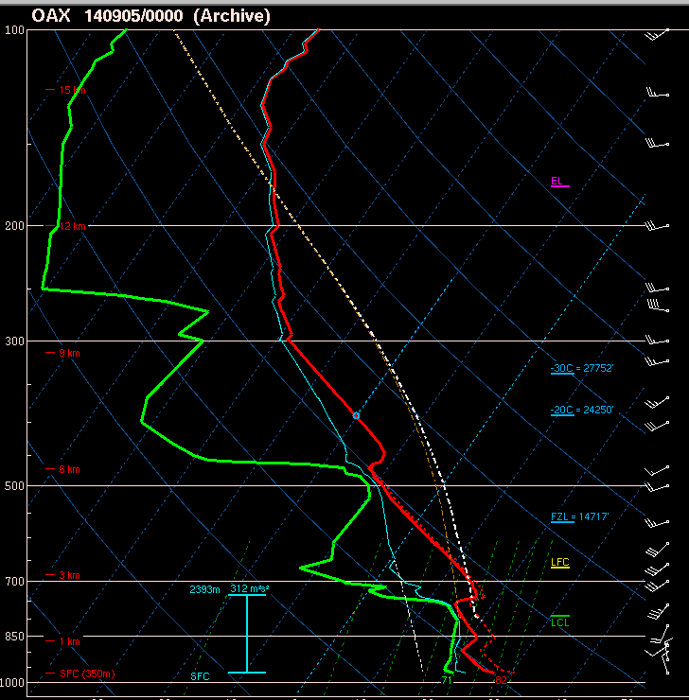
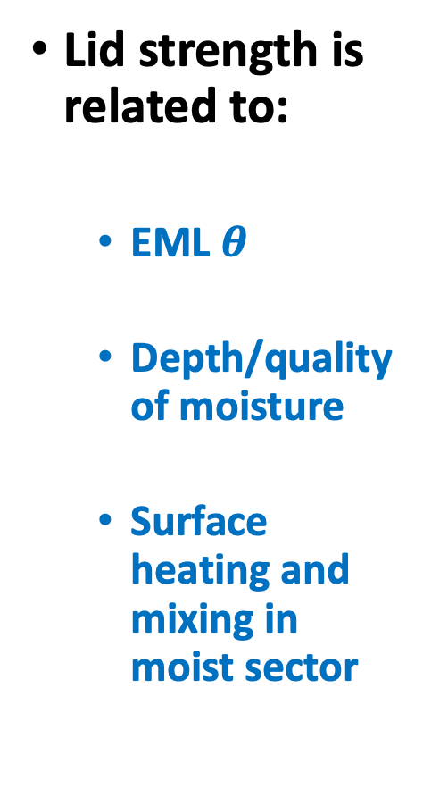
Cap strength is related to:

Slide 15
Lift
Synoptic-scale lift
  1-10 cm/s for many hours (6 hours ~2 km ascent (SFC-800 hPa))
  6 hours to reach LFC
  Conditions environment for deep, moist convection over broad area
    Lapse rate stretching
    Removal of inhibition
  Layered clouds in regions of isentropic lift; some elevated storms can form
Mesoscale lift
  1 m/s for minutes to hours (1 hour ~3.6 km ascent (SFC-650 hPa))
  < 1 hour to reach LFC
  Narrow zones of ascent along boundaries and terrain features
  Direct initiation of thunderstorms
Storm-scale lift
  10 m/s for minutes (15 mins ~9 km of ascent (SFC-300 hPa))
  5 minutes to reach LFC
  Storm maintenance and propagation (supercells, MCSs, squall lines, etc.)

Slide 16
Synoptic-Scale Lift
QG sources
  Warm advection/isentropic lift and differential vorticity advection
Jet streaks (also QG)
  Straight jet: ascent in right entrance and left exit regions
  Curved jet: ascent downstream and along jet core

Slide 17
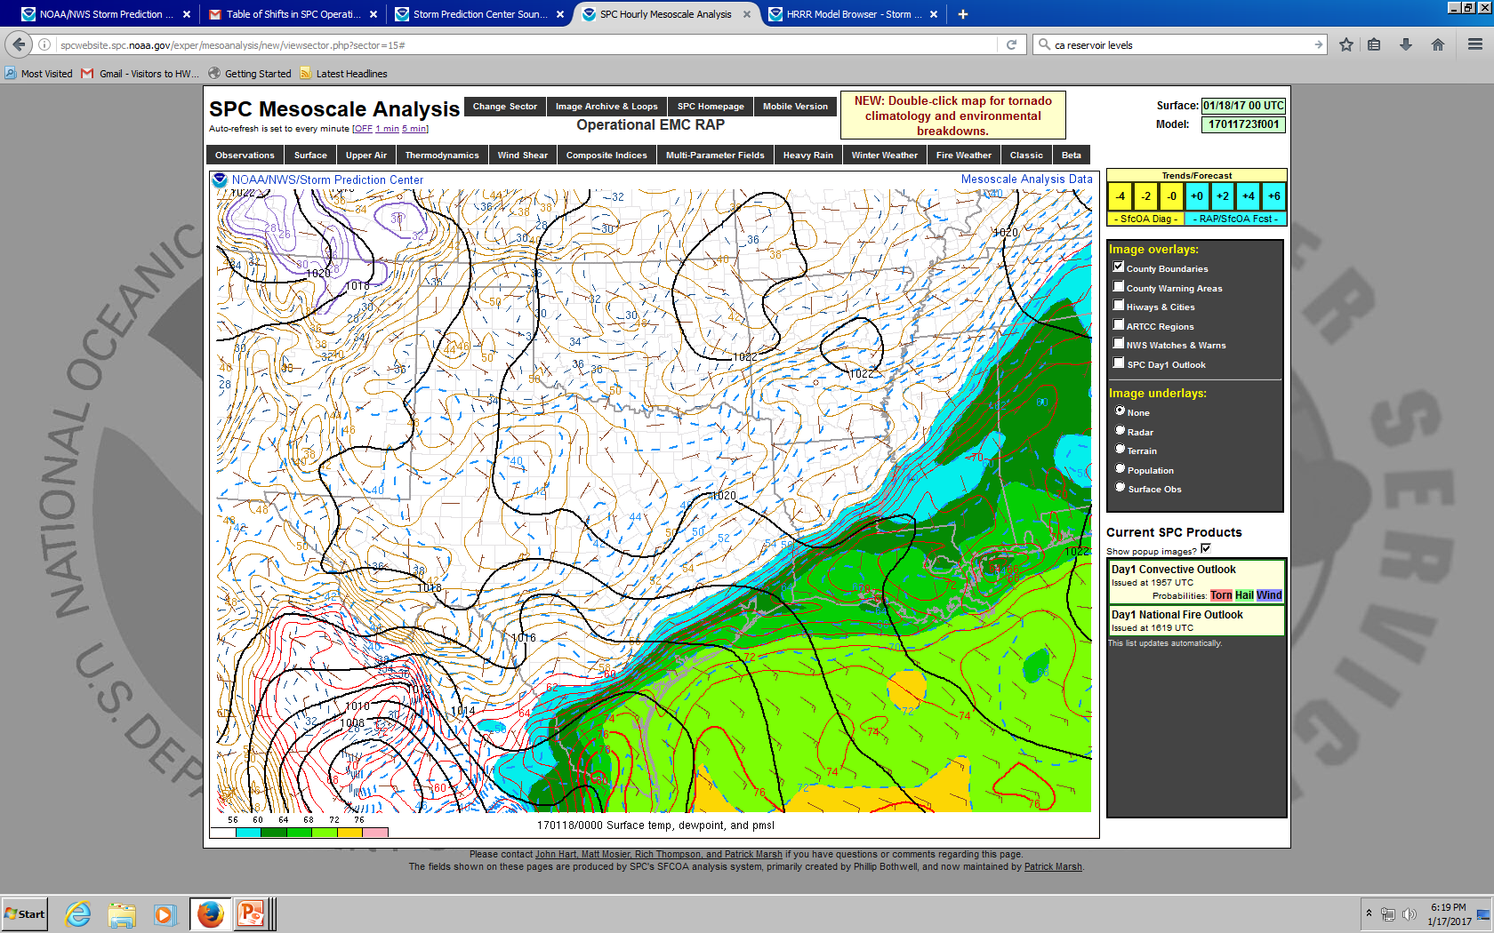

Slide 18
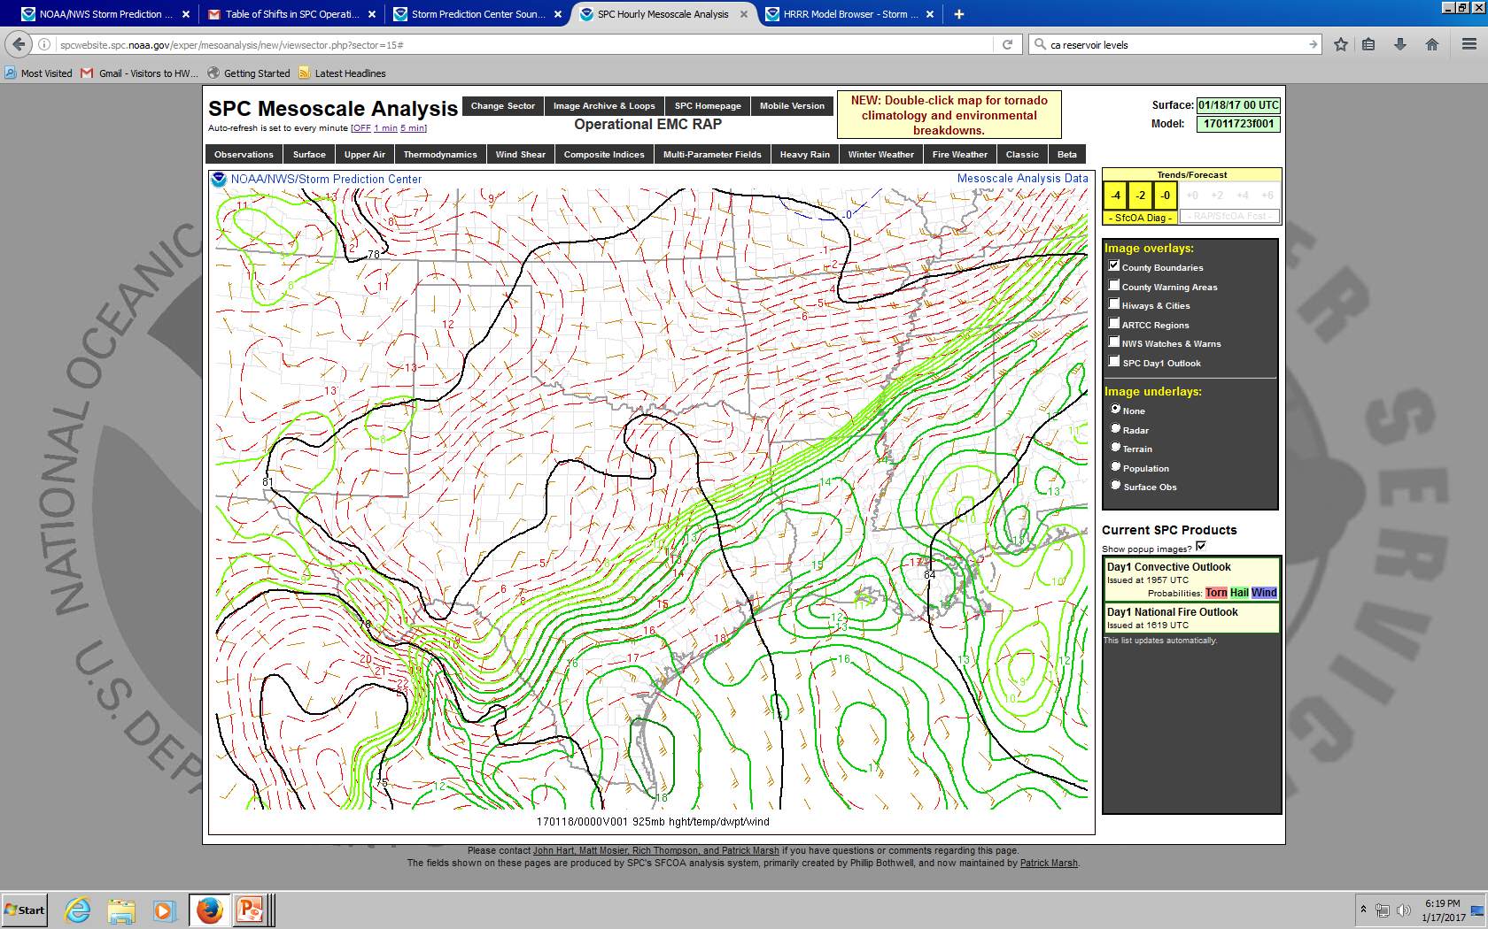

Slide 19
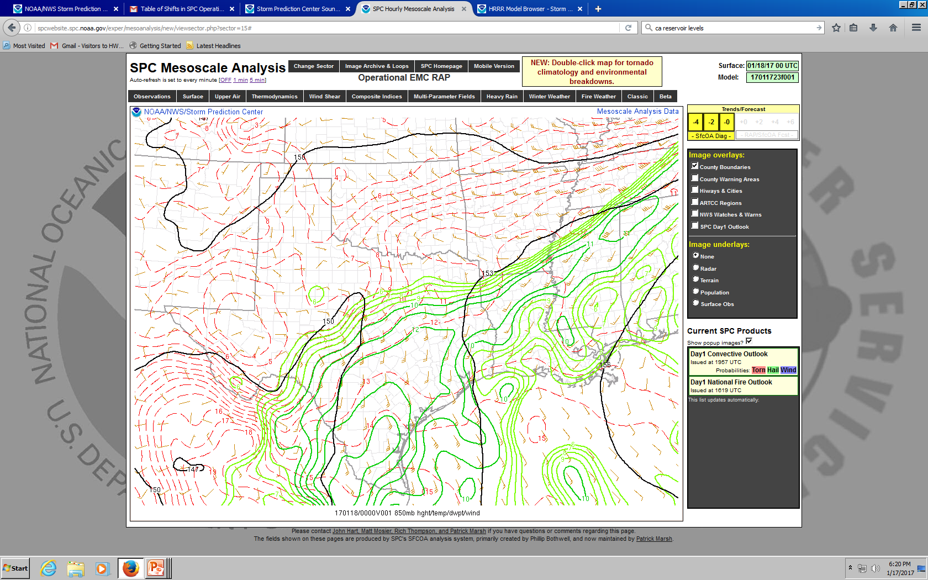

Slide 20
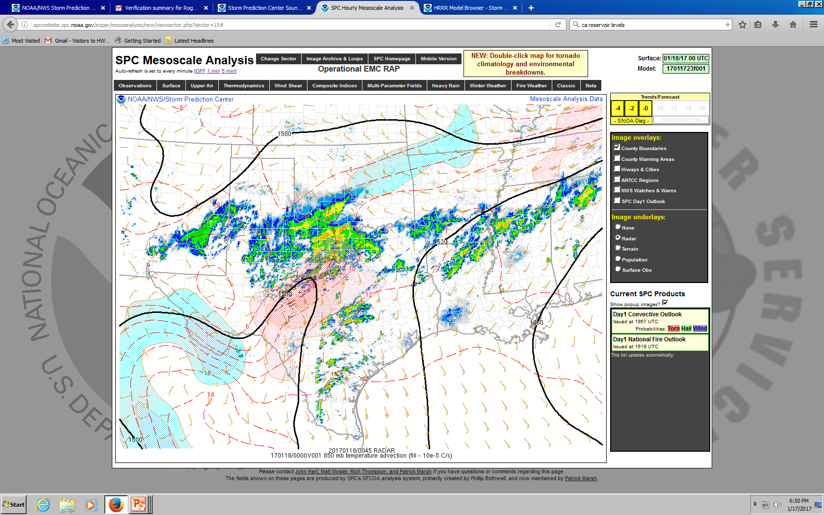
Notes:
But are any of these storms surface based?

Slide 21
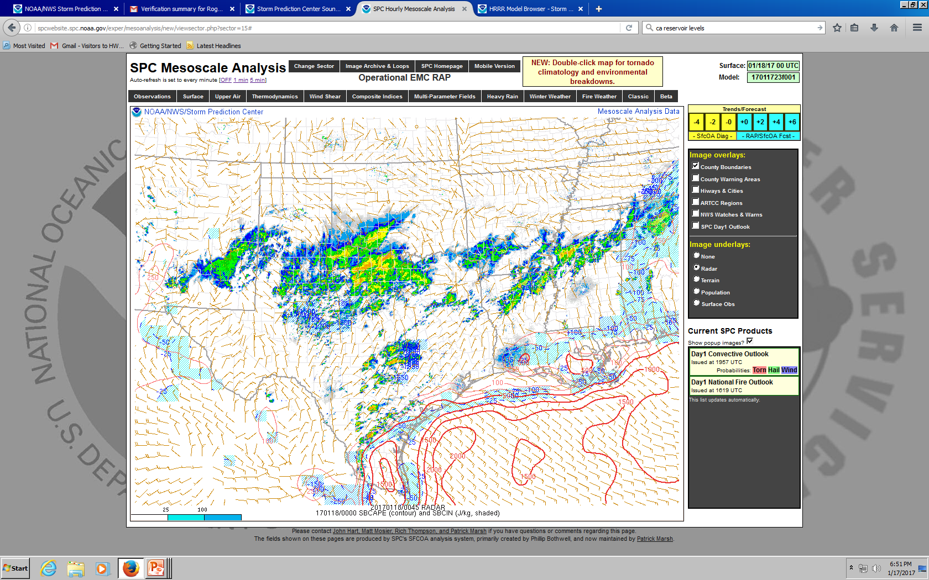
Notes:
Nope.

Slide 22
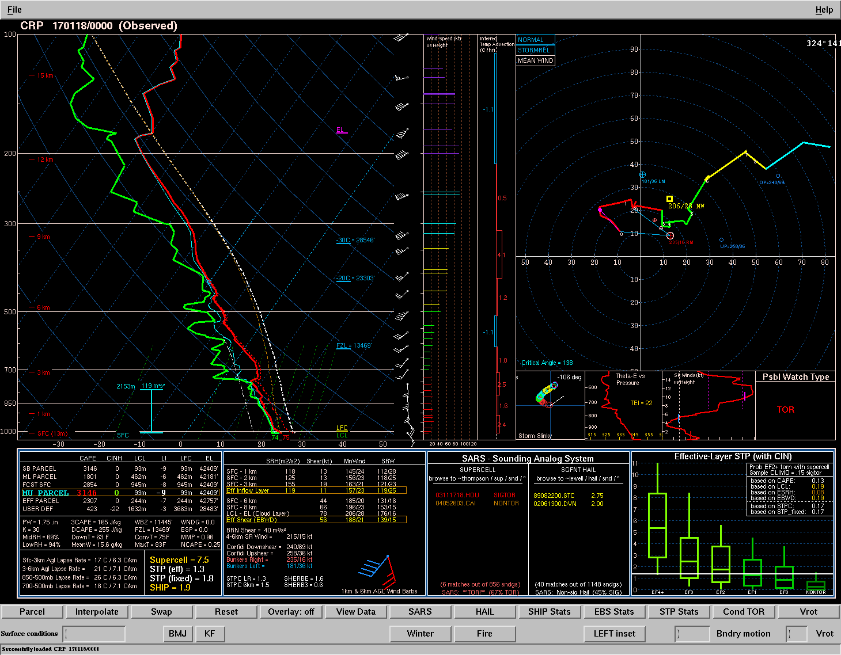
Notes:
Corpus Christi

Slide 23
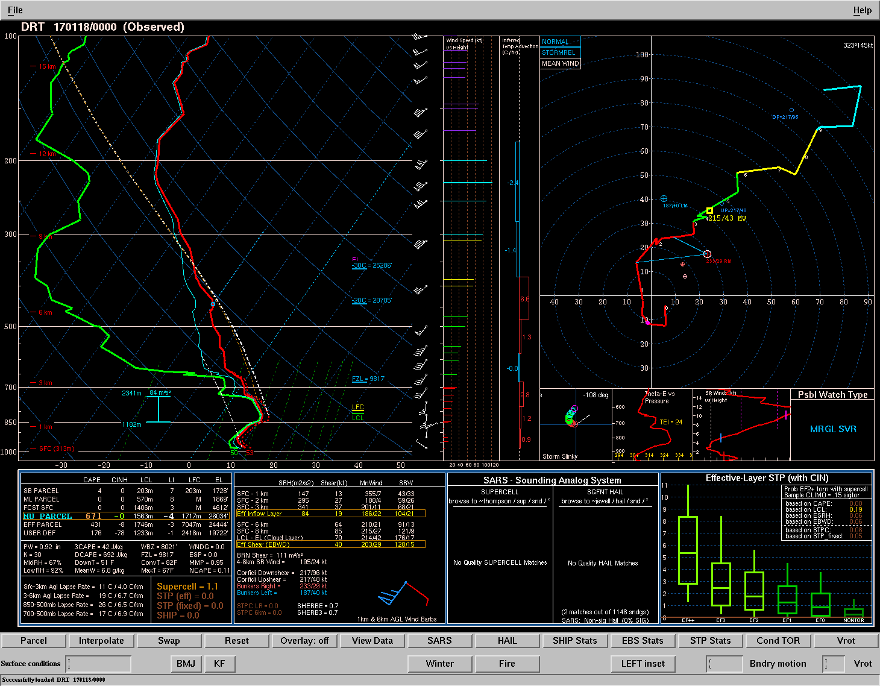
Notes:
Del Rio. Note the inversion at low levels associated with the front. Will the storm “feel” SRH in this layer?

Slide 24
Synoptic-Scale Lift Summary
Gradual ascent over many hours
  Warm advection and differential vorticity advection are primary drivers
Primary role of QG ascent is to precondition environment for convection
  Can also initiate elevated storms in regions of warm advection
  Most surface-based storms are triggered by mesoscale ascent

Slide 25
Mesoscale Lift
Focused and narrow zones of lift for minutes to hours
Fronts
  Rising on warm side with frontogenesis
  Isentropic ascent on sloped warm front
Outflow boundary
  Lift is governed by depth/strength of cold pool and low-level vertical wind shear [Rotunno-Klemp-Weisman (RKW) Theory]
Dryline
  Lift on dry/hot side (lower density air)
  Lift governed by depth of mixing west of dryline and depth of moist layer east of dryline

Slide 26
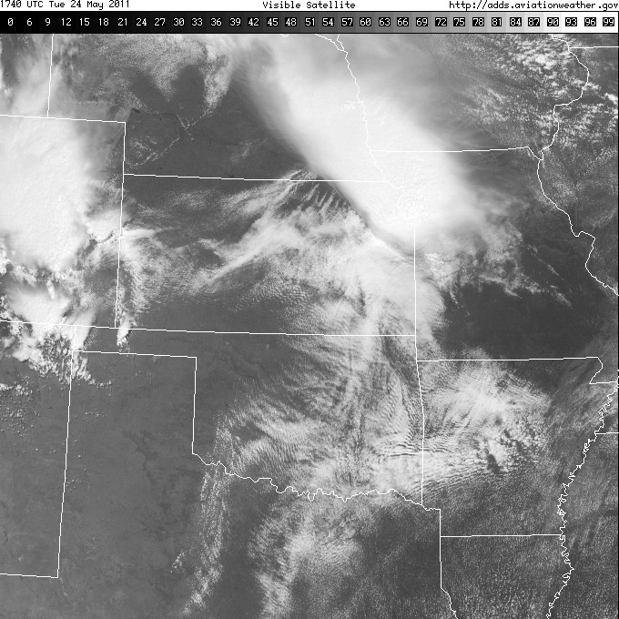

Slide 27
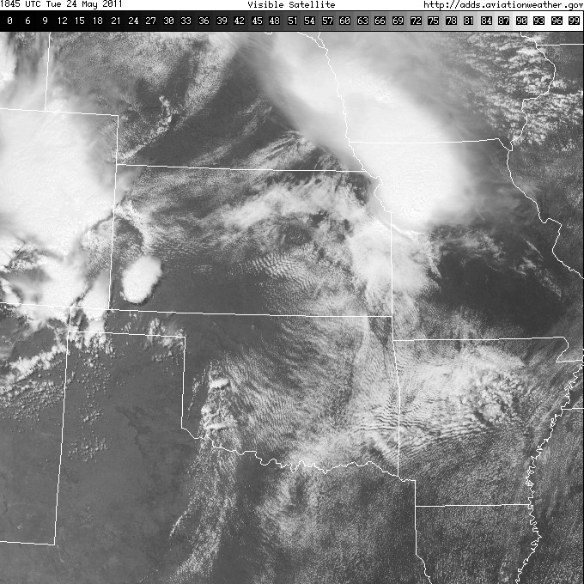

Slide 28
Dryline
Focused ascent along dryline can be ~1 m/s (~1 hour to reach LFC)
  Lift depends on depth of mixing west of dryline and depth of moist layer ahead of dryline
  Maximum vertical motion along dryline scales with height of moist layer
Convection initiation linked to the residence time of air in the zone of ascent
  Winds above the surface parallel to dryline keeps air in zone of lift longer
Convection will initiate in points or bands
  Usually the mode of initiation for surface-based supercells in central/southern Plains

Slide 29
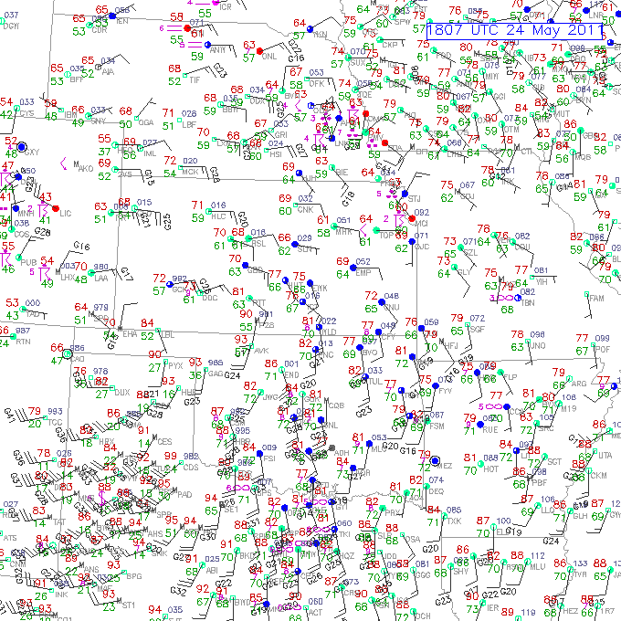
Notes:
Trajectories parallel to the dryline and stay in this zone of ascent = good!

Slide 30
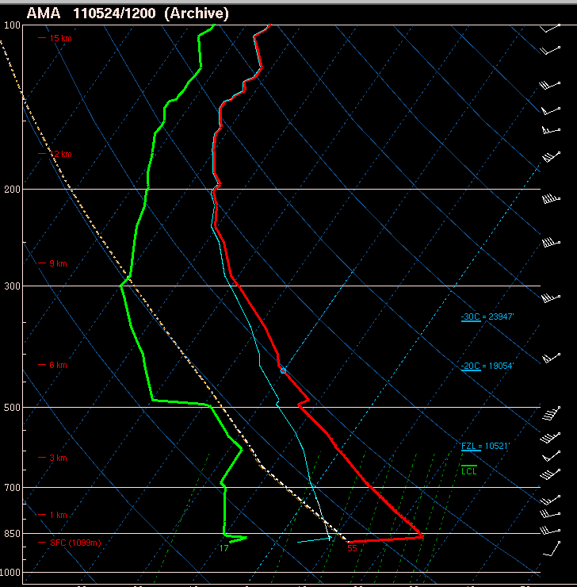

Slide 31
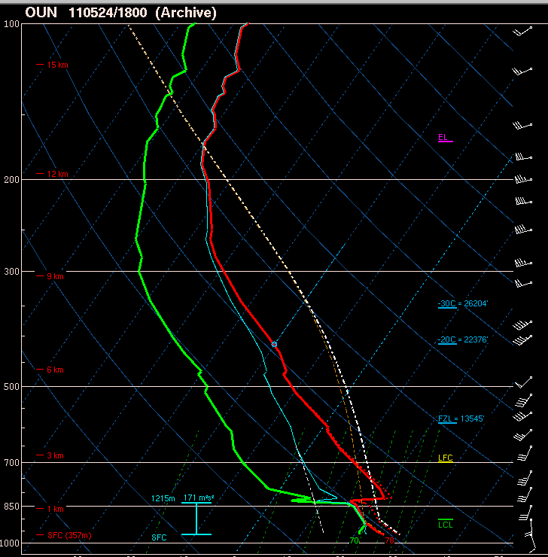
LFC is within the deep dryline circulation
Keep parcels in the zone of ascent – winds within circulation SSW (parallel to dryline)

Slide 32
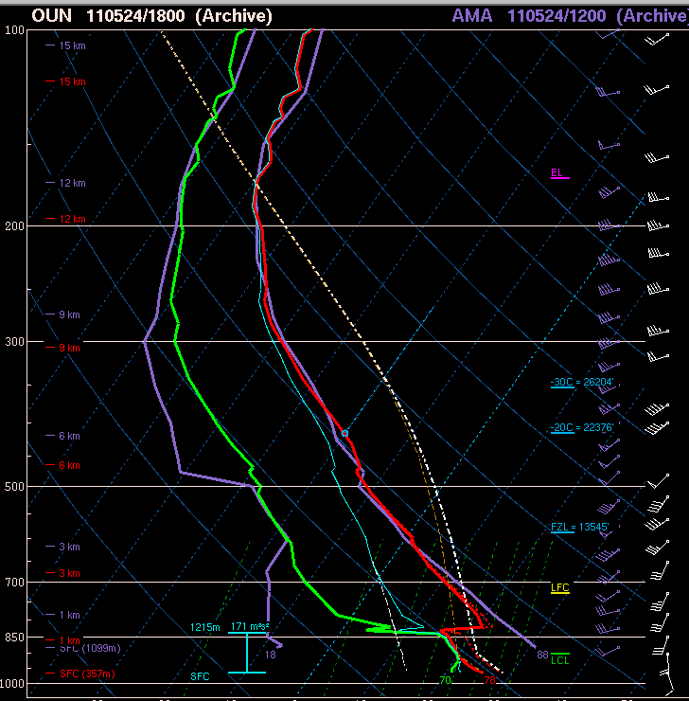

Slide 33
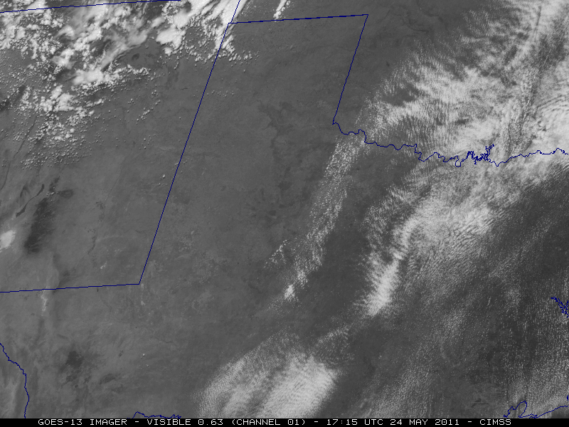

Slide 34
Moisture
Moisture in PBL needs to be large and deep enough for convection
Return flow
Inland vertical mixing/diurnal processes
Evapotranspiration

Slide 35
Low-level Moisture Return Flow
Key elements include air mass modifications over warmer water and return flow trajectories
Air mass modification is a multi-date process
Ask yourself the following:
  Where is the air coming from?
  What are the underlying ocean characteristics?
  What is the character of the returning moist layer?

Slide 36
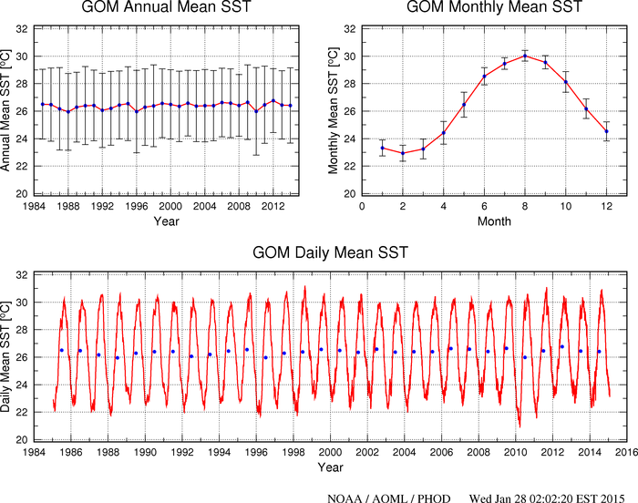

Slide 37
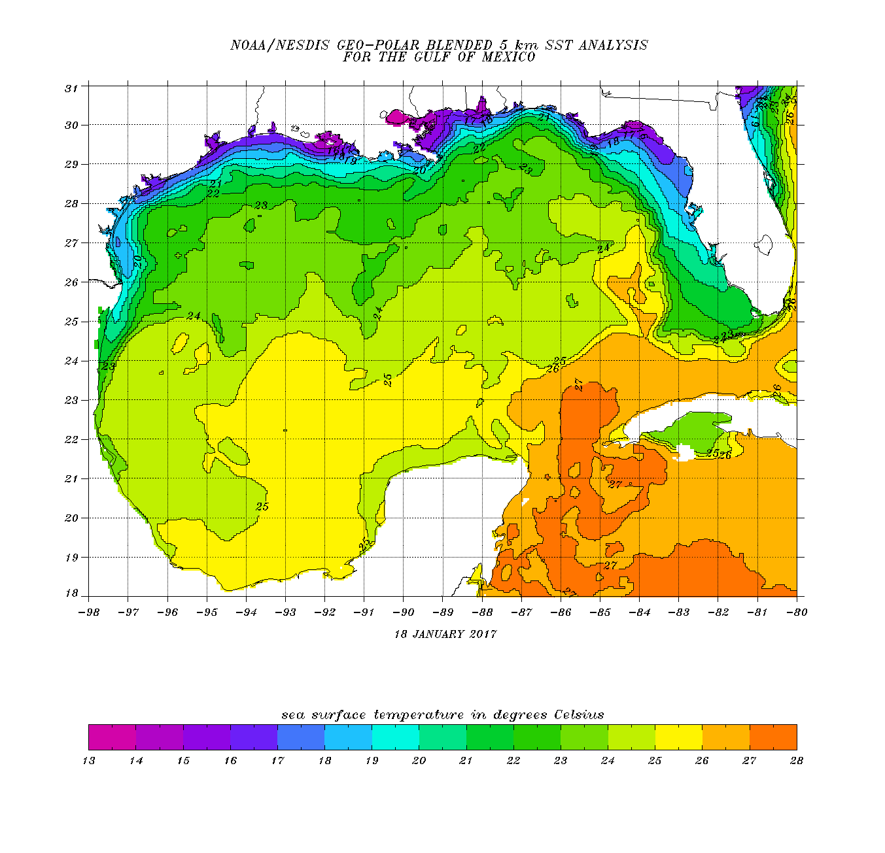
Air temperature after cold front passage
T_{a}=18C
T_{a}=19C
T_{a}=21C
T_{a}=22C
T_{a}=23C

Slide 38
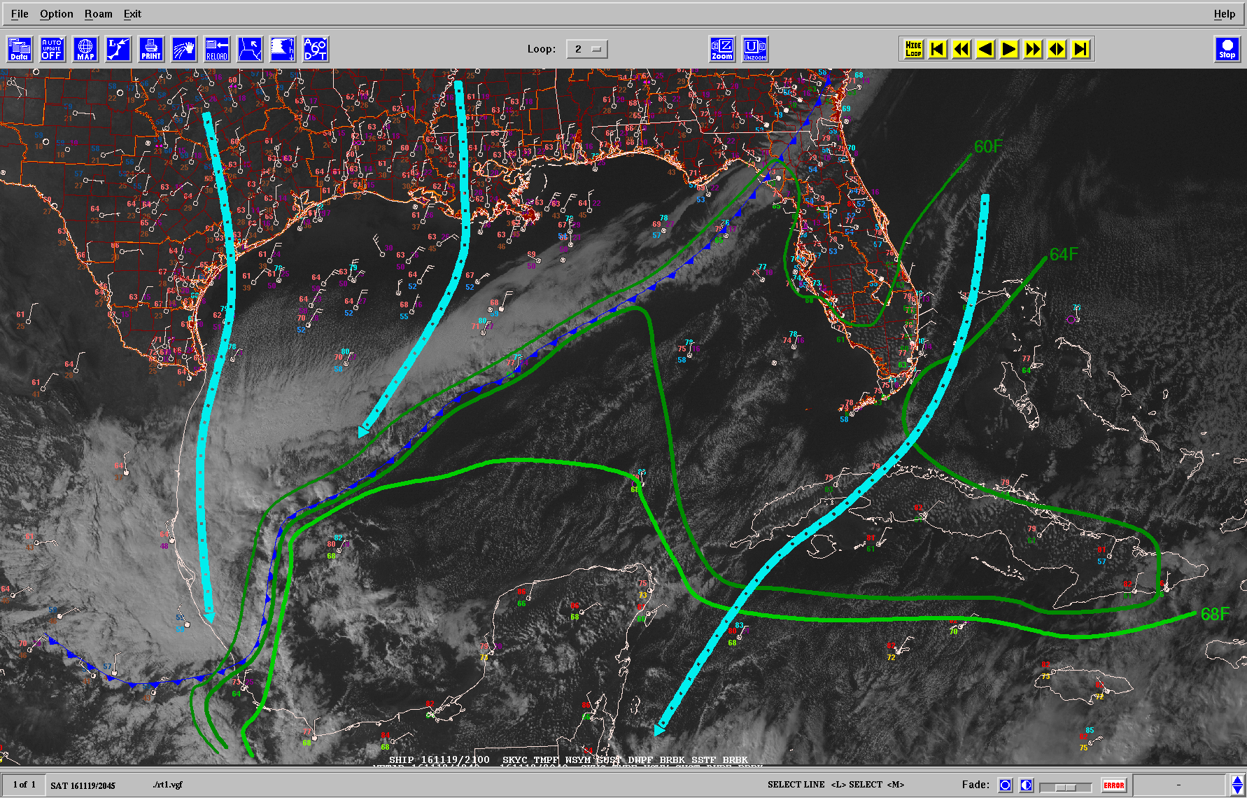
~15F ΔΤ

Slide 39
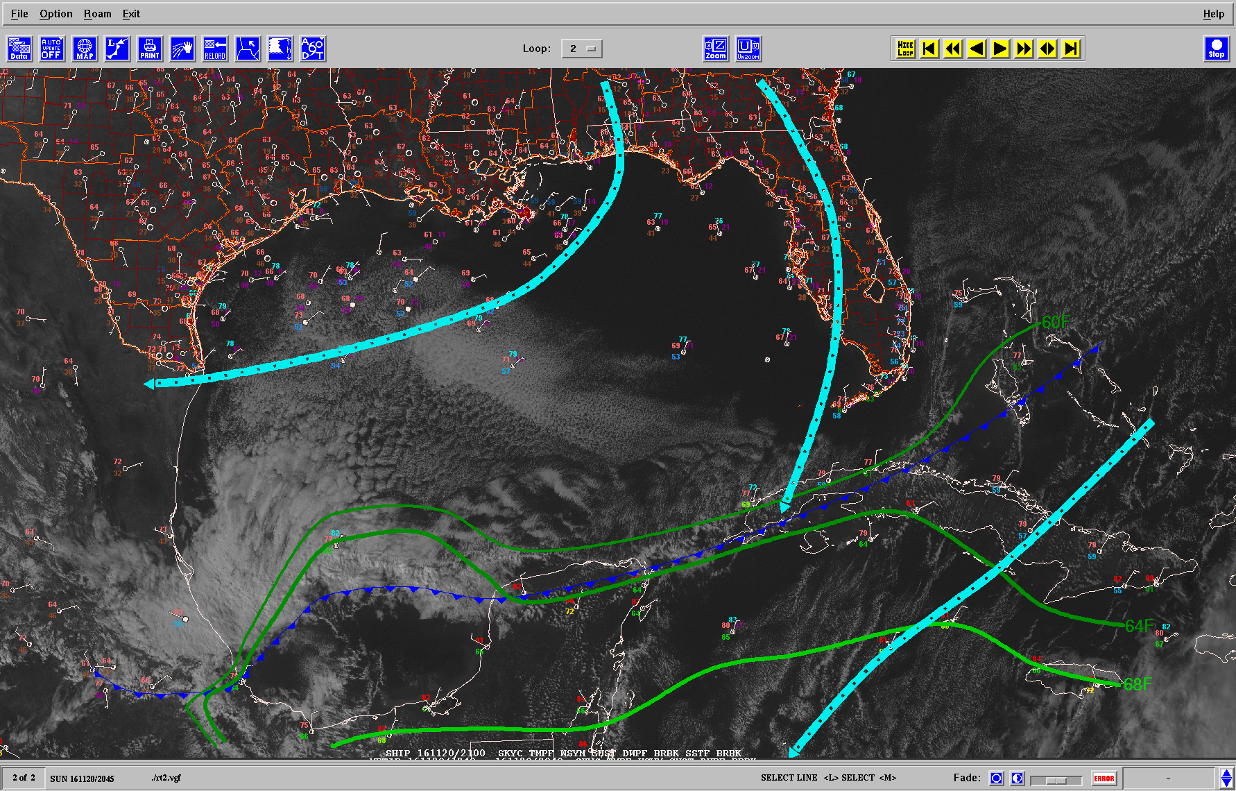
~10F ΔΤ

Slide 40
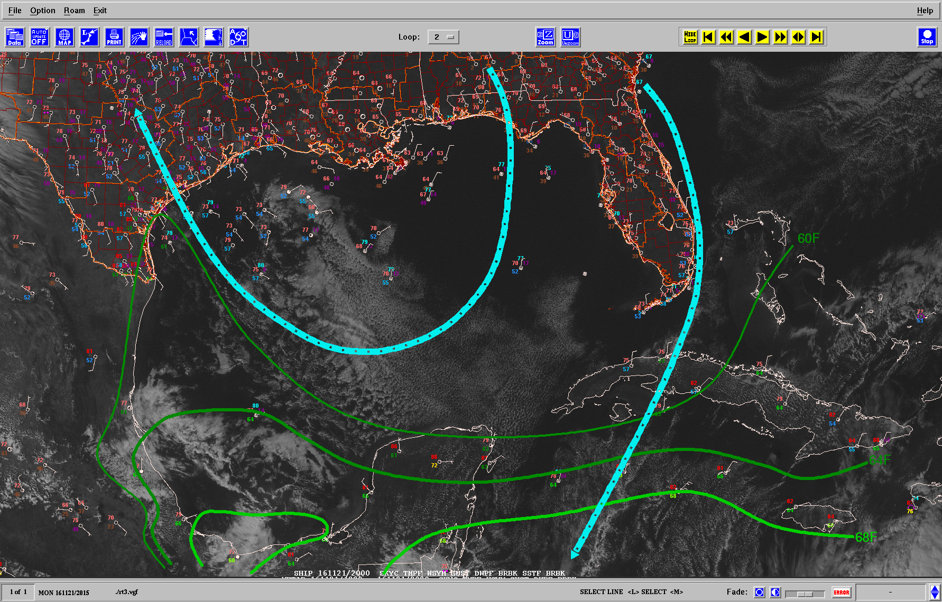
~5F ΔΤ

Slide 41
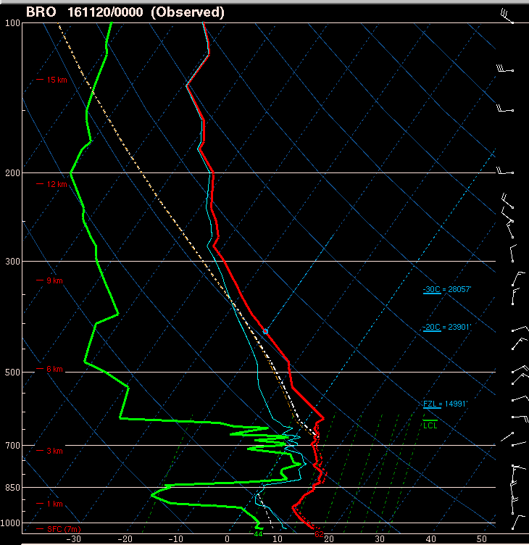
Return flow evolution

Slide 42
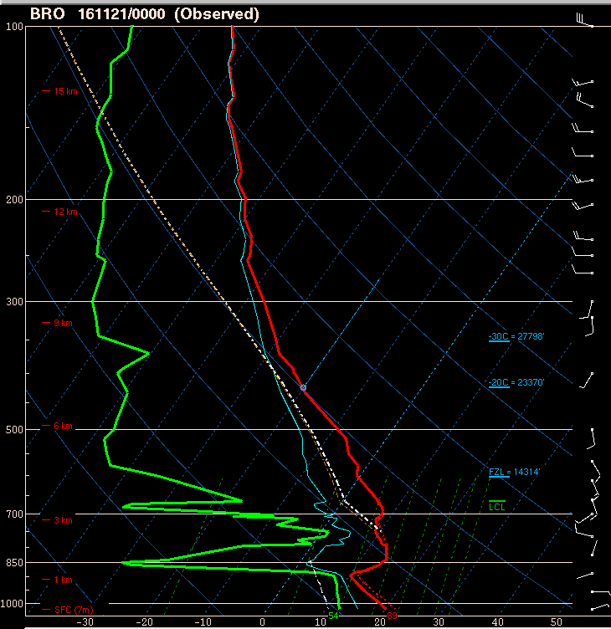

Slide 43
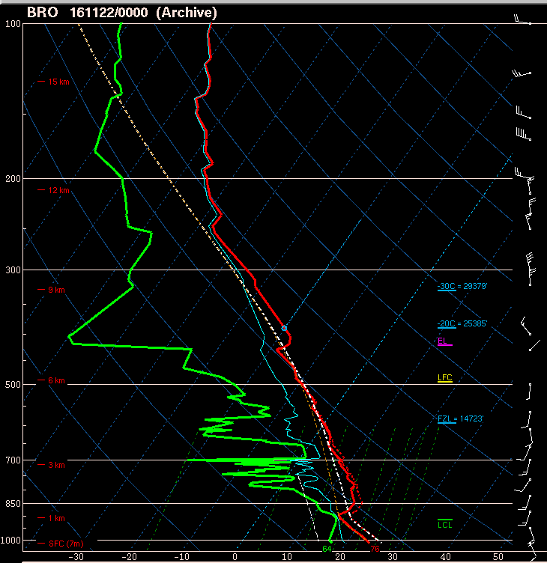

Slide 44
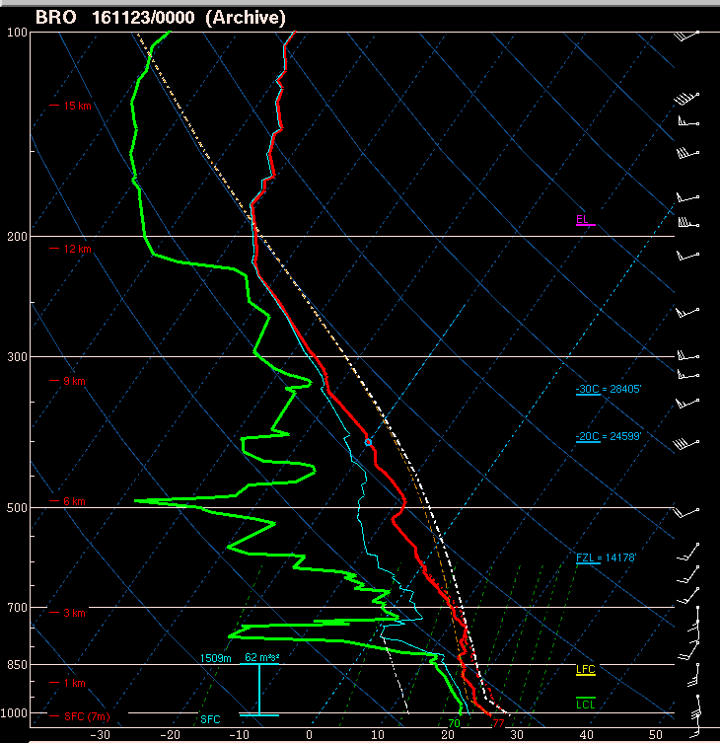

Slide 45
Inland Vertical Mixing
Surface moisture can decrease during the daytime when:
  Daytime heating/mixing extends deeper than original moist layer depth
  Moisture advection is not enough to offset mixing
  Compounded by dry soil, little green vegetation, and ongoing drought
Daytime mixing is governed by:
  Vertical moisture structure
  Height and strength of lid/cap
  Upstream moisture sources
  Local moisture sources

Slide 46
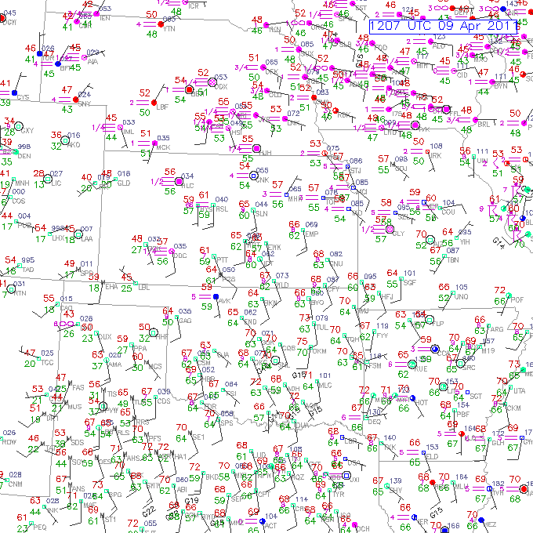
60 F
64 F

Slide 47
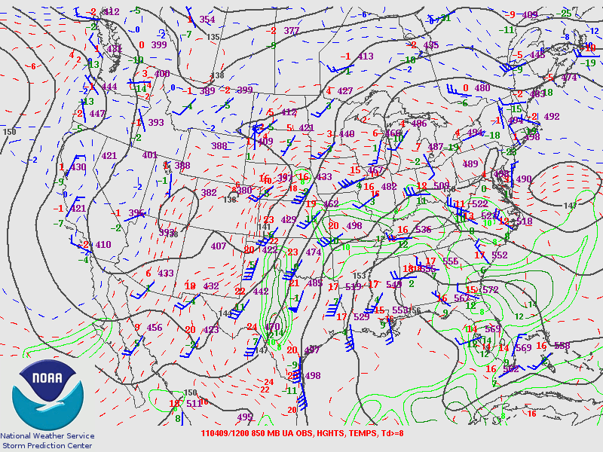

Slide 48
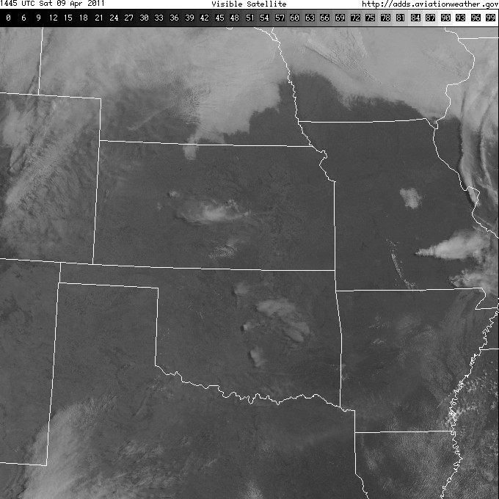
OAX
LMN
OUN

Slide 49
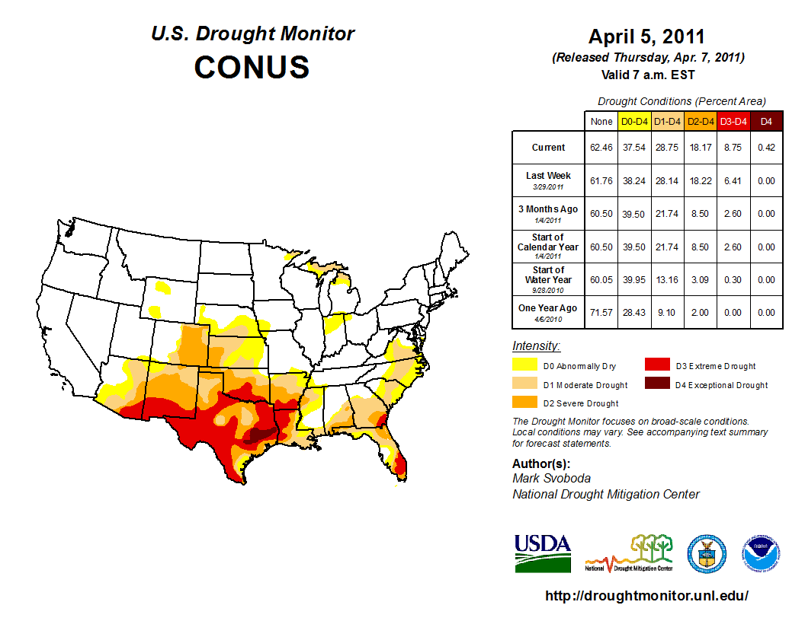
Notes:
Pretty dry in terms of drought.

Slide 50
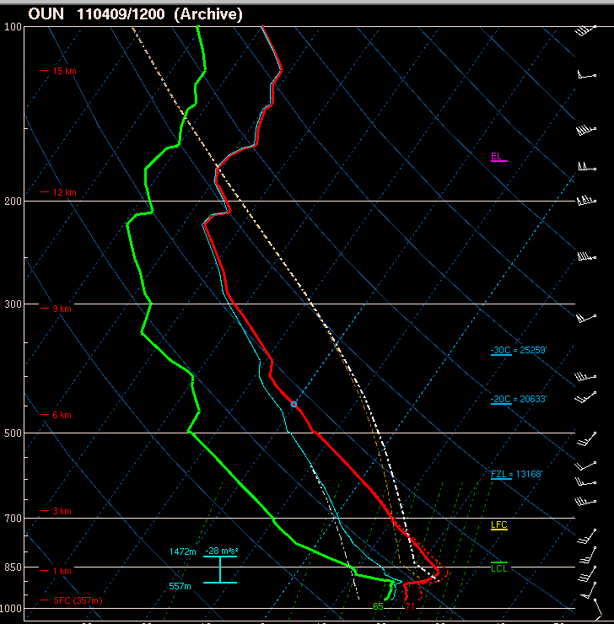
Notes:
Here’s OUN at 12z.

Slide 51
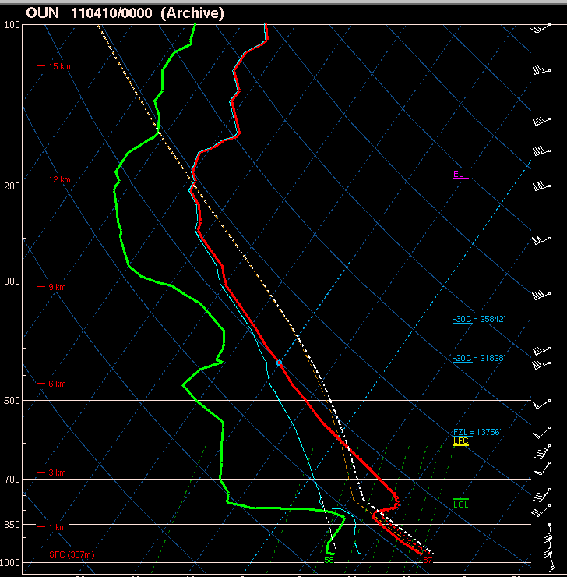
Notes:
And here’s OUN 12 hours later. Moisture mixed out due to surface conditions.

Slide 52
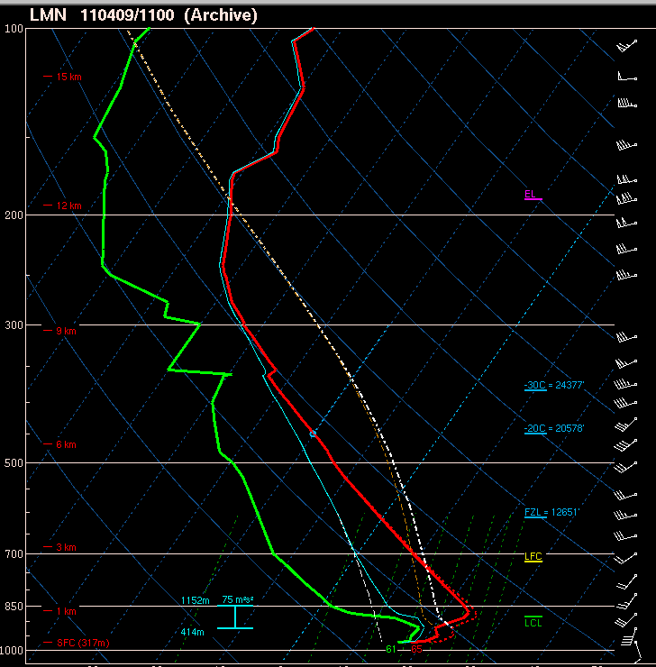

Slide 53
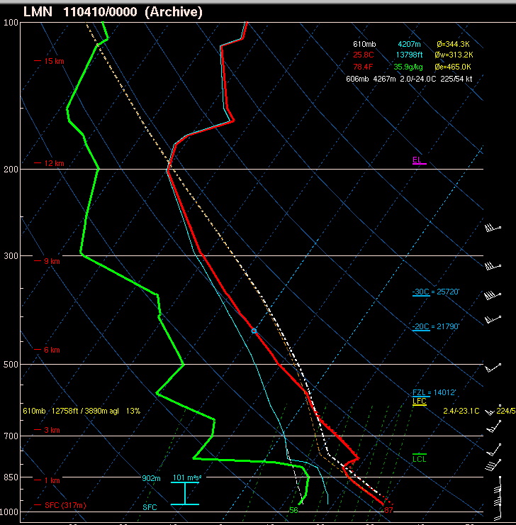

Slide 54
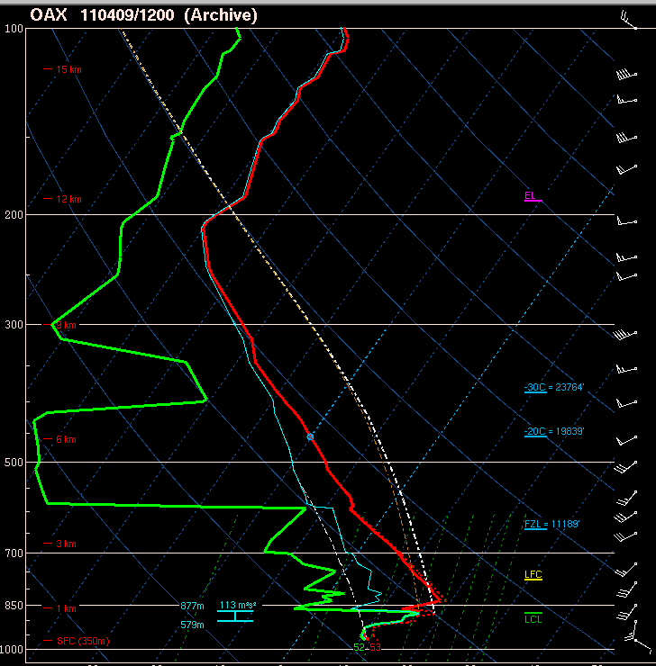

Slide 55
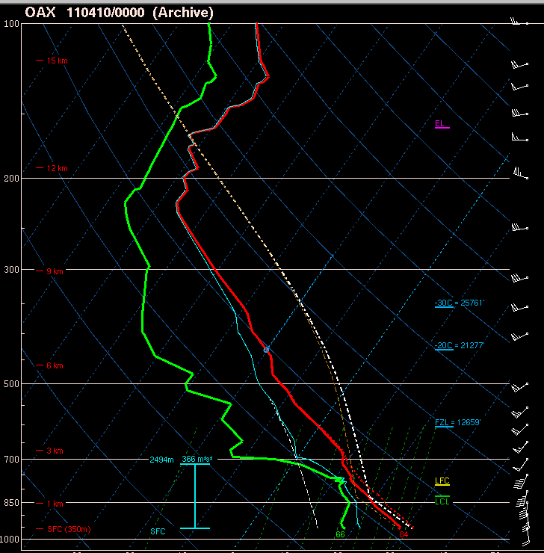
Notes:
Remember, drought wasn’t as bad up in this region, so moisture “sticks around” in the BL.

Slide 56
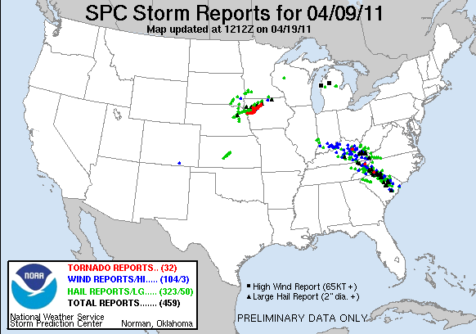
Notes:
Where was the big storm of the day? Up north of the drought conditions.

Slide 57
Evapotranspiration
Need moist soil and growing vegetation
Plentiful rain previous 1-2 weeks
Maturing crops (wheat, corn, or canola)
Capped boundary layer to trap moisture; relatively weak winds
Almost always a significant return flow contribution (in addition)

Slide 58
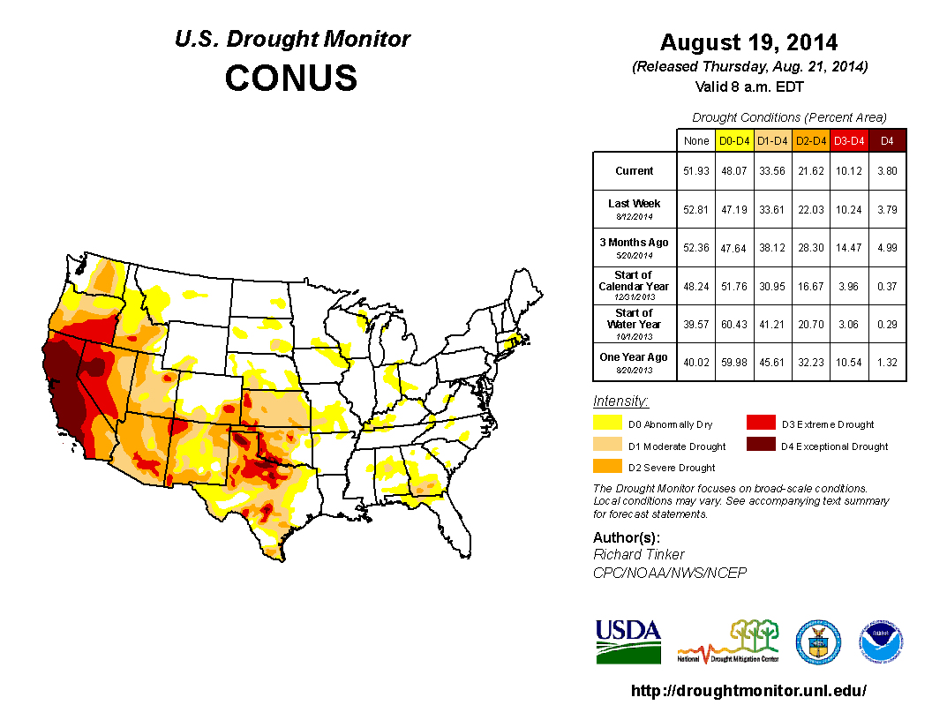

Slide 59
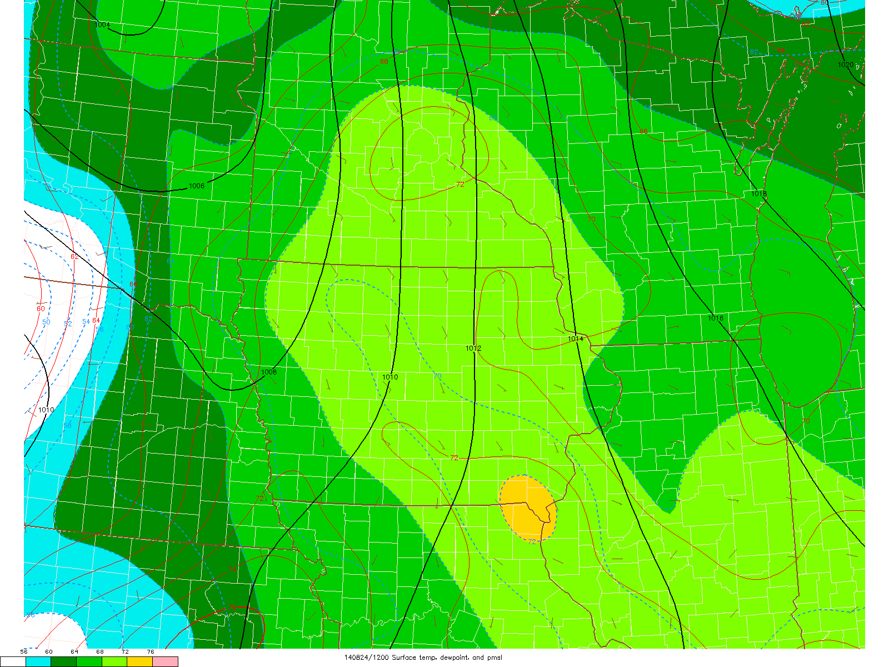

Slide 60
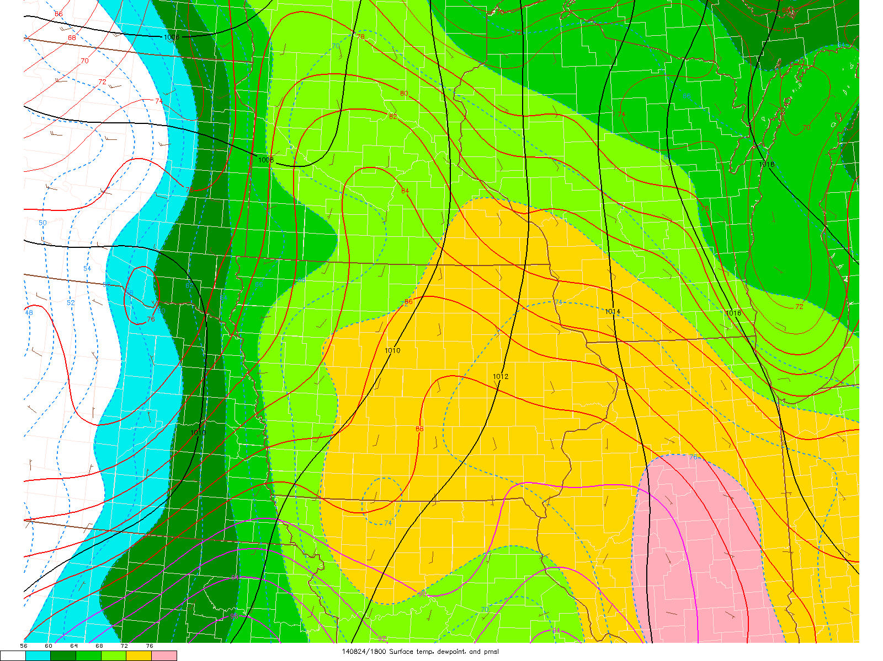

Slide 61
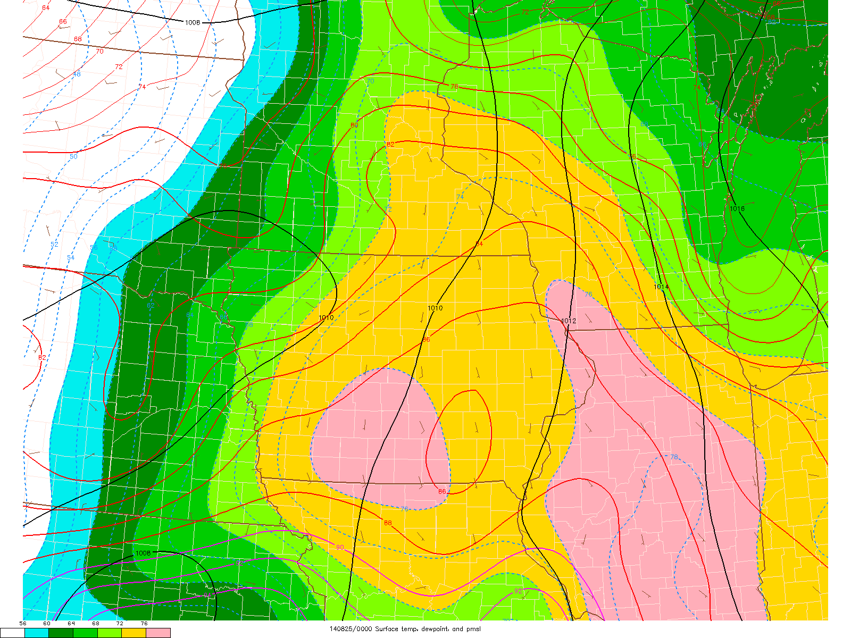

Slide 62


Slide 63


Slide 64


Slide 65


Slide 66
Lee Cyclogenesis
Midlevel flow crosses high terrain:
  Subsidence and warming E of mountains
  Warming of column leads to “warm core” low formation
  Strongest pressure falls with strongest flow crosses highest terrain
The lee trough/cyclone deepens before arrival of strongest Q-G forcing for ascent:
  Head start on differential advection, “loaded gun” sounding, and veering winds with height

Slide 67


Slide 68

Lee Cyclogenesis
Mid-level flow crosses high terrain:
  Subsidence and warming E of mountains
  Stronger diabatic heating across slope results in rising motion from induced katabatic flow. (Frontogenesis)
  Warming of column and rising motion leads to “warm core” low formation
  Strongest pressure falls with strongest flow crosses highest terrain
The lee trough/cyclone deepens before arrival of strongest Q-G forcing for ascent: (More QG Later)
  Head start on differential advection, “loaded gun” sounding, and veering winds with height
Background U and downslope
L

Slide 69

Lee Cyclogenesis PV Framework
Conservation of Potential Vorticity
  Assumptions:
    Constant density/stable
    Adiabatic
    Frictionless
Stretching of the column vertically requires an increase in relative vorticity between the theta surfaces inducing positive vorticity.
Stretching also lowers the static stability of the atmosphere. easier to spin and lift
ΔZ small Zeta is also small little spin
Θ+𝝙Θ
U
L
ΔZ is large Zeta also has to be large. Big Spin!
Θ

Slide 70


Slide 71


Slide 72

L

Slide 73

L

Slide 74
Nocturnal Low-Level Jet (LLJ)
Plains often see early nocturnal low-level jet (LLJ) ramp up with lee cyclogenesis
Related to two primary factors:
  Boundary-layer decoupling and loss of surface friction (“inertial oscillation”)
  Diurnal temperature variations over sloped terrain (thermal wind)
Part of the process that can favor late evening/early overnight tornadoes (with favorable moisture/CAPE)

Slide 75

Nocturnal Low-Level Jet (LLJ) Formation
LLJs form in response to difference in terrain heights, heat fluxes and thickness across pressure surfaces that induces a horizontal Pressure Gradient Force.
Coriolis forcing turns the momentum northward resulting in an enhanced southerly flow.
Surface decoupling favors lower friction and acceleration of the jet above the surface
Lee Cyclones can also enhance it by increasing the PGF.
850 mb
Constant geopotential Height
PGF
850 mb
Lower
Thickness
Higher
Thickness
V++
Surface decoupling lower friction

Slide 76


Cyclone induced Low-Level Jet (LLJ) Formation
LLJs form in response to difference in heat fluxes and thickness across pressure surfaces that induces a horizontal Pressure Gradient Force.
Coriolis forcing turns the momentum northward resulting in an enhanced southerly flow.
Surface decoupling favors lower friction and acceleration of the jet above the surface
Lee Cyclones can also enhance it by increasing the PGF.
L
850 mb
Constant geopotential Height
PGF
850 mb
Lower
Thickness
and pressure
Higher
Thickness
Cold Front
V++
Surface decoupling lowers friction at night

Slide 77

EF2+ supercell events
Nontornadic supercell events

Slide 78
Lee Cyclogenesis Summary
Lee cyclogenesis occurs where upper-level flow is perpendicular to terrain features (westerly flow for Rockies)
Lee cyclogenesis more robust with lower static stability
Lee cyclone helps drive low-level moisture return AND vertical windshear (more later)
Nocturnal low-level jet associated with lee cyclone is driven by inertial oscillation and thermal wind → increased low-level shear and tornado threat in evening and after dark if adequate CAPE

