Slide 1

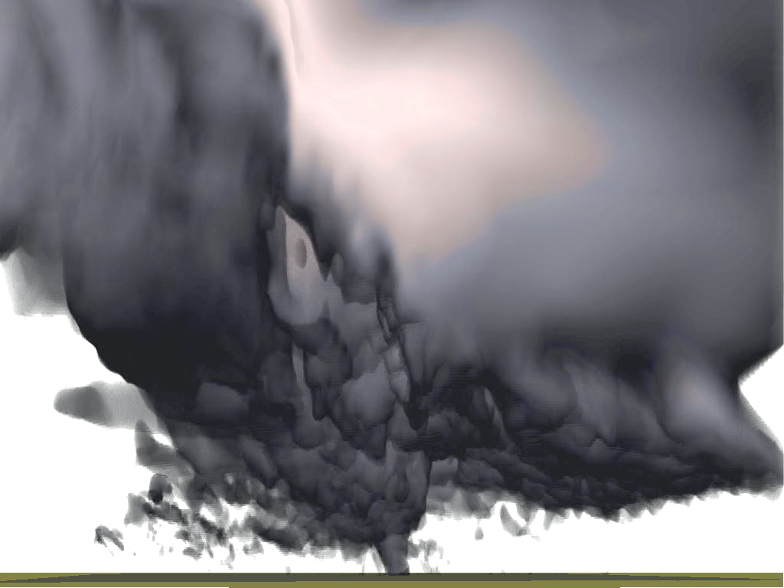

Huang, W., and M. Xue, 2023: Sub-vortices within a numerically simulated real-case tornado: The role of vortex Rossby waves. J. Atmos. Sci., 80, 2503 - 2529. https://doi.org/10.1175/JAS-D-22-0237.1.
Sub-vortices within a numerically simulated real-case tornado: The role of vortex Rossby waves
MingXue
Center for Analysis and Prediction of Storms and School of Meteorology
University of Oklahoma
ARPS模拟龙卷（Xue 2004）

Slide 2
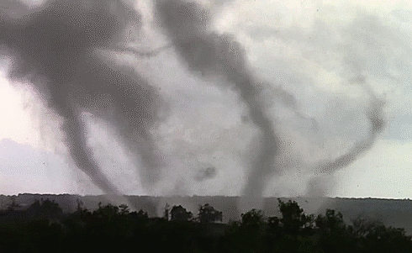
Multi-Vortex Tornado

Slide 3
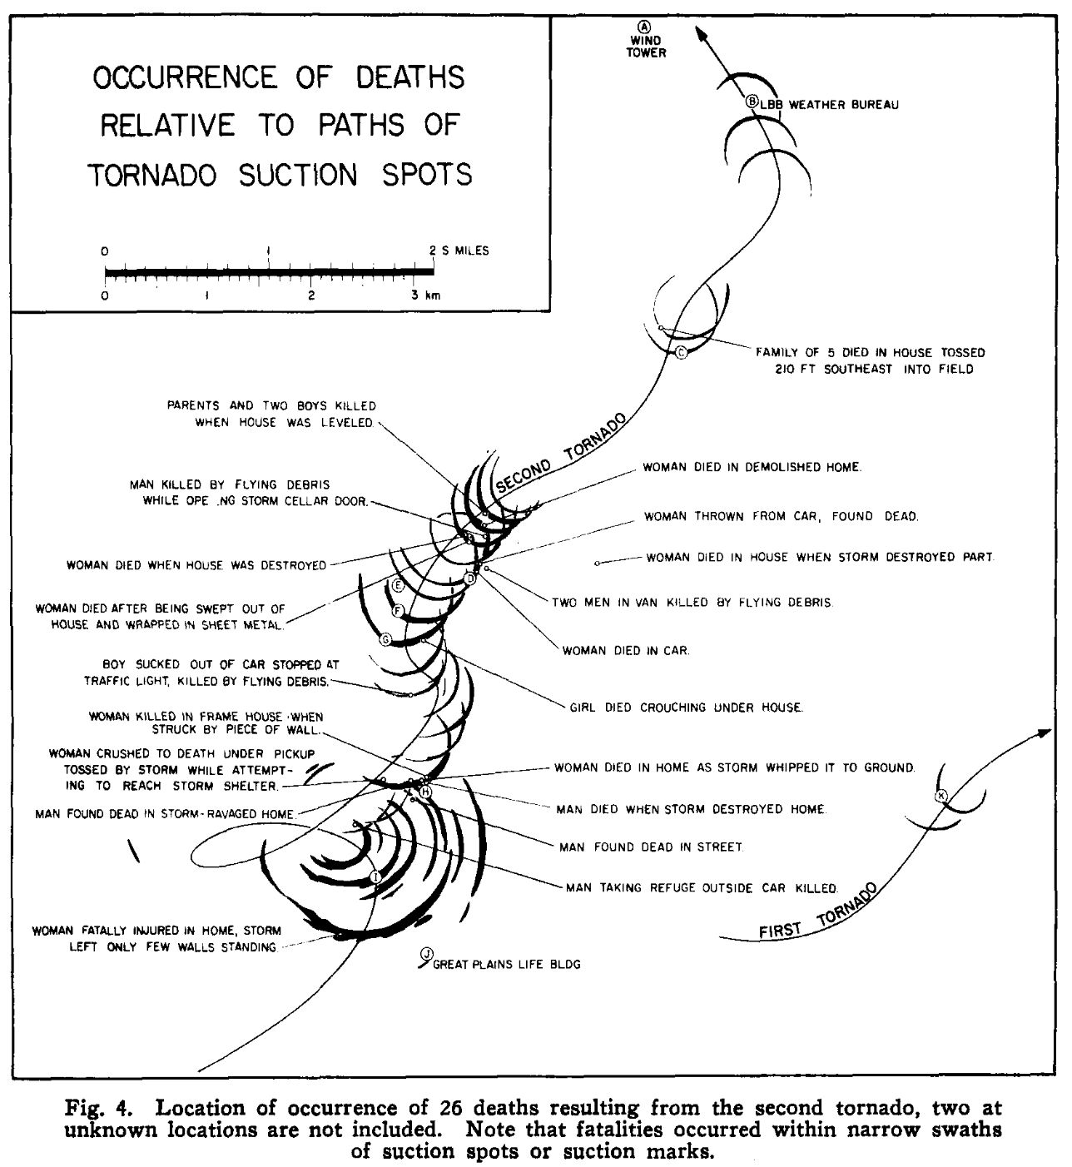
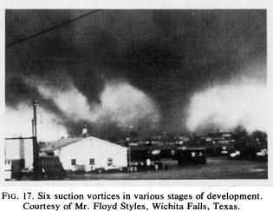
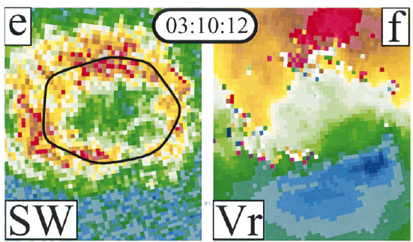
Background
”suction marks” made by suction sub-vortcies
Fujita (1981) first photographed multi-vortex tornado that contained 6个 sub-vortices, that he called suction vortices.
Sub-vortices had been observed by mobile Doppler radars (Wurman 2002; Alexander and Wurman 2005; Bluestein et al. 2003; Lee and Wurman 2005; Kosiba and Wurman 2010)。
The strongest wind damages are often associated with sub-vortices.
Vorticity ring
sub-vortices
Fujita (1970) The Lubbock Tornadoes: A Study of Suction Spots, Weatherwise, 23, 161-173。
Fujita (1981)
Wurman (2002)

Slide 4
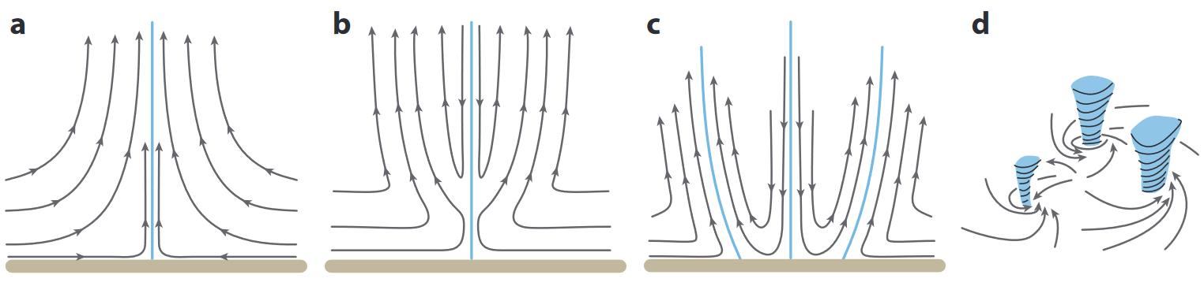
One-cell
Two-cell
Multiple vortices
Swirl ratio(~ tangential wind/radial inflow-w) increases from left to right (Davies-Jones 1986)
Inertial instability (Church et al. 1977; Snow 1978)
Earlier idealized studies suggested some possible mechanisms for sub-vortex formation but no well accepted theory
Cylindrical vortex sheet instability (Rotunno 1978)
Barotropic instability (Staley and Gall 1979; Gall 1983; Walko and Gall 1984)
Notes:
b不需要

Slide 5
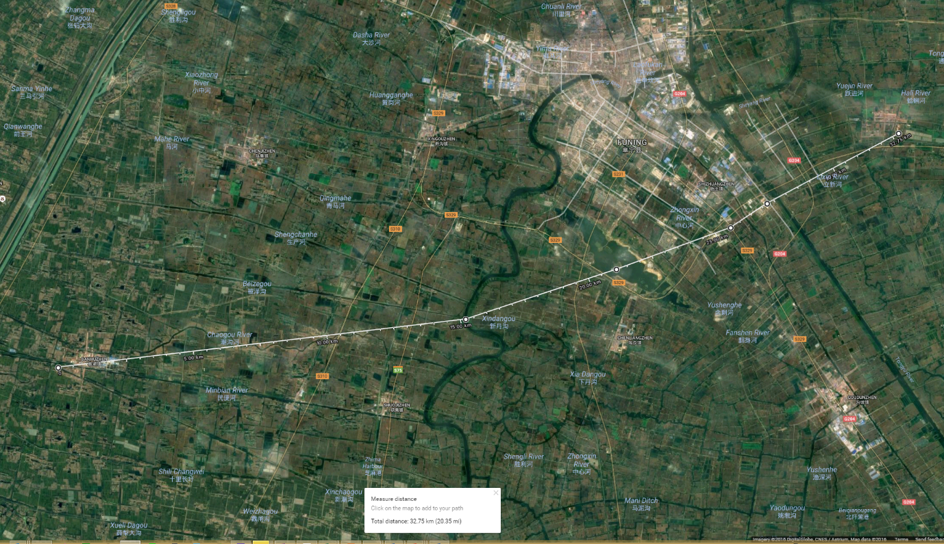
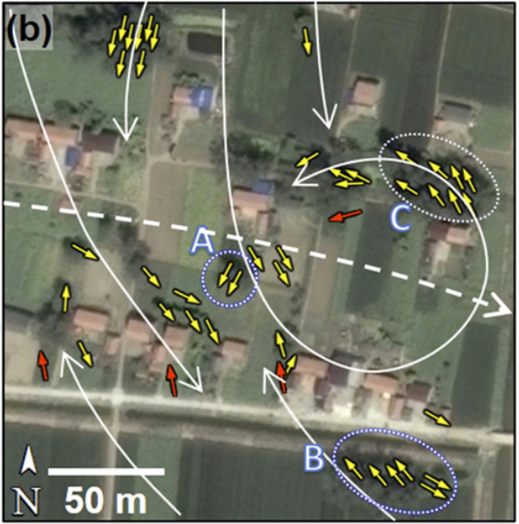
An EF4 supercell tornado occurred in Funing, Jiangsu Province of China on June 23, 2016 that caused 99 death.
It tracked ~35 km and was as wide as 4.5 km.
Meng et al. (2018) documented irregular damages paths and suggest the presence of sub-vortices
阜宁县
~35 km long, up to 4.5 km wide
Meng et al. (2018)
Notes:
阜宁龙卷破坏情况和基本信息给出文本，个例介绍

Slide 6
Over-laid 10-m vertical vorticity on 49 m grid
10-m wind vectors, wind speed (color) and vertical vorticity (contours)
Over-laid 10-m horizontal wind speed on 49 m grid
Sun，Xue et al (AR 2019) simulated the case using WRF with 5-levels of nested grids down to 49 m, and obtained well developed multi-vortices
The multi-vortices were analyzed to seek understanding of their causes.
Notes:
实验不需要给那么多信息，介绍嵌套层数，最内层分辨率。表格换成文本。模拟出来的龙卷路径和

Slide 7
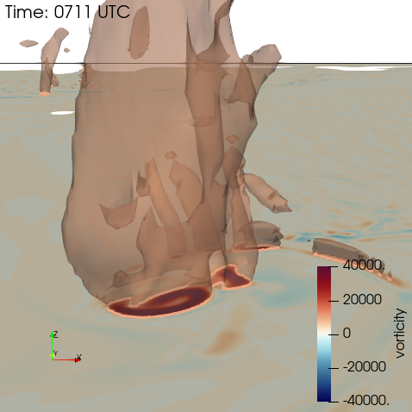
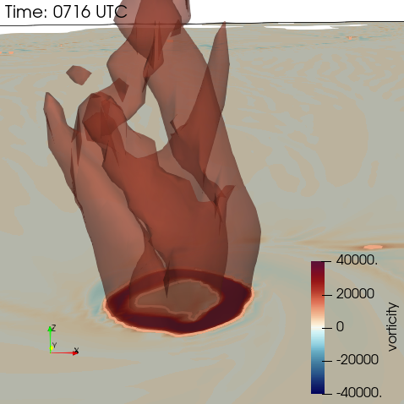
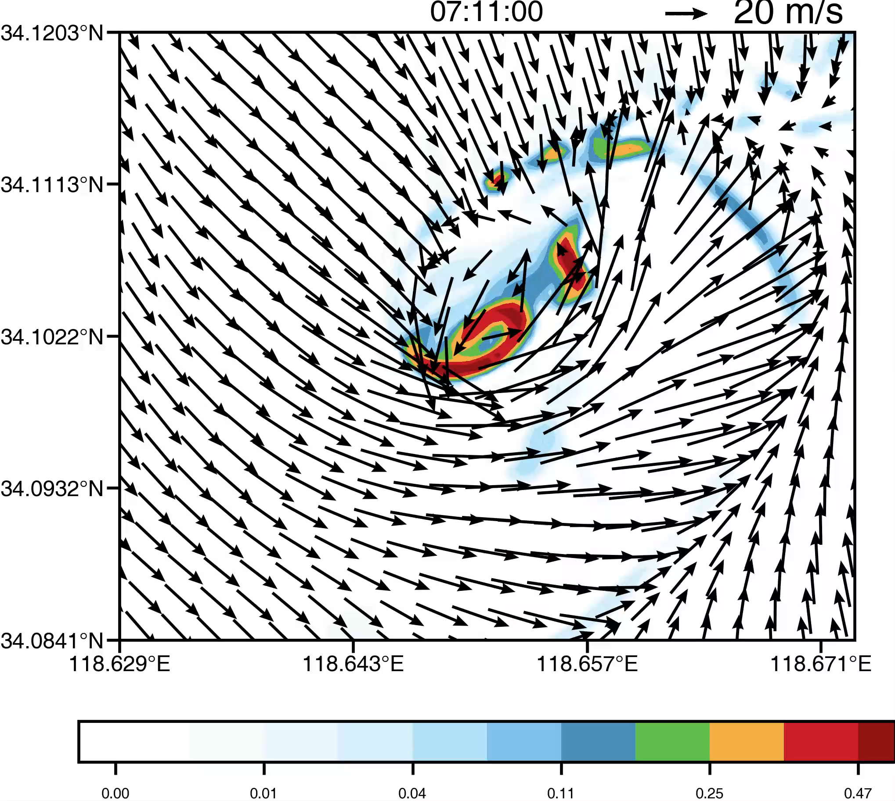
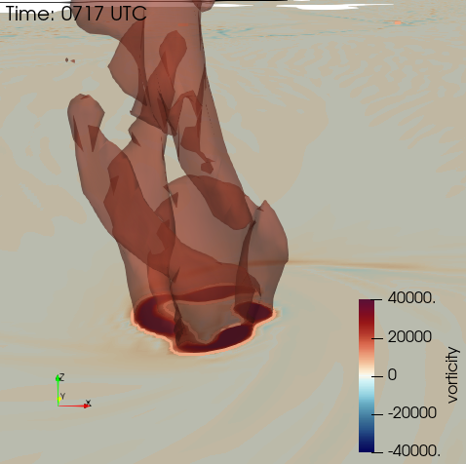
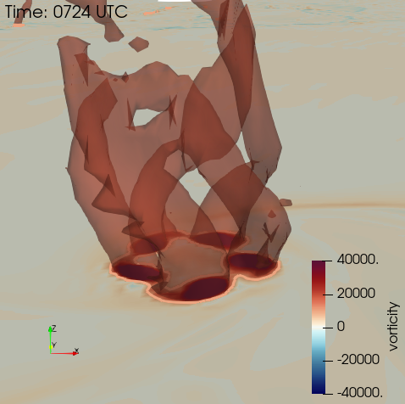
Iso-surfaces of vertical vort + sfc vertical vort.
Simulated vertical vorticity
Vorticity ring
Four sub-vortices
Five sub-vortices

Slide 8
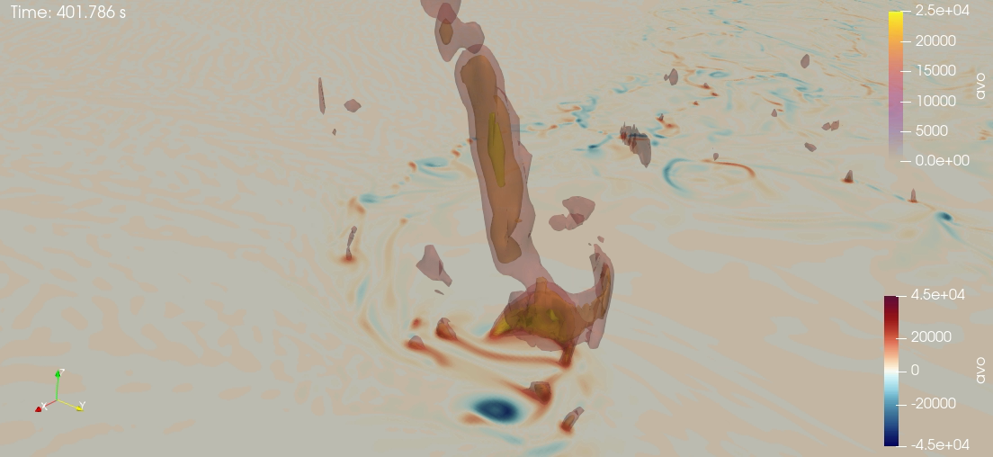
Vertical vorticity isosurfaces
one-cell (Vort max at center)
two-cell (vorticity ring)
5 sub-vortices
Notes:
先show 2D的龙卷演变的过程，再3D。2D animation + 3D 单个时刻的 (4个时刻)

Slide 9
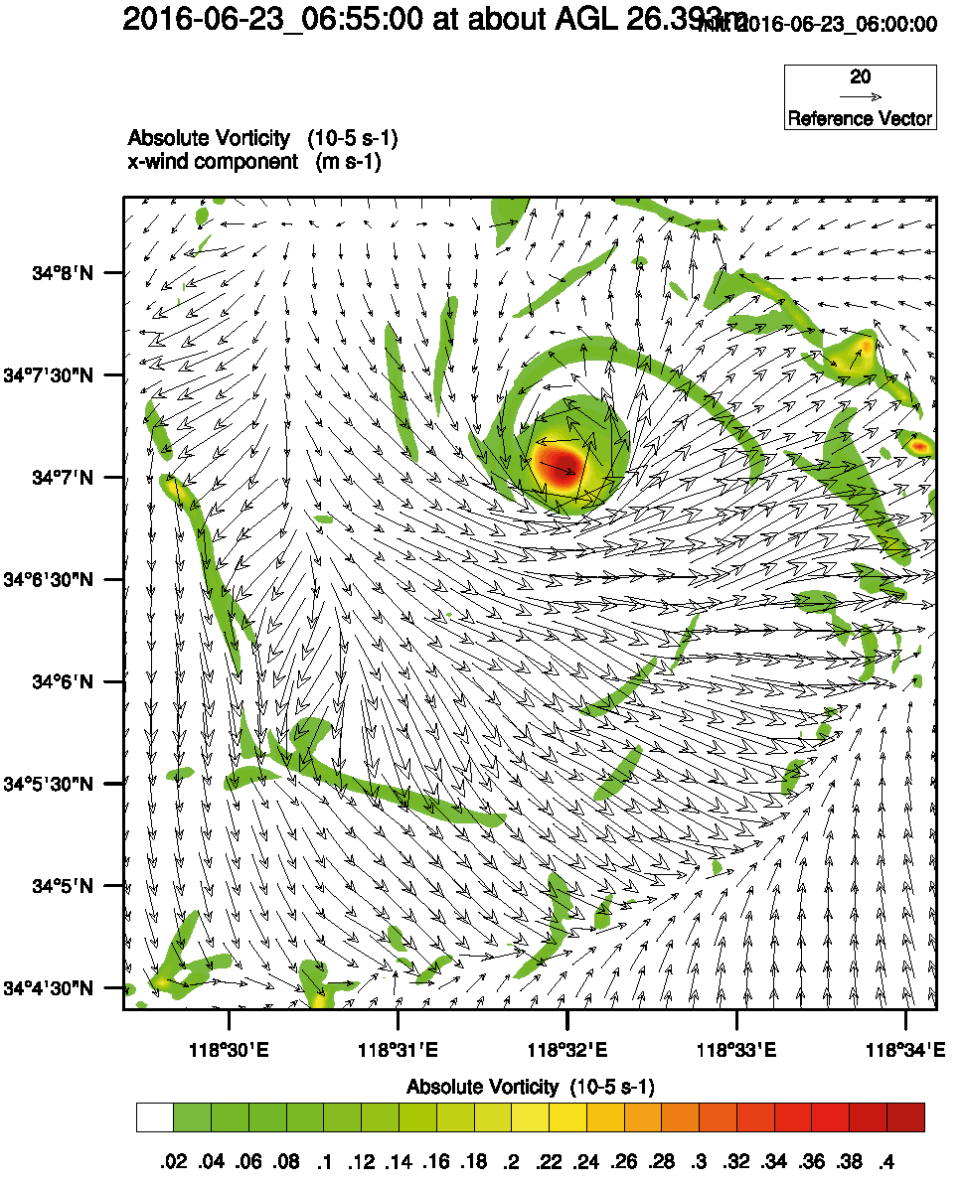
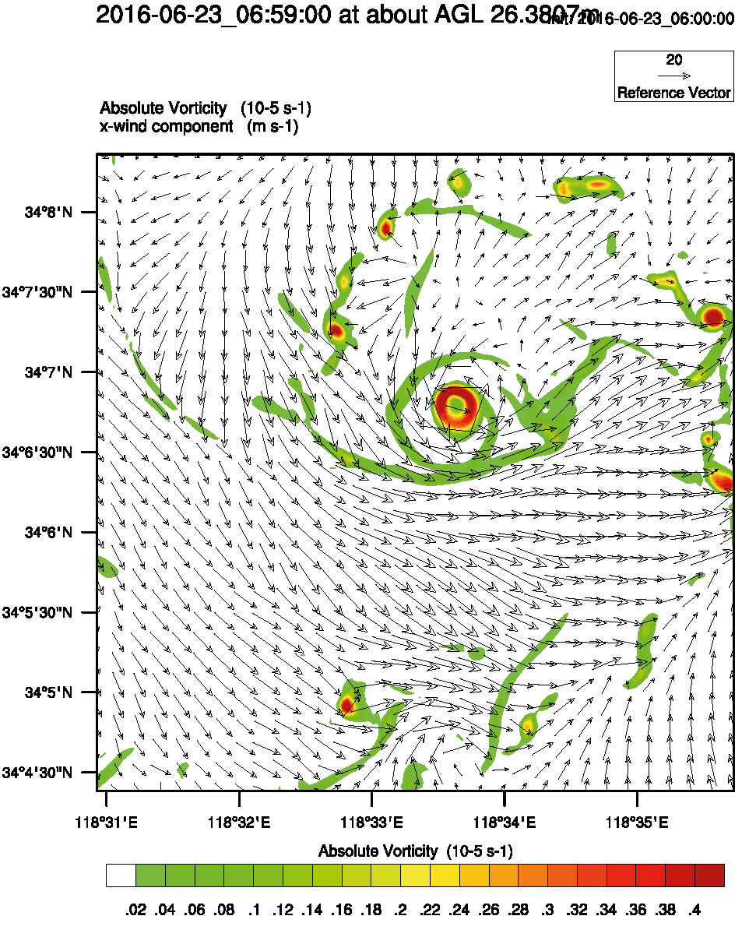
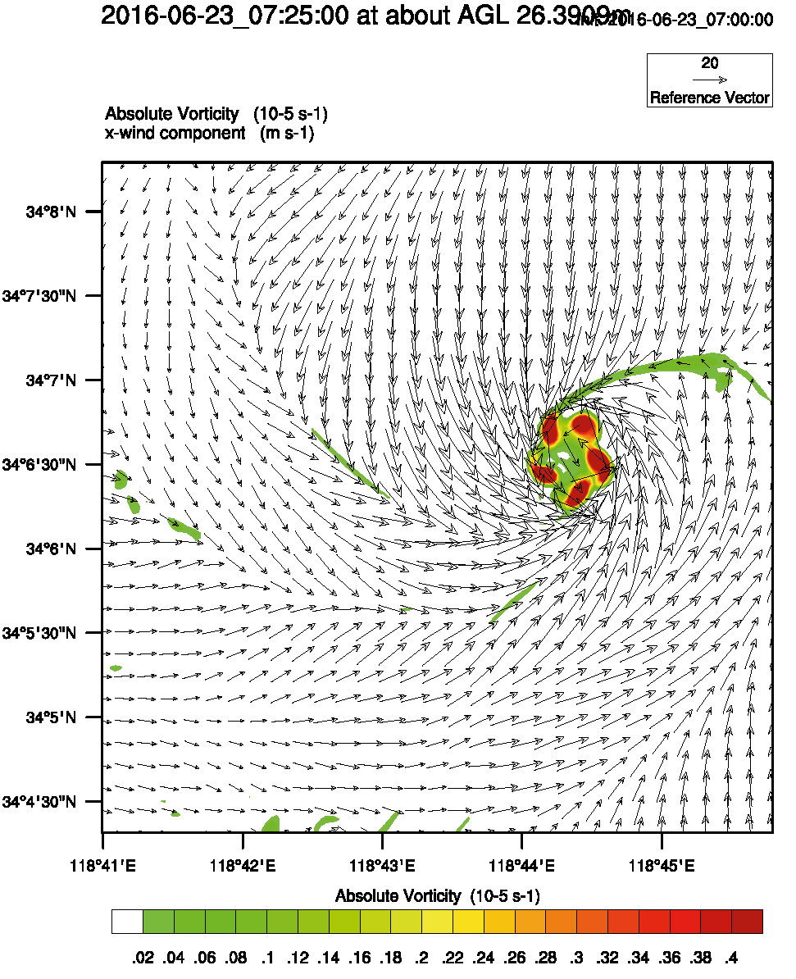
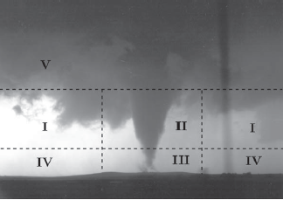
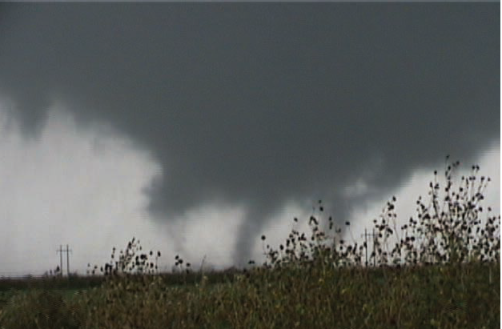
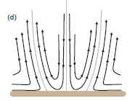
Three stages of simulated tornado
06:55 UTC 06:59 UTC 07:25 UTC
One-cell tornado Two-Cell tornado Multi-Vortices
Notes:
模拟的龙卷经历了生命史3个不同阶段（单细胞，双细胞，多涡旋），这样的模拟结果将被用于深入细致的诊断分析，以揭示龙卷形成机理。

Slide 10
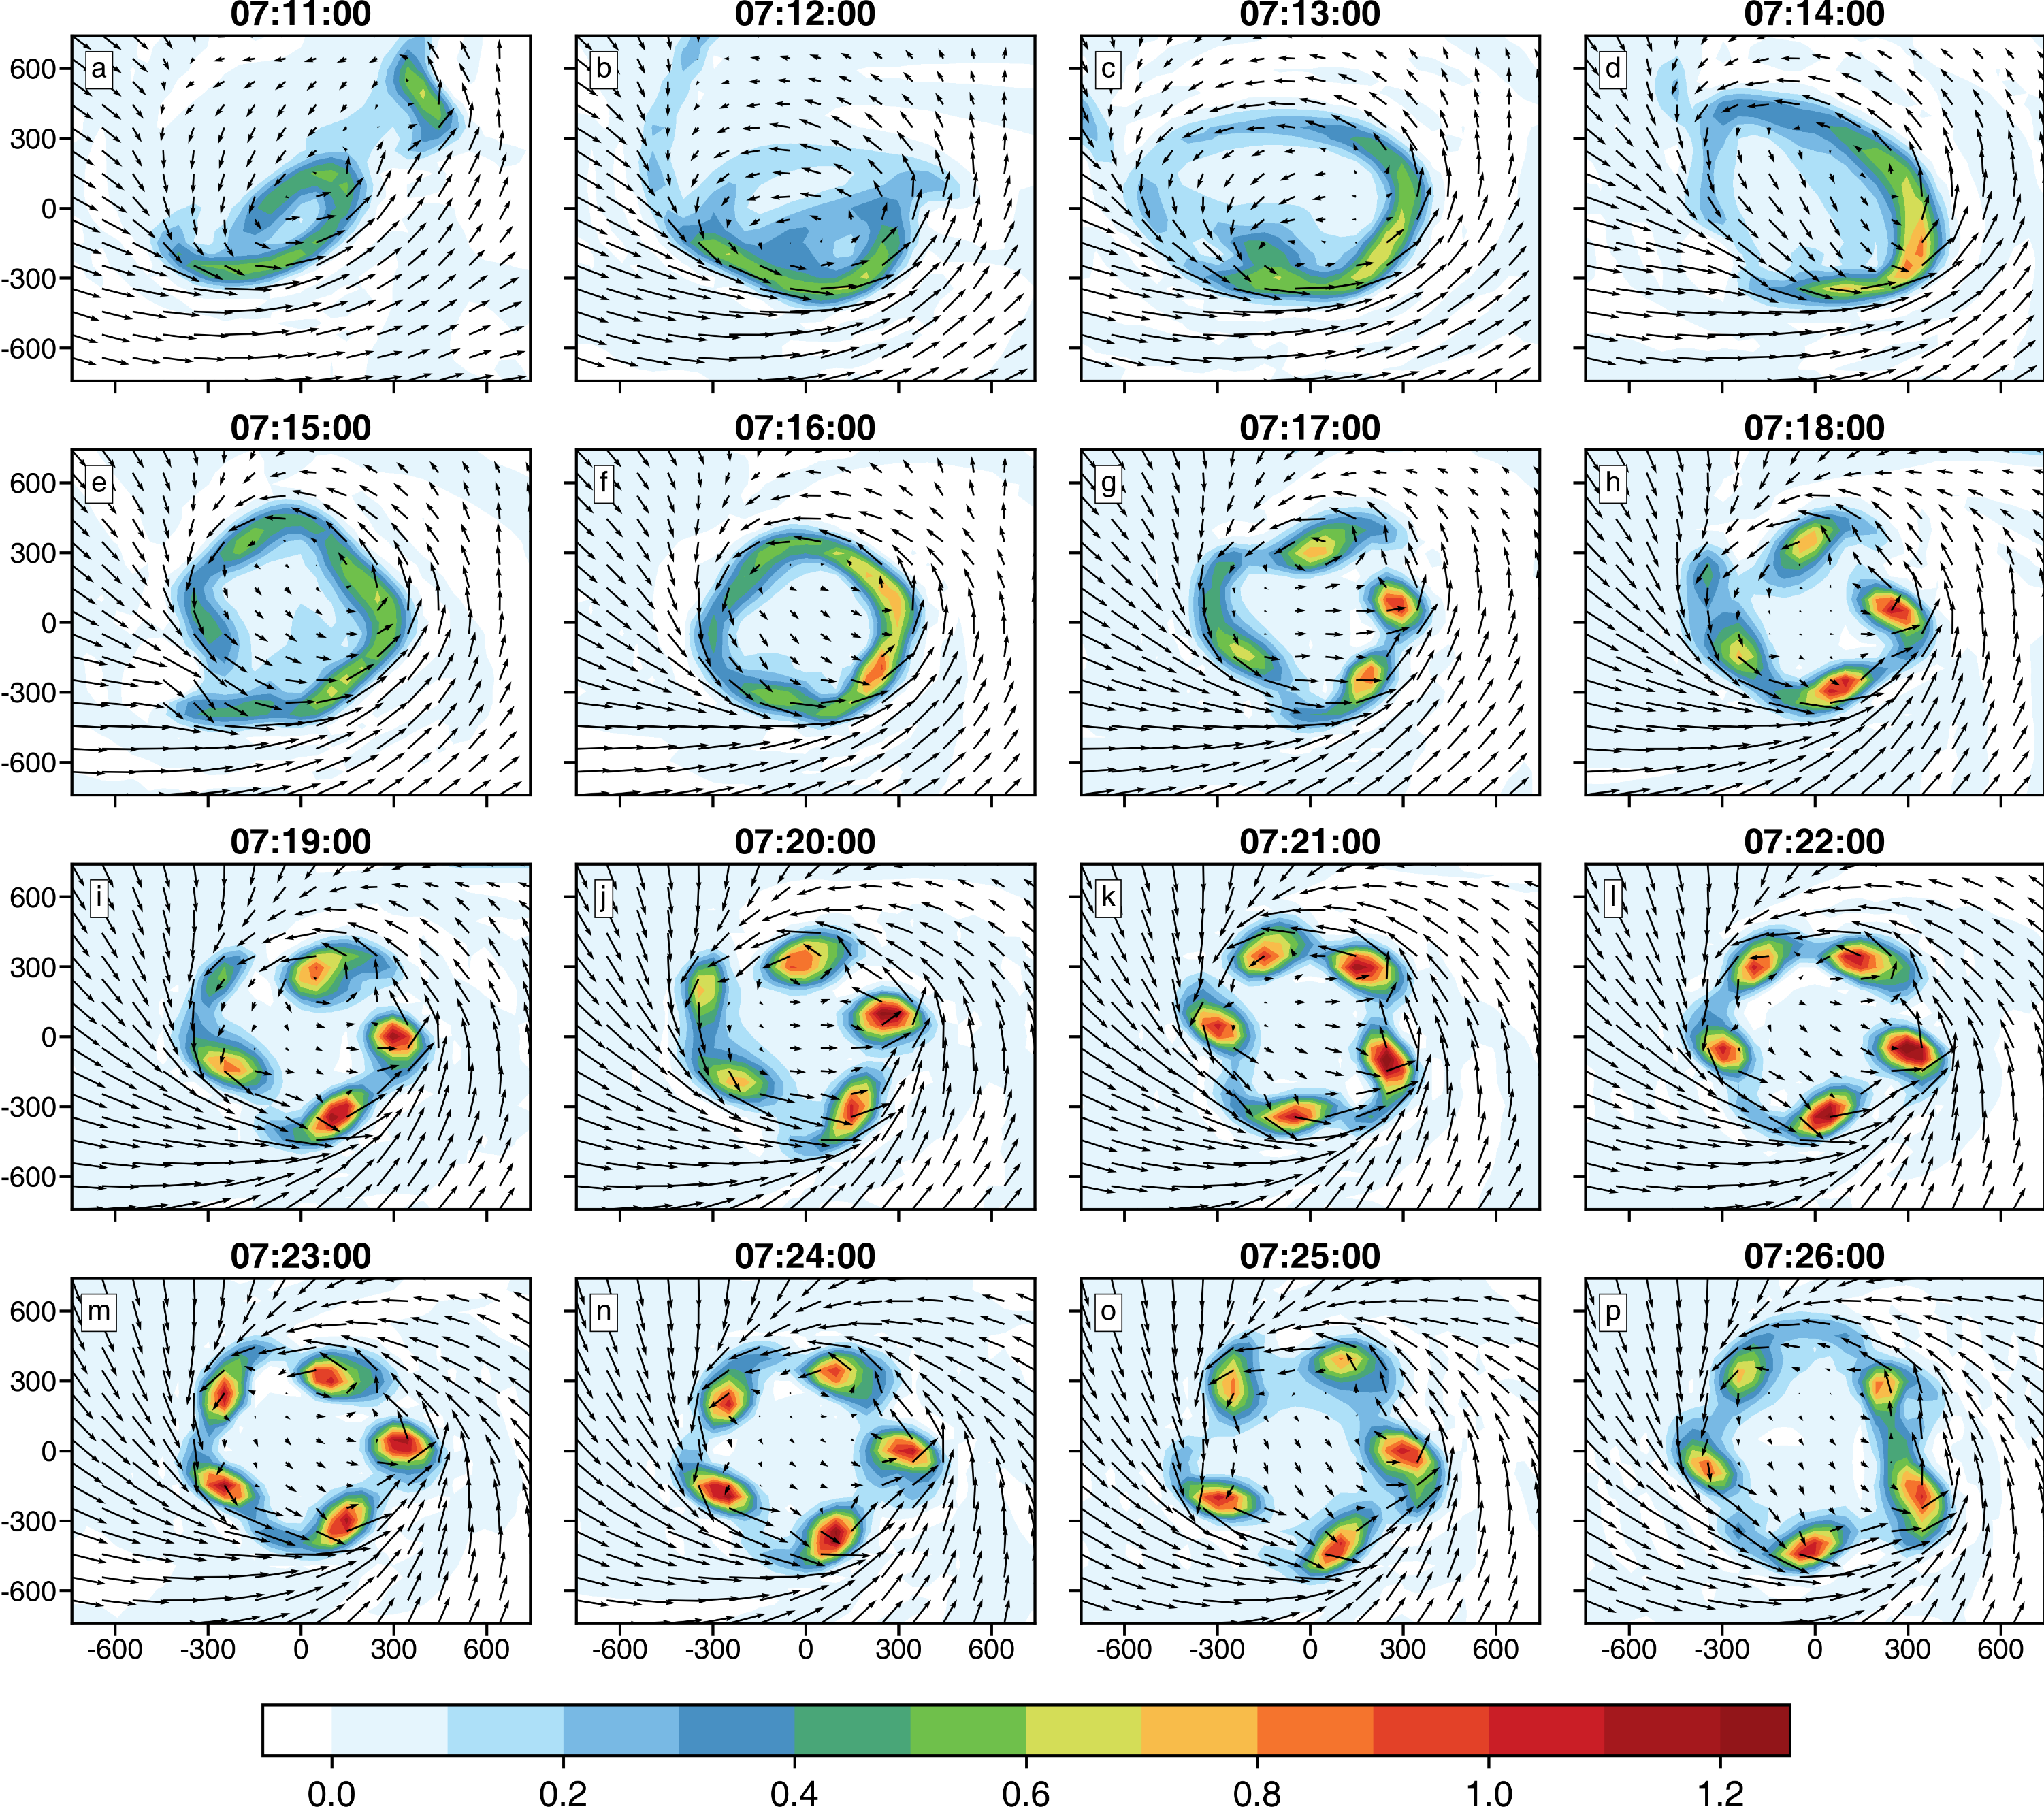
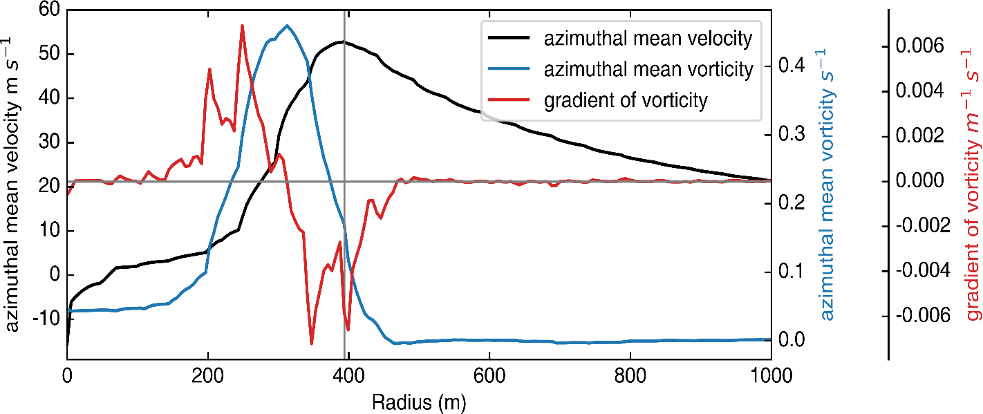





Vortex Evolution
26 m AGL vertical vort + wind
Vortex ring
5 sub-vortices
0716 UTC
Radial gradient of vorticity changes sign – satisfying necessary condition for barotropic instability
Barotropic instability is the cause of Vortex Rossby Waves – VRW in hurricanes (Wang 2002)
$$\overline{V}$$
$$\frac{∂\overline{ζ}}{∂r}>0$$
$$\frac{∂\overline{ζ}}{∂r}<0$$
$$\overline{ζ}$$
$$R_{Vmax}$$
radius

Slide 11
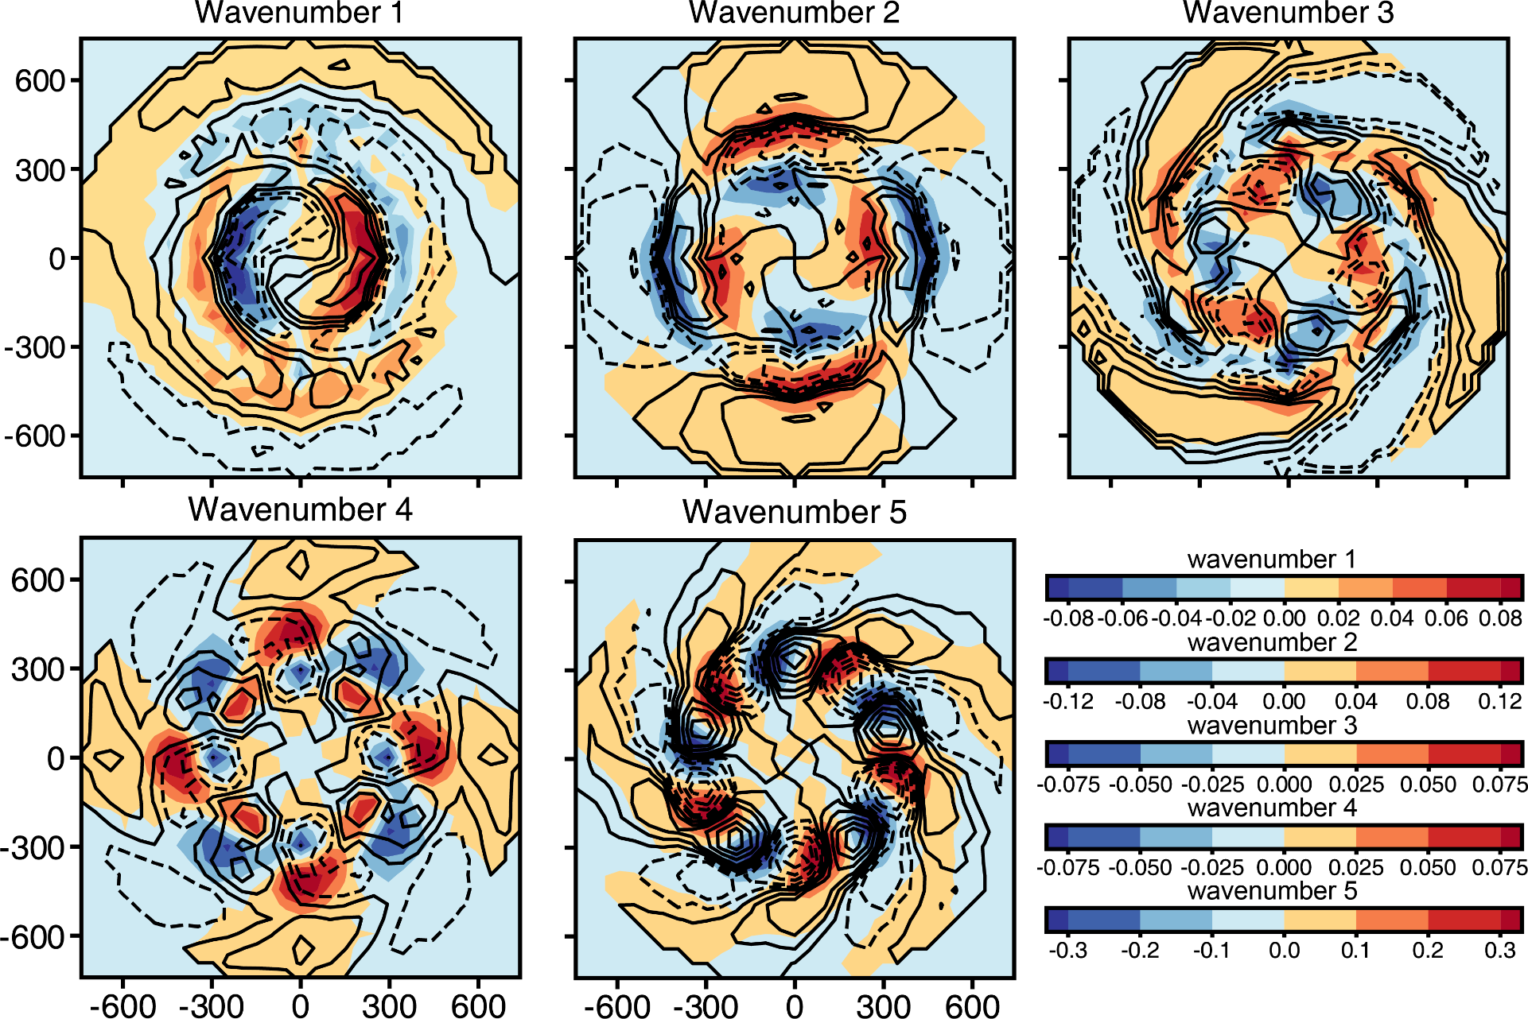
多子涡旋形成机制：涡旋罗斯贝波 (VRW)
Fourier decomposition (0716UTC ~26 m)
Vert. Vort + Wind vectors
WN5 has largest energy
WN3-5 w leads the phase of vert. vort. by π/2，agreeing with expected VRW structure
WN5 is strongest
$ζ（$color) w (contours)
Notes:
为了证明涡旋罗斯贝波的存在，我们首先对垂直涡度和垂直速度进行傅里叶分解，得到1-5波分量。尽管此时涡旋呈现较为对称的分布，但五波量级较其他波数大。3-5波分量均有垂直速度超前垂直涡度四分之一位相的分布，和Wang (2002) 一致 (台风理想模拟得到的VRW)。

Slide 12
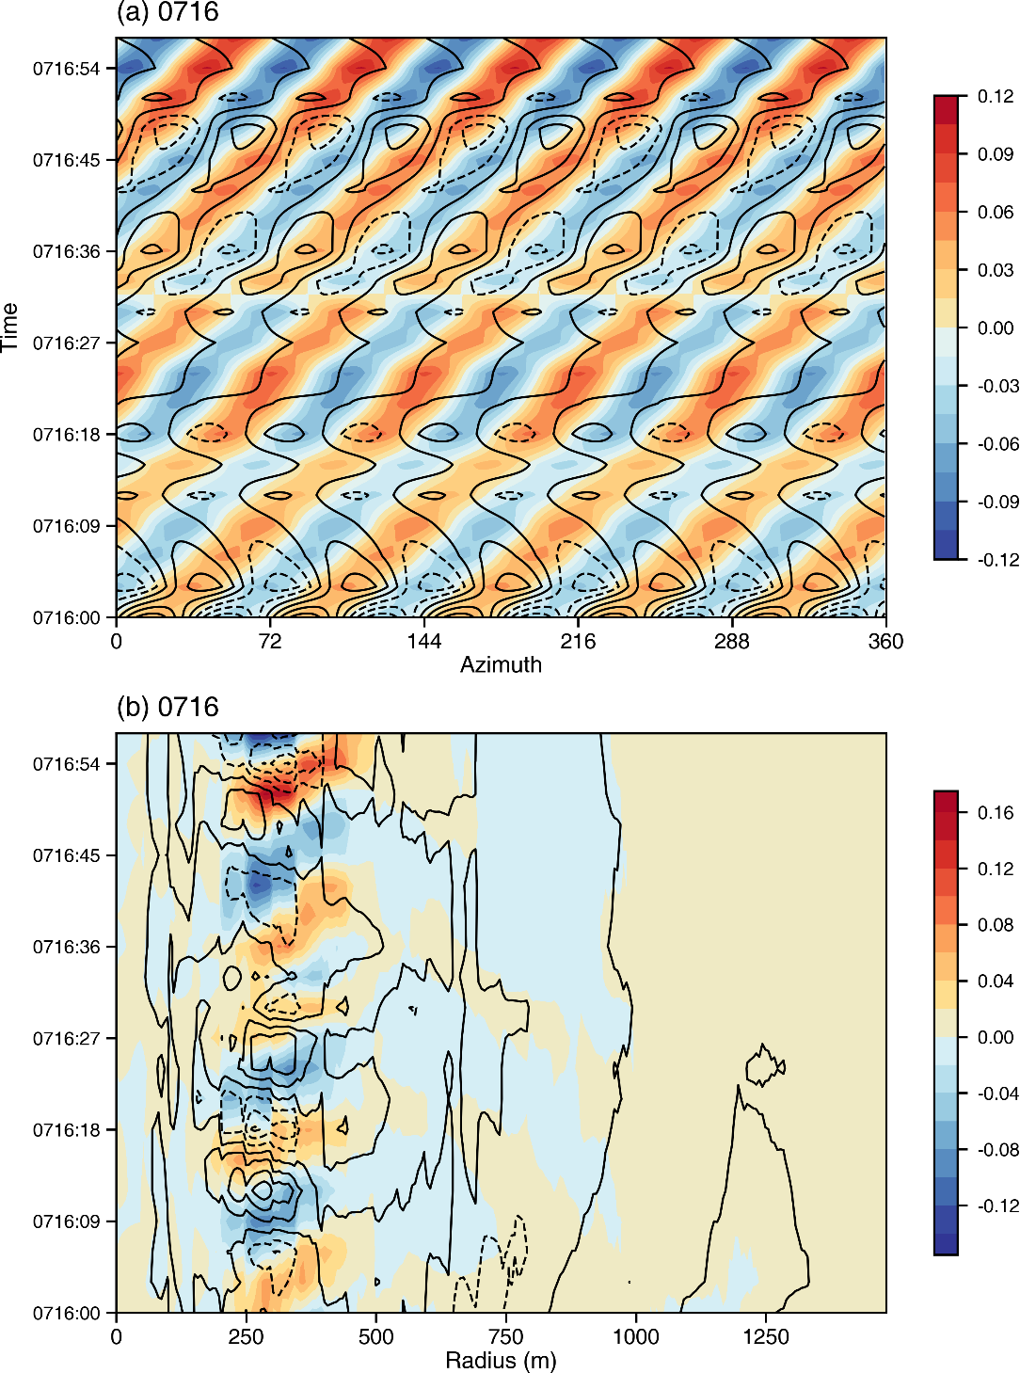
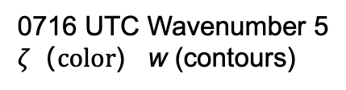
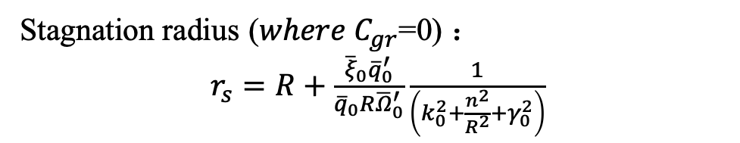
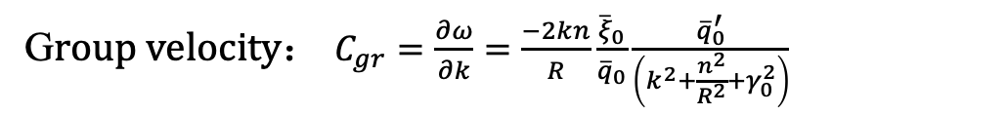
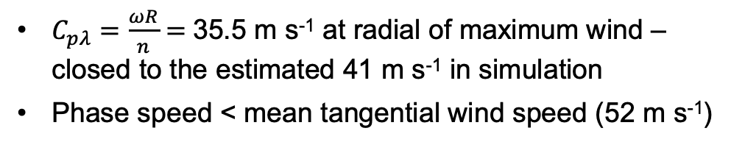
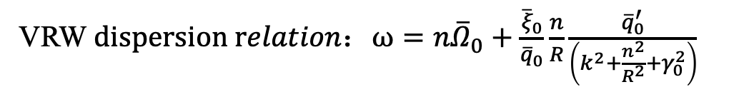
0716 UTC Wavenumber 5
$ζ（color$) w (contours)
Hovmoller Diagrams
VRW $dispersion relation：ω=n{\overline{Ω}}_{0}+\frac{{\overline{ξ}}_{0}}{{\overline{q}}_{0}}\frac{n}{R}\frac{{\overline{q}}_{0}^{′}}{\left(k^{2}+\frac{n^{2}}{R^{2}}+γ_{0}^{2}\right)}$
Time
$C_{pλ}=\frac{ωR}{n}=$35.5 m s⁻¹ at radial of maximum wind – closed to the estimated 41 m s⁻¹ in simulation
Phase speed < mean tangential wind speed (52 m s⁻¹)
angle
G$roup velocity：$ $C_{gr}=\frac{∂ω}{∂k}=\frac{−2kn}{R}\frac{{\overline{ξ}}_{0}}{{\overline{q}}_{0}}\frac{{\overline{q}}_{0}^{′}}{\left(k^{2}+\frac{n^{2}}{R^{2}}+γ_{0}^{2}\right)}$
Takes ~60 s to make one circle, C_{p} =~41 m s⁻¹
Stagnation radius (${where C}_{gr}$=0) $：$
$r_{s}=R+\frac{{{\overline{ξ}}_{0}\overline{q}}_{0}^{′}}{{\overline{q}}_{0}R{\overline{Ω}}_{0}^{′}}\frac{1}{\left(k_{0}^{2}+\frac{n^{2}}{R^{2}}+γ_{0}^{2}\right)}$
Time
Stagnation r from dispersion relation (~ 436 m) is closed that estimated from left figure
r
(Montgomery and Kallenbach 1997)
Stagnation radius
Notes:
此外，我们还计算了VRW的切向相速度和停滞半径, 以五波为例，此时最大风速半径处的切向相速度为35.5m/s，和涡旋的实际旋转速度差异不大。根据频散关系式，在最大切向风半径处涡度<0，则右边整项<0，即最大切向风半径处VRW的传播速度是小于平均切向风风速，这个和模拟也是一致的。此外停滞半径，即径向群速度=0所在的半径，大约为436m和图中垂直涡度停滞的位置是吻合的，以上均符合VRW的性质，证明了VRW的存在，即涡旋罗斯贝波触发了次级涡旋的产生。

Slide 13
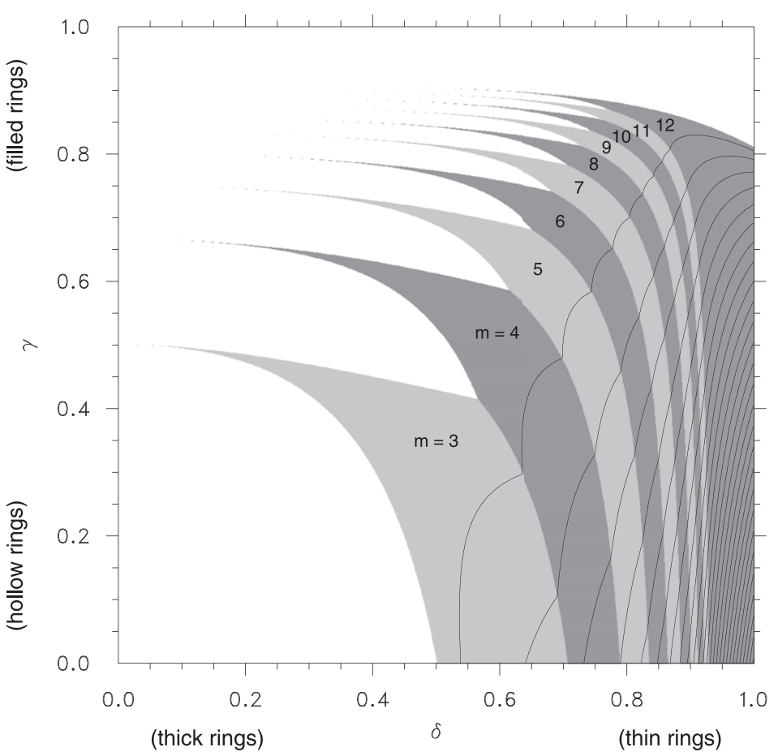



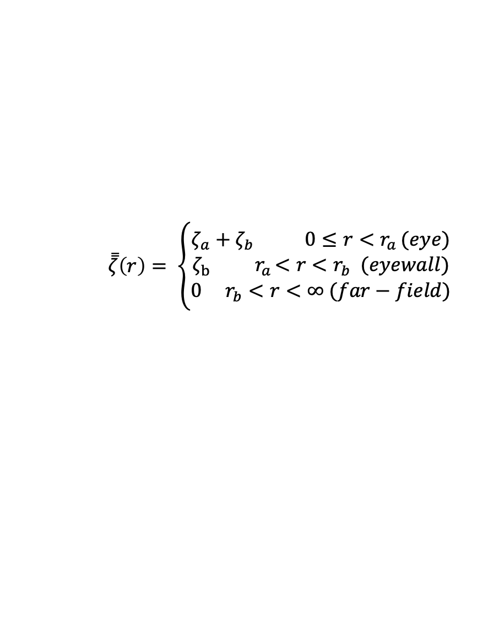
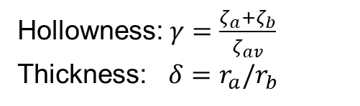
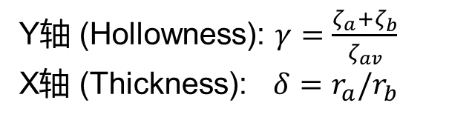

最不稳定波数
填色: 最不稳定波数 (波动增长率最大的波数)
高涡度环
$$\overset{̿}{ζ}\left(r\right)= \left\{\begin{aligned}ζ_{a}+ζ_{b} 0≤r<r_{a }(eye) \\ ζ_{b} { r}_{a}<r<r_{b} (eyewall) \\ 0 { r}_{b}<r<∞ (far−field)\end{aligned}\right.$$
$$r_{a}$$
$$ζ_{a}+ζ_{b}$$
Hollowness: $γ=\frac{ζ_{a}+ζ_{b}}{ζ_{av}}$
Thickness: $δ=r_{a}/r_{b}$
$$ζ_{b}$$
$$r_{b}$$
利用hollowness和thickness两个参数可以定量估计每个波对应的增长率
最不稳定波数即波动增长率最大的波数(左图)
thickness越趋近于1 (涡环越细), hollowness越趋近于1最不稳定波数越大，即最不稳定波数与涡环的形态及其上的涡度分布相联系
Y轴 (Hollowness): $γ=\frac{ζ_{a}+ζ_{b}}{ζ_{av}}$
X轴 (Thickness): $δ=r_{a}/r_{b}$
(Schubert et al. 1999)
Notes:
基于正压模式和线性稳定理论（linear stability theory）

Slide 14
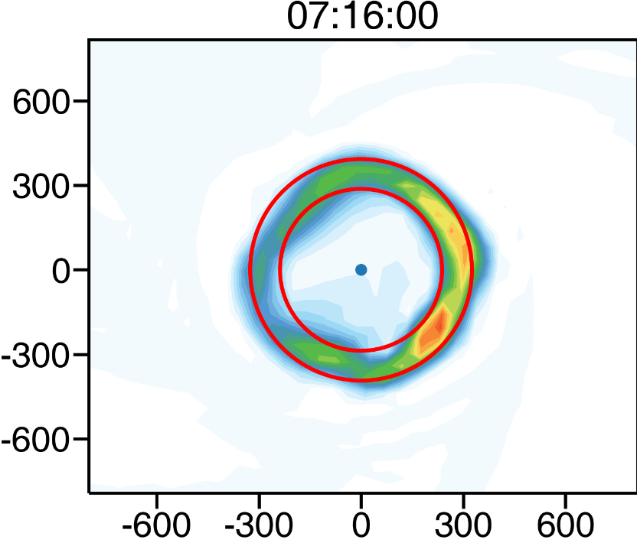
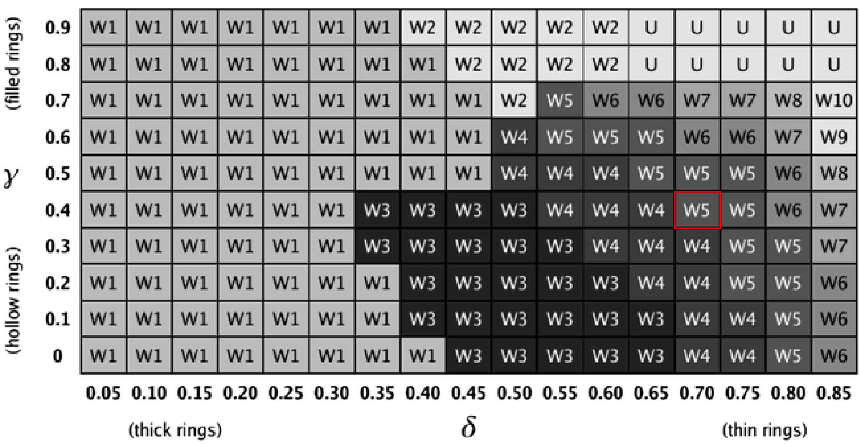
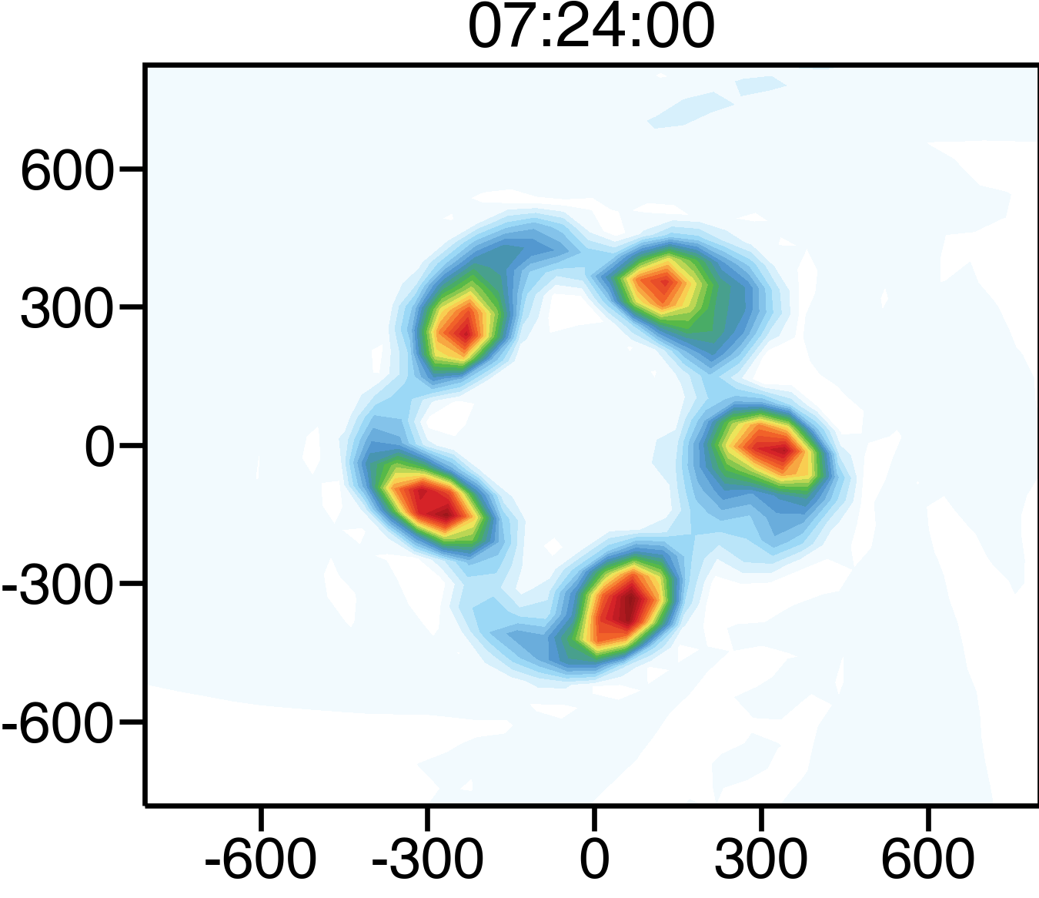


Most unstable WN for different hollowness and thickness in idealized vortex model
$$r_{a}$$
$$r_{b}$$
(Hollowness)
Hollowness：0.47
Thickness： 0.73
Vert. vort
(Thickness)
5 vortices
Agree with the most unstable WN predicted by the Schubert et al. (1999) model
Vert. vort
Notes:
选取0716 UTC，涡环比较对称的时刻计算hollowness和thickness两个参数

