Slide 1
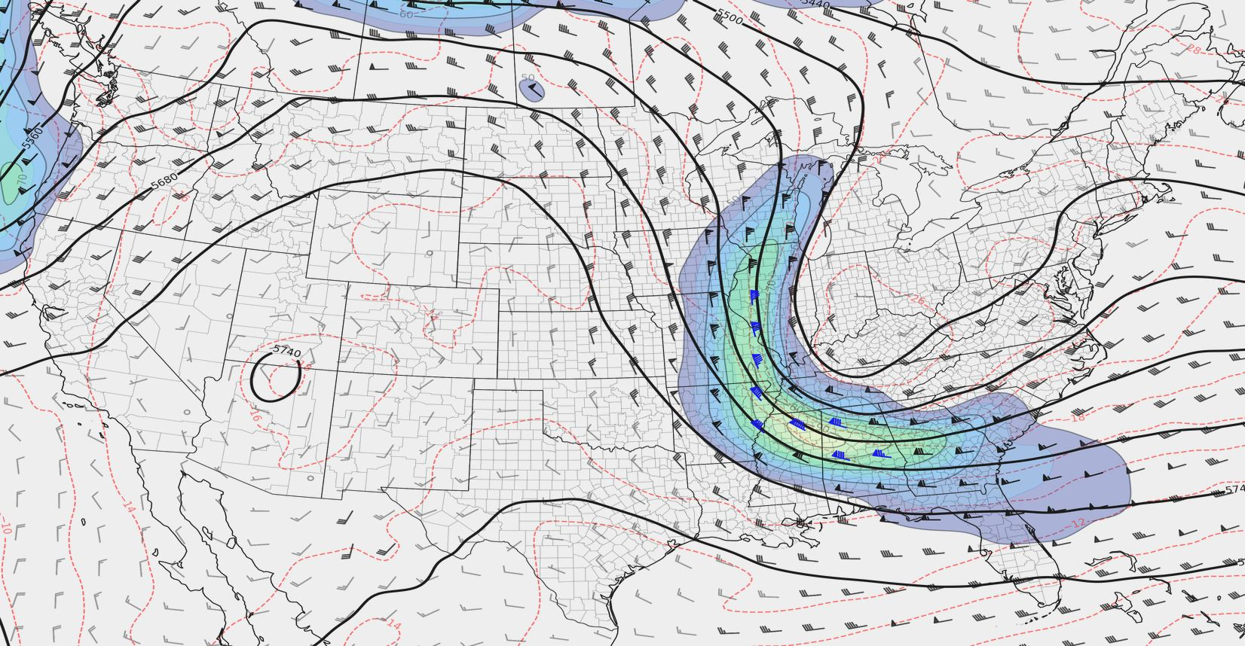
QG Omega
(and drylines!)
Arranged by Andrew Moore
Contributions from Thomas Galarneau

Slide 2
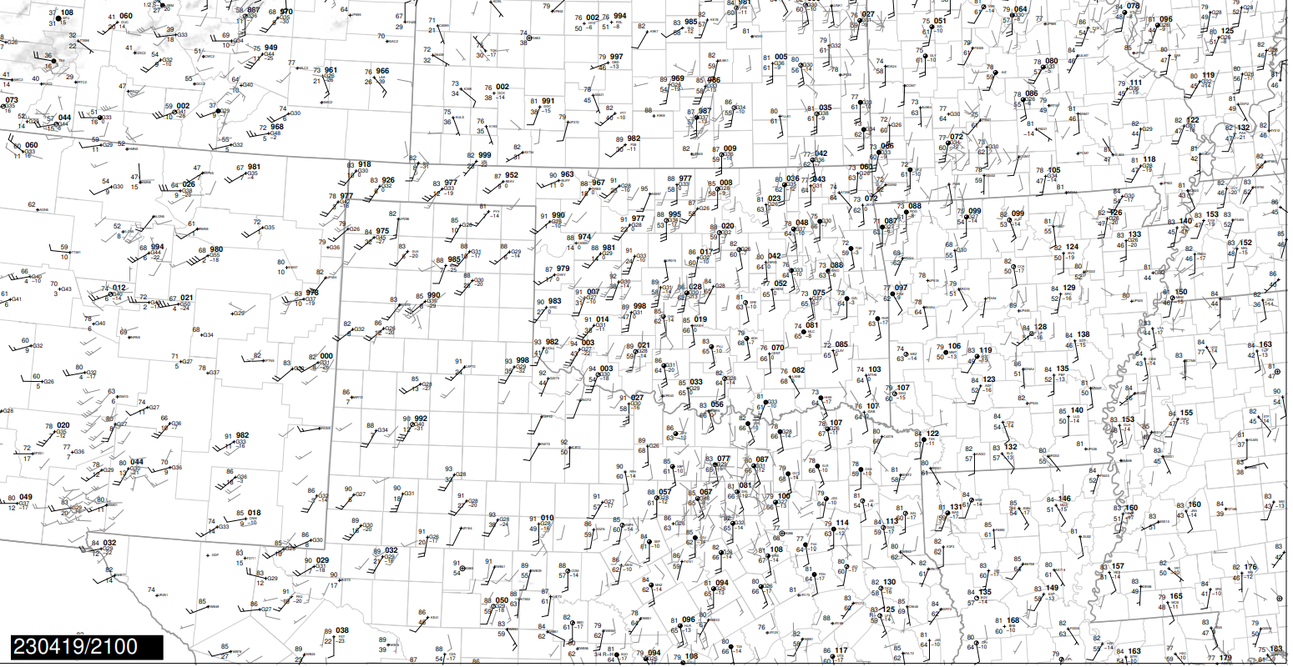
Ascent Along
Drylines

Slide 3
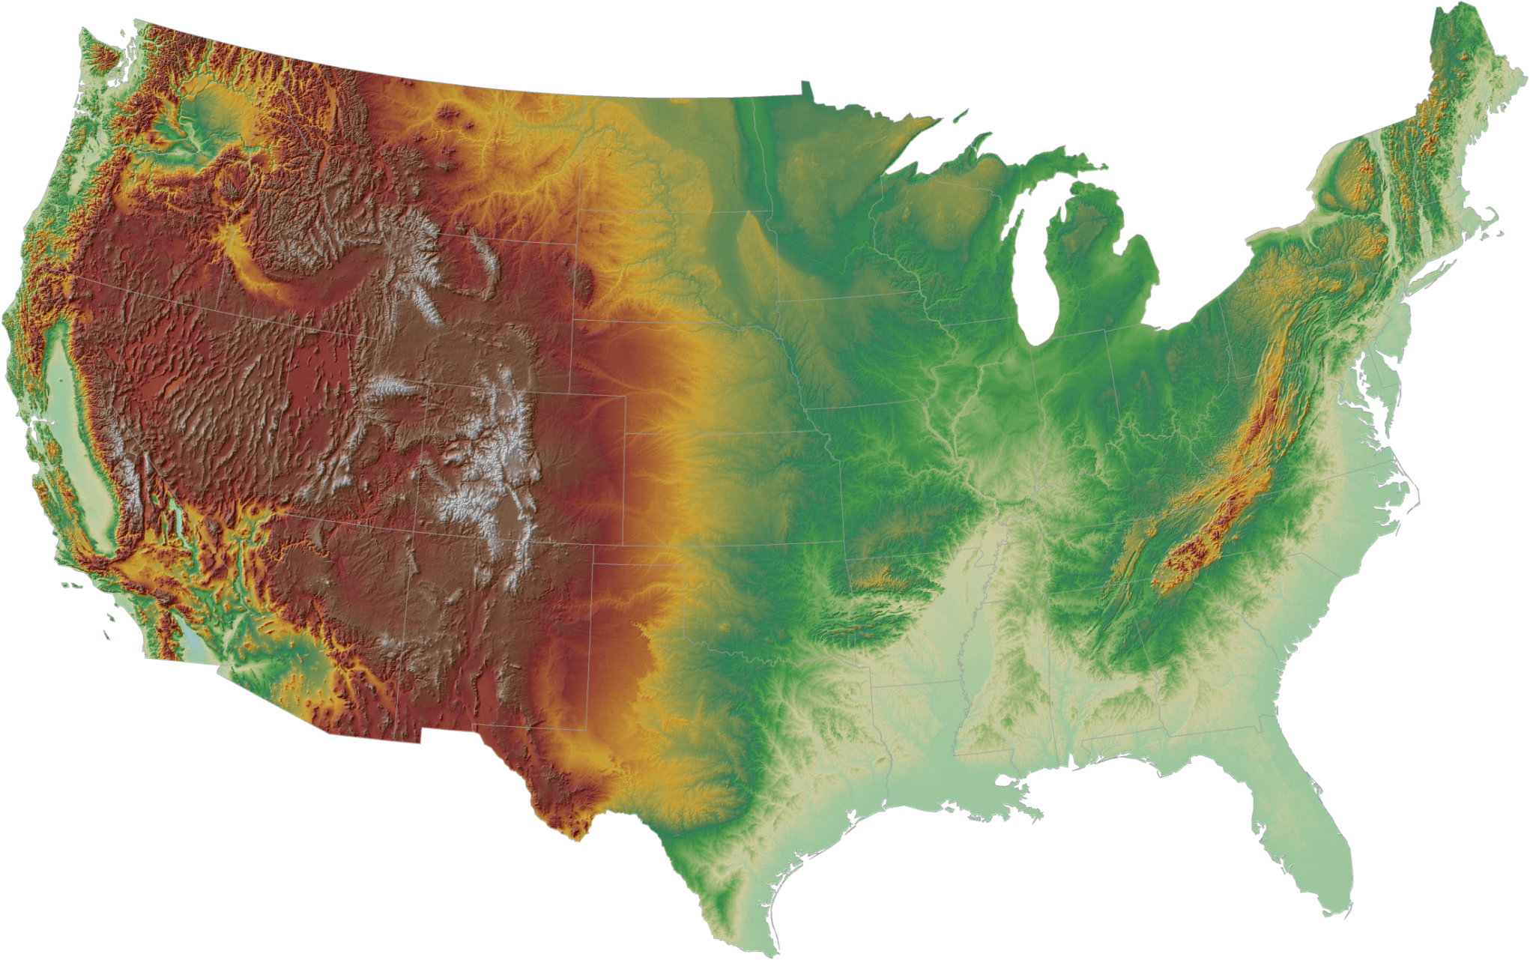
What is a dryline?
This is simply a density discontinuity between warm/moist air and hot/dry air.
L

Slide 4
What is a dryline?
This is simply a density discontinuity between warm/moist air and hot/dry air.
L
Let’s take a cross-sectional look!

Slide 5
What is a dryline?
This is simply a density discontinuity between warm/moist air and hot/dry air.
Dry Air
Elevated Mixed Layer
Moist Air
(ground)

Slide 6
What is a dryline?
This is simply a density discontinuity between warm/moist air and hot/dry air.
Dry Air
Elevated Mixed Layer
Moist Air
(ground)

Slide 7
How does a dryline move?
By mixing!
Strong boundary-layer flow within the hot/dry air
mechanically mixes out the moisture.
Dry Air
Elevated Mixed Layer
Moist Air
(ground)

Slide 8
How does a dryline move?
Eventually, low-level convergence and/or moisture depth
is strong enough to resist further eastward mixing
Dry Air
Elevated Mixed Layer
Moist Air
(ground)
Let’s zoom in again!

Slide 9
How do we get T-storm development?
Low-level convergence acts to tighten moisture gradient.
Dry air overruns the low-level moisture.
Parcels can not yet reach their LFC
LFC
Dry Air
Moist Air

Slide 10
How do we get T-storm development?
With time, there is an upward moisture flux.
Ascent increases, parcels begin to approach LFC,
but need additional ascent…
LFC
Dry Air
Moist Air

Slide 11
How do we get T-storm development?
Boundary-layer eddies (such as HCRs) locally enhance ascent along dryline, helps parcels reach the LFC.
LFC
Moist Air

Slide 12
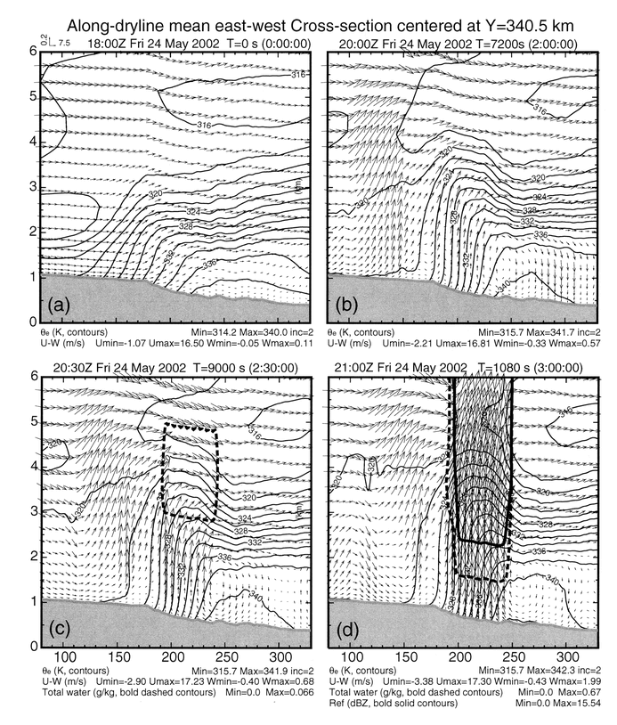
Dryline & ascent strengthening in ARPS simulations
(Fig 10 from Xue and Martin 2006a)

Slide 13
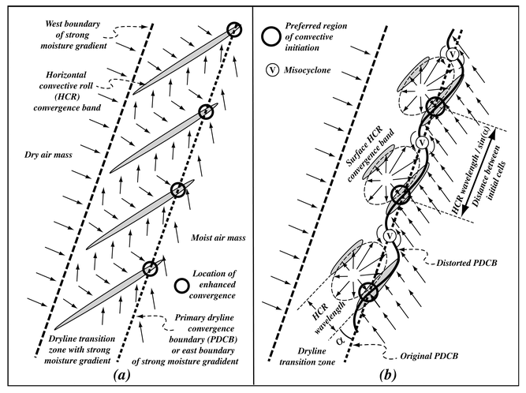
Boundary-layer eddies/discontinuities intersect the dryline and cause it to distort.
Areas of localized low-level convergence emerge.
CI becomes more probable in these localized area.
Fig 11 from Xue and Martin 2006b

Slide 14
Initial parcels reach the LFC & condense - but do they survive?
Strong cross-boundary flow may displace parcels away from ascent before convection can be self-sustained.
LFC
Moist Air

Slide 15
Initial parcels reach the LFC & condense - but do they survive?
Weaker cross-boundary flow OR along-boundary flow can maintain parcels within zone of ascent - better chance for sustained convection!
LFC
Moist Air

Slide 16
The question becomes whether the circulation can lift parcels to their LFC. The depth of the ascent can be estimated by comparing the height of the LCL on the dry side to the LFC on the moist side.
Dry side LCL
Moist Side LFC
Favorable for convective initiation

Slide 17
The question becomes whether the circulation can lift parcels to their LFC. The depth of the ascent can be estimated by comparing the height of the LCL on the dry side to the LFC on the moist side.
Dry side LCL
Moist Side LFC
Unfavorable for convective initiation

Slide 18
The other consideration is how long will air parcels reside within the zone of ascent. If they are ejected from the zone prematurely, they may not reach their LFCs.
With too much westerly flow near the LFC, parcels may be ejected too quickly out of the zone of ascent.
Dry side LCL
Moist Side LFC
Unfavorable for convective initiation

Slide 19
The other consideration is how long will air parcels reside within the zone of ascent. If they are ejected from the zone prematurely, they may not reach their LFCs.
With too much westerly flow near the LFC, parcels may be ejected too quickly out of the zone of ascent.
Dry side LCL
Moist Side LFC
Unfavorable for convective initiation

Slide 20
Lift along the dryline can be enhanced simply by mass convergence associated with the eastward progression of the boundary.
L
Weaker ascent
L
Enhanced ascent
850 mb - 700 mb
Speed max = stronger momentum flux to surface

Slide 21
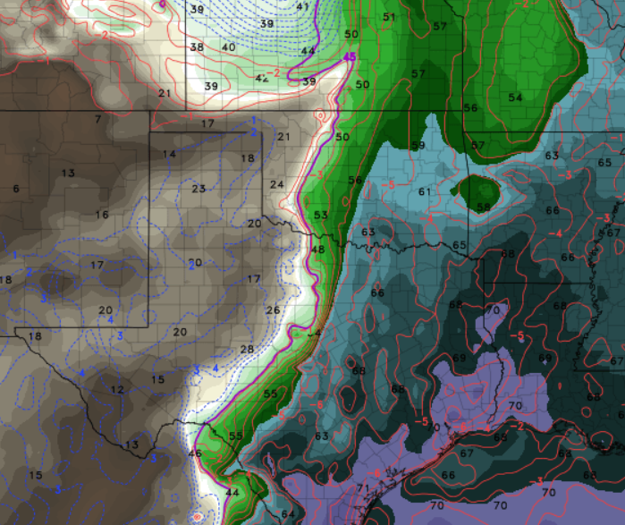
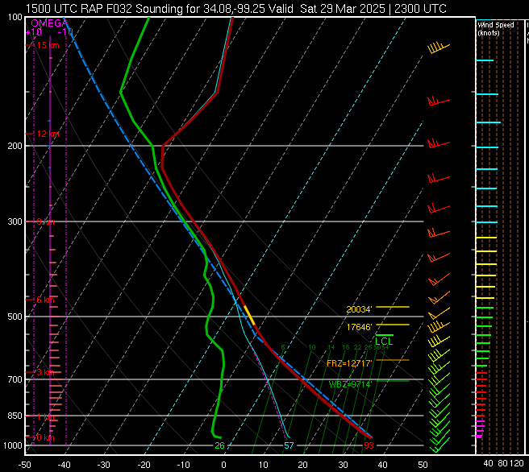
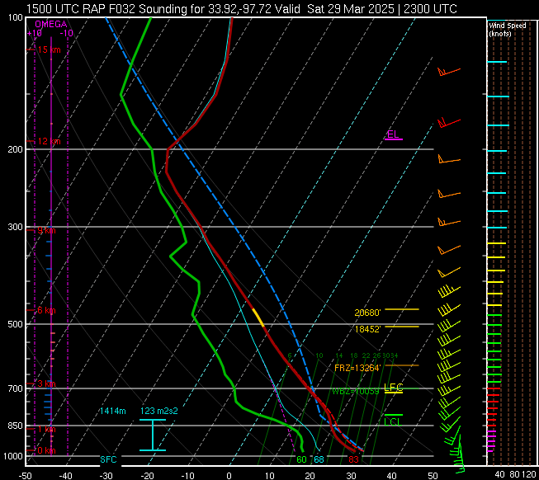

Slide 22
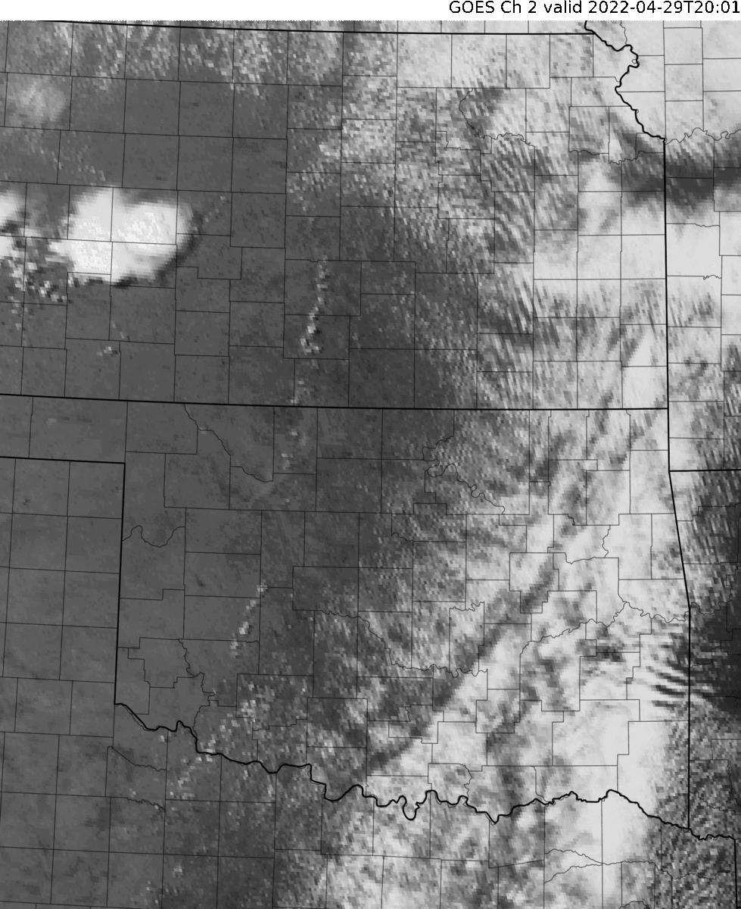
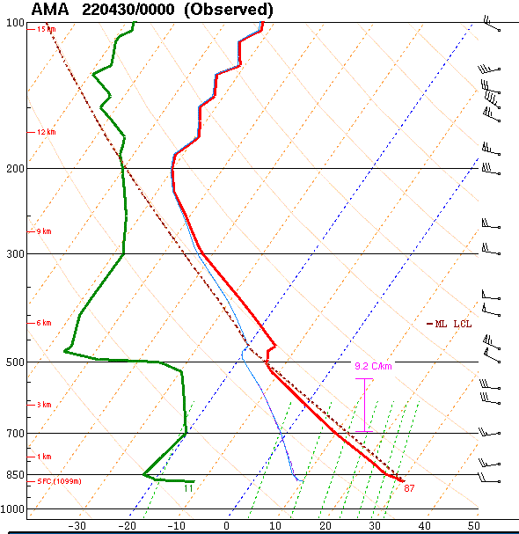
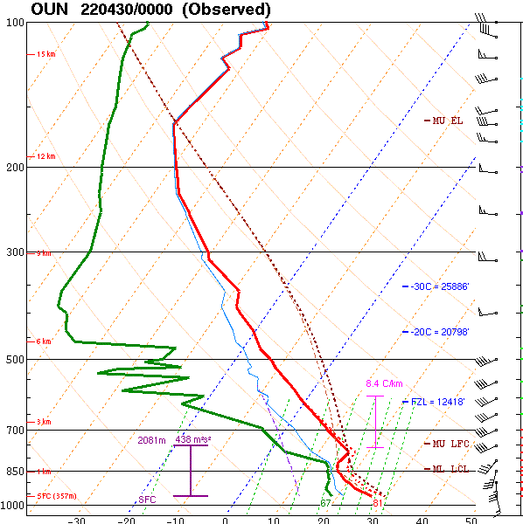
April 29, 2022
Low-level ascent too
weak in OK?
Parcels ejected out of ascent too quickly?

Slide 23
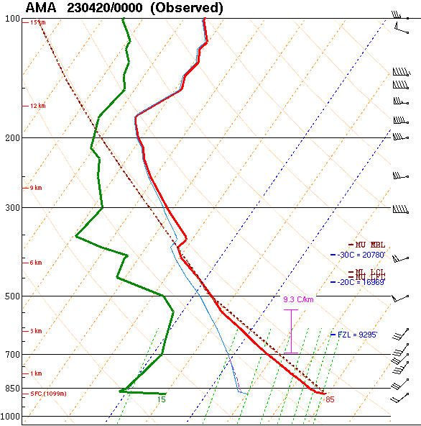
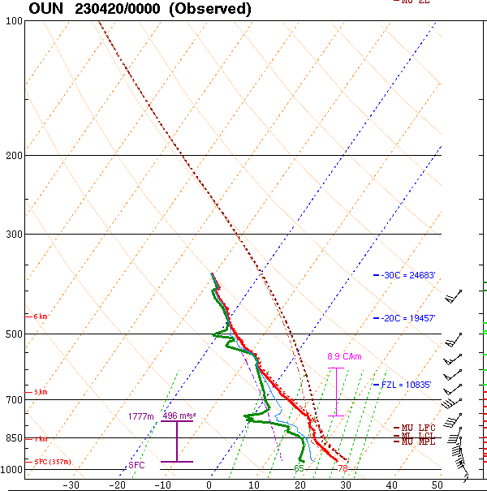
April 19, 2023
Will parcels be ejected out of ascent too quickly?

Slide 24
April 19, 2023
Where would the dryline ascent be strongest?
In other words, where is T-storm development most likely?
A
B
C

Slide 25
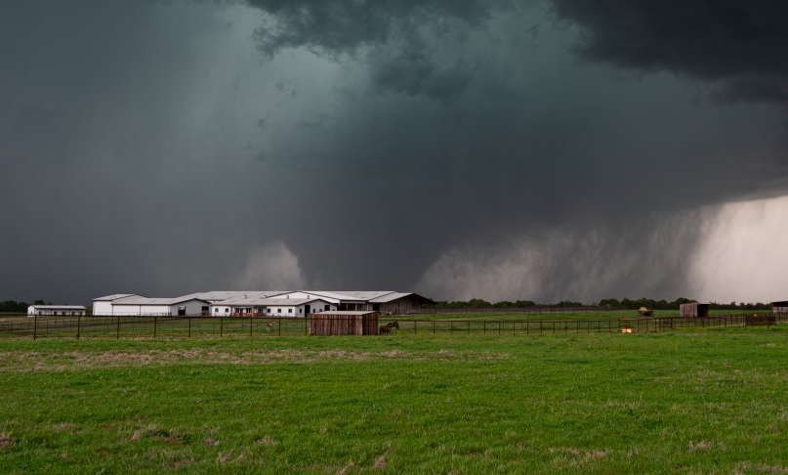
April 19, 2023
EF-3 near Cole, OK
Courtesy of Sean Earnst

Slide 26
Back to QG Omega…

Slide 27
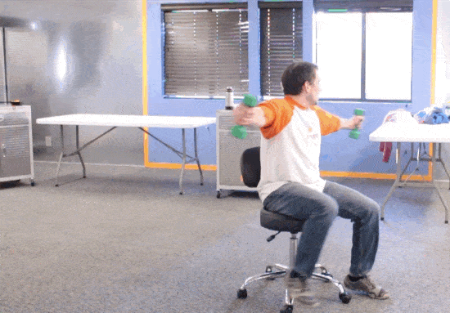
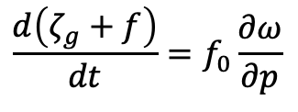

Physical Intuition:
Vorticity and Divergence
Notice what happens when the weights (i.e. mass) are brought inward.
Spin (i.e. vorticity) increases!
Change in a parcel’s
vorticity (spin)
Vertical acceleration
but by mass conservation this is also convergence/divergence!
Another example: https://i.imgur.com/7h5GvdK.mp4

Slide 28
Physical Intuition:
Vorticity and Divergence
Let’s imagine we have this 500 mb chart.
Let’s assume that a parcel will propagate through the mean flow faster than the speed of the upper-wave/jet-streak.
This means that the parcel’s vorticity will change as it moves through the trough.
Xmax
Xmin

Slide 29
Physical Intuition:
Vorticity and Divergence
The air parcel approaches the base of an upper trough and acquires absolute vorticity
As the parcel exits the base of the trough it loses absolute vorticity.

Slide 30
Physical Intuition:
Vorticity and Divergence
The air parcel approaches the base of an upper trough and acquires mass (convergence)
As the parcel exits the base of the trough it loses mass (divergence)

Slide 31
Physical Intuition:
Vorticity and Divergence
Let’s imagine we have this 500 mb chart.
Let’s assume that a parcel will propagate through the mean flow faster than the speed of the upper-wave/jet-streak.
This means that the parcels vorticity will change as it moves through the trough.
Convergence
Xmax
Xmin
Divergence
So then how do we get ascent?

Slide 32
Physical Intuition:
Vorticity and Divergence
Tropopause
induced descent
due to mass conservation
induced ascent
due to mass conservation
No vorticity changes near ground

Slide 33
Physical Intuition:
Vorticity and Divergence
Differential changes in vorticity with height induce upward/downward motions.
The direction of vertical motion is determined by which level has the strongest change in vorticity (and the sign).
In general, it’s safe to assume that vorticity changes (i.e. advection) near ground is weaker than vorticity changes aloft.
Not always the case in some scenarios.
Descent
Xmax
Xmin
Ascent

Slide 34
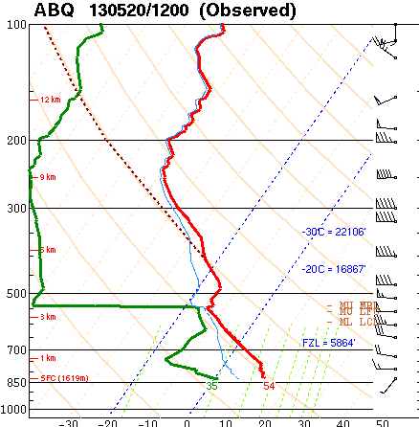
Physical Intuition:
Temperature Advection & Ascent
Let’s start with isentropes!
Notice that the potential temperatures increase with height!
This means we can use potential temperature values and/or isentropes as an approximate vertical coordinate.

Slide 35
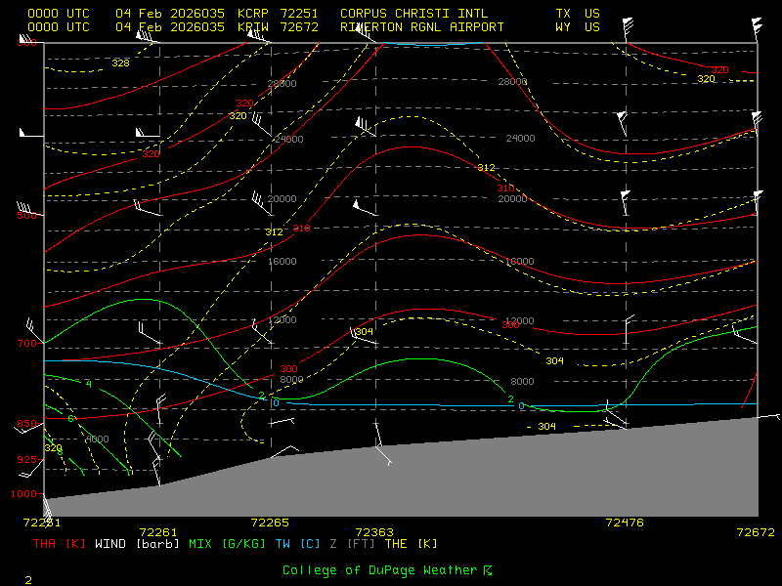
Focus on the red lines

Slide 36
Focus on the red lines
isentropes slope up to the north
700 mb isobaric surface
Colder
Warmer

Slide 37
Focus on the red lines
Path a parcel would take on its trek north
Colder
Warmer

Slide 38
Focus on the red lines
Note what’s happening:
parcel starts at 850 mb
Is being pushed northward into
colder air.
Increases its height to above 700 mb.
Let’s zoom in!
Colder
Warmer

Slide 39
Our parcel is displaced horizontally.
Because of the sloped isentropic surfaces, it is now warmer than its environment.
Adiabatic ascent must occur to restore the parcel to its isentrope.
This response is adiabatic ascent due to warm advection!
𝚹+1
𝚹
isentropic surface
𝚹-1
path parcel is forced to take
𝚹-2
Warmer
Colder

Slide 40
𝚹+1
The opposite is true for cold air advection.
Parcel is displaced to a warmer isentropic surface.
Adiabatic descent must occur to restore the parcel to its original isentropic surface.
path parcel is forced to take
𝚹
isentropic surface
𝚹-1
𝚹-2
Warmer
Colder

Slide 41
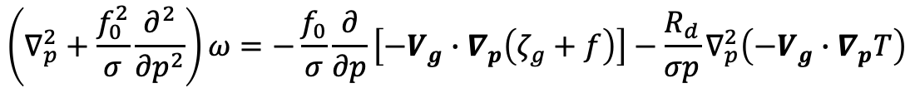
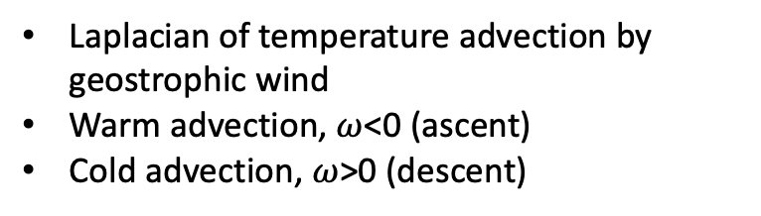
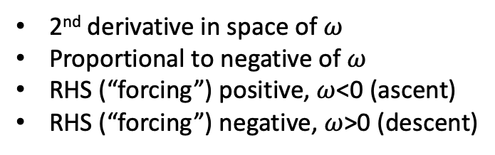
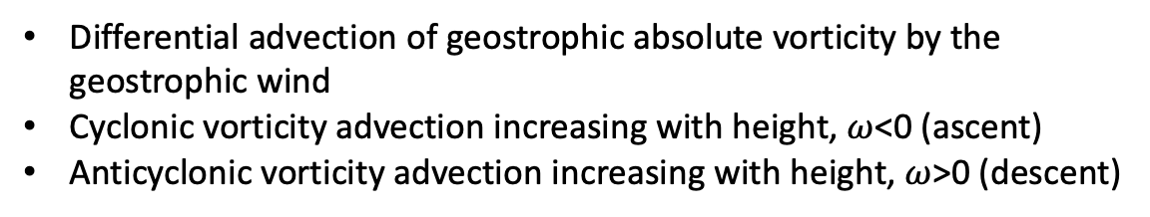


QG Omega Equation (Traditional form)
See Bluestein Vol1 p329.

Slide 42
QG Omega Equation: differential vorticity advection term
Differential advection of geostrophic absolute vorticity by the geostrophic wind
Assume vorticity advection near surface = 0.
534
500 hPa height
SLP
540
546
-1 * -1* (+DVA) = -1* ⍵
+DVA = -1* ⍵
552
+DVA = ascent!
Xmax
area of positive differential vorticity advection (DVA)

Slide 43
QG Omega Equation: differential vorticity advection term
Differential advection of geostrophic absolute vorticity by the geostrophic wind
Assume vorticity advection near surface = 0.
534
500 hPa height
SLP
540
Xmin
546
-1 * -1* (-DVA) = -1* ⍵
-DVA = -1* ⍵
552
DVA = ⍵
Xmax
area of negative differential vorticity advection (DVA)
DVA = descent!

Slide 44
QG Omega Equation: differential vorticity advection term
Differential advection of geostrophic absolute vorticity by the geostrophic wind
Assume vorticity advection near surface = 0.
534
500 hPa height
SLP
540
TA = Temperature Advection
WAA
546
-1 * -1* (+TA) = -1* ⍵
L
+TA = -1* ⍵
552
+TA = ascent!
CAA

Slide 45
QG Omega Equation: differential vorticity advection term
Differential advection of geostrophic absolute vorticity by the geostrophic wind
Assume vorticity advection near surface = 0.
534
500 hPa height
SLP
540
TA = Temperature Advection
WAA
546
-1 * -1* (-TA) = -1* ⍵
L
-TA = -1* ⍵
552
-TA = descent!
CAA

Slide 46
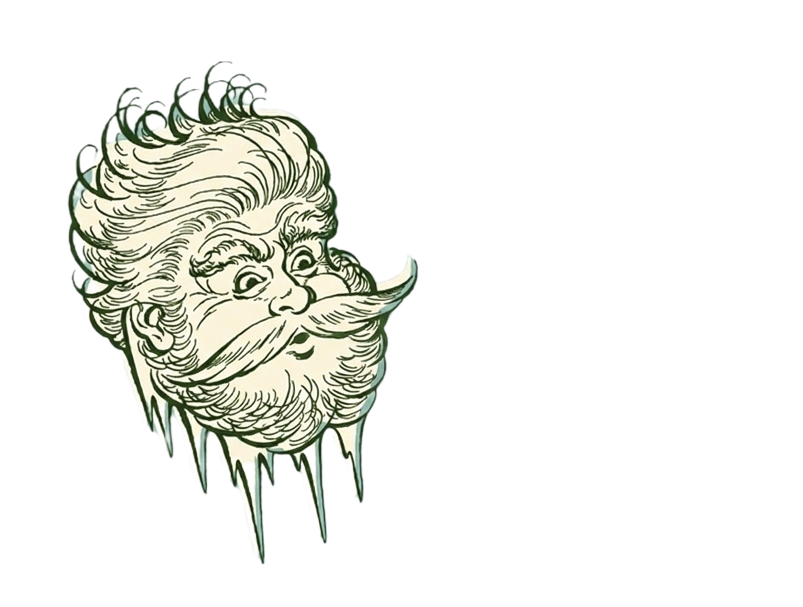
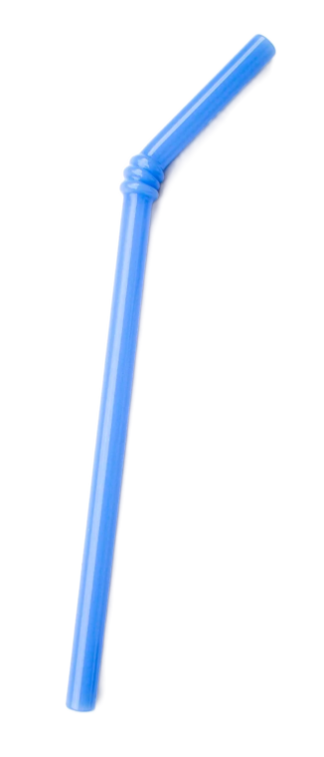

One Final Consideration:
Static Stability
Consider this:
Which is easier to sip
up through a straw?
Note that static stability is found in each term of the QG Omega equation.
But what does this mean?
More dense air = higher static stability
Less dense air = lower static stability
Omega is inversely related to static stability.
Higher density => lower omega!
So in other words, cold air may subdue ascent
compared to warm air!

Slide 47

One Final Consideration:
Static Stability
Consider this:
Which is easier to sip
up through a straw?
Note that static stability is found in each term of the QG Omega equation.
But what does this mean?
More dense air = higher static stability
Less dense air = lower static stability
Omega is inversely related to static stability.
Higher density => lower omega!
So in other words, cold air may subdue ascent
compared to warm air!

Slide 48
One Final Consideration:
Static Stability
You expect ascent to overspread OK and KS.
But where will ascent be subdued?
Where might a surface low develop (based on ascent and mass continuity)?

Slide 49
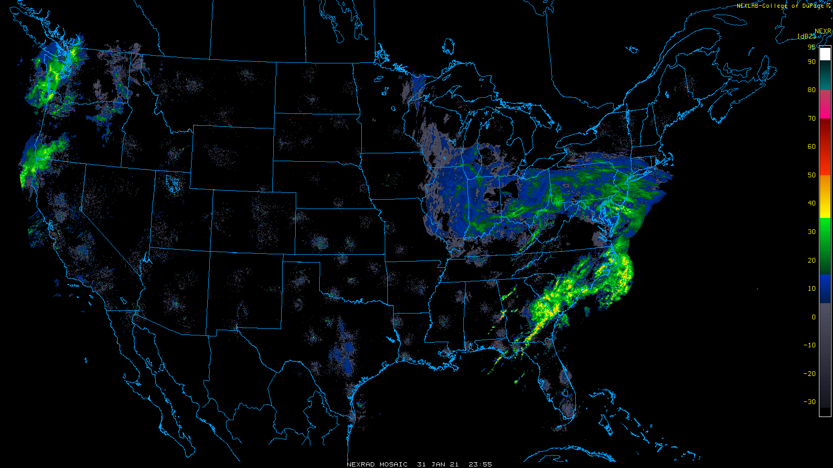
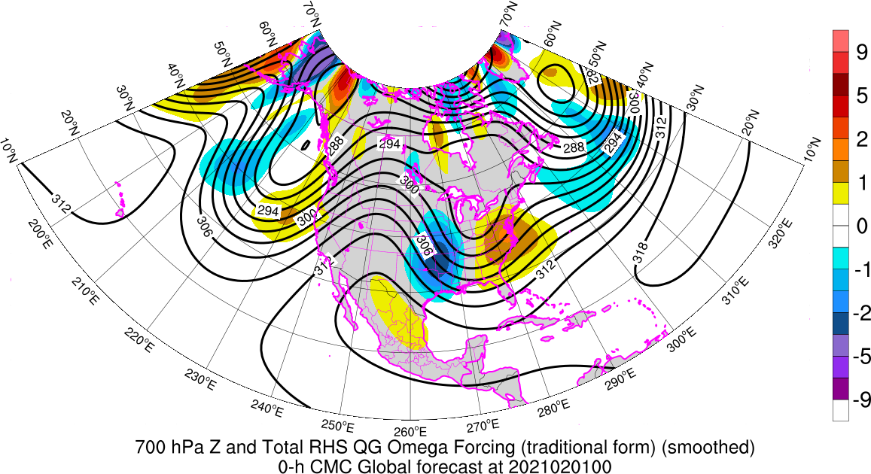
Reflectivity Mosaic
2355Z/31 Jan 2021
700 hPa Z and QG Omega Forcing (Term B+Term C)
00Z/1 Feb 2021
https://www2.mmm.ucar.edu/imagearchive/
https://inside.nssl.noaa.gov/tgalarneau/real-time-qg-diagnostics/

Slide 50
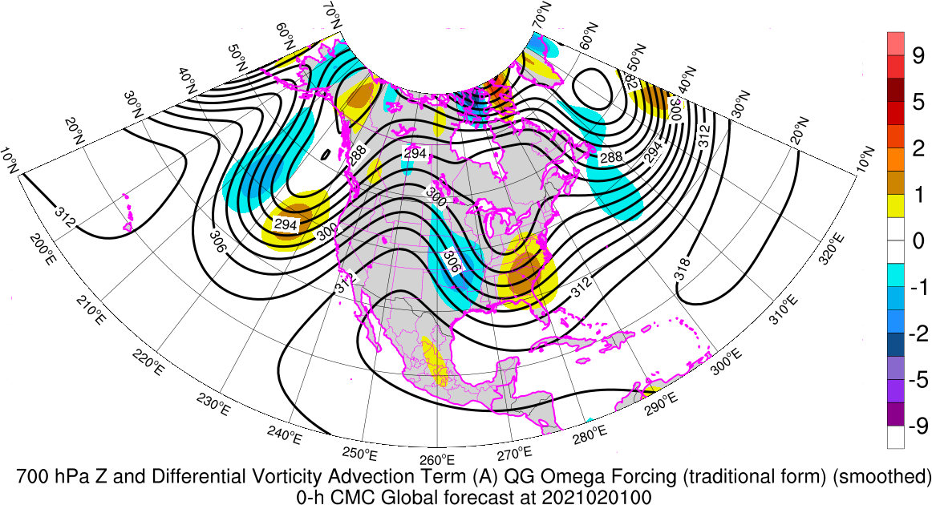
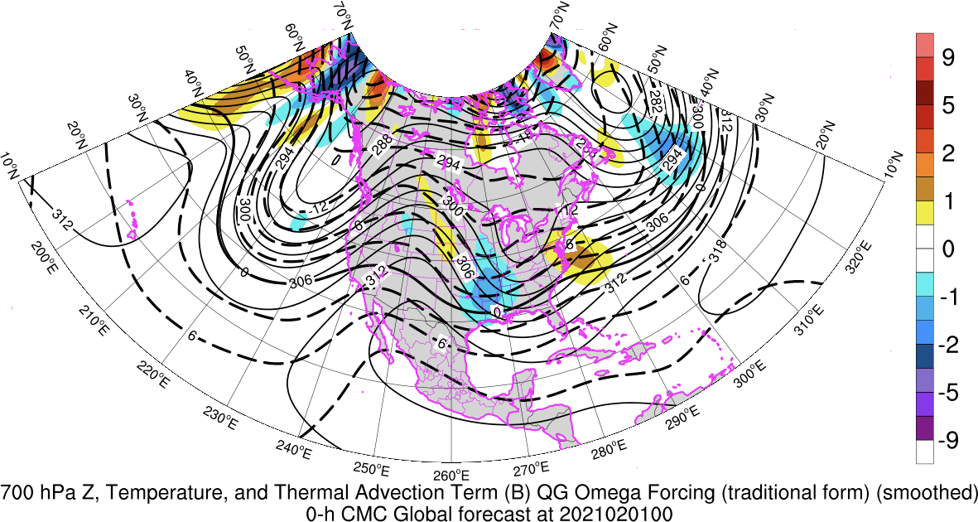
Precip in PA/NJ in region of QG ascent assoc. with warm advection
Convection in NC to FL in region of QG ascent assoc. with differential cyclonic vorticity advection
Total forcing=Term B+Term C
B
C

