Slide 1
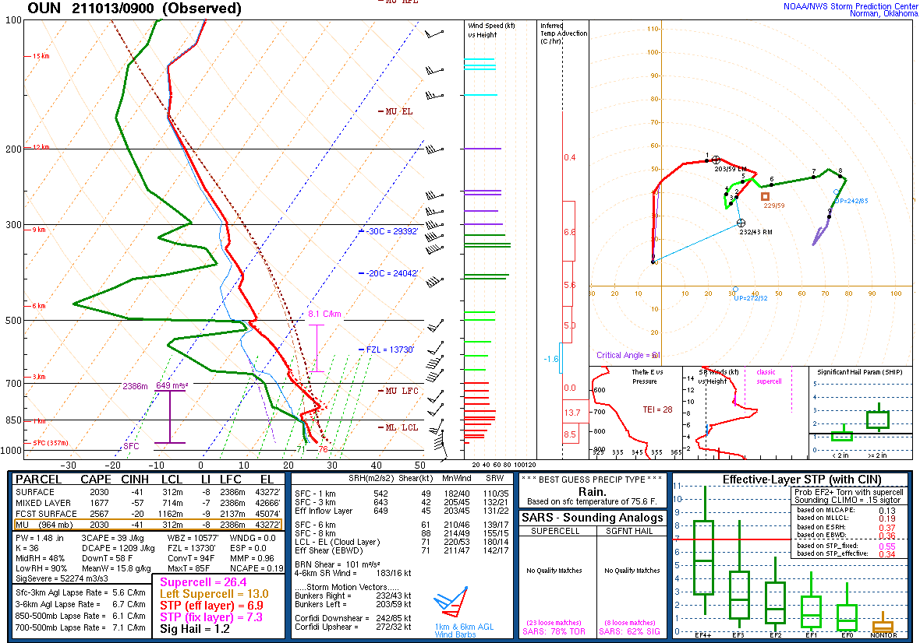
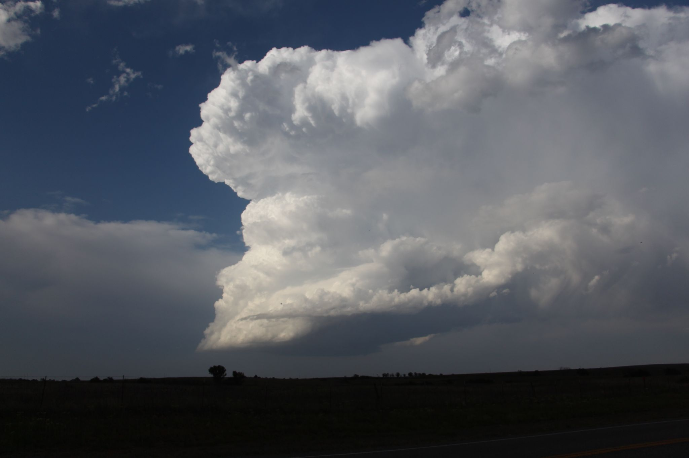
Lapse Rate Tendency
Material by Rich Thompson, Ariel Cohen, Andrew Moore, Tom Galarneau
Photo by Andrew Moore

Slide 2
Why do we care about lapse rates?
Helps generate buoyancy (influences T-storm intensity)
Influences convective initiation (Houston and Niyogi 2007)
Influence precipitation intensity (Takemi 2009)

Slide 3
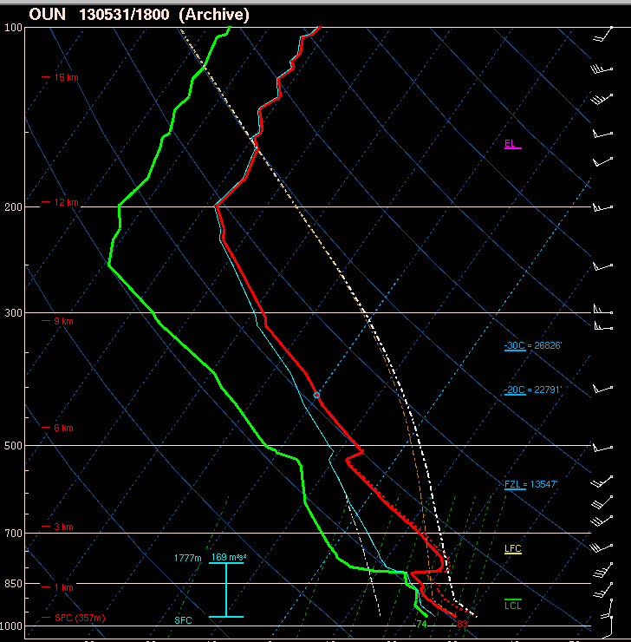
Lapse rates in most T-storm environments will be conditionally unstable…
In other words, between the dry adiabatic lapse rate (9.8 C/km) and the moist adiabatic lapse rate.
Absolutely Stable
Conditionally Unstable
Moist Adiabat
Dry Adiabat
Absolutely Unstable
LFC

Slide 4
Lapse rates in most T-storm environments will be conditionally unstable…
In other words, between the dry adiabatic lapse rate (9.8 C/km) and the moist adiabatic lapse rate.
Compare the CAPE profiles for these three environmental lapse rates. What are the implications for updraft acceleration?
(Recall: Wmax = sqrt(2*CAPE))
Absolutely Stable
Absolutely Unstable
LFC

Slide 5
How do lapse rates change?
Horizontal lapse rate advection
Influence of lift/stretching
Local change in lapse rate =
Differential Thermal Advection
Diabatic Heating

Slide 6
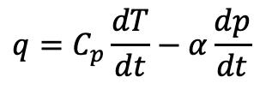

Lapse Rate Tendency
What physical processes alter the environment lapse rate?
Start with 1st Law of Thermodynamics
This is an important point!
Our ability to anticipate changes in lapse rate derives directly from the first law of thermodynamics!
temperature
pressure
heating
rate
specific
heat
time

Slide 7
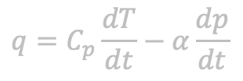

Lapse Rate Tendency
What physical processes alter the environment lapse rate?
Start with 1st Law of Thermodynamics
temperature
pressure
heating
rate
specific
heat
time
Expand full derivatives and assume hydrostatic conditions (OK for synoptic and mesoscale)
Local change in temperature with time
Horizontal temperature advection
Vertical temperature advection
Local change in pressure
Horizontal pressure advection
Vertical pressure advection

Slide 8

Lapse Rate Tendency
What physical processes alter the environment lapse rate?
Start with 1st Law of Thermodynamics
temperature
pressure
heating
rate
specific
heat
time
Expand full derivatives and assume hydrostatic conditions (OK for synoptic and mesoscale)
Relatively small
Assume that the hydrostatic approx applies

Slide 9

Lapse Rate Tendency
What physical processes alter the environment lapse rate?
Start with 1st Law of Thermodynamics
temperature
pressure
heating
rate
specific
heat
time
Expand full derivatives and assume hydrostatic conditions (OK for synoptic and mesoscale)
Relatively small,
assume hydrostatic

Slide 10

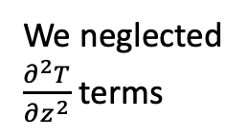
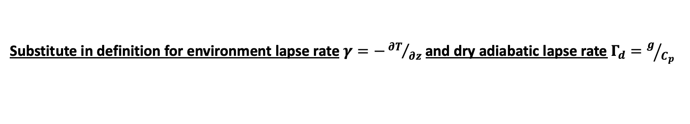
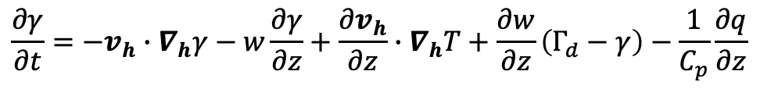
Lapse Rate Tendency
What physical processes alter the environment lapse rate?
Start with 1st Law of Thermodynamics
temperature
pressure
heating
rate
specific
heat
time
Expand full derivatives and assume hydrostatic conditions (OK for synoptic and mesoscale)
Relatively small,
assume hydrostatic

Slide 11
Lapse Rate Tendency
What physical processes alter the environment lapse rate?
Start with 1st Law of Thermodynamics
temperature
pressure
heating
rate
specific
heat
time
Expand full derivatives and assume hydrostatic conditions (OK for synoptic and mesoscale)
Relatively small,
assume hydrostatic
Lapse rate tendency equation

Slide 12
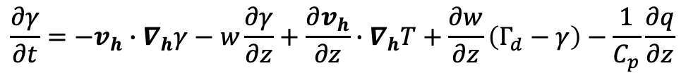
Lapse Rate Tendency Equation
A
B
C
D
E
F
We’ll work through each term to understand the physical mechanisms

Slide 13
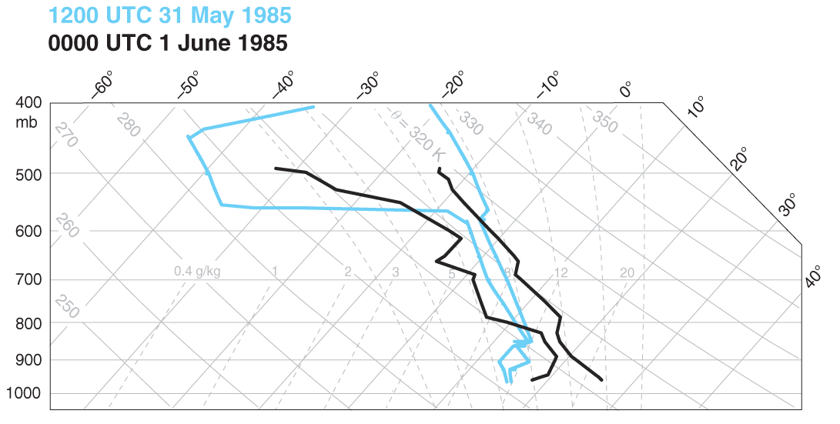
Lapse Rate Tendency Equation
A
B
C
D
E
F
Term A: local time rate of change of environment lapse rate
(Markowski and Richardson 2010, Fig. 7.3)

Slide 14
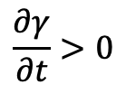


Lapse Rate Tendency Equation
A
B
C
D
E
F
Term A: local time rate of change of environment lapse rate
lapse rate increasing at PIT
due to warming below 600 mb
(Markowski and Richardson 2010, Fig. 7.3)

Slide 15
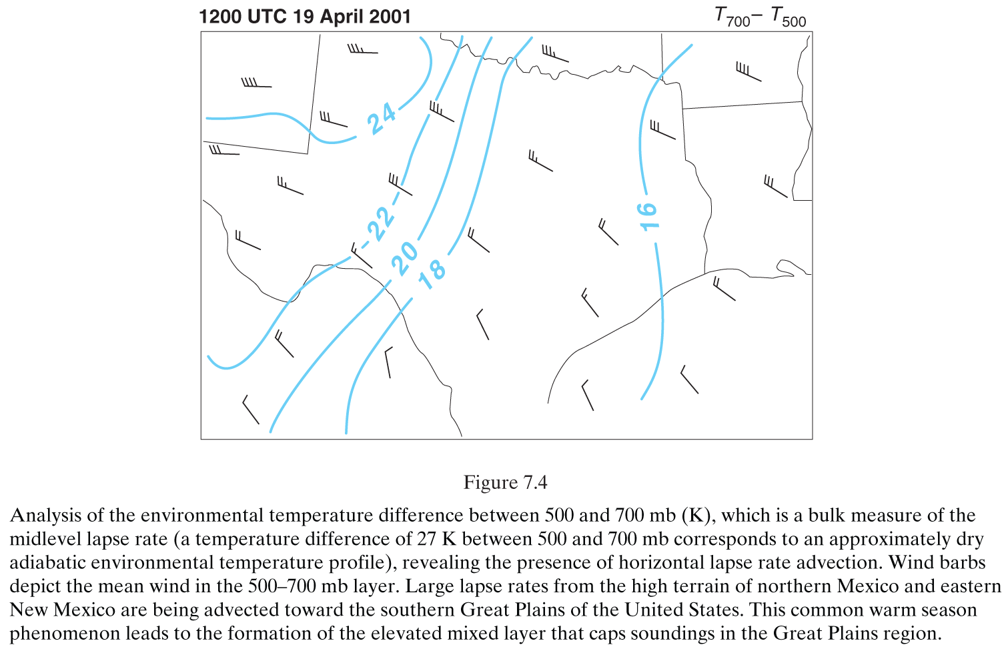
Lapse Rate Tendency Equation
A
B
C
D
E
F
Term B: horizontal lapse rate advection - this one is very important! Let’s take a closer look!
(Markowski and Richardson 2010, Fig. 7.4)

Slide 16
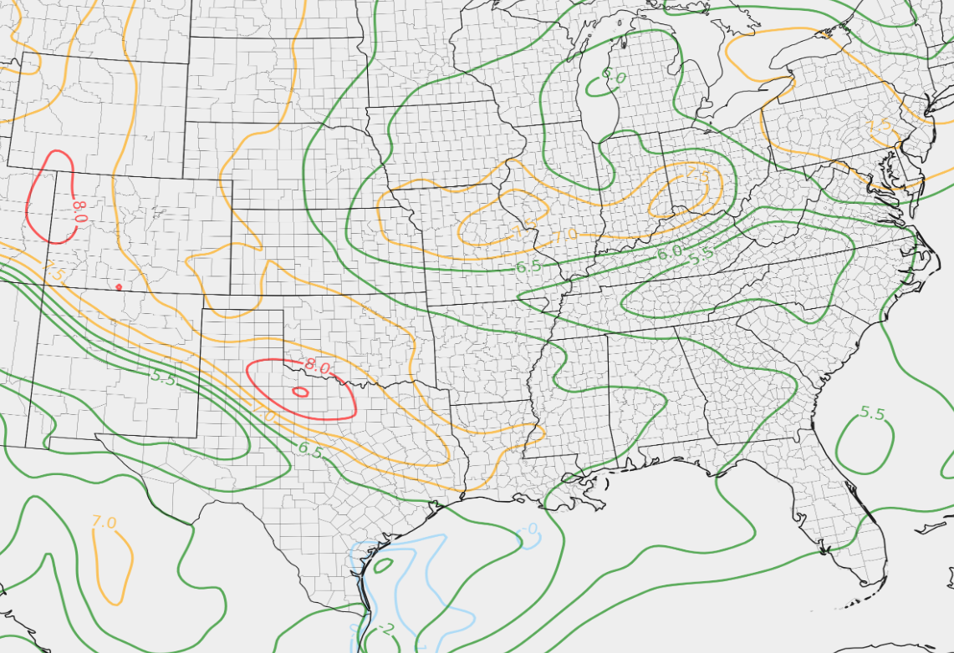
700-500 mb lapse rates
700-500 mb mean wind
Given these wind vectors, what do you expect to happen to the lapse rates at LZK?
LZK

Slide 17
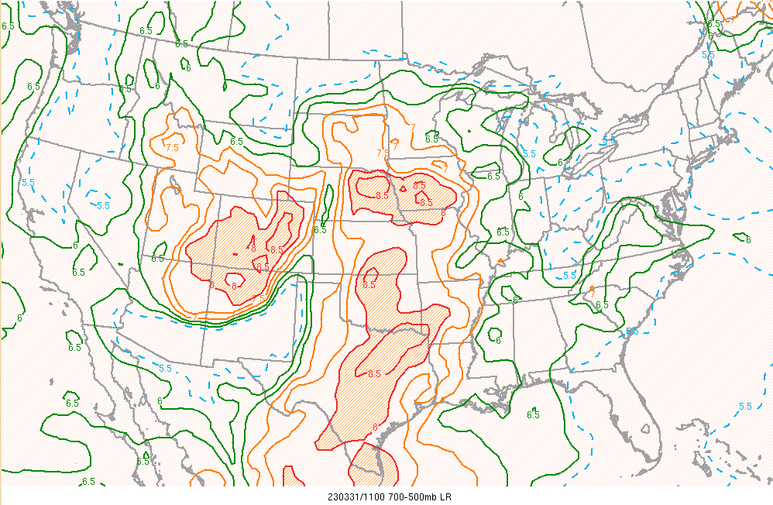
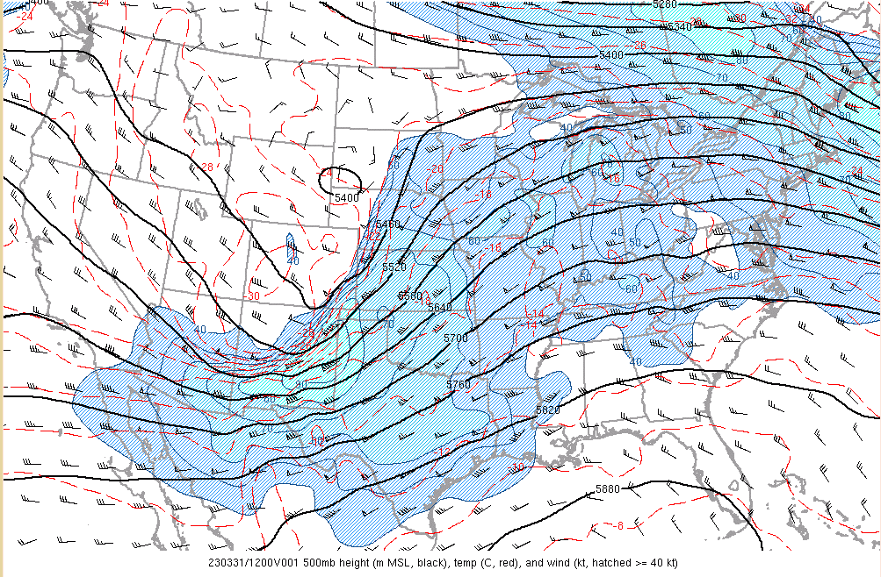
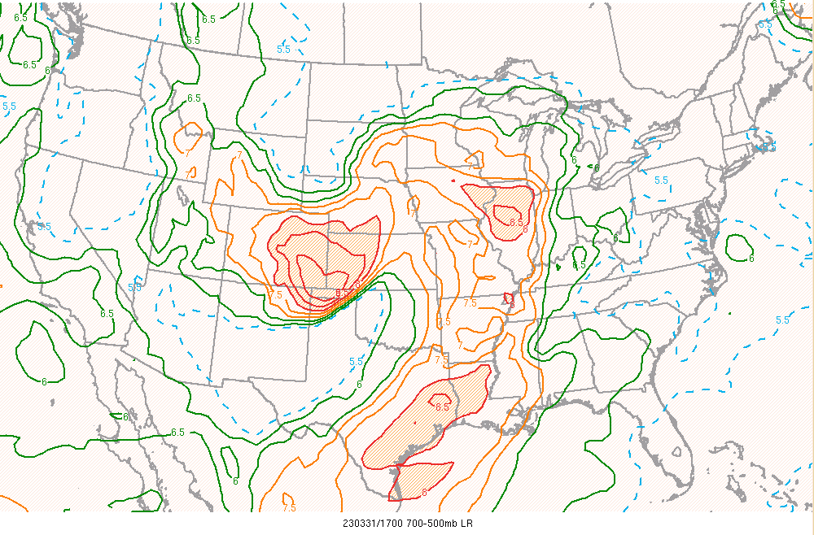
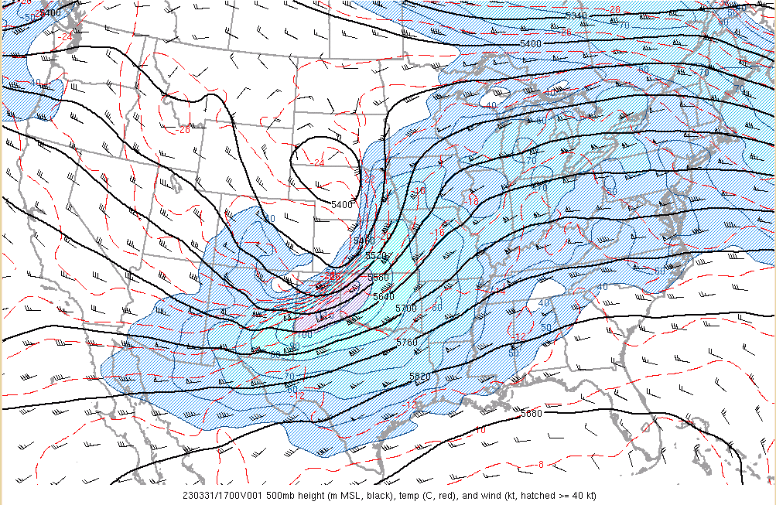
Example from March 31, 2023
Tornado Outbreak

Slide 18
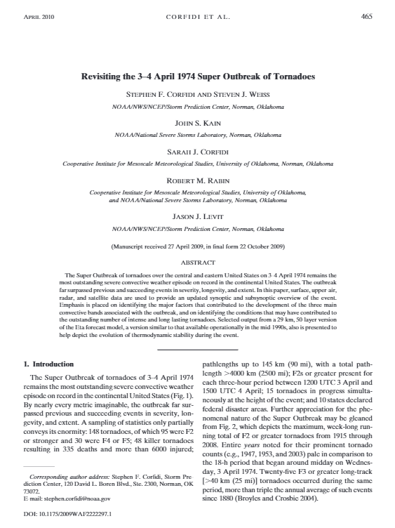
Example from March 31, 2023
Tornado Outbreak
Just like moisture, lapse rates can be tracked days ahead of a severe weather outbreak!

Slide 19
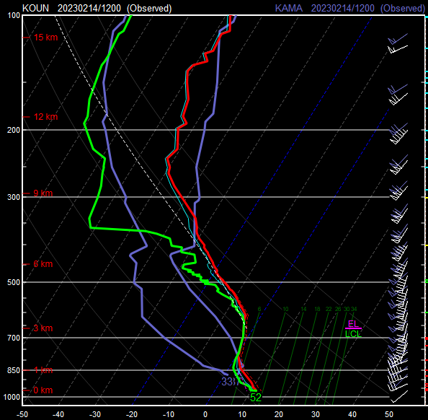
Here’s another example.
Notice the steeper lapse rates upstream at AMA.
Given westerly winds, what do you think will happen to the lapse rates at OUN?
Downstream
OUN sounding
Notice westerly
Flow at AMA
Upstream AMA
sounding

Slide 20
Break! Will resume on Friday!

Slide 21
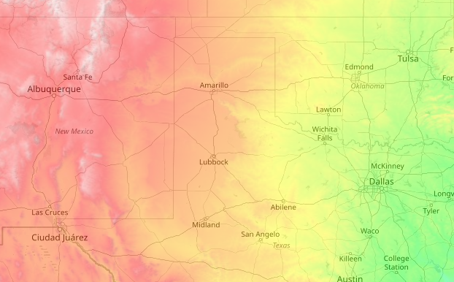

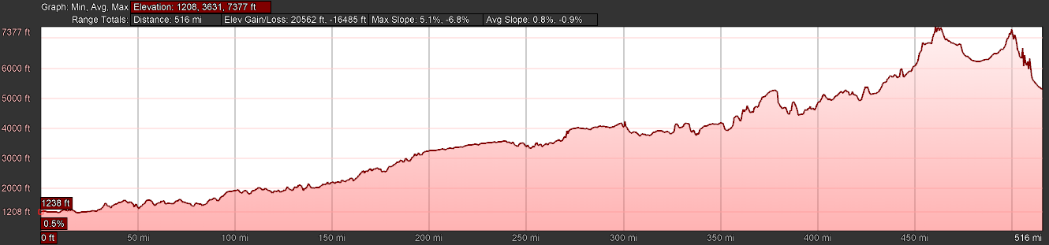
Consider the terrain!
Elevation generally increases as you go west towards the mountains. What would happen if we advected a surface parcel from ABQ to OUN?
ABQ
OUN
5309 ft MSL
1238 ft MSL

Slide 22
Consider the terrain!
Elevation generally increases as you go west towards the mountains. What would happen if we advected a surface parcel from ABQ to OUN?
Parcel is now at a higher altitude AGL!
ABQ
OUN
5309 ft MSL
1238 ft MSL

Slide 23
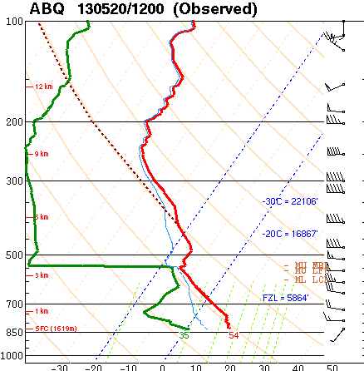
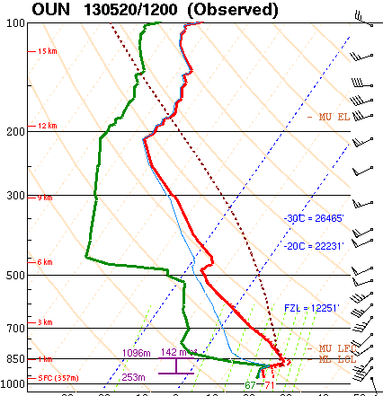
The last slide was a slight exaggeration of what occurs (parcels can descend in altitude), but illustrates an important point.
The deep, well-mixed boundary layer over the southern Rockies can be advected east over the plains…
And becomes an Elevated Mixed Layer!
OUN-ABQ Terrain Profile
ABQ
OUN
5309 ft MSL
1238 ft MSL

Slide 24
This is an important process for generating steep lapse rates over the Plains, which in turn support large CAPE values.
OUN-ABQ Terrain Profile
ABQ
OUN
5309 ft MSL
1238 ft MSL

Slide 25
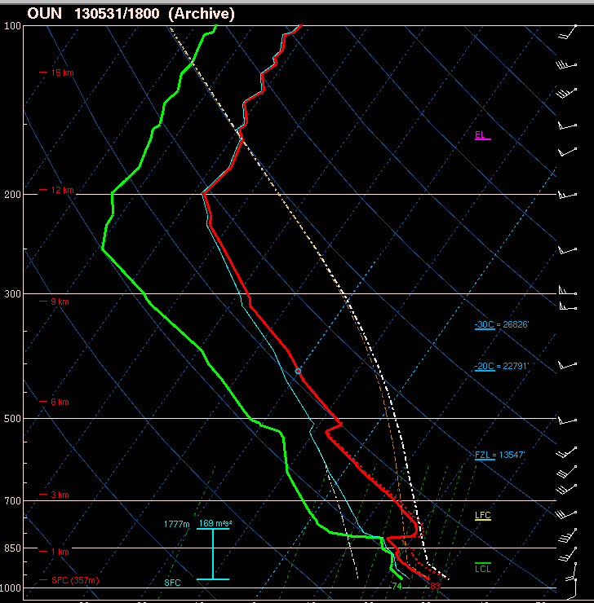
Nearly neutral layer
above boundary layer in
Norman noon sounding.
Notice the southwesterly flow in this layer - it likely originated from New Mexico plateau!

Slide 27
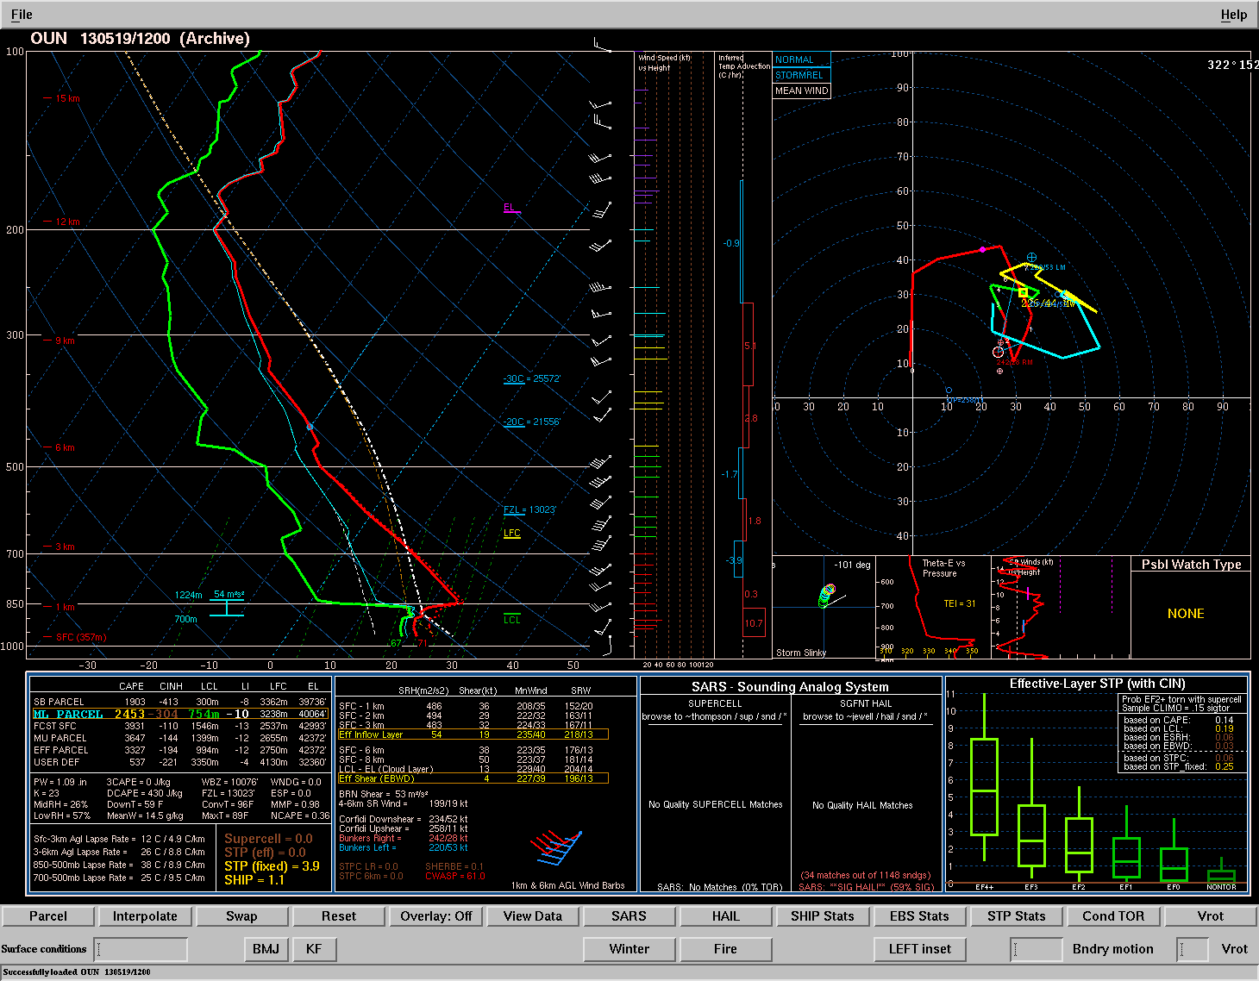
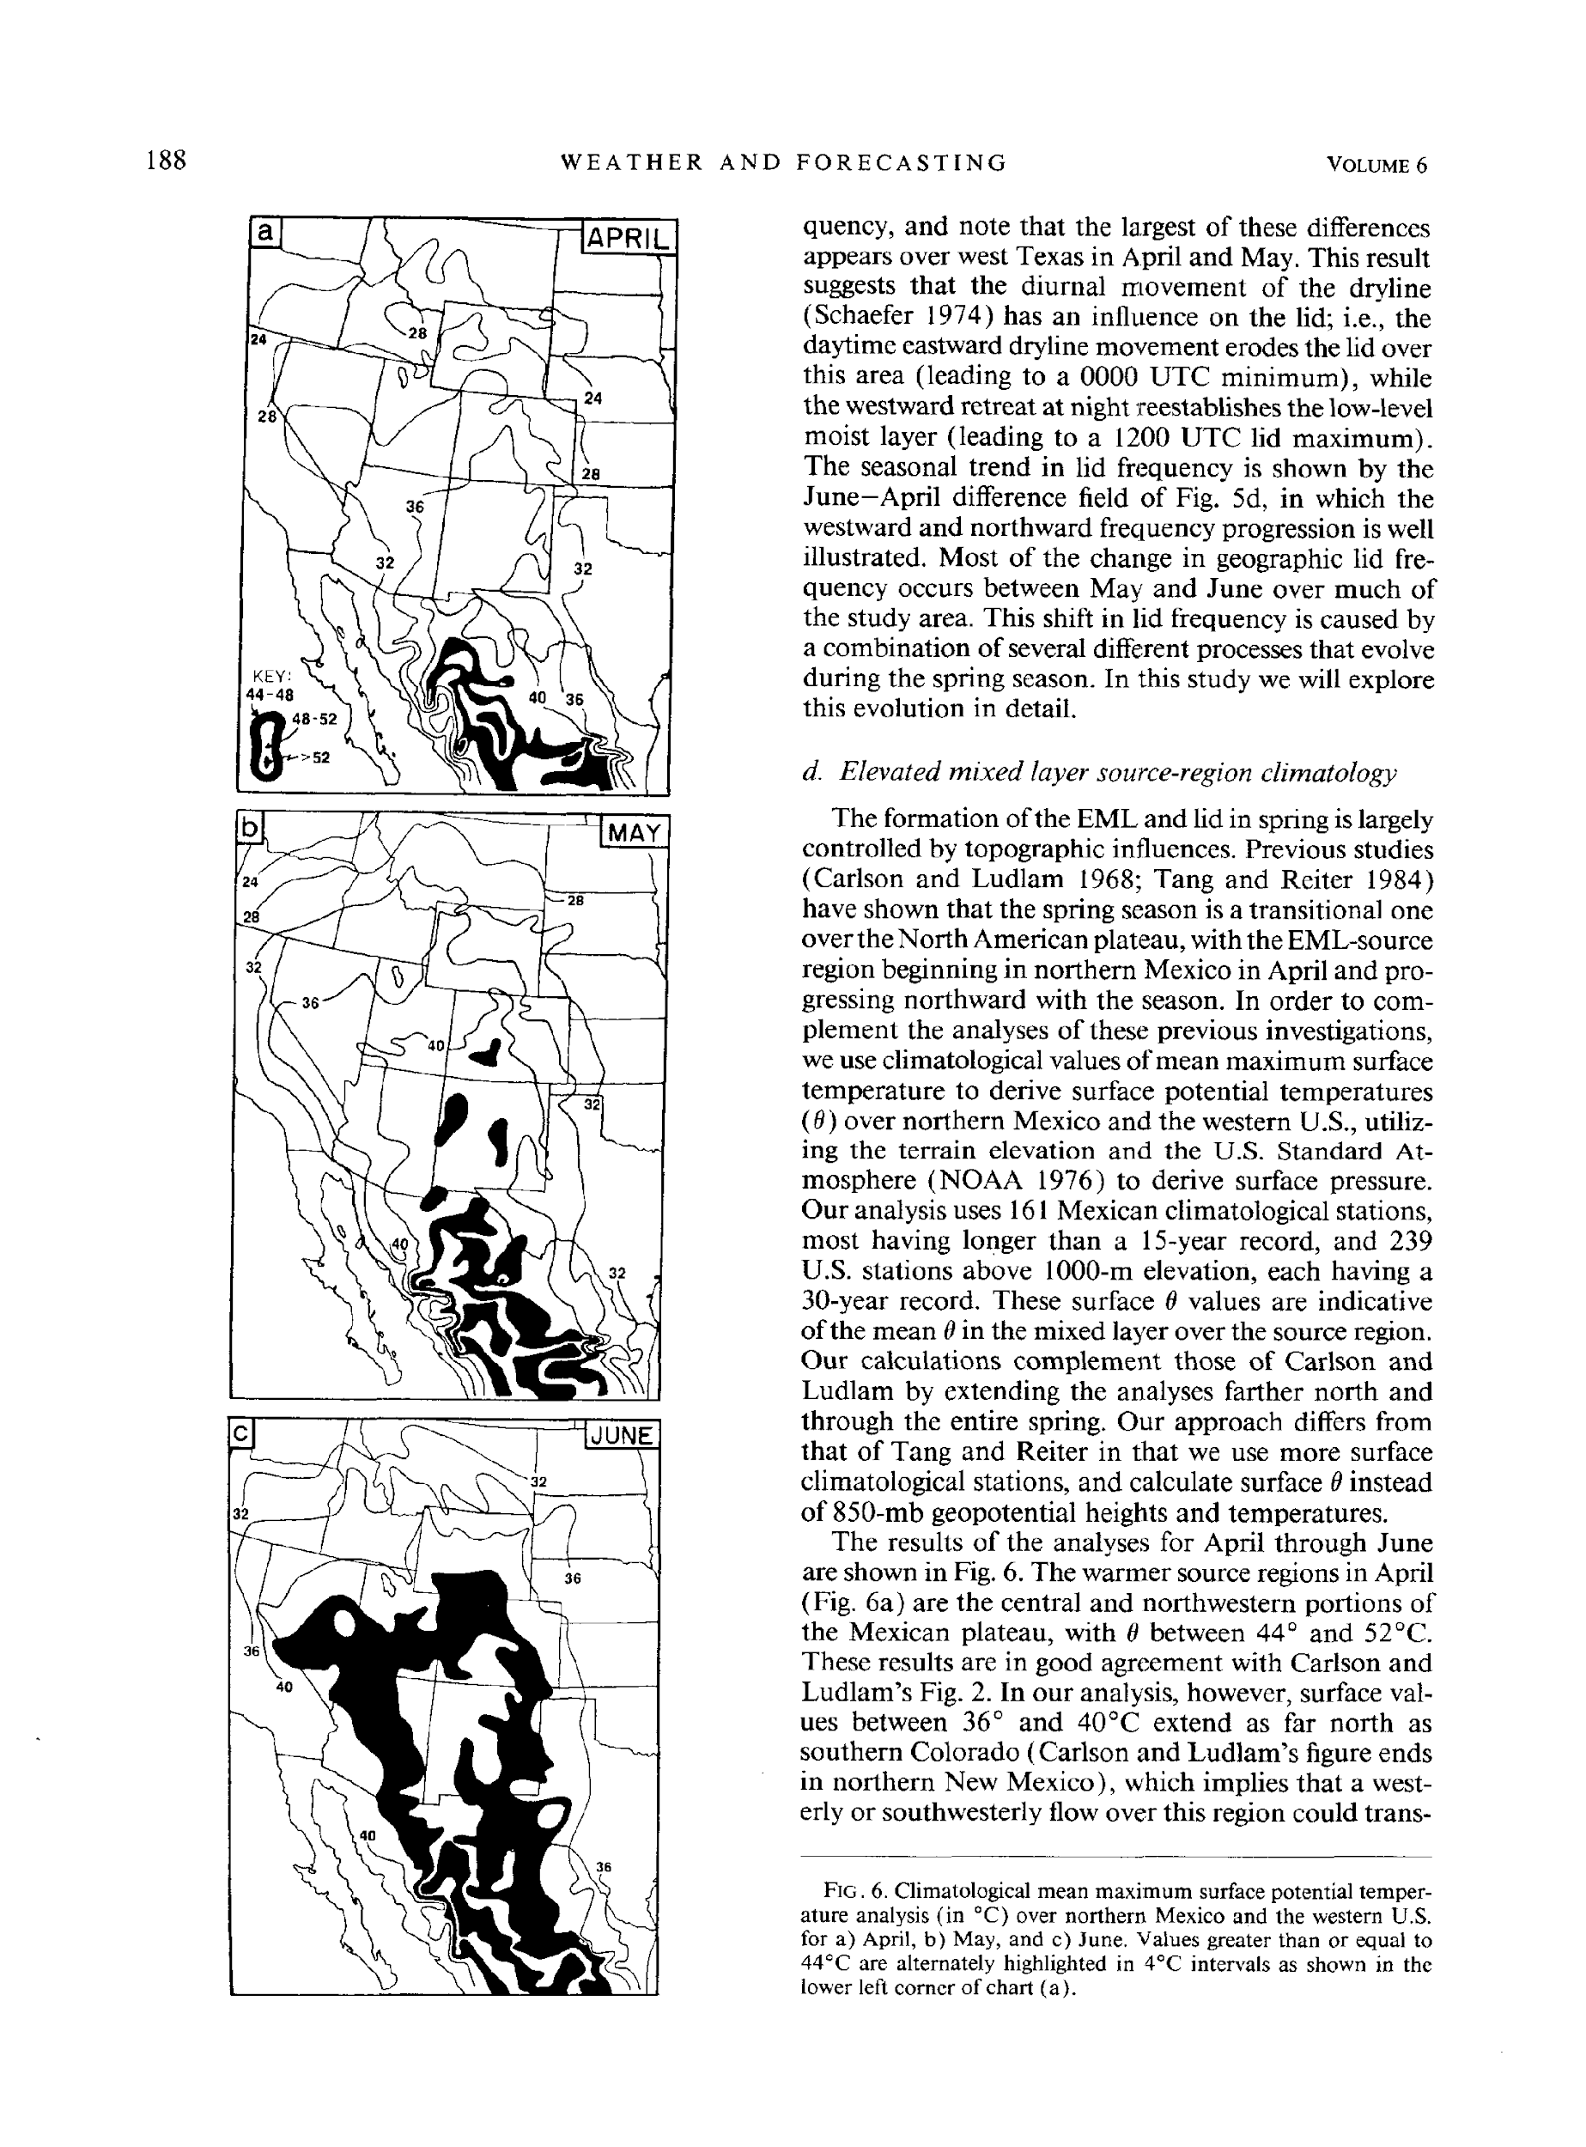
Lapse Rate Tendency
Horizontal lapse rate advection
early MAY
Climatology of
surface theta
(and EML)
Lanicci and Warner (1991)
early JUNE
early APR

Slide 28
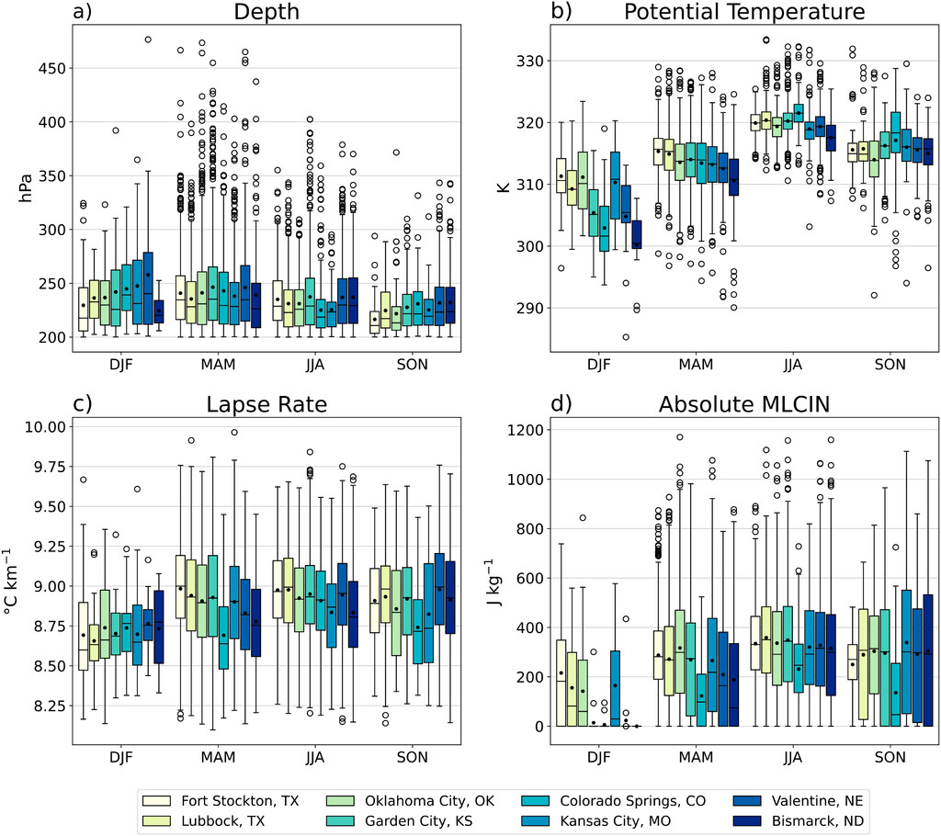
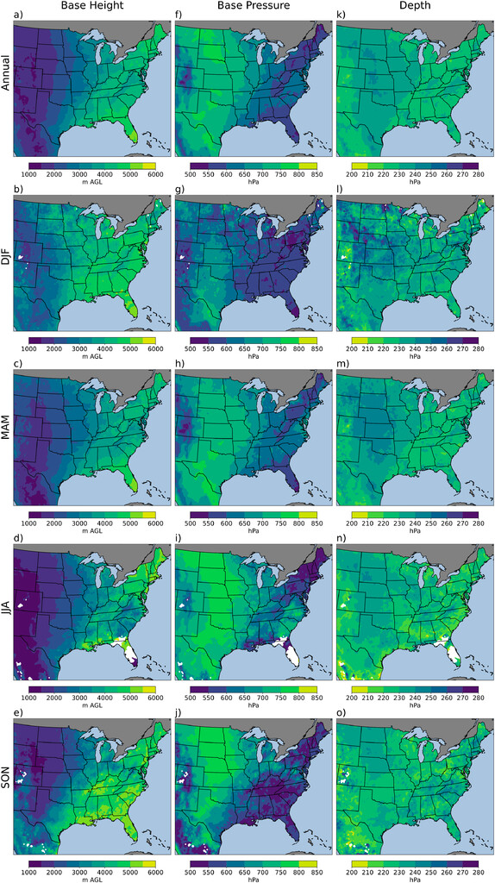

Slide 29
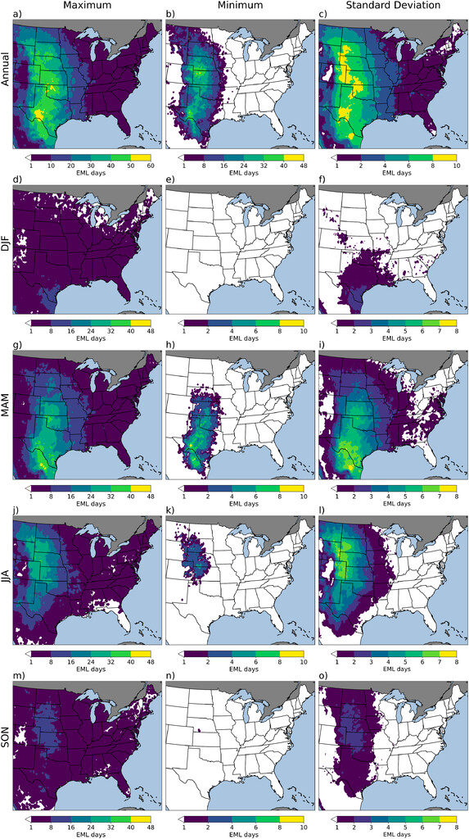
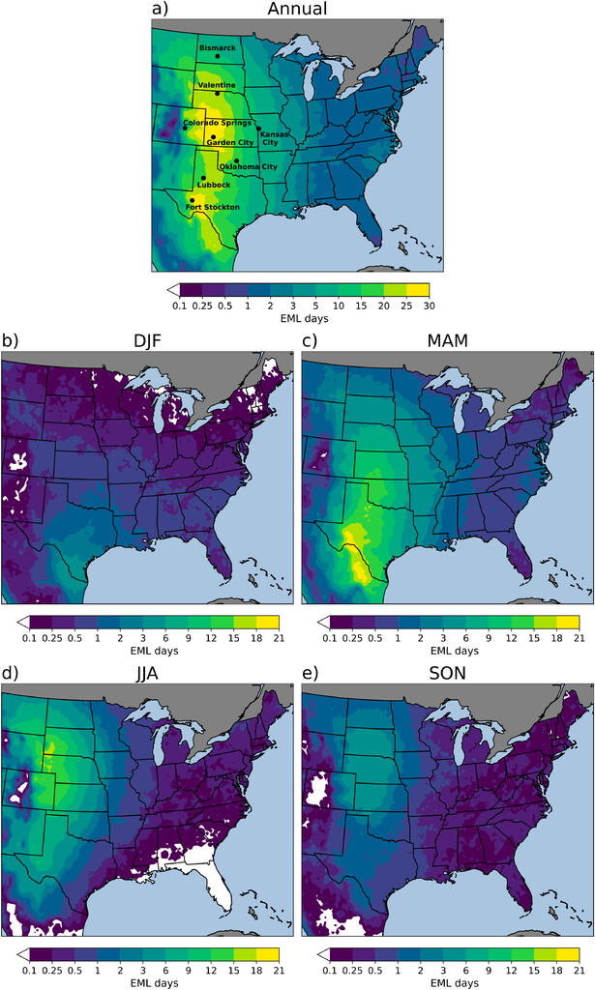
Source: Climatology of the Elevated Mixed Layer over the Contiguous United States and Northern Mexico Using ERA5: 1979–2021
Andrews et., al 2024 JOC

Slide 30
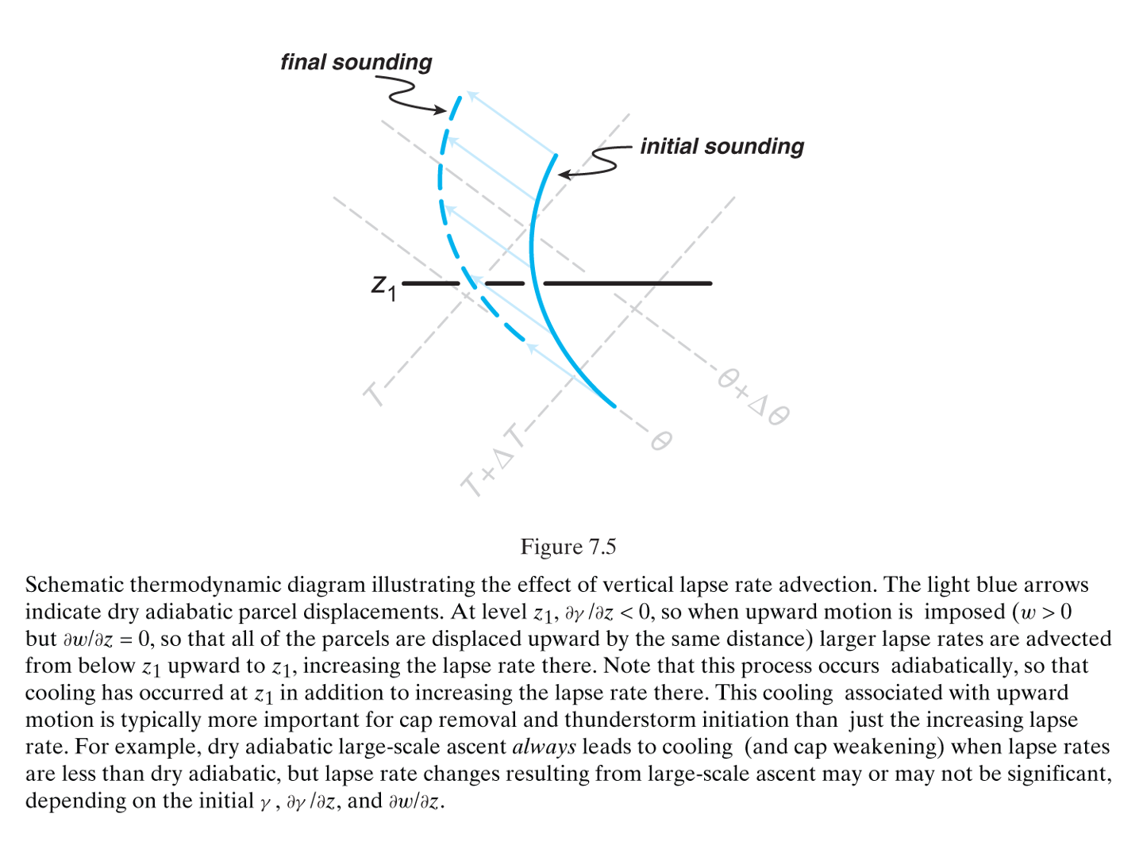
Lapse Rate Tendency Equation
A
B
C
D
E
F
Term C: vertical lapse rate advection
(Markowski and Richardson 2010, Fig. 7.5)

Slide 31
Lapse Rate Tendency Equation
A
B
C
D
E
F
Term C: vertical lapse rate advection
Positive lapse rate advection will contribute to increasing lapse rates
In this case, lapse rates at level z1 increase as steeper lapse rates from below are advected upward
Can be order of magnitude larger than term B on mesoscale
What mesoscale features might this be important for?
(Markowski and Richardson 2010, Fig. 7.5)

Slide 32
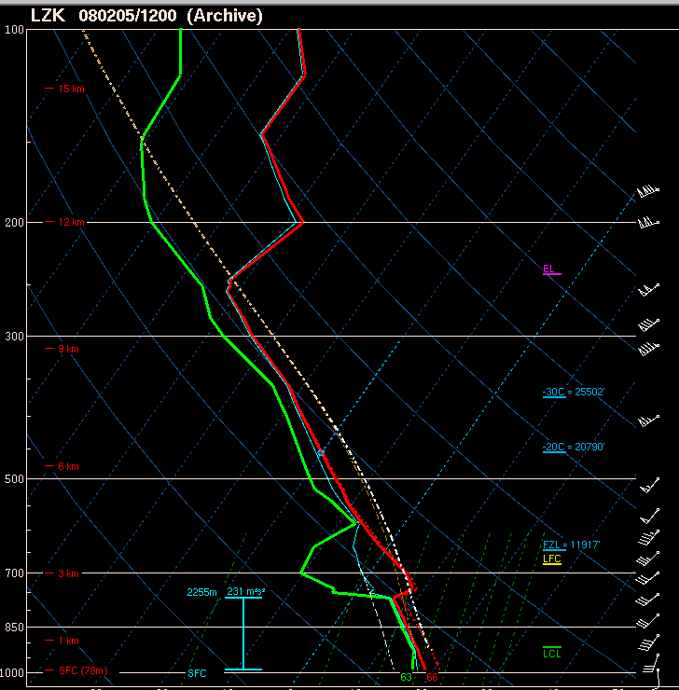
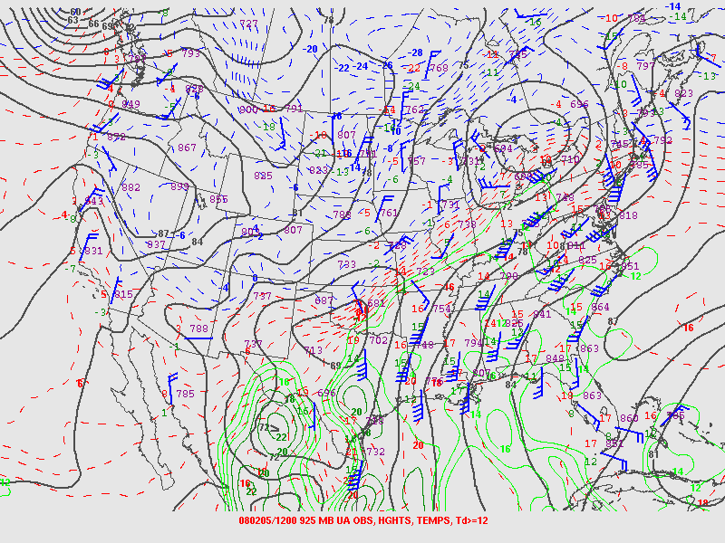
Influence of Lift/Stretching
Influence of persistent lift/stretching
L.R. steepens
L.R. steepens

Slide 33
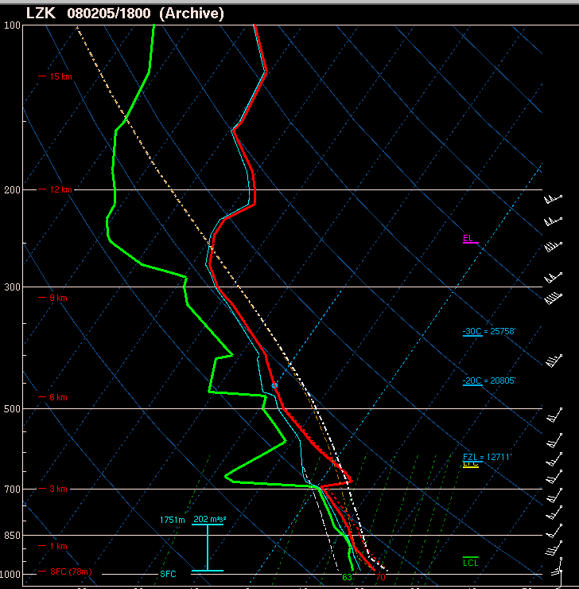
Influence of Lift/Stretching
Influence of persistent lift/stretching
L.R. steepens
L.R. steepens

Slide 34
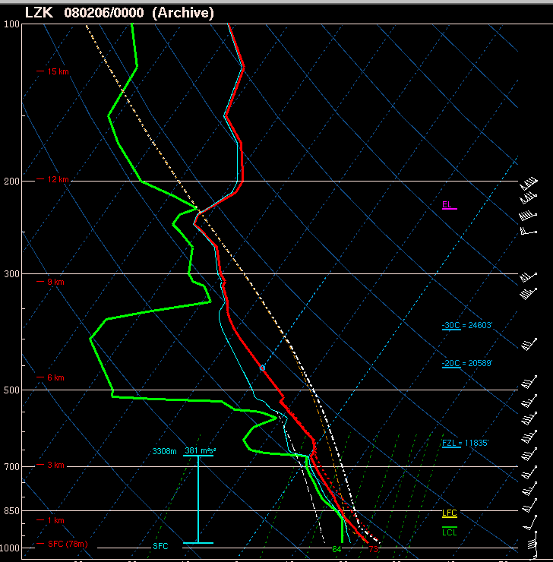
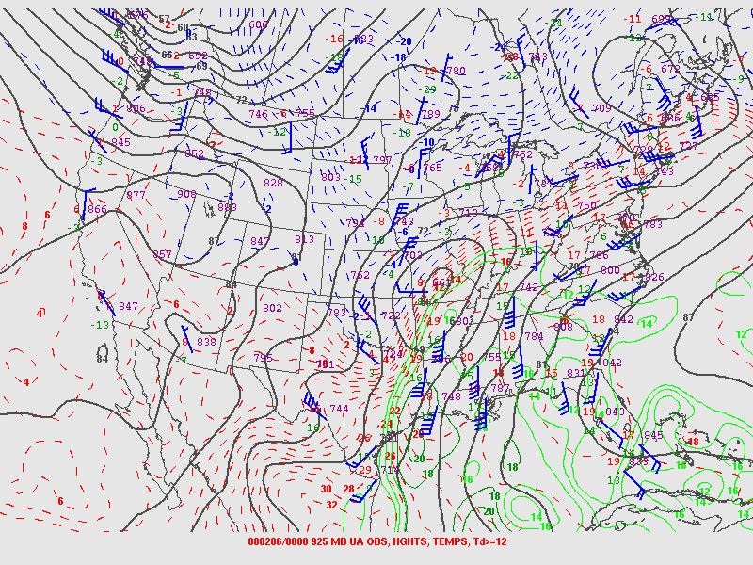
Influence of Lift/Stretching
Influence of persistent lift/stretching
L.R. steepens
L.R. steepens

Slide 35
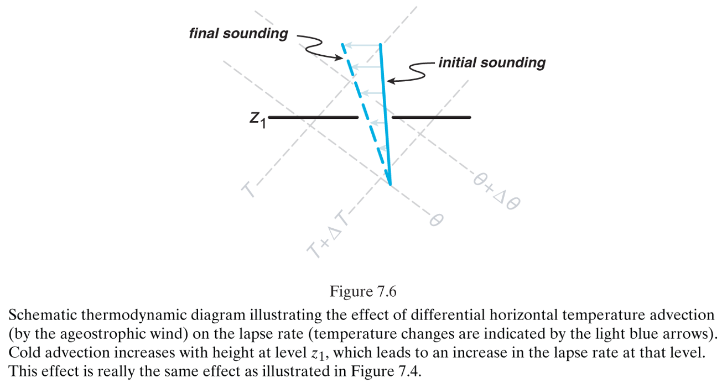
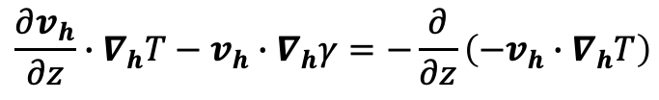
Lapse Rate Tendency Equation
A
B
C
D
E
F
Term D: when combined with term B, this term represents differential temperature advection
(Markowski and Richardson 2010, Fig. 7.6)

Slide 36
Lapse Rate Tendency Equation
A
B
C
D
E
F
Term D: when combined with term B, this term represents differential temperature advection
Lapse rates will increase in situations where cold advection is increasing with height or warm advection is decreasing with height
In this case, lapse rates at level z1 increase in response to cold air advection increasing with height
Can be order of magnitude larger than term B on mesoscale
(Markowski and Richardson 2010, Fig. 7.6)

Slide 37
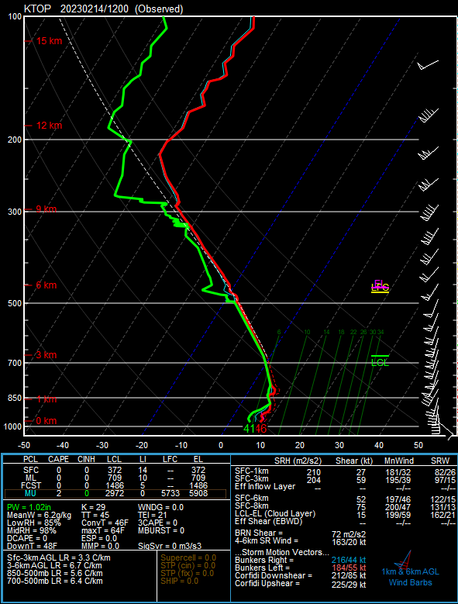
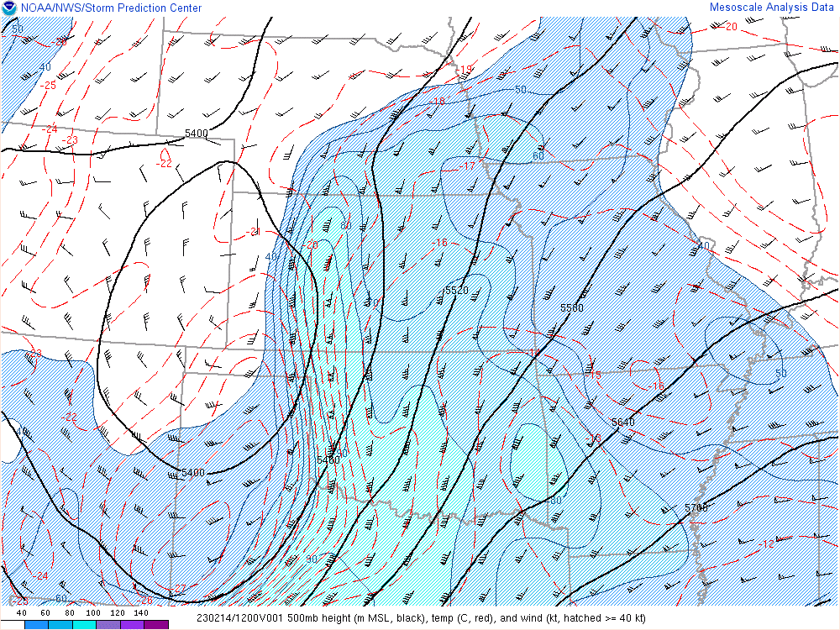
Differential Thermal Advection

Slide 38
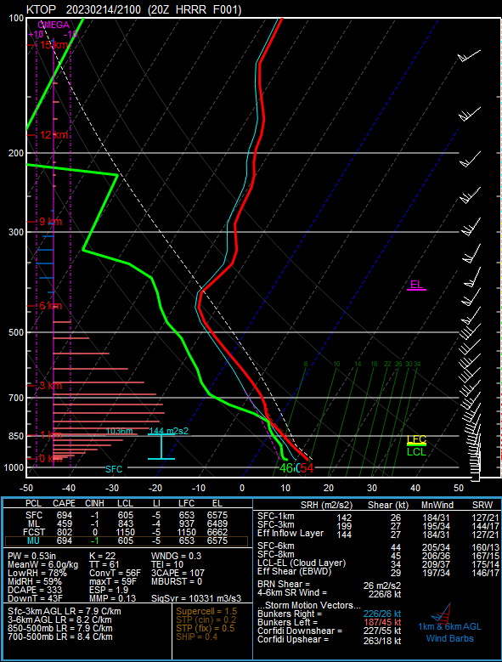
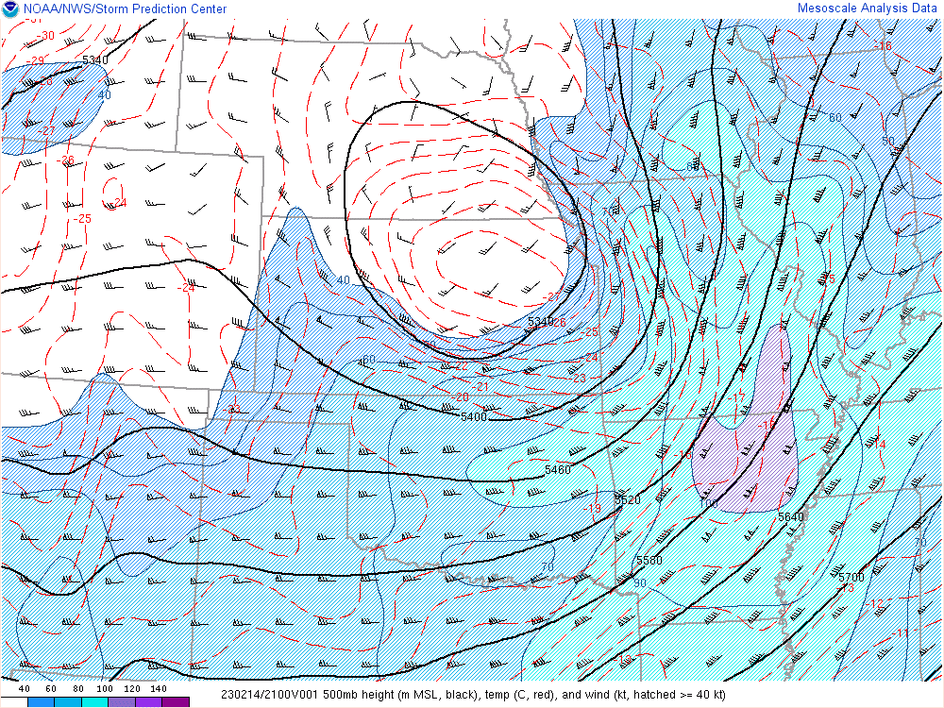
Differential Thermal Advection
Cooling aloft
Warming
down low

Slide 39
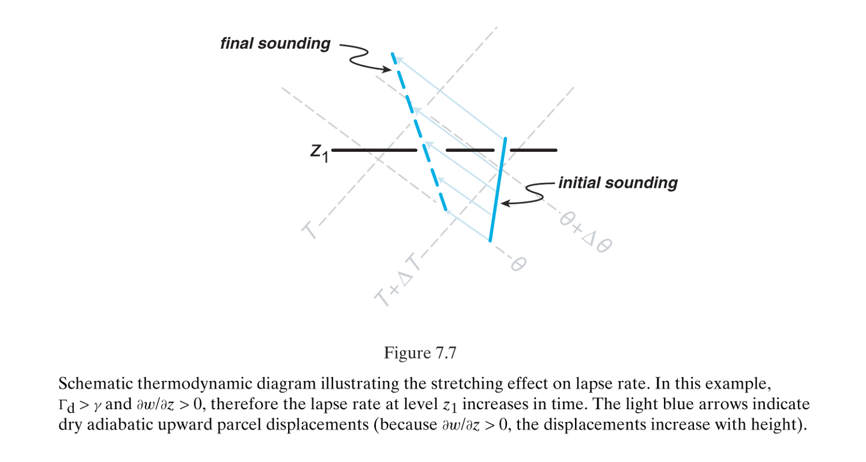
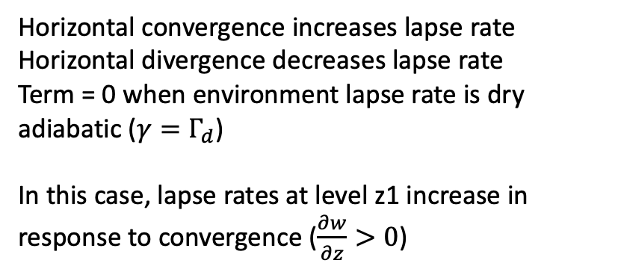
Lapse Rate Tendency Equation
A
B
C
D
E
F
Term E: stretching effect on lapse rate
Stronger ascent = cools faster
Weaker ascent = cools slower
Can be order of magnitude larger than term B on mesoscale
(Markowski and Richardson 2010, Fig. 7.7)

Slide 40
Influence of Lift/Stretching
Influence of persistent lift/cooling
Lift erodes cap

Slide 41
Influence of Lift/Stretching
Influence of persistent lift/cooling
Lift erodes cap

Slide 42
Influence of Lift/Stretching
Influence of persistent lift/cooling
Lift erodes cap

Slide 43
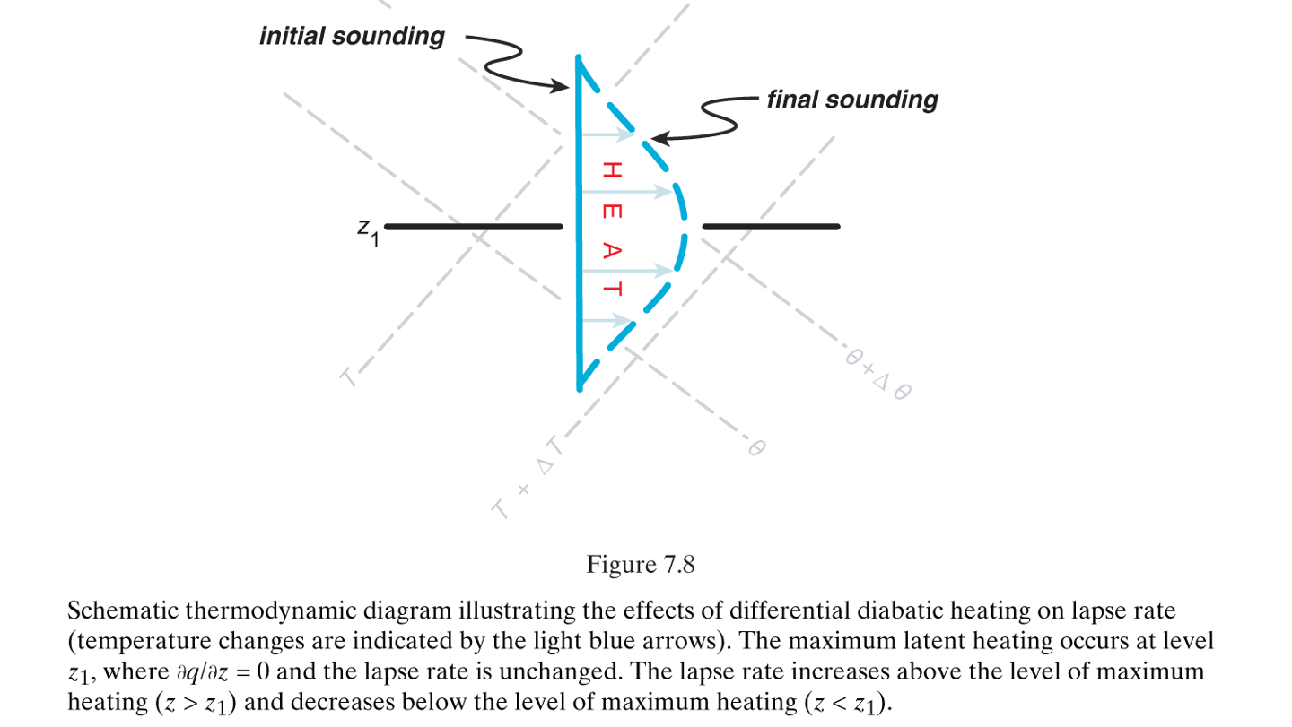
Lapse Rate Tendency Equation
A
B
C
D
E
F
Term F: diabatic heating effect on lapse rate
In this case, in response to a diabatic heating maximum at level z1, lapse rates increase above and decrease below level z1.
Where does most diabatic heating occur?
Can be order of magnitude larger than term B on mesoscale
(Markowski and Richardson 2010, Fig. 7.8)

Slide 44
T=morning
Maximum in
diabatic cooling
T=mid day
Radiation has reversed
sun warming the
ground
T= afternoon
Maximum solar
heating
Solar/terrestrial radiation of near surface air is a primary driver of low-level lapse rates.
Increases lapse rates near the ground when heated.
Heating is a very important part of convective development.

Slide 45
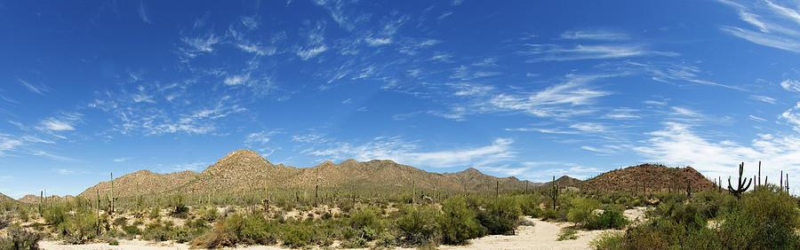
Initial Profile
Convection Occurs
Final Profile
Latent heat release warms temperatures
Evaporative cooling lowers temperatures

Slide 46
INFLUENCE OF FAILED CONVECTION
ON THE THERMODYNAMIC PROFILE
Weak ascent supports an initial, isolated updraft

Slide 47
INFLUENCE OF FAILED CONVECTION
ON THE THERMODYNAMIC PROFILE
Dry air entrainment near the capping inversion erodes the updraft.
Updraft may reach LFC, but residual updraft/pressure perturbation is too weak to support further development (turkey tower).
Convective initiation has failed.

Slide 48
INFLUENCE OF FAILED CONVECTION
ON THE THERMODYNAMIC PROFILE
Major assumption: On the mesoscale, the effects of evaporative cooling and mixing in a small layer (dz ~ 0) are larger than the amount of diabatic (latent heat) release from these small convective updrafts. This also assumes lift effects are not dominating.
Condensation leads to evaporative cooling in the path of the failed updraft cools/moistens the column.
This leads to a localized reduction in CIN by cooling environmental temperatures.
Latent heat release can also locally steepen lapse rates above failed CI.

Slide 49
INFLUENCE OF FAILED CONVECTION
ON THE THERMODYNAMIC PROFILE
If mesoscale lift continues in this localized area of reduced CIN, subsequent attempts at convective initiation have a higher probability of success!

Slide 50
INFLUENCE OF FAILED CONVECTION
ON THE THERMODYNAMIC PROFILE
Additional Considerations:
It may take multiple attempts at CI to sufficiently reduce CIN.
Consider time of day (is this occurring at 20 UTC (additional diurnal heating expected) or at 00 UTC (peak diurnal heating)?
Strong forcing for ascent can reduce CIN via lift/cooling and/or overcoming cap by lifting parcels to LFC (i.e. is the depth of the lift greater than the LFC?)
Watching satellite trends is vital!

Slide 51
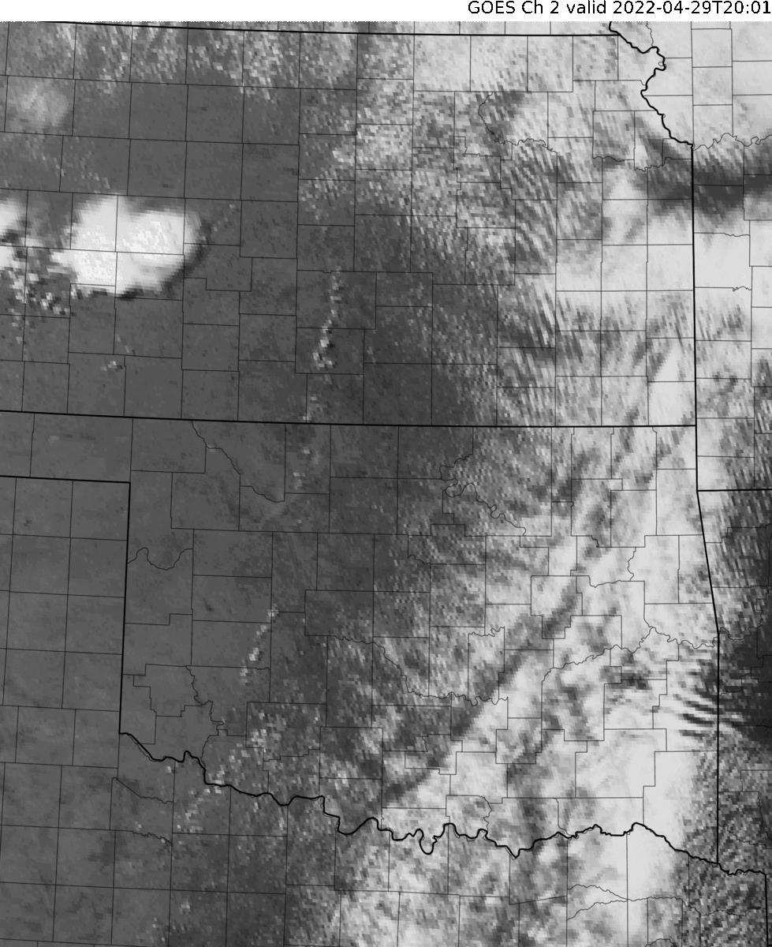
April 29, 2022
In this loop, watch for:
Initial attempts at CI along dryline
Successful CI following the failed attempts
Maturation of tornadic supercells

Slide 52

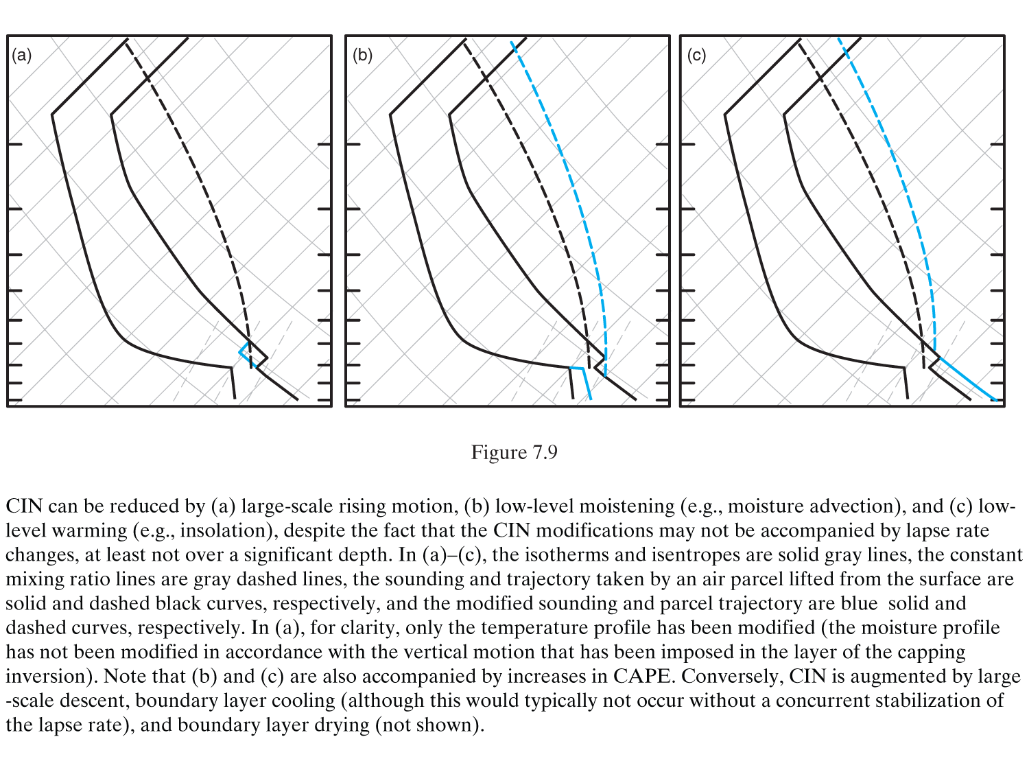
CIN can be reduced and/or CAPE increased by:
Rising motion
Low-Level Moistening
Low-Level Warming
(Markowski and Richardson 2010, Fig. 7.9)

Slide 53
In reality a combination of processes change 𝝲
Horizontal lapse rate advection
Differential thermal advection
Ascent stretching/vertical advection
Low-level diabatic heating
Net Effect: Steep lapse rates!

