Slide 1
The use of Convection-Allowing Models for Severe Weather Forecasting

Slide 2
What is Convection-Allowing Model (CAM)?
CAM means NWP models running at 1-4 km grid spacings so that convection is allowed to explicitly develop and evolve in the model, rather than relying on cumulus parameterization.
If convective storms are adequately resolved, the model can be called convection-resolving – believed to require sub-km grid spacings.
If CAM model can accurately predict the initiation and later evolution of convective storms, we will need to rely less on subjective projection based on environmental conditions.

Slide 3
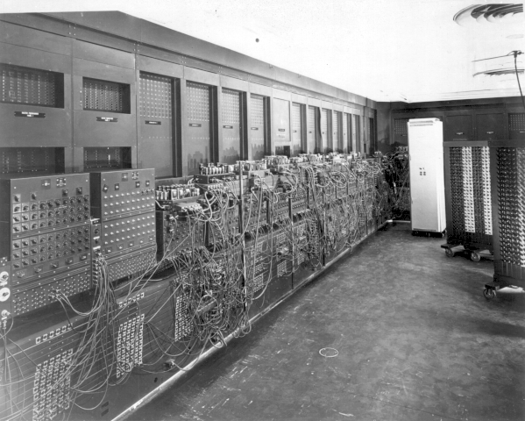
History of Numerical Weather Prediction (NWP)
NWP began in the 1920s through the efforts of Lewis Richardson, a British scientist, who produced a six-hour forecast by hand for the atmosphere over two points in central Europe, taking at least six weeks to do so, but the forecast was a failure because it was unknown that small enough time step size had to be used to ensure stable time integration.
NWP wasn’t practical until electronic computers were invented that made numerical integration faster than the weather evolution.
First useful NWP was made in 1950 on ENIAC using a 2D barotropic vorticity equation – can capture large scale Rossby waves
Operational NWP started in the U.S. in 1955
1st electronic computer ENIAC

Slide 4
History of Numerical Weather Prediction (NWP)
Earlier NWP models all made the hydrostatic assumptions, with horizontal grid spacings of tens to hundreds of kilometers.
Vertical velocity is diagnosed, not predicted by vertical momentum equation.
The horizontal grid spacings of hydrostatic models are too coarse to explicitly revolve/present convective storms. Convection is parameterized with cumulus schemes and only the bulk effects (latent heating, removal of instability, precipitation falling to ground) of convection is modeled.
To explicitly represent/resolve convection, grid spacings of few km are needed, and vertical velocity (which is directly responsible for convection) should be directly predicted.
Idealized three-dimensional thunderstorm simulations started in mid-1970’s.
  A lot was learned on supercell storm and squall line dynamics
Numerical prediction of thunderstorms did not begin until early 1990’s.

Slide 5
History of Numerical Weather Prediction (NWP)
Actually, the Center for Analysis and Prediction of Storms (CAPS) of OU was established as an NSF Science and Technology Center to tackle the exact problem of numerical prediction of thunderstorms.
“Lilly, D. K., 1990: Numerical prediction of thunderstorms - Has its time come?
QJRMS” discusses the vision of convective-scale NWP.
  Operational WSR-88D radar network, advent of massively parallel supercomputers, advanced data assimilation methods such as 4DVar, development of non-hydrostatic models made it possible.
Nonhydrostatic mesoscale models they were widely used for research and operational forecasting:
  Reginal Atmospheric Modeling System (RAMS) of CSU
  Advanced Regional Prediction System (ARPS) of OU
  Mesoscale Model version 5 (MM5) of Penn-State/NCAR
  Weather Research and Forecasting (WRF) model with 2 dynamic cores developed by NCAR and EMC/NCEP
The two dynamic cores of WRF have been used for regional operational forecasting at NCEP (WRF-ARW for RAP and HRRR, WRF-NMM/NMMB for NAM and NAM hi-res windows, and for hurricane forecasting)
The next version of regional model, Rapid Refresh Forecasting System (RRFS) will use the FV3 dynamics core, that is already used by GFS.

Slide 6
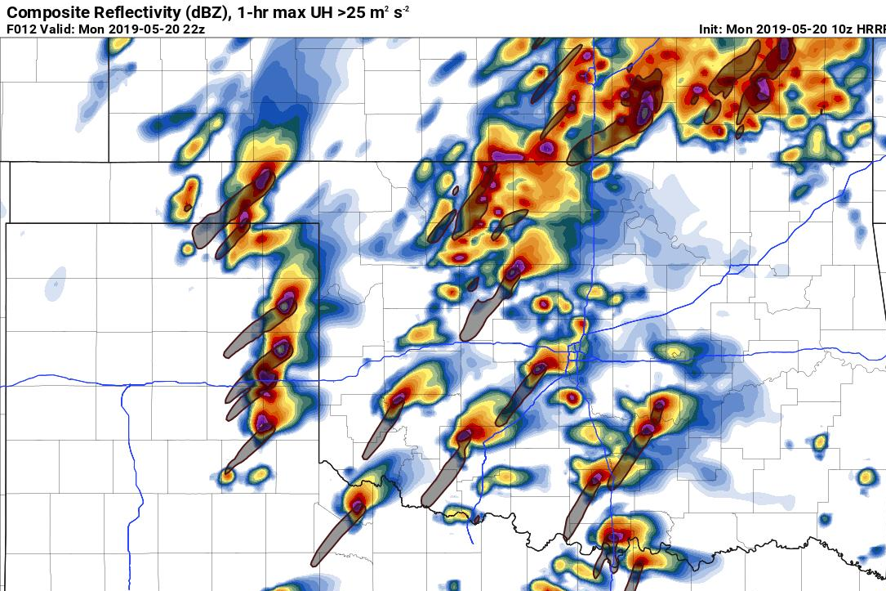
CAMS –Convection-Allowing Models
Forecast Applications and their Consequences
UH: Updraft Helicity
2-5 km integral of
w * ζ

Slide 7
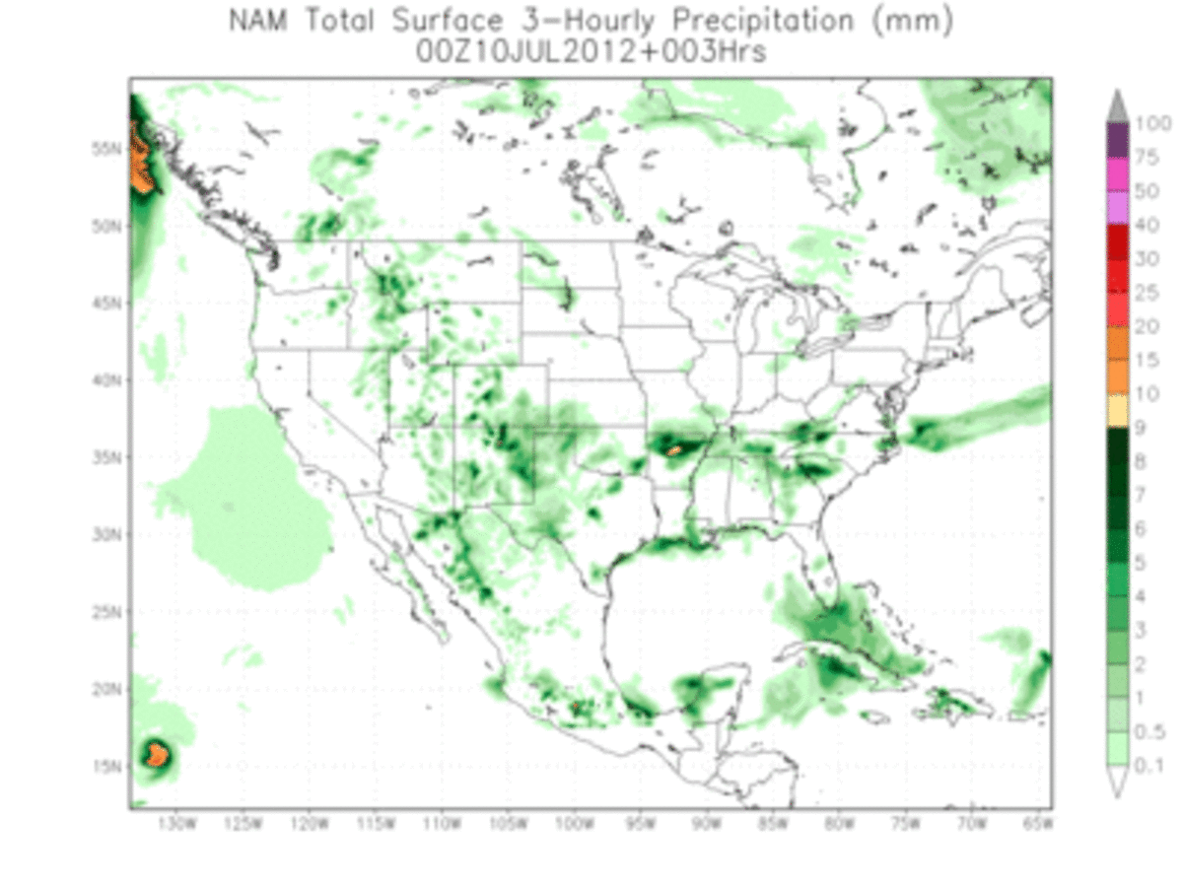
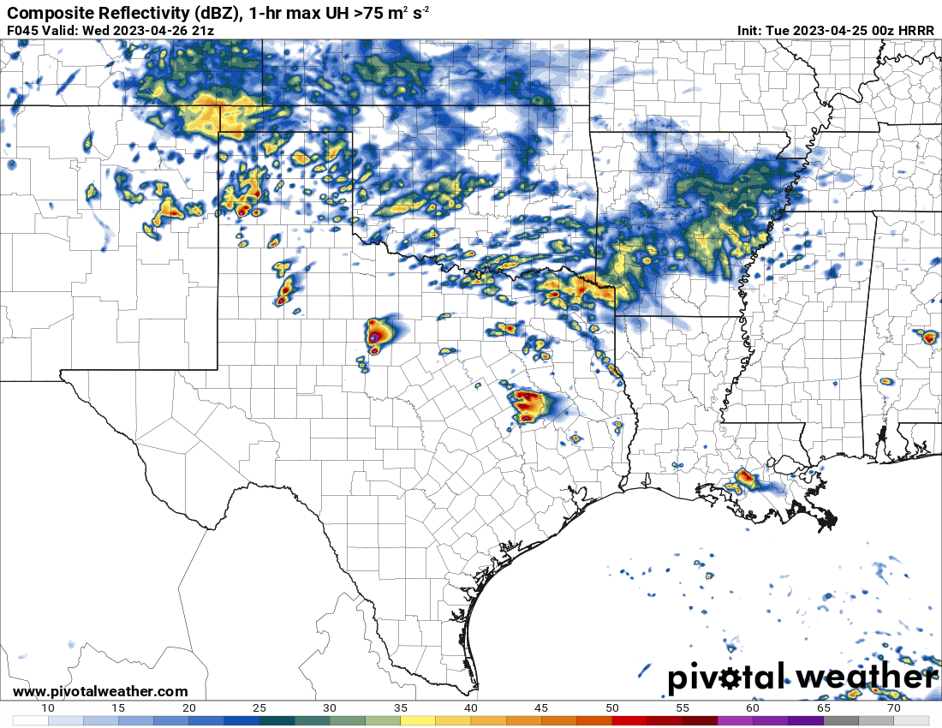
History and background:
Convection-Allowing or Convection-Permitting Models (CAMS) are high-res NWP models capable of explicitly representing convective scale processes.
  Small horizontal and vertical grid spacing (1-4 km)
    Event higher-resolutions qualify as convection-resolving
  Captures fast evolution of storms.
  Need to assimilate convective-scale observations
  CAPS started realtime testing at ~3 km grids in mid-1990’s
First CONUS-scale Experimental CAM (3-4km)
forecasts in early 2000s
  OU CAPS
  NSSL
  NCAR
Operational Models started in the mid 2000s
HRRR, NAM Hi-Res windows.
Still under active research in CAM forecasts, including model improvement, DA and ensemble forecasting.

Slide 8
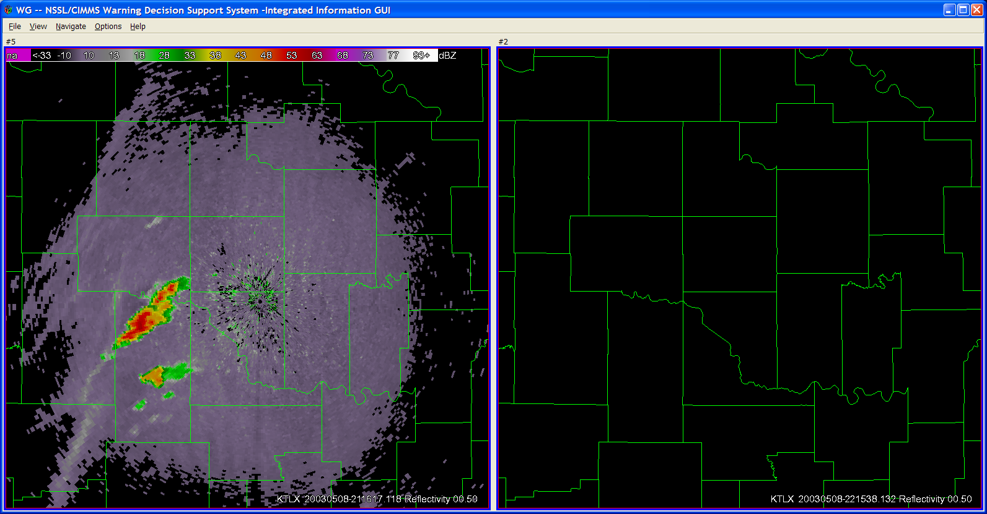
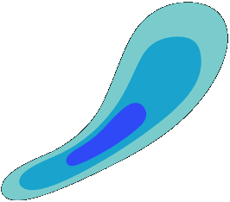
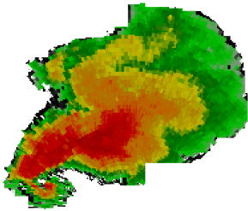
Vision: Warn-on-Forecast
Radar and Initial Forecast at 2100 CST
Radar at 2130 CST: Accurate Forecast
An ensemble of storm-scale NWP models predict the path of a potentially
tornadic storm. A Warning is Issued!
The warning issued based on the computer model forecast(s) includes detailed information on the expected event
Most
Likely
Tornado
Path
Most
Likely
Tornado
Path
Developing
Thunderstorm
30%
30%
50%
50%
70%
70%
T=2200 CST
T=2200 CST
T=2150
T=2150
T=2140
T=2140
T=2120 CST
T=2130
T=2120 CST
T=2130
Aim to more than triple current Tornado Warning lead times
Improved warnings allow enhanced community response
(Stensrud, Xue and others 2009)

Slide 9
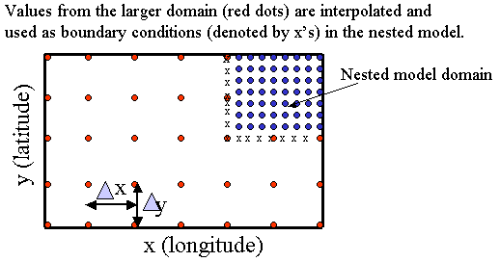
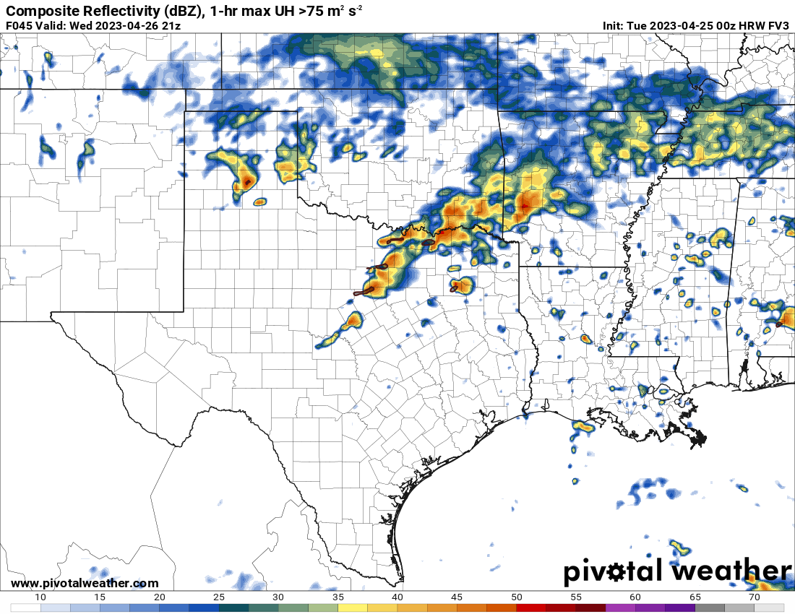
How CAMS Work
Small Horizontal and Vertical Grid Spacing. Lots of computer power.
Initial conditions obtained by assimilating high-resolution observations and sometimes radar data frequently, for HRRR at hourly intervals.
The lateral boundary conditions come from global model forecasts or from a larger-domain regional forecasts (e.g., HRRR from RAP)
Models are integrated with sub-minute time steps (sometimes a few seconds)
Output are typically produced at hourly or shorter intervals.
Special forecast products such as hourly max updraft helicity (UH) fields and radar reflectivity are produced within model or in postprocessing step.
Common CAM outputs include:
  Simulated Reflectivity
  Updraft helicity (UH) – w * vertical vorticity integrated over a depth
  Precip/Snow accumulation
  STP, Helicity, low-level vorticity/rotation

Slide 10
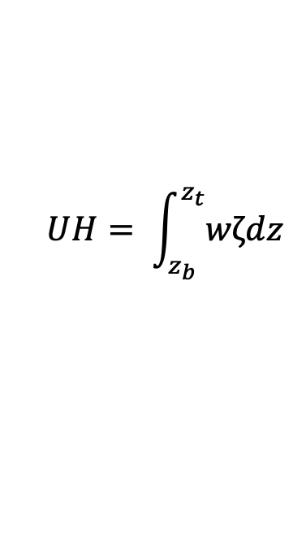
Updraft Helicity (UH)
$$UH= \int_{z_{b}}^{z_{t}}{wζdz}$$
For mid-level UH, used 1-6 km depth
For low-level UH, used 0-2 km depth
Look for positive values of UH, mid-level UH maximum accompanied by a low-level UH max
UH tracks have been shown to be one of the best forecast products/indicators for severe weather including tornado and hail

Slide 11
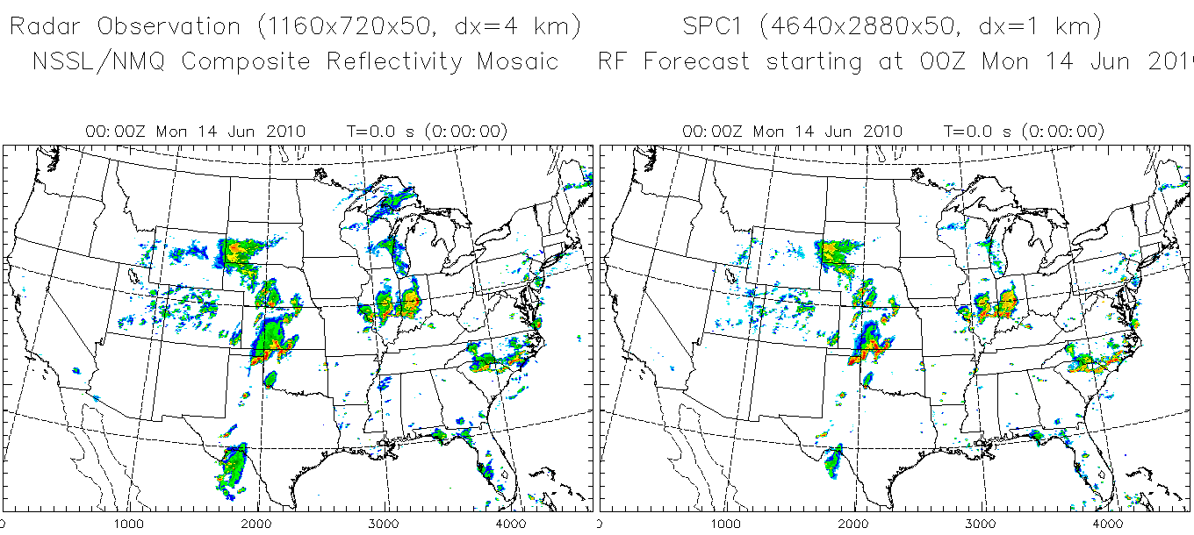
June 14, 2010 – Oklahoma City Flooding Case
Radar reflectivity observation 1 km CAPS realtime forecast using WRF
Movie

Slide 12
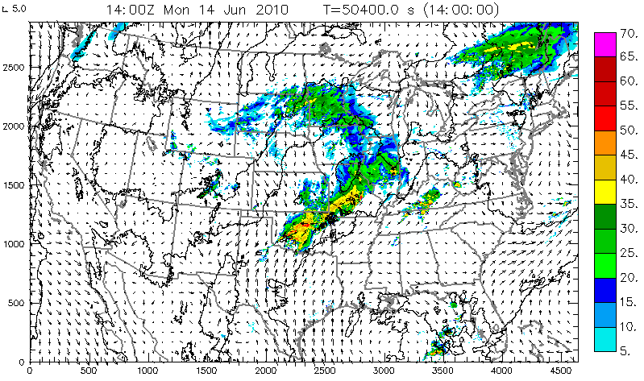
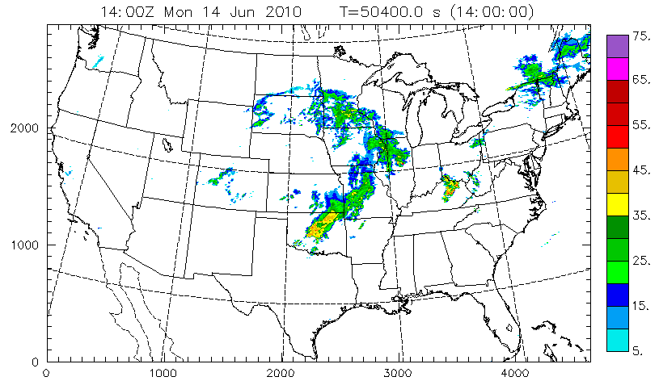
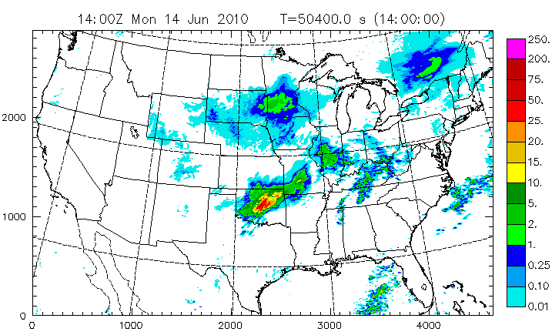
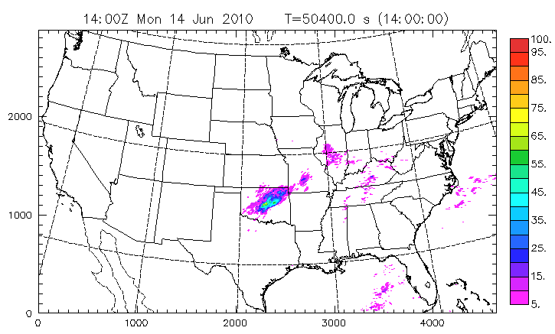
June 14, 2010 – OKC Flooding Case
1 km forecast reflectivity
Observed reflectivity
Max=125mm
Max=71%
Probability-matched
ensemble mean hourly precip
probability of hourly
precipitation >0.5 inch

Slide 13
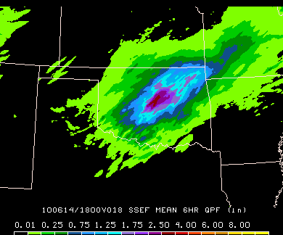
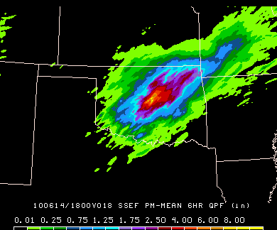
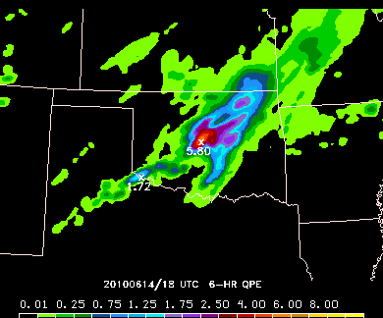
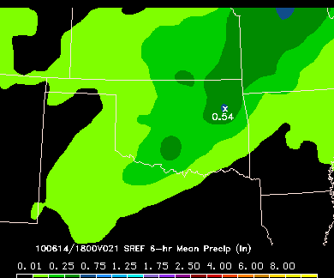
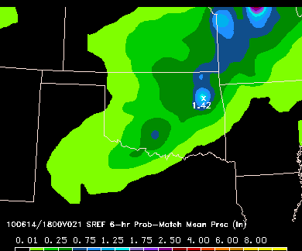
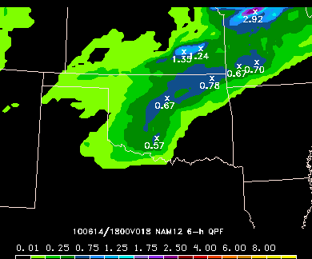
12–18Z accumulated precipitation: 18h
(June 14, 2010 – OKC Flood Day)
SSEF mean
CAPS SSEF Prob match
QPE
NCEP SREF mean
NCEP SREF Prob match
NCEP 12 NAM
NWS Operational Fcsts

Slide 14
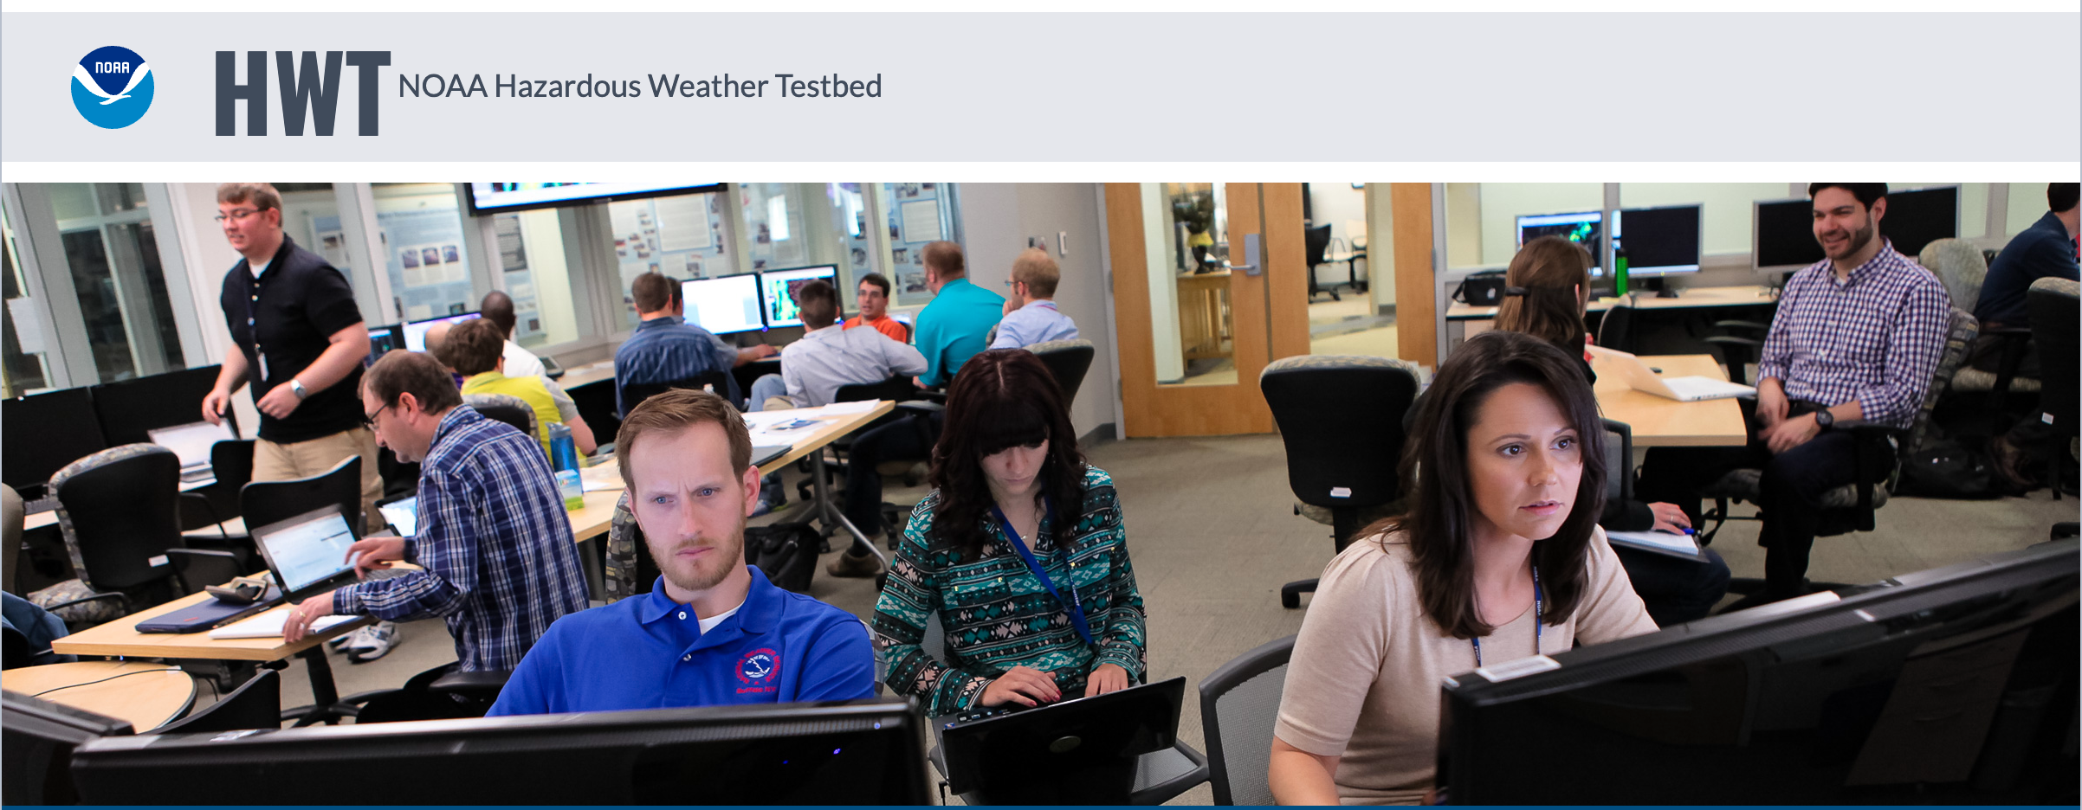
Experimental Forecast Products Produced and Evaluated during Hazadous Weather Testbed (HWT) Spring Experiments

Slide 15
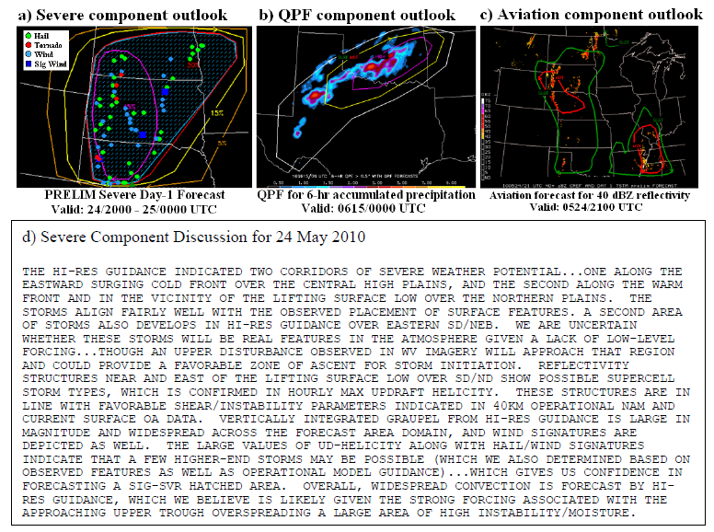
Probabilistic Forecasts for Severe, QPF (>0.5 inch/6h) and Aviation Weather (Z>40dBZ) and Verifying Weather
(Clark et al. 2012 BAMS)
Notes:
(a) A preliminary (i.e., issued the morning of 24 May 2010) severe weather outlook valid for the 4-h period 2000 UTC 24 May – 0000 UTC 25 May 2010. Contours for 5% (brown), 15% (yellow), 30% (red), and 45% (purple) probabilities of severe weather (i.e., tornadoes, hail size ≥ 1-inch, and wind gusts ≥ 50 knots) within 25 miles of a point are shown. The hatching marks areas with 10% or greater probability of significant severe weather (i.e., EF2 or greater tornadoes, hail size ≥ 2-inch, and wind gusts ≥ 65 knots) within 25 miles of a point. Locations of observed severe weather during the outlook period are marked (see legend in upper left). (b) A QPF outlook for 6-h accumulated precipitation greater than 0.5-inch for the period ending 0000 UTC 15 June 2010. Contours for 25% (slight; white), 50% (moderate; yellow), and 75% (high; purple) probabilities are shown. Areas where observed precipitation was greater than 0.5-inches during the outlook period are shaded (first shading level is for 0.5-in). (c) A preliminary aviation outlook for instantaneous reflectivity greater than 40 dBZ valid 2100 UTC 24 May 2010. Contours for 25% (slight; green) and 50% (moderate; red) are shown. Areas where observed reflectivity was greater than 40 dBZ at the valid time are shaded. d) The accompanying severe component discussion.

Slide 16
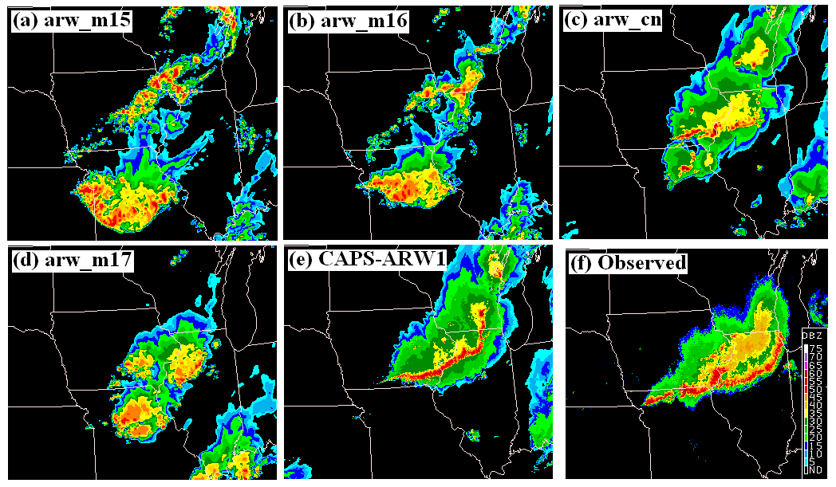
Products – Simulated Reflectivity
CAPS 1 km run
(Clark et al. 2012 BAMS)
Notes:
(a) – (d) Simulated composite reflectivity from SSEF members with identical configurations except for microphysics schemes for 27-h forecasts initialized 0000 UTC 18 June 2010. The microphysics schemes are (a) Thompson, (b) WDM6, (c) WSM6, and (d) Morrison. (e) Same as (c), except simulated composite reflectivity forecasts are from 1-km grid-spacing CAPS run. (f) Corresponding observations of composite reflectivity.

Slide 17
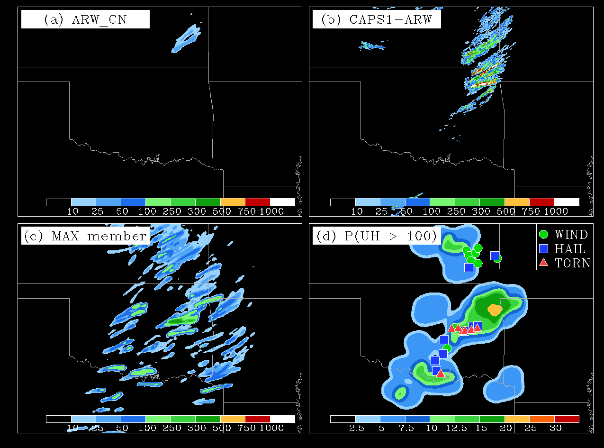
Hourly Maximum Updraft Helicity (t=25h)
24h forecast
Valid at 00-01 UTC May 11, 2010.
Updraft helicity CAPS 4km cntl
Updraft helicity CAPS 1 km
Pn (UH>100)
Max of any member
(Clark et al. 2012 BAMS)
Notes:
HMF updraft helicity (m²s⁻²) from 25-h forecasts initialized 0000 UTC 10 May 2010 from (a) the ARW control member of the SSEF system, and (b) the 1-km grid-spacing CAPS run. (c) Maximum HMF updraft helicity from any SSEF member, and (d) neighborhood probabilities for updraft helicity greater than 100 m²s⁻² and storm reports that occurred between 0000 and 0100 UTC 11 May (legend in upper-right).
In the SSEF system, HMFs were computed for six diagnostic fields conceptually thought to be related to CAM storm attributes and potential severe convective hazards: 1) maximum updraft and 2) maximum downdraft velocities between 3- and 6-km AGL, which indicate the intensity of convective overturning, 3) simulated reflectivity at 1-km AGL, which should also be related to the intensity of convection, 4) updraft helicity (Kain et al. 2008) – the integral of vertical vorticity times updraft velocity between 2- and 5-km AGL – which is designed to detect mesocyclones in model simulated storms, 5) wind speeds at 10-m AGL, which was tested for predicting severe surface wind gusts, and 6) vertically integrated graupel (or depth of equivalent liquid in mm), which was tested for predicting large hail. To complement HMF displays from single model forecasts, maximum values of HMFs from any SSEF member were displayed, which provided estimates of the potential peak storm intensity. Additionally, neighborhood exceedance probabilities for selected HMF thresholds were computed, providing information on the likelihood of storm attributes reaching different intensity levels.

Slide 18
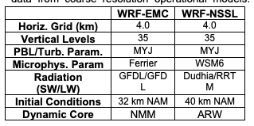
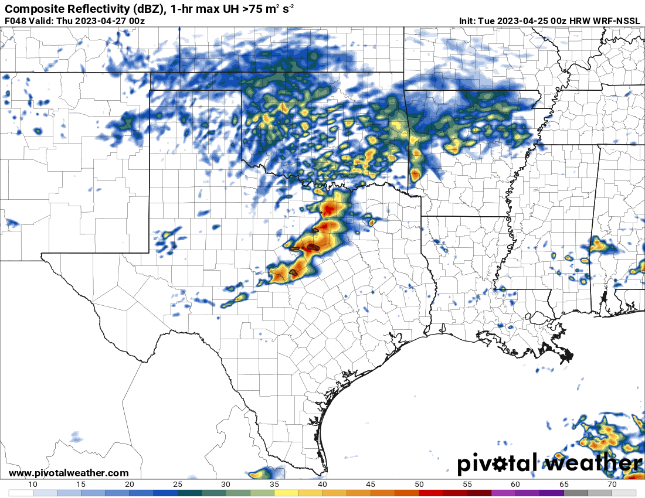
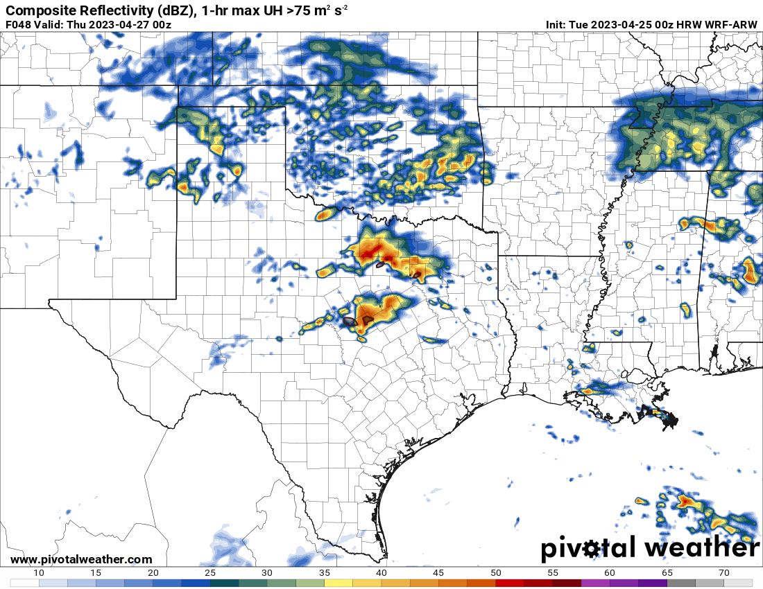
Current CAMS: WRF
Weather Research and Forecasting model (WRF)
  One of the most well known and important CAM/model frameworks.
  “A state of the art mesoscale numerical weather prediction system designed for both atmospheric research and operational forecasting applications.”
  Developed by NCAR in the mid 2000s - it is widely used.
Multiple Flavors with own Biases
  NSSL (cool and moist PBL)
  ARW (Formerly EMC) (Dry and overmixing)
  NNMB (Moist Boundary layer Buoyancy too high )
Variable grid spacing and microphysics schemes.
Multiple cores and schemes allow for dispersive ensembles.

Slide 19
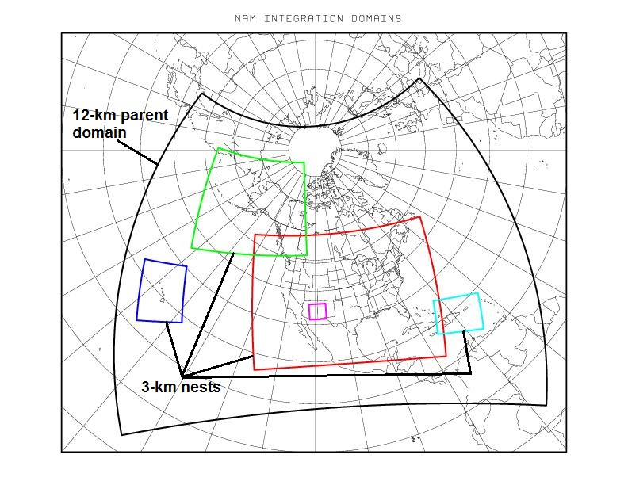
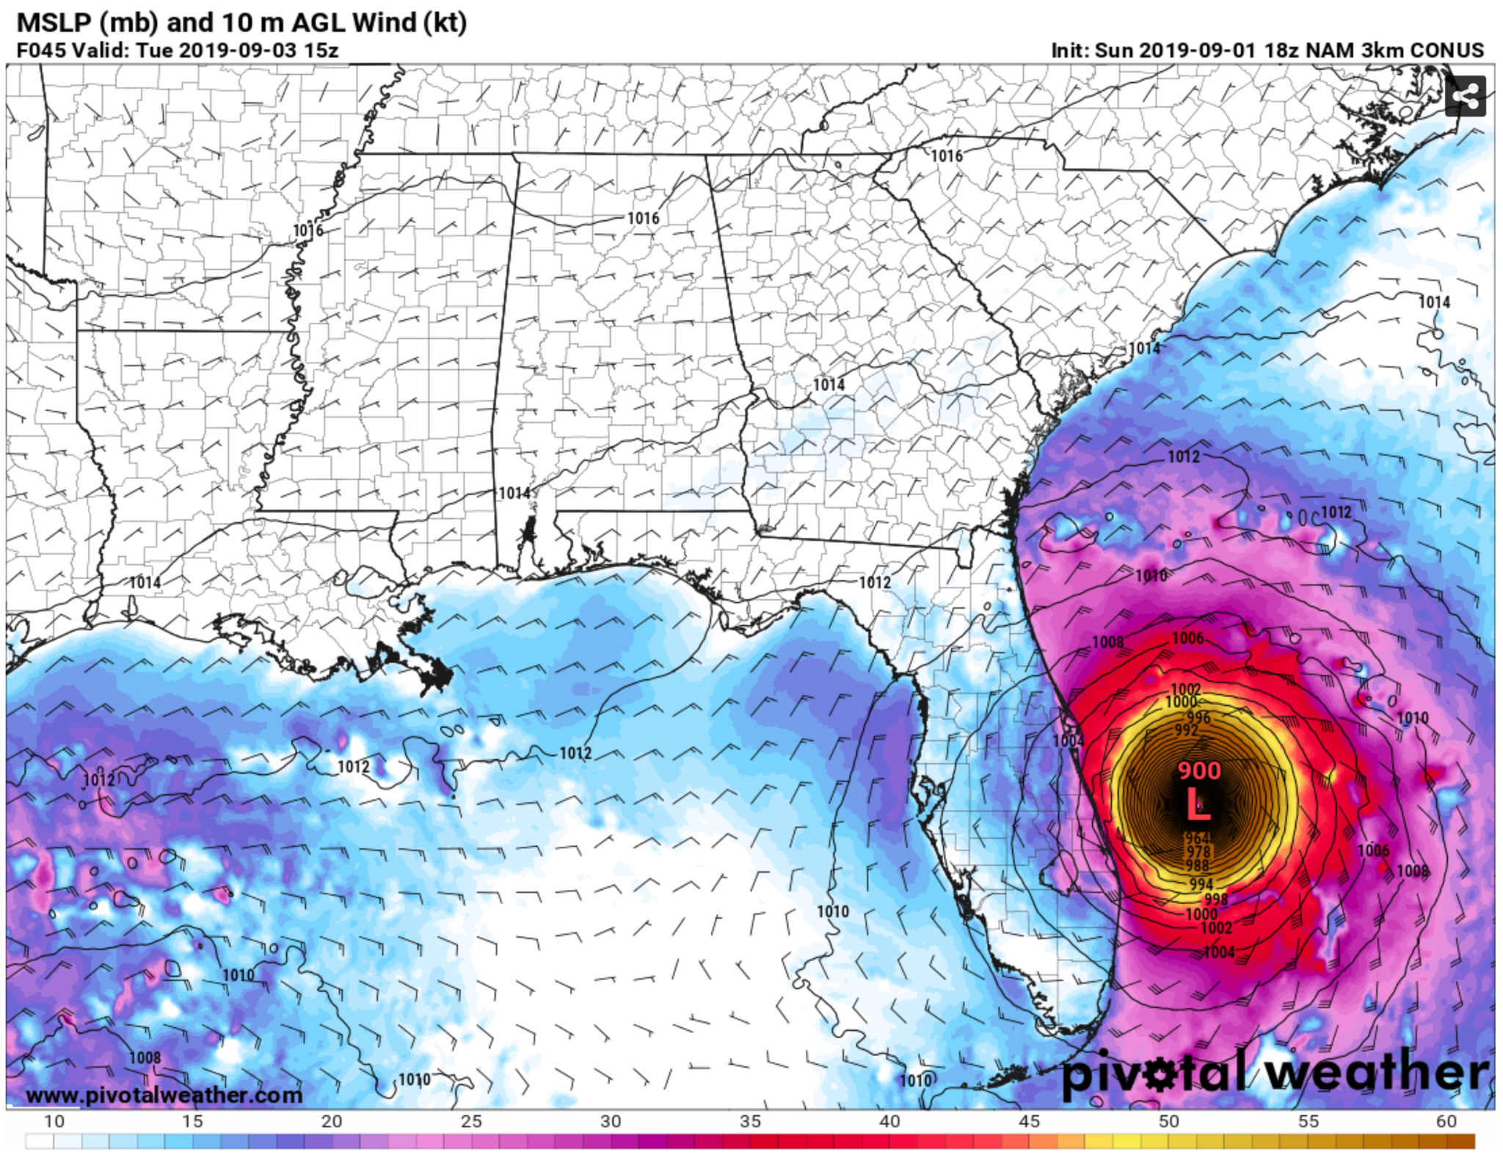
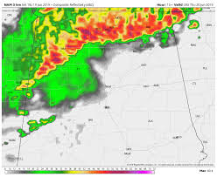
Current CAMS: NAM Nest
Nested North American Model (NAM Nest/NAM 3/4k)
  Nested subgrid version of the North American Model.
  12 km NAM for used boundary conditions
  1 km nested fire-weather domain
Hybrid Ensemble 3DVAR data assimilation scheme.
Known Biases:
  Cool and moist bias often found at the surface with overdone buoyancy.
  Cold pool overdevelopment can lead to erroneous convection, rapid upscale growth or lack of storms entirely.
  Significantly Overdeepens TCs

Slide 20
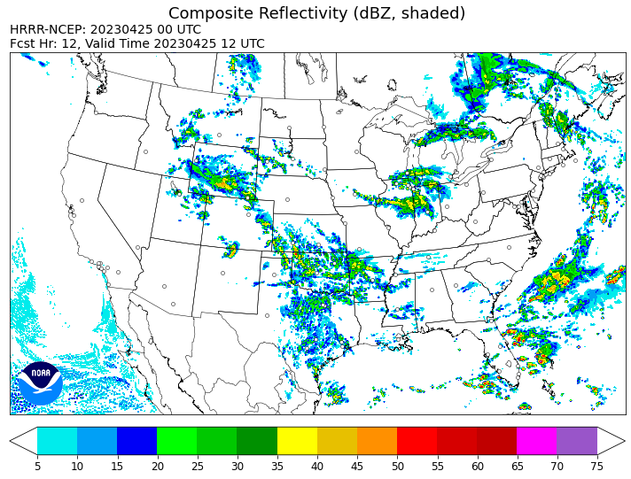
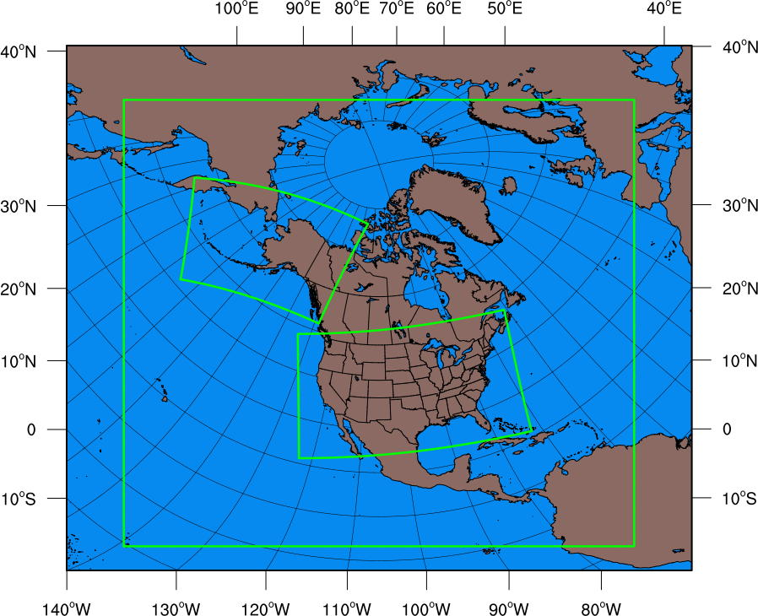
Current CAMS HRRR
High Resolution Rapid Refresh developed by EMC 30th of Sept 2014. Also has an ensemble version HRRR(E)
Will be replaced by FV3-based RRFS (Rapid Refresh Forecast System) in 2026.
3 km Rapid Updating (hourly and 15 minute)
RAP 13km forecasts as boundary conditions and assimilates radar data using EnVar.
Thompson microphysics and MYNN PBL scheme
Known Biases include:
  Significant over mixing bias in warm season boundary layers
    Pushes dryline too far east
    Lowers dew points and buoyancy.
  Overdevelopment of surface cold pools
    Upscale growth too fast.
  Fails to produce convection in weak forcing cases.

Slide 21
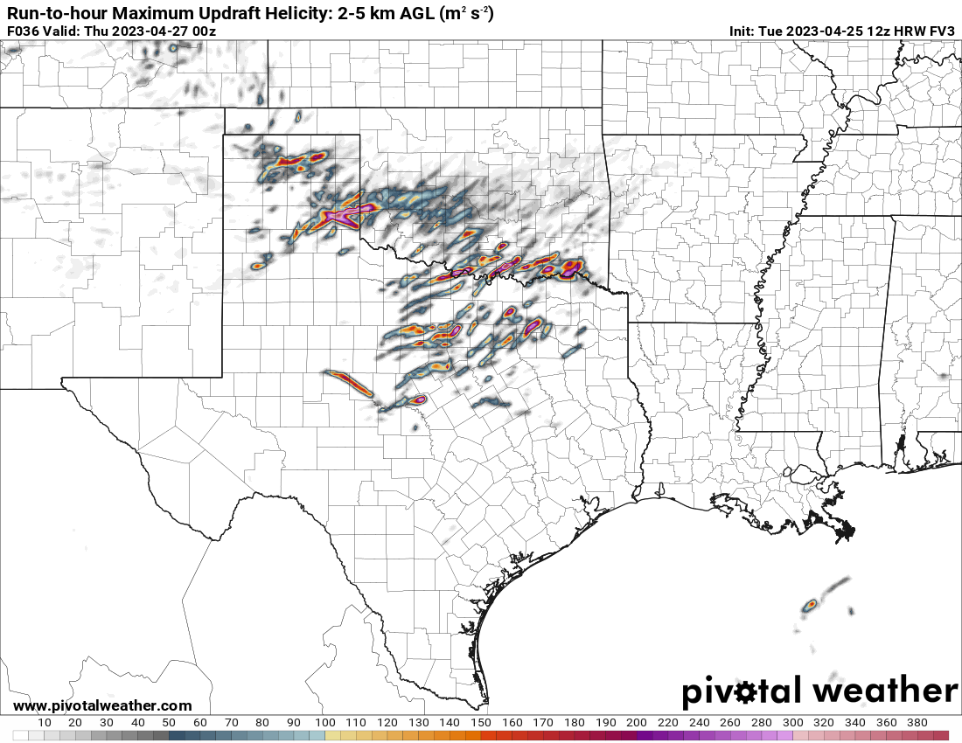
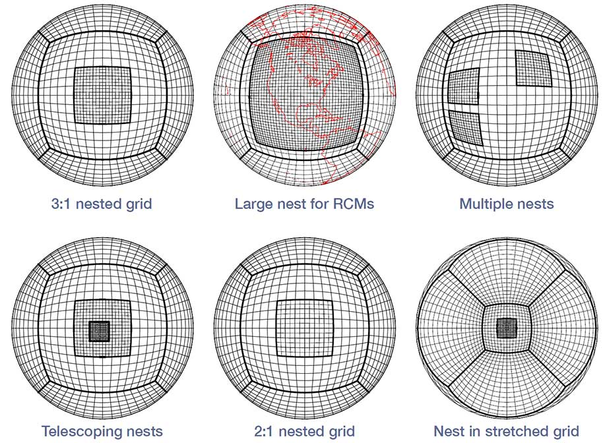
Current CAMS: Hi-Res FV3, RRFSv1
High Resolution Finite­ Volume Cubed-Sphere dynamical core (FV3)
Part of NOAA's next generation unified forecasting system (UFS)
Same dynamical core as the GFS used to provide boundary conditions.
EnVar-EnKF combination for data assimilation.
Known Biases:
  Overmixing and dry bias
  Lower buoyancy
  Over convective within weak forcing.
  Much higher updraft helicity due to grid spacing and calculations
Can handle certain boundary layer cases better than other models with a “middle ground”
RRFS (Rapid Refresh Forecasting System) V1 is going through rigorous pre-implementation evaluations, and is expected to become operational in 2026.

Slide 22
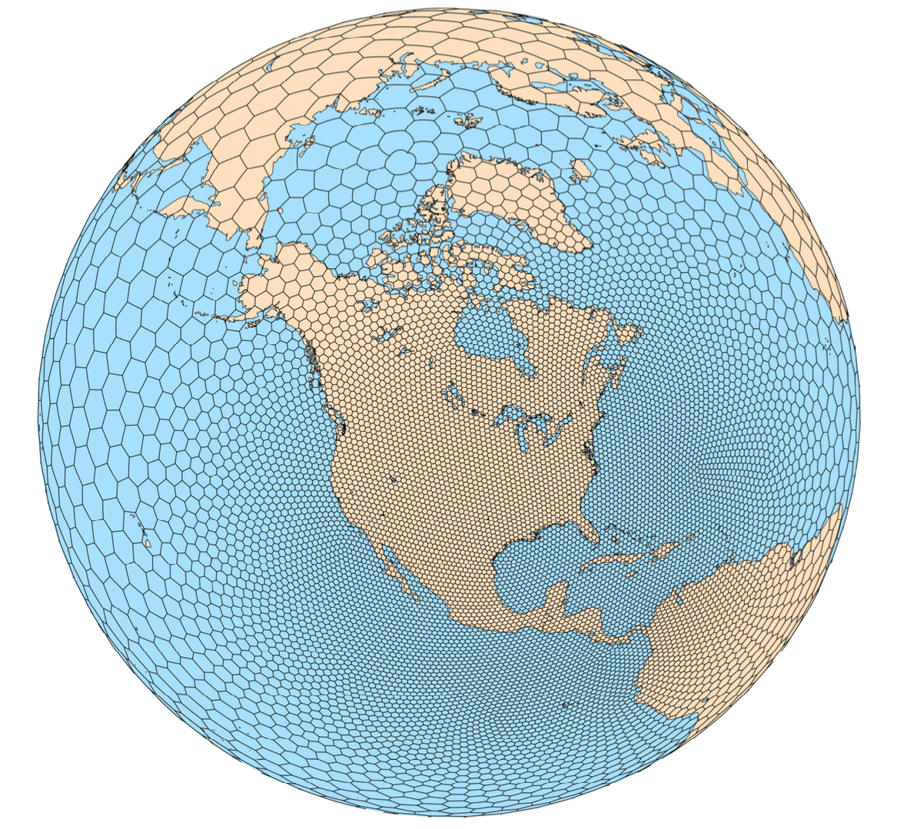
RRFS v2 will be based on MPAS developed by NCAR
MPAS – Model for Prediction Across Scales (https://mpas-dev.github.io/)
The atmospheric component of MPAS uses an unstructured centroidal Voronoi mesh (grid) and C-grid staggering for horizontal discretization.
The unstructured variable resolution meshes allows for smoothly-varying mesh transitions
The flexibility allows for applications in high-resolution NWP and regional climate, in addition to global uniform-resolution NWP and climate applications.
Can be configured for a stand-alone regional domain also.
The current plan is to use MPAS instead of FV3 in RRFSv2. RRFS will replace all regional forecasting systems run at NCEP.

Slide 23
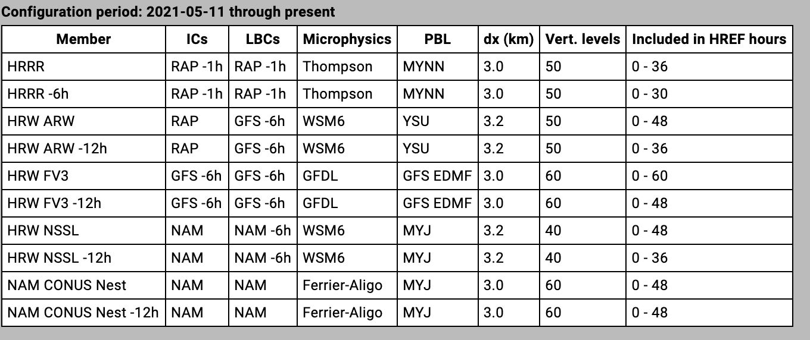
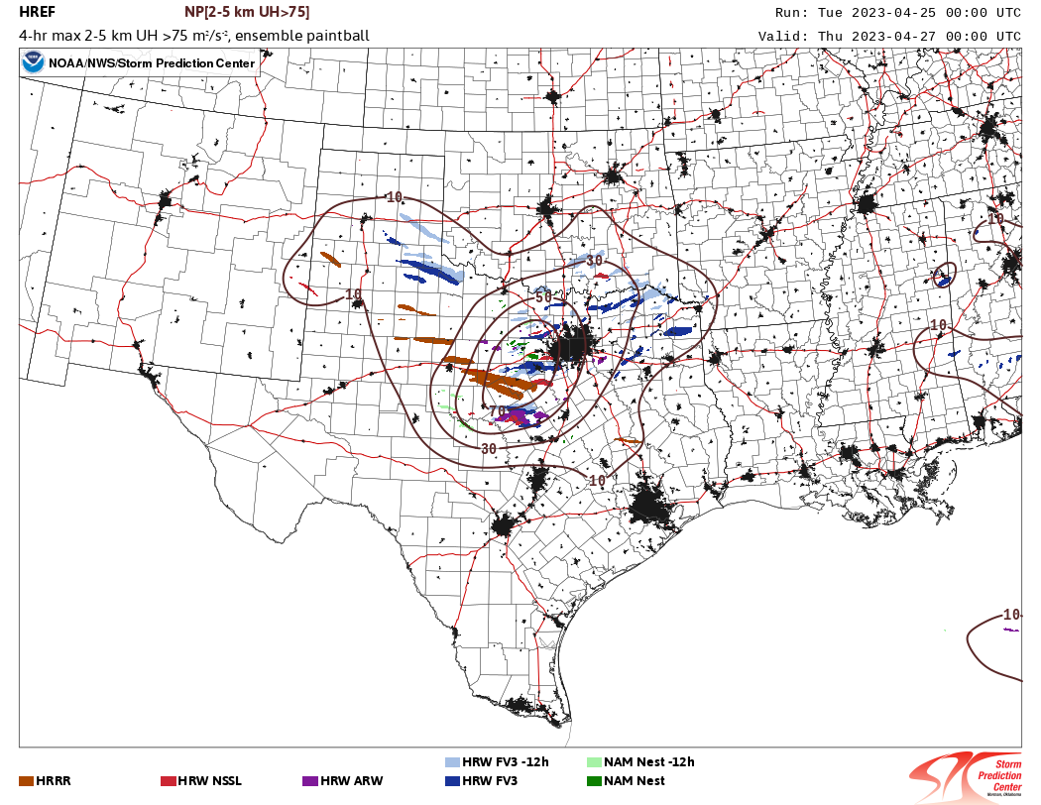
CAM Ensembles: HREF
High Resolution Ensemble Forecast System
Began in the mid 2010s as the Storm Scale Ensemble of Opportunity (SSEO) at SPC.
HREF is a 48 hour 10 member ensemble of operation convection allowing models.
  5 Model cores
  5 time lagged members
Produces a number of different hourly max and ensemble products.
Serves as a good basis for nearly all types of forecasts.

Slide 24
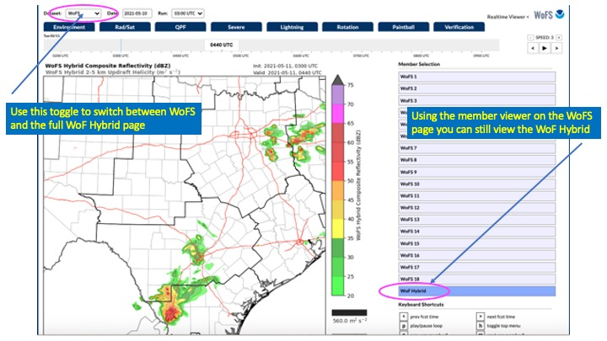
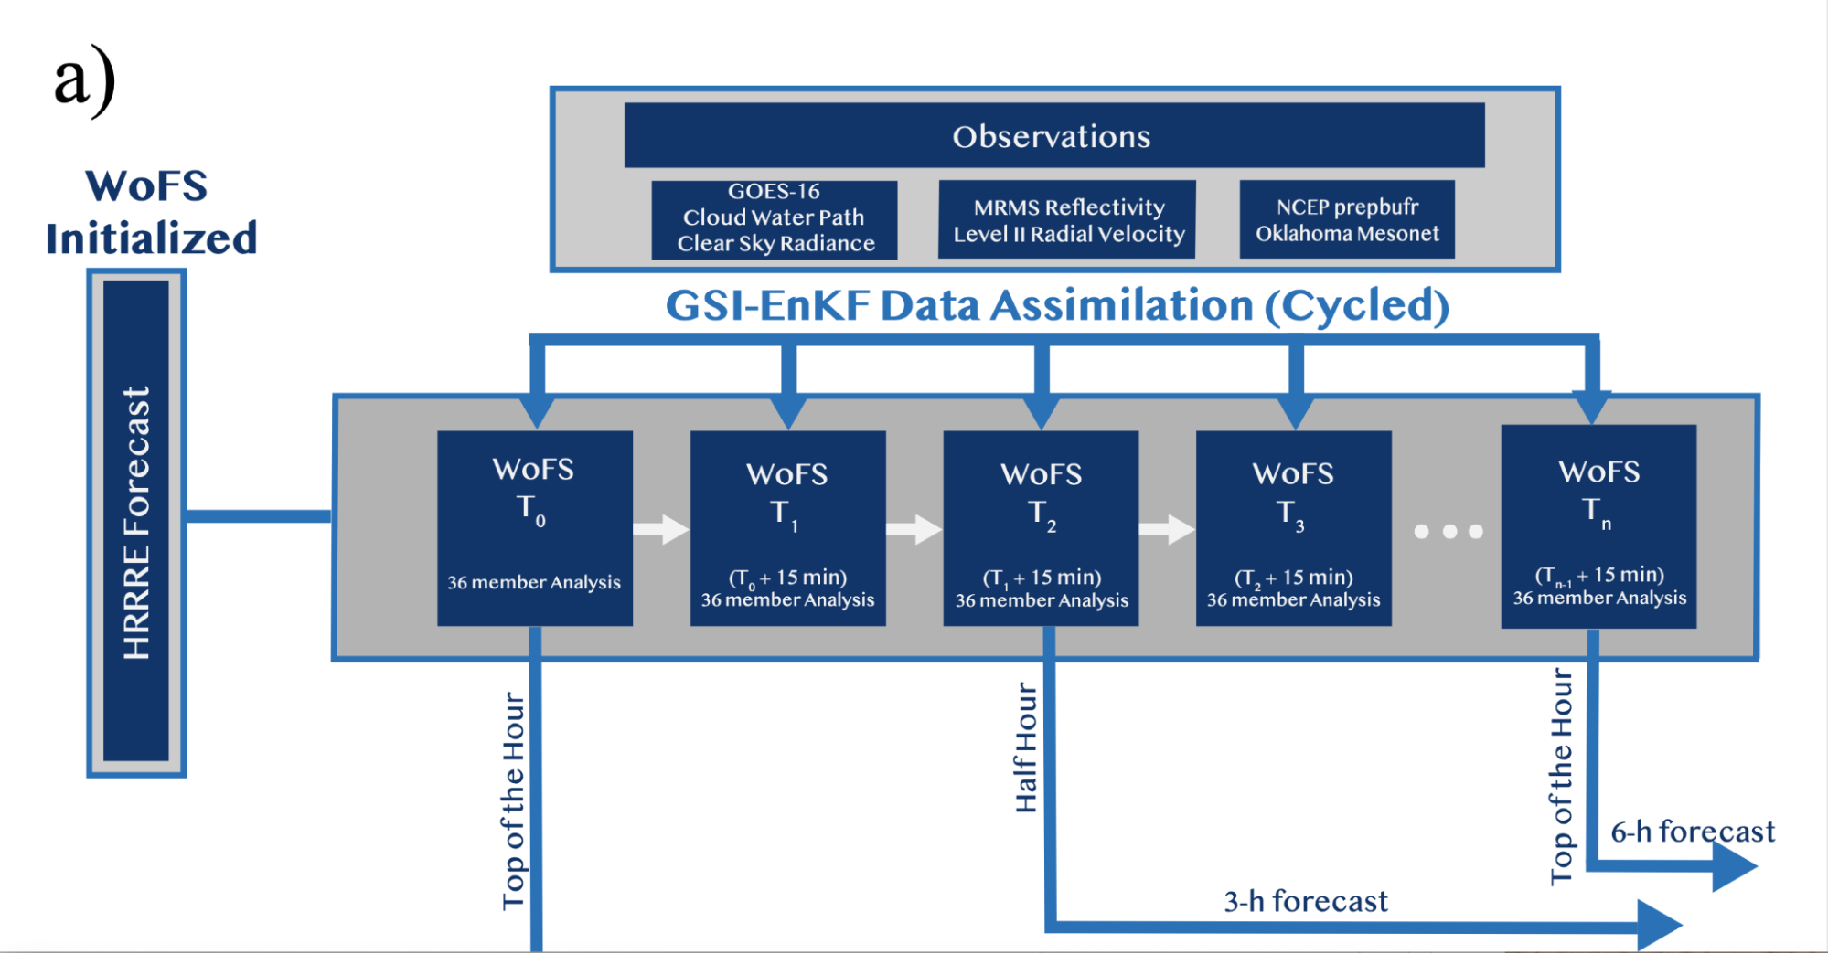
CAM Ensembles: WOFS
WARN On Forecast System (WOFS) is experimental CAM ensemble run by NSSL.
Runs during the Spring Forecast Experiment Hazardous Weather Testbed (HWT) and on certain extra days.
3 km ensemble forecasts
High Spatial and temporal frequency (hourly and 15 min runs out to 6 hours)
Will become quasi-operational in near future

Slide 25

Common CAM Problems
CAM forecasts have additional issues
Longer range forecasts depends on accuracy of global model forecasts that are used as lateral boundary conditions.
CAM models try to prediction small/convective scale phenomena that are not well observed, even with the WSR-88D radar network.
Data assimilation at CAM scales is more difficult due to incomplete observations. Convective scale errors grow much faster.
“Spin Up Time”: When precipitation systems are not properly presented in IC, significant time is needed to “spin up” the precipitation
Weak forcing can be difficult to initiate storms in the model.
  Very common along drylines.
  Inverse is true for strong forcing along cold fronts or other boundaries. Models develop too many storms or rapid upscale growth can happen

Slide 26
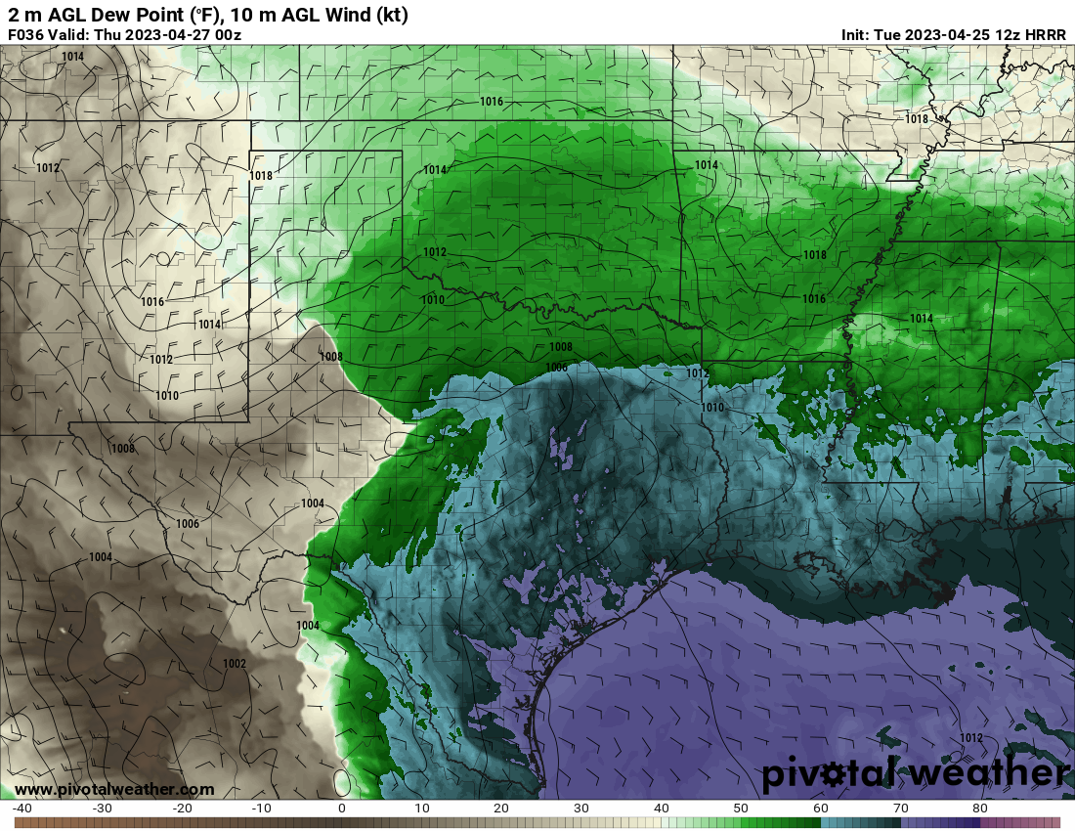
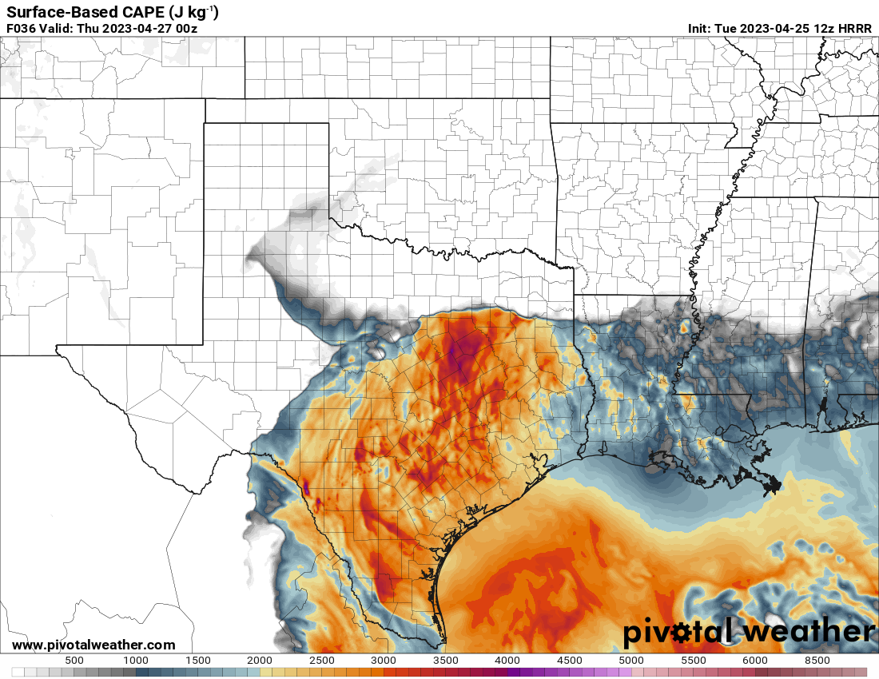
How to use CAMS: Environment
CAMs can provide useful information when interrogating small but potential favorable environments for severe weather.
They can also provide greater resolution and more information in cases where regional or global model (much more coarse) spacing misses important attributes.
  Near outflow boundaries.
  Complex terrain.
  Ongoing convection.
  Land ocean interfaces
Compare how models initialize but also check back as they can “catch up” if run frequently.

Slide 27
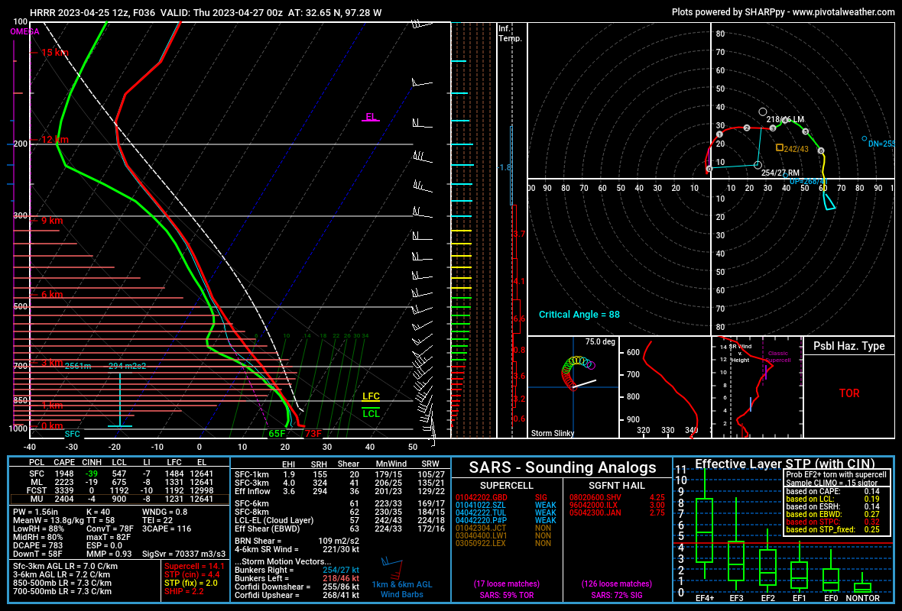
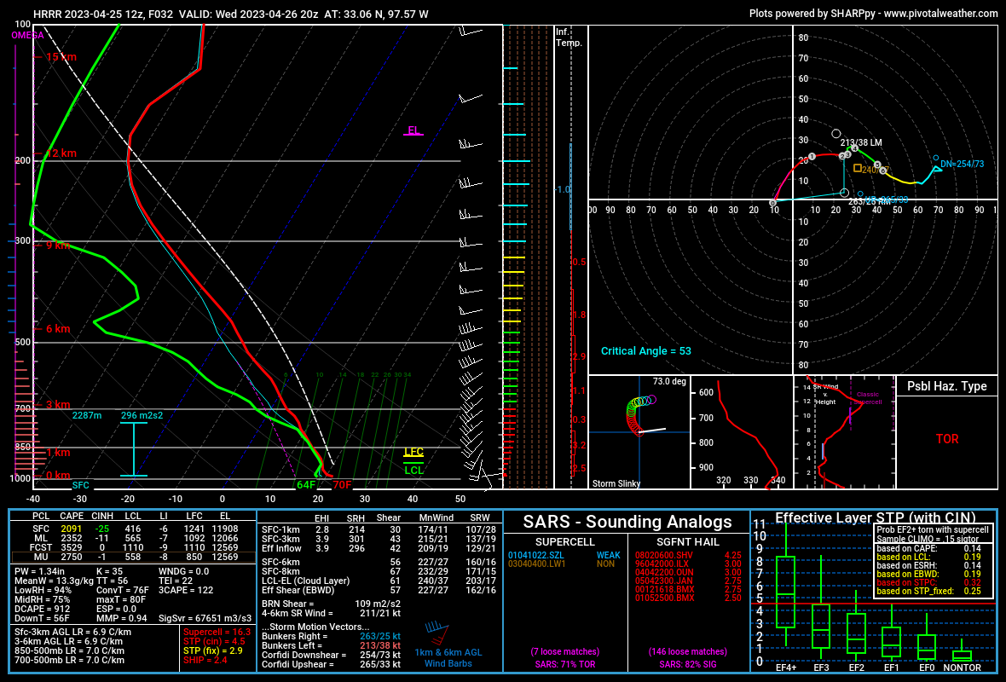
How to use CAMS: Soundings
Soundings are a great way to visualize pre-convective environment using CAMS.
Tighter grid spacing (Horizontal and vertical) allows more useful sounding locations with less interpolation.
Often can catch subtle features such as shortwave troughs with weak forcing for warm season storms.
CAUTION
  Best practice is to only use for pre-convective environment.
  Soundings can be “contaminated” by ongoing storms resulting in unrealistic environment.
  Compare and modify soundings to real world observations as much as possible.

Slide 28
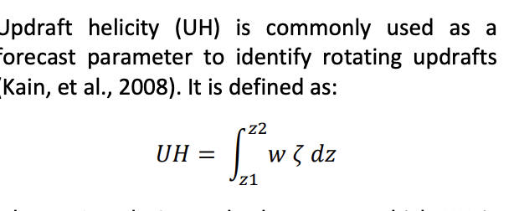
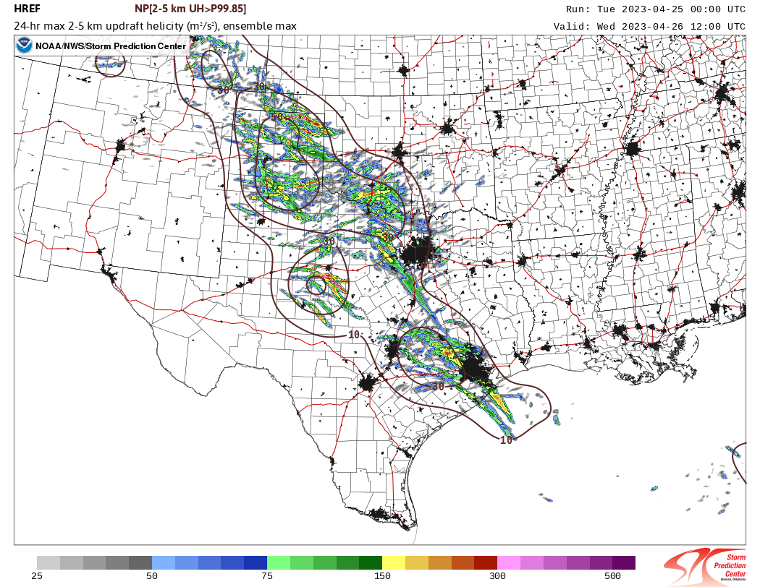
How to use CAMS: Hourly Output
Summation of output over 1-24 hours.
  Updraft helicity
  Updraft velocity
  Simulated reflectivity
  Max Wind gust
Can be very useful for quick estimation of storm intensity.
  Severe weather is correlated with higher updraft helicity but with many caveats.
Caution:
  Updraft helicity is usually estimated at 2-5 km (mid-levels) tells you nothing about potential storms low-level updraft or tornadoes only supercells.
  Can be elevated above the surface with more of a hail threat
  Looks cool and scary

Slide 29
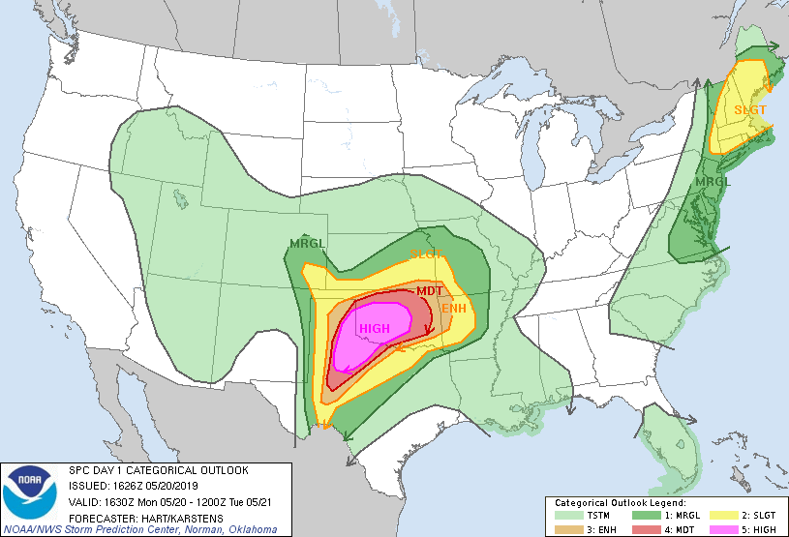
How NOT to use CAMS
The higher resolution the model the more realistic it can appear. It’s tempting to fully trust CAM output, but that is rarely how the atmosphere works.
Avoid looking only at CAMS, know the background state of the atmosphere from observations.
Don’t “cherry pick” by looking at one or two flashy parameters or output from one or two models.
  Ensembles can give you a much better idea of the range of outcomes.
Do not rely on CAM output as the root of your forecast and know their biases.

Slide 30
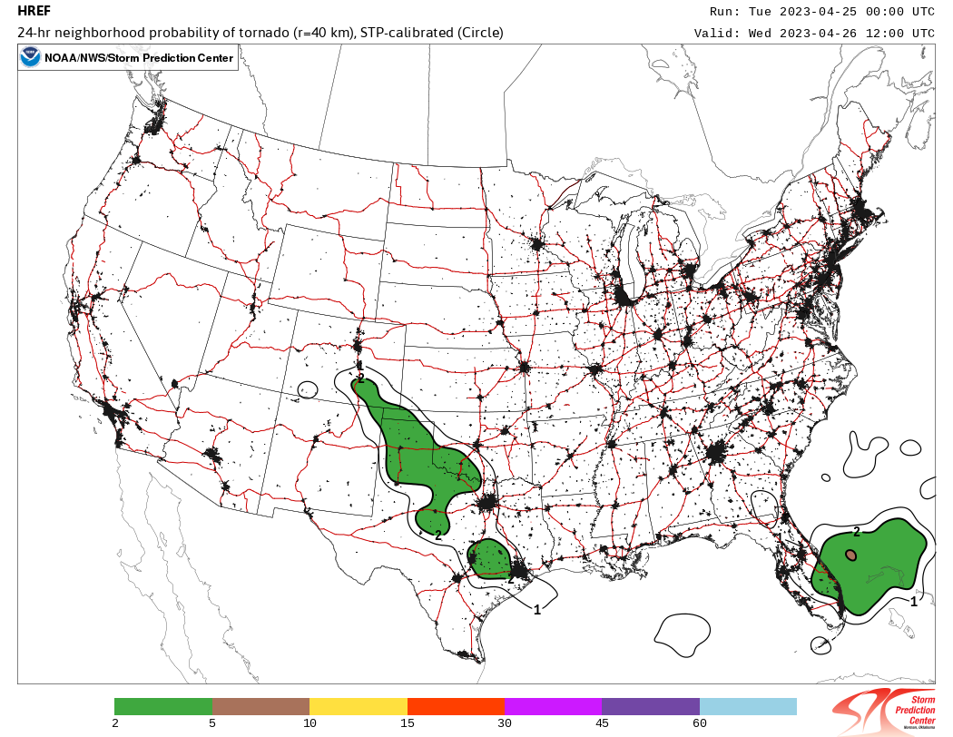
CAMS Extras: Post Processed Calibrated Guidance/Probability
Relatively new area of research focusing on applying statistical models to CAM output.
Can create probability distributions for events when correlated with storm reports.
Often look very close to human forecasts.
Use caution when interpreting them as the same biases with CAMS apply to the output.

Slide 31
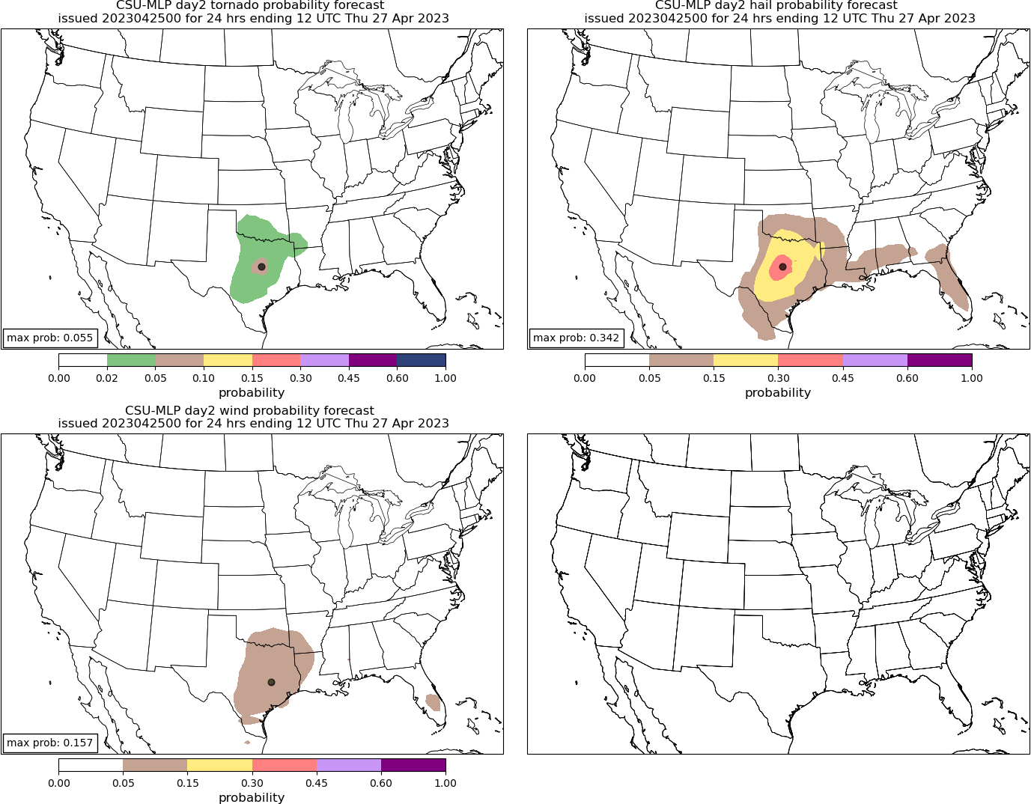
Future: Combining Machine learning with CAM output
Calibrated guidance using machine learning and storm reports.
Output often looks very similar to human forecasts but can differ a great deal.
Not well understood given the complexity of machine learning.
Do not always rely on the same predictors humans use to make their forecasts.
Subject to biases also
Emerging area of research.

Slide 32
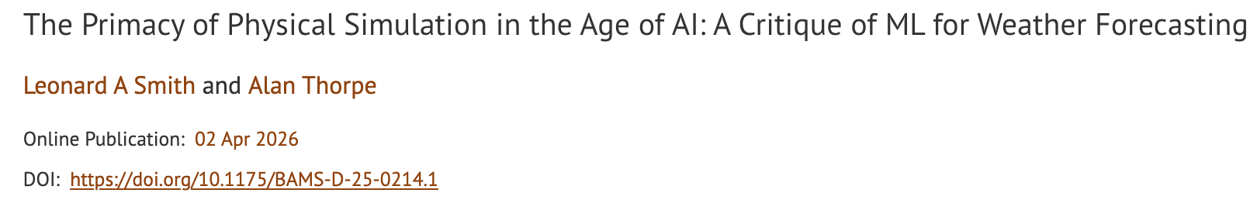
Is AI/ML going to replace physics models/NWP?
Read the following paper:
https://doi.org/10.1175/BAMS-D-25-0214.1
Abstract
The case is made that machine-learning statistical estimation neither can nor should be expected to supplant physics-based simulation for weather forecasting.

Slide 33
Now let’s look at the Cams for Today!
https://www.spc.noaa.gov/exper/href/ for HREF products
Look at each different model.
  HRRR
  FV3
  NAM3k
  NSSL WRF

