Slide 1
Group Forecasting Exercise
Goal: Practice your forecast process using limited data.
Take initial information and make SPC-style probability forecasts of tornadoes, hail, and damaging wind for your city.
Probability of 1+ events within 25 n mi of a point
We’ll discuss forecasts at each stage with group spokesperson

Slide 2
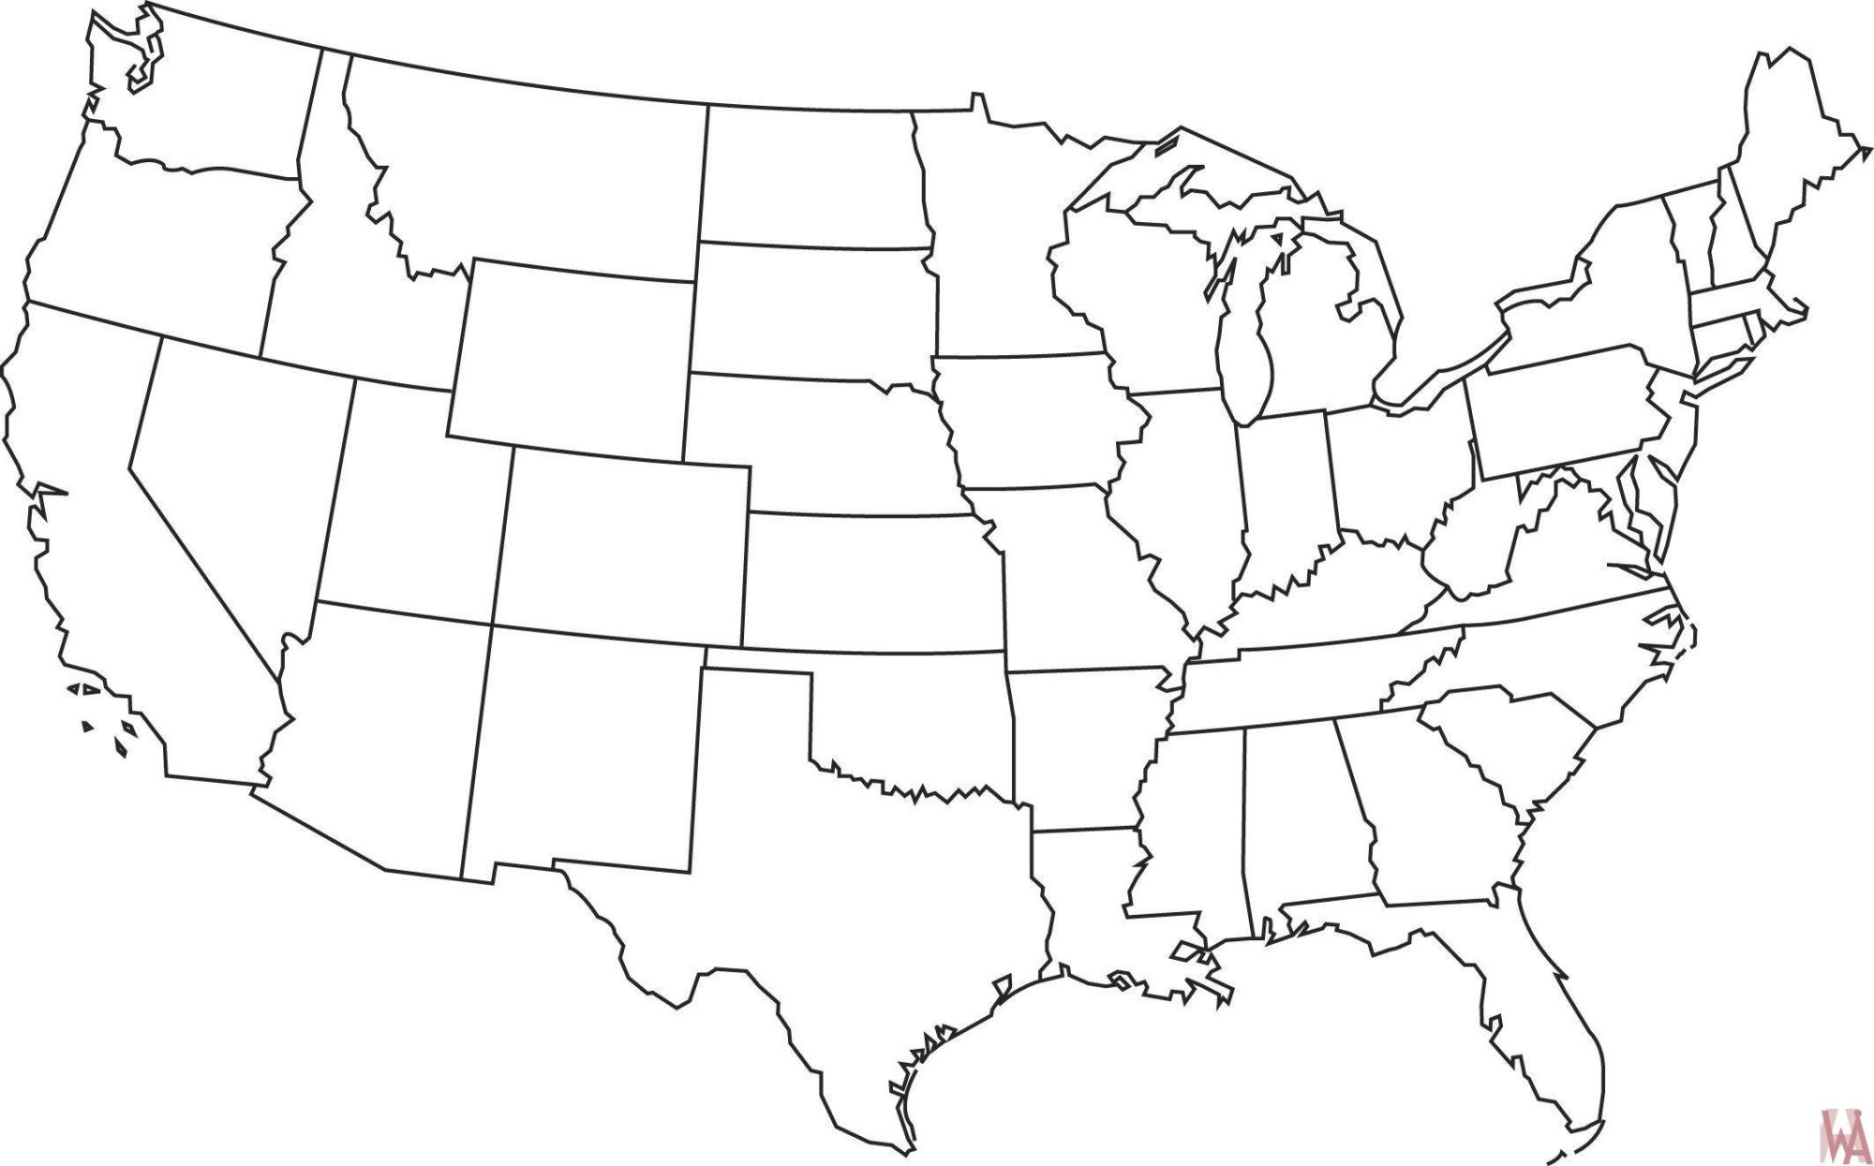
OAX
TOP
OUN

Slide 3
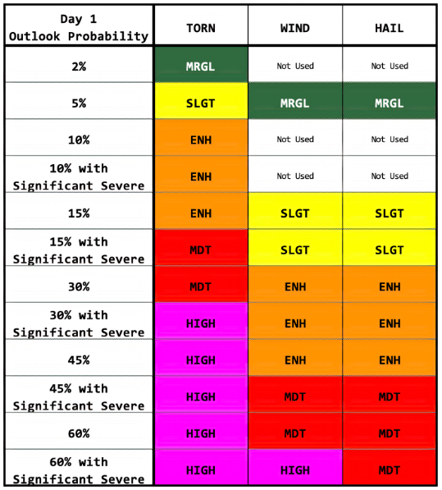
Make first forecast (by 10:15)
“Representative” hail, wind and tornado probs

Slide 4
Round 2 (by 10:35)
Rotate CWAs
OUN -> OAX
TOP -> OUN
OAX -> TOP
Produce tornado, hail, and wind probability forecasts for your new CWA.
Recall your “inherited” forecast from previous group.

Slide 5
Round 3 (by 10:55)
Rotate CWAs
OUN -> OAX
TOP -> OUN
OAX -> TOP
Produce tornado, hail, and wind probability forecasts for your new CWA.
Recall your “inherited” forecast from previous group.

Slide 6
Round 4 (by 11:15)
Rotate CWAs
OUN -> OAX
TOP -> OUN
OAX -> TOP
Produce tornado, hail, and wind probability forecasts for your original CWA.
Recall your “inherited” forecast from previous group.

Slide 7
What happened?

Slide 8
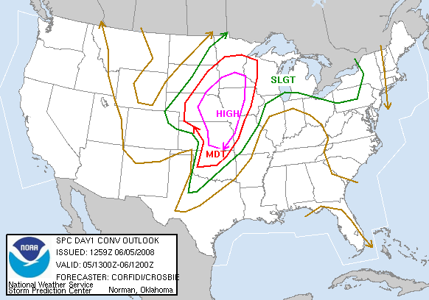

Slide 9
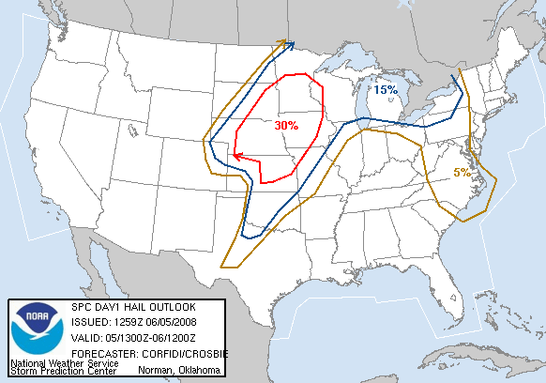

Slide 10
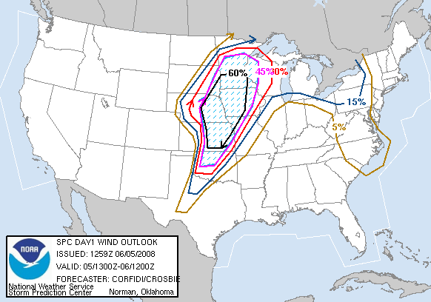

Slide 11
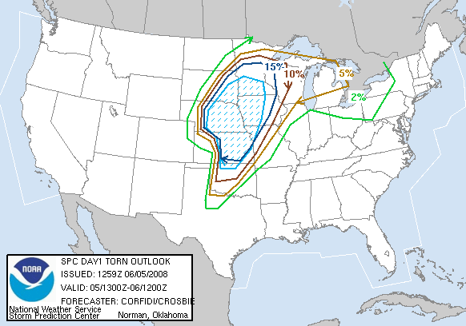

Slide 12
