Slide 1
TC TORNADOES and SPC FORECASTS in TC SITUATIONS
Part TWO: Case Investigations
Harry Weinman & Roger Edwards
METR 4403/5403: Applications of Meteorological Theory to Severe-Thunderstorm Forecasting
Notes:
1
Title

Slide 2
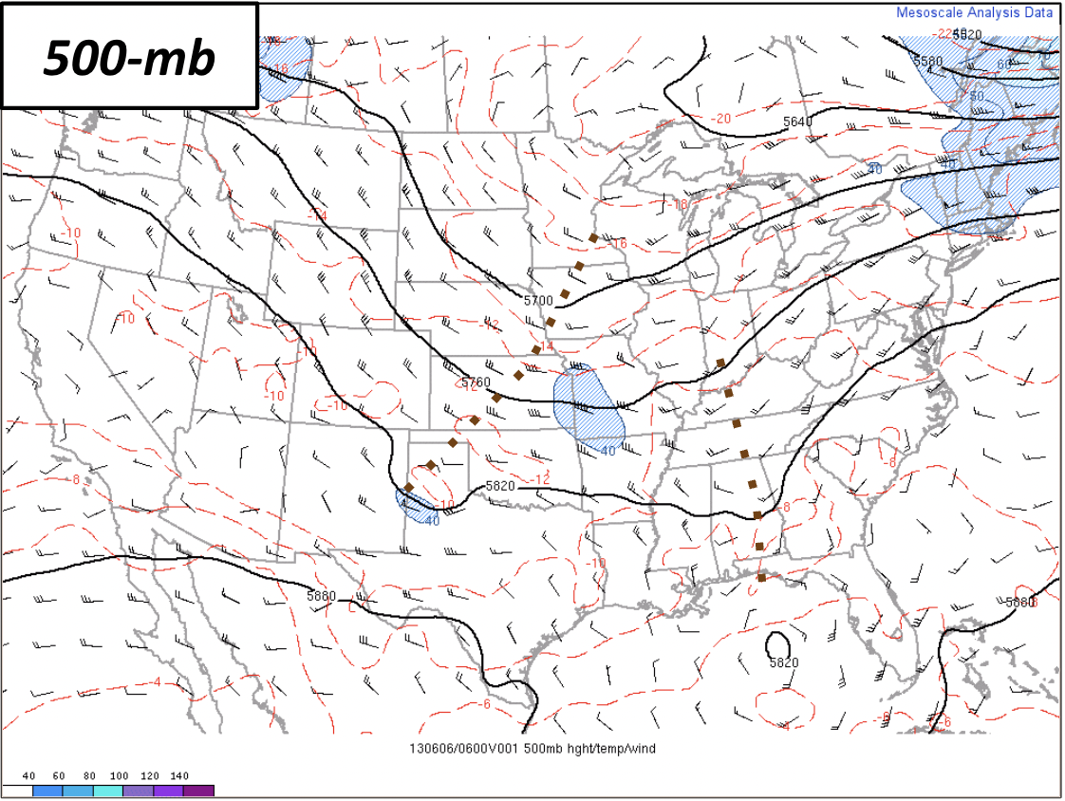
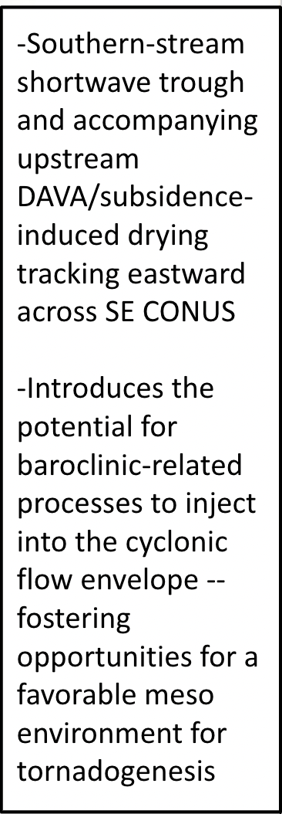
TC TORNADO EXAMPLE CASES 1 (ANDREA 2013)
Notes:
2

Slide 3
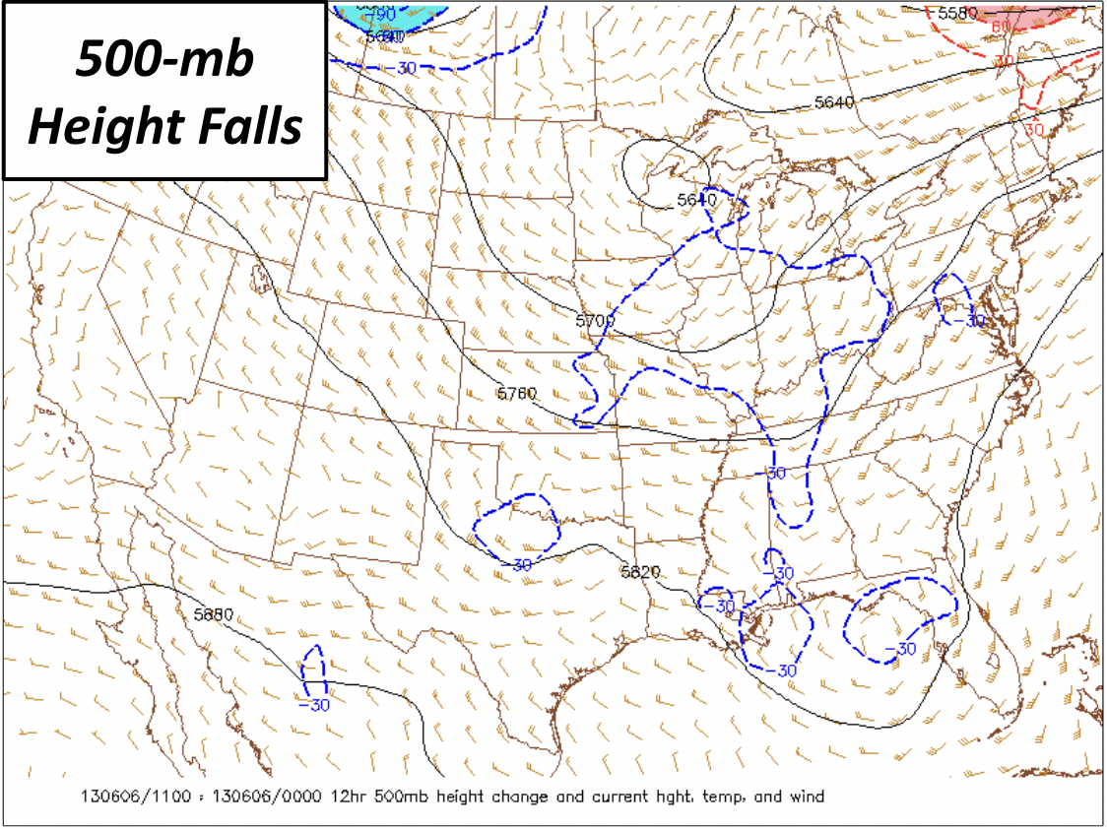
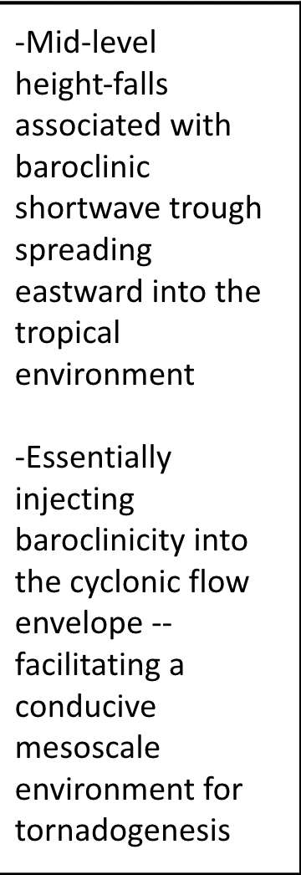
TC TORNADO EXAMPLE CASES 1 (ANDREA 2013)
Notes:
3

Slide 4
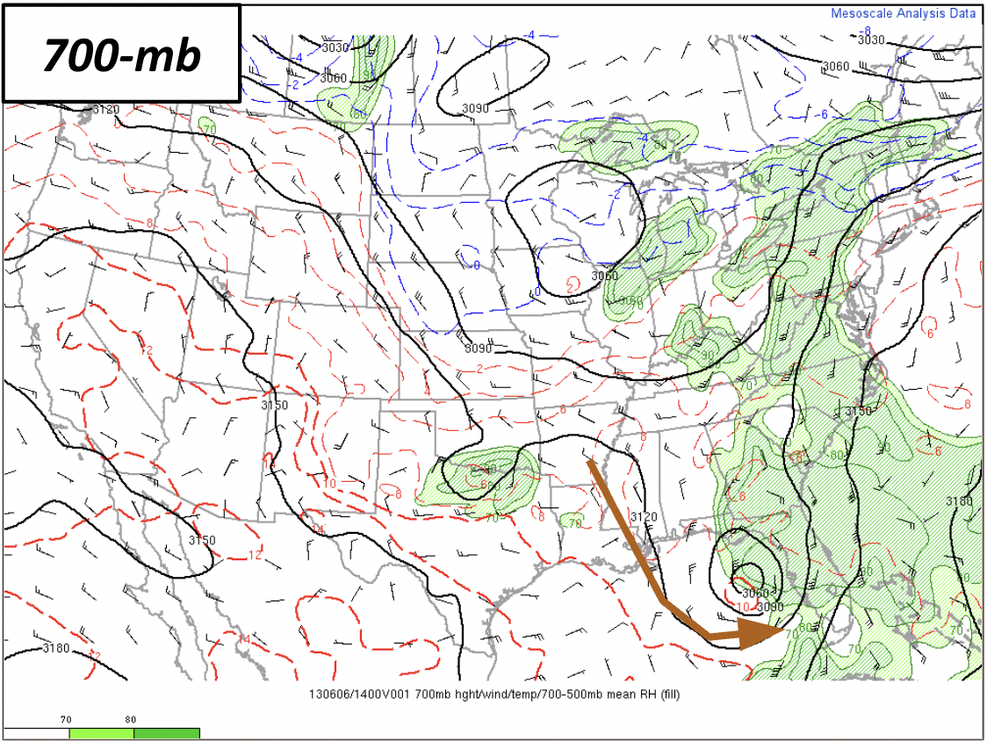
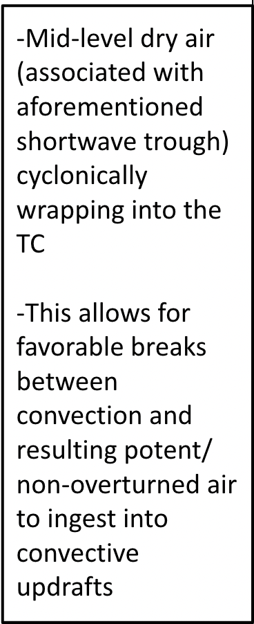
TC TORNADO EXAMPLE CASES 1 (ANDREA 2013)
Notes:
4

Slide 5
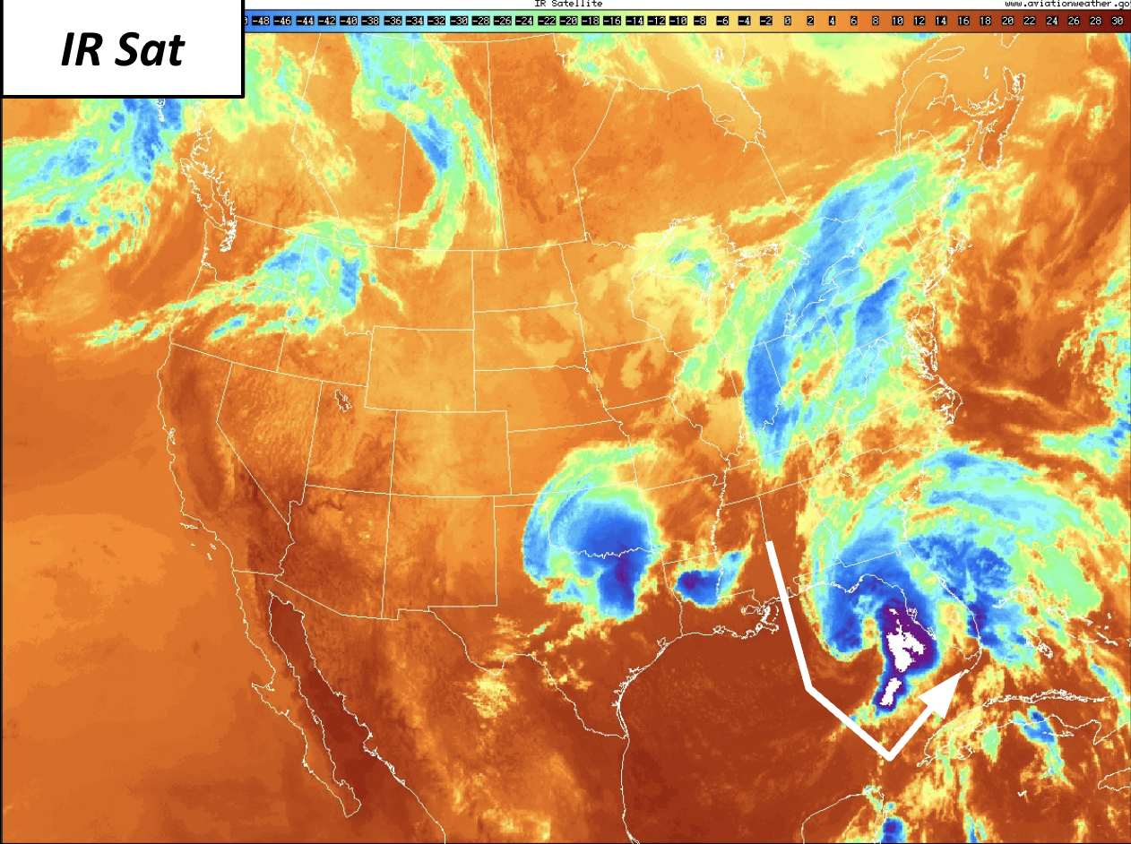
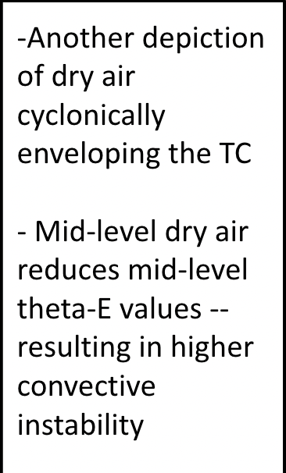
TC TORNADO EXAMPLE CASES 1 (ANDREA 2013)
-Dry slots can promote
enhanced heating/
differential heating,
setting up temporary baroclinic zones
Notes:
5

Slide 6
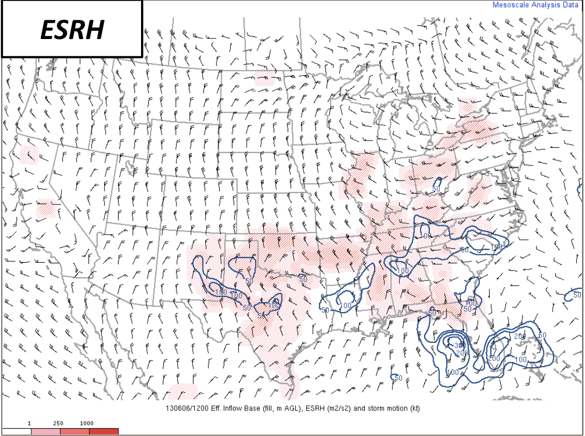
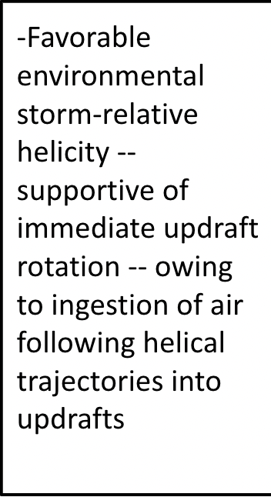
TC TORNADO EXAMPLE CASES 1 (ANDREA 2013)
Notes:
6

Slide 7
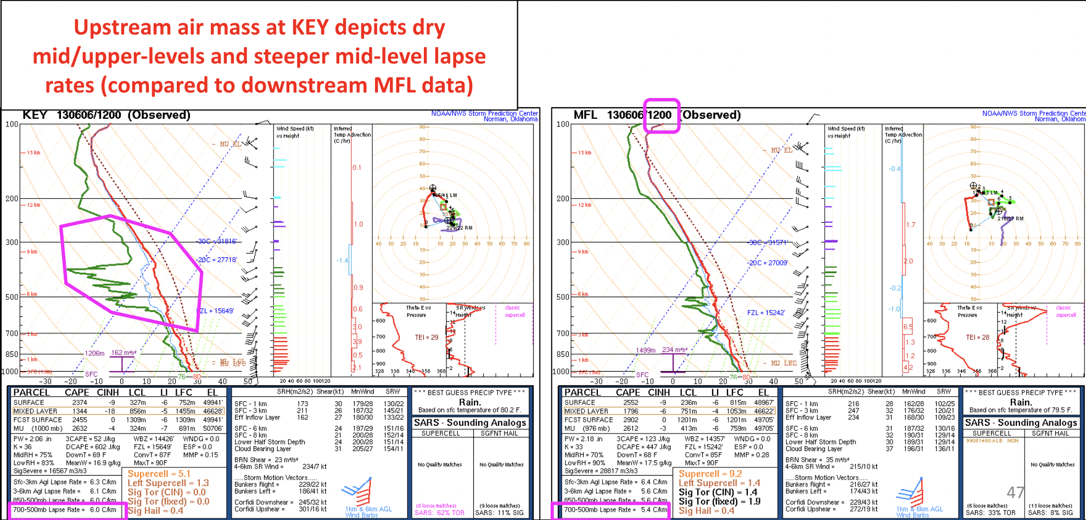
TC TORNADO EXAMPLE CASES 1 (ANDREA 2013)
Notes:
7

Slide 8
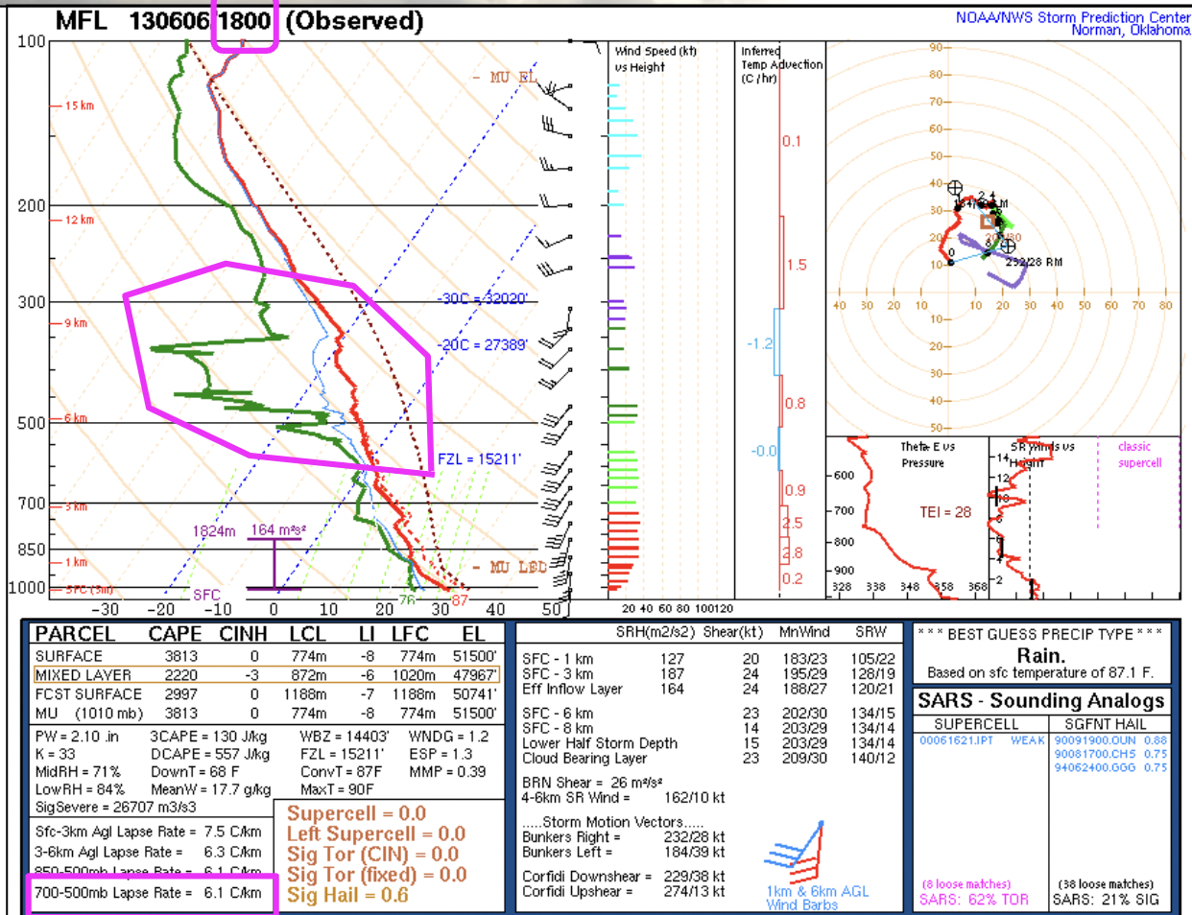
TC TORNADO EXAMPLE CASES 1 (ANDREA 2013)
Notes:
8

Slide 9
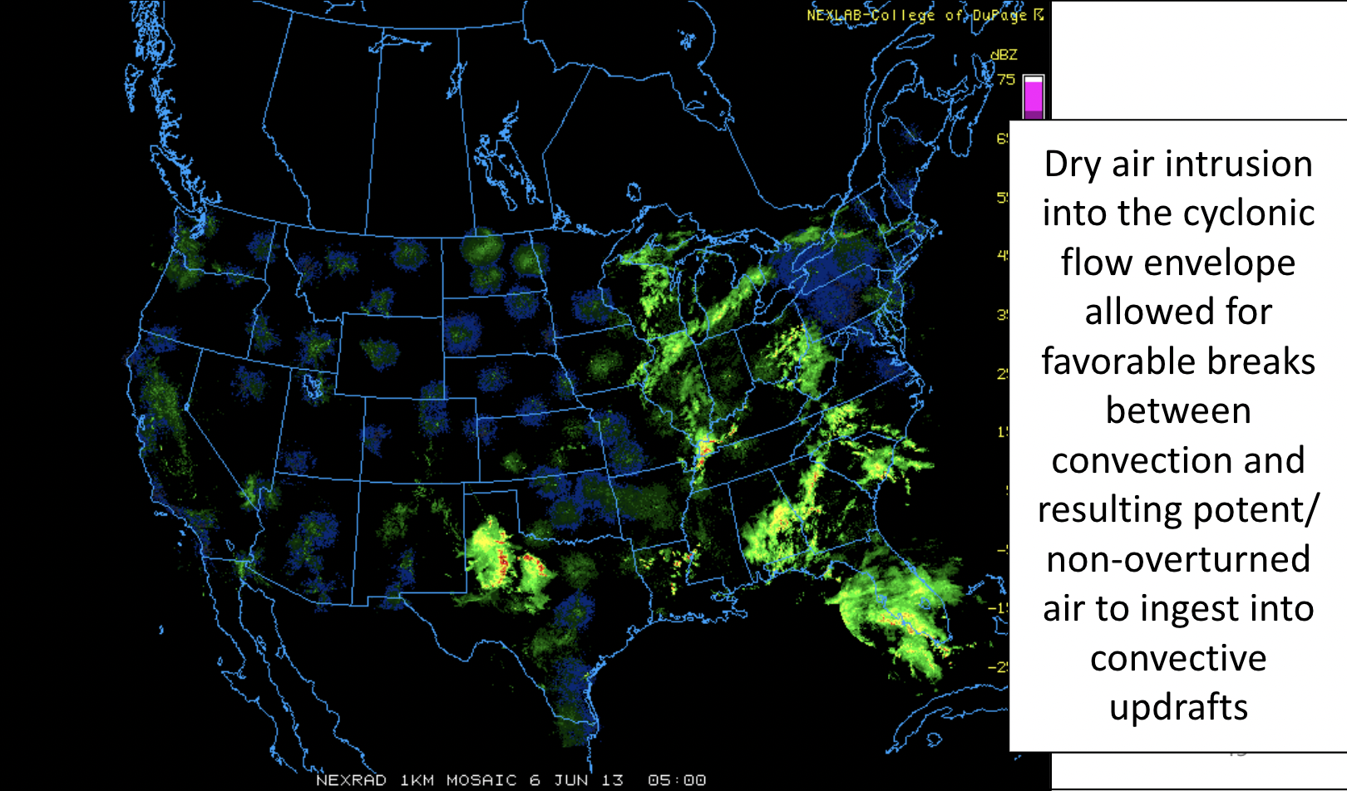
TC TORNADO EXAMPLE CASES 1 (ANDREA 2013)
Notes:
9

Slide 10
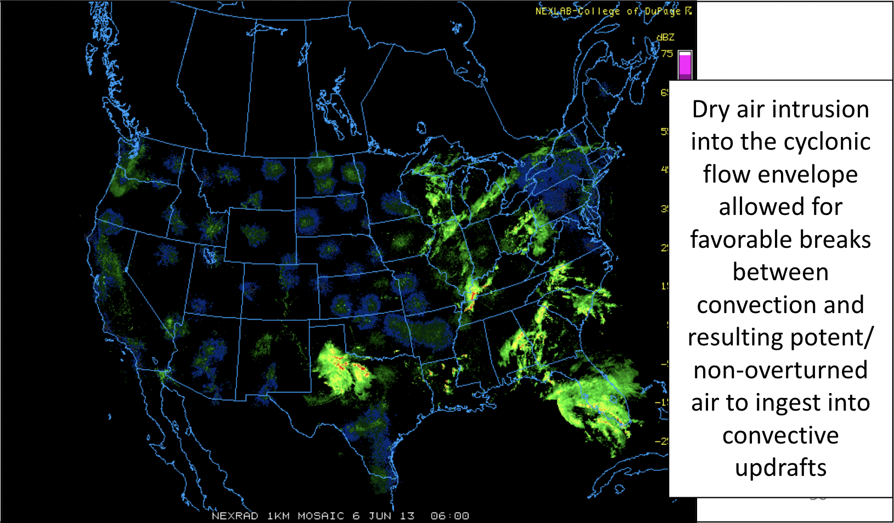
TC TORNADO EXAMPLE CASES 1 (ANDREA 2013)
Notes:
10

Slide 11
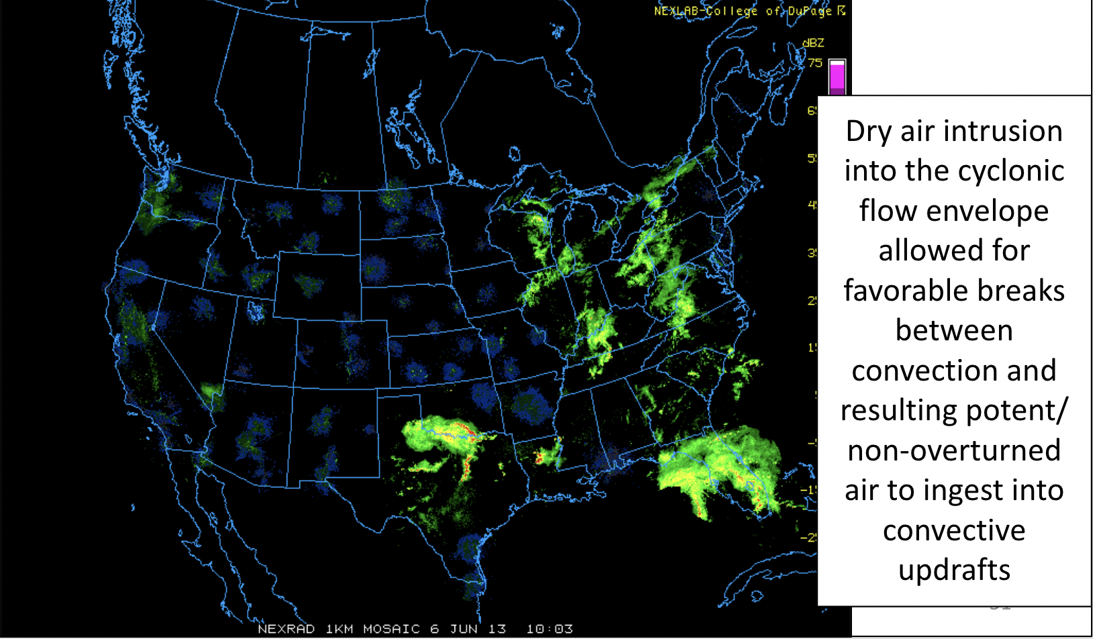
TC TORNADO EXAMPLE CASES 1 (ANDREA 2013)
Notes:
11

Slide 12
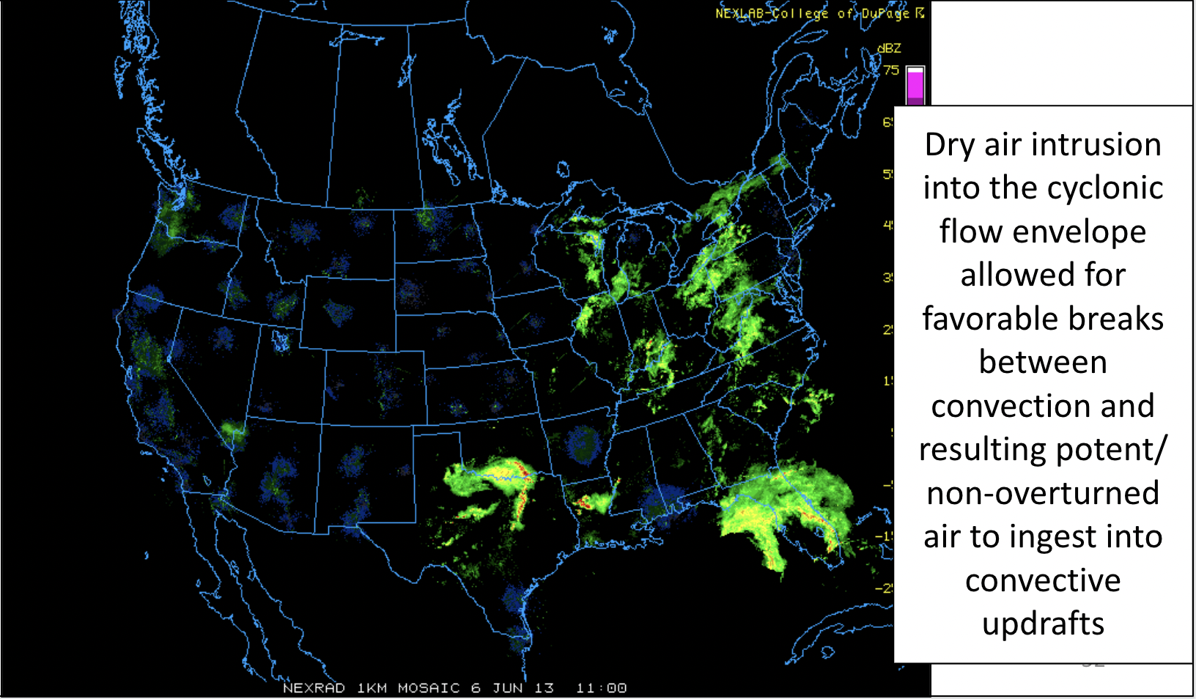
TC TORNADO EXAMPLE CASES 1 (ANDREA 2013)
Notes:
12

Slide 13
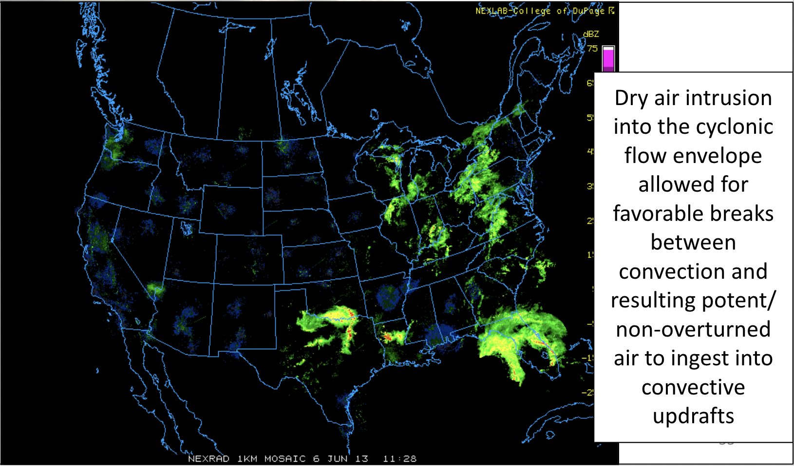
TC TORNADO EXAMPLE CASES 1 (ANDREA 2013)
Notes:
13

Slide 14
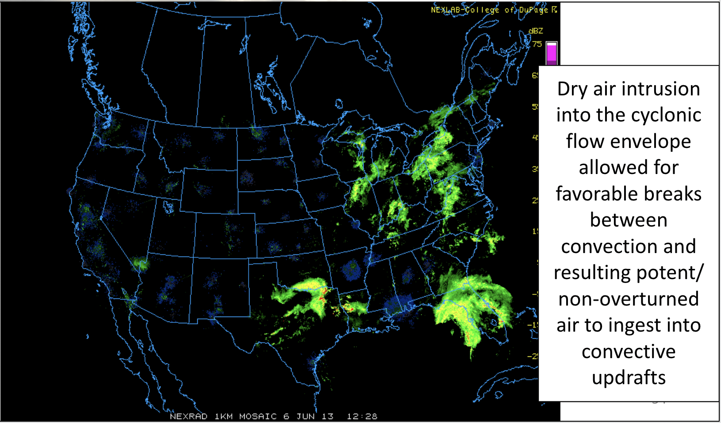
TC TORNADO EXAMPLE CASES 1 (ANDREA 2013)
Notes:
14

Slide 15
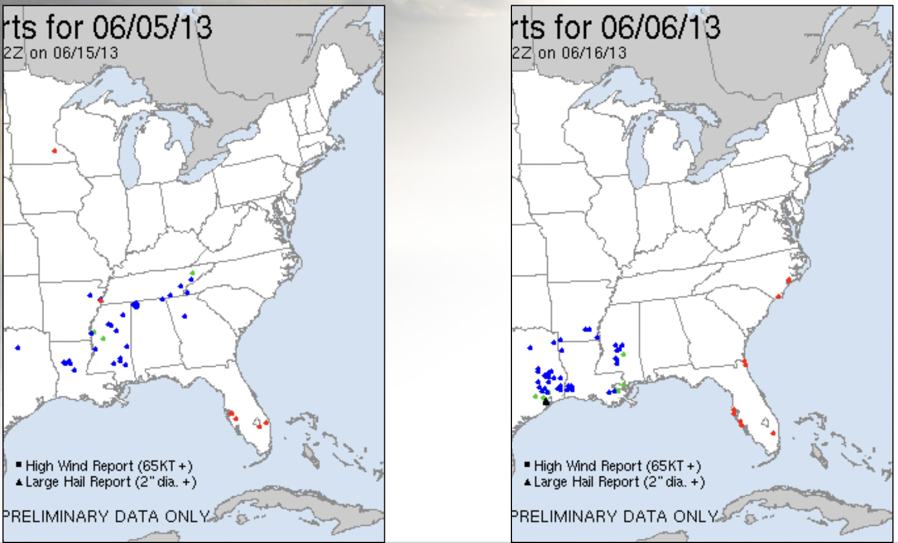
TC TORNADO EXAMPLE CASES 1 (ANDREA 2013)
Notes:
15

Slide 16
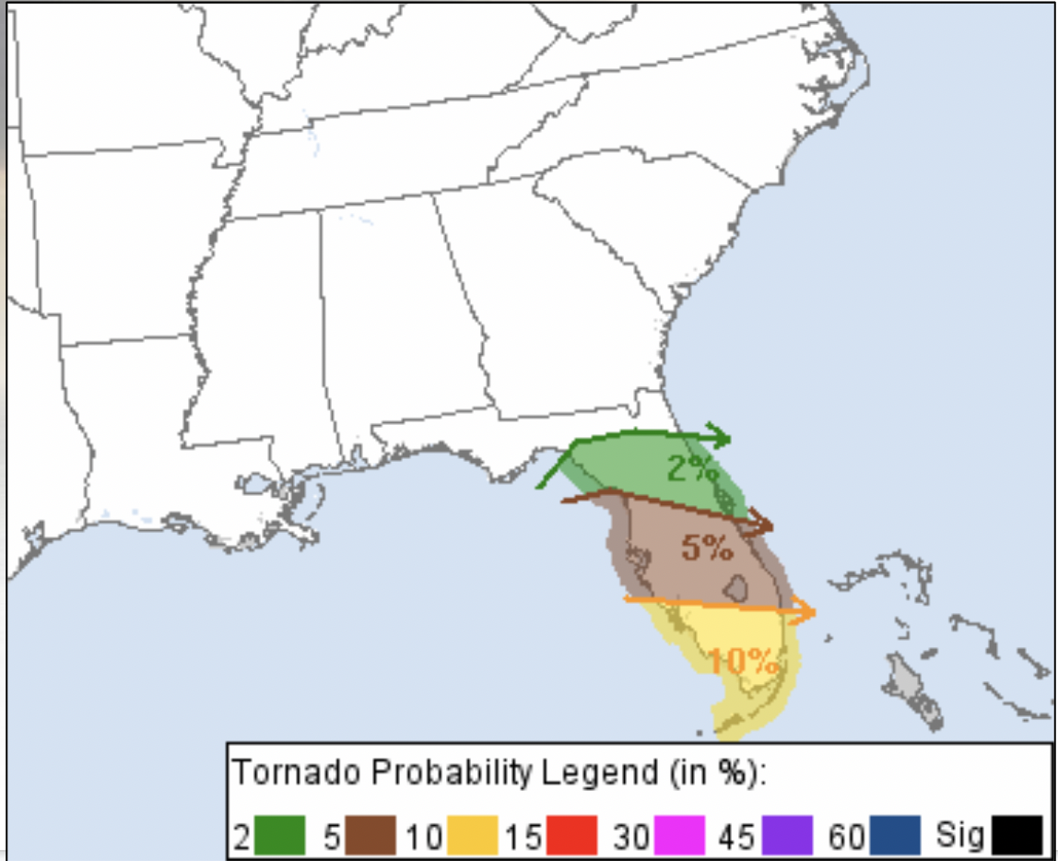
TC TORNADO EXAMPLE CASES 2
(ISAAC 2012)
Notes:
16

Slide 17
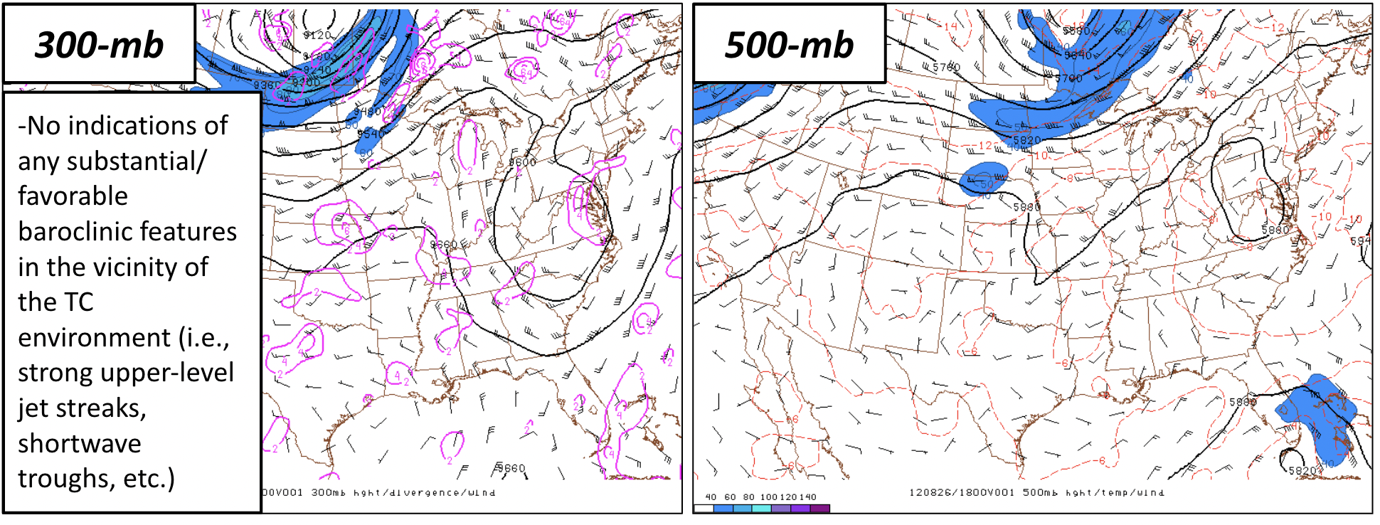
TC TORNADO EXAMPLE CASES 2
(ISAAC 2012)
Notes:
17

Slide 18
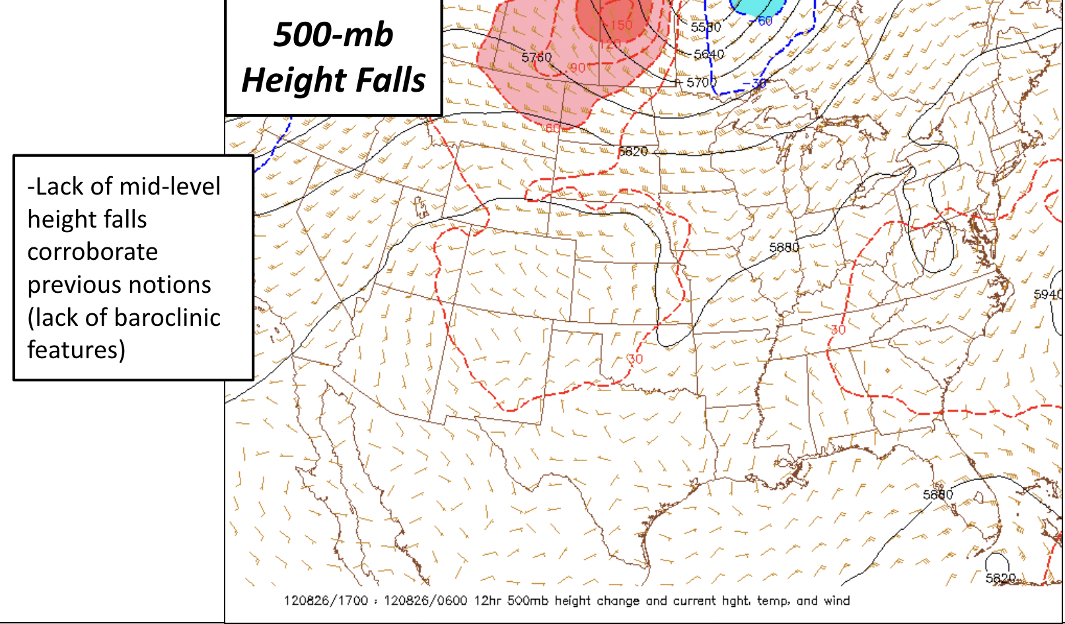
TC TORNADO EXAMPLE CASES 2
(ISAAC 2012)
Notes:
18
-Lack of mid-level height falls corroborates previous notions

Slide 19
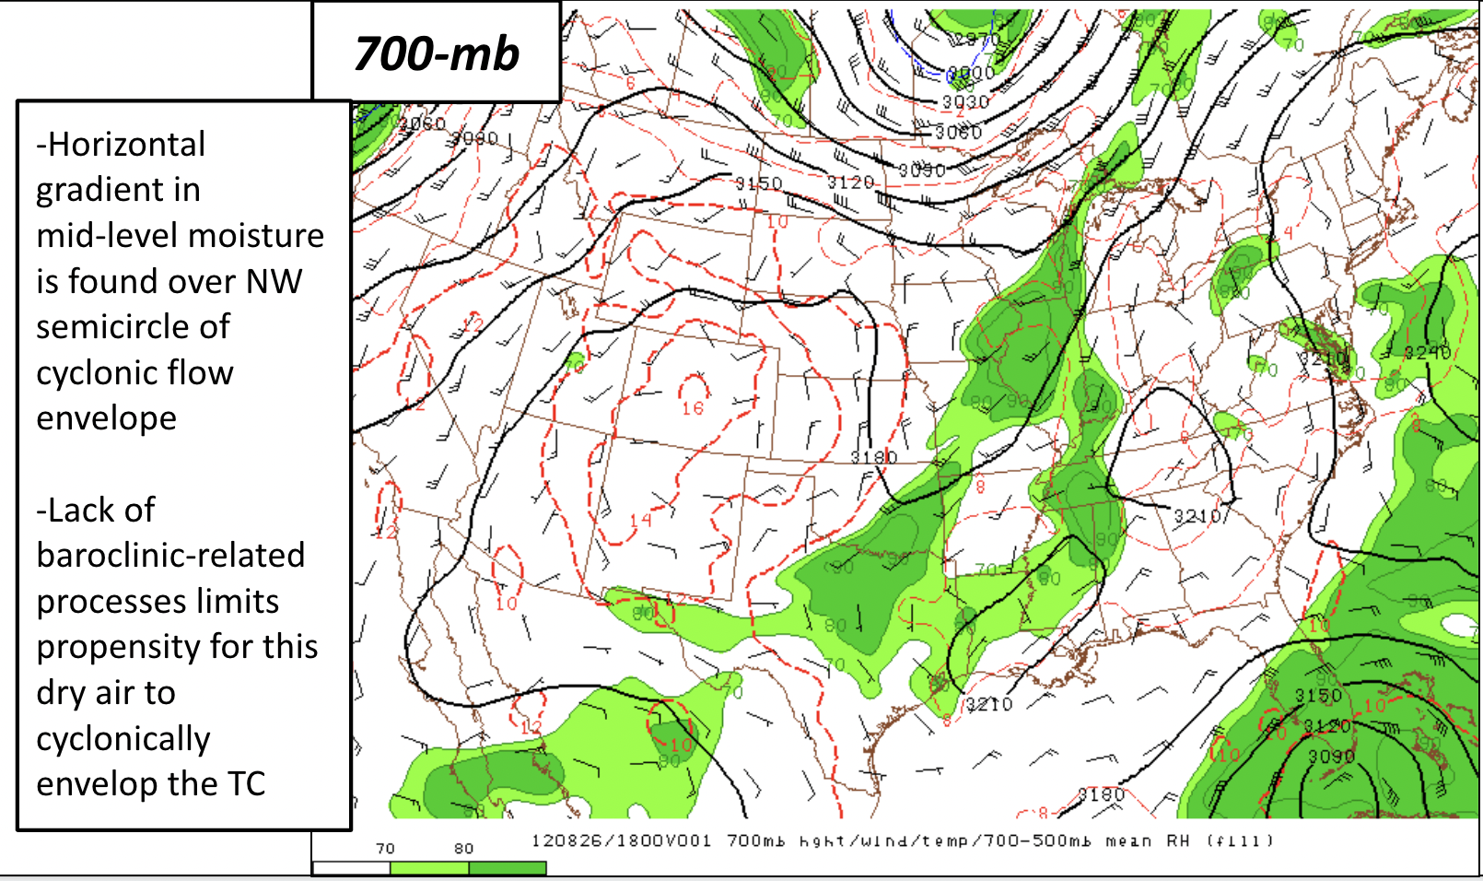
TC TORNADO EXAMPLE CASES 2
(ISAAC 2012)
Notes:
19
-Very large area of high moisture content surrounding the TC -- with no evident baroclinic-related processes to allow for favorable mid-level dry air intrusions into the TC environment

Slide 20
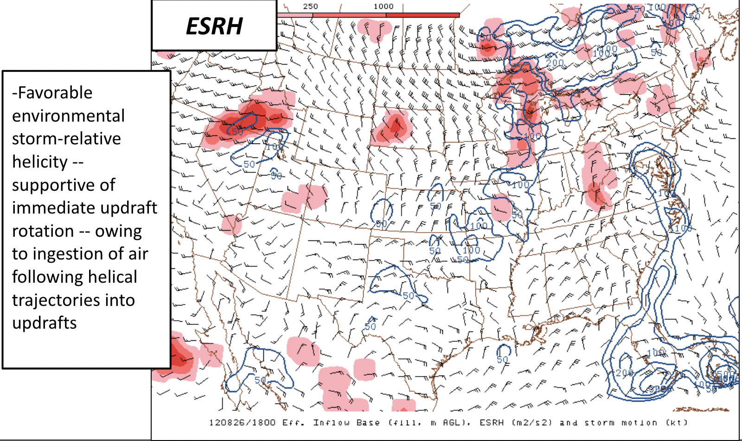
TC TORNADO EXAMPLE CASES 2
(ISAAC 2012)
Notes:
20

Slide 21
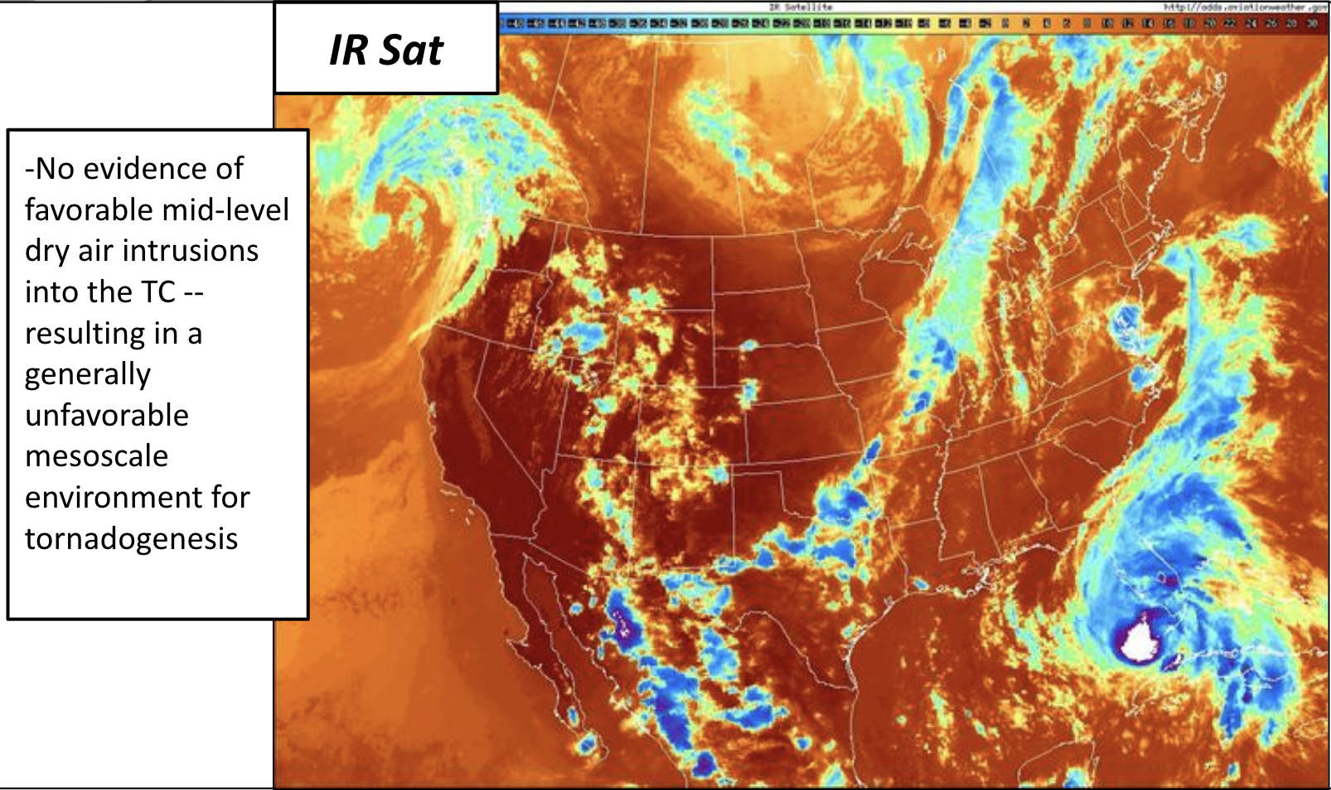
TC TORNADO EXAMPLE CASES 2
(ISAAC 2012)
Notes:
21

Slide 22
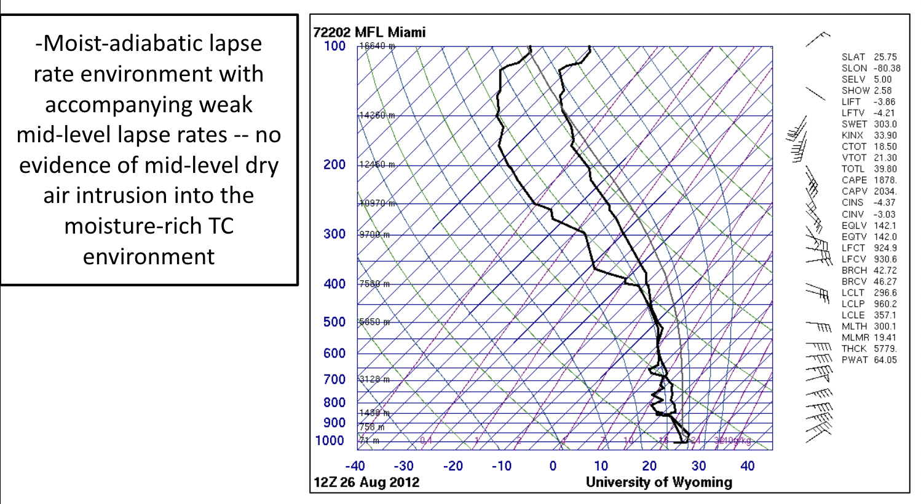
TC TORNADO EXAMPLE CASES 2
(ISAAC 2012)
Notes:
22

Slide 23
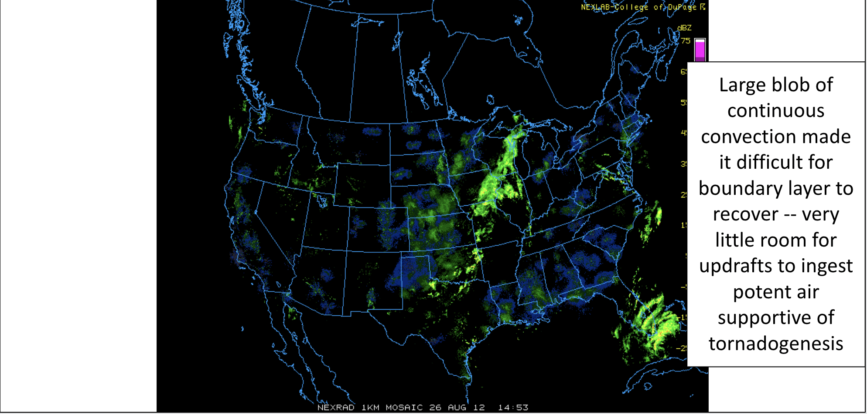
TC TORNADO EXAMPLE CASES 2
(ISAAC 2012)
Notes:
23

Slide 24
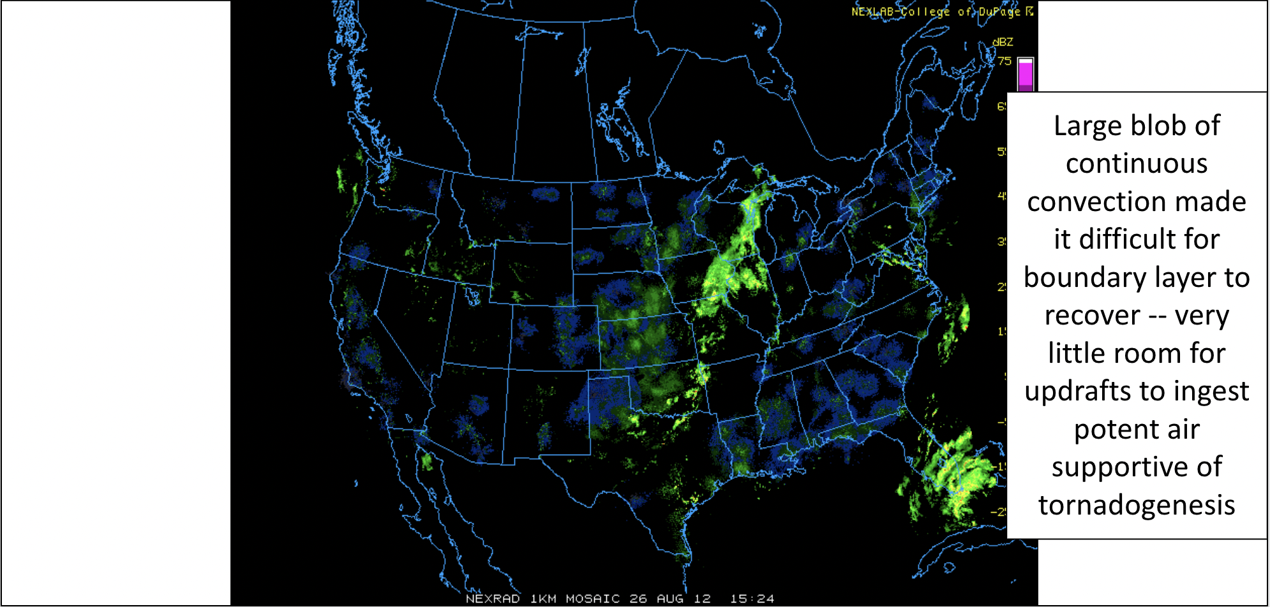
TC TORNADO EXAMPLE CASES 2
(ISAAC 2012)
Notes:
24

Slide 25
TC TORNADO EXAMPLE CASES 2
(ISAAC 2012)
Notes:
25

Slide 26
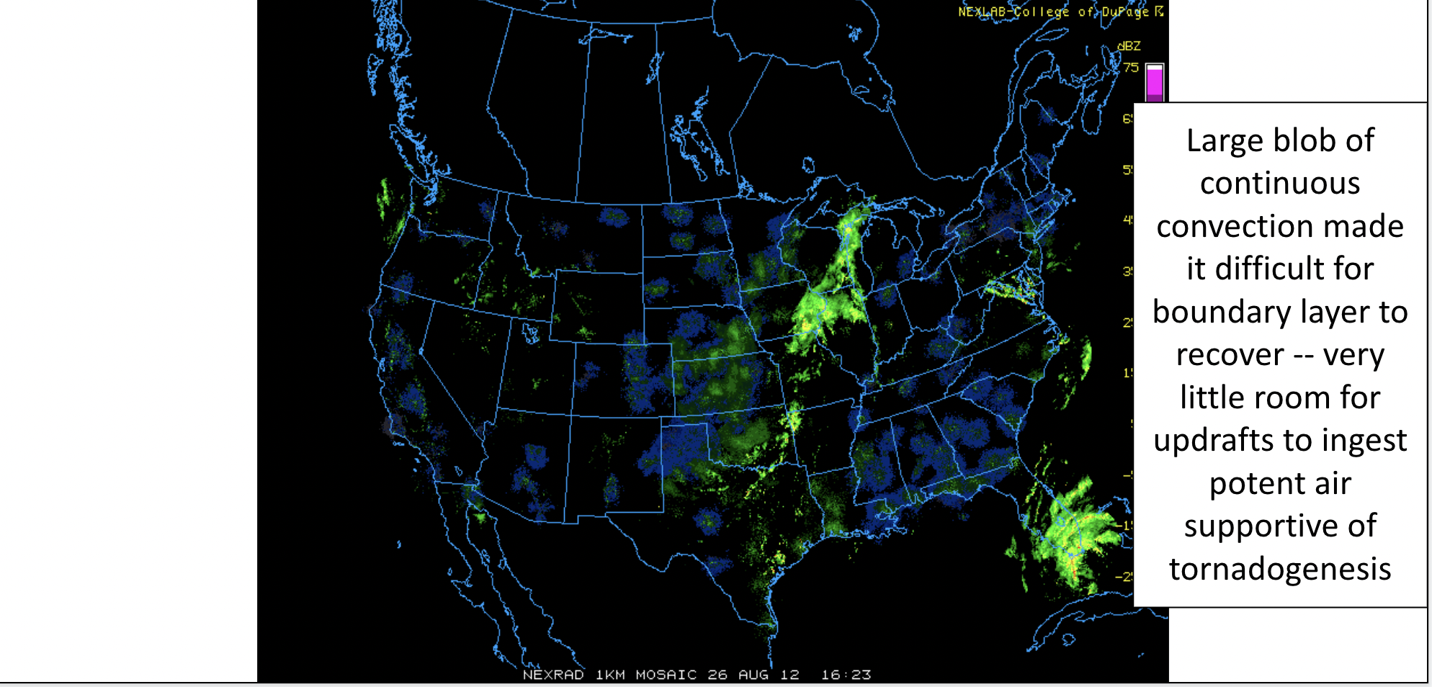
TC TORNADO EXAMPLE CASES 2
(ISAAC 2012)
Notes:
26

Slide 27
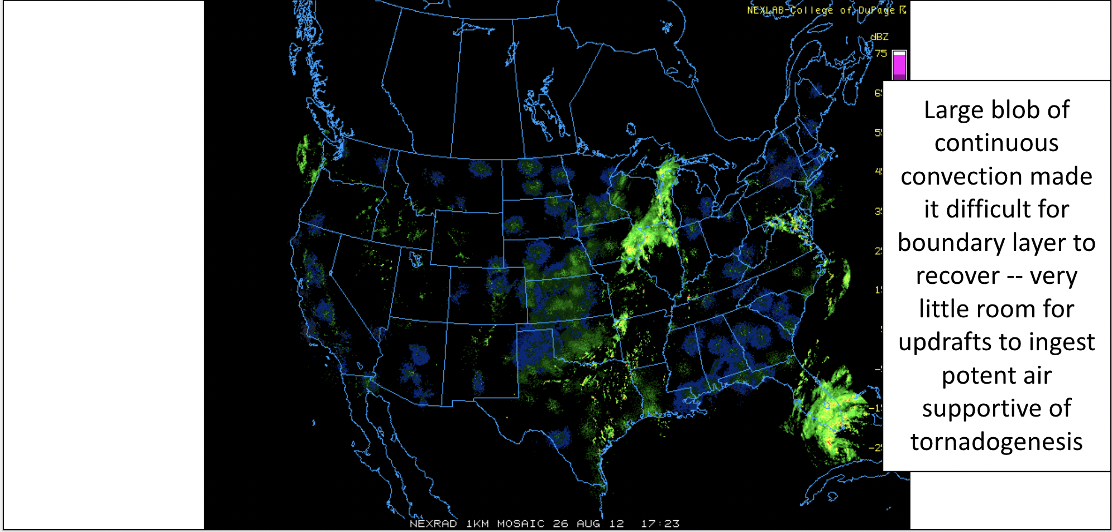
TC TORNADO EXAMPLE CASES 2
(ISAAC 2012)
Notes:
27

Slide 28
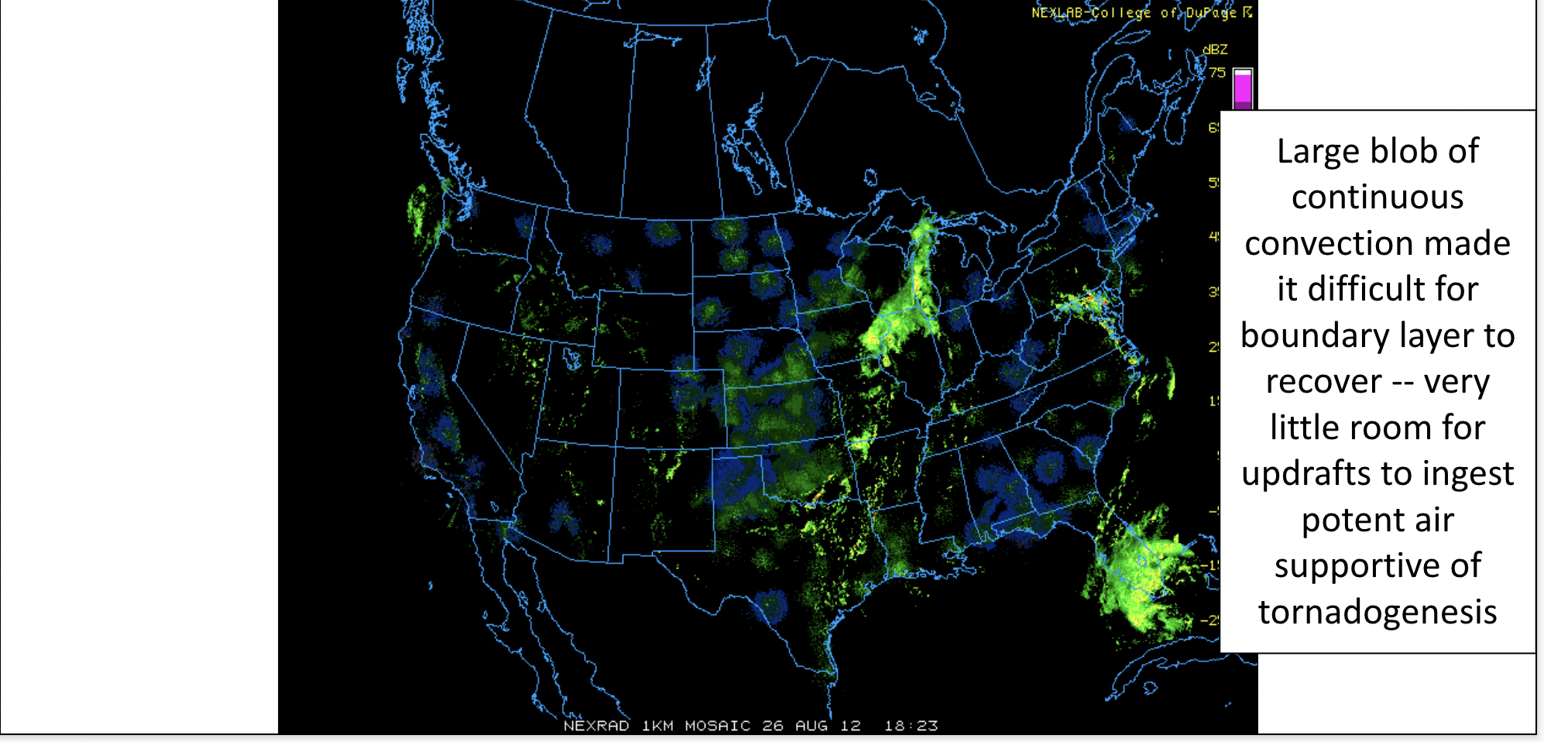
TC TORNADO EXAMPLE CASES 2
(ISAAC 2012)
Notes:
28

Slide 29
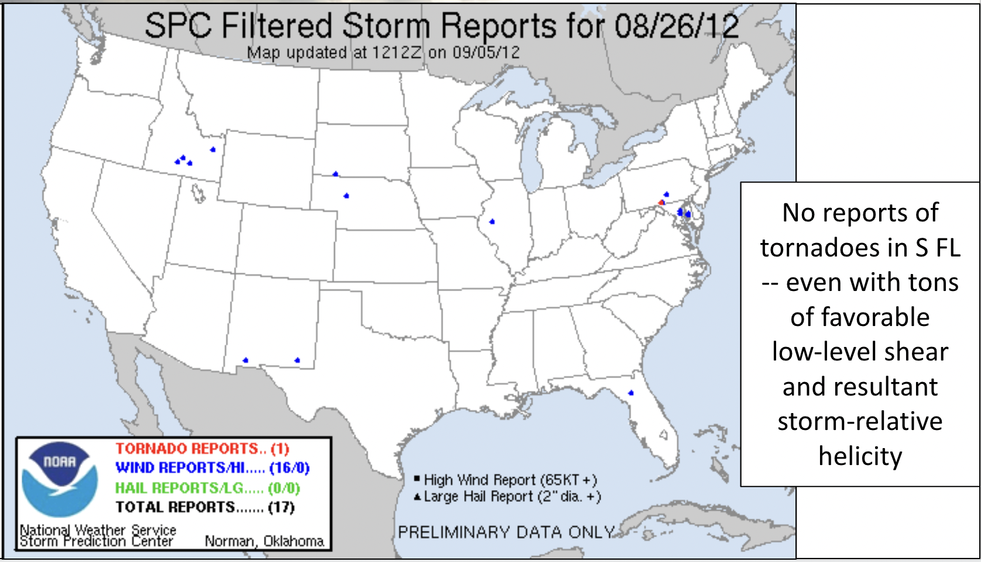
TC TORNADO EXAMPLE CASES 2
(ISAAC 2012)
Notes:
29

Slide 30
TC TORNADO EXAMPLE CASES 3
(NOW YOU TRY!)
Now you try! Does Case 3 depict a favorable or unfavorable synoptic environment
for TC tornadoes?
Notes:
30

Slide 31
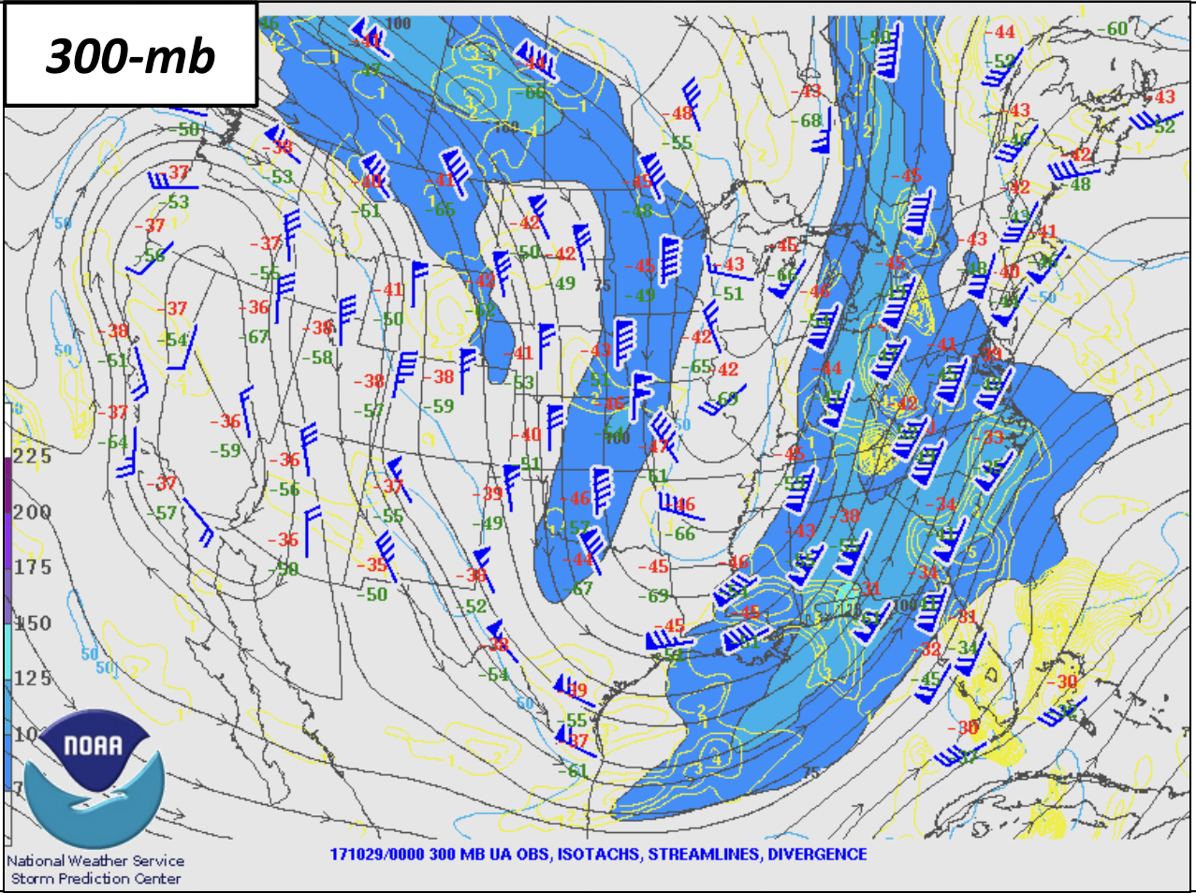
TC TORNADO EXAMPLE CASES 3
(FAVORABLE OR UNFAVORABLE?)
Notes:
31

Slide 32
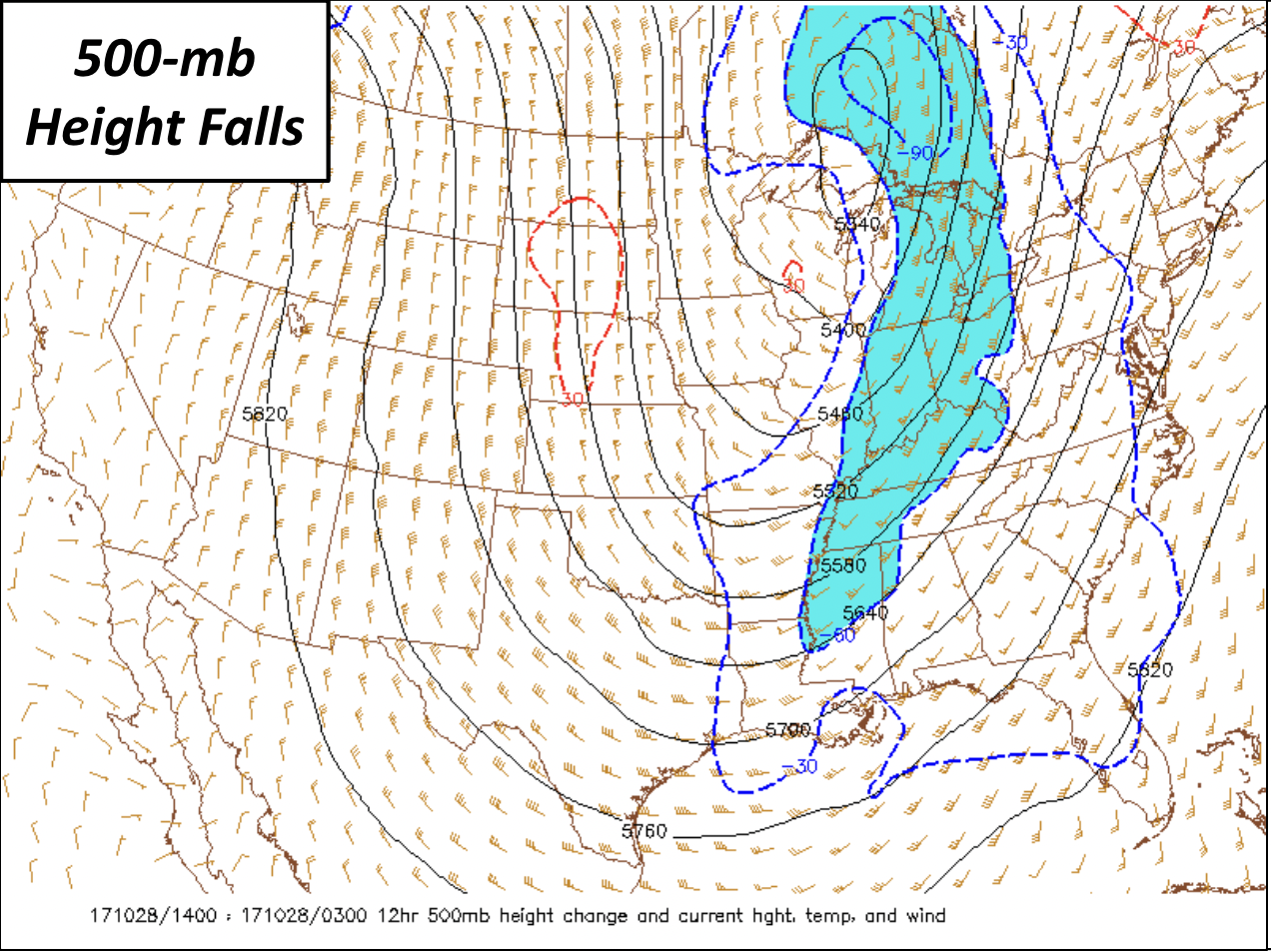
TC TORNADO EXAMPLE CASES 3
(FAVORABLE OR UNFAVORABLE?)
Notes:
32

Slide 33
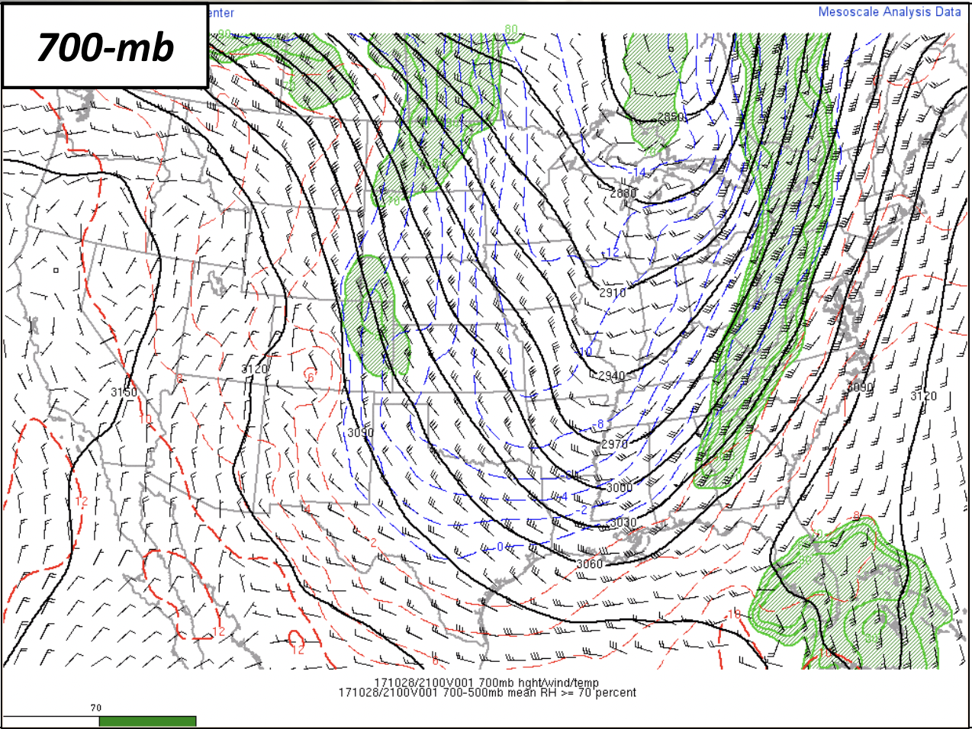
TC TORNADO EXAMPLE CASES 3
(FAVORABLE OR UNFAVORABLE?)
Notes:
33

Slide 34
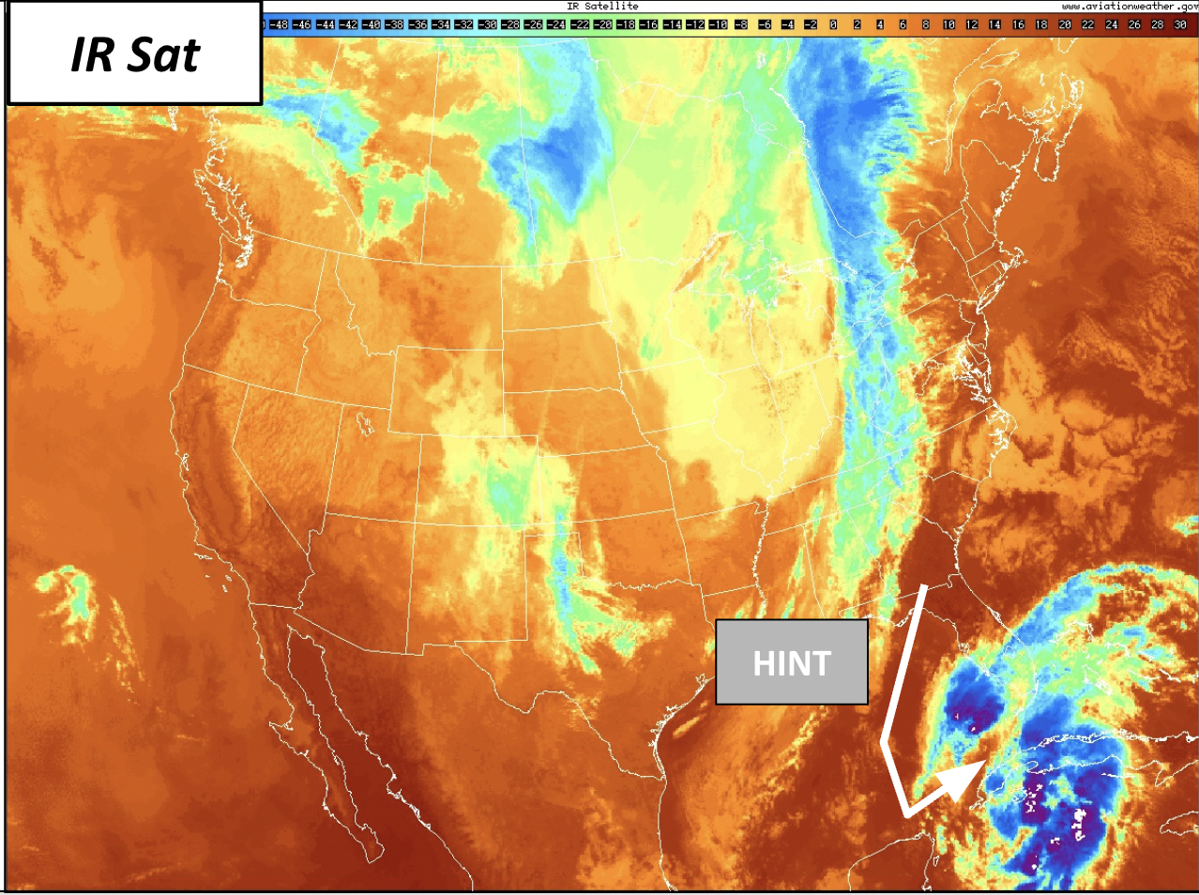
TC TORNADO EXAMPLE CASES 3
(FAVORABLE OR UNFAVORABLE?)
Notes:
34

Slide 35
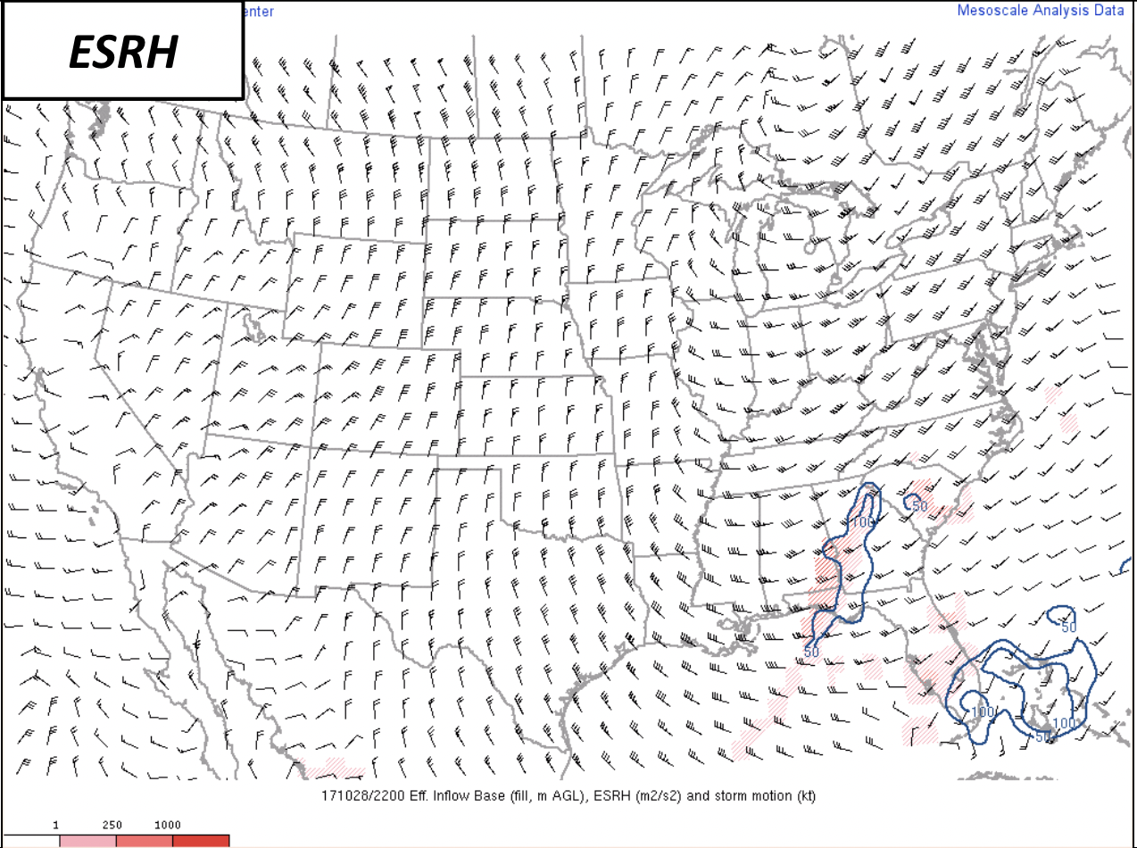
TC TORNADO EXAMPLE CASES 3
(FAVORABLE OR UNFAVORABLE?)
Notes:
35

Slide 36
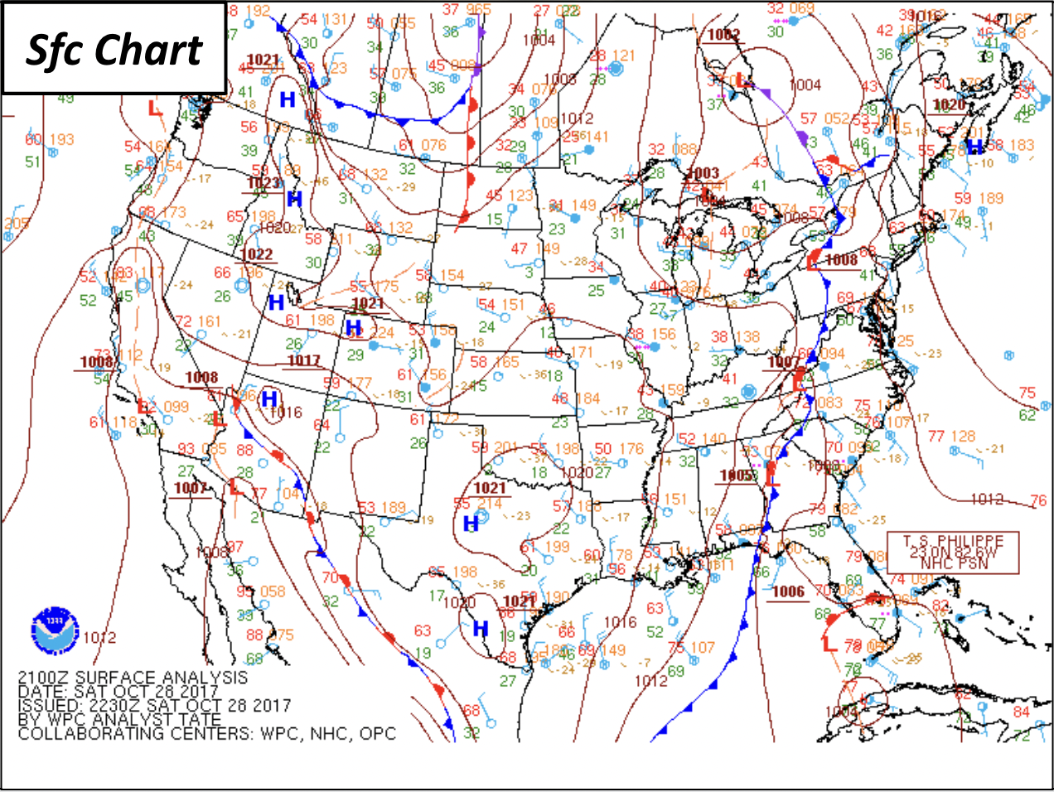
TC TORNADO EXAMPLE CASES 3
(FAVORABLE OR UNFAVORABLE?)
Notes:
36

Slide 37
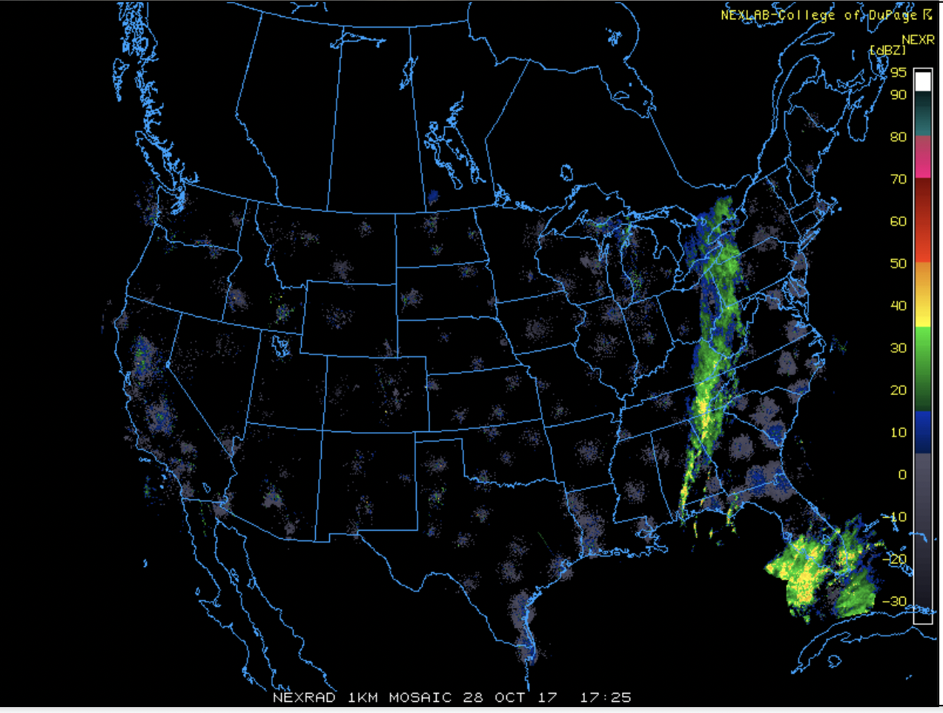
TC TORNADO EXAMPLE CASES 3
(FAVORABLE OR UNFAVORABLE?)
Notes:
37

Slide 38
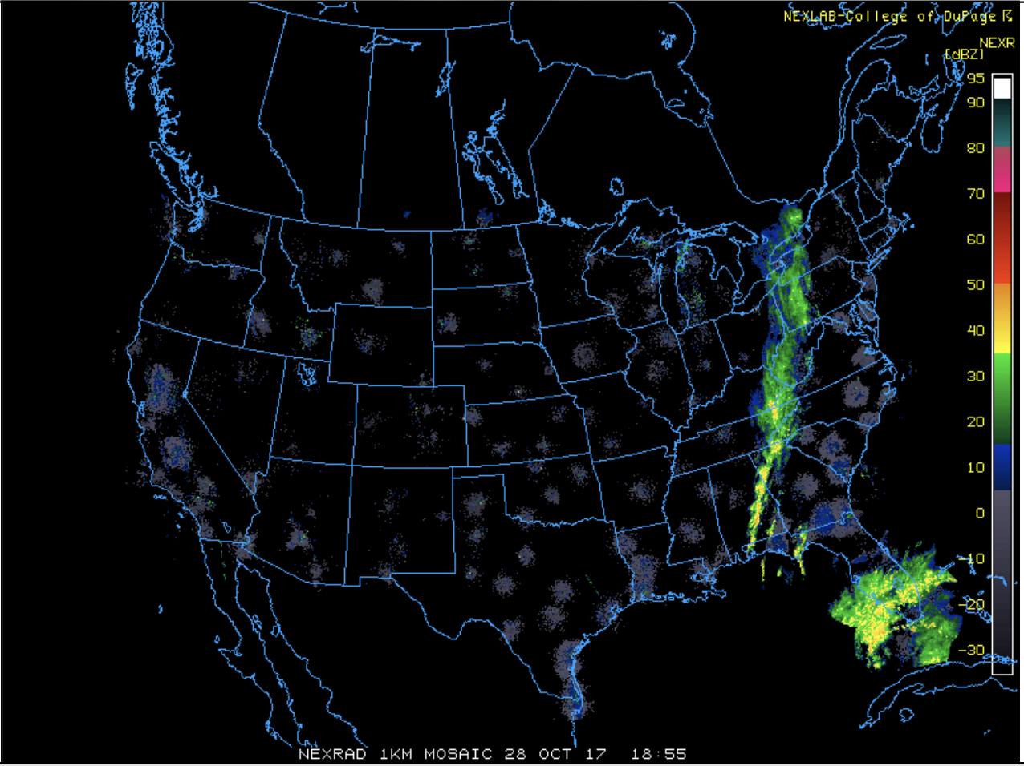
TC TORNADO EXAMPLE CASES 3
(FAVORABLE OR UNFAVORABLE?)
Notes:
38

Slide 39
TC TORNADO EXAMPLE CASES 3
(FAVORABLE OR UNFAVORABLE?)
Notes:
39

Slide 40
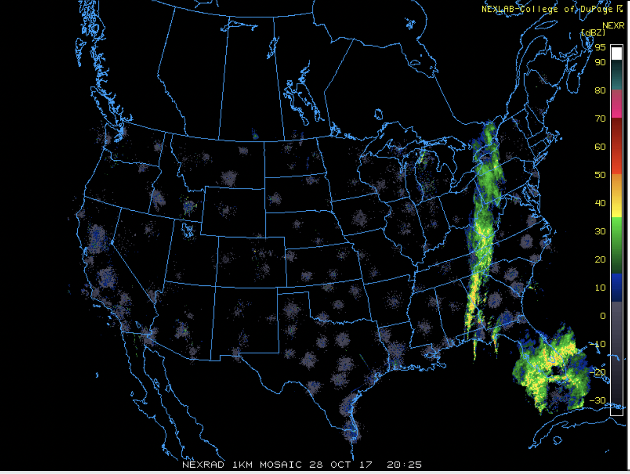
TC TORNADO EXAMPLE CASES 3
(FAVORABLE OR UNFAVORABLE?)
Notes:
40

Slide 41
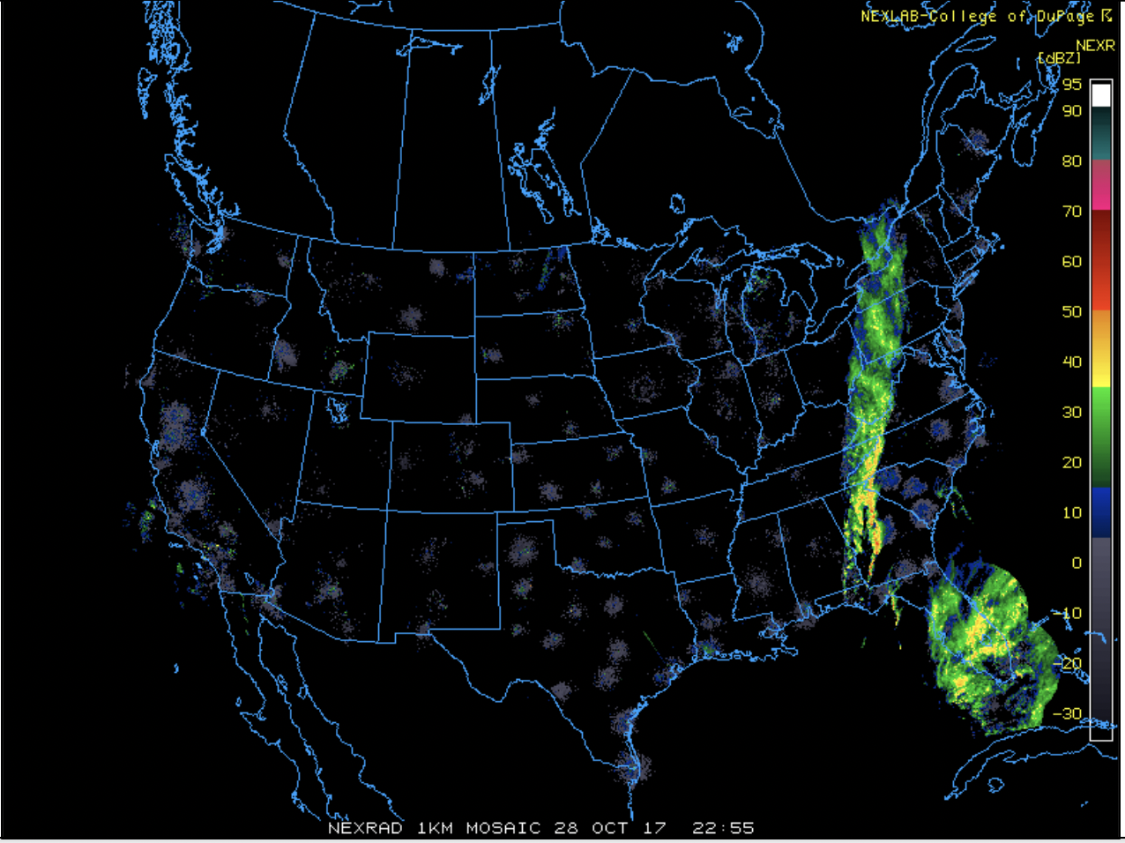
TC TORNADO EXAMPLE CASES 3
(FAVORABLE OR UNFAVORABLE?)
Notes:
41

Slide 42
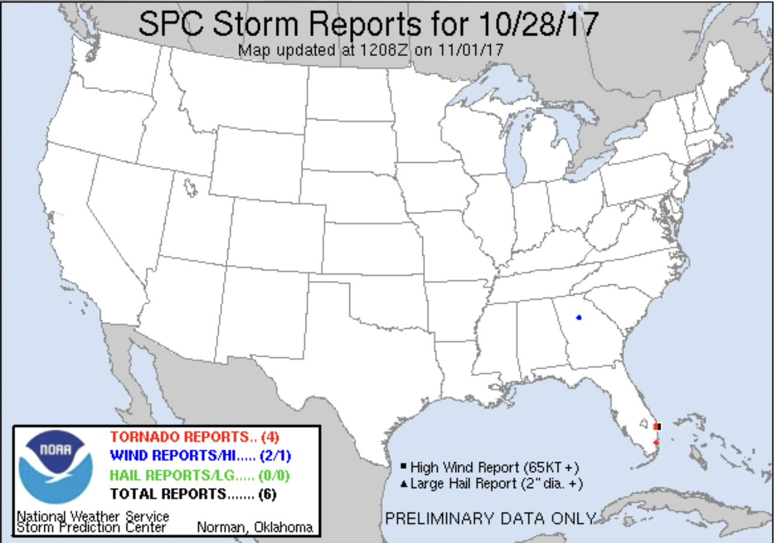
TC TORNADO EXAMPLE CASES 3
(FAVORABLE OR UNFAVORABLE?)
Favorable (barely)!
(Philippe 2017)
Notes:
42

Slide 43
DATABASE and DOCUMENTATION
ONLINE: www.spc.noaa.gov/publications
Contact: Harry.Weinman@noaa.gov
Tornado.Specialist@gmail.com
Notes:
43
Where to get data and info

