Slide 1
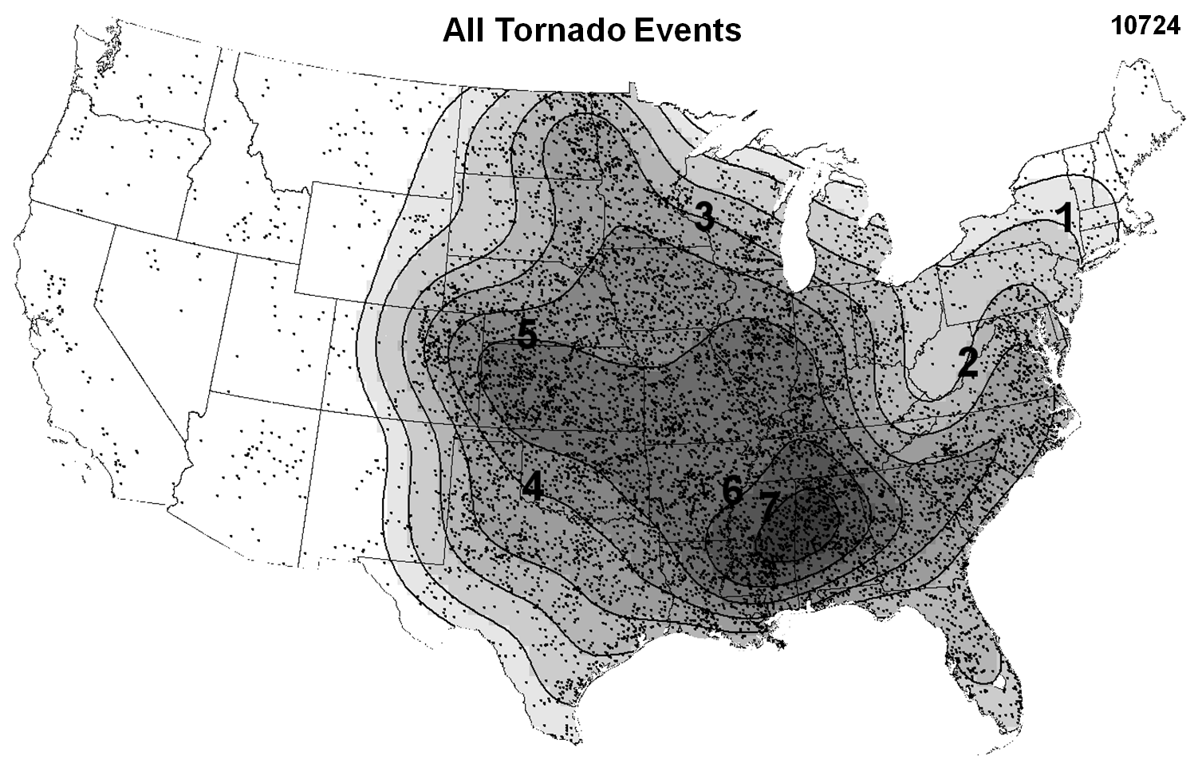
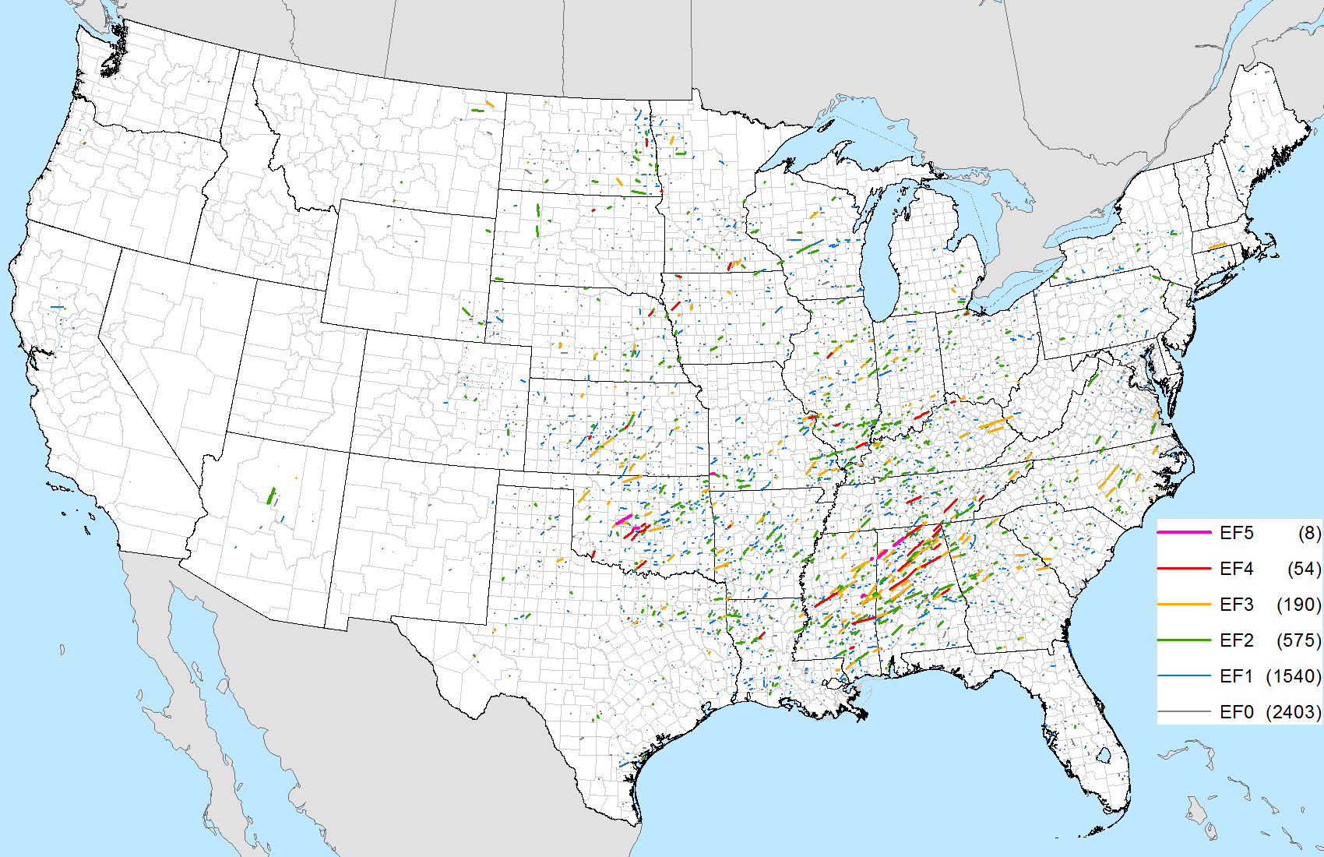
Tornado Climatology
To answer in-class questions go to: pollev.com/severeclass641
Notes:
Data from: Thompson et al. 2013, Grams et al. 2012, Thompson et al. 2010

Slide 2
Climatology: Why Should We Care?
I’m here to learn about tornadoes!
What do I care about climatology?!
Being aware of severe weather climatology helps us establish a baseline of what’s “normal”.
In turn, this allows us to identify
anomalous environments
(whether anomalously low or high).
Notes:
Based on parameter space alone, the 2% tornado threat appears appropriate.

Slide 3
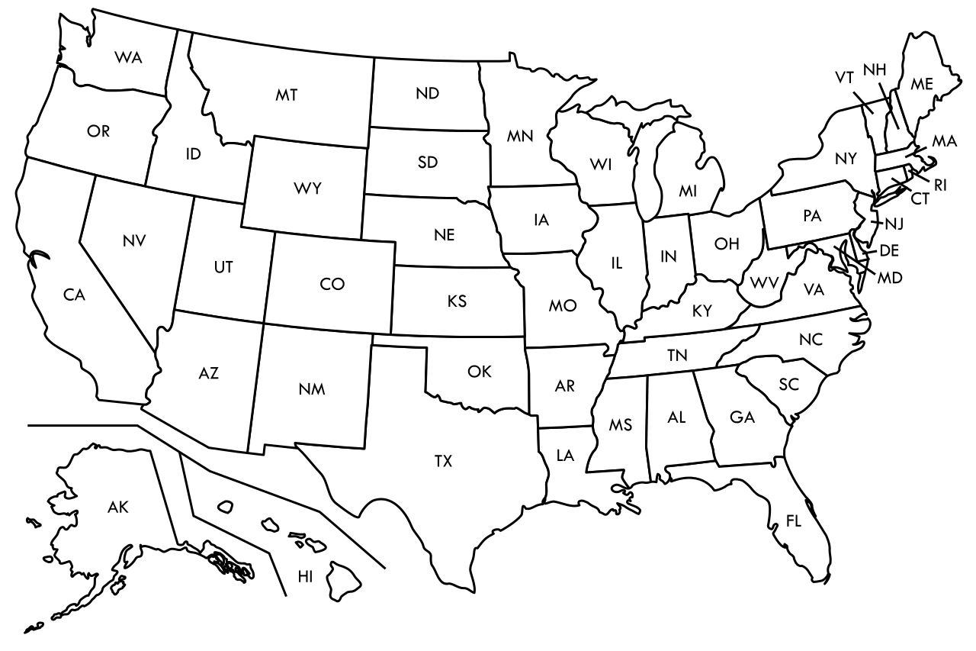
MLCAPE = 2000 J/kg
A
MLCAPE of 2000 J/kg is most
common for which location?
Is it common for this time of year?
Is it common for environments associated with tornadoes?
C
B
D
Notes:
Based on parameter space alone, the 2% tornado threat appears appropriate.

Slide 4
MLCAPE = 3000 J/kg
It’s mid-May with an
MLCAPE of 3000 J/kg and a dryline across western OK.
Is this a higher than normal risk for severe thunderstorms?
Notes:
Based on parameter space alone, the 2% tornado threat appears appropriate.

Slide 5
MLCAPE = 3000 J/kg
Understanding climatology can help answer these questions!
Notes:
Based on parameter space alone, the 2% tornado threat appears appropriate.

Slide 6
Tornado Climatology
Work done by SPC forecasters to identify tornado/ingredient climatologies
Smith et al. 2012 (Weather and Forecasting)
Thompson et al. 2012 (Weather and Forecasting)
Grams et al. 2012 (Weather and Forecasting)
Looked at ~10,000 tornado cases
Period: 2003-2011
Considered Supercell EF-2+ and QLCS EF-1+
Assigned storm mode based on WSR-88D data
Ex: discrete supercell, QLCS, cluster supercell, etc…
Collected SPC Mesoanalysis data for each instance at the nearest grid point
Created plots of tornado events and ingredients based on:
Seasonal (spring, summer, fall, winter)
Convective mode
Notes:
Based on parameter space alone, the 2% tornado threat appears appropriate.

Slide 7
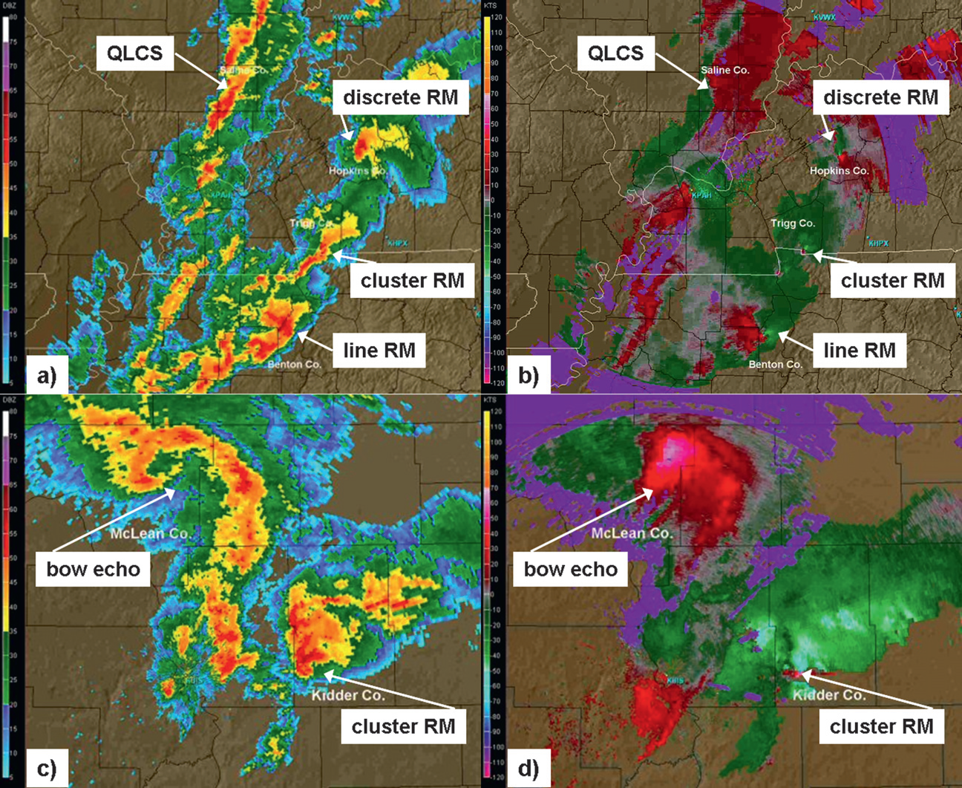
Fig 2. Smith et al. 2012
Fig 3. Smith et al. 2012
Notes:
Based on parameter space alone, the 2% tornado threat appears appropriate.

Slide 8
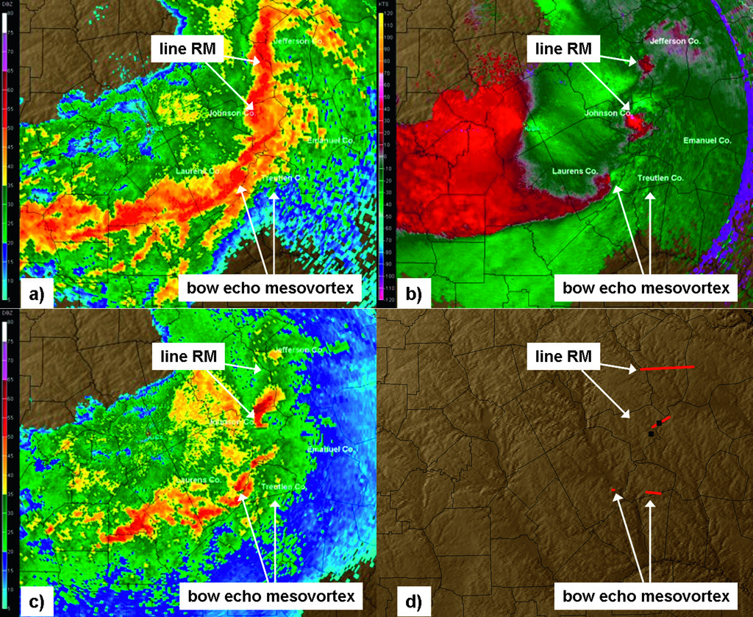
Fig 4. Smith et al. 2012
Notes:
Based on parameter space alone, the 2% tornado threat appears appropriate.

Slide 9
Ingredient Climatology
Considered tornado environments for right-moving supercell and QLCS tornado events
Considered seasonal variations in:
MLCAPE
MLCIN
Effective BWD
Effective SRH
MLLCL
STP
Notes:
Based on parameter space alone, the 2% tornado threat appears appropriate.

Slide 11
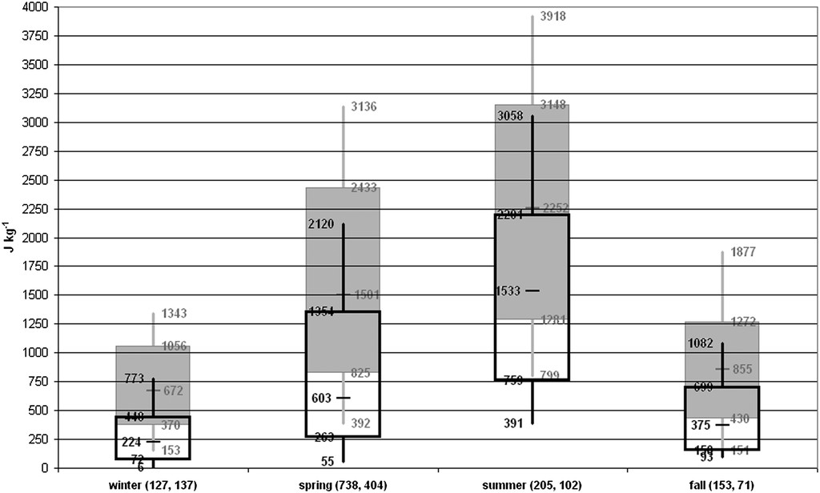
MLCAPE
Consider low-level moisture availability in summer vs. winter.
RM Supercell EF-2+
QLCS EF-1+
Notes:
Based on parameter space alone, the 2% tornado threat appears appropriate.

Slide 12
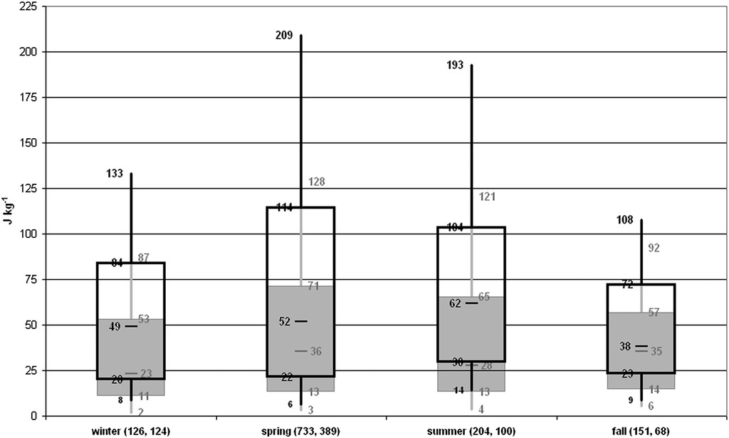
MLCIN
RM Supercell EF-2+
QLCS EF-1+
Notes:
Based on parameter space alone, the 2% tornado threat appears appropriate.

Slide 13
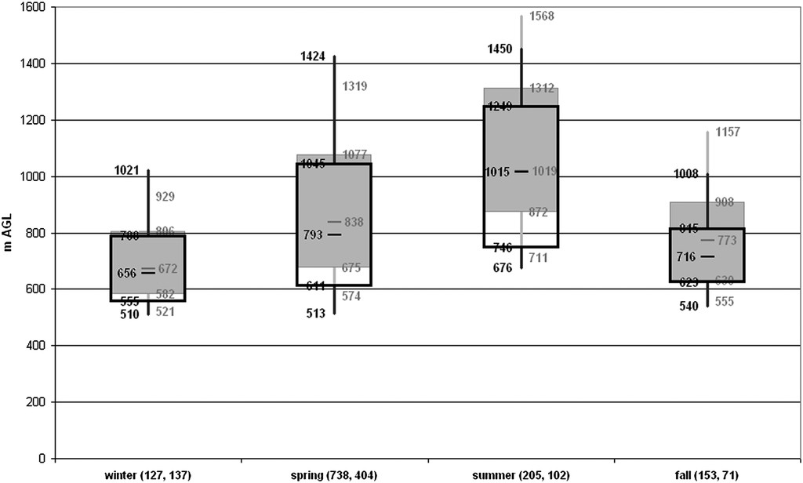
MLLCL
RM Supercell EF-2+
QLCS EF-1+
Consider seasonal temperature trends.
Notes:
Based on parameter space alone, the 2% tornado threat appears appropriate.

Slide 14
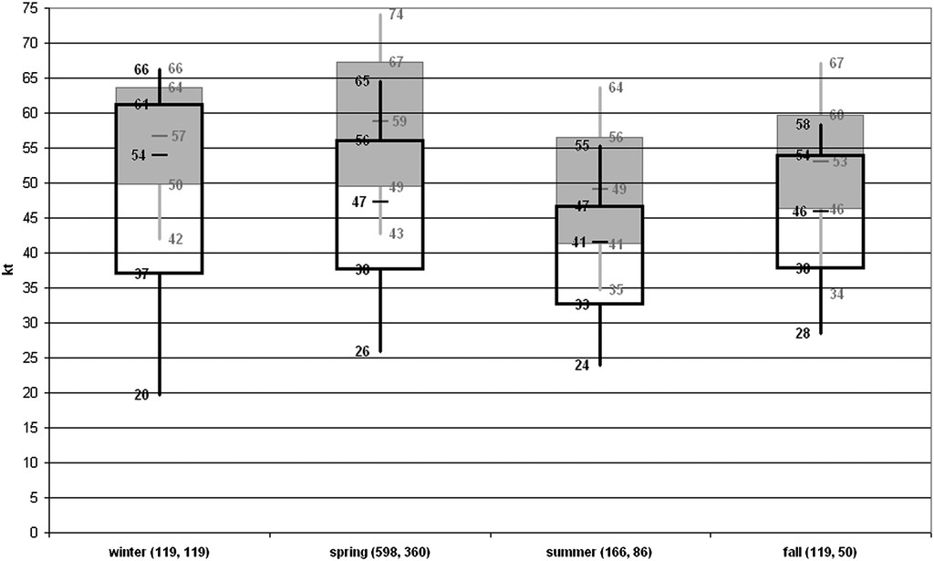
Eff. Bulk Wind Difference
RM Supercell EF-2+
Consider seasonal patterns in the upper-level jet stream
QLCS EF-1+
Notes:
Based on parameter space alone, the 2% tornado threat appears appropriate.

Slide 15
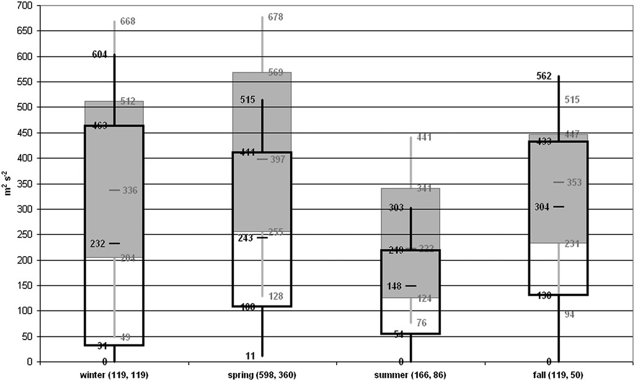
Eff. SRH
RM Supercell EF-2+
QLCS EF-1+
Notes:
Based on parameter space alone, the 2% tornado threat appears appropriate.

Slide 16
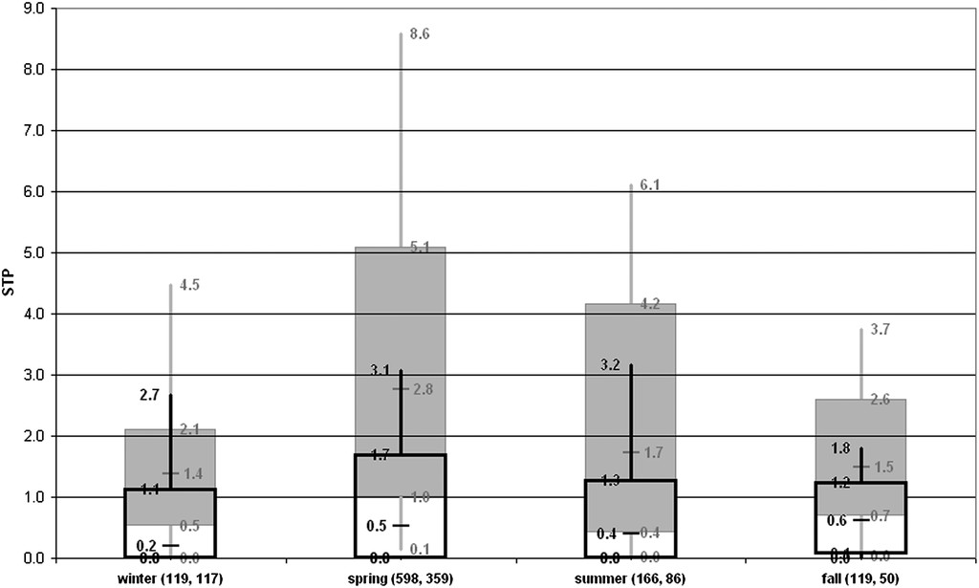
Eff. STP
RM Supercell EF-2+
QLCS EF-1+
Notes:
Based on parameter space alone, the 2% tornado threat appears appropriate.

Slide 17
MLCAPE (J/kg)
QLCS
RM Supercell
10th
50th
90th
Notes:
Based on parameter space alone, the 2% tornado threat appears appropriate.

Slide 18
MLLCL (m)
QLCS
RM Supercell
10th
50th
90th
Notes:
Based on parameter space alone, the 2% tornado threat appears appropriate.

Slide 19
0-6 km Bulk Wind Difference (kt)
QLCS
RM Supercell
10th
50th
90th
Notes:
Based on parameter space alone, the 2% tornado threat appears appropriate.

Slide 20
0-1 km SRH (m2/s2)
QLCS
RM Supercell
10th
50th
90th
Notes:
Based on parameter space alone, the 2% tornado threat appears appropriate.

Slide 21
Fixed-Layer STP
QLCS
RM Supercell
10th
50th
90th
Notes:
Based on parameter space alone, the 2% tornado threat appears appropriate.

Slide 22
STP distribution is largely driven by the overlap in MLCAPE and 0-1 km SRH
Supercell MLCAPE
Supercell 0-1 km SRH
Supercell STP
Notes:
Based on parameter space alone, the 2% tornado threat appears appropriate.

Slide 23
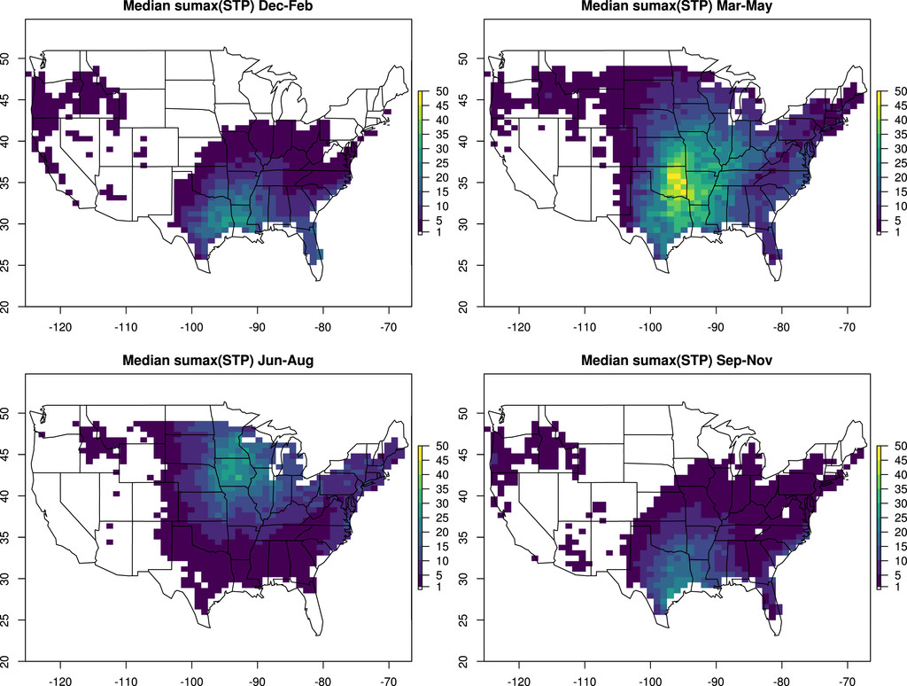
STP distribution is largely driven by the overlap in MLCAPE and 0-1 km SRH
Supercell MLCAPE
Supercell 0-1 km SRH
Supercell STP
From Gensini and Bravo de Guenni 2019
Notes:
Based on parameter space alone, the 2% tornado threat appears appropriate.

Slide 24
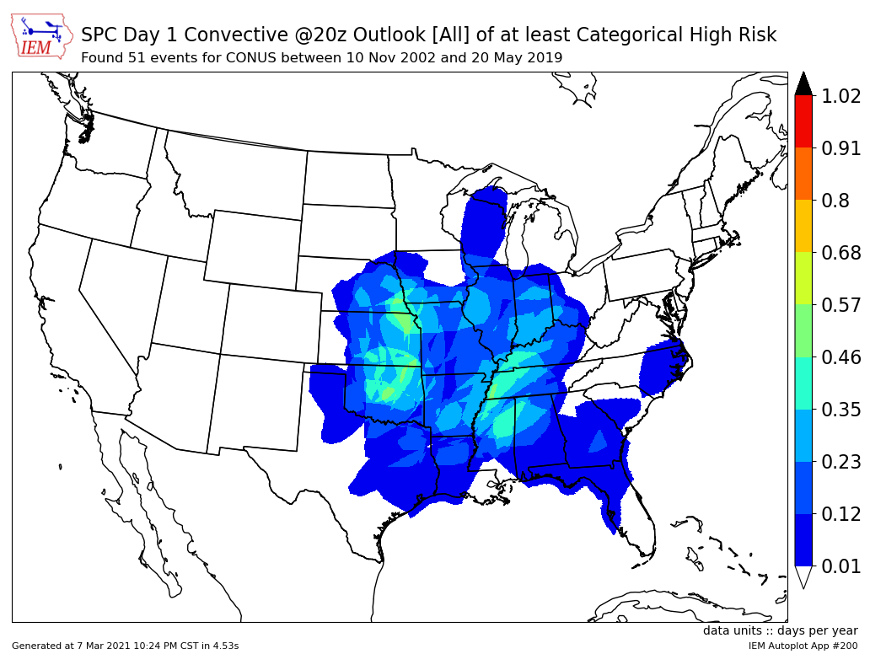
STP distribution is largely driven by the overlap in MLCAPE and 0-1 km SRH
Supercell MLCAPE
Supercell 0-1 km SRH
Supercell STP
Notes:
Based on parameter space alone, the 2% tornado threat appears appropriate.

Slide 25
Ingredients Summary
Clear regional and seasonal variations in tornado ingredients
Seasonal variations are physically tied to other seasonal trends (ex: temp)
Regional variations in thermodynamic parameters between Supercell and QLCS
Larger CAPE and higher LCL heights for supercells in the Plains
Vertical shear is similar spatially for Supercell and QLCS tornadoes
Slightly greater wind shear in MS/TN Valleys
Notes:
Based on parameter space alone, the 2% tornado threat appears appropriate.

Slide 26
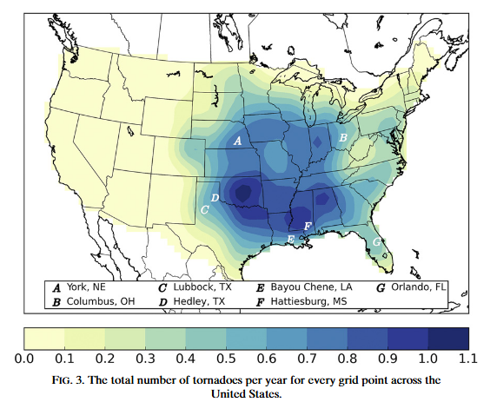
Overall Frequency:
Tornadoes/year
Notes:
Based on parameter space alone, the 2% tornado threat appears appropriate.

Slide 27
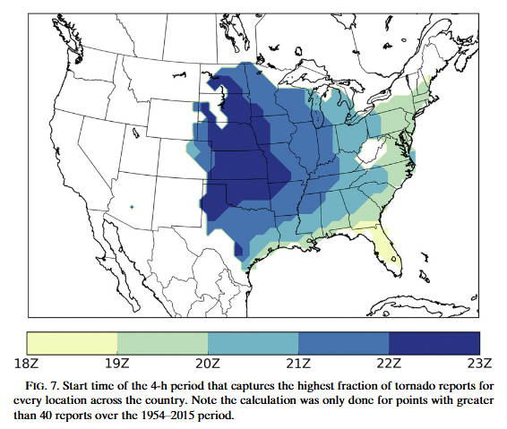
Diurnal Trend
Start time of the 4-hour period that captures the highest fraction of tornado reports.
(Requires N > 40)
See also:
Krocak and Brooks 2020 (WAF)
Notes:
Based on parameter space alone, the 2% tornado threat appears appropriate.

Slide 28
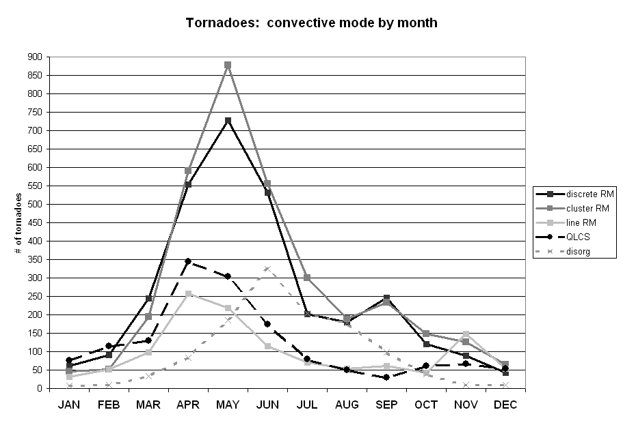
Notes:
Based on parameter space alone, the 2% tornado threat appears appropriate.

Slide 29
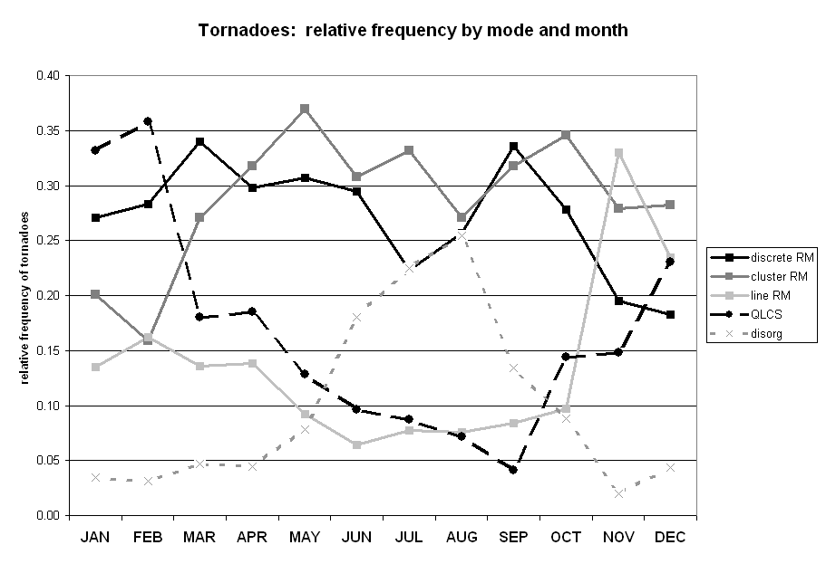
Notes:
Based on parameter space alone, the 2% tornado threat appears appropriate.

Slide 30
Supercell Tornadoes tend to dominate throughout the year
Notes:
Based on parameter space alone, the 2% tornado threat appears appropriate.

Slide 31
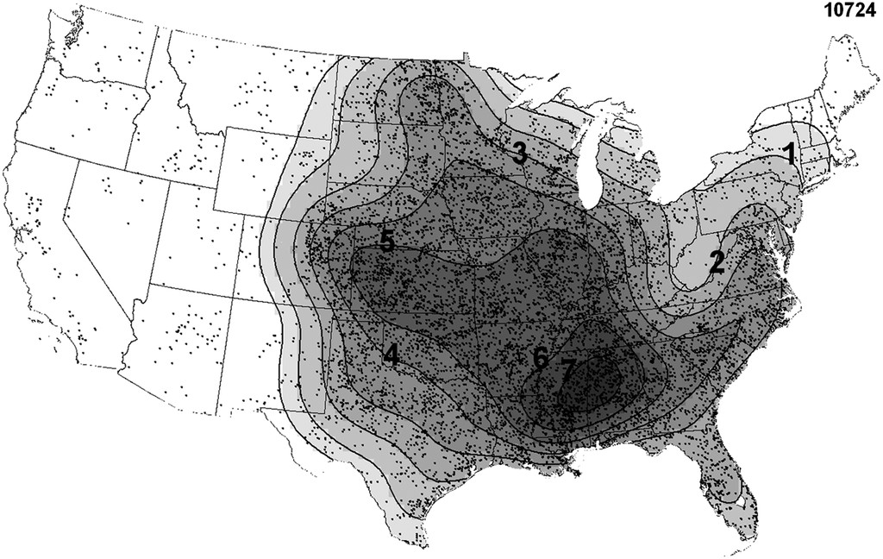
Tornado Events per Decade
Notes:
Based on parameter space alone, the 2% tornado threat appears appropriate.

Slide 32
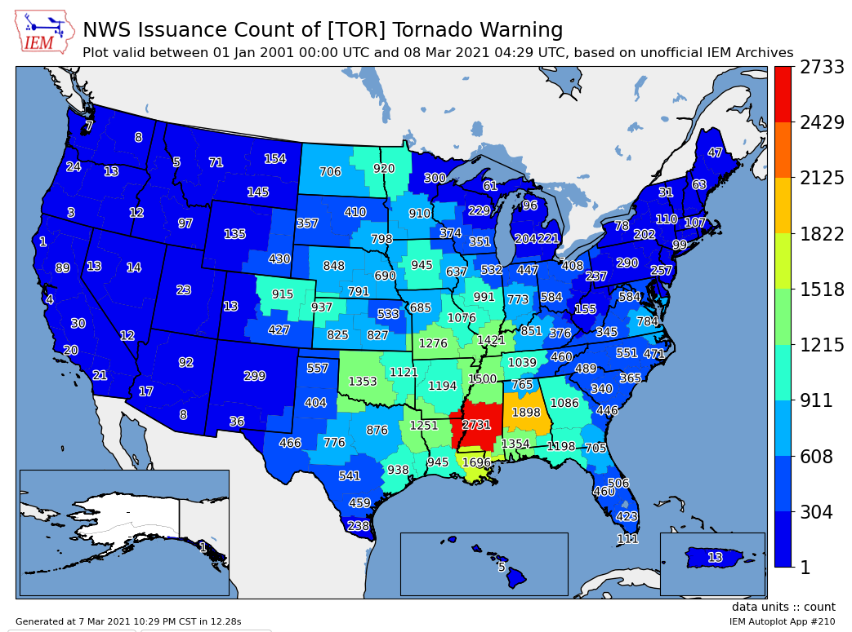
Tornado Events per Decade
This result is supported well by the number of tornado warnings issued over the past 20 years
(Though these datasets are not entirely independent…)
Notes:
Based on parameter space alone, the 2% tornado threat appears appropriate.

Slide 33
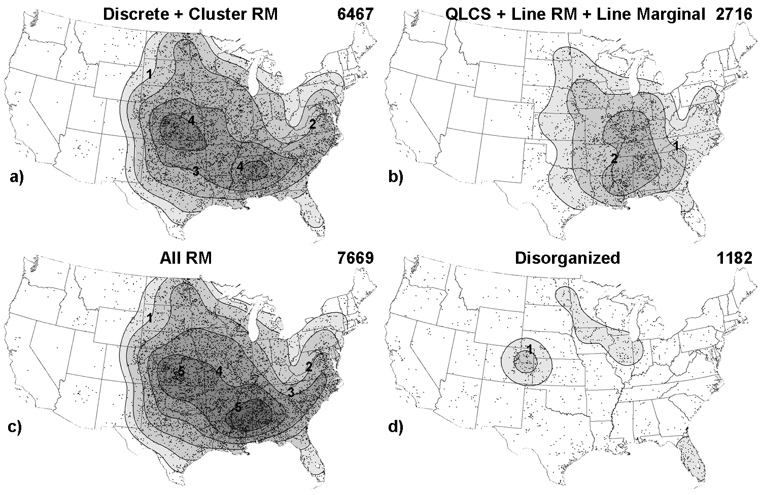
Tornado Events per Decade
Notes:
Based on parameter space alone, the 2% tornado threat appears appropriate.

Slide 34
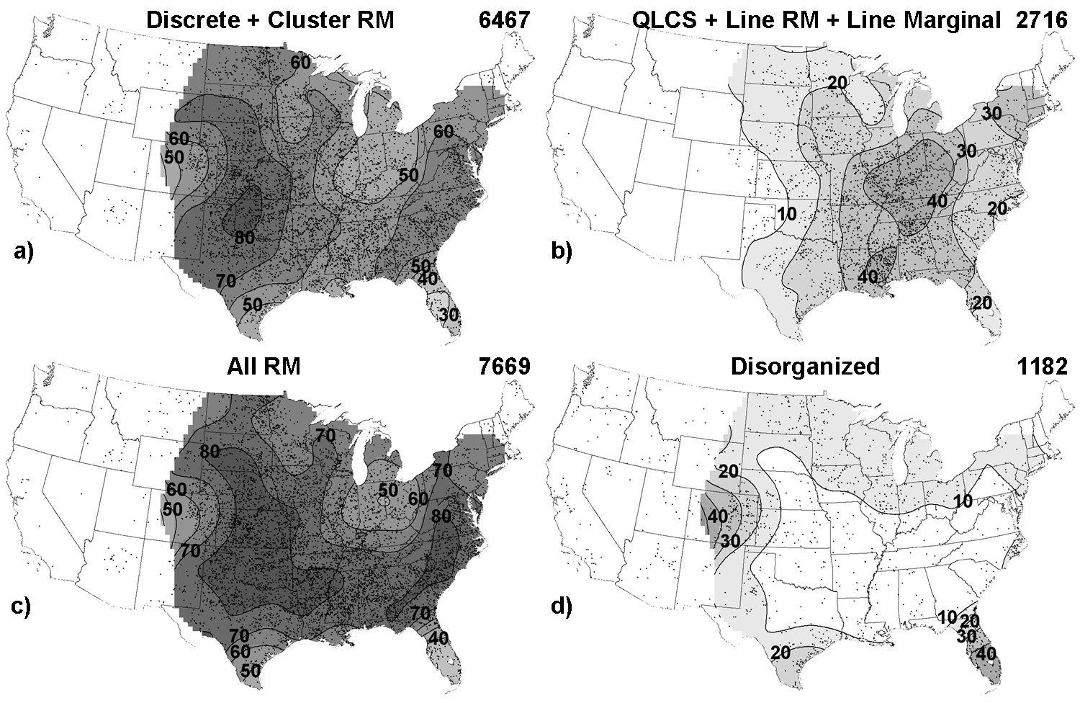
Tornado Relative Frequency
Notes:
Based on parameter space alone, the 2% tornado threat appears appropriate.

Slide 35
Tornado Relative Frequency
Why do we see this shift in distribution?
Notes:
Based on parameter space alone, the 2% tornado threat appears appropriate.

Slide 37
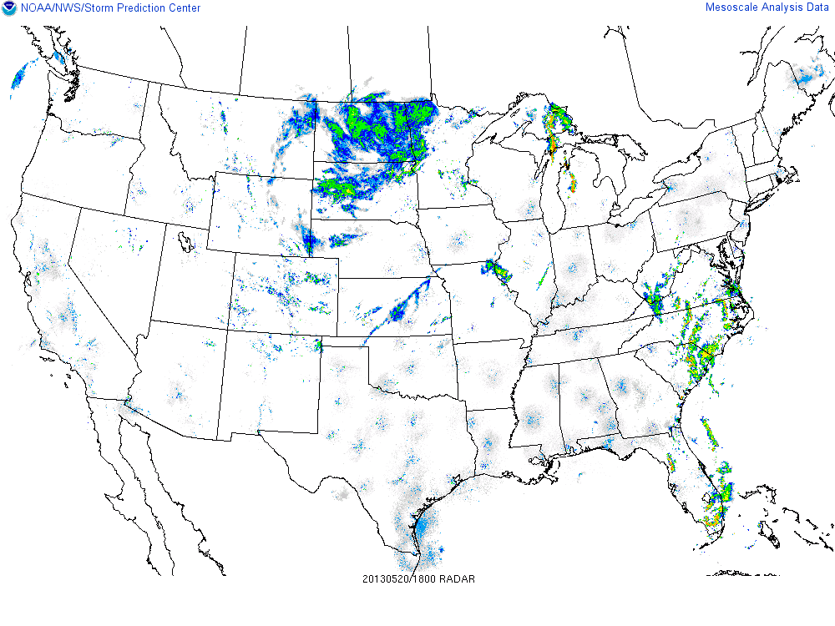
Tornado Relative Frequency
Discrete over the Plains transitions to linear mode over the MS Valley
Notes:
Based on parameter space alone, the 2% tornado threat appears appropriate.

Slide 38
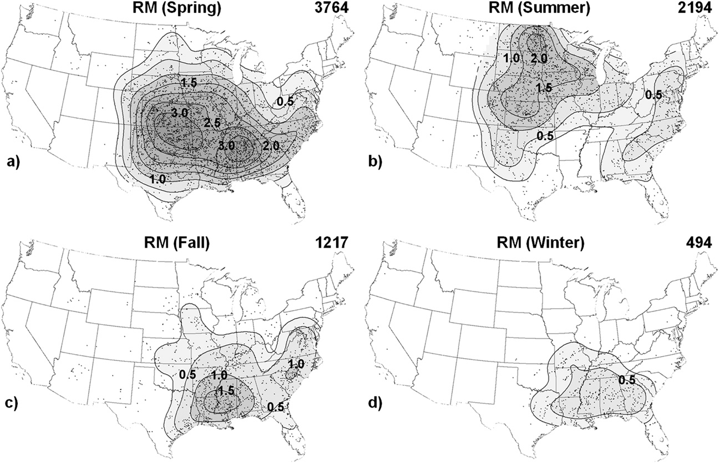
RM Supercell Tornadoes by Season
Notes:
Based on parameter space alone, the 2% tornado threat appears appropriate.

Slide 39
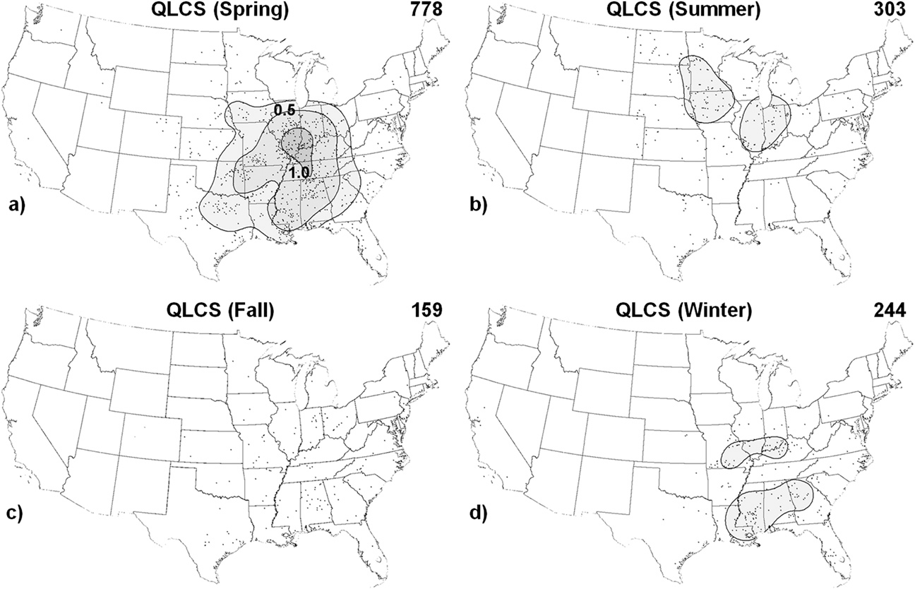
QLCS Tornadoes by Season
Notes:
Based on parameter space alone, the 2% tornado threat appears appropriate.

Slide 40
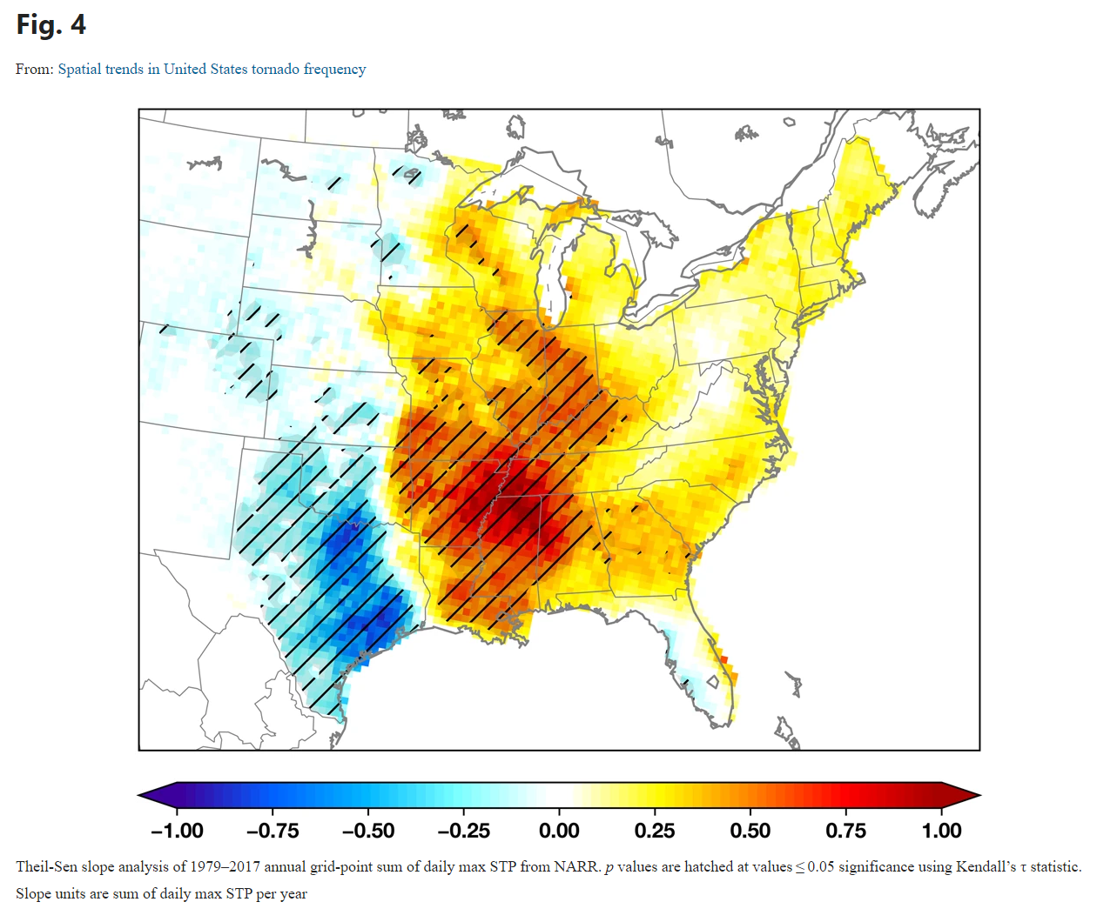
Shifting Tornado Climatology?
From Gensini and Brooks 2018
Recent work by Gensini and Brooks (2018) argues that the frequency of tornadoes may be shifting eastward.
This study used STP (from the NARR) as a proxy for tornado environments and occurrences (recall that even more recent work by Gensini and Bravo de Guenni showed STP was a strong covariate for tornado frequency).
They noted that the annual “accumulation” of STP was decreasing across the southern Plains and increasing across the Midwest/Southeast.
The cause? Unknown at this point!
Still lots of room for research!
Notes:
Based on parameter space alone, the 2% tornado threat appears appropriate.

Slide 41
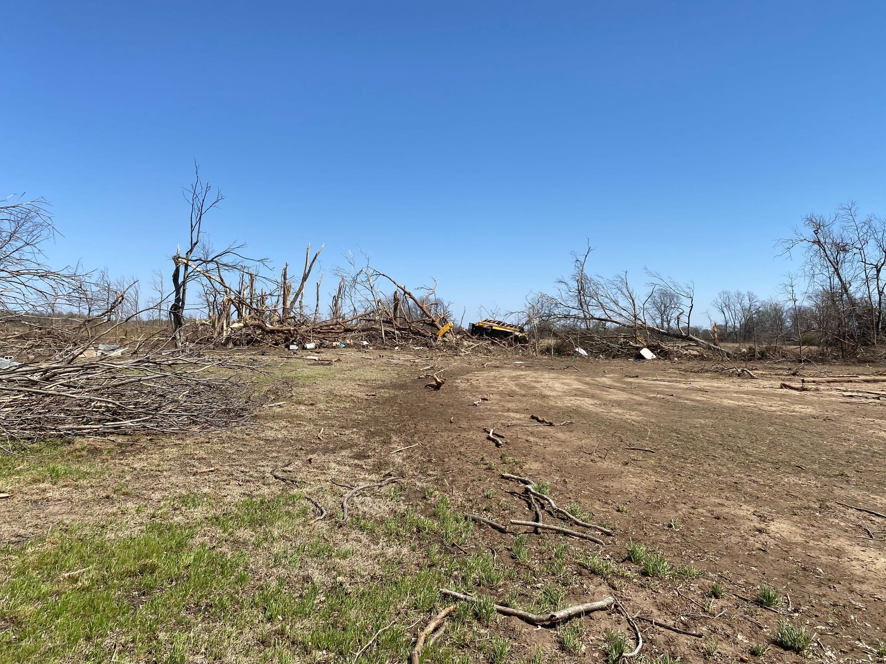
A Few Notes on Tornado Intensity Estimation
The Fujita Scale was developed in 1971 to quickly estimate tornado intensity from damage surveys.
Ratings with wind speed ranges were developed so that a reasonable range of possible wind speeds could be estimated without the need for detailed forensic engineering studies of structures.
Engineers quickly raised concerns that wind speeds for the higher damage ratings were overestimates of the wind speeds necessary to cause the associated damage.
The Enhanced Fujita Scale was debuted in 2007 to provide more damage indicators to estimate tornado intensity and to lower the wind speed ranges for the higher ratings (EF2–EF5).
EF4-rated damage from the Rolling Fork, MS, tornado on 24 March 2023.
Notes:
Based on parameter space alone, the 2% tornado threat appears appropriate.

Slide 42
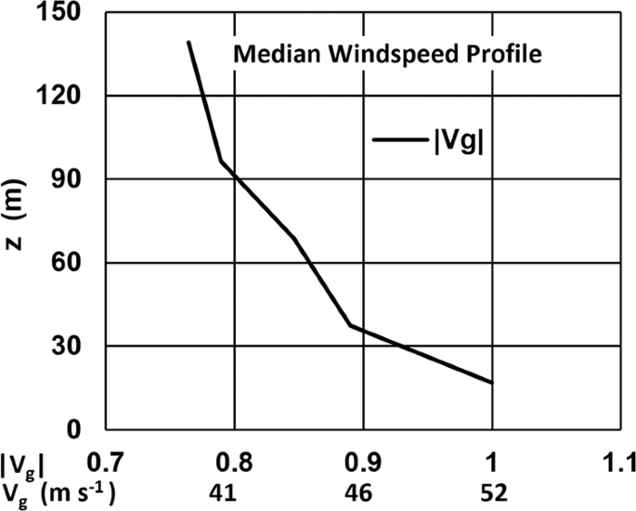
A Few Notes on Tornado Intensity Estimation
The American Society of Civil Engineers (ASCE) has formed a Wind Speed Estimation Standard Committee (WSEC) to develop a standard for estimating tornado wind speeds.
The WSEC is working on a revised EF scale, as well as standard methods for tornado wind speed estimation using radar, forensic engineering, tree fall pattern analysis, in-situ observations, and satellite and UAS remote sensing.
Radar estimation of tornado wind speeds is of particular interest since radar has a unique ability to detect wind components throughout the entire vortex at relatively high-resolution.
Work by Kosiba and Wurman (2023) used a radar climatology of tornadoes sampled with Doppler on Wheels (DOWs) to illustrate that tornado winds may be strongest near the ground (consistent with past modeling studies).
Fig. 4 from Kosiba and Wurman (2023).
Notes:
Based on parameter space alone, the 2% tornado threat appears appropriate.

Slide 43
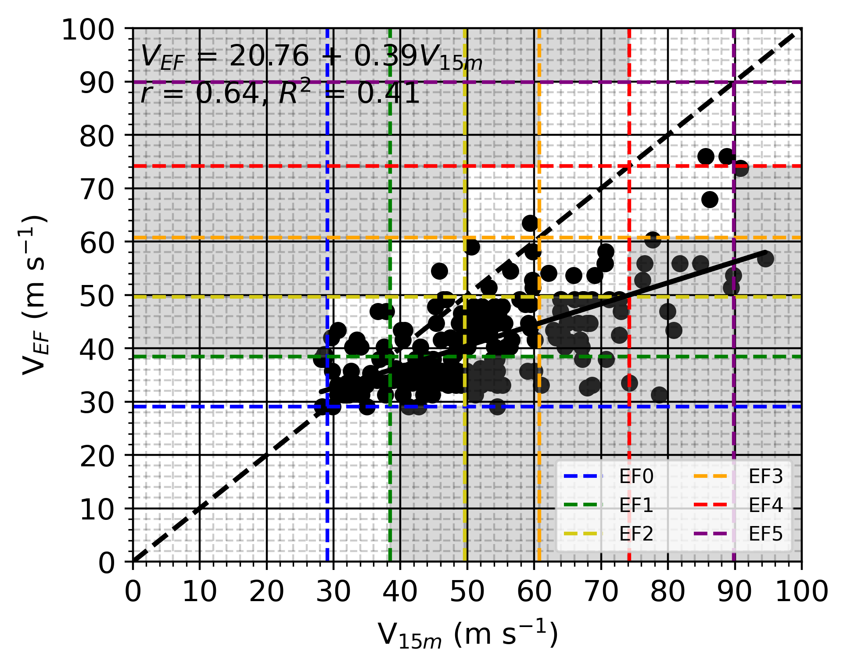
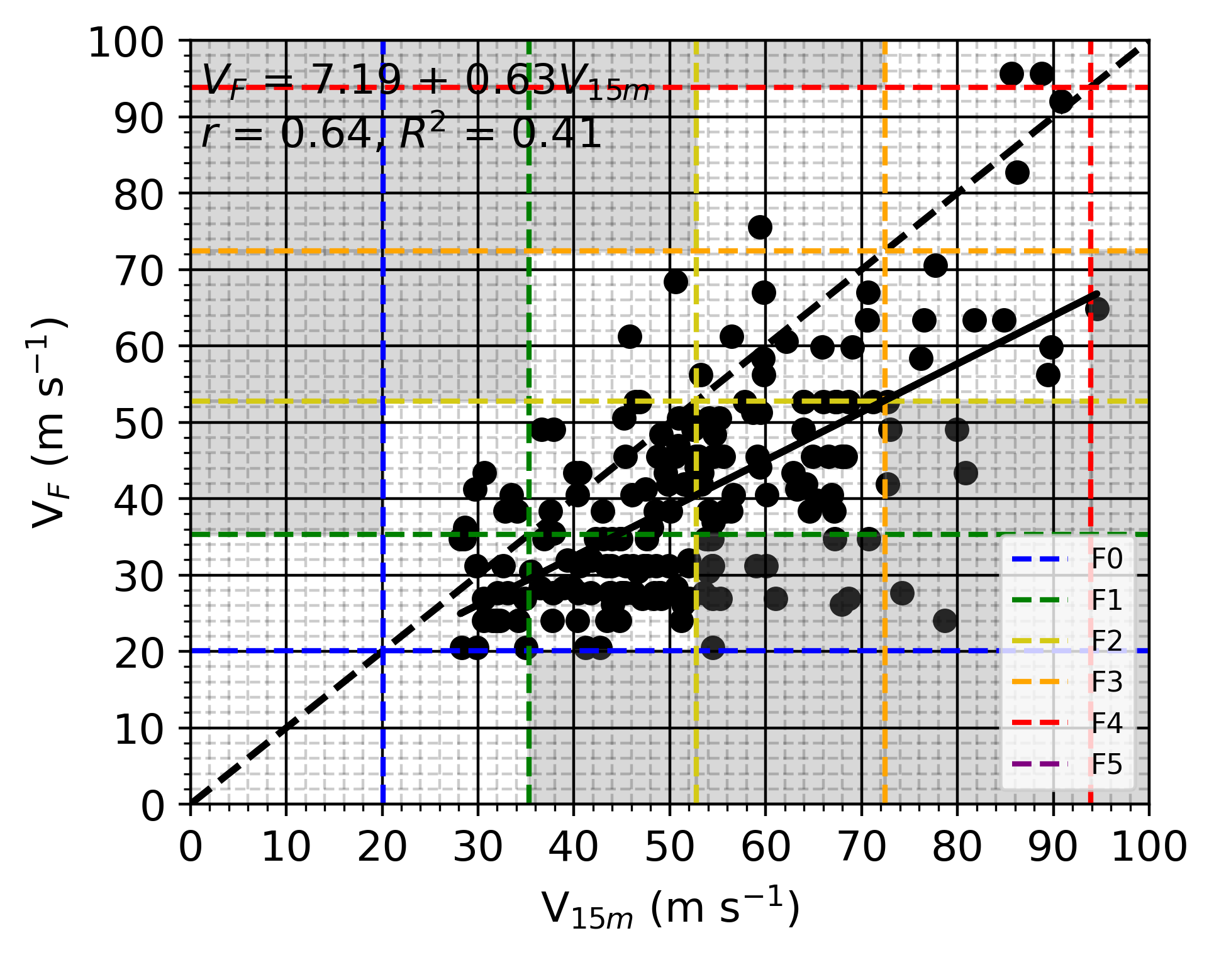
A Few Notes on Tornado Intensity Estimation
EF-Scale Wind Speed Estimate from Damage
F-Scale Wind Speed Estimate from Damage
Lyza et al. (2024) gathered 194 observations from 105 different tornadoes that had observations from WSR-88D radars 150 m AGL and compared those observations to both EF and F-scale estimates of wind speed from damage.
Applied two different assumptions to estimate winds near the ground: (1) that wind speeds increase along the Kosiba and Wurman (2023) curve and (2) that wind speeds remain constant from radar beam height to the surface.
For both assumptions, radar-based intensity estimates of near-ground winds increase more quickly than wind speed estimates from damage from the EF scale as vortex intensity increases.
Damage-based wind speed estimates from EF scale more closely match radar for weak tornadoes, while wind speed estimates from the F scale more closely match radar for strong–violent tornadoes. However…
Wind speed increasing from radar beam to near-ground
Wind speed constant from radar beam to near-ground
Adapted from Figs. 6, 12, and 17 of Lyza et al. (2024; MWR)
Notes:
Based on parameter space alone, the 2% tornado threat appears appropriate.

Slide 44
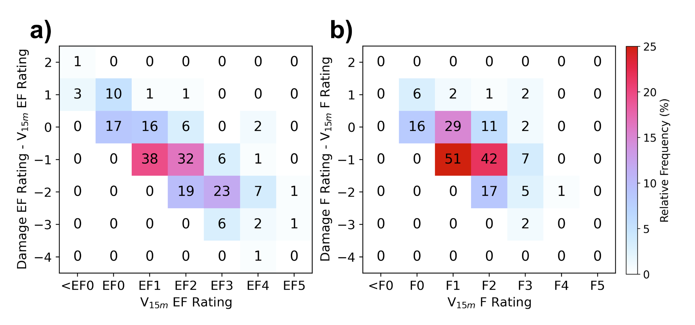
A Few Notes on Tornado Intensity Estimation
EF-Scale Wind Speed Ranges
F-Scale Wind Speed Ranges
The official tornado climatology is still based on the ratings of tornadoes.
When the radar-based wind speed estimates and damage-based wind speed estimates are both binned into their respective EF and F scale ratings, the F scale yields less rating error than the EF scale across the entire range of tornado intensities.
Key Takeaway: Tornado intensity estimation is still a very difficult task, and damage-based estimates of tornado intensity can still contain a lot of error. Estimates of tornado intensity from the EF scale likely yield lower-bound estimations of actual tornado intensity in many cases, especially for stronger tornadoes.
Wind speed increasing from radar beam to near-ground
Wind speed constant from radar beam to near-ground
Adapted from Figs. 14 and 17 of Lyza et al. (2024; MWR)
Notes:
Based on parameter space alone, the 2% tornado threat appears appropriate.

Slide 45
Tornado Climatology Summary
Tornadoes tend to occur more frequently across the southern Plains and northern Gulf states
Typically occur mid/late afternoon over the central CONUS, but can occur at any time of day.
Associated STP values tend to be higher in this region - suggesting a favorable tor environment
Supercell tornadoes tend to dominate the distribution
Can occur over a wider range of the eastern 2/3rds of the CONUS compared to QLCS tornadoes
Favored over the Plains in the spring, but can occur throughout the year across the CONUS.
Spring maxima is due to favorable overlap of quality CAPE/Shear.
Western maxima may be related to initiation mechanisms favoring discrete modes vs. upscale growth further east
QLCS tornadoes are also most common in the spring with a minimum in the fall.
However, these can also occur throughout the year.
Tornado maxima over the OH/MS River Valleys may be related to upscale growth from the west
Tornado intensity estimation is still a work in progress!
Notes:
Based on parameter space alone, the 2% tornado threat appears appropriate.

Slide 46
Tornado Climatology: Application
So tornadoes happen in the Spring in the center U.S. - big deal!
How is this helpful?!
We can use tornado ingredient climatologies to help characterize how favorable an environment is for tornadoes.
Notes:
Based on parameter space alone, the 2% tornado threat appears appropriate.

Slide 47
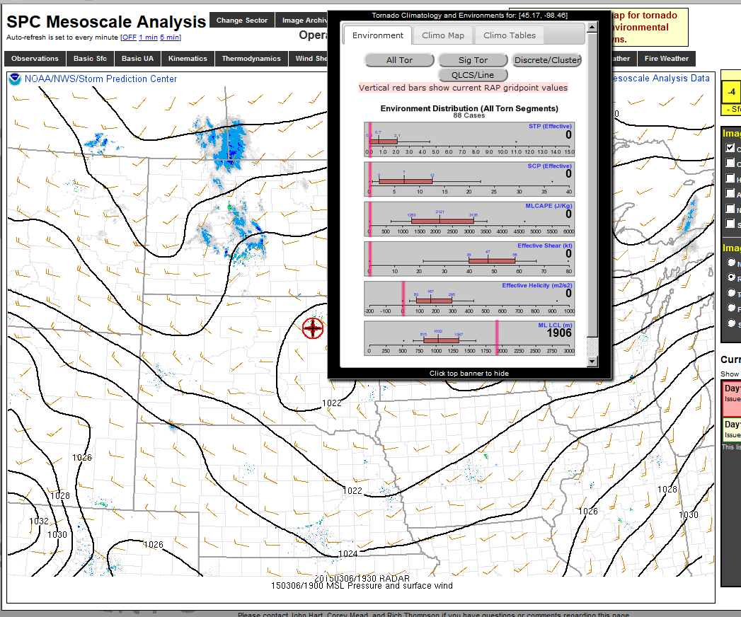
Notes:
Based on parameter space alone, the 2% tornado threat appears appropriate.

Slide 49
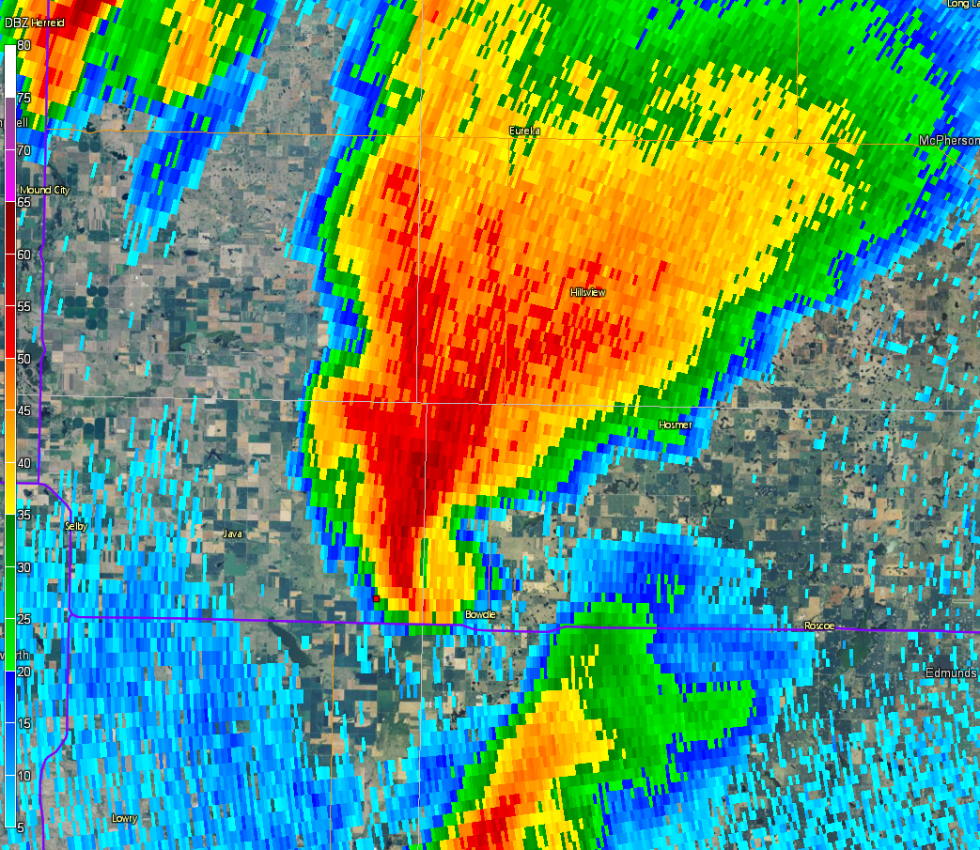
Notes:
Based on parameter space alone, the 2% tornado threat appears appropriate.

Slide 50
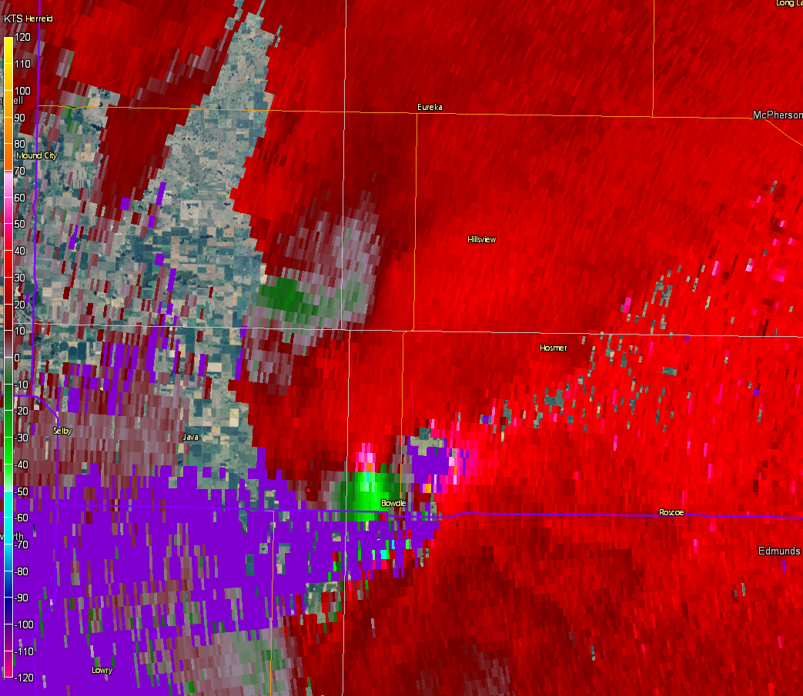
Notes:
Based on parameter space alone, the 2% tornado threat appears appropriate.

Slide 51
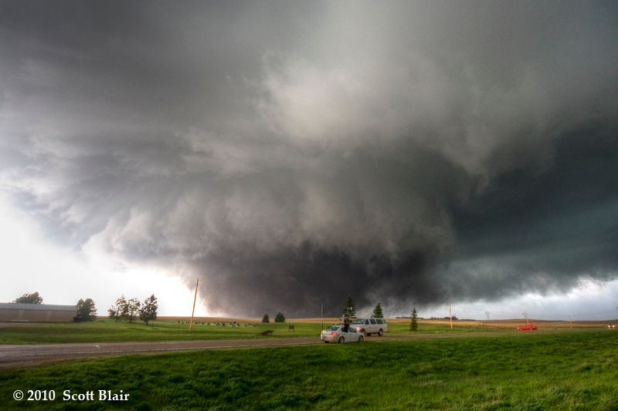
May 22, 2010 Bowdle, SD EF-4
Notes:
Based on parameter space alone, the 2% tornado threat appears appropriate.

Slide 52
Notes:
Based on parameter space alone, the 2% tornado threat appears appropriate.

Slide 54
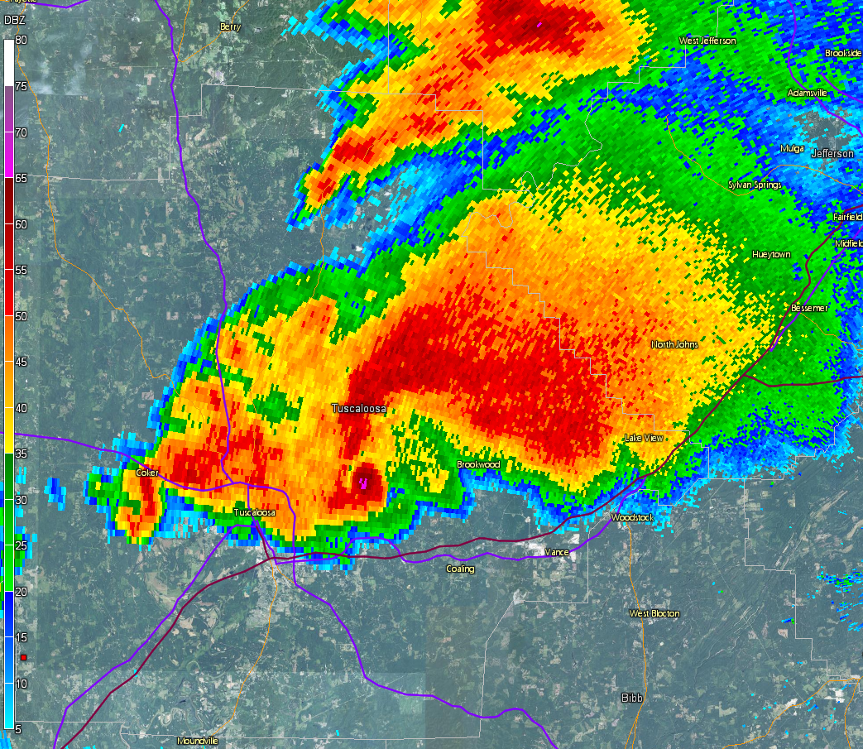
Notes:
Based on parameter space alone, the 2% tornado threat appears appropriate.

Slide 55
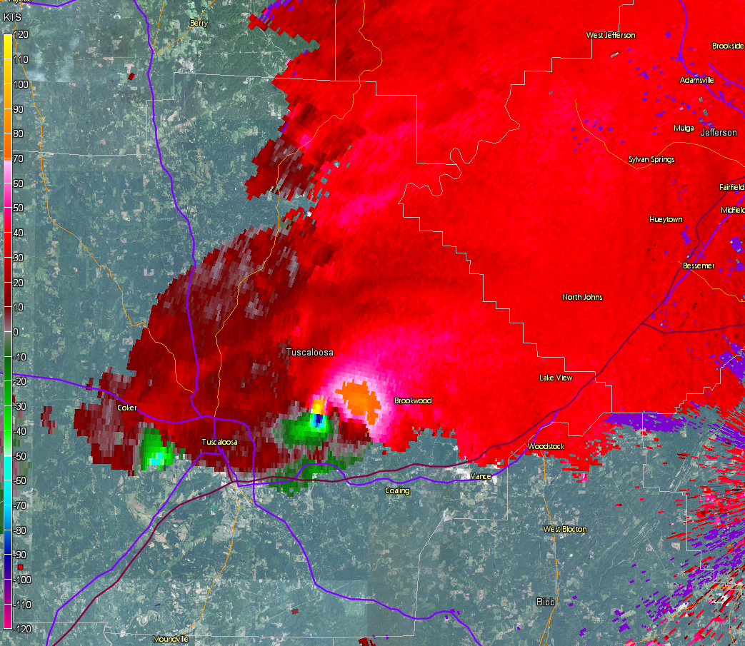
Notes:
Based on parameter space alone, the 2% tornado threat appears appropriate.

Slide 56
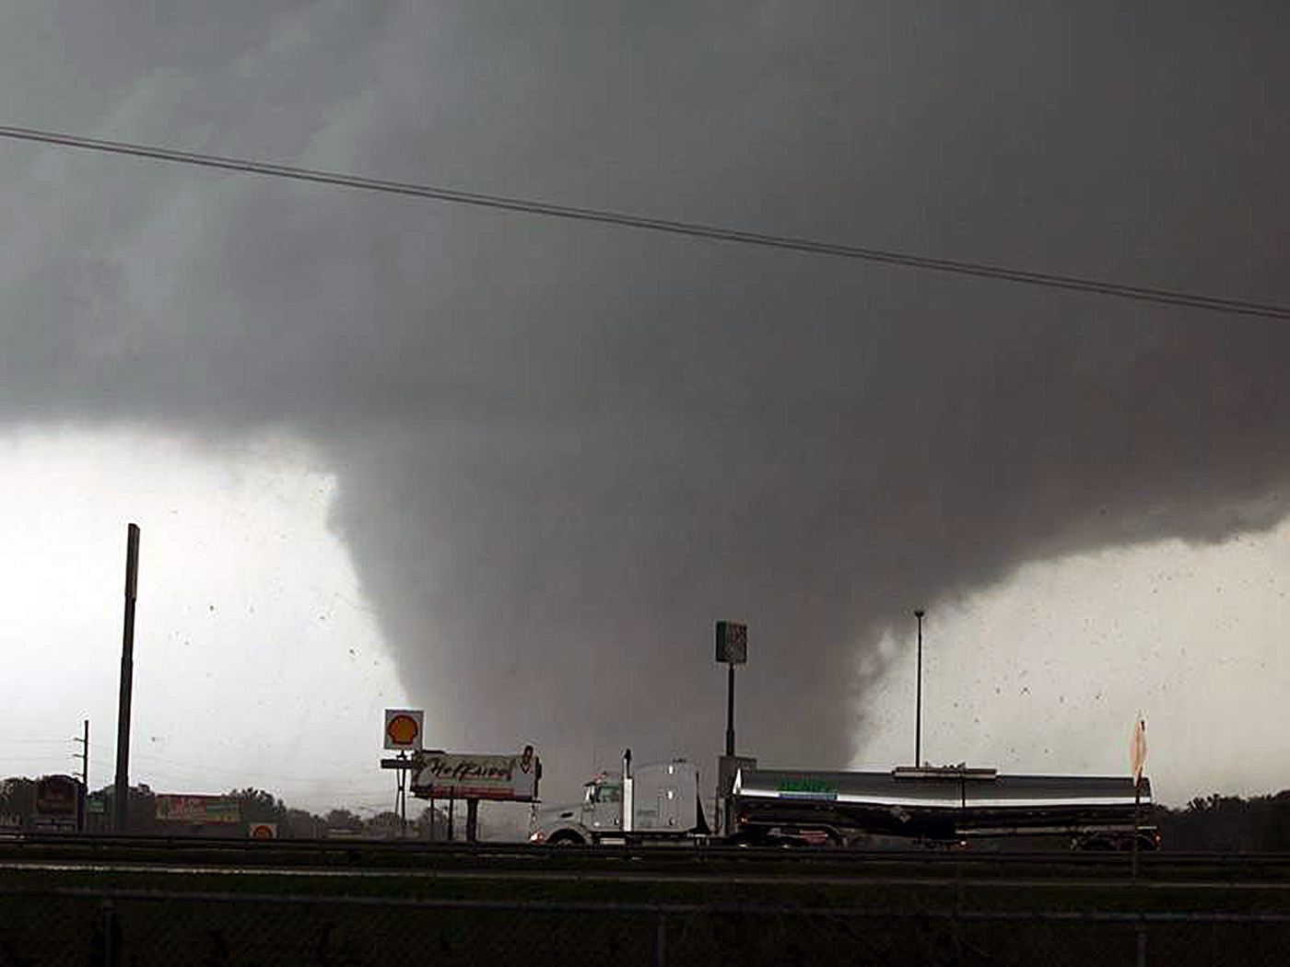
April 27, 2011 Tuscaloosa, AL EF-4
Notes:
Based on parameter space alone, the 2% tornado threat appears appropriate.

Slide 57
Notes:
Based on parameter space alone, the 2% tornado threat appears appropriate.

Slide 59
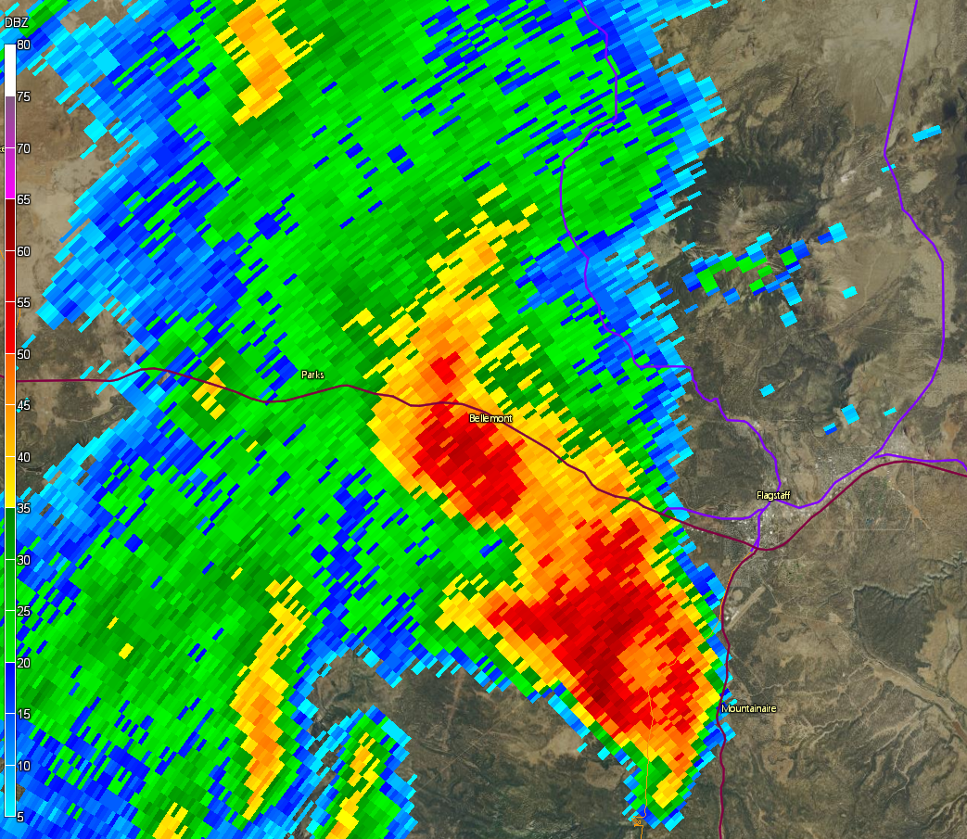
Notes:
Based on parameter space alone, the 2% tornado threat appears appropriate.

Slide 60
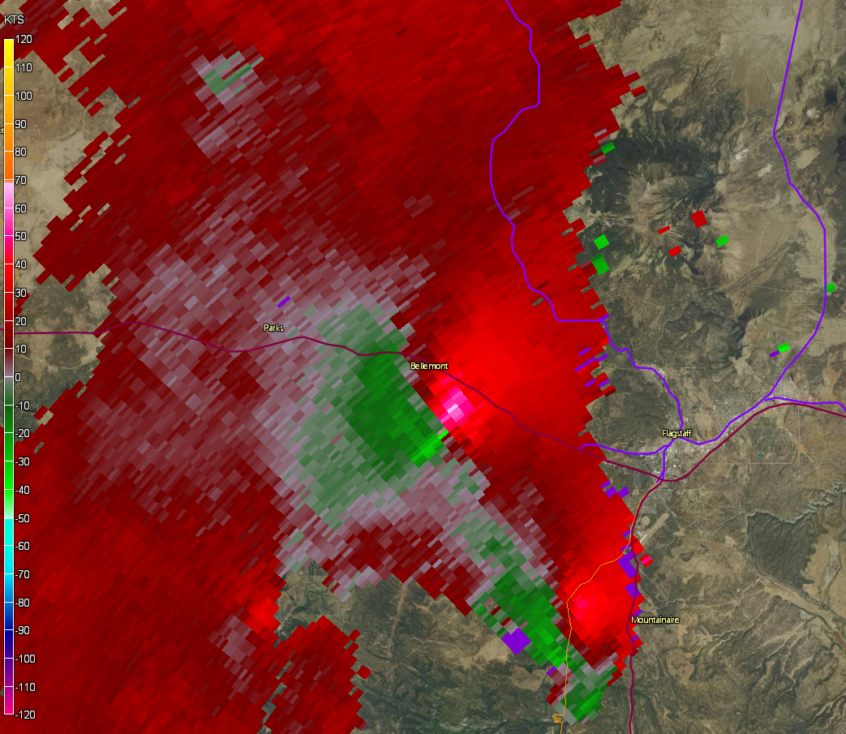
Notes:
Based on parameter space alone, the 2% tornado threat appears appropriate.

Slide 61
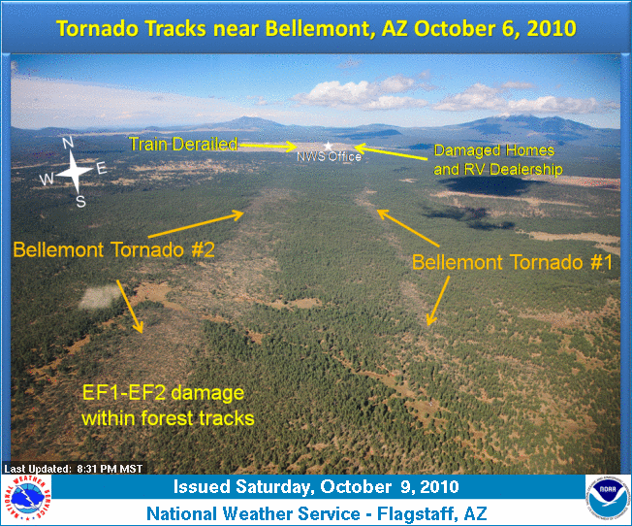
Bellemont, AZ
EF-2
Doesn’t just apply to high-end Plains/SE Environments!
Convective parameter magnatudes are relative to location/season.
Notes:
Based on parameter space alone, the 2% tornado threat appears appropriate.

Slide 62
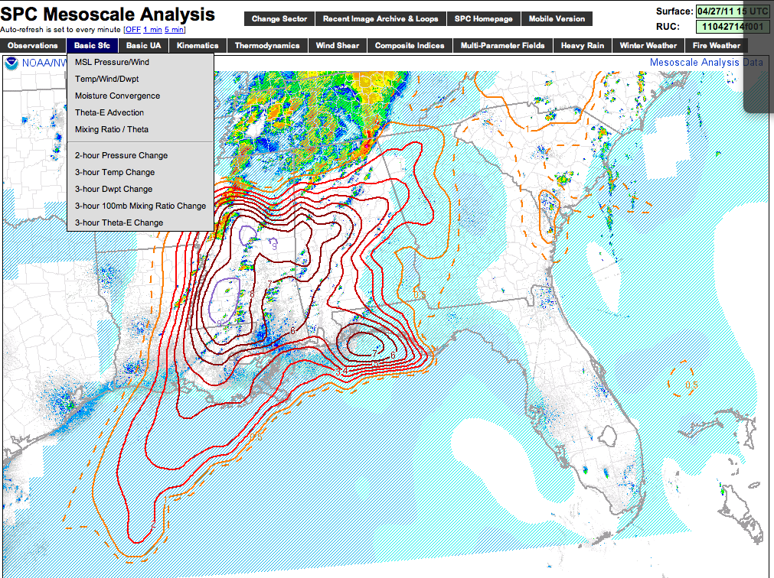
Estimating Tornado Probability & Intensity in Real Time
Notes:
Based on parameter space alone, the 2% tornado threat appears appropriate.

Slide 63
Estimating Tornado Probability & Intensity in Real Time
Recent studies have shown that observed WSR-88D and environmental trends can yield reasonable probabilities of tornado occurrence and intensity in real time.
Smith et al. 2015 (WAF)
Thompson et al. 2017 (WAF)
Cohen et al. 2018 (WAF)
Smith et al. 2020 (parts 1 & 2) (WAF)
Recent studies by SPC featured:
~4700 tornadoes from 2009-2013
~10500 severe events & tornadoes from 2014
Tornado events required credible report or TDS
Environmental data, such as STP, also collected
Used 2009-2014 tornadoes to create conditional probabilities by EF scale
Used 2014-2015 tornadoes and severe events to create unconditional probabilities by EF scale.
Notes:
Based on parameter space alone, the 2% tornado threat appears appropriate.

Slide 64
Tornado Detection Via WSR-88D
Combined radar attributes (same place and time)
Storm-relative velocity (V_{rot} > ~40 kt)
Stronger and deeper 🡺higher EF2+ probability
Correlation coefficient < 0.8
More obvious and deeper 🡺higher EF2+ probability
Reflectivity > 20 dbZ (can include “debris ball”)
Low ZDR
Radar signatures combined with expectation based on storm environment

Slide 65
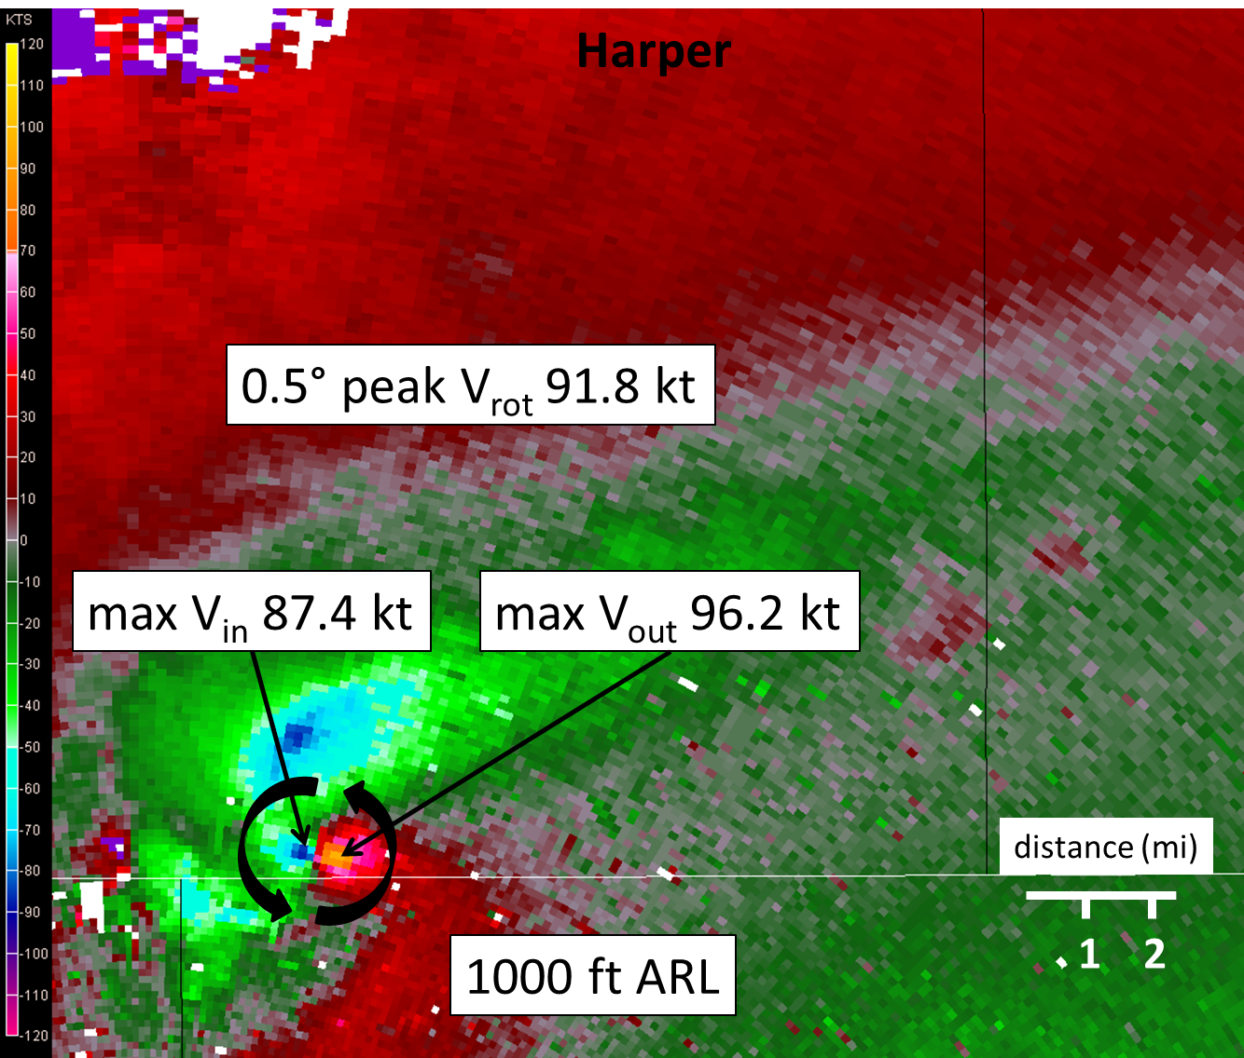
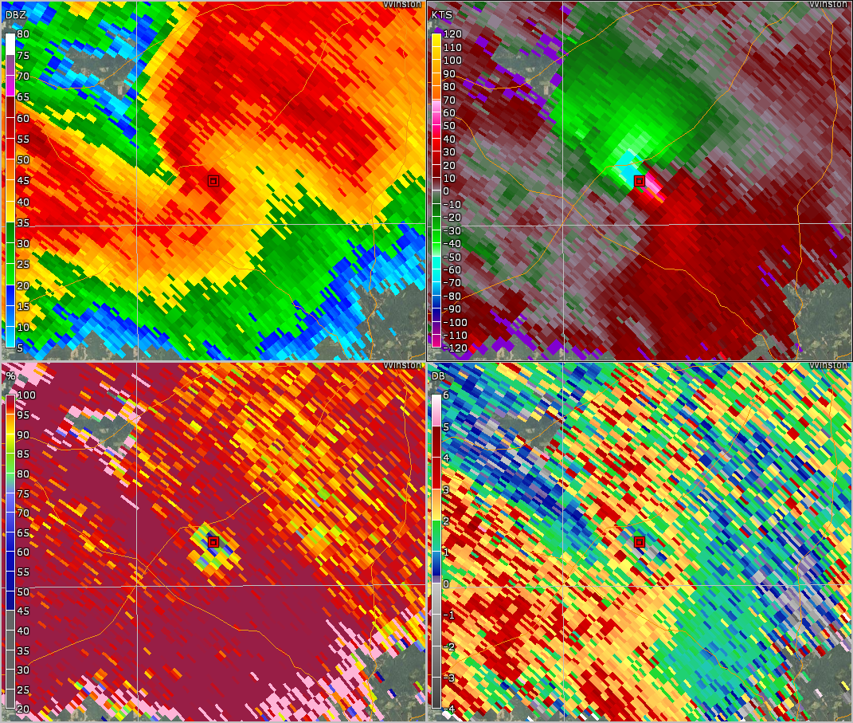
Step 3: Find Vrot
Vrot Example
0.5º
0.5º
0.5º
0.5º
Rotational Velocity (Vrot) = (Max Inbound + Max Outbound) /2
Notes:
Based on parameter space alone, the 2% tornado threat appears appropriate.

Slide 66
A Quick Note on WSR-88D Tornado Signatures
0.5º
0.5º
0.5º
0.5º
Notes:
Based on parameter space alone, the 2% tornado threat appears appropriate.

Slide 67
A Quick Note on WSR-88D Tornado Signatures
0.5º
0.5º
0.5º
0.5º
Notes:
Based on parameter space alone, the 2% tornado threat appears appropriate.

Slide 68
A Quick Note on WSR-88D Tornado Signatures
Inbound Velocity
0.5º
0.5º
Outbound Velocity
0.5º
0.5º
Notes:
Based on parameter space alone, the 2% tornado threat appears appropriate.

Slide 69
A Quick Note on WSR-88D Tornado Signatures
Max (realistic) Inbound
0.5º
0.5º
Max (realistic) Outbound
0.5º
0.5º
Rotational Velocity (Vrot) = (Max Inbound + Max Outbound) /2
Notes:
Based on parameter space alone, the 2% tornado threat appears appropriate.

Slide 70
A Quick Note on WSR-88D Tornado Signatures
0.5º
0.5º
CC minimum/Tornadic Debris Signature (TDS)
0.5º
0.5º
Heavier, non-uniform FFD precip
(likely contains hail)
Light, uniform inflow precipitation
Notes:
Based on parameter space alone, the 2% tornado threat appears appropriate.

Slide 71
A Quick Note on WSR-88D Tornado Signatures
0.5º
0.5º
TDS noted in ZDR
0.5º
0.5º
Notes:
Based on parameter space alone, the 2% tornado threat appears appropriate.

Slide 72
Step 1: Identify a velocity couplet
0.5º
0.5º
0.5º
0.5º
Notes:
Based on parameter space alone, the 2% tornado threat appears appropriate.

Slide 73
Step 2: Note distance between maxima (closer = better)
0.5º
0.5º
0.5º
0.5º
Notes:
Based on parameter space alone, the 2% tornado threat appears appropriate.

Slide 74
Step 3: Find Vrot
0.5º
0.5º
0.5º
0.5º
Rotational Velocity (Vrot) = (Max Inbound + Max Outbound) /2
Notes:
Based on parameter space alone, the 2% tornado threat appears appropriate.

Slide 75
Step 4: Note beam height/distance from radar
0.5º
0.5º
To RDA
0.5º
0.5º
Notes:
Based on parameter space alone, the 2% tornado threat appears appropriate.

Slide 76
Step 5: Check for TDS
0.5º
0.5º
0.5º
0.5º
Notes:
Based on parameter space alone, the 2% tornado threat appears appropriate.

Slide 77
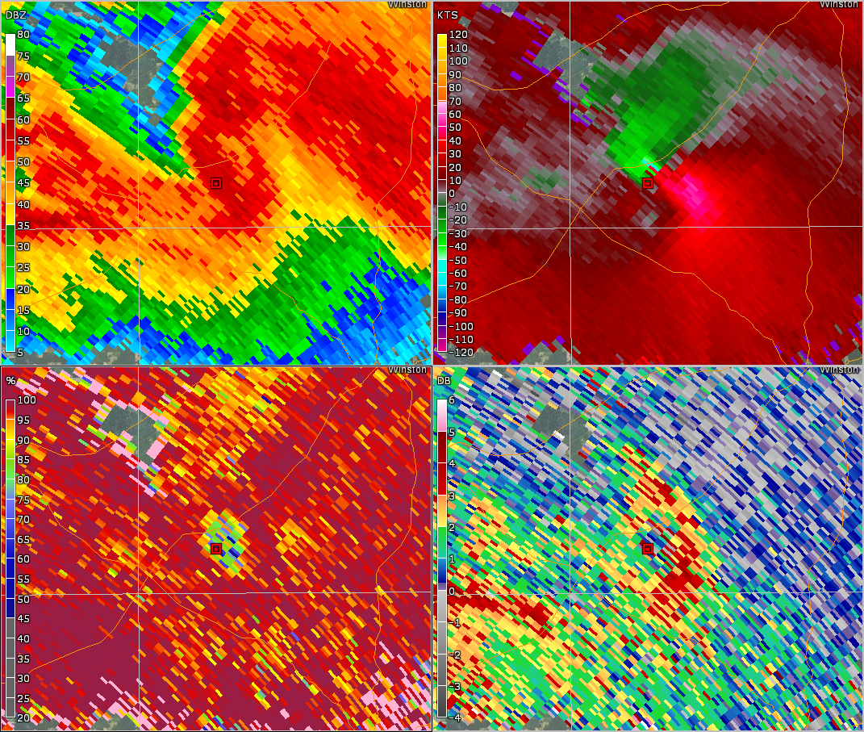
Step 6: Check TDS Height
0.5º
1.3º
0.5º
1.3º
0.5º
1.3º
0.5º
1.3º
Notes:
Based on parameter space alone, the 2% tornado threat appears appropriate.

Slide 78
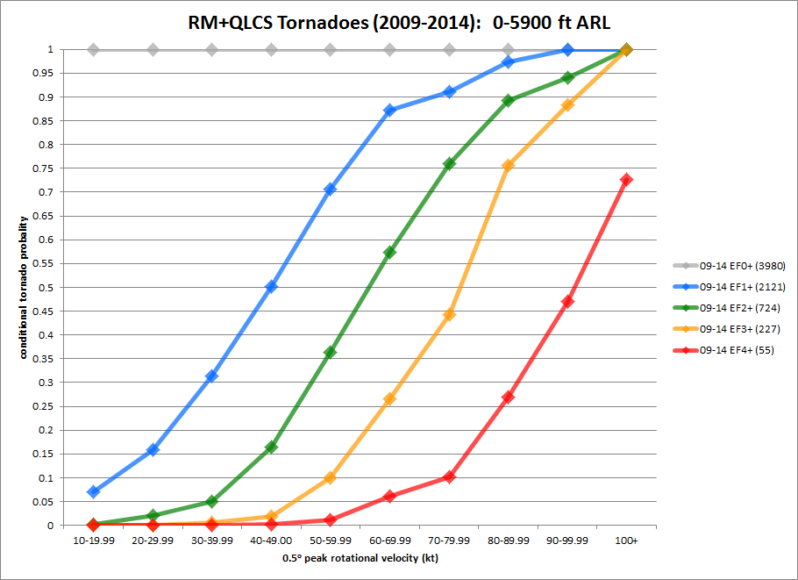
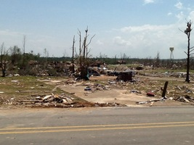
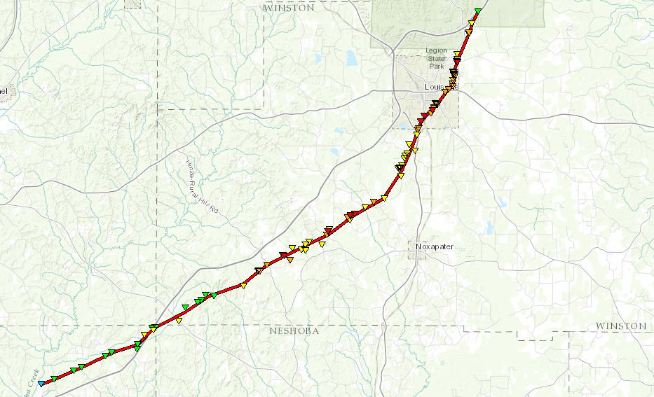
Step 7: Check Conditional Tornado Probs
Valid for this range
These are conditional probabilities:
You know a tornado is occurring
(TDS)
76% EF2+
44% EF3+
Louisville, MS EF4
28 April 2014
10 fatalities
10% EF4+
Notes:
Based on parameter space alone, the 2% tornado threat appears appropriate.

Slide 79
0.5º
2236z

Slide 80
0.5º
2238z

Slide 81
0.5º
2241z

Slide 82
0.5º
2244z

Slide 83
0.5º
2246z

Slide 84
0.5º
2249z

Slide 85
0.5º
2249z

Slide 86
0.5º
V_{rot} = 69 kt
2249z

Slide 87
0.5º
Inflow Notch
Inflow Notch
Inflow Notch
2249z

Slide 88
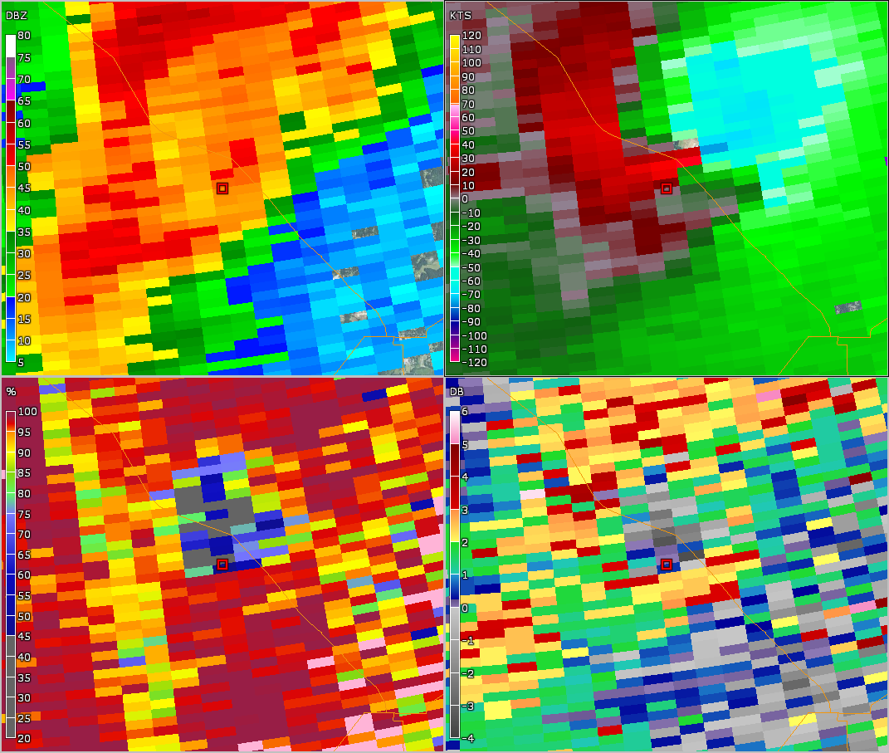
0.5º
0.9º
Inflow Notch
Inflow Notch
Inflow Notch
2249z
2249z

Slide 89
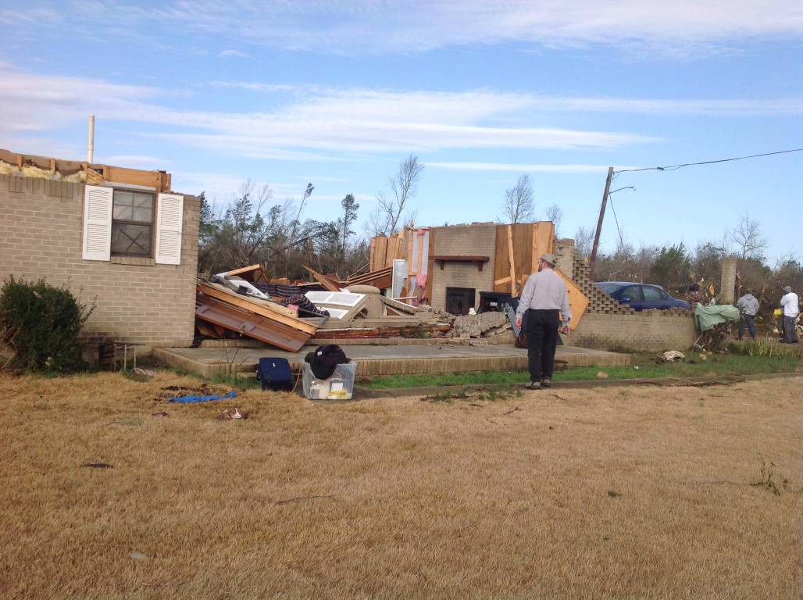
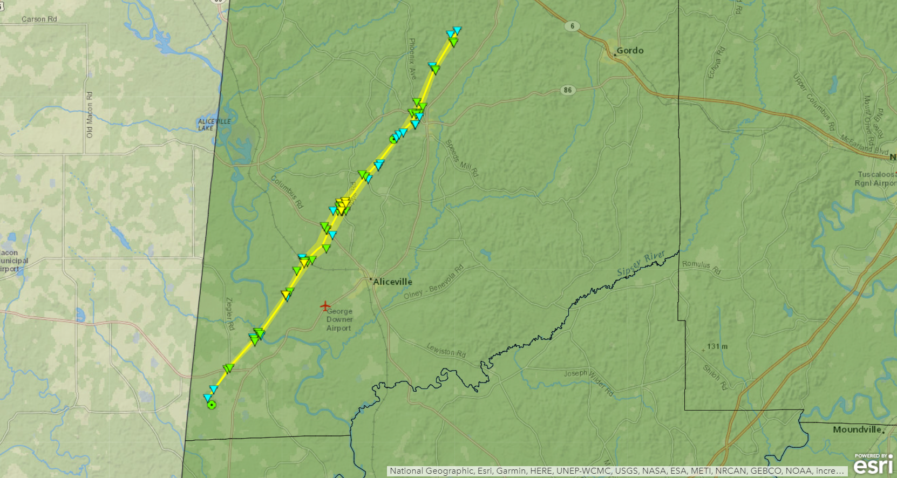
Step 7: Check Conditional Tornado Probs
Valid for this range
These are conditional probabilities:
You know a tornado is occurring
(TDS)
57% EF2+
26% EF3+
6% EF4+
McMullen, AL EF2
2 February 2016
Notes:
Based on parameter space alone, the 2% tornado threat appears appropriate.

Slide 92
Unconditional Tornado Probabilities
Often don’t know if a tornado is occurring in remote areas or at night
Must consider “null” cases with low-level storm rotation to develop unconditional tornado probabilities

Slide 93
Is a tornado occurring?
80% NULL
20% EF0+
10% EF1+

Slide 94
Combined Tornado Probabilities

Slide 95
Need to consider influences of beam height/range
Lower tornado probabilities with distant circulations sampled well above ground
Higher tornado probabilities with closer circulations sampled near the ground

Slide 96
For your awareness...

Slide 97
Even in the Plains there are radar gaps!

Slide 98
Variations by height ARL

Slide 99
Variations by height ARL

Slide 100
Variations by height ARL

Slide 101
Need to consider influences of circulation diameter
Lower tornado probabilities with broad circulations
Higher tornado probabilities with tight circulations
VS.

Slide 102
Variations by circulation diameter

Slide 103
Variations by circulation diameter

Slide 104
Variations by circulation diameter

Slide 105
Conditional Probs by Height ARL

Slide 106
Conditional Probs by Distance

Slide 107
Conditional Probs (TDS vs. No-TDS)

Slide 108
What about regional differences?

Slide 109
Need to consider storm environment
So far we’ve only considered WSR-88D signatures, but the env can help!
Try to keep the environment estimate simple
Look at significant tornado parameter (STP)
Take max value within 80 km of each storm
Forecasters consider more than a point value!

Slide 110
Tornado Probabilities by Vrot

Slide 111
Tornado Probabilities by Eff. STP

Slide 112
Increasing EF2+ probabilities

Slide 113
Tornado Probabilities by Eff. STP
Available at http://arctic.som.ou.edu/tburg/products/R2O/torprob/
Try it yourself!
Tornado probability tool developed by Tomer Burg.
Based on research outlined in Cohen et al. 2018

Slide 114
Questions?
Notes:
Based on parameter space alone, the 2% tornado threat appears appropriate.

