Slide 1
Severe Weather Ingredients
Material by Tom Galarneau Andrew Lyons,
Rich Thompson and Harry Weinman

Slide 2
Ingredients for
Organized Severe Thunderstorms
Instability (Lapse Rates)
Lift (QG, mesoscale, convective scale)
Moisture (return flow, soil moisture, evapotranspiration)
Vertical wind shear

Slide 3
Ingredients for
Organized Severe Thunderstorms
Instability (Lapse Rates)
Lift (QG, mesoscale, convective scale)
Moisture (return flow, soil moisture, evapotranspiration)
Vertical wind shear - a separate lecture
This lecture
Key ingredient for organized severe storms

Slide 4
Instability: The Basics
Give a parcel a nudge and see what happens!
We determine an environments stability by its lapse rate (Change of environmental temperature with height)
EL
Parcel is warmer
than surroundings
LFC
LCL

Slide 5
Instability: The Basics
Integrate the depth where parcel is warmer/less dense than its surrounding
CAPE (Convective Available Potential Energy)
CAPE

Slide 6
Instability: The Basics
Take a small finite layer depth within CAPE profile
Upward Acceleration!
Short/thick CAPE:
Drives larger upward acceleration
1. Offsets negative effects of dry air entrainment into updraft
2. Mitigates effects of precipitation drag on updraft
Tall/narrow CAPE:
Smaller upward acceleration
Water loading and entrainment more substantially weaken updraft

Slide 7
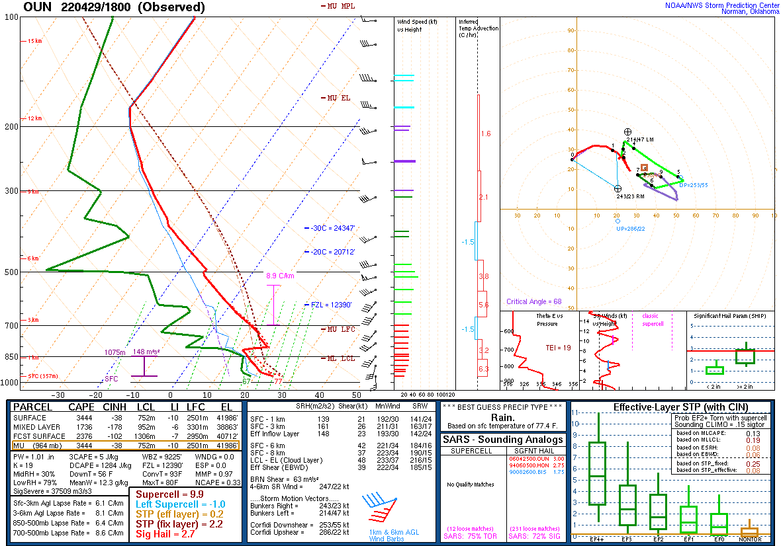
So, how do we get wider CAPE?
Looking for steep midlevel lapse rates!

Slide 8
Instability: Elevated Mixed Layer (EML)
Deep mixed layer forms over Rockies and Sierra Madre in response to surface heating
Stronger heating and/or cooler temperatures aloft results in deeper mixed layer
Mixed layer is advected eastward and becomes elevated east of the Rockies and Sierra Madre (really, east of the dryline)
Differential advection (eastward advection of EML above northward advection of moisture from GoM) created “loaded gun” profile

Slide 9
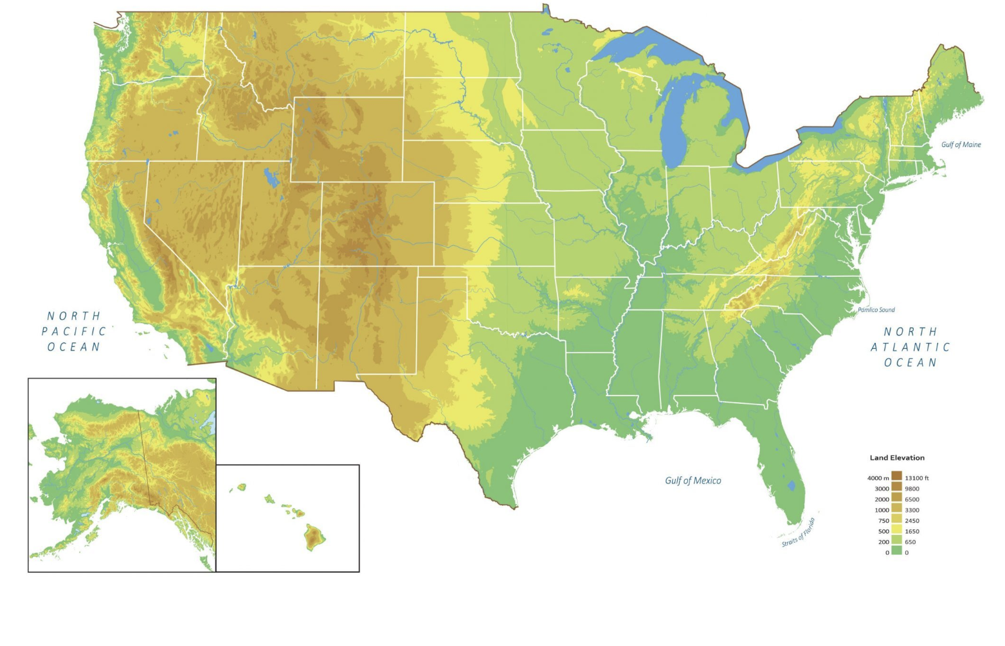
Elevated Mixed Layer (EML) Differential Advection
A’
A
A
A’

Slide 10
EML at OUN (0000 UTC 4 May 1999)
Cap: inversion at
base of EML
Notes:
Comparing the two. EML is the same, there’s just a surface layer in AMA.

Slide 13
Cap strength is related to:

Slide 14
Lift
Synoptic-scale lift
1-10 cm/s for many hours (6 hours ~2 km ascent (SFC-800 hPa))
6 hours to reach LFC
Conditions environment for deep, moist convection over broad area
Lapse rate stretching
Removal of inhibition
Layered clouds in regions of isentropic lift; some elevated storms can form
Mesoscale lift
1 m/s for minutes to hours (1 hour ~3.6 km ascent (SFC-650 hPa))
< 1 hour to reach LFC
Narrow zones of ascent along boundaries and terrain features
Direct initiation of thunderstorms
Storm-scale lift
10 m/s for minutes (15 mins ~9 km of ascent (SFC-300 hPa))
5 minutes to reach LFC
Storm maintenance and propagation (supercells, MCSs, squall lines, etc.)

Slide 15
Synoptic-Scale Lift
QG sources
Warm advection/isentropic lift and differential vorticity advection
Jet streaks (also QG)
Straight jet: ascent in right entrance and left exit regions
Curved jet: ascent downstream and along jet core

Slide 16
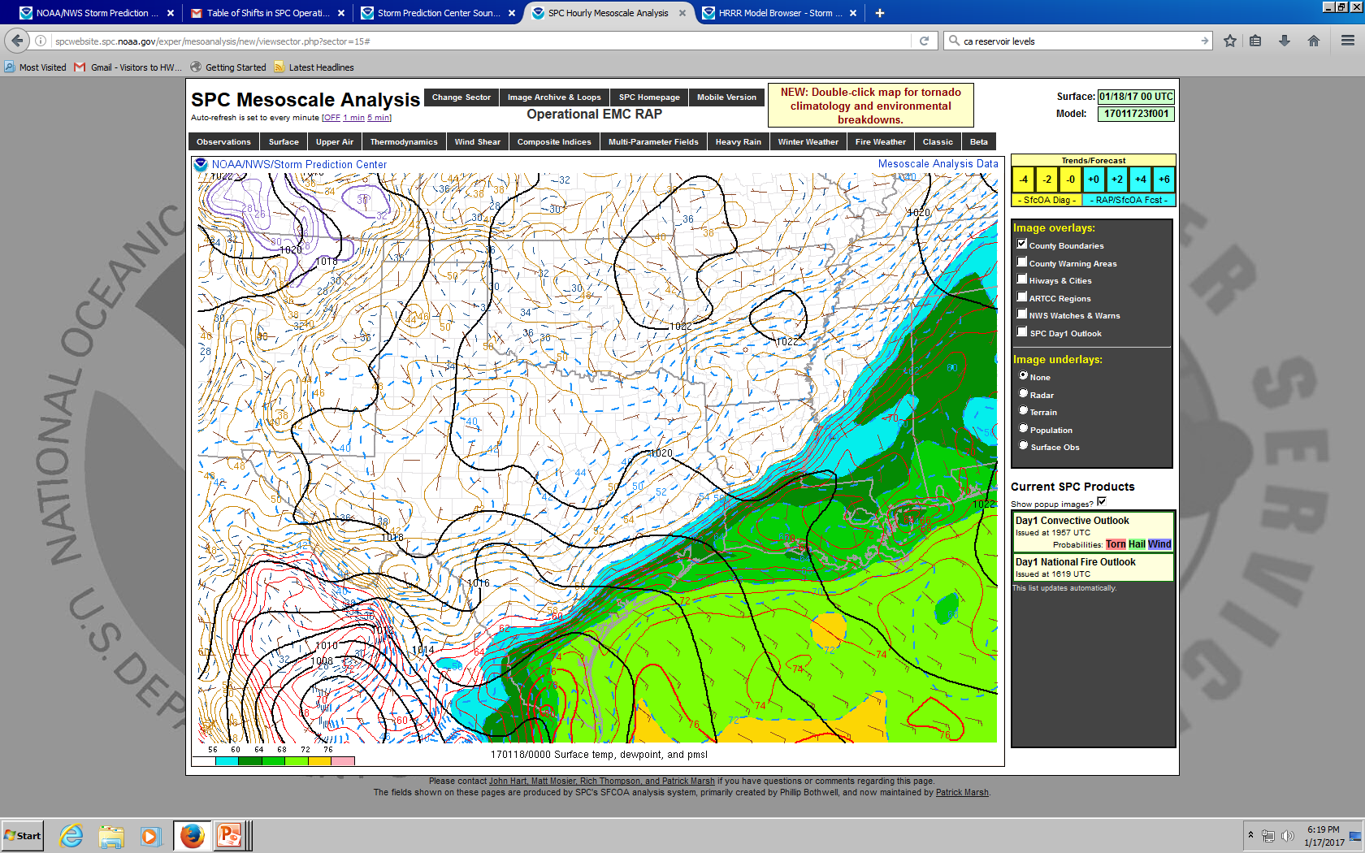

Slide 17
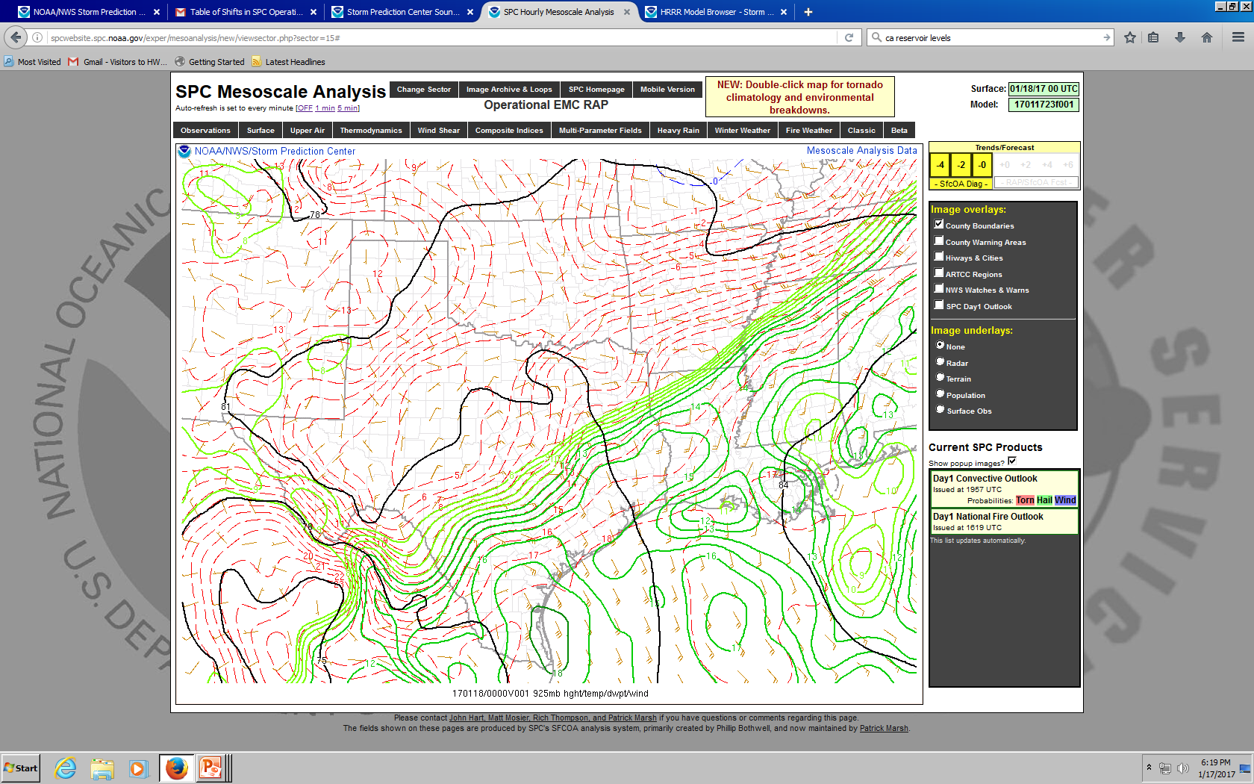

Slide 18
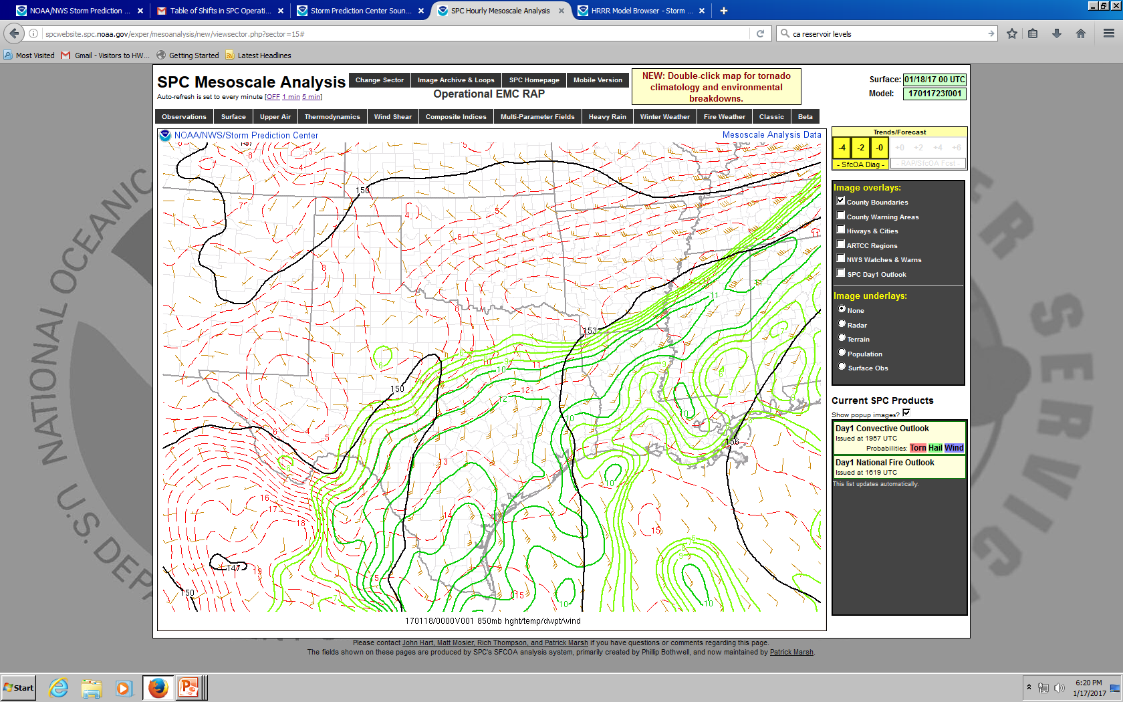

Slide 19
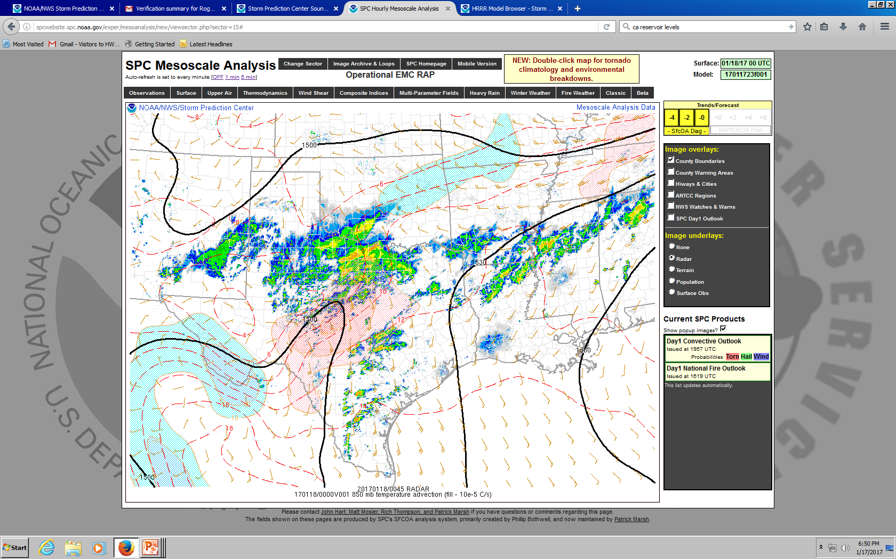
Notes:
But are any of these storms surface based?

Slide 20
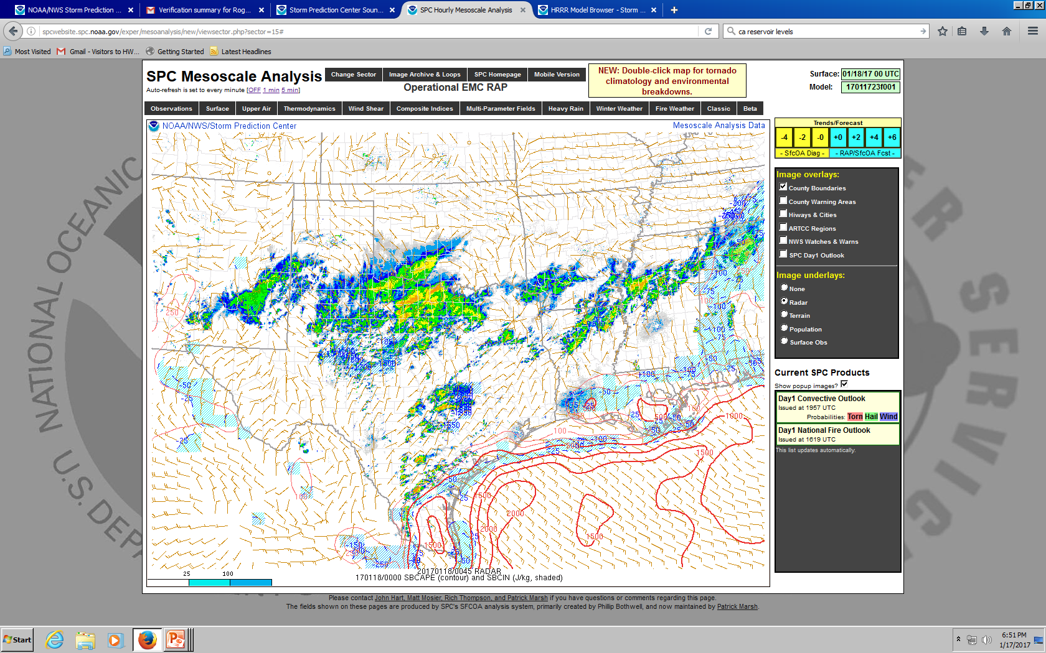
Notes:
Nope.

Slide 21
Notes:
Corpus Christi

Slide 22
Notes:
Del Rio. Note the inversion at low levels associated with the front. Will the storm “feel” SRH in this layer?

Slide 23
Synoptic-Scale Lift Summary
Gradual ascent over many hours
Warm advection and differential vorticity advection are primary drivers
Primary role of QG ascent is to precondition environment for convection
Can also initiate elevated storms in regions of warm advection
Most surface-based storms are triggered by mesoscale ascent

Slide 24
Mesoscale Lift
Focused and narrow zones of lift for minutes to hours
Fronts
Rising on warm side with frontogenesis
Isentropic ascent on sloped warm front
Outflow boundary
Lift is governed by depth/strength of cold pool and low-level vertical wind shear [Rotunno-Klemp-Weisman (RKW) Theory]
Dryline
Lift on dry/hot side (lower density air)
Lift governed by depth of mixing west of dryline and depth of moist layer east of dryline

Slide 25
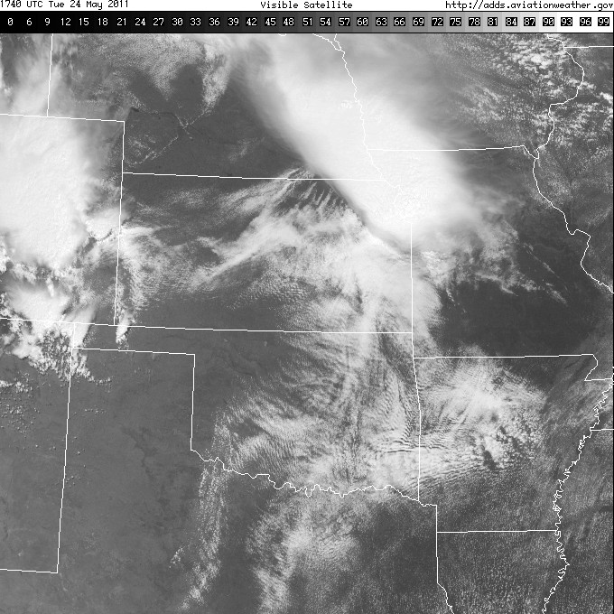

Slide 26
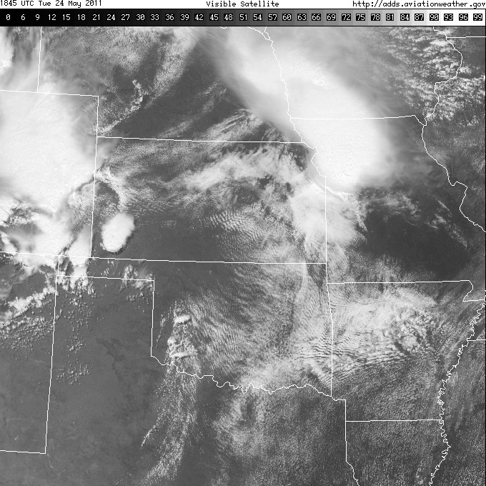

Slide 27
Dryline
Focused ascent along dryline can be ~1 m/s (~1 hour to reach LFC)
Lift depends on depth of mixing west of dryline and depth of moist layer ahead of dryline
Maximum vertical motion along dryline scales with height of moist layer
Convection initiation linked to the residence time of air in the zone of ascent
Winds above the surface parallel to dryline keeps air in zone of lift longer
Convection will initiate in points or bands
Usually the mode of initiation for surface-based supercells in central/southern Plains

Slide 28
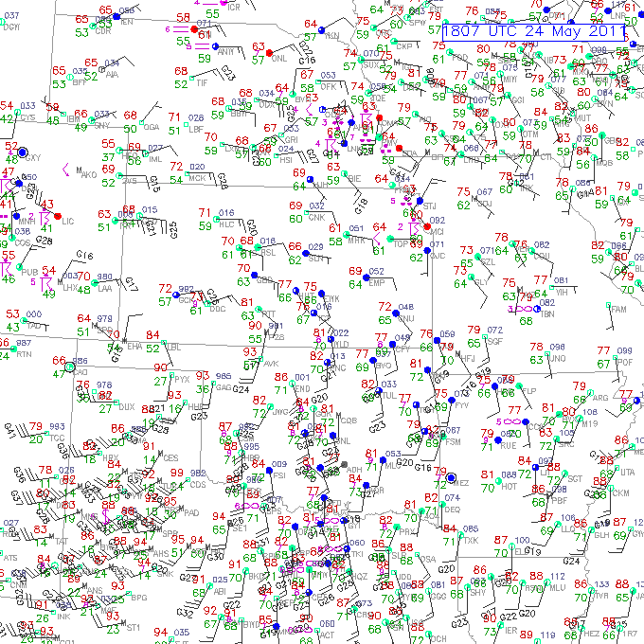
Notes:
Trajectories parallel to the dryline and stay in this zone of ascent = good!

Slide 30
LFC is within the deep dryline circulation
Keep parcels in the zone of ascent – winds within circulation SSW (parallel to dryline)

Slide 33
Moisture
Moisture in PBL needs to be large and deep enough for convection
Return flow
Inland vertical mixing/diurnal processes
Evapotranspiration

Slide 34
Low-level Moisture Return Flow
Key elements include air mass modifications over warmer water and return flow trajectories
Air mass modification is a multi-date process
Ask yourself the following:
Where is the air coming from?
What are the underlying ocean characteristics?
What is the character of the returning moist layer?

Slide 35
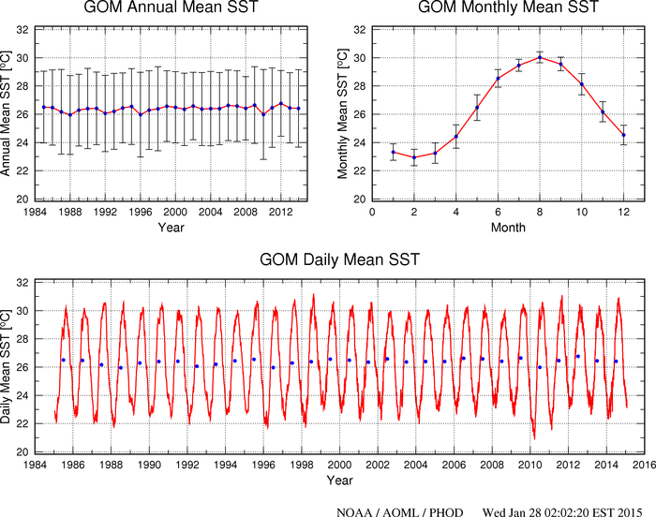

Slide 36
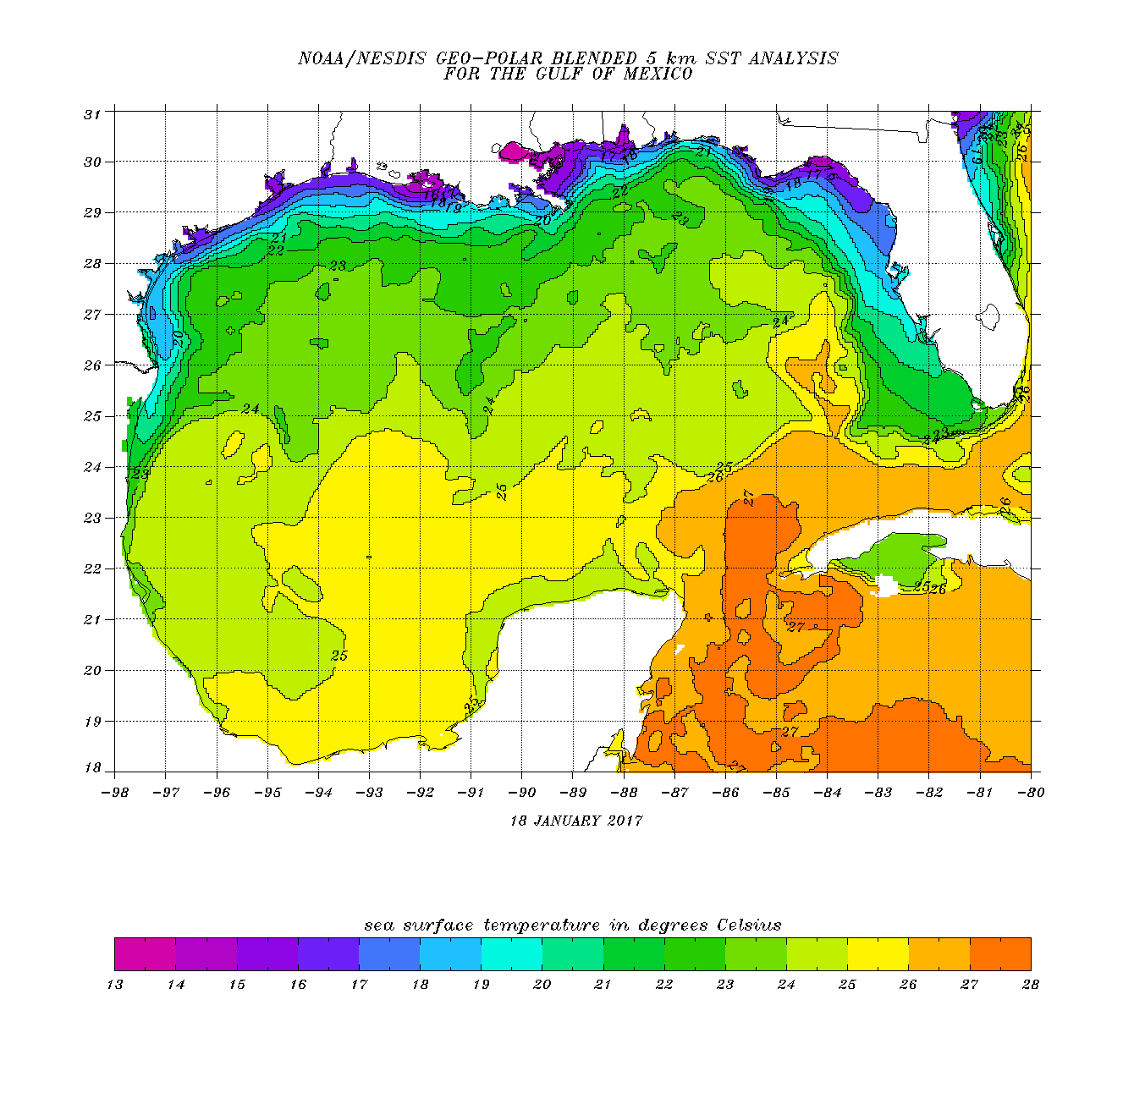
Air temperature after cold front passage
T_{a}=18C
T_{a}=19C
T_{a}=21C
T_{a}=22C
T_{a}=23C

Slide 37
~15F ΔΤ

Slide 38
~10F ΔΤ

Slide 39
~5F ΔΤ

Slide 40
Return flow evolution

Slide 44
Inland Vertical Mixing
Surface moisture can decrease during the daytime when:
Daytime heating/mixing extends deeper than original moist layer depth
Moisture advection is not enough to offset mixing
Compounded by dry soil, little green vegetation, and ongoing drought
Daytime mixing is governed by:
Vertical moisture structure
Height and strength of lid/cap
Upstream moisture sources
Local moisture sources

Slide 45
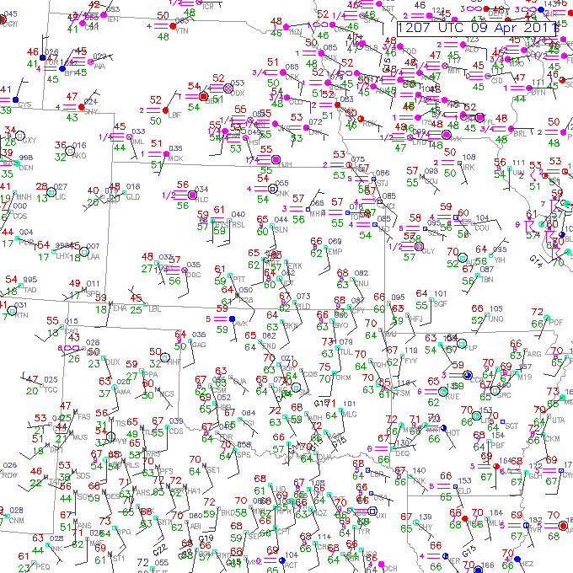
60 F
64 F

Slide 46
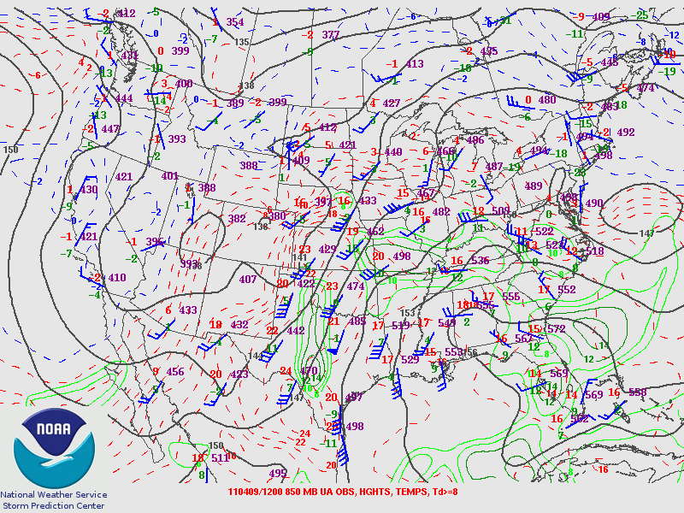

Slide 47
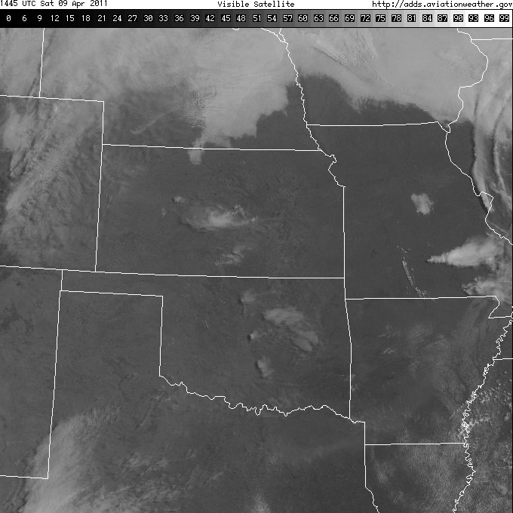
OAX
LMN
OUN

Slide 48
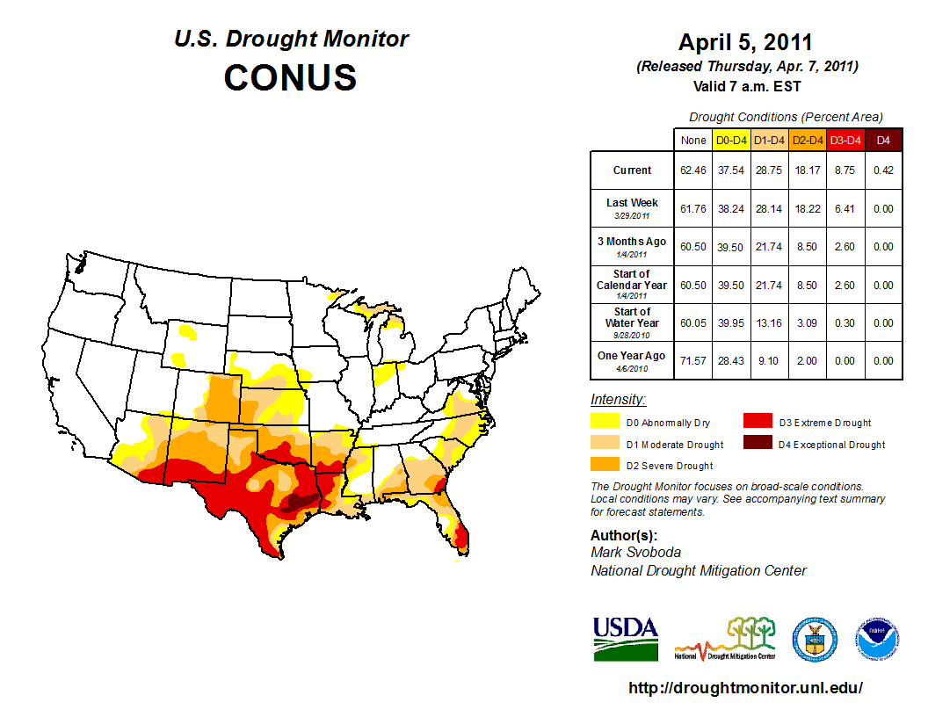
Notes:
Pretty dry in terms of drought.

Slide 49
Notes:
Here’s OUN at 12z.

Slide 50
Notes:
And here’s OUN 12 hours later. Moisture mixed out due to surface conditions.

Slide 54
Notes:
Remember, drought wasn’t as bad up in this region, so moisture “sticks around” in the BL.

Slide 55
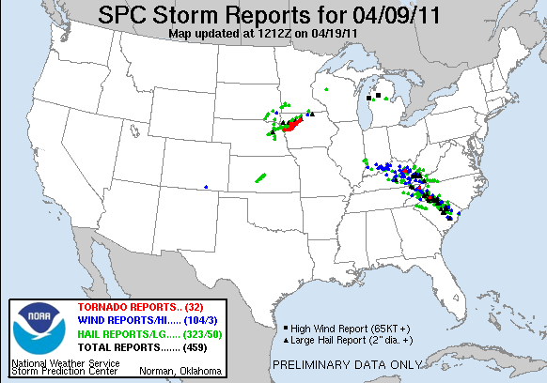
Notes:
Where was the big storm of the day? Up north of the drought conditions.

Slide 56
Evapotranspiration
Need moist soil and growing vegetation
Plentiful rain previous 1-2 weeks
Maturing crops (wheat, corn, or canola)
Capped boundary layer to trap moisture; relatively weak winds
Almost always a significant return flow contribution (in addition)

Slide 57
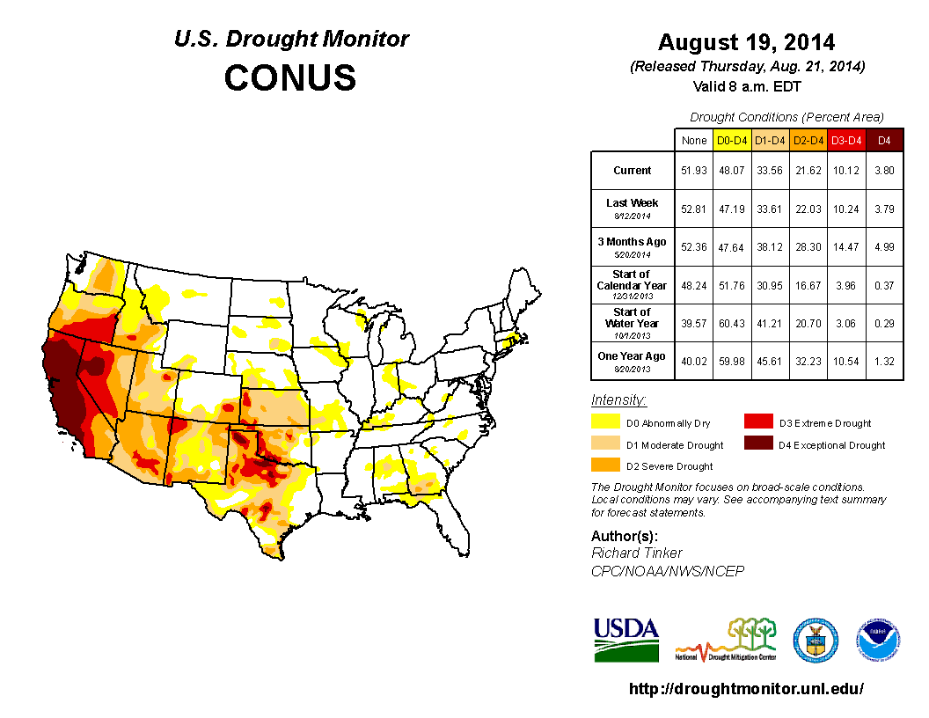

Slide 58
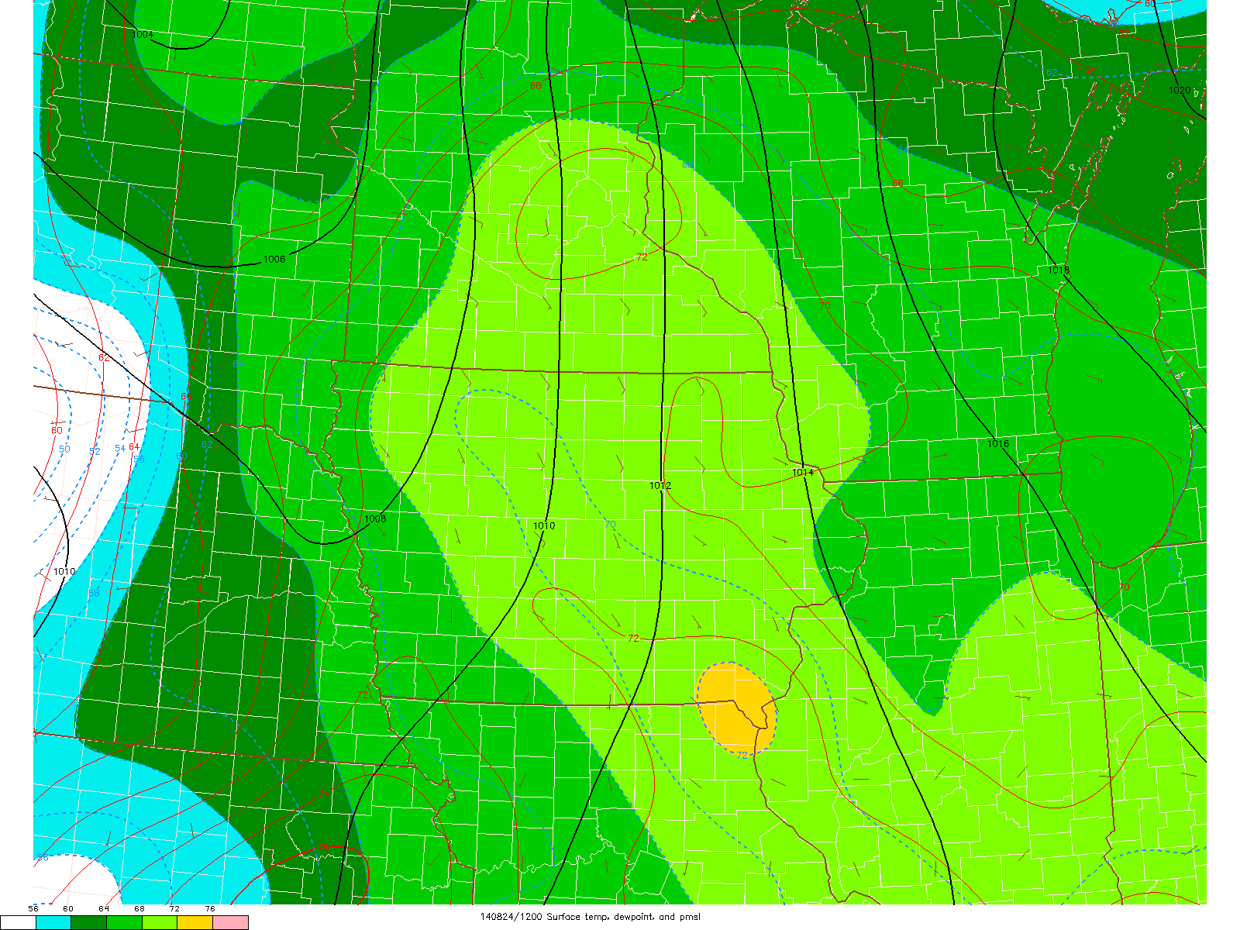

Slide 59
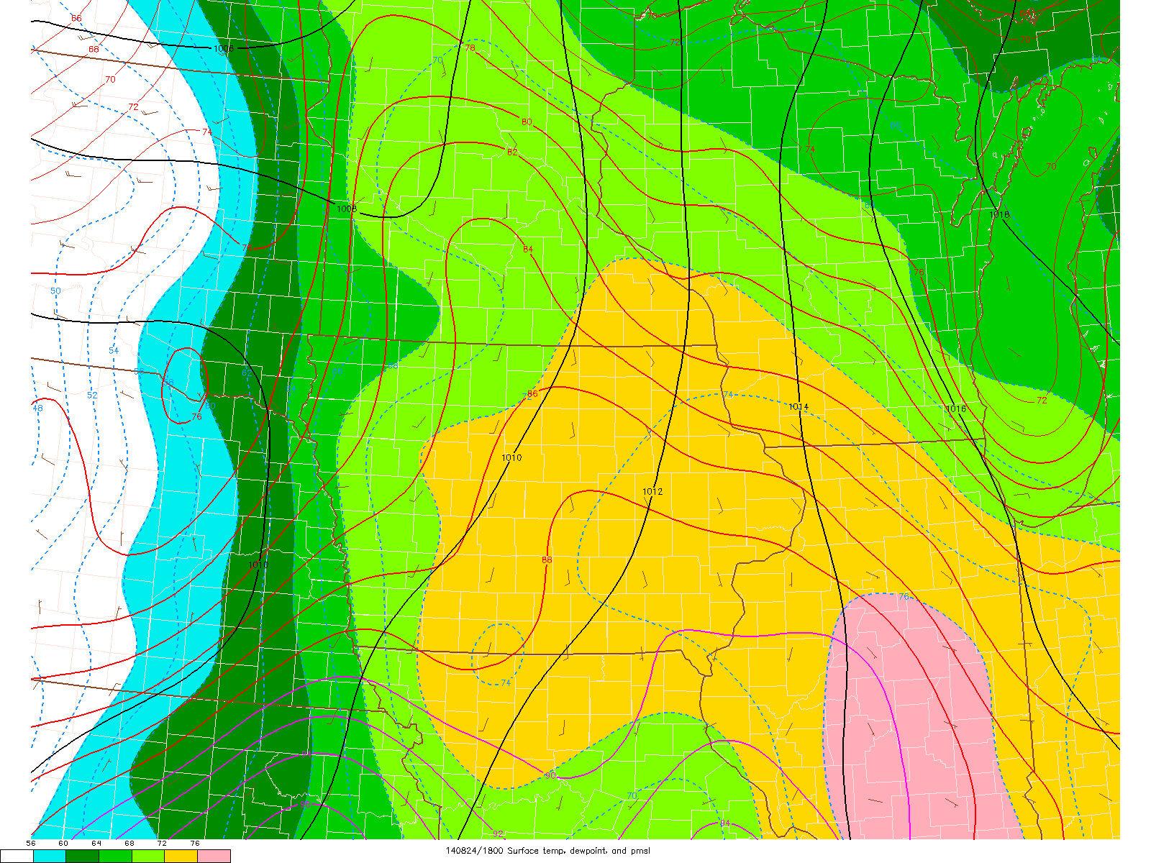

Slide 60
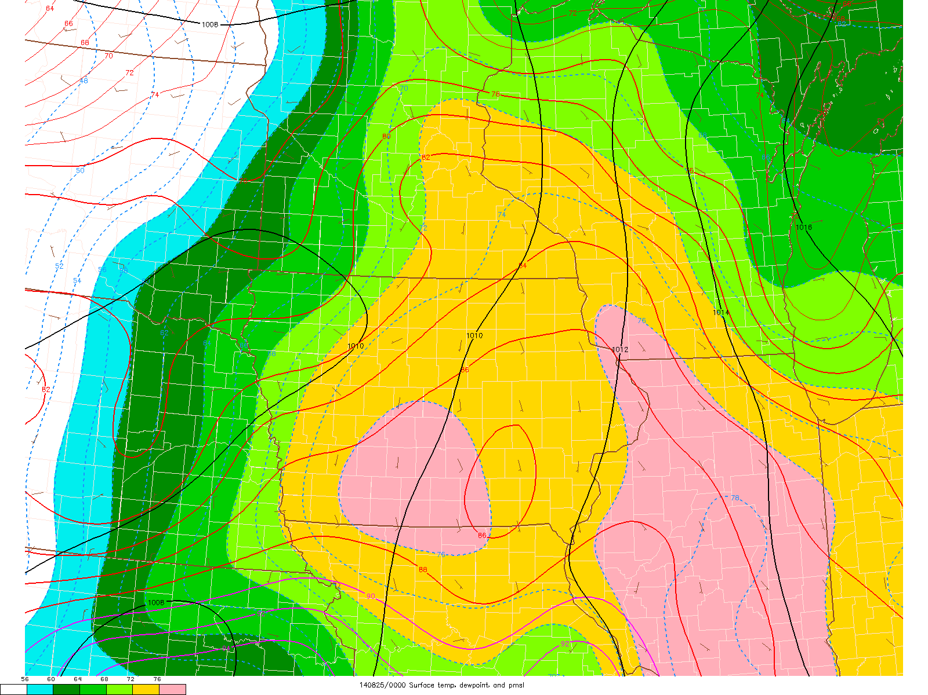

Slide 65
Lee Cyclogenesis
Midlevel flow crosses high terrain:
Subsidence and warming E of mountains
Warming of column leads to “warm core” low formation
Strongest pressure falls with strongest flow crosses highest terrain
The lee trough/cyclone deepens before arrival of strongest Q-G forcing for ascent:
Head start on differential advection, “loaded gun” sounding, and veering winds with height

Slide 67
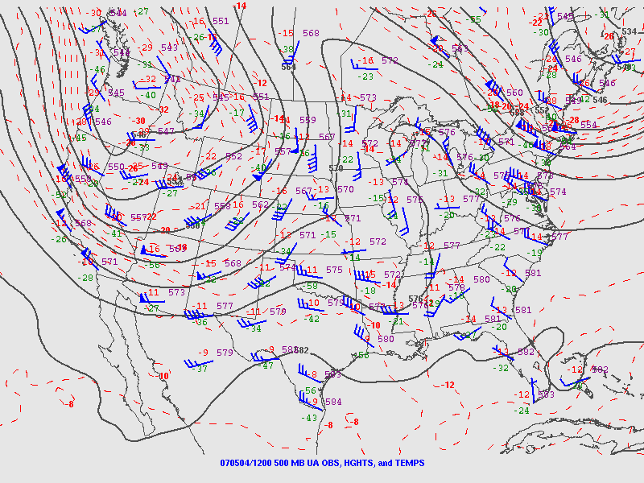

Slide 68
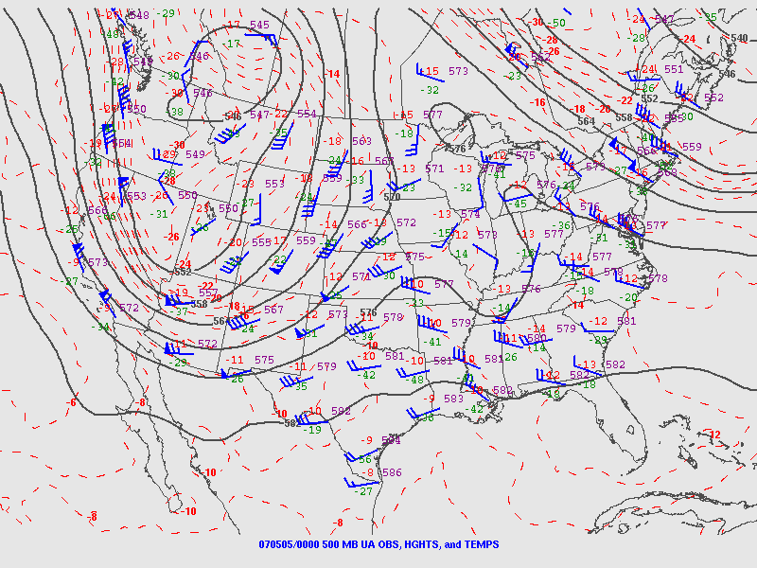

Slide 69
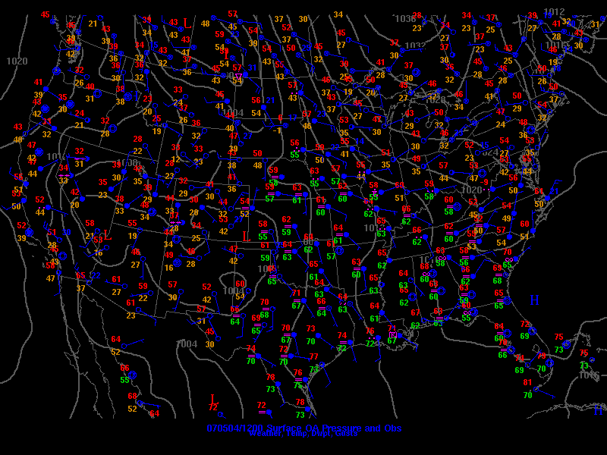
L

Slide 70
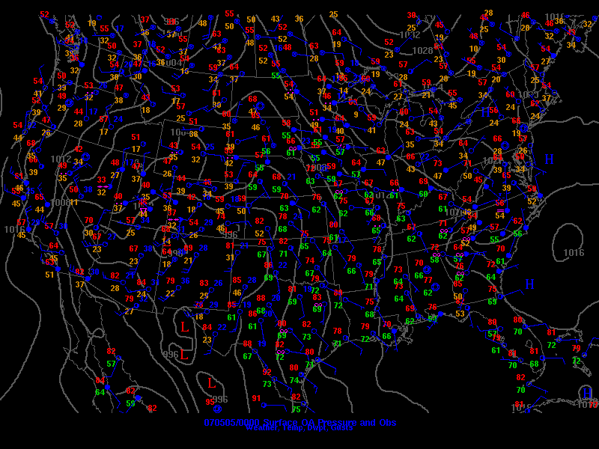
L

Slide 71
Nocturnal Low-Level Jet (LLJ)
Plains often see early nocturnal low-level jet (LLJ) ramp up with lee cyclogenesis
Related to two primary factors:
Boundary-layer decoupling and loss of surface friction (“inertial oscillation”)
Diurnal temperature variations over sloped terrain (thermal wind)
Part of the process that can favor late evening/early overnight tornadoes (with favorable moisture/CAPE)

Slide 72
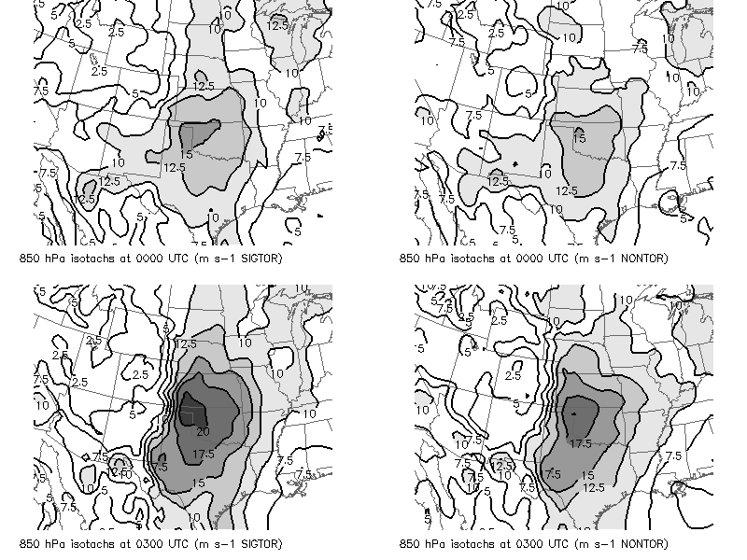
EF2+ supercell events
Nontornadic supercell events

Slide 73
Lee Cyclogenesis Summary
Lee cyclogenesis occurs where upper-level flow is perpendicular to terrain features (westerly flow for Rockies)
Lee cyclogenesis more robust with lower static stability
Lee cyclone helps drive low-level moisture return
Nocturnal low-level jet associated with lee cyclone is driven by inertial oscillation and thermal wind → increased low-level shear and tornado threat in evening and after dark if adequate CAPE

