Slide 1
Skew-T Diagram Basics
METR 4403/5403
Material originally prepared by Rich Thompson

Slide 2
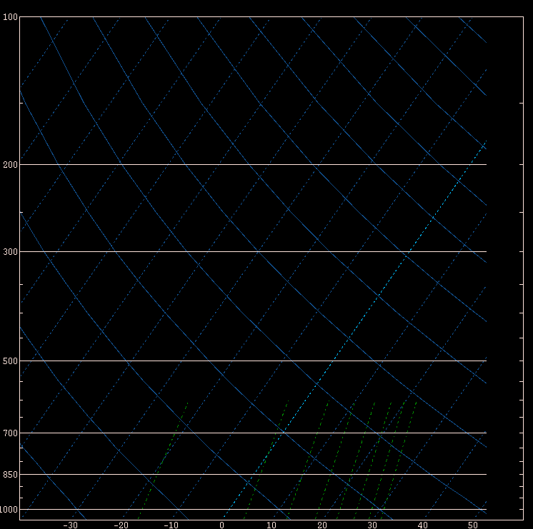
Raw SkewT-log P diagram
Constant pressure
Constant Temp
Dry adiabat
Constant
Mixing ratio
“skew”

Slide 3
Features of note in SkewT log P
Temperature is skewed about 90º from the dry adiabats
Pressure decreases as a logarithm of height (faster at bottom than top)
Mixing ratio crosses over temperature lines
It’s a function of pressure, which is why the same dew point temperature at higher elevation contributes more to buoyancy
One thing missing is a plot of saturated parcel ascent

Slide 4
Saturated ascent (clouds) –
parcel cools at a rate of
~6.5 C km⁻¹
(pseudo adiabatic “lapse rate”)
Lapse rates between saturated and unsaturated – “conditionally unstable”
Dry ascent (no clouds) –
parcel cools at a rate of ~9.8 C km⁻¹
(dry adiabatic “lapse rate”)

Slide 5
Lifted Parcel (chunk of air)
Begin at lifted parcel level (ground)
Rise “dry adiabatically” until saturation
Where dry adiabat crosses mixing ratio
We call this the “lifting condensation level” or LCL
First guess at cloud base

Slide 6
Moist adiabat

Slide 7
Illustration of lifted parcel
From LCL, rise “moist adiabatically” to “level of free convection” or LFC
“Free convection” begins where lifted parcel becomes warmer than environment
Energy resisting lift below LFC is known as “convective inhibition” or CIN
From LFC, continue up to the “equilibrium level” or EL. Accumulated area (energy) from LFC to EL is known as CAPE
“Overshoot” above EL

Slide 8
Common Sounding Terms
Lapse rate – change in temperature with height
Dry adiabat ≈ 9.8 C km⁻¹
Moist adiabat ≈ 6.5 C km⁻¹
Conditional instability – lapse rate between dry and moist adiabatic
LCL – lifting condensation level
LFC – level of free convection
EL – equilibrium level
CAPE – buoyancy (positive area)
CIN – convective inhibition (negative area)

Slide 9
Positive area (CAPE)
Negative area (CIN)

Slide 10
What’s the difference between the lifted parcels?
Virtual temperature accounts for moisture
Warmer than measured temperature
Makes most difference with tropical moisture
Virtual temperature correction increases CAPE and reduces CIN
Which chunk of air to lift?
Some sort of averaging is usually more representative
Surface vs. “mixed layer” or “most unstable”

Slide 11
Lifted parcel (virtual temp)
Lifted parcel
(non-virtual)

Slide 12
Surface and most unstable parcel are the same

Slide 13
Lowest 100 mb mean parcel

Slide 14
Surface parcel

Slide 15
100 mb mean parcel

Slide 16
Most unstable parcel

Slide 17
What are we assuming?
No mixing with environment (not true)
“entrainment” usually reduces updraft strength from expectations based on CAPE alone
All rain falls out instantly (not true)
Suspended rain particles reduces updraft strength
That’s why we say “pseudo” adiabatic for saturated parcel ascent
“Parcel Theory” is a first guess at a complicated process!

Slide 18
Always keep in mind what we don’t know:
Uncertainty in observations
“Good” measurements?
Do they represent what we’re trying to forecast?
Unknown details with lifted parcels
What is right layer to view?
What assumptions are valid, and which might be terribly wrong?
Lots of room for error, but the concepts are useful!

Slide 19
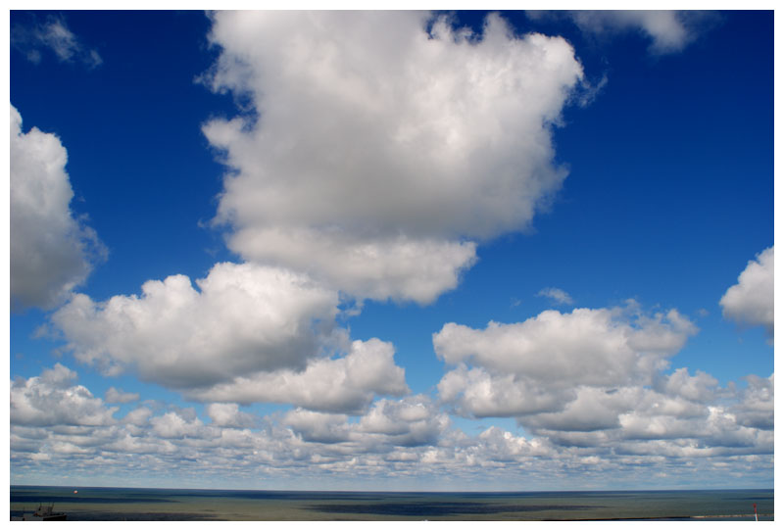
Simple vertical mixing
Surface heating drives thermals and mixing, which take heat and moisture both upward (from surface) and downward (from aloft)
Usually see surface dew point drop in afternoon if not offset by moisture advection (bringing in greater moisture from somewhere else)

Slide 21
Surface heating drives vertical mixing

Slide 23
“super adiabatic” contact layer – lapse rate steeper than dry adiabatic drives vertical mixing

Slide 24
Impact of ascent and moisture advection
See moist layer deepen faster than you would expect with just surface heating and mixing
“Deep” moist layer and horizontal moisture advection both combat vertical mixing driven by surface heating
Can see moist layer deepen while dew points increase near surface

Slide 31
Sounding diagrams are used for…
Moisture and temperature profiles
Estimates of CAPE, CIN, Lifted Index, etc.
Will storms form?
Vertical wind shear (material on hodographs to come!)
What kind of storms will form?
Many of your favorite thunderstorm parameters are based in these diagrams, and subject to the same errors and concerns!

Slide 32
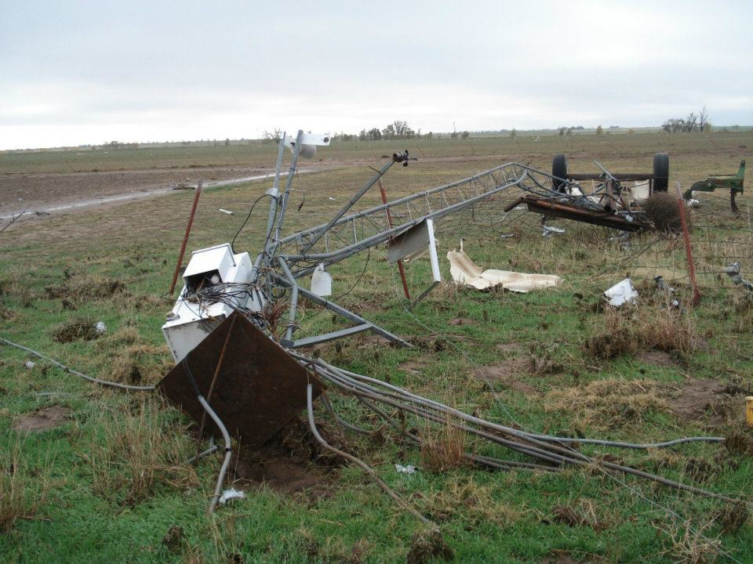
Quality of Surface Observations?
Courtesy of Oklahoma Mesonet
Notes:
Tipton mesonet, got knocked over by a tornado

Slide 33
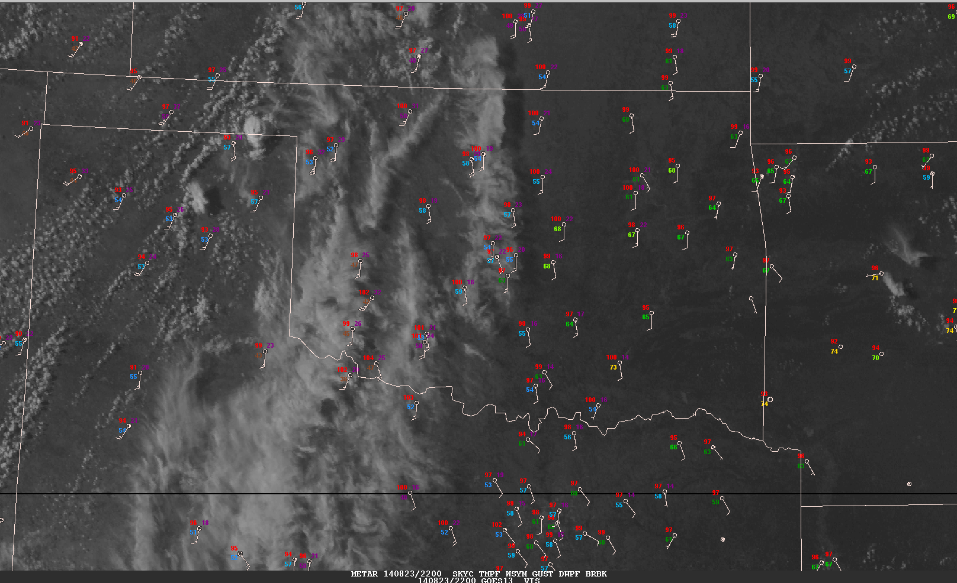
Standard surface observations

Slide 34
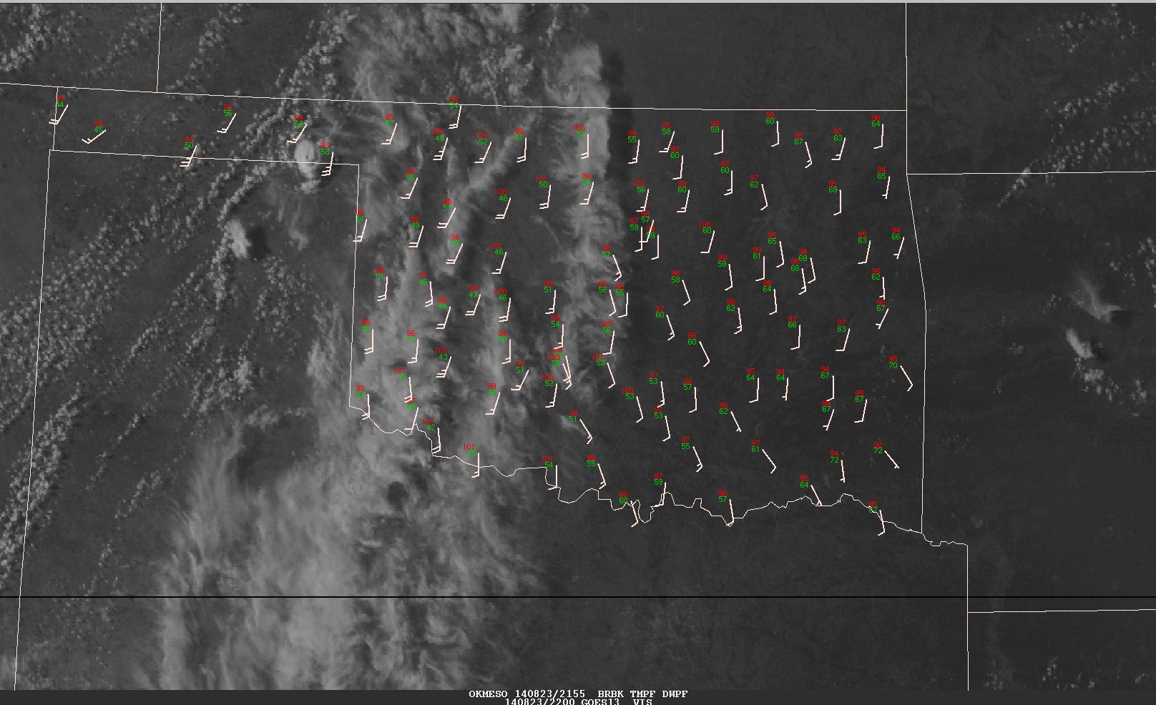
OK mesonet observations at the same time

Slide 35
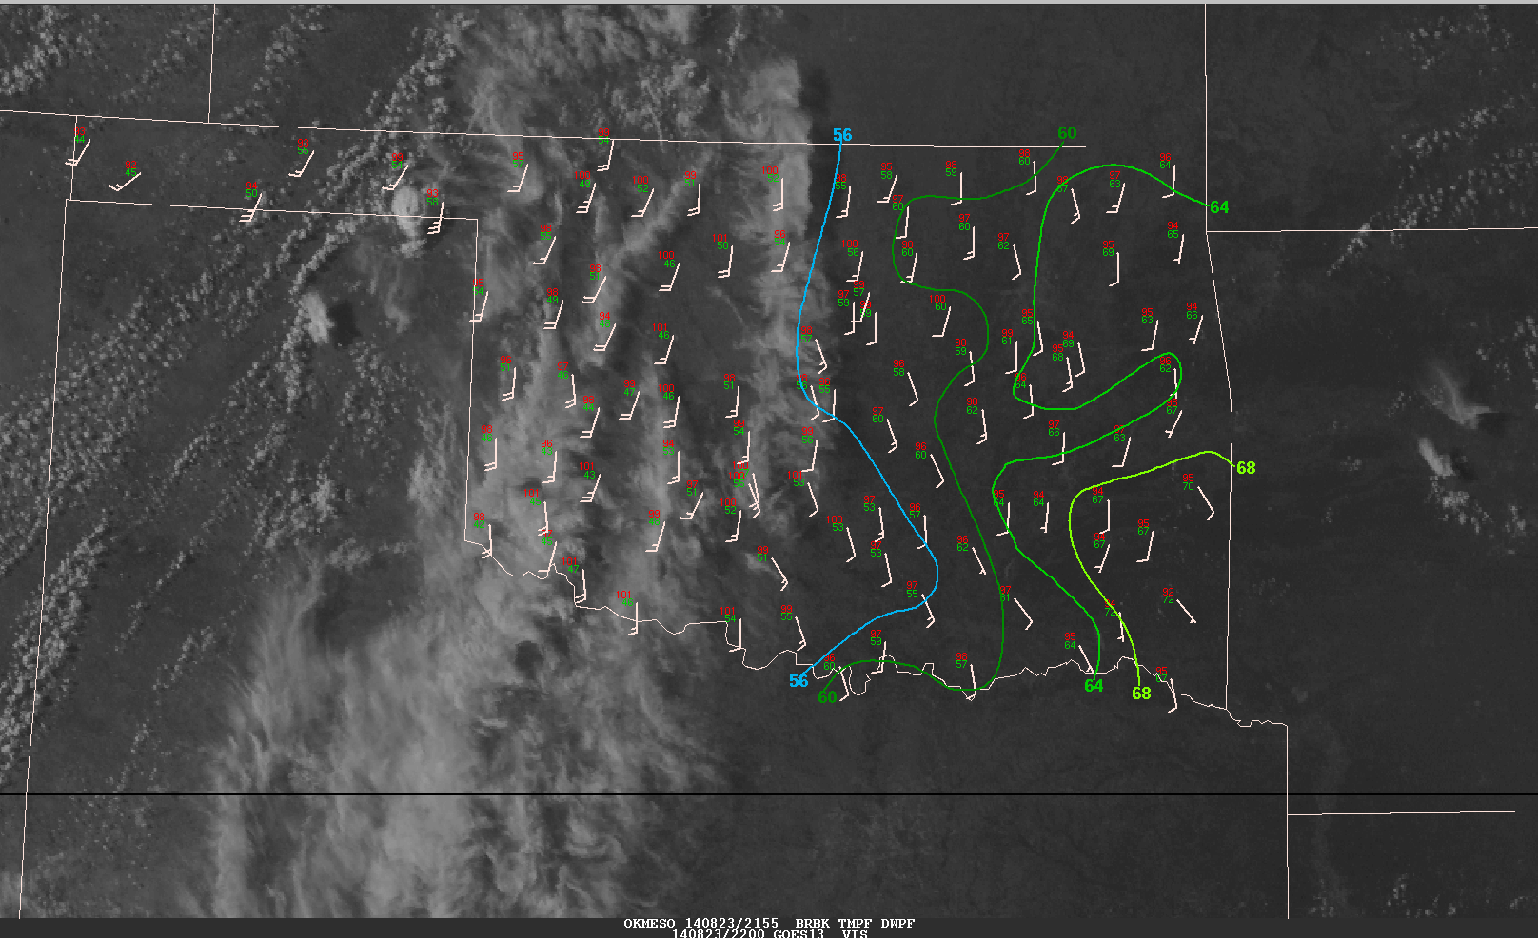
Dew point analysis for OK mesonet observations

Slide 36
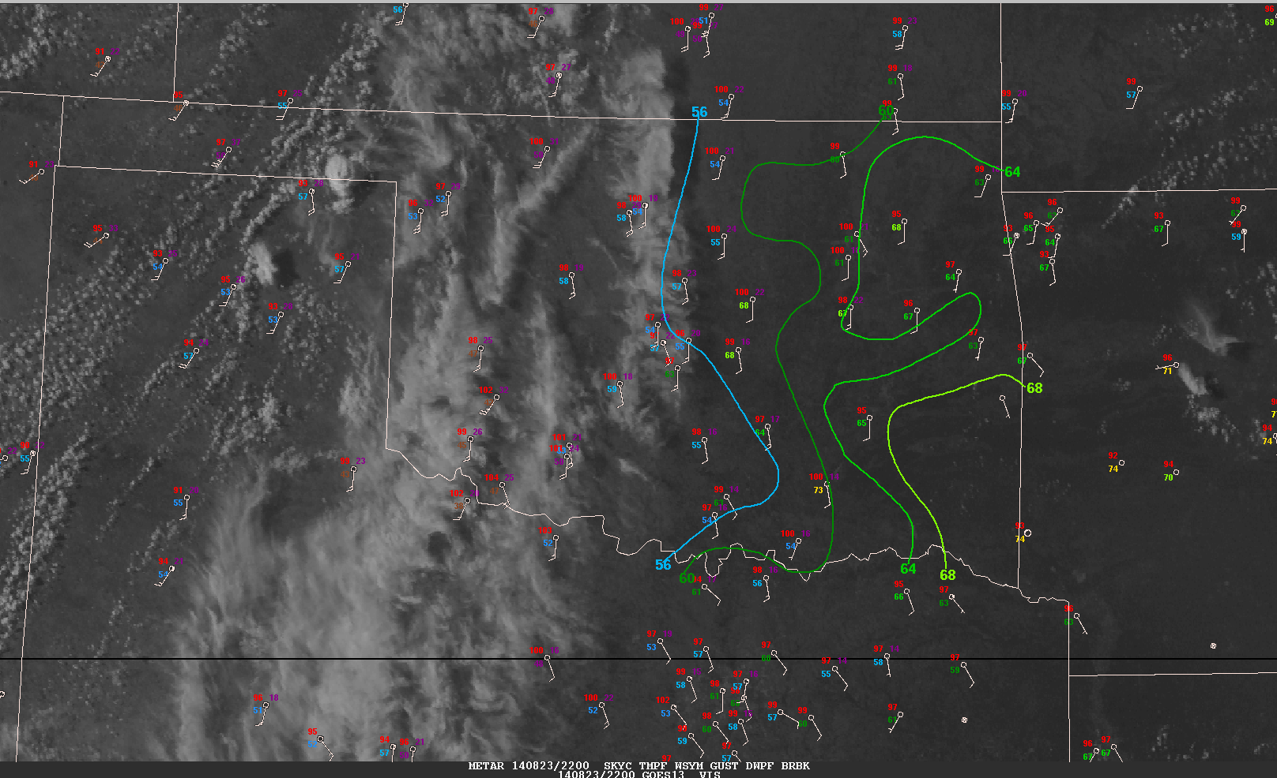
What do these sites have in common?
68
63
68
73
Notes:
ASOS stations are inferior to AWOS stations (OK Mesonet).

Slide 37
Quality of Observations Aloft?

Slide 41
Understand the Data and Processes!
Understanding the processes gives you a sound way to interpret weather data, and recognize errors
If you don’t know what you’re using, how do you know if you’re using it correctly?
Must consider data quality
Focus on observations!

Slide 42
Parcel Theory
Material prepared by Tom Galarneau

Slide 43
Buoyancy
Buoyancy is the upward force arising from the displacement of a fluid by another fluid or object (Archimedes’ Principle)
The upward force is equal to the weight of the displaced fluid
Buoyancy is the key force for convection! (Supercells are more complicated…)
Vertical momentum equation for convective scales goes as:
B controls the parcel acceleration. So, rising parcels can continue to rise for some time after becoming negatively buoyant (like overshooting top!)

Slide 44
Buoyancy
Write buoyancy in terms of temperature since we measure that
Reference state temperature is environment (temperature line on sounding)
Using ideal gas law:
For small mach number:
T_{vp} is virtual temperature of air parcel
T_{venv} is virtual temperature of ambient environment

Slide 45
Parcel theory
We need to be able to determine whether a lifted parcel has buoyancy
Convective available potential energy (CAPE) tells us the kinetic energy a parcel may gain due to buoyant acceleration
Convective inhibition (CIN) tells is the work done by a parcel against stable stratification to reach its LFC
Vertical integration of buoyancy from LFC to EL.
Caveats: CAPE>0 does not guarantee convection.
Not all parcels have an LFC.
Vertical integration of buoyancy from ground to EL.
Need to overcome CIN to trigger convection.

Slide 46
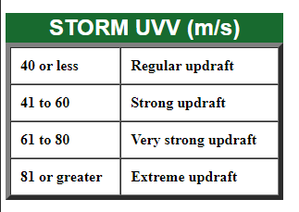
Theoretical Maximum Updraft Speed
1000 J kg⁻¹ CAPE 🡪 45 m s⁻¹ updraft (??)

Slide 47
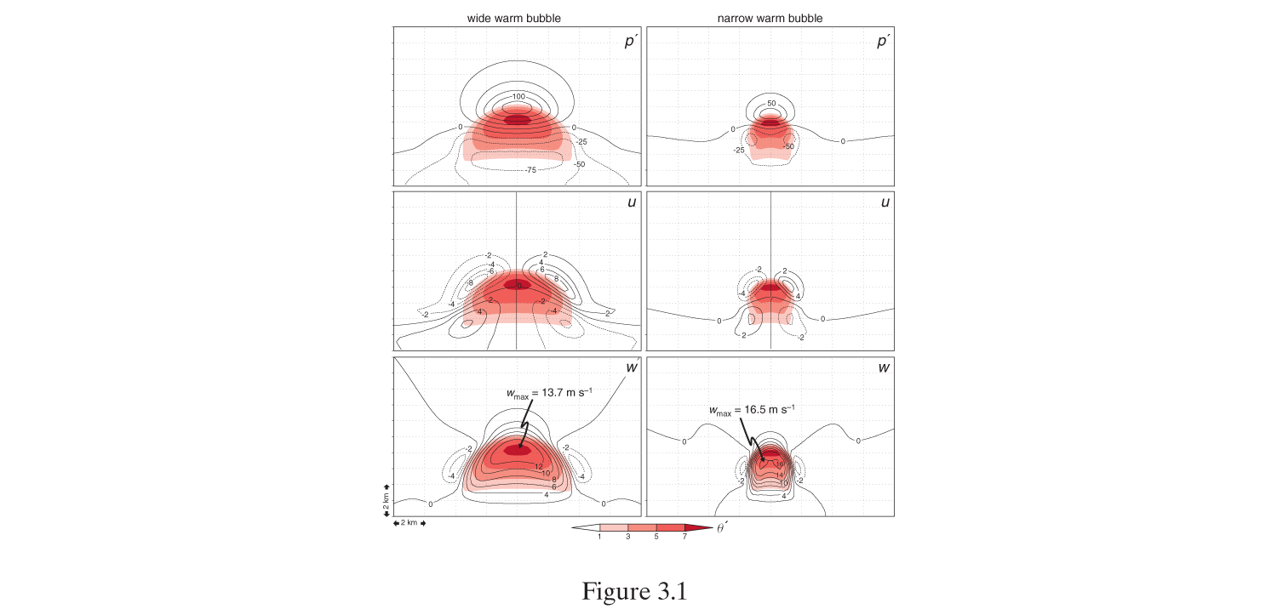
1. Vertical PGF
Wider thermal has larger PGF compared to narrow thermal (more air needs to be moved out of the way)
As thermal becomes wider the scenario approaches hydrostatic where PGF offsets buoyancy (dw/dt=0)
In theory, narrow thermals more favorable for convective initiation
B
B
H
H
PGF
L
PGF
L
2. Entrainment
Mixing of environment air into rising thermal
If env is cooler/drier, evaporation cools thermal, reduces B
Updraft dilution more detrimental for narrow or tilted updrafts (wider is better)
Fig. 3.1 MR 2010

Slide 48
Summary
Parcel theory overestimates updraft speed
Vertical PGF limits updraft speed; significant for wide updrafts
Entrainment limits updraft speed; significant for narrow/tilted updrafts
Hydrometeor loading also limits updraft speed
Bryan and Weisman 2000

