Slide 1
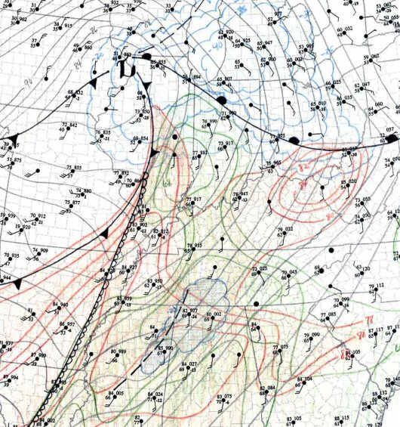
Subjective Analysis: History and Uses in modern forecasting
“Despite the powerful computers, there is no substitute for drawing weather maps by hand for making a forecaster take the time to thoroughly understand the ongoing weather situation. And without knowing the intricate details of what's happening now, a forecast can suffer. So SPC forecasters routinely draw -- by hand -- surface and upper air features on printed maps, many times per day. This is a piece of a surface map containing lows and warm fronts (bright red), highs and cold fronts (blue), outflow boundaries (purple dash-dot), pressure troughs and isobars (dark gray), isotherms and warm spots for temperature (dark red), isodrosotherms and moist spots for dew point (green), a dryline (dark brown), and finally, snapshots of wind flow called streamlines (tan). It may look like a jumbled mess, bad food or abstract art; but to a severe storms meteorologist, it is stuffed with useful information”
-SPC Tornado FAQ

Slide 2

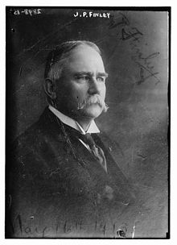
A brief History
1870 US Congress establishes a weather unit within the US Army Signal Corps. Precursor to today’s NWS
1872 Signal Corps weather unit begins collecting country wide observations via telegraph for use in forecasts for agriculture and commerce. (NOAA is under the Department of Commerce today)
John Finley, a Signal Corps forcaster, began the first systematic study of tornadoes through the use of surface observations, tornado reporters (spotters) and climatology in 1884. Recognized the need for more observations and data.
I highly recommend Storm Kings by Lee Sandlin for the history of tornado forecasting and the National Weather Service.
<-John Park Finley Us Army Signal Corp

Slide 3
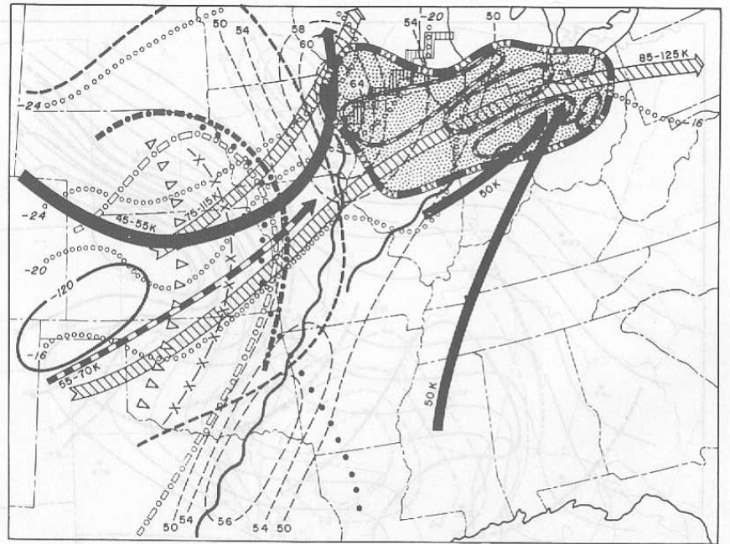
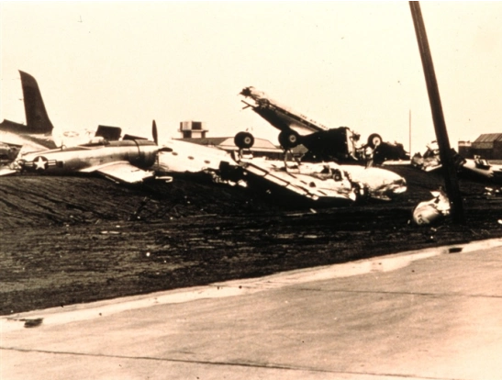
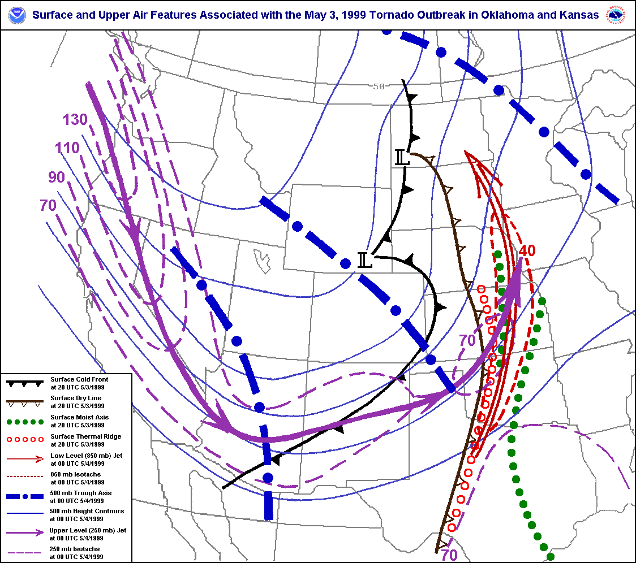
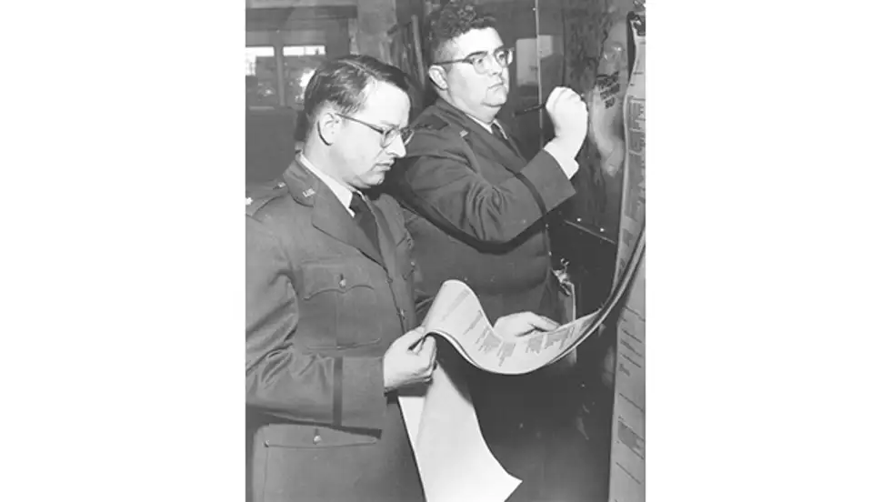
Surface maps and next Steps; Fawbush and Miller Tornado Forecasting
Standardized surface maps became the norm for weather and forecasting for decades. Still remain essentially the same today.
Captain Robert C. Miller and Major Ernest J. Fawbush USAF became the first successful tornado forecasters on March 25th 1948 Tinker AFB OKC after recognizing a similar pattern from a tornado just 5 days before.
Fawbush and Miller spent the rest of their careers pionering tornado research and forecasting methods for the USAF. This included creating composite charts of surface and upper-atmospheric features. (Look Familiar?)
In 1952-3 the Weather Bureau created the Severe Local Storms unit SELS (precursor to SPC) based on the work of Fawbush and Miller.
  https://www.spc.noaa.gov/history/early.html
Planes destroyed at Tinker AFB; March 20, 1948
Capt. Miller
Maj. Fawbush

Slide 4
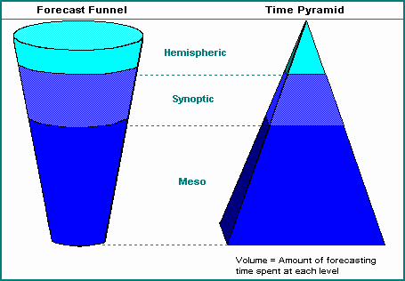
Cool, why do we care?
Serves as a solid basis for building a successful forecasting routine.
  “Even Michael Jordan starts his warm-up with chest passes.” - Unknown
Observations should serve as the basis for all forecasts with numerical models and other tools “filling in the gaps”.
Model guidance and objective analysis can, and will, lead you astray!
  Hand analysis allows you to identify when guidance/objective analysis has initialized poorly.
Hand analyses don’t have to be pretty so long as they give you the information you need.

Slide 5
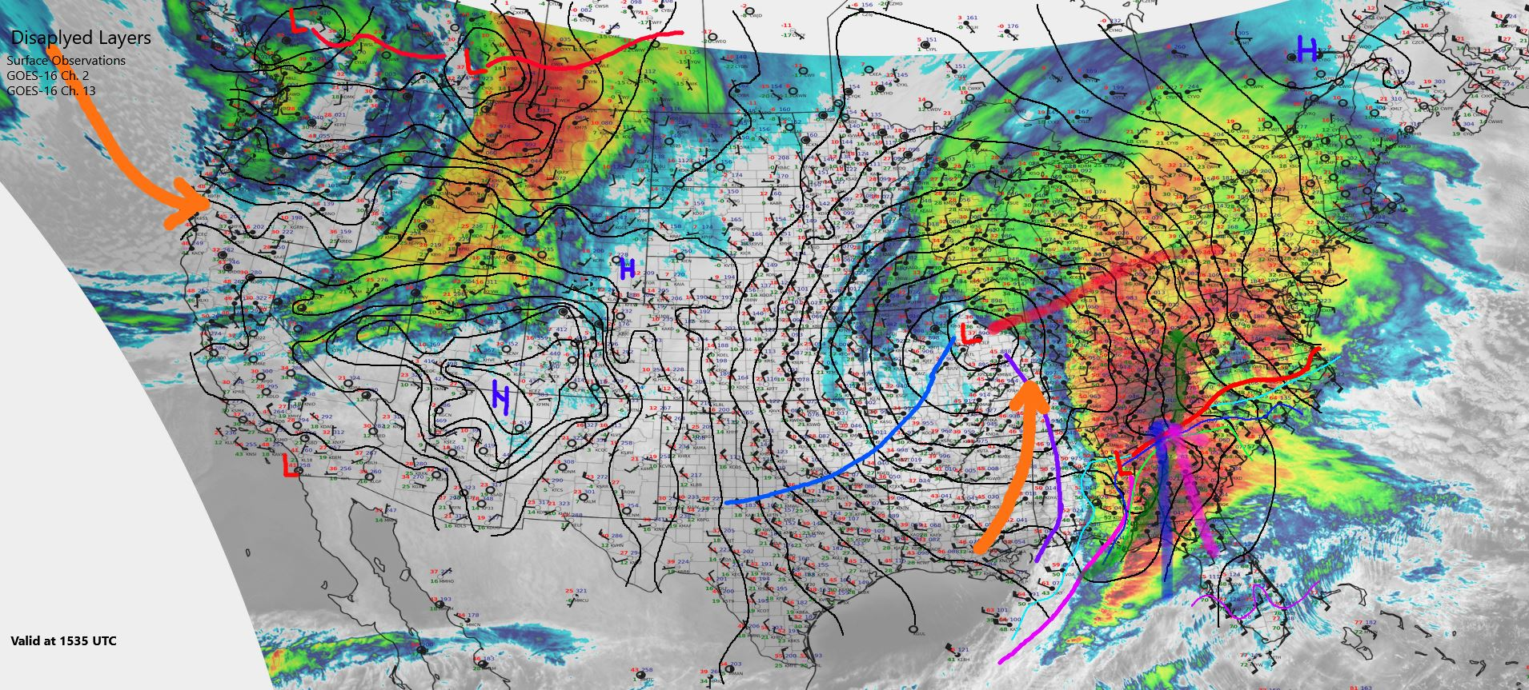

Slide 6

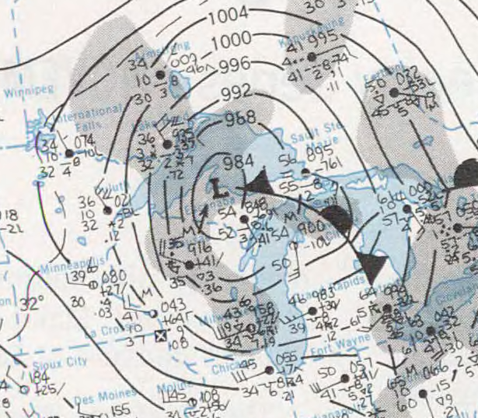
Break out the Pencils!

Slide 7
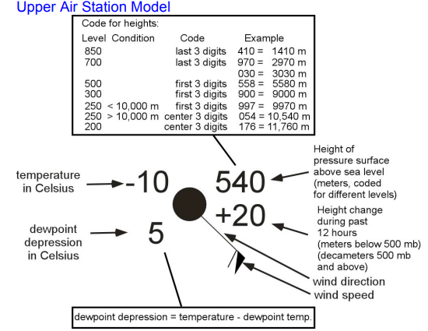
Upper Air Analysis
300 mb
Notes:
300 mb is typically near 9000 meters. Heights on chart typically omit the ending “0”
(so 9120 meters is 912 on the chart).
Use:
Jet stream and upper-wave identification
What to draw:
Isotachs (wind speed) every 25 knots
Isohypses (heights) every 120 meters
850 mb
Notes:
850 mb is typically near 1170 meters. Heights on chart typically omit the leading digit
(so 1320 meters is 320 on the chart).
Use:
Low-level wave identification.
Thermal advection regimes
Low-level moisture
Low-level jets
What to draw:
Isohypses (heights) every 30 meters
Isotherms (temperature) every 4 C
Isodrosotherms (dewpoint) every 4 C
above 8 C
700 mb
Notes:
700 mb is typically near 3100 meters. Heights on chart typically omit the leading digit
(so 3050 meters is 050 on the chart).
Use:
Mid-level wave identification.
Thermal advection regimes
Mid-level moisture
What to draw:
Isohypses (heights) every 30 meters
Isotherms (temperature) every 4 C
Isodrosotherms (dewpoint) every 4 C above -4 C
500 mb
Notes:
500 mb is typically near 6000 meters. Heights on chart typically omit the ending “0”
(so 5640 meters is 564 on the chart).
Use:
Upper-wave identification
What to draw:
Isohypses (heights) every 60 m
Isotherms every 4 C

Slide 8
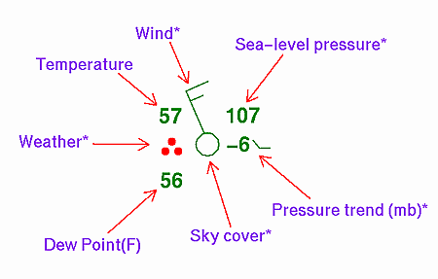
Surface Analysis
Main goal: Identify air masses and boundaries!
Isobars (pressure): Every 2 or 4 mb (Depends on CONUS vs. Regional scale. For this exercise, do 4 mb)
Isodrosotherms (dewpoint): Every 4 C (Allows you to scale down to 2 C as needed)
Isotherms (temperature): Every 4 C (Allows you scale down to 2 C as needed)
Boundaries:
Cold Fronts
Warm Fronts
Stationary Fronts
Occluded Fronts
Drylines
Surface troughs
Surface Ridges
Confluence axes
Outflow boundaries
For this exercise, prioritize:
Surface Pressure
Dewpoint
Boundaries
Temperature

Slide 9
Let’s put it all together
Quick and dirty maps can give you insight on small details mesoanalysis may miss.
They don't have to be pretty, only functional!
Think in 4D (XYZ &T). The atmosphere changes in space and Time! Composite charts are a great way to do this on the fly.
Do multiple charts to see the progression of features(OFBs fronts ect…)

Slide 10
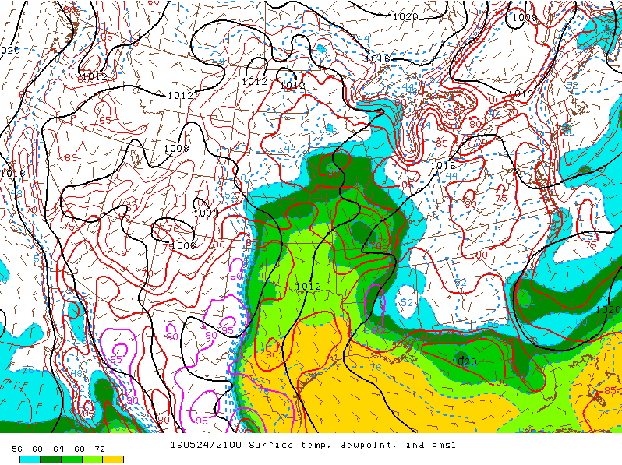
Compare/Contrast
How did your chart compare to the objective analysis?
What features did you capture (or miss)?
Did you catch the “boundary of the day”???

Slide 11
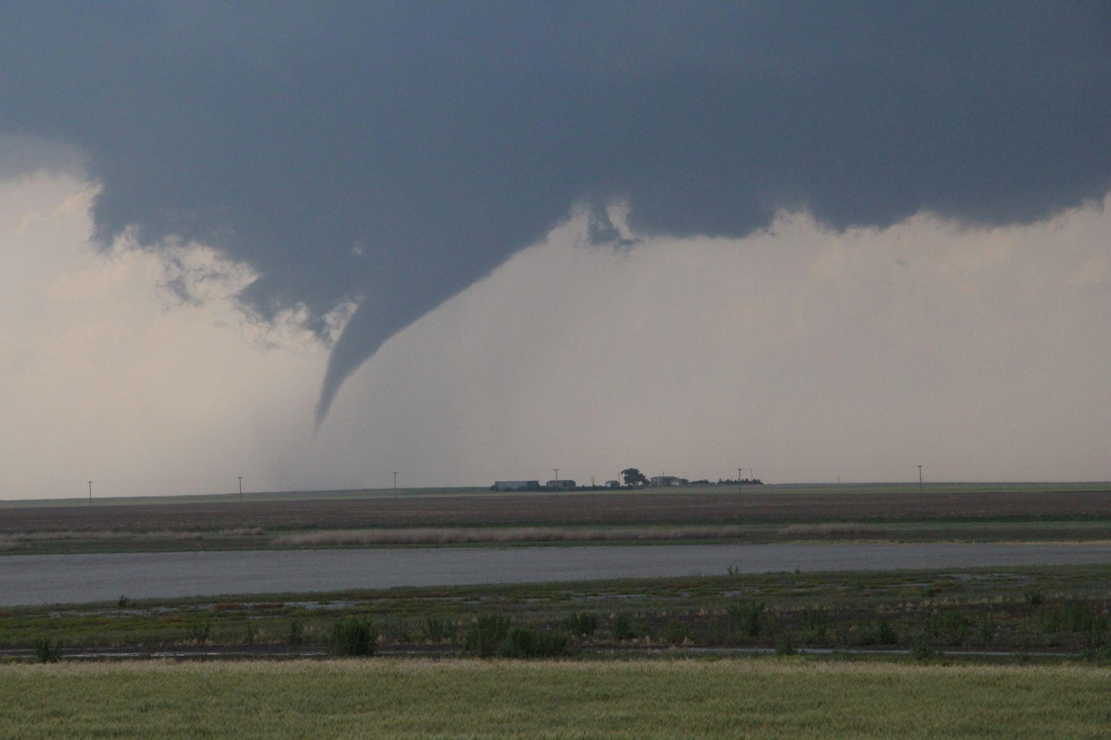
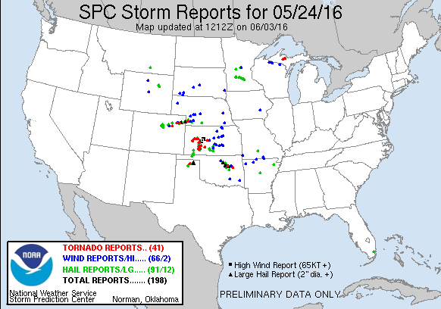
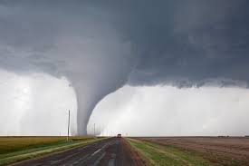
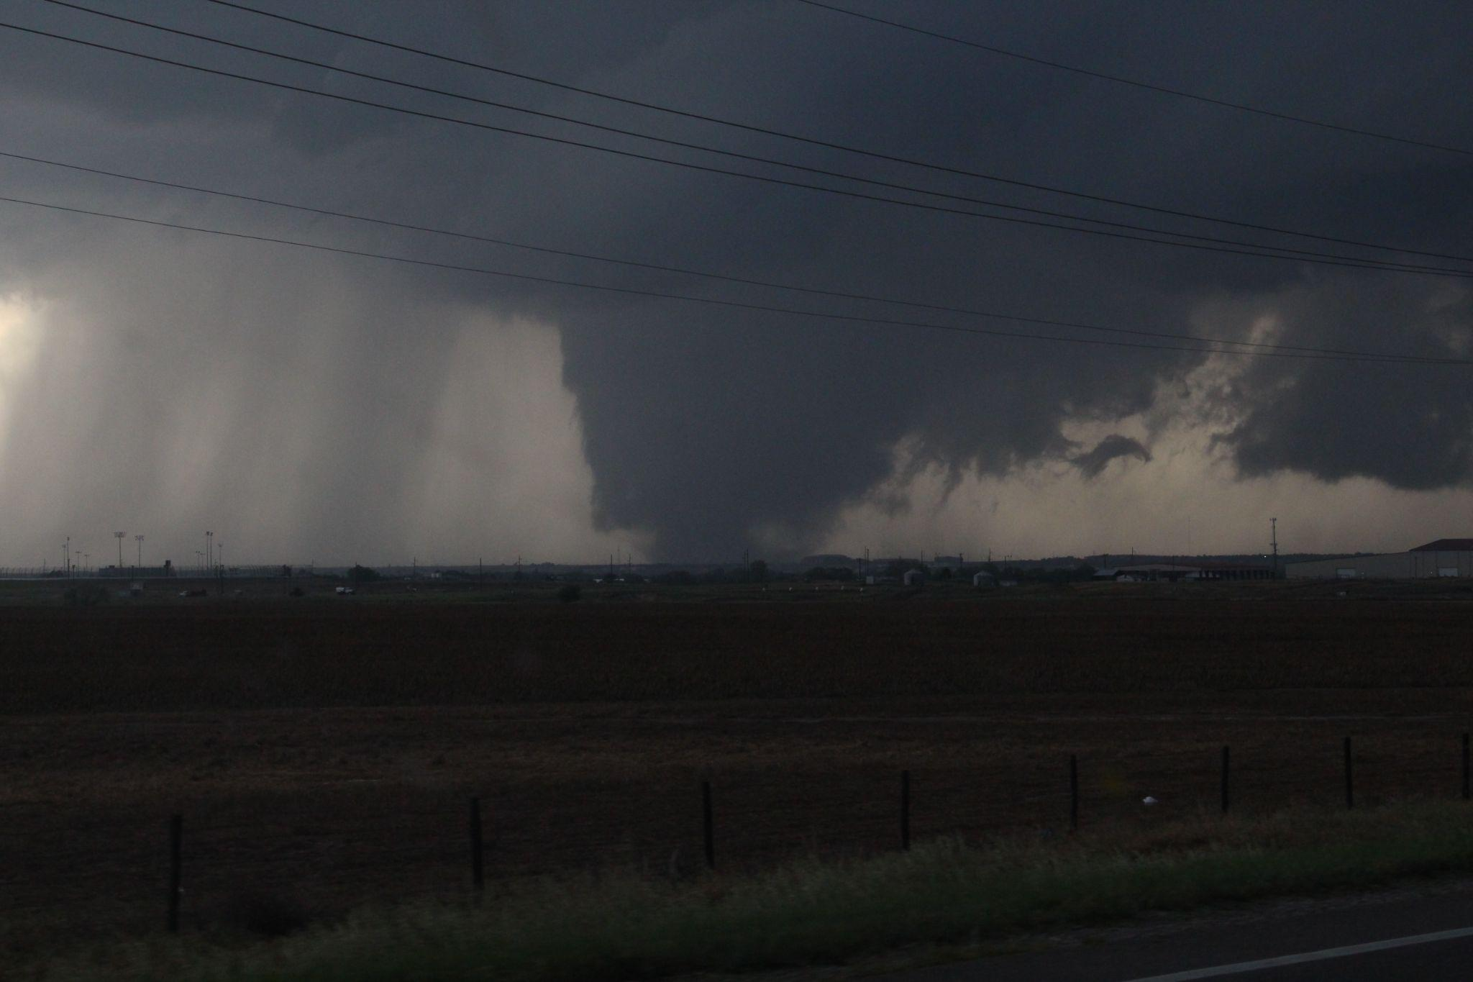

Slide 12
Additional Analysis Types:
Streamline Analysis
Helps identify confluence axes where there may be subtle lift.
Start at a point and follow the observed wind vectors until your
streamline intersects another streamline or leaves the analysis area.

Slide 13
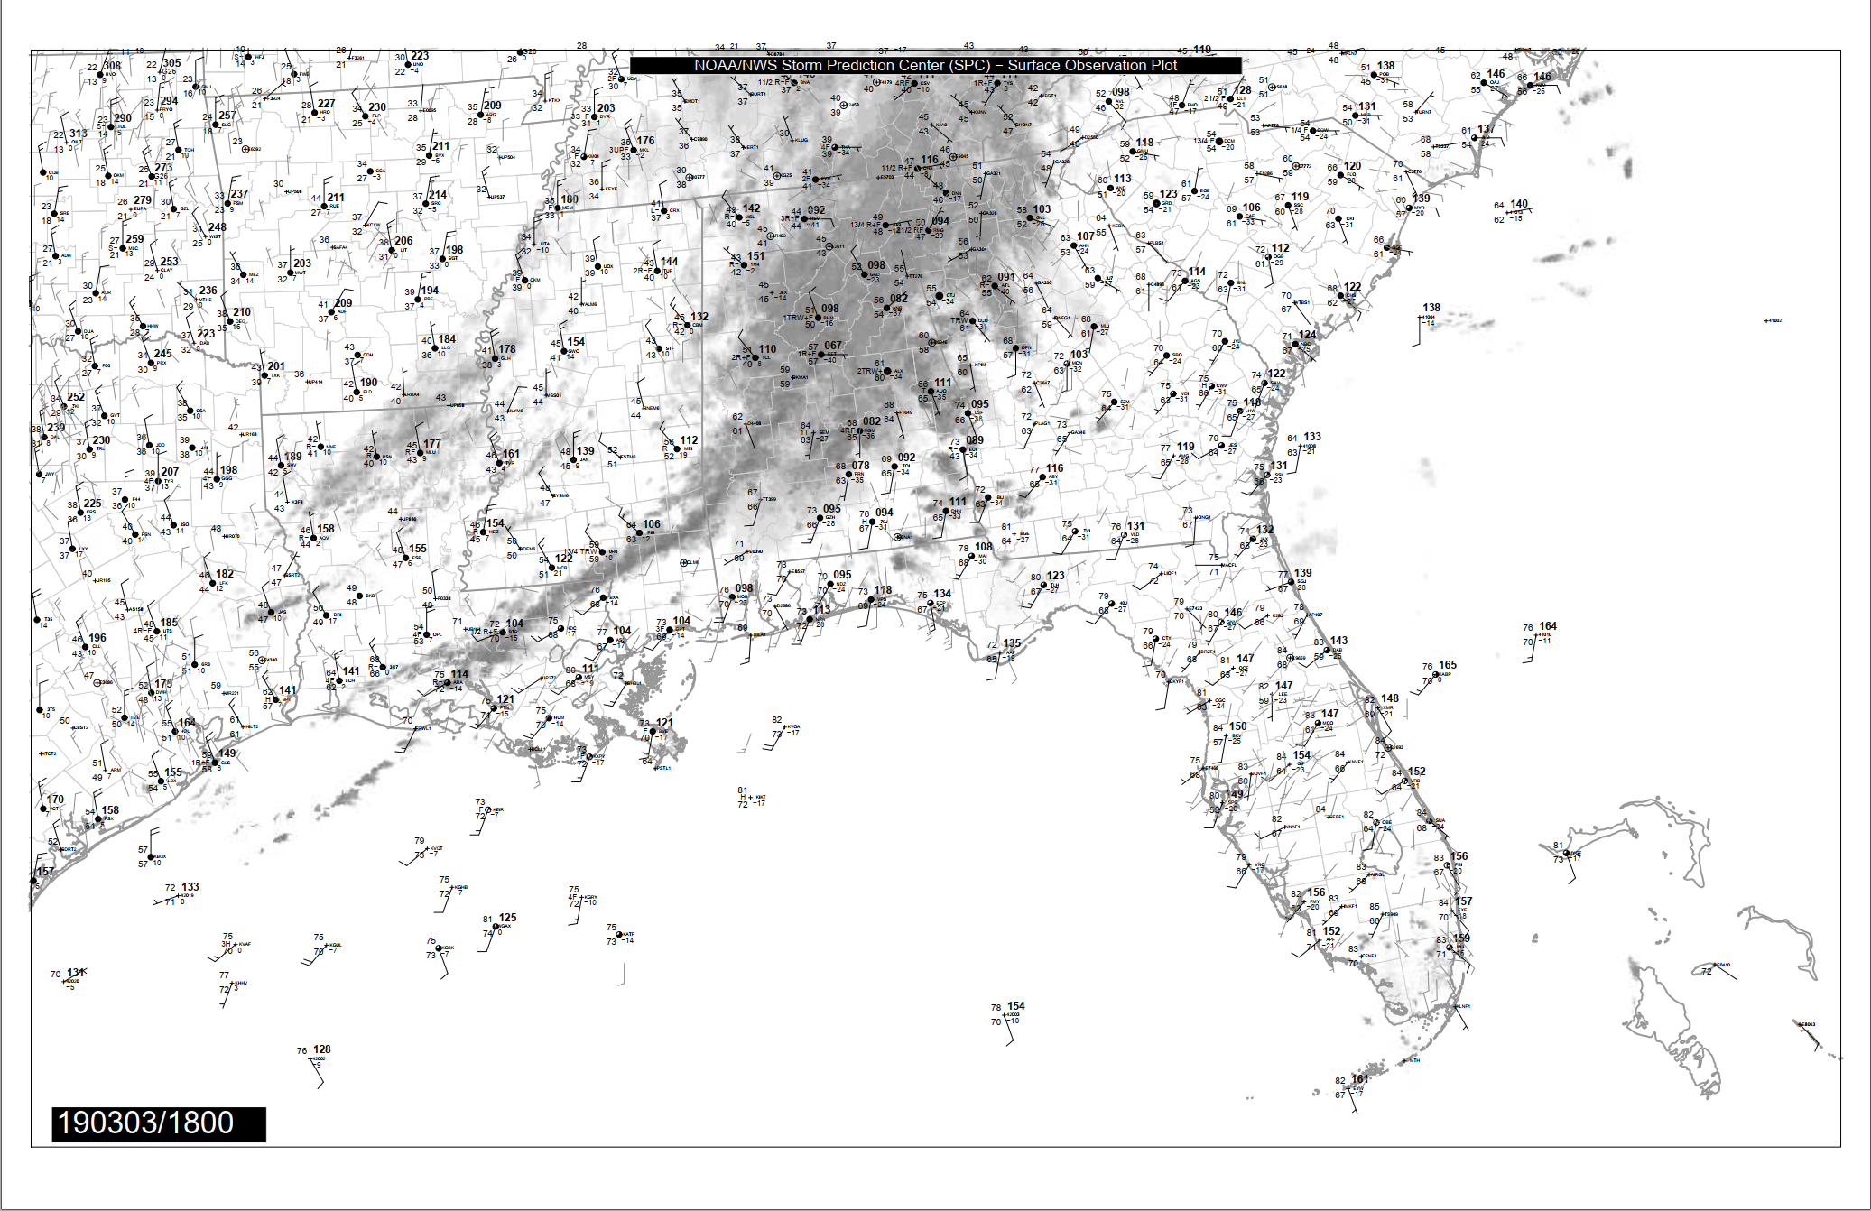

Slide 14
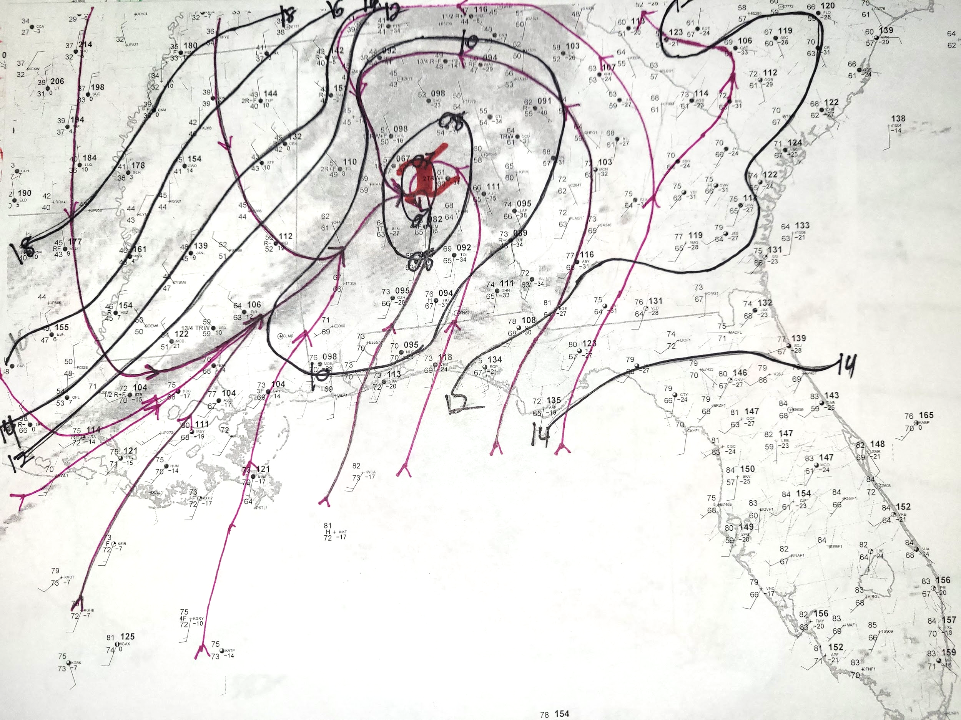

Slide 15
Additional Analysis Types:
Surface Pressure Tendency
Helps identify where lift is likely ongoing (think back to mass conservation).
This may be important for synoptic evolution and T-storm initiation.
Can also help identify pressure rise/fall couplets that can be associated with strong winds.

Slide 16
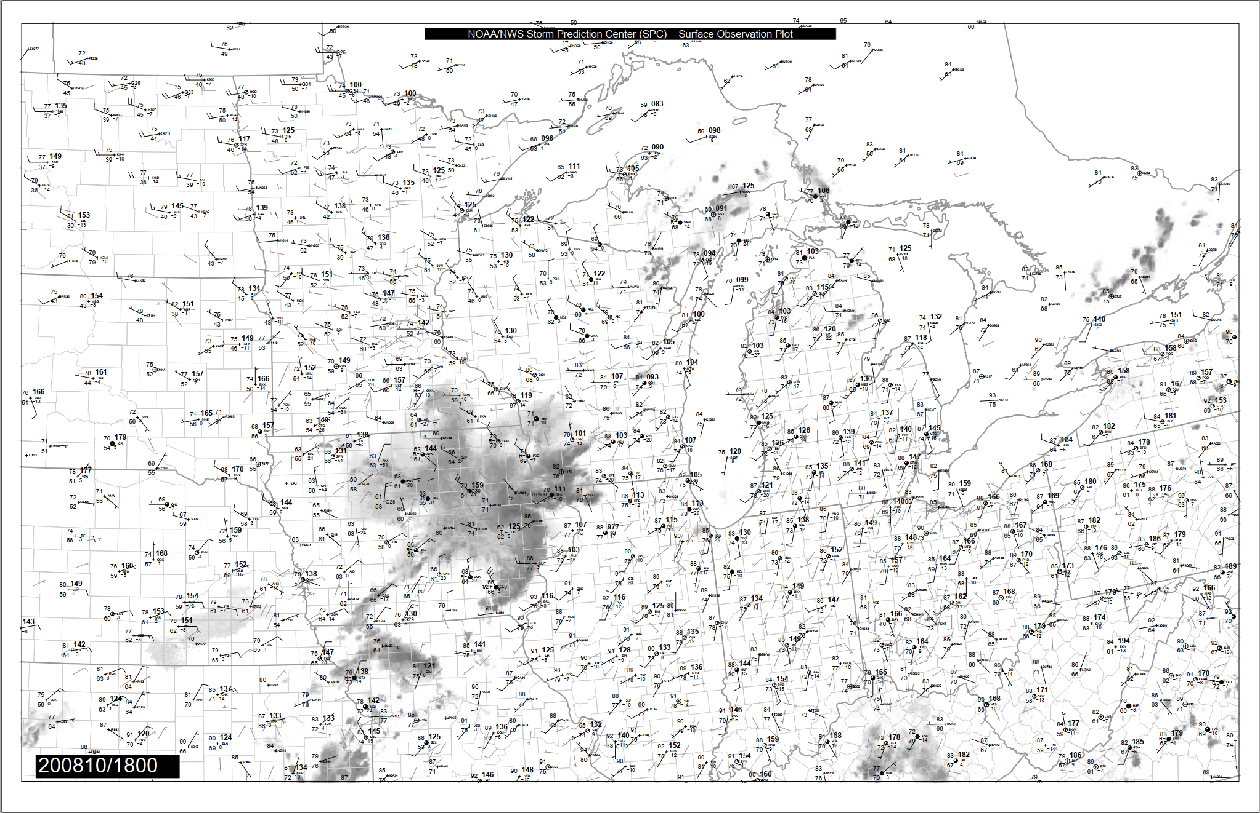

Slide 17
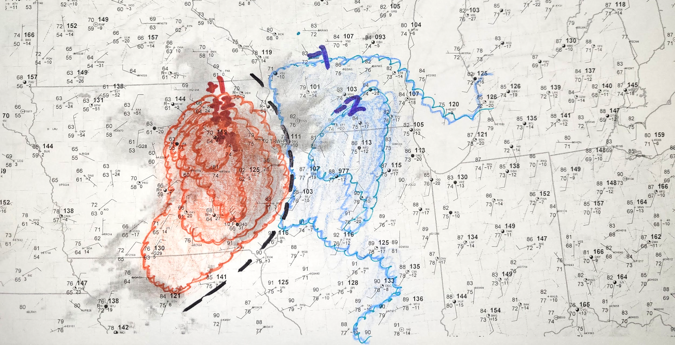

Slide 18
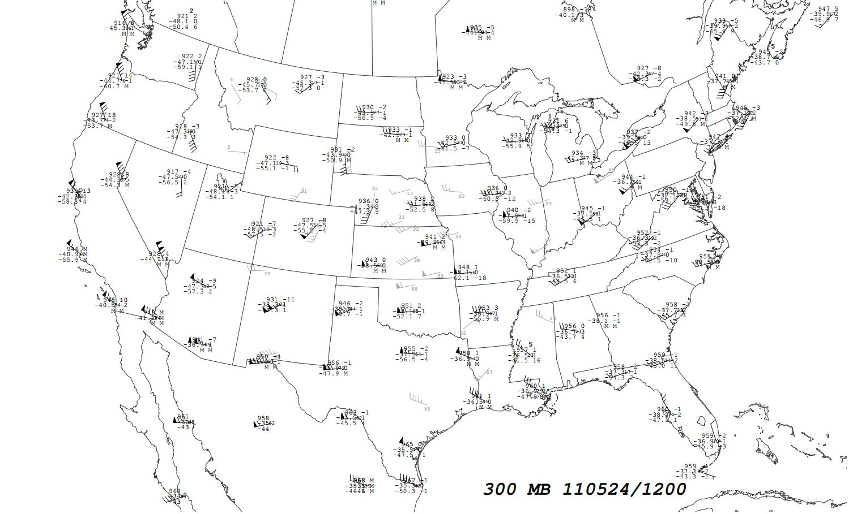

Slide 19
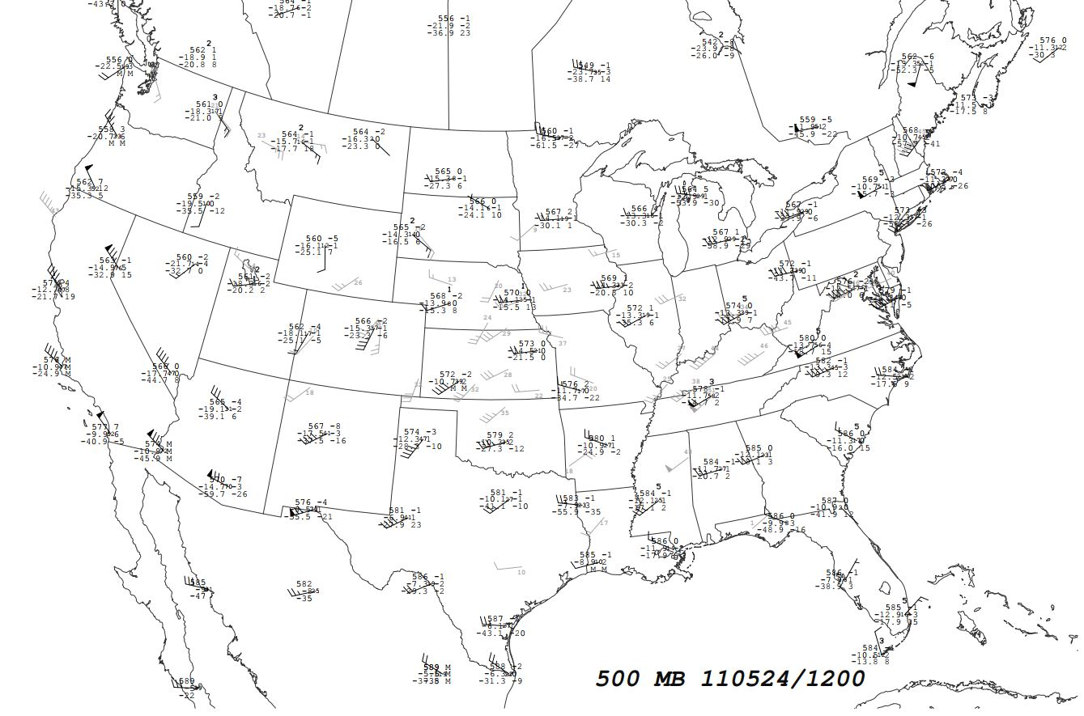

Slide 20
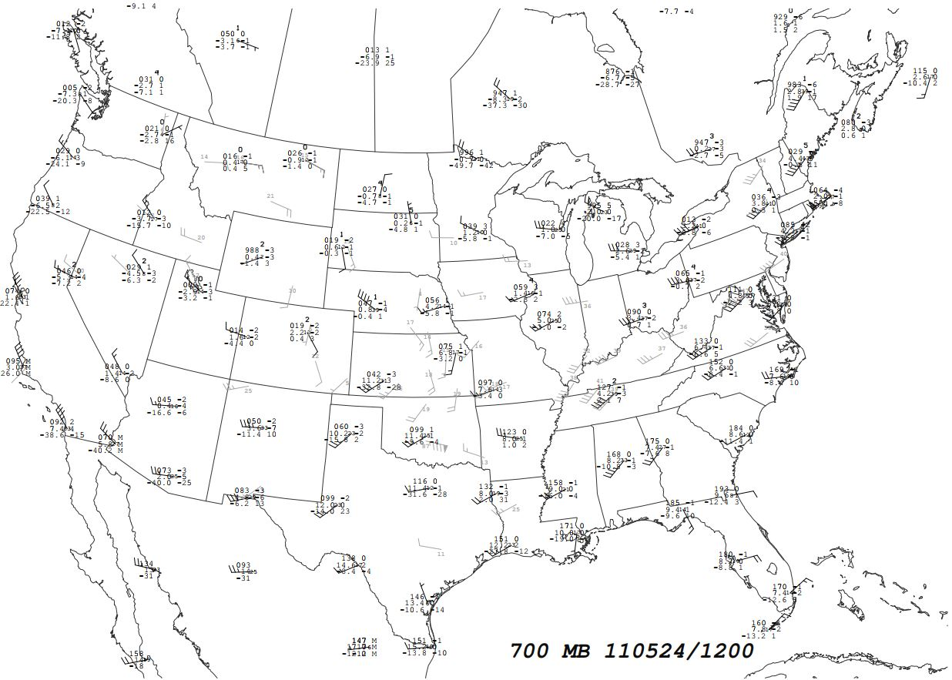

Slide 21
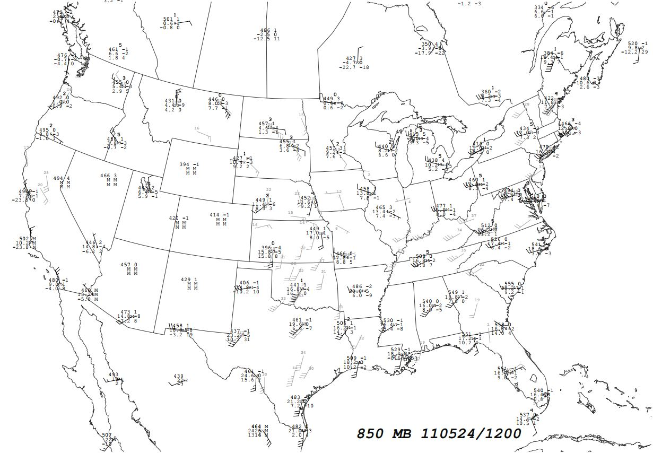

Slide 22
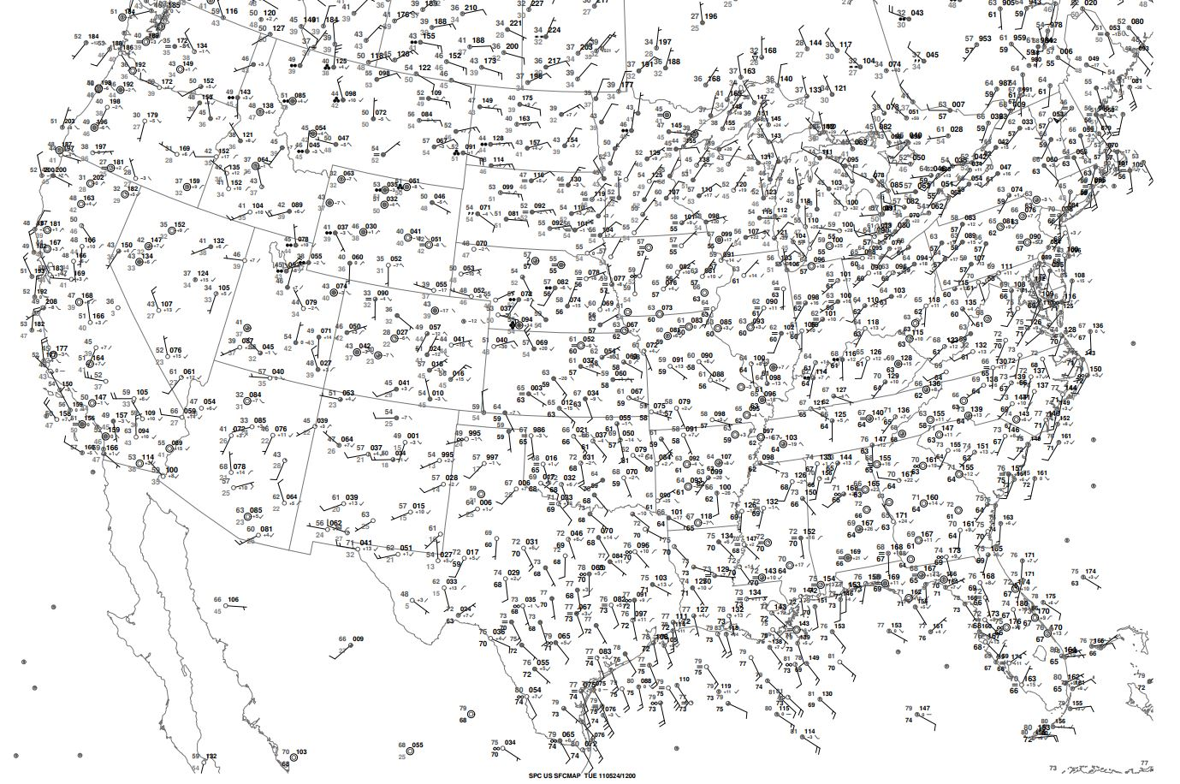
L
H
L
H
L
H

Slide 23
Composite Chart
Look back on your upper-air analysis.
Discuss in your group which features are important and should be added to your surface chart to create a complete composite chart.

Slide 24
L
H
L
H
X
L
300 mb Jet
H
500 mb Jet & Low (X)
850 Jet & Moisture Axis

Slide 25
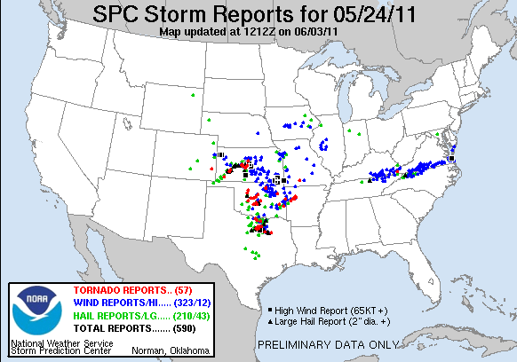
L
H
L
H
X
L
300 mb Jet
H
500 mb Jet & Low (X)
850 Jet & Moisture Axis

Slide 26
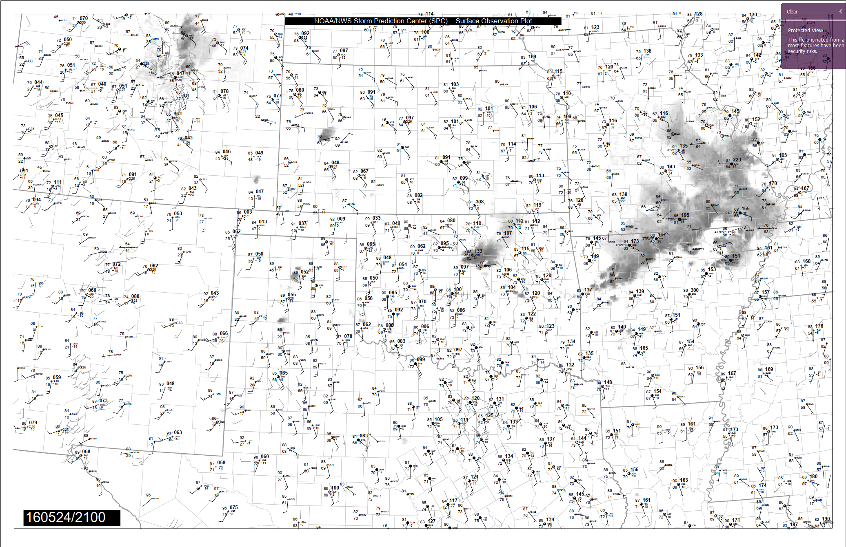

Slide 27
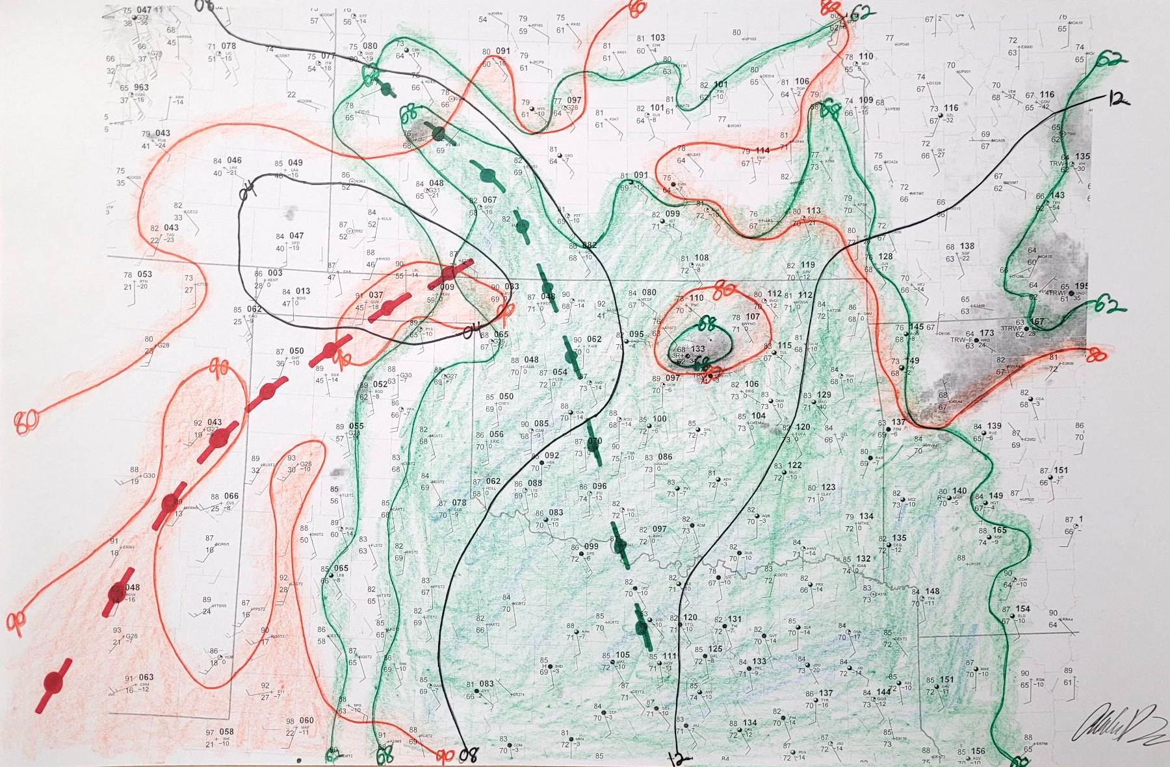

Slide 28
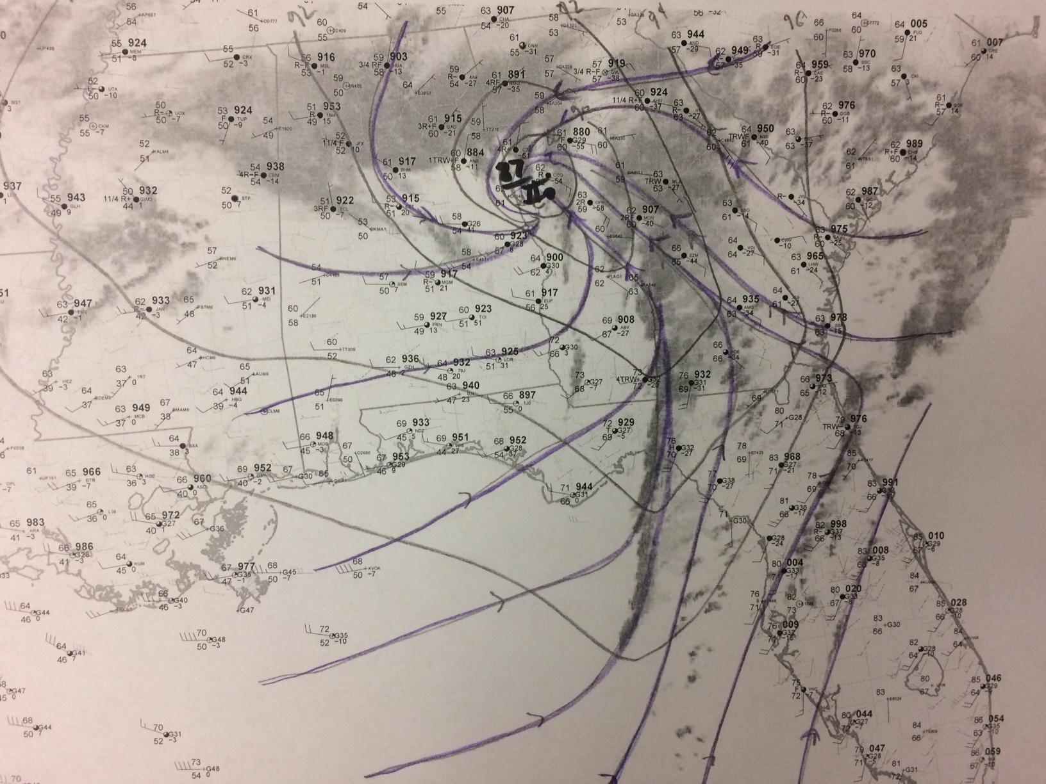
Notes:
jan 22 2017

Slide 29
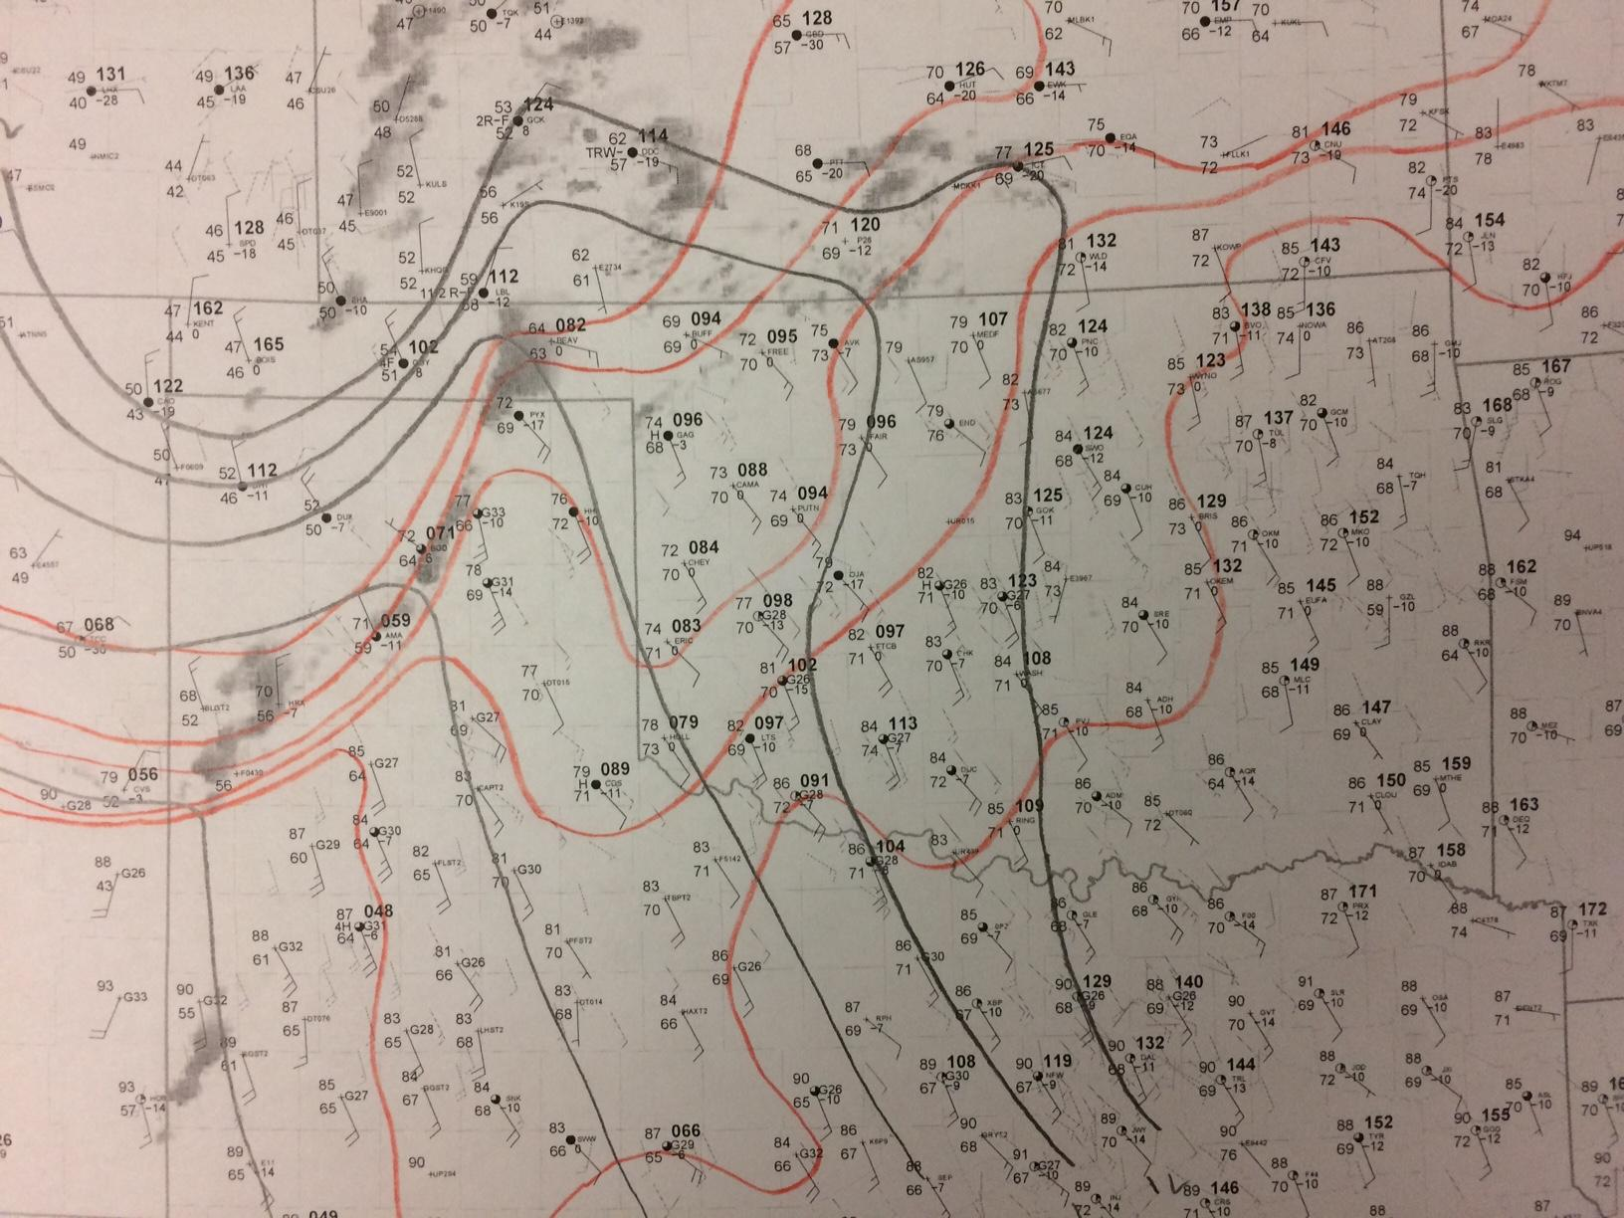

Slide 30
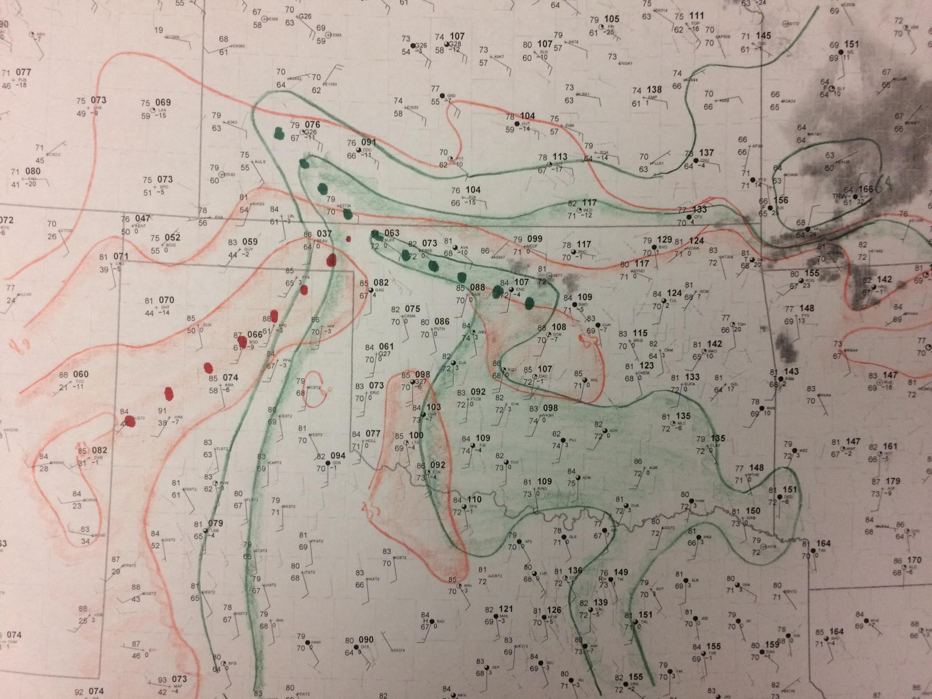
Notes:
dodge city 2016

Slide 31
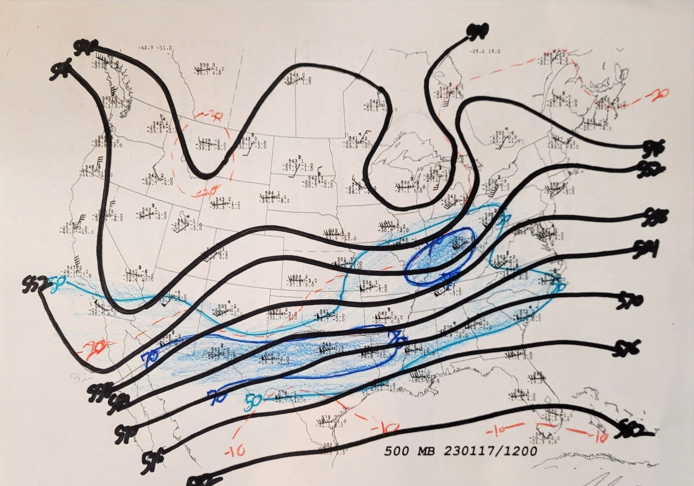

Slide 32
