Slide 1
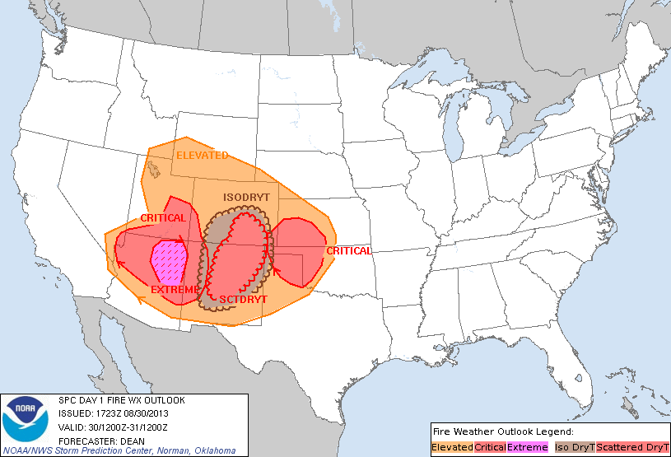
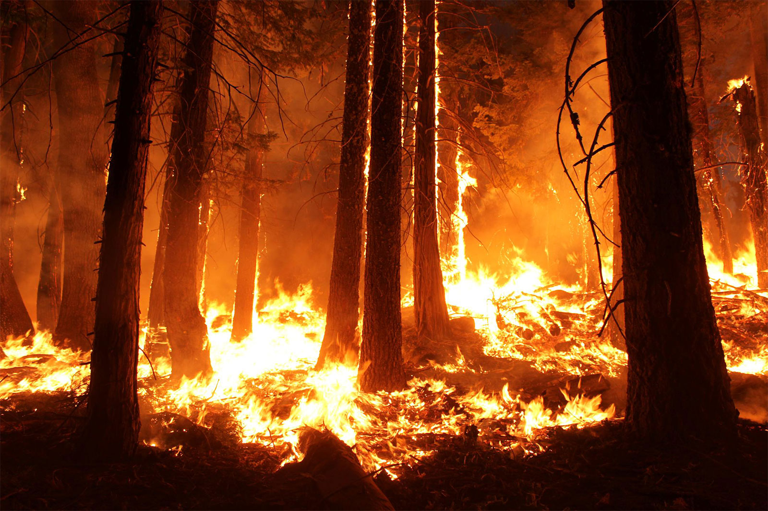
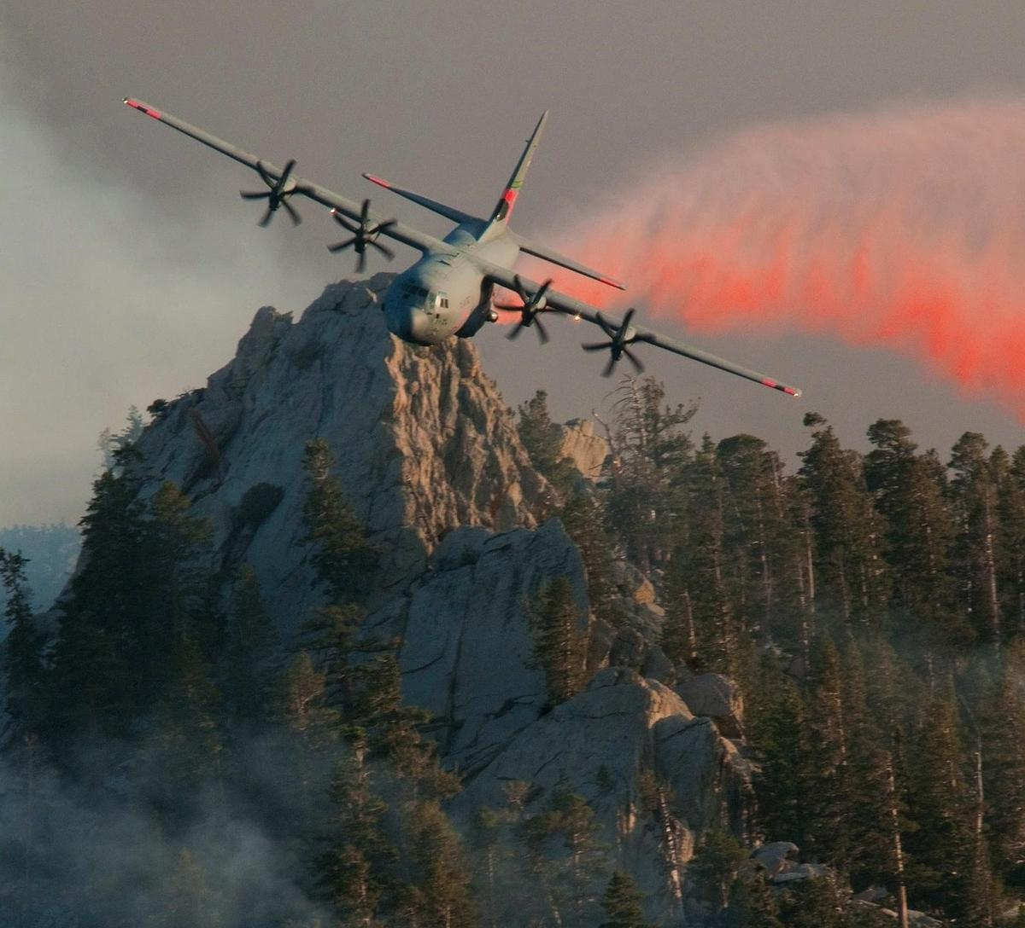
SPC Fire Weather Forecasts

Slide 2
The Basics
Like severe weather, fire weather can be thought of in an ingredients based framework.
Ingredients can take several forms but the most common are:
Low humidity
Low fuel moisture
High winds
Warm temperatures (optional)

Slide 3
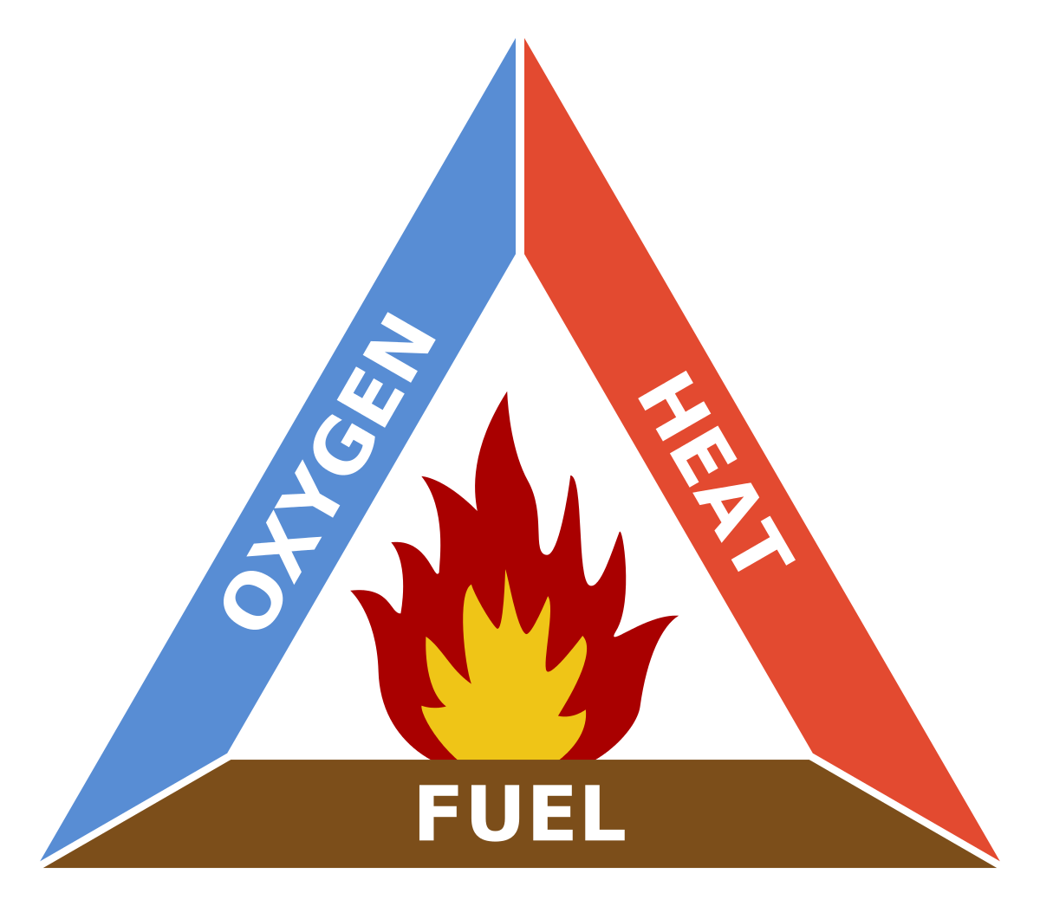
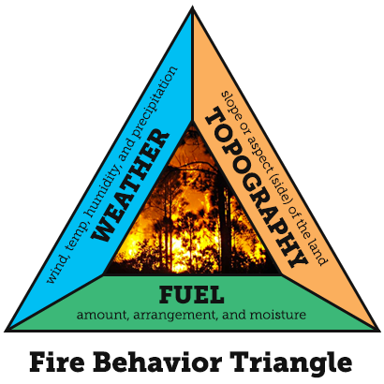
The Two Triangles
Combustion
Fire Behavior

Slide 4
Combustion Triangle
Fire requires heat to raise fuels to their ignition temperature. Cooling fuels can suppress a fire.
Fire needs oxygen to burn, removing oxygen can extinguish a fire
Fire needs something to burn!
If there is no fuel (sticks, leaves, buildings), there can be no fire.

Slide 5
Fire Behavior Triangle
Weather influences:
Fire movement
Plume structure
Probability of ignition
Rates of spread
Topography influences:
Fire movement
Preheating of fuels
Fuel dryness
Fuels influence:
Fire intensity
Rates of spread
Probability of ignition

Slide 6
Topography

Slide 7
Topographic Influence
East Slope:
Warms earlier in the morning
Cools earlier in the evening.
West Slope:
Warms later in the morning
Cools later in the evening.
West Slope
East Slope

Slide 8
Topographic Influence
South Slope:
Receives more sunlight throughout the year*
Leads to drier fuels than other slopes
North Slope:
Receives less sunlight throughout the year*
Leads to more moist fuels than other slopes
South Slope
North Slope
*In the northern hemisphere!

Slide 12
Quiz Time!
I’ll show you a picture - you decide where in the U.S. the picture is from.

Slide 13
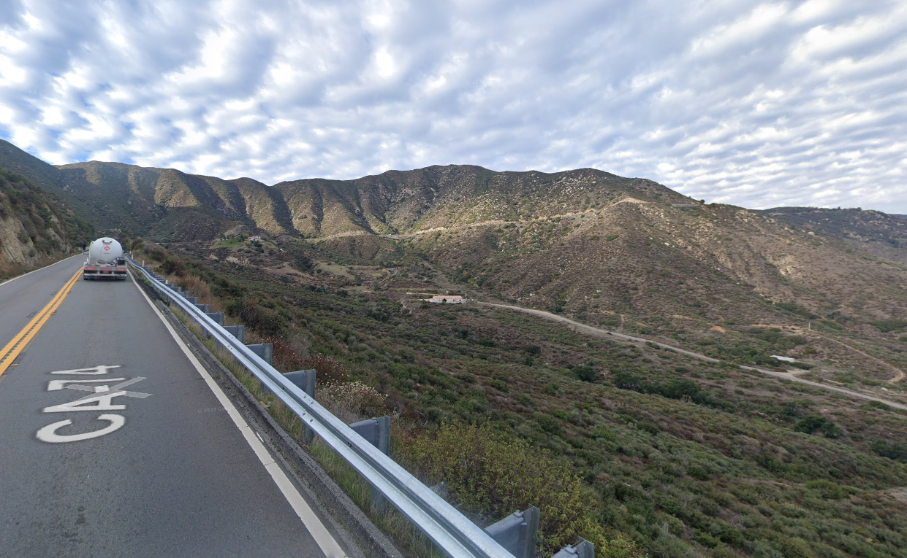
Picture 1

Slide 14
Southern CA

Slide 15
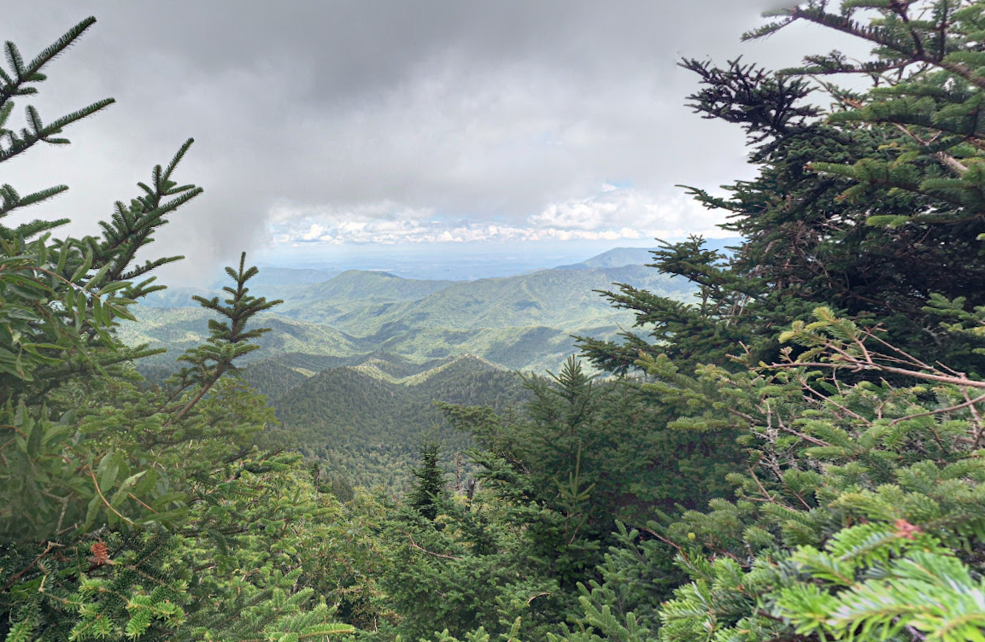
Picture 2

Slide 16
Smoky Mtns. National Park

Slide 17
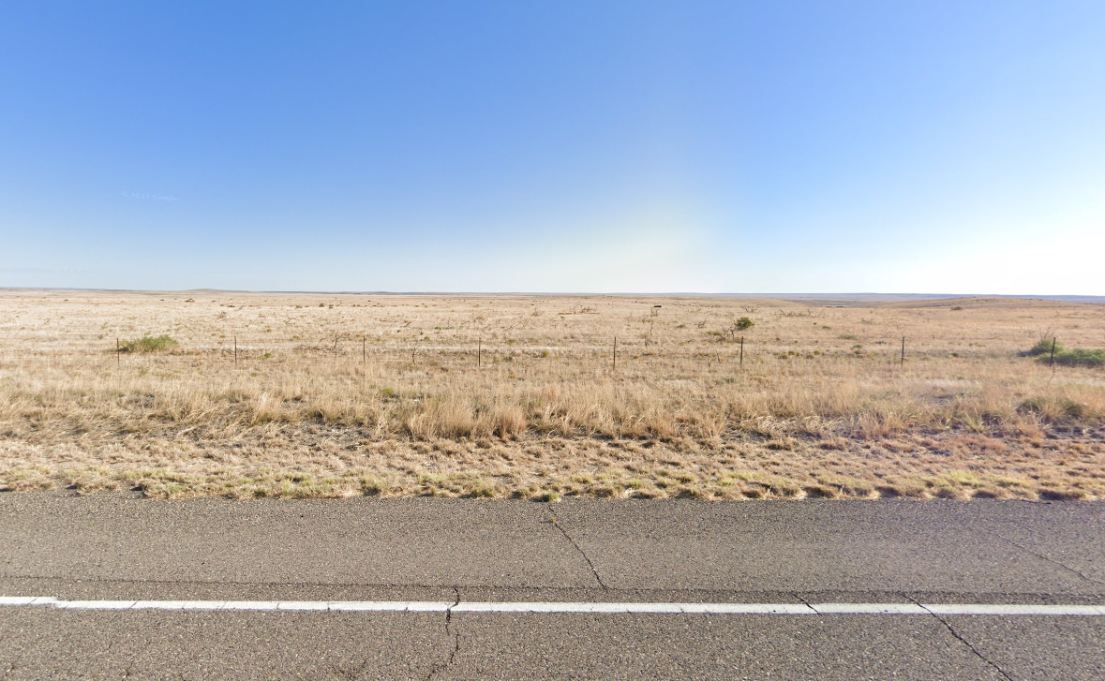
Picture 3

Slide 18
Roswell, NM

Slide 19
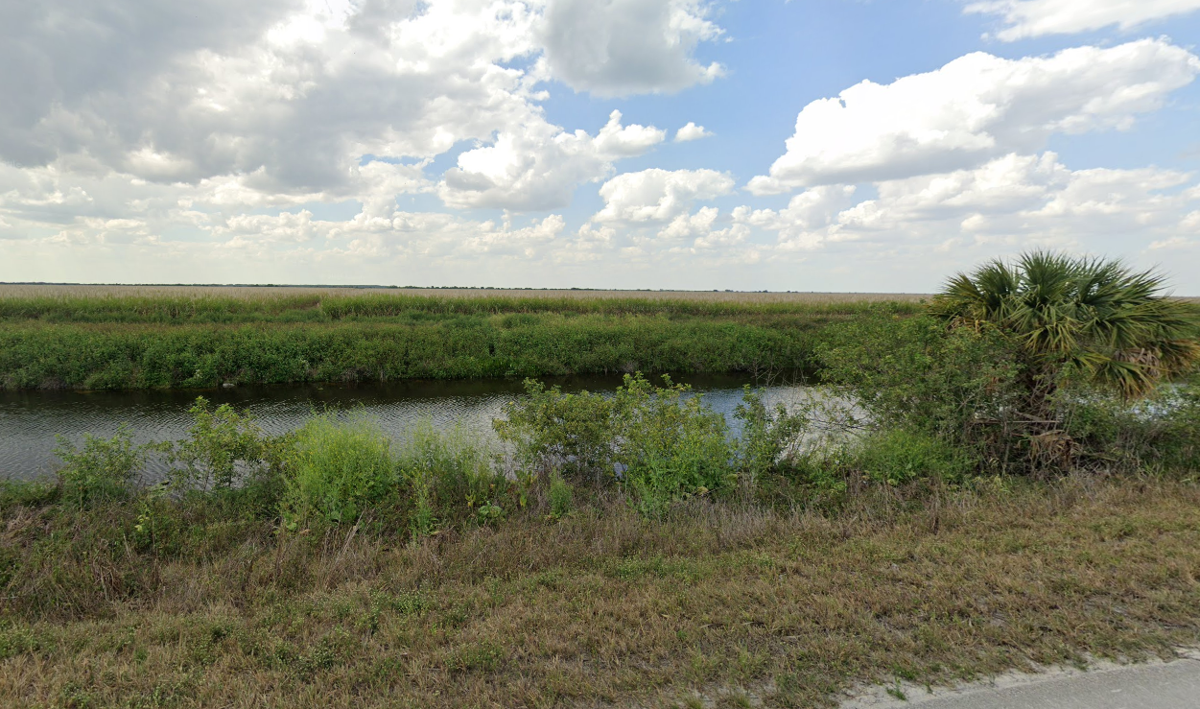
Picture 4

Slide 20
Southern FL

Slide 21
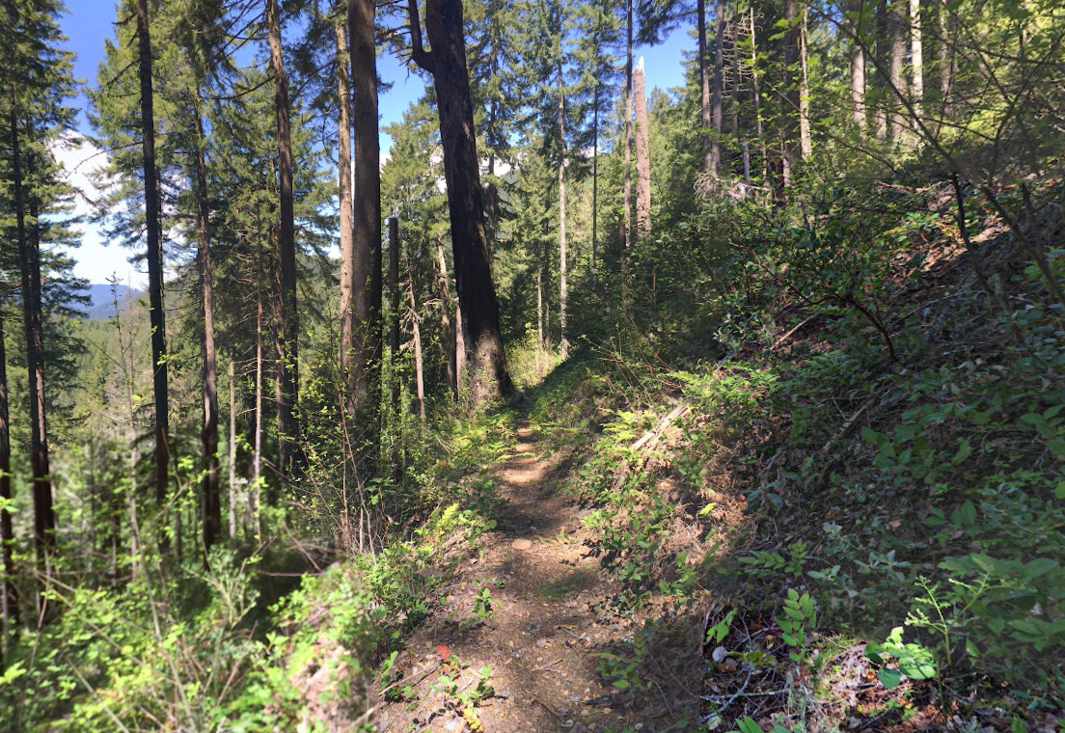
Picture 5

Slide 22
Willamette National Park, OR

Slide 23
Fuels - Will they burn?

Slide 24
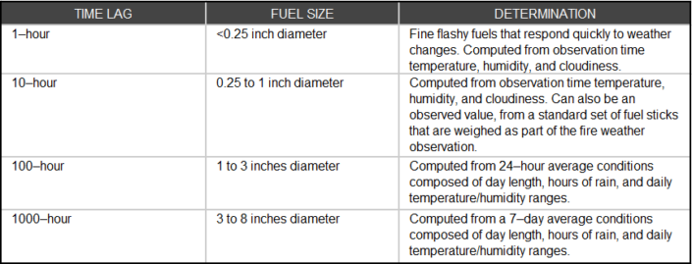
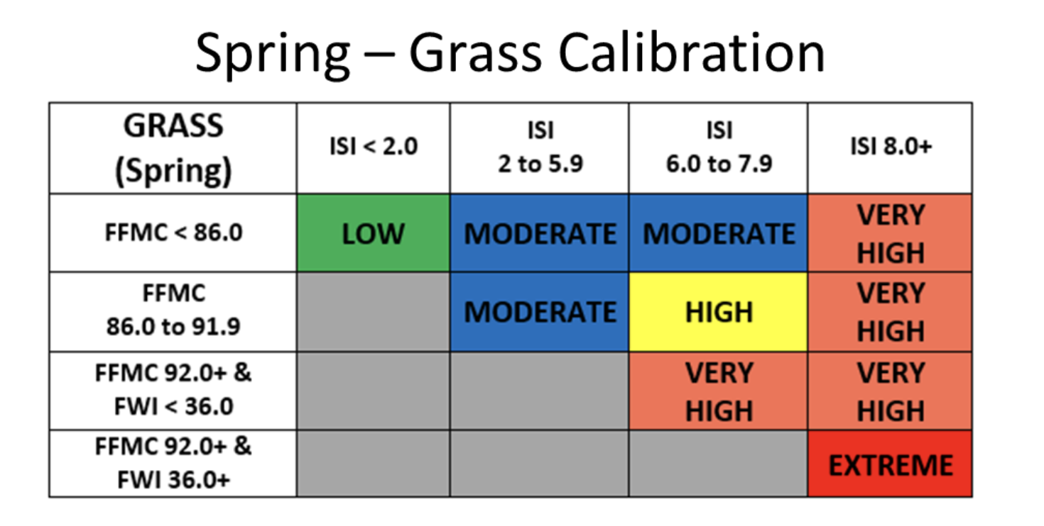
Forecasting Fuels: Fuel Types
A fuel’s time lag classification is proportional to its diameter and is loosely defined as the time it would take for 2/3 (67%) of the dead fuel to respond to atmospheric moisture.
For example, if a fuel had a “1-hour” time lag, one could expect its wildfire susceptibility to change after only 1 hour of humid weather.

Slide 25
Fuel indices
ERC (Energy Release Component)
BI (Burning Index)
Fossberg Index
Haines index
Spread Component (SC)
FFMC (Fine Fuel Moisture Code)
HDWI (Hot Dry Windy Index)
As with severe parameters, use with caution! Composites can lead you astray!

Slide 26
Fire Weather Indices: ERC SC and BI
Energy Release Component (ERC) is a calculated output of the National Fire Danger Rating System (NFDRS). The ERC is a number related to the available energy (BTU) per unit area (square foot) within the flaming front at the head of a fire.
Spread Component (SC) "the spread component is numerically equal to the theoretical ideal rate of spread expressed in feet-per-minute.
Burning Index (BI) is a number used by the National Oceanic and Atmospheric Administration (NOAA) to describe the potential amount of effort needed to contain a single fire in a particular fuel type within a rating area. The National Fire Danger Rating System (NFDRS) uses a modified version of Bryam's equation for flame length – based on the Spread Component (SC) and the available energy (ERC) – to calculate flame length from which the Burning Index is computed.^{[1]}

Slide 27
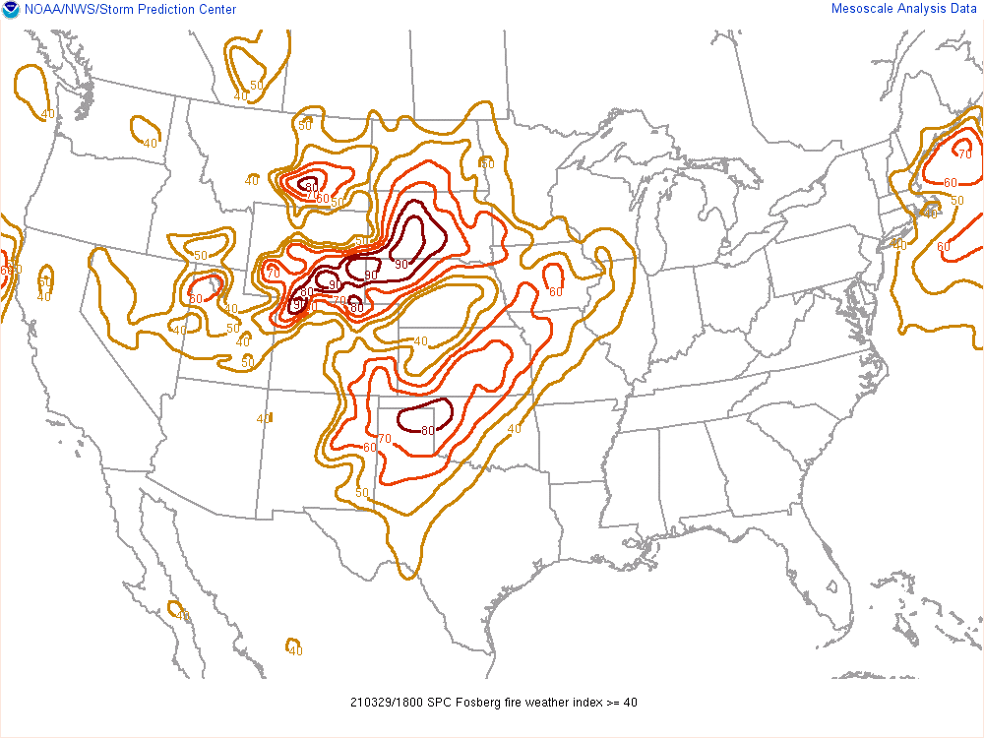
Fire Weather Indices: Fossberg FWI
It is a non-linear filter of meteorological data developed by first transforming temperature and relative humidity to equilibrium moisture content, then transforming the equilibrium moisture content to combustion efficiency. The index is approximated by F = D((Rate of Spread) (Energy Release)) ^0.46
Scaled to represent 0% moisture with a 30 mph wind.
Values of 0-100, greater than 50 is considered significant.
Most commonly used for strong wind driven fire events. (Plains/Southeast)

Slide 28
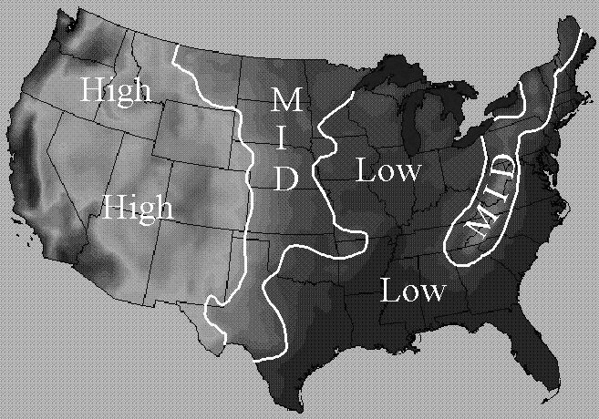
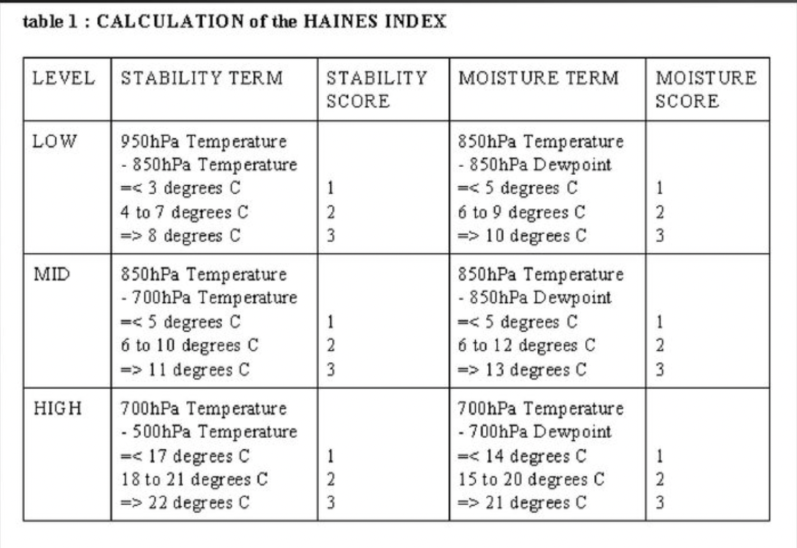
Fire Weather Indices: Haines Index
Haines index is a multi regional fire weather tool used to assess the likelihood of plume dominated fire behavior from atmospheric stability and moisture.
Hi = Stability term + Moisture term
Stability term = T1 - T2
Moisture (Td Depression) Term =T1 - Td1
Each term is scored based on the values. The added scores are the final haines index value.

Slide 29
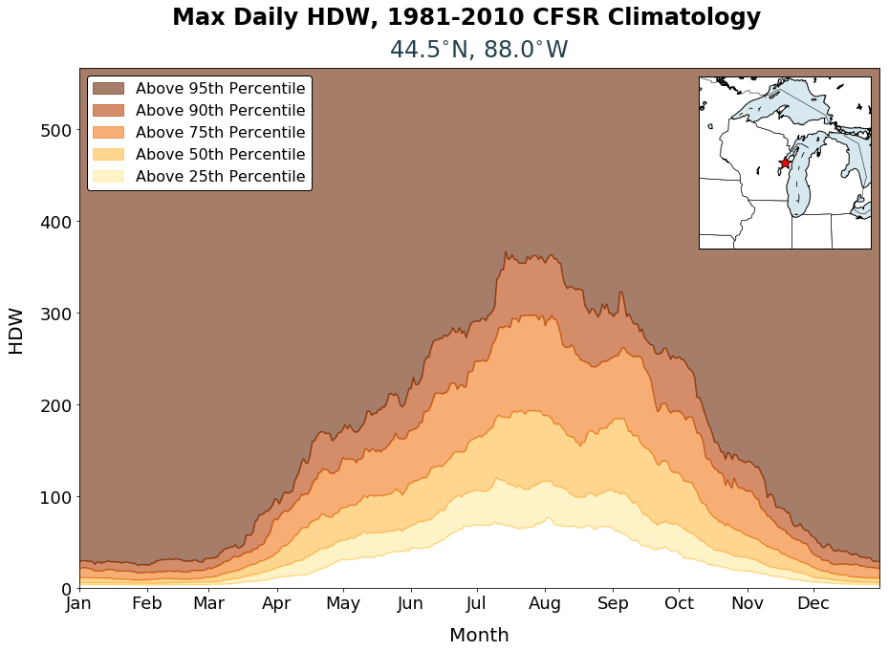
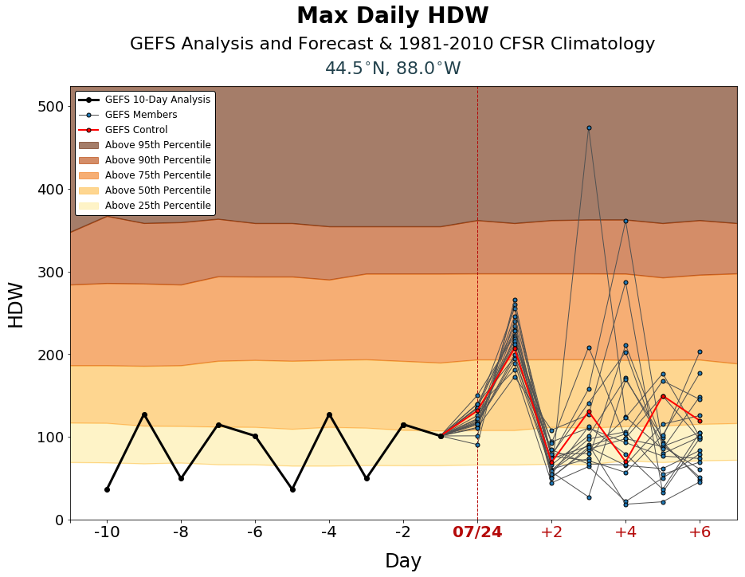
Fire Weather Indices: HDWI Hot Dry Windy Index
“HDW was designed to be very simple – a multiplication of the maximum wind speed and maximum vapor pressure deficit (VPD) in the lowest 50 or so millibars in the atmosphere. Because HDW is affected by heat, moisture, and wind, seasonal and regional variability can be found when comparing HDW values from different locations and times.”
HDW = Wmax * VPD
Wmax = 50 mb max wind
VPD = Es - E Vapor Pressure deficit. Very similar to RH

Slide 30
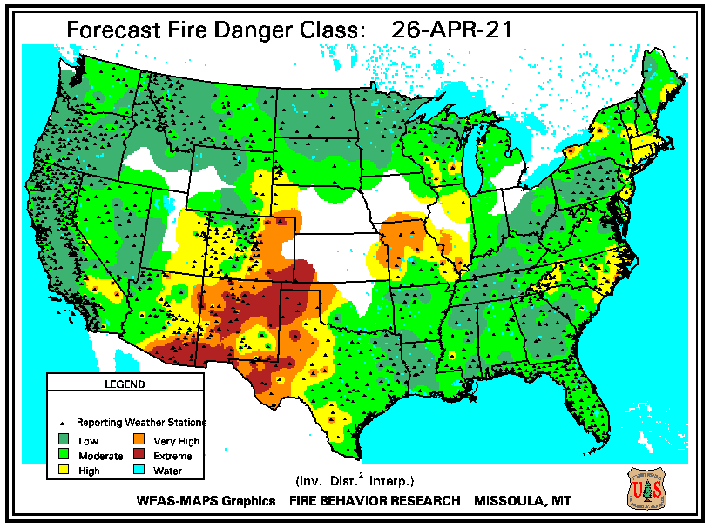
National Fire Danger Rating System (NFDRS)
A fire assessment system used to provide a daily estimate of wildfire risk.
This uses a system of equations with variables that include weather inputs, topography, and fuel types to determine the fire danger category.
Easy-to-interpret categories allow for easier communication of fire risk.

Slide 31
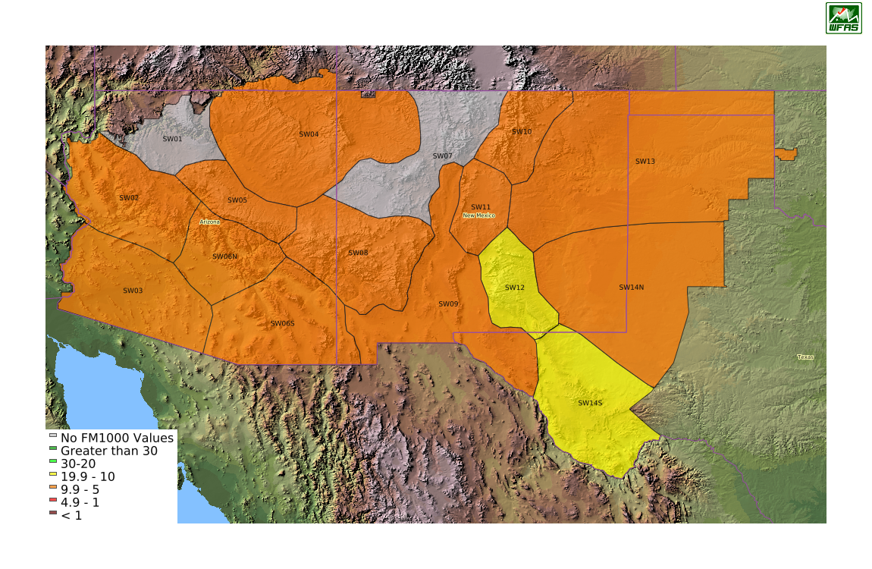
Fine Fuel Moisture Code FFMC
The Fine Fuel Moisture Code (FFMC) represents fuel moisture of forest litter fuels under the shade of a forest canopy.
It is intended to represent moisture conditions for shaded litter fuels, the equivalent of 16-hour timelag. It ranges from 0-101. Subtracting the FFMC value from 100 can provide an estimate for the equivalent (approximately 10h) fuel moisture content.
Most accurate when FFMC values are roughly above 80.

Slide 32
Forecasting Fuels
Geographic Area Coordination Centers predictive service specialists produce fuel and fire forecasts for specific areas of the US.
Controlled by the National interagency Fire Council (NIFC)
Planning levels determine the threat on a scale of 1 to 5.

Slide 33
Basic Fire Weather Forecasting Workflow
The “Big Picture”
Start with a broad overview of the synoptic weather conditions. Know the climo. Find your major features. Do a quick fuels assessment. Look for favorable fuel areas. Get rid of any areas with QPF greater than .25 inches over the last 1-2 days.
1
Narrow your focus
Begin looking for more focused/intense fire weather corridors. Forecast soundings offer a great tool to quickly assess stability and fire danger. Look more closely at the fuels. How dry are they?
2
The details
Really dive into the areas of potential concern. Look for terrain features using land-use maps. FInd the fuel rich areas and assess the conditions over them. HREF and cams can give you powerful details on wind/RH combos. Remember to only draw where fuels can burn. Urban/wilderness interfaces.
3

Slide 34
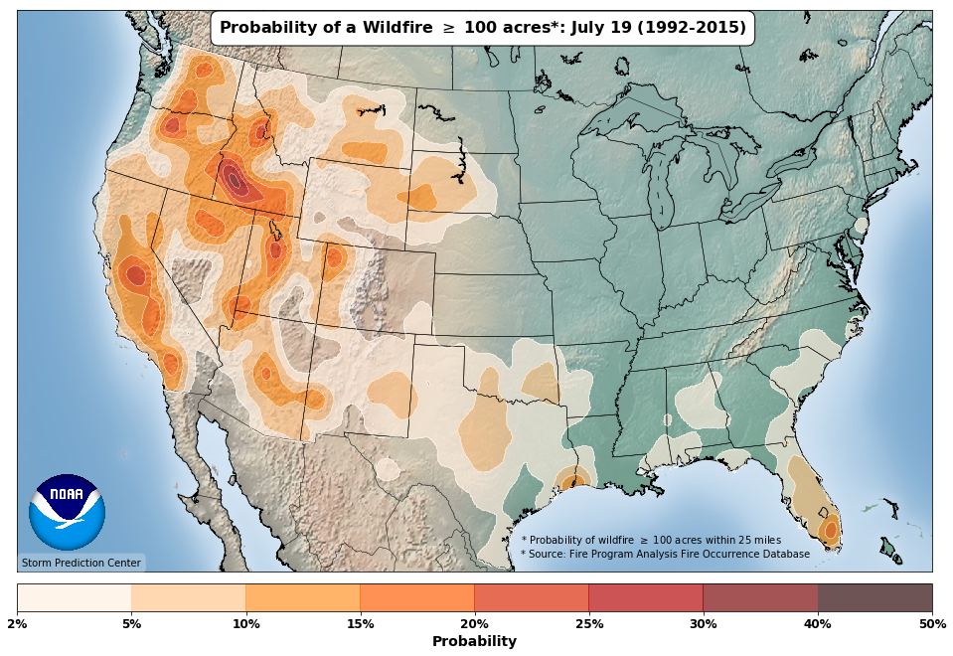
Climatology
When and where do big fires occur?
https://youtu.be/Zr5-H6j9f7A

Slide 35
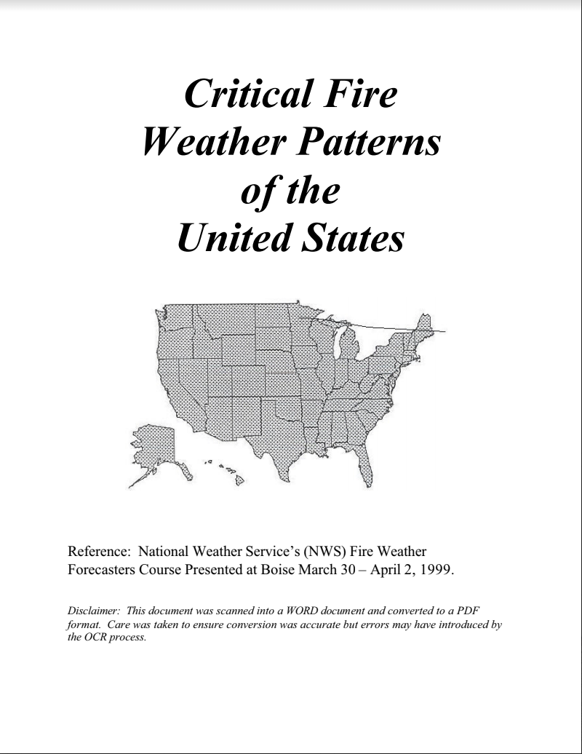
Fire Weather Regimes
See this document for an excellent dive into different types of fire weather patterns.
A variety of fire weather regimes exist across the CONUS.
Every state has some sort of fire weather pattern or response.
Much of the western CONUS is the “big leagues” for fire weather forecasting.
Internationally: Australia, Brazil, Portugal/Spain, Russia, Indonesia, and others are among some of the most active fire weather areas in the world.

Slide 36
Fire Weather Regimes
Keep in mind the fire weather ingredients:
Low humidity
Low fuel moisture
High winds
Warm temperatures (optional)

Slide 37
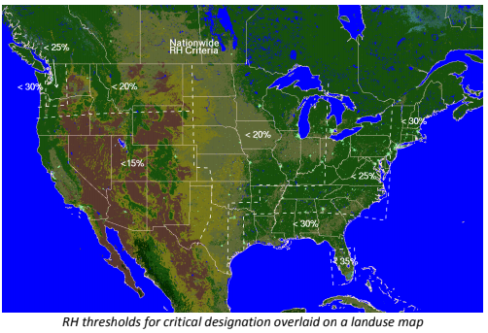
Red Flag Warnings have different thresholds for different areas of the country.
Why?
Variety of fuels
Variety of land use
These differences are driven by:
Terrain
Precip distributions

Slide 38
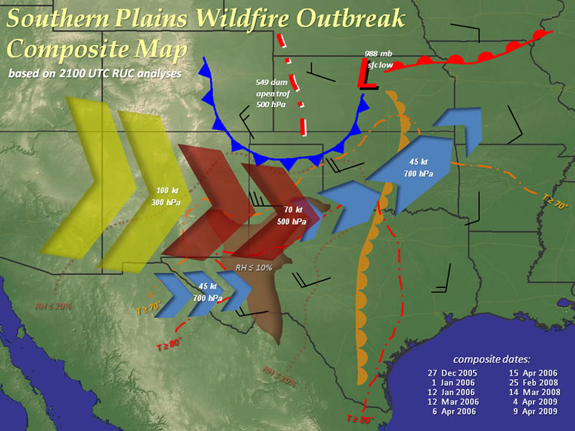
Southern Plains
Dominated by fast moving shrub and grass fires.
Occur ahead of deep 500 mb troughs with strong low and mid-level flow.
Dryline acts as eastward boundary.
Most common during the “pre and post greenup ” periods of late winter/ early spring and early to mid fall.
Western US drought usually a significant predictor.

Slide 39
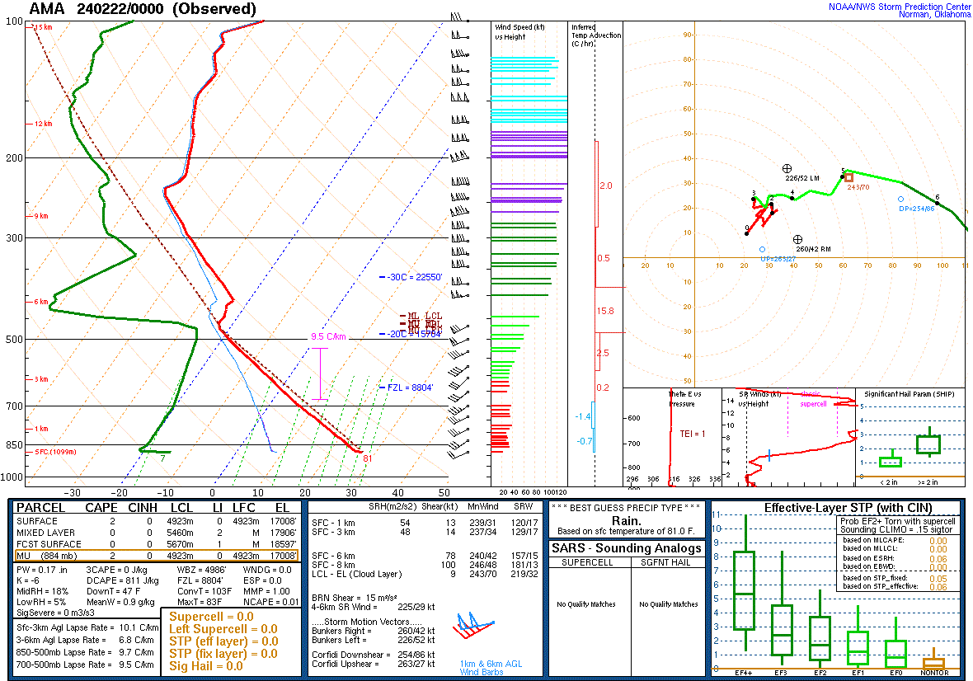
Southern Plains

Slide 40
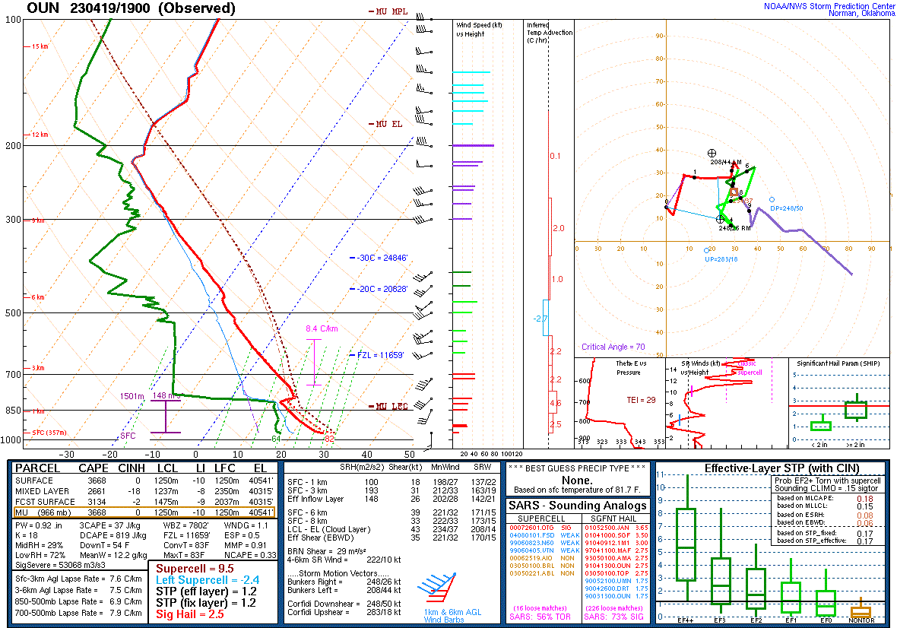
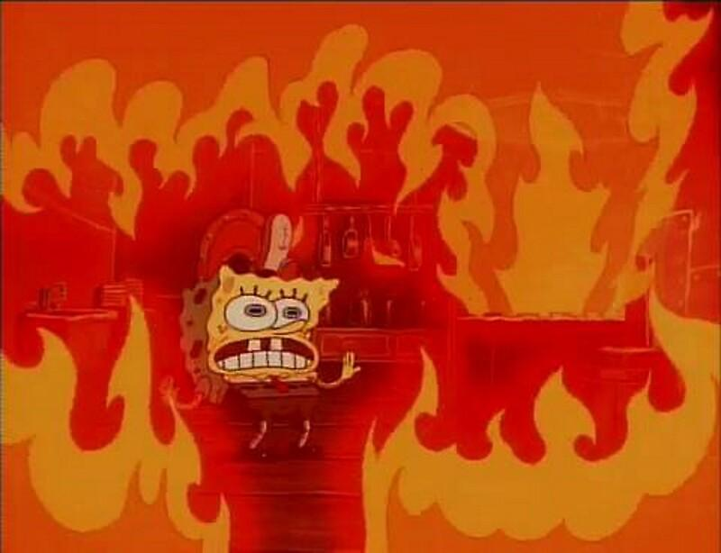
Southern Plains

Slide 41
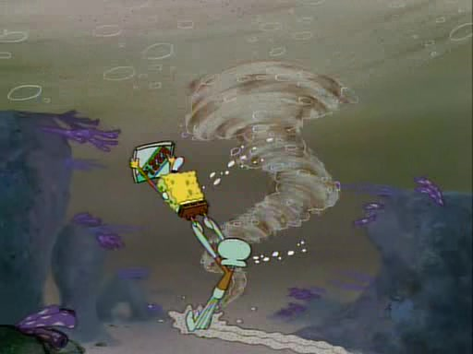
Southern Plains
S. Plains wildfire outbreak regimes are often S. Plains severe weather outbreak regimes!

Slide 42
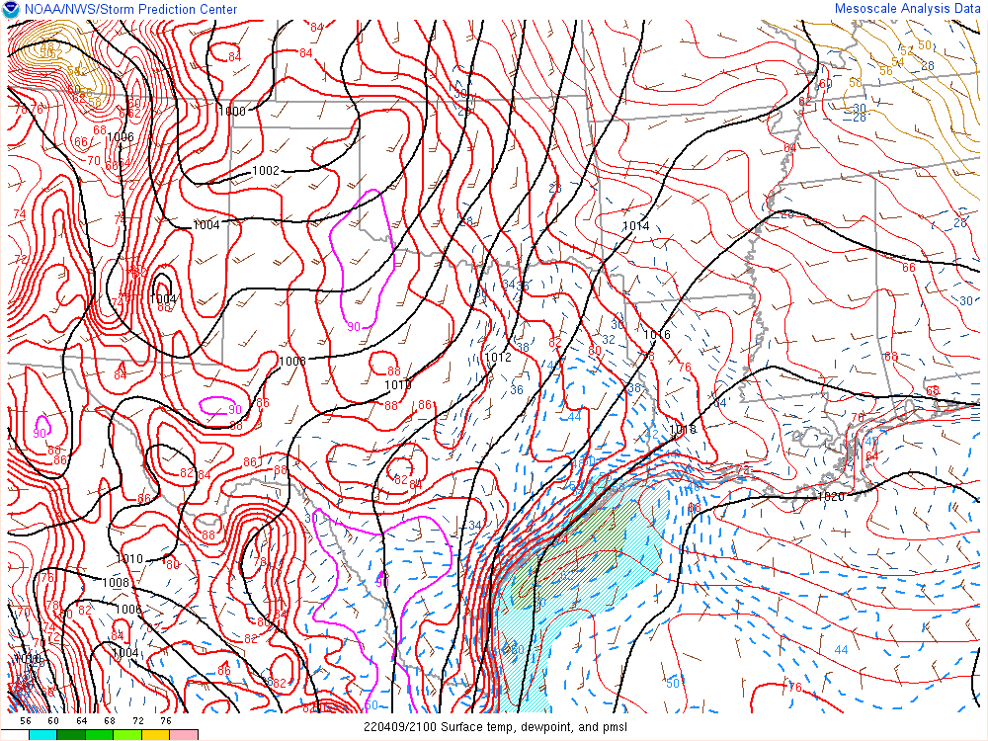
Southern Plains - Dry Return Flow
Dry return flow is characterized by gusty southerly winds across the southern and central High Plains in the absence of deep gulf moisture.
Usually driven by low-amplitude mid-level troughs crossing the Rockies.
Enhanced by lee troughing/cyclogenesis, surface winds of 20-30 mph are common.
Low- level thermal ridge contributes to low RH (<20%)

Slide 43
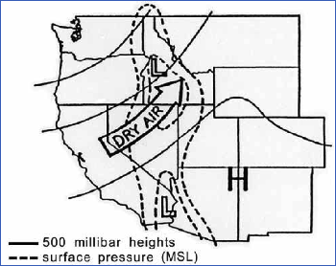
Rockies and Southwest
“Big Bubble no Trouble” -An old forecasterism also known as ridge breakdown
A mid-level ridge is broken down (partially or fully) by an advancing shortwave trough.
A deceptive pattern with important implications for fire potential.
Winds aloft may not be that strong.
Quiescent but hot weather
Dry frontal passages
Dry Thunderstorms and gusty outflow
Very common throughout summer and early fall before and after Monsoon.

Slide 44
Southeastern U.S.
Northerly winds behind a cold frontal passage ushers in drier air.
Relative Humidity values may be higher than you would expect (30-40%)
Winds may be lighter than normally expected (15-20 mph)
20%
L
30%
40%

Slide 45
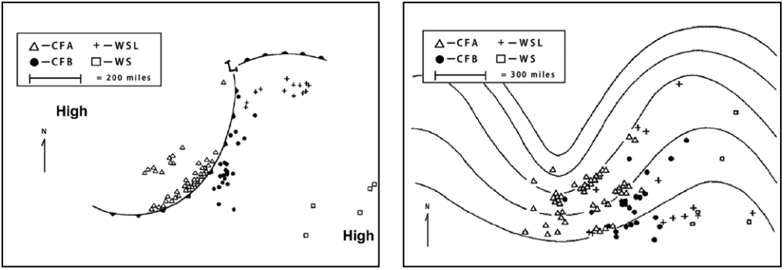
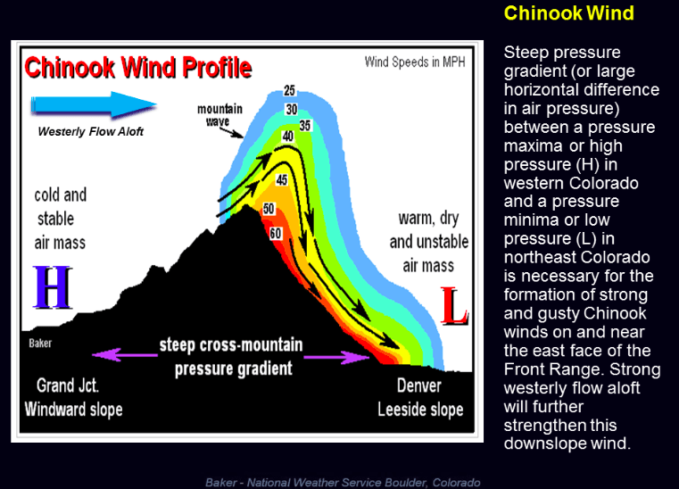
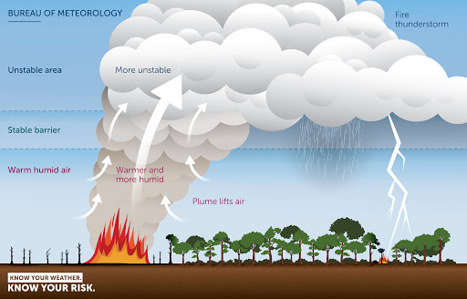
Smaller-Scale Details

Slide 46
Dry Cold Fronts
Cold fronts producing very little rainfall but strong wind shifts.
Common across the western US and southern Plains.
Can cause rapid fire spread/spotting.
South Canyon Fire (Storm king Mountain Colorado burnover 14 smoke jumpers killed )

Slide 47
Dry Cold Front Fire Direction Changes
Fire spread

Slide 48
Dry Cold Front Fire Direction Changes
Fire spread

Slide 49
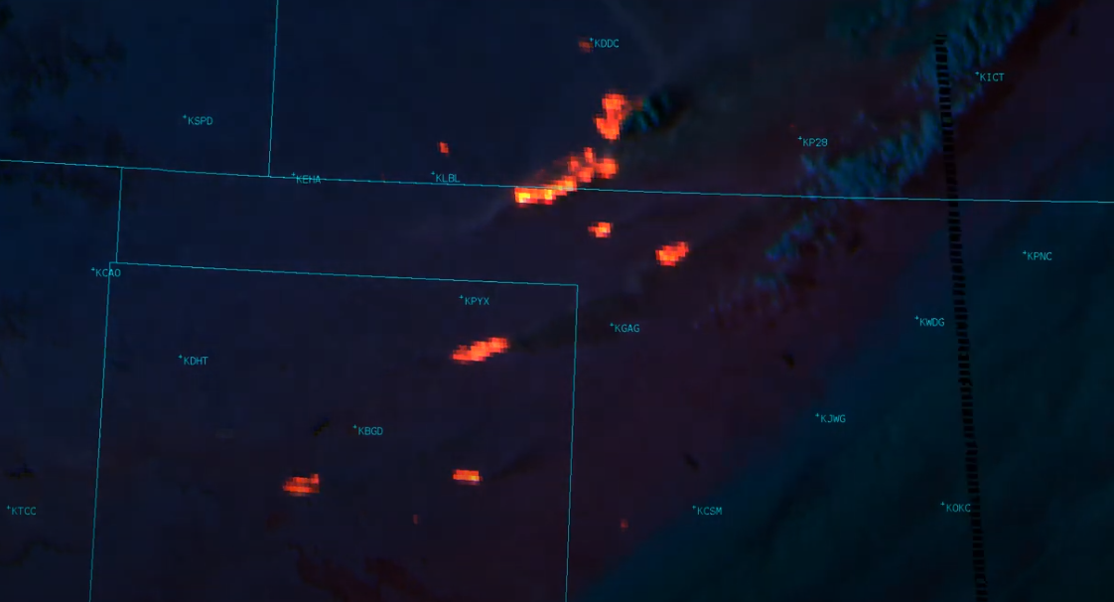
Dry Cold Front Fire Direction Changes
March 6-7, 2017 S. Plains Wildfire Outbreak
https://www.youtube.com/watch?v=h11A0zbCrM0&t=1s

Slide 50
Lee of the Rockies
Downslope winds
Common through Colorado Wyoming and Montana.
Weaker during the summer when flow retreats northward but early/ late Season Events (Aug-Oct & May-June) can drive very strong wildfire events.
Winds may exceed 150 mph through terrain gaps and at ridge top level.

Slide 51
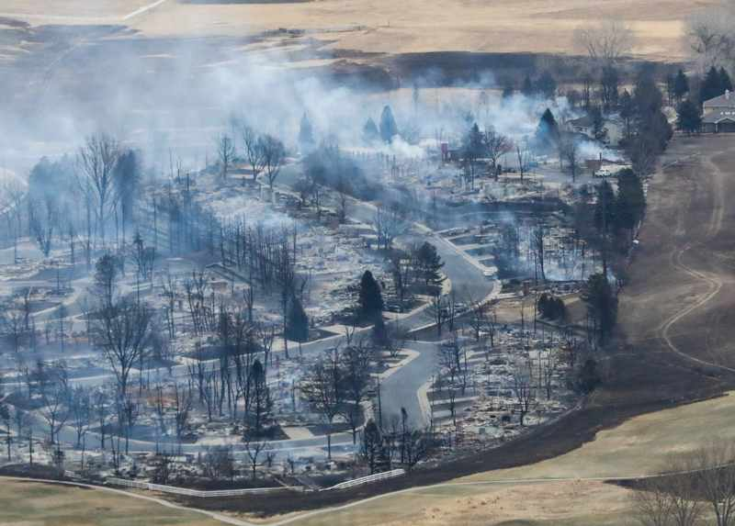
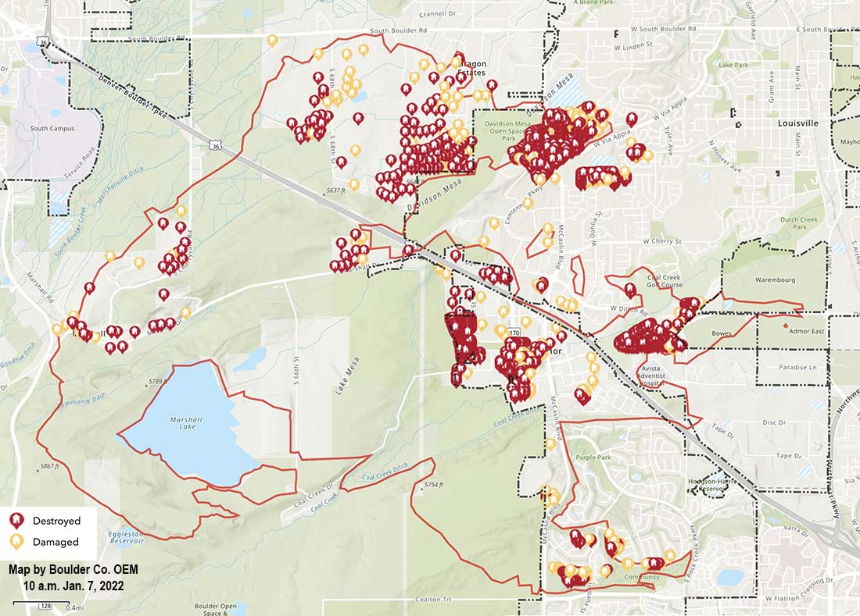
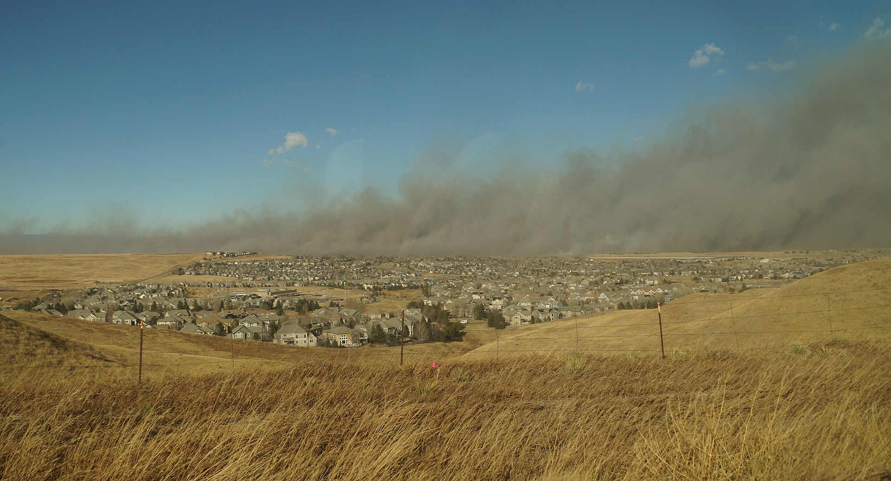
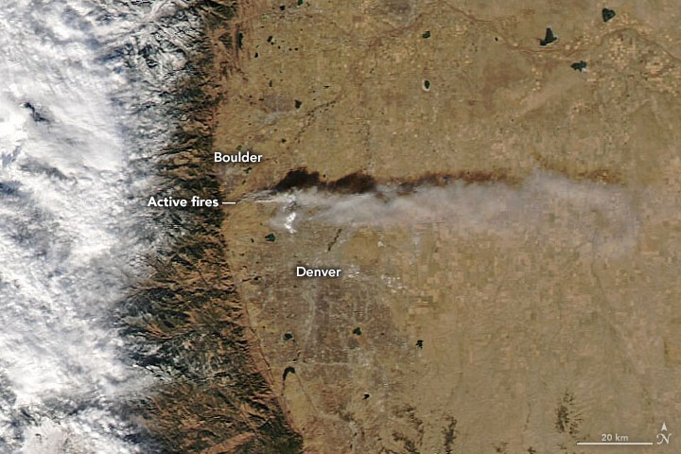
2022 Marshall Fire boulder County, CO
Unusual time of year Dec 31-Jan downslope wind storm gusts to 115 mph supported rapid spread.
$513+ million in damages.
1k structures destroyed and 6k acres 2 fatalities.
Most damaging fire in CO history after only 12 hours.
Exacerbated by expanding Wildland Urban Interface and poor open space management practices.

Slide 52
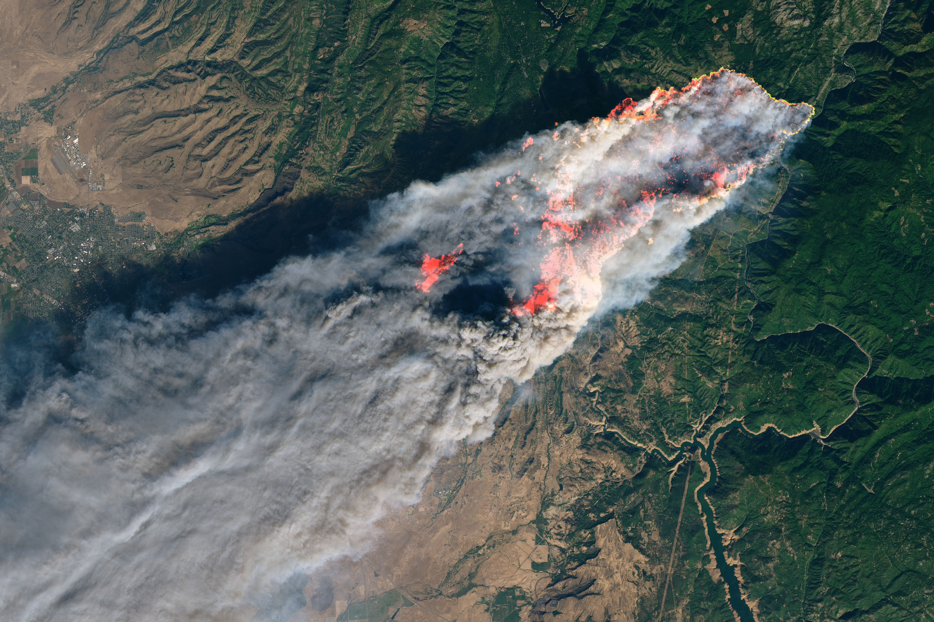
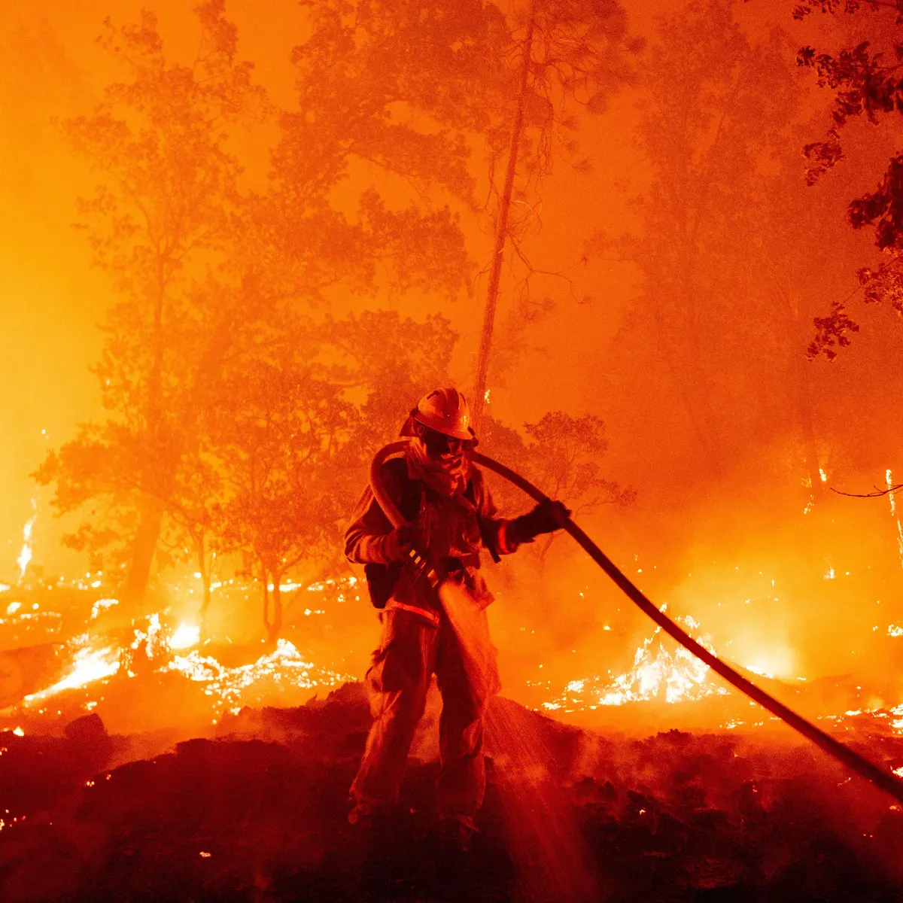
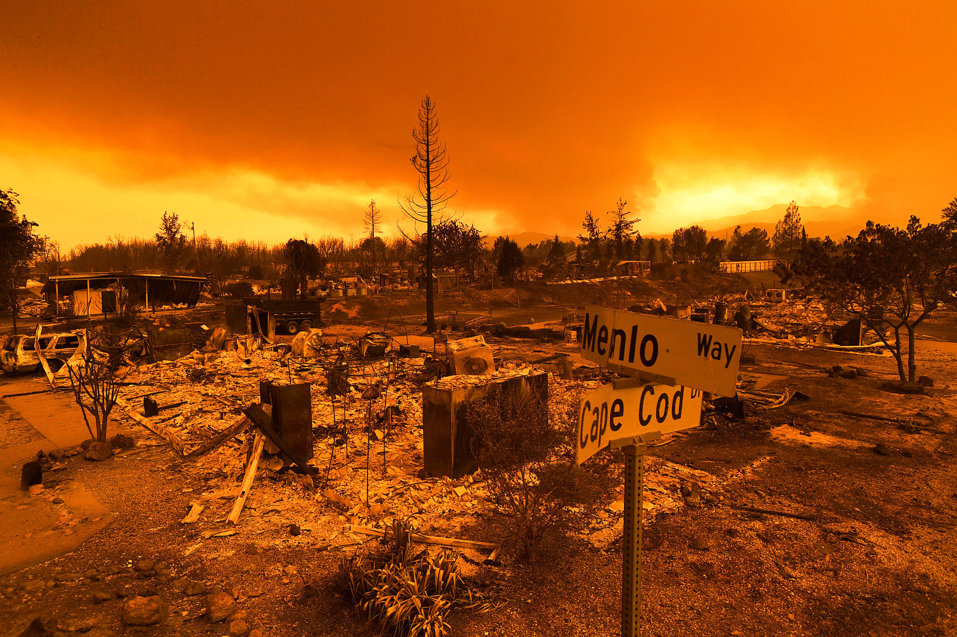
California

Slide 53
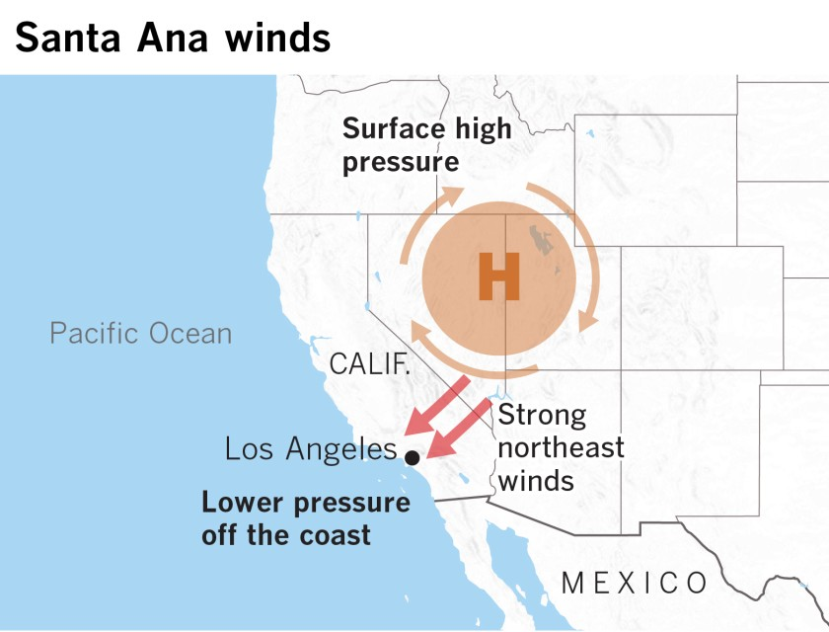
Santa Anas
A localized type of Foehn wind driven by offshore pressure gradients.
Adiabatic drying and advective drying over the Great Basin produce extremely low RH as low as 1-3%
Winds may exceed 80 mph through terrain and gaps.
Extreme fire behavior develops as a combination of very combustible fuels and extreme winds.
L

Slide 56
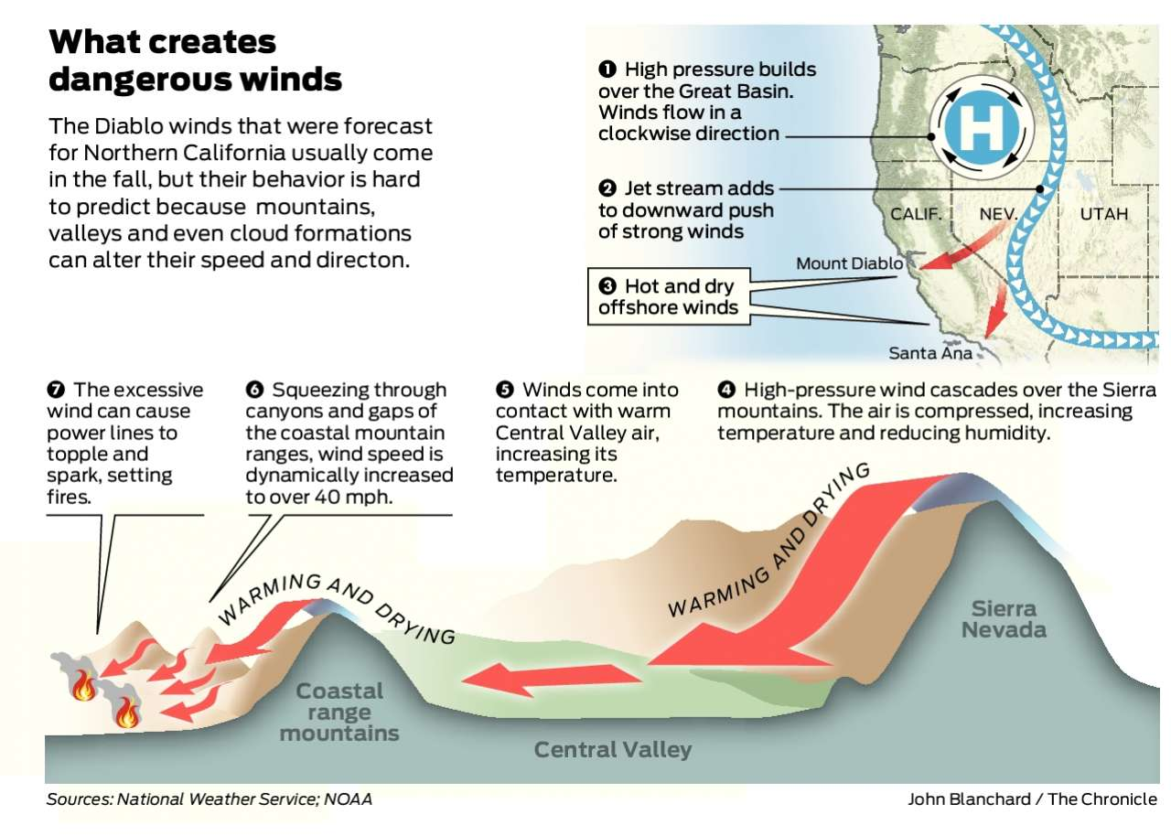

Slide 57
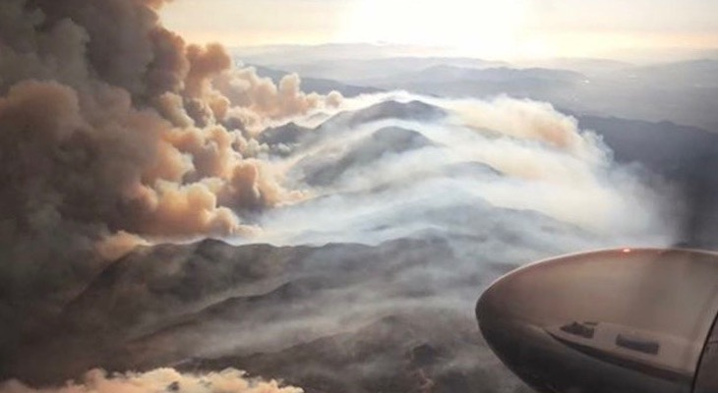
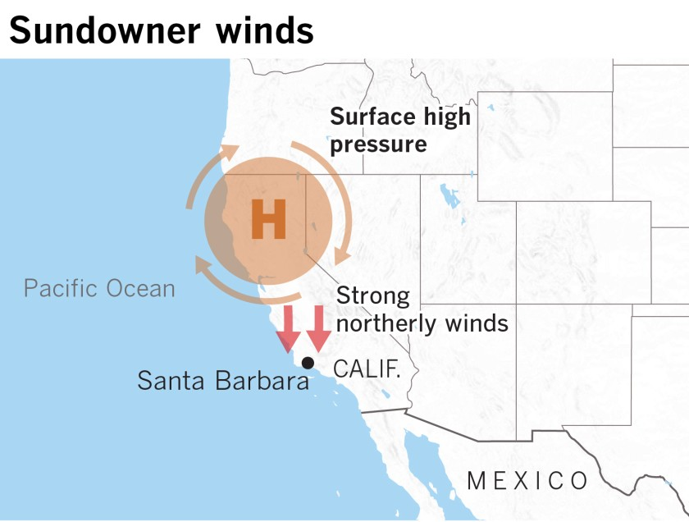
Sundowners
Special case of Santa Ana winds with an offshore low
Small but very impactful area with high population
L

Slide 58
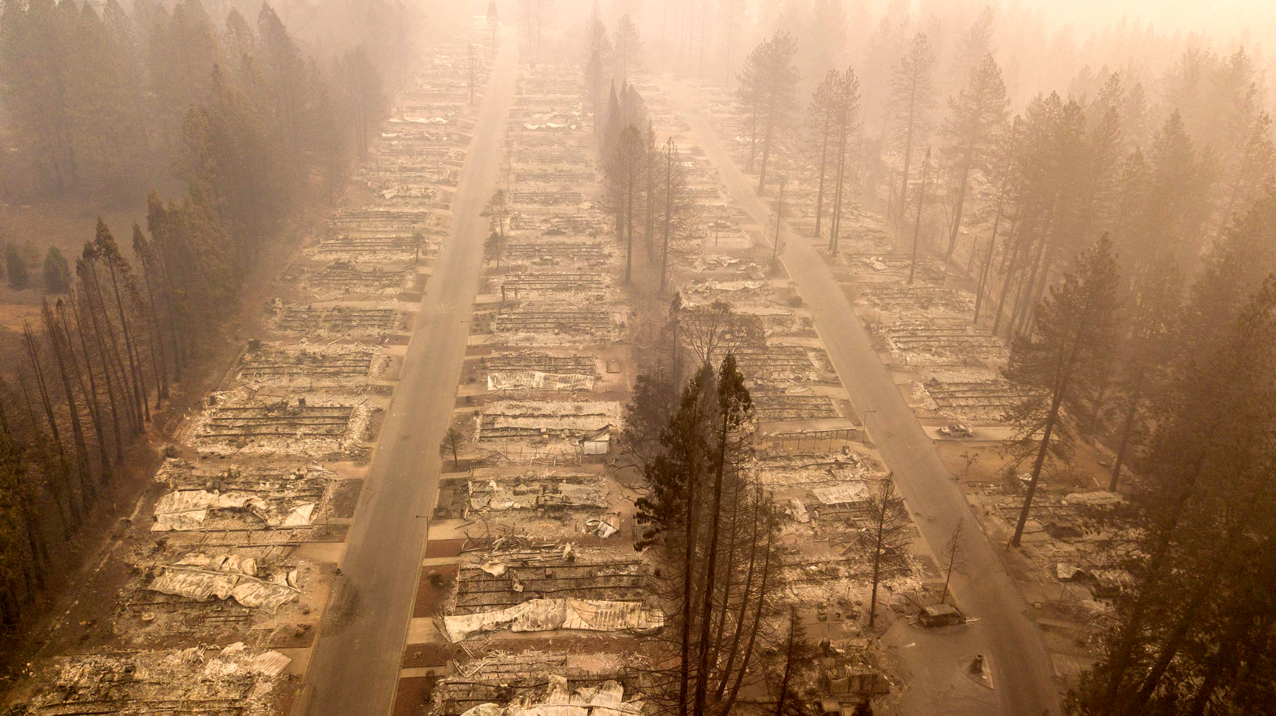
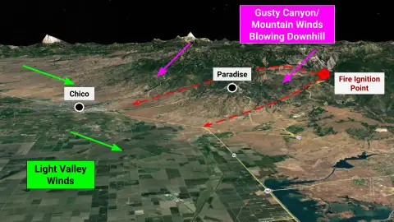
Camp Fire Nov 2018
153,000 Acres
18,000 Buildings Destroyed
85 Fatalities $16.5 Billion

Slide 59
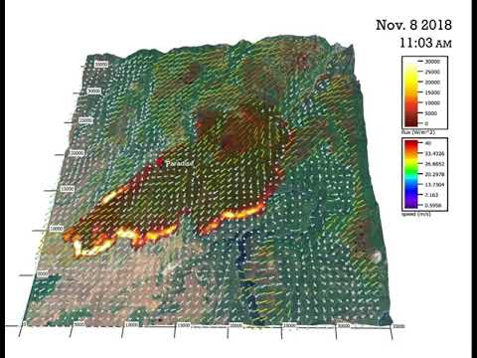
https://www.youtube.com/watch?v=dyfJYOZgiyA

Slide 60
“Plume Dominated” vs “Wind Driven” events
Prototypical fire regimes are often characterized by warm temperatures, low relative humidity, and strong boundary-layer winds. AKA “Hot Dry Windy”
Low RH cures fuels by increasing the potential energy of a material. High winds bring oxygen and spread flames/sparks creating spot fires. Literally fanning the flames.
Just like thunderstorms atmospheric instability can also drive fire weather. Hot dry and unstable conditions can be just as dangerous as hot dry and windy.
Fires can create their own environment from strong buoyant updrafts collapsing and reforming.
Plumes can loft embers for miles and create strong inflow/outflow winds on collapse leading to long range spotting, new fires, and rapid burnovers.

Slide 61
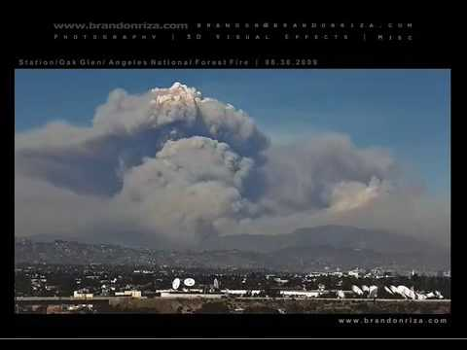
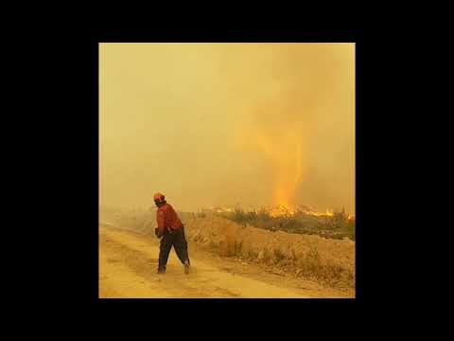
Pyro Cumulus

Slide 62
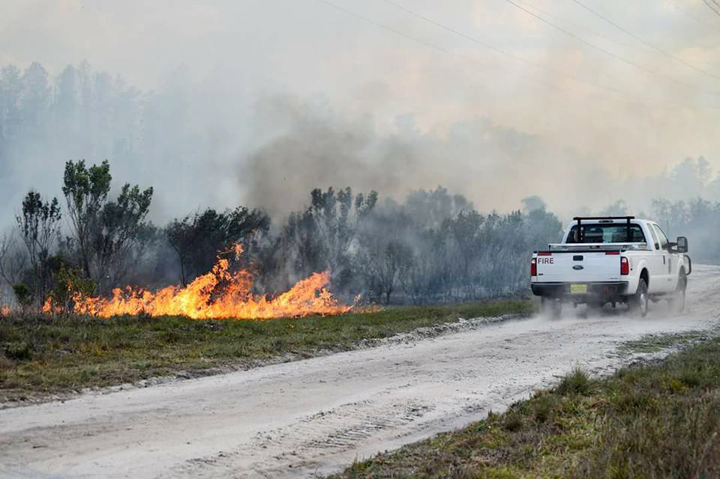
Other less common patterns
In the northern plains, Great Lakes, and the northeastern US, pre-frontal high pressure from the Pacific, Northwestern Canada, and Hudson Bay all can produce very dry conditions. Cold fronts produce relatively short lived periods of high winds and instability that can produce extreme fire behavior.
In the southeastern US, drought is frequently associated with the La Niña state of the southern oscillation pattern or a blocking ridge aloft near the Atlantic coast. Often critical weather patterns follow the frontal passage that brings extremely dry air due to a strong westerly or northwesterly flow. Look for strong winds that accompany the flow. Beware of advancing tropical storms as well as sea breeze boundaries across Florida.

Slide 64
Dry Thunderstorms
A fast moving or high based thunderstorm producing cloud to ground lightning and less than 0.10 inches of precipitation accumulation in 1 hour.
Lightning ignitions account for a significant fraction of wildfires.
Climate change suggests dry thunder/lightning ignition outbreaks may increase.

Slide 65
Dry Thunderstorms
Deep and dry boundary layer. As much as 5-600 mb!
Mid Level moisture advection results in destabilization. PW values of 0.5 to 0.75 inches most common
Low CAPE and low shear (storms move slowly)
Mixed storm modes most frequent

Slide 68
Yarnell Hill Fire
June 30, 2013
Ignited by dry lightning
Erratic behavior on June 30th due to outflow winds

Slide 69
SPC Fire Products
Fire Weather Outlooks
The Fire Weather Outlooks are intended to delineate areas of the continental U.S. where pre-existing fuel conditions, combined with forecast weather conditions during the next 8 days, will result in a significant threat for the ignition and/or spread of wildfires. This product is designed for use in the NWS, as well as other federal, state, and local government agencies.
Each outlook consists of a categorical forecast that graphically depicts fire weather risk areas across the continental United States, along with a text narrative. Through various labels and colors on the graphic, the five types of Fire Weather Outlook risk areas are:
ELEVATED (orange) - Elevated risk from wind and relative humidity
CRITICAL (red) - Critical risk from wind and relative humidity
EXTREME (magenta) - Extremely Critical risk from wind and relative humidity
ISODRYT (brown) - Elevated risk from dry thunderstorms
SCTDRYT (red) - Critical risk from dry thunderstorms

Slide 70
September 2nd 2020 Montana fire outbreak

Slide 76
Wrap Up
Fire weather can be thought of in an ingredients based framework.
Fuels are one of the most important but difficult aspects of forecasting.
Forecasting should follow a similar flow to severe weather.
Big Picture
Narrow your focus
The details
Fire weather regimes vary widely across the CONUS.
Fire weather is one of the most difficult and poorly understood aspects of severe weather forecasting.

