Slide 1
Mode of Convection
METR 4403/5403 – Spring 2024

Slide 2
Mode and Environment Conditions
Ordinary thunderstorm, multicell storms, and supercells
Environment conditions (CAPE and shear) influence convective mode
Vertical wind shear:
has greatest influence on thunderstorm structure and behavior (mode)
acts to promote longevity and organization of thunderstorms
0–6 km bulk shear is most common measure (but it neglects details in hodograph that matter!)
< 10 m s⁻¹ weak
10–20 m s⁻¹ moderate
> 20 m s⁻¹ strong
MR (2010), Fig. 8.1

Slide 3
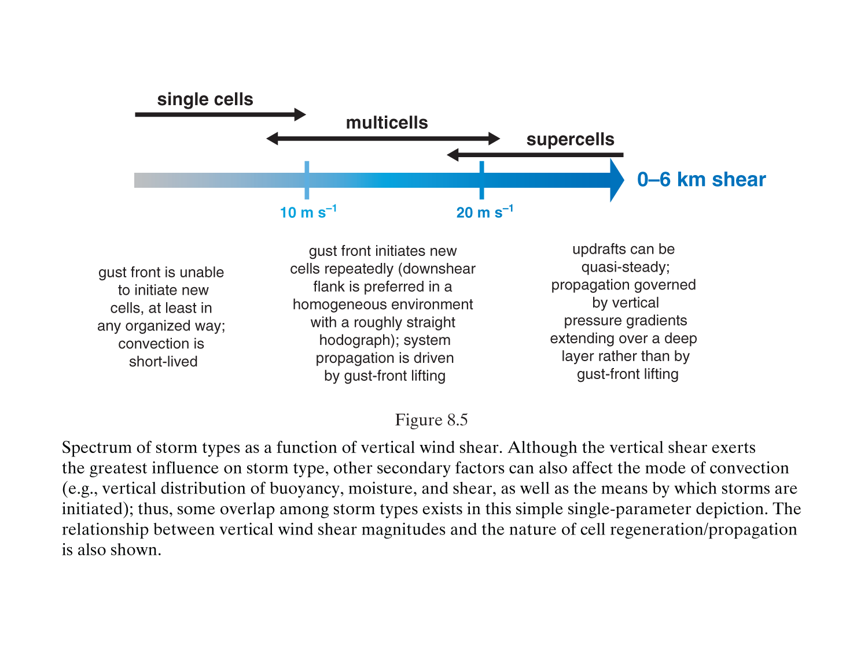
MR (2010)

Slide 4
Importance of Vertical Shear
Interference between precipitation and updraft is reduced as vertical shear increases
Precipitation falls downwind of updraft
Strong storm-relative winds aloft blows precipitation away from updraft core
Storm-relative inflow at low-levels can slow speed of gust front, limiting its ability to undercut updraft
Weak shear
Strong shear
Dynamic pressure effects via vertical PGF in shear can produce strong lifting
MR (2010), Fig. 8.2

Slide 5
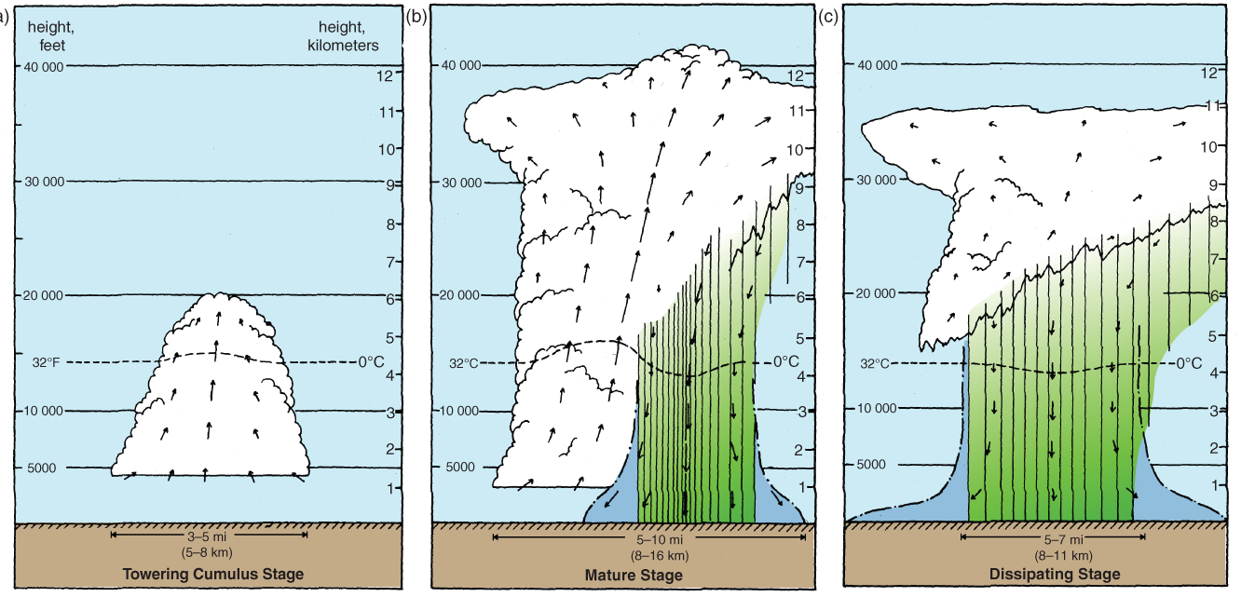
Ordinary Thunderstorm (single cell)
H=scale height
w₀=average updraft speed
v_{t}=terminal velocity of precipitation
Time for precipitation produced by ascent to fall to ground
Time for air to ascend from surface to EL
Life cycle:
Towering cumulus (only updraft)
Mature (precipitation falls into updraft, downdraft and gust front forms, anvil forms)
Dissipating stage (downdraft cuts off updraft; orphan anvil)
MR (2010), Fig. 8.8

Slide 6
5
10
15

Slide 7
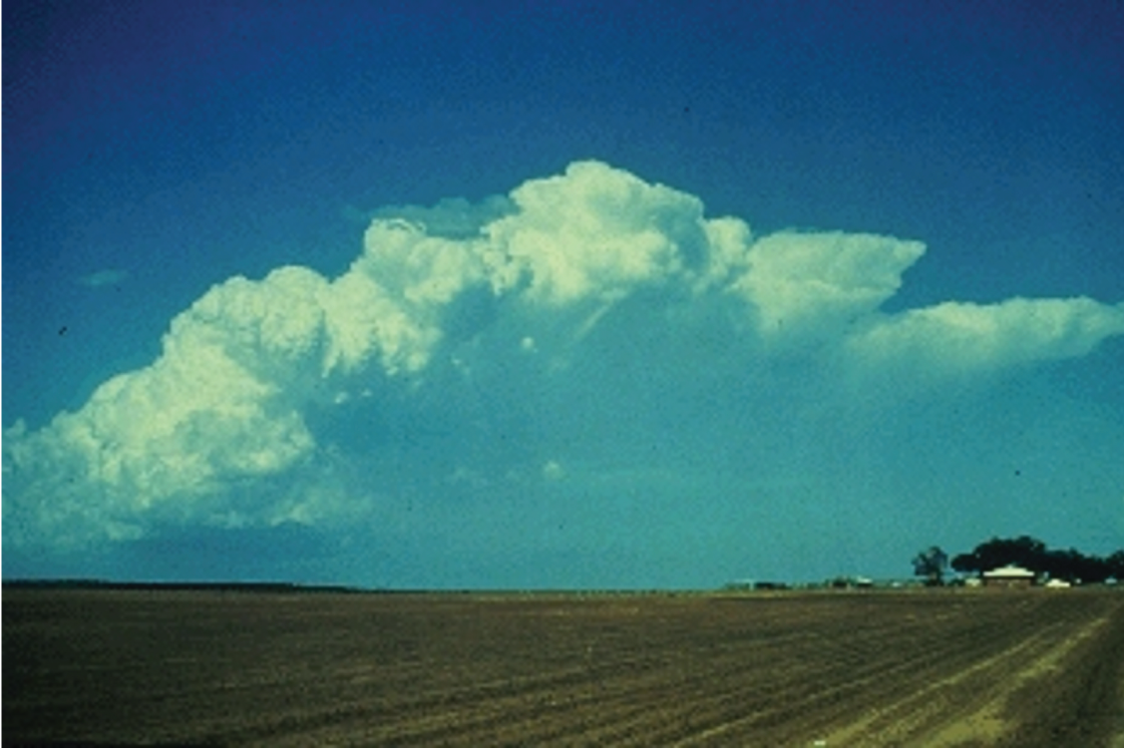
Multicell Convection
Characterized by repeated development of new cells along the gust front
Longer-lived cluster of storms in moderate vertical shear and small to large CAPE
Individual storms in cluster may be ordinary, lasting 30-60 mins
In high CAPE moderate shear, multicell convection can produce swaths of damaging winds and hail
Cell 3
Cell 4
Cell 2
Cell 5
Cell 1
MR (2010), Fig. 8.9

Slide 8
Evolution of Multicell Convection
Mean wind=0
Individual cells move with the mean wind averaged over their depth
New cells initiate along gust front
@ Time 0:
Cell 1 – dissipative stage
Cell 2 – mature stage
Cell 3 – precipitation beginning to form
Cell 4 – towering cumulus stage
@ Time 10:
Cell 1 – orphan anvil
Cell 2 – dissipative stage
Cell 3 – mature stage
Cell 4 – precipitation beginning to form
Cell 5 – towering cumulus stage
@ Time 20: …and so on.
propagation
MR (2010), Fig. 8.11

Slide 9
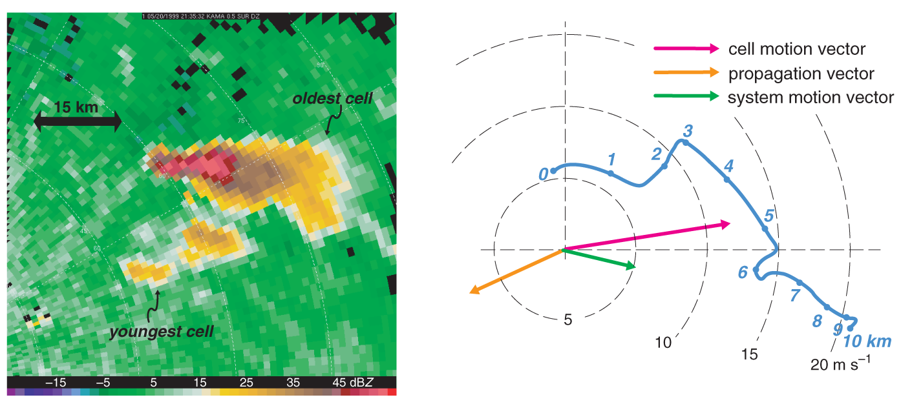
Movement versus propagation
Individual cells move with the mean wind
Repeated development of new cells on flank of system leads to propagation of system
Total motion is cell motion+propagation
New cells develop on gust front on downshear side of cold pool
MR (2010), Fig. 8.10
Shear vector
MR (2010), Fig. 8.12

Slide 10
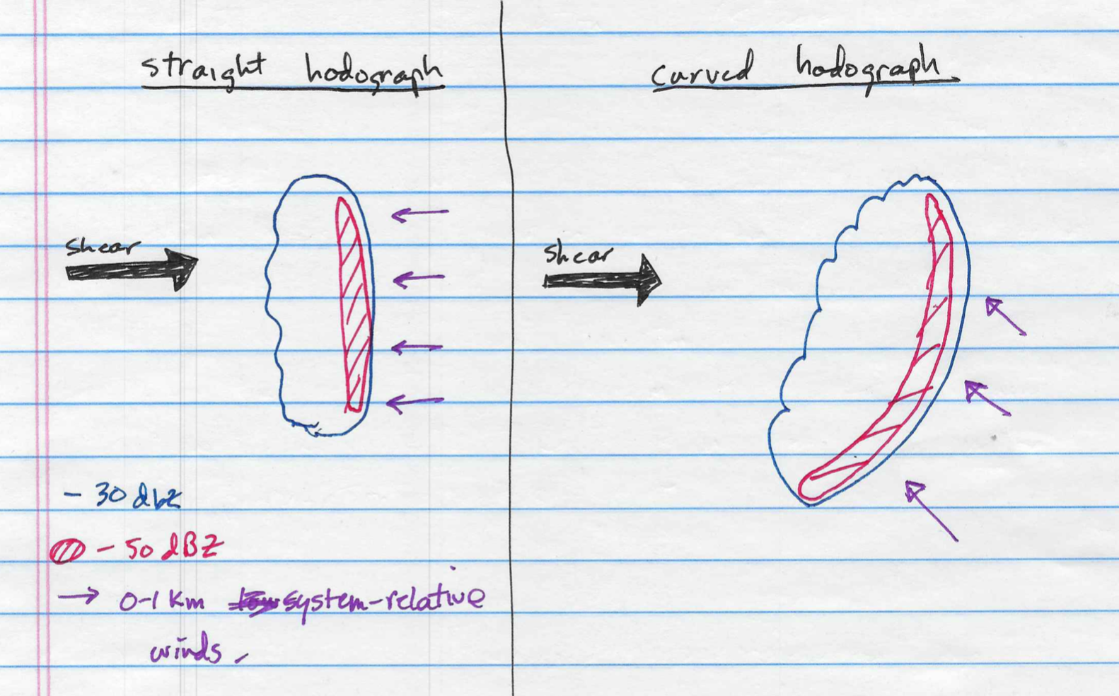
Movement versus propagation
System-relative head winds
Environment moisture gradients
MR (2010), Fig. 8.14
Formation of new cells along the gust front is also influenced by the low-level system-relative winds (left) and moisture heterogeneities (right)

Slide 11
5
10
15
20

Slide 12
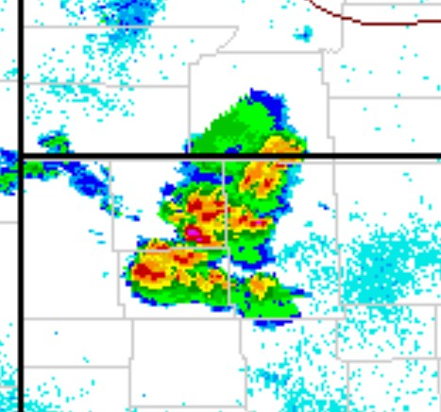
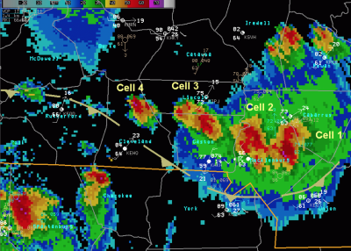
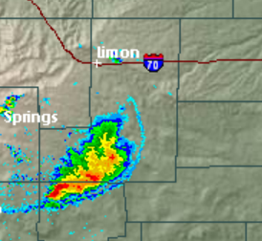
Multi Cell Clusters
Aggregates of multi-cell storms are common over parts of the Southeast in the summer. Each storm can be in a different phase of the life cycle.
Can act as a loosely organized MCS or as vague as a large convective blob.
Forcing is usually weak and the primary risk is damaging outflow winds from collapsing storms but can also produce hail.

Slide 13
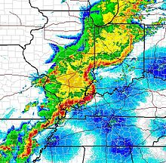
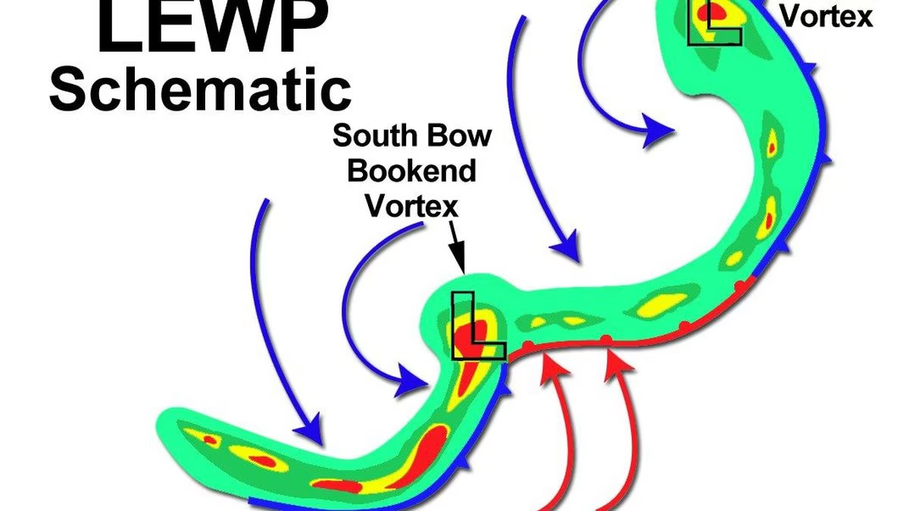
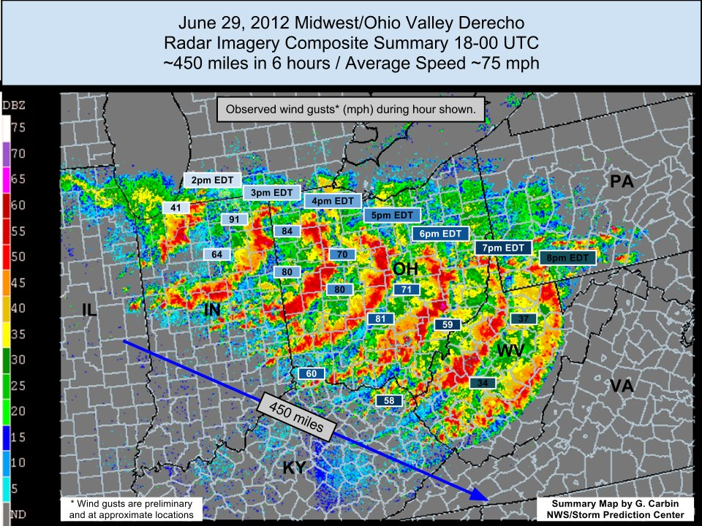
Multi Cell Lines
Collections of multicell storms along a line with a large length to width ratio.
Can take multiple forms
Serial MCS
Progressive MCS
LEWPs (line echo wave patterns)
Bow echos
Derechos
Usually more organized than clusters with stronger vertical shear.
Can produce Damaging wind gusts tornadoes and some hail.

Slide 14
5
15
25
35
50

Slide 15
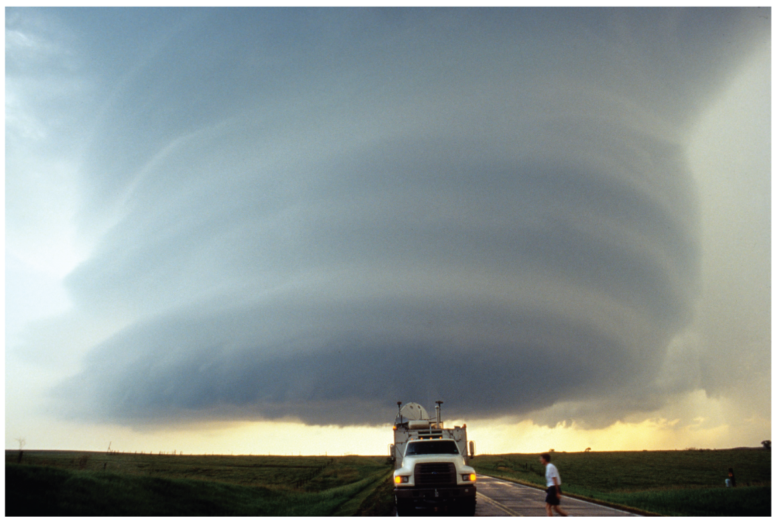
Supercells
Characterized by a thunderstorm with a sustained, deep, rotating updraft 🡪 mesocyclone
Occur in strong vertical shear through a deep layer (big storm-relative winds), but high CAPE not necessary
Motion deviates significantly from mean wind
Vertical PGF enhances updraft, a special property of supercells
MR (2010), Fig. 8.17

Slide 16
Supercell Features
Single, long-lived, quasi-steady, rotating, precipitation free, updraft
Wall cloud at updraft base where humid, rain-cooled air drawn upward
Two downdraft regions: rear flank downdraft (RFD) and forward flank downdraft (FFD)
MR (2010), Fig. 8.22

Slide 17
Supercell Types
For isolated storms, supercell type is (maybe) a function of storm-relative winds (SRW) at level of anvil (9–12 km AGL)
Weak upper-level storm-relative winds (<18 m/s): HP; moderate (18-28 m/s): classic; strong (>28 m/s): LP
For multiple storms in close proximity, precipitation from one storm may seed another storm, favoring HP types
Stronger SRW favors larger updrafts resistant to entrainment.
MR (2010), Fig. 8.24
MR (2010), Fig. 8.16
MR (2010), Fig. 8.26

Slide 18
5
15
25
35
50

Slide 19
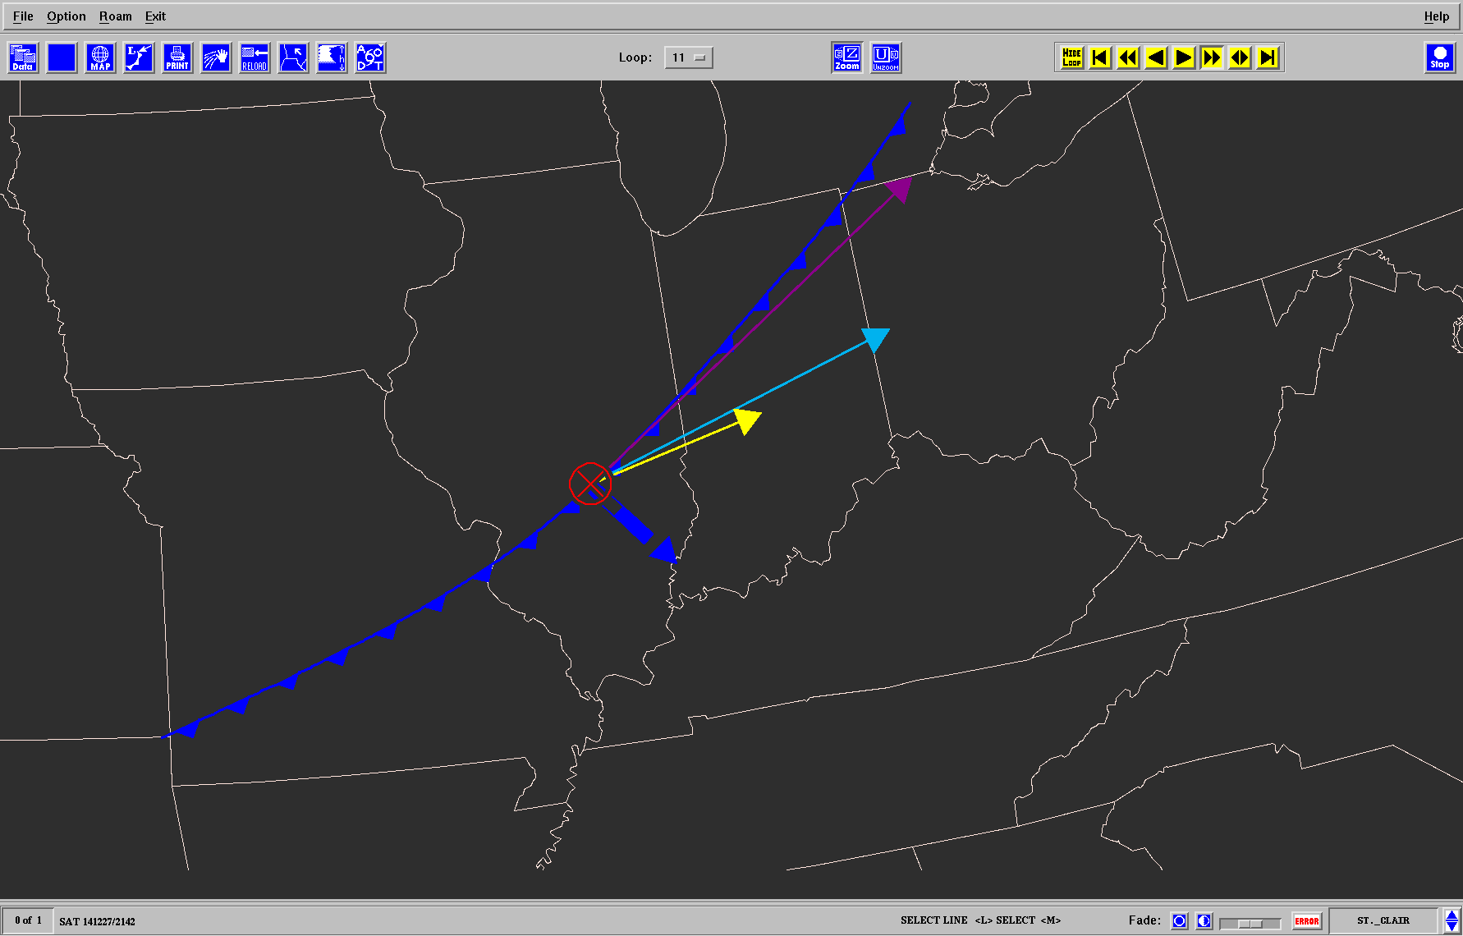
Vector-boundary orientation
Setup Favoring Linear Convection
9-11 km SR wind
Zone of Forced ascent
0-6 km shear vector
Boundary motion
Storm motion
T+2
T+1
T+0

Slide 20
Recipe for a Squall Line
Deep-Layer flow, shear vectors, and SR winds largely parallel to boundary
Overlapping and interacting storms
Strong linear convergence (ascent) along the boundary
Form lots of storms close to one another
Storms do not move away from the zone of ascent
Longer residence time in the zone of ascent leads to more updrafts and more mature updrafts interacting with each other.

Slide 21
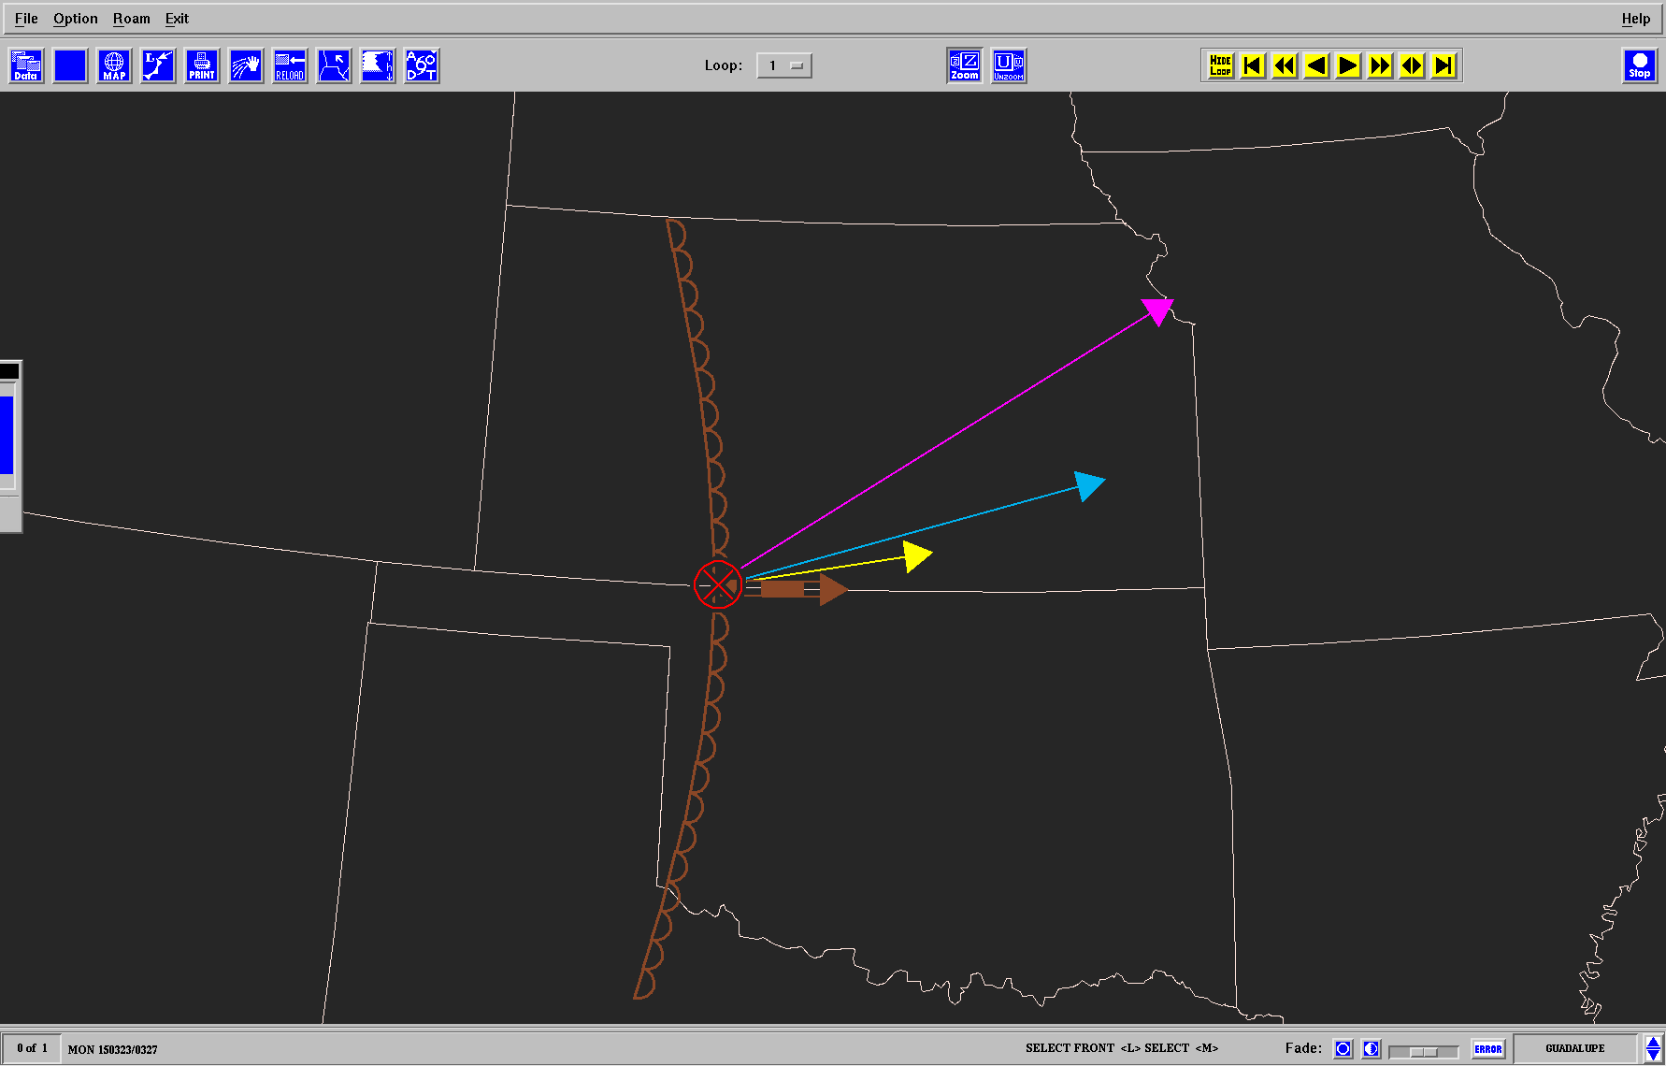
Setup Favoring Discrete Convection
9-11 km SR wind
T+2
T+1
T+0
0-6 km shear vector
Zone of Ascent
Storm motion
Boundary motion

Slide 22
Recipe for Discrete Storms
Deep-Layer flow, shear vectors, and SR winds oriented across a boundary
Storms tend to not interact (need to also consider storm splitting)
Weaker convergence (ascent) along the boundary
Fewer storms form
Storms move away from the zone of ascent faster
Less chance for upscale growth into a line

Slide 23
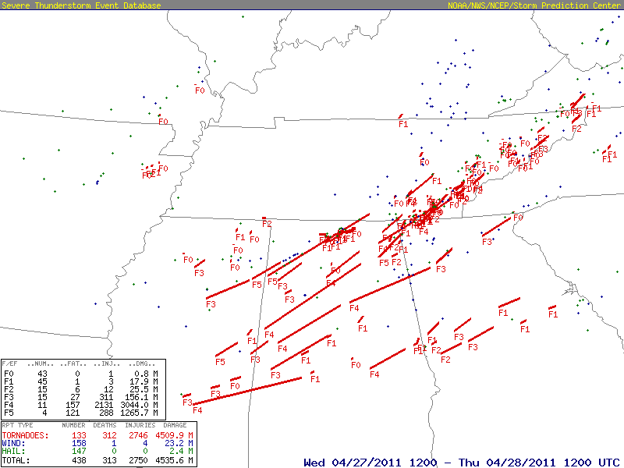
27 April 2011 Supercell Mode Case

Slide 24
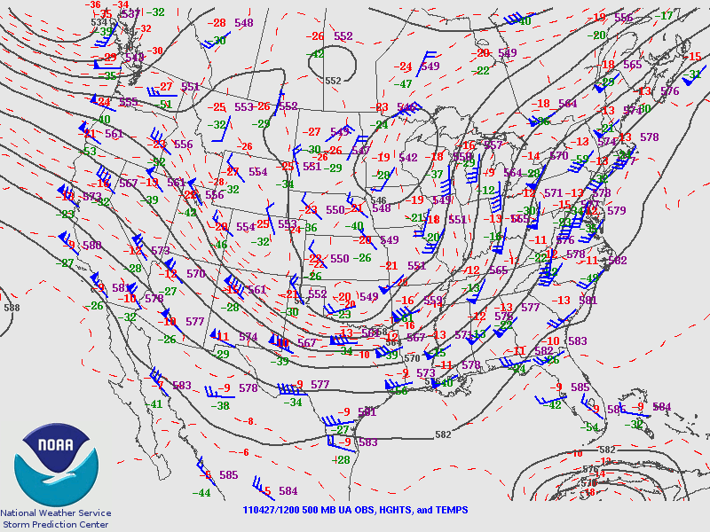
27 APR 2011 12z

Slide 25
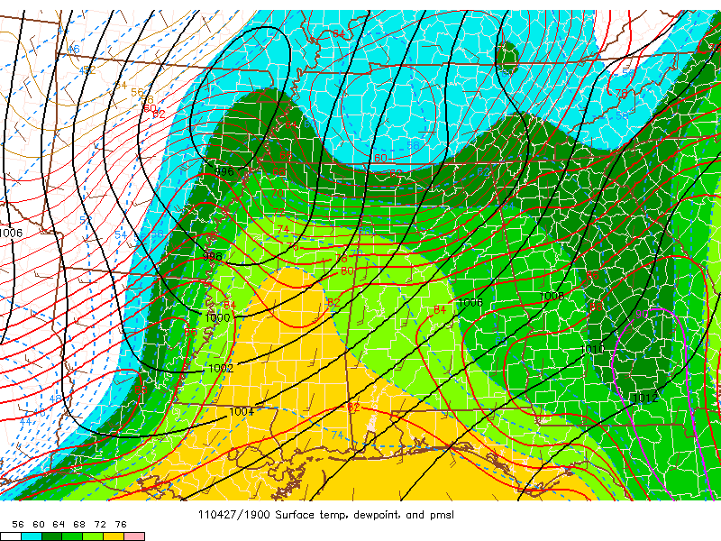
Surface T, Td, and PMSL
27 APR 19z

Slide 26
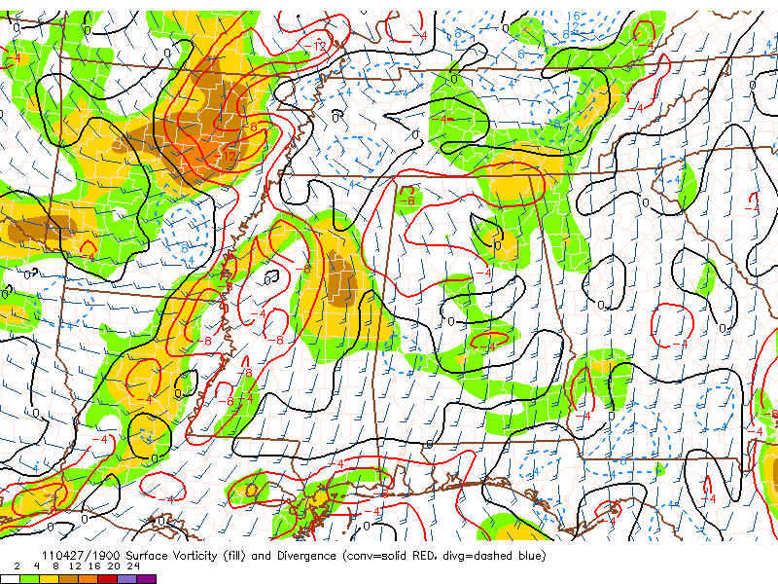
Surface convergence and vorticity
27 APR 19z

Slide 27
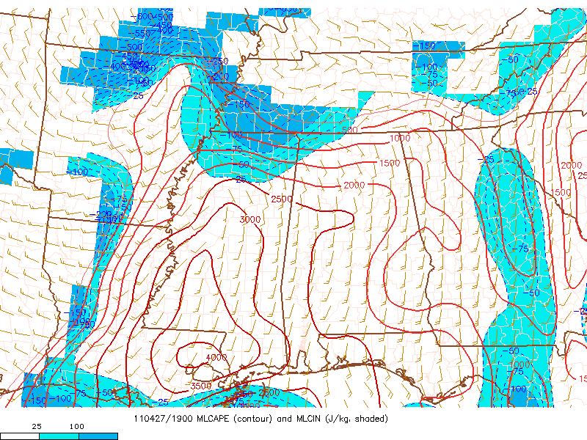
MLCAPE and MLCIN
27 APR 19z

Slide 28
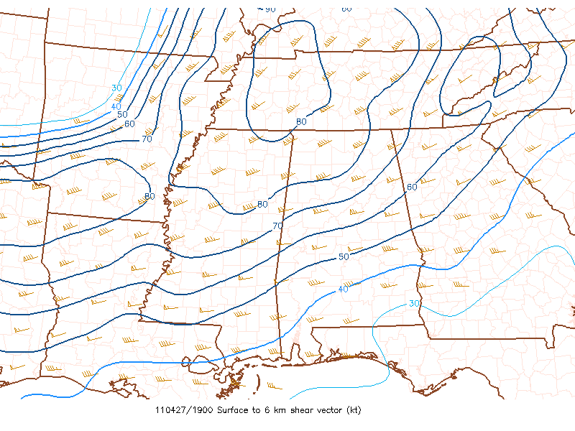
0-6 km shear vectors
27 APR 19z

Slide 29
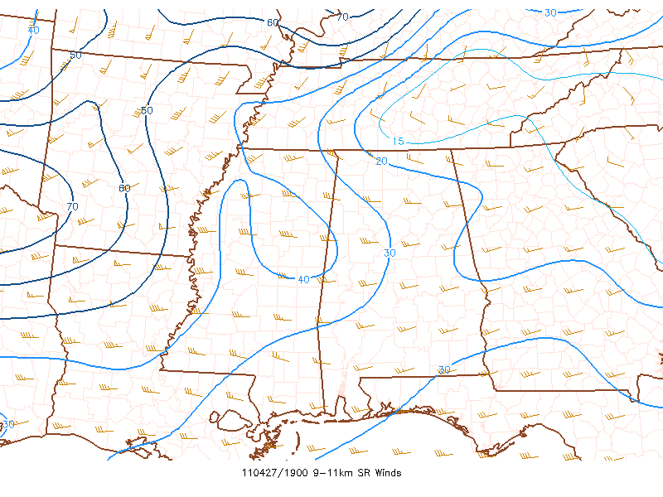
9-11 km storm-relative winds
27 APR 19z

Slide 30
18z JAN

Slide 31
Vectors relative to boundary
Supercell motion
0-6 km shear
9-11 SR wind
N-S dryline moving E at 20 kt

Slide 32
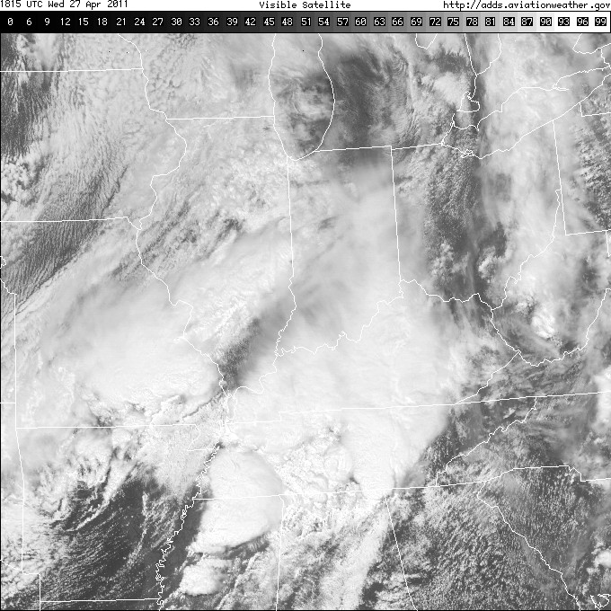
1815z

Slide 33
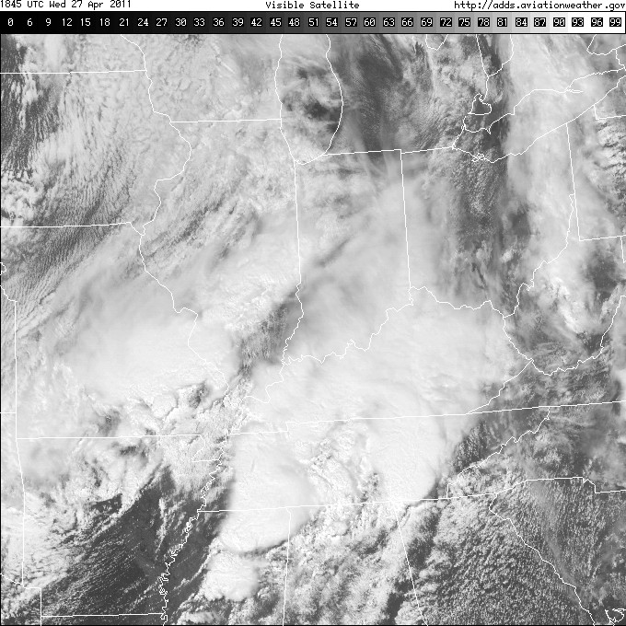
1845z

Slide 34
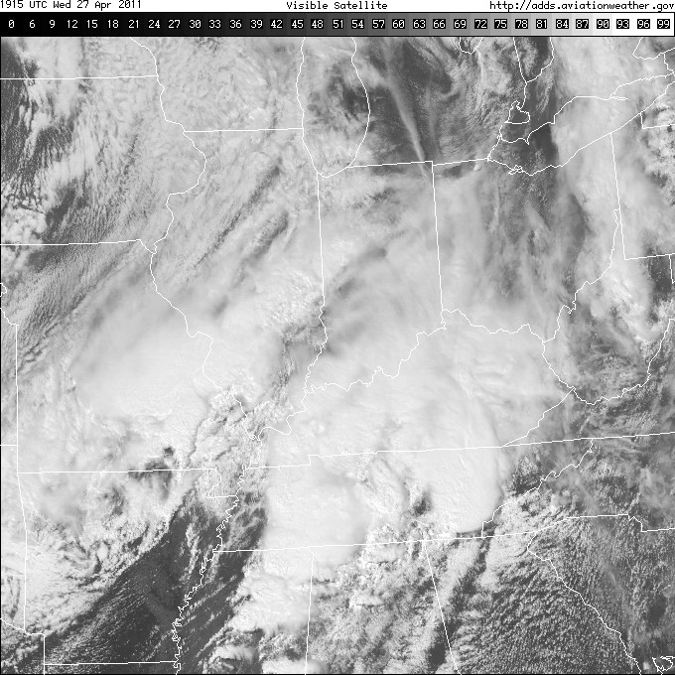
1915z

Slide 35
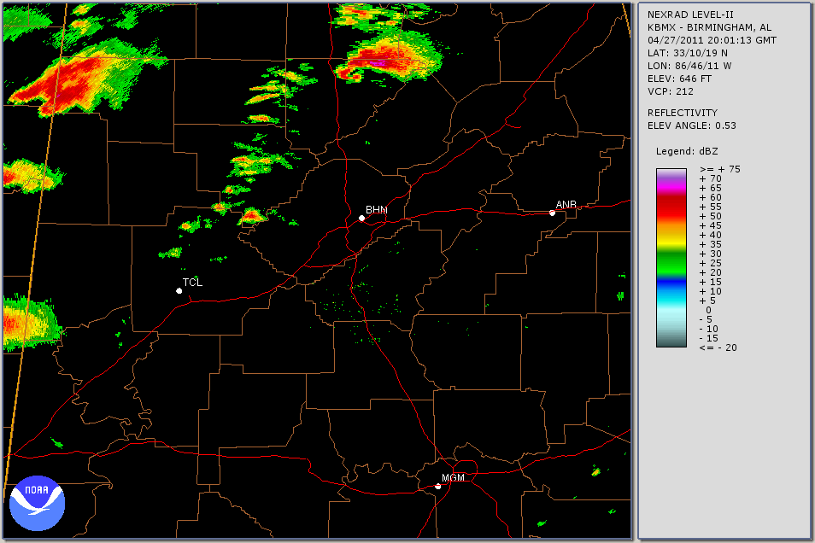

Slide 36
Forced Squall Line Case
Still some cross-boundary flow and shear vectors
Stronger cap and moderate buoyancy
Much stronger low-level convergence
Front moved as fast as the storms
Relative speed is often overlooked. A surging front may travel as fast if not faster than the storms that form on it.

Slide 37
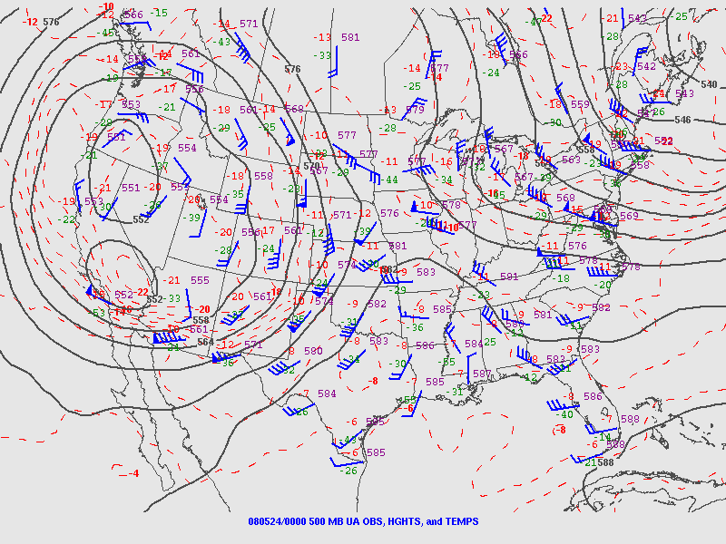
24 MAY 2008 00z

Slide 38
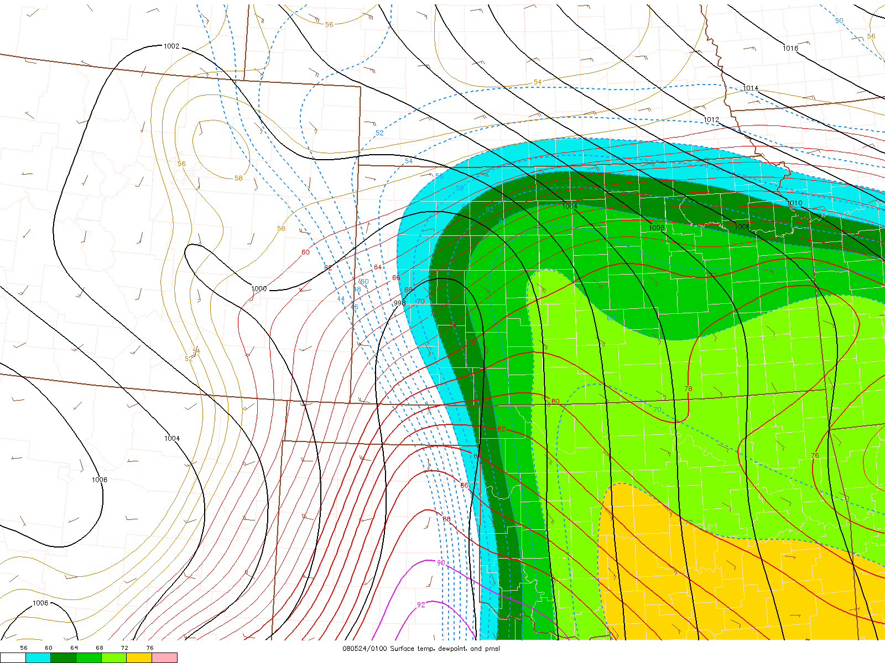
Surface T, Td, and PMSL
24 MAY 01z

Slide 39
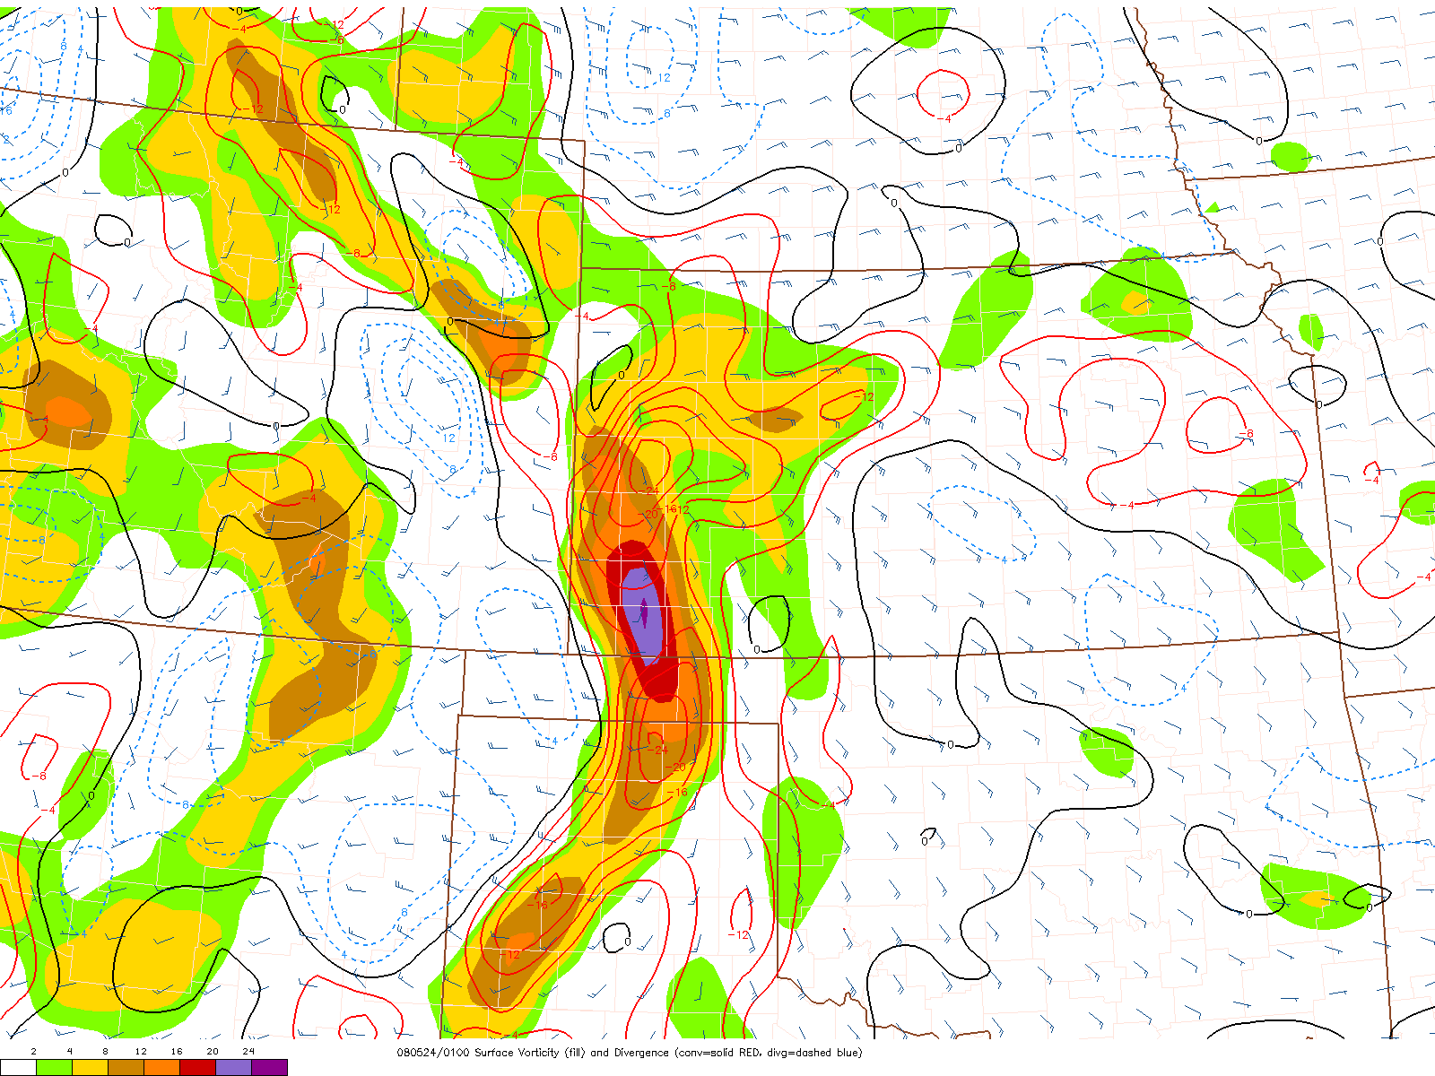
Surface convergence and vorticity
24 MAY 01z

Slide 40
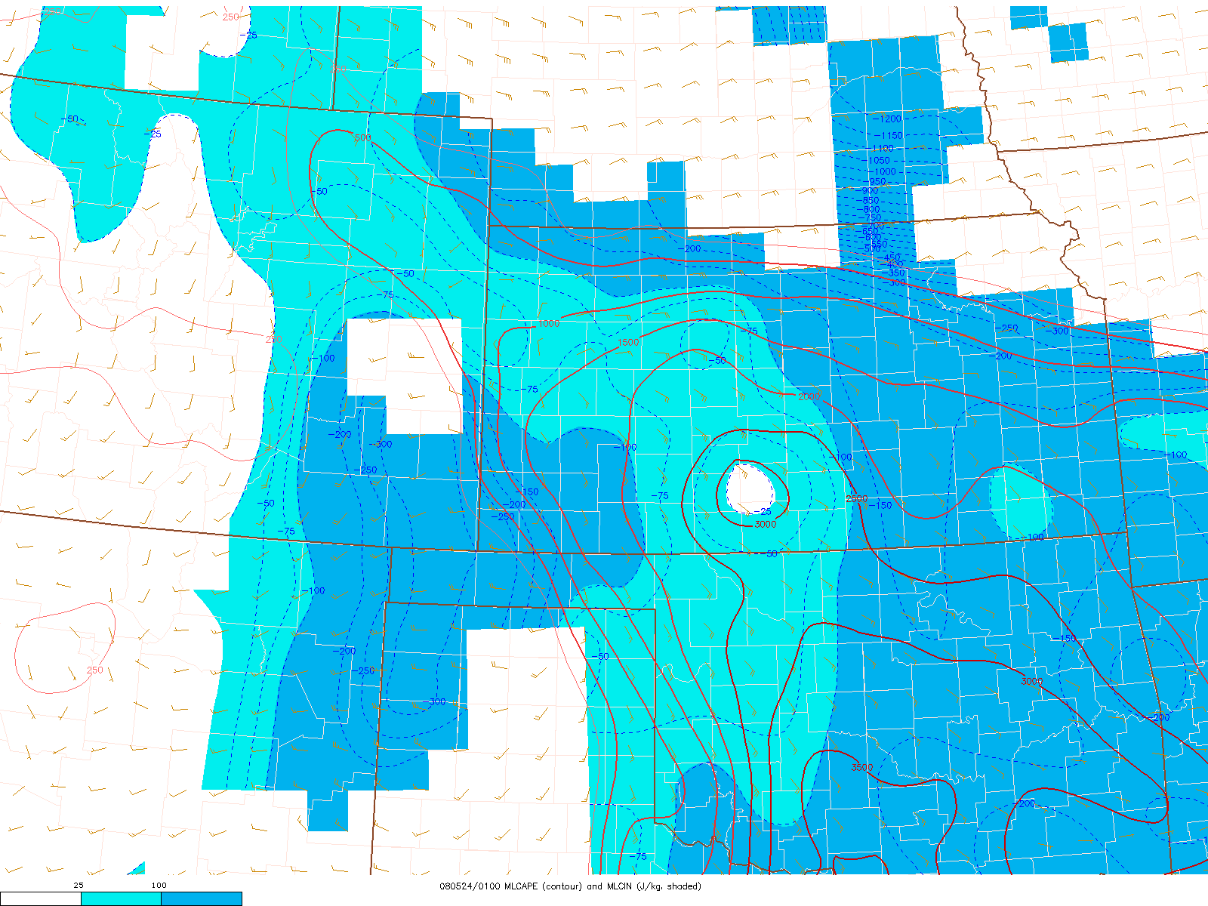
MLCAPE and MLCIN
24 MAY 01z

Slide 41
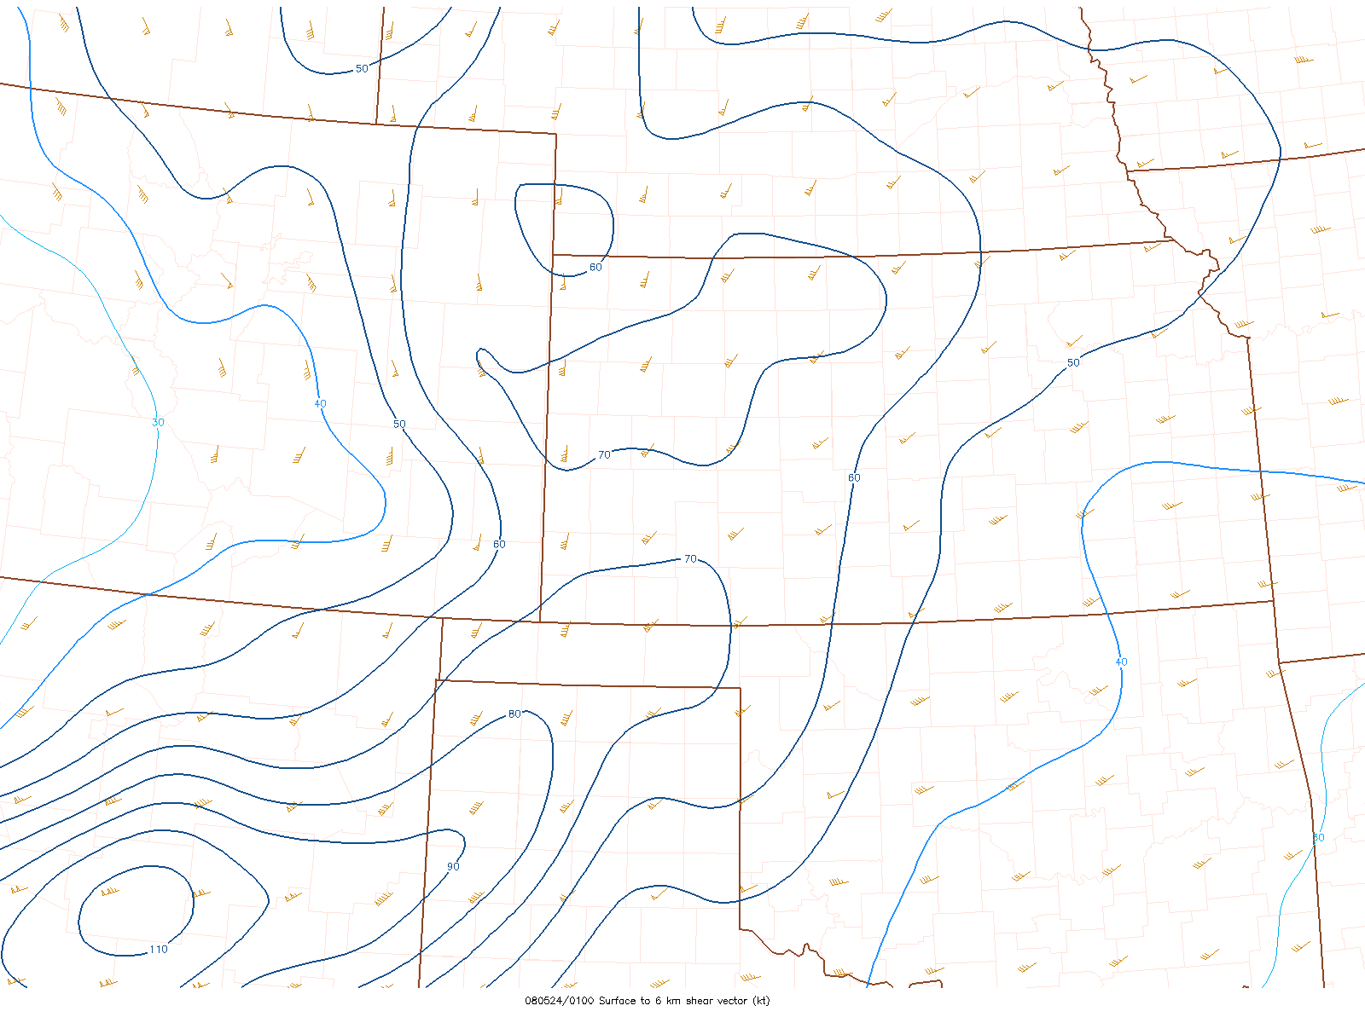
0-6 km shear vectors
Upper Jet near Trough later
Flow Earlier over bent-back dryline
24 MAY 01z

Slide 42
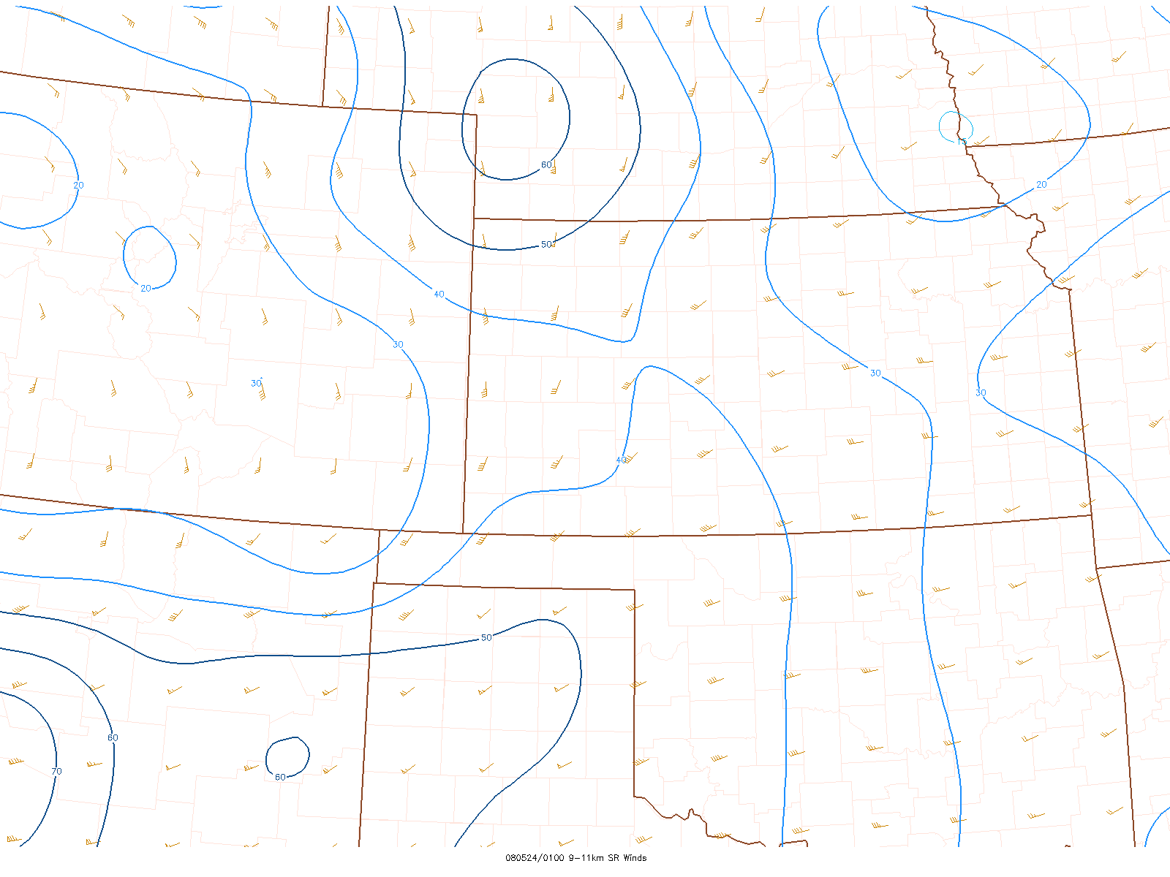
9-11 km storm-relative winds
24 MAY 01z

Slide 43
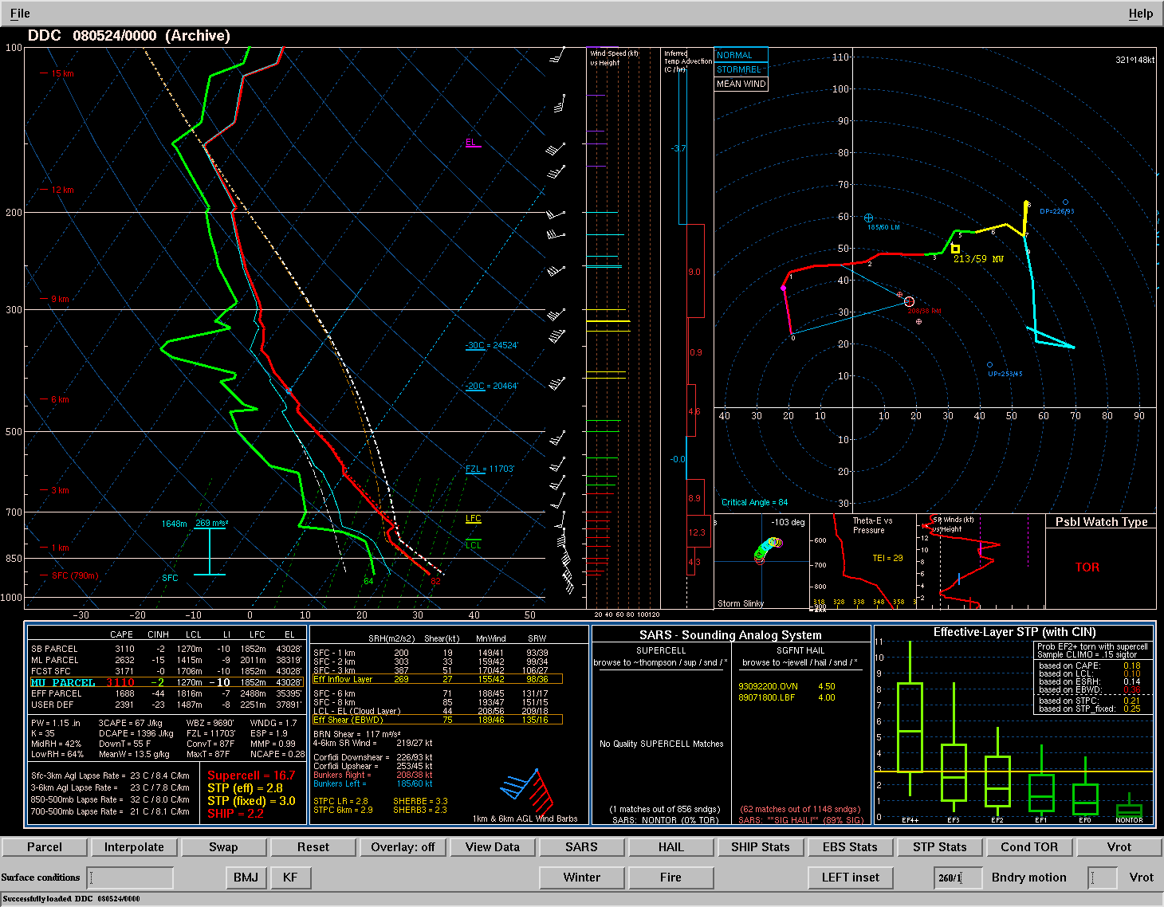
00z DDC

Slide 44
N-S cold front moving E at ~30 kt

Slide 45
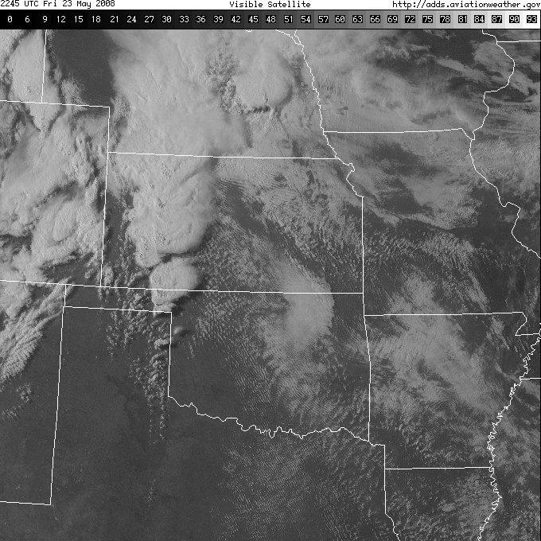
2245z

Slide 46
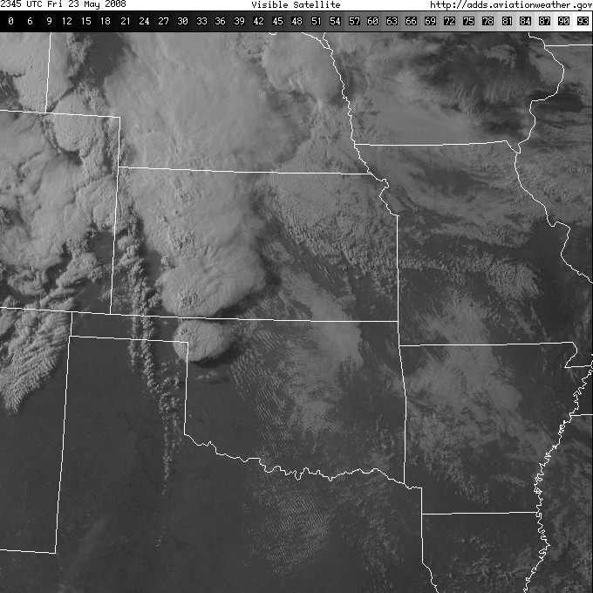
2345z

Slide 47
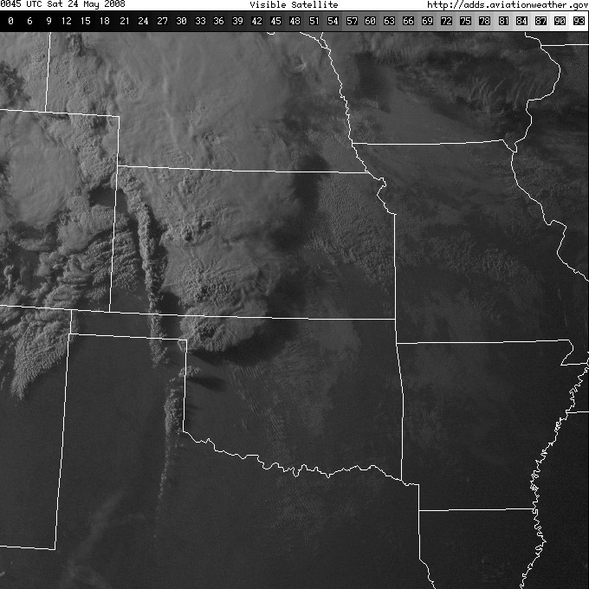
0045z

Slide 48
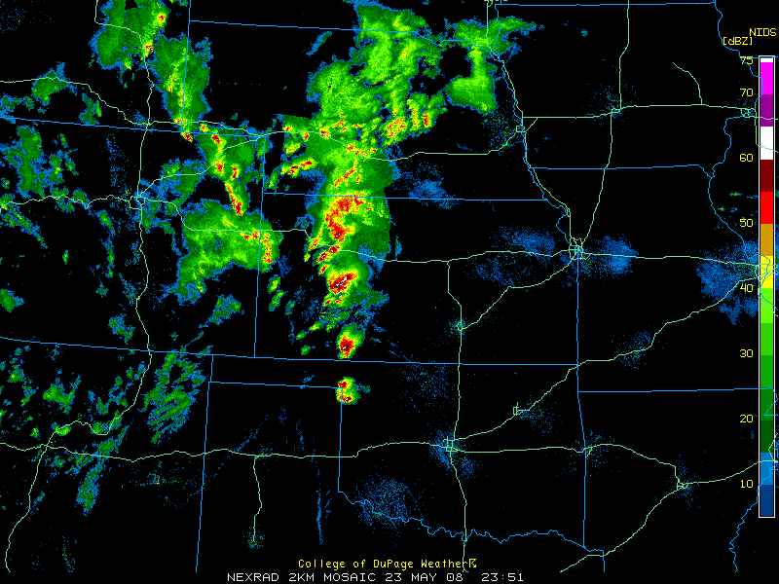
Initial Supercell
2351z

Slide 49
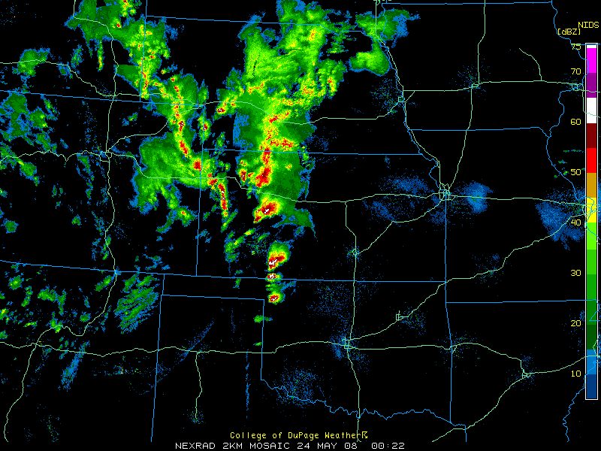
0022z

Slide 50
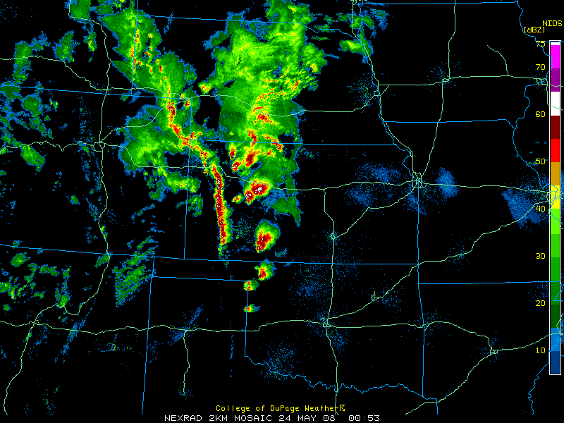
Rapidly growing squall line
0053z

Slide 51
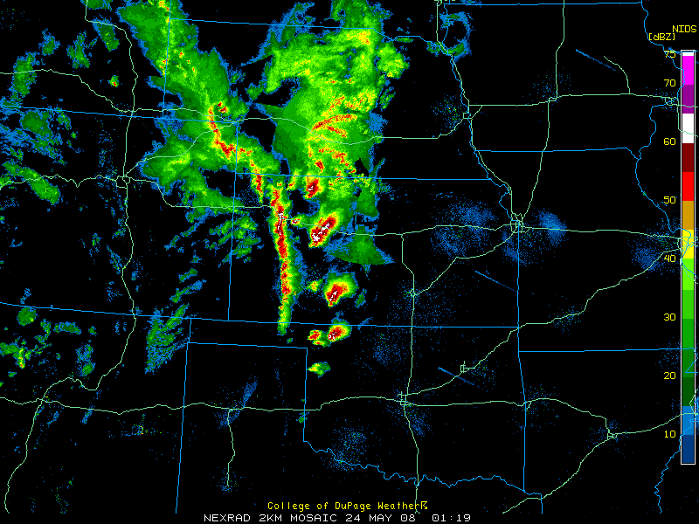
0119z

Slide 52
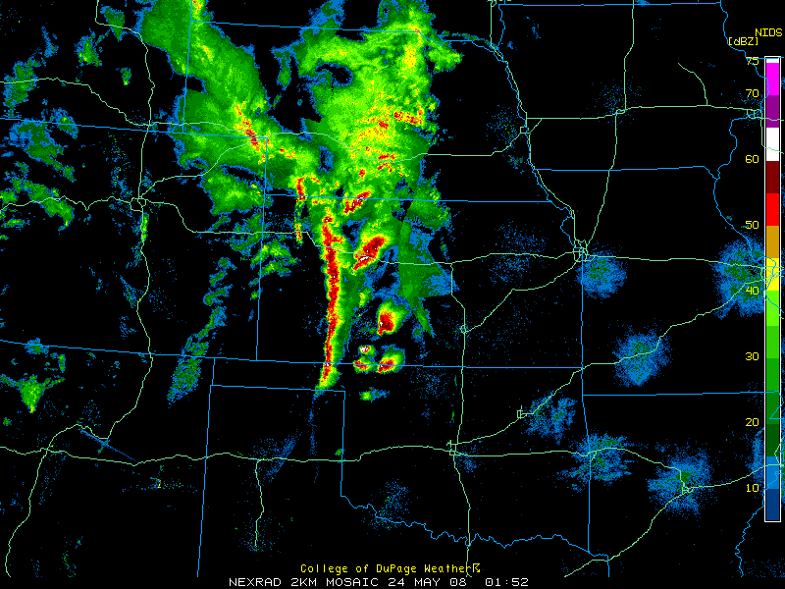
0152z

Slide 53
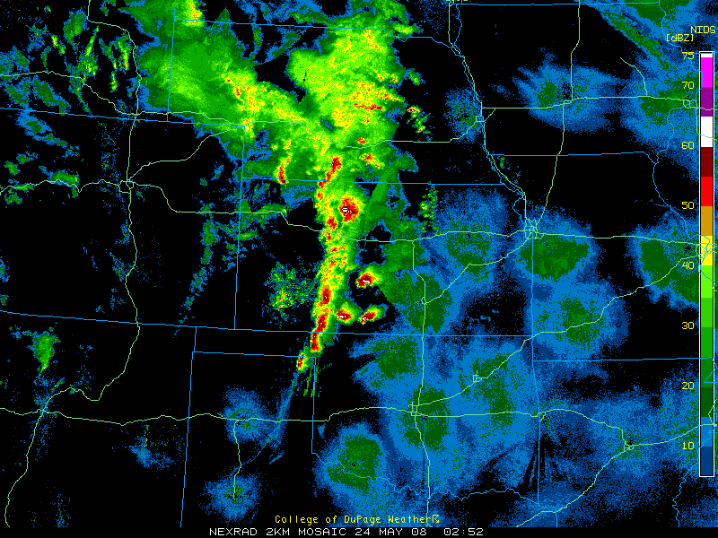
0252z

Slide 54
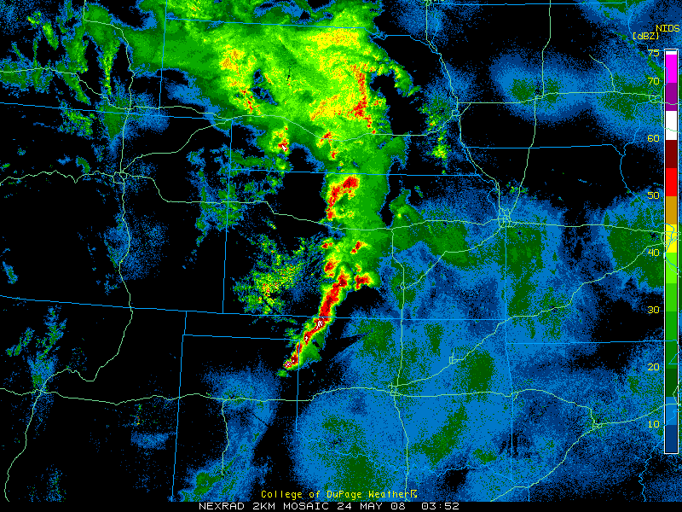
0352z

Slide 55
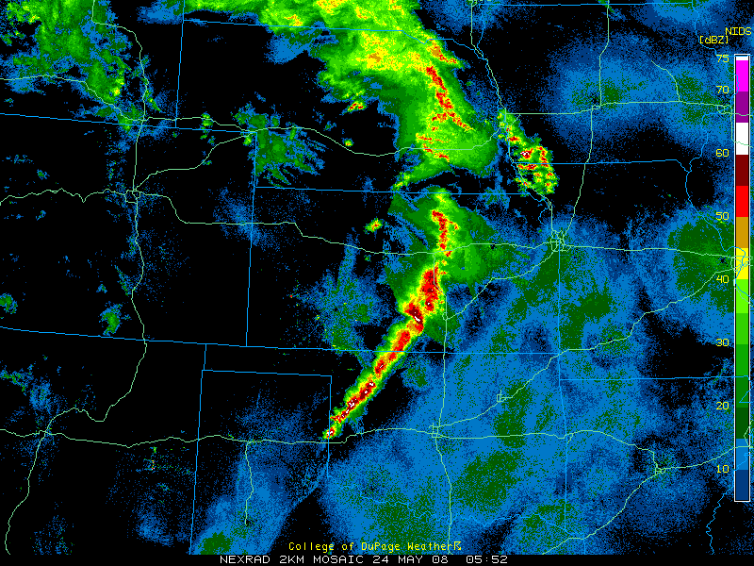
0552z

Slide 56
Summary
Convective mode and storm organization are primarily modulated by vertical shear.
Strength of forcing for ascent is likely the most important factor, along with whether or not storms will move off a boundary.
Shear Vector orientation and storm relative flow determine residence time within zones of ascent along boundaries.
Shear vector orientation is more important in cases with weaker forcing for ascent, where storm interactions could lead to upscale growth

Slide 60
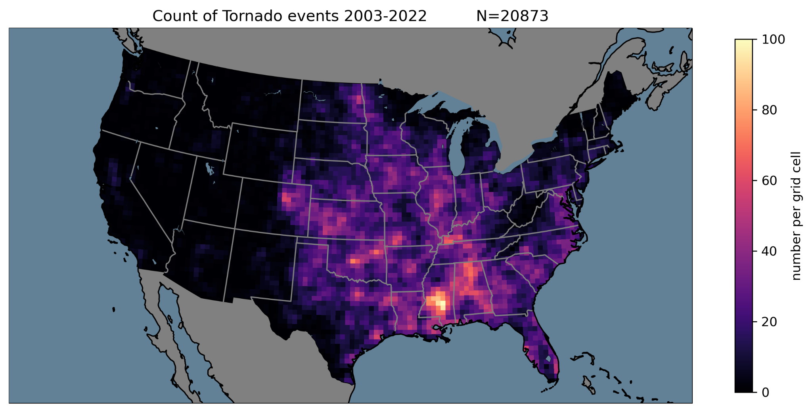

Slide 61
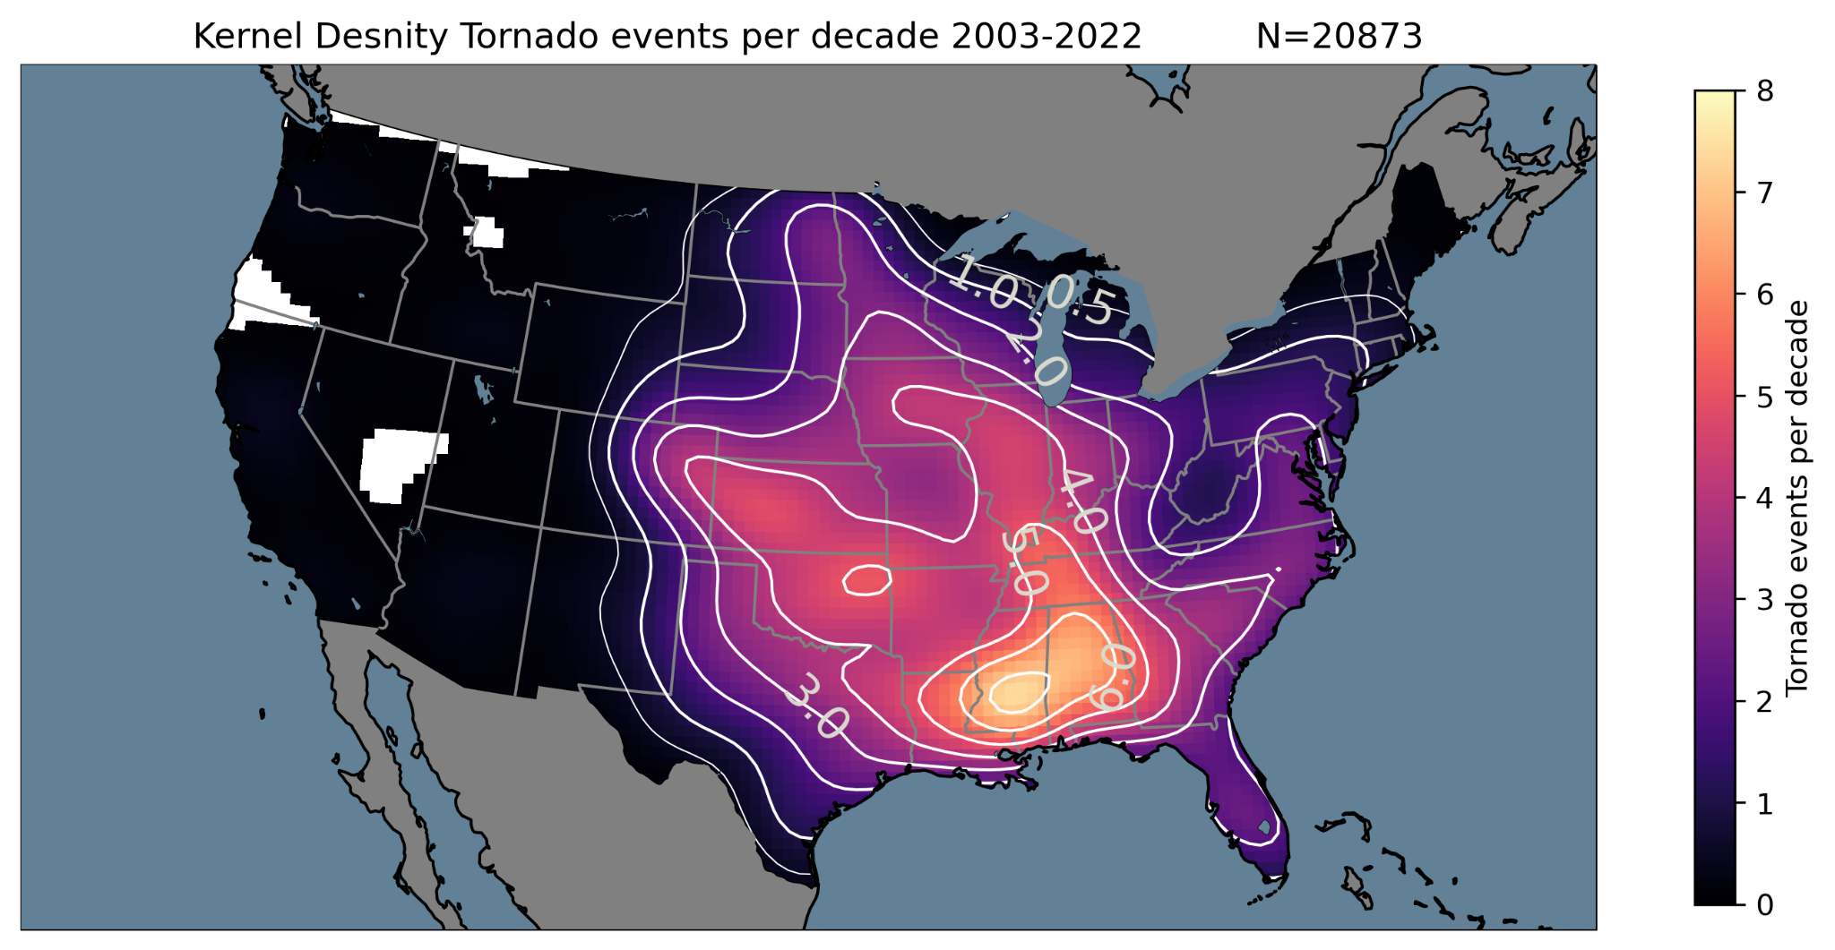

Slide 62
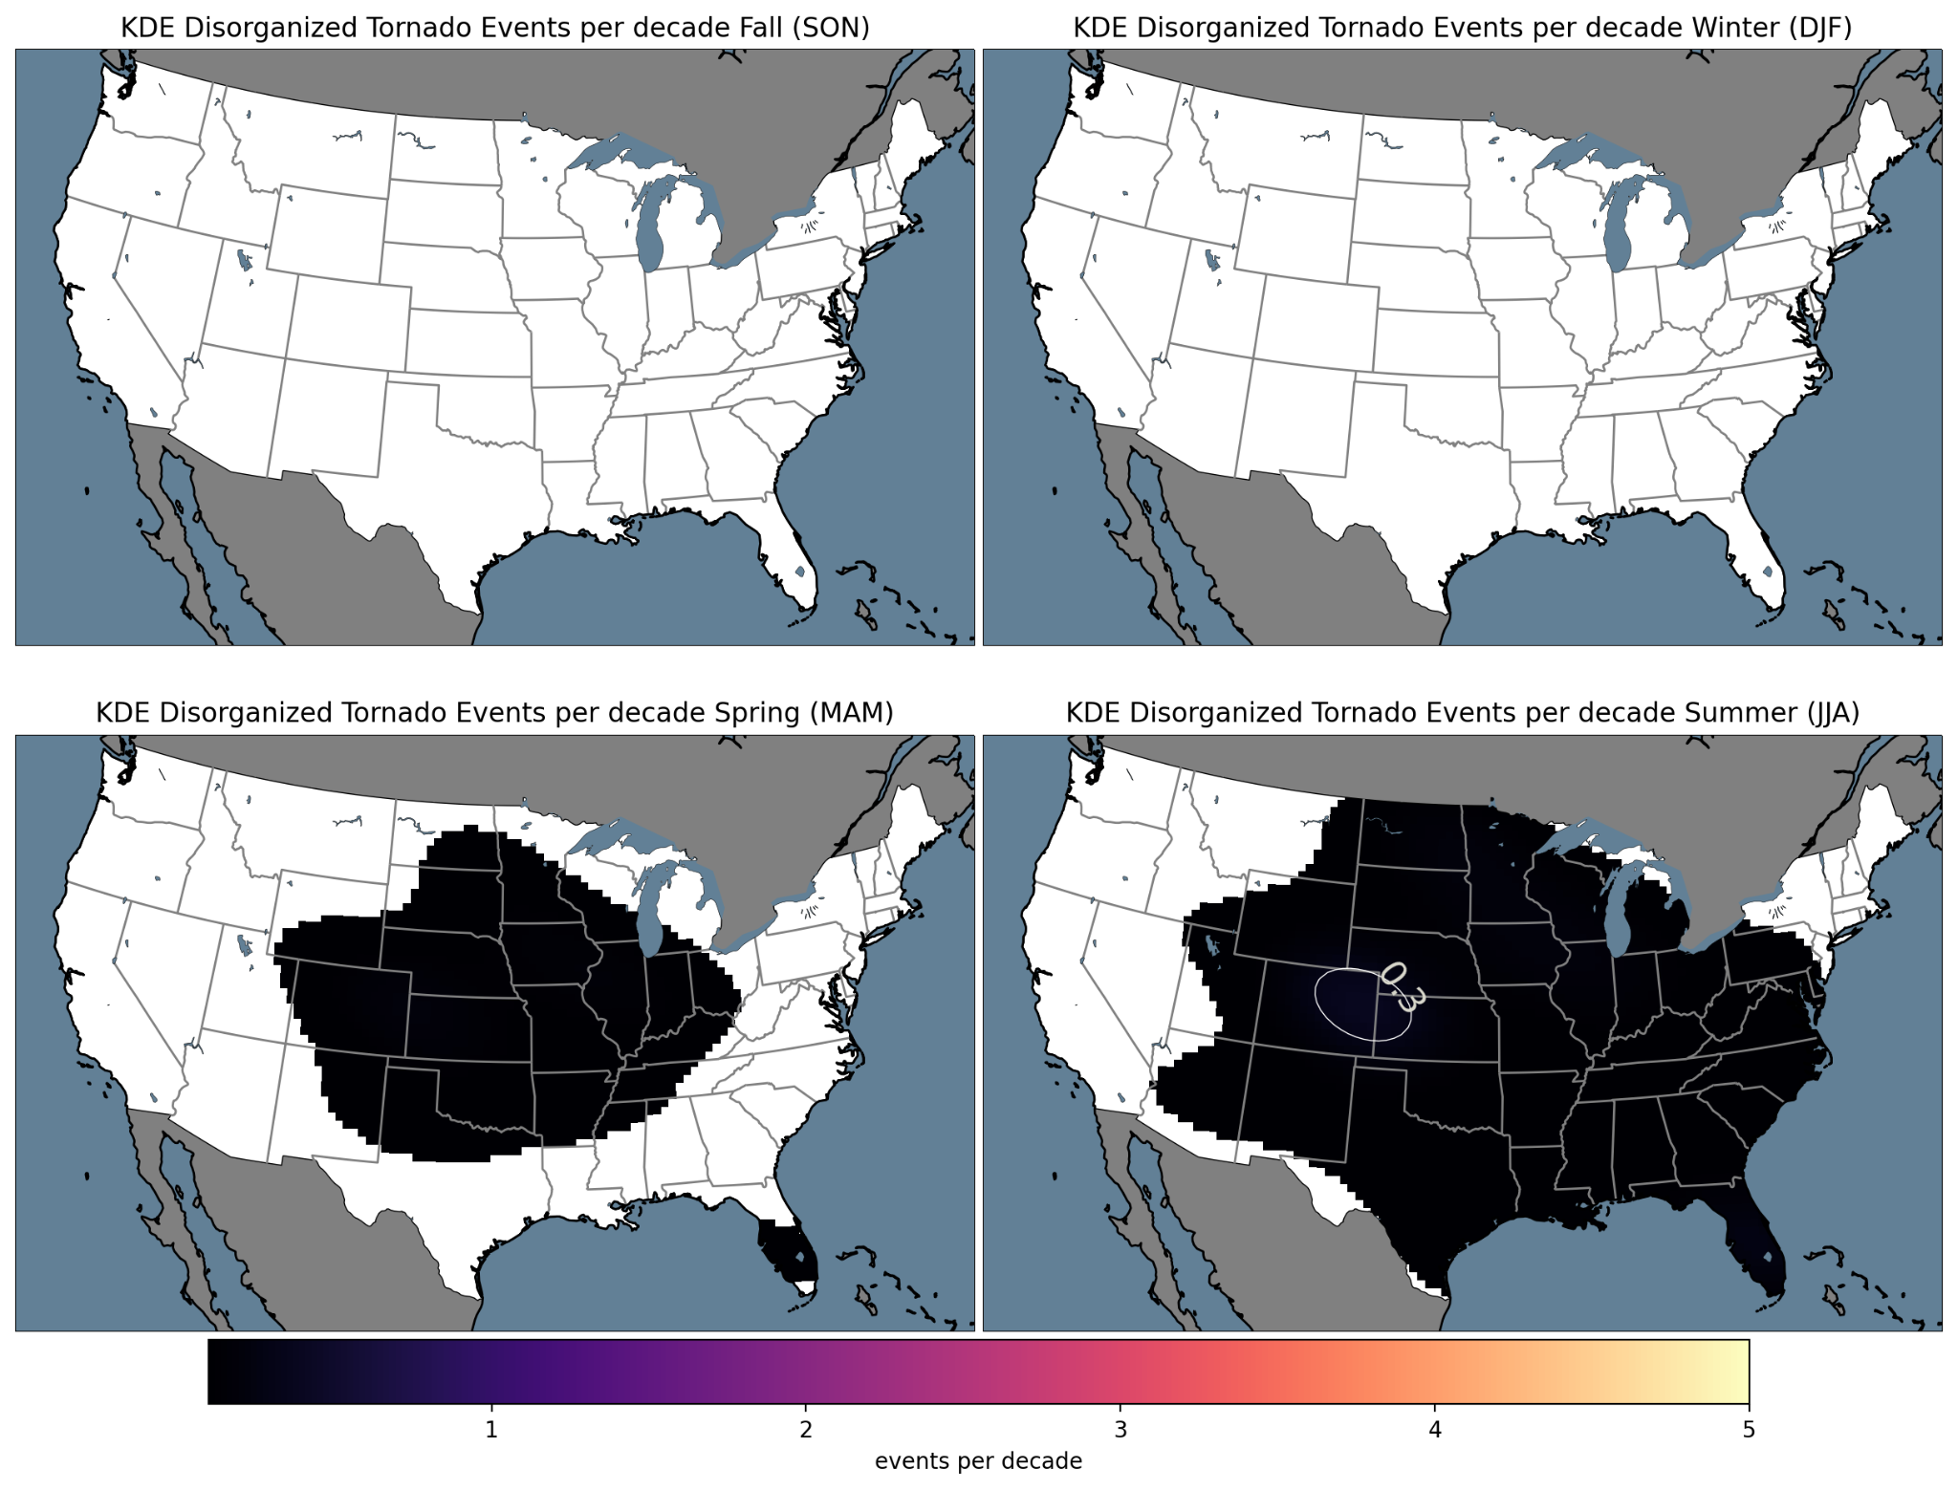

Slide 63
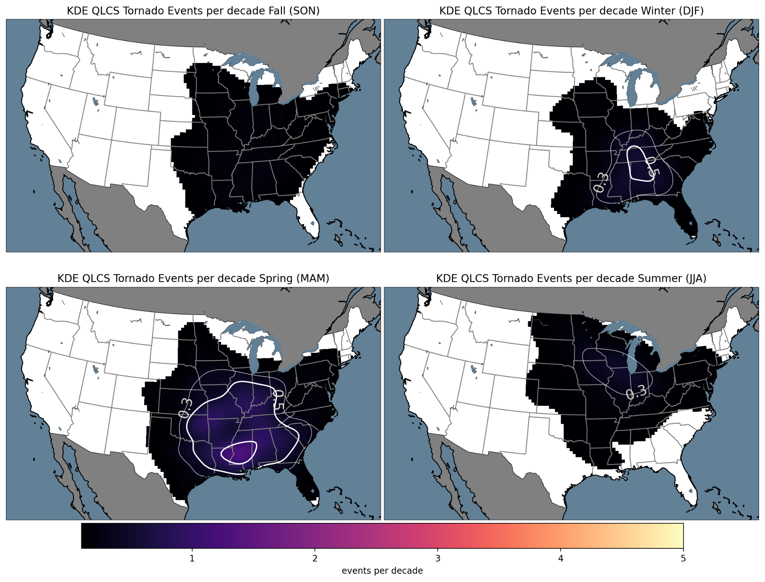

Slide 64
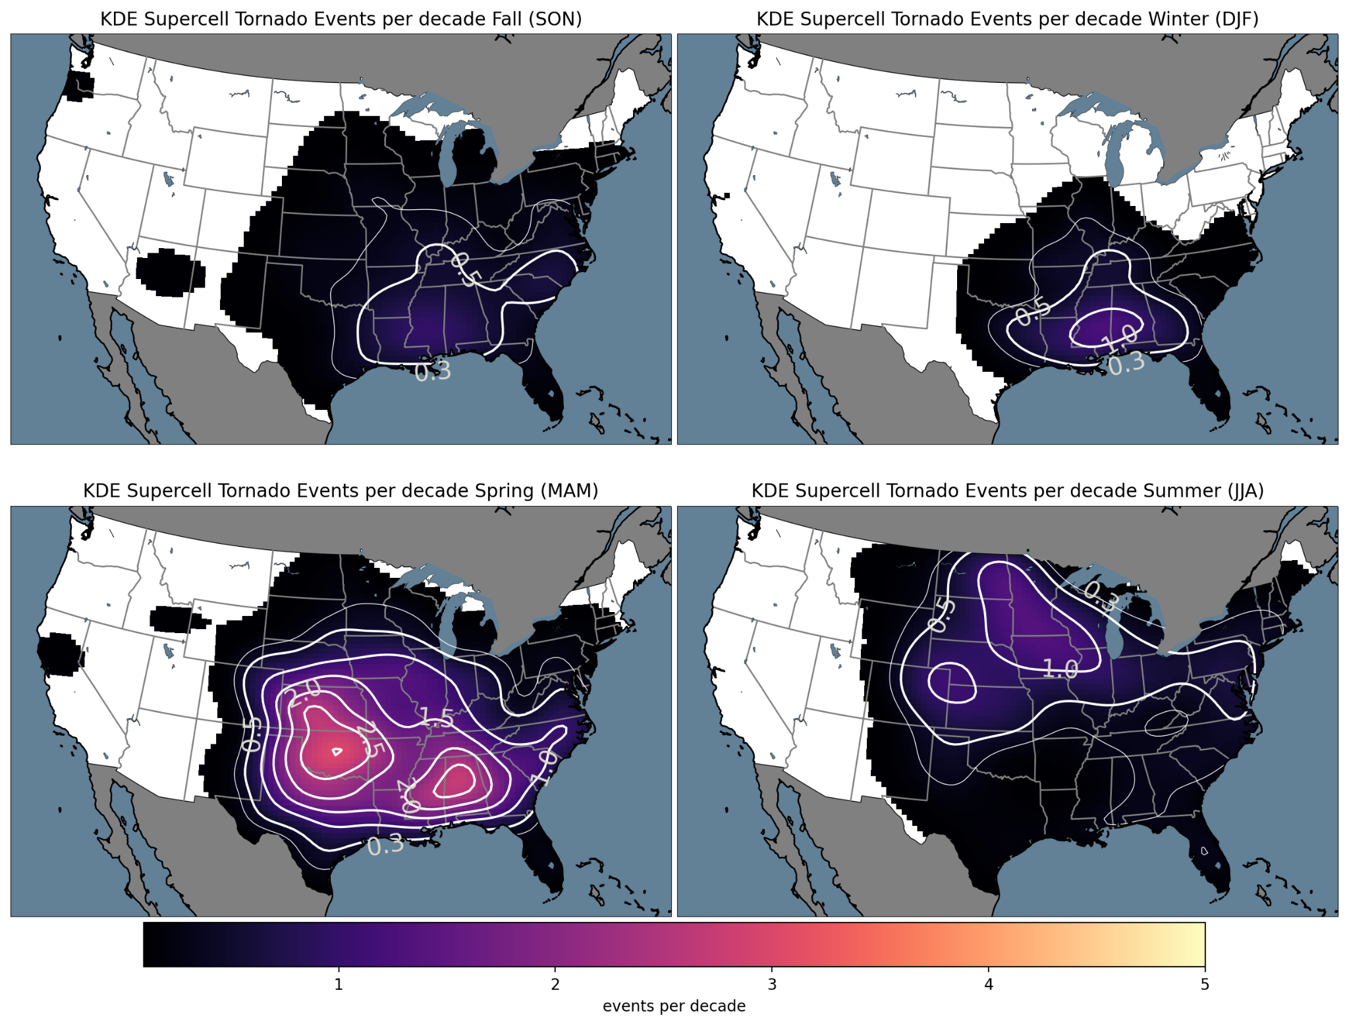

Slide 65
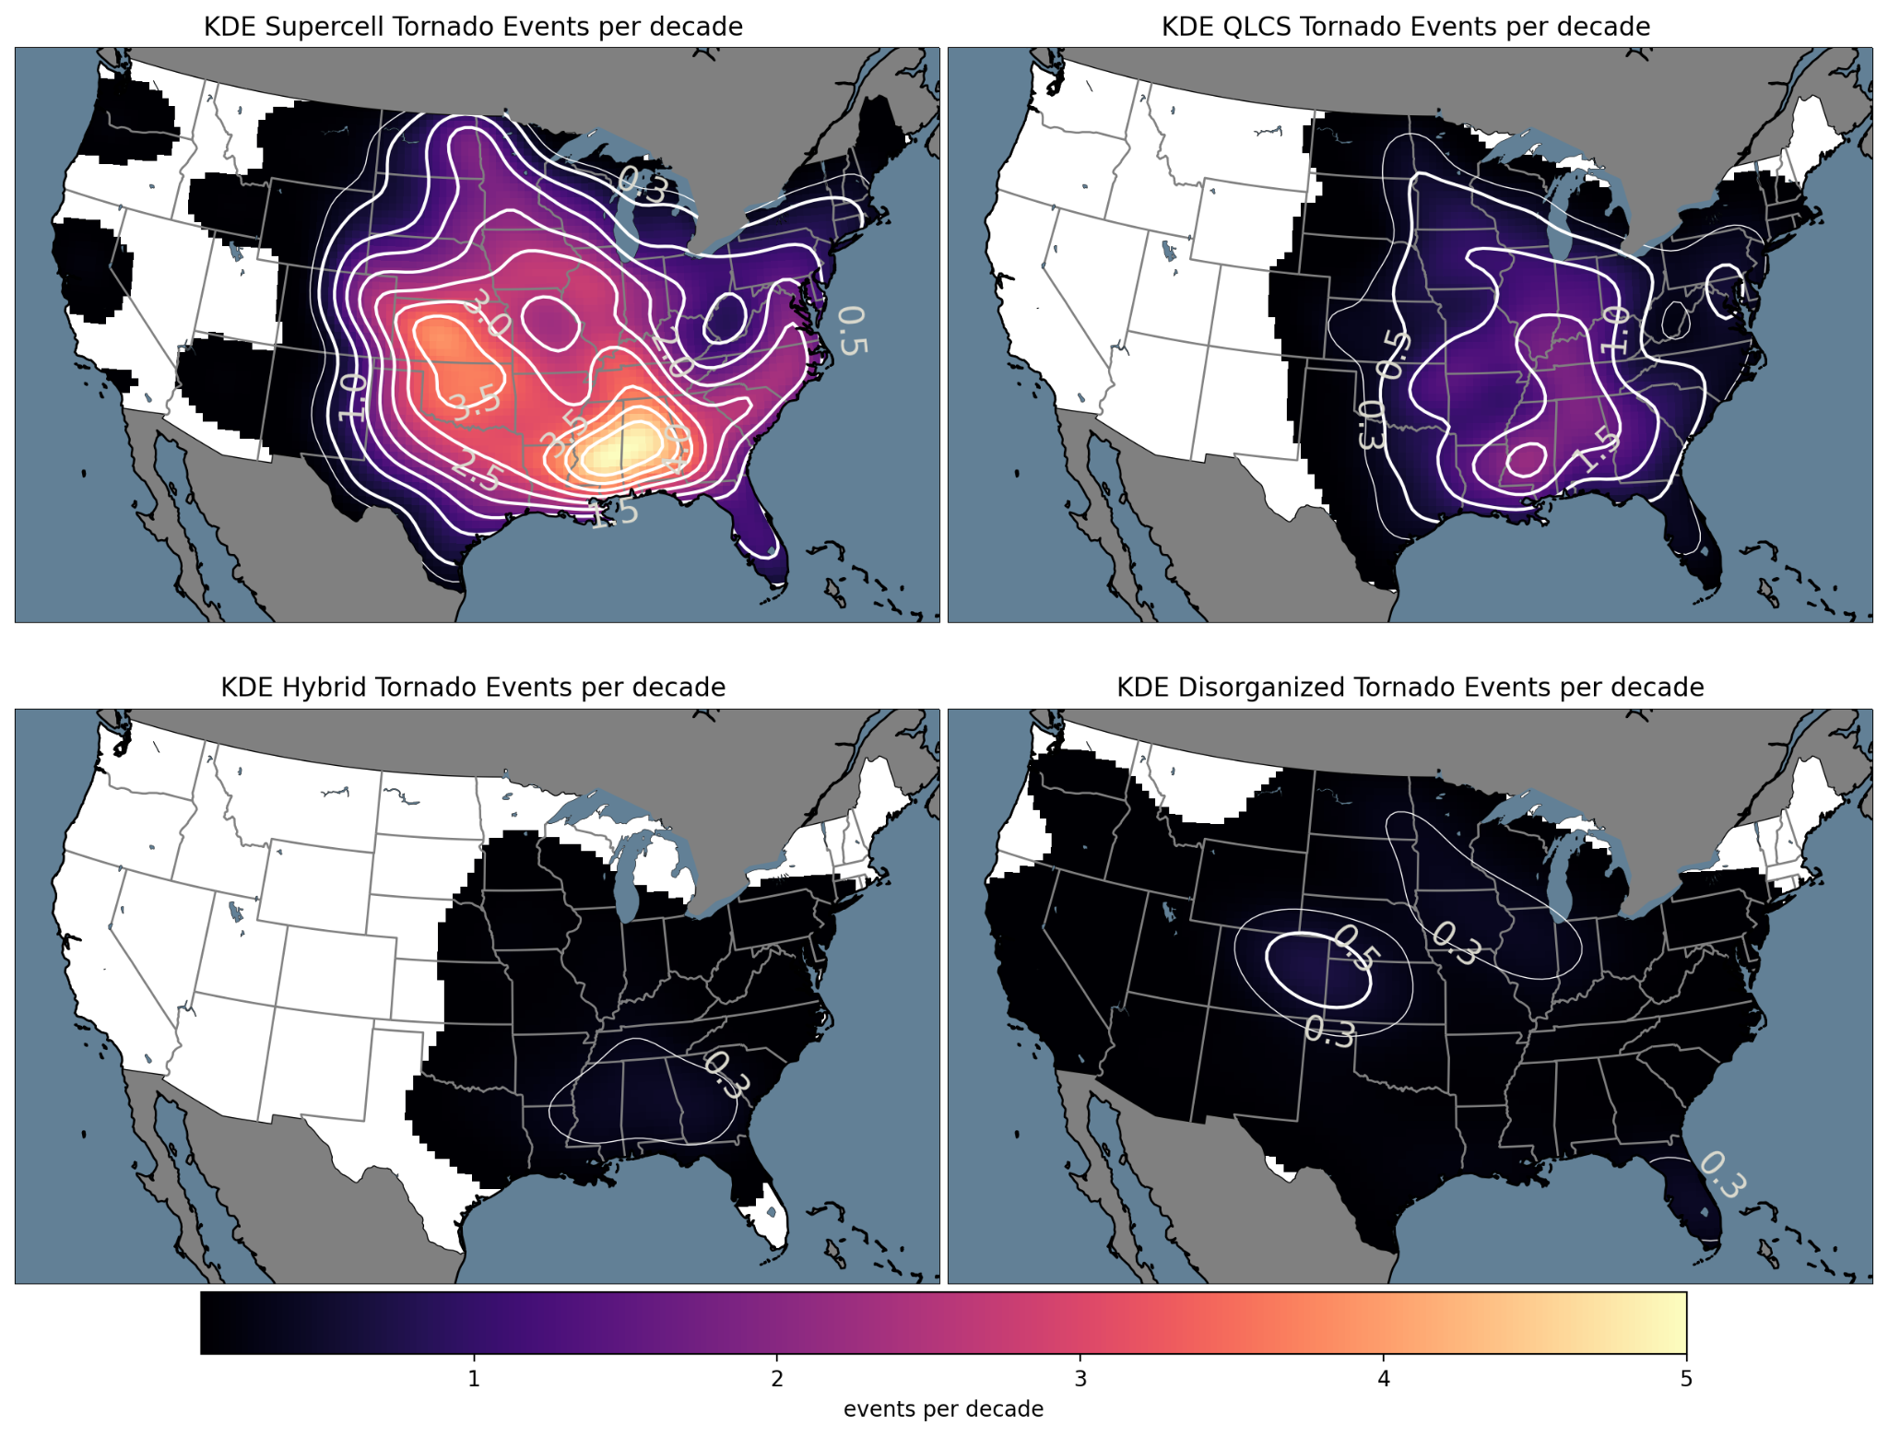

Slide 66
Quiz ideas
Storm mode types.
Convective Mode types.
Mode identification question.
total motion propagation.

