Slide 1
01z Outlook Update
Will go through process with an actual event
Start with inherited 20z outlook
Examine last 3-6 hrs leading up to 00z
Consider large-scale pattern evolution
Distribution of supercell-tornado ingredients
Buoyancy, vertical shear, moisture, and storm mode
Project future threat areas (or lack thereof) using only synoptic and mesoscale interpretations (no explicit numerical model forecasts)

Slide 2
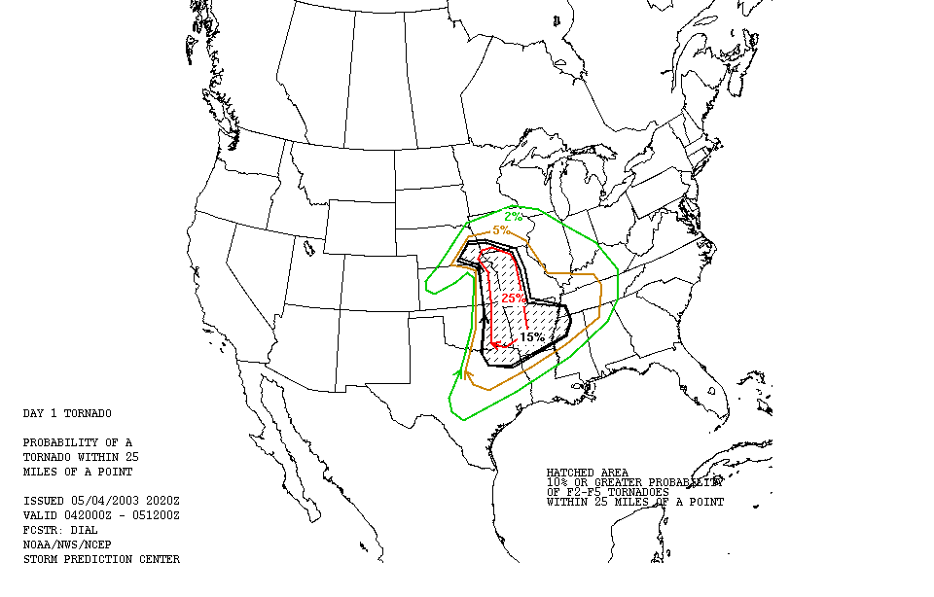

Slide 3
Diagnose Synoptic Pattern
Expected movement and intensity changes of shortwave troughs, cyclones, etc.
Mass responses to cyclogenesis, and how that affects supercell-tornado ingredients.

Slide 4
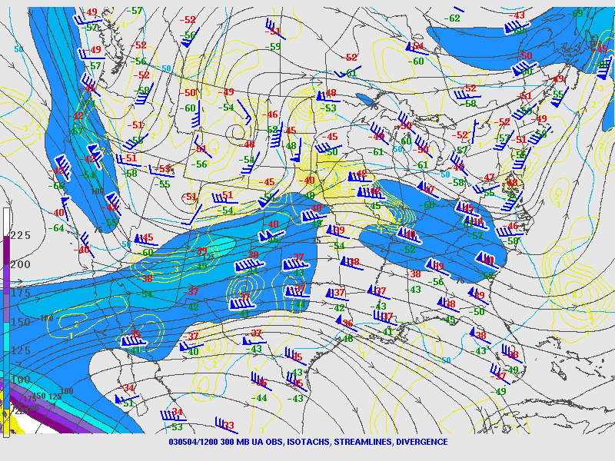
12z: 300 mb

Slide 5
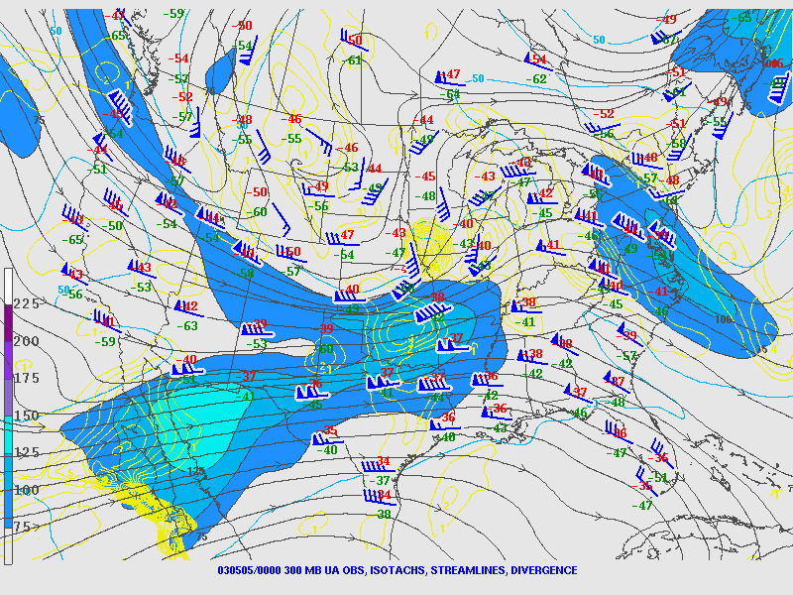
00z: 300 mb
Notes:
Left entrance of jet streak. Divergence aloft and PVA. Also mention phasing of polar and subtropical jets. Oof.

Slide 6
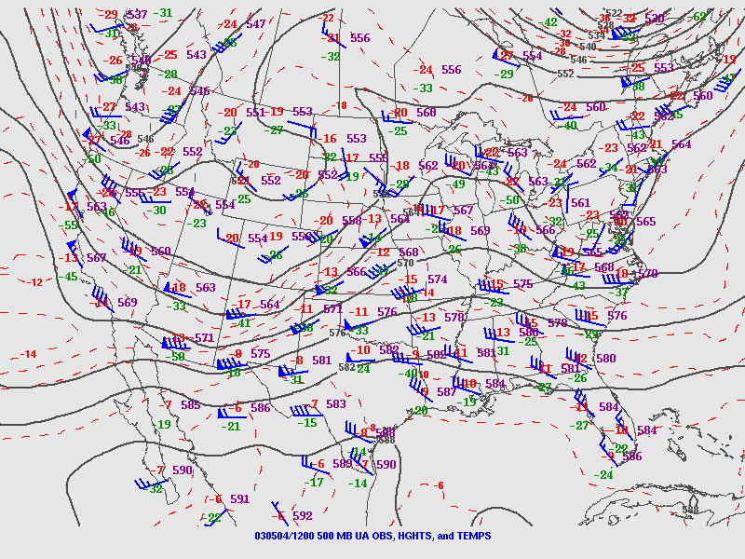
12z: 500 mb

Slide 7
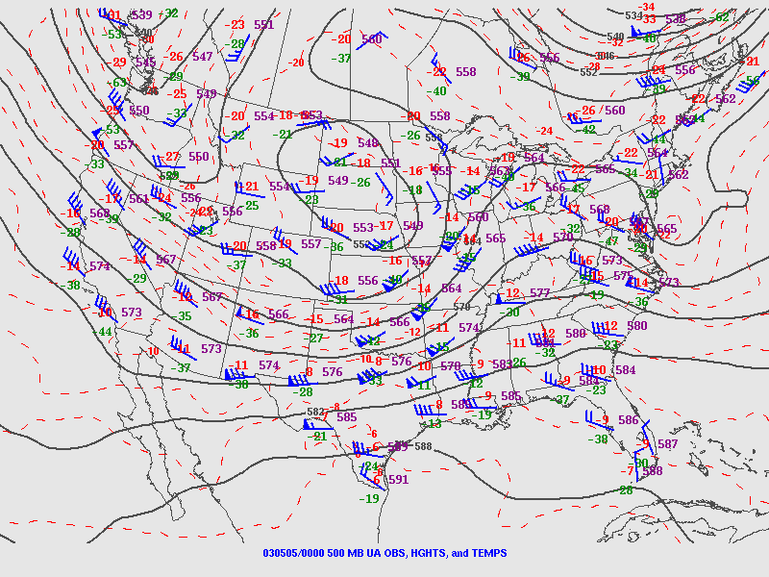
00z: 500 mb
Notes:
PVA here downstream of the trough axis. Also note downstream pattern… no moisture-sucking shortwaves, Gulf likely open.

Slide 8
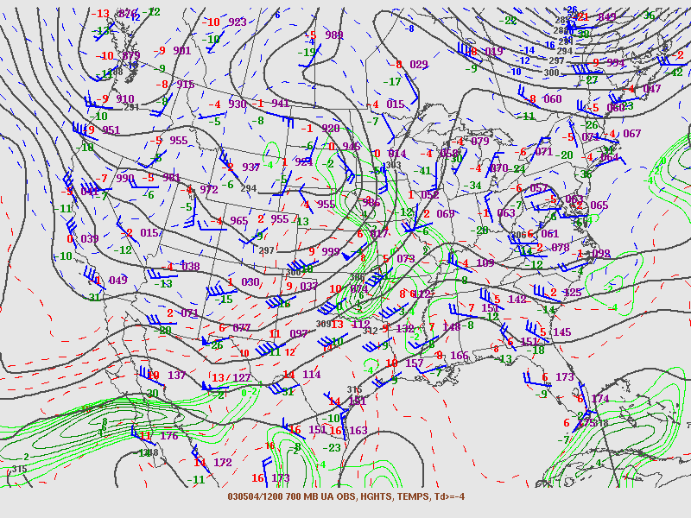
12z: 700 mb

Slide 9
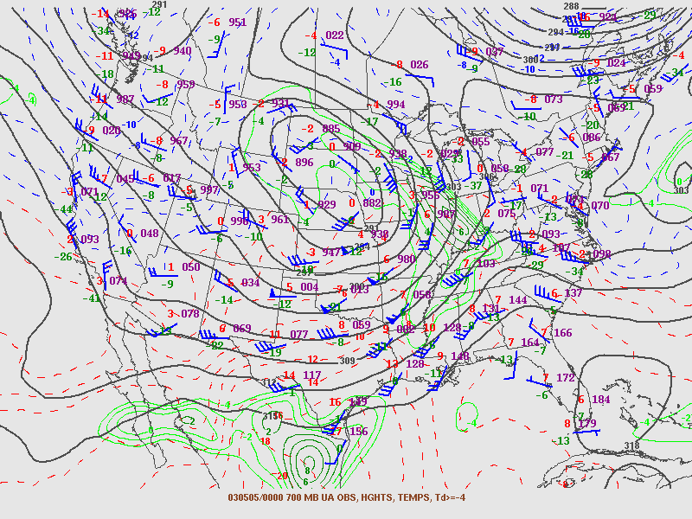
00z: 700 mb

Slide 10
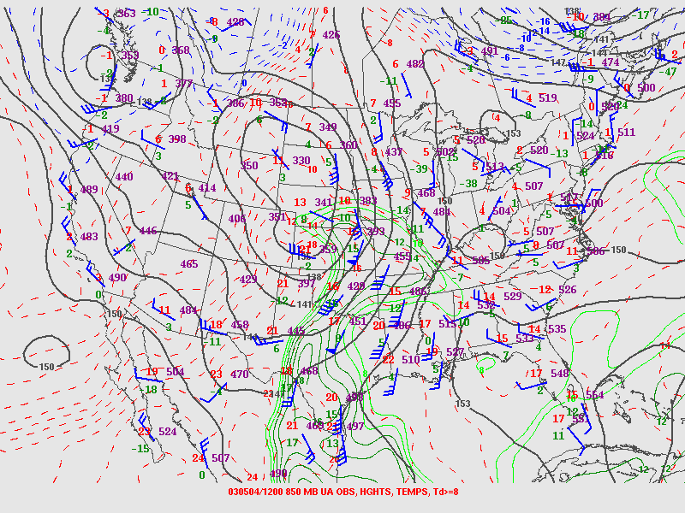
12z: 850 mb

Slide 11
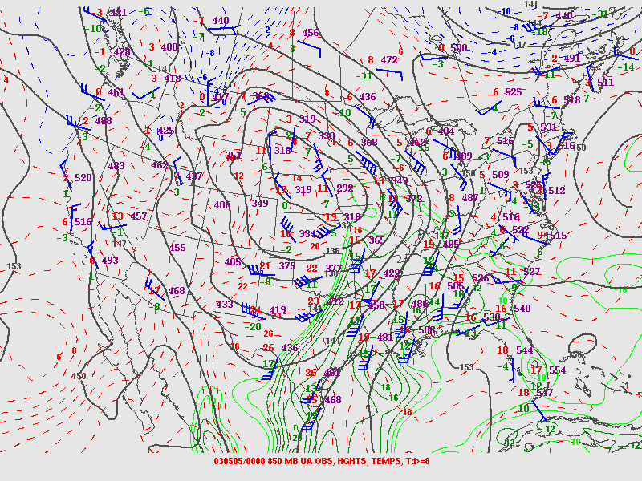
00z: 850 mb
Notes:
Note location of warm sector.

Slide 12
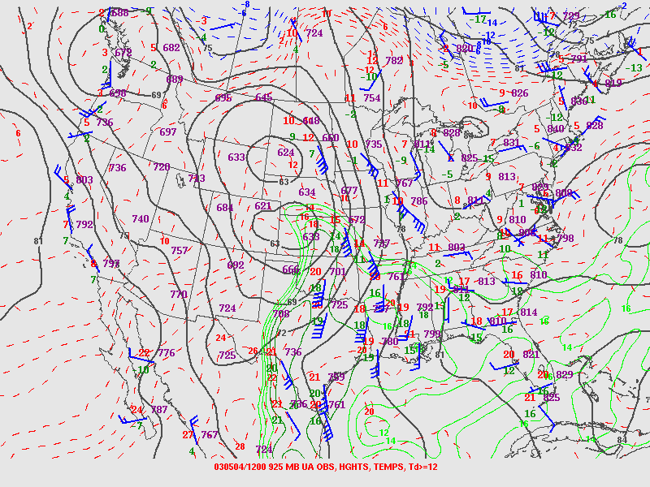
12z: 925 mb

Slide 13
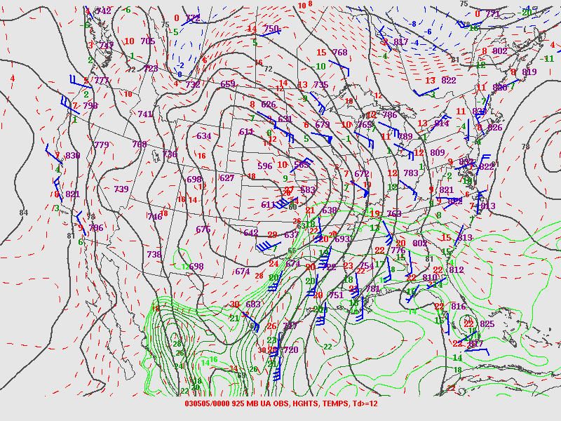
00z: 925 mb
Notes:
Location of warm front, dryline,no cold front really.

Slide 14
Diagnose Vertical Profiles
Distribution of and changes in moisture, lapse rates, and vertical shear.
First consider within the main outlook area, then around the periphery.

Slide 15
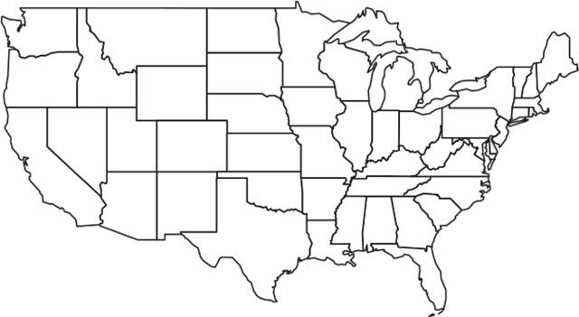
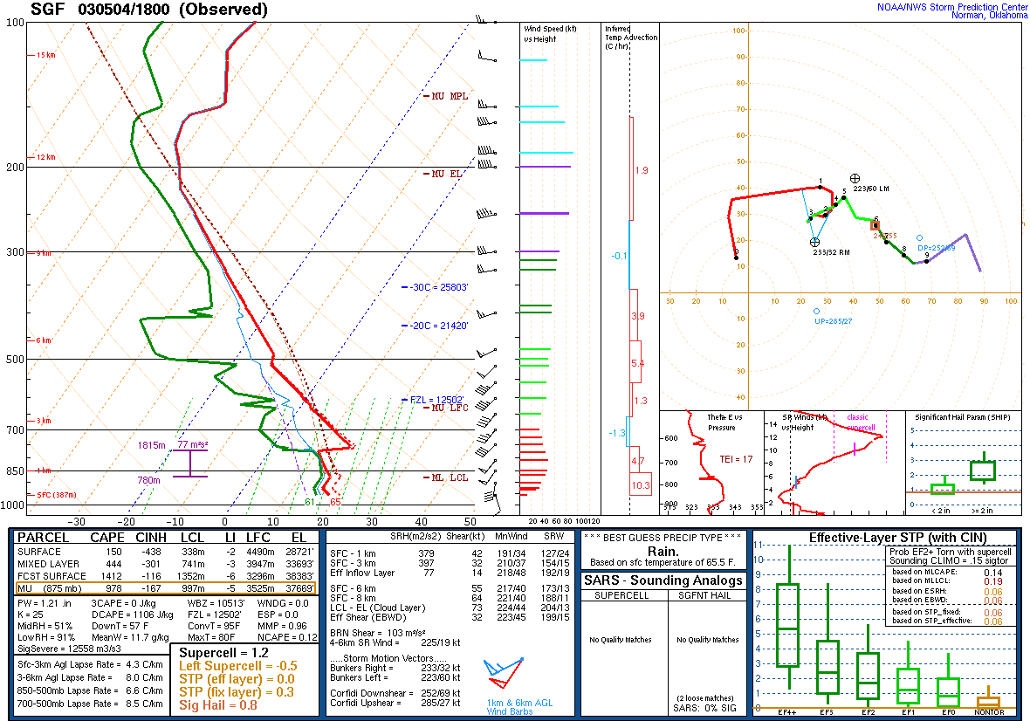
Notes:
Springfield (SW MO).

Slide 16
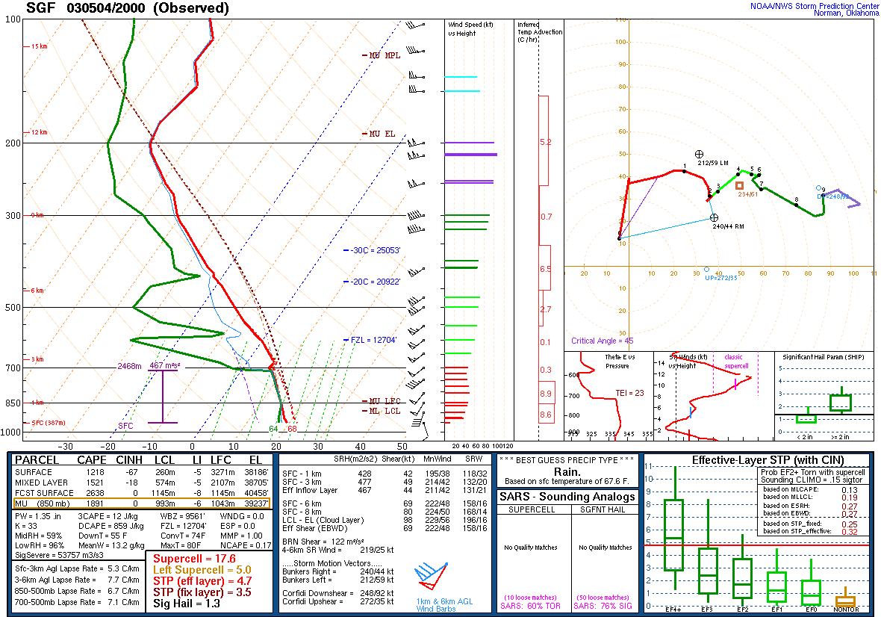
Notes:
Where’d the cap go?!

Slide 17
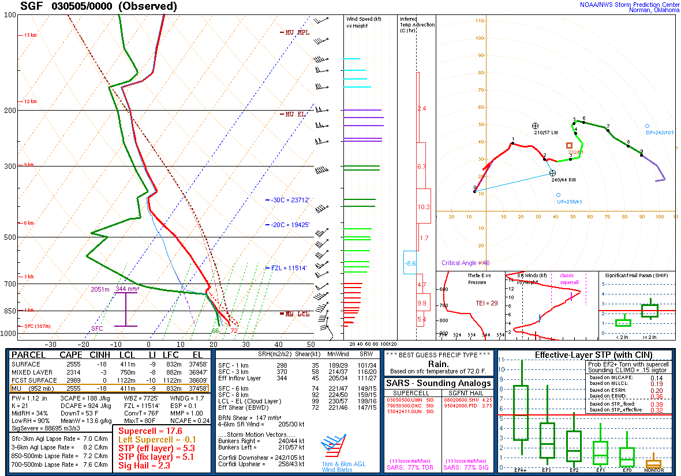

Slide 18
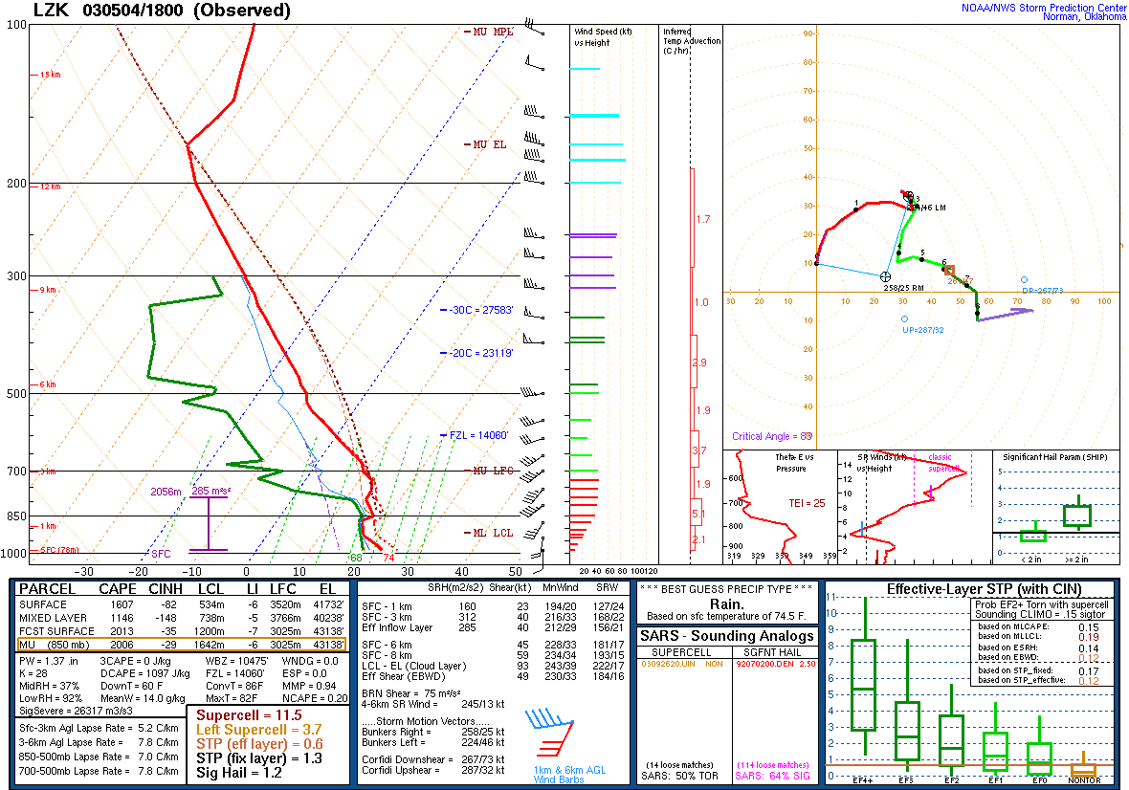
Notes:
Little Rock, AR (central AR).

Slide 19
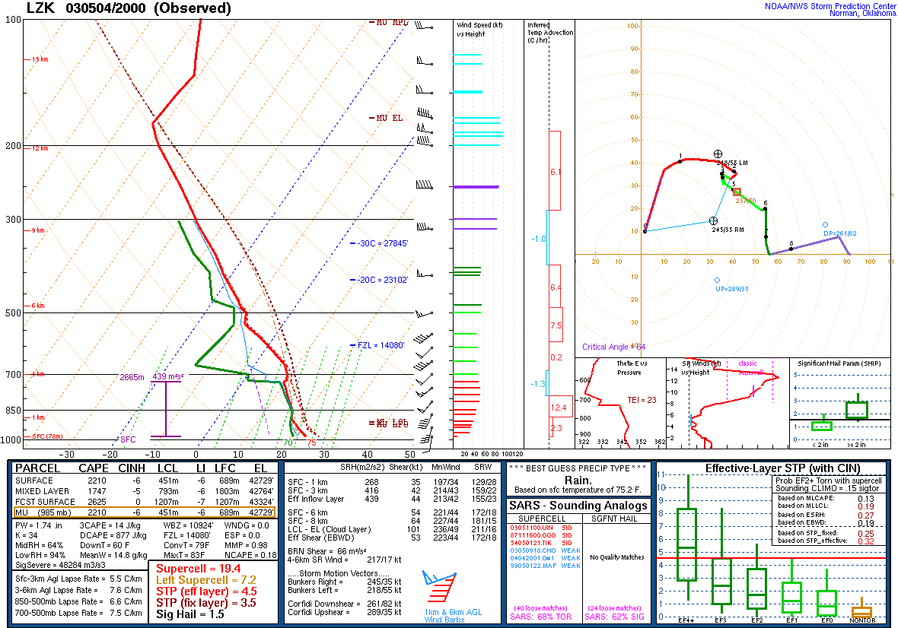
Notes:
Cap lifted again, and low-level shear enhanced.

Slide 20
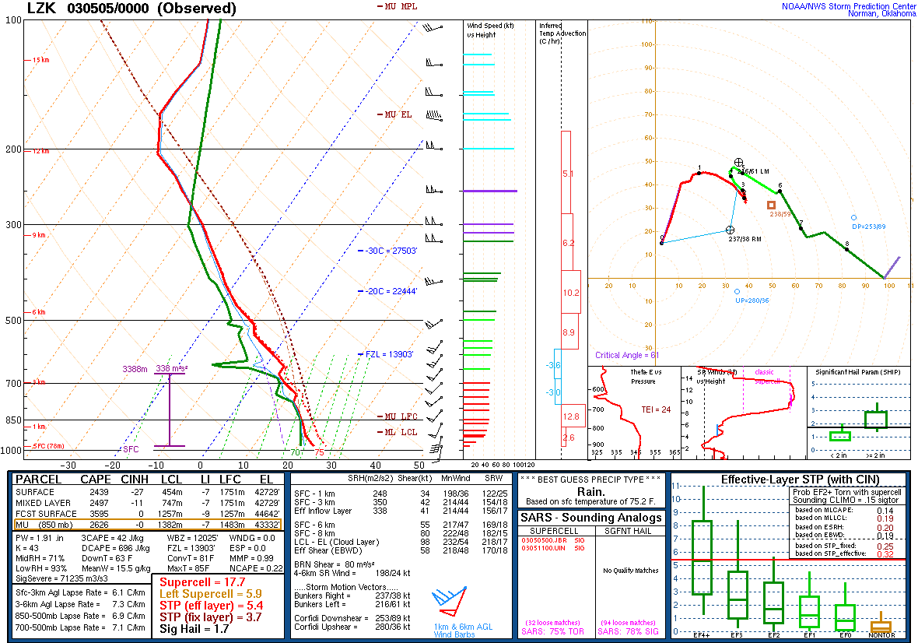

Slide 21
Notes:
Shreveport (NW LA).

Slide 22
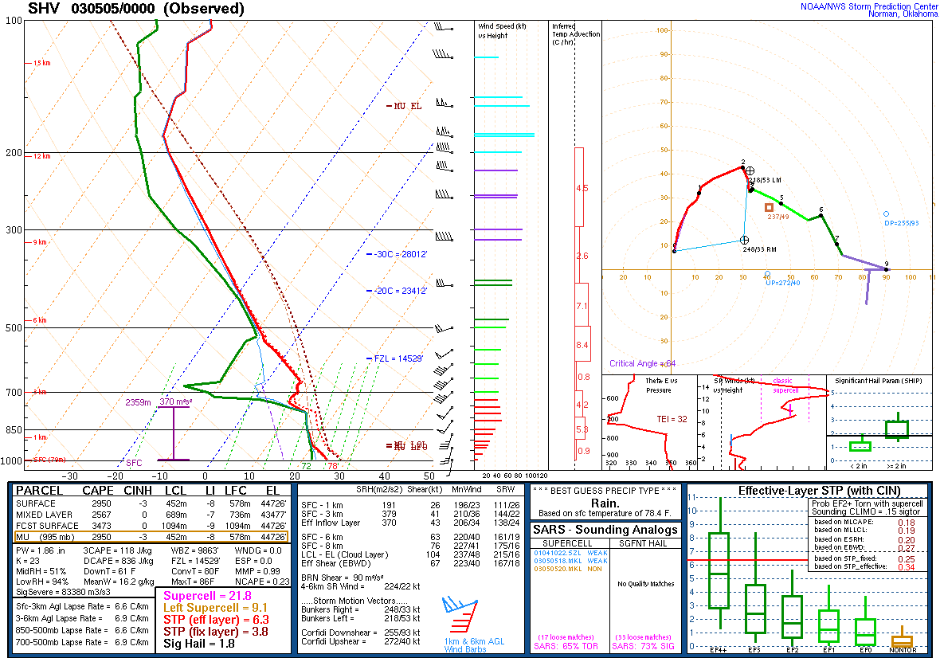

Slide 23
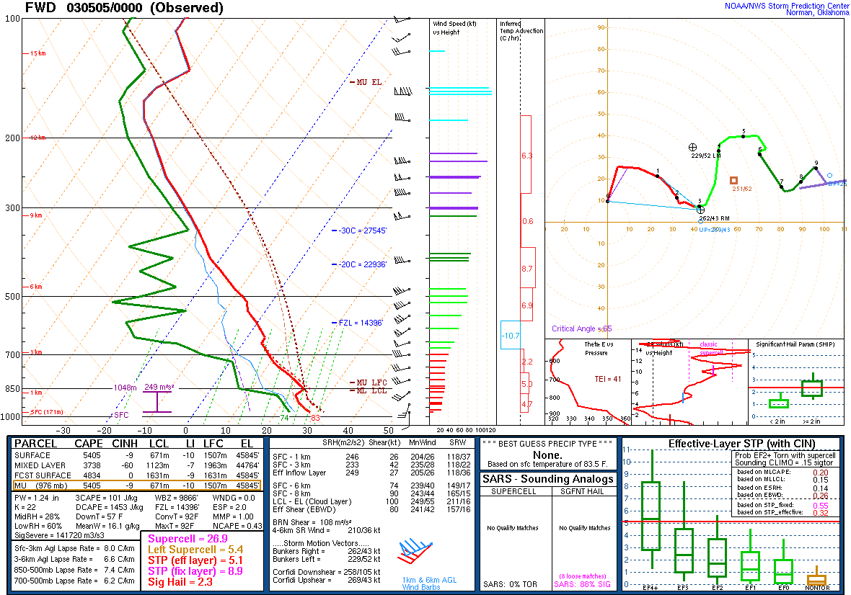

Slide 24
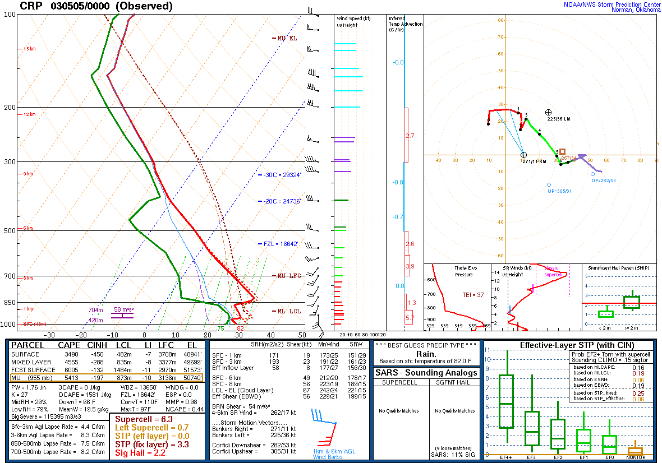

Slide 25
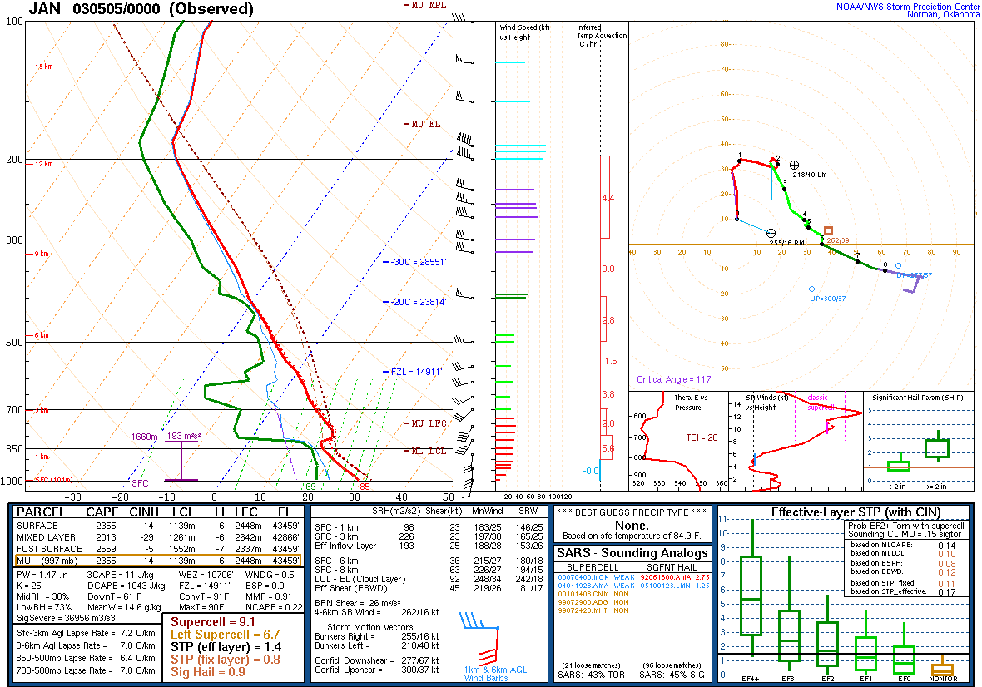

Slide 26
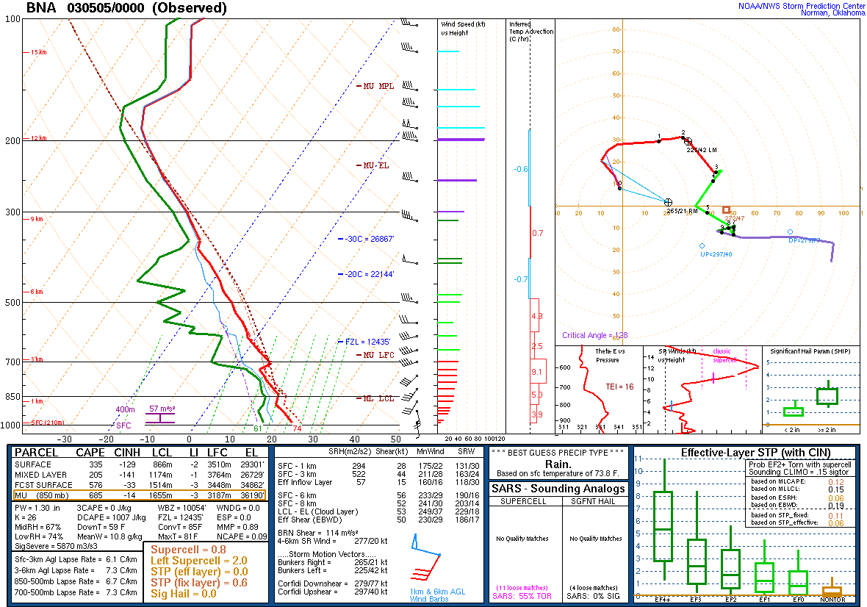
Notes:
Nashville.

Slide 27
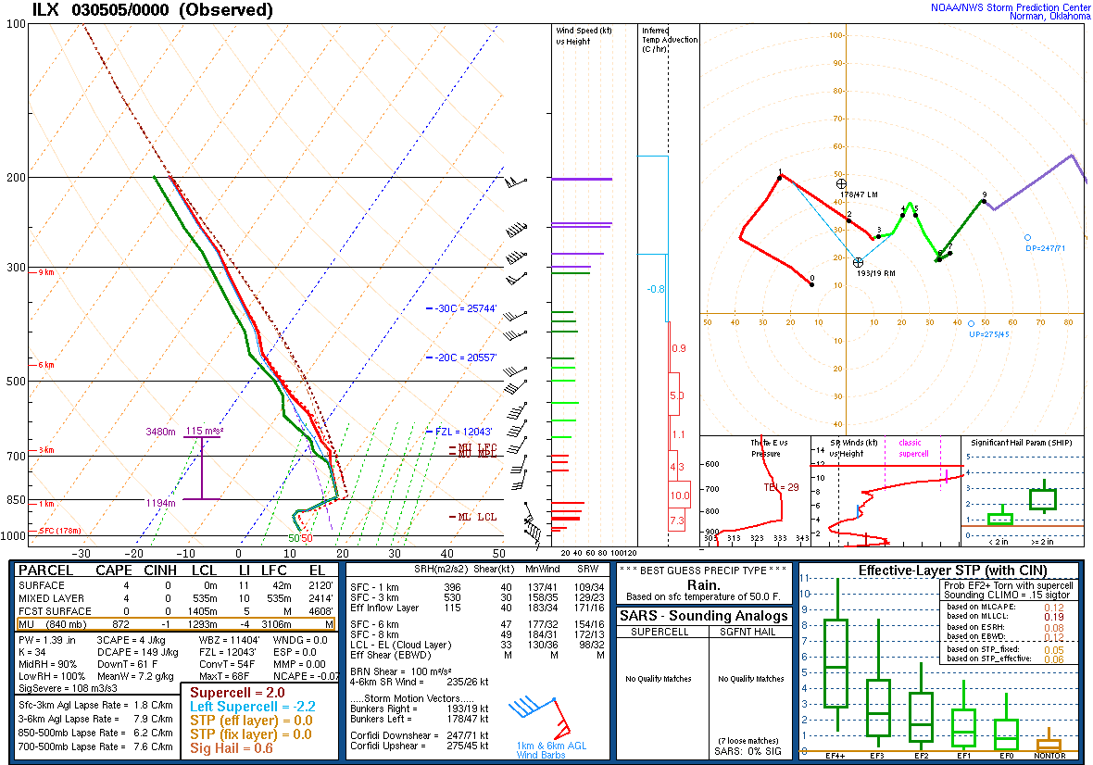
Notes:
Central Illinois.

Slide 28
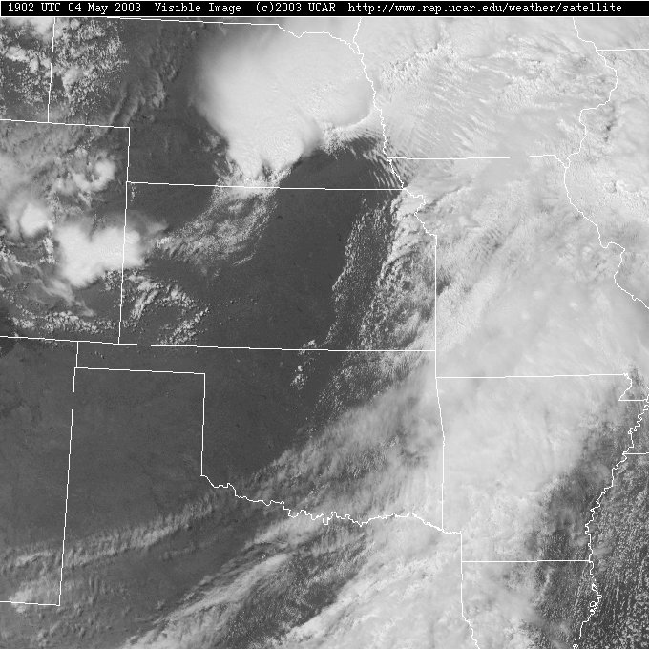
1902 UTC

Slide 29
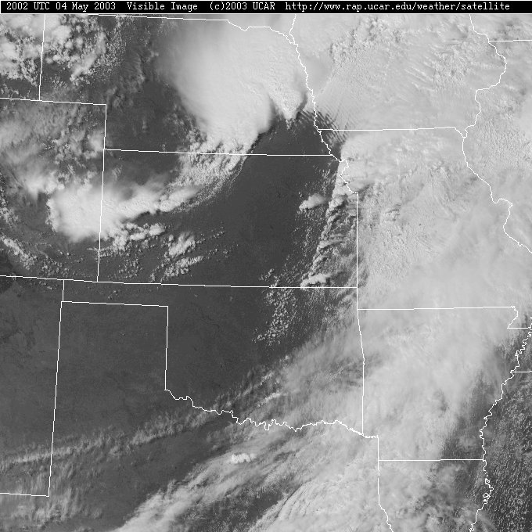
2002 UTC

Slide 30
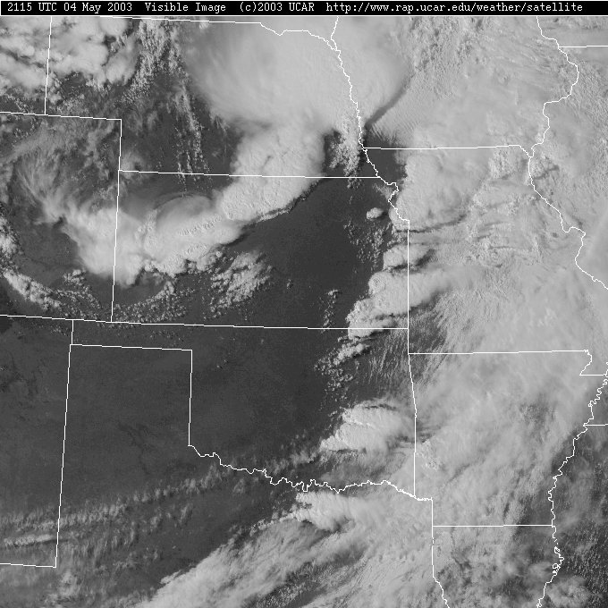
2115 UTC

Slide 31
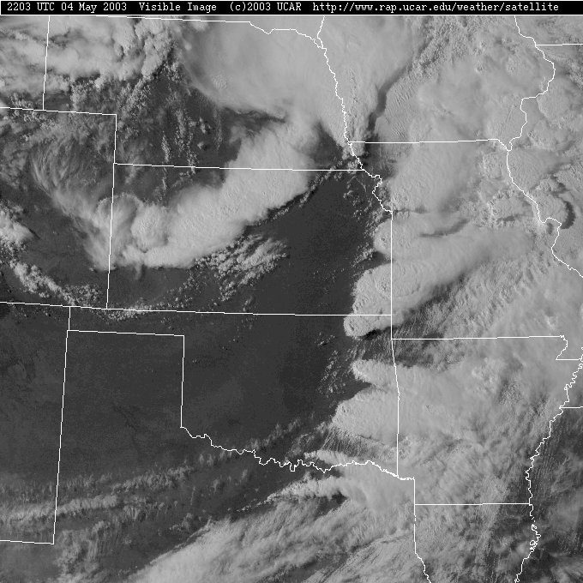
2203 UTC

Slide 32
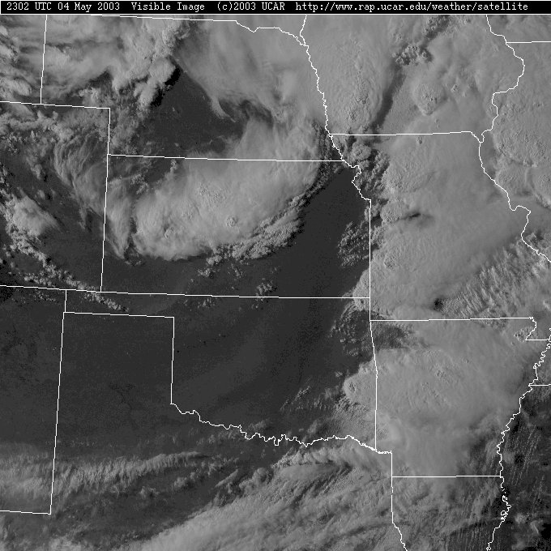
2302 UTC

Slide 33
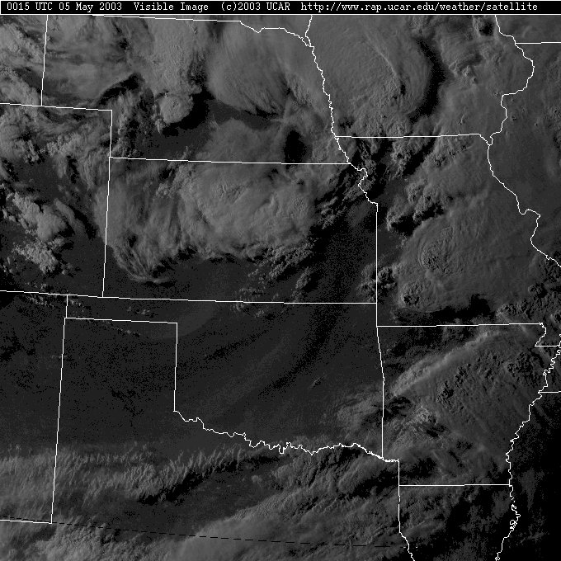
0015 UTC

Slide 34
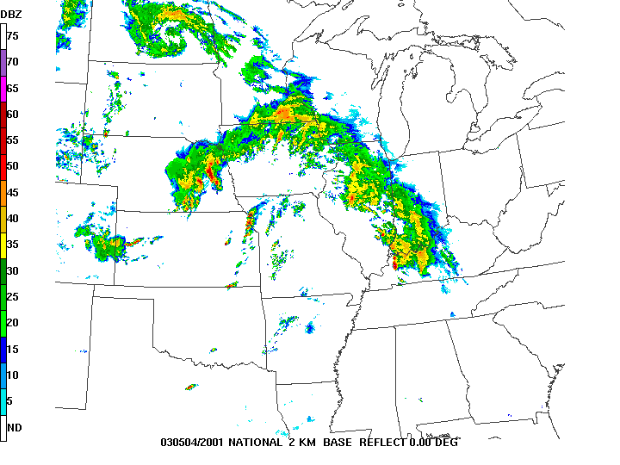
2001 UTC

Slide 35
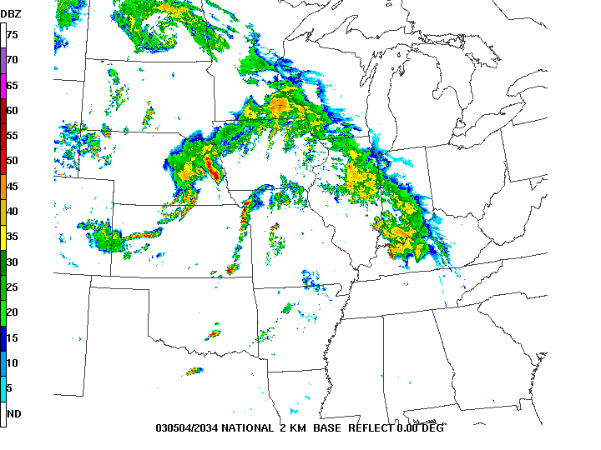
2034 UTC

Slide 36
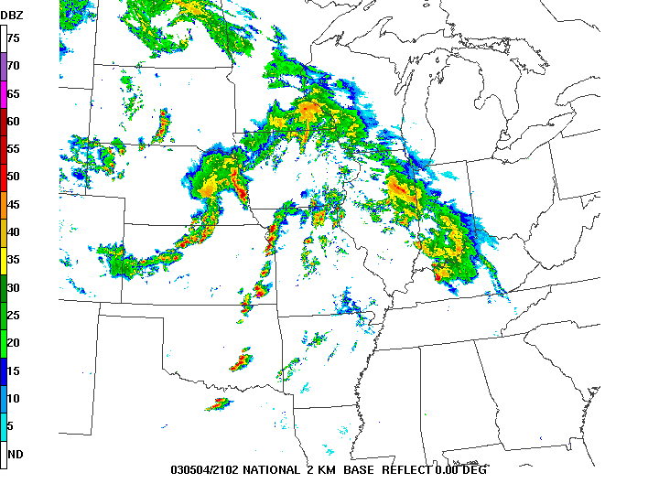
2102 UTC

Slide 37
2131 UTC

Slide 38
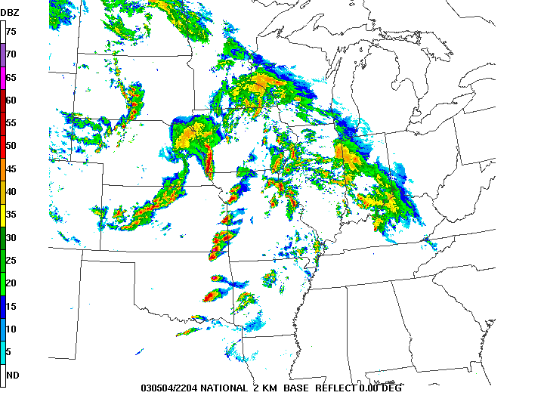
2204 UTC

Slide 39
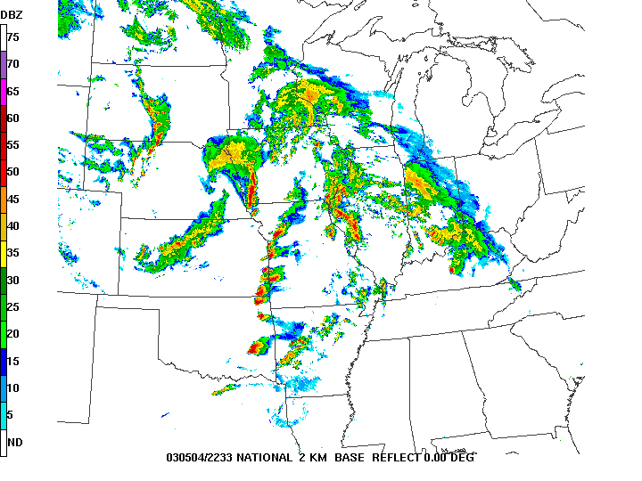
2233 UTC

Slide 40
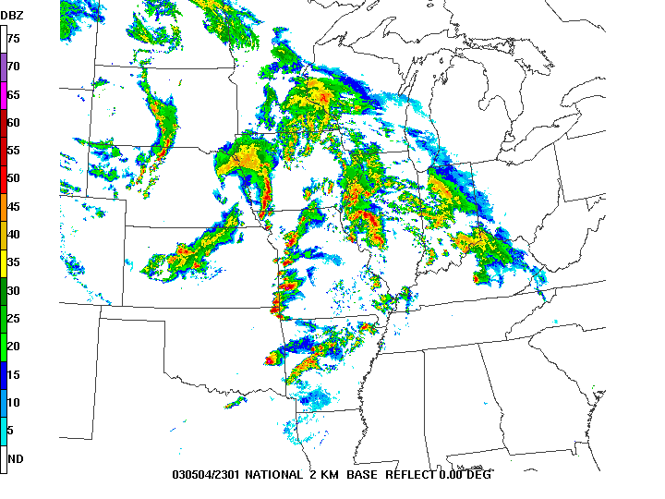
2301 UTC

Slide 41
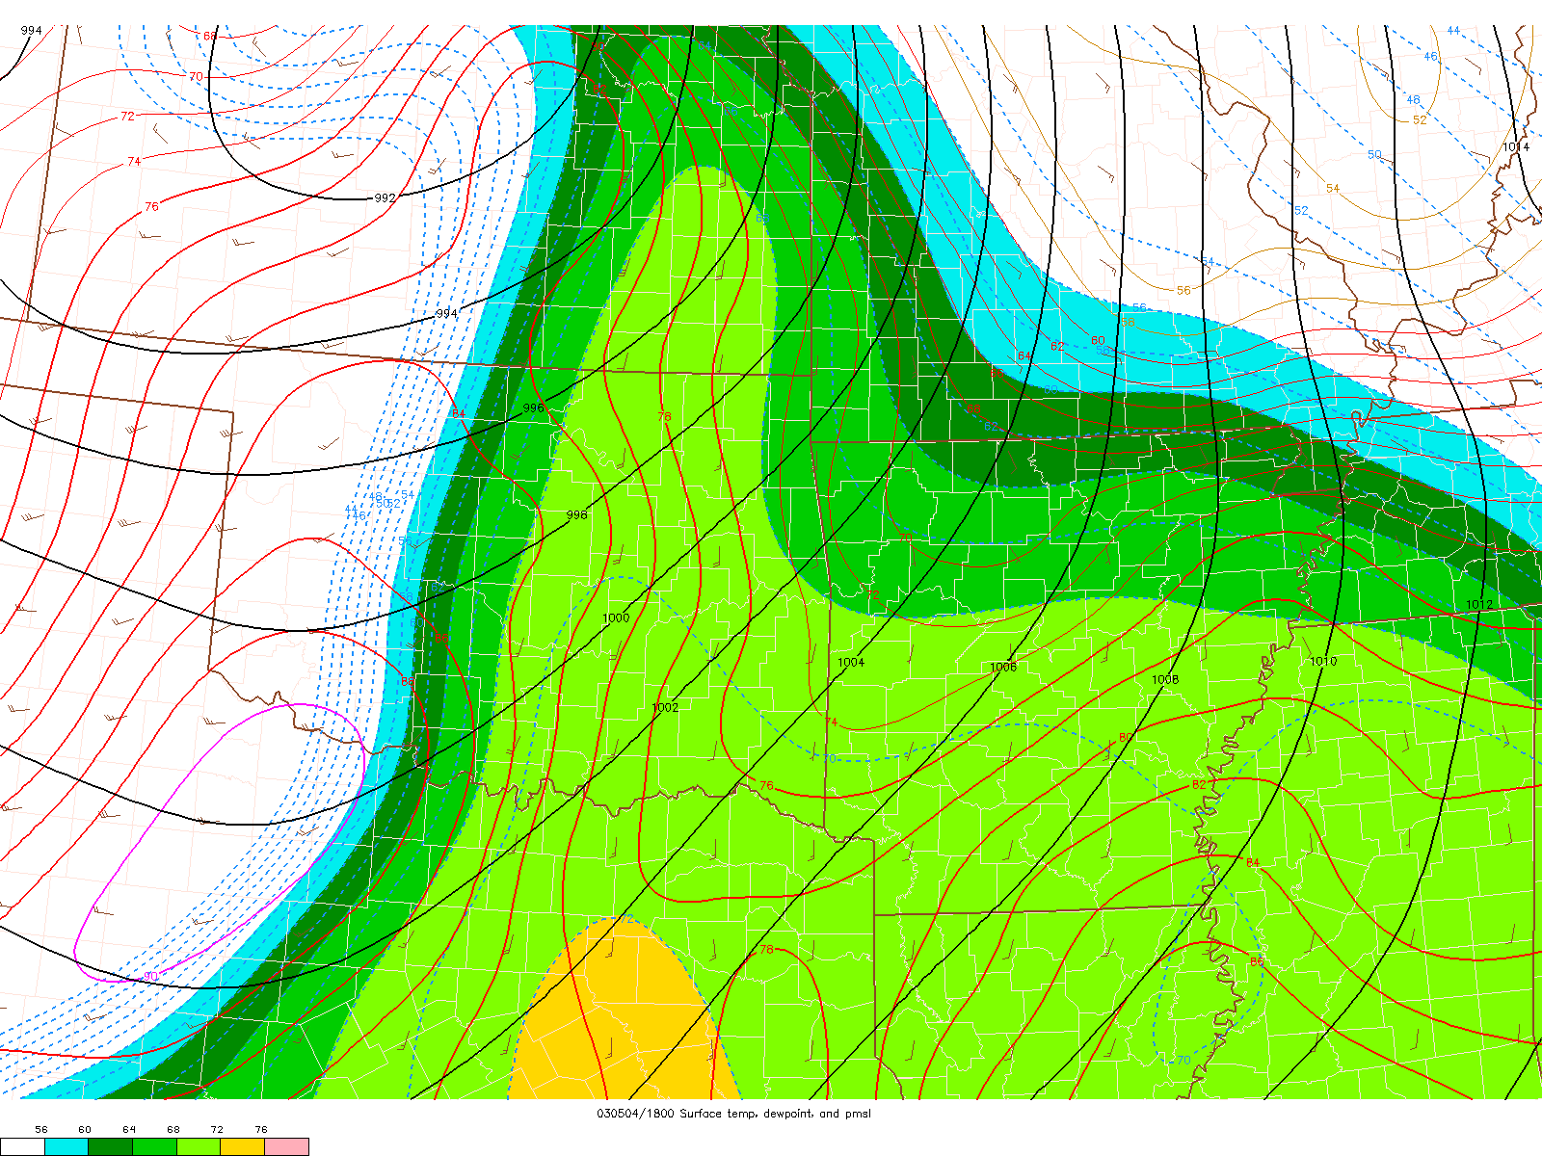
Dewpoint @ 1800 UTC

Slide 42
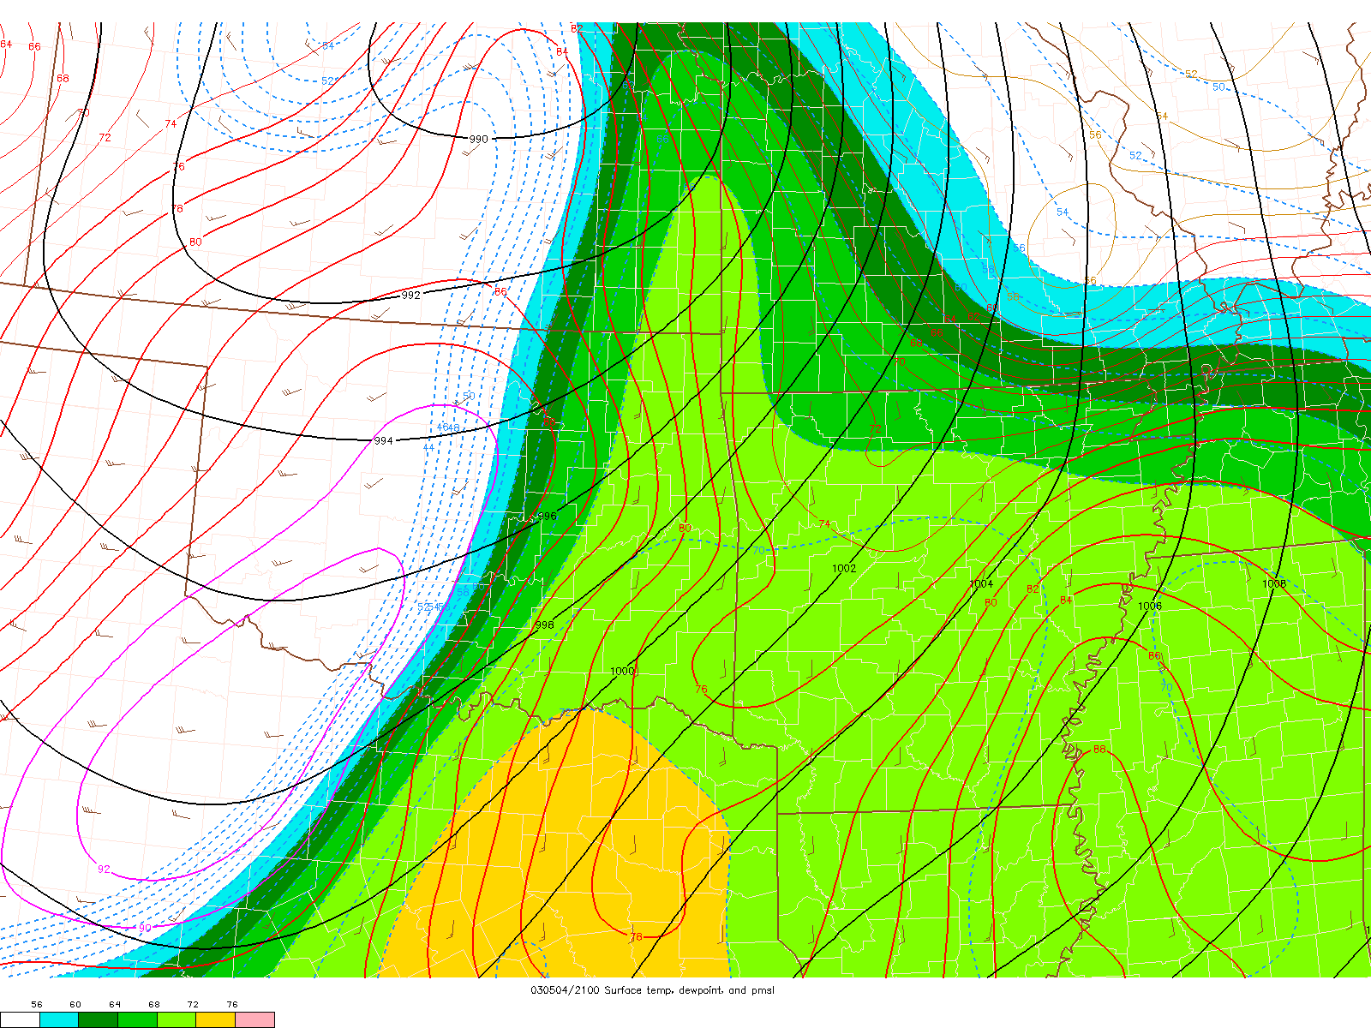
Dewpoint @ 2100 UTC

Slide 43
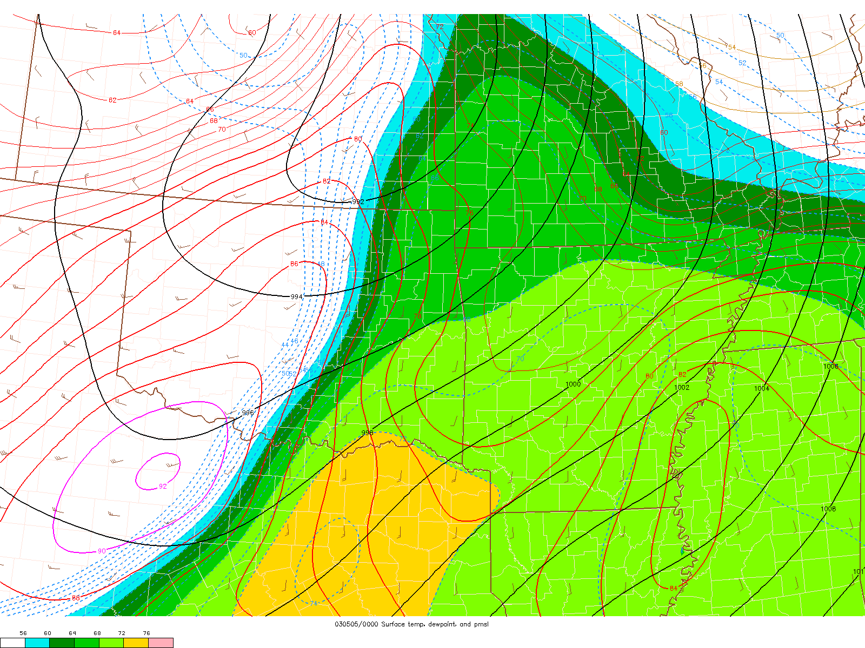
Dewpoint @ 0000 UTC

Slide 44
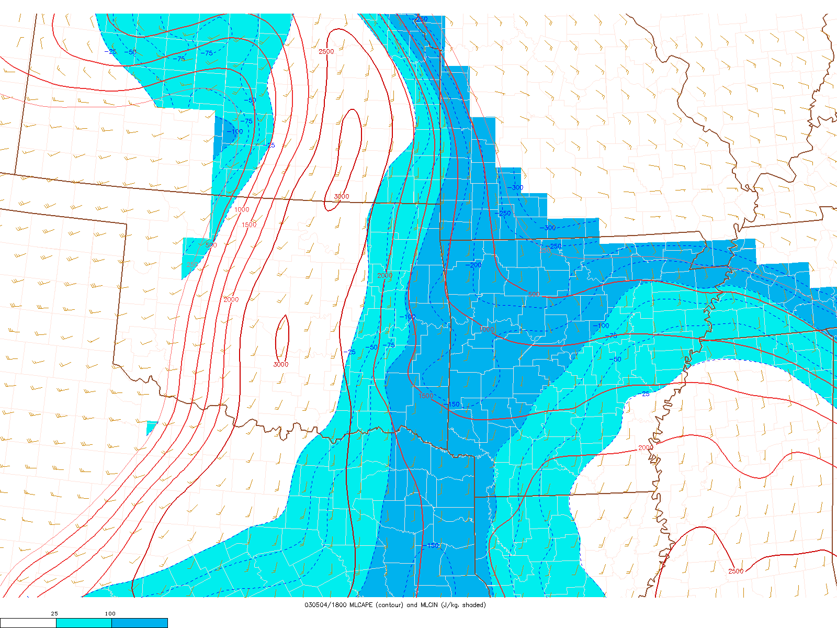
MLCAPE/MLCIN @ 1800 UTC

Slide 45
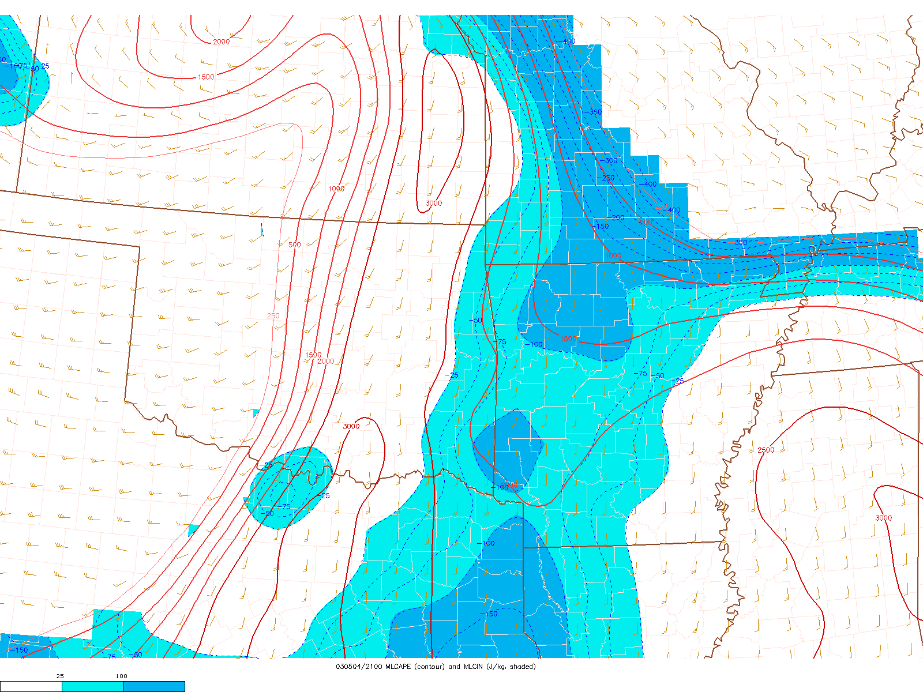
MLCAPE/MLCIN @ 2100 UTC

Slide 46
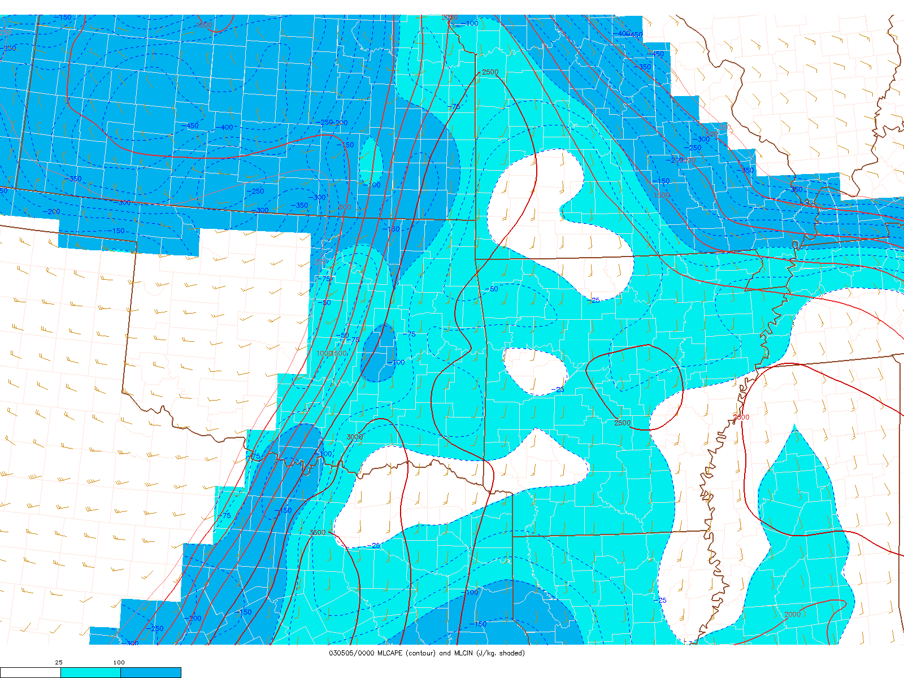
MLCAPE/MLCIN @ 0000 UTC

Slide 47
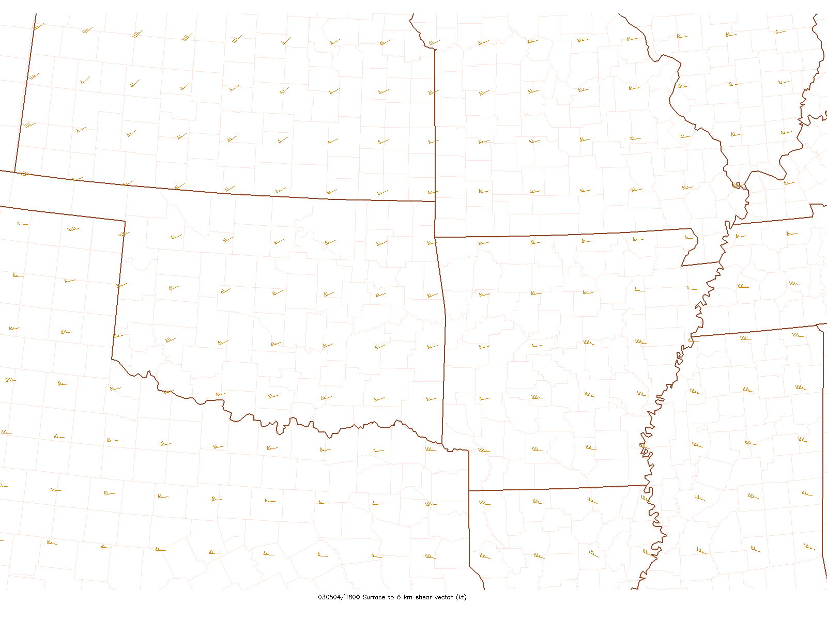
0–6-km shear @ 1800 UTC

Slide 48
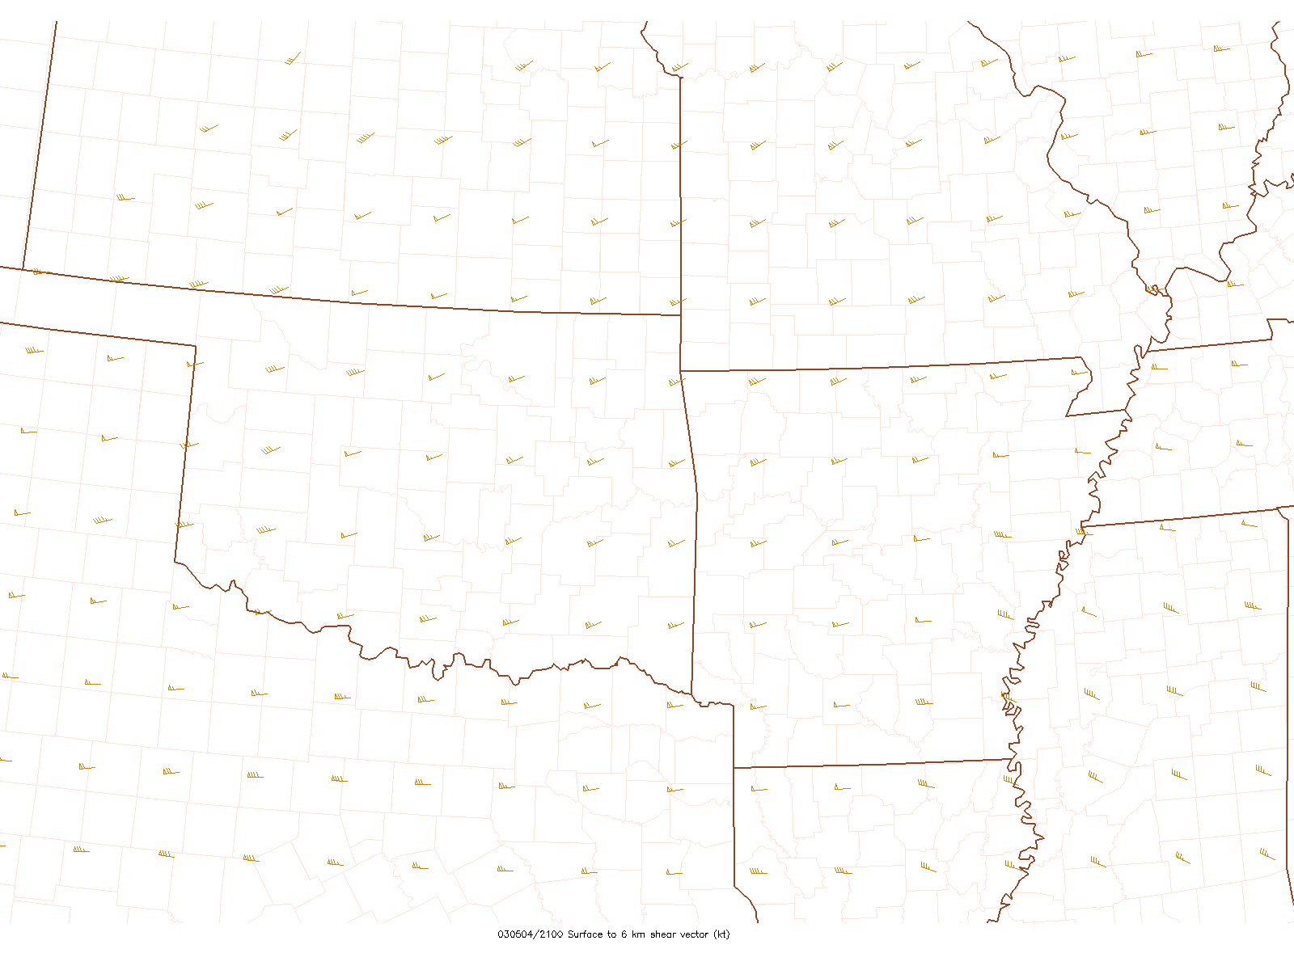
0–6-km shear @ 1800 UTC

Slide 49
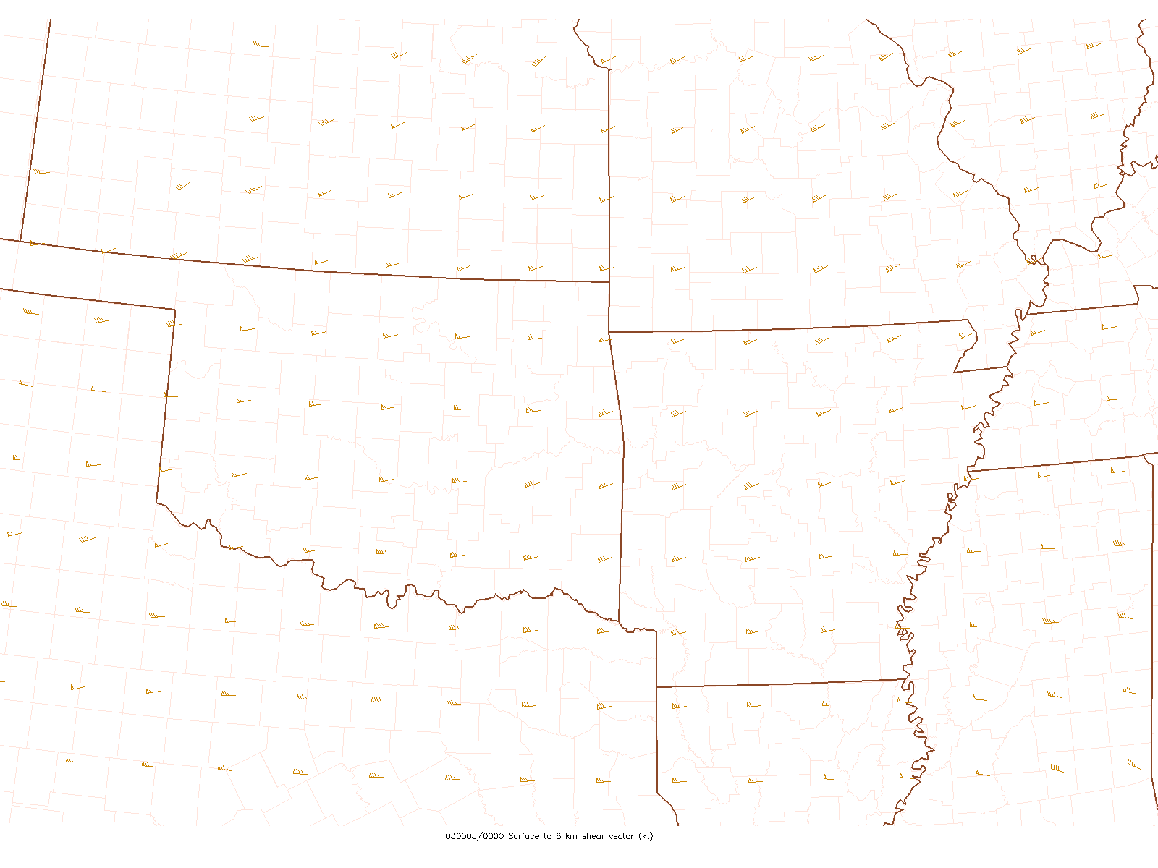
0–6-km shear @ 1800 UTC

Slide 50
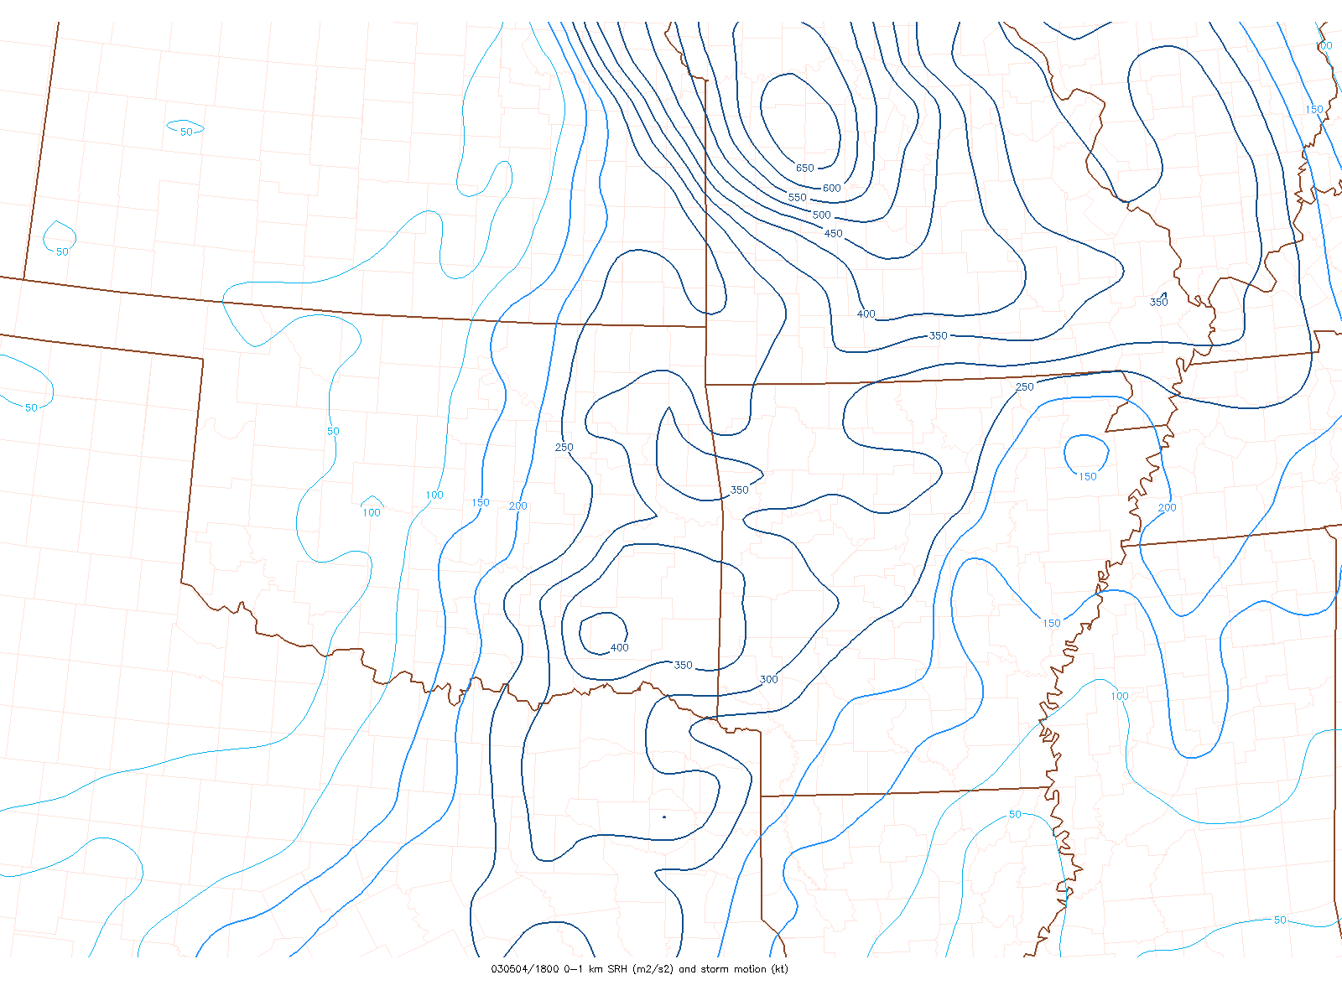
0–1-km SRH @ 1800 UTC

Slide 51
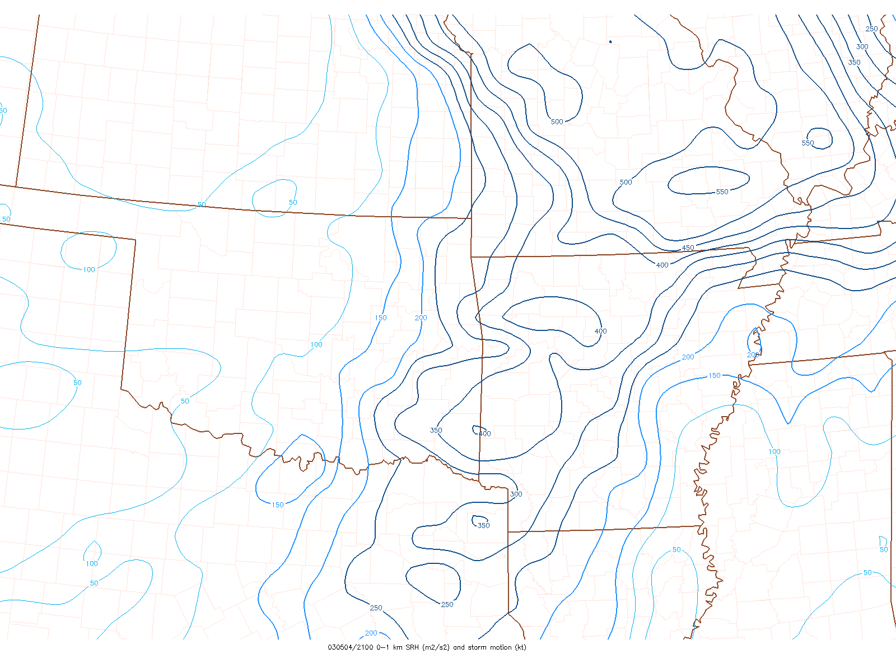
0–1-km SRH @ 2100 UTC

Slide 52
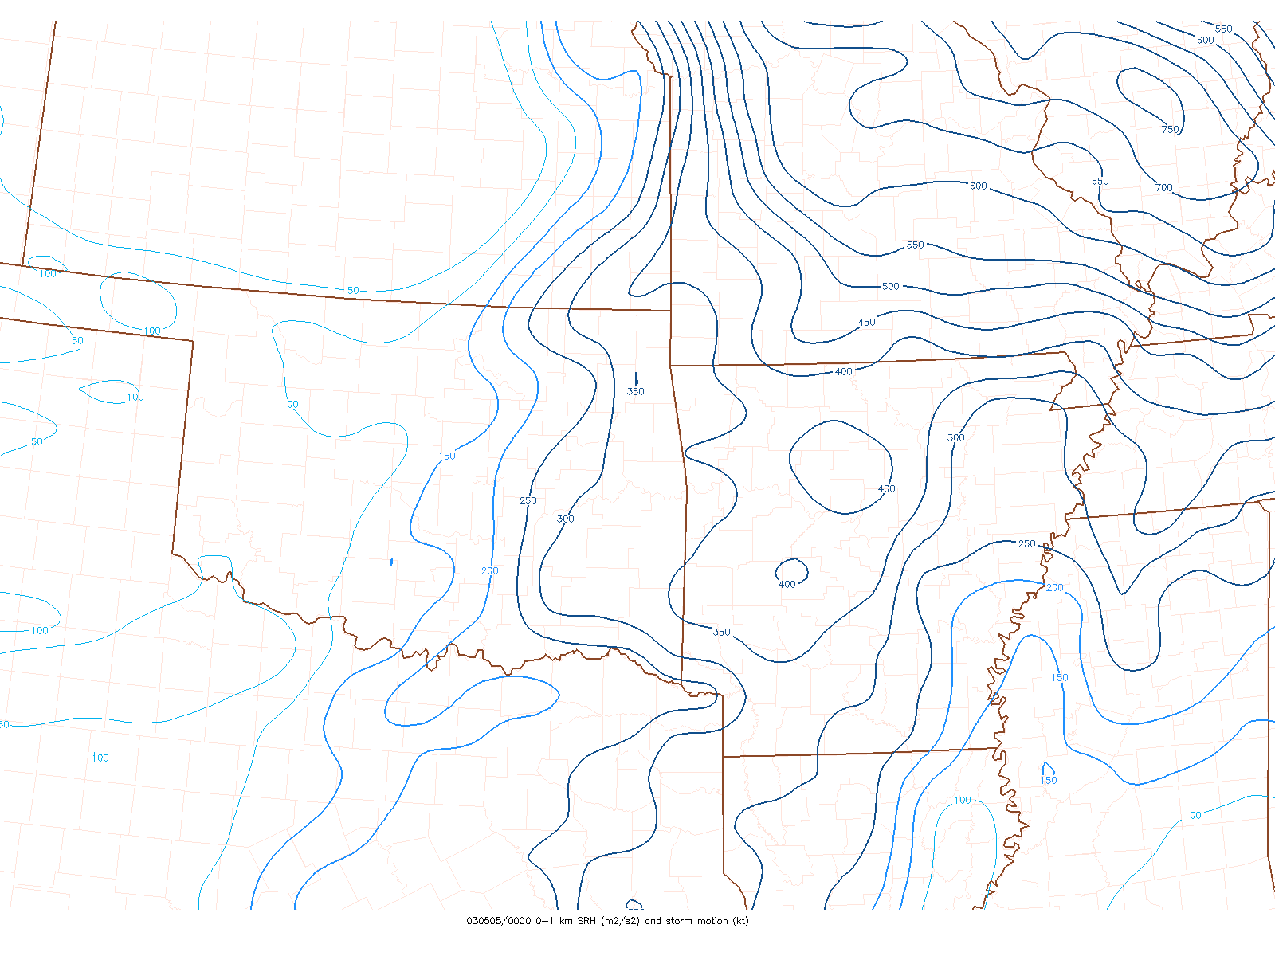
0–1-km SRH @ 0000 UTC

Slide 53
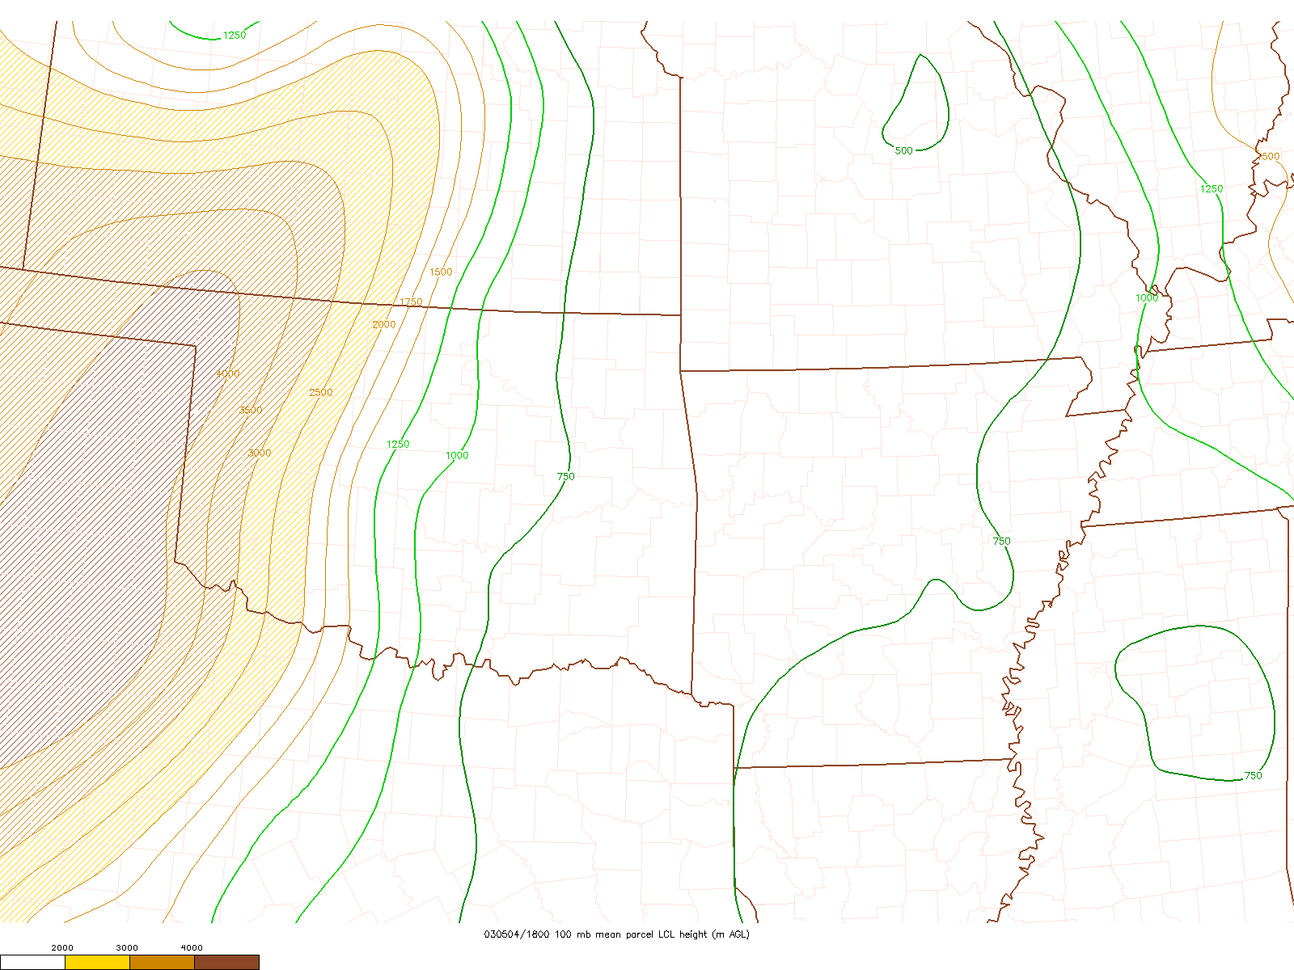
MLLCL @ 1800 UTC

Slide 54
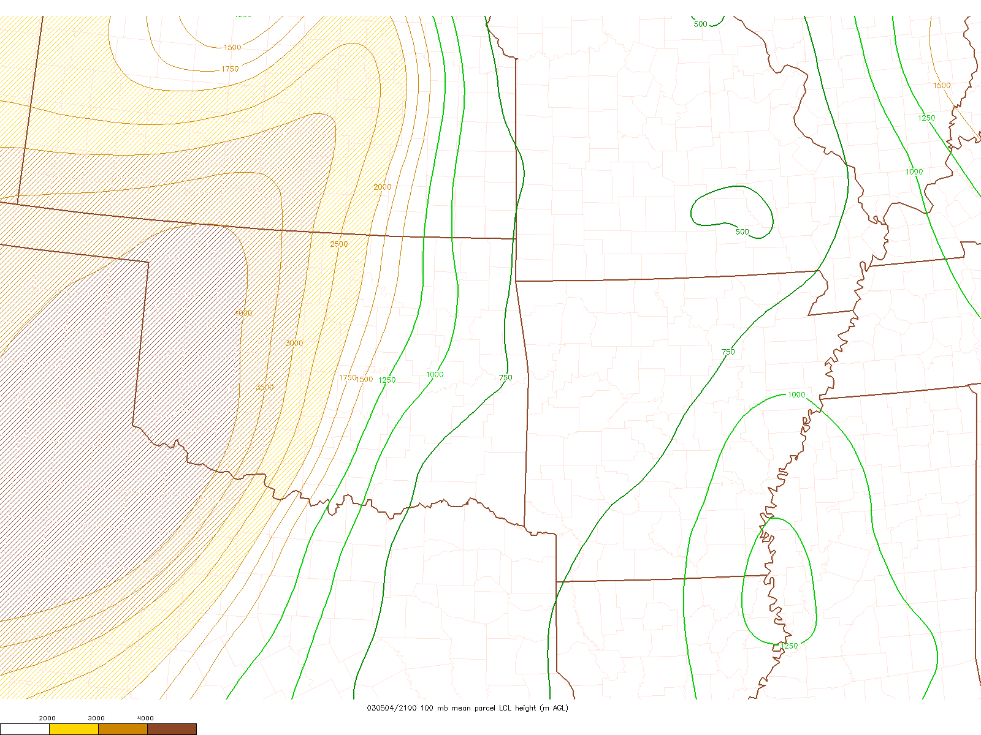
MLLCL @ 2100 UTC

Slide 55
MLLCL @ 0000 UTC

Slide 56
Draw your 01z tornado probabilities!
Moderate line for 15%
High line for 30%
Black for hatched
Email this slide to matthew.flournoy@noaa.gov

Slide 57
THE ANSWER

Slide 66
Summary
Synoptic wave should maintain intensity and move to the east or east-northeast.
Surface cyclone should develop toward the east-northeast in response to combined Q-G forcing for ascent.
Mass response to cyclogenesis will be LLJ developing eastward toward MS River.
Moist/unstable environment will maintain tornado risk overnight, esp. with cluster supercells across the Mid South.

