Slide 1
An overview on derechos
Brian Squitieri, Ph.D.
Storm Prediction Center
National Weather Service

Slide 2
What is a derecho?
Historically, the term derecho has been applied ambiguously
Lack of agreement as to the specific criteria needed to confirm a derecho
What storm modes and ambient environments support such events
Should internal storm-scale mechanisms matter in derecho production? Think of the differences between supercell-tornadoes vs. landspouts for example.
There is a general understanding (agreement) that derechos are widespread severe windstorms originating from MCSs (or organized, mostly linear convection)
What makes a given event a derecho in the eyes of the meteorology community, broadcast media, stakeholders, or the public?
“You know it when you see it.”

Slide 3
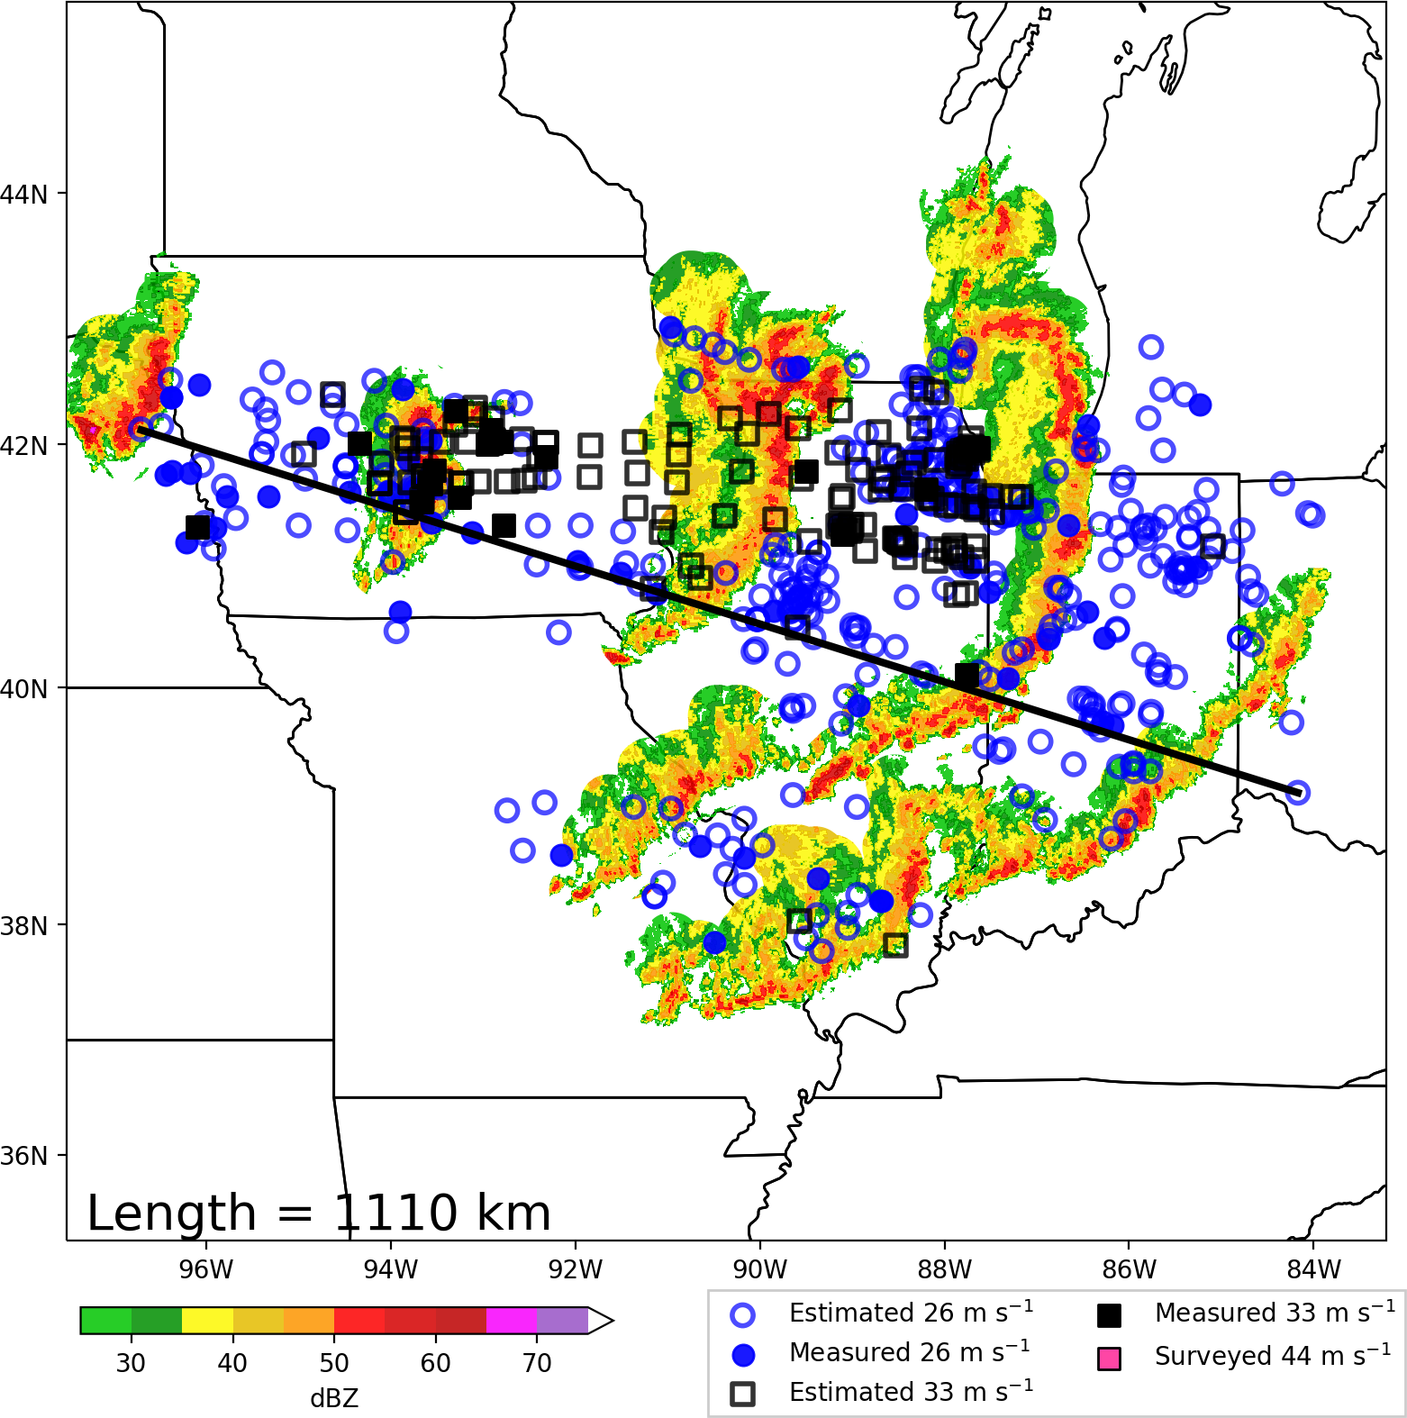
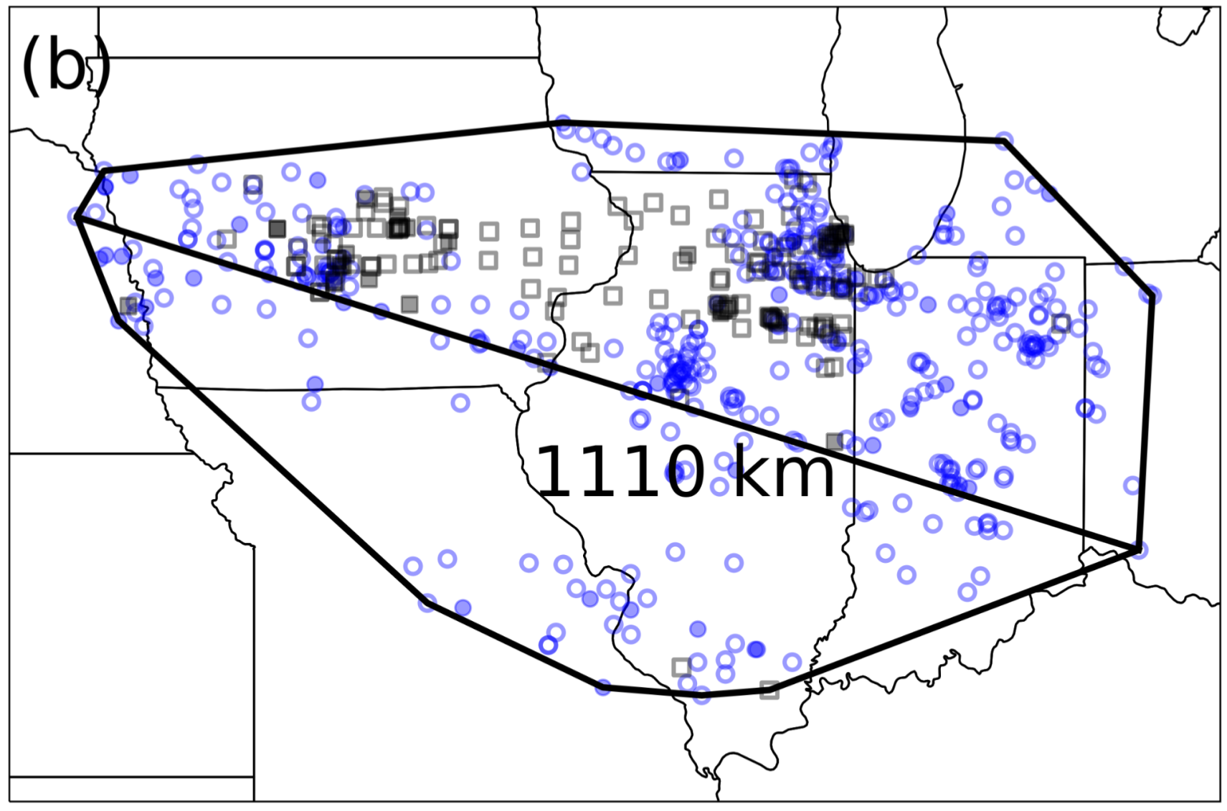
What is a derecho?
(a)
Derecho
DMCS
Parent MCS is known as the derecho-producing MCS (DMCS)
The derecho is the series of downbursts, evident via swaths of wind reports
Calling an MCS a derecho is like calling a supercell a tornado.

Slide 4
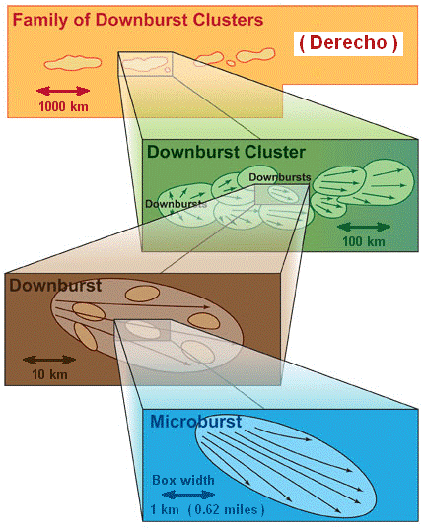
What is a derecho?
Downburst winds occur on varying scales of motion.
Typically, instances of stronger winds occur within increasingly shorter-lived, shorter-tracked, narrower swaths.
Analogous to stronger winds contained within single-suction vortices of multiple-vortex tornadoes.
Fujita and
Wakimoto (1981)

Slide 5
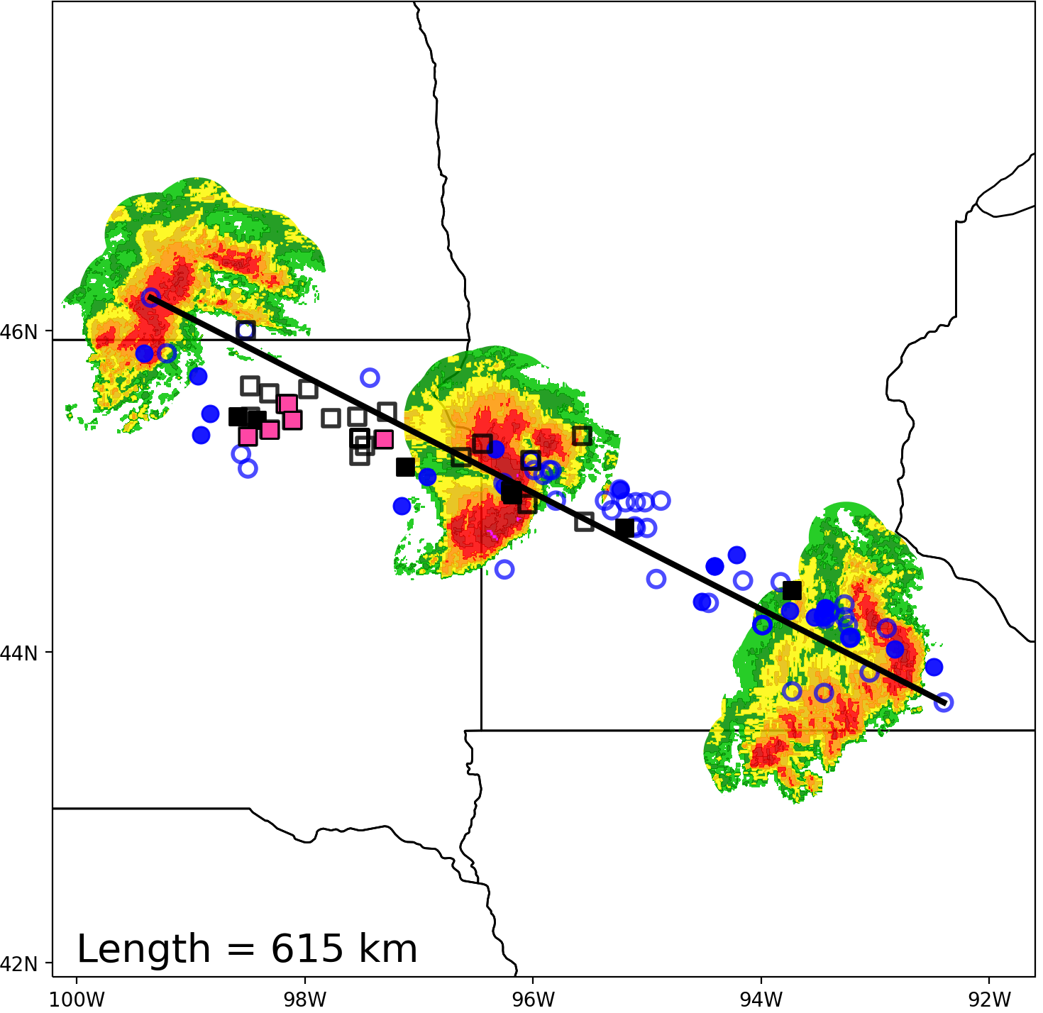
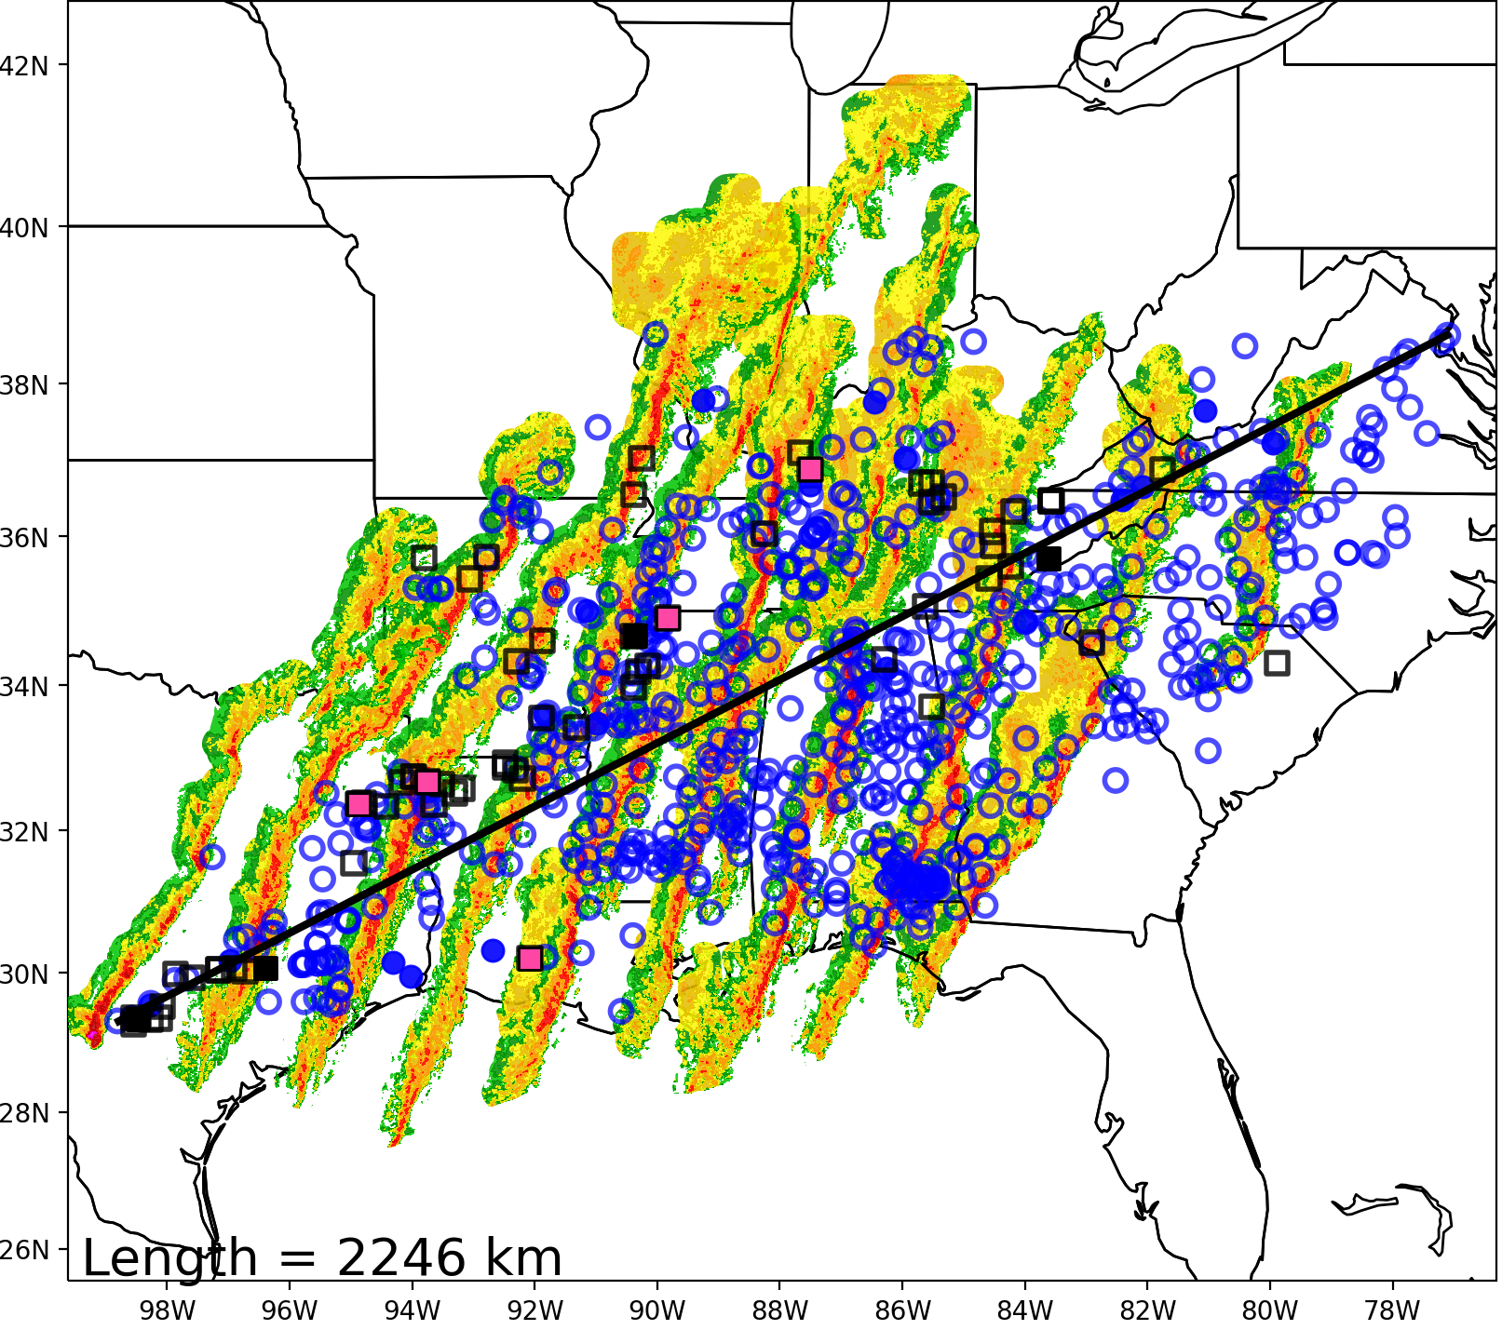
Derecho and DMCS Types
Progressive Derecho
Serial Derecho
Bow-Echo DMCS
31 July 2008
Squall-Line DMCS
10 January 2020

Slide 6
Defining Derechos
Johns and Hirt (1987) was the first to robustly study derechos, identifying progressive/serial derecho types in the process.
Quantitative criteria were introduced to stratify between potent wind swaths and more ordinary severe wind events.
Defined derechos as “widespread windstorms originating from a singular MCS”

Slide 7
Defining Derechos
Corfidi et al. (2016) proposed a new derecho definition:
“A family of damaging downburst clusters associated with a forward-propagating, mesoscale convective system (MCS) that, during part of its existence, displays evidence of one or more sustained bow echoes with mesoscale vortices and/or rear-inflow jets.”
The proposed definition would exclude serial squall line events, which were hypothesized to be driven primarily be downward momentum transport of the synoptic flow aloft.
Progressive DMCSs are self-organized, with severe/hurricane-force winds generated by internal mechanisms (discussed later).

Slide 8
Derecho Classification
What are the quantitative criteria that a wind swath must meet to be classified as a derecho?

Slide 9
 | Johns and Hirt (1987) JH87 | Bentley and Mote (1998) BM98 | Bentley and Sparks (2003) | Coniglio and Stensrud (2004) CS04 | Corfidi et al. (2016) C16
Years | 1980-1983 | 1986-1995 | 1986-2000 | 1986-2001 | 2010-2014
N | 70 | 112 | 230 | 244 | 365 (25)
Type | Progressive Serial | Progressive Serial | Progressive Serial | Progressive Serial | Progressive
1 | There must be a concentrated area of convective wind gusts exceeding 26 m s⁻¹ with a major axis path length of at least 400 km. | As in JH87 | As in JH87 | As in JH87 | Like JH87, but for a path length of 650 km (N = 25 cases that met this length criteria).
2 | There must be at least 3 reports (separated by 64 km) of F1 damage or 33+ m s⁻¹ wind gusts during the MCS stage. | Not Used | As in BM98 | Low end: BM98 Moderate: JH87 High end: Like JH87, but 3 reports must exceed 38 m s⁻¹, with 2 occurring at MCS stage. | As in BM98
3 | No more than 3 h can elapse between successive reports. | No more than 2 h can elapse between successive reports. | As in BM98 | Like JH87, but for 2.5 h. | No more than 1 h elapsed between successive reports.
4 | Wind reports must have chronological progression. | As in JH87 | As in JH87 | As in JH87 | As in JH87
5 | The associated MCS must have spatial or temporal continuity in surface pressure or wind fields. | Continuity confirmed when no more than 2º lat/lon separation occurs between reports. | As in BM98 | Like BM98, but no more than 200 km allowed between any reports in the swath. | Like CS04, but no more than 100 km allowed between any reports in the swath.
6 | All damage swaths must accompany the same MCS based on radar data. | MCS confirmed by temporally mapping wind reports without radar data. | As in BM98 | As in JH87 | As in JH87

Slide 10
Derecho Classification
Varying quantitative criteria classifying derechos introduces sensitivity to spatial climatology and overall annual frequency
See recommended reading – first article for more details
Previous derecho studies evaluated events over smaller periods of time, which can also influence climatology results
A need arises for a more consistently applied definition and associated quantitative criteria to better understand the mechanisms and ambient environments supporting the most intense, destructive wind swaths. Can also derive a more accurate spatial climatology.

Slide 11
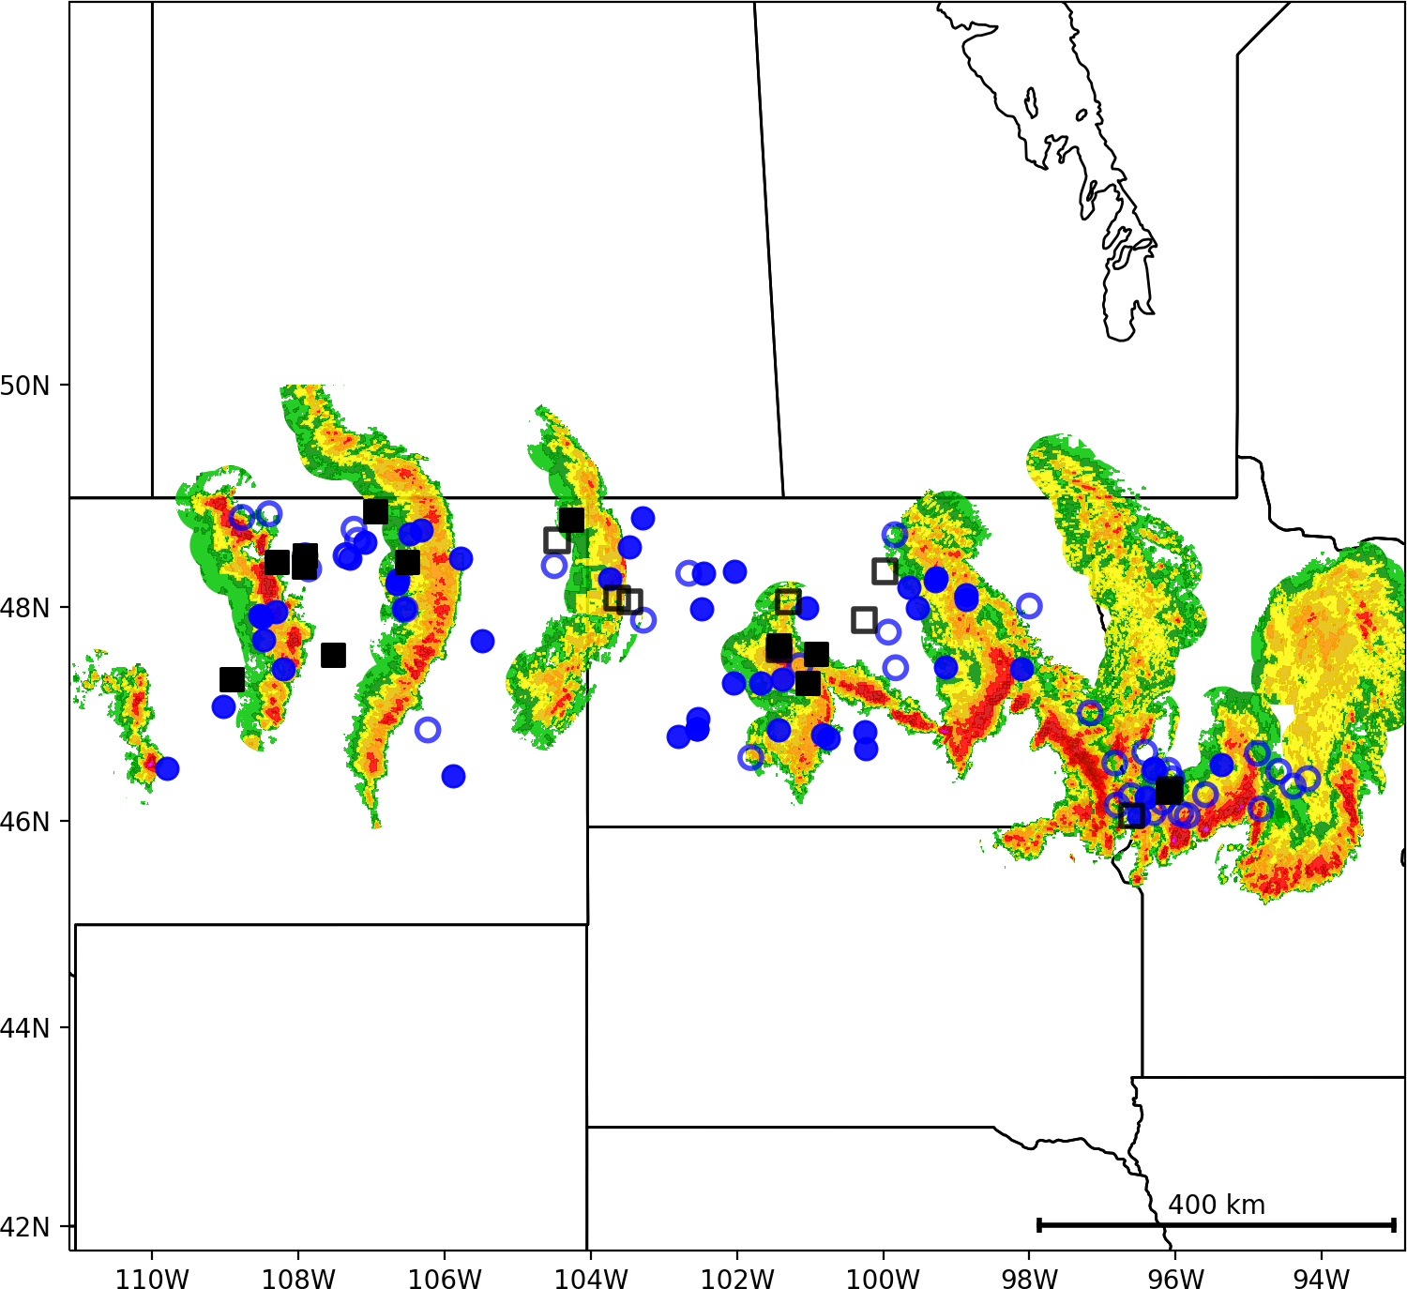
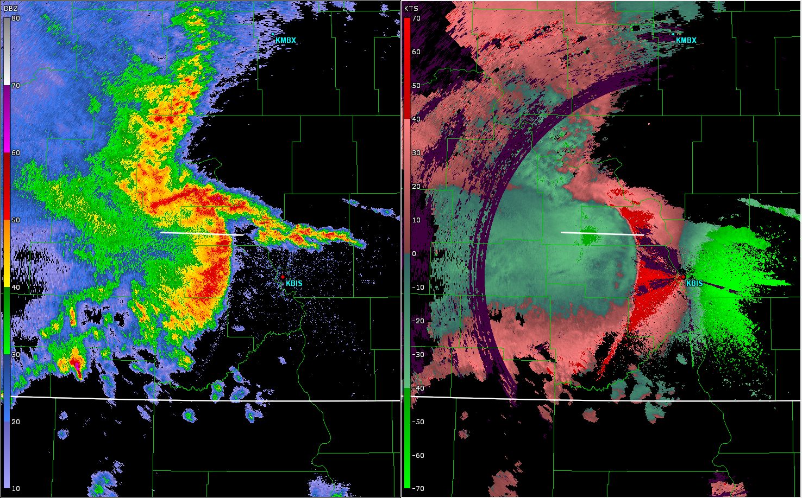
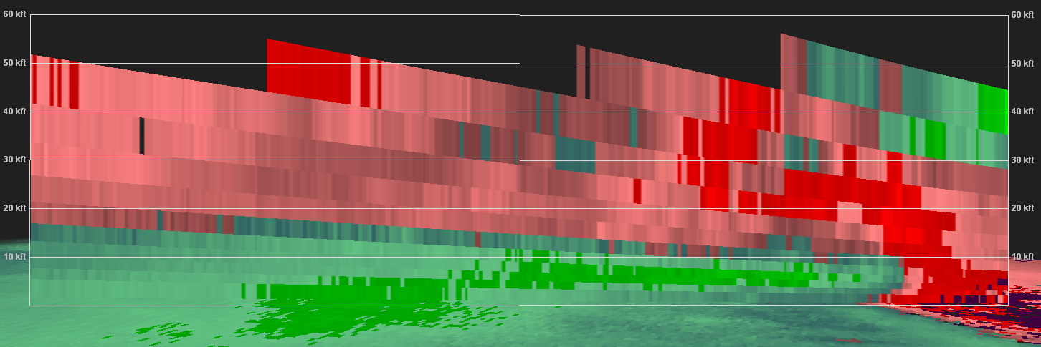
Progressive Derecho
0414 UTC 08 July 2020
Storm Relative Velocity Scan
234 Degrees / 46 kts
Line-End
Mesovortex
A
B
A
B
KBIS
Bow-Echo DMCS
Descending
Rear-Inflow Jet
Regional
Radar
Domain
Regional
Radar
A
B
Notes:
Figure 09

Slide 12
Refined Derecho Definition
“A widespread, severe windstorm, characterized by a family of destructive downbursts with embedded hurricane-force gusts, associated with an extra-tropical mesoscale convective system.”
For a wind swath to be classified as a derecho, the following criteria are needed:
Widespread severe reports (wind damage or 26+ m s⁻¹ gusts) comprising the wind swath all occur from the same MCS.
All reports in the wind swath must occur in progressive sequence.
Evidence must exist of severe winds being generated by internal storm-scale processes, including: a long-lived bow echo reflectivity structure associated with a rear-inflow jet, system-scale line-end mesovortex, leading-line mesovortices, or a rapidly propagating cold pool.
No more than 1 h may elapse between reports in the wind swath.
Spatial gaps between reports in the wind swath may not exceed 200 km.
The wind swath must be at least 400 km long.
At least five 33+ m s⁻¹ gust reports must occur in the 400-km long wind swath.
At least three measured 33+ m s⁻¹ or NWS damage-surveyed 44+ m s⁻¹ gusts are required in the wind swath.

Slide 13
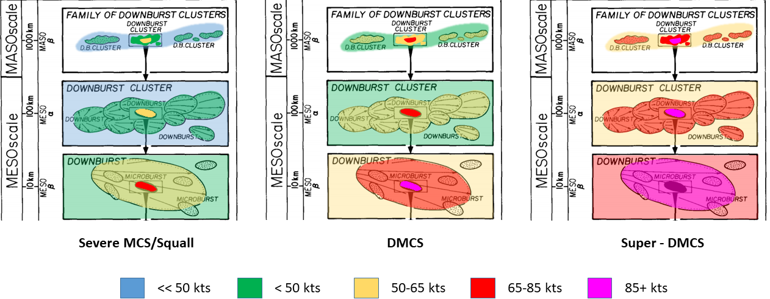
Refined Derecho Definition
Original figure from Fujita and Wakimoto (1981)
Many earlier studies classified derechos with the severe-wind distribution as shown under column 1.
The spirit of the refined definition is to classify the most intense wind swaths as derechos (i.e. columns 2-3).
Events in column 3 are quite rare, with future work intending to label these events as the top category within a classification system designed to rank MCS wind swaths by expanse and intensity.

Slide 14
 | Johns and Hirt (1987) JH87 | Bentley and Mote (1998) BM98 | Bentley and Sparks (2003) | Coniglio and Stensrud (2004) CS04 | Corfidi et al. (2016) C16 | Current Criteria
Years | 1980-1983 | 1986-1995 | 1986-2000 | 1986-2001 | 2010-2014 | 1996-2022
N | 70 | 112 | 230 | 244 | 365 (25) | 78
Type | Progressive Serial | Progressive Serial | Progressive Serial | Progressive Serial | Progressive | Progressive Serial
1 | There must be a concentrated area of convective wind gusts exceeding 26 m s⁻¹ with a major axis path length of at least 400 km. | As in JH87 | As in JH87 | As in JH87 | Like JH87, but for a path length of 650 km (N = 25 cases that met this length criteria). | As in JH87
2 | There must be at least 3 reports (separated by 64 km) of F1 damage or 33+ m s⁻¹ wind gusts during the MCS stage. | Not Used | As in BM98 | Low end: BM98 Moderate: JH87 High end: Like JH87, but 3 reports must exceed 38 m s⁻¹, with 2 occurring at MCS stage. | As in BM98 | At least 5 reports (separated by 80 km) of 33+ m s⁻¹ wind gusts during the MCS stage. At least 3 reports must be measured at 33 m s⁻¹ or NWS surveyed at 44 m s⁻¹.
3 | No more than 3 h can elapse between successive reports. | No more than 2 h can elapse between successive reports. | As in BM98 | Like JH87, but for 2.5 h. | No more than 1 h elapsed between successive reports. | As in C16
4 | Wind reports must have chronological progression. | As in JH87 | As in JH87 | As in JH87 | As in JH87 | As in JH87
5 | The associated MCS must have spatial or temporal continuity in surface pressure or wind fields. | Continuity confirmed when no more than 2º lat/lon separation occurs between reports. | As in BM98 | Like BM98, but no more than 200 km allowed between any reports in the swath. | Like CS04, but no more than 100 km allowed between any reports in the swath. | As in CS04
6 | All damage swaths must accompany the same MCS based on radar data. | MCS confirmed by temporally mapping wind reports without radar data. | As in BM98 | As in JH87 | As in JH87 | As in JH87

Slide 15
Refined Derecho Definition
Key Takeaways
Imposing strict 33+ m s⁻¹ criteria reduces the derecho count, even with a longer study period (78 derechos in 23 years).
Most previous studies average 10-15 derechos nationally. The current study only averages 3 derecho nationally.

Slide 16
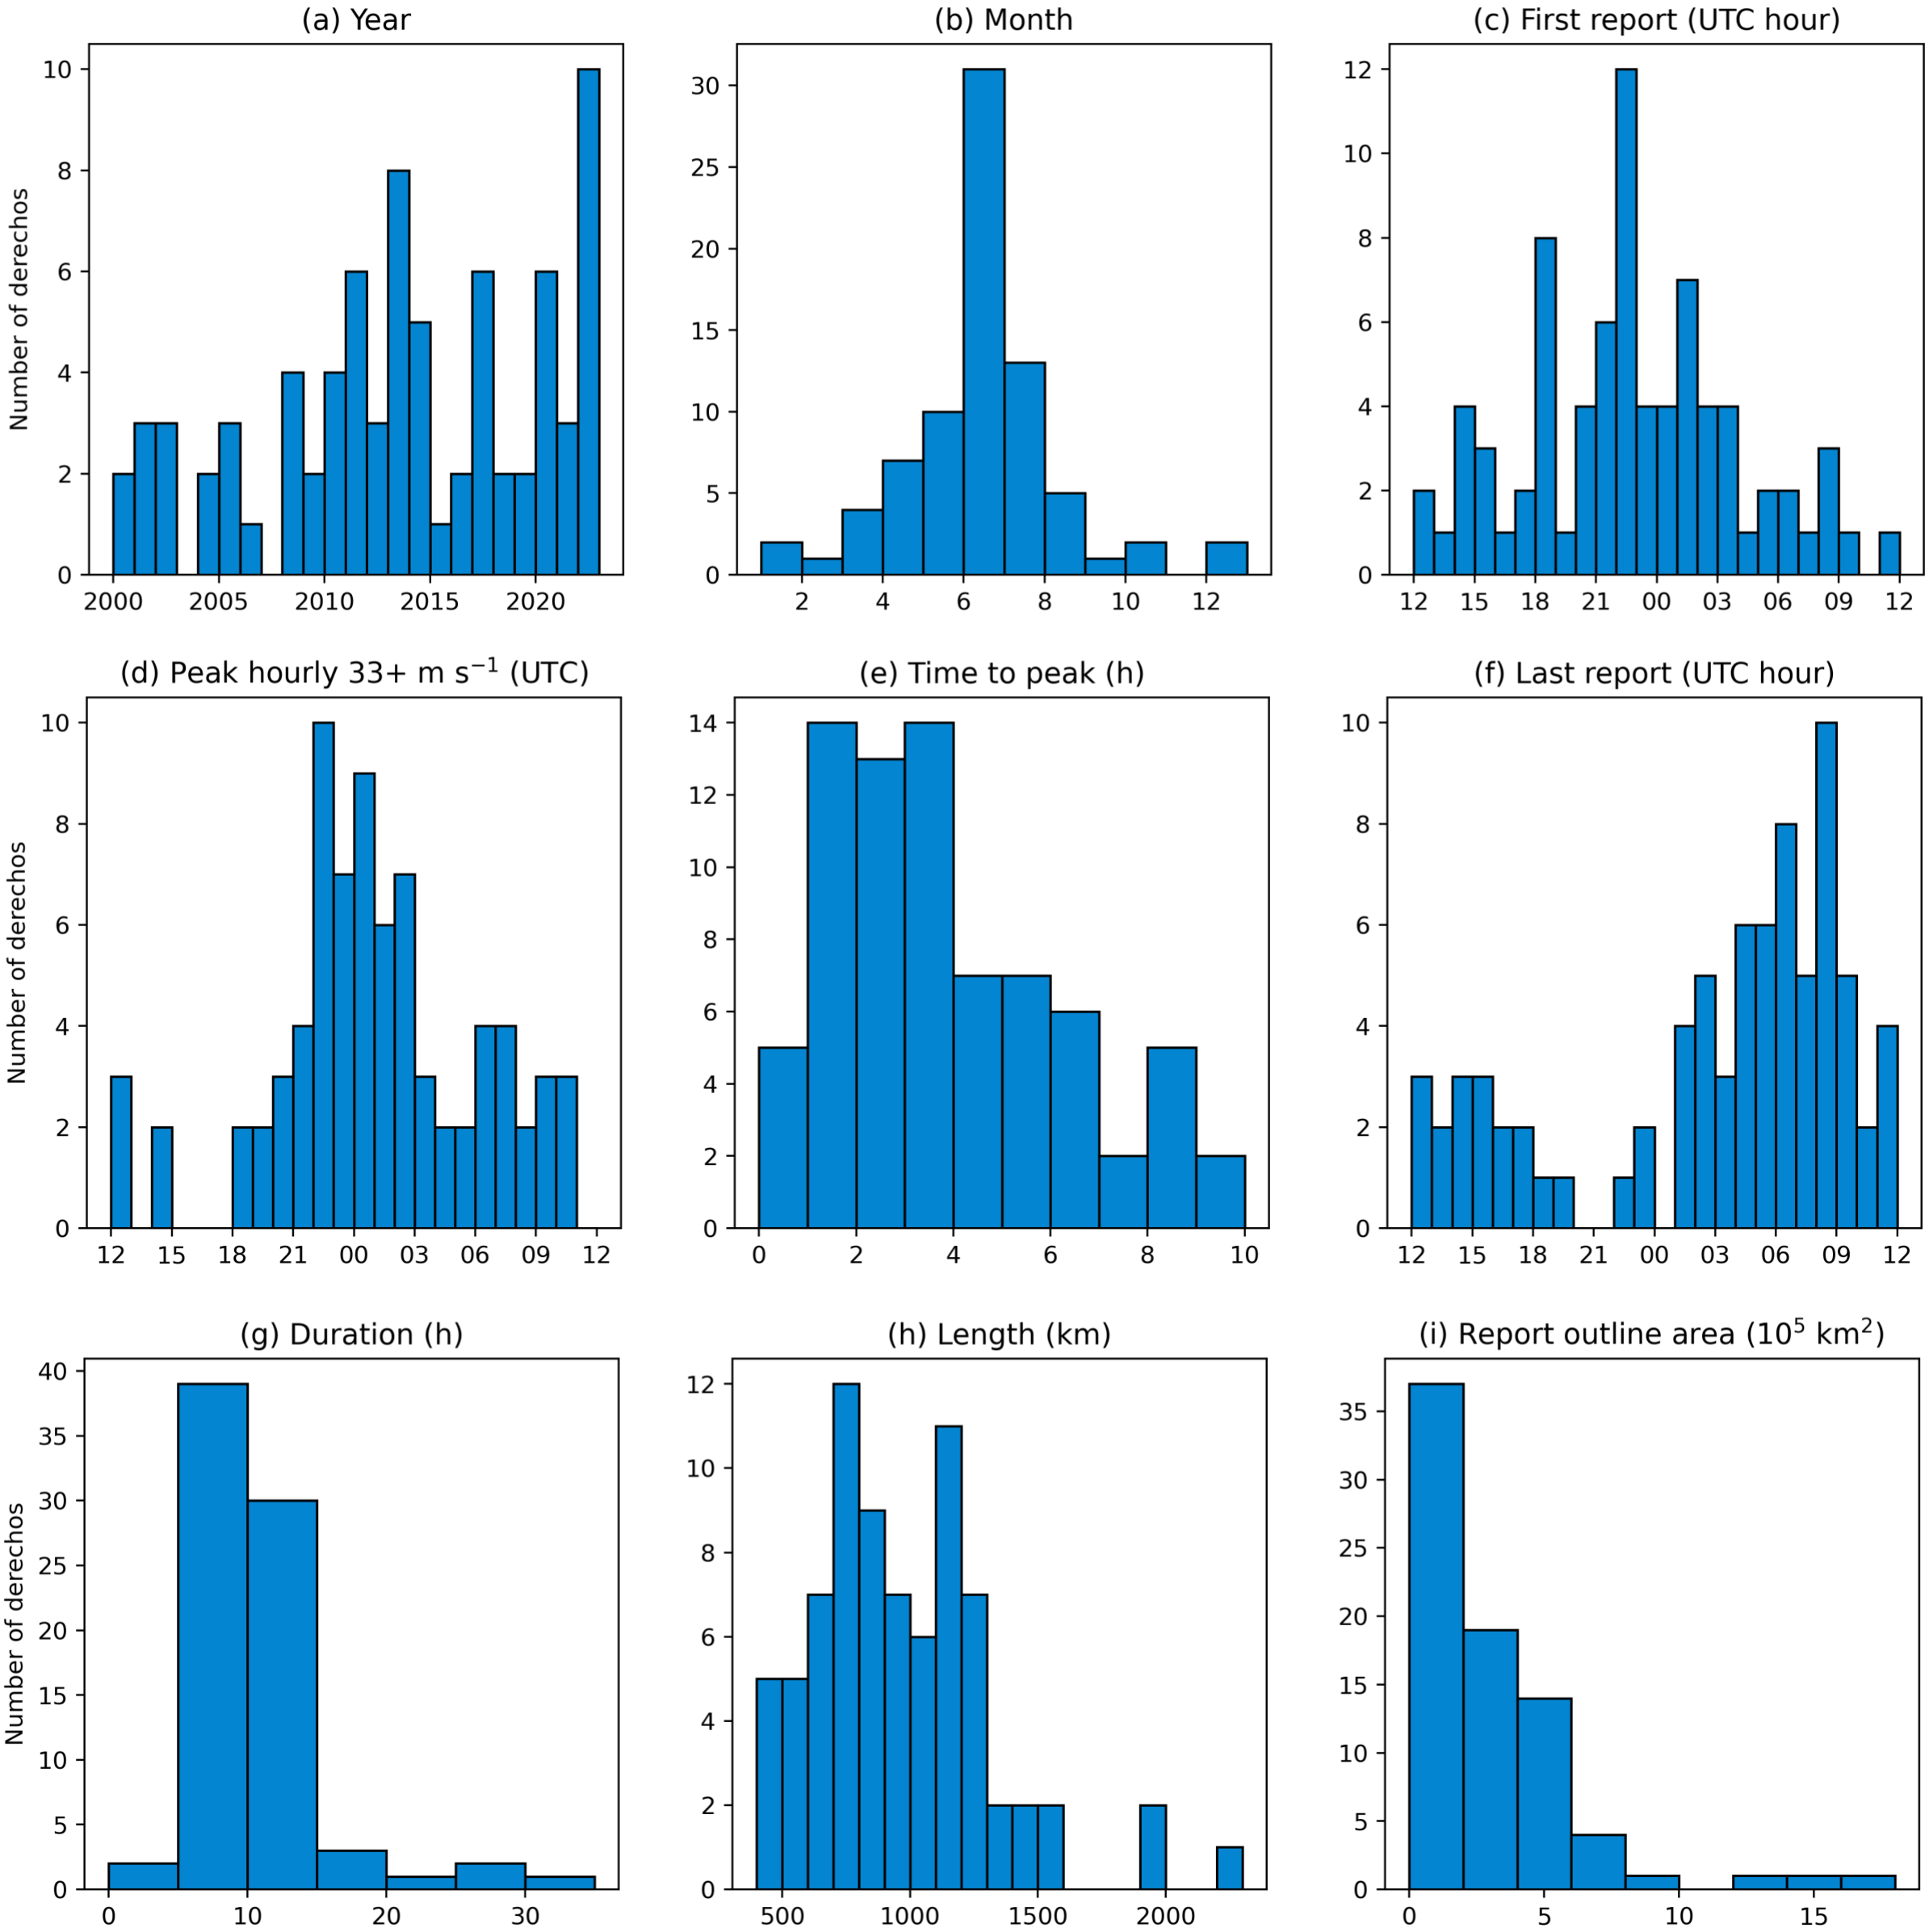
Key takeaways
Derechos can be frequent or infrequent on any given year
Derechos are most common during the summer and least
common in winter
Derechos typically start during the afternoon, dissipate overnight,
and peak in intensity only a few hours after initiation.
Derechos typically last ~10 hours, but can last as long as 30 hours.
Most derechos have 600-1200 km path lengths, but my travel over
2000 km.
Most derechos have an areal coverage under 1 million km², but some can cover more than 1.5 million km².
Most of the derechos with outlier durations, path lengths, or areal
coverage are intense, cool-season squall lines (see next slide for
examples).

Slide 17
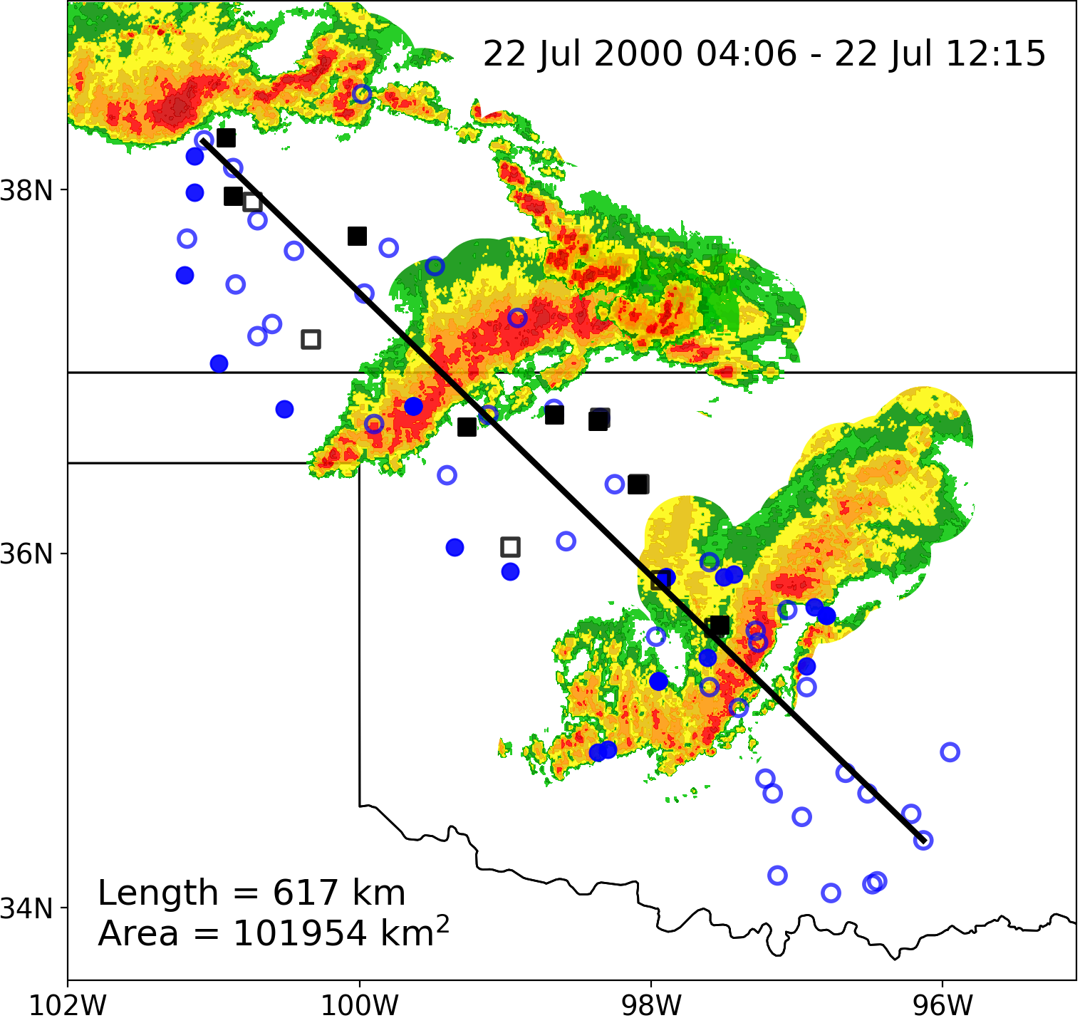
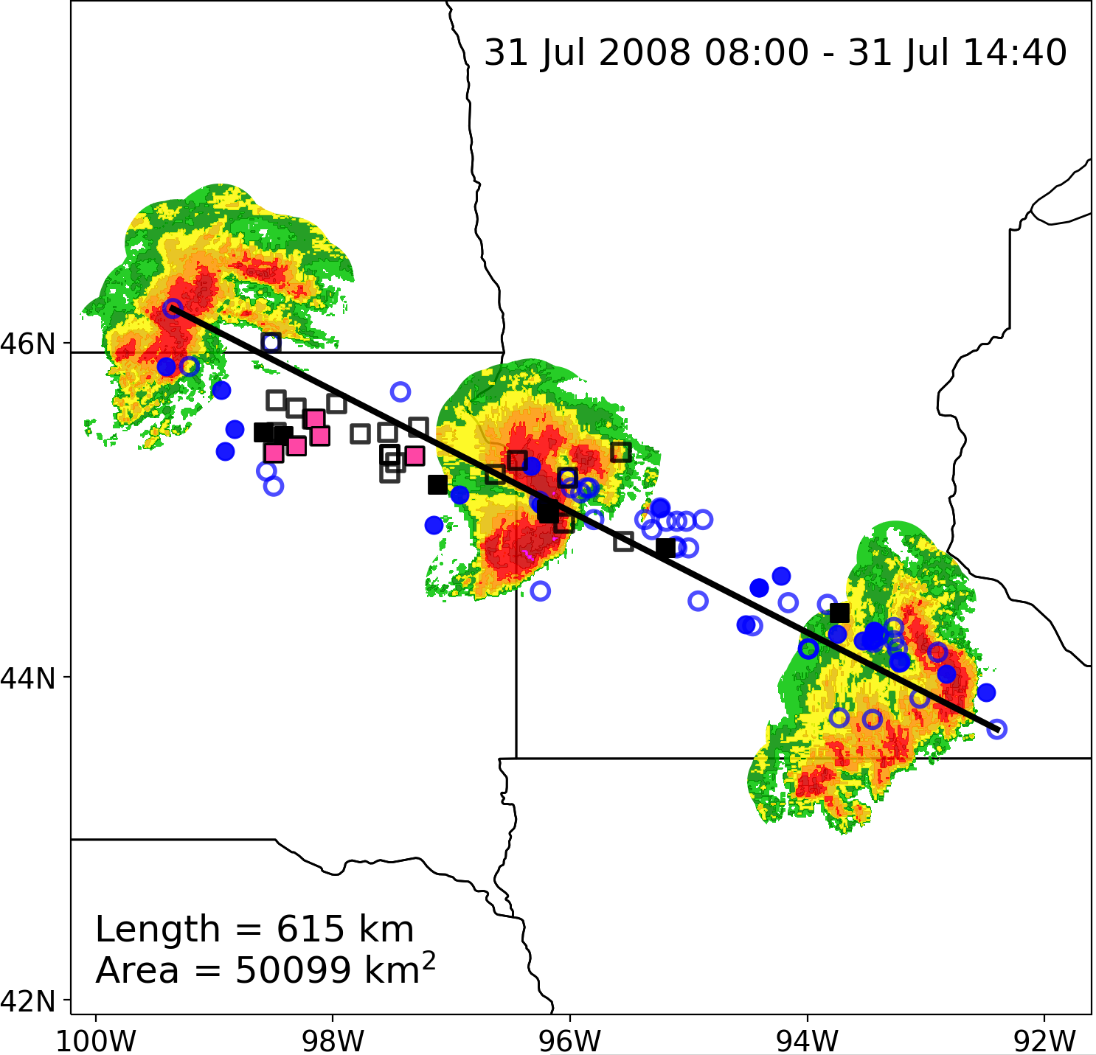
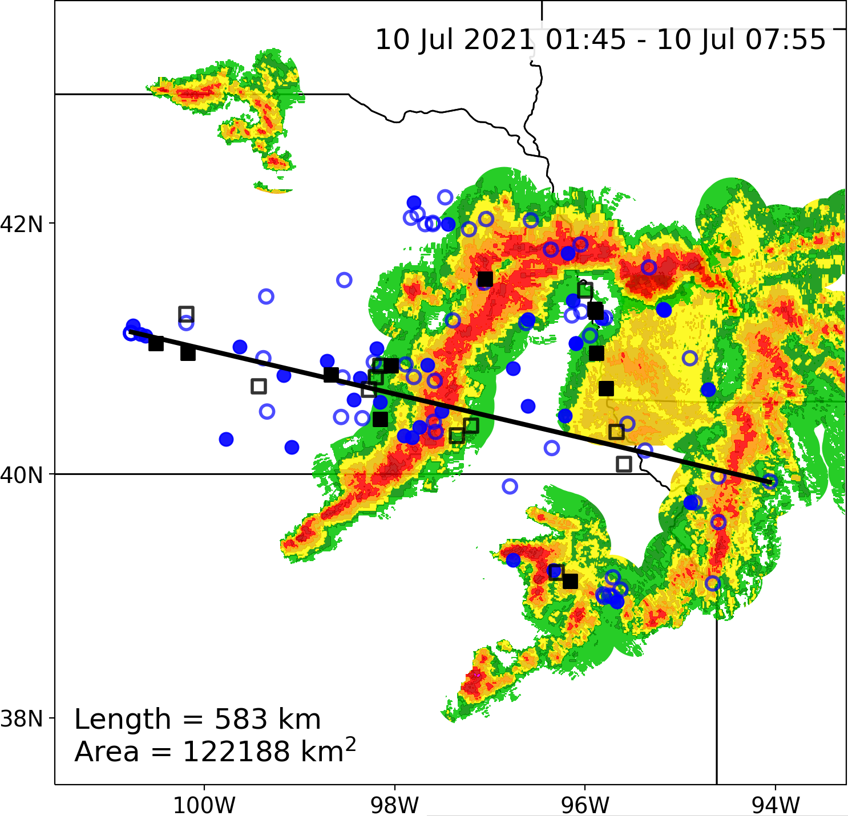
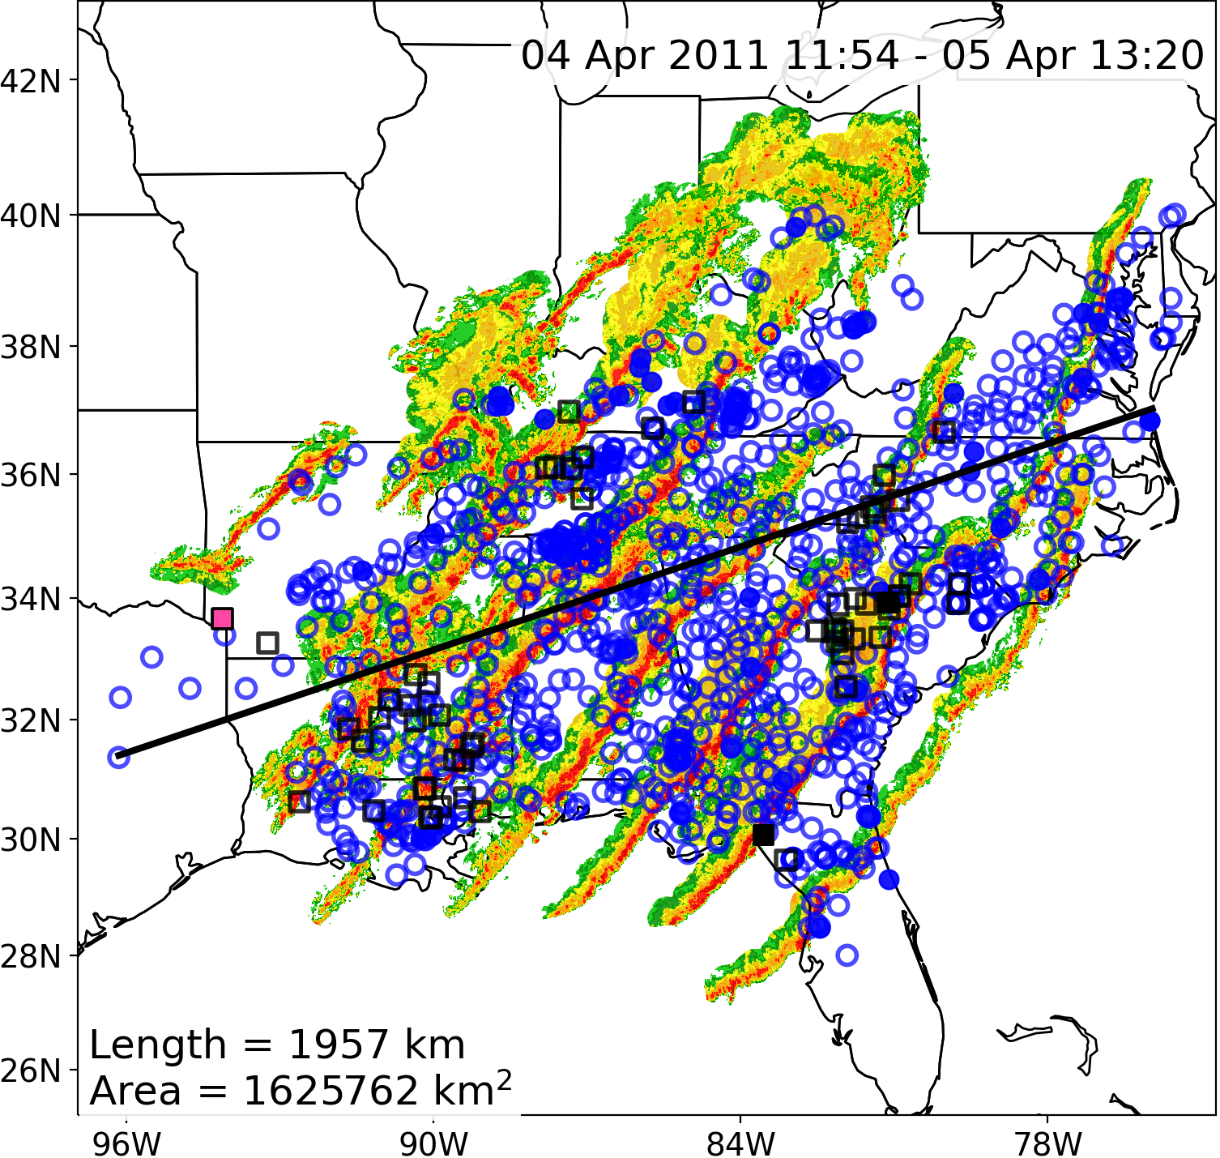
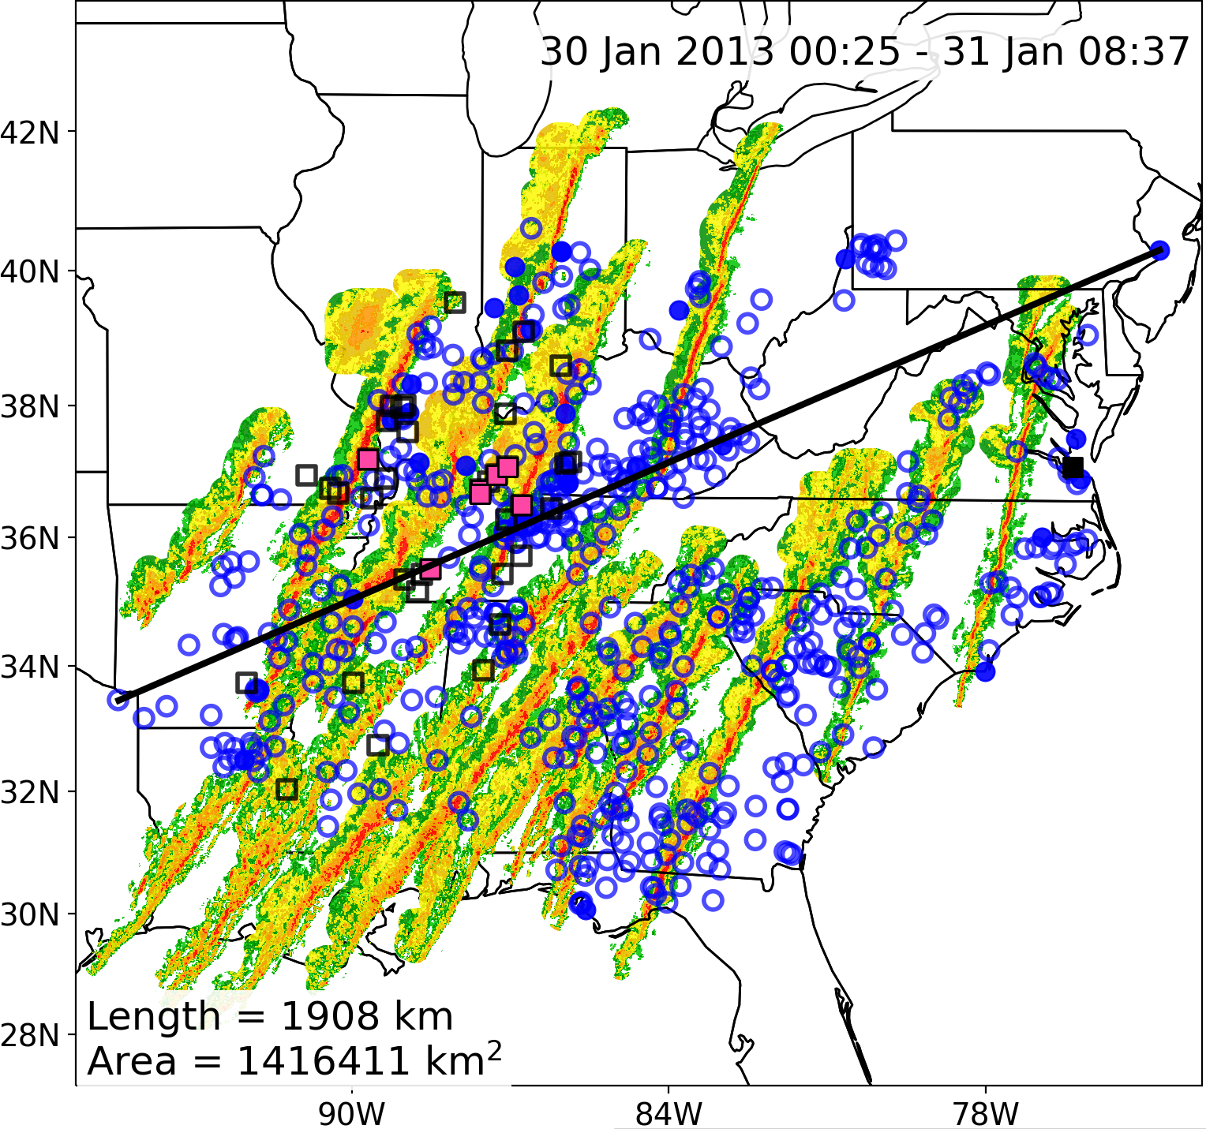
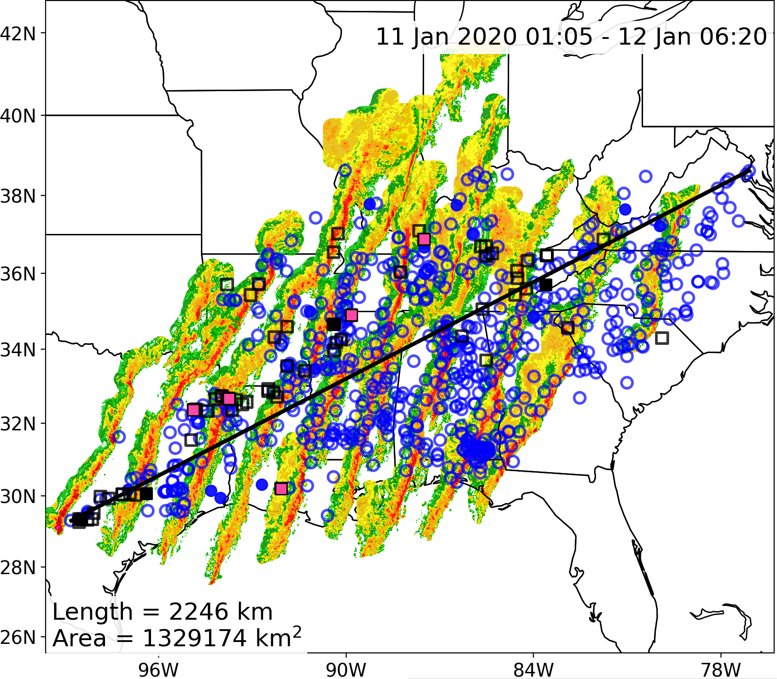
ND
KS
IA
MN
NE
SD
TX
OK
KS
IA
Notes:
Figure S3

Slide 18
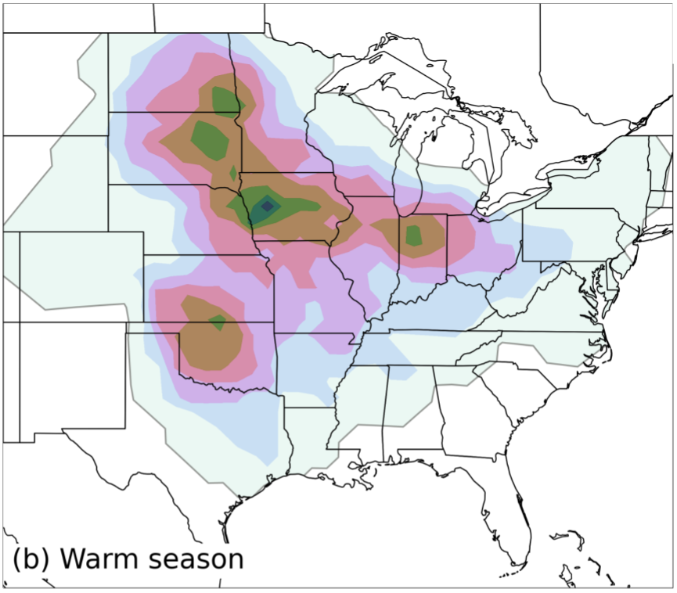
~5 derechos
per yr
~1.5 derechos
per yr
~1.5 derechos
per yr
~1.5 derechos
per yr
~1 derecho
per 2 yrs
Up to 1 derecho
per yr

Slide 19
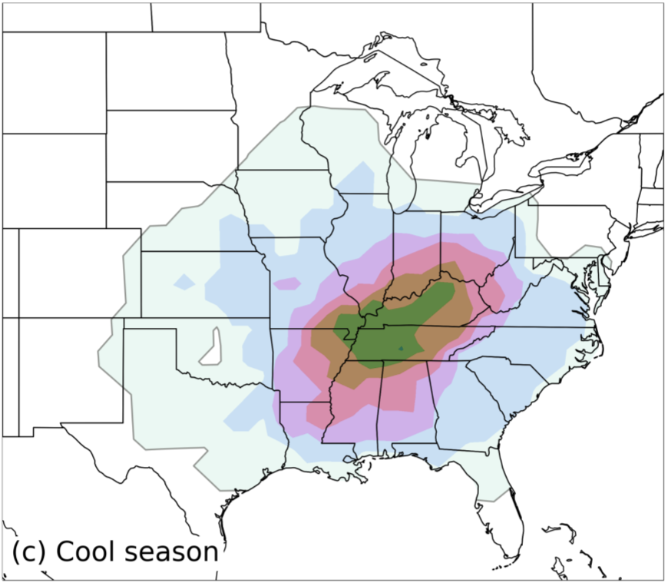
~1.5 derechos
per yr
~1.5 derechos
per yr
~1 derecho
per 2 yrs

Slide 20
Derecho Spatial Climatology
Key Takeaways
The warm-season northern Plains/Midwest and southern Plains corridors are in general agreement with past research.
The cool-season corridor shifted 500-700 km in the current study compared to previous studies. Some reasons include:
Less 33+ m s-1 occur farther south, and previous studies did not include a 33+ m s-1 gust requirement.
More significant “wind damage” (confirmed via NWS surveys) may be classified as QLCS tornadoes due to recent advances in high-resolution and dual-polarimetric radar technology. Evidence is supported by an increase in QLCS tornadoes over LA/MS (Thompson et al. 2023).
An overall decrease in derecho frequency is noted during any season/location since derechos are inherently less common with the stricter 33+ m s⁻¹ criteria.
Cool-season derechos are disproportionately rarer compared to warm-season events in the present study relative to other studies, but the cool-season frequency magnitudes more closely match earlier studies and the current warm-season study.
Cool-season derechos are very expansive and often overlap the same areas (TN Valley), whereas warm-season bow echo wind swaths are inherently narrower, with regional occurrences varying more greatly (see slide 20 for examples).

Slide 21
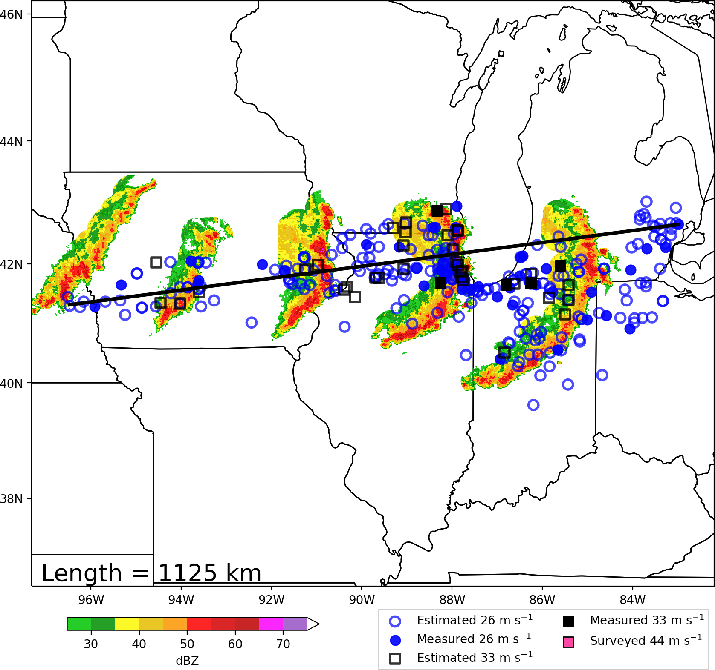
How do bow-echo DMCSs form?
Lets do a
Theoretical
Cross-section!
Looking
North

Slide 22
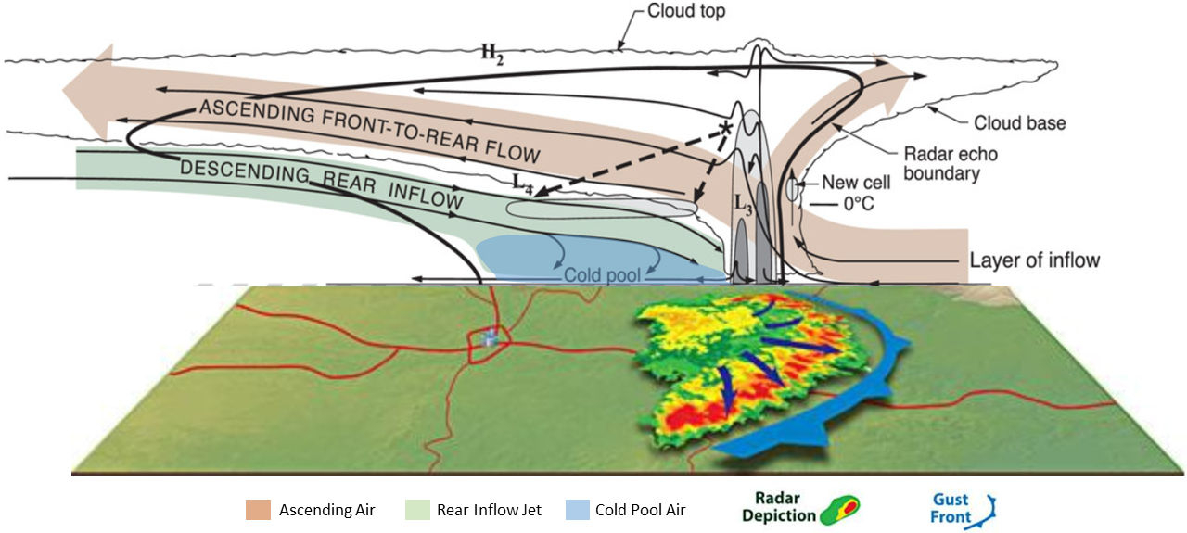
How do bow-echo DMCSs form?
Houze et al. (1989)
Key Points
Derechos originate from highly organized MCSs and bow echoes.
Front-to-rear flow transports liquid/ice species that melt and evaporate behind the main leading line, generating a cold pool and horizontal buoyancy gradient
This buoyancy gradient fosters rear inflow jet development, which support bow-echo structure and derecho winds.

Slide 23
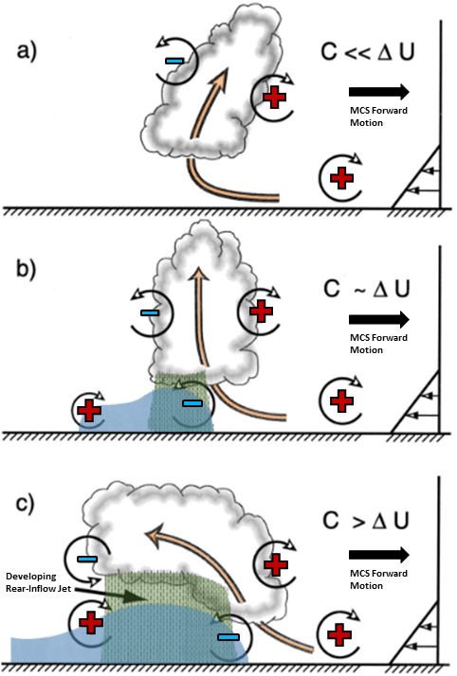
Key Points
Combined cold pool depth and strength (C) must be at least a little stronger then the countering low-level shear (Δu) to allow for persistent rearward flow (C > Δu). C >> Δu is sub-optimal because the cold pool could undercut the convective leading line.
The persistent rearward flow allows for prolonged hydrometeor advection and rainfall evaporation, supporting a deepening, strengthening cold pool.
The horizontal buoyancy gradient also strengthens, promoting intensifying horizontal circulations, with countering circulations above/behind the cold pool fostering rear-inflow jet development.
Weisman (1992)

Slide 24
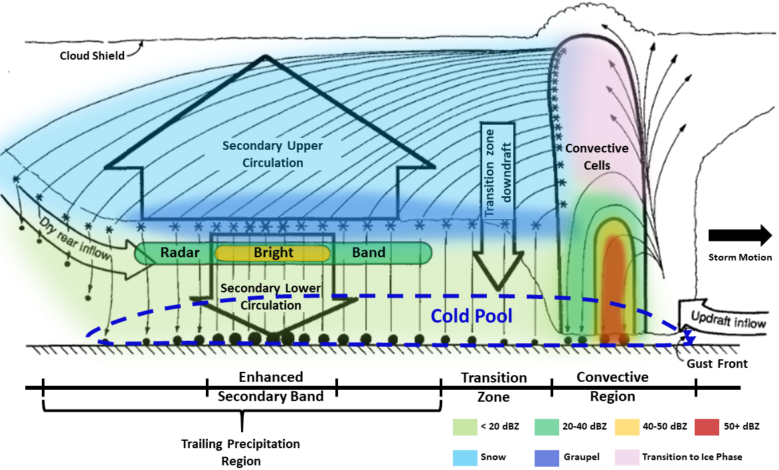
Biggerstaff and Houze (1991)
Most of the phase change along and beneath the RIJ axis is rainwater evaporation.
As such, rainwater evaporation is the biggest contributor to cold pool development and intensity.

Slide 25
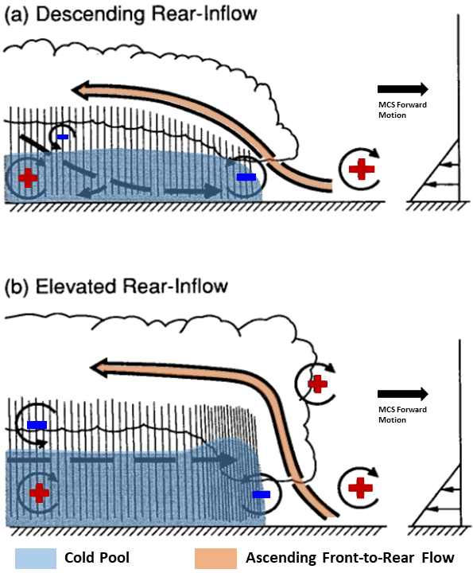
Ordinary MCSs
Key Points
Most MCSs and bow echoes have rearward advection, evaporative cooling behind the main convective line, and cold pool development
The difference with the longest-lived bow-echoes and DMCSs is an unusually strong/deep cold pool, with pronounced countering circulations that support an intense but elevated rear inflow jet.
The stronger, elevated RIJ then supports stronger, deeper convergence along the MCS leading line, which augments leading-line updraft intensity, perhaps for long periods of time.
Long-lived
bow-echo MCSs
and DMCSs
Weisman (1992)

Slide 26
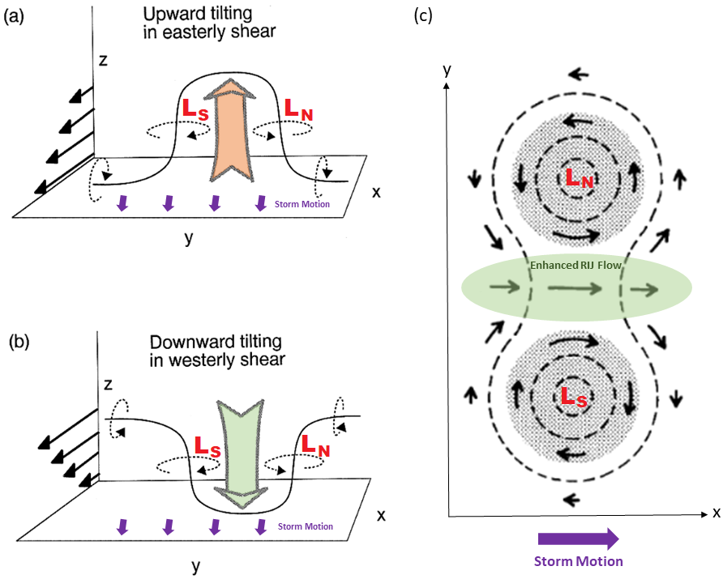
Northern vortex dominates
due to Coriolis force
Key Points
The downward rear inflow jet, or upward motion from the convective leading-line, supports the tilting of horizontal vorticity, resulting in the development of “book-end” vortices.
Flow is augmented between the countering circulations, resulting in further strengthening of the RIJ, hence why the strongest surface winds are found near the bow-echo apex.
The northern book-end vortex often dominates due to effects related to the Coriolis force.
Weisman (1993)
Weisman and Davis (1998)

Slide 27
Progressive Derecho
0414 UTC 08 July 2020
Storm Relative Velocity Scan
234 Degrees / 46 kts
Line-End
Mesovortex
A
B
A
B
KBIS
Bow-Echo DMCS
Descending
Rear-Inflow Jet
Regional
Radar
Domain
Regional
Radar
A
B
The line-end mesovortex is a typical example of the northern book-end vortex dominating, with an augmented RIJ occurring just to the south along the bow-echo apex.
Notes:
Figure 09

Slide 28
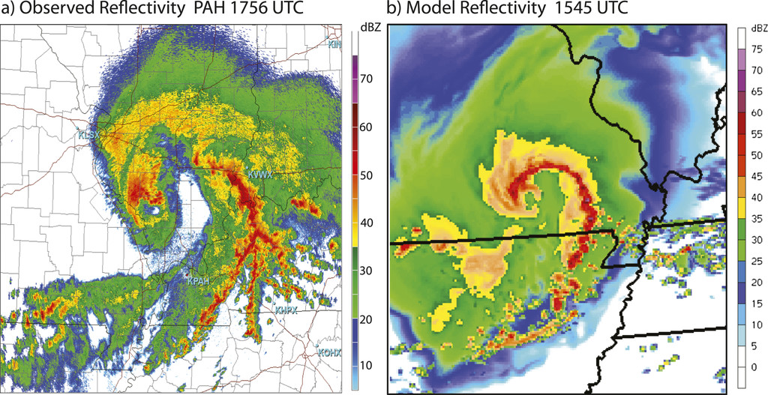
Line-End
Mesovortex
Area favorable for
leading-line/system-scale
mesovortices
Weisman et al. (2013)
08 May 2009 “Super-Derecho” Case
In rare cases, deep, intense vortices may develop (such as the unusual warm-core vortex from the 08 May 2009 DMCS).
This DMCS was preceded by the strongest of LLJs and steepest of lapse rates observed by forecasters in this region of the county, and it is theorized that these anomalous conditions contributed to the development of this warm-core vortex.
Please read Weisman et al. (2013) and Evans et al. (2014) for details on the warm-core vortex origins and evolution.

Slide 29
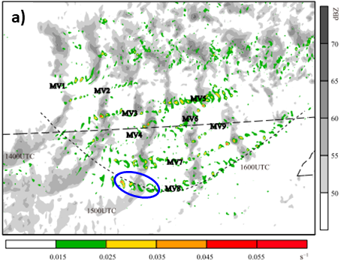
Key Points
Leading-line system-scale mesovortices are very small
These mesovortices are responsible for many squall-line and bow-echo QLCS tornadoes that can accompany derecho events.
Missouri
Arkansas
Xu et al. (2015a)

Slide 30
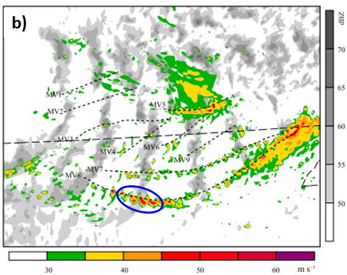
Key Points
The strongest surface winds with mesovortices are contained in narrow swaths (similar to supercell RFDs)
Missouri
Arkansas
Xu et al. (2015a)

Slide 31
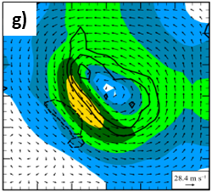
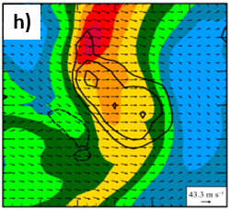
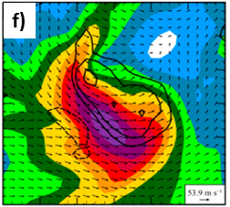
Xu et al. (2015a)
Vortical Flow
Background Flow
Total Flow
The strongest winds in leading-line mesovortices tends to occur south of the circulation center, since the rotational component of flow and background flow align here. The background flow can originate from RIJs in bow-echoes or ambient winds in a squall line.
These narrow currents, especially aligned along and immediately north of a bow-echo apex, often produce the strongest gusts observed in a derecho, sometimes exceeding 100 mph. These may be the strongest winds seen in microbursts and burst-swaths (see slide 16 for illustrations)

Slide 32
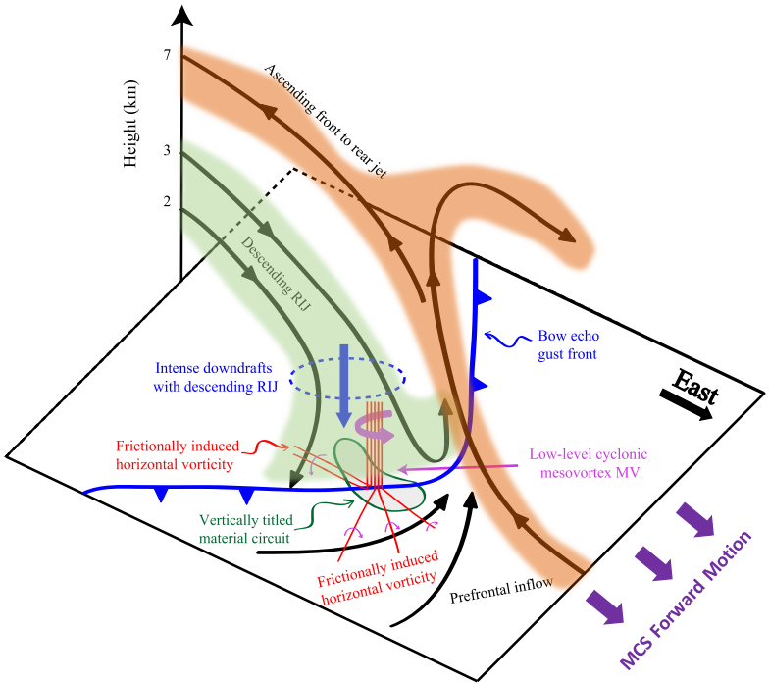
Xu et al. (2015b)

Slide 33
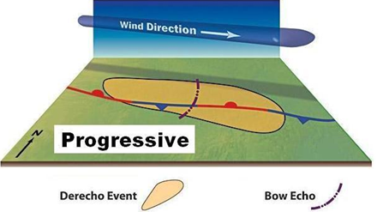
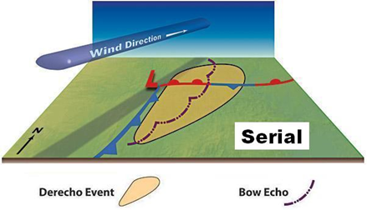
Derecho Environments
Figure created by Dennis Cain and hosted by the Storm Prediction Center (2024)
Progressive bow-echoes are often aligned roughly normal to the mean wind.
Intense cold pool typically supports a faster MCS forward motion then the mean wind speed.
Serial squall-lines usually form ahead of a surface front and drift slowly eastward.
Embedded line-echo-wave patterns (LEWPS) can produce a series of enhanced wind swaths, and these LEWPS typically travel in the same direction as the mean wind.

Slide 34
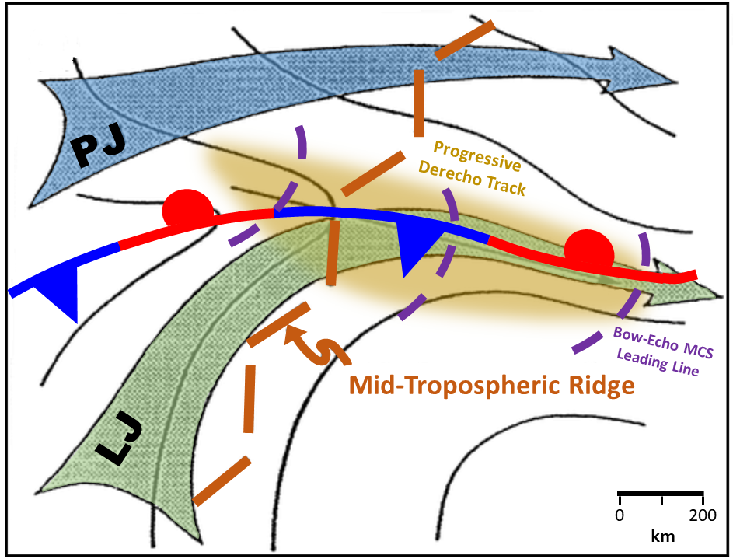
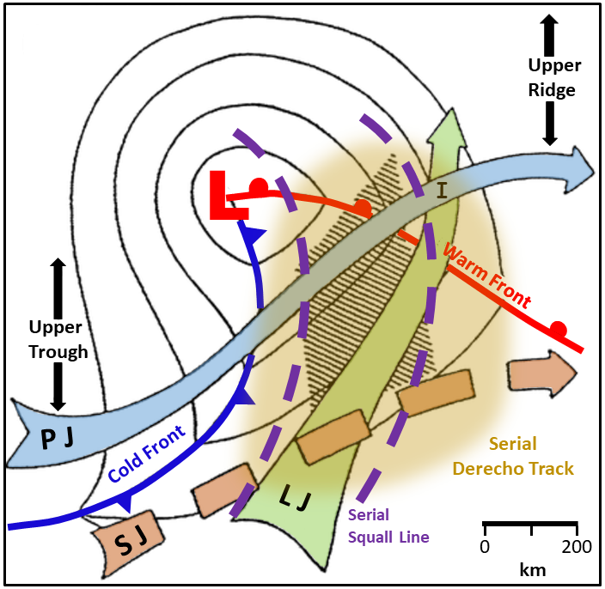
Derecho Environments
Johns (1993)
Johns (1993)
Warm-season progressive derechos tend to be weakly forced, and usually occur in upper ridging environments. Harder to predict given weak forcing.
Near the mid-level ridge axis, warm-season progressive DMCSs develop at the terminus (“nose”) of low-level warm-air advection, south of the right-entrance region of an upper-level jet streak.
The DMCS develops north of a surface boundary, and will either parallel the boundary to the north or traverse the boundary through evolution.
Cool-season serial squall lines are strongly forced (thus relatively easier to predict) and occur in synoptic environments similar to tornado outbreaks.
Primary difference is that deep-layer winds are more unidirectional, which encourages linear forcing, and that the low to mid-levels are often drier, which encourages more evaporative cooling and downward momentum transport.

Slide 35
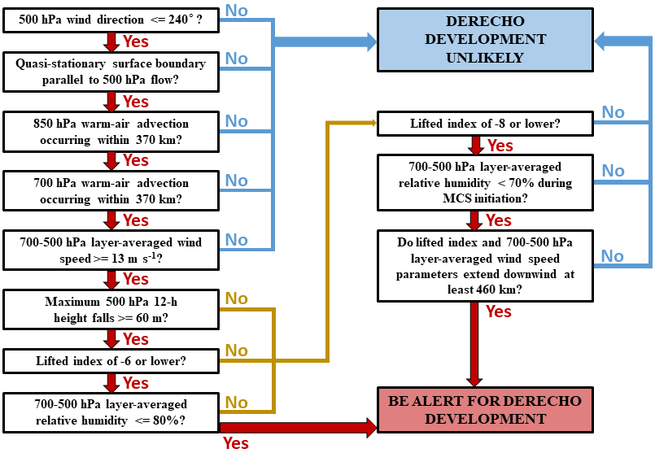
Johns and
Hirt (1987)

Slide 36
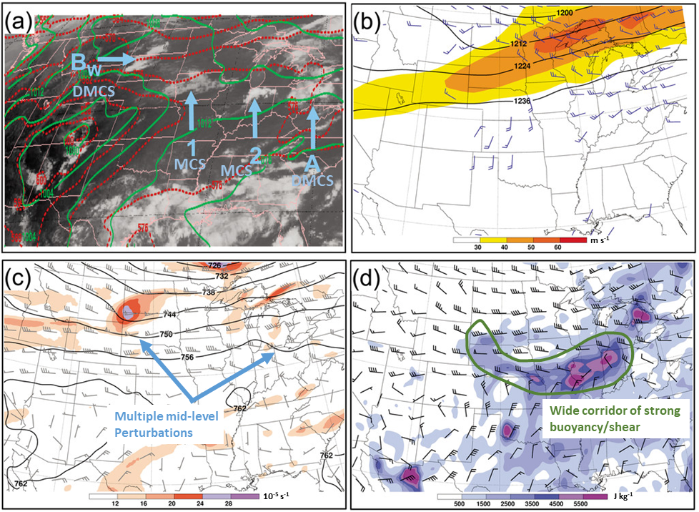
Key Points
Warm-season progressive DMCSs need an elongated corridor of overlapping extreme instability and favorable wind shear to support a long-track derecho wind event.
DMCSs rarely occur alone! When a given DMCS develops, there is a greater then 50% chance that 1-2 more efficient damaging-wind producing MCSs (perhaps producing derechos) will follow, each separated by no more than 72 hours.
The most favorable environment for intense MCSs occurring in series is a stationary mid/upper-level ridge. In this environment, MCSs can initiate from a series of embedded mid-level impulses traversing the ridge. Also, earlier MCSs can leave behind boundaries, serving as a focus for the initiation of additional MCSs.
Forecasters in the northern Plains, Midwest, and OH Valleys should pay close attention to these environments during the summer. When one damaging MCS occurs, it will probably be followed by another!
Metz and Bosart (2010)

Slide 37
Key Points
Warm-season progressive derechos are notoriously difficult to forecast
Weak forcing lowers confidence in the parent MCS developing
There are several ways that a warm-season derecho forecast can fail including:
1.) Little to no convective initiation
2.) Lack of MCS organization
3.) Downstream convection contaminating the warm sector
4.) Wrong storm mode (i.e. could get more discrete supercells that do not merge their cold pools)
5.) Cold pool could undercut parent MCS too early, so a long duration wind event does not materialize.
Metz and Bosart (2010)

Slide 38
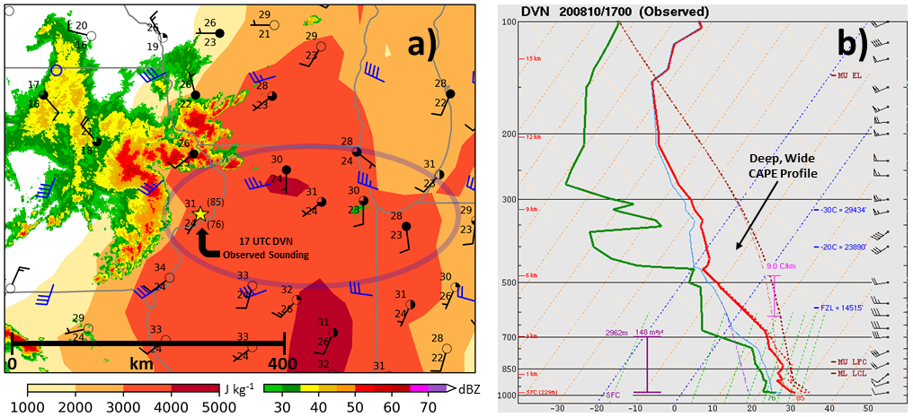
10 Aug 2020 – 1700 UTC
Warm-season progressive derechos in weakly forced environments favor extreme buoyancy (i.e. several thousand J kg⁻¹ MLCAPE).
Very strong to extreme CAPE in these environments is driven by rich low-level moisture, overspread by a deep elevated mixed layer, comprised of 700-500 mb dry air and very steep mid-level lapse rates. Previous studies suggest that anomalously steep lapse rates have often supported historic derecho events.
Deep-layer shear should be strong enough to support MCS organization.

Slide 39
More dry air aloft supports stronger evaporative cooling
Greater evaporative cooling can support greater downward momentum transport of RIJ air over a broader area
Severe winds can be more prolonged compared to ordinary squall-line/MCS cases
Mahoney and Lackmann (2011)

Slide 40
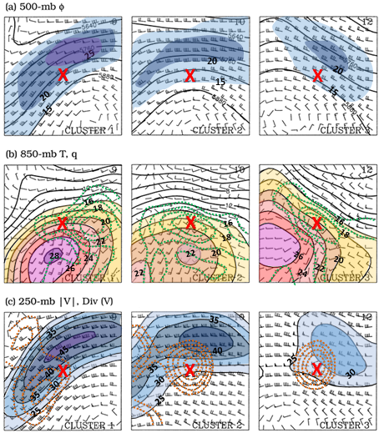
Weakly forced, warm-season derecho synoptic setups can vary appreciably.
DMCSs can form along, upstream, or downstream of an upper-ridge axis and may occur along or upstream of low-level moisture advection.
Low-level warm-air advection usually originates from veered 850-700 mb flow.
Regardless of upper-level jet orientation, DMCSs almost always initiate to the south of the upper-jet maxima (closer to the right-front quadrant, where upper-level divergence is strongest).
As shown on next slide (first 3 columns) these environments support most derechos in the Upper MS Valley to the OH Valley.
The northwesterly mid-level flow setup over the Rockies is most conducive for supporting the Southern Plains derechos.
Coniglio et al. (2004)

Slide 41
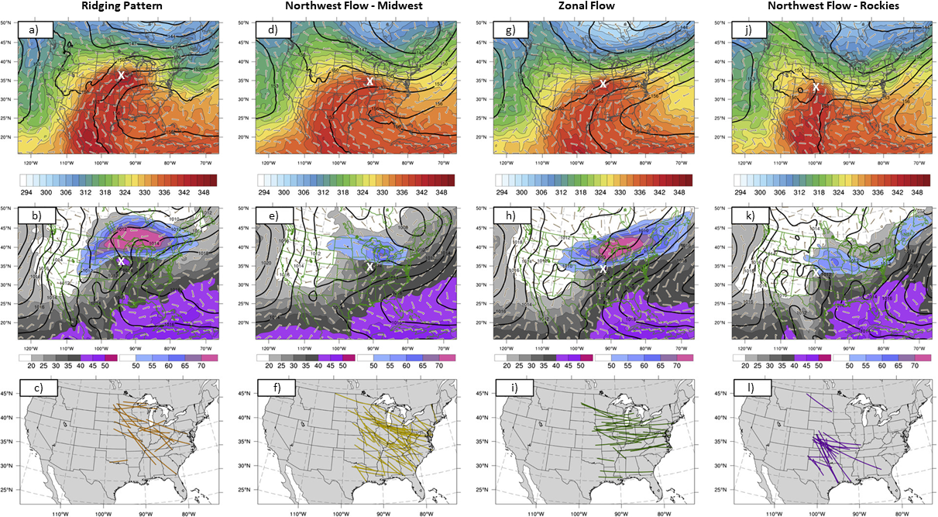
Guastini and Bosart (2016)

Slide 42
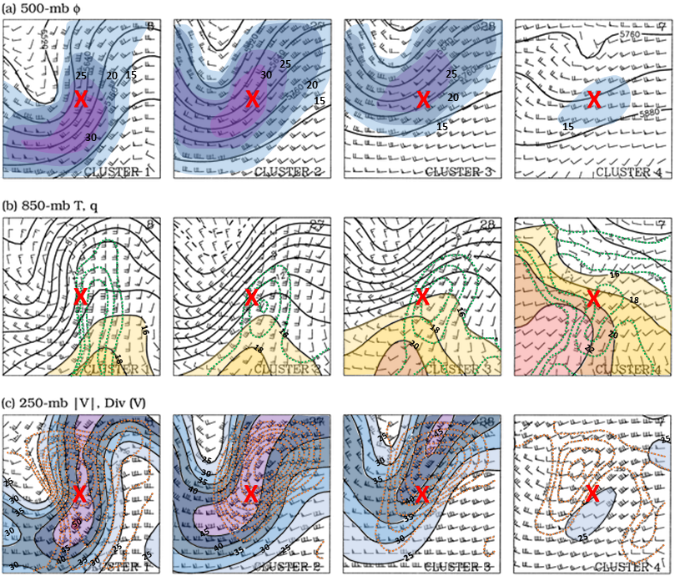
Strongly forced synoptic setups (most of which occur in the cool season) vary less compared to weakly forced setups.
Nearly all strongly forced DMCSs initiate ahead of both the mid-level and upper-level trough axes, though they may develop anywhere along mid/upper jet maxima.
Most strongly forced DMCSs are preceded by low-level moisture advection, with low-level warm-air approaching mostly from the south.
However, some warm-season derechos can occur with stronger forcing (see next slide). These synoptic setups have pronounced mid-level troughs and sometimes even low-level cyclone development (or at least strong low-level troughing).
Such setups are sometimes loosely termed “hybrid” derecho environments.
A forecaster should not strictly rely on the Johns and Hirt (1987) or Johns (1993) model of classic, weakly-forced ridging environments when monitoring for derecho events during the summer!
Coniglio et al. (2004)

Slide 43
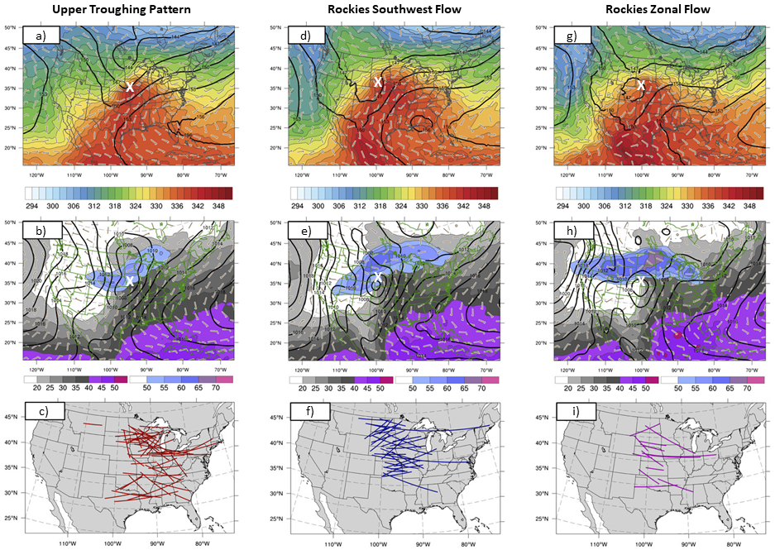
Guastini and
Bosart (2016)

Slide 44
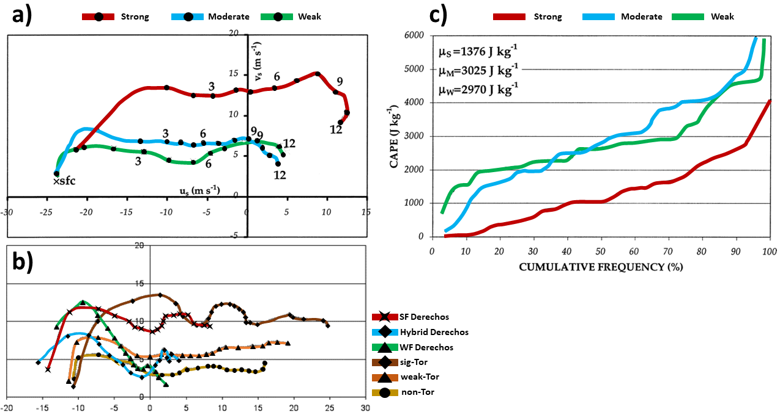
Strongly forced derechos do not need as much buoyancy as weakly-forced events, with CAPE values varying greatly between events, though weakly-forced events almost always need strong to extreme CAPE.
Shear is stronger in strongly forced derecho cases, which is typically evident via larger hodographs, whereas weakly-forced derechos have overall weaker deep-layer shear, so smaller hodographs.
Compared to tornadic supercell environments, weakly-forced derechos need shorter hodographs (i.e. weaker upper shear), but still need at least modest low-level shear (evident via modest curved hodographs). This allows for adequate storm-relative inflow to support efficient DMCS organization, and for enough Δu to counter the cold pool.
Doswell and Evans (2003)

Slide 45
Questions?
Recommended Reading
Squitieri, B. J., A. R. Wade, and I. L. Jirak, 2023: A historical overview on the science of derechos. Part I: Identification, climatology, and societal impacts. Bull. Amer. Meteor. Soc., 104, E1709–E1733, https://doi.org/10.1175/BAMS-D-22-0217.1
Squitieri, B. J., A. R. Wade, and I. L. Jirak, 2023: A historical overview on the science of derechos. Part II: Parent storm structure, environmental conditions, and history of numerical forecasts. Bull. Amer. Meteor. Soc., 104, E1734-E1763, https://doi.org/10.1175/BAMS-D-22-0278.1

