Slide 1
TC TORNADOES and SPC FORECASTS in TC SITUATIONS
Harry Weinman & Roger Edwards
METR 4403/5403: Applications of Meteorological Theory to Severe-Thunderstorm Forecasting
Notes:
‹#›
Title

Slide 2
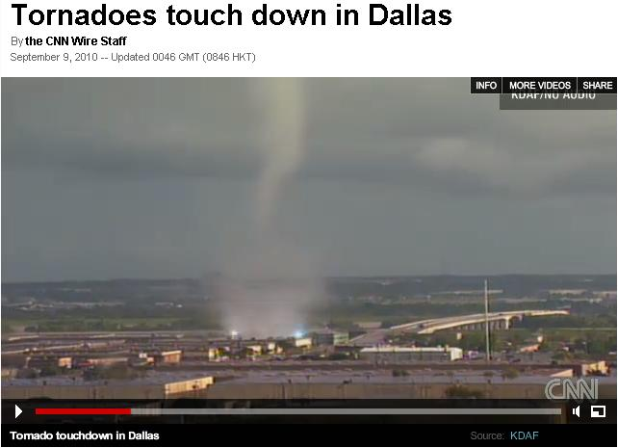
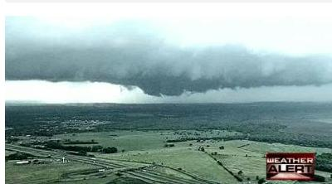
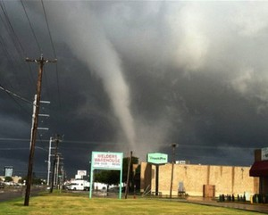
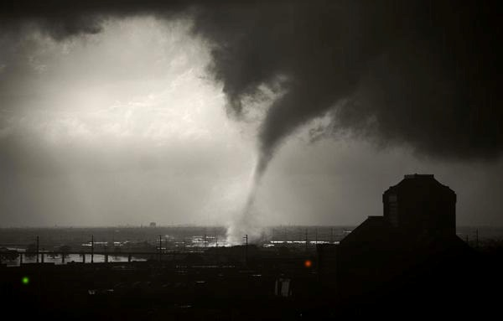
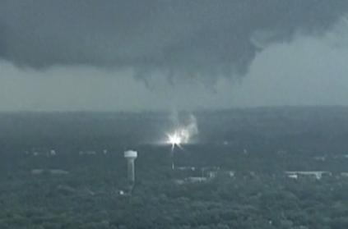
TC HERMINE TORNADOES HIT DALLAS
Notes:
‹#›
Impacts! Your requisite eye candy from TC Hermine (Sep 2010). This was an important late-summer tornado event in the DFW Metroplex.

Slide 3
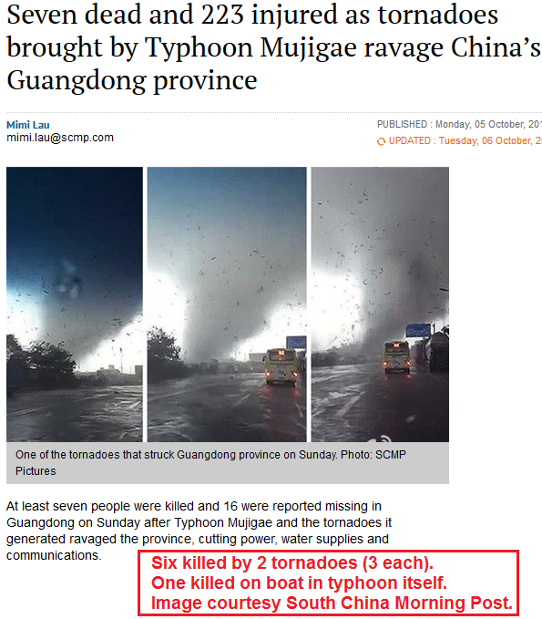
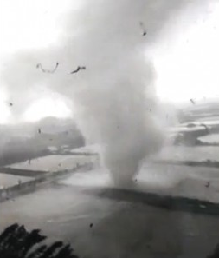
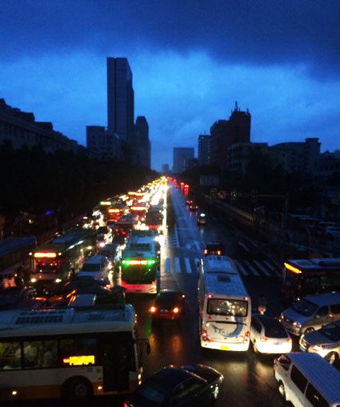
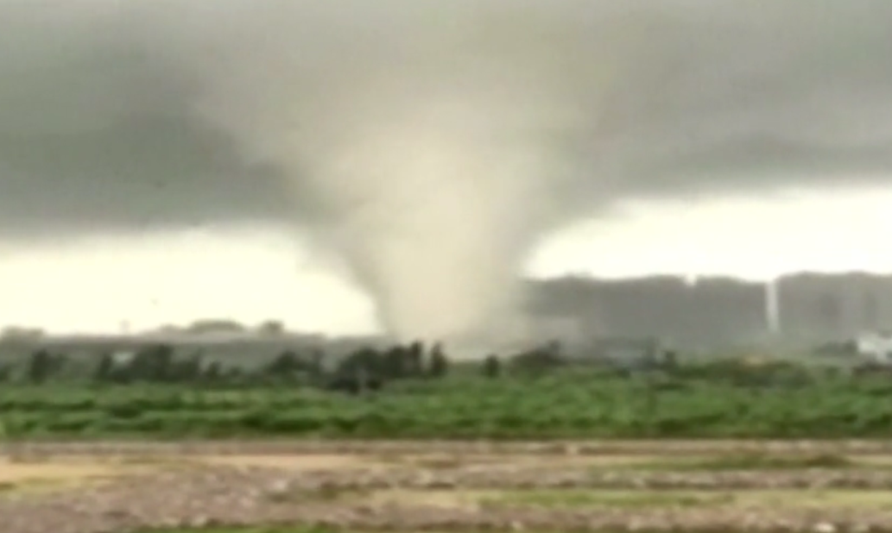
TC MUJIGAE TORNADOES HIT CHINA
Notes:
‹#›
TC tornadoes are not just a U.S. problem. They have been reported in many countries, including Australia, China, and Cuba. More news, this time from TC Mujigae in southern China (October 2015).

Slide 4
TC TORNADO FACTS & CLIMATOLOGY
MOST COMMON IN <50-kt WIND AREA
MOST COMMON NNW-NE-SE OF CENTER
MOST COMMON AND DAMAGING FROM MINI-SUPERCELLS (EF0-EF3, TWO F4S SINCE 1950)
OCCASIONALLY REPORTED FROM NON-SUPERCELL RADAR FEATURES (WEAK – EF0-EF1)
SHARP DECREASE >500 km FROM COASTS
MORE COMMON DIURNALLY
OCCUR OVER WATER AND CAN MOVE ASHORE
OCCUR IN EVERY STAGE OF CLASSIFICATION
DETAILED DISCUSSION IN EDWARDS (2012), EJSSM
Notes:
‹#›
Summary of TC tornado facts & climatology

Slide 5
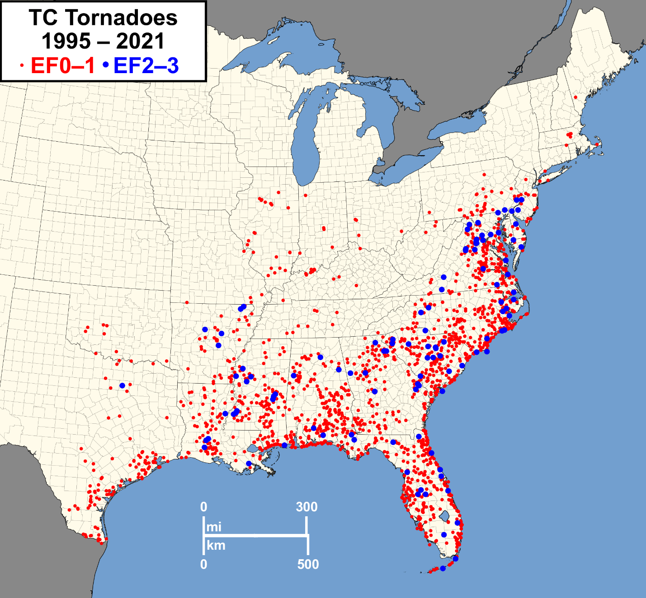
TC TORNADO FACTS & CLIMATOLOGY
Geography of TCTOR events
Notes:
‹#›
SPC maintains a database of TC tornadoes, now available 1995-2021. TCTOR is quality controlled by meteorological analyses of surface, satellite and upper-air data for optimal confidence that each event indeed was within the envelope of a classified or remnant TC circulation. This is subject to revision as new information arises, even years later. See Edwards 2010 (SPC Publications Page). Some graphics in this talk have been updated to 2009 (original TCTOR documentation), 2010 (for EJSSM formal paper), or 2011 (yearly chart, part of TCTOR spreadsheet).

Slide 6
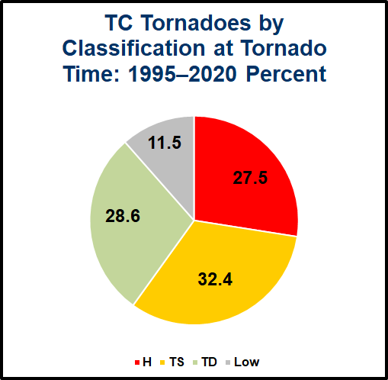
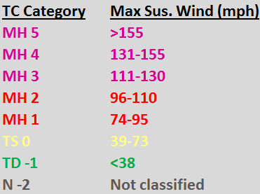
TC NAME | TORNADOES | C_{L} | C_{MAX}
MH Ivan (2004) | 118 | 3 | 5
H Frances (2004) | 103 | 2 | 4
MH Rita (2005) | 98 | 3 | 5
MH Katrina (2005) | 59 | 3 | 5
TS Fay (2008) | 50 | 0 | 0
H Gustav (2008) | 49 | 2 | 4
H Cindy (2005) | 48 | 1 | 1
H Georges (1998) | 48 | 2 | 4
MH Jeanne (2004) | 42 | 3 | 3
MH Opal (1995) | 35 | 3 | 4
TC TORNADO FACTS & CLIMATOLOGY
TCTOR DATA: TC STRENGTH AT TORNADO TIME (from HURDAT)
Notes:
‹#›
Table shows top-10 most tornado-producing TCs 1995-2020, along with OFCL landfall category and max OFCL category AT THE TIME OF THE TORNADO. MH is major hurricane. H is hurricane. TS is tropical storm. TD is tropical depression. N is unclassified and post-tropical. Number is TC category (0 and negative numbers are not official but used for database purposes). Colors follow NHC graphical conventions.

Slide 7
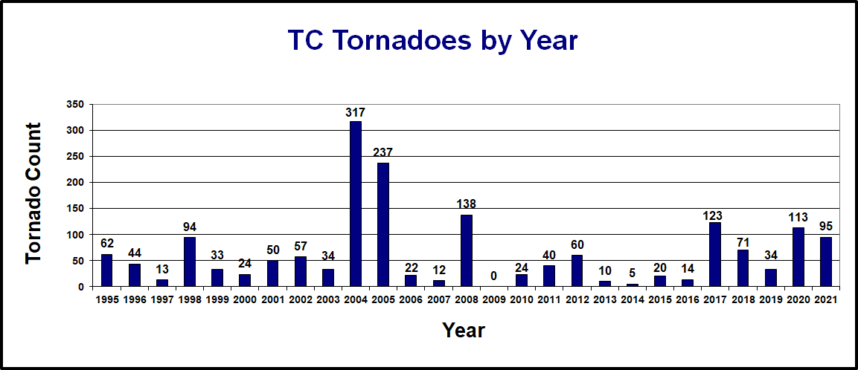
TC TORNADO FACTS & CLIMATOLOGY
Highly variable year-to-year in WSR-88D era
Notes:
‹#›
TC tornadoes vary with seasonal activity (2004-2005) peaks and very active individual storms (Ivan, 2004, had a record 118 tornadoes). TCTOR, for now, is constrained to the WSR-88D era (1995-present) for relatively consistent “modernized” NWS detection and verification practices. Trends before the WSR-88D were remarkably lower…

Slide 8
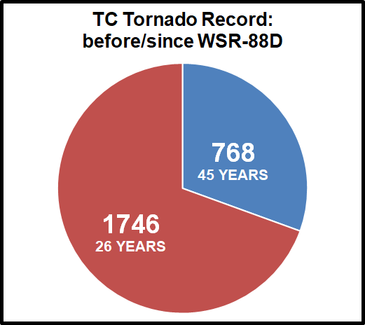
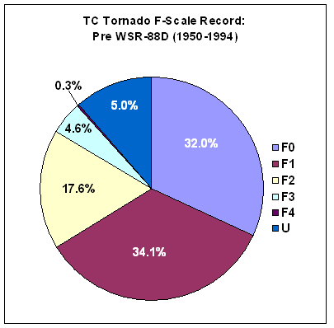
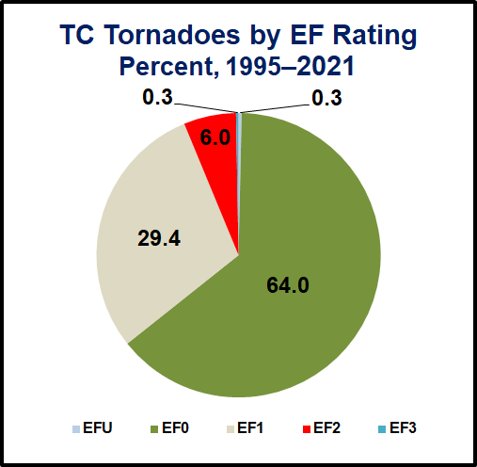
TC TORNADO FACTS & CLIMATOLOGY
88D era: Many more weak TC tornado reports, Many more TC tornado reports PERIOD!
Pre-TCTOR data from Schultz and Cecil (2009)
Notes:
‹#›
The modernized NWS warning and verificaiton era has influenced the tornado climatology greatly, and this includes TC tornadoes! Data analyzed at SPC and provided by Schultz and Cecil (2009).

Slide 9
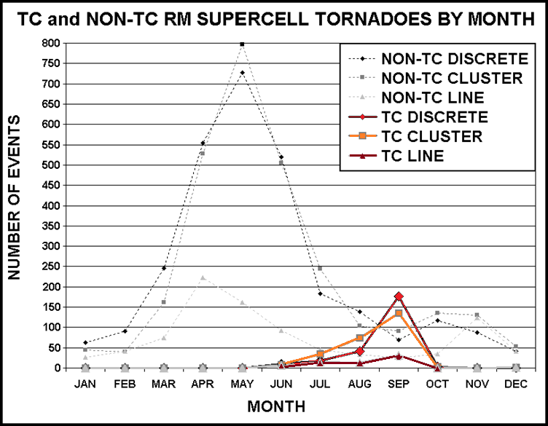
TC TORNADO FACTS & CLIMATOLOGY
data from Edwards et al. (2012)
Notes:
‹#›
TCs account for most of the tornadic supercells in the nation in September, and many in Jul-Oct. This is from an upcoming (to be in early online release this summer) paper dealing with convective modes for TC tornadoes.

Slide 10
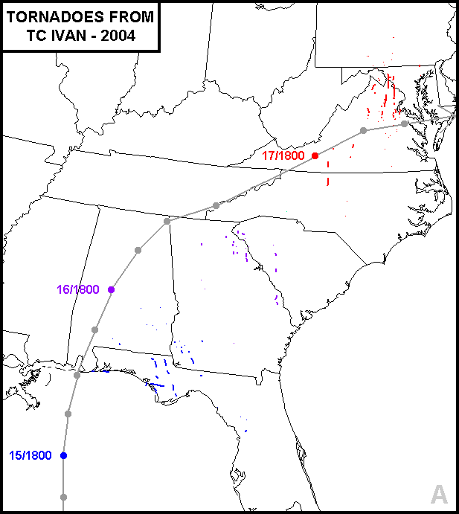
TC TORNADO FACTS & CLIMATOLOGY
…and the single-storm winner is
IVAN
118 in 3-DAY CYCLE
MAY HAVE SET ALL-TIME RECORD
(115 – BEULAH 1967)
Notes:
‹#›
Hurricane Ivan was the most prolific tornado producer in the modern era and did so over a 3 day period. The most reliable and through formal account (from Orton) tallies 115 tornadoes for Beulah of 1967, most of which were on one day! We may never know.

Slide 11
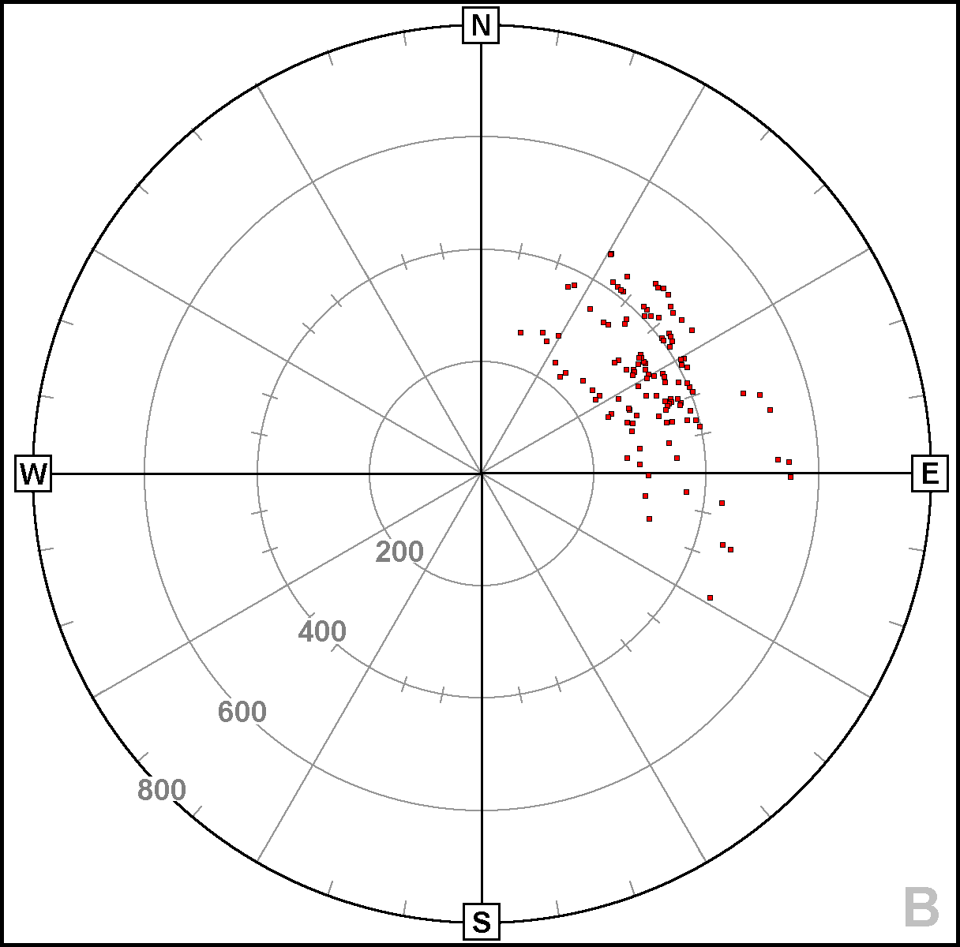
TC TORNADO FACTS & CLIMATOLOGY
3 DAYS COMBINED
TOTAL TORNADO DISTRUBITION FROM CENTER FOR IVAN (2004)
VERY TIGHT!
km
Notes:
‹#›
Over its 3-day cycle of outbreaks, regardless of landfall or inland-decay phases, Ivan’s tornadoes were remarkably tightly distributed with respect to radius and sector. As implied by the previous slide, they also had distinctive nighttime minima (between one day and the next).

Slide 12
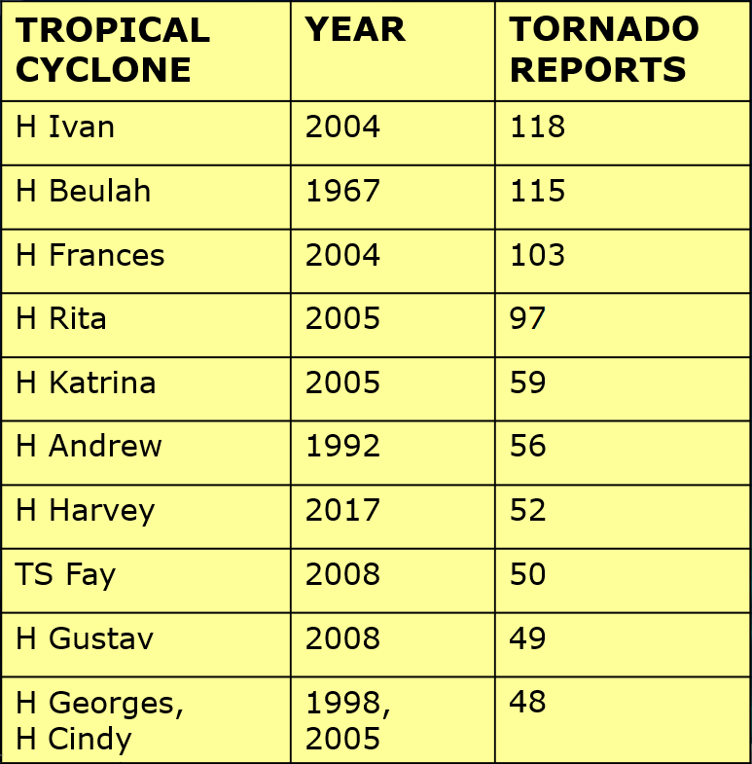
TC NAME | TORNADOES | C_{L} | C_{MAX}
MH Ivan (2004) | 118 | 3 | 5
H Frances (2004) | 103 | 2 | 4
MH Rita (2005) | 98 | 3 | 5
MH Katrina (2005) | 59 | 3 | 5
TS Fay (2008) | 50 | 0 | 0
H Gustav (2008) | 49 | 2 | 4
H Cindy (2005) | 48 | 1 | 1
H Georges (1998) | 48 | 2 | 4
MH Jeanne (2004) | 42 | 3 | 3
MH Opal (1995) | 35 | 3 | 4
TC TORNADO FACTS & CLIMATOLOGY
TOP-10 LIST
From TCTOR and pre-1995 formal references
Peak classification
Notes:
‹#›
Table shows top-10 most tornado-producing TCs along with the system’s maximum HURDAT classification at anytime in its lifespan.

Slide 13
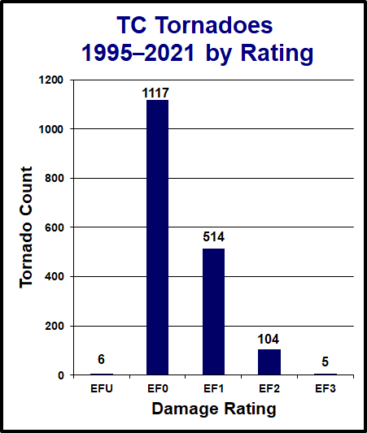
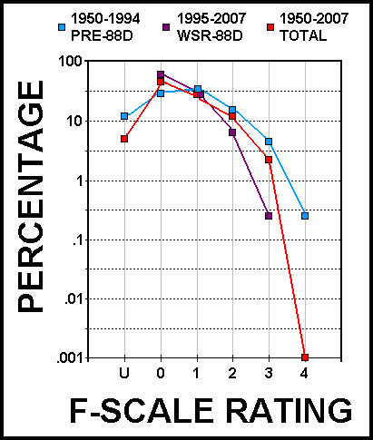
TC TORNADO FACTS & CLIMATOLOGY
Logarithmic plot of damage ratings from Schultz and Cecil data
Bar plot from 1995-2021 TCTOR
Notes:
‹#›
Here you can see the tornado distribution by damage rating from two different datasets, using two different kinds of measurements. The distribution is more heavily skewed to the weak end than midlatitude tornadoes. It appears TC tornadoes overall have gotten weaker RATINGS since the WSR-88D. Remember, RATING isn’t necessarily synonymous with INTENSITY due to sampling problems and lack of direct wind measurement in tornadoes.

Slide 14
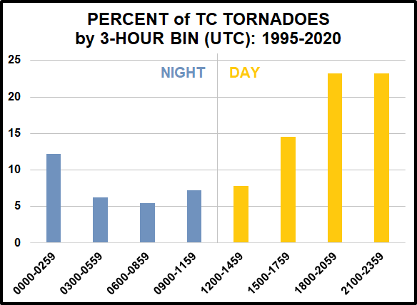
CLIMATOLOGICAL APPLICATION TO FORECASTING CONCEPTS
DIURNAL TREND:
In moist-adiabatic lapse rate environment, even subtle thermal warming under cloud cover greatly increases CAPE.
Dry air intrusions into TCs allow for gaps between convective rainbands
Notes:
‹#›
TCTOR by UTC time bins. Distinct preference for daytime (inland diurnal destabilization – even subtle beneath cloud cover – can increase CAPE greatly in a moist-adiabatic lapse rate environment).

Slide 15
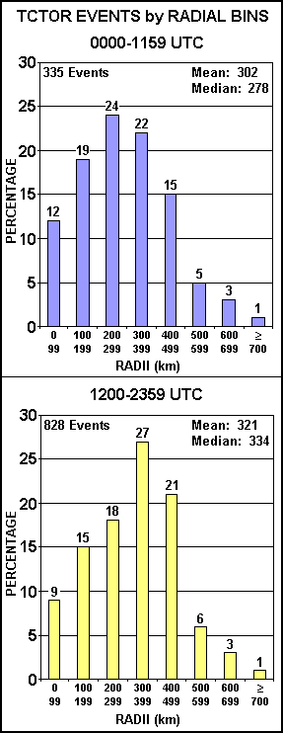
CLIMATOLOGICAL APPLICATION TO FORECASTING CONCEPTS
LIKE NIGHT and DAY
NIGHT: Less common, weaker ratings*. Tendency toward more nonsupercell tornado reports inward toward center. Fewer supercells overall.
DAY: More common overall. Tendency toward outward radial shift of tornado risk by day (thanks to diurnal CAPE)
Notes:
‹#›
Some more TCTOR findings presented in published analyses (Edwards 2012, Edwards et al. 2012).

Slide 16
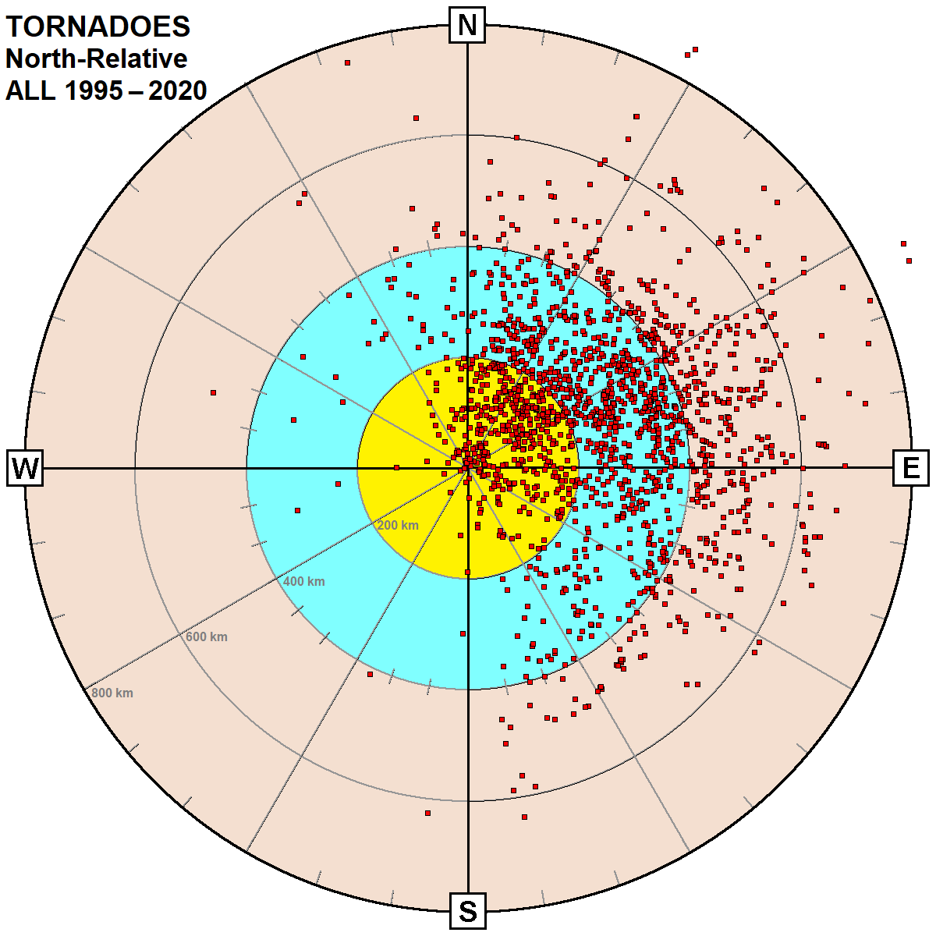
CLIMATOLOGICAL APPLICATION TO FORECASTING CONCEPTS
AZRAN of TCTOR events from center
Notes:
‹#›
Tornado AZRAN from center: Cartesian (north). Why not motion-relative? Hint: Most of the time they’re not very different, except…

Slide 17
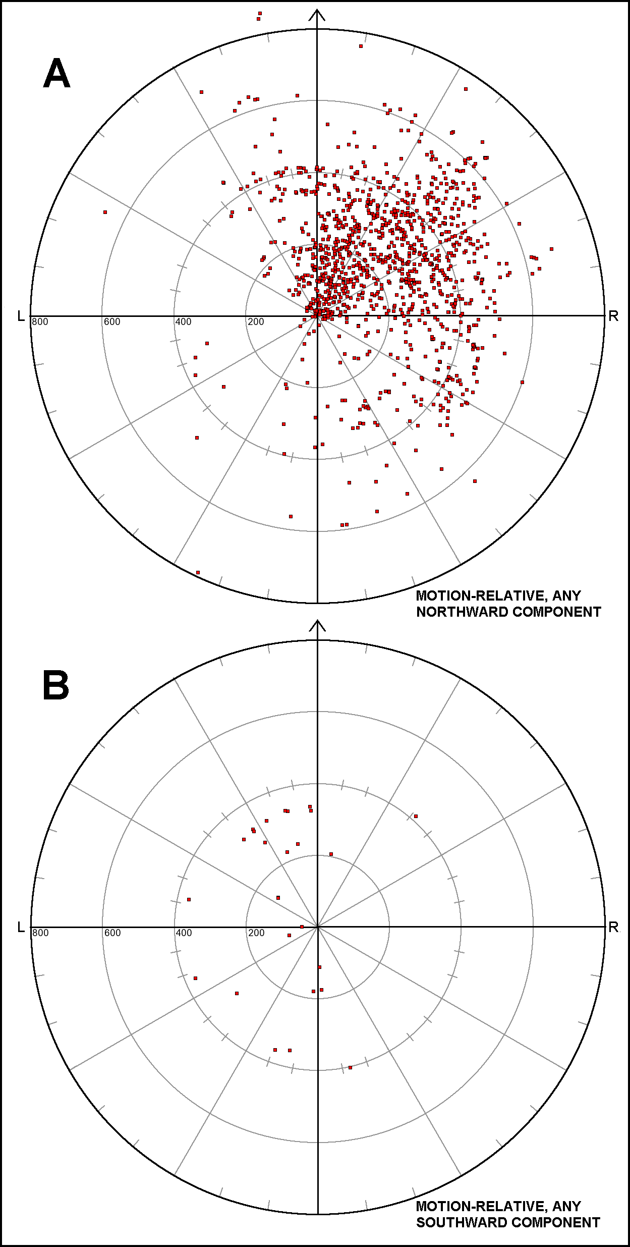
CLIMATOLOGICAL APPLICATION TO FORECASTING CONCEPTS
Motion-relative AZRAN of TCTOR events from center: Northward translation component
HOW MOTION-RELATIVE FAILS
Motion-relative AZRAN of TCTOR events from center: Southward translation component
Notes:
‹#›
…on those tiny fraction of occasions when a TC shows strongly deviant (southward) translation. Then, tornadoes are LEFT of motion (generally still some component east of actual center). Lesson: do not use right-front quadrant. Think in Cartesian terms, where ambient wind and shear vectors as TCs interact with midlatitude flow influence deep-layer shear toward the northeastern part of the storm. AVOID STRICT QUADRANT-BASED THINKING!

Slide 18
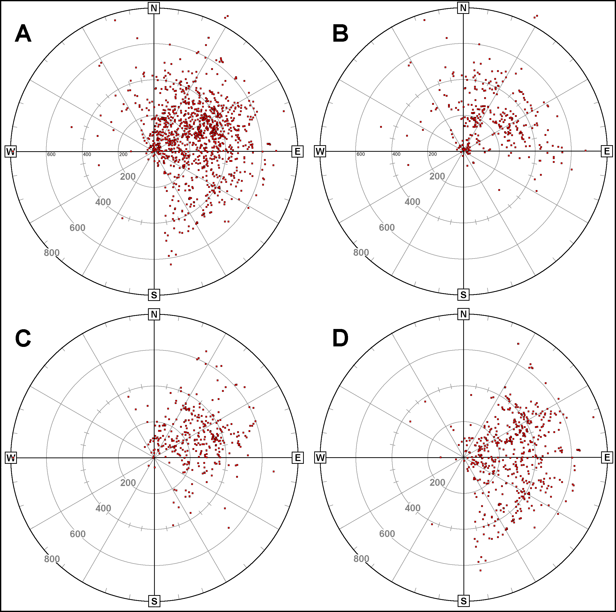
CLIMATOLOGICAL APPLICATION TO FORECASTING CONCEPTS
Tornadoes more common in SE sectors as TCs weaken…WHY?
ALL TCs
H
…partly due to that sector’s being over water when most are mature hurricanes!
TS
TD and Unc.
Notes:
‹#›
TC tornadoes tend to be more common SE of center when the system is weaker, as in inland-decay stages when the storm is a weakening TS, TD or unclassified. This is more Memorex than real, however; as the potentially tornadic SE area of the TC envelope tends to be over water much more often for mature hurricanes.

Slide 19
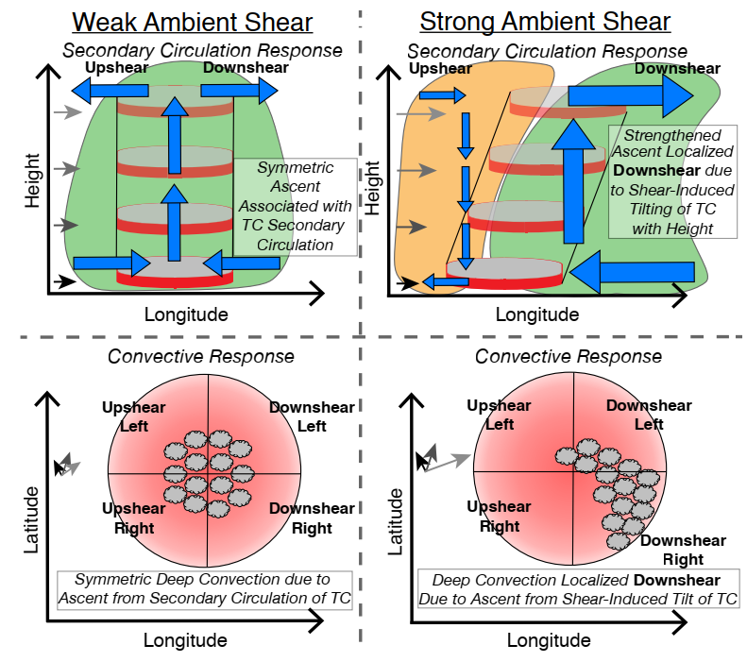
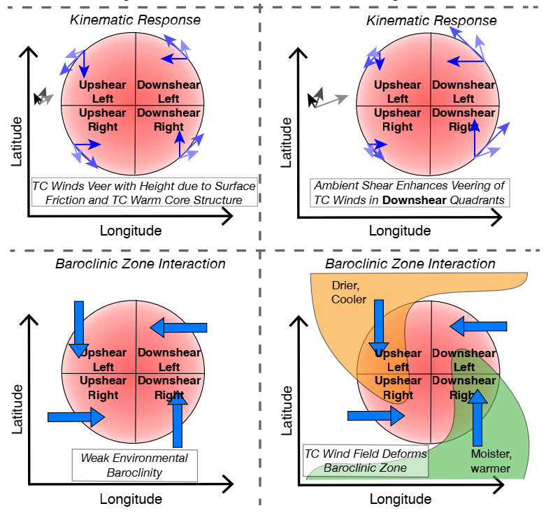
CLIMATOLOGICAL APPLICATION TO FORECASTING CONCEPTS
Shear-vector-relative distributions with physical basis (Schenkel et al. 2020 – October 2020 WaF)
Notes:
‹#›
Recent research by Schenkel et al. has shown a strong dependence of TC tornado distribution within the cyclone on deep shear affecting the TC. Here’s a couple schematics showing how that works. In short, stronger deep shear deforms the cyclone horizontally *and* vertically to favor supercell environments in the downshear left (near) and right (farther) quadrants. Since the deep shear in northern midlatitudes is often from the south to west, this explains physically why so many tornadoes occur in the northeastern to eastern sector of tropical cyclones in our climatologies.

Slide 20
CLIMATOLOGICAL APPLICATION TO FORECASTING CONCEPTS
Shear-vector-relative distributions with physical basis (Schenkel et al. 2020 – October 2020 WaF)
Notes:
‹#›
Deep-shear-relative gridded TC-tornado distribution from Schenkel et al.

Slide 21
TC TORNADO FORECASTING CONCEPTS
Shifting from climatology-based and empirical to
INGREDIENTS-BASED THINKING
For supercells in midlatitude systems and tropical cyclones!
MOISTURE: usually no problem
INSTABILITY: helps to have diurnal heating with large antecedent BL theta-e to offset weak lapse rates aloft
(source for) LIFT: Spiral bands, embedded boundaries concentrate threat on mesoscale and smaller – FREQUENT HAND ANALYSIS is CRUCIAL!
VERTICAL SHEAR: Peak hodographs in climatologically favored N-NE-SSE sector, which is DOWNSHEAR
Edwards 2012
Notes:
‹#›
The basic ingredients for supercells apply regardless of the setting. Here we see how they apply to TCs. The baroclinic and kinematic boundaries in TCs that can limit or boost tornado potential might be subtle (Edwards and Pietrycha 1996, SPC Publications website). Therefore, we strongly encourage frequent hand analysis of isotherms at 1-2 deg F intervals in the TC setting, as well as streamline analysis (for the confluent zones).

Slide 22
TC TORNADO FORECASTING CONCEPTS
Objectively analyzed parameters (e.g. SPC SFCOA)
TESTED FOR 2003-2011 TC TORNADO ENVIRONMENTS
LITTLE DIFFERENCE WITH ANY PARAMETER between WEAK & STRONG TC TORNADOES
HIGH PW, WEAK LAPSE RATES, LOWER MLCAPE WITH TC vs. MIDLATITUDE TORNADOES
LOWER/MORE COMPRESSED SCP AND STP DISTRIBUTIONS FOR TC TORNADOES
RUC-BASED: WAS UNRELIABLE/INACCURATE WITH WIND AND PRESSURE TOWARD CENTER OF TS AND HURRICANE. TOO FEW CASES on RAPID REFRESH.
Edwards et al. 2012
Notes:
‹#›
Some findings from a WAF paper by Edwards, Dean, Thompson and Smith (2012). To nobody’s big surprise, moisture- and lapse rate-influenced parameters best distinguished the TC tornado environment from midlatitude systems. Derived parameters (SCP and STP) were useful on a limited basis, mainly in the outer parts. SPC SFCOA was RUC-based dfor this study, and the RUC just wasn’t designed to resolve hurricane and TS gradients, which is more relevant inward.

Slide 23
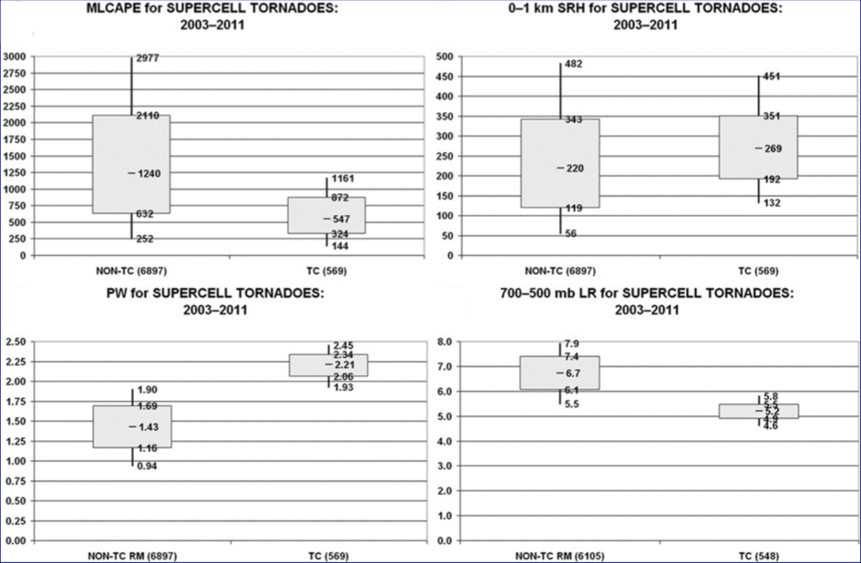
TC TORNADO FORECASTING CONCEPTS
Notes:
‹#›

Slide 24
TC TORNADO FORECASTING CONCEPTS
Notes:
‹#›

Slide 25
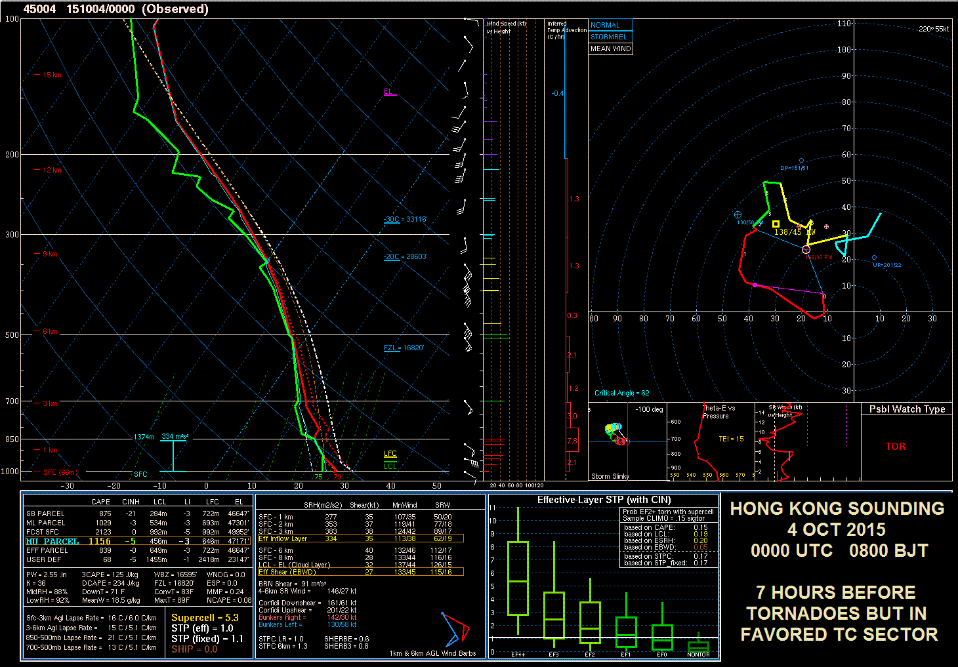
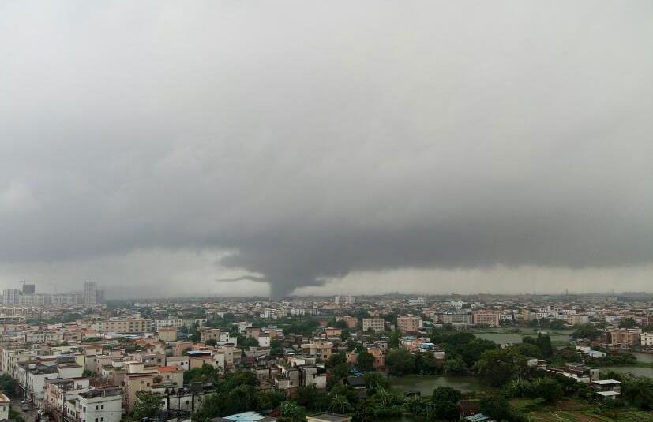
TC TORNADO FORECASTING CONCEPTS
Shear Limiting
Notes:
‹#›
Sounding analysis reveals much about the TC tornado threat, at least when one is available! This sounding was in the favored sector of the TC but 7 hours before tornadoes. There was another sounding 6 hours later and within an hour of tornado time, but it crashes my software. ☹

Slide 26
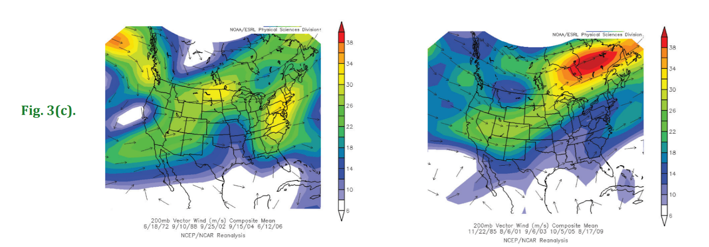
TC TORNADO FORECASTING CONCEPTS – SYNOPTIC PATTERNS
Substantially Tornadic TCs: Produce at least 4 tornadoes
Non-Substantially Tornadic TCs: Produce no more than 1 tornado
Mean 200-mb flow for
Substantially Tornadic TCs
Mean 200-mb flow for
Non-Substantially Tornadic TCs
-Right entrance region of enhanced 200-mb jet streak enhances tornado potential over Southeast.
-Any upper-level jet streak associated with non-substantial tornadic TCs was much weaker.
Notes:
‹#›
The presence of the right-entrance region of upper-level jet streak enables a more favorable mesoscale environment for tornadogenesis
In this entrance region, the ascending branch of the ageostrophic circulation is driven by strong differential cyclonic vorticity advection and upper-level divergence -- favoring increasing instability (through differential cooling through differential motion), potential for mid-level dry air to wrap into the cyclone (through baroclinic processes/development of dry conveyor belt) and synoptic-scale ascent (enhancing convective activity).
This gives the potential for baroclinic-related processes to superimpose with the tropical cyclone circulation and create a favorable mesoscale environment. (injection of baroclinic-related processes into the cyclonic flow envelope (i.e., dry conveyor belt)
Cohen, A. E., 2010: Synoptic-scale analysis of tornado producing tropical cyclones along the Gulf Coast. Natl. Wea. Dig., 34 (2), 99-115.

Slide 27
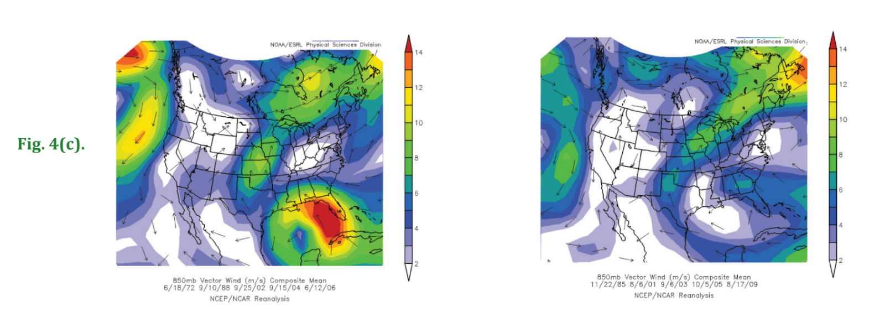
TC TORNADO FORECASTING CONCEPTS – SYNOPTIC PATTERNS
Substantially Tornadic TCs: Produce at least 4 tornadoes
Non-Substantially Tornadic TCs: Produce no more than 1 tornado
Mean 850-mb flow for
Substantially Tornadic TCs
Mean 850-mb flow for
Non-Substantially Tornadic TCs
-850-mb flow field -- associated with subst. tornadic TCs -- are well organized, large, and directionally-symmetric, with strongest flow in NE semicircle of cyclonic flow envelope
-In this region, SRH will be maximized, enhancing tornadogenesis potential
Notes:
‹#›
-850-mb flow field shows a definitive response to the presence of the TC itself, though the influence of the TC on mass and kinematic fields is typically expansive (approaching the synoptic-scale).
-In the substantially tornadic TCs, the 850-mb storm-induced cyclonic flow field is considerably larger with greater organization and directional symmetry
-Additionally, the strongest 850-mb flow is in the NE semicircle of the cyclonic flow envelope
-The strength of the 850-mb wind maximum is important, with speeds of at least 20 to 30 knots for substantially tornadic TCs
**The strength of the TC must be considered in tandem with other factors (such as size and organization of the cyclonic flow envelope) to determine the propensity for tornadogenesis (i.e., enhancement to the low-level shear)
Cohen, A. E., 2010: Synoptic-scale analysis of tornado producing tropical cyclones along the Gulf Coast. Natl. Wea. Dig., 34 (2), 99-115.

Slide 28
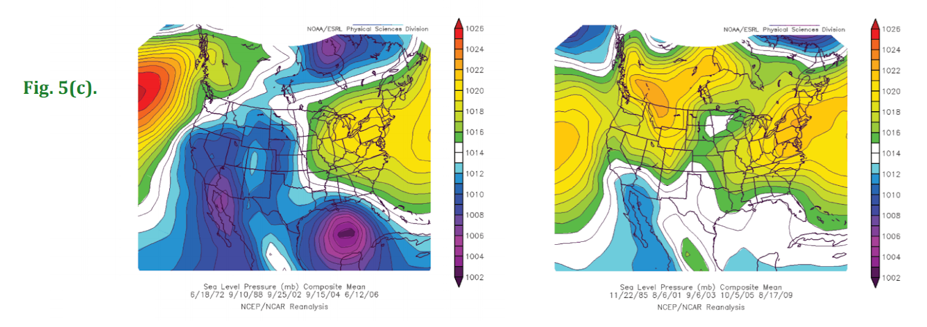
TC TORNADO FORECASTING CONCEPTS – SYNOPTIC PATTERNS
Substantially Tornadic TCs: Produce at least 4 tornadoes
Non-Substantially Tornadic TCs: Produce no more than 1 tornado
Mean MSLP for
Substantially Tornadic TCs
Mean MSLP for
Non-Substantially Tornadic TCs
-The area of low pressure associated with subst. tornadic TCs well-defined and symmetric, as opposed to a broad trough
-Pressure gradient maximized in NE semicircle. In this region, SRH will be maximized, enhancing tornado potential
Notes:
‹#›
- Of note: Mean minimum pressures below 1006 mb are noted in substantially tornadic TCs
- Similar to 850-mb flow pattern, the larger-scale MSLP distribution is driven by the presence of the TC itself, which forces the kinematic field -- locally enhancing tornado potential
-The aforementioned gradient drives a low-level flow with a pronounced easterly component -- maximizing storm-relative helicity -- owing to low-level veering of the flow
-While helicity is considered to be a mesoscale variable, the synoptic-scale circulation plays a crucial role in locally enhancing helicity values.
Cohen, A. E., 2010: Synoptic-scale analysis of tornado producing tropical cyclones along the Gulf Coast. Natl. Wea. Dig., 34 (2), 99-115.

Slide 29
TC TORNADO FORECASTING CONCEPTS – SYNOPTIC PATTERNS
Substantially Tornadic TCs: Produce at least 4 tornadoes
Non-Substantially Tornadic TCs: Produce no more than 1 tornado
Mean 600-mb RH for
Substantially Tornadic TCs
Mean 600-mb RH for
Non-Substantially Tornadic TCs
-Presence of a spatially-broad, yet strong, horizontal gradient in mid-level moisture is found over NW semicircle of cyclonic flow envelope
-Dry air driving this gradient enhances low-level buoyancy in vicinity of rain bands through mid-level dry air entrainment into the TC
Notes:
‹#›
More info on dry air entrainment and relevance to tornado potential:
- Strongest horizontal mid-level moisture gradient found around 300 km NW of center of the mid-level TC-induced moisture maximum
- This mid-level dry air is found to cyclonically envelop the TC, intruding into its eastern semicircle.
- The presence of a mid-level dry air intrusion (which will be evident in thermodynamic soundings) likely contributes to development of more substantial cold pools in storms located in the outer rainbands -- enhancing RFDs for tornadogenesis (enhancing low-level horizontal vorticity
- Intrusion of mid-level dry air increases low-level buoyancy by limiting the coverage of convection, therefore increasing diurnal heating/destabilization between rainbands
Cohen, A. E., 2010: Synoptic-scale analysis of tornado producing tropical cyclones along the Gulf Coast. Natl. Wea. Dig., 34 (2), 99-115.

Slide 30
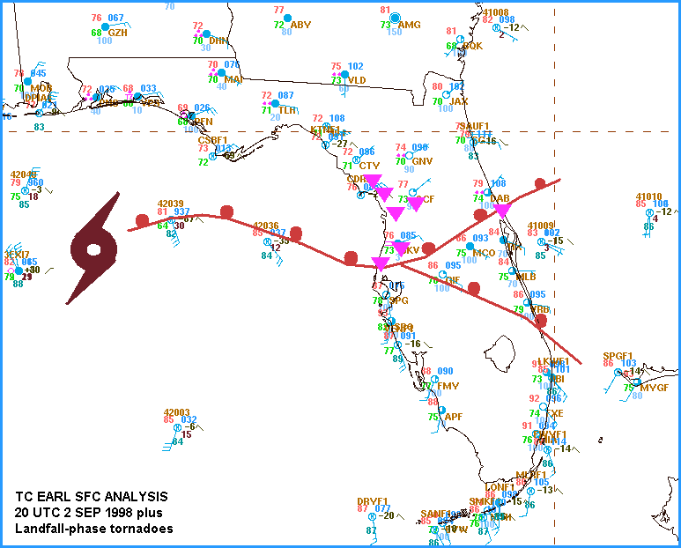
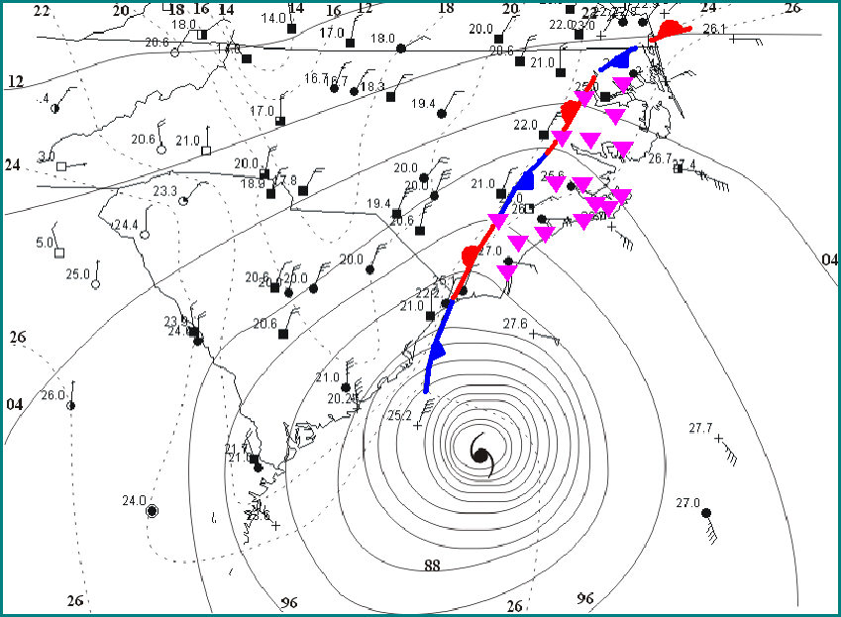
TC TORNADO FORECASTING CONCEPTS – MESOSCALE BOUNDARIES
Baroclinic and wind boundaries can influence threat
FLOYD
Shear Limiting
EARL
Buoyancy Limiting
Favorable buoyancy on both sides, only favorable shear on cool side.
Favorable shear on both sides, only favorable buoyancy on warm side.
Edwards and Pietrycha 2006
Notes:
‹#›
Baroclinic boundaries—whether in the form of pre-existing fronts or boundaries forming in the TC envelope—can enhanced CAPE or shear in one of three ways: 1. CAPE on one side, shear on both (look to the side with overlap); 2. Shear on both sides, buoyancy on one (look for overlap); 3. Buoyancy on one side, shear on the other (look for narrow overlap near front). See Edwards and Pietrycha (2006, SPC Publications page).

Slide 31
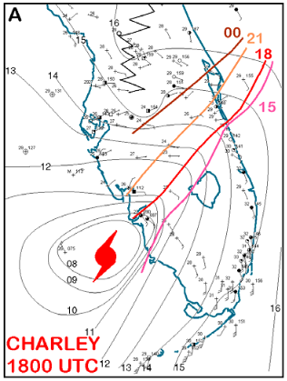
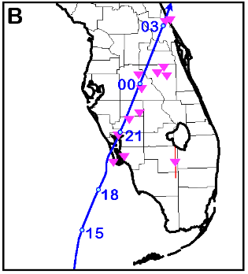
TC TORNADO FORECASTING CONCEPTS – MESOSCALE BOUNDARIES
Buoyancy-Shear Overlap
Favorable buoyancy on one side, favorable shear on the other. (Slim corridor of overlap near the boundary)
Edwards and Pietrycha 2006
Notes:
‹#›
Baroclinic boundaries—whether in the form of pre-existing fronts or boundaries forming in the TC envelope—can enhanced CAPE or shear in one of three ways: 1. CAPE on one side, shear on both (look to the side with overlap); 2. Shear on both sides, buoyancy on one (look for overlap); 3. Buoyancy on one side, shear on the other (look for narrow overlap near front). See Edwards and Pietrycha (2006, SPC Publications page).

Slide 32
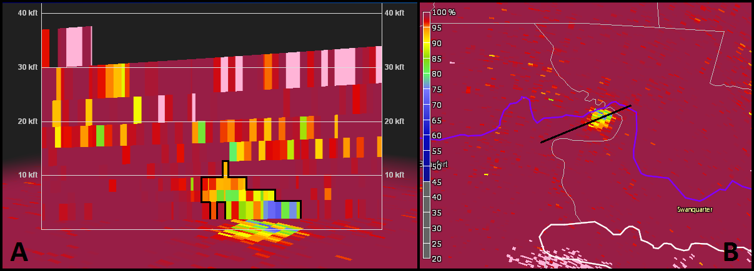
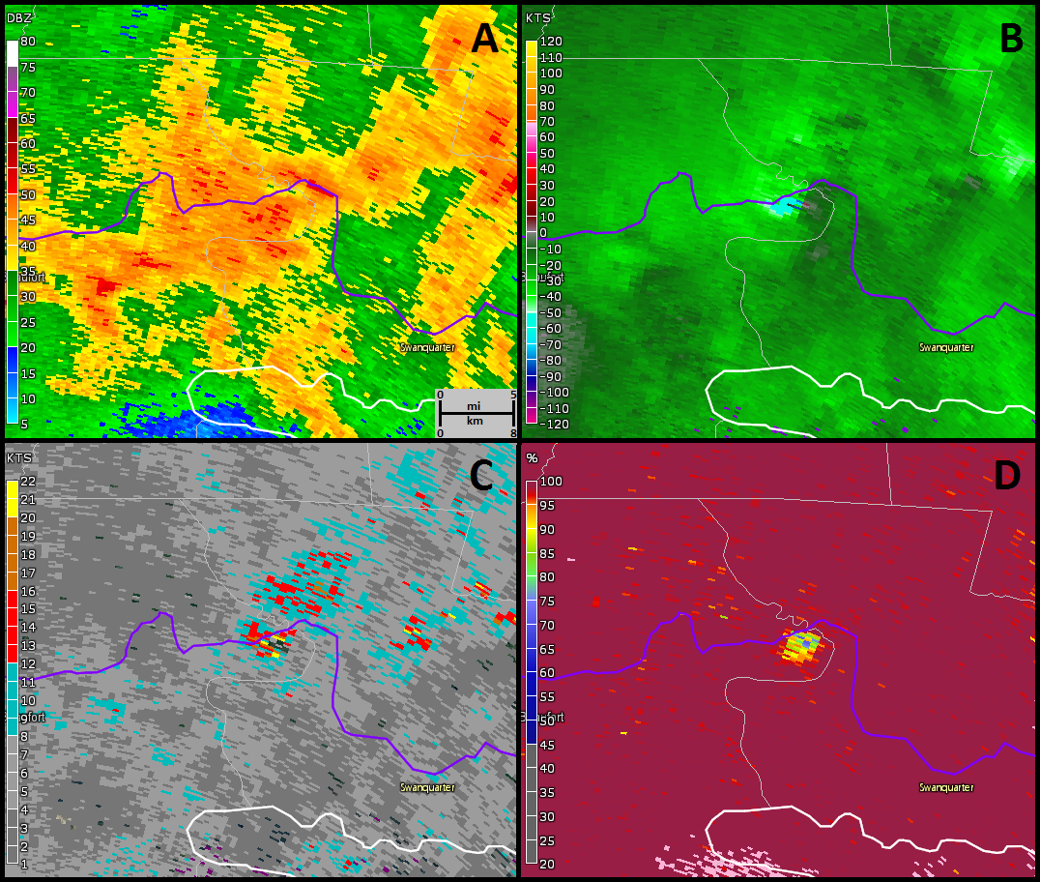
RADAR CONCEPTS for TC TORNADOES
Edwards and Picca 2016
Beaufort Co. N. Carolina 27 Aug 2011 0203 UTC
Notes:
‹#›
New techniques and parameters are being tested that are more relevant in the TC environment. Phased-array radar shows great promise because its denser spatiotemporal resolution and sectorized targeting are ideally suited for the transience of TC tornadoes and their parent supercells. But will PAR be deployed around the Gulf and East coasts in my lifetime…or yours?

Slide 33
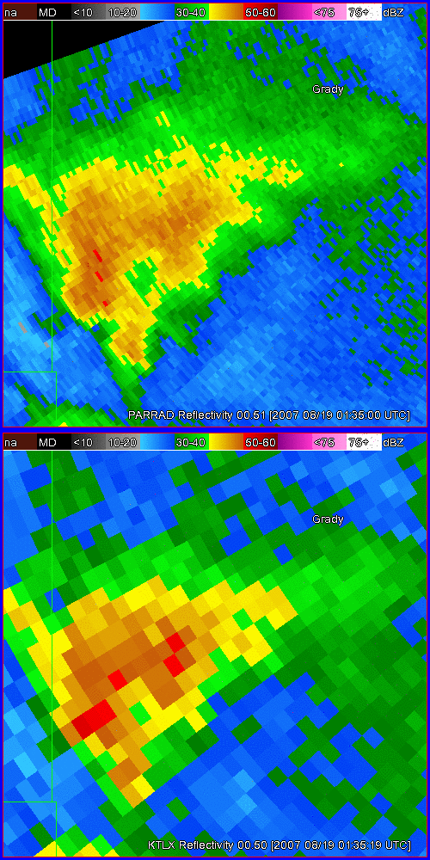
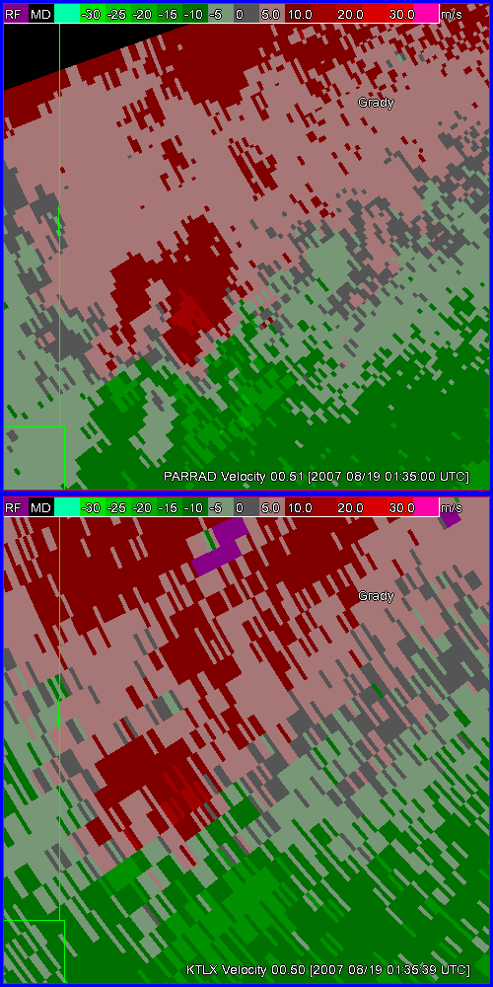
RADAR CONCEPTS for TC TORNADOES
Tornado Warned Supercell near Norge OK TC Erin
PAR VCP 12 60° sector
0.5° oversampling in azimuth
Interval ~ 43 s
19 Aug 2007 0135-0154 UTC
WSR-88D
VCP 12
Interval ~ 4.1 min
Notes:
‹#›
New techniques and parameters are being tested that are more relevant in the TC environment. Phased-array radar shows great promise because its denser spatiotemporal resolution and sectorized targeting are ideally suited for the transience of TC tornadoes and their parent supercells. But will PAR be deployed around the Gulf and East coasts in my lifetime…or yours?

Slide 34
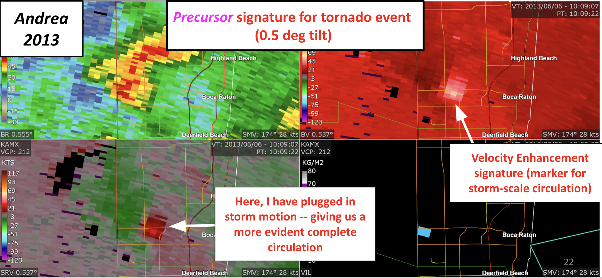
RADAR CONCEPTS for TC TORNADOES – VELOCITY ENHANCEMENT SIGNATURE
Notes:
‹#›

Slide 35
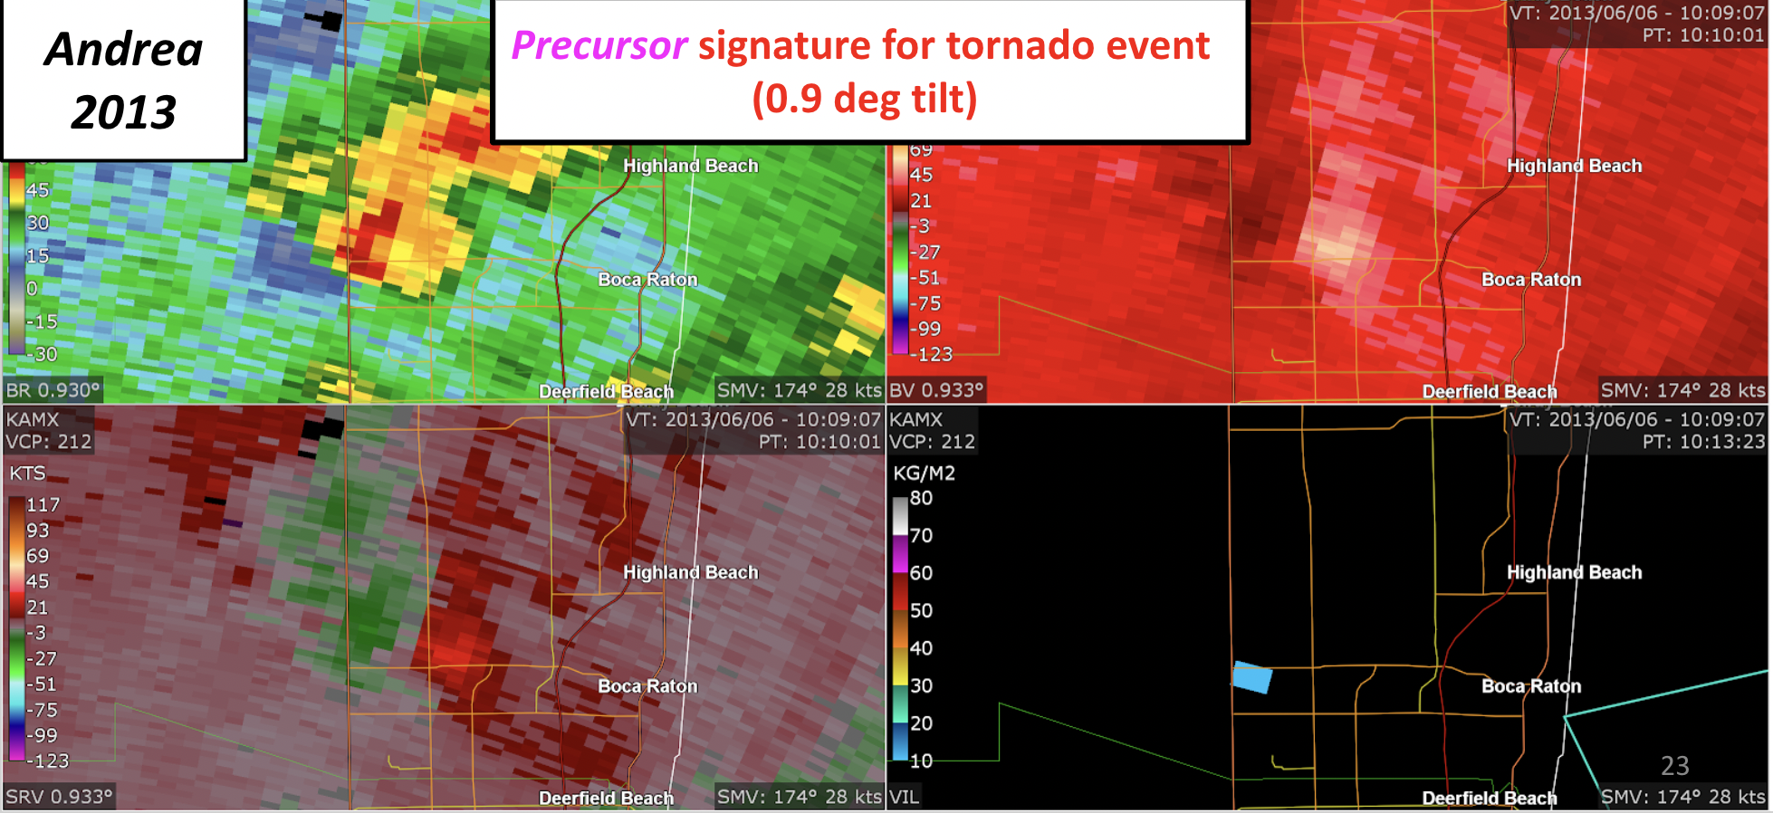
RADAR CONCEPTS for TC TORNADOES – VELOCITY ENHANCEMENT SIGNATURE
Notes:
‹#›

Slide 36
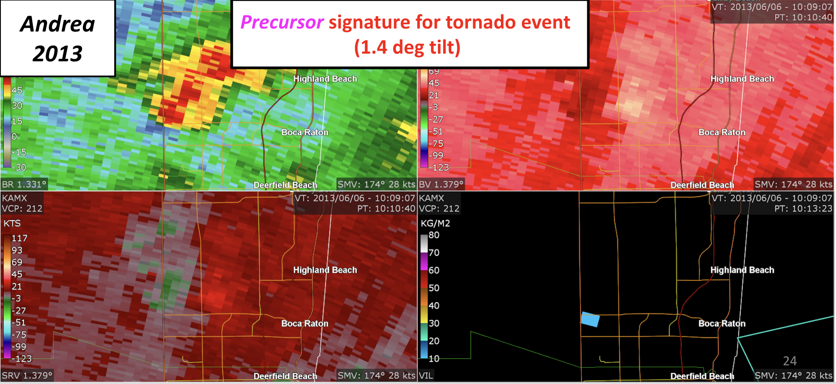
RADAR CONCEPTS for TC TORNADOES – VELOCITY ENHANCEMENT SIGNATURE
Notes:
‹#›

Slide 37
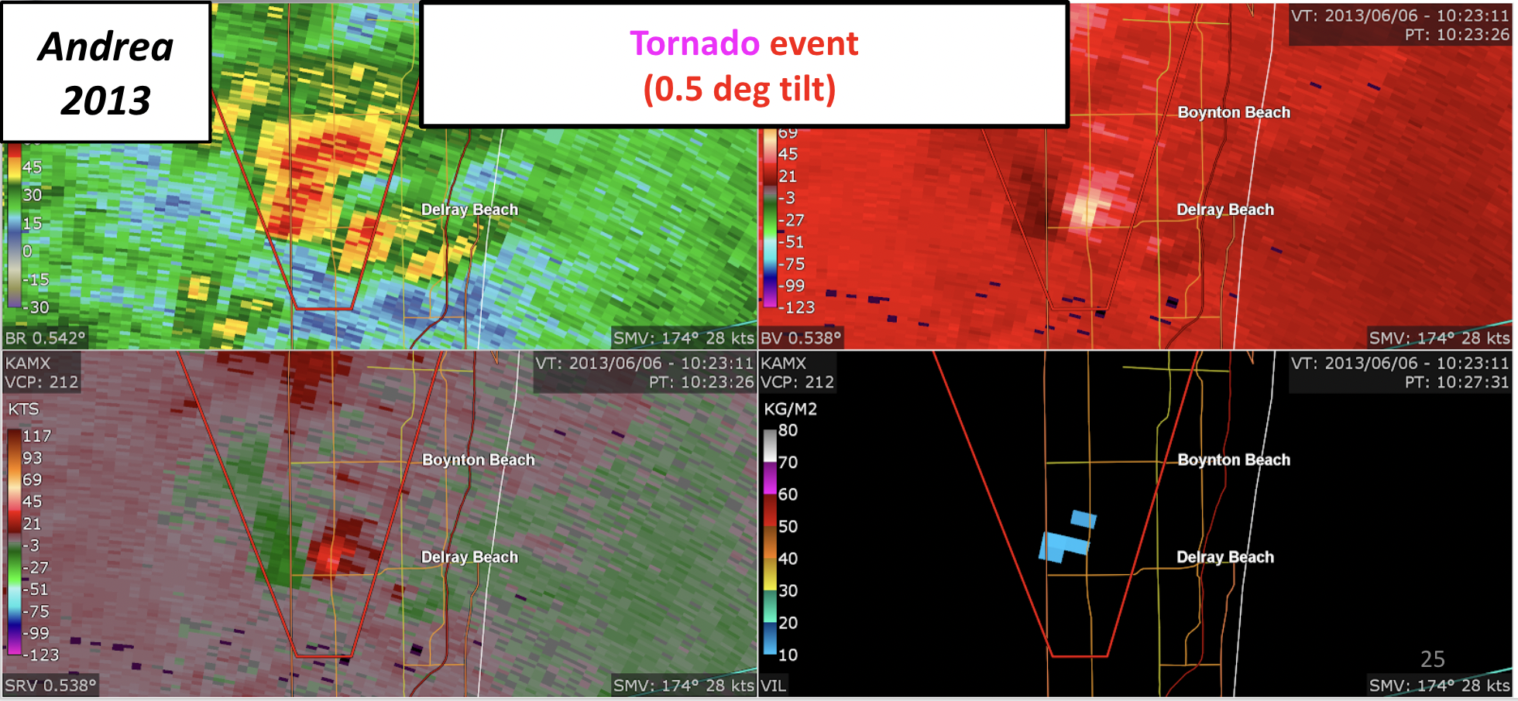
RADAR CONCEPTS for TC TORNADOES – VELOCITY ENHANCEMENT SIGNATURE
Notes:
‹#›

Slide 38
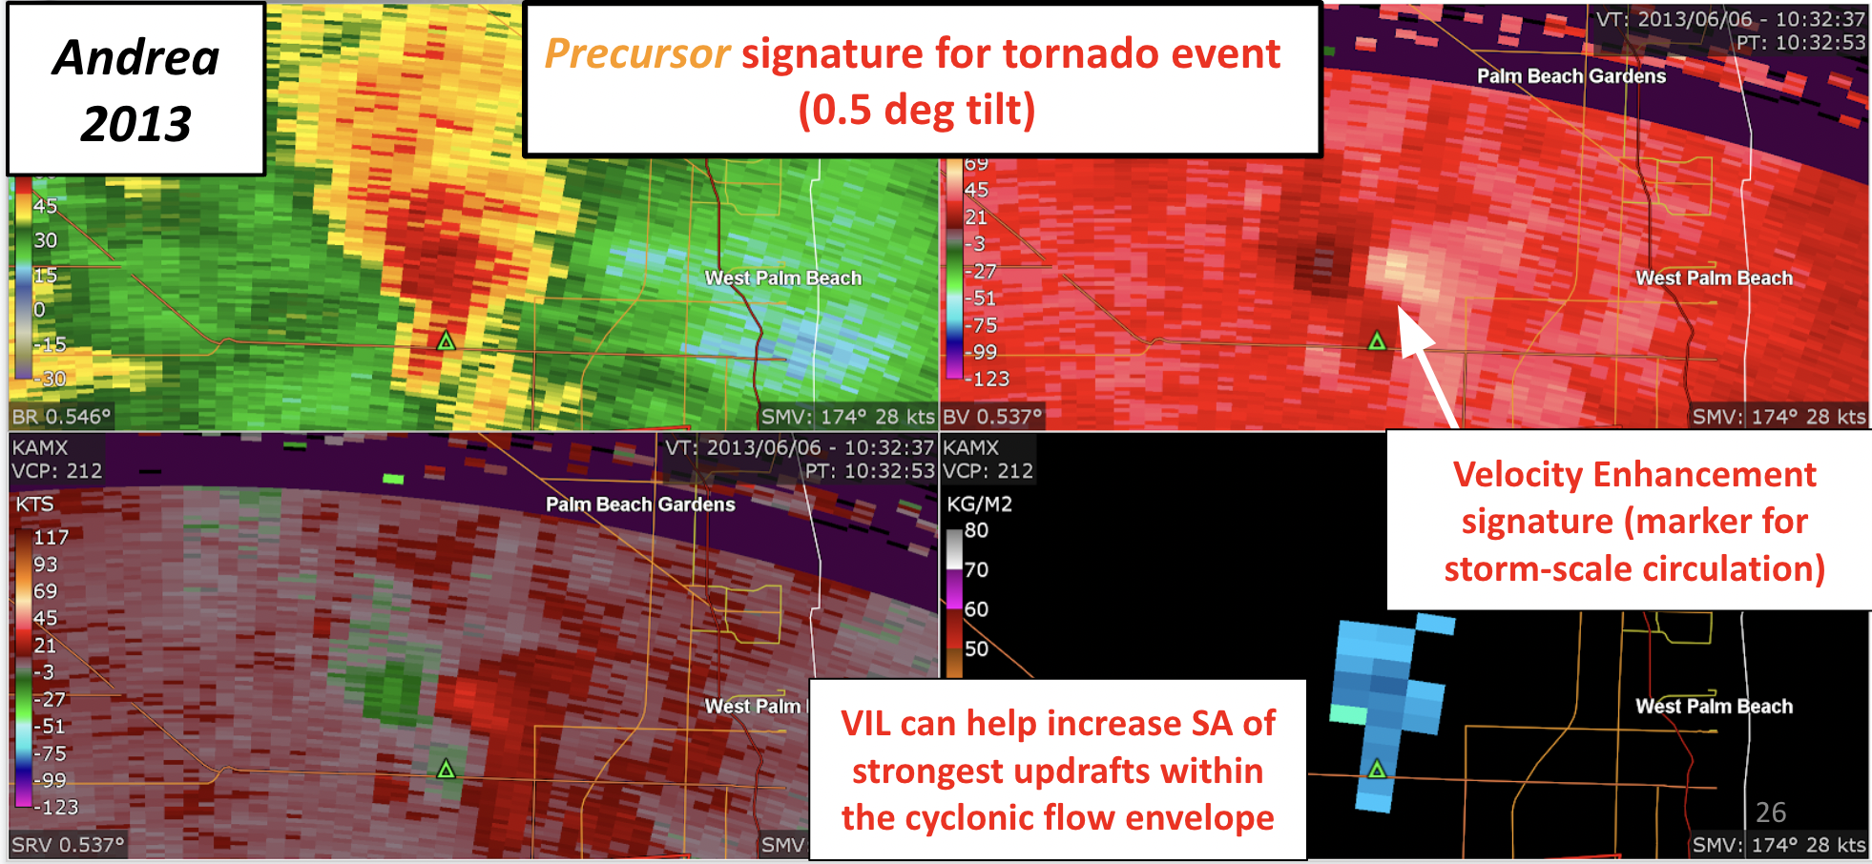
RADAR CONCEPTS for TC TORNADOES – VELOCITY ENHANCEMENT SIGNATURE
Notes:
‹#›

Slide 39
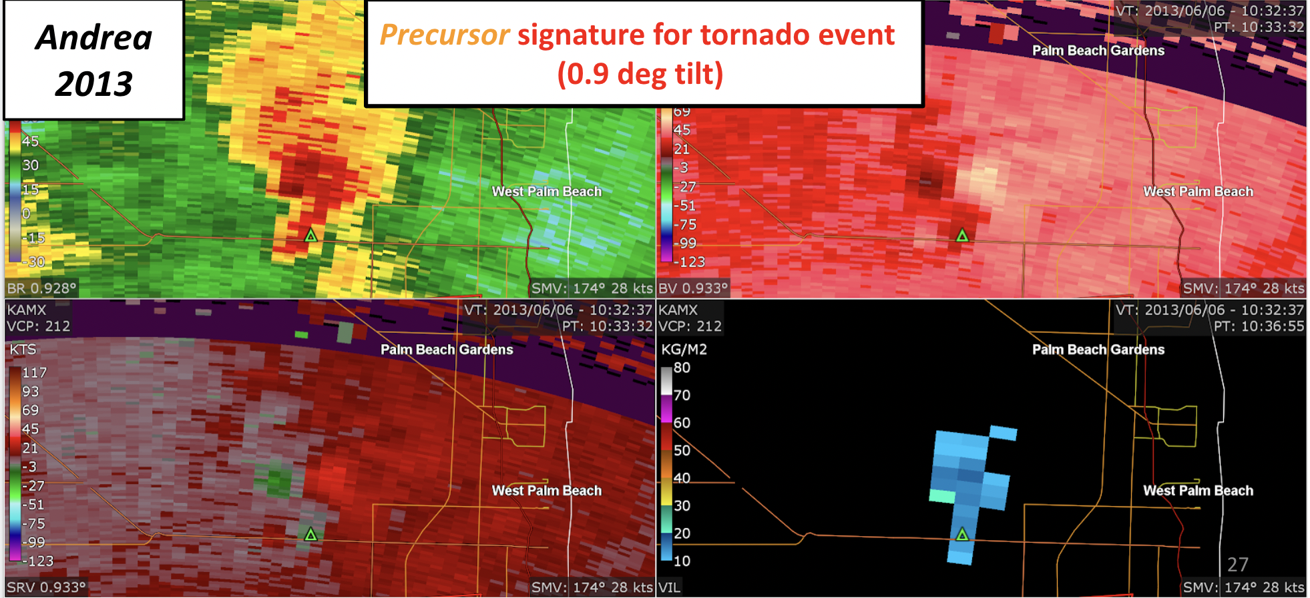
RADAR CONCEPTS for TC TORNADOES – VELOCITY ENHANCEMENT SIGNATURE
Notes:
‹#›

Slide 40
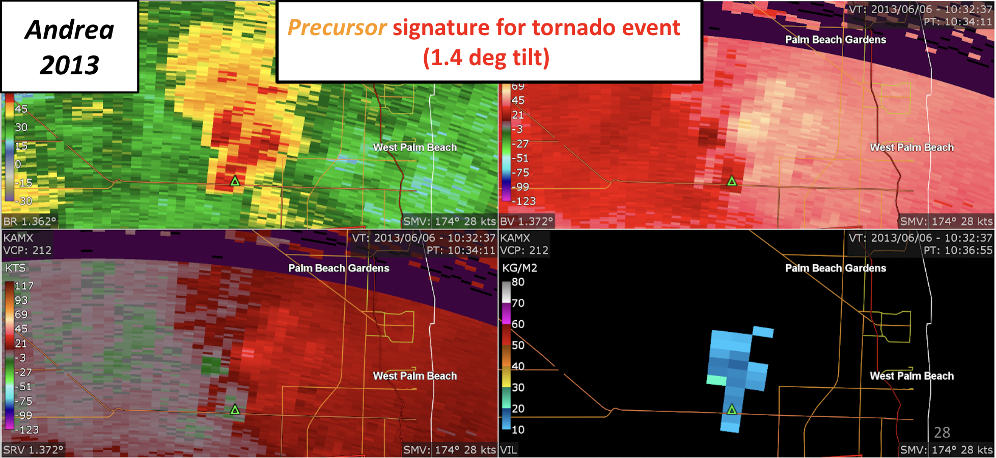
RADAR CONCEPTS for TC TORNADOES – VELOCITY ENHANCEMENT SIGNATURE
Notes:
‹#›

Slide 41
RADAR CONCEPTS for TC TORNADOES – VELOCITY ENHANCEMENT SIGNATURE
Notes:
‹#›

Slide 42
RADAR CONCEPTS for TC TORNADOES – VELOCITY ENHANCEMENT SIGNATURE
Notes:
‹#›

Slide 43
C.A.M. CONCEPTS for TC TORNADOES
CONVECTION-ALLOWING MODELS
~ Verifying reflectivity
~1.5 km resolution
valid 2317Z, 28 Aug 2005
NOAA P-3 airborne
NCAR WRF (ARW core)
4 km mesh
valid 0Z, 29 Aug 2005
48h forecast
NCAR WRF (ARW )
1.33 km mesh
valid 0Z, 29 Aug 2005
48h forecast
PRECISION IS NOT THE SAME AS ACCURACY
Notes:
‹#›
New techniques and parameters are being tested that are more relevant in the TC environment. Convection-allowing models (CAMs) show some promise, especially version of the HWRF (not shown) and midlatitide WRF (next slide). But how well can they really resolve what’s going on, much less predict, when TC supercells are so small and shallow? Don’t confuse precision with accuracy; treat CAMs as tools, not crutches.

Slide 44
C.A.M. CONCEPTS for TC TORNADOES
Promising applications of hi-res CAM NWP (Carroll-Smith et al. (2019, EJSSM): Successful simulation of Ivan (2004)
TCT “surrogates”
Notes:
‹#›
CAMs will assume a place in TC tornado prediction over time. Carroll-Smith et al. (EJSSM) research summary: high-res real-data nested WRF simulations of Hurricane Ivan (2004). Simulated TCT “surrogates” using thresholds based on percentile values of max UH and simulated reflectivity. Her work represented Ivan and its record robust tornado production quite well. How well can it work for other, perhaps messier and weaker systems?

Slide 45
SPC FORECAST EXAMPLES FOR TCs
OUTLOOKS (Day-3 examples for HARVEY)
Notes:
‹#›
Day 4-8 total-severe outlooks are issued by SPC but haven’t been used for TCs due to the mesoscale nature of the tornado threat, and the track and intensity uncertainties that far out. To some extent this extends into the day-3 total-severe outlook period, where TC outlooks are not common but can happen when uncertainties are low, as with Harvey-17.

Slide 46
SPC FORECAST EXAMPLES FOR TCs
OUTLOOKS (Day-2 examples for HARVEY)
Notes:
‹#›
Day-2 series for Harvey-17.

Slide 47
SPC FORECAST EXAMPLES FOR TCs
OUTLOOKS (Day-1 examples for HARVEY)
Succinct NHC+SPC+WFO discussion on Hotline
Notes:
‹#›
Day-1 series for Harvey-17. Brief SPC/NHC discussion on Hurricane Hotline (now an internal video circuit).

Slide 48
SPC FORECAST EXAMPLES FOR TCs
MESOSCALE DISCUSSIONS
Example: HARVEY (2017)
Issued for watch potential or watch updates
Situational, no deadlines nor rigid thresholds
Notes:
‹#›
MCDs alert you to the potential that a watch may be needed, and also, are issued as meteorological situation updates during watches. They contain detailed mesoscale reasoning specific to the unique TC situation and based in the climatological and forecasting concepts we’ve covered so far in this talk.

Slide 49
SPC FORECAST EXAMPLES FOR TCs
WATCHES
Coordinated SPC+WFO
County based
Cleared/extended by WFO
Legacy polygon for aviation
Tornado probabilities offered with watch
Targeted to situational tornado threat
Not necessary for all TCs. Some TCs don’t produce tornadoes!
Example from Harvey (2017)
Notes:
‹#›
Tornado watches for TC situations are not automatic. Every TC is a mesoscale convective system (MCS) of unique character that presents its own unique tornado situation. This is a change in thinking over the past 10-15 years! Watches therefore are issued with probabilities assigned, as the threat warrants, based on careful mesoscale diagnosis and prediction of the threat, just as they would be in any midlatitude system. Because we employ ingredients-based forecasting and scientific/physical reasoning in the watch decision process, sometimes the threat is too small for a watch and one will not be issued. Watches that are issued will vary in size and time duration according to the scope, magnitude and duration of the actual tornado threat. Marginal and very isolated tornado threats from a TC may not warrant a watch.

Slide 50
TC TORNADO EXAMPLE CASES 1 (ANDREA 2013)
Notes:
‹#›

Slide 51
TC TORNADO EXAMPLE CASES 1 (ANDREA 2013)
Notes:
‹#›

Slide 52
TC TORNADO EXAMPLE CASES 1 (ANDREA 2013)
Notes:
‹#›

Slide 53
TC TORNADO EXAMPLE CASES 1 (ANDREA 2013)
-Dry slots can promote
enhanced heating/
differential heating,
setting up temporary baroclinic zones
Notes:
‹#›

Slide 54
TC TORNADO EXAMPLE CASES 1 (ANDREA 2013)
Notes:
‹#›

Slide 55
TC TORNADO EXAMPLE CASES 1 (ANDREA 2013)
Notes:
‹#›

Slide 56
TC TORNADO EXAMPLE CASES 1 (ANDREA 2013)
Notes:
‹#›

Slide 57
TC TORNADO EXAMPLE CASES 1 (ANDREA 2013)
Notes:
‹#›

Slide 58
TC TORNADO EXAMPLE CASES 1 (ANDREA 2013)
Notes:
‹#›

Slide 59
TC TORNADO EXAMPLE CASES 1 (ANDREA 2013)
Notes:
‹#›

Slide 60
TC TORNADO EXAMPLE CASES 1 (ANDREA 2013)
Notes:
‹#›

Slide 61
TC TORNADO EXAMPLE CASES 1 (ANDREA 2013)
Notes:
‹#›

Slide 62
TC TORNADO EXAMPLE CASES 1 (ANDREA 2013)
Notes:
‹#›

Slide 63
TC TORNADO EXAMPLE CASES 1 (ANDREA 2013)
Notes:
‹#›

Slide 64
TC TORNADO EXAMPLE CASES 2
(ISAAC 2012)
Notes:
‹#›

Slide 65
TC TORNADO EXAMPLE CASES 2
(ISAAC 2012)
Notes:
‹#›

Slide 66
TC TORNADO EXAMPLE CASES 2
(ISAAC 2012)
Notes:
‹#›
-Lack of mid-level height falls corroborates previous notions

Slide 67
TC TORNADO EXAMPLE CASES 2
(ISAAC 2012)
Notes:
‹#›
-Very large area of high moisture content surrounding the TC -- with no evident baroclinic-related processes to allow for favorable mid-level dry air intrusions into the TC environment

Slide 68
TC TORNADO EXAMPLE CASES 2
(ISAAC 2012)
Notes:
‹#›

Slide 69
TC TORNADO EXAMPLE CASES 2
(ISAAC 2012)
Notes:
‹#›

Slide 70
TC TORNADO EXAMPLE CASES 2
(ISAAC 2012)
Notes:
‹#›

Slide 71
TC TORNADO EXAMPLE CASES 2
(ISAAC 2012)
Notes:
‹#›

Slide 72
TC TORNADO EXAMPLE CASES 2
(ISAAC 2012)
Notes:
‹#›

Slide 73
TC TORNADO EXAMPLE CASES 2
(ISAAC 2012)
Notes:
‹#›

Slide 74
TC TORNADO EXAMPLE CASES 2
(ISAAC 2012)
Notes:
‹#›

Slide 75
TC TORNADO EXAMPLE CASES 2
(ISAAC 2012)
Notes:
‹#›

Slide 76
TC TORNADO EXAMPLE CASES 2
(ISAAC 2012)
Notes:
‹#›

Slide 77
TC TORNADO EXAMPLE CASES 2
(ISAAC 2012)
Notes:
‹#›

Slide 78
TC TORNADO EXAMPLE CASES 3
(NOW YOU TRY!)
Now you try! Does Case 3 depict a favorable or unfavorable synoptic environment
for TC tornadoes?
Notes:
‹#›

Slide 79
TC TORNADO EXAMPLE CASES 3
(FAVORABLE OR UNFAVORABLE?)
Notes:
‹#›

Slide 80
TC TORNADO EXAMPLE CASES 3
(FAVORABLE OR UNFAVORABLE?)
Notes:
‹#›

Slide 81
TC TORNADO EXAMPLE CASES 3
(FAVORABLE OR UNFAVORABLE?)
Notes:
‹#›

Slide 82
TC TORNADO EXAMPLE CASES 3
(FAVORABLE OR UNFAVORABLE?)
Notes:
‹#›

Slide 83
TC TORNADO EXAMPLE CASES 3
(FAVORABLE OR UNFAVORABLE?)
Notes:
‹#›

Slide 84
TC TORNADO EXAMPLE CASES 3
(FAVORABLE OR UNFAVORABLE?)
Notes:
‹#›

Slide 85
TC TORNADO EXAMPLE CASES 3
(FAVORABLE OR UNFAVORABLE?)
Notes:
‹#›

Slide 86
TC TORNADO EXAMPLE CASES 3
(FAVORABLE OR UNFAVORABLE?)
Notes:
‹#›

Slide 87
TC TORNADO EXAMPLE CASES 3
(FAVORABLE OR UNFAVORABLE?)
Notes:
‹#›

Slide 88
TC TORNADO EXAMPLE CASES 3
(FAVORABLE OR UNFAVORABLE?)
Notes:
‹#›

Slide 89
TC TORNADO EXAMPLE CASES 3
(FAVORABLE OR UNFAVORABLE?)
Notes:
‹#›

Slide 90
TC TORNADO EXAMPLE CASES 3
(FAVORABLE OR UNFAVORABLE?)
Favorable!
(Philippe 2017)
Notes:
‹#›

Slide 91
DATABASE ONLINE: www.spc.noaa.gov/
misc / edwards / TCTOR / TCTOR.xls
misc / edwards / TCTOR / readme.txt
DOCUMENTATION:
www.spc.noaa.gov/publications
Contact: Roger.Edwards@noaa.gov
Harry.Weinman@noaa.gov
Notes:
‹#›
Where to get data and info

