Slide 1
Supercell Propagation and Diagnostic Pressure Equation

Slide 2
Derivation of Diagnostic Pressure Equation
Apply divergence operator
Boussinesq approximated moment equations (neglecting friction and Coriolis force)
(1a)
(1b)
Expand and combine terms and remembering we get:
(1c)

Slide 3
Diagnostic Pressure Equation
Diagnostic pressure equation is obtained by taking the divergence of the u, v, w momentum equations and then linearizing
$$S=\frac{∂\overline{u}}{∂z} \vec{i}+\frac{∂\overline{v}}{∂z}\vec{j}$$
$$\frac{1}{ρ_{0}}∇^{2}p^{′}=− \left[{\left(\frac{∂u^{′}}{∂x}\right)}^{2}+{\left(\frac{∂v^{′}}{∂y}\right)}^{2}+{\left(\frac{∂w^{′}}{∂z}\right)}^{2}\right]−2\left(\frac{∂v^{′}}{∂x}\frac{∂u^{′}}{∂y}+\frac{∂w^{′}}{∂x}\frac{∂u^{′}}{∂z}+\frac{∂w^{′}}{∂y}\frac{∂v^{′}}{∂z}\right)−2S∙∇_{h}w^{′}+\frac{∂B}{∂z}$$
Nonlinear dynamic pressure
perturbation, $p_{dnl}′$
Linear dynamic
pressure
perturbation, $p_{dl}′$
Buoyancy pressure
perturbation, $p_{b}′$
Fluid extension terms
NL
If we assume pure rotation (no div, deformation) and ignore extension terms (i.e., look at the effect of vertical rotation only), then

Slide 4
Diagnostic Pressure Equation
Diagnostic pressure equation is obtained by taking the divergence of the u, v, w momentum equations and then linearizing
Simplify by neglecting horizontal vorticity, deformation, and fluid extension terms, and rewriting remaining nonlinear term $2\left(\frac{∂v′}{∂x}\frac{∂u′}{∂y}\right)$
$$p^{′}∝ \left[{\left(\frac{∂u′}{∂x}\right)}^{2}+{\left(\frac{∂v′}{∂y}\right)}^{2}+{\left(\frac{∂w′}{∂z}\right)}^{2}\right]+2\left(\frac{∂v′}{∂x}\frac{∂u′}{∂y}+\frac{∂w′}{∂x}\frac{∂u′}{∂z}+\frac{∂w′}{∂y}\frac{∂v′}{∂z}\right)+2S∙∇_{h}w^{′}−\frac{∂B}{∂z}$$
Fluid extension terms
Nonlinear dynamic pressure
perturbation, $p_{dnl}′$
Linear dynamic
pressure
perturbation, $p_{dl}′$
Buoyancy pressure
perturbation, $p_{b}′$
$$p^{′}∝−\frac{1}{2}{ζ^{′}}^{2}+2S∙∇_{h}w^{′}−\frac{∂B}{∂z}$$
$$p_{dnl}′$$
$$p_{dl}′$$
$$p_{b}′$$
“spin term”

Slide 5
Dynamic Vertical PGF
Dynamic vertical PGF that drives dw/dt (momentum eqn) goes as
Dynamic forcing (nonlinear+linear) has same order of magnitude as buoyancy forcing for supercells because of strong updraft rotation
$$−\frac{∂{p^{′}}_{d}}{∂z}∝\frac{1}{2}\frac{∂{ζ^{′}}^{2}}{∂z}−2\frac{∂}{∂z}\left(S∙∇_{h}w′\right)$$
Nonlinear dynamic
forcing
Linear dynamic
forcing

Slide 6
Nonlinear Dynamic Forcing
$$\frac{∂{p′}_{d}}{∂z}∝−\frac{1}{2}\frac{∂{ζ^{′}}^{2}}{∂z}$$
Crosswise vorticity dominant environment:
vortex pair forms on flank of updraft by tilting
nonlinear forcing creates low pressure in each vortex on flanks of updraft
Upward-directed PGF_{d} on updraft flanks below max ${ζ′}^{2}$ causes updraft to split
Vortex lines tilt downward in rainy downdraft resulting in 2 vortex pairs
Updraft of right-moving member propagates toward positive vorticity on right flank.
Updraft of left-moving member propagates toward negative vorticity on left flank
$$\frac{1}{2}\frac{∂{ζ^{′}}^{2}}{∂z}>0$$
$$∴\frac{∂{p′}_{d}}{∂z}<0$$
Source: MR (2010)

Slide 7
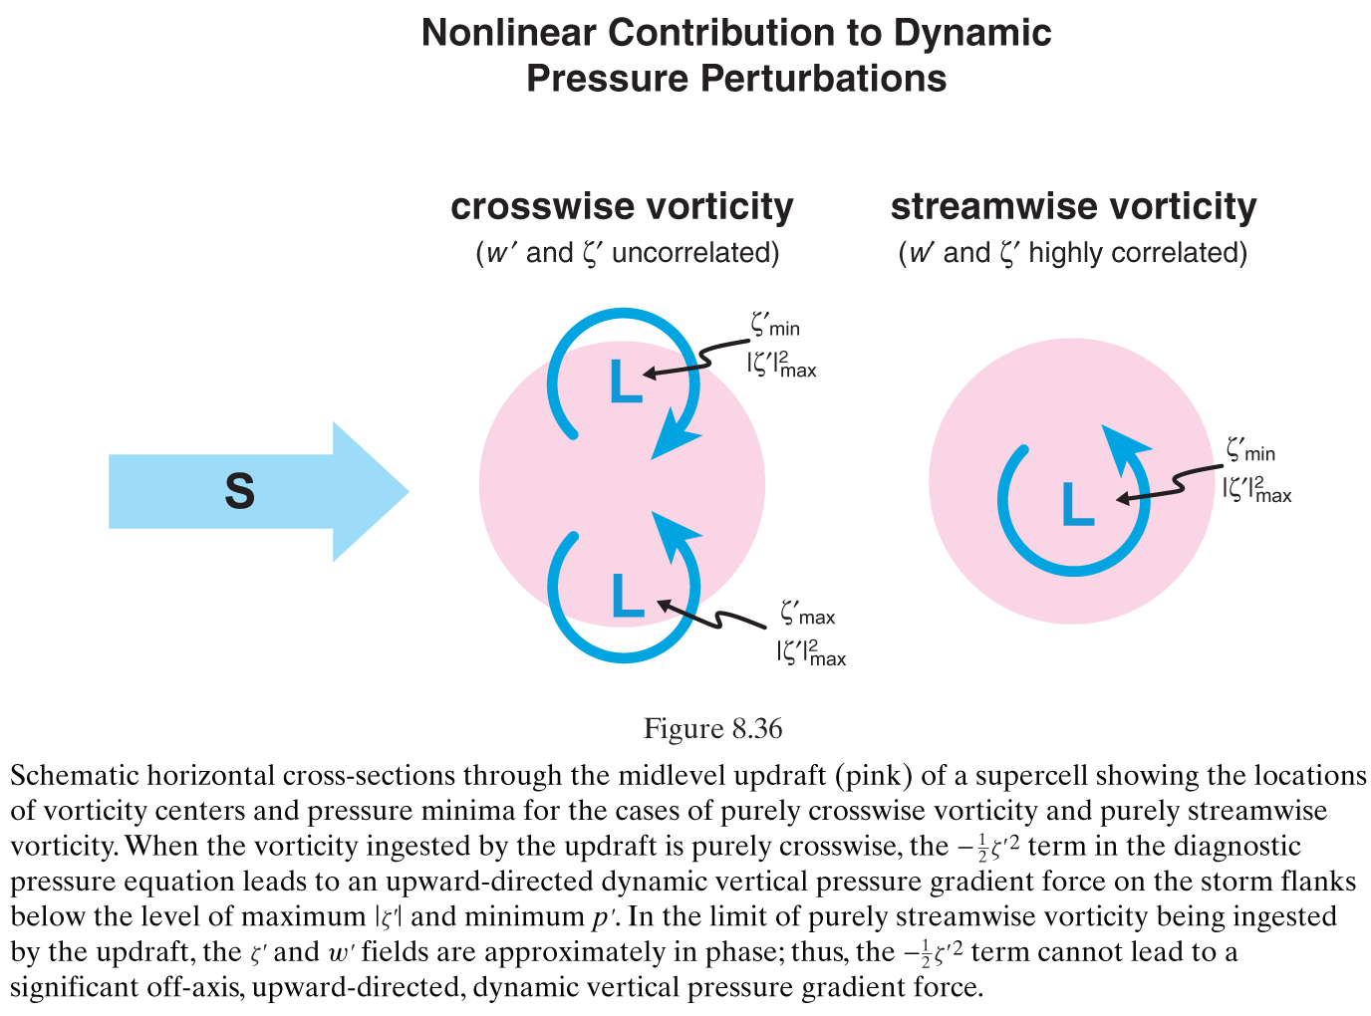
Nonlinear Dynamic Forcing
$$\frac{∂{p′}_{d}}{∂z}∝−\frac{1}{2}\frac{∂{ζ^{′}}^{2}}{∂z}$$
For pure crosswise vorticity (straight hodograph), forcing leads to upward-directed PGF on flanks of updraft below maximum ${ζ′}^{2}$
Storm splitting!
For pure streamwise vorticity (curved hodograph) vorticity and updraft centered are collocated
No storm splitting and right-mover favored!
Source: MR (2010)

Slide 8
Nonlinear Dynamic Forcing
$$\frac{∂{p′}_{d}}{∂z}∝−\frac{1}{2}\frac{∂{ζ^{′}}^{2}}{∂z}$$
Straight hodograph (crosswise):
Storm initially moves with mean wind “on the hodograph”
After storm splitting, motion of left and right movers are “off the hodograph”
Motion “off the hodograph” creates streamwise vorticity for right mover and antistreamwise vorticity for left mover → mesocyclone and updraft become aligned
Curved hodograph (streamwise)
Initial updraft tilts streamwise vorticity from the beginning
Storm splitting suppressed
Favors cyclonic (anticyclonic) supercell for clockwise (counterclockwise) turning hodograph
See animation of ARPS simulations:
https://twister.ou.edu/MM2007/supercell.html
Source: MR (2010)

Slide 9
Linear Dynamic Forcing
$$\frac{∂{p^{′}}_{d}}{∂z}∝2\frac{∂}{∂z}\left(S∙∇_{h}w′\right)$$
High (low) pressure is found upshear (downshear) of updraft
No pressure perturbations on left or right flanks of updraft
Source: MR (2010)

Slide 10
Linear Dynamic Forcing
$$\frac{∂{p^{′}}_{d}}{∂z}∝2\frac{∂}{∂z}\left(S∙∇_{h}w′\right)$$
Straight hodograph (panel a):
W max is at mid-level
Linear pressure perturbations are vertically stacked
Upward (downward) PGF on downshear (upshear) side of updraft
Horizontal PGF parallel to shear vectors so cannot force lateral (left/right) propagation
Source: MR (2010)

Slide 11
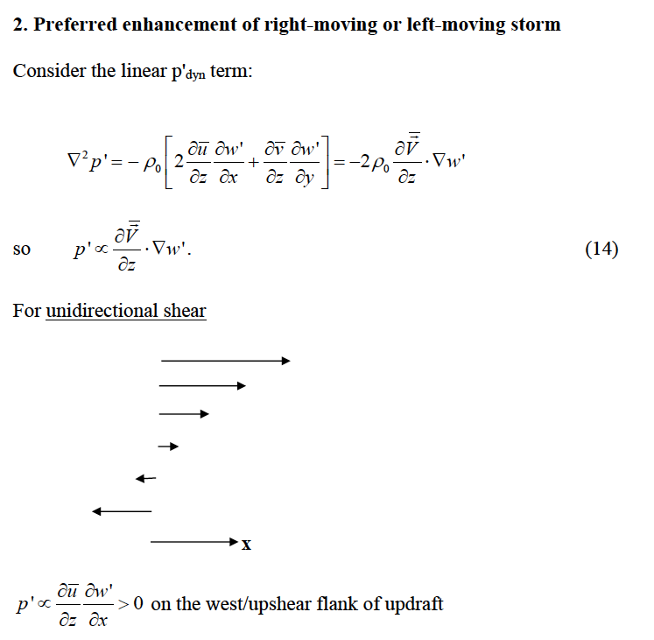
w' largest at mid-level

Slide 12
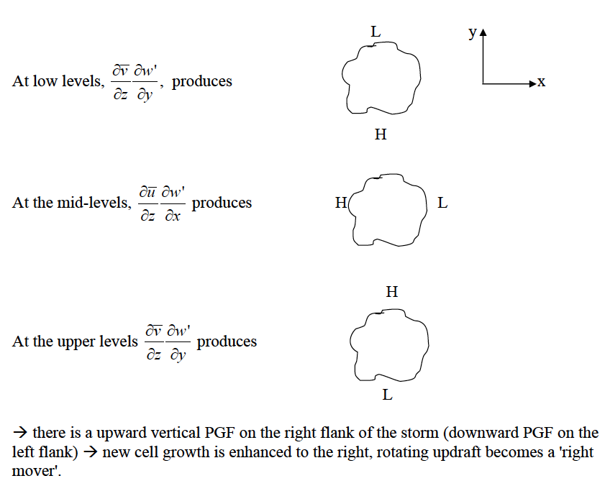
$$∂z$$

Slide 13
Linear Dynamic Forcing
$$\frac{∂{p^{′}}_{d}}{∂z}∝2\frac{∂}{∂z}\left(S∙∇_{h}w′\right)$$
Curved hodograph (panel b):
Vertical PGF is upward on right flank of updraft, favoring right-moving storm
Vertical PGF is downward on left flank of updraft, weakening left-moving storm
Source: MR (2010)

Slide 14
Straight hodograph
Curved hodograph

Slide 15
Straight versus Curved Hodographs
Straight hodograph
Curved hodograph
Curved hodograph
Curved hodograph
Source: MR (2010)
Straight hodograph will result in symmetrical storm splitting
Curved hodograph will result in asymmetrical storm splitting and dominant right mover
Source: MR (2010)

Slide 16
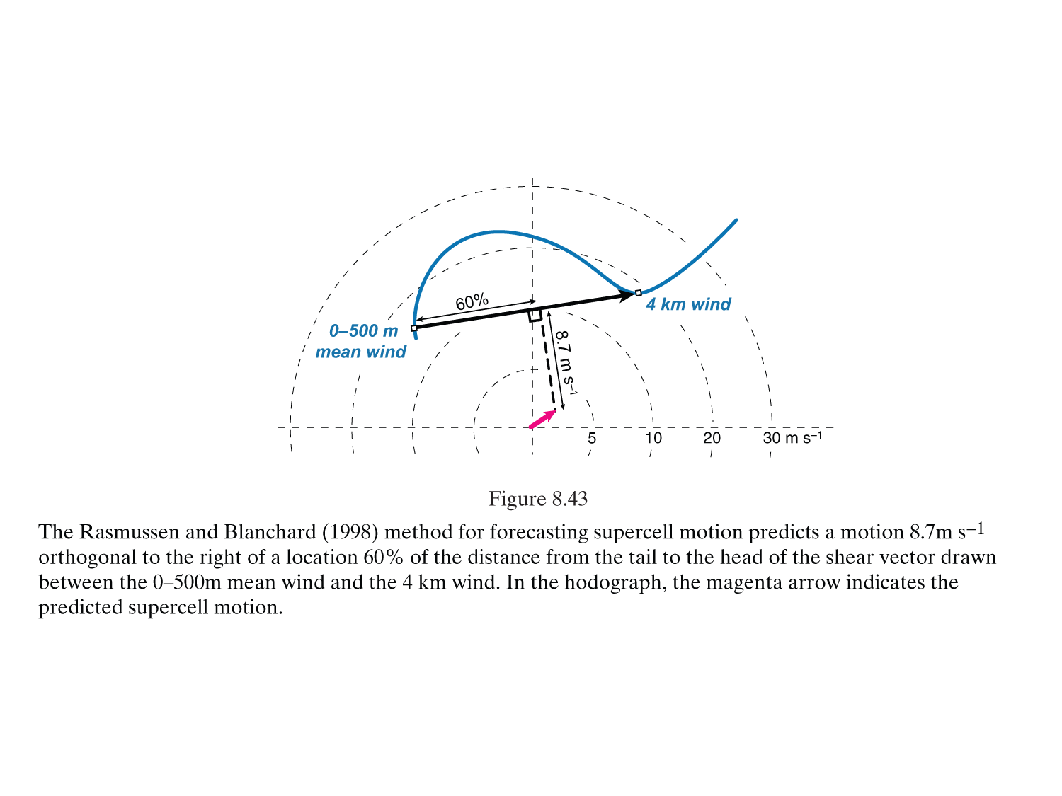
Forecasting Supercell Motion
Supercell motion is the result of:
Downwind advection by mean wind
Propagation due to dynamic pressure forcing on storm flanks
Movement of gust front (lesser effect)
Rasmussen and Blanchard (1998) method:
Source: MR (2010)
Bunkers et al. (2000) method: motion is 7.5 m/s orthogonal to the right of the shear vector between the 0–500 m mean wind and the 0–6 km mean wind.

Slide 17
Comparison of Supercell Behavior
Property | Straight Hodograph | Strongly Curved Hodograph
Symmetry of left/right movers | Yes | No
Net updraft rotation in initial storm | No | Yes
Cyclonic vortex in initial storm | On right side of updraft | In strong updraft
Anticyclonic vortex in initial storm | On left side of updraft | In downdraft or weak updraft
Storm splitting | Highly significant | Insignificant or absent
Time to first mesocyclone | Slower | Faster
Low and midlevel mesocyclone intensity | Generally less intense | Generally more intense
Mesoanticyclone | In left mover | Generally absent
Max updraft strength | Weaker | Stronger
Direction of low level environment vorticity versus baroclinically generated horizontal vorticity | Very different (roughly orthogonal) | In roughly same direction
Lateral updraft propagation | Via nonlinear dynamic forcing | Via linear dynamic forcing
Good source: A Convective Storm Matrix: Buoyancy/Shear Dependencies (https://www.meted.ucar.edu/convectn/csmatrix/)

