Slide 1
Severe Weather Ingredients
Material prepared by Tom Galarneau
and Rich Thompson

Slide 2
Ingredients for
Organized Severe Thunderstorms
Instability (Lapse Rates)
Lift (QG, mesoscale, convective scale)
Moisture (return flow, soil moisture, evapotranspiration)
Vertical wind shear

Slide 3
Ingredients for
Organized Severe Thunderstorms
Instability (Lapse Rates)
Lift (QG, mesoscale, convective scale)
Moisture (return flow, soil moisture, evapotranspiration)
Vertical wind shear - a separate lecture
This lecture

Slide 4
Instability: Elevated Mixed Layer (EML)
Deep mixed layer forms over Rockies and Sierra Madre in response to surface heating
Stronger heating and/or cooler temperatures aloft results in deeper mixed layer
Mixed layer is advected eastward and becomes elevated east of the Rockies and Sierra Madre (really, east of the dryline)
Differential advection (eastward advection of EML above northward advection of moisture from GoM) created “loaded gun” profile

Slide 5
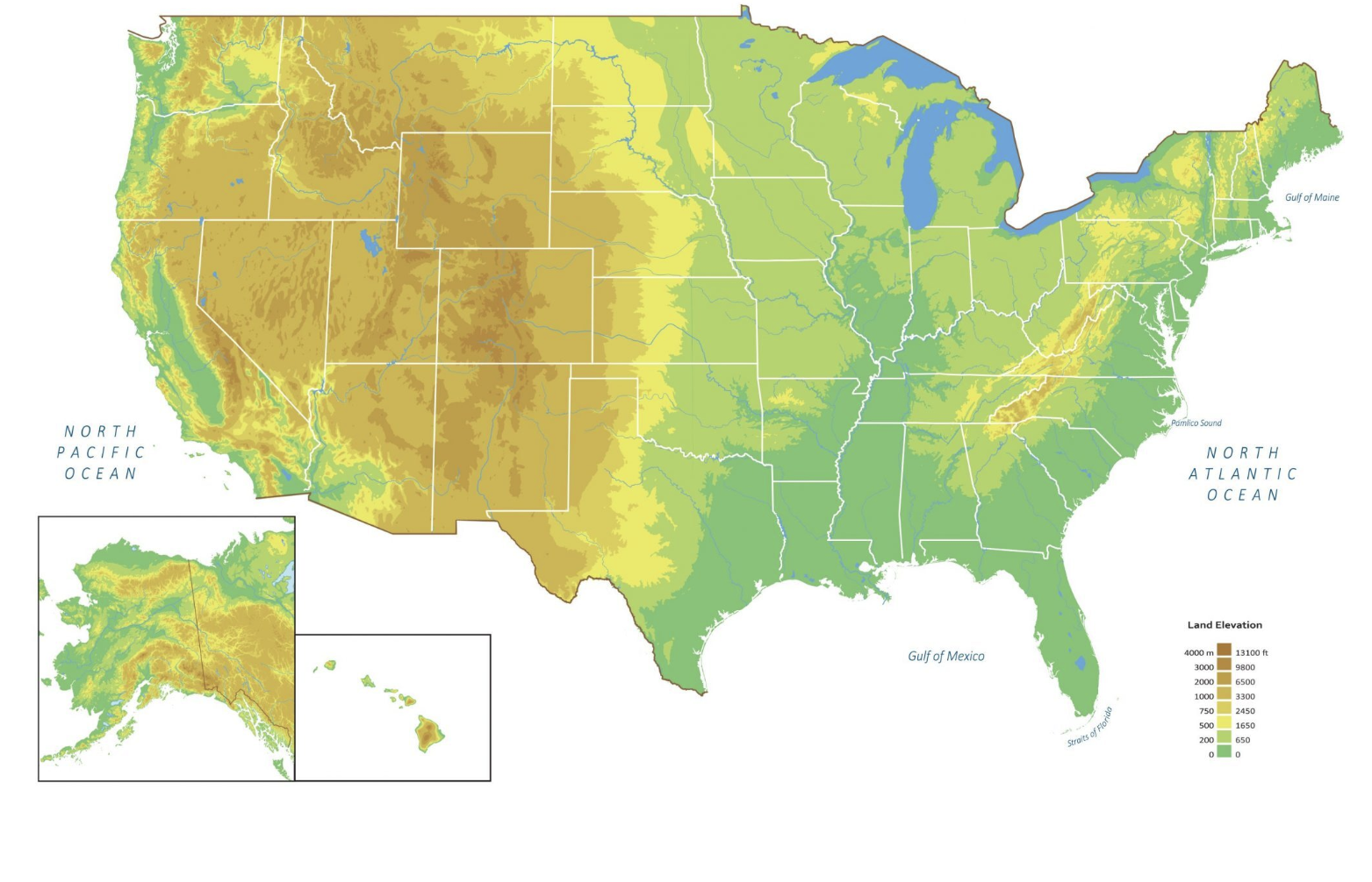
Elevated Mixed Layer (EML) Differential Advection
A’
A
A
A’

Slide 6
EML at OUN (0000 UTC 4 May 1999)
Lid: inversion at
base of EML
Notes:
Comparing the two. EML is the same, there’s just a surface layer in AMA.

Slide 7
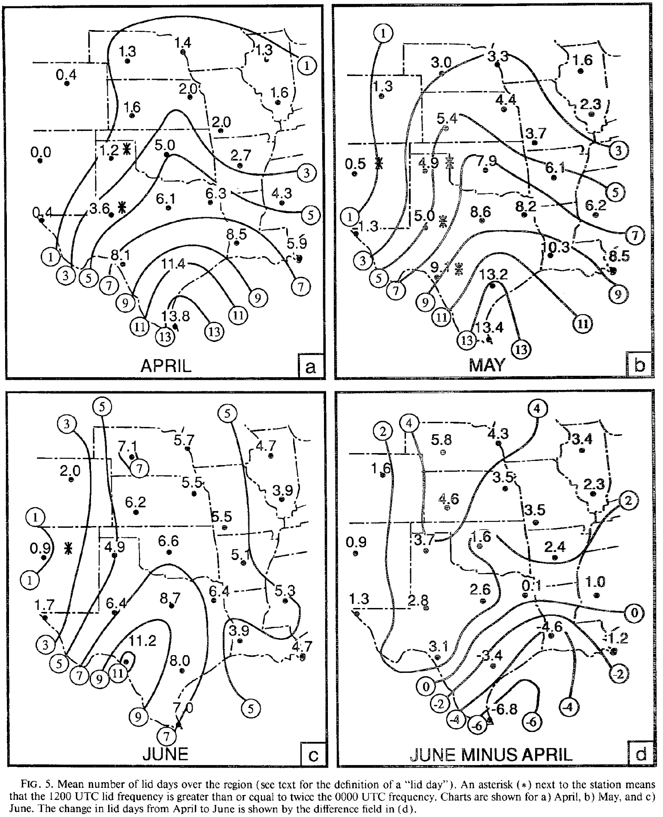
Climatology of Lid Occurrence
Series of papers by Lanicci and Warner (1991)
Weather and Forecasting (June issue)
Distribution of maximum surface potential temperature
What is the “normal” dry adiabat value by month over the high terrain of the west?
See their Fig. 6 for April (36-40 C), May (40-44 C), and June (48-52 C)
Lanicci and Warner (1991)

Slide 8
Lanicci and Warner (1991)

Slide 12
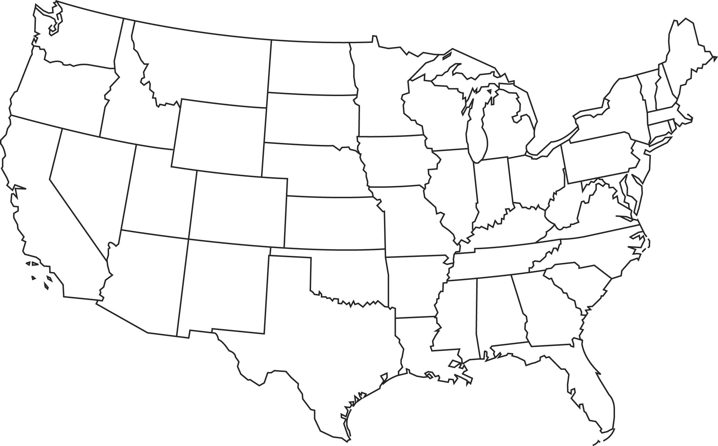
EML Potential Temperature
early MAY
early
JUN
early APR

Slide 13
Lift
Synoptic-scale lift
1-10 cm/s for many hours (6 hours 🡪 ~2 km ascent (SFC-800 hPa))
6 hours to reach LFC
Conditions environment for deep, moist convection over broad area
Layered clouds in regions of isentropic lift; some elevated storms can form
Mesoscale lift
1 m/s for minutes to hours (1 hour 🡪 ~3.6 km ascent (SFC-650 hPa))
< 1 hour to reach LFC
Narrow zones of ascent along boundaries and terrain features
Direct initiation of thunderstorms
Storm-scale lift
10 m/s for minutes (15 mins 🡪 ~9 km of ascent (SFC-300 hPa))
5 minutes to reach LFC
Storm maintenance and propagation (supercells, MCSs, squall lines, etc.)

Slide 14
Synoptic-Scale Lift
QG sources
Warm advection/isentropic lift and differential vorticity advection
Jet streaks (also QG)
Straight jet: ascent in right entrance and left exit regions
Curved jet: ascent downstream and along jet core

Slide 15
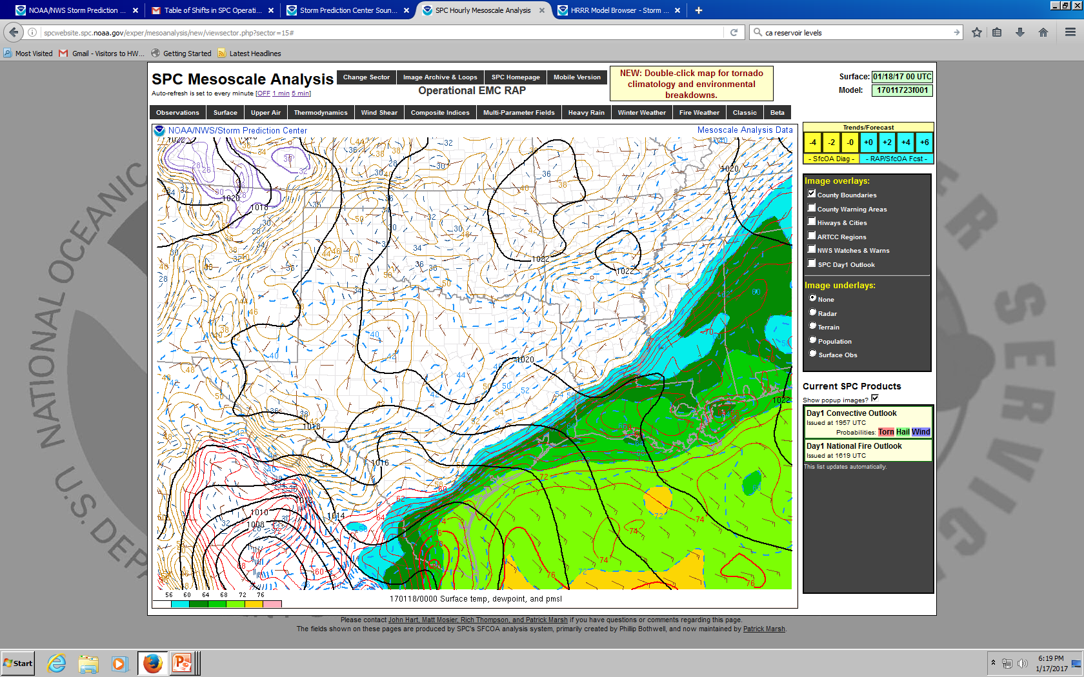

Slide 16
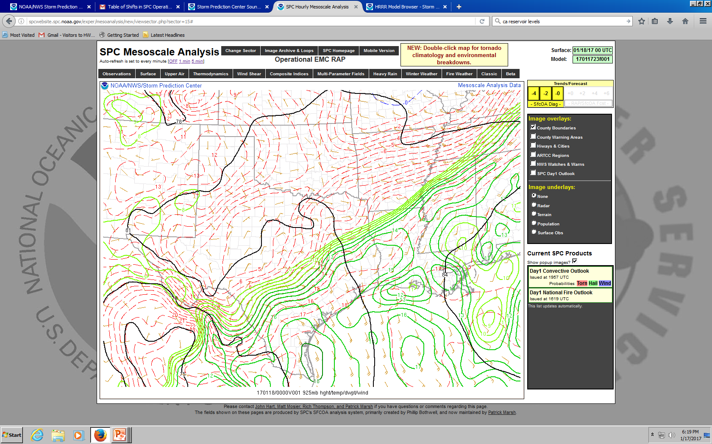

Slide 17
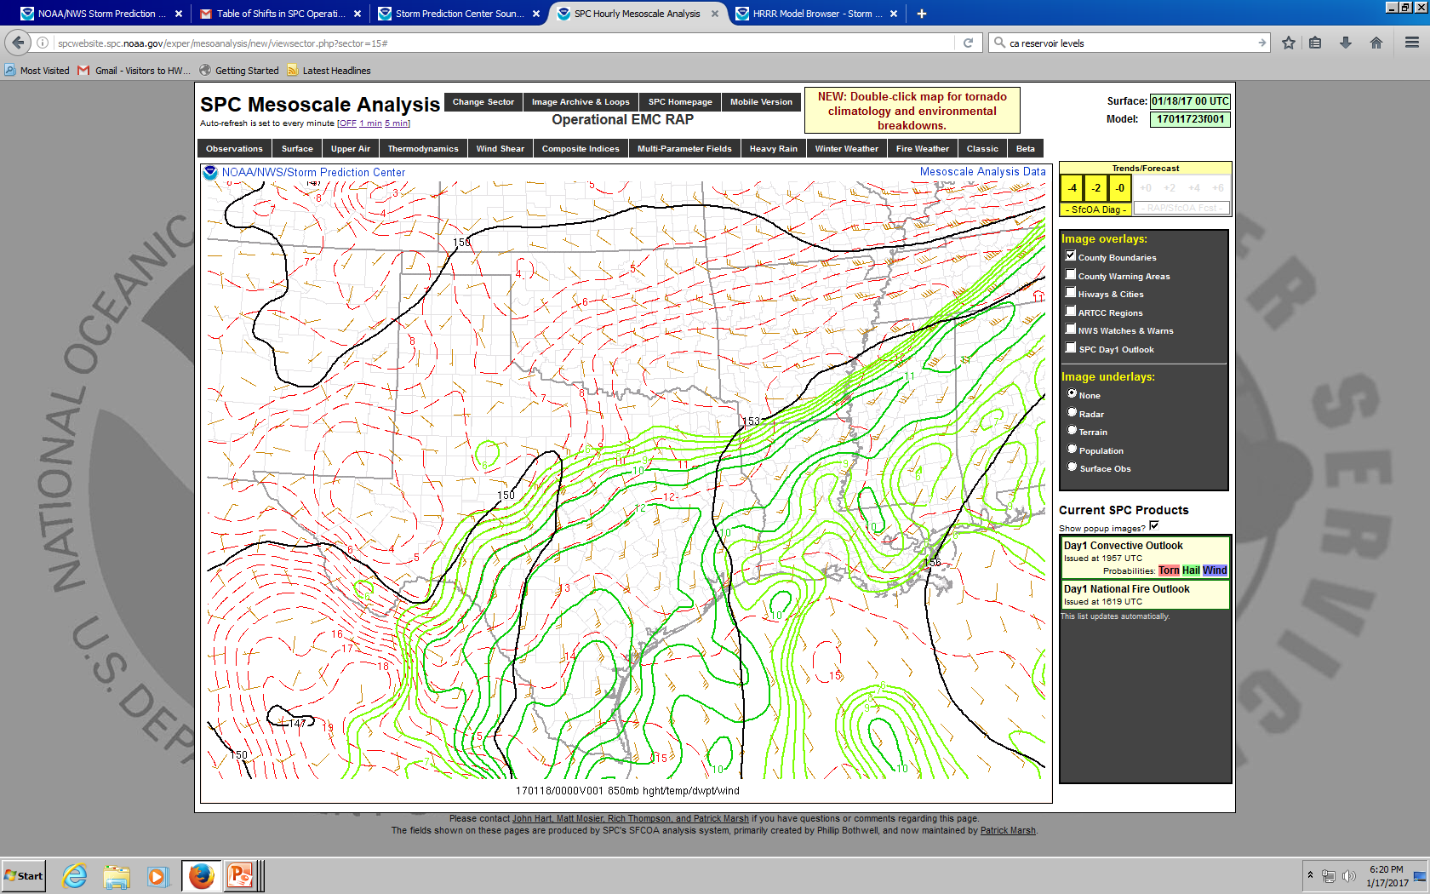

Slide 18
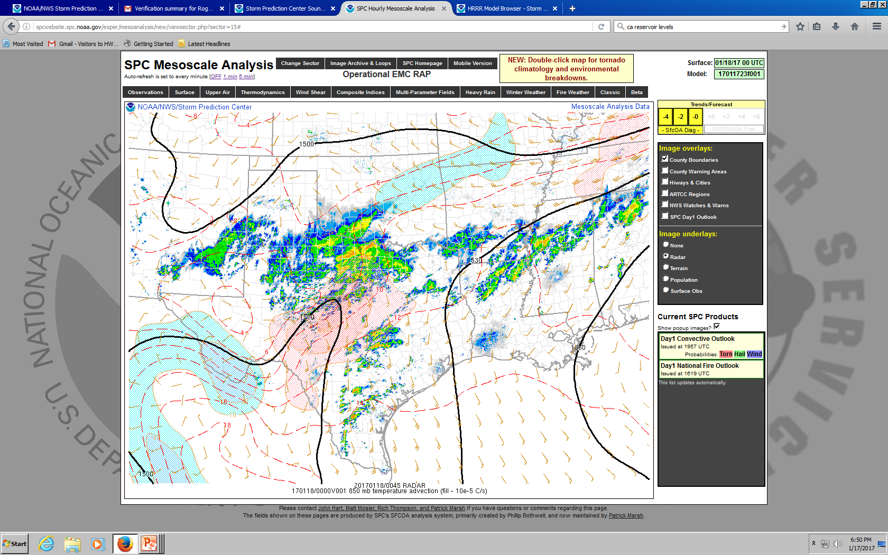
Notes:
But are any of these storms surface based?

Slide 19
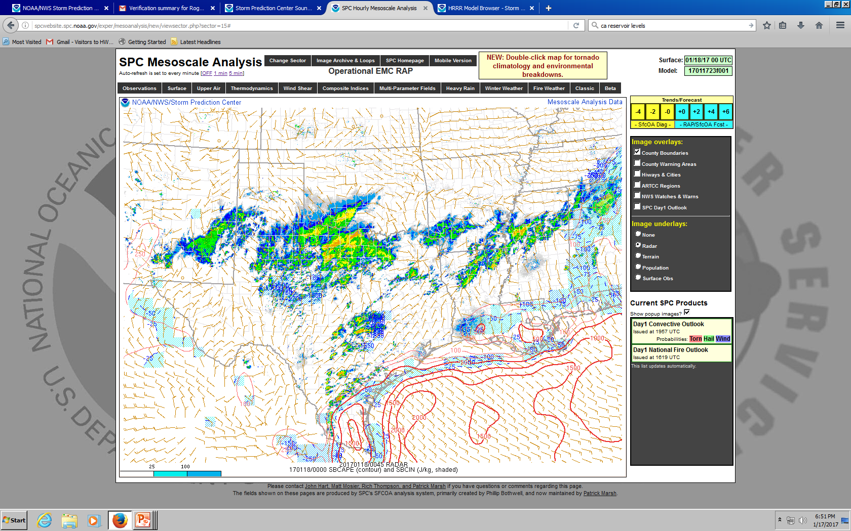
Notes:
Nope.

Slide 20
Notes:
Corpus Christi

Slide 21
Notes:
Del Rio. Note the inversion at low levels associated with the front. Will the storm “feel” SRH in this layer?

Slide 22
Synoptic-Scale Lift Summary
Gradual ascent over many hours
Warm advection and differential vorticity advection are primary drivers
Primary role of QG ascent is to precondition environment for convection
Can also initiate elevated storms in regions of warm advection
Most surface-based storms are triggered by mesoscale ascent

Slide 23
Mesoscale Lift
Focused and narrow zones of lift for minutes to hours
Fronts
Rising on warm side with frontogenesis
Isentropic ascent on sloped warm front (“overrunning”); similar to synoptic lift except in focused bands
Outflow boundary
Lift is governed by depth/strength of cold pool and low-level vertical wind shear [Rotunno-Klemp-Weisman (RKW) Theory]
Dryline
Lift on dry/hot side due to frontogenesis
Lift also governed by depth of mixing west of dryline and depth of moist layer east of dryline

Slide 24
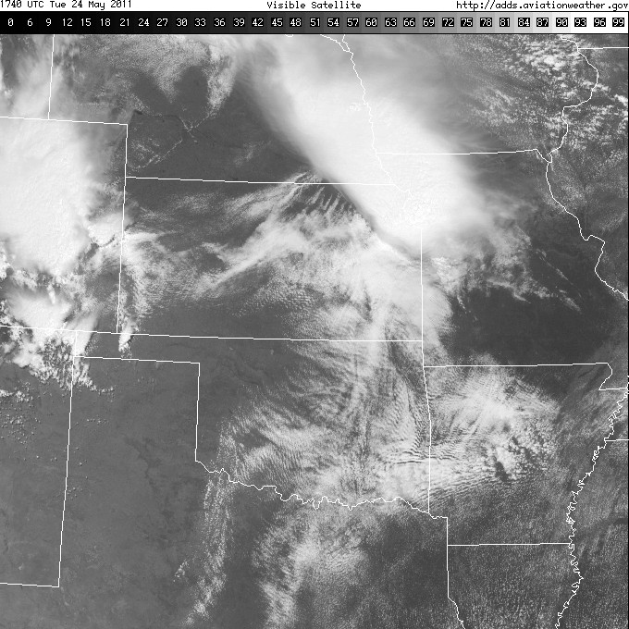

Slide 25
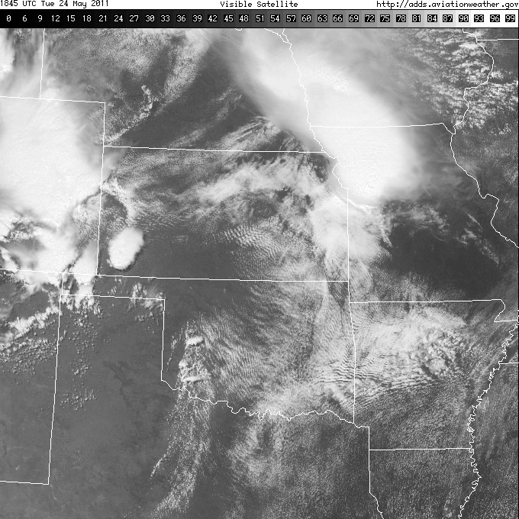

Slide 26
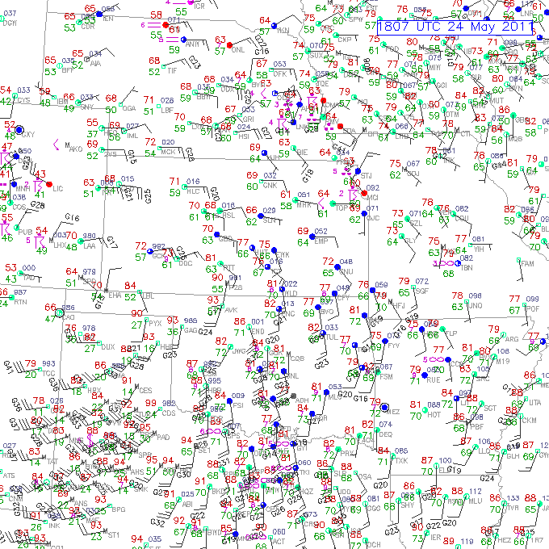
Notes:
Trajectories parallel to the dryline and stay in this zone of ascent = good!

Slide 31
Dryline Summary
Focused ascent along dryline can be ~1 m/s (~1 hour to reach LFC)
Lift depends on depth of mixing west of dryline
Convection initiation linked to the residence time of air in the zone of ascent
Winds above the surface parallel to dryline keeps air in zone of life longer
Convection will initiate in points or bands
Usually the mode of initiation for surface-based supercells in central/southern Plains

Slide 32
Moisture
Moisture in PBL needs to be large and deep enough for convection
Return flow
Inland vertical mixing/diurnal processes
Evapotranspiration

Slide 33
Low-level Moisture Return Flow
Key elements include air mass modifications over warmer water and return flow trajectories
Air mass modification is a multi-date process
Ask yourself the following:
Where is the air coming from?
What are the underlying ocean characteristics?
What is the character of the returning moist layer?

Slide 34
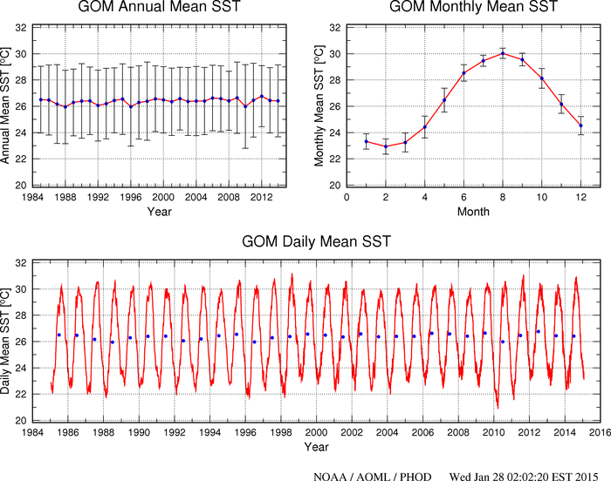

Slide 35
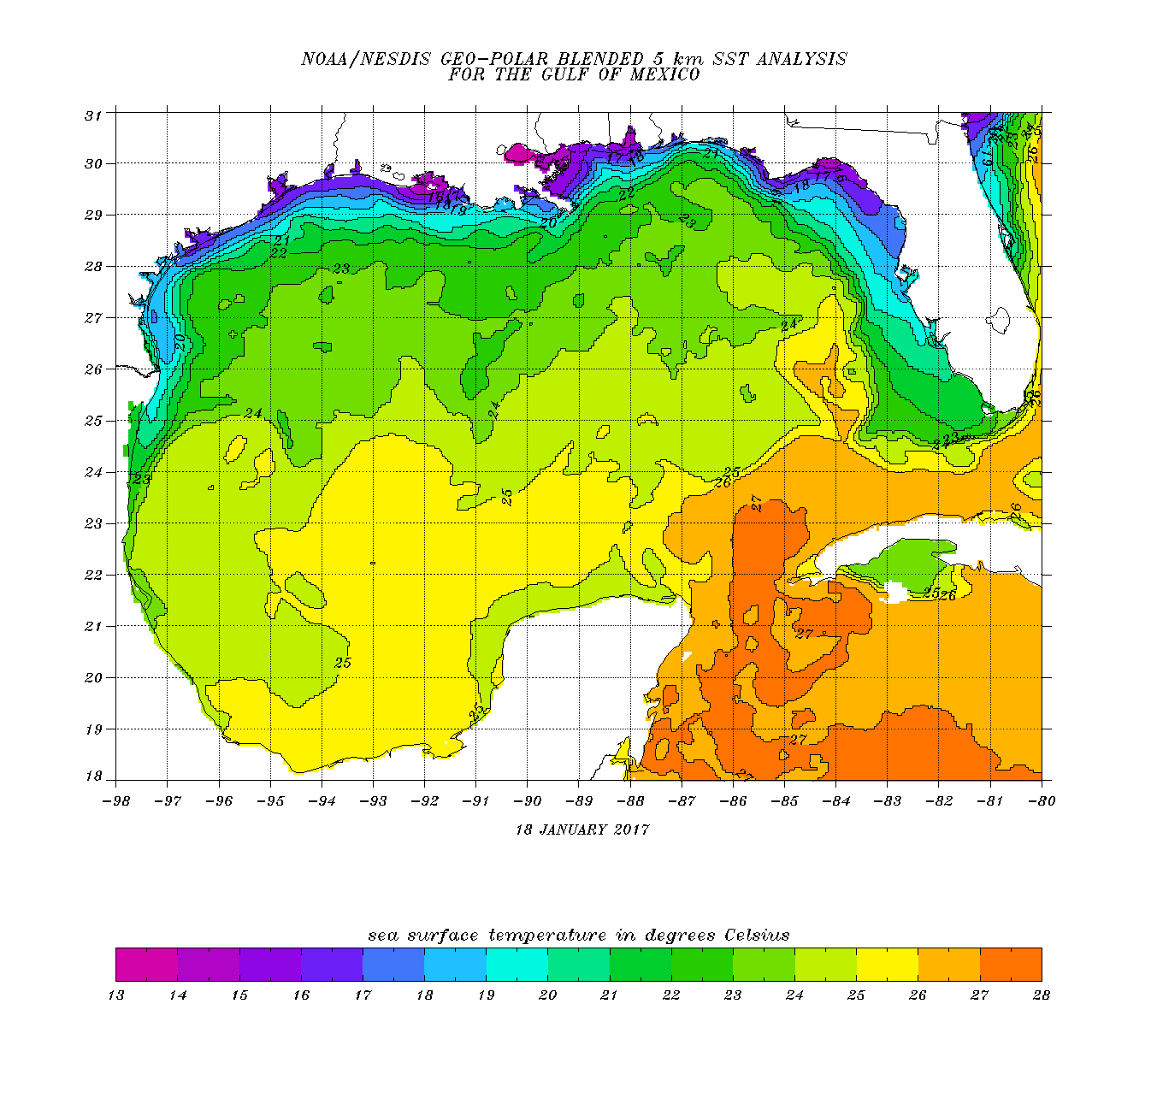
Air temperature after cold front passage
T_{a}=18C
T_{a}=19C
T_{a}=21C
T_{a}=22C
T_{a}=23C

Slide 36
~15F ΔΤ

Slide 37
~10F ΔΤ

Slide 38
~5F ΔΤ

Slide 39
Return flow evolution

Slide 43
Inland Vertical Mixing
Surface moisture can decrease during the daytime when:
Daytime heating/mixing extends deeper than original moist layer depth
Moisture advection is not enough to offset mixing
Compounded by dry soil, little green vegetation, and ongoing drought
Daytime mixing is governed by:
Vertical moisture structure
Height and strength of lid/cap
Upstream moisture sources
Local moisture sources

Slide 44
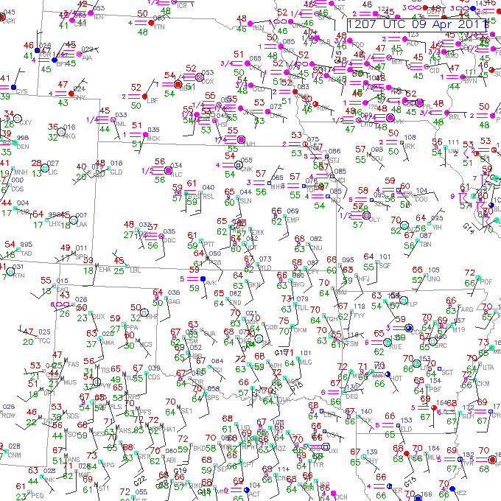
60 F
64 F

Slide 45
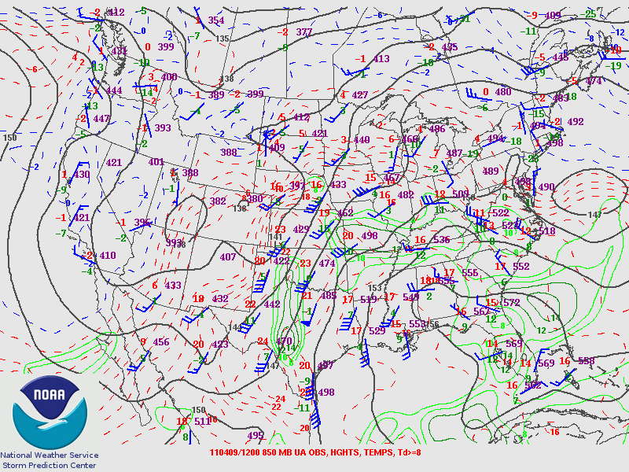

Slide 46
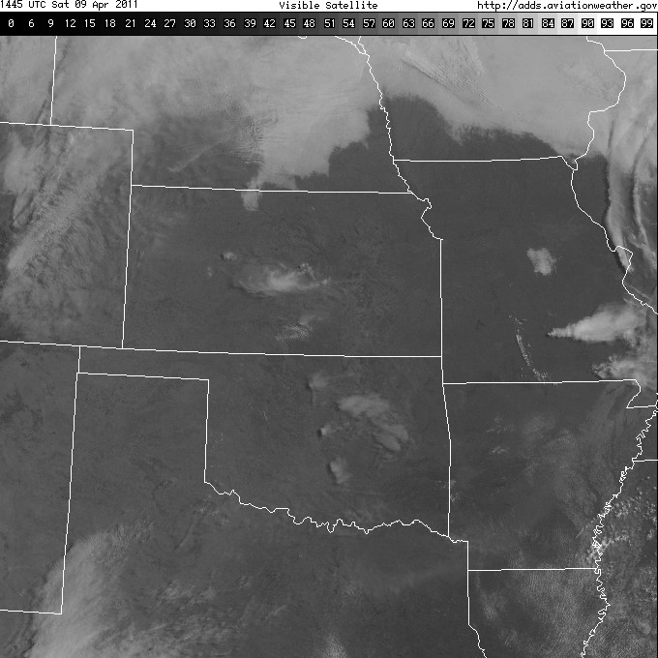
Notes:
Do you see much moisture (i.e. clouds) here?

Slide 47
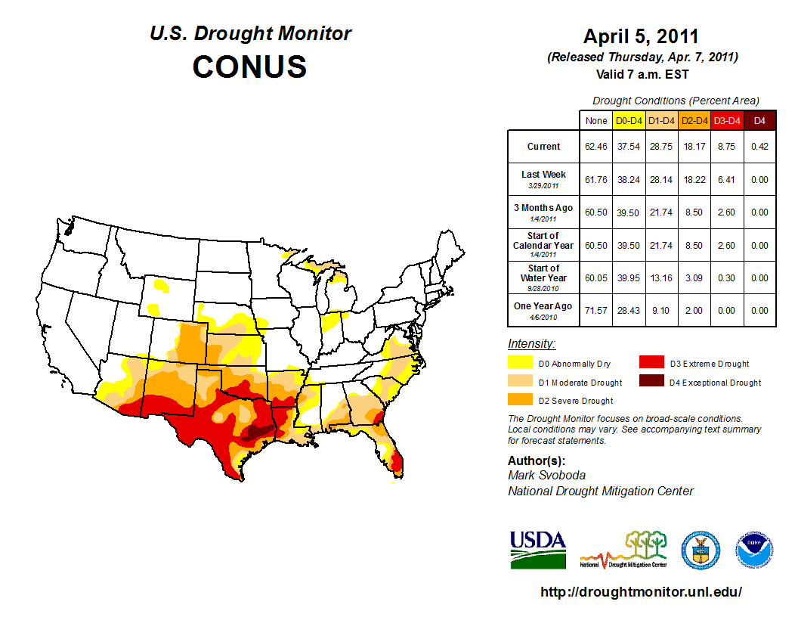
Notes:
Pretty dry in terms of drought.

Slide 48
Notes:
Here’s OUN at 12z.

Slide 49
Notes:
And here’s OUN 12 hours later. Moisture mixed out due to surface conditions.

Slide 53
Notes:
Remember, drought wasn’t as bad up in this region, so moisture “sticks around” in the BL.

Slide 54
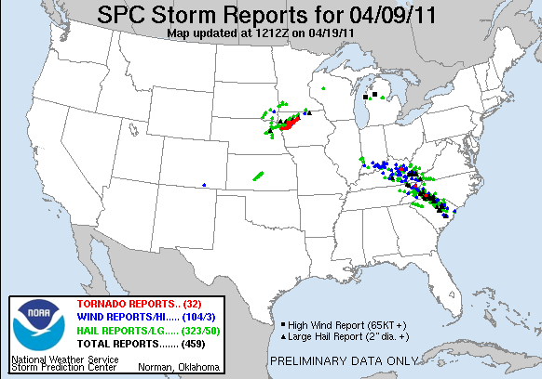
Notes:
Where was the big storm of the day? Up north of the drought conditions.

Slide 55
Evapotranspiration
Need moist soil and growing vegetation
Plentiful rain previous 1-2 weeks
Maturing crops (wheat, corn, or canola)
Capped boundary layer to trap moisture; relatively weak winds
Almost always a significant return flow contribution (in addition)

Slide 56
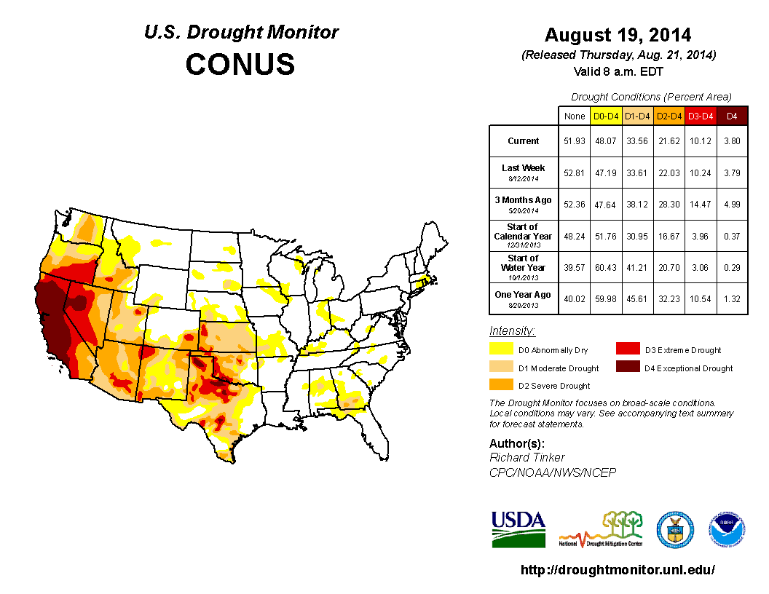

Slide 57
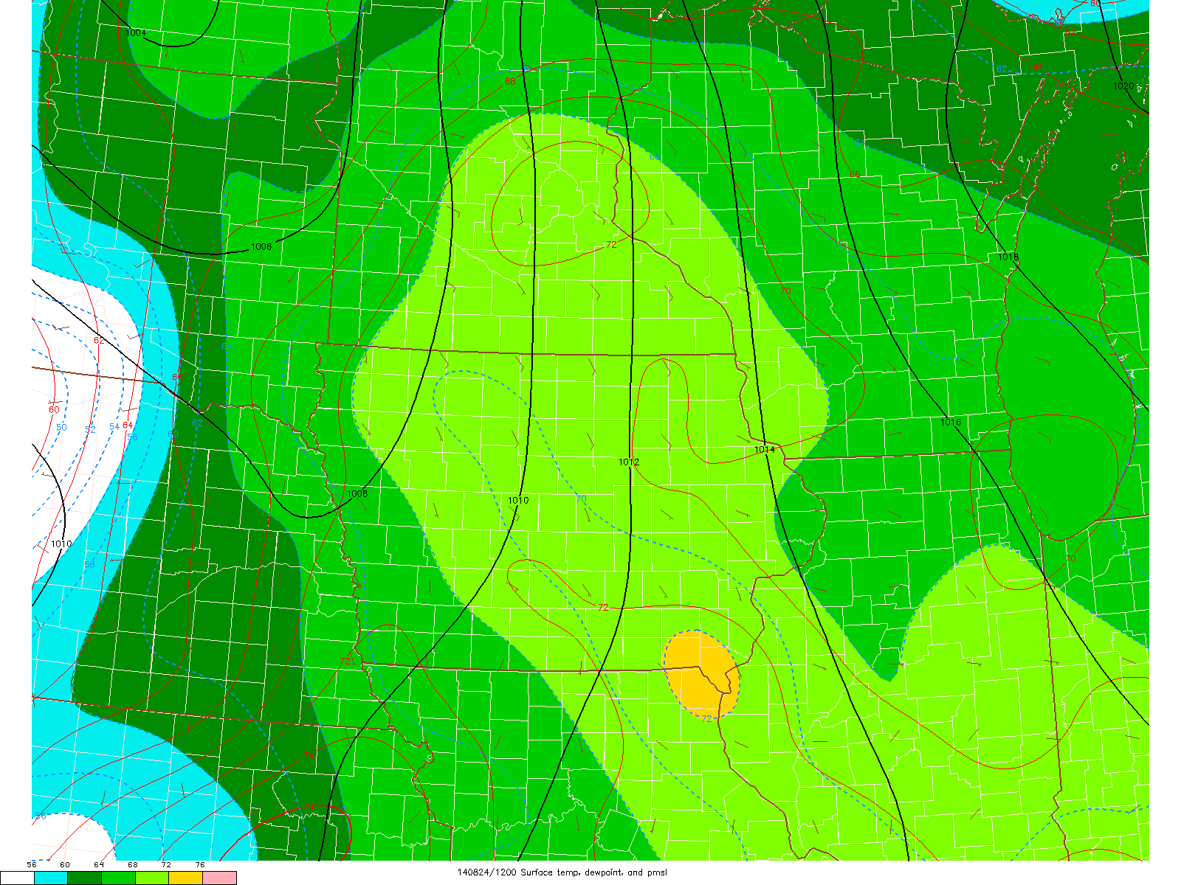

Slide 58
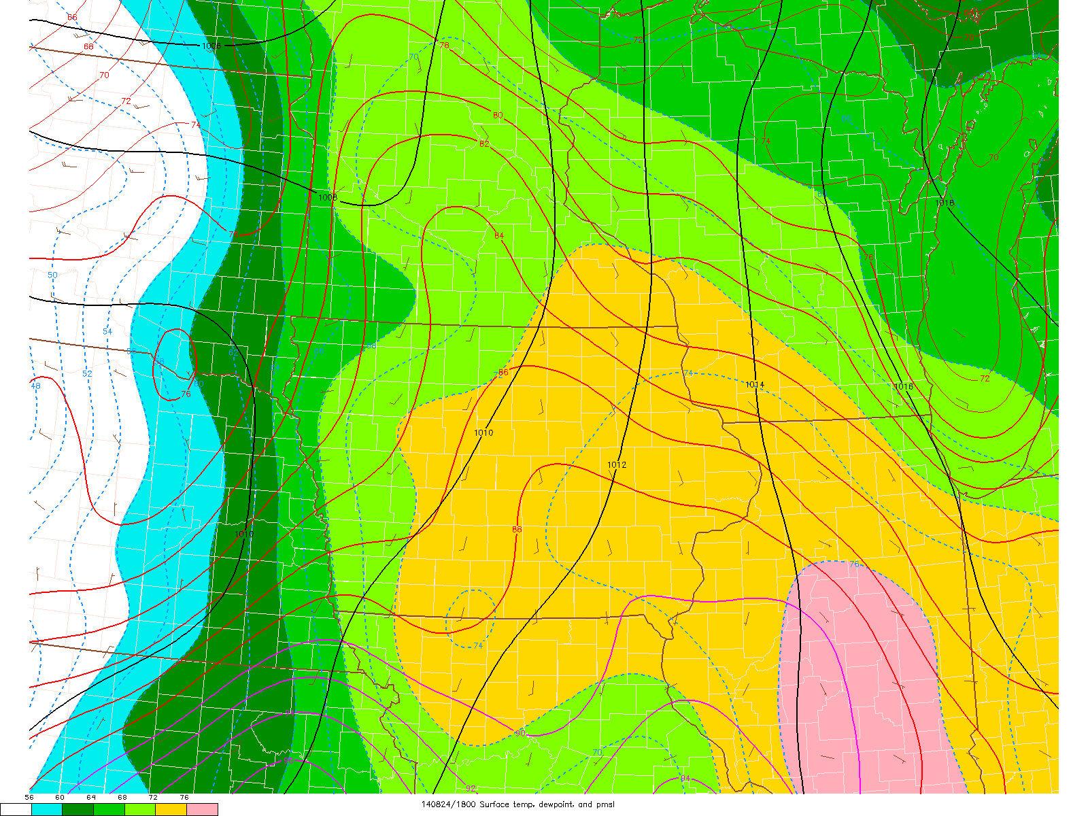

Slide 59
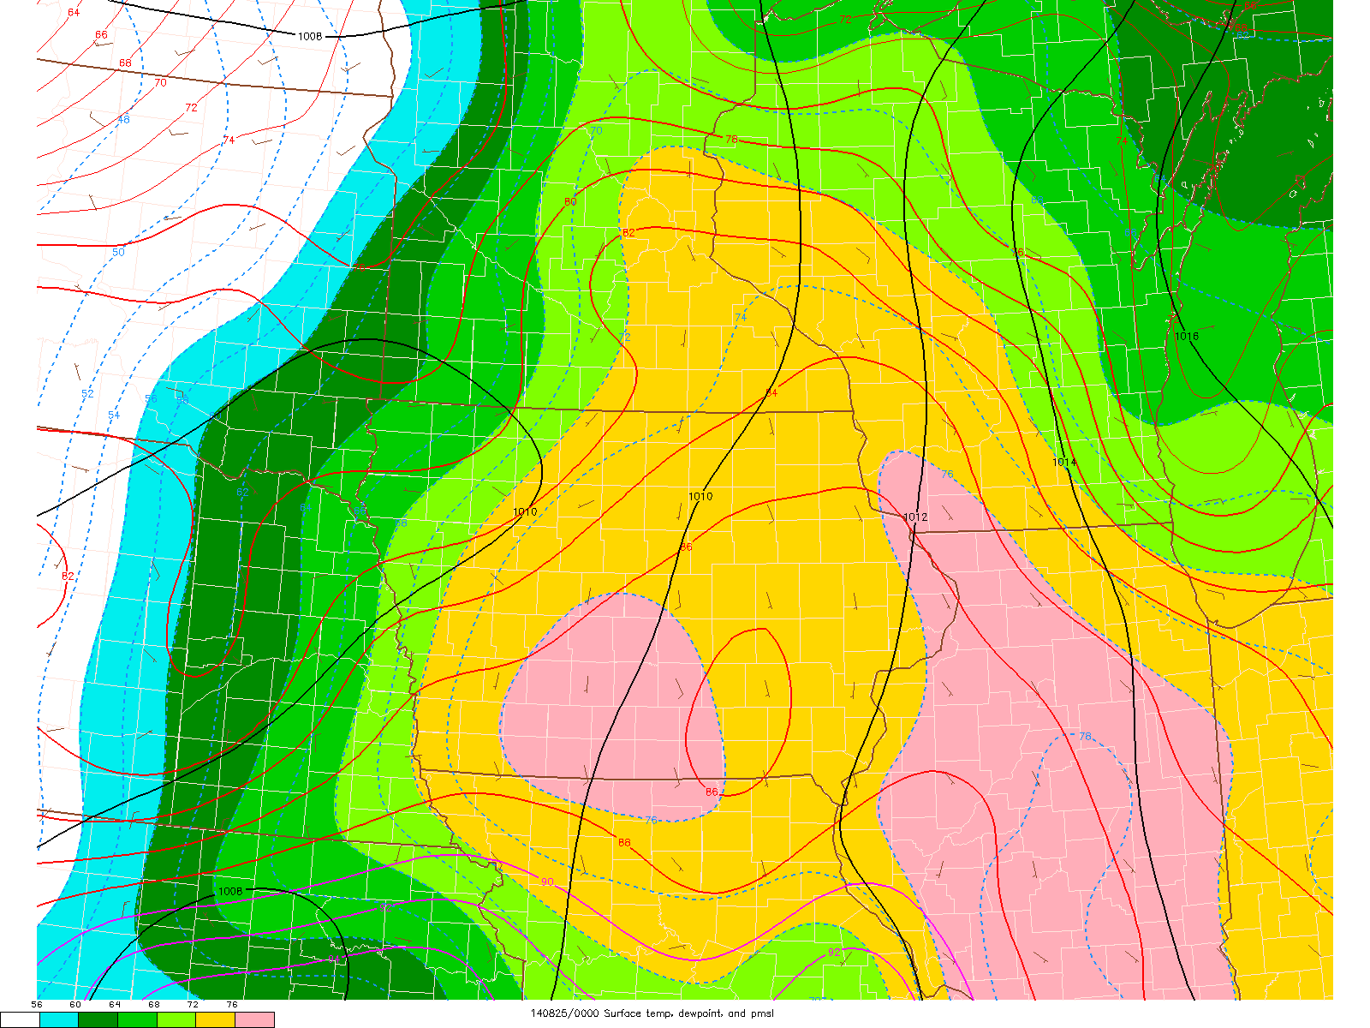

Slide 64
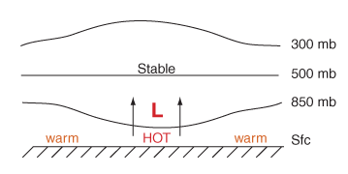
Lee Cyclogenesis
Midlevel flow crosses high terrain:
Subsidence and warming E of mountains
Stronger diabatic heating across slope results in rising motion from induced katabatic flow. (Frontogenesis)
Warming of column and rising motion leads to “warm core” low formation
Strongest pressure falls with strongest flow crosses highest terrain
The lee trough/cyclone deepens before arrival of strongest Q-G forcing for ascent:
Head start on differential advection, “loaded gun” sounding, and veering winds with height
L

Slide 66
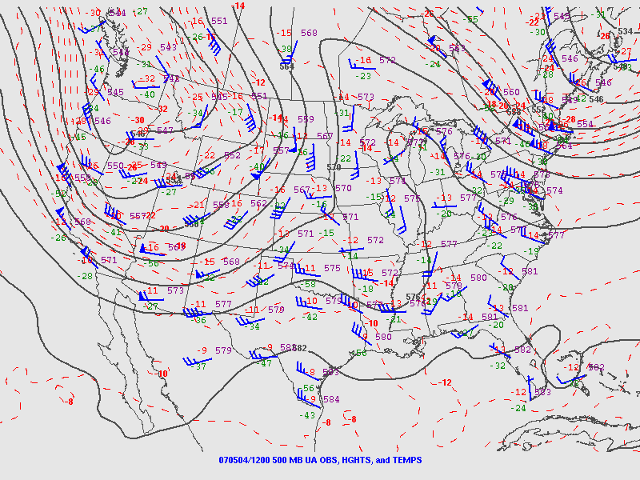

Slide 67
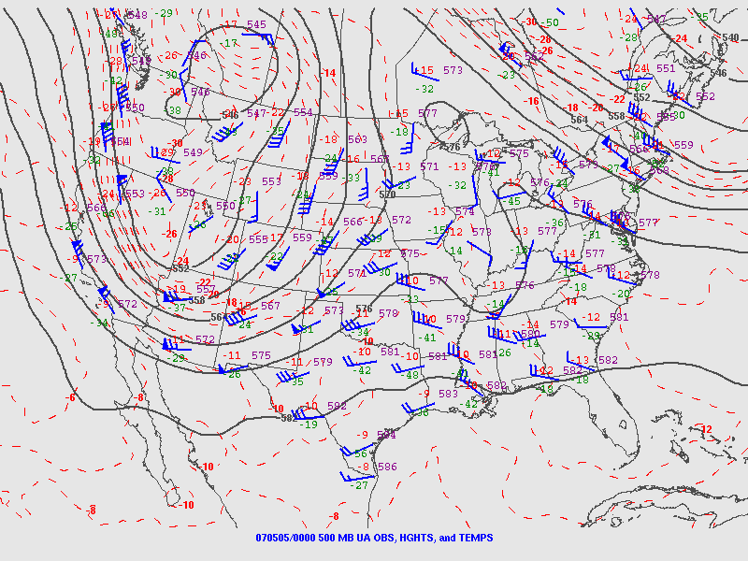

Slide 68
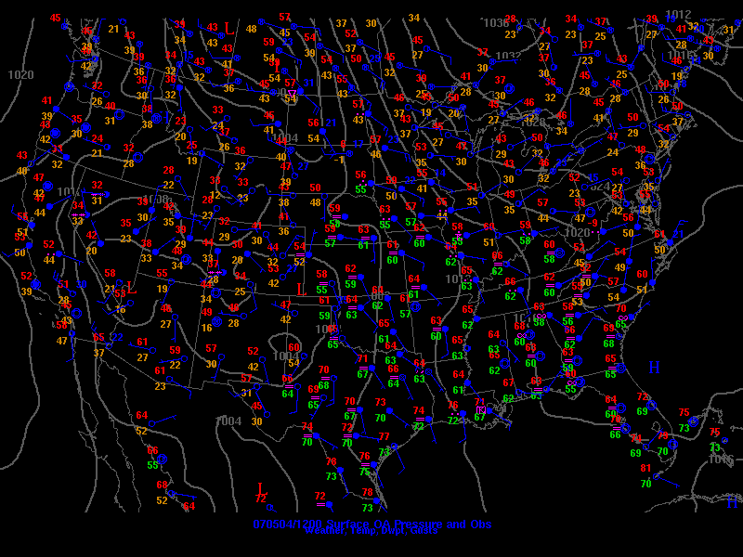
L

Slide 69
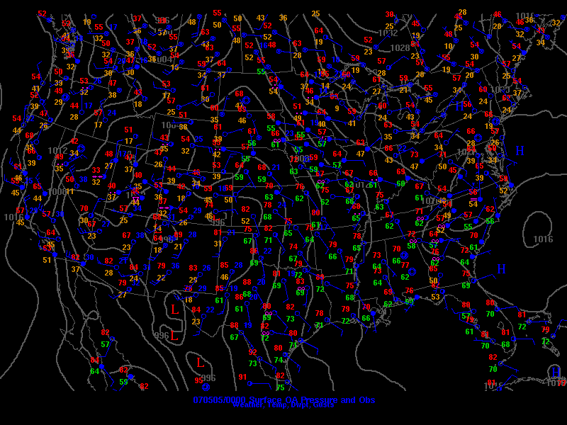
L

Slide 70
Lee Cyclogenesis PV Framework
Conservation of Potential Vorticity
Assumptions:
Constant density/stable
Adiabatic
Frictionless
Stretching of the column vertically requires an increase in relative vorticity between the theta surfaces inducing positive vorticity.
Stretching also lowers the static stability of the atmosphere.
Θ+𝝙Θ
U
L
ΔZ
Θ

Slide 71
Nocturnal Low-Level Jet (LLJ)
Plains often see early nocturnal low-level jet (LLJ) ramp up with lee cyclogenesis
Related to two primary factors:
Boundary-layer decoupling and loss of surface friction (“inertial oscillation”)
Diurnal temperature variations over sloped terrain (thermal wind)
Part of the process that can favor late evening/early overnight tornadoes (with favorable moisture/CAPE)

Slide 72
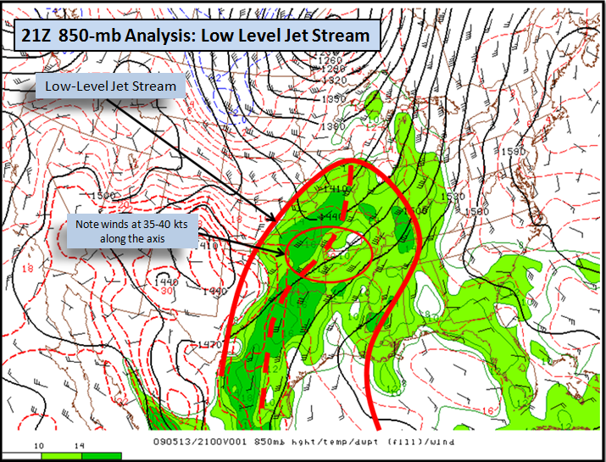
Nocturnal Low-Level Jet (LLJ) Formation
LLJs form in response to difference in terrain heights, heat fluxes and thickness across pressure surfaces that induces a horizontal Pressure Gradient Force.
Coriolis forcing turns the momentum northward resulting in an enhanced southerly flow.
Surface decoupling favors lower friction and acceleration of the jet above the surface
Lee Cyclones can also enhance it by increasing the PGF.
850 mb
Constant geopotential Height
PGF
850 mb
Lower
Thickness
Higher
Thickness
Surface decoupling lower friction

Slide 73
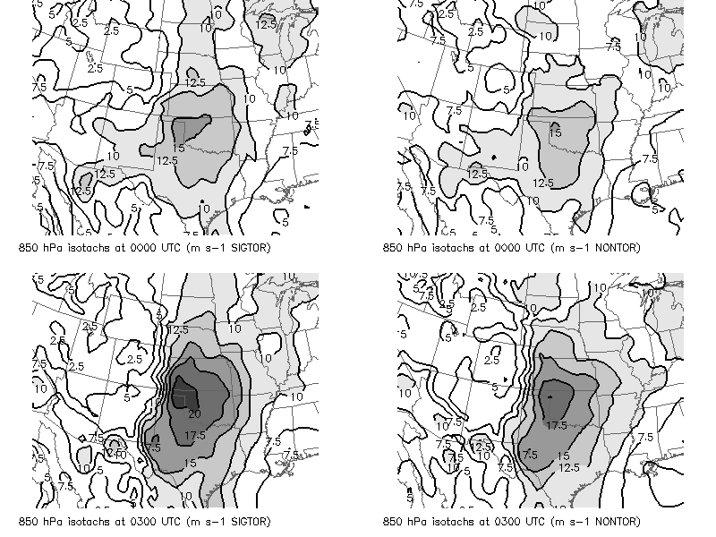
EF2+ supercell events
Nontornadic supercell events

Slide 74
Lee Cyclogenesis Summary
Lee cyclogenesis occurs where upper-level flow is perpendicular to terrain features (westerly flow for Rockies)
Lee cyclogenesis more robust with lower static stability
Lee cyclone helps drive low-level moisture return
Nocturnal low-level jet associated with lee cyclone is driven by inertial oscillation and thermal wind 🡪 increased low-level shear and tornado threat in evening and after dark if adequate CAPE

