Slide 1
Parcel Theory
METR 4403/5403 – Spring 2023
Based on materials originally prepared by Tom Galarneau

Slide 2
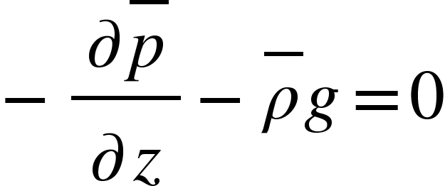
Buoyancy
Buoyancy is the upward force arising from the displacement of a fluid by another fluid or object (Archimedes’ Principle)
The upward force is equal to the weight of the displaced fluid
Buoyancy is the key force for convection! (Supercells are more complicated…)
Vertical momentum equation for convective scales goes as:
B controls the parcel acceleration. So, rising parcels can continue to rise for some time after becoming negatively buoyant (like overshooting top!)
$$\frac{dw}{dt}=−\frac{1}{ρ}\frac{∂p^{′}}{∂z}−g\frac{ρ^{′}}{ρ}=−\frac{1}{ρ}\frac{∂p^{′}}{∂z}+B$$
$$B=−g\frac{ρ^{′}}{ρ}=buoyancy$$
If $ρ^{′}>0$, parcel is more dense than environment. $∴B<0 → \frac{dw}{dt}<0$
Note hydrostatic equation used
If $ρ^{′}<0$, parcel is less dense than environment. $∴B>0 → \frac{dw}{dt}>0$

Slide 3
Buoyancy
Write buoyancy in terms of temperature since we measure that
Reference state temperature is environment (temperature line on sounding)
Using ideal gas law:
$$B=−g\frac{ρ^{′}}{\overline{ρ}}=g\left(\frac{T_{v}′}{\overline{T_{v}}}−\frac{p′}{\overline{p}}\right)$$
For small mach number:
$$\left|\frac{p′}{\overline{p}}\right|≪\left|\frac{T_{v}′}{\overline{T_{v}}}\right|$$
$$∴B=g\frac{{T_{v}}^{′}}{\overline{T_{v}}}=g\frac{{θ_{v}}^{′}}{\overline{θ_{v}}}$$
$$B=g\frac{θ^{′}}{\overline{θ}}$$
Neglecting
water vapor
$$∴B=g\left(\frac{T_{vp}−T_{venv}}{T_{venv}}\right)$$
T_{vp} is virtual temperature of air parcel
T_{venv} is virtual temperature of ambient environment
If $T_{vp}<T_{venv}$, parcel is colder than environment. $∴B<0 → \frac{dw}{dt}<0$
If $T_{vp}>T_{venv}$, parcel is warmer than environment. $∴B>0 → \frac{dw}{dt}>0$
(
)

Slide 4
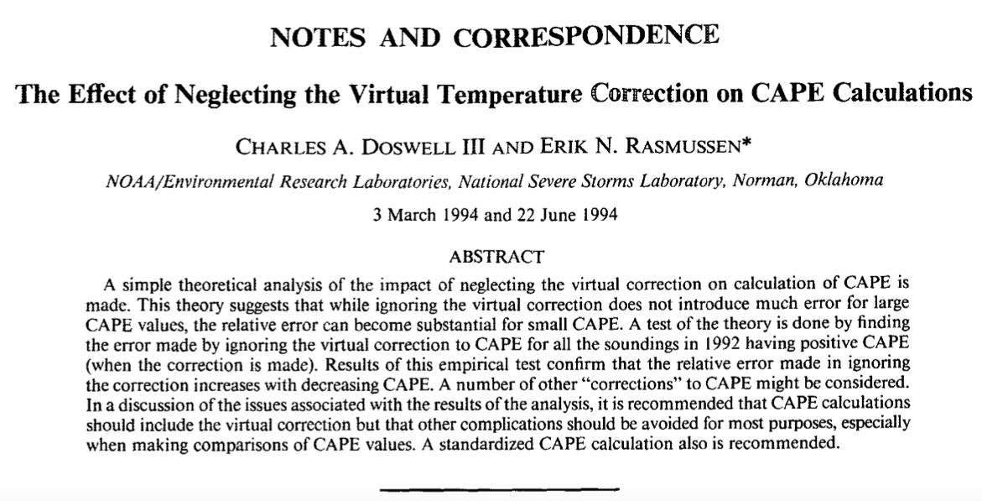
https://doi.org/10.1175/1520-0434(1994)009<0625:TEONTV>2.0.CO;2

Slide 5
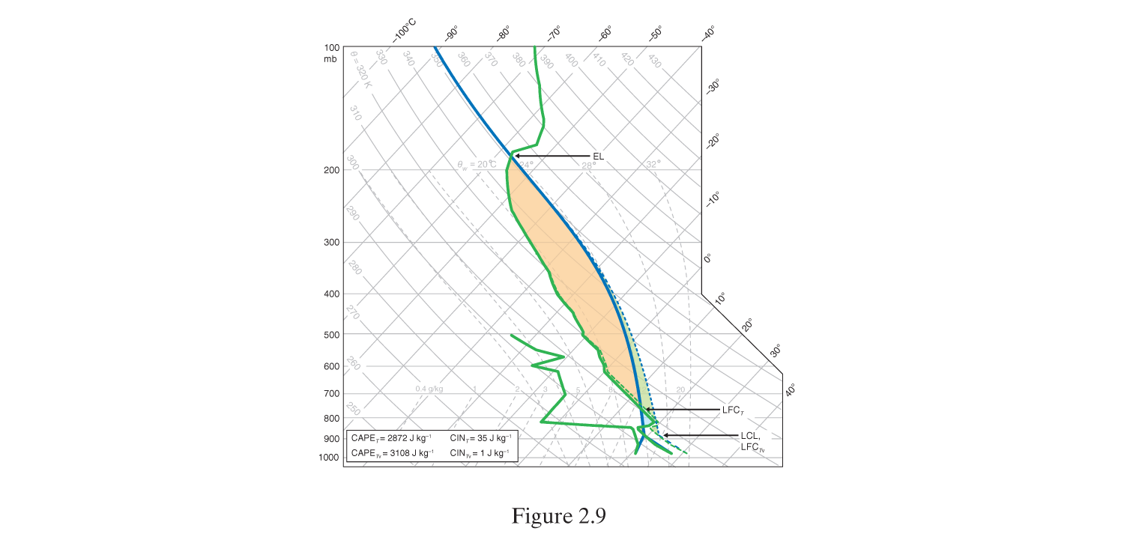
Inclusion of water vapor impacts CAPE/CIN calculation
Fig. 2.9 MR 2010

Slide 6
Parcel theory
Vertical accelerations are due to parcel buoyancy alone
Vertical momentum equation for convective scales goes as:
Parcel theory neglects vertical pressure gradient force, viscosity, entrainment, hydrometeor loading, environment modifications
$$\frac{dw}{dt}=B$$

Slide 7
Parcel theory
We need to be able to determine whether a lifted parcel has buoyancy
Convective available potential energy (CAPE) tells us the kinetic energy a parcel may gain due to buoyant acceleration
Convective inhibition (CIN) is the work done by a parcel against stable stratification to reach its LFC
$$CAPE=\int_{LFC}^{EL}{B}dz$$
Vertical integration of buoyancy from LFC to EL.
Caveats: CAPE>0 does not guarantee convection.
Not all parcels have an LFC.
$$CIN=−\int_{0}^{LFC}{B}dz$$
Vertical integration of buoyancy from ground to EL.
Need to overcome CIN to trigger convection.

Slide 8
Theoretical Maximum Updraft Speed
Parcel theory can be used to estimate w_{max} from buoyancy alone
Manipulate vertical momentum equation ($\frac{dw}{dt}=B$) for parcel theory
Theoretical updraft speeds based on CAPE seem large – what factors counteract buoyant accelerations for air parcels?
$dz \frac{dw}{dt}$ = B $dz$ → $wdw$= B $dz$ →
$d\left(\frac{w^{2}}{2}\right)=$ B dz
$$w_{max}=\sqrt{2∗CAPE}$$
1000 J kg⁻¹ CAPE → 45 m s⁻¹ updraft (??)

Slide 9
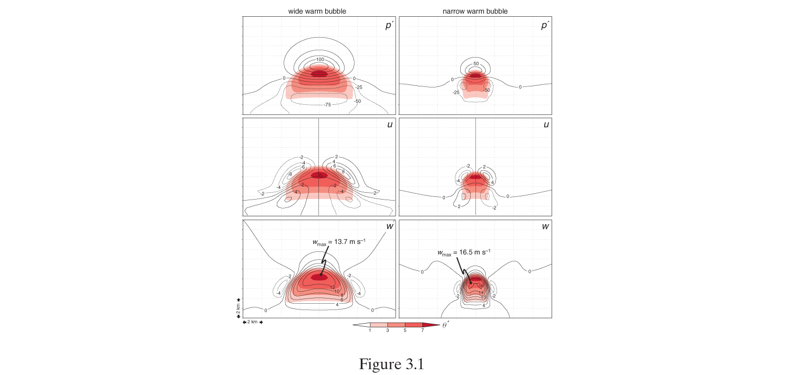
1. Vertical PGF
Wider thermal has larger PGF compared to narrow thermal (more air needs to be moved out of the way)
As thermal becomes wider the scenario approaches hydrostatic where PGF offsets buoyancy (dw/dt=0)
Narrow updrafts more favorable for thunderstorm development
B
B
H
H
PGF
L
PGF
L
2. Entrainment
Mixing of environment air into rising thermal
If env is cooler/drier, evaporation cools thermal, reduces B
Updraft dilution more detrimental for narrow or tilted updrafts (wider is better)
$$\frac{D}{L}≈0.15$$
$$\frac{D}{L}≈0.5$$
Fig. 3.1 MR 2010

Slide 10
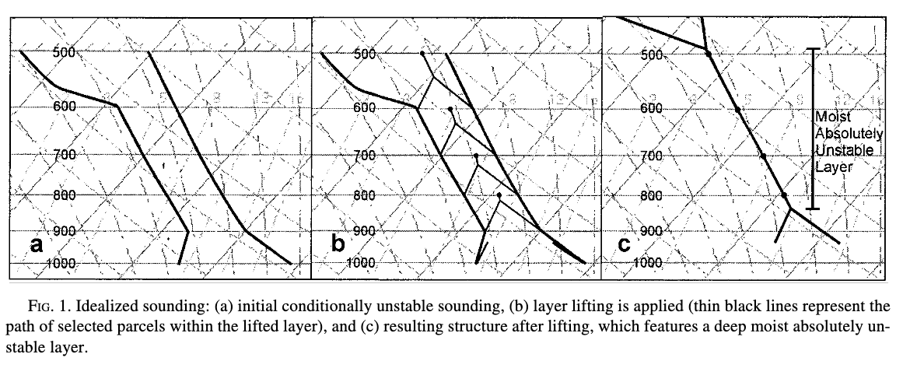
Summary
Parcel theory overestimates updraft speed
Vertical PGF limits updraft speed; significant for wide updrafts
Entrainment limits updraft speed; significant for narrow/tilted updrafts
Hydrometeor loading also limits updraft speed
Parcel theory does not account for layer lifting and development of moist absolutely unstable layers (MAULs)
Bryan and Weisman 2000

Slide 11
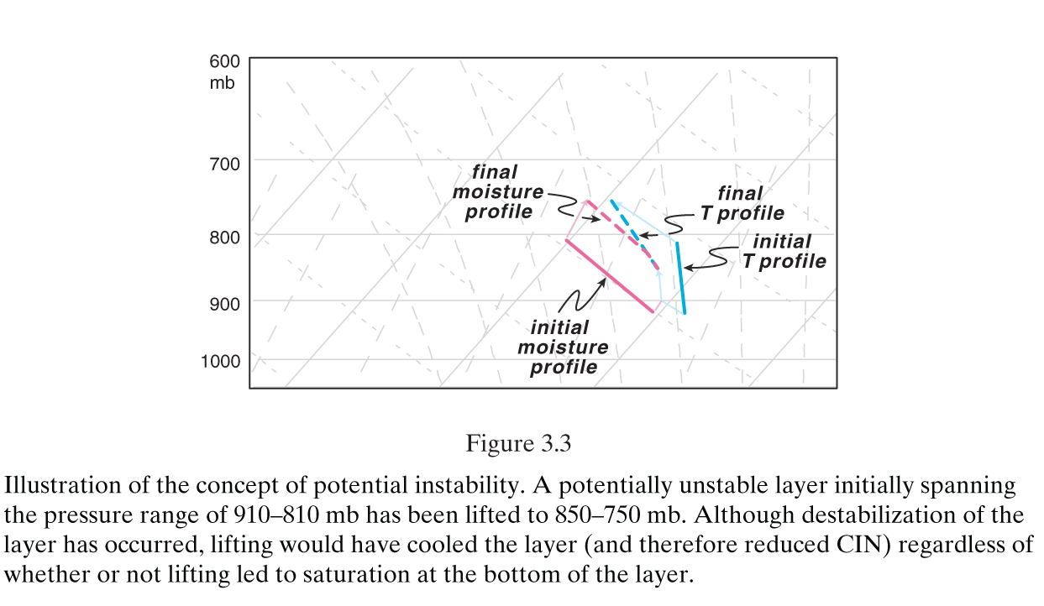
Layer Lifting
Layer lifting can lead to convectively unstable conditions
Unsaturated layer lifted, bottom reaches saturation before top of layer
Bottom of layer cools at $Γ_{m}$
Top of layer cools at $Γ_{d}$
Layer destabilizes!
Fig. 3.3 MR 2010

Slide 12
Skew-T Diagram Basics
METR 4403/5403 – Spring 2023
Material originally prepared by Rich Thompson

Slide 13
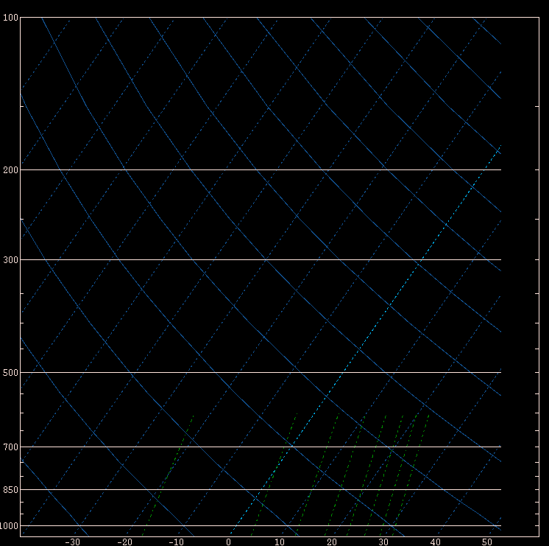
Raw SkewT-log P diagram
Constant pressure
Constant Temp
Dry adiabat
Constant
Mixing ratio
“skew”

Slide 14
Features of note in SkewT log P
Temperature is skewed about 90º from the dry adiabats
Pressure decreases as a logarithm of height (faster at bottom than top)
Mixing ratio crosses over temperature lines
One thing missing is a plot of saturated parcel ascent

Slide 15
Saturated ascent (clouds) –
parcel cools at a rate of
~6.5 C km⁻¹
(pseudo adiabatic “lapse rate”)
Lapse rates between saturated and unsaturated – “conditionally unstable”
Dry ascent (no clouds) –
parcel cools at a rate of ~9.8 C km⁻¹
(dry adiabatic “lapse rate”)

Slide 16
Lifted Parcel (chunk of air)
Begin at lifted parcel level (ground)
Rise “dry adiabatically” until saturation
Where dry adiabat crosses mixing ratio
We call this the “lifting condensation level” or LCL
First guess at cloud base

Slide 17
Moist adiabat

Slide 18
Illustration of lifted parcel
From LCL, rise “moist adiabatically” to “level of free convection” or LFC
“Free convection” begins where lifted parcel becomes warmer than environment
Energy resisting lift below LFC is known as “convective inhibition” or CIN
From LFC, continue up to the “equilibrium level” or EL. Accumulated area (energy) from LFC to EL is known as CAPE
“Overshoot” above EL

Slide 19
Common Sounding Terms
Lapse rate – change in temperature with height
Dry adiabat ≈ 9.8 C km⁻¹
Moist adiabat ≈ 6.5 C km⁻¹
Conditional instability – lapse rate between dry and moist adiabatic
LCL – lifting condensation level
LFC – level of free convection
EL – equilibrium level
CAPE – buoyancy (positive area)
CIN – convective inhibition (negative area)

Slide 20
Positive area (CAPE)
Negative area (CIN)

Slide 21
What’s the difference between the lifted parcels?
Virtual temperature accounts for moisture
Warmer than measured temperature
Makes most difference with tropical moisture
Virtual temperature correction increases CAPE and reduces CIN
Which chunk of air to lift?
Some sort of averaging is usually more representative
Surface vs. “mixed layer” or “most unstable”
Leading to different CAPE values – mixed layer CAPE, most unstable CAPE (MCAPE), sfc-based CAPE.

Slide 22
Lifted parcel (virtual temp)
Lifted parcel
(non-virtual)

Slide 23
Surface and most unstable parcel are the same

Slide 24
Lowest 100 mb mean parcel

Slide 25
Surface parcel

Slide 26
100 mb mean parcel

Slide 27
Most unstable parcel

Slide 28
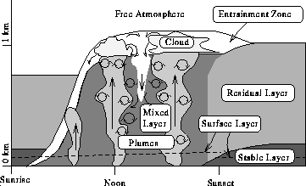
Boundary layer vertical mixing
During daytime, surface heating drives thermals and mixing, which take heat and moisture both upward (from surface) and downward (from aloft)
Usually see surface dew point drop in afternoon if not offset by moisture advection (bringing in greater moisture from somewhere else)

Slide 29
Norman OK sounding
Morning

Slide 30
Surface heating drives vertical mixing
Norman OK soounding
Late afternoon

Slide 31
Flagstaff, AZ sounding
Morning

Slide 32
“super adiabatic” contact layer – lapse rate steeper than dry adiabatic drives vertical mixing
Flagstaff, AZ sounding
Late afternoon
Contact layer is moister than rest of boundary layer

Slide 33
Impact of ascent and moisture advection
See moist layer deepen faster than you would expect with just surface heating and mixing
“Deep” moist layer and horizontal moisture advection both combat vertical mixing driven by surface heating
Can see moist layer deepen while dew points increase near surface

Slide 34
Little Rock, AL sounding
Morning
Nearly saturated and
close to moist adiabat

Slide 35
Little Rock, AL sounding
Noon
Easy to develop mixing

Slide 36
Little Rock, AL sounding
Late afternoon

Slide 37
Shreveport, LA sounding
Morning
Strong inversion and large
CIN in the morning

Slide 38
Shreveport, LA sounding
Noon
CIN is gone by noon
due to surface heating
and upward shifting of
inversion

Slide 39
Shreveport, LA sounding
Late afternoon
Convection can easily
develop

Slide 40
Sounding diagrams are used for…
Moisture and temperature profiles
Estimates of CAPE, CIN, Lifted Index, etc.
Will storms form?
Vertical wind shear (material on hodographs later!)
What kind of storms will form?
Many of your favorite thunderstorm parameters are based in these diagrams, and subject to the same errors and concerns!

