Slide 1
Overview of Ingredients for Severe Storms
METR 4403/5403
Spring 2023

Slide 2
Ingredients for Severe Convective Storms
What do you think are the key ingredients for several convective storms?

Slide 3
Ingredients for Severe Convective Storms
Lift:
What kind of lift can you get?
By what weather systems?
At what scales?
LIFT
INSTABILITY
MOISTURE

Slide 4
Ingredients for Severe Convective Storms
Mesoscale lift must be deep and persistent enough for parcels to reach LFC
Synoptic-scale lift does not initiate convection, but does precondition the environment for convection
LIFT
INSTABILITY
MOISTURE
Visible satellite imagery on 27 May 1997
(Markowski and Richardson 2010, Fig. 7.2)
Deep moist convection (DMC) tends to be initiated along air mass boundaries, which are usually accompanied by a wind shift and convergence. This allows forecasters to enjoy at least modest predictability with regard to anticipating the location of convection initiation, for such boundaries are fairly easily observable in routinely available synoptic surface observations and radar and satellite data.
The sequence of visible satellite images shows the development of a line of severe thunderstorms along a cold front on 27 May 1997. The town of Jarrell, TX, was devastated by a tornado during this event.

Slide 5
Ingredients for Severe Convective Storms
Mesoscale lift must be deep and persistent enough for parcels to reach LFC
Synoptic-scale lift does not initiate convection, but does precondition the environment for convection
Instability:
What is the most used parameter to measure convective instability?
LIFT
INSTABILITY
MOISTURE
Visible satellite imagery on 27 May 1997
(Markowski and Richardson 2010, Fig. 7.2)
Moisture of sufficient depth and amount is required
The dry atmosphere is usually stable to vertical parcel displacement.

Slide 6
Ingredients for Severe Convective Storms
Mesoscale lift must be deep and persistent enough for parcels to reach LFC
$$CAPE=\int_{LFC}^{EL}{g\frac{T_{v_p}−T_{v_env}}{T_{v_env}}dz}=\left[\frac{kg m^{2}}{s^{2}}\frac{1}{kg}\right]=\left[\frac{m^{2}}{s^{2}}\right]$$
Synoptic-scale lift does not initiate convection, but does precondition the environment for convection
(not sufficient for convection initiation)
$$=\left[\frac{J}{kg}\right]$$
$$\frac{CAPE}{∆Z}=\left[\frac{m^{2}}{s^{2}}\right]\left[\frac{1}{m}\right]=\left[\frac{m}{s^{2}}\right]$$
LIFT
INSTABILITY
“Short-Wide” CAPE drives faster vertical accelerations compared to “tall-narrow” CAPE (Blanchard 1998, Wea. Forecasting)
Entrainment and water loading limit vertical acceleration
MOISTURE
Visible satellite imagery on 27 May 1997
(Markowski and Richardson 2010, Fig. 7.2)
Moisture of sufficient depth and amount is required
DRT sounding at 1800 UTC 14 May 2008
(Markowski and Richardson 2010, Fig. 2.9)

Slide 7
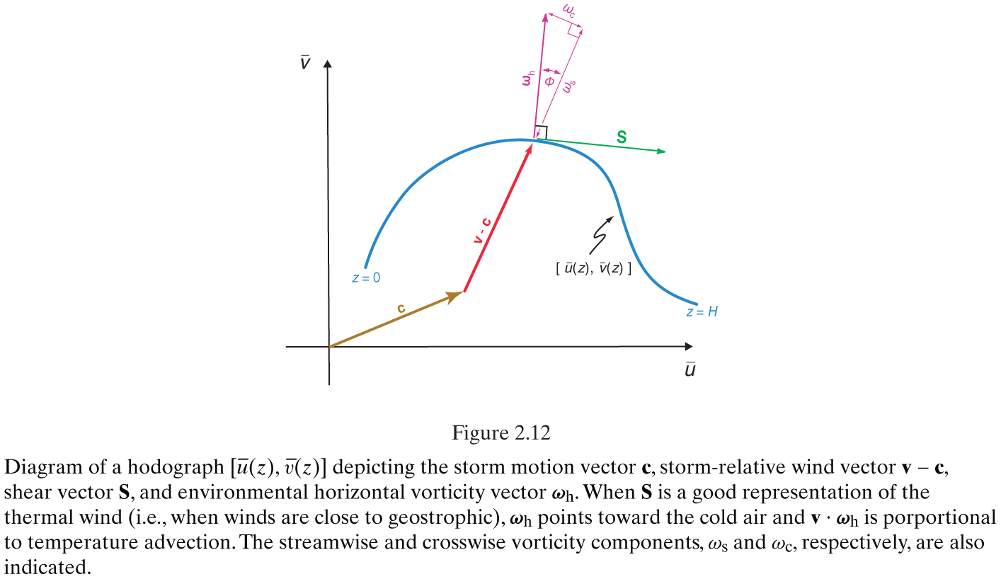
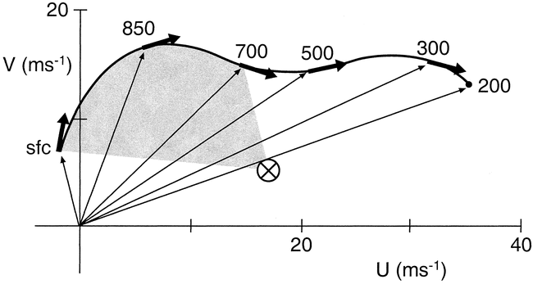
Vertical Wind Shear
Large vertical wind shear is a key ingredient for severe storms.
Why? Rotating updraft can induce additional upward pressure gradient force that enhances vertical acceleration, in addition to buoyancy.
(Markowski and Richardson 2010, Fig. 2.12)
Storm-relative helicity
$$SRH=\int_{0}^{3}{\left(v−c\right)∙ω_{h}}dz$$
$$ω_{h}=\hat{k}×\frac{∂v_{h}}{∂z}=\hat{k}×S$$
(Weisman and Rotunno 2000, J. Atmos. Sci., Fig. 1)

Slide 8
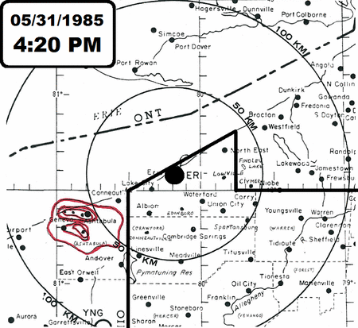
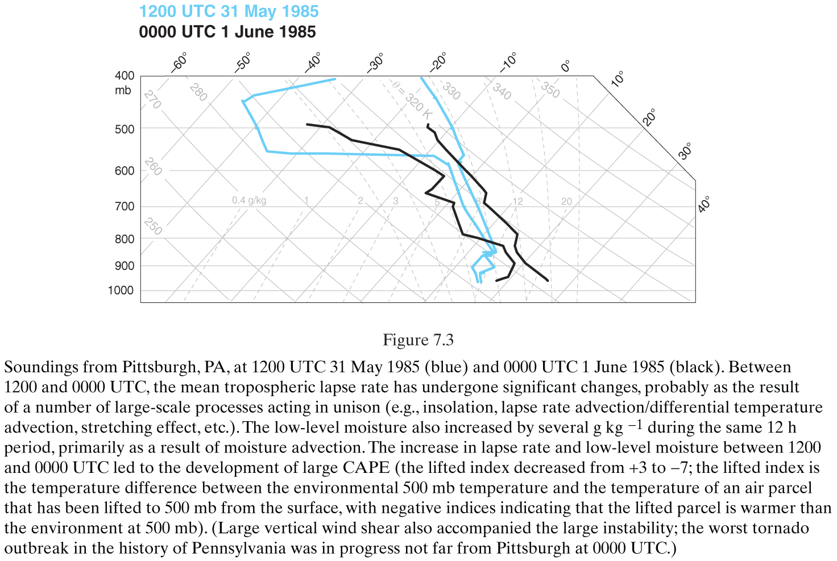
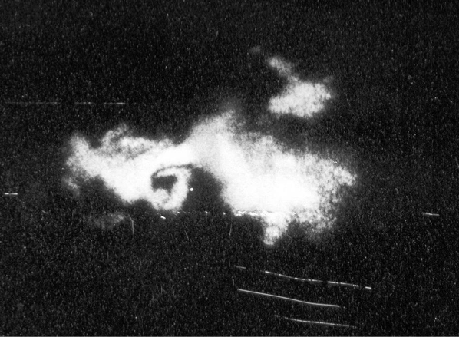
Evolution of Lapse Rate, CAPE, and CIN
Radar summary maps from WSR-74 at Erie, PA
“This image, courtesy Greg Forbes via Paul Markowski, is from the radar that was atop the Walker Building, home of Penn State Meteorology Department, around 8pm EST. It shows a pronounced hook echo (center of photo) within the storm moving through Moshannon State Forest about 20 miles north of State College, Centre County.”
(Markowski and Richardson 2010, Fig. 7.3)
What physical processes drive changes in lapse rate, CAPE, and CIN?
(there is will be separate lecture on this topic)
Source: https://www.weather.gov/ctp/TornadoOutbreak_May311985

Slide 9
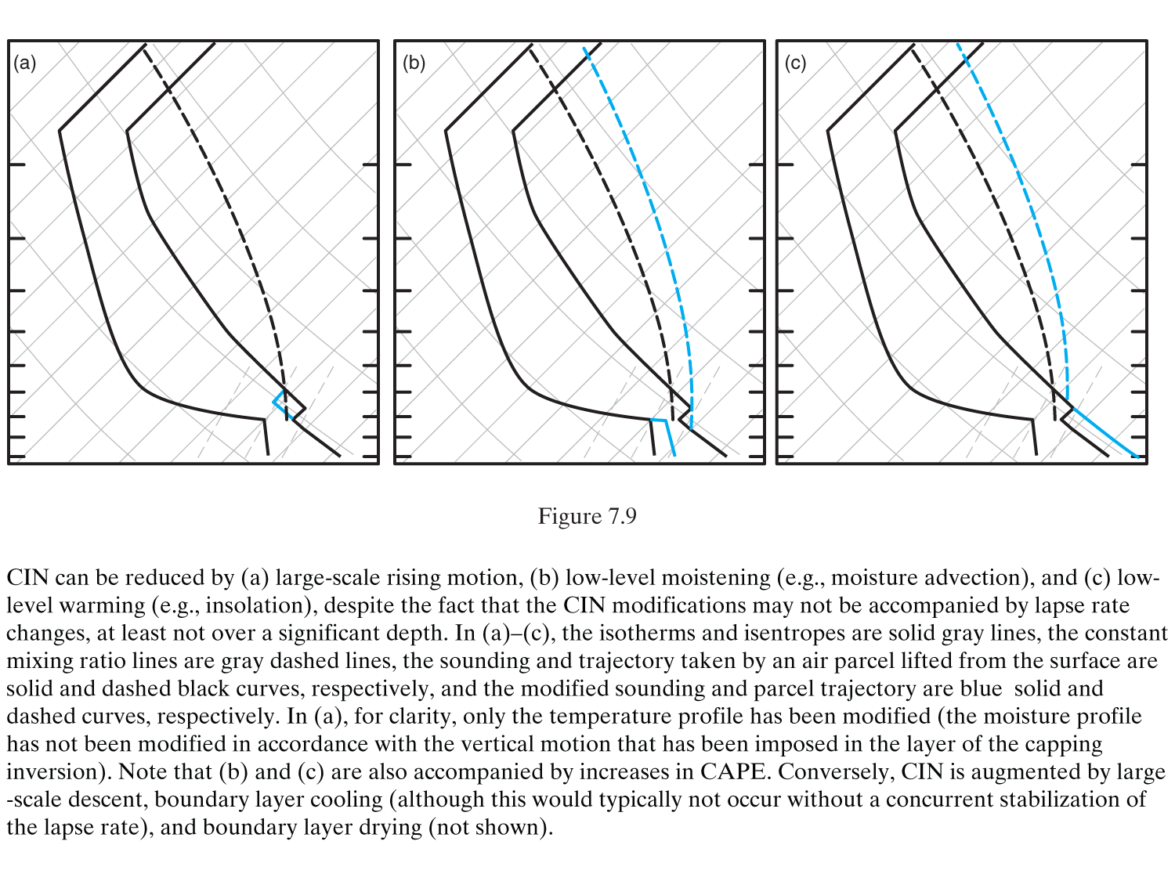
CAPE/CIN Changes Independent of $γ$ Tendency
CIN can be reduced and/or CAPE increased by:
Rising motion
Low-Level Moistening
Low-Level Warming
(Markowski and Richardson 2010, Fig. 7.9)

Slide 10
Features Driving Convection Initiation
Mesoscale ascent along boundaries such as:
Cold front aloft
Split cold fronts
Surface-based fronts
Conveyor belts
Dryline
Outflow boundaries
Shear lines
Sea breeze circulations
Differential cloud cover and frontogenetic secondary circulation
Soil moisture gradients and frontogenetic secondary circulation
Terrain-driven circulations (upslope flow)

Slide 11
Sea Breeze Front
Schematic diagram showing the interaction between the sea-breeze front and horizontal convective rolls and how it related to cloud development on 12 August 1991 during the Convection and Precipitation/Electrification Experiment (CaPE). The sea-breeze front is delineated by the heavy blue barbed line. The circulation along the leading portion of the sea-breeze front is shaded purple. The horizontal vorticity vectors associated with the counter-rotating roll circulations are also shown, as are clouds along the horizontal convective rolls and at the intersection points along the front. The shear vector and low-level winds are indicated with black and green arrows, respectively. This is the same case as shown in Figure 5.33. (Adapted from Atkins and Wakimoto [1995].)
(Markowski and Richardson 2010, Fig. 7.11)

Slide 12
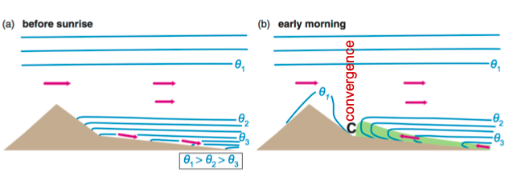
Terrain-Driven Upslope Flow
(Markowski and Richardson 2010, Fig. 11.4)
Upslope flow due to differential heating
Upslope flow develops in the morning as higher terrain warms, driving convergence in the lee
Lifting of flows by terrain – flows towards mountain

Slide 13
Wang, Q., M. Xue, and Z. Tan, 2016: Convective initiation by topographically induced convergence forcing over Dabie Mountains on 24 June 2010. Adv. Atmos. Sci., 33, 1120-1136.
CI by topographically induced convergence forcing over Dabie Mountains
Conceptual model for the formation of low-level convergence regions and the primary convergence line over the eastward-extending Dabie Mountains ridge in a moderate low-level easterly flow (indicated by the wind barbs).
The thermally-driven upslope winds in the late morning (shown by red curved arrows with feather tails) induce convergence zones (red ellipses) over the main mountain peaks along the ridge.
Additional convergence zones are induced on the leeside of the main mountain peaks on the ridge (blue ellipses) by around peak flows (shown as blue curved arrows with rhomboid tails).
Further, upslope winds (green short arrows) along the roughly north–south oriented valleys (thick dashed lines), due to thermal and channeling effects, create additional convergence zones (green ellipses) between the peaks along the ridge.
The superposition of the flow convergence due to the above processes creates a primary convergence line (bold solid line) along the eastward-extending ridge line of the Dabie Mountains, with locally enhanced convergence centers (three small white-filled black circles labeled C1 through C3) that tend to initialize convection the quickest.

Slide 14
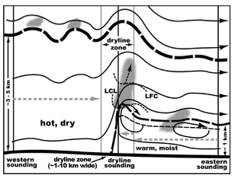
Dryline
Mesoscale lifting allows air parcels to reach their LFC
Convection initiation (CI) not uniform along dryline
Misocyclones may modulate CI
(Ziegler and Rasmussen 1998, Fig. 17)
(Markowski and Richardson 2010, Fig. 7.10)
(Markowski and Richardson 2010, Fig. 7.13)
Deep convection initiates within ~10 km west to ~40 km east of the surface dryline
Possible reasons convection initiates near the dryline: surface convergence; dryline is western-most boundary of moist, unstable airmass; bulges, misocyclones enhance convergence; secondary circulation, persistent lift

Slide 15
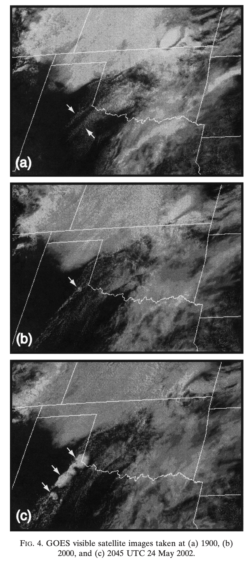
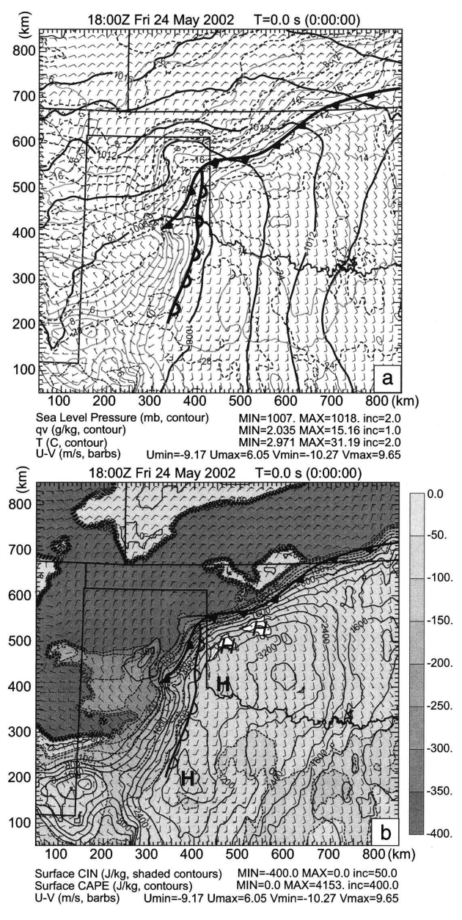
Dryline Convective Initiation – a case study
Xue, M. and W. Martin, 2006: A high-resolution modeling study of the 24 May 2002 case during IHOP. Part I: Numerical simulation and general evolution of the dryline and convection. Mon. Wea. Rev., 134, 149-171.

Slide 16
Time and Location of Initiation (Loop time: 17UTC – 22 UTC)

Slide 17
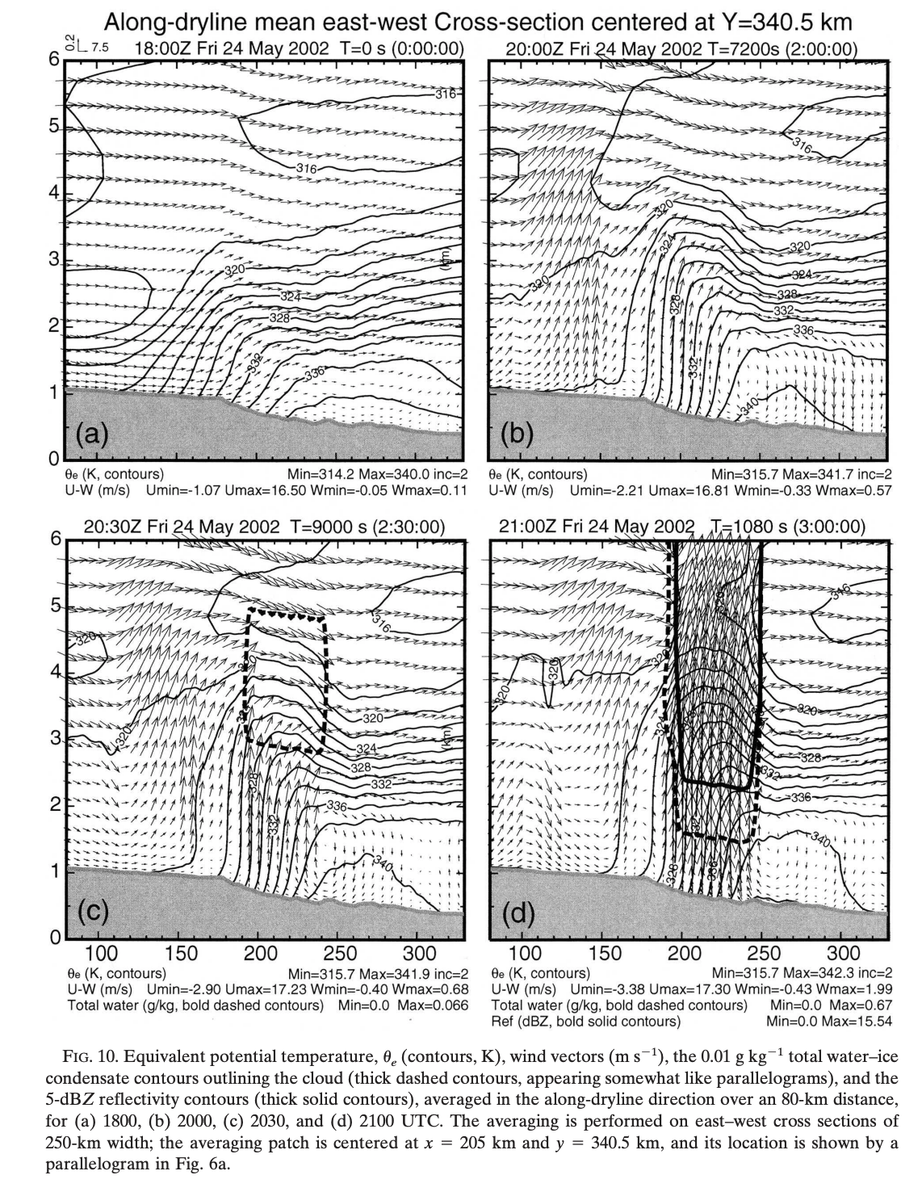
Dryline Convective Initiation – a case study
Xue, M. and W. Martin, 2006: A high-resolution modeling study of the 24 May 2002 case during IHOP. Part I: Numerical simulation and general evolution of the dryline and convection. Mon. Wea. Rev., 134, 149-171.

Slide 18
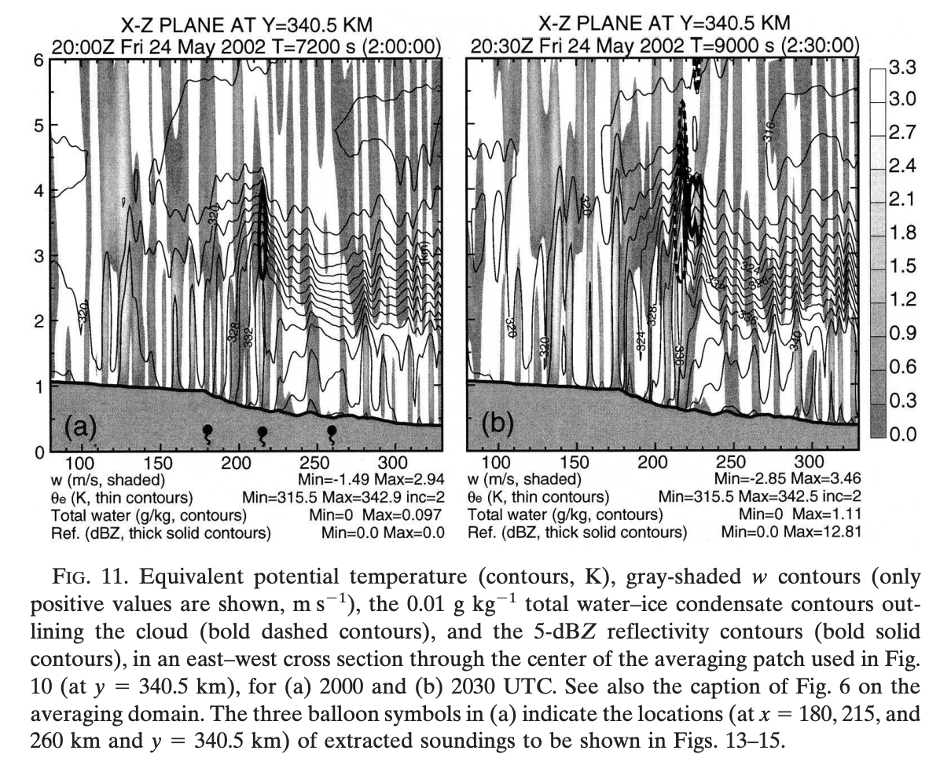
Dryline Convective Initiation – a case study
Xue, M. and W. Martin, 2006: A high-resolution modeling study of the 24 May 2002 case during IHOP. Part I: Numerical simulation and general evolution of the dryline and convection. Mon. Wea. Rev., 134, 149-171.

Slide 19
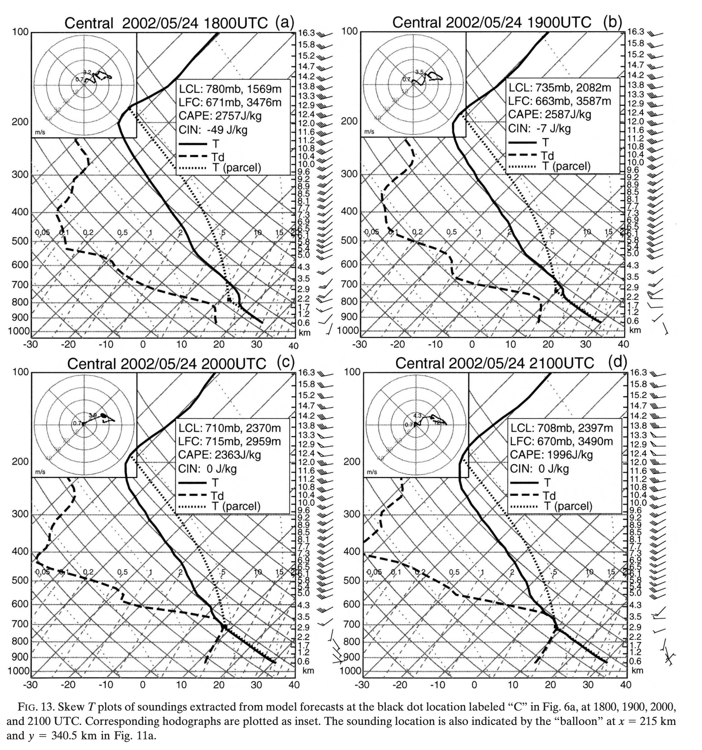
Dryline Convective Initiation – a case study
Xue, M. and W. Martin, 2006: A high-resolution modeling study of the 24 May 2002 case during IHOP. Part I: Numerical simulation and general evolution of the dryline and convection. Mon. Wea. Rev., 134, 149-171.

Slide 20
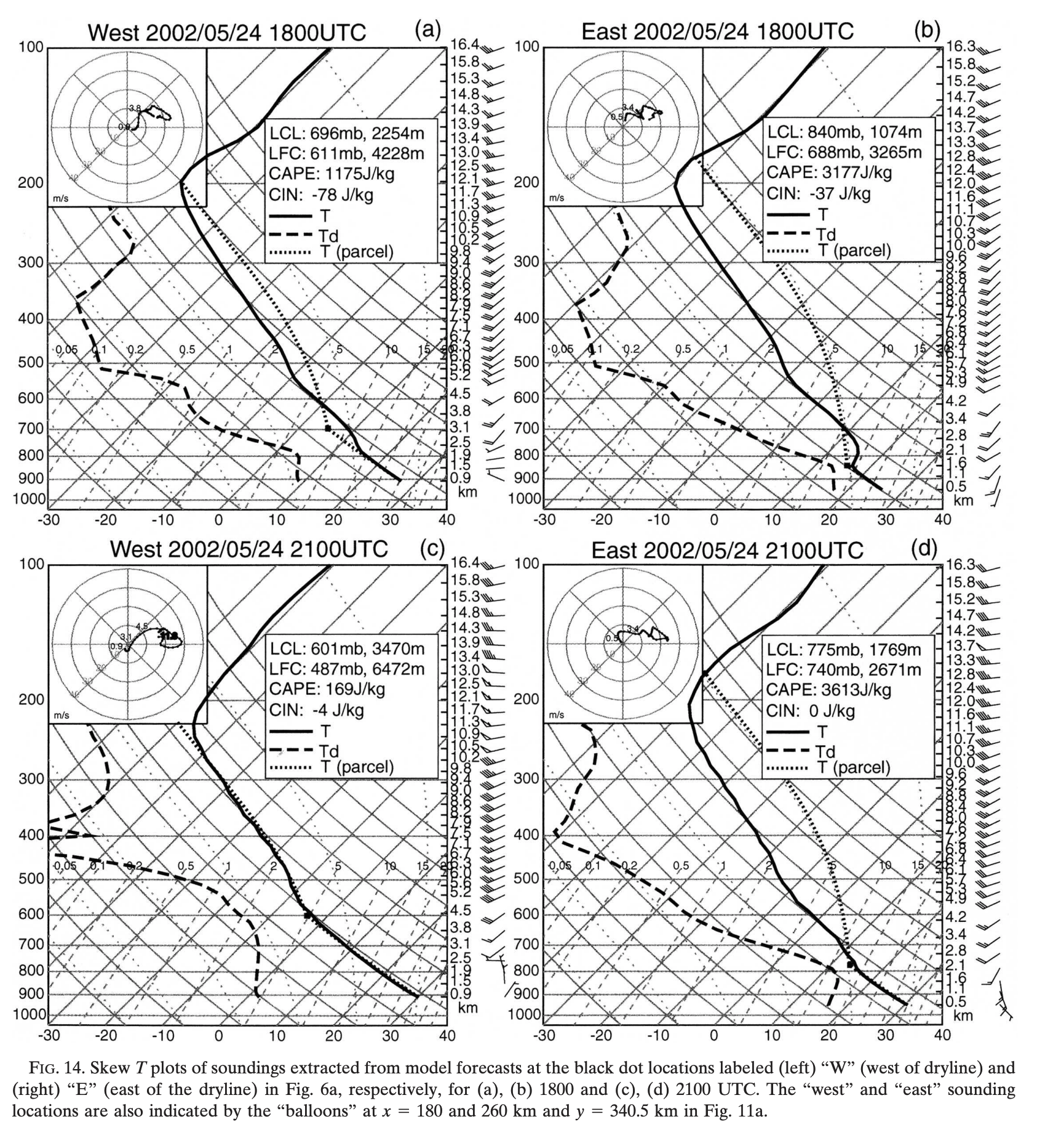
Dryline Convective Initiation – a case study
Xue, M. and W. Martin, 2006: A high-resolution modeling study of the 24 May 2002 case during IHOP. Part I: Numerical simulation and general evolution of the dryline and convection. Mon. Wea. Rev., 134, 149-171.

Slide 21
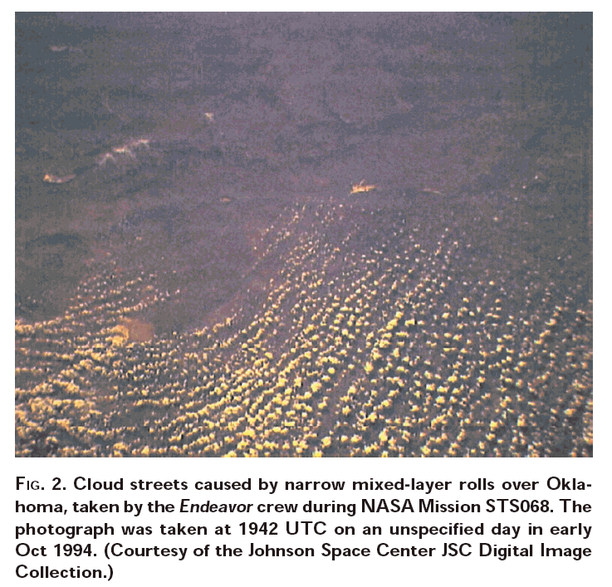
Horizontal convective rolls

Slide 22
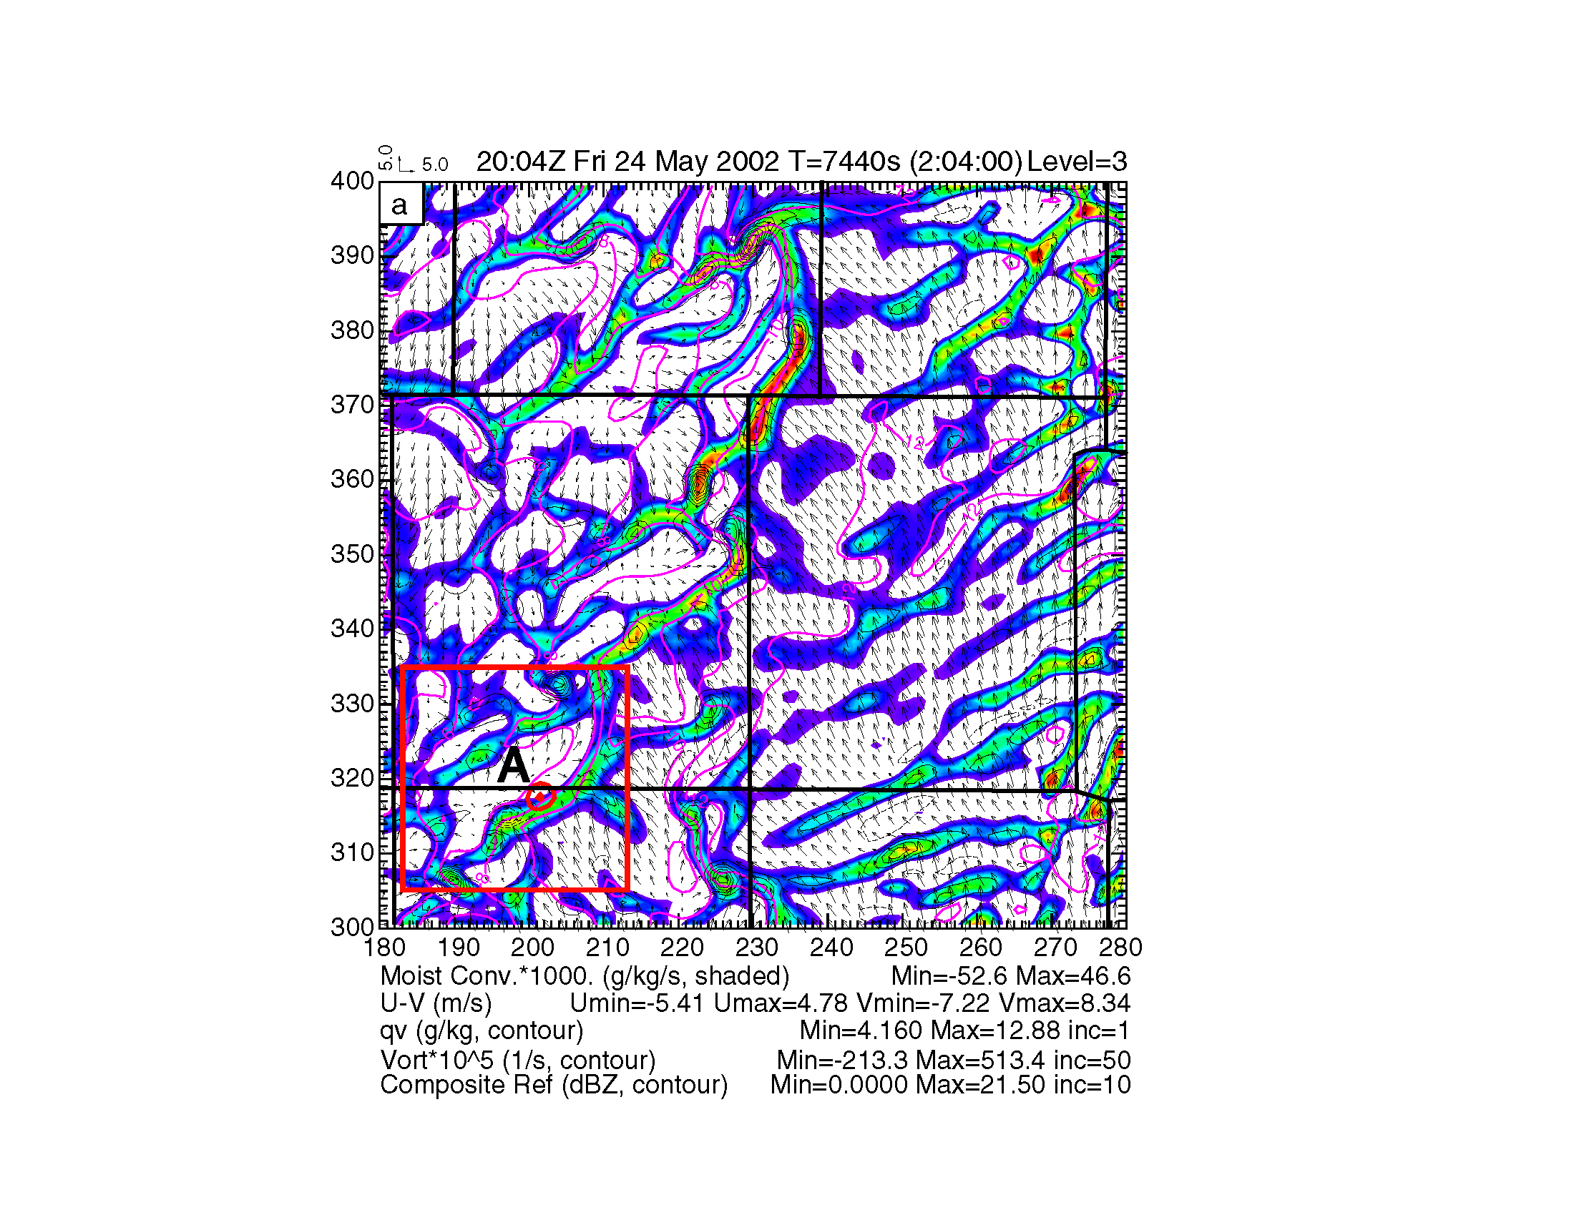
Simulated surface moisture convergence bands associated with HCRs on east and west sides of a dryline
Xue, M. and W. Martin, 2006: A high-resolution modeling study of the 24 May 2002 case during IHOP. Part II: Horizontal convective rolls and convective initiation. Mon. Wea. Rev., 134, 172-191.

Slide 23
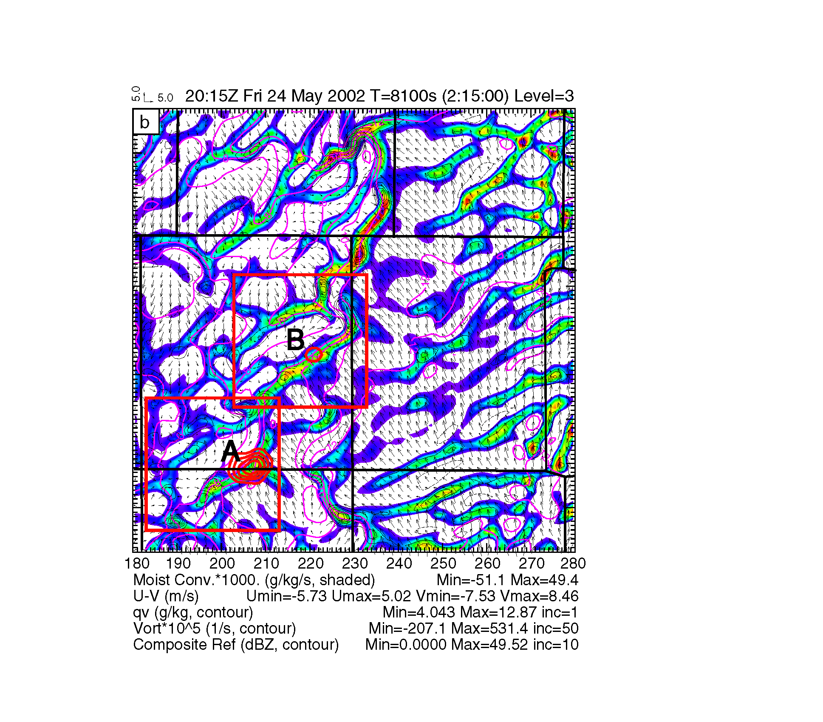
Simulated surface moisture convergence bands associated with HCRs on east and west sides of a dryline

Slide 24
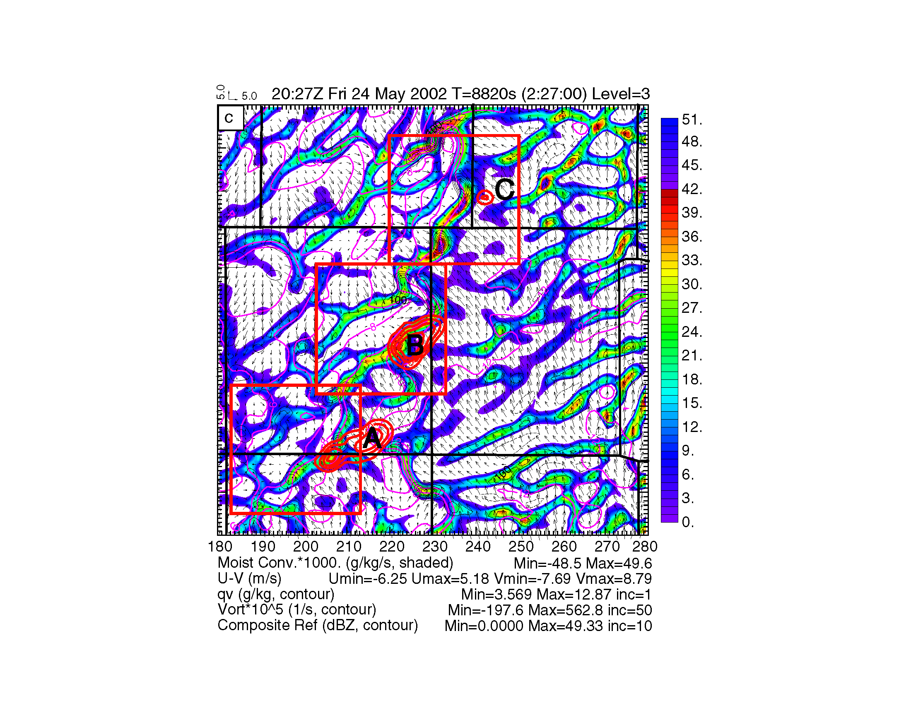
Simulated surface moisture convergence bands associated with HCRs on east and west sides of a dryline

Slide 26
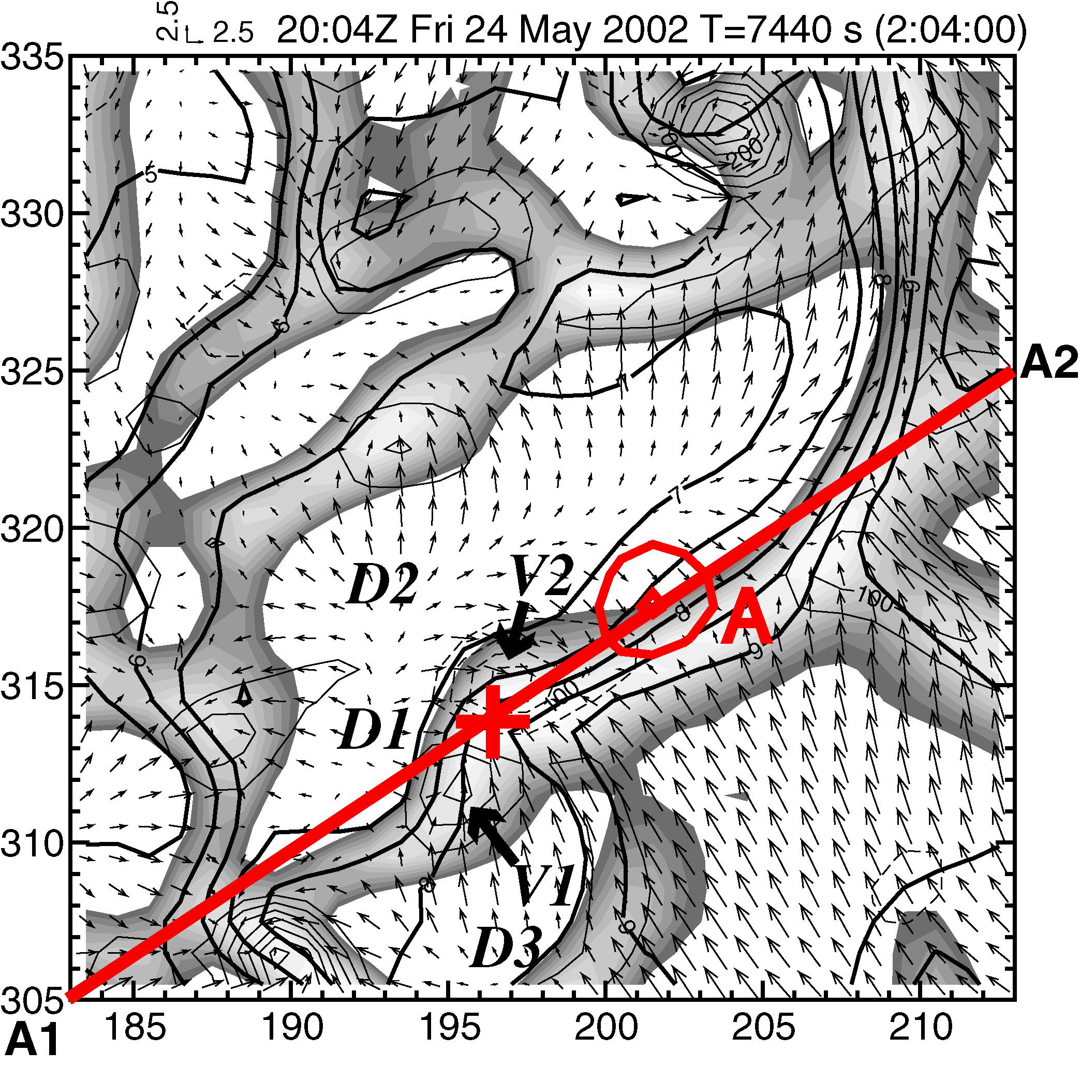
30x30km

Slide 27
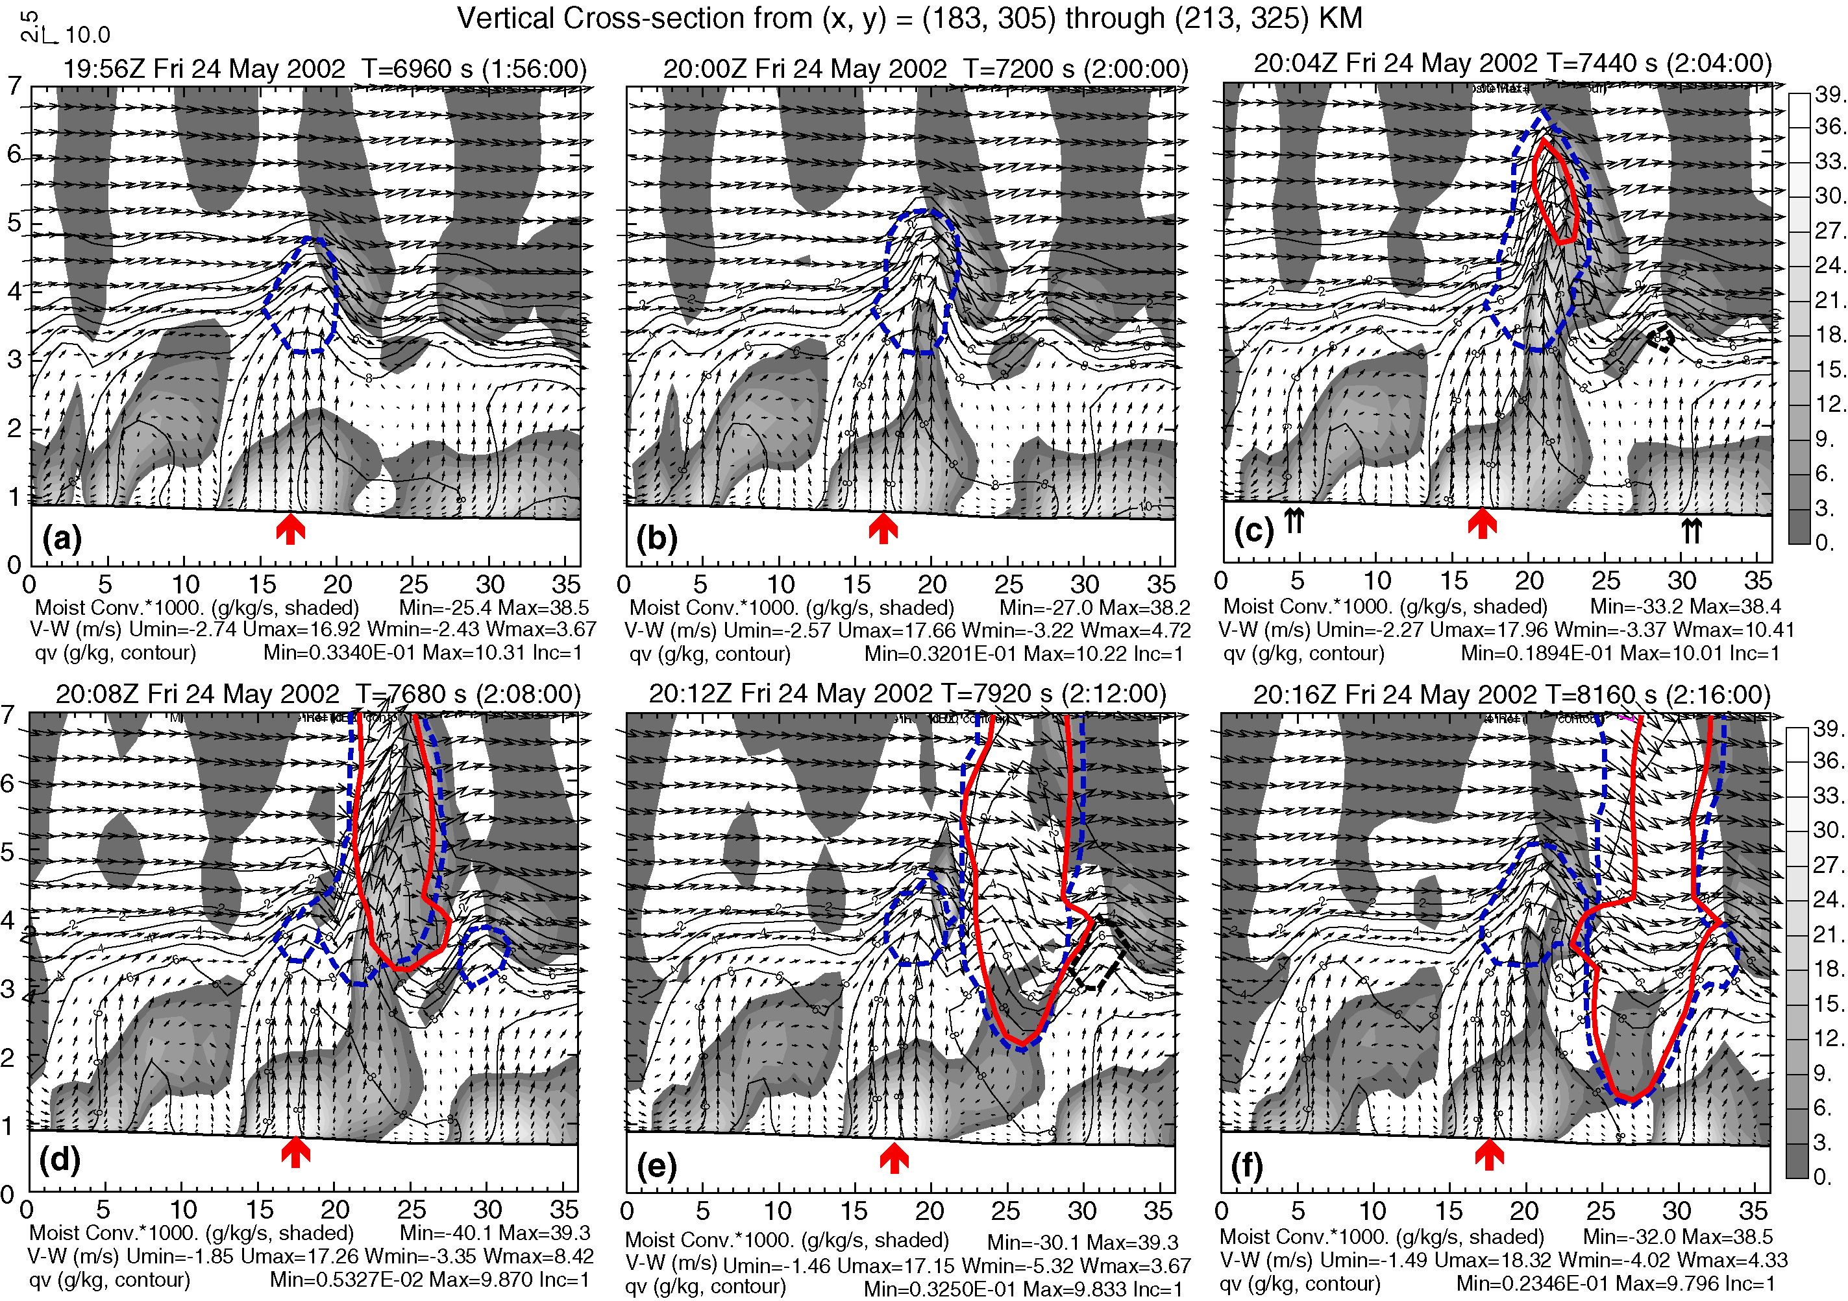
4min intervals

Slide 28
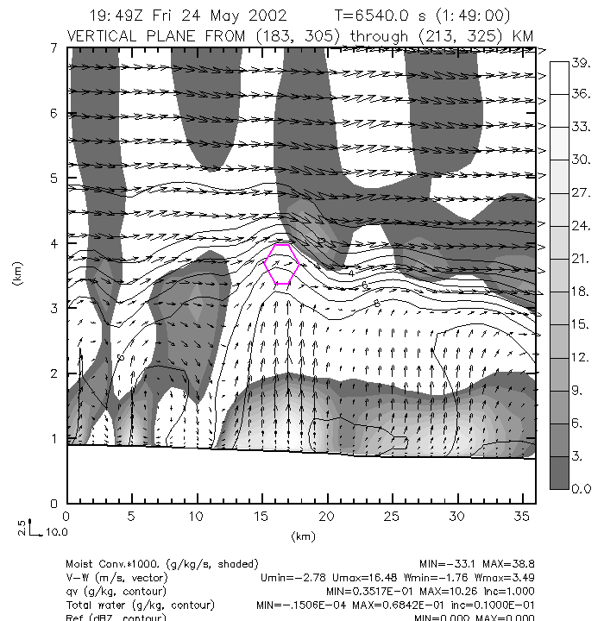

Slide 29
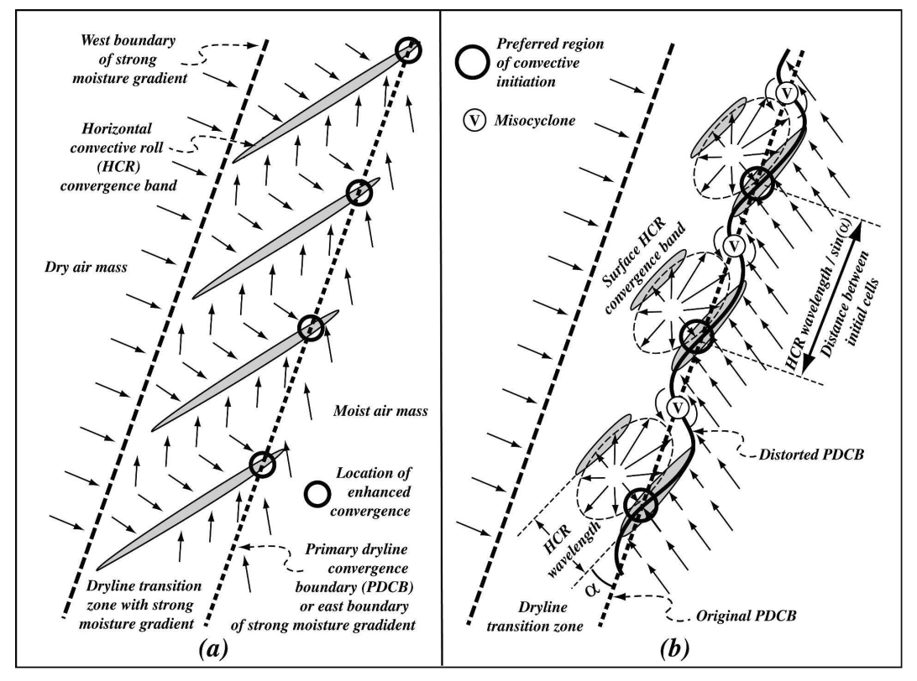
CI at Intercepting Points of HCRs and dryline
A conceptual model of dryline convective initiation due to the interaction of the PDCB with the evolving HCRs that originate at and on the west side of the PDCB and are aligned at an acute angle, , with the dryline. The PDCB is the boundary between the southerly to southeasterly moist flow and the drier, generally westerly flow in the dryline transition zone, where a strong moist gradient is found. The PDCB undistorted by the HCR circulation is marked by the thick, straight, short-dashed line. The thick, straight, long-dashed line marks the location of the western boundary of the dryline transition zone, toward the west of which the air is exclusively from the dry high plateau to the west with a specific humidity of few g kg1 . (a) The earlier stage of HCR development when the HCRs are quasi-two-dimensional and the roll circulations result in surface divergence flow and convergence bands (shaded gray) between the opposing roll circulations. The background southwesterly wind in the transition zone causes the surface divergence flow of the rolls to point in the downwind direction. The rolls are aligned in the direction of the mean low-level vertical shear vector and the northeastern ends of the convergence bands intersect the PDCB, creating localized convergence maxima. (b) The low-level flow at the mature stage of HCR development, about 1–2 h after (a), when significant cellular structures develop with the rolls and the convergence bands become segmented and shorter but more intense. The convergence bands protrude further into the moist air mass across the original PDCB and distort the PDCB into a wavy pattern. The divergence flow between the convergence bands develops into asymmetric elliptic patterns, with the northeastward wind components being stronger due to downward transport of southwesterly momentum and due to the original background flow in the same direction. The mesoscale convergence along the dryline is enhanced by the elevated heating to the west, hence by the increased solenoidal forcing. It narrows the dryline transition zone, turns the HCRs into a more north–south orientation. The easterly component of the moist flow is increased, which, together with HCR divergence flow, creates convergence maxima along the PDCB, at locations marked by thick circles, where convective initiation is preferred. Such locations are also roughly where HCRs intersect the original PDCB and the distance between such preferred locations is roughly equal to the HCR wavelength divided by sin(). When the initiated clouds move along the HCR convergence bands, they develop into deeper clouds faster and have a much better chance of growing into a full intensity convective storm. When older cells that are initiated at the persistent maximum low-level convergence forcing move away, new cells tend to form at the same location, resulting in a series of cells. The thin circles enclosing “V” indicate locations of vorticity maxima (or misocyclones) along the PDCB. Misocyclones usually do not collocate with maximum surface convergence but their circulation can enhance convergence to their south and north, and nonsupercell tornadoes can develop when their vertical vorticity is stretched by cumulus congestus clouds that move over them.
Xue, M. and W. Martin, 2006: A high-resolution modeling study of the 24 May 2002 case during IHOP. Part II: Horizontal convective rolls and convective initiation. Mon. Wea. Rev., 134, 172-191.

Slide 30
Insufficiency of CIN Removal
CI should be expected when CIN is removed completely. Yet, sometimes CI still does not occur. Why?

Slide 31
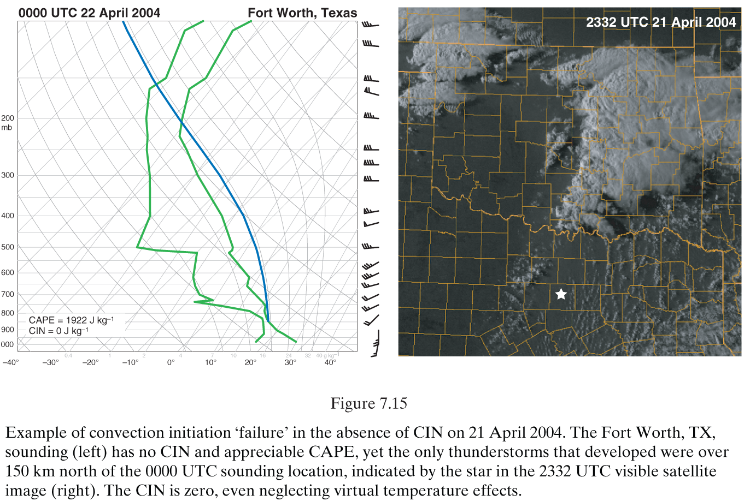
Insufficiency of CIN Removal
CI should be expected when CIN is removed completely. Yet, sometimes CI still does not occur. Why?
1) Observed sounding not representative the actual storm environment
(Markowski and Richardson 2010, Fig. 7.15)

Slide 32
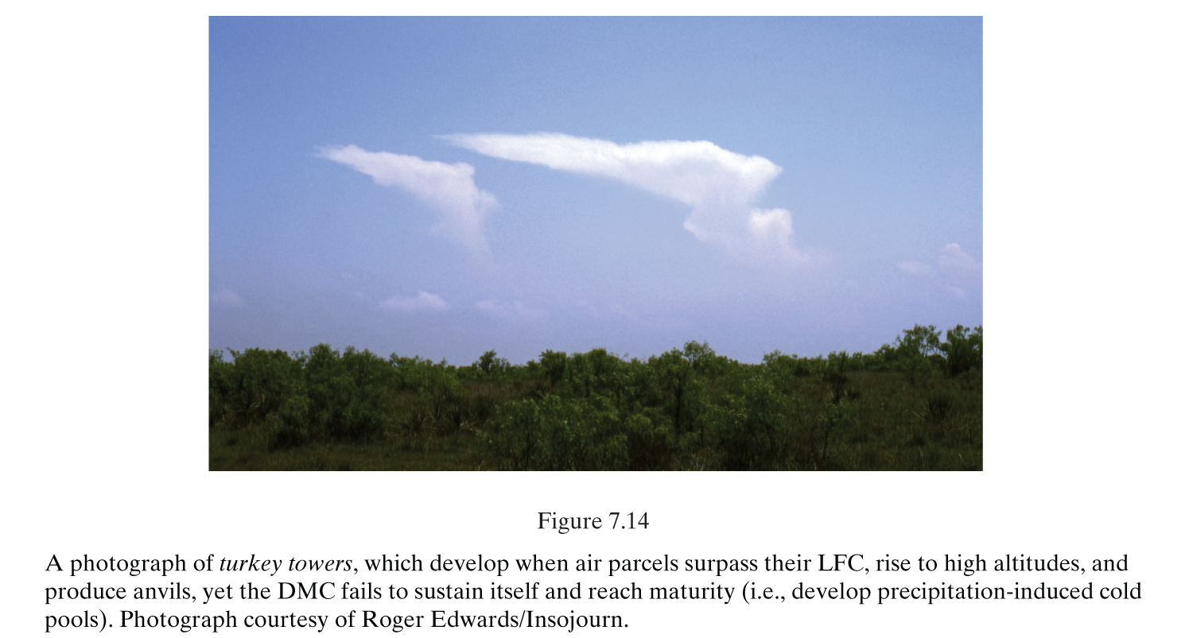
Insufficiency of CIN Removal
CI should be expected when CIN is removed completely. Yet, sometimes CI still does not occur. Why?
2) Entrainment of environmental dry air into the updraft
(Markowski and Richardson 2010, Fig. 7.14)

Slide 33
Insufficiency of CIN Removal
CI should be expected when CIN is removed completely. Yet, sometimes CI still does not occur. Why?
3) small-scale heterogeneities in moisture, temperature, wind
4) mesoscale circulations
Schematic showing the effect of boundary layer roll circulations on the moisture profiles measured by soundings. A sounding that ascends through the updraft of a roll samples larger water vapor concentrations than a sounding that ascends through the downdraft of a roll. Thus, the LCL height based on a sounding that has ascended through a downdraft might be overestimated compared with the bases of the observed clouds, which generally reside within boundary layer updrafts. CAPE and CIN values computed from a sounding would also be sensitive to whether the sounding ascended through an updraft or a downdraft.
Horizontal cross-section of the mean vertical wind shear in the 0–1 km AGL layer at 1945 UTC 12 June 2002, obtained from a dual-Doppler wind synthesis. The dashed lines are gravity wave phase fronts, the dash–dot line is an outflow boundary, and the line with open scallops is a dryline. Note the remarkable variability of the vertical wind shear field, partly due to thermals and partly as a result of the mesoscale boundaries. CIN might have similar complexity. If so, it would be very difficult to anticipate convection initiation based on the characteristics of a single sounding alone.
(Markowski and Richardson 2010, Fig. 7.16)
(Markowski and Richardson 2010, Fig. 7.17)

