Slide 1
SPC Case #2
May 3 2023

Slide 2
Background
It’s 6:45 am and you’ve just shown up for a shift, your first of the week, after a great few days off of not checking the weather.
Its mid Spring/ early Summer and the mid shift forecasters mention a lower end severe weather risk today. They don’t seem too worried about it.
Upper flow is weak and storms look like they could be more pulsey than sustained.
You keep that in mind as you start to look at the data.
Next up is the outlook you inherited.

Slide 3
1300z SPC Outlook.
TOR
Wind
Hail

Slide 4
STOP!

Slide 5
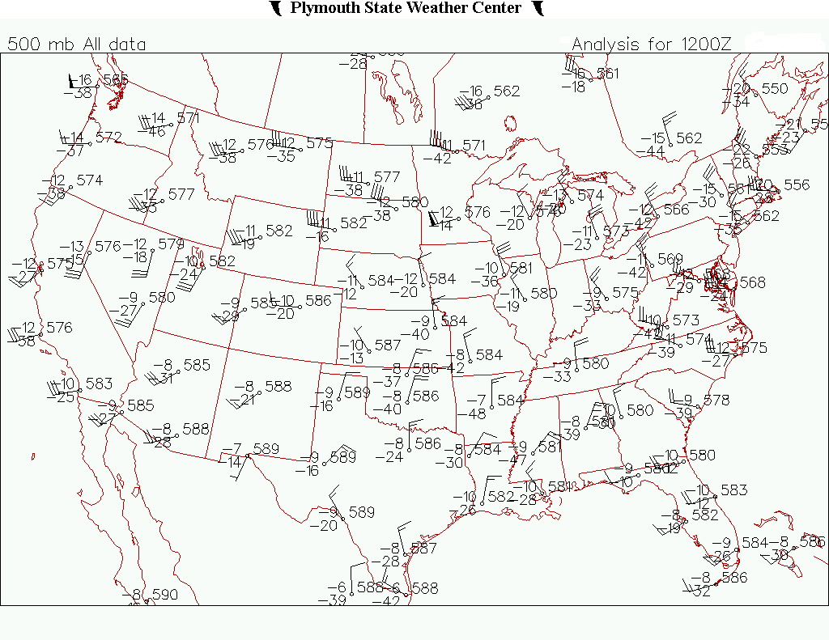
500 MB Plot.
Do a rough analysis of the western US at 500 mb.
Hint: Start at 564 dm. Intervals every 6 dm

Slide 6
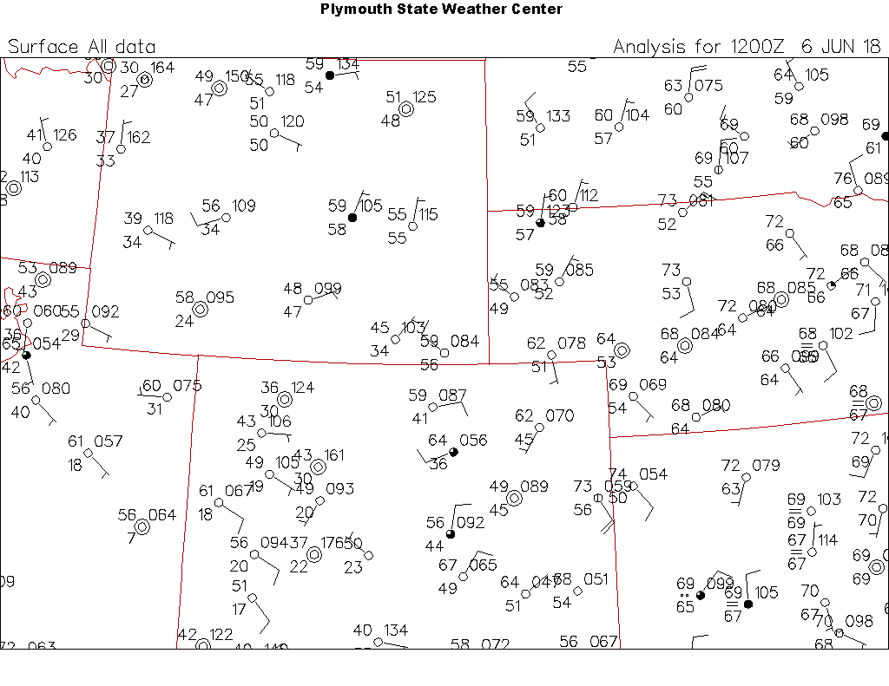
12z Surface Plot.
Do a rough analysis
Hint: Look for fronts lows and moisture.

Slide 7
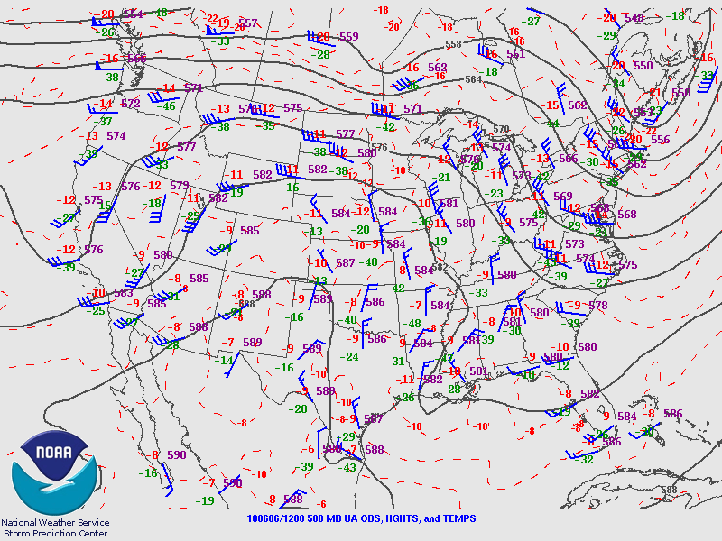
500 mb 12z Plots

Slide 8
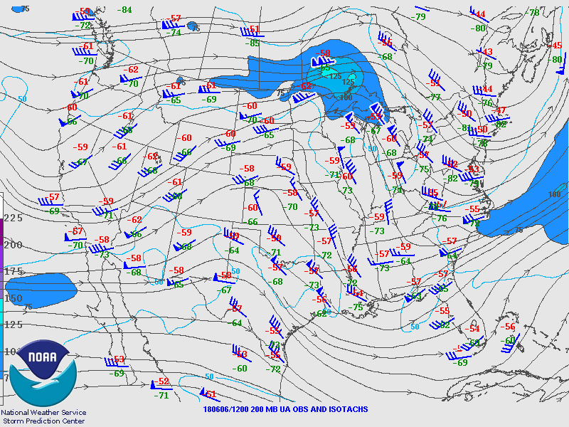
200 mb 12z Plots

Slide 9
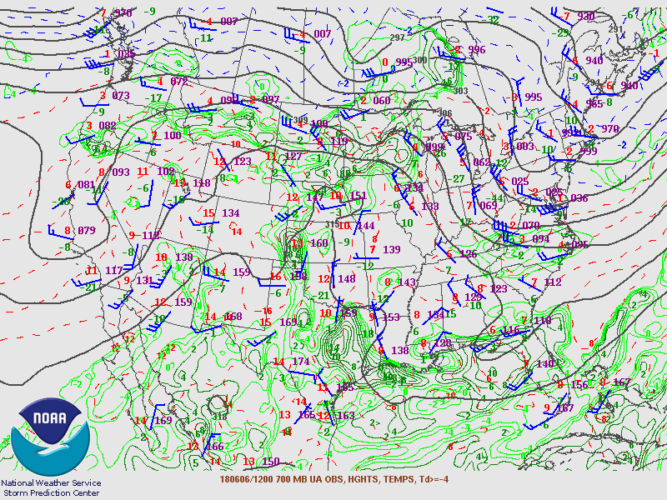

Slide 10
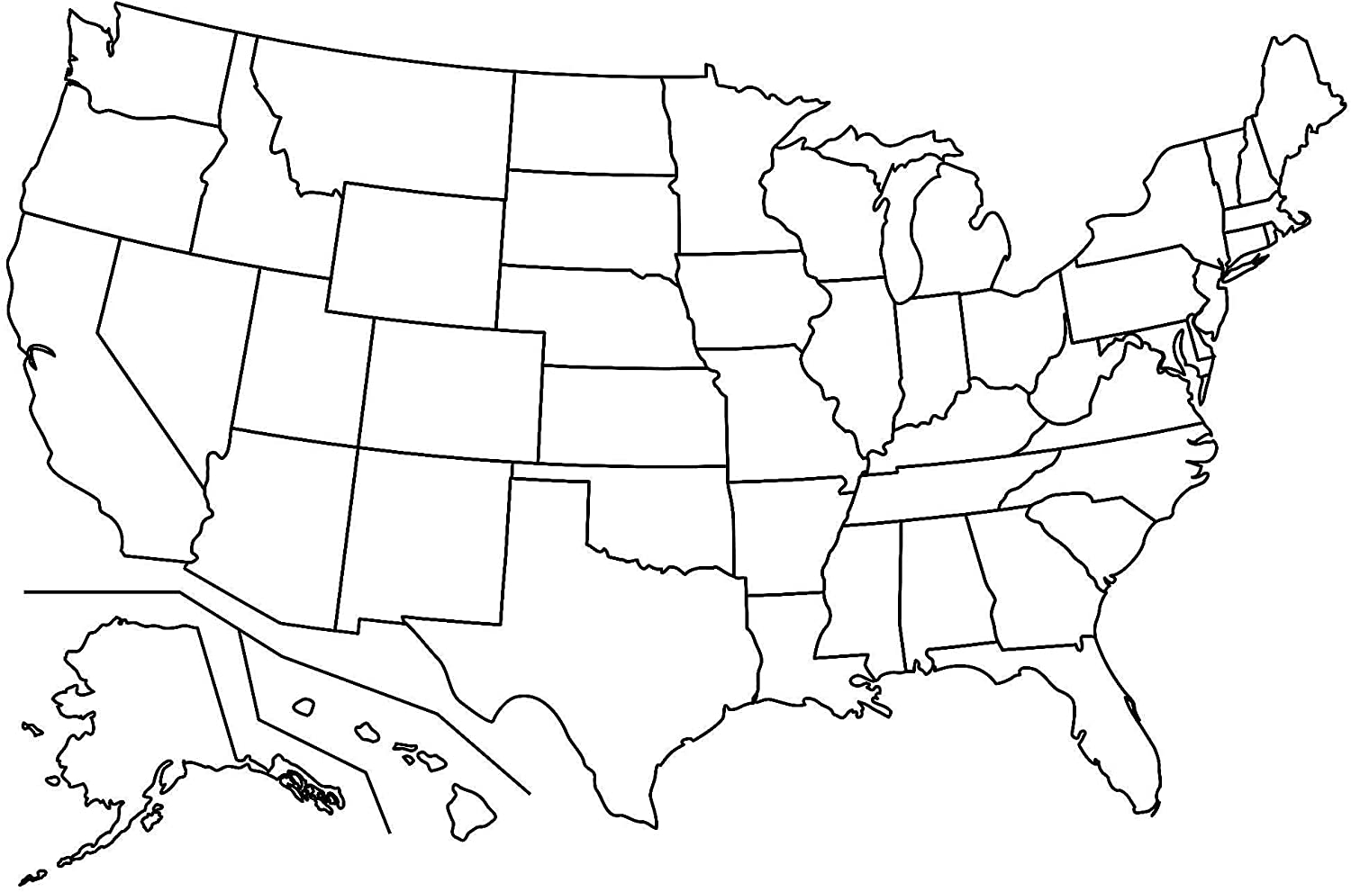
12z Observed Soundings

Slide 11
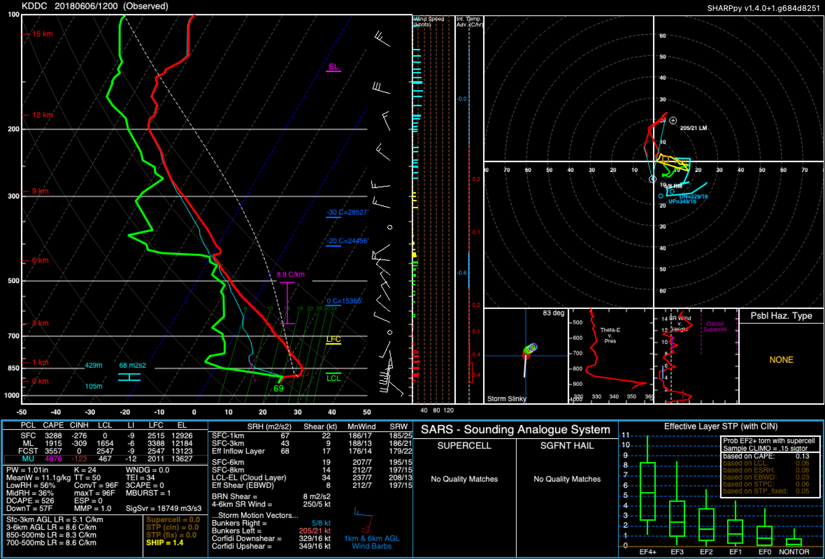

Slide 12
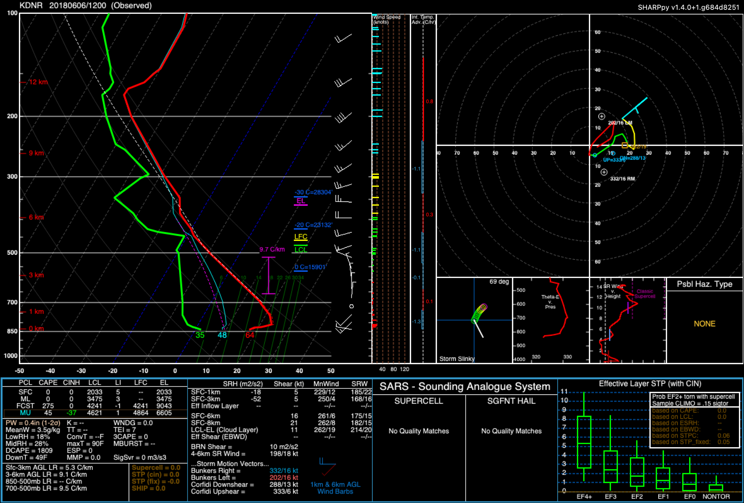

Slide 13
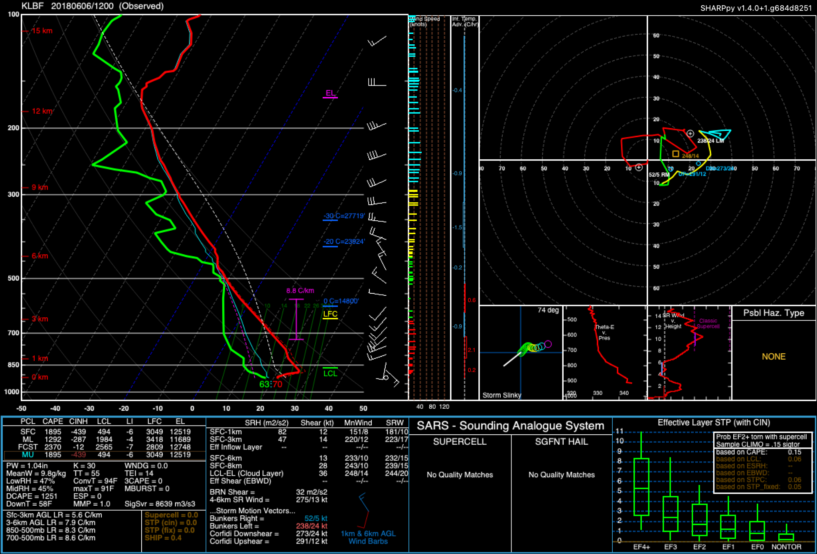

Slide 14
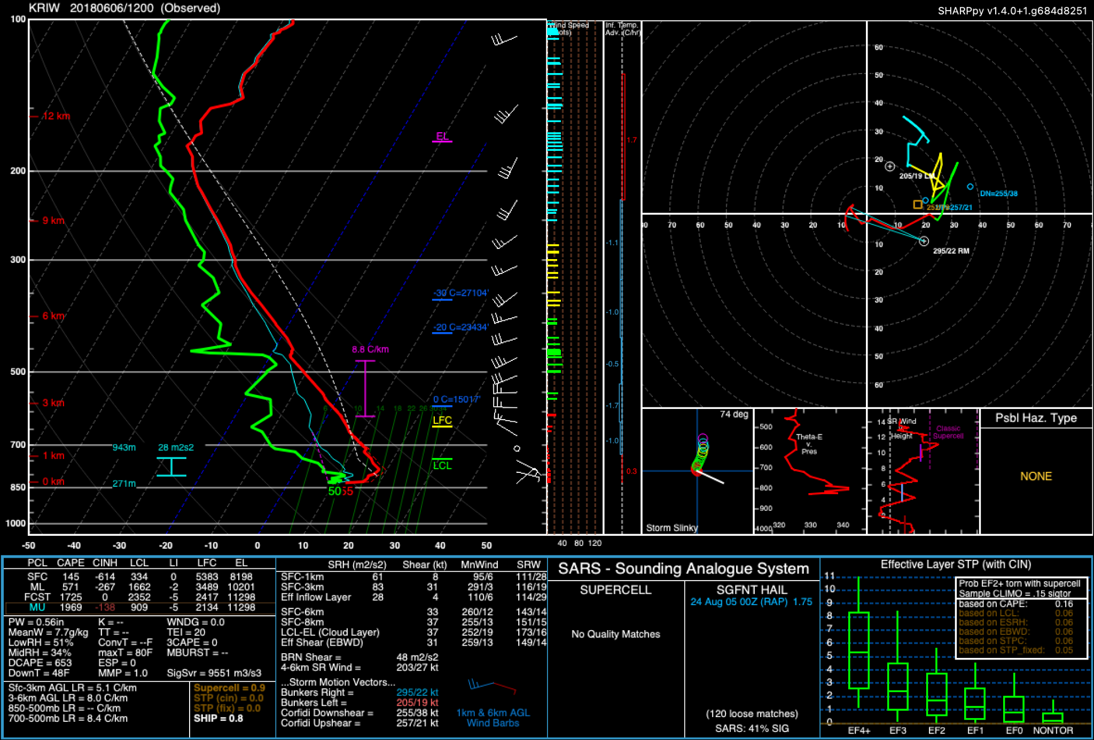

Slide 15
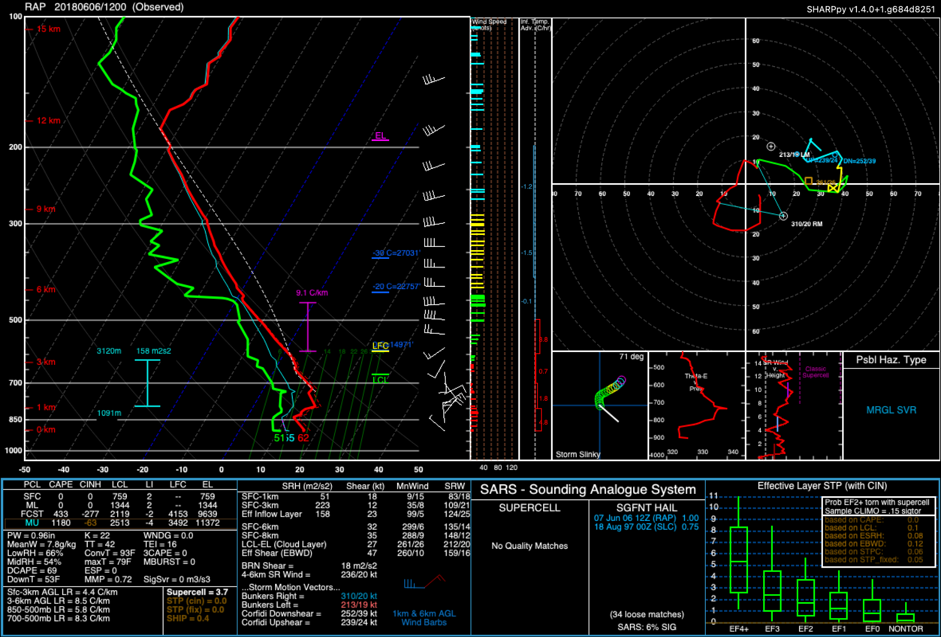

Slide 16
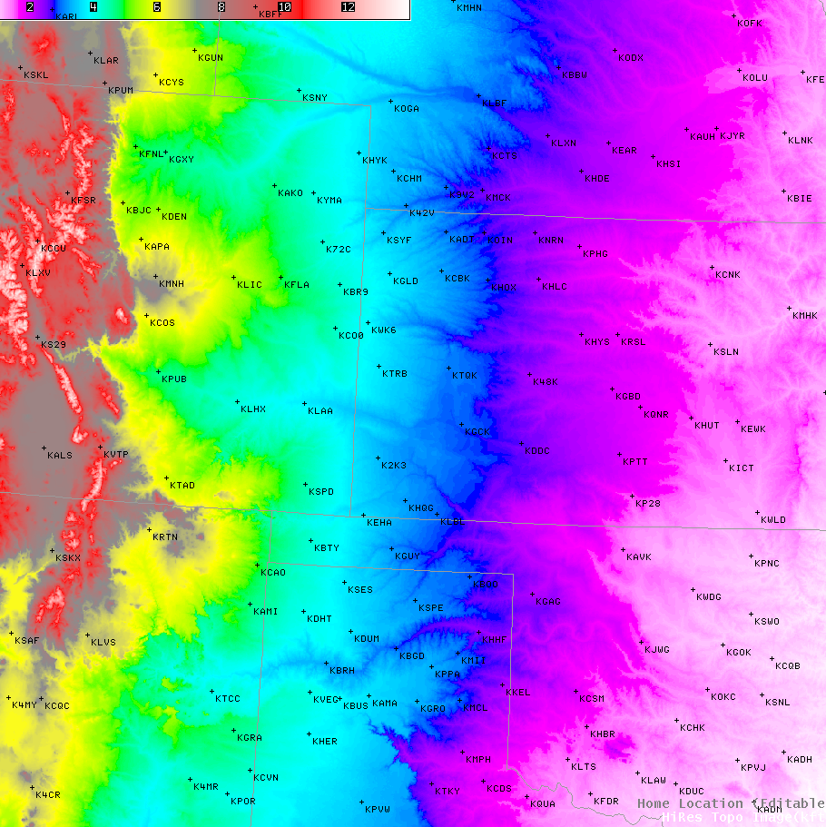
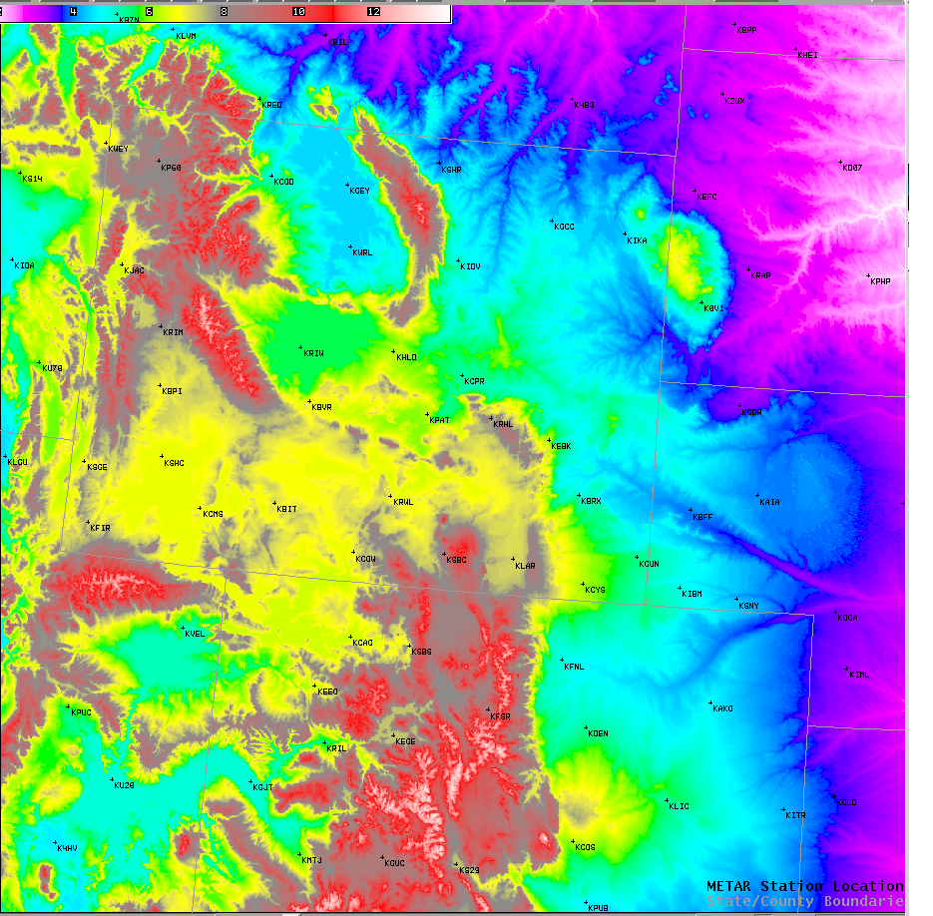

Slide 17
STOP!

Slide 18
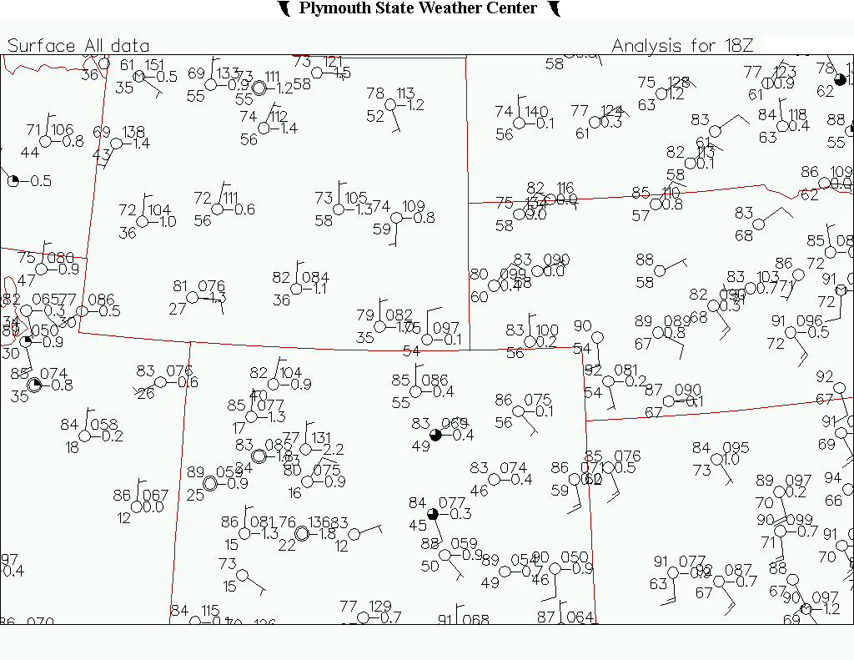
18z Surface Grab some colored pencils!
Do a rough surface analysis 6 hours later.
What surface features can you identify?
Think ingredients including upper air.
What do you have and where?

Slide 19
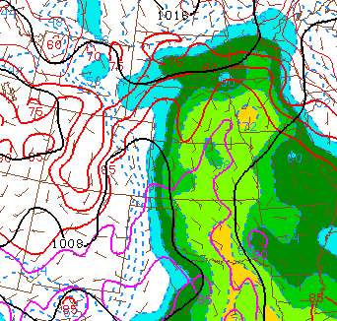
Could you identify all the relevant surface features? The WF and DL?
Do you see triggers for convection?
How will the triggers move over the next few hours?
Where do you think the greatest threat area is?
L

Slide 20
Pick some model data to review
HRRR/RAP Plots
Surface Plots
500 & 700 mb Winds
SBCAPE & Effective Shear
ESRH & Supercell Composite param
HREF UH Tracks
Buffkit RAP Soundings for selected Airports
KCYS (Cheyenne, WY)
KLAR (Laramie, WY)
KDEN (Denver, CO)
KAKO (Akron, CO)
KBFF (Scottsbluff, NE)
KRAP (Rapid City, SD)
KGLD (Goodland, KS)
KSHR (Sheridan, WY)

Slide 21
Model Sounding Locations
LAR
CYS
DEN

Slide 22
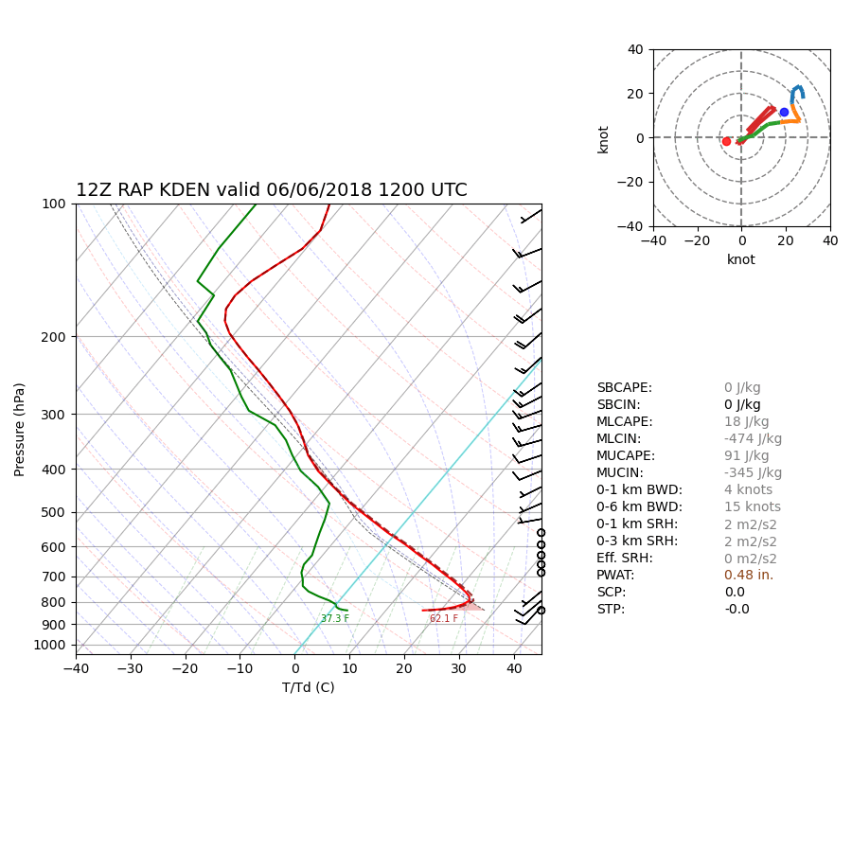

Slide 23
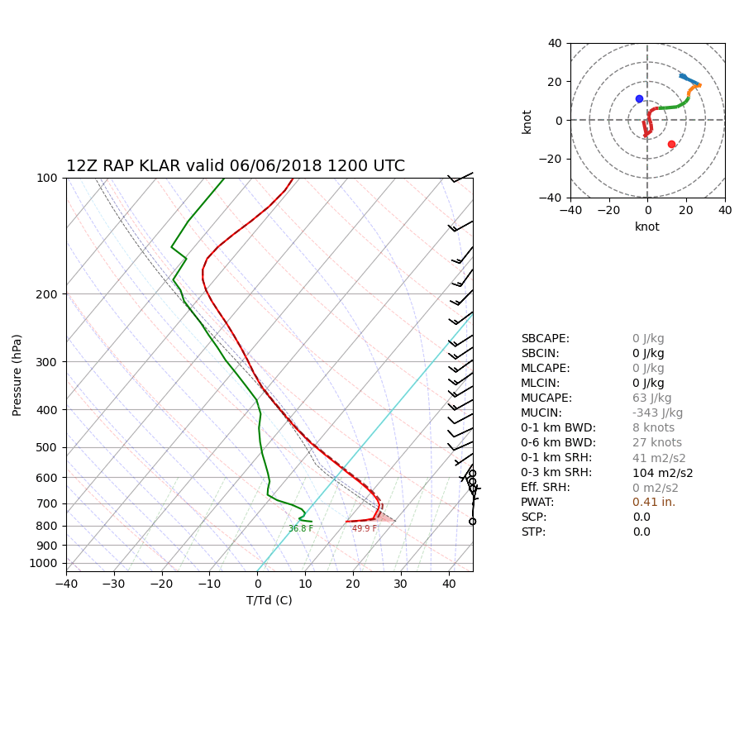

Slide 24
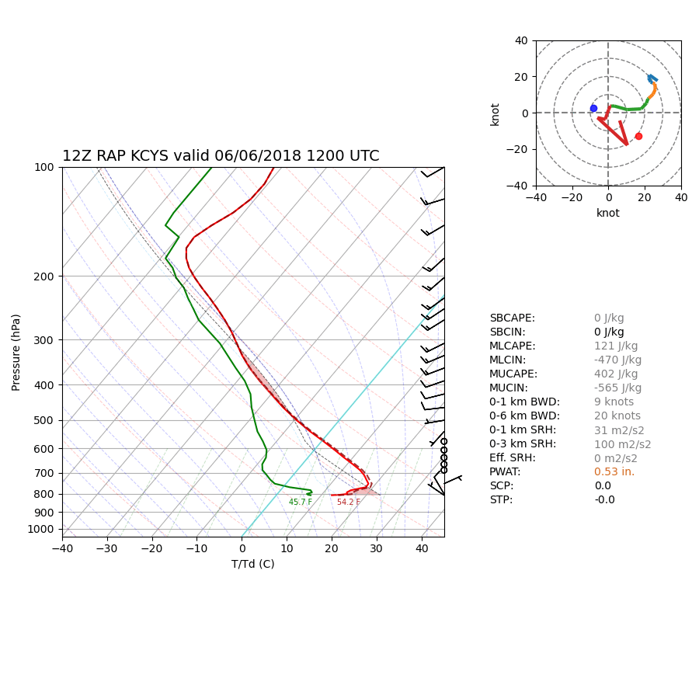

Slide 25
HRRR
Surface Plot

Slide 26
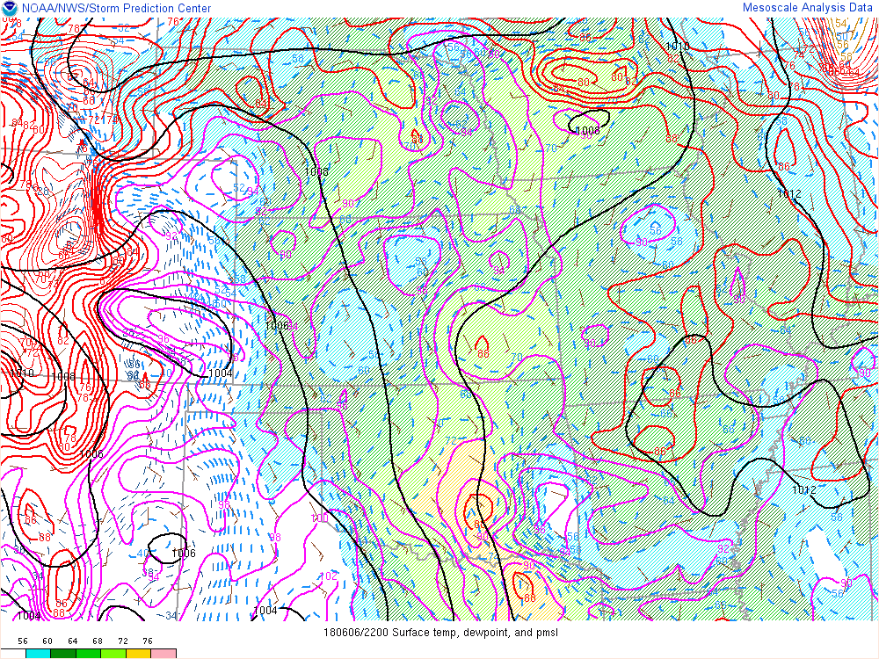
22z

Slide 27
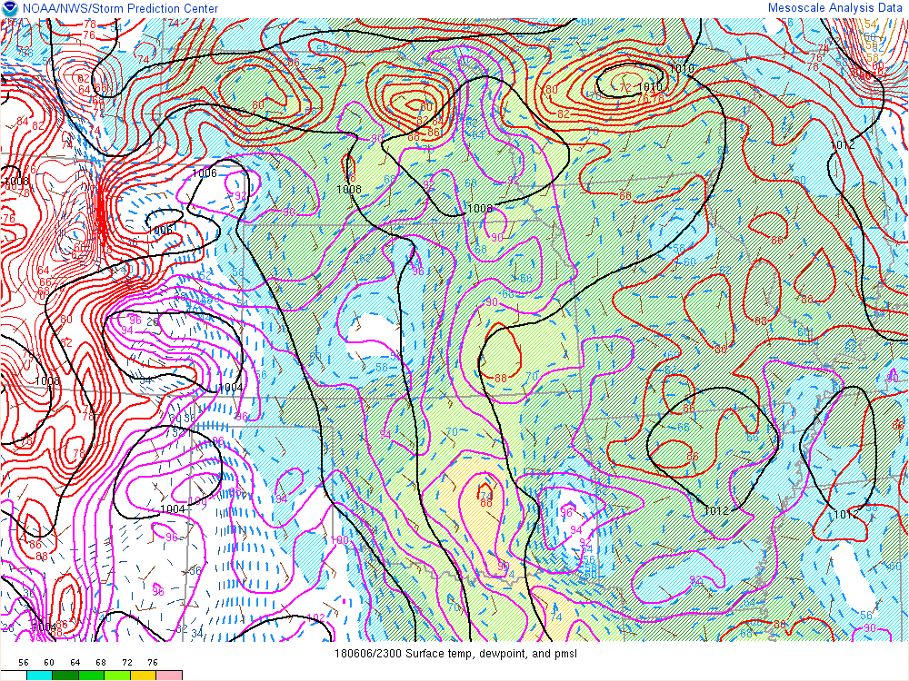
23z

Slide 28
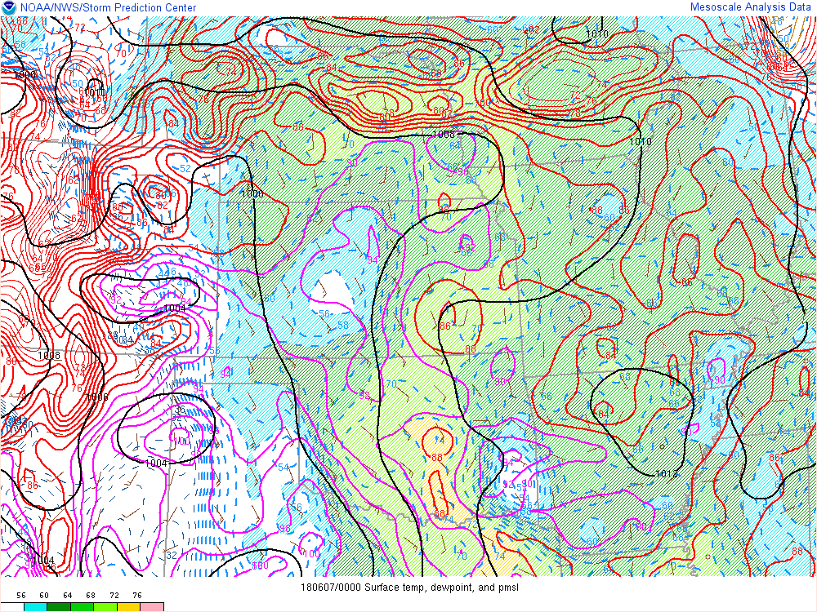
00z

Slide 29
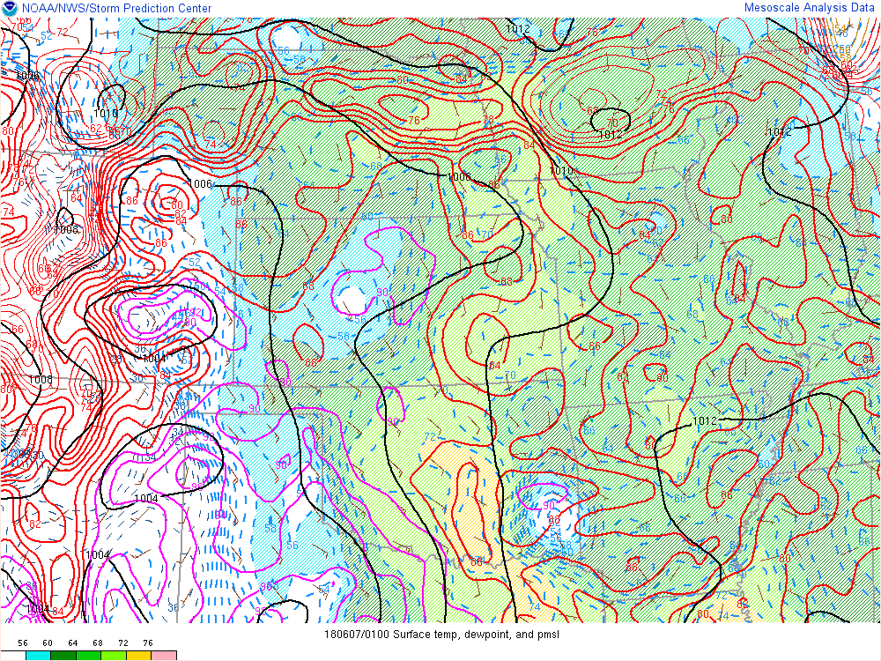
01z

Slide 30
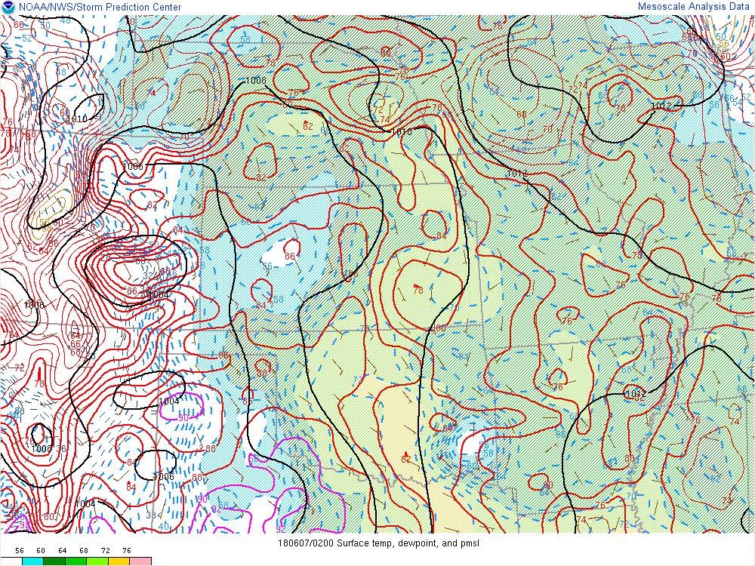
02z

Slide 31
HRRR
500 MB

Slide 32
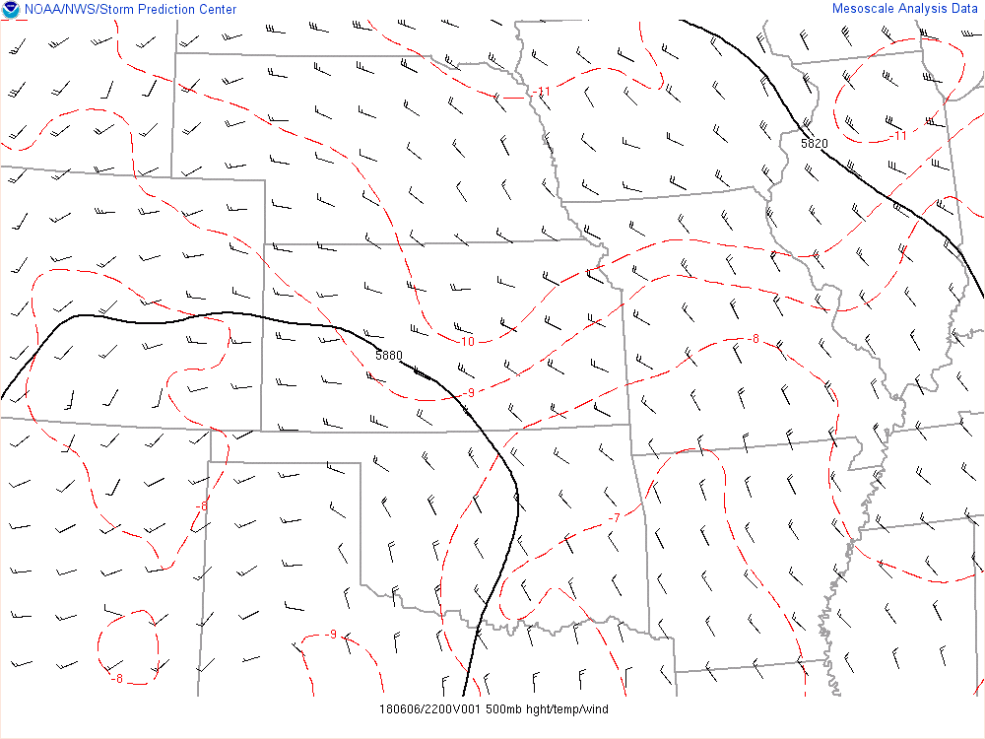
22z

Slide 33
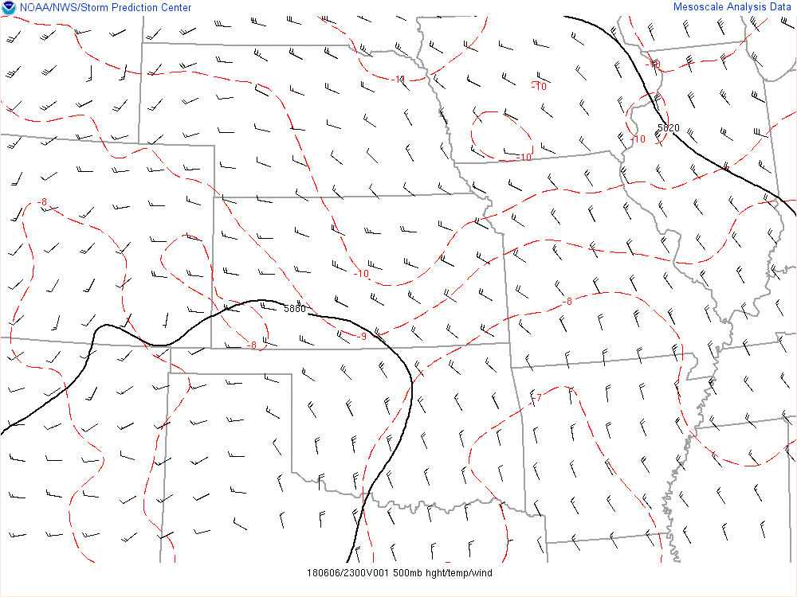
23z

Slide 34
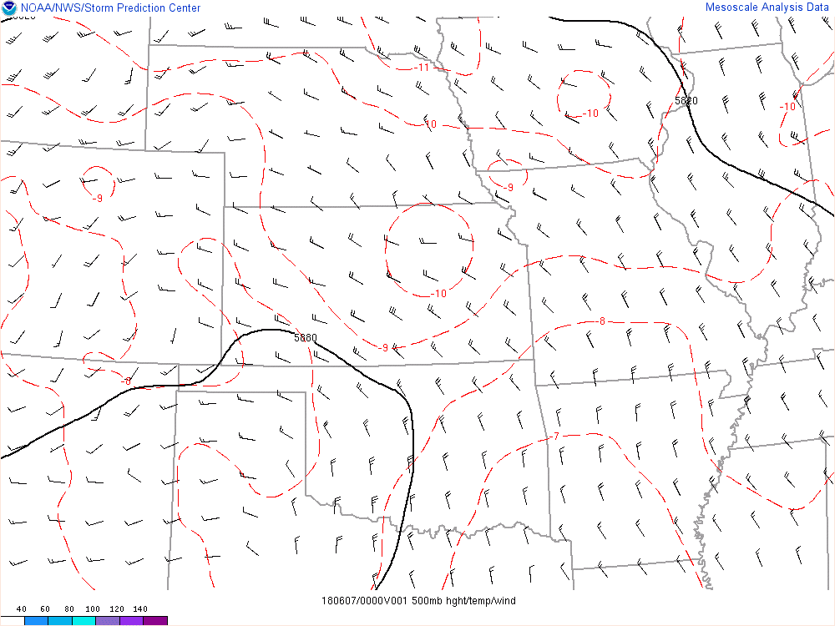
00z

Slide 35
01z

Slide 36
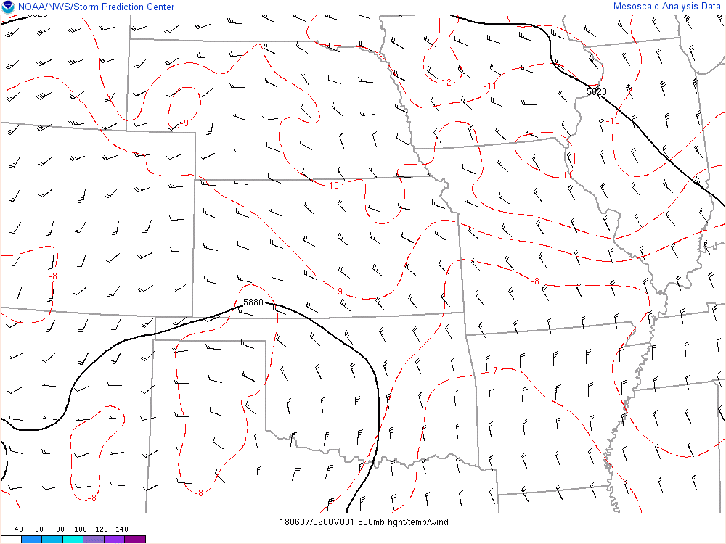
02z

Slide 37
HRRR
700 MB

Slide 38
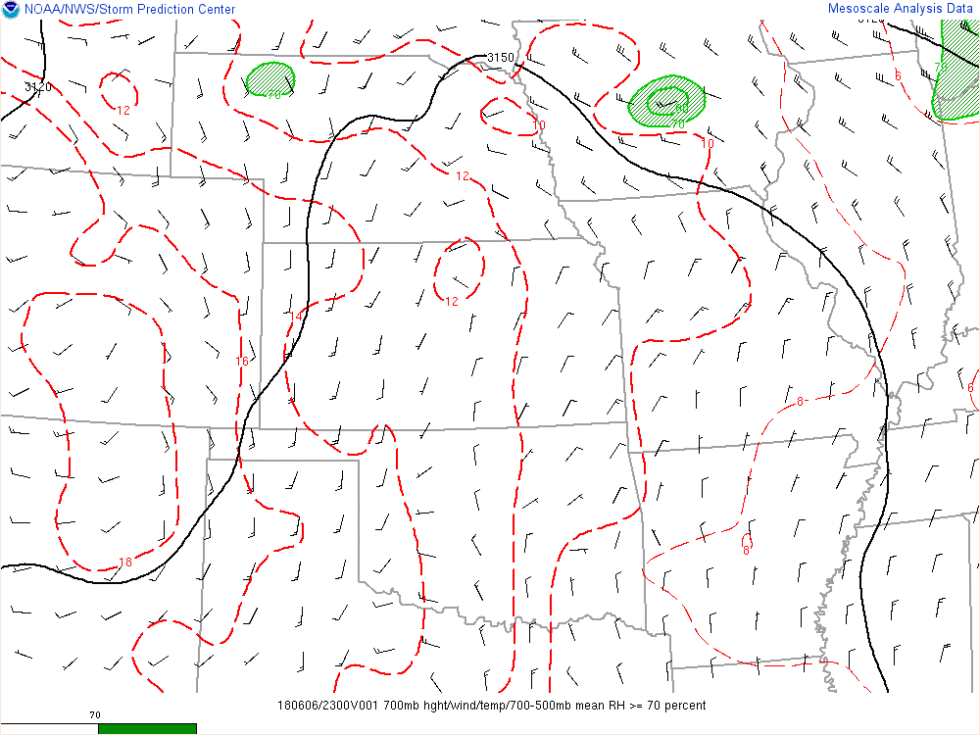
23z

Slide 39
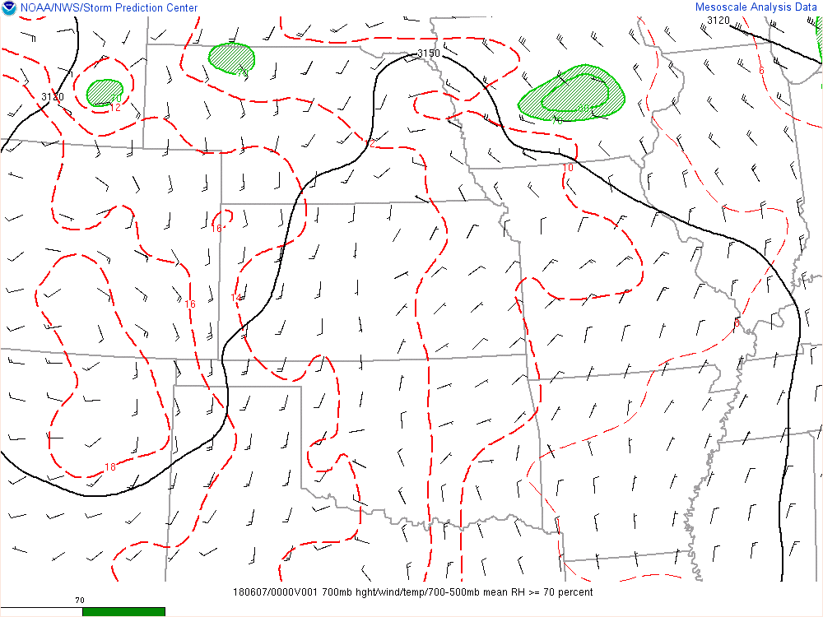
00z

Slide 40
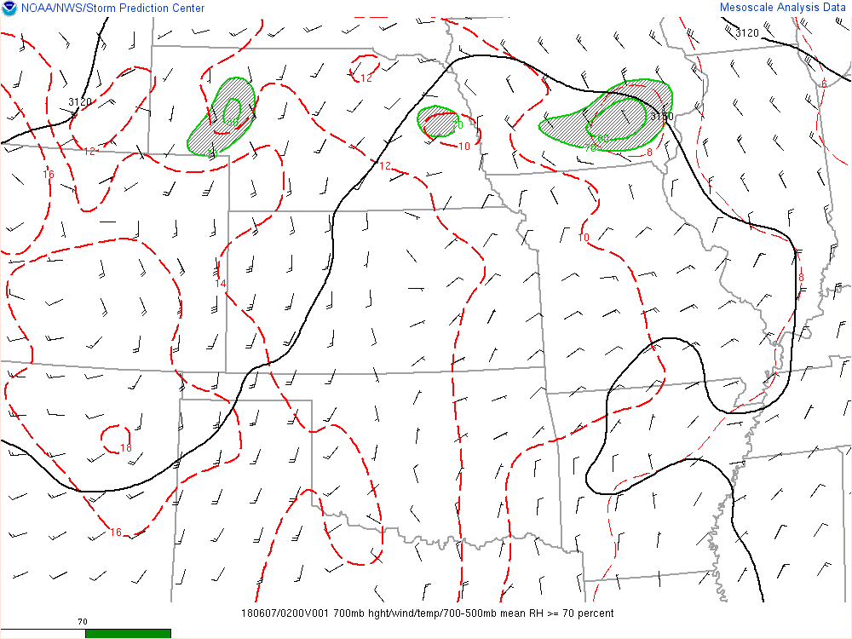
02z

Slide 41
HRRR
Surface CAPE

Slide 42
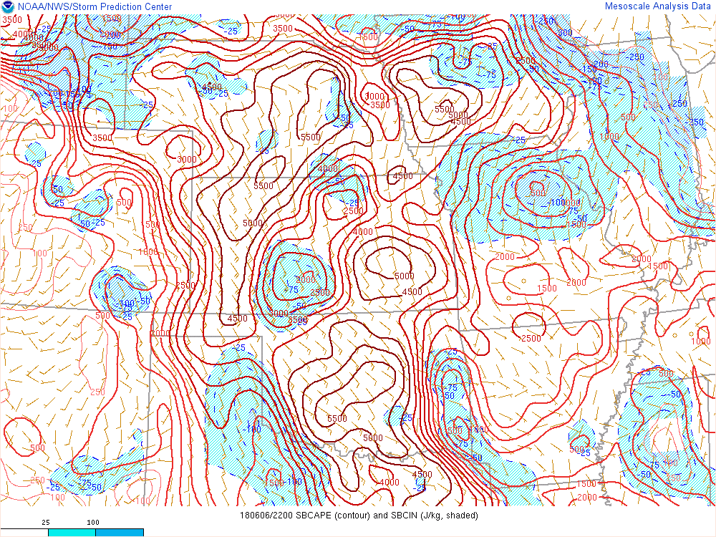
22z

Slide 43
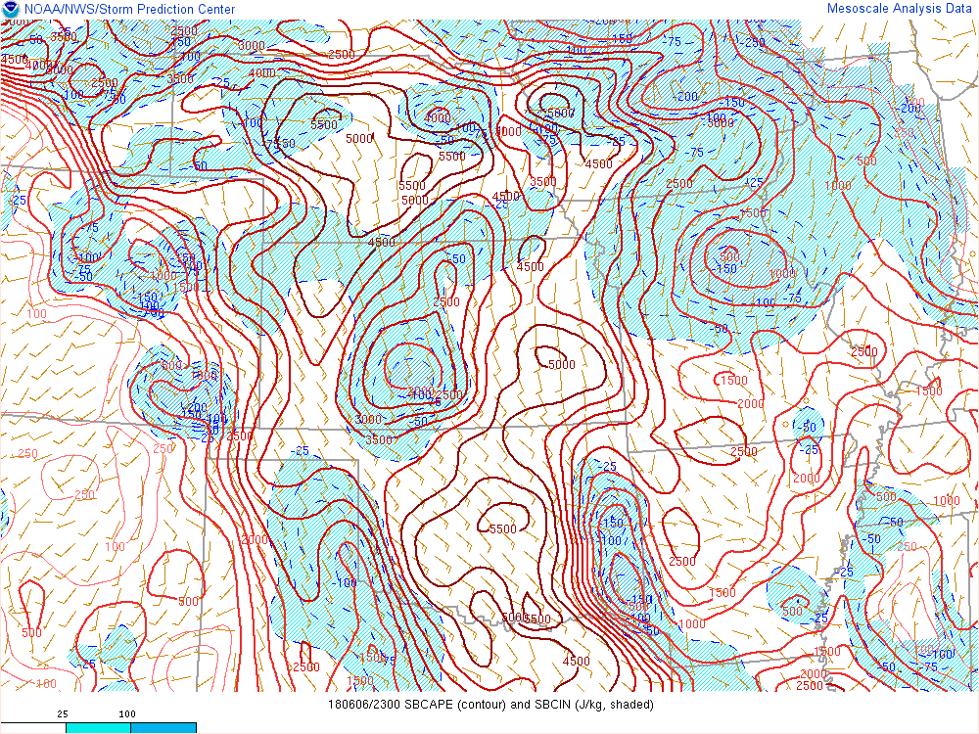
23z

Slide 44
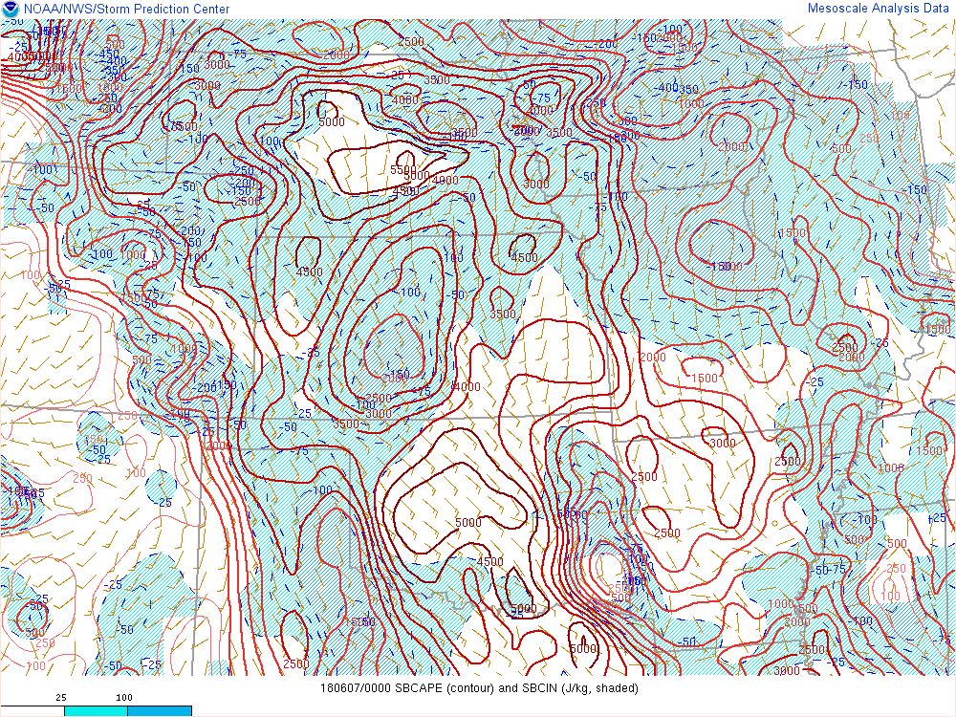
00z

Slide 45
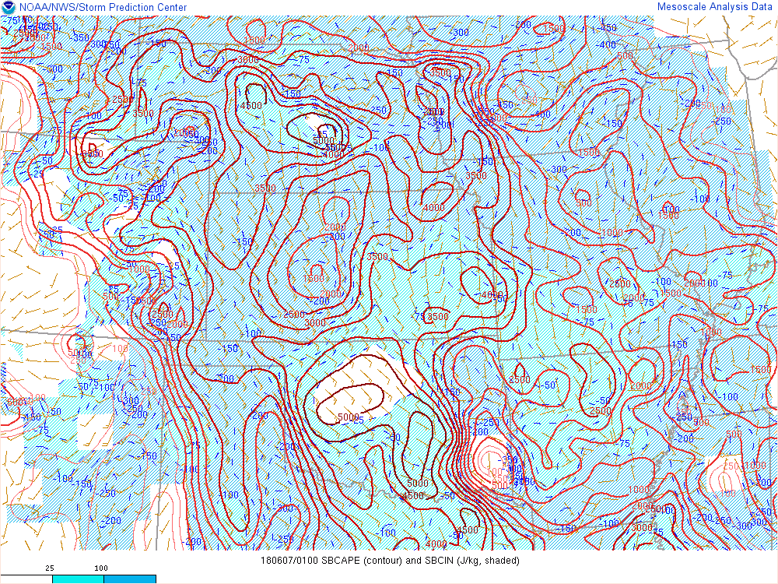
01z

Slide 46
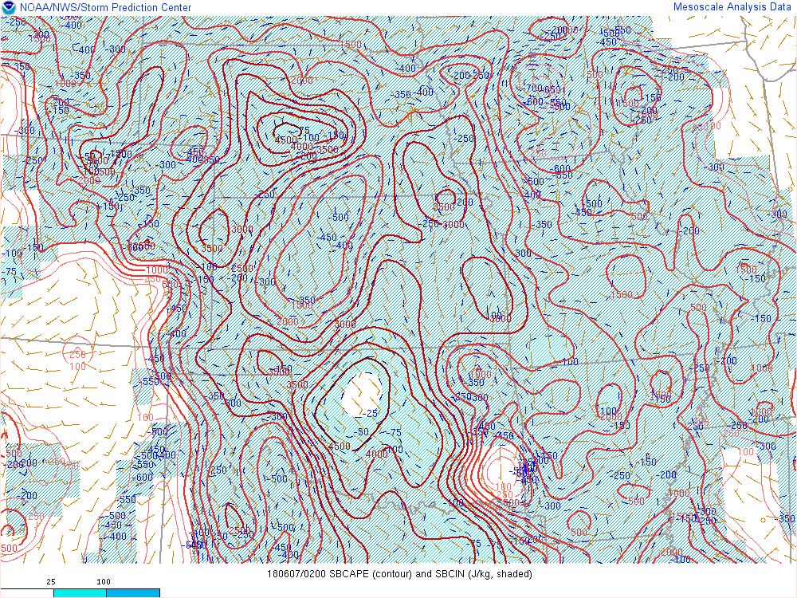
02z

Slide 47
HRRR
Effective Bulk Shear

Slide 48
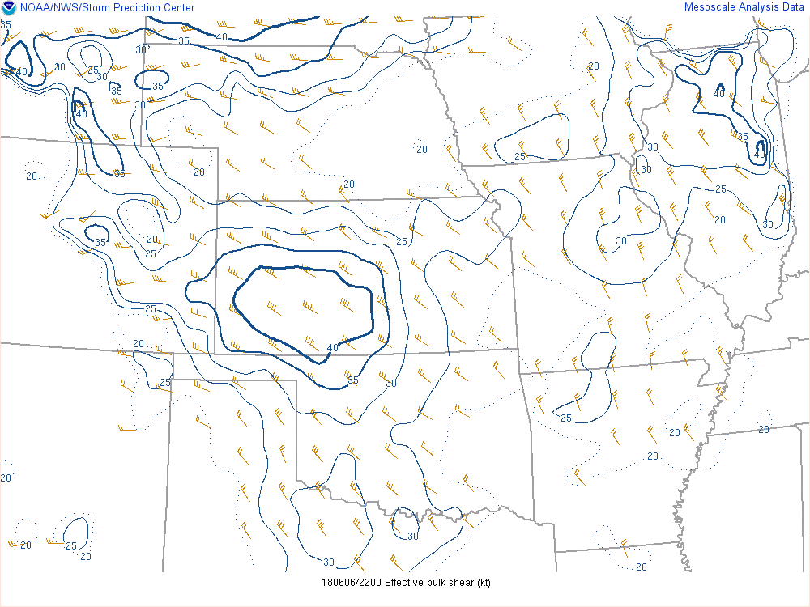
22z

Slide 49
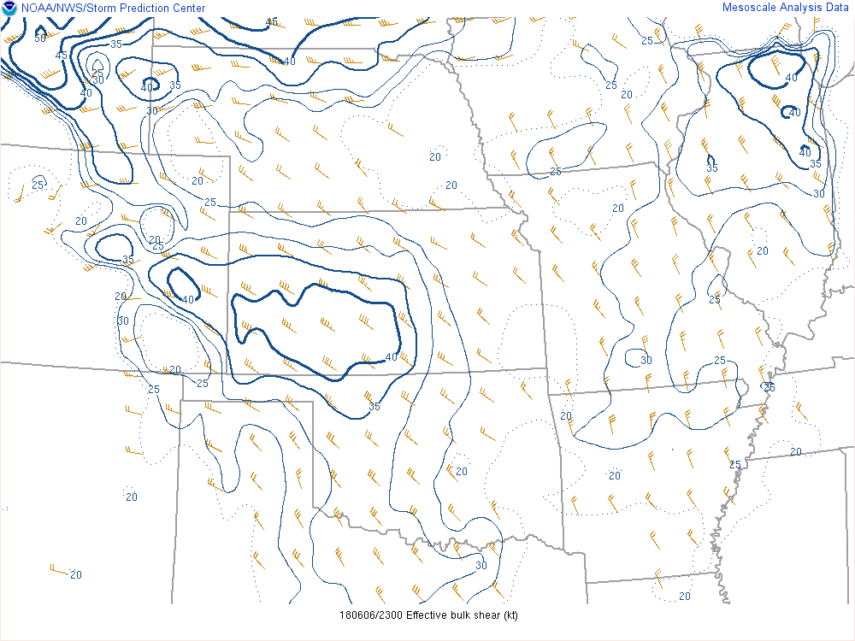
23z

Slide 50
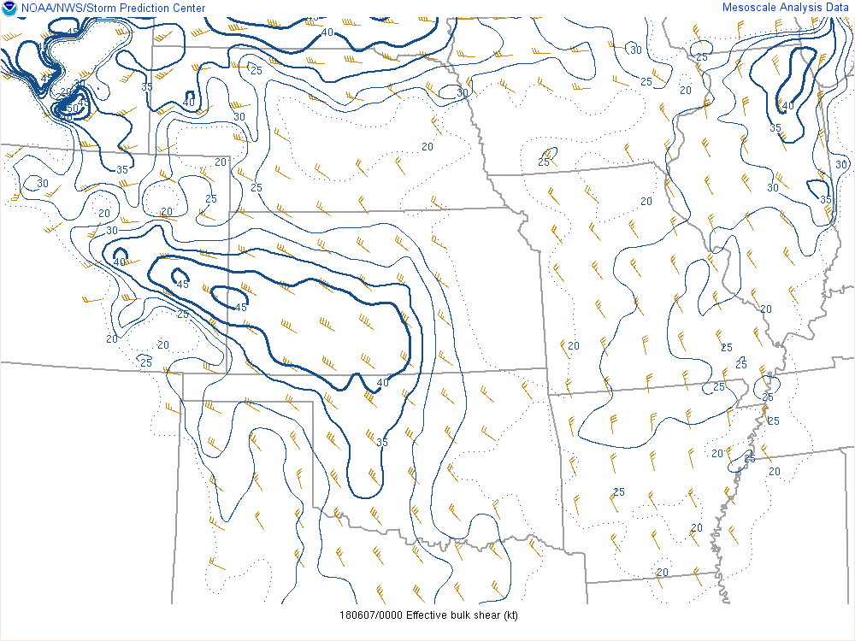
00z

Slide 51
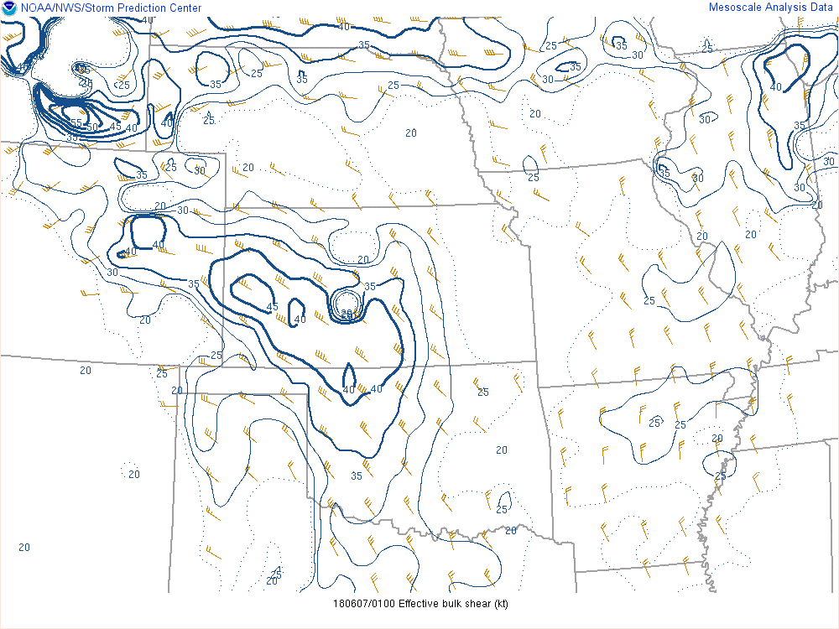
01z

Slide 52
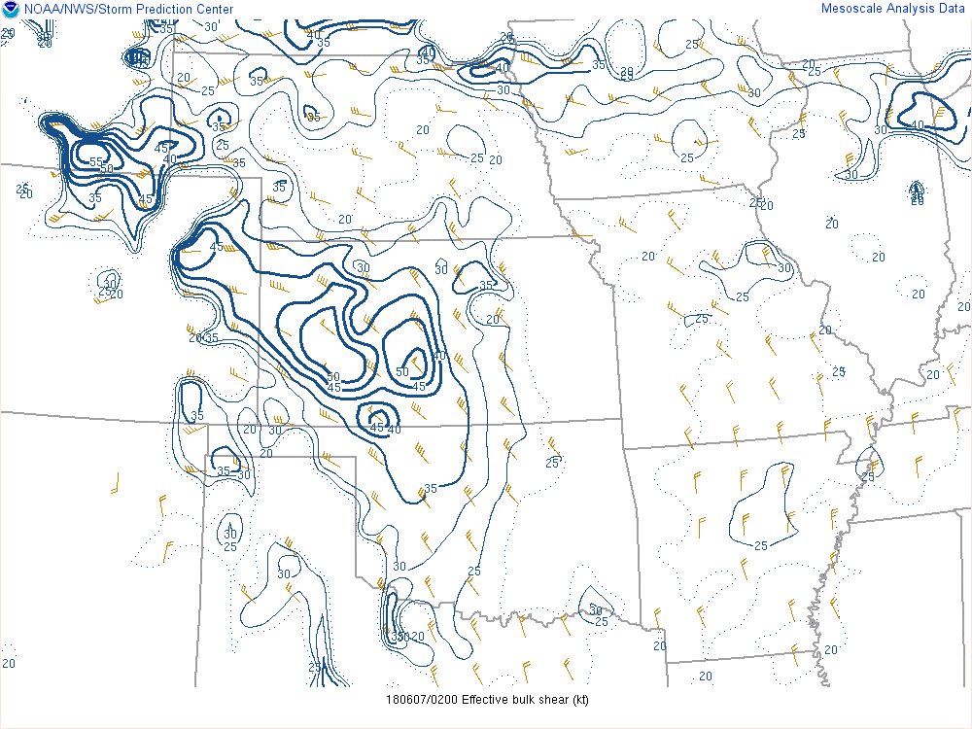
02z

Slide 53
HRRR
Effective Inflow Storm Relative Helicity

Slide 54
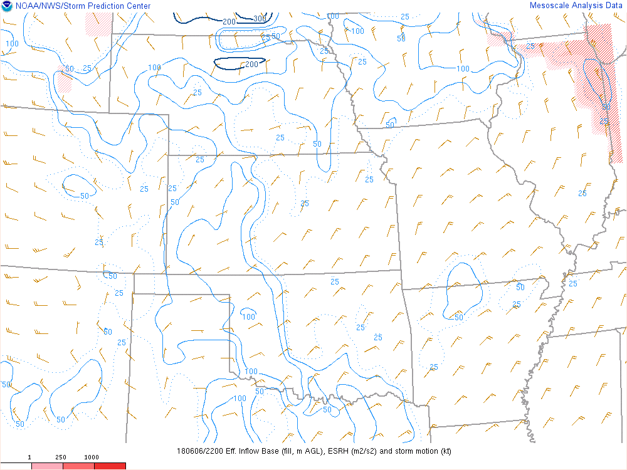
22Z

Slide 55
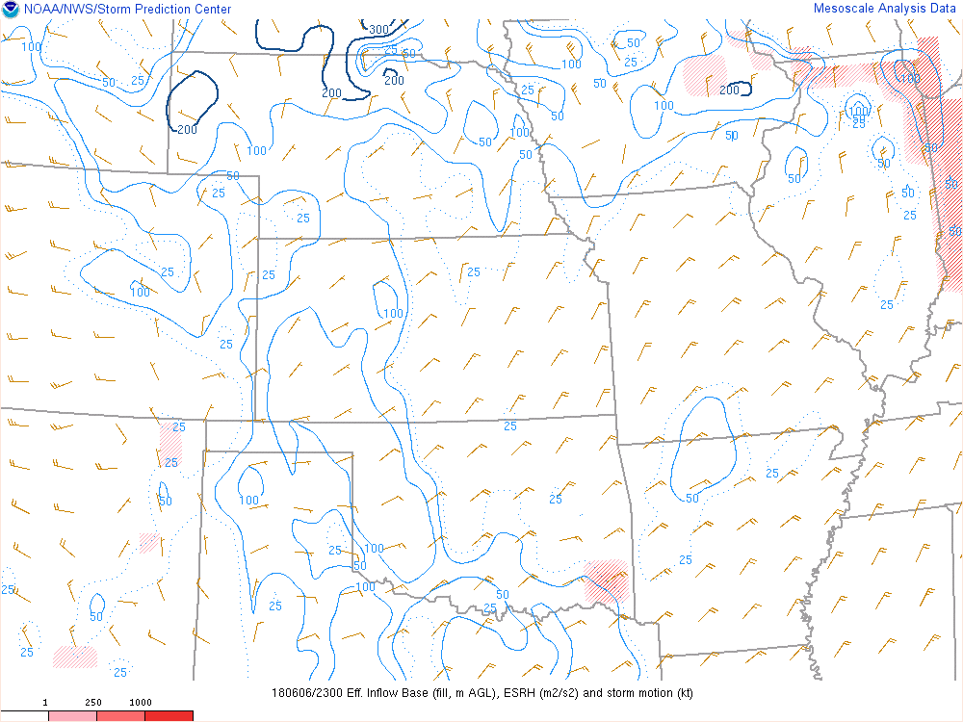
23Z

Slide 56
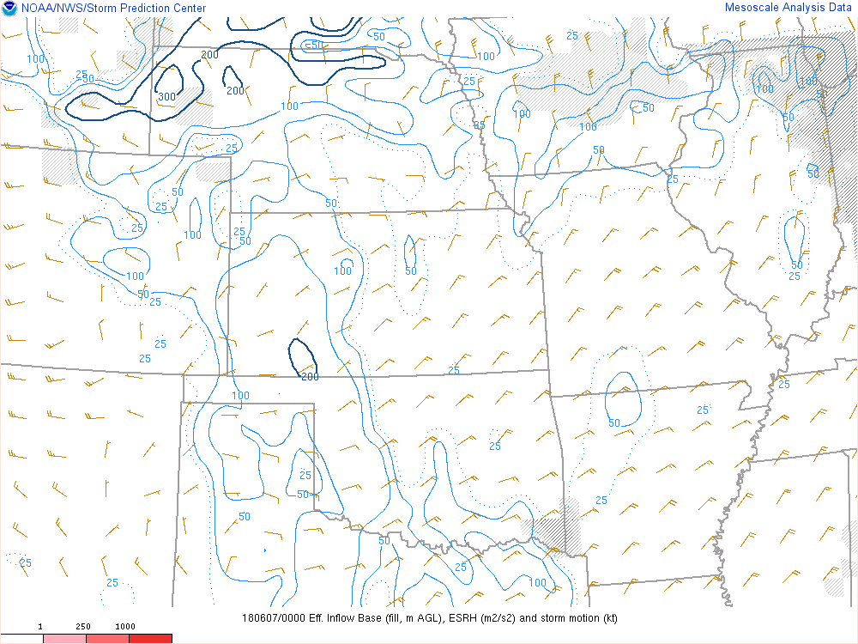
00Z

Slide 57
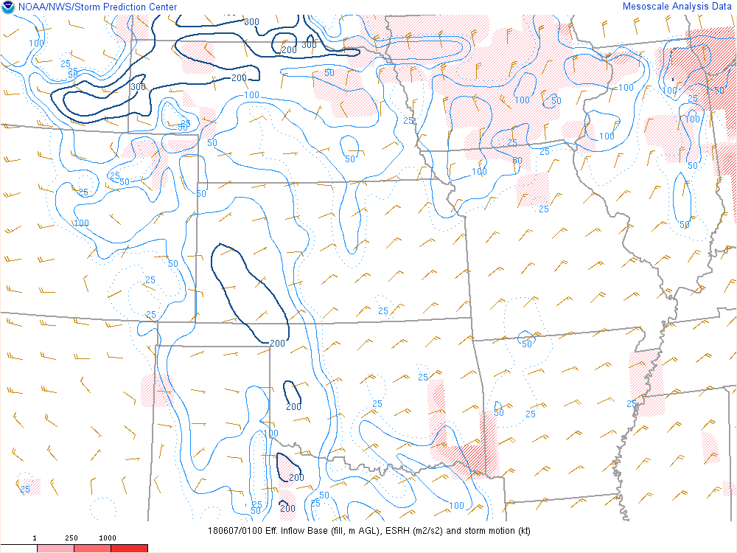
01Z

Slide 58
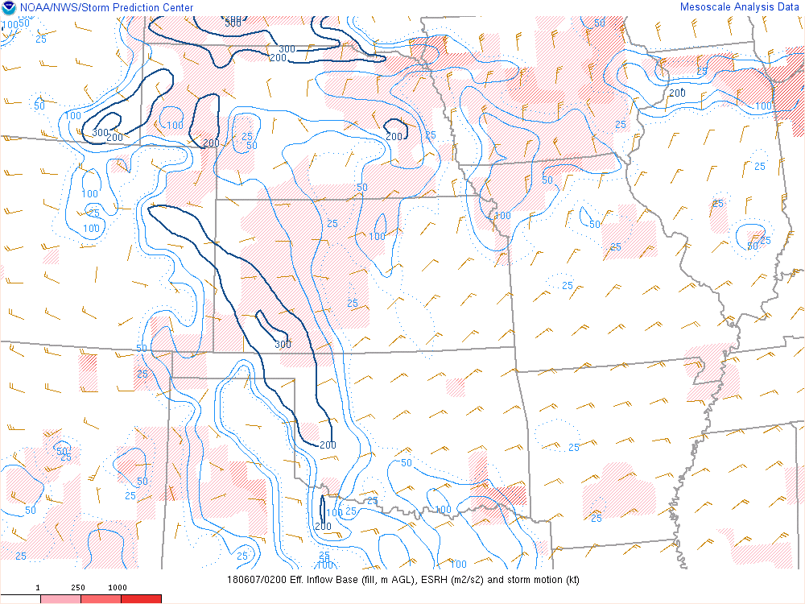
02Z

Slide 59
HRRR
Supercell Composite Parameter

Slide 60
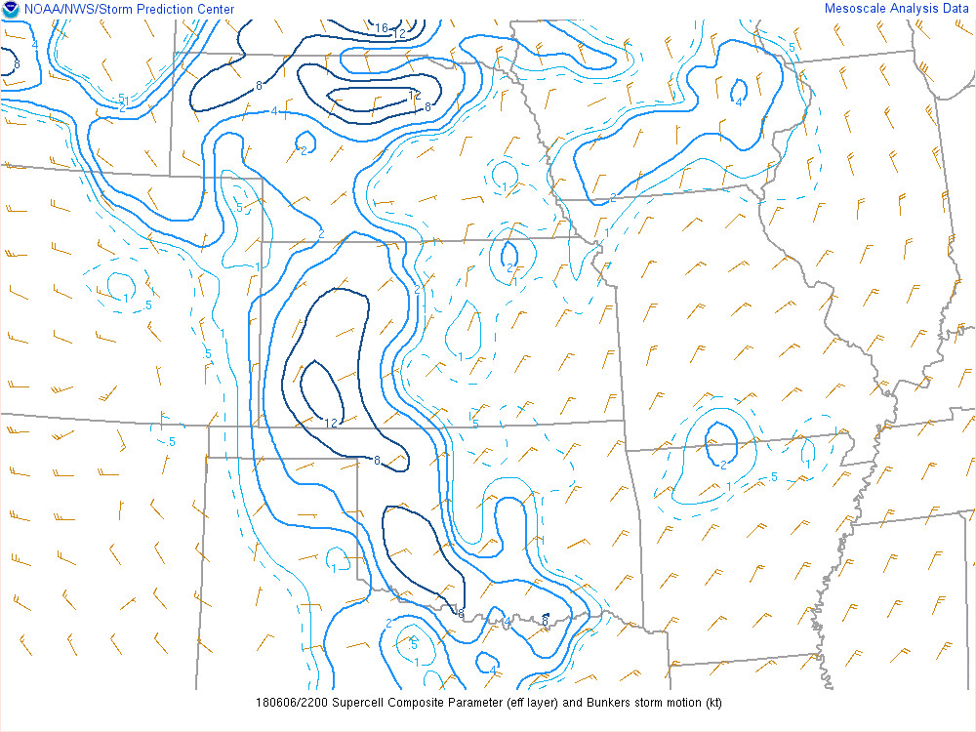
22Z

Slide 61
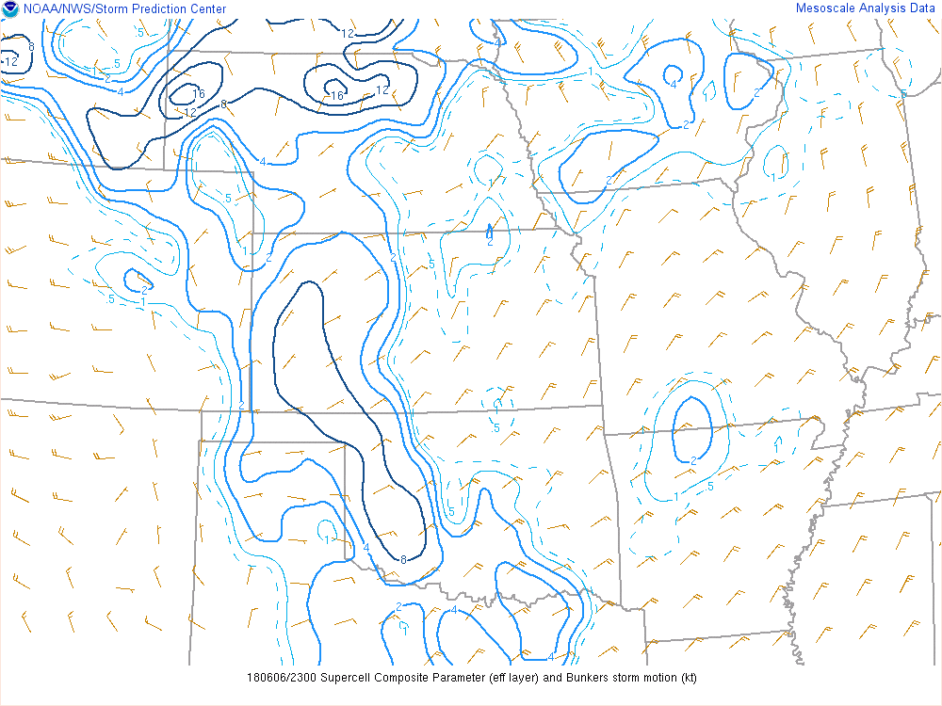
23Z

Slide 62
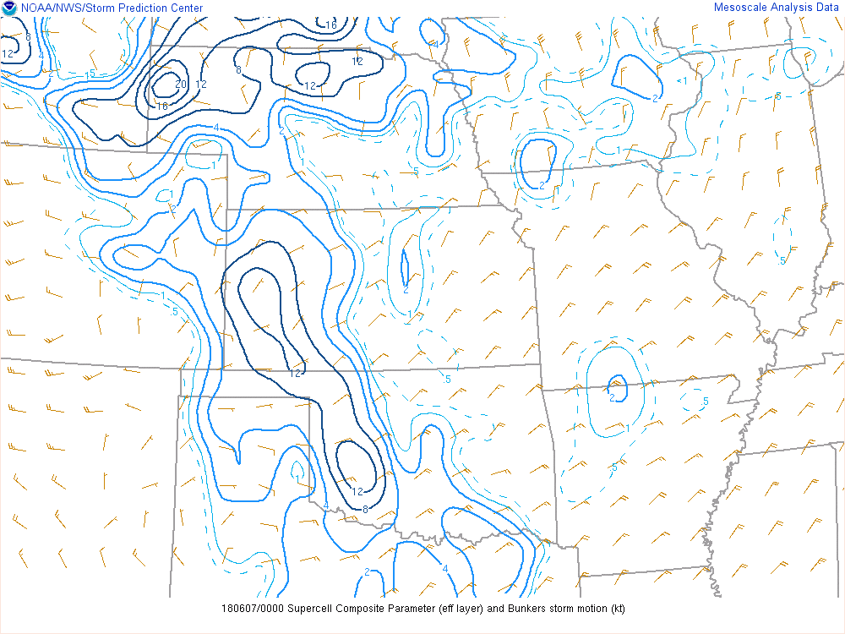
00Z

Slide 63
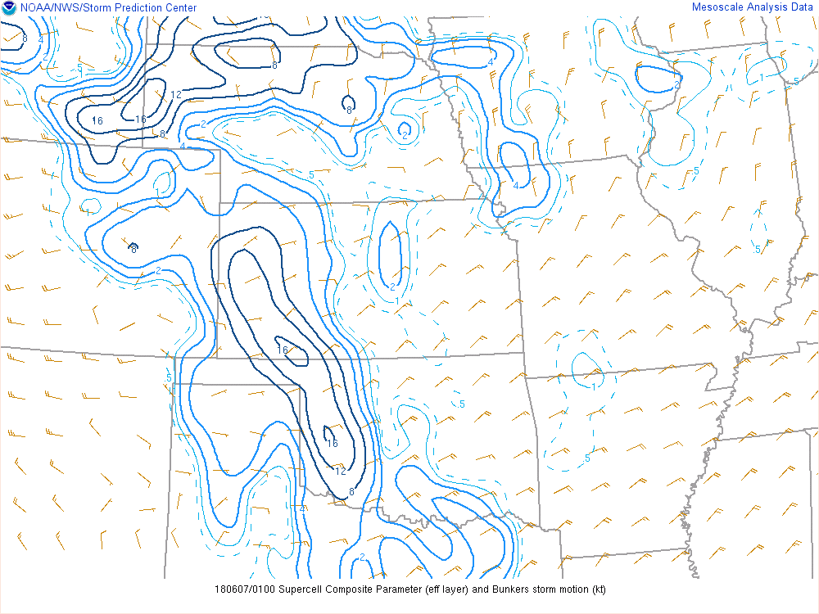
01Z

Slide 64
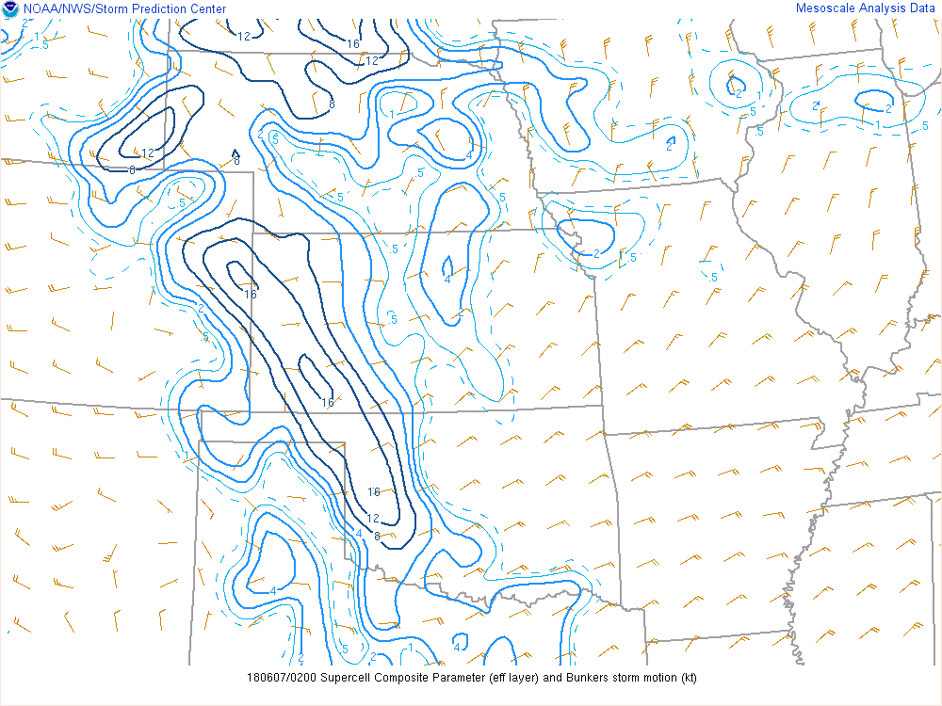
02Z

Slide 65
HREF
UH Tracks

Slide 66
24 Hour Max
00Z Run

Slide 67
24 Hour Max
12z Run

Slide 68
HREF WRF-ARW Simulated Reflectivity valid 2300z

Slide 69
HREF WRF-NSSL Simulated Reflectivity valid 2300z

Slide 70
STOP!

Slide 71
Evaluation
Do you think storms will form?
Where are you focused on convective potential?
Where are the models putting storms?
Does this jive with what you were thinking?
What kind of environment is available if storms form? Good? bad?
Come up with a list of hazards by probability
Tornado %?
Large Hail %?
Wind %?
What's your reasoning?

Slide 72
Outlook Time
Do you agree with the previous Outlook?
Location?
Threats?
Timing?
Impacts?
Why or Why not?
What would you focus on or look at?
Draw your own 1630z outlook

Slide 74
Watch Decision
Do you think you need a watch?
Location?
Threats?
Timing?
Impacts?
Why or Why not?
What would you focus on or look at?

Slide 87
So What Happened?

Slide 88
Watch 4:30 PM 22:30 UTC

