Slide 1


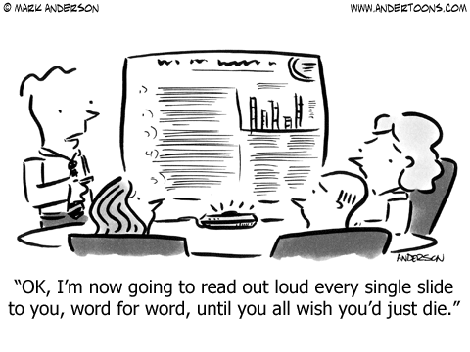
How to Give a Memorable Talk
Greg McFarquhar
Cooperative Institute for Severe and High Impact Weather Research and Operations
School of Meteorology
19 April 2018

Slide 2
Advice for Giving Memorable Talk
Never prepare your talk
  Spontaneous is better
  You can always read of your slides
  Better to spend time doing more research
  Don’t worry about questions you might get: You are smart, you can handle them

Slide 3
Advice for Giving Memorable Talk
Never prepare your talk
  Spontaneous is better
  You can always read of your slides
  Better to spend time doing more research
  Don’t worry about questions you might get: You are smart, you can handle them
Cram all information from your research into your talk
  It’s an educated audience and they can keep up
  They are smart: they will understand the details
  Don’t waste time explaining the basics
    That would insult your audience & waste time
  They will know what you are doing and why

Slide 4
Advice for Giving Memorable Talk
Always go over your allotted time
  Shows that you have done a lot of work
  If you’re not last, your work is more important than those following you
  Everyone wants to know all the details of what you did
  Going over time saves you from potential questions
  Breaks are added into schedule to accommodate talk over runs

Slide 5
Advice for Giving Memorable Talk
Always go over your allotted time
  Shows that you have done a lot of work
  If you’re not last, your work is more important than those following you
  Everyone wants to know all the details of what you did
  Going over time saves you from potential questions
  Breaks are added into schedule to accommodate talk over runs
Prepare many viewgraphs with small type
  That way you get more information in each slide
  The more lines, colors & symbols the better
  Don’t worry about the point you want to make
    Someone in audience will figure it out
  Need lots of slides to show you did a lot of work
  If audience understands every point on each slide, they will think you are stupid and that you have not accomplished very much

Slide 6
Advice for Giving Memorable Talk
Add a put-down to answer of every question
  If someone dares to question your work, they deserve to be publicly criticized: they must be idiots so should be ridiculed
  Prepare a list of “one-line insults” in advance
  Fly off the handle if need be
  Remember, intimidation always wins!

Slide 7
Alternate Strategies
Why talks are important
What to present
How to prepare
How to handle the dreaded day
Questions and Answers

Slide 8
Importance of presentations
Communicates ideas
“Show off” what you are doing
Helps you get/keep a job
Get feedback on what you are doing
Networking/funding

Slide 9
Who are you talking to?
Gear your presentation to your audience
  Specialists in your field
  Colleagues in SoM/CIMMS
  Funding agents
  General public
  Undergraduate students
Choose your language accordingly

Slide 10
What to present
Tell a story
  Beginning, middle and end
Start where your audience is
  Not where you want them to be
Have an overview
  Put your story in the proper context
  Don’t overestimate the audience

Slide 11
How to start
Show title slide first (include name, affiliation & title)
Then show something attention grabbing (e.g., photos of ice crystals in clouds)
Explain what you will talk about (e.g., use of observed ice crystals to calculate cloud radiative properties)
Give an outline of your talk

Slide 12
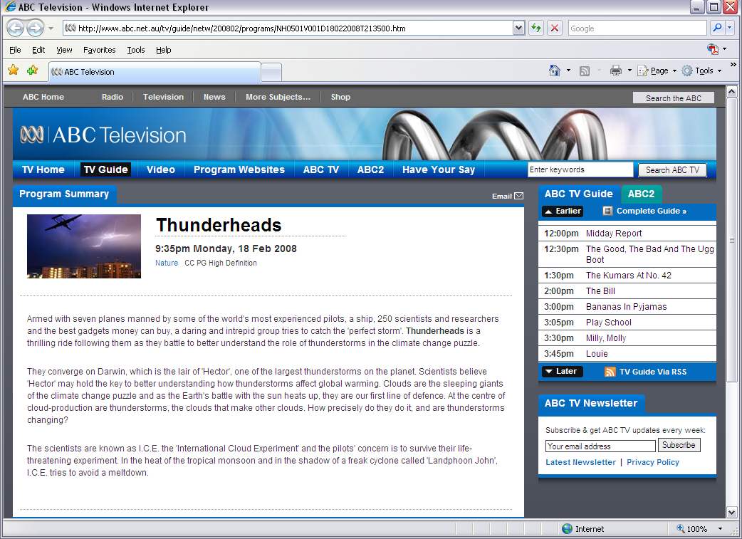

Slide 15
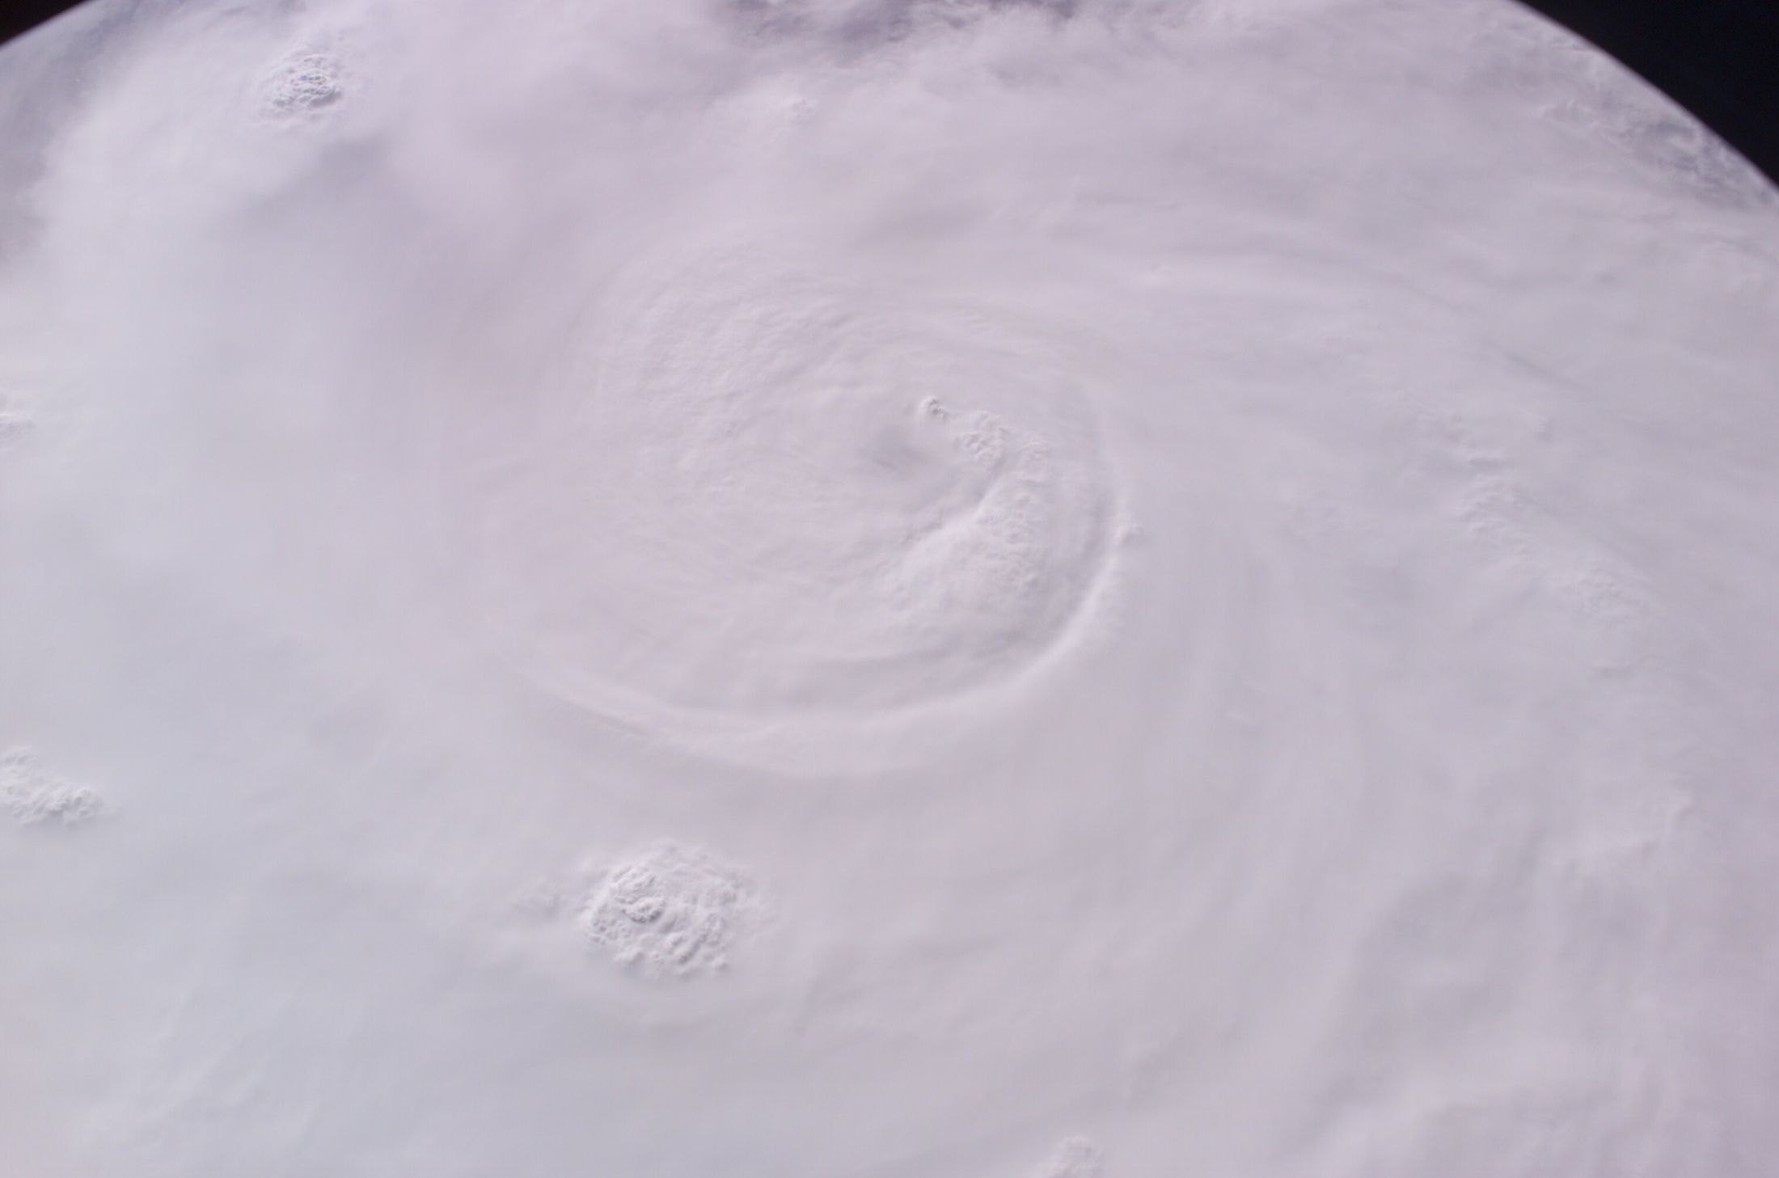
Microphysics: The Effect!
Microphysics: The effect!
On Oct. 13, 1947, the US military dropped 80 kg of dry ice into a hurricane over the Atlantic Ocean
Shortly thereafter, the hurricane changed course and traveled inland, where it did extensive damage
Irving Langmuir later stated that there was a 99% probability that the change in course was a result of the cloud seeding

Slide 16
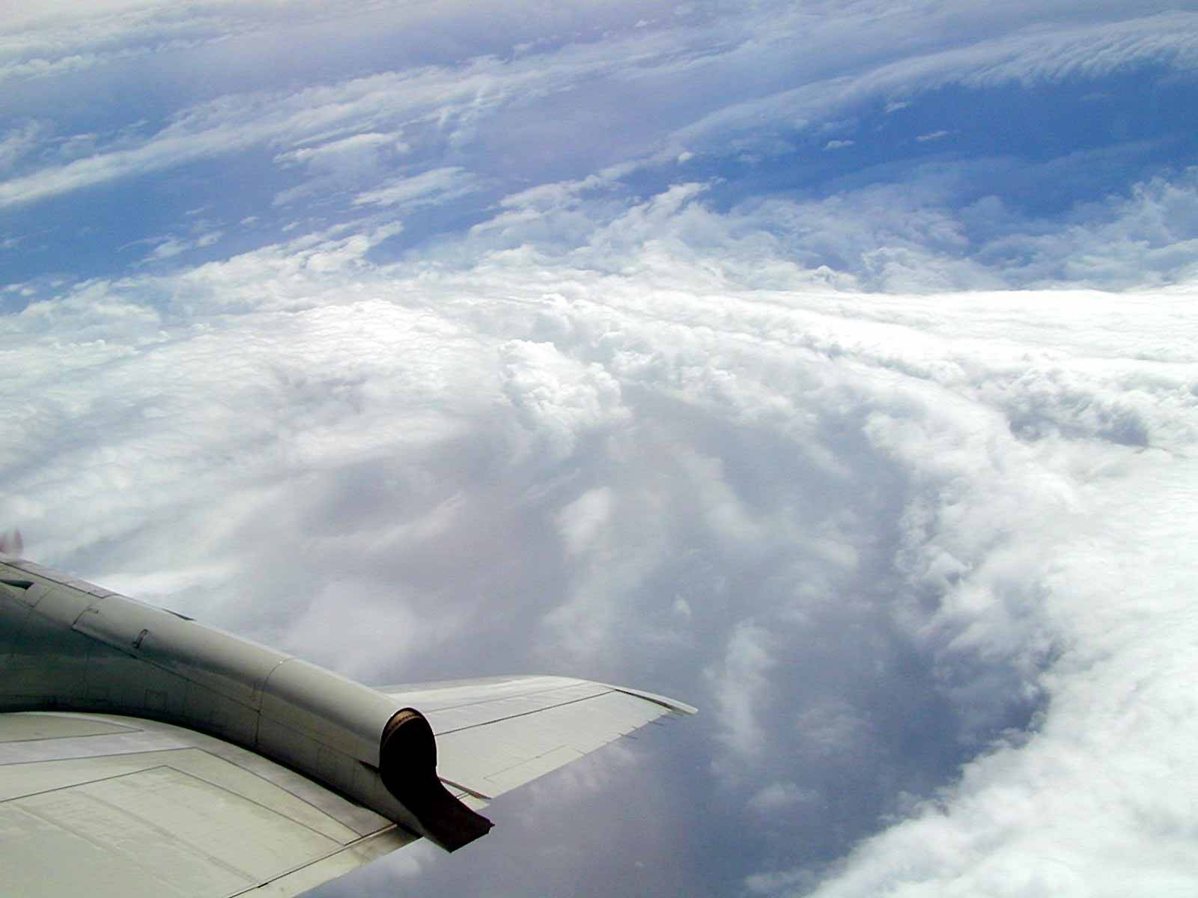
Well maybe microphysics does not matter quite that much ….

Slide 17
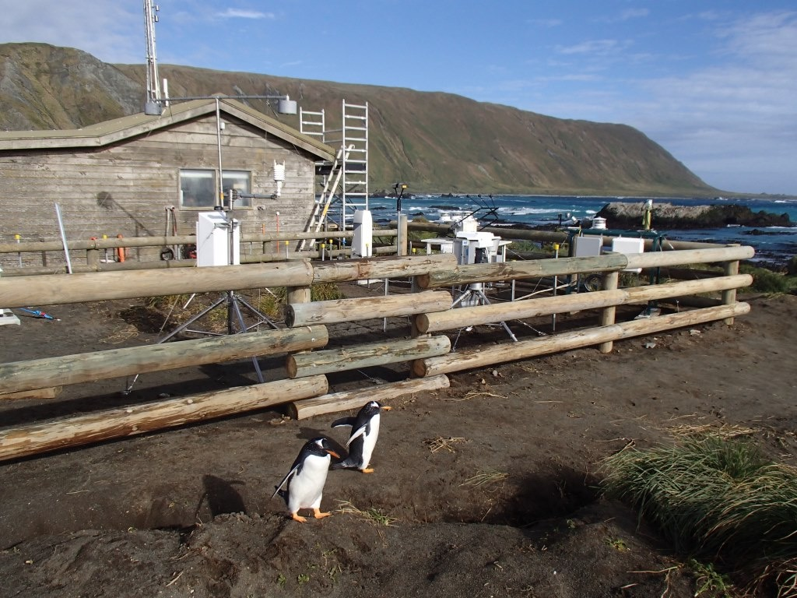

Slide 18
What to present
Information overload
  Limit yourself (think of yourself listening to others: how much can you absorb?)
Selection
  Ask if it is essential, otherwise toss it out!
  Know the point you are going to make for each slide
Summarize
  Tell them what you are going to tell them
  Tell them
  Tell them what you told them
3 important points to the talk
  Not 10!

Slide 19
Preparing Material
Slide guidelines
  18 pt font or bigger (check in advance if redable)
  Look for typos
  Don’t clutter your viewgraphs
  Remember old people are sitting at back of room and they don’t see well!
Equations
  Use if absolutely essential
  Try to explain in words
  Those interested in details can read paper later

Slide 20
Practice makes perfect
Rehearse, rehearse, rehearse
Give practice talk to colleagues
Reduce talk to required time limit
Rehearse again

Slide 21
The dreaded day
Get up early and rehearse
Introduce yourself to the chair
Familiarize yourself with equipment
Empty your pockets
Dress tidily, but don’t overdo it

Slide 22
Speaking
Speak to audience, not screen
Speak clearly and slowly
  Many in our field are not native speakers
  Use microphone
Make eye contact with audience
Explain your viewgraph axis
Show enthusiasm
Keep on time (ditch things if need be)
Have a point to every slide!

Slide 23
Questions
Let the chair handle who asks questions
If you don’t know, say so
Never be rude (whatever provocation)
If discussion becomes long, appeal to chair “That is interesting, perhaps we should discuss this later”
Don’t panic, accept that life may not be perfect!

Slide 24
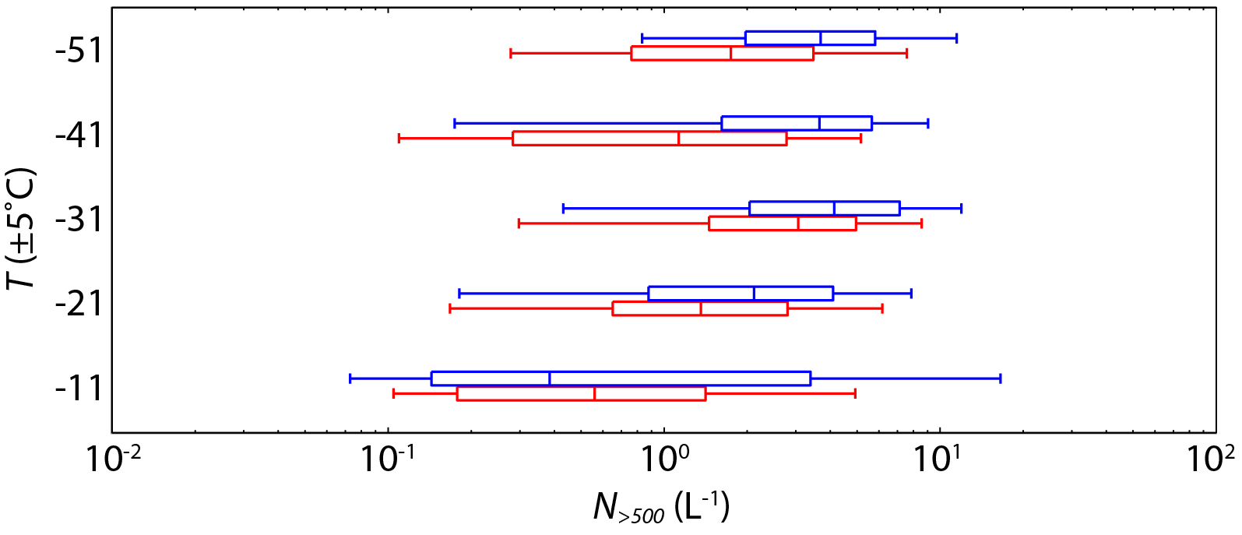
N_{>500} statistics for all GC regions
Plummer, McFarquhar et al. 2014
No completely consistent trend with respect to temperature
GC cores
Between GCs
With little exception, N_{>500} percentiles larger in GC cores
N_{>500} averaged 1.9 times larger in GC cores overall
5th-25th-50th-75th-95th percentile values by temperature

Slide 25
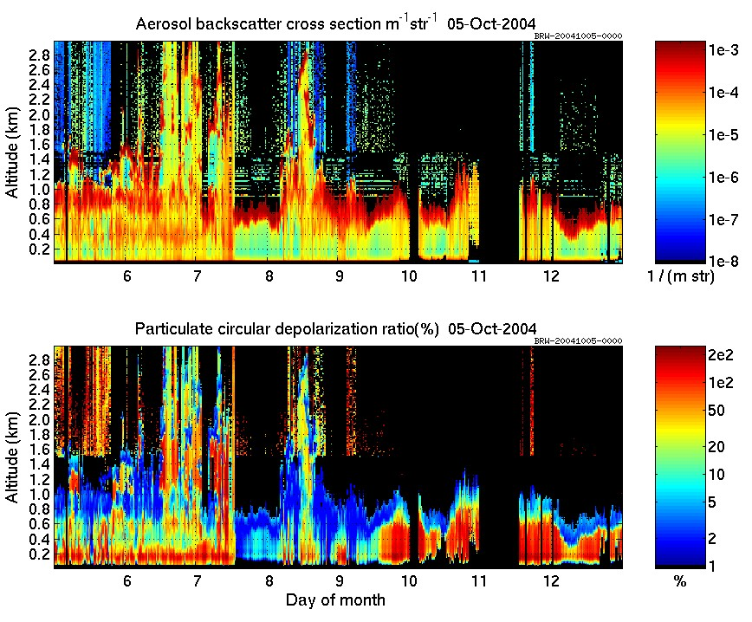
2010: Mixed-phase cloud appearance
Eloranta
Notes:
Divide into different slides with arrows popping up

Slide 26
2010: Mixed-phase cloud appearance
In single layer
Eloranta
Notes:
Divide into different slides with arrows popping up

Slide 27
2010: Mixed-phase cloud appearance
In single layer
Liquid near top
Eloranta
Notes:
Divide into different slides with arrows popping up

Slide 28
2010: Mixed-phase cloud appearance
In single layer
Liquid near top
Ice near base
Eloranta
Notes:
Divide into different slides with arrows popping up

Slide 29
2010: Mixed-phase cloud appearance
In single layer
In multi layers
Liquid near top
Ice near base
Eloranta
Notes:
Divide into different slides with arrows popping up

Slide 30
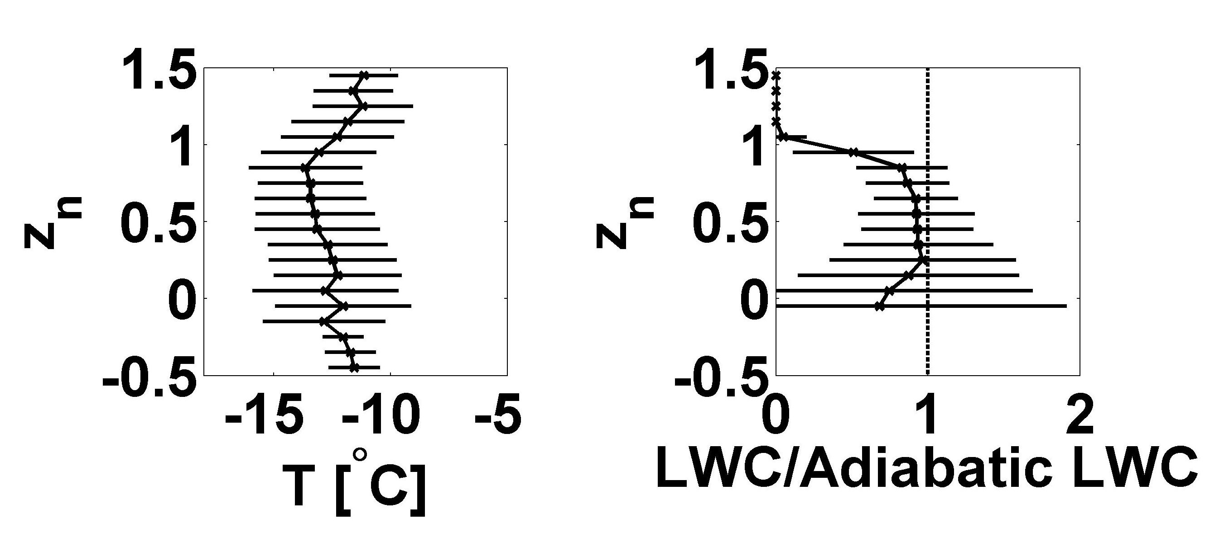
Jackson et al. 2012

Slide 31
Jackson et al. 2012
Strong capping inversion between normalized altitude (z_{n}) of 0.8 to 1.2

Slide 32
Jackson et al. 2012
Strong capping inversion between normalized altitude (z_{n}) of 0.8 to 1.2
Subadiabatic LWC for z_{n} > 0.8 consistent with entrainment of dry air above cloud top or growth of ice at expense of liquid water

