Slide 1
Statistical Analysis Demo – Compositing
Guest Lecturer: Jason C. Furtado
METR 3334 - Principles of Research & Communication in Meteorology
21 March 2022

Slide 2
Let’s Do a Quick Check!
What is your familiarity with common statistical techniques and how to code them?
Mentimeter Poll

Slide 3
What is Compositing?
Compositing means taking the average (mean) of a particular field for a particular event or category.
The idea is: Isolate the SIGNAL from the NOISE!
Steps for Compositing
Determine your categories or events (YOU CHOOSE!)
Examples?
Compute the mean of each variable of interest for each category.
Display the results to the reader, including adding significance and description (figure or table).

Slide 4
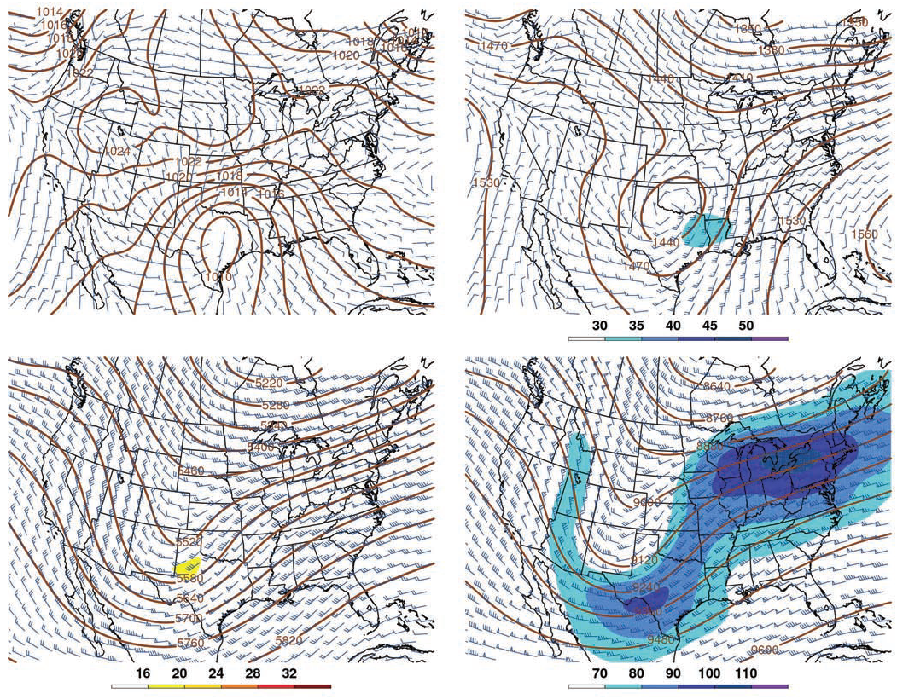
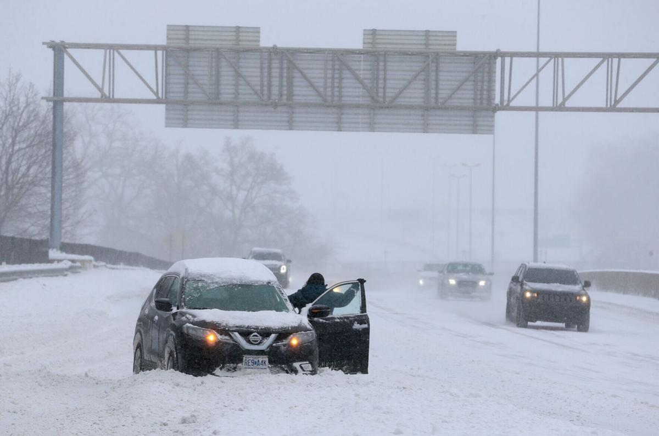
Compositing Example
Synoptic setup for snowstorms in the
St. Louis/Springfield MO Area

Slide 5
Today’s In-Class Example: Compositing Precipitation with Different Phases of the El Niño-Southern Oscillation (ENSO)
Question: What is the El Niño-Southern Oscillation (ENSO)?

Slide 6
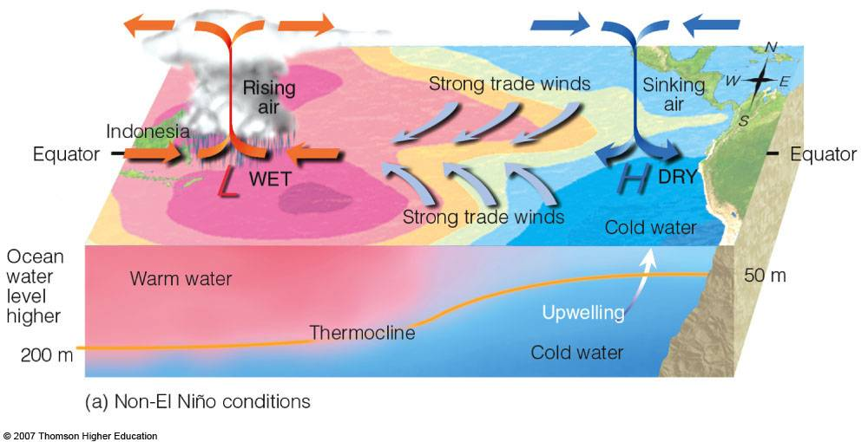
Normal Conditions
Walker Circulation – The pattern of rising/subsiding cells of air across the tropical Pacific.
Note the slope of the thermocline across the Pacific.

Slide 7
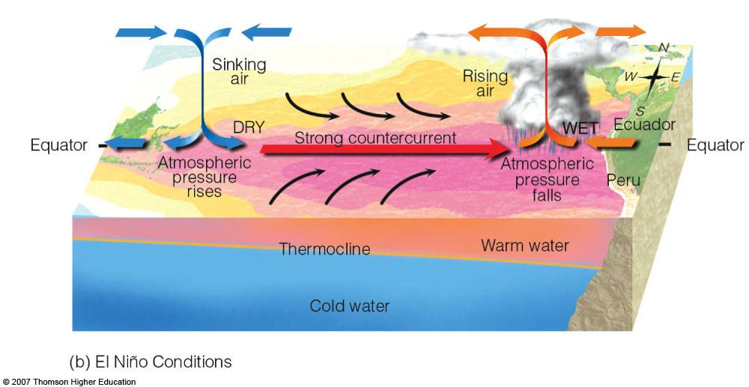
El Niño Conditions
Characteristics of El Niño
Weakening or reversal of the trade winds
Weakening of upwelling off of South America
Shift in the Walker Circulation
Dry conditions in the western Pacific
Wet conditions in the eastern Pacific.
Strengthening of the Equatorial Countercurrent.
El Niño = “The Christ Child”
So named because the phenomenon peaks near Christmas.

Slide 8
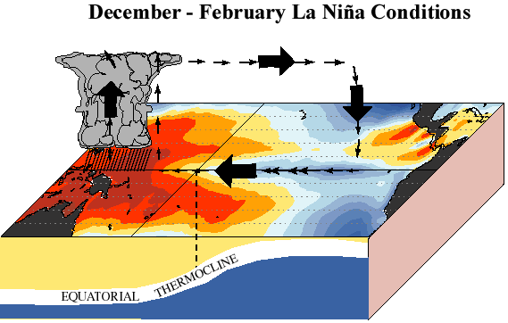
La Niña
The opposite of El Niño
Follows an El Niño episode
Characterized by colder than normal SSTs over the equatorial Pacific.
Reinforcement of the Walker Circulation.
Can be considered the supernormal base state.
From http://www.cpc.noaa.gov/products/analysis_monitoring/ensocycle/

Slide 9
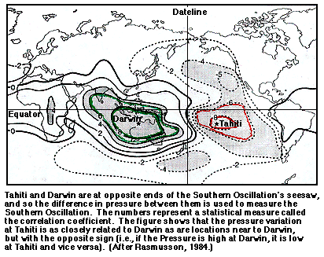
Southern Oscillation
Consistent SOI > 0: La Niña-like
Consistent SOI < 0: El Niño-like

Slide 10
Monitoring ENSO
Many indices are used to measure ENSO (both atmosphere and ocean).
Nino Region Indices - https://www.ncdc.noaa.gov/teleconnections/enso/sst

